Slide 1
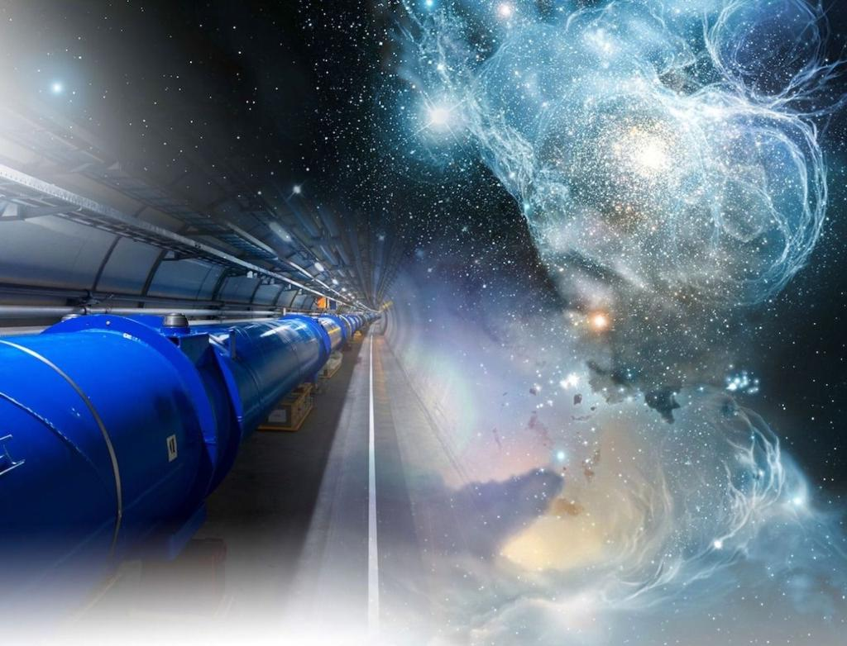
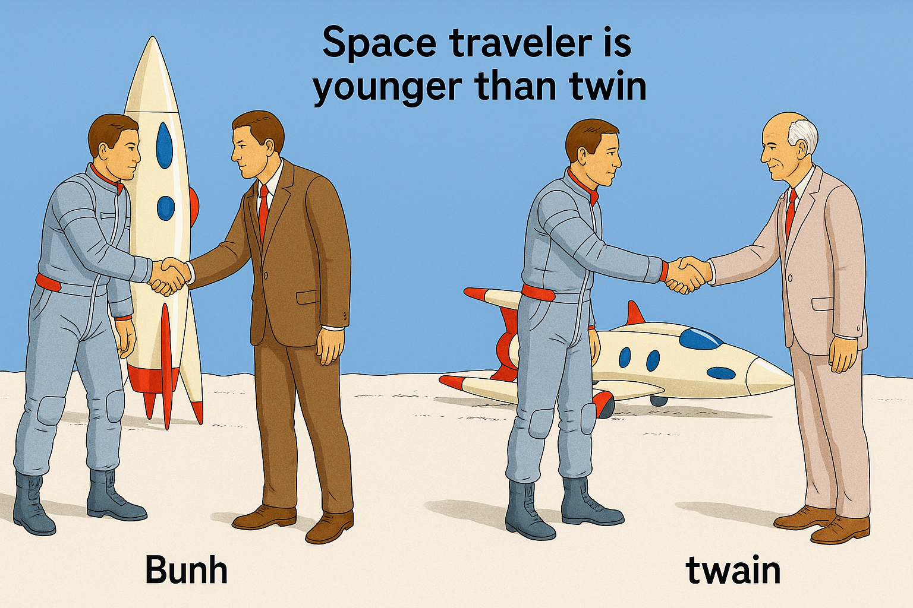
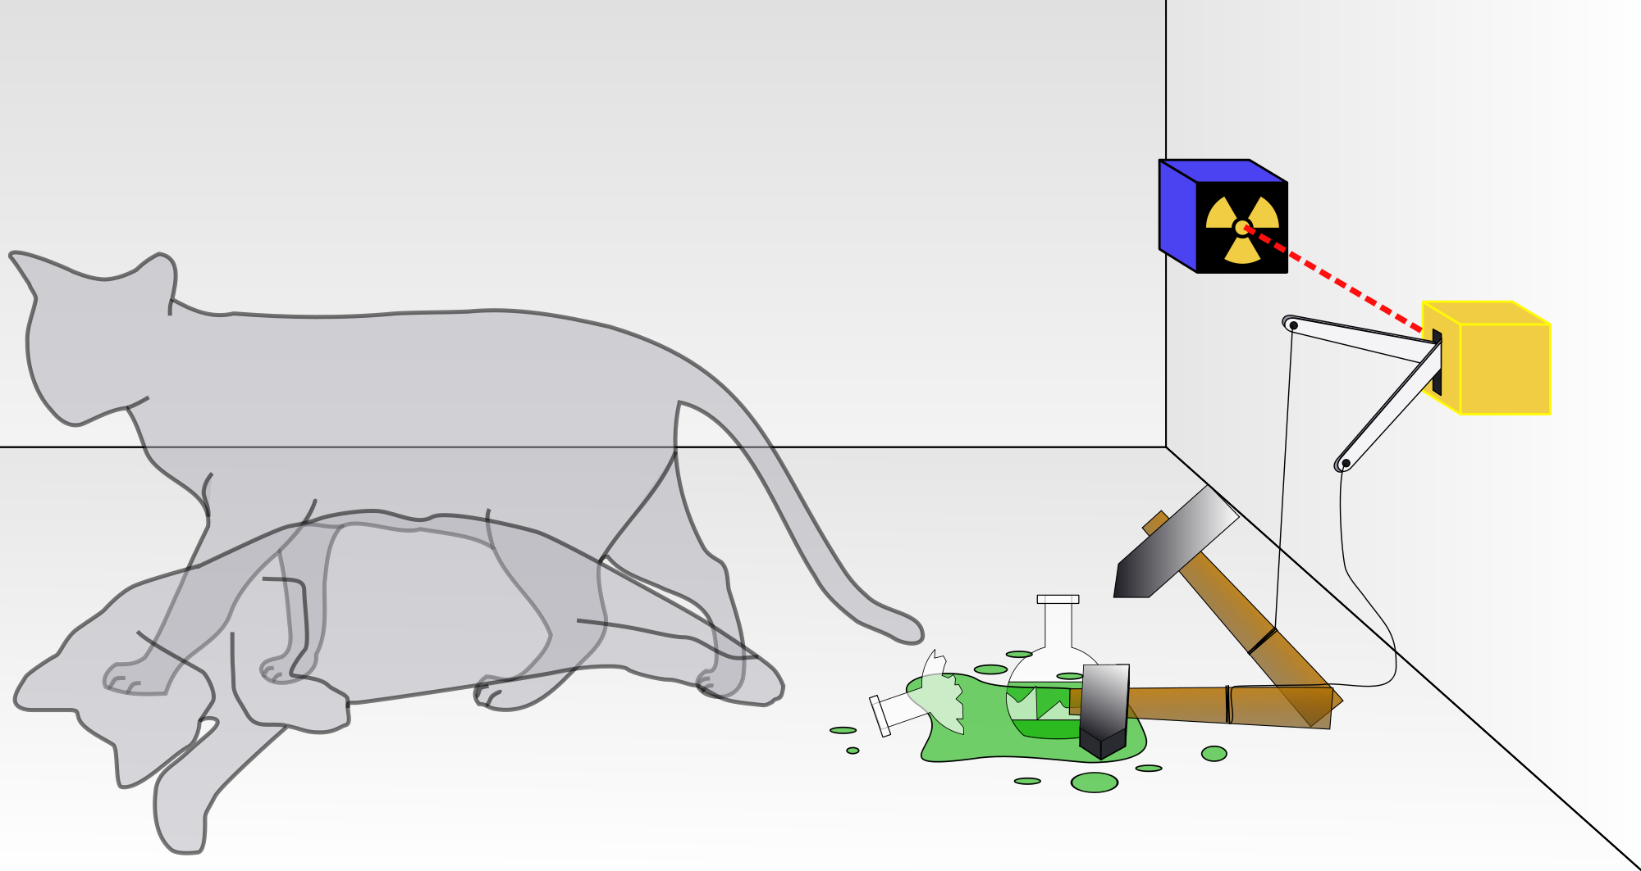
The Relativistic Quantum World
Relativity
A lecture series on
Relativity Theory and Quantum Mechanics
Before
After
Quantum
Alive
Marcel Merk
Studium Generale Maastricht
Sep 10 – Oct 8, 2025
Dead
Notes:
Explain picture. Interesting (“bizarre”) aspects of relativity and QM

Slide 2
The Relativistic Quantum World
1
Lecture 1: The Principle of Relativity and the Speed of Light
Lecture 2: Time Dilation and Lorentz Contraction
Lecture 3: The Lorentz Transformation and Paradoxes
Lecture 4: General Relativity and Gravitational Waves
Sep. 10:
Relativity
Sep. 17:
Lecture 5: The Early Quantum Theory
Lecture 6: Feynman’s Double Slit Experiment
Lecture 7: Wheeler’s Delayed Choice and Schrodinger’s Cat
Lecture 8: Quantum Reality and the EPR Paradox
Quantum
Mechanics
Sep. 24:
Oct. 1 :
Standard
Model
Lecture 9: The Standard Model and Antimatter
Lecture 10: Why is there something rather than nothing?
Oct. 8:
Lecture notes, written for this course, are available: www.nikhef.nl/~i93/Teaching/
Prerequisite for the course: High school level physics & mathematics.
Notes:
Ambitious!

Slide 3
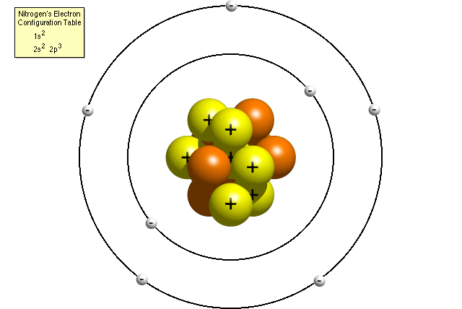
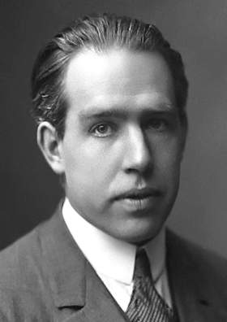
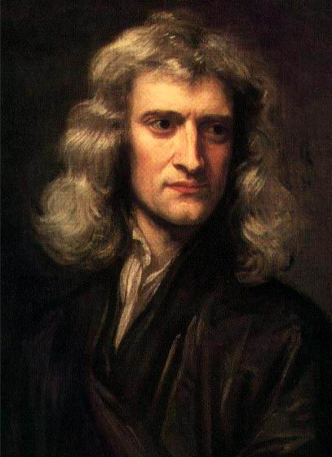
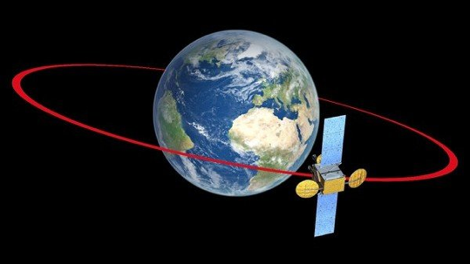
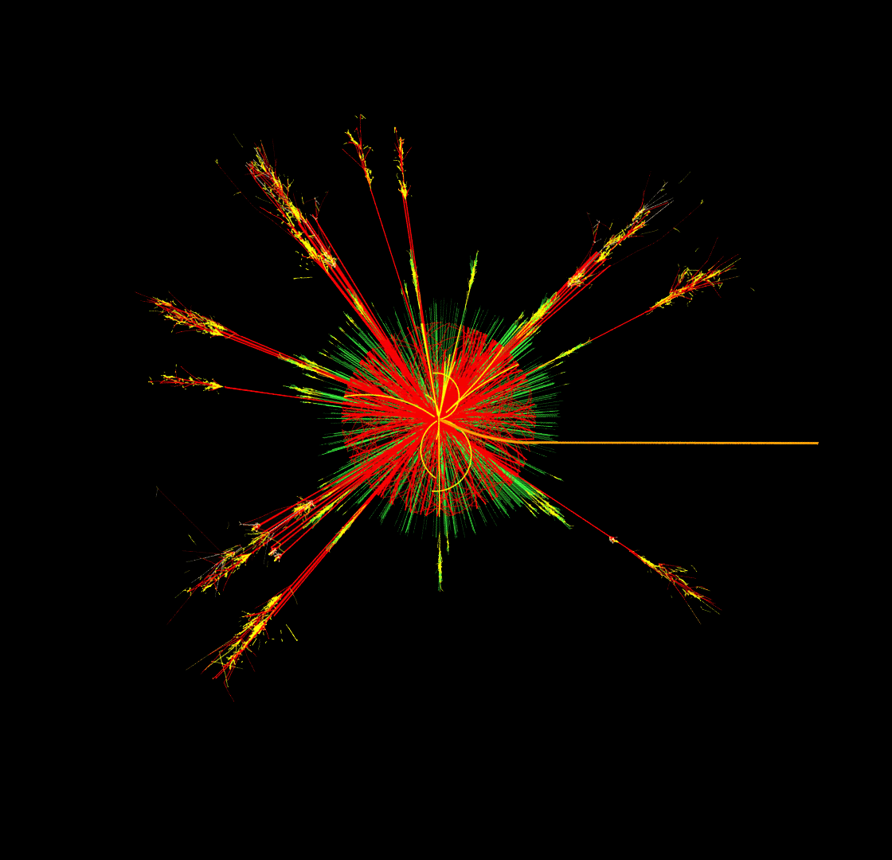
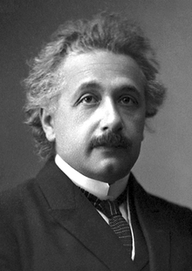
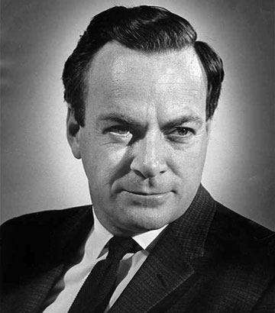

Relativity and Quantum Mechanics
Classical Mechanics
Quantum Mechanics
Smaller Sizes (ħ)
Newton
Bohr
Higher Speed (c)
Dirac
Feynman
Einstein
Relativity Theory
Quantum Field Theory
Notes:
Classical physics based on daily experience. Physics of the very fast and very small is counterintuitive! c and h-bar are fundamental constants of nature. Is there something that goes beyond c and h? No. QFT combines Relativity and QM.

Slide 4
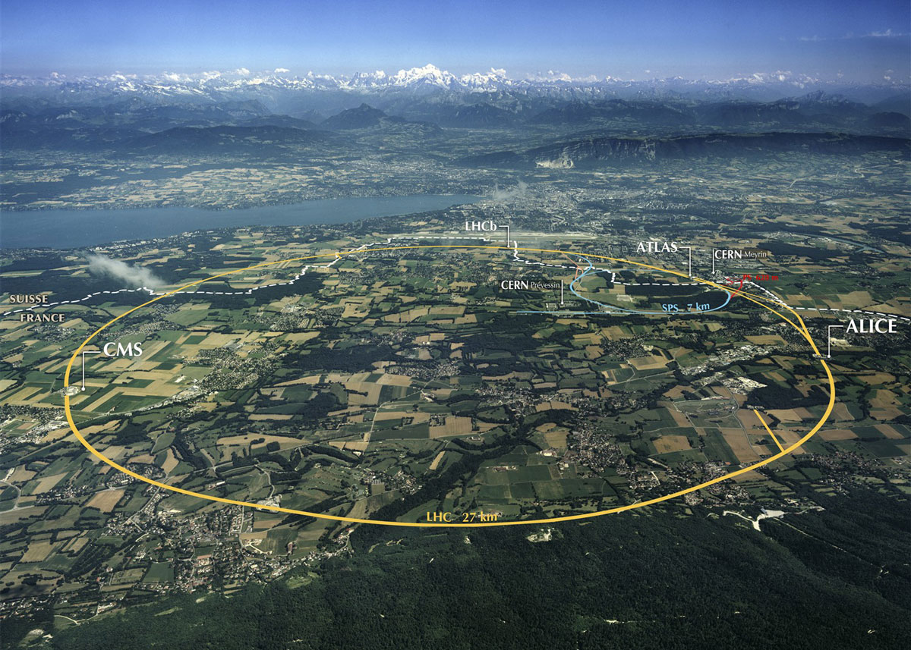
Relativity and Quantum Mechanics
Classical Mechanics
Quantum Mechanics
Smaller Sizes (ħ)
Newton
Bohr
Higher Speed (c)
LHC @ CERN
LHC @ CERN
Dirac
Feynman
Einstein
Relativity Theory
Quantum Field Theory
Notes:
Classical physics based on daily experience. Physics of the very fast and very small is counterintuitive! c and h-bar are fundamental constants of nature. Is there something that goes beyond c and h? No. QFT combines Relativity and QM.

Slide 5
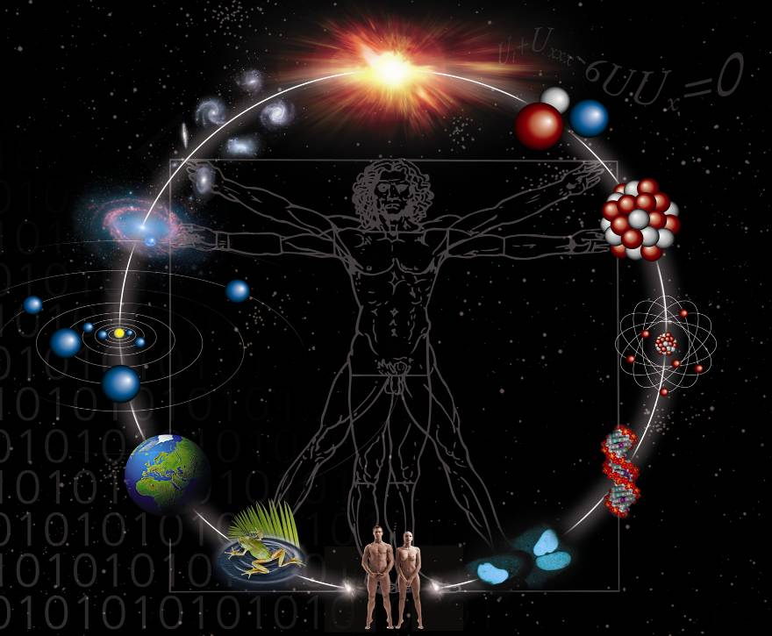
Astronomy
Particle- Physics
Lecture 9: The Standard Model and Antimatter
1: Elementary Particles
2: Antimatter and the Big Bang
3: Forces and the Standard Model

Slide 6
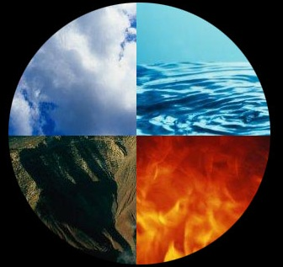
1: Elementary Particles
”All things come in three”
air
water
earth
fire
?
Notes:
Empedocles was first, later adopted by Aristotle in 450 BC.
Plato first called it elements

Slide 7
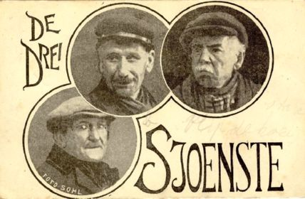
1: Elementary Particles
”All things come in three”
Pie de Bökkum
Ensinck de Kletskop
Flup de Koojstart
Operetta by Jacques Pirson, executed by Fons Olterdissen (1928)
Notes:
Operette geschreven door Jacques Pirson 1928, uitgevoerd door Fons Olterdissen in Bonbonniere. (Olterdissen bekend van Trijn de Begijn)

Slide 8
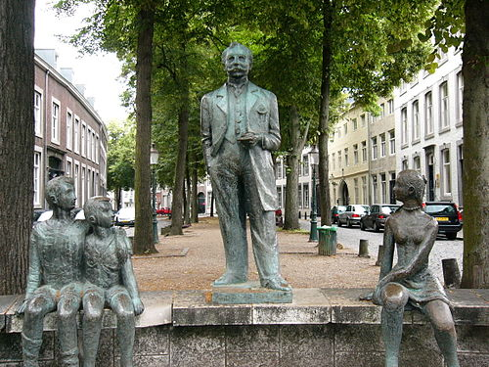
1: Elementary Particles
”All things come in three”
Fons Olterdissen (1865-1923)
Author Maastricht anthem
Notes:
Operette geschreven door Jacques Pirson 1928, uitgevoerd door Fons Olterdissen in Bonbonniere.
Slotkoor van Trijn de Begijn is Maastrichts Volslied

Slide 9
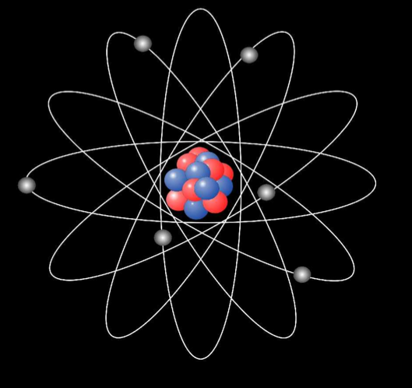
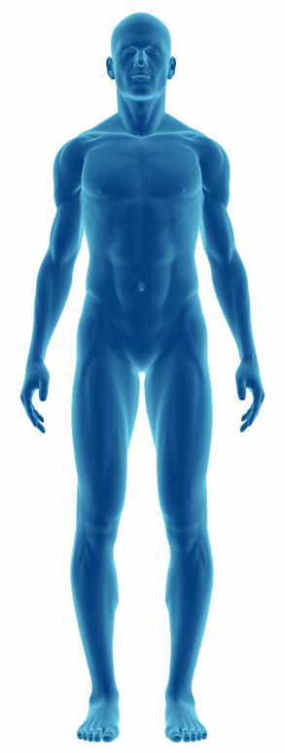
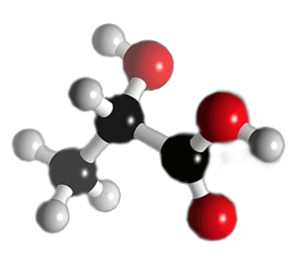
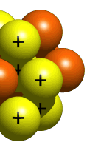
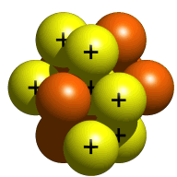
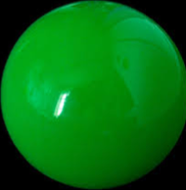
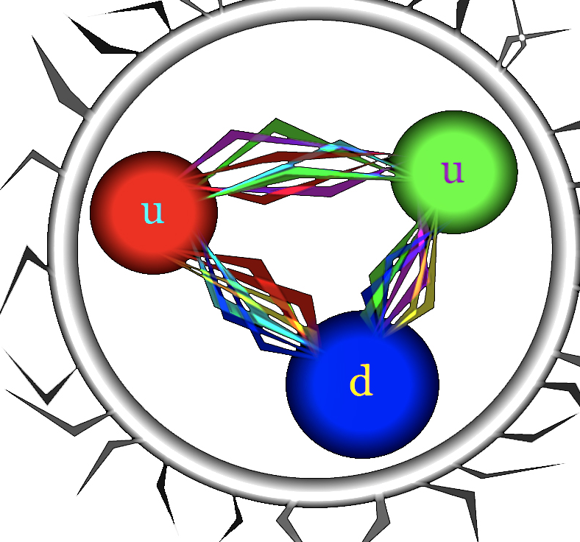

Building blocks of Matter
Atom
Molecule
Electron
fundamental
Quark
Proton/Neutron
$$u$$
Fons Olterdissen
Atom-nucleus

Slide 10

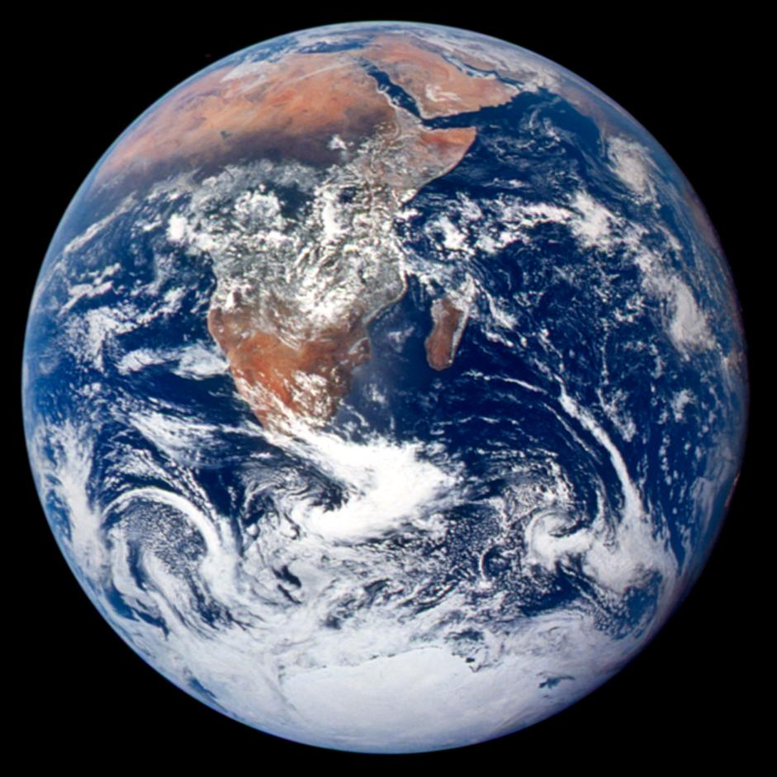

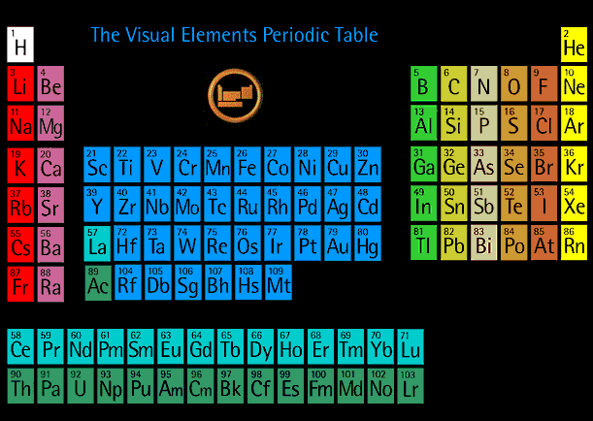
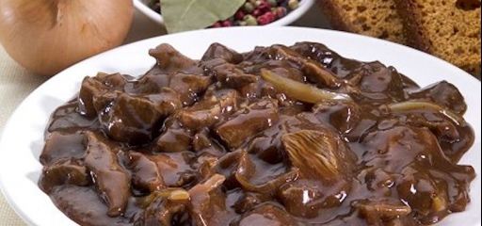
Stable Matter on Earth
‘Lego blocks’ of nature
Even…
Mendeleev system
Zoer-vleis…?
Notes:
Simple: world everything is made of electron, up, down. Chemistry explained with quantum mechanics.

Slide 11
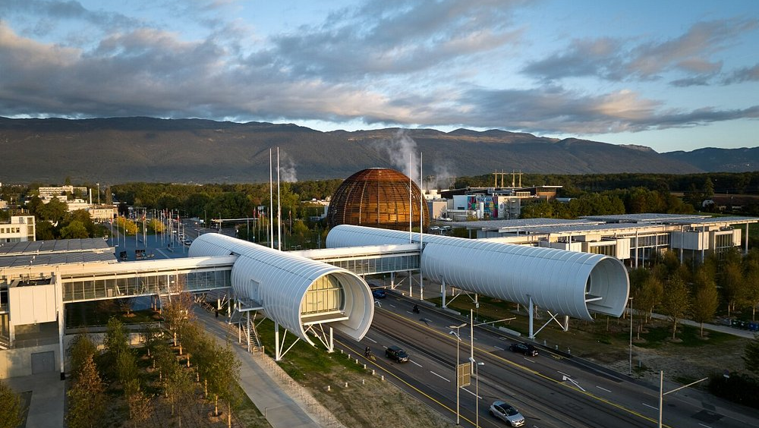
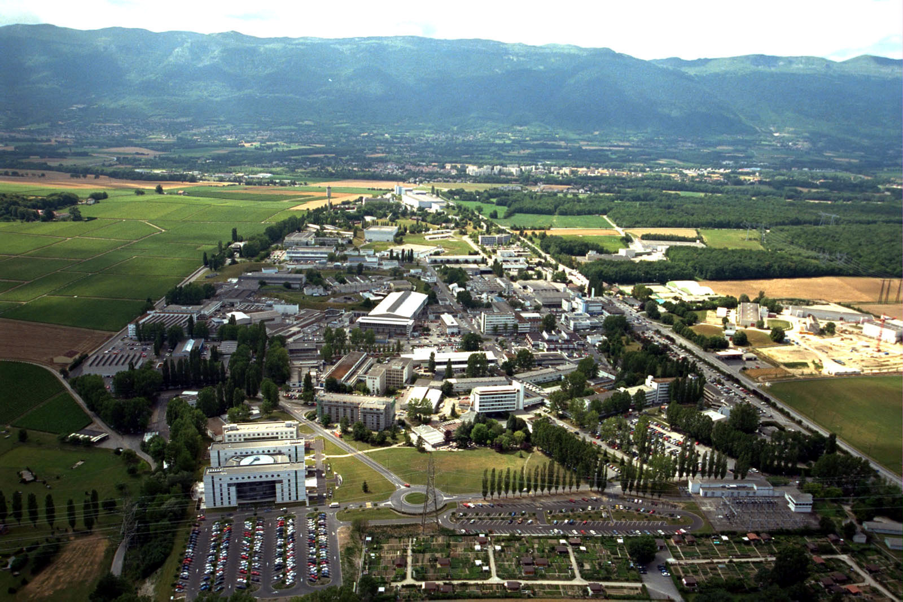
CERN: particle physics lab
Particle beam 2
Particle beam 1

Slide 12
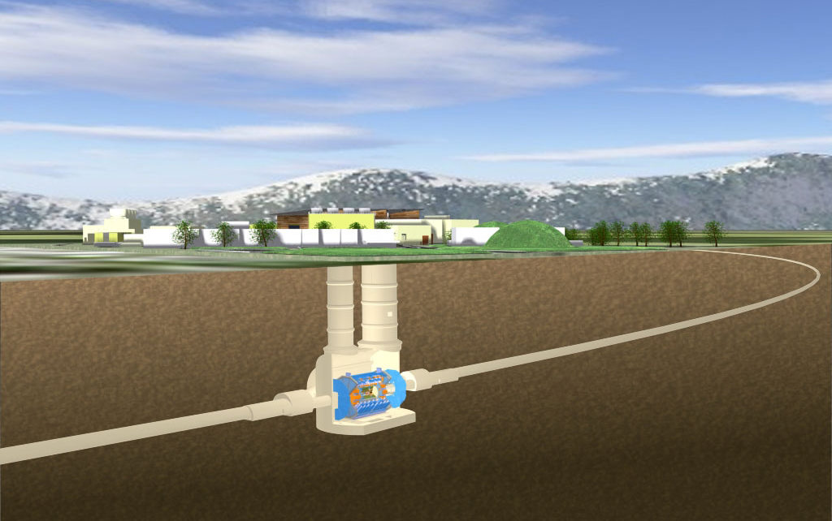
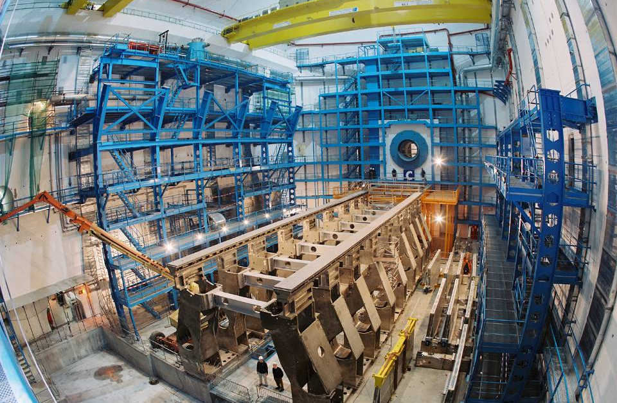
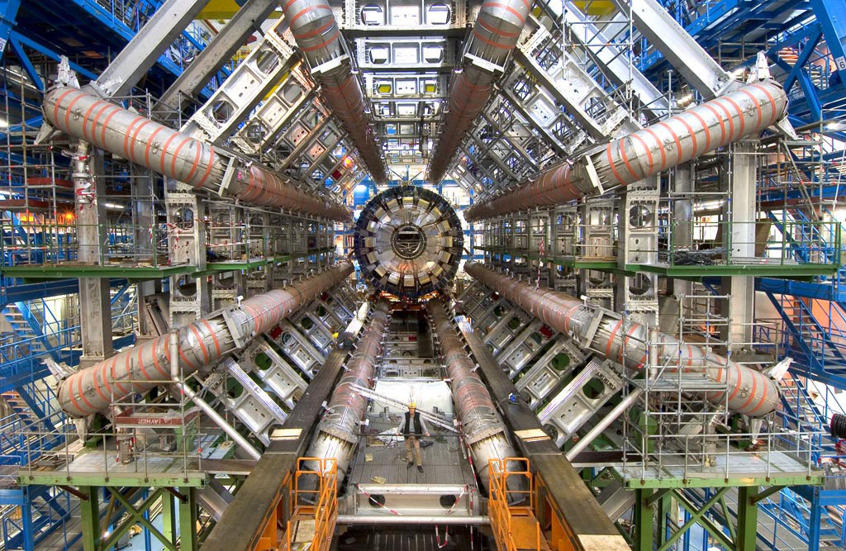
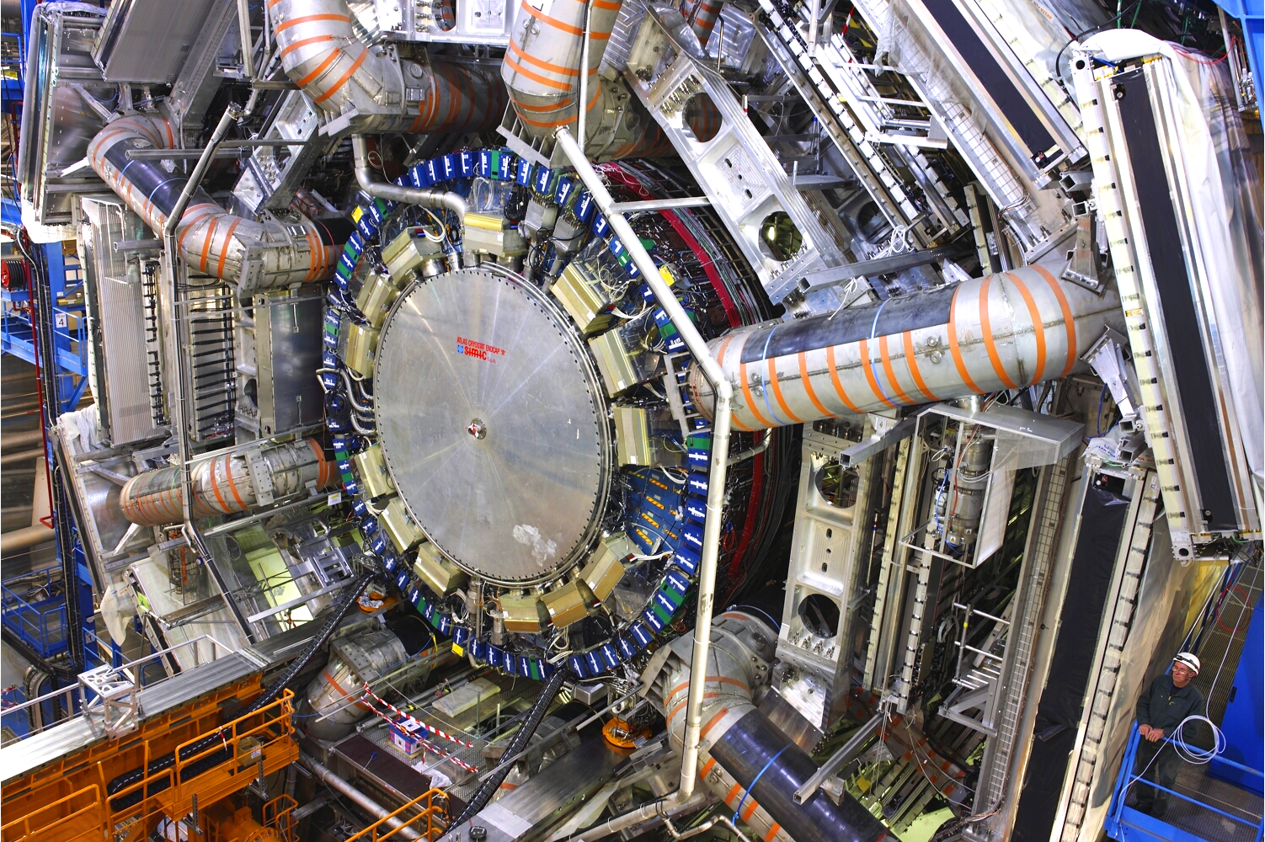
Construction of the Atlas detector at LHC

Slide 13
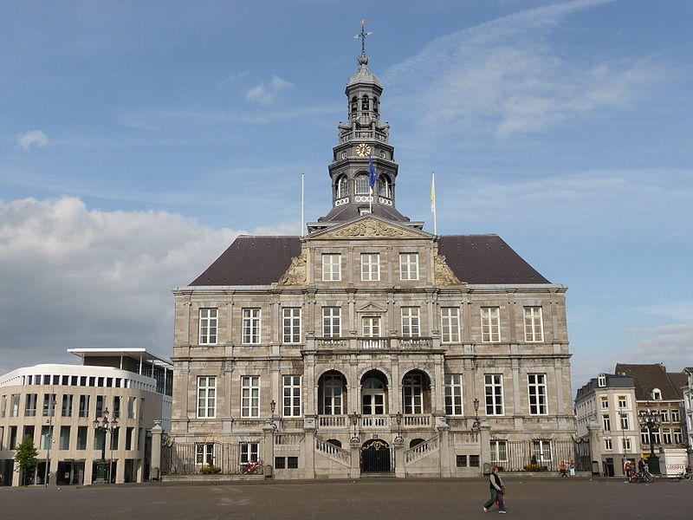
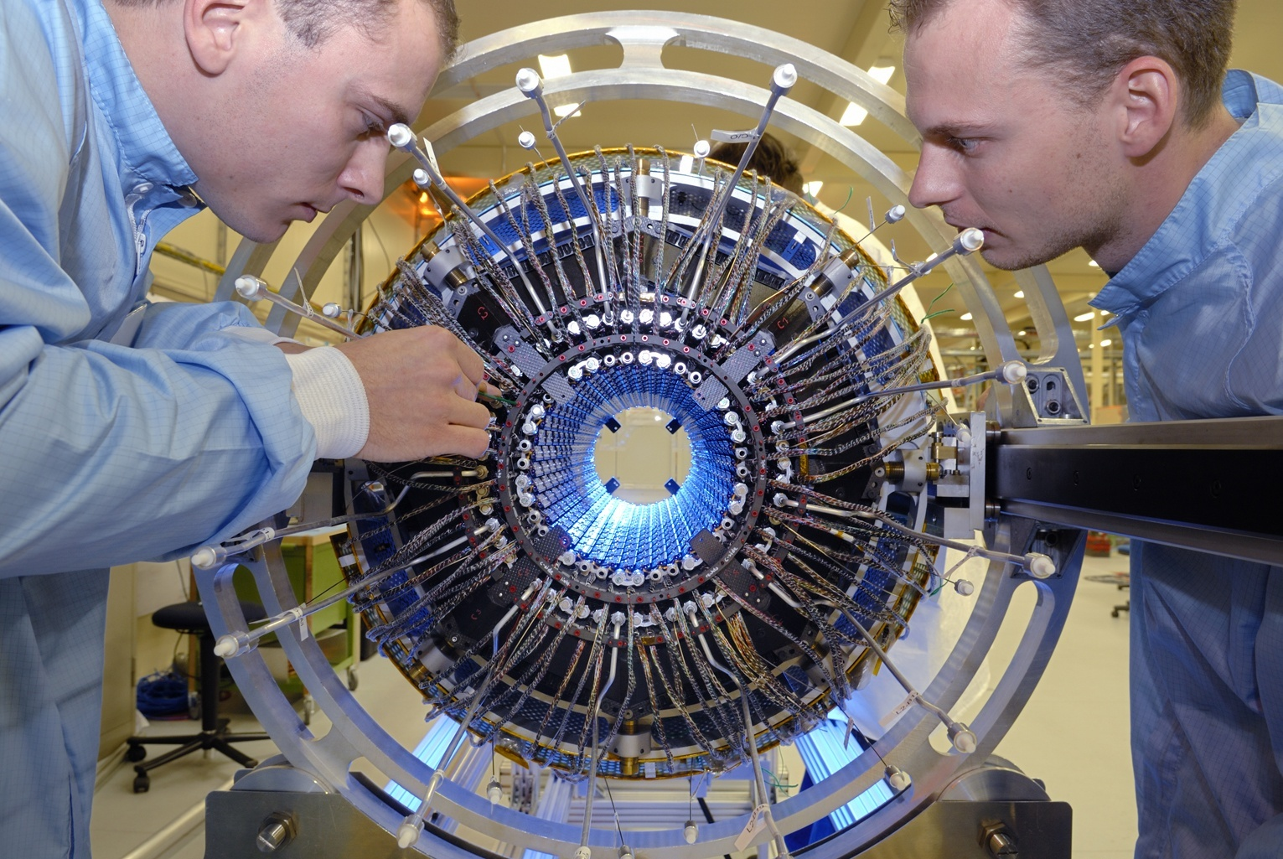
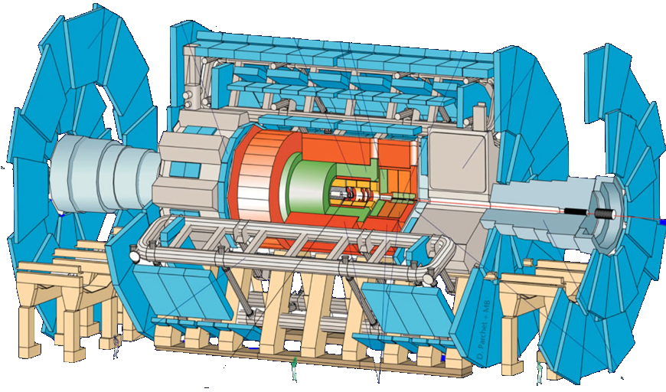
The Atlas Experiment
Largest “photocamera” on earth
45 m x 25 m
3000 physicists
80 MegaPixel “camera”: 40.000.000 pictures per second
Notes:
Dimitri John, Martijn van Overbeek

Slide 14
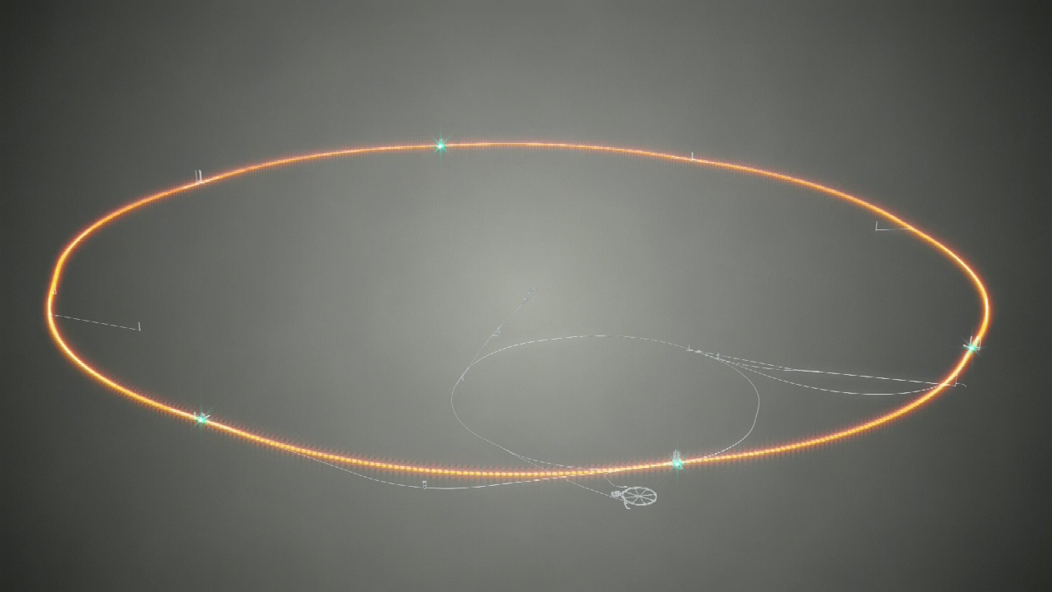

Slide 15
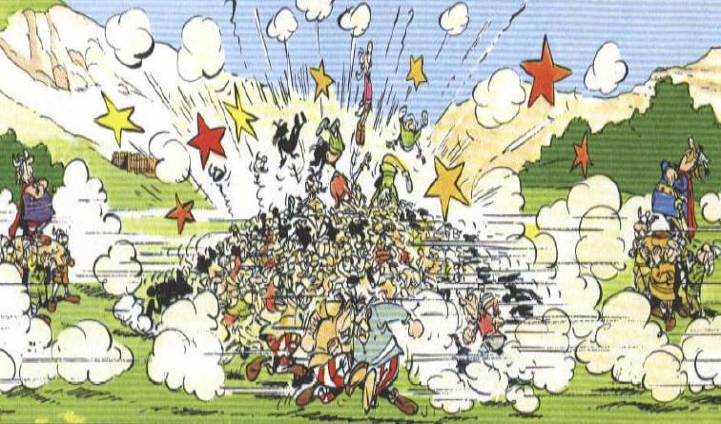
QM: “Everything that can happen will happen”
Particle Collisions

Slide 16

For a nice video of data collection: https://www.youtube.com/watch?v=jDC3-QSiLB4
Particle Collisions

Slide 17
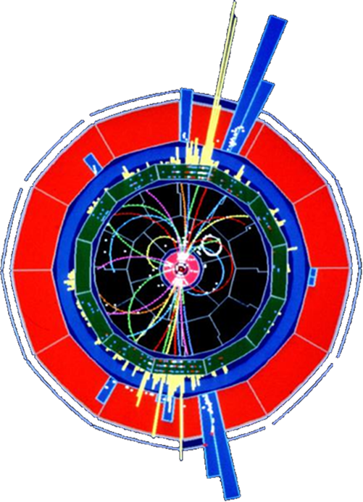
Elementary Particles
Generation:
I
II
III
Charge
u
c
t
+2/3 e
quarks
(1976)
(1995)
d
s
b
-1/3 e
(1947)
(1978)
3 “generations” of particles?!
e
μ
τ
-1 e
leptons
(1895)
(1936)
(1973)
ν_{e}
ν_{μ}
ν_{τ}
0 e
(1956)
(1963)
(2000)
Matter
Notes:
Neutrino: Cowan en Reines reactor antineutrino’s. Neutrinos produced in the sun and reactors (radioactivity)

Slide 18
Elementary Particles
Generation:
I
II
III
Charge
u
c
t
+2/3 e
quarks
(1976)
(1995)
d
s
b
-1/3 e
(1947)
(1978)
Why do three copies of matter particles exist?!
3 “generations” of particles?!
e
μ
τ
-1 e
leptons
(1895)
(1936)
(1973)
ν_{e}
ν_{μ}
ν_{τ}
0 e
(1956)
(1963)
(2000)
Matter
Notes:
Neutrino: Cowan en Reines met reaktor antineutrino’s. We hebben na jaren geleerd dat er nog meer bouwstenen zijn dan het up en down quark. Allereerst is er het neutrino dat in de zon geproduceerd wordt en ook in kerncentrales. Het electron en het neutrino noemen we samen leptons. Maar daarnaast komen er nog kopieen voor van de bekende deeltjes. Het muon is het zwaardere broer van het electron, maar er zijn ook nog de zogenaamde “C” en “S” quarks: dit staat voor Charm en Strange. We spreken van een tweede generatie. De jaartallen geven aan wanneer de deeltjes ontdekt zijn. We hebben ook een 3e generatie ontdekt en we weten vanaf 1990 dat er niet meer generaties zijn. Er zijn er 3 in totaal. Ook de lading van de deeltjes is aangegeven. Rechts ziet U weer een voorbeeld van een weergave van een gebeurtenis uit een experiment uit de 90-er jaren van de vorige eeuw.

Slide 19
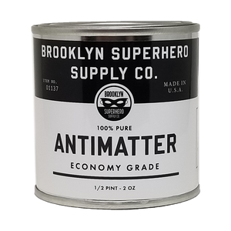
Elementary Particles
Generation:
I
II
III
Charge
u
c
t
+2/3 e
How about…
quarks
(1976)
(1995)
d
s
b
-1/3 e
(1947)
(1978)
3 “generations” of particles?!
e
μ
τ
-1 e
leptons
(1895)
(1936)
(1973)
ν_{e}
ν_{μ}
ν_{τ}
0 e
(1956)
(1963)
(2000)
Matter
Notes:
Neutrino: Cowan en Reines met reaktor antineutrino’s. We hebben na jaren geleerd dat er nog meer bouwstenen zijn dan het up en down quark. Allereerst is er het neutrino dat in de zon geproduceerd wordt en ook in kerncentrales. Het electron en het neutrino noemen we samen leptons. Maar daarnaast komen er nog kopieen voor van de bekende deeltjes. Het muon is het zwaardere broer van het electron, maar er zijn ook nog de zogenaamde “C” en “S” quarks: dit staat voor Charm en Strange. We spreken van een tweede generatie. De jaartallen geven aan wanneer de deeltjes ontdekt zijn. We hebben ook een 3e generatie ontdekt en we weten vanaf 1990 dat er niet meer generaties zijn. Er zijn er 3 in totaal. Ook de lading van de deeltjes is aangegeven. Rechts ziet U weer een voorbeeld van een weergave van een gebeurtenis uit een experiment uit de 90-er jaren van de vorige eeuw.

Slide 20
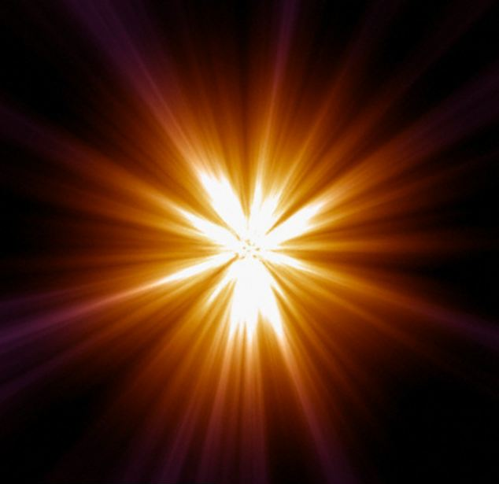
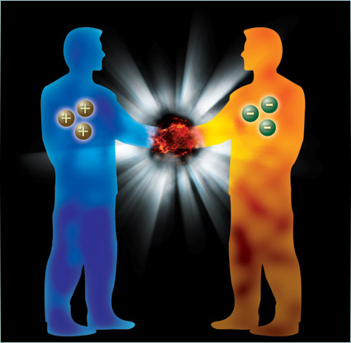
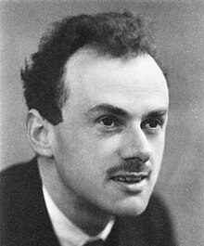
2: Antimatter and Big Bang
The genius of Paul Dirac

Slide 21
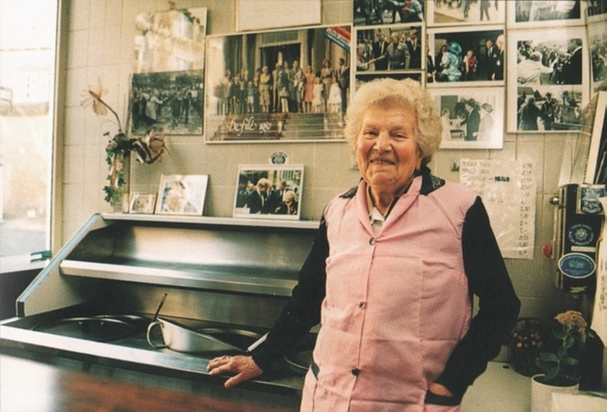
2: Antimatter and Big Bang
The genius of Paul Dirac
Rika (genius of frites?)
Biography from Graham Farmelo:“The Strangest Man”
(The hidden life of Paul Dirac, quantum genius)

Slide 22
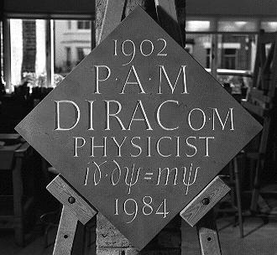
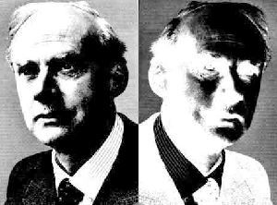
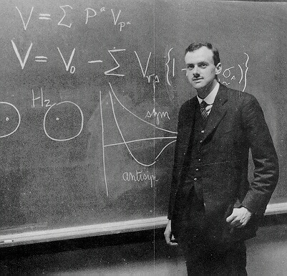
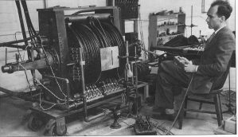
Paul Dirac and antimatter
1928:
  Dirac’s relativistic quantum theory
  Prediction: for each matter particle there exists an identical antimatter particle!
1932:
  Anderson discovers the anti-electron
Paul Dirac
Carl Anderson
Dirac
AntiDirac
Notes:
Combination of Relativity and quantum mechanics: Dirac Equation: two solutions: positive and negative energy.
Westminster Abbey grave.
Bubble chamber Anderson looked at cosmic radiation.

Slide 23
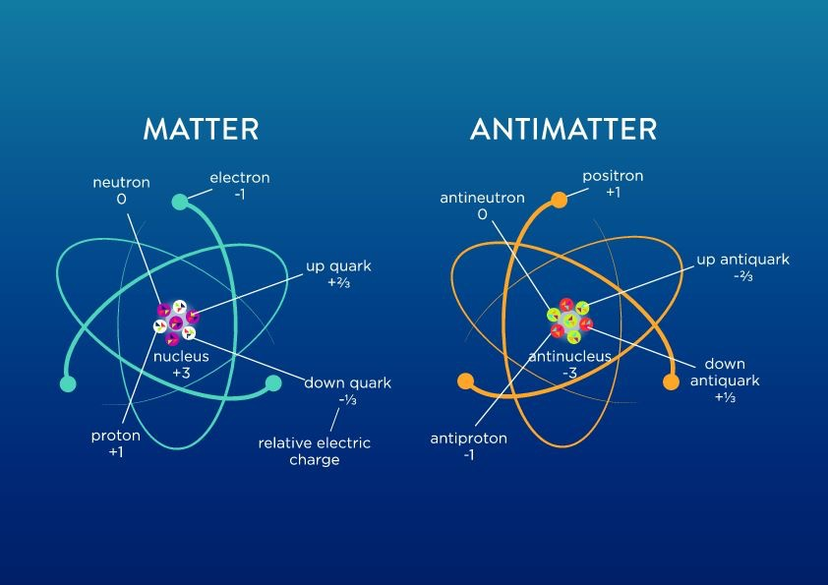
Matter and Antimatter
Atom
Anti-atom

Slide 24
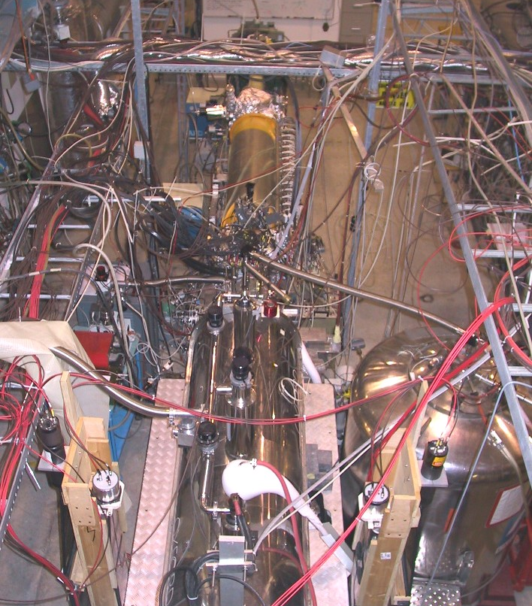
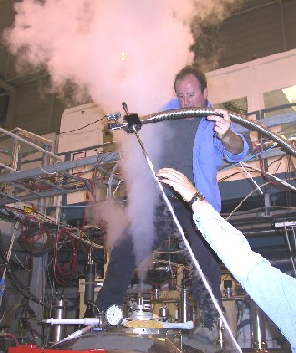
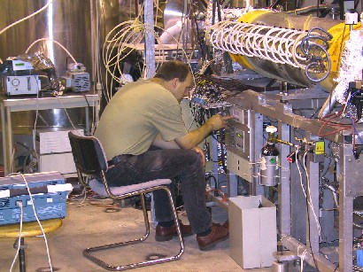







The ATHENA experiment at CERN (2002)
Antihydrogen ($p^{−}e^{+}$) exists!
$$p^{+}+p^{−}→4 π$$
$$e^{−}+e^{+}→γγ$$
Notes:
Imprssion CERN experiment
p+ p- → pi+pi-pi+pi- (yellow) en e+e- →gamma gamma (red)

Slide 25
A world of matter and …
Atom
Molecule
Electron
Quark
Proton/Neutron
Atom-nucleus

Slide 26
… a world of antimatter?
Anti-Atom
Anti-Molecule
Anti-electron
Anti-Quark
Anti-Proton / anti-Neutron
Identical
anti-world
Anti atom-nucleus

Slide 27


Alpha experiment: successor of Athena
News on 27 Sept 2023:
  Several thousands of antimatter hydrogen atoms were dropped in the gravitational field
  Antimatter falls “down” to earth in the same way as matter does
See: CERN news

Slide 28




Albert Einstein: Energy = matter + antimatter
e⁻
e⁺
E=mc²
Creation:
Energy → matter + antimatter :
→
e⁺
e⁻
Annihilation:
matter + antimatter → energy :
→
e⁺
e⁻

Slide 29

Albert Einstein: Energy = matter + antimatter
e⁻
e⁺
E=mc²
Creation:
Energy → matter + antimatter :
→
e⁺
e⁻
Annihilation:
matter + antimatter → energy :
→
e⁺
e⁻

Slide 30

Is there antimatter in nature?
Does it occur on earth?
No, we would immediately see it:
  “Annihilation”
e
e
+
-

Slide 31



Is there antimatter in cosmic radiation?
  The AMS experiment
The answer:
No!
Notes:
In March 2013 Sam Ting reported 400 000 positrons by AMS with a positron over electron ratio increasing between 10 GeV and 250 GeV, consistent with dark matter annihilation.

Slide 32

Are there antimatter galaxies?
No!
e
e
(matter + anti-matter = Intense gamma radiation)
+
-
Notes:
.

Slide 33



Early Universe: where did the antimatter go?
Only matter
Why is there something rather than nothing?

Slide 34
Early Universe: where did the antimatter go?
Why is there something rather than nothing?

Slide 35

Back to the Big-Bang
Assume: creates equal amounts of matter and antimatter
Notes:
.

Slide 36
The early hot universe
Time=0.00000000001 second
Imagine:
matter:
1000000001
(E=mc²)
antimatter:
1000000000
light
So: “teeny weeny” more matter particles
than antimatter particles

Slide 37

The expanding and cooling universe
Time ~1 second
$$E=\frac{hc}{λ}$$
matter
antimatter
After cooling
and
annihilate
light
What remains: lots of light and a bit of matter
Ratio : 1000000000 1

Slide 38



Cosmic Microwave Background Radiation
1964: Penzias and Wilson
discover: “background light”
(photons)
Remnant of the Big Bang
A temperature map…
Of the univesre
-270⁰ C
Nobelprize 1978
For each matter particle there are a billion photons…
2.7248K
2.7252K
Notes:
Penzias en Wilson looked for weak radiosignals in space (purpose: communicatie satellieten)
Observed strong signal: CMB from big bang! (No pigeon shit)
Infrared microwave radiation (1 mm)
Cosmological discovery of remnant big bang.
Temperature map of the universe. Nobelprijs 1978.
Mather en Smoot observed spectrum CMB and angular distribution (Cobe sattelite): nobelprize 2006

Slide 39

The universe as we see it today
Observed Background light:
“many”
(1000000000)
+
Remaining
Matter particles:
“few”
( 1 )
Notes:
Het waargenomen nagloeilicht van Penzias en Wilson (heel veel fotonen) en de resterende materie vormen alle sterrenstelsels.

Slide 40


How did we get a small asymmetry in the Big Bang?
Laws of Nature
Big Bang
Matter
Dominates
Small surplus
49.999999%
anti-matter
0.000001%
matter
50.000001%
matter
(+99.999999%
radiation)
?
Apparently anti-matter is not
the exact mirror image of matter!

Slide 41


3: Forces: “Standard Model”
Forces
s

Slide 42


3: Forces: “Standard Model”
Giel (“de Piele”) Hameleers: also standard model?
Forces
s
Notes:
Petit Paris 1959 – 1972 – 14 juillet party on Amorsplein

Slide 43


Forces in Quantum Mechanics: exchange of quanta
“Repulsive force”
There is no
“action at a distance”
“Atractive force”
Notes:
Exchange of quanta!

Slide 44




Four fundamental forces of nature
Gravity:
Strong nuclear force:
Quantum
Graviton exchange?
Quantum
gluon exchange:
m
m
m
G
m
Acts on quarks
Acts on particles with mass
Electromagnetism:
Weak nuclear force:
Quantum
photon exchange:
Quantum
W, Z exchange:
Acts on all charged particles
Acts on all particles

Slide 45

How strong are the forces?
Strength
0.00000000000000000000000000000000000000001
0.0001
1
60

Slide 46
Standard Model: Particles and Forces
Forces
s

Slide 47



Standard Model: Theory
Notes:
John Ellis

Slide 48

Standard Model
“The formula”
“The building blocks”

Slide 49


Standard Model
“The formula”
“The building blocks”
1865: Maxwell
equations
Quantum particles
of the forces
Notes:
Lagrangian: T – V Kinetic minus potential energy

Slide 50

Standard Model
“The formula”
“The building blocks”
1928: Dirac
equation
Matter particles

Slide 51



Standard Model
“The formula”
“The building blocks”
The ‘Higgs’ field
fills the vacuum
1964:
Standard Model prediction:
empty space is not empty!
Brout
Englert
Higgs

Slide 52


Standard Model
“The formula”
“The building blocks”
Mass is generated by the Higgs field!
1972:
With 3 copies of particles an asymmetry
between matter and antimatter is possible!
Kobayashi
Maskawa

Slide 53
How did antimatter disappear in the Big bang?
Big Bang
Small Surplus
Dominates
49.999999%
anti-matter
0.000001%
matter
50.000001%
matter
(+99.999999%
radiation)
Forces
Antimaterie not the exact mirror image of matter?!
1
2
3
Theoretically this requires three copies of all particles!
s

Slide 54


Honey, you did your best, but that was really disgusting!

Slide 56

Standard Model

