Slide 1
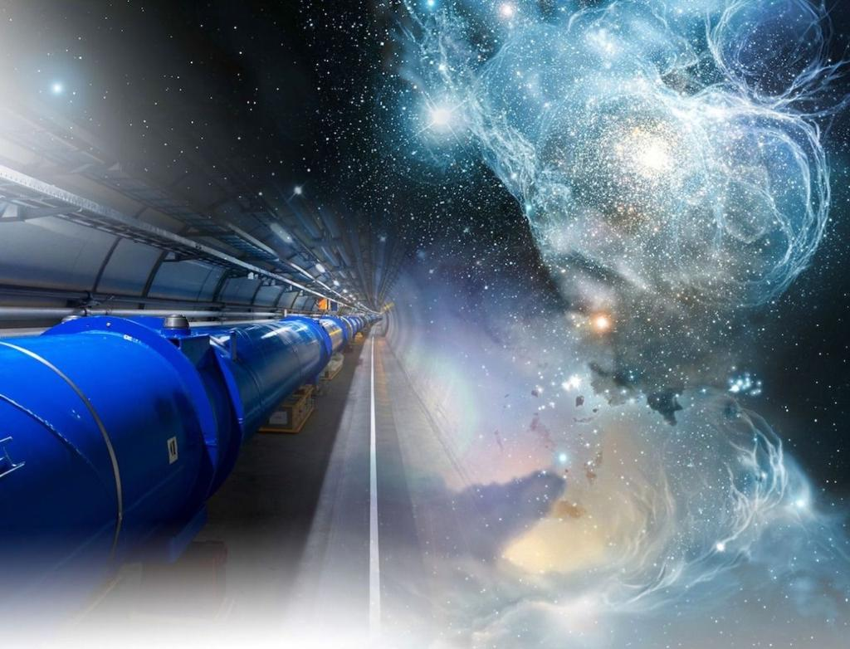
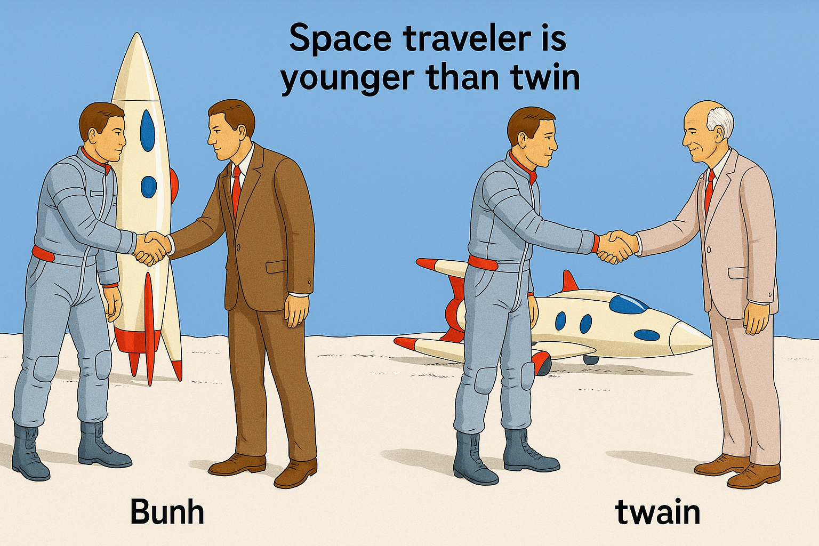
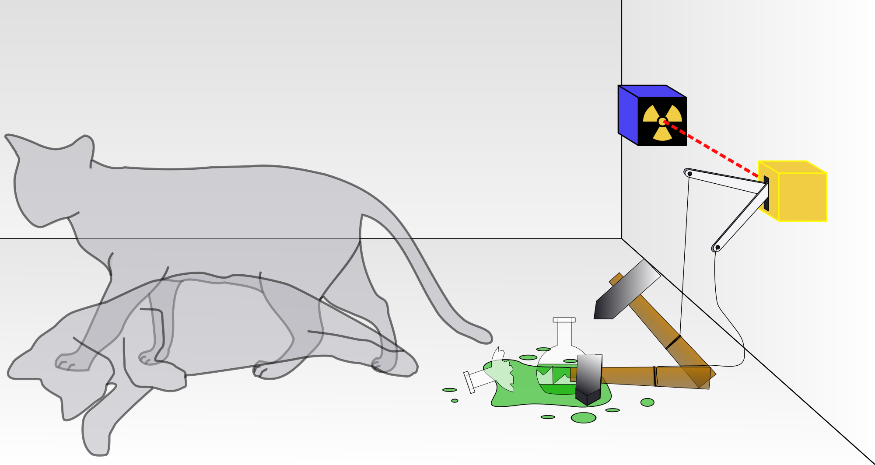
The Relativistic Quantum World
Relativity
A lecture series on
Relativity Theory and Quantum Mechanics
Before
After
Quantum
Alive
Marcel Merk
Studium Generale Maastricht
Sep 10 – Oct 8, 2025
Dead
Notes:
Explain picture. Interesting (“bizarre”) aspects of relativity and QM

Slide 2
The Relativistic Quantum World
1
Lecture 1: The Principle of Relativity and the Speed of Light
Lecture 2: Time Dilation and Lorentz Contraction
Lecture 3: The Lorentz Transformation and Paradoxes
Lecture 4: General Relativity and Gravitational Waves
Sep. 10:
Relativity
Sep. 17:
Lecture 5: The Early Quantum Theory
Lecture 6: Feynman’s Double Slit Experiment
Lecture 7: Wheeler’s Delayed Choice and Schrodinger’s Cat
Lecture 8: Quantum Reality and the EPR Paradox
Quantum
Mechanics
Sep. 24:
Oct. 1 :
Standard
Model
Lecture 9: The Standard Model and Antimatter
Lecture 10: Why is there something rather than nothing?
Oct. 8:
Lecture notes, written for this course, are available: www.nikhef.nl/~i93/Teaching/
Prerequisite for the course: High school level physics & mathematics.
Notes:
Ambitious!

Slide 3
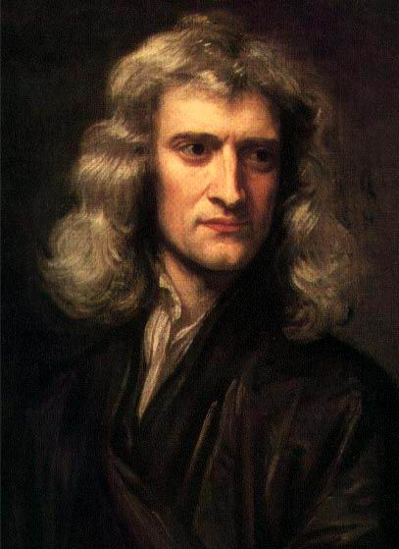
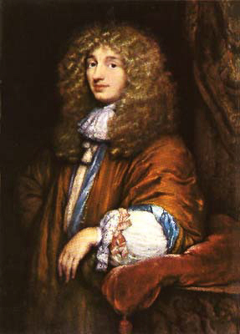
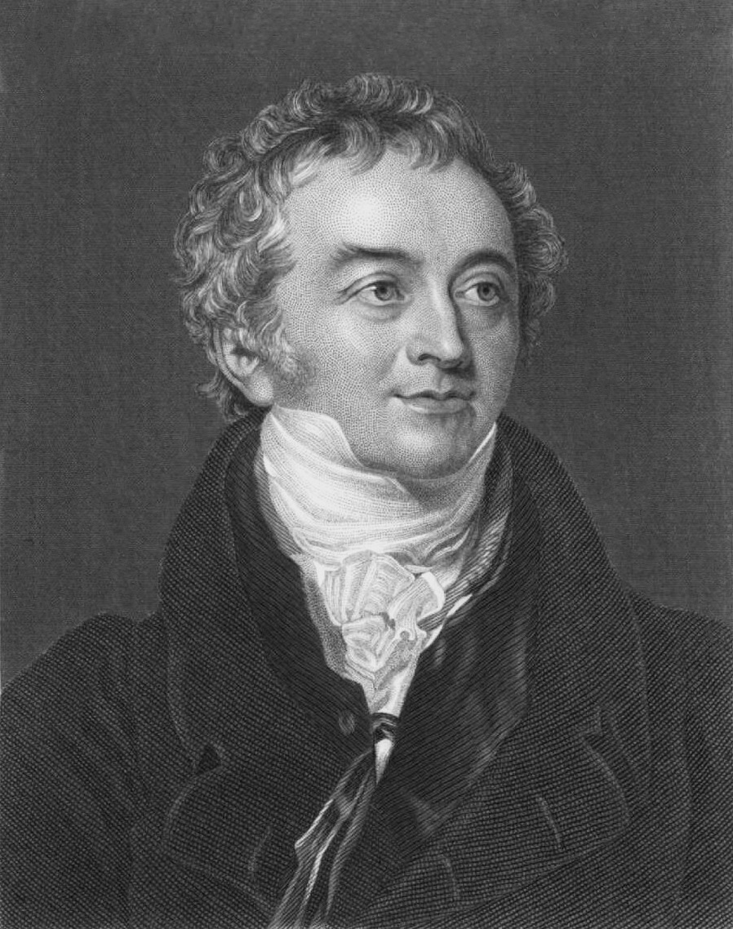
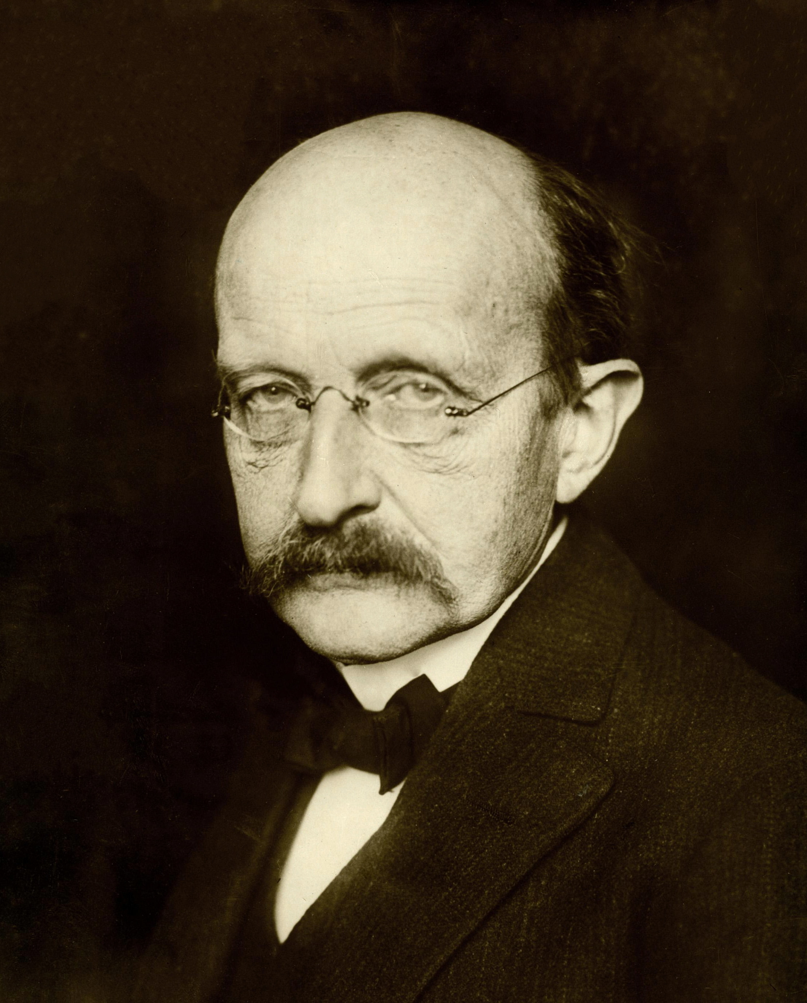
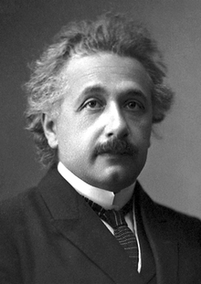
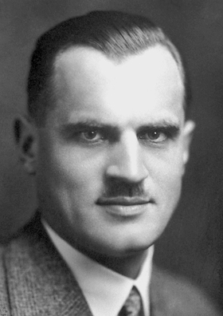
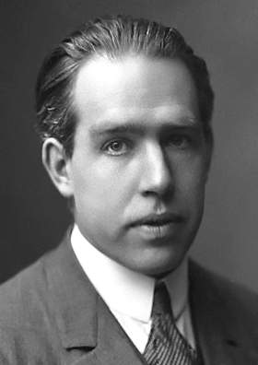
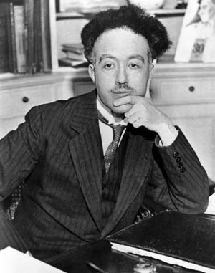
Quantum Mechanics
2
No, similar to
sound light consists
of waves
Yes, because
it interferes
Light is a stream
of particles
Light is emitted
in quanta
Isaac Newton
Christiaan Huygens
Thomas Young
Max Planck
The nature of light is quanta
Particles have a
wave nature:
λ = h/p
Yes, because
photons collide!
Particles are probability waves
Albert Einstein
Arthur Compton
Louis de Broglie
Niels Bohr
Notes:
Summary of Quantum Mechanics sofar.

Slide 4
Quantum Mechanics
2
No, similar to
sound light consists
of waves
Yes, because
it interferes
Light is a stream
of particles
Light is emitted
in quanta
Isaac Newton
“Particle” and “Wave” are
complementary aspects.
Christiaan Huygens
Thomas Young
Max Planck
The nature of light is quanta
Particles have a
wave nature:
λ = h/p
Yes, because
photons collide!
Particles are probability waves
Albert Einstein
Arthur Compton
Louis de Broglie
Niels Bohr

Slide 5
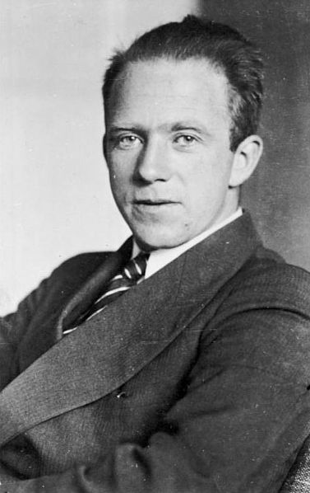
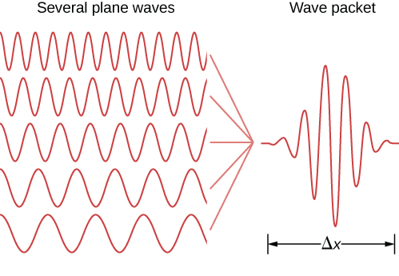
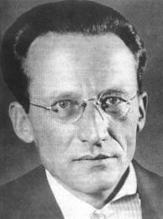
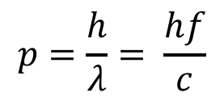
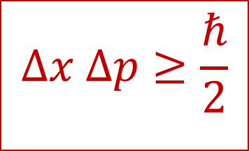
Uncertainty Relation
3
$$Δx Δp≥\frac{ℏ}{2}$$
It is not possible to determine position and momentum at the same time:
Δp
Erwin Schrödinger
Werner Heisenberg
$$p=\frac{h}{λ}= \frac{hf}{c}$$
A particle does not have well defined position and momentum at the same time.
Notes:
Heisenberg and Schrodinger also had to complementary ways to describe it ;-)

Slide 6
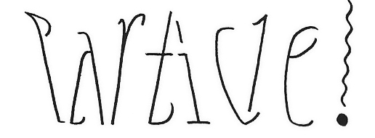
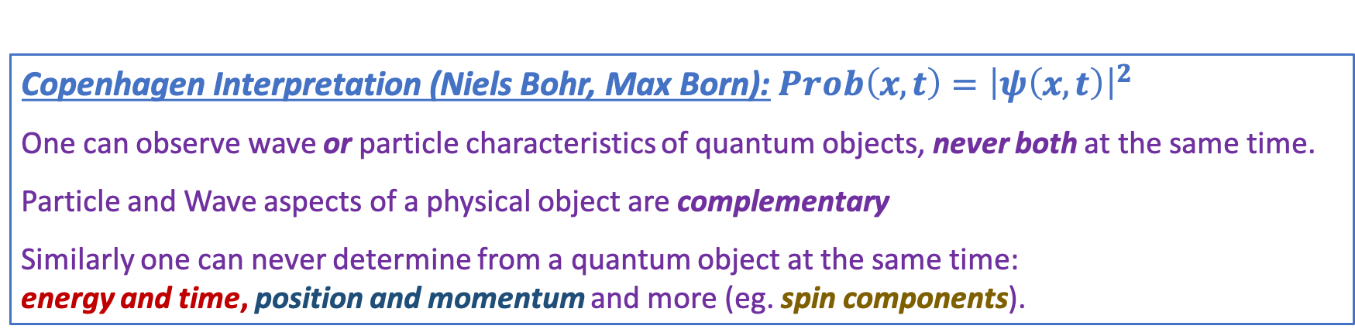
Complementarity
4
Subatomic matter is not just waves and it is not just particles.
It is nothing we know from macroscopic world.
Niels Bohr
1885 - 1962
Copenhagen Interpretation (Niels Bohr, Max Born):$Prob\left(x,t\right)={\left|ψ\left(x,t\right)\right|}^{2}$
One can observe wave or particle characteristics of quantum objects, never both at the same time.
Particle and Wave aspects of a physical object are complementary
Similarly one can never determine from a quantum object at the same time:
energy and time, position and momentum and more (eg. spin components).
Notes:
Niels Bohr: Nestor of the Copenhagen interpretation of Quantum Mechanics

Slide 7
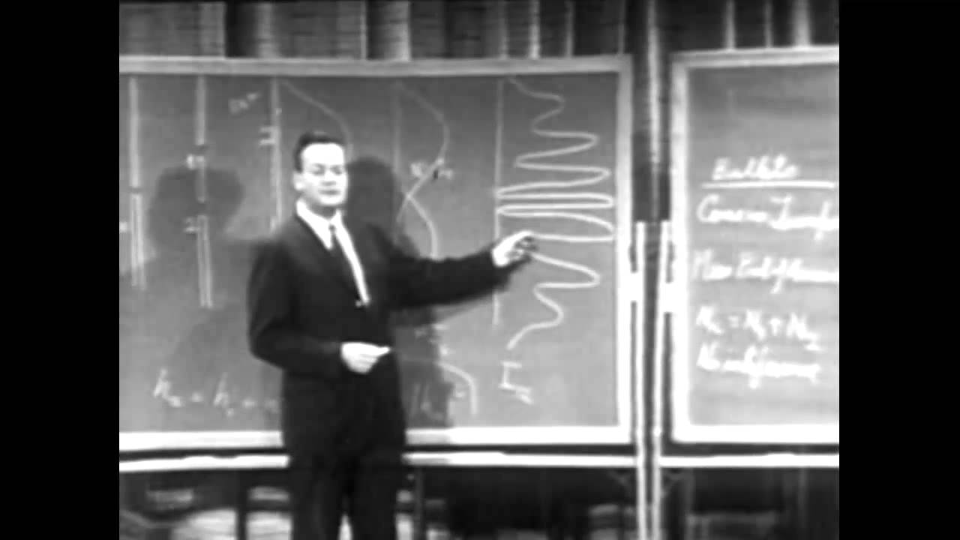
Richard Feynman and the double slit experiment
5
The double slit experiment demonstrates the fundamental aspect of the quantum world.
Notes:
We will take it further today

Slide 8
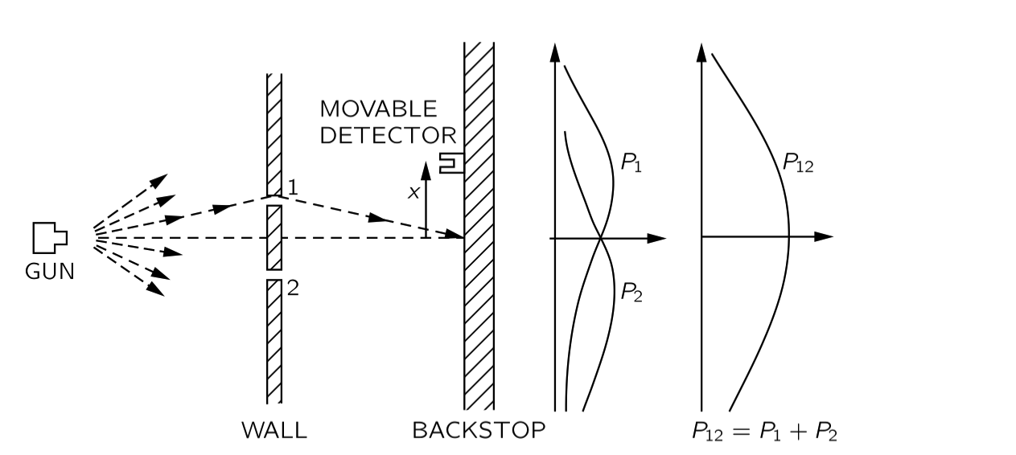
Case 1: Experiment with Bullets
6
A gun fires bullets in random direction. Slits 1 and 2 are openings through which bullets can pass. A moveable detector “collects” bullets and counts them.
P₁ is the probability curve when only slit 1 is open
P₂ is the probability curve when only slit 2 is open
When both slits are open: P₁₂ = P₁ + P₂
We can just add up the probabilities.
Notes:
Last week

Slide 9
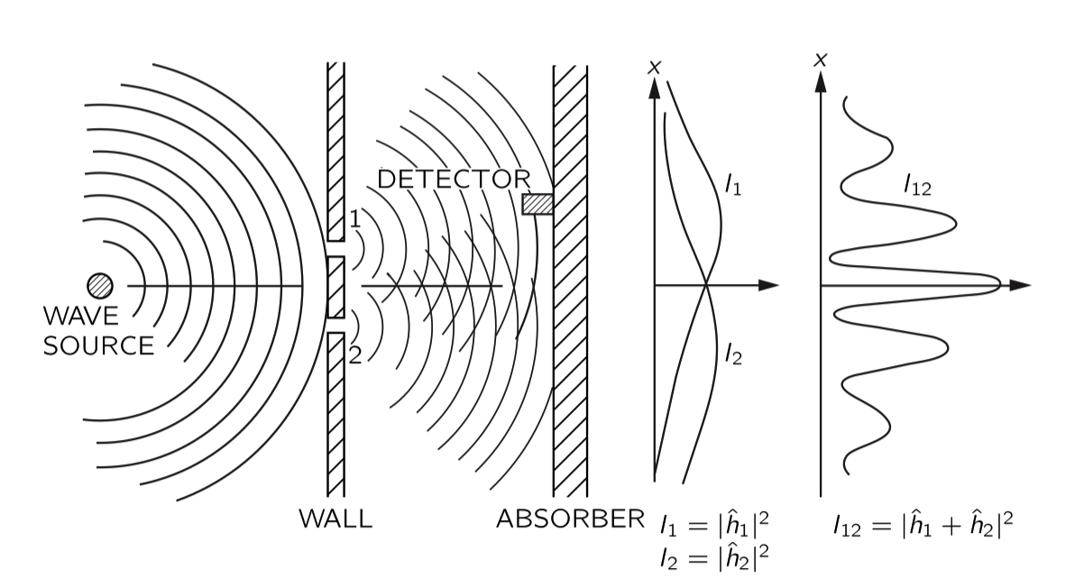
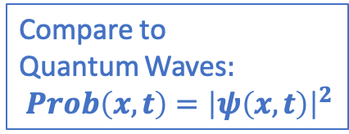

Case 2: Experiment with Waves
7
Let waves pass the slits. When both slits are open there are two contributions to the wave the oscillation at the detector: $W\left(t\right)=W_{1}\left(t\right)+W_{2}\left(t\right)$
Compare to
Quantum Waves$:$ $Prob\left(x,t\right)={\left|ψ\left(x,t\right)\right|}^{2}$
Contrary to “bullets” we can not just add up Intensities.
Interference pattern: $I_{12}={\left|W_{1}+W_{2}\right|}^{2}=h_{1}^{2}+h_{2}^{2}+2h_{1}h_{2}\cos\left(Δφ\right)$
Regions where waves are amplified and regions where waves are cancelled.
Notes:
Add up the waves and then square the result for the intensity. Similar to quantum probability which is the square of the wave function.

Slide 10
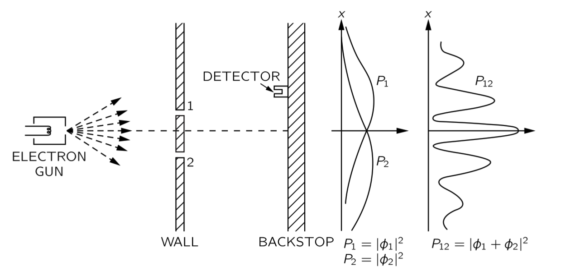
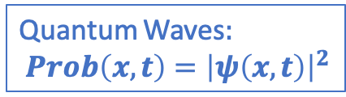
Case 3: Experiment with Electrons
8
Shoot single electrons, one by one at the double slit:
Observe a wave-like quantum interference!
Quantum Waves$:$ $Prob\left(x,t\right)={\left|ψ\left(x,t\right)\right|}^{2}$
|ψ₁|²
|ψ₁ + ψ₂|²
|ψ₂|²

Slide 11
Case 3: Experiment with Electrons
8
Shoot single electrons, one by one at the double slit:
Observe a wave-like quantum interference!
Quantum Waves$:$ $Prob\left(x,t\right)={\left|ψ\left(x,t\right)\right|}^{2}$
Although the electron is detected as a “lump” on the screen, apparently it has gone through both slits!
|ψ₁|²
|ψ₁ + ψ₂|²
|ψ₂|²

Slide 12
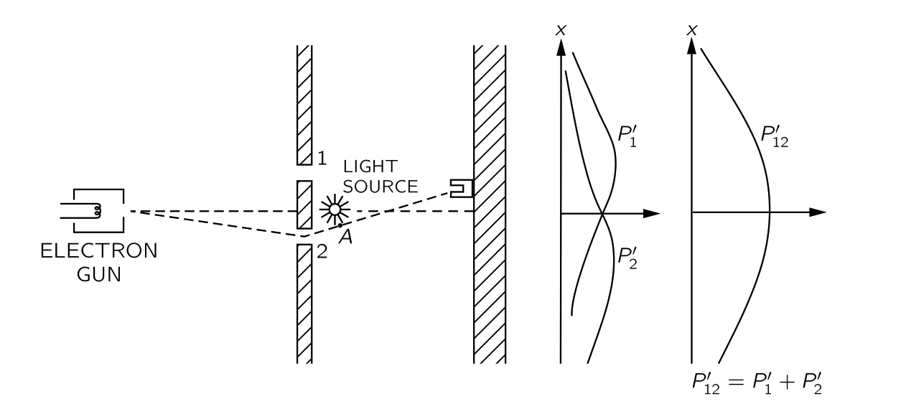

Case 4: Watch the Electrons
9
When we watch through which slit the electrons go, we destroy the interference!
Now the electron behaves just like a classical particle (“bullet”).
D₁
D₂
$Prob\left(x,t\right)={\left|ψ\left(x,t\right)\right|}^{2}$
It requires an observation to let the quantum wave function “collapse” into reality.
As long as no measurement is made the wave function keeps “all options open”.
If you watch half the time; you only get the interference for the cases you did not watch.

Slide 13
10
Lecture 7
Wheeler’s Delayed Choice Experiment
“Your theory is crazy, but not crazy enough to be true.”
Niels Bohr
“Nothing exists, until it is measured.”
Niels Bohr
“I don’t like it, and I’m sorry I ever had anything to do with it.”
Erwin Schrödinger

Slide 14
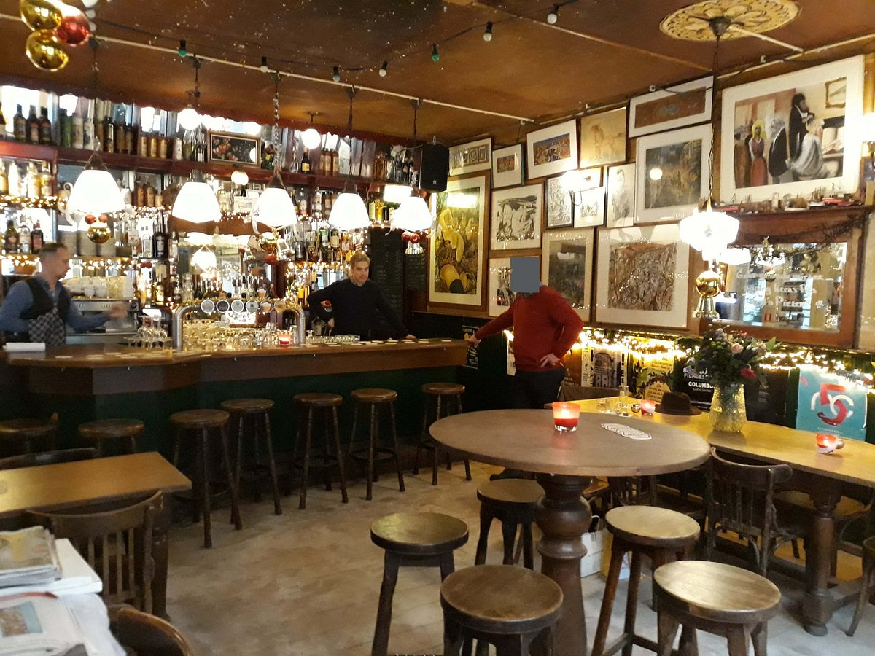

The Double Slit Experiment
11
Case 5:
The Delayed Choice Experiment
Notes:
Café de Pieter in Pieterstraat

Slide 15
Case 4: Watch the Electrons
12
Consider again the double slit experiment in which we watch the electrons.
D₁
D₂
Can we try to “fool” the electron?

Slide 16
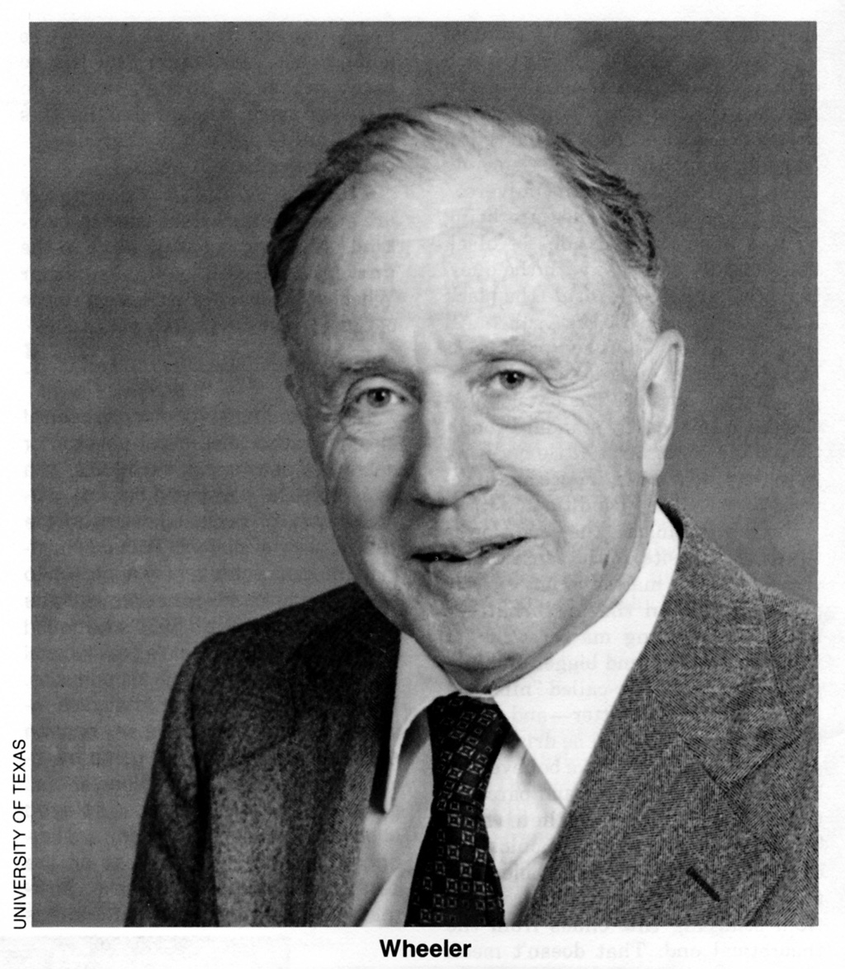
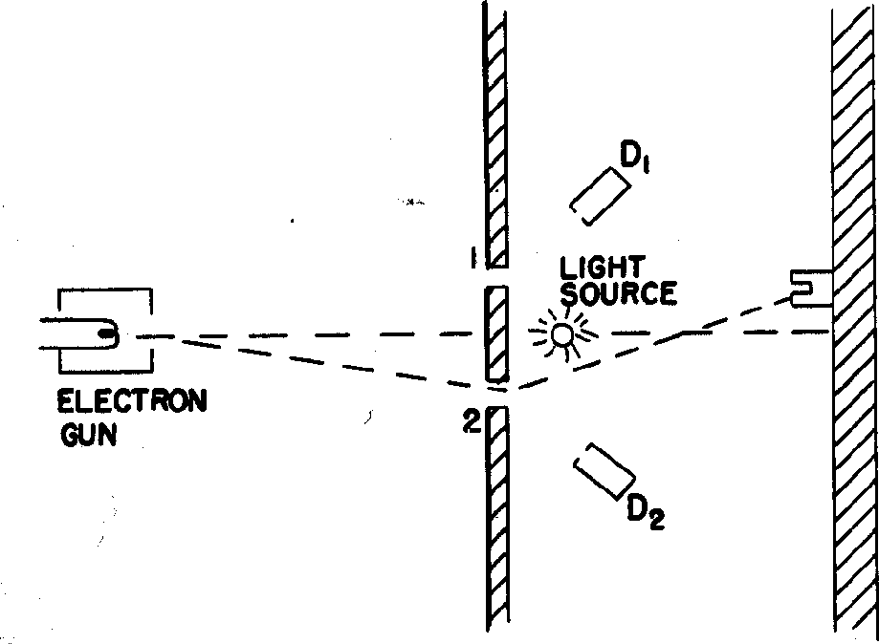
Case 5: Wheeler’s Suggestion (1978)
13
John Wheeler (1911 – 2008):
Famous for work on gravitation
(Black holes – quantum gravity)
Replace detectors D₁ and D₂ with telescopes T₁ and T₂ which are focused on slits 1 and 2
T₁
T₂
What happens if we afterwards check whether the electron went through slit 1 or slit 2?
Notes:
Same set-up, but move the microscopes very far away……
Wheeler: promotor of Feynman and Everett III

Slide 17
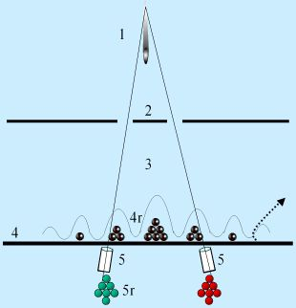
Wheeler’s Delayed Choice Experiment
14
Even better: we can suddenly decide to look at the electrons or not.
We decide whether or not to look after the electrons passed the slits!
T₁
T₂
What will we see?
An wave interference (black) pattern or a bullet-like non-interference (red-green) pattern?
Notes:
At Right:
Do we see “bullets” distribution in green and red, or
Do we see “waves”, distributions in black?

Slide 18
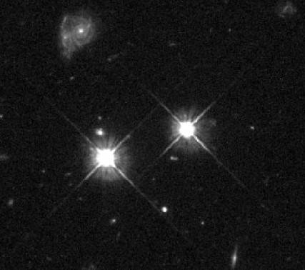
Thought Experiment with Gravitational Lensing
15
What if we make the distance from slits to screen very long?
John Archibald Wheeler
Light beams bend in gravitation field.
Two different light-paths can arrive in the same position in our eyes/telescope.
We then see the same object in two locations.
➔ We can make a “double slit” photon experiment
Notes:
Gravitational lensing: light bends around galaxies.
The galaxies now work as a “double slit”
Example right bottom: two images of the same galaxy with lensing.

Slide 19
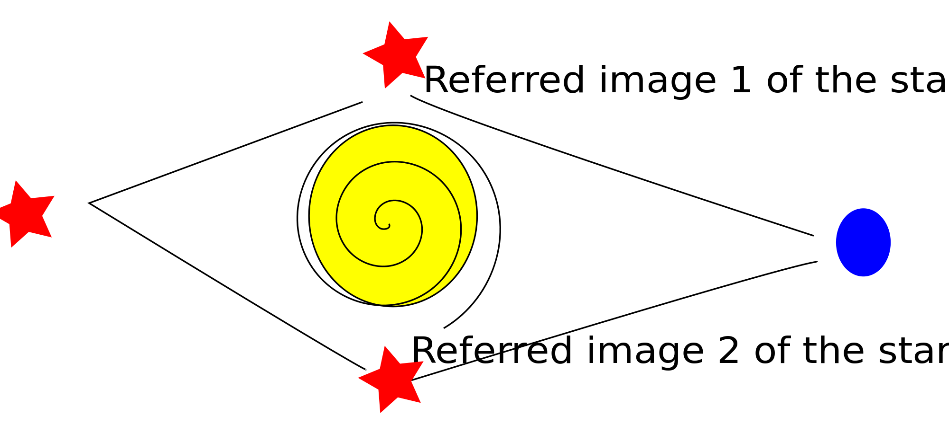
Wheeler’s Delayed Choice Experiment
16
What if we make the distance from slits to screen very long?
Wheeler uses “gravitational lensing” as a “double slit”.
In this case the electrons are replaced by photons.
Star
T₁
One screen or two screens
Galaxy
T₂
Then, either: Project image of T₁ and T₂ on separate screens,
Or: Combine the image of T₁ and T₂ on one screen
→ QM: no interference!
→ QM: interference!
Notes:
Elecrons or photons is not important: “quanta”.
Count the photons “left” and “right” or make an interference:
Each photon goes both ways!!

Slide 20
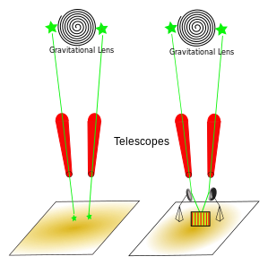
Wheeler’s Delayed Choice Experiment
17
What if we make the distance from slits to screen very long?
Wheeler uses “gravitational lensing” as a “double slit”.
In this case the electrons are replaced by photons.
Star
T₁
One screen or two screens
Galaxy
T₂
Then, either: Project image of T₁ and T₂ on separate screens,
Or: Combine the image of T₁ and T₂ on one screen
→ QM: no interference!
→ QM: interference!

Slide 21
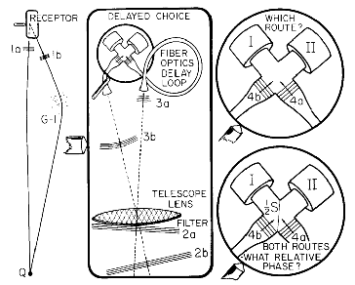
Wheeler’s Delayed Choice Experiment
18
What if we make the distance from slits to screen very long?
Wheeler uses “gravitational lensing” as a “double slit”.
In this case the electrons are replaced by photons.
Star
T₁
One screen or two screens
Galaxy
T₂
Then, either: Project image of T₁ and T₂ on separate screens,
Or: Combine the image of T₁ and T₂ on one screen
→ QM: no interference!
→ QM: interference!
Crucial point: it must be impossible to know which path the photon took!

Slide 22
Wheeler’s Delayed Choice Experiment
19
Even better: we can suddenly decide to look at the electrons.
Suppose we decide (random) to look after the electrons passed the slits!
T₁
T₂
What will we see?
An wave interference (black) pattern or a bullet-like non-interference (red-green) pattern?
Answer: “Bullets”. We still have killed the interference by measuring!!!

Slide 23
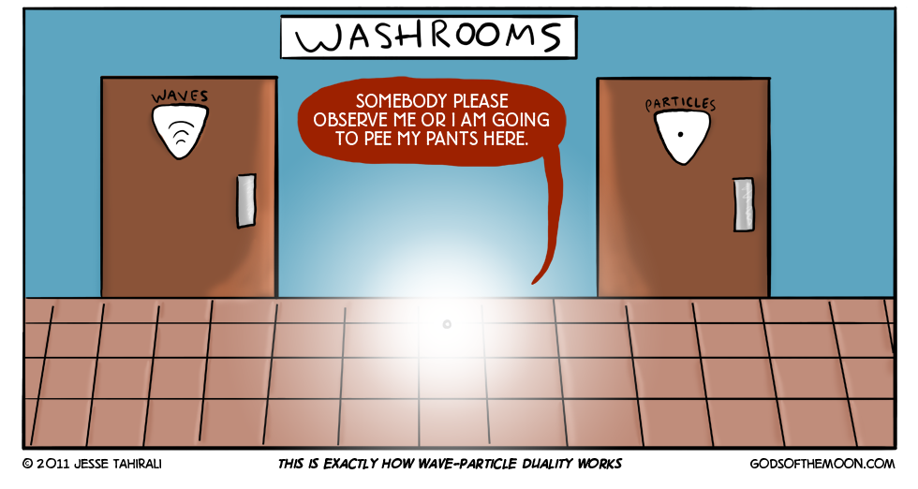
Delayed Choice…?
20

Slide 24
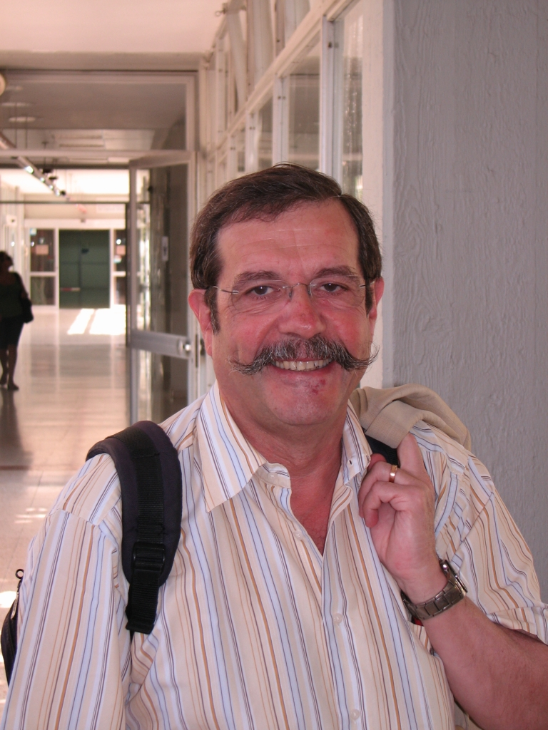
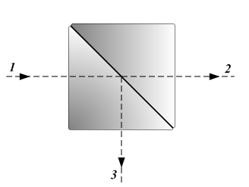
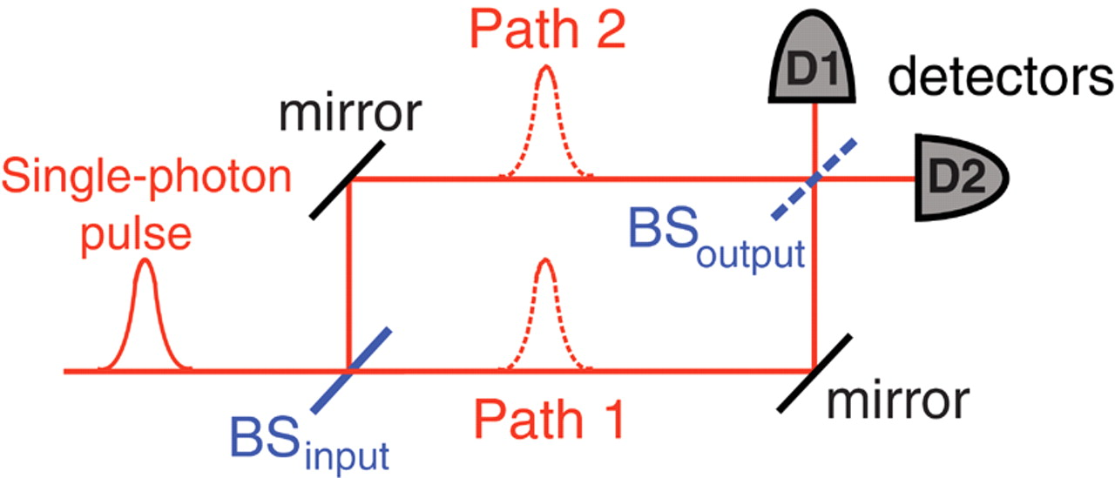
The Experiment of Aspect (2007)
21
Alain Aspect and his team have done the experiment!
In yet another way: using photons in the lab.
They used beam-splitters to create two alternative routes
for a photon to reach the same place. Path 1 = Path 2 = 48 m
Alain Aspect
BS Beam-splitter:
Photon has 50% chance to pass through and 50% chance to reflect.
Like 2-slits: the quantum can do both!
Notes:
D1=path1 D2=path2
Beam splitters: 50% light is transmitted, 50% light is reflected (also single photon waves!)

Slide 25
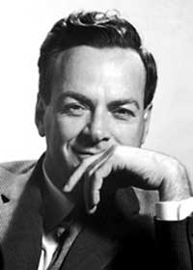
Three Equivalent Experiments
22
T₁
T₂

Slide 26
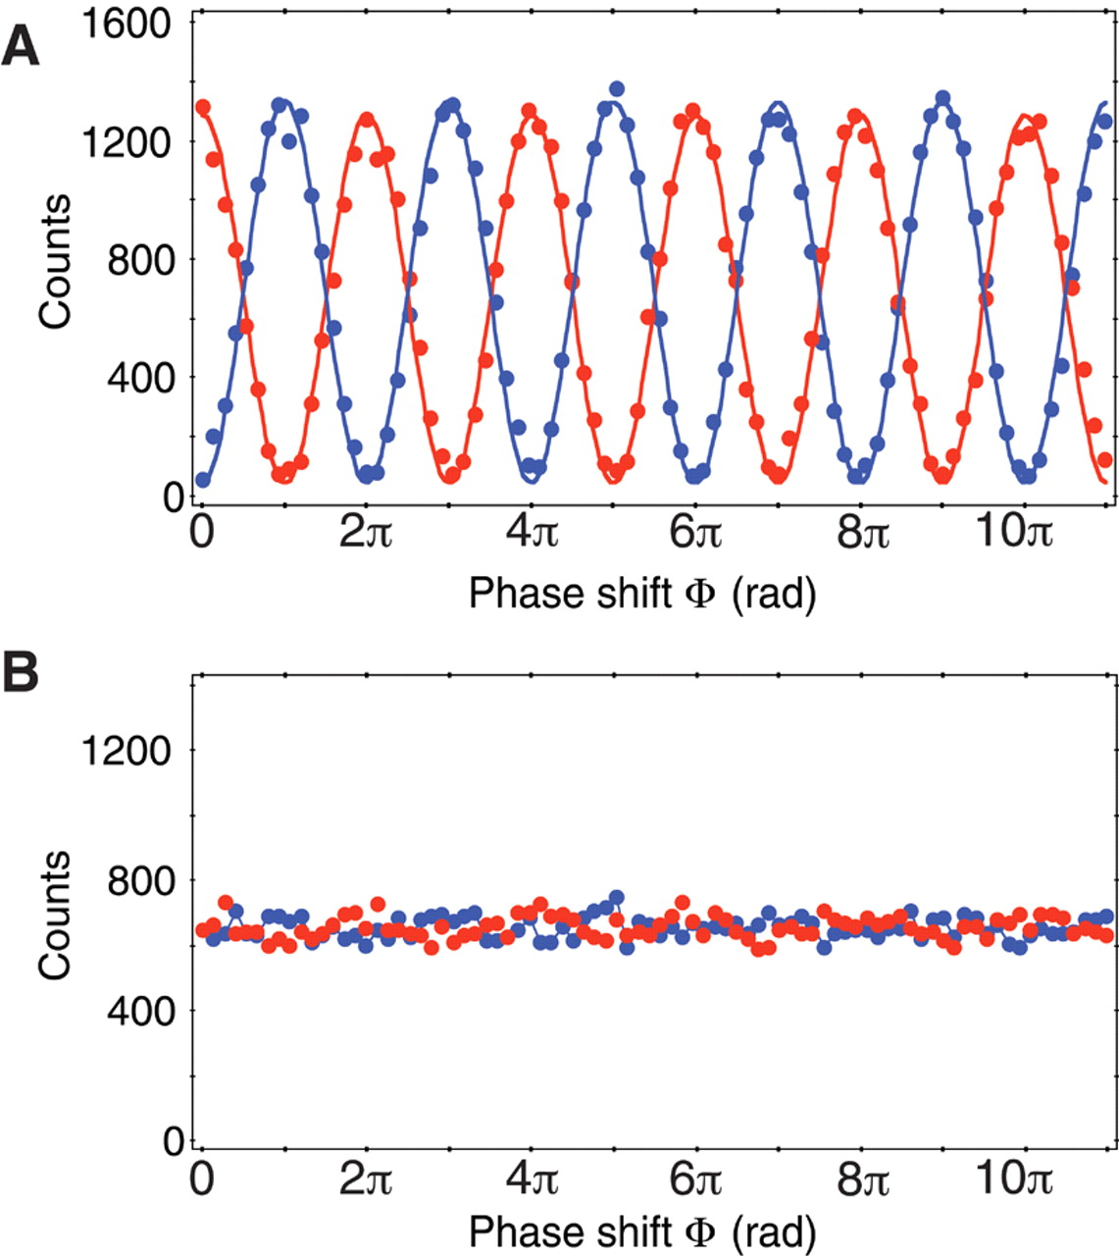
The Experiment of Aspect (2007)
23
Situation 1: “Are you a particle?” (open BS_{output})
Answer: “Yes!” (Photon never on 2 paths)
.
”Looking”
.
Counts in D1
Counts in D2
(Phase shift = change length Path2 – Path1)
Situation 2: “Are you a wave?” (closed BS_{output})
Answer: “Yes!” (Photon on 2 paths)
“Not Looking”
Notes:
Looking: D1 “looks” at path1 – D2 looks at path2
"Are you a particle?" Yes!
Not looking: mirror mixes again path1 and path2
"Are you a wave?" Yes!
Phase shift by changing the length of path1 and path2

Slide 27
The Experiment of Aspect (2007)
24
Situation 1: “Are you a particle?” (open BS_{output})
”Looking”
Make the choice to close BS_{output} well after the photon has passed BS_{input}!
(Phase shift = change length Path2 – Path1)
Situation 2: “Are you a wave?” (closed BS_{output})
Answer: “Yes!” (Photon on 2 paths)
“Not Looking”
Notes:
Make the paths very long and decide to open or close *after* the photon chose path1 or path2.

Slide 28
The Experiment of Aspect (2007)
24
Situation 1: “Are you a particle?” (open BS_{output})
Answer: “Yes!” (Photon never on 2 paths)
”Looking”
“Thus one decides the photon shall have come by one route or by both
routes after it has already done its travel”
”Past has no existence except as recorded in the present”
- John A. Wheeler
Situation 2: “Are you a wave?” (closed BS_{output})
Answer: “Yes!” (Photon on 2 paths)
“Not Looking”
Apparently the quantum wave function includes both possibilities.
The observation makes one of them a reality via the collapse of the wave function.

Slide 29

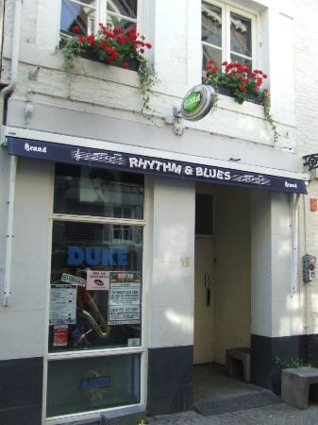
25
Schrödinger’s Cat
Notes:
Blues café the Duke in de Koestraat

Slide 30
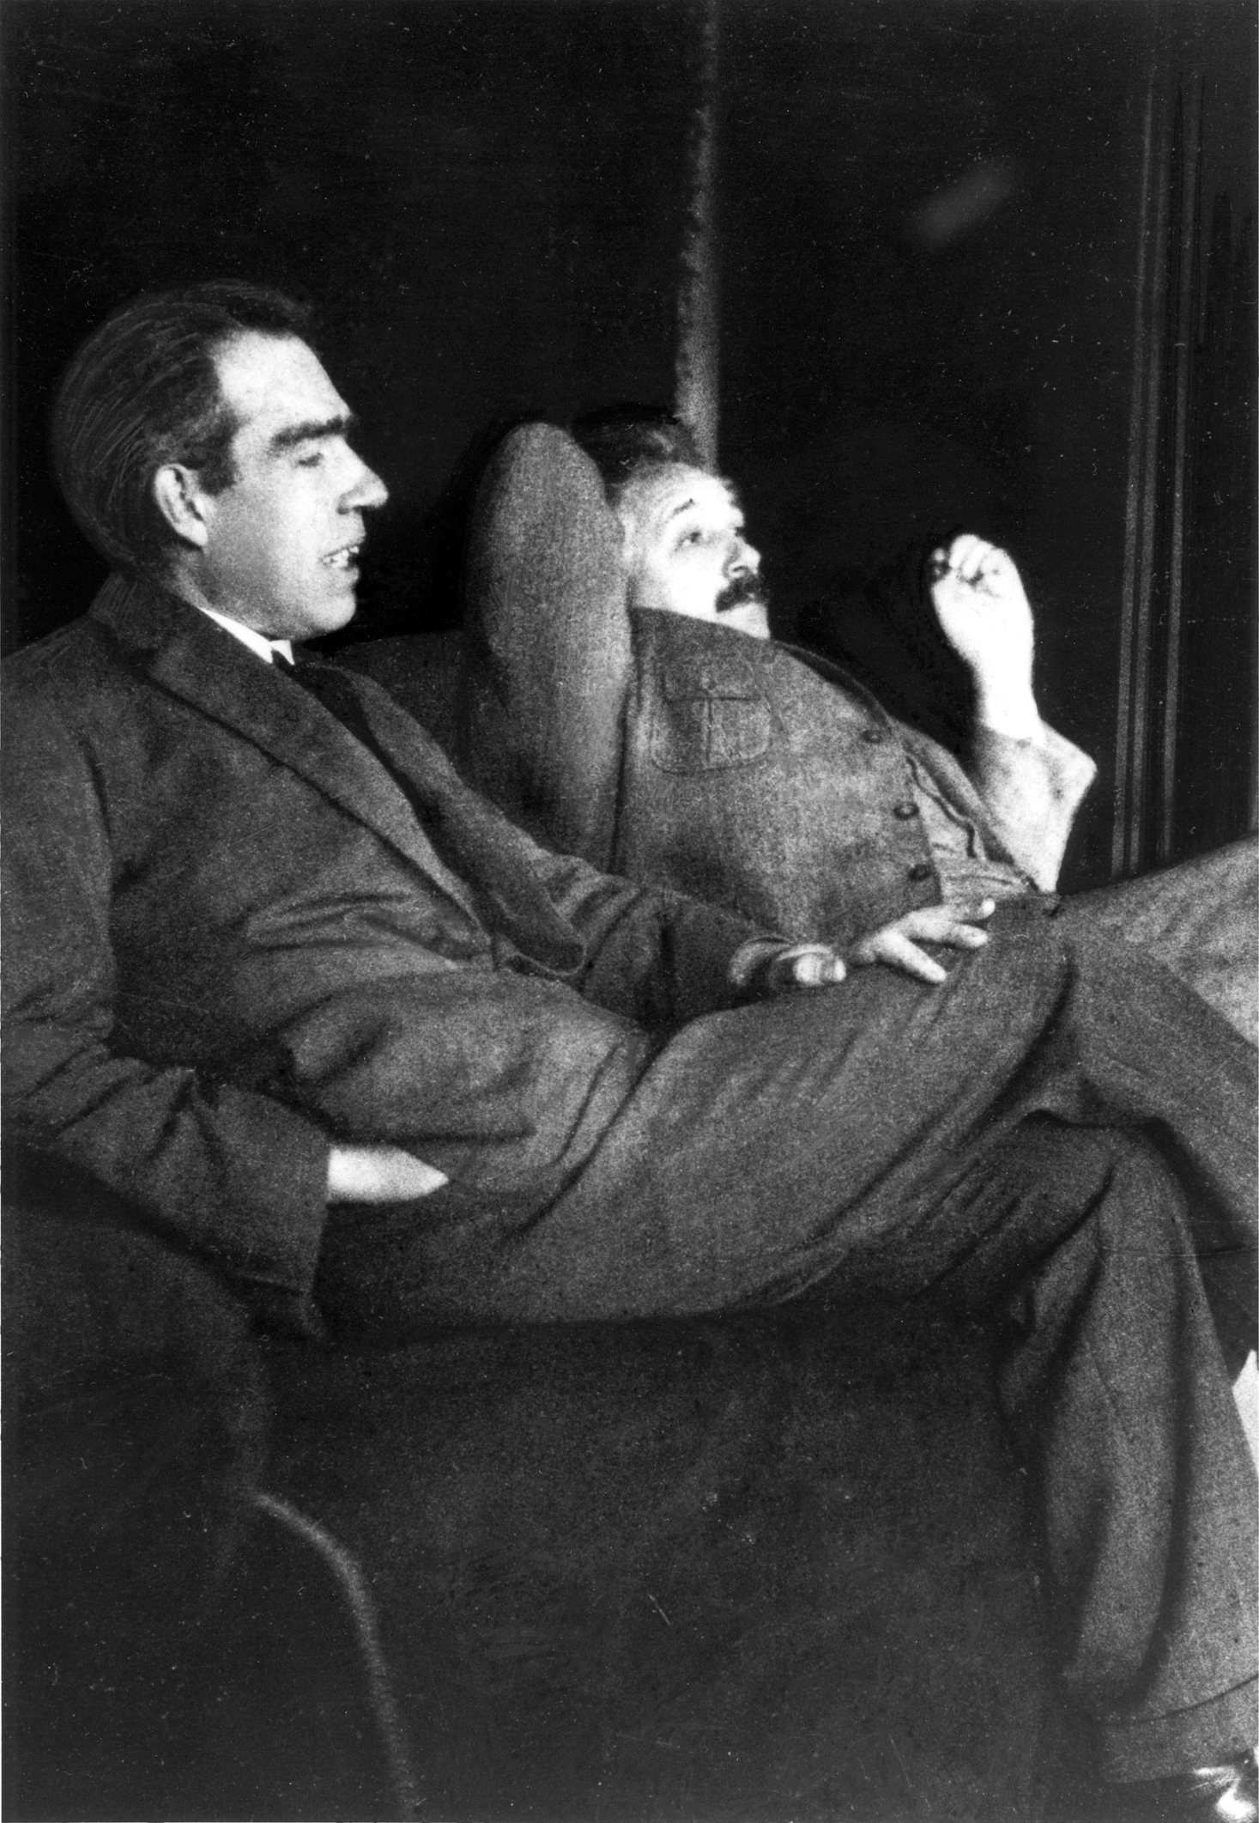
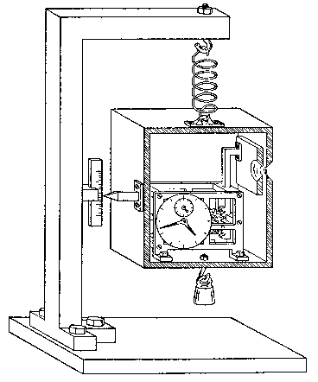
The Copenhagen Interpretation
26
Niels Bohr and Albert Einstein debates at Solvay conf.
Niels Bohr:
Uncertainty relation
Complementary, collapse of
the wave function.
1927
Albert Einstein:
“God does not play dice”
Objective Reality
Photo: Paul Ehrenfest
(December 1925)
Complementarity: A quantum object is both a particle and a wave.
A measurement can illustrate either particle or wave nature but not both at the same time, because the object is affected by the act of measurement.
Superposition: A quantum leaves all options open until it is forced to bring one into reality by a measurement.

Slide 31
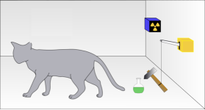
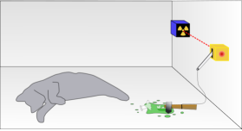
Schrodinger’s Cat
27
Paradox (thought experiment) invented by Erwin Schrödinger in 1935 to demonstrate that the Copenhagen interpretation makes no sense.
E. Schrödinger
Compare quantum choice with double slit situation.
In a radioactive source, a single random quantum event has 50% probability to trigger a lever arm and break a flask containing deadly poison.

Slide 32
Schrodinger’s Cat
28
Paradox (thought experiment) invented by Erwin Schrödinger in 1935 to demonstrate that the Copenhagen interpretation makes no sense.
Superposition
E. Schrödinger
In a radioactive source, a single random quantum event has 50% probability to trigger a lever arm and break a flask containing deadly poison.
Notes:
As long as we don't look the cat is in a superposition of both states.

Slide 33
Schrodinger’s Cat
28
Paradox (thought experiment) invented by Erwin Schrödinger in 1935 to demonstrate that the Copenhagen interpretation makes no sense.
Superposition
In simple mathematics: probability is 𝜓²
The wave function of the particle in 2-slit (”superposition”):
𝜓_{wave} = 𝜓_{left} + 𝜓_{right}
Probability before measurement:
(𝜓_{wave})² = (𝜓_{left} + 𝜓_{right})² = (𝜓_{left})² + (𝜓_{right})² + 2 𝜓_{left・}𝜓_{right}
Measurement: force the particle to go left or right!
E. Schrödinger
“Interference”
In a radioactive source, a single random quantum event has 50% probability to trigger a lever arm and break a flask containing deadly poison.

Slide 34
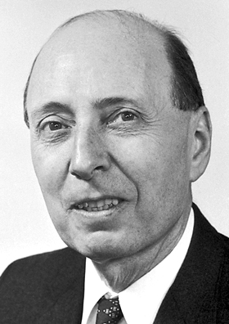
Schrodinger’s Cat
29
Paradox (thought experiment) invented by Erwin Schrödinger in 1935 to demonstrate that the Copenhagen interpretation makes no sense.
Superposition
In simple mathematics: probability is 𝜓²
The wave function of the cat in the box (“superposition”):
𝜓_{cat} = 𝜓_{alive} + 𝜓_{dead}
Probability before measurement:
(𝜓_{cat})² = (𝜓_{alive} + 𝜓_{dead})² = (𝜓_{alive})² + (𝜓_{dead})² + 2 𝜓_{alive・}𝜓_{dead}
Measurement: force cat to be either dead or alive!
E. Schrödinger
“Interference”
In a radioactive source, a single random quantum event has 50% probability to trigger a lever arm and break a flask containing deadly poison.
Is the cat both dead and alive before we open the box to observe?
Eugene Wigner
”Wigner’s Friend” problem: Who is observer? When does the wave function collapse?
Is it the cat? The Experimenter? The press reporter? Or you when you hear the news?
Does it require consciousness?

Slide 35
Schrodinger’s Cat
30
Paradox (thought experiment) invented by Erwin Schrödinger in 1935 to demonstrate that the Copenhagen interpretation makes no sense.
E. Schrödinger
In a radioactive source, a single random quantum event has 50% probability to trigger a lever arm and break a flask containing deadly poison.
Is the cat both dead and alive before we open the box to observe?
Eugene Wigner
”Wigner’s Friend” problem: Who is observer? When does the wave function collapse?
Is it the cat? The Experimenter? The press reporter? Or you when you hear the news?
Does it require consciousness?

Slide 36
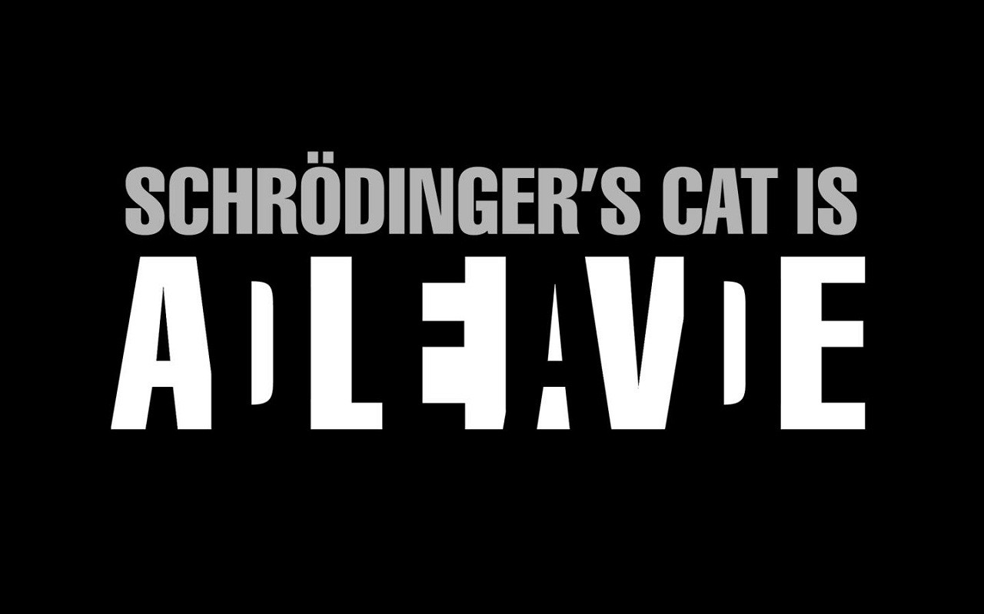
Schrodinger’s Cat
30
Paradox (thought experiment) invented by Erwin Schrödinger in 1935 to demonstrate that the Copenhagen interpretation makes no sense.
E. Schrödinger
In a radioactive source, a single random quantum event has 50% probability to trigger a lever arm and break a flask containing deadly poison.
Is the cat both dead and alive before we open the box to observe?
Eugene Wigner
”Wigner’s Friend” problem: Who is observer? When does the wave function collapse?
Is it the cat? The Experimenter? The press reporter? Or you when you hear the news?
Does it require consciousness?

Slide 37
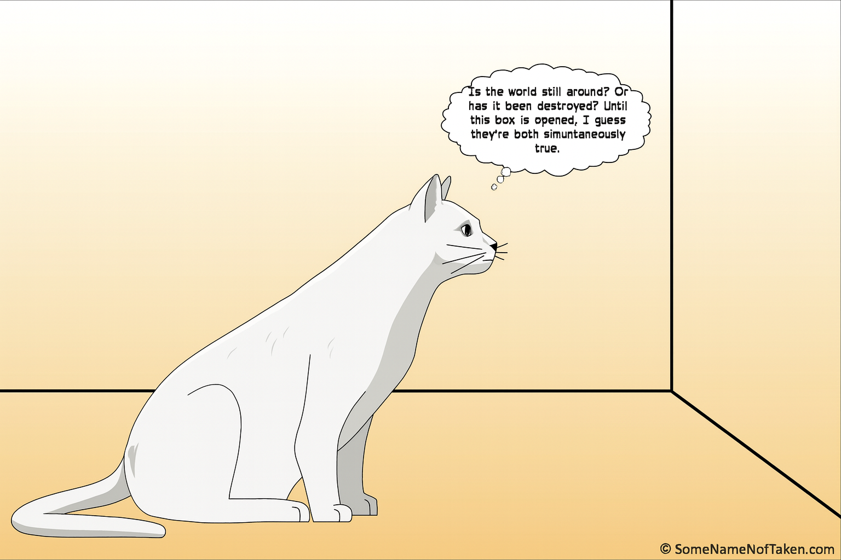
Schrodinger’s Cat – from the inside of the box…
30
31
E. Schrödinger
Eugene Wigner

Slide 38
John Archibald Wheeler: The Participatory Universe
32
Inventor of terms:
“black hole”, “worm hole”, “quantum foam”
Famous book on gravitation
Proposed a one-electron universe
PhD supervisor
Richard Feynman
Hugh Everett III
Participatory universe: “it from bit”
John Wheeler: 1911 – 2008
John Wheeler: “The real reason universities have students is to educate the professors”

Slide 39
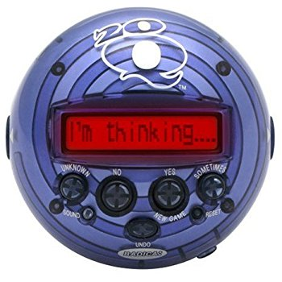
Wheeler: 20 Questions Analogy
33
A Word Game:
At a party one guest has to guess a word that is agreed upon by the others asking questions to be answered with “yes”/”no”.
➔ The pre-existing word is guessed.
The “20-Q” game
Alternative game:
No word is agreed at beginning. Each person in turn answers yes/no consistently with all previous “yes”/”no” answers.
Gets more and more difficult
Finally the person guessing says: “Is it a cloud?” Answer: “Yes!”
➔ There was no pre-existing word. The final word
was brought into being by the questions asked.
Analogy:
Nature gives consistent answers on quantum questions asked by the “collapse of the wave function”
➔ The observer creates reality by making an observation.
“No phenomenon is a real phenomenon until it is an observed phenomenon.”
- John Archibald Wheeler
Notes:
A nice game invented by Wheeler based on the 20Q game.
You have to guess a word within 20 yes/no questions.
2^20 ~ 1 million

Slide 40
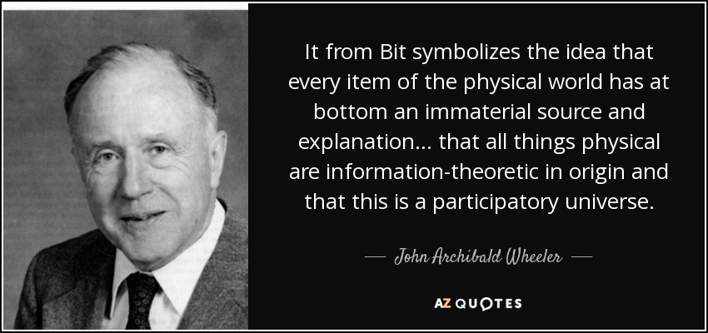

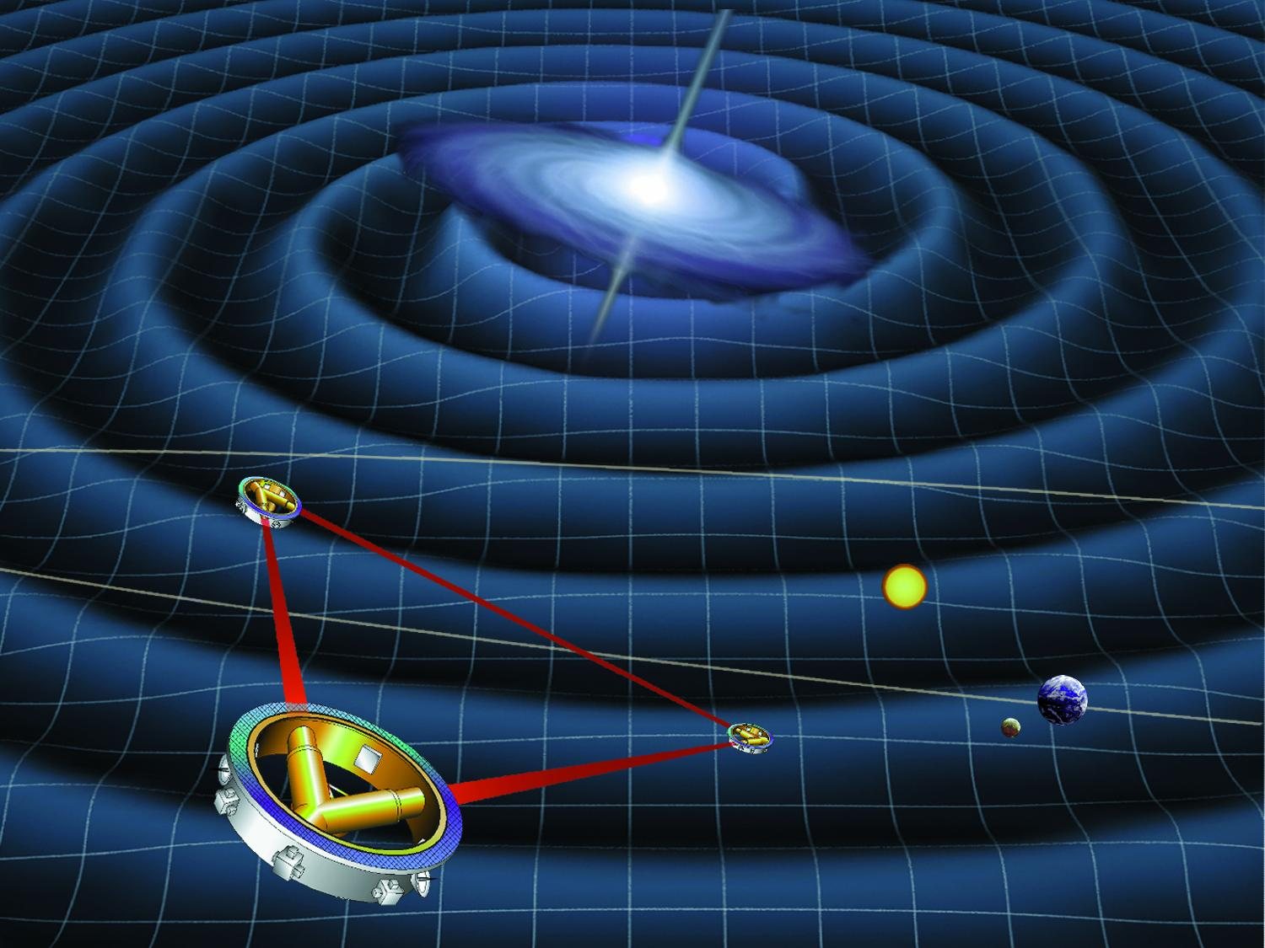
“It from Bit” and “Participatory Universe”
34
?
Build a gravitational wave detector
and look back directly at the big bang….
The universe does not exist
“out there independent of all acts of observation.”
- John Archibald Wheeler
Notes:
Wheeler’s commented his career in three parts:
Everything is particles
Everything is fields
Everything is Information

Slide 41

Next Lecture: Einstein’s Objection
35
The EPR paradox

