Slide 1
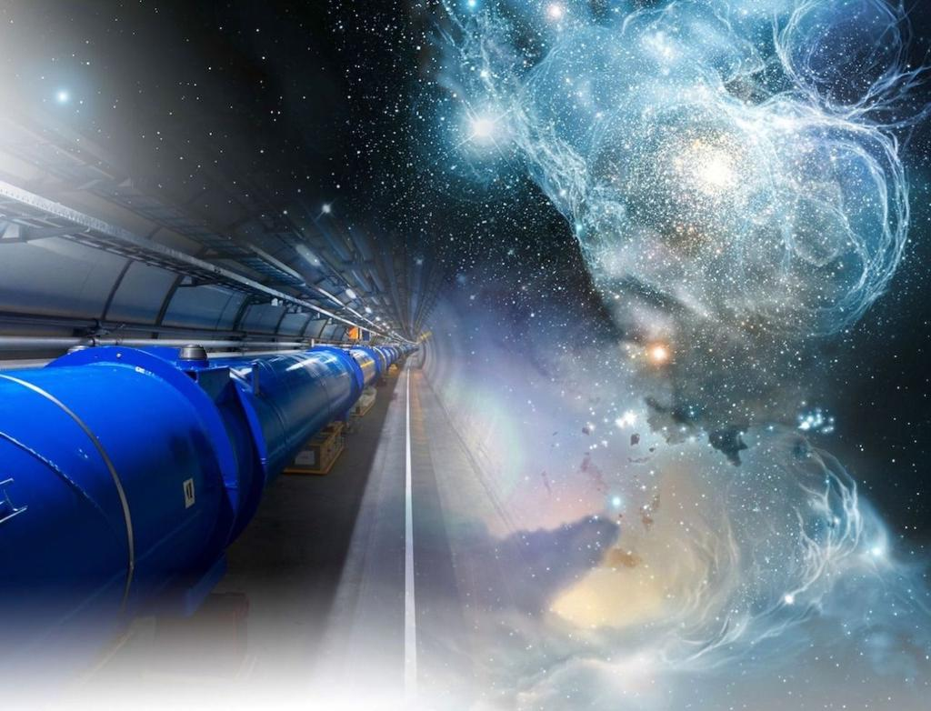
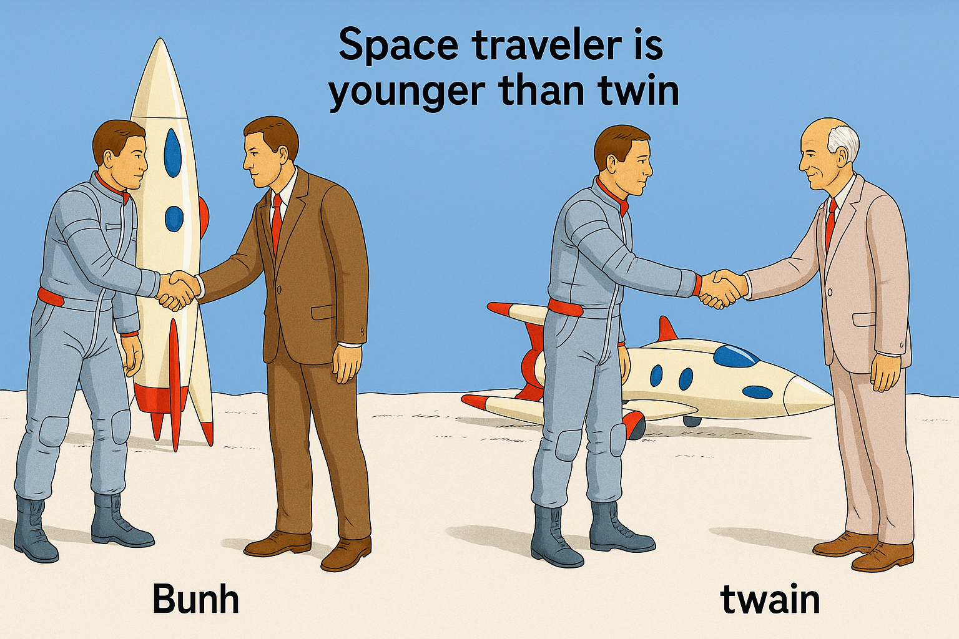
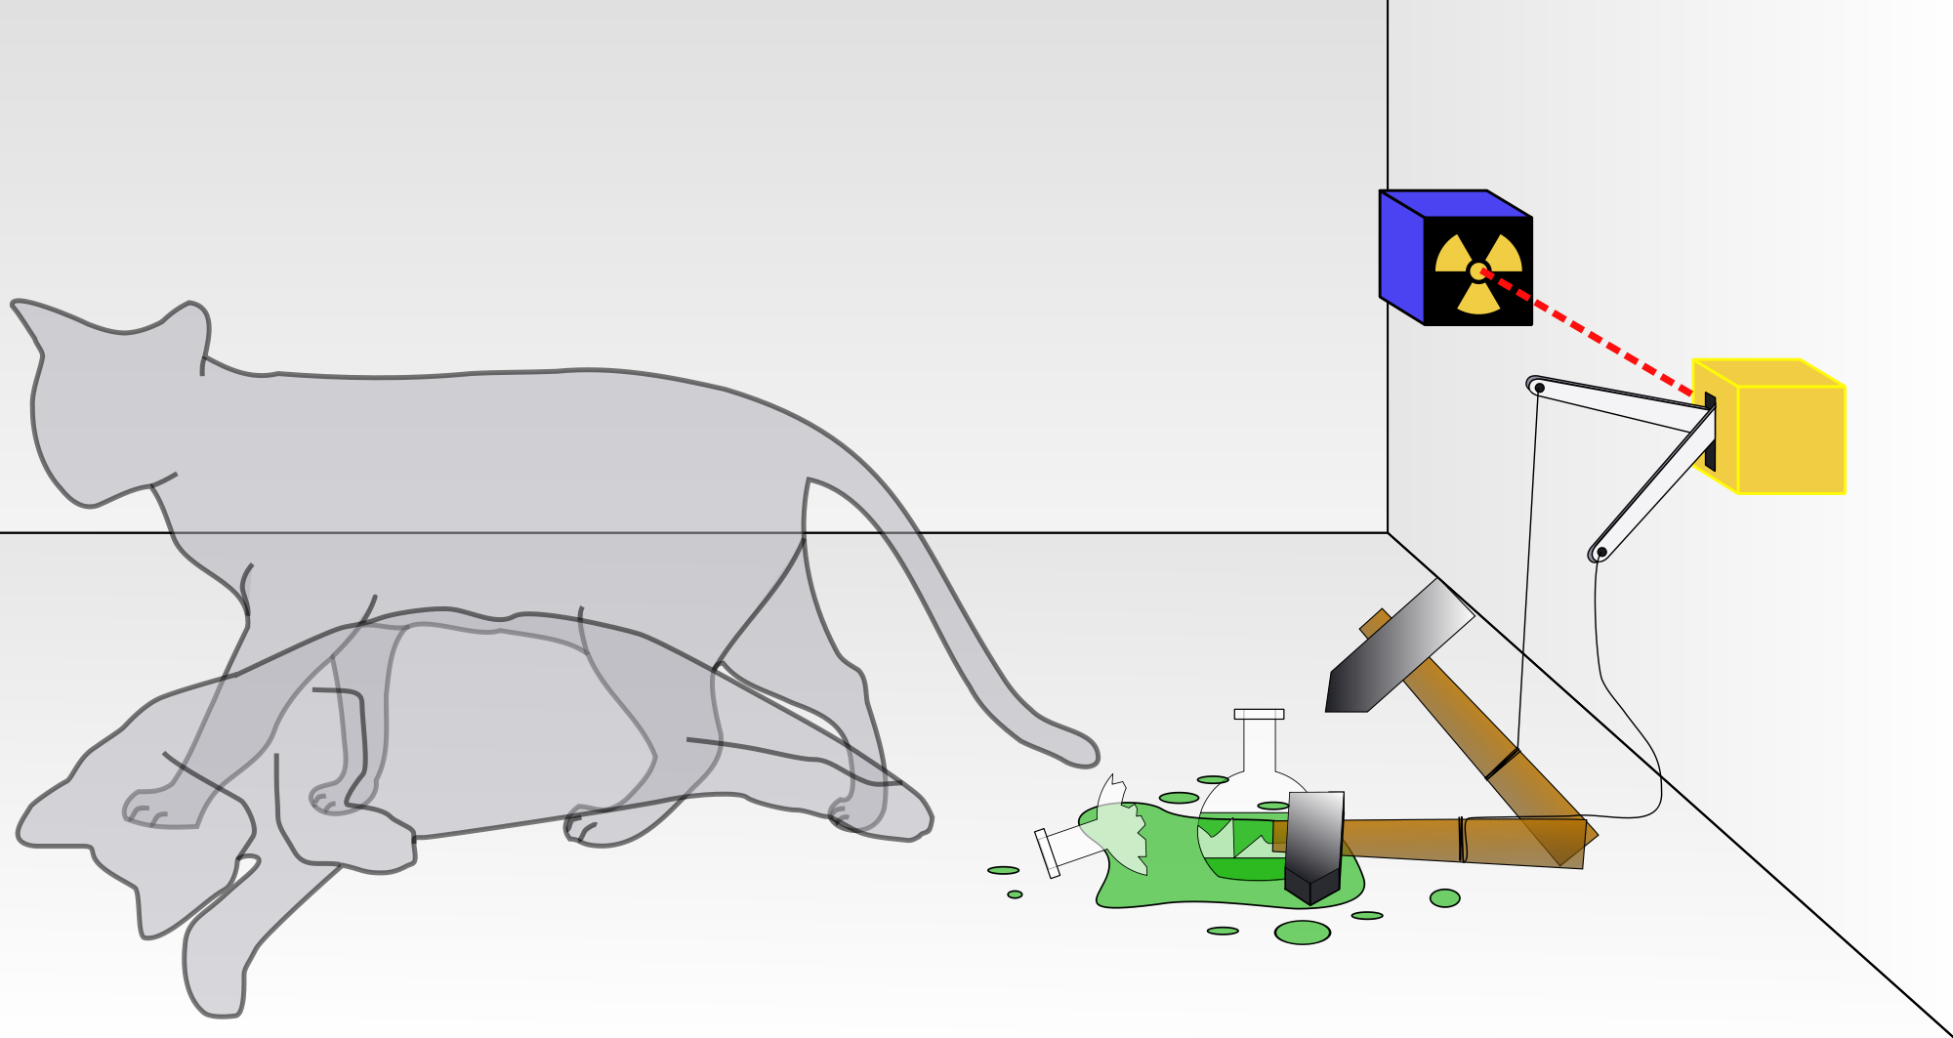
The Relativistic Quantum World
Relativity
A lecture series on
Relativity Theory and Quantum Mechanics
Before
After
Quantum
Alive
Marcel Merk
Studium Generale Maastricht
Sep 10 – Oct 8, 2025
Dead
Notes:
Explain picture. Interesting (“bizarre”) aspects of relativity and QM

Slide 2
The Relativistic Quantum World
1
Lecture 1: The Principle of Relativity and the Speed of Light
Lecture 2: Time Dilation and Lorentz Contraction
Lecture 3: The Lorentz Transformation and Paradoxes
Lecture 4: General Relativity and Gravitational Waves
Sep. 10:
Relativity
Sep. 17:
Lecture 5: The Early Quantum Theory
Lecture 6: Feynman’s Double Slit Experiment
Lecture 7: Wheeler’s Delayed Choice and Schrodinger’s Cat
Lecture 8: Quantum Reality and the EPR Paradox
Quantum
Mechanics
Sep. 24:
Oct. 1 :
Standard
Model
Lecture 9: The Standard Model and Antimatter
Lecture 10: Why is there something rather than nothing?
Oct. 8:
Lecture notes, written for this course, are available: www.nikhef.nl/~i93/Teaching/
Prerequisite for the course: High school level physics & mathematics.
Notes:
Ambitious!

Slide 3
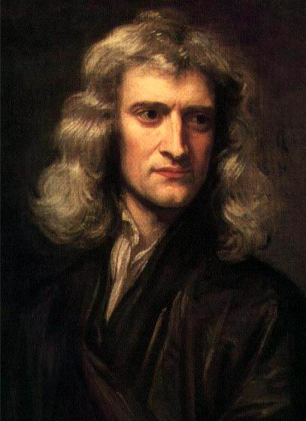
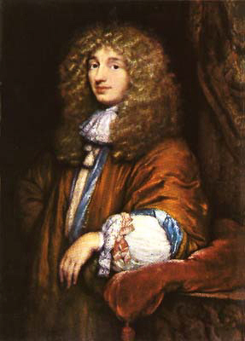
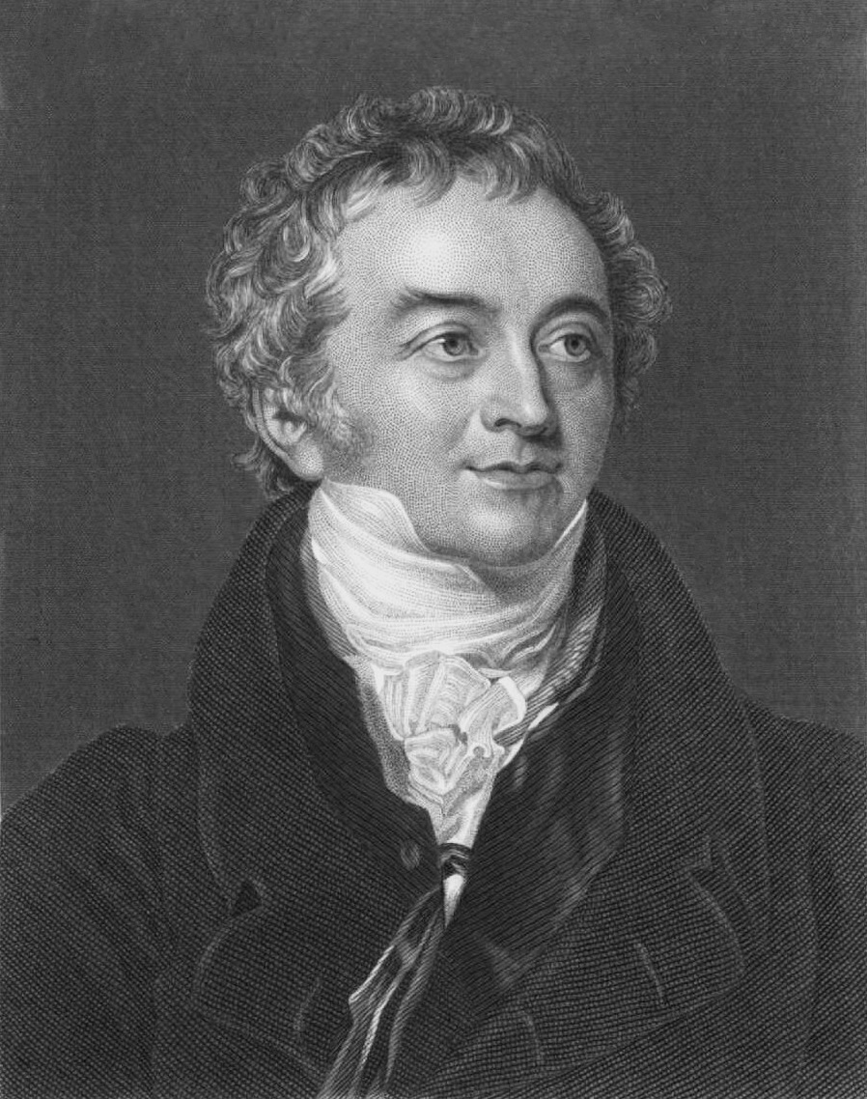
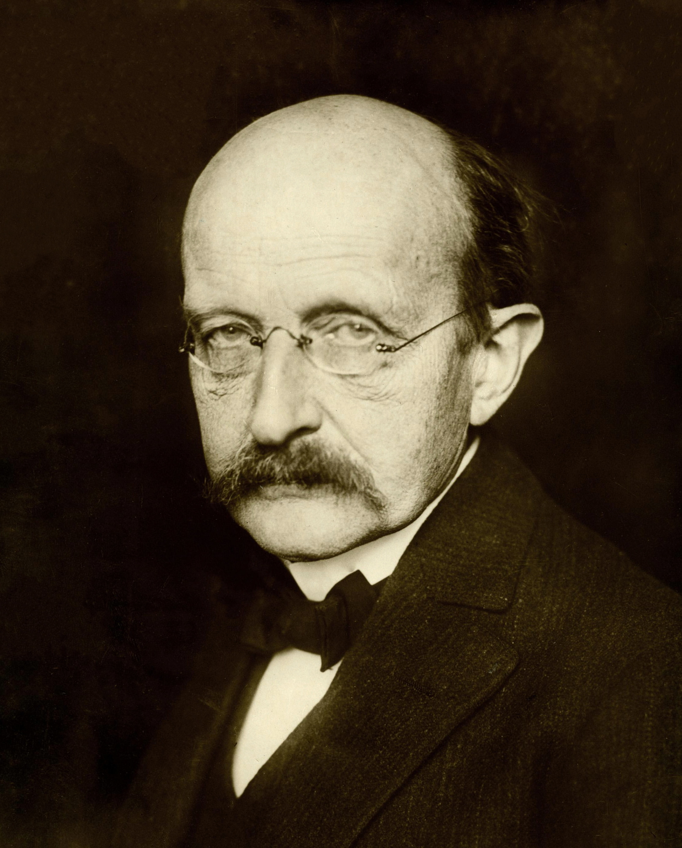
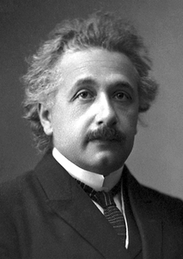
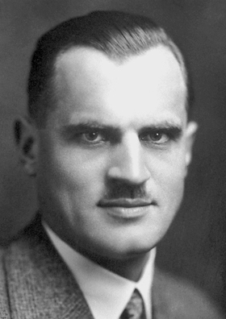
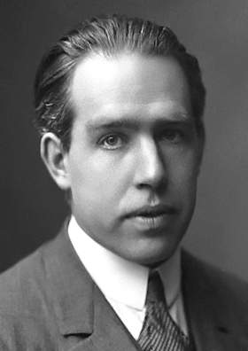
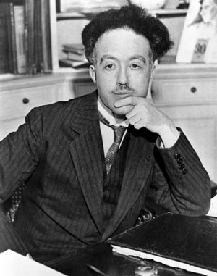
Quantum Mechanics
2
No, similar to
sound light consists
of waves
Yes, because
it interferes
Light is a stream
of particles
Light is emitted
in quanta
Isaac Newton
Christiaan Huygens
Thomas Young
Max Planck
The nature of light is quanta
Particles have a
wave nature:
λ = h/p
Yes, because
photons collide!
Particles are probability waves
Albert Einstein
Arthur Compton
Louis de Broglie
Niels Bohr

Slide 4
Quantum Mechanics
2
No, similar to
sound light consists
of waves
Yes, because
it interferes
Light is a stream
of particles
Light is emitted
in quanta
Isaac Newton
“Particle” and “Wave” are
complementary aspects.
Christiaan Huygens
Thomas Young
Max Planck
The nature of light is quanta
Particles have a
wave nature:
λ = h/p
Yes, because
photons collide!
Particles are probability waves
Albert Einstein
Arthur Compton
Louis de Broglie
Niels Bohr

Slide 5
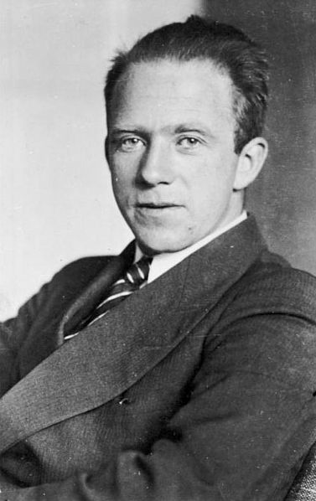
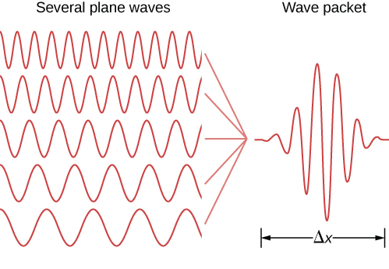
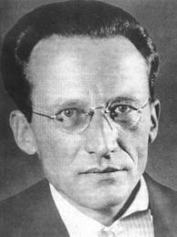
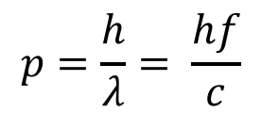
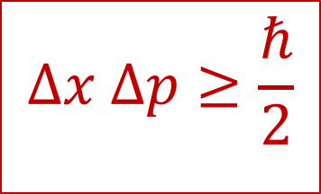
Uncertainty Relation
3
$$Δx Δp≥\frac{ℏ}{2}$$
It is not possible to determine position and momentum at the same time:
Δp
Erwin Schrödinger
Werner Heisenberg
$$p=\frac{h}{λ}= \frac{hf}{c}$$
A particle does not have well defined position and momentum at the same time.

Slide 6
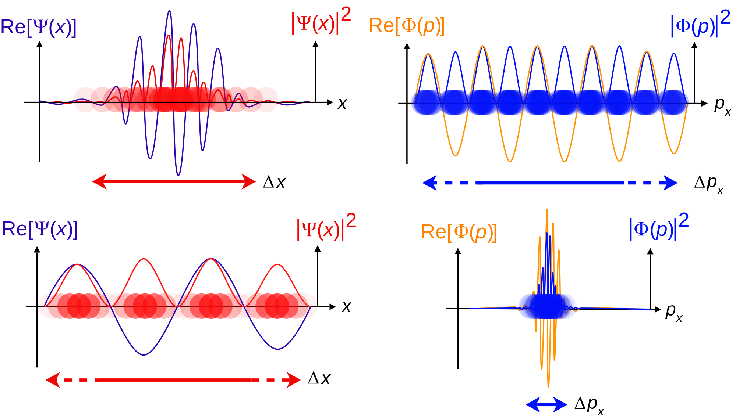
The wave function ψ
4
Position fairly known
Momentum badly known

Slide 7
The wave function ψ
4
Position fairly known
Momentum badly known
➔probability for
being at any x
➔probability for
having p
➔probability for
being at any x
➔probability for
having any p
Position badly known
Momentum fairly known
Notes:
Now look at the red (left) blue(right) lines!

Slide 8
5
Lecture 6
Feynman’s Double Slit Experiment
“It doesn’t matter how beautiful your theory is, it doesn’t matter how smart you are. If it doesn’t agree with experiment it’s wrong.”
Richard Feynman

Slide 9
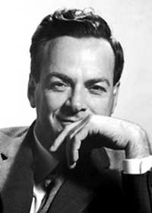
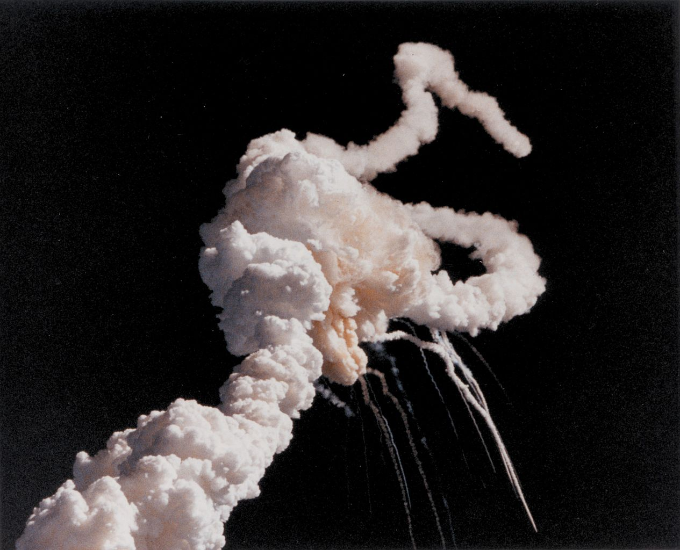
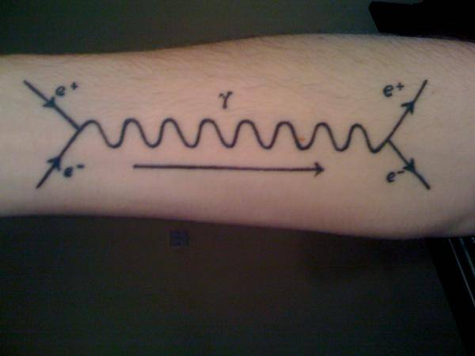
Richard Feynman (1918 – 1988) .
6
Nobelprize 1965: Quantum Electrodynamics
(Path Integral formulation of quantum mechanics)
Mostly known from:
・Feynman diagrams
・Challenger investigation
・Popular books
Challenger disaster 1986
Feynman diagram
Notes:
Feynman found out that the material of O-rings could not deal with cold weather at Cape canaveral, causing the disaster.
"Surely you're joking, Mr Feynman"
"What do you care what other people think"

Slide 10
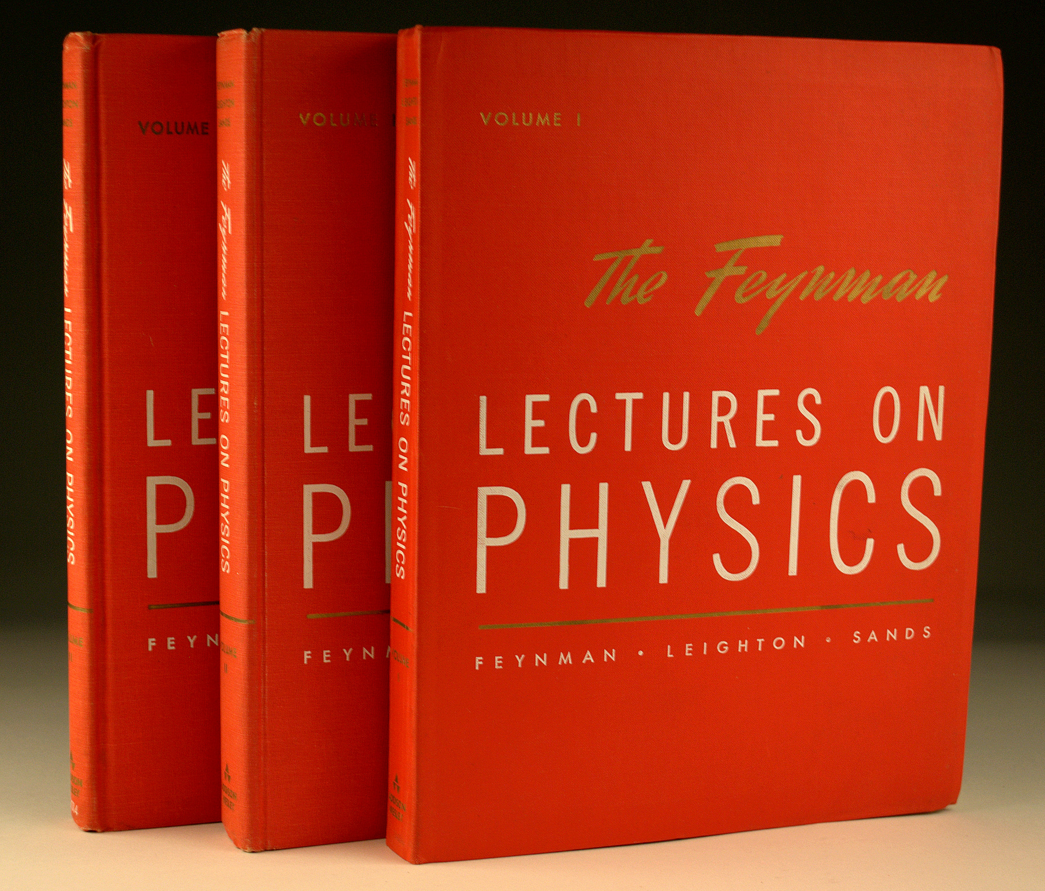
Richard Feynman (1918 – 1988) .
7
Nobelprize 1965: Quantum Electrodynamics
(Path Integral formulation of quantum mechanics)
Challenger disaster
Feynman diagram
Notes:
Feynman found out that the material of O-rings could not deal with cold weather at Cape canaveral, causing the disaster.
"Surely you're joking, Mr Feynman"
"What do you care what other people think"

Slide 11
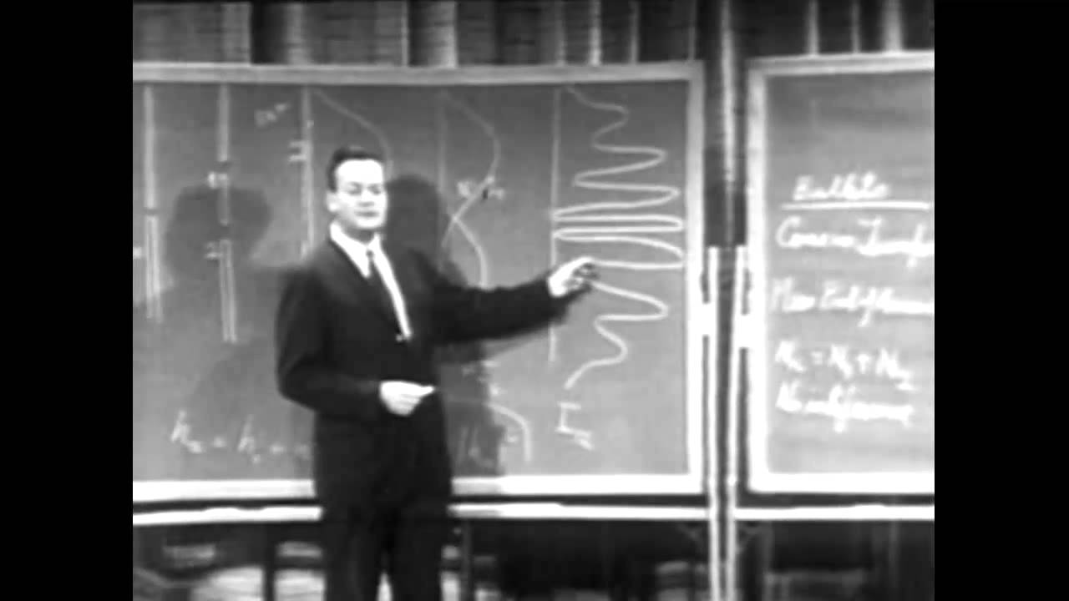
Richard Feynman and the double slit experiment
8
The double slit experiment demonstrates the fundamental aspect of the quantum world.

Slide 12


The Double Slit Experiment
9
Case 1:
An Experiment with Bullets
Notes:
In de Karkol

Slide 13
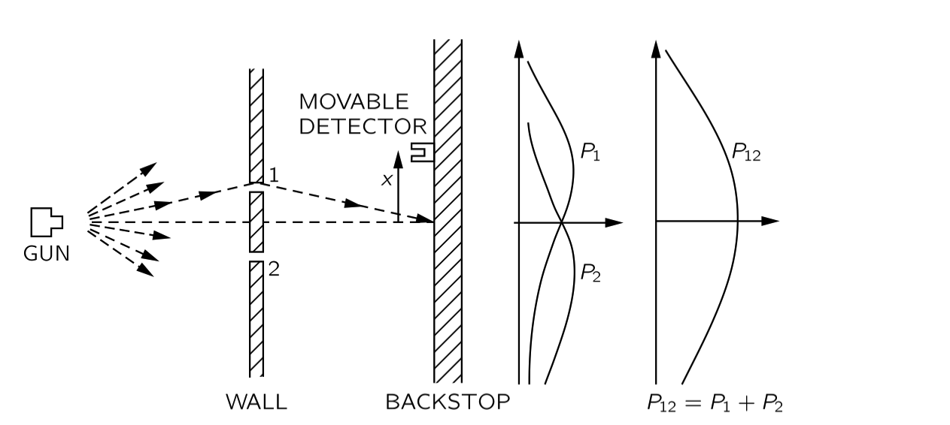
Case 1: Experiment with Bullets
10
A gun fires bullets in random direction. Slits 1 and 2 are openings through which bullets can pass. A moveable detector “collects” bullets and counts them.
Observation:
Bullets come in
“lumps”.
P₁ is the probability curve when only slit 1 is open
P₂ is the probability curve when only slit 2 is open
What is the probability curve when both slit 1 and slit 2 are open?
Notes:
Not very friendly example. Thought Experiment!
The detector "counts" the arriving bullets.
(Instead of bullets, think particles)

Slide 14
Case 1: Experiment with Bullets
11
A gun fires bullets in random direction. Slits 1 and 2 are openings through which bullets can pass. A moveable detector “collects” bullets and counts them.
P₁ is the probability curve when only slit 1 is open
P₂ is the probability curve when only slit 2 is open
When both slits are open: P₁₂ = P₁ + P₂
We can just add up the probabilities.

Slide 15

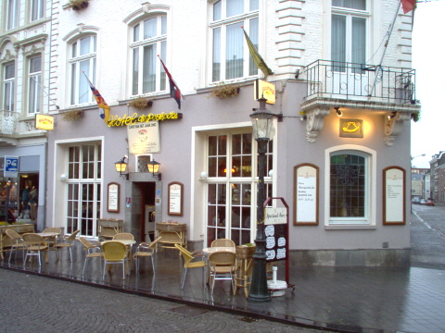
The Double Slit Experiment
12
Case 2:
An Experiment with Waves
Notes:
Poshoorn in Wijck (andere kant van de maas: particles <-> waves) ;-)

Slide 16
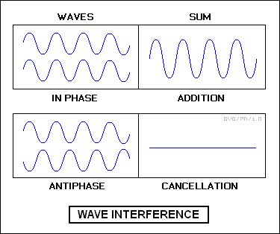
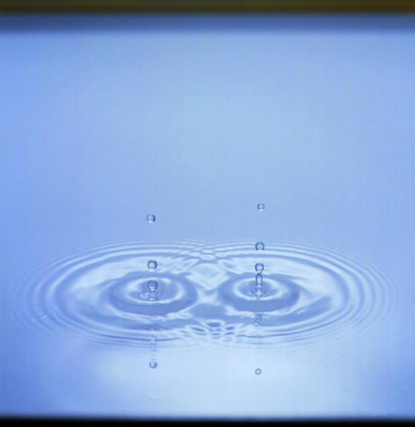
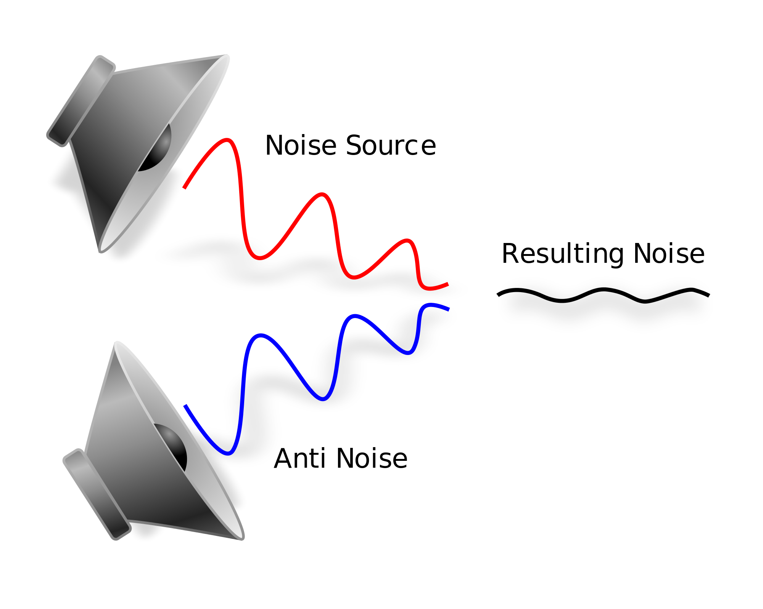
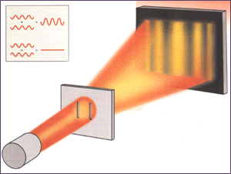
Waves & Interference : water, sound, light
13
Waves: Interference principle:
Water: Interference pattern:
wave + wave can cancel each other
Sound: Active noise cancellation:
Light: Thomas Young experiment:
sound + sound can give silence
light + light can give darkness!

Slide 17
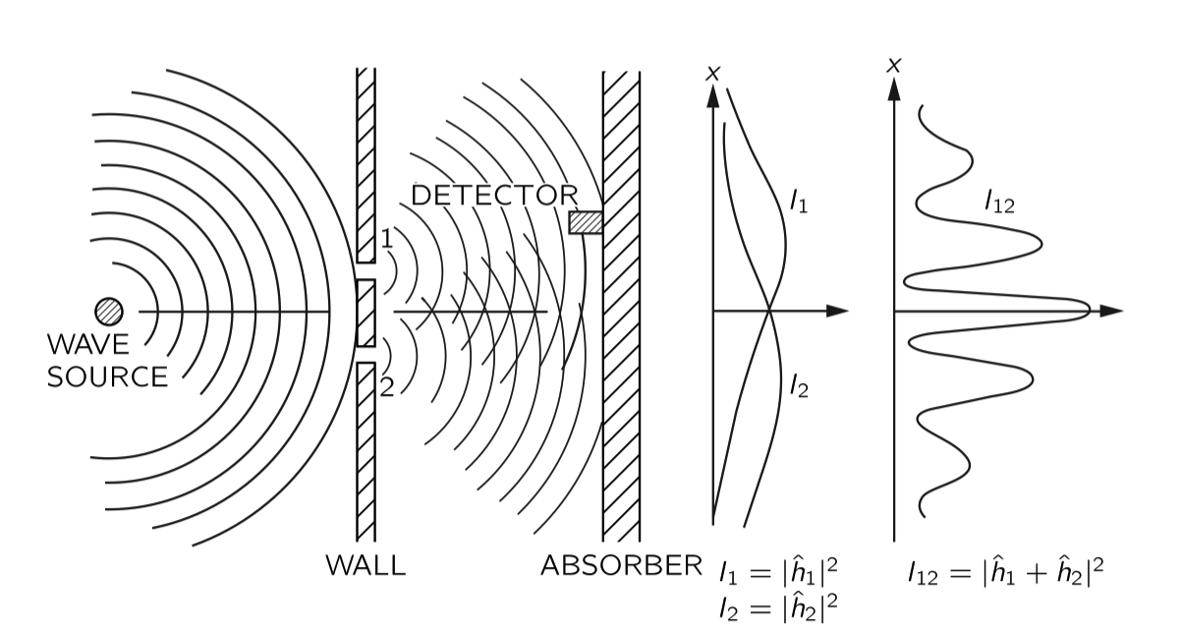
Case 2: Experiment with Waves
14
We replace the gun by a wave generator: think of water waves. Slits 1 and 2 act as new wave sources. The detector measures now the intensity (energy) in the wave.
Observation:
Waves do not
Come in “lumps”.
I₁ = |h₁|²
Only 1 is open
I₂ = |h₂|²
Only 2 is open
I₁₂ = ??
Both 1 and 2 open
The intensity of a wave is the square of the amplitude…
Notes:
Due to diffraction each of the slits acts as a source of waves - think water moving "up" and "down"

Slide 18
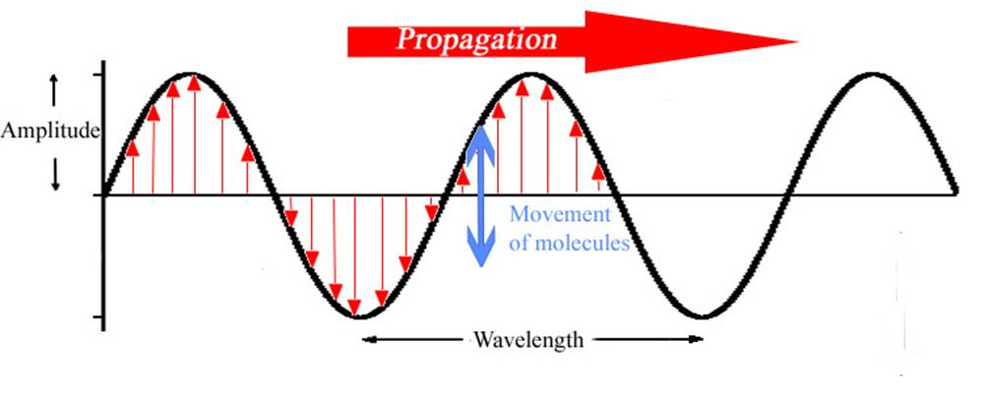
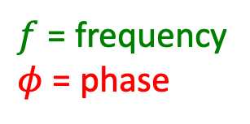

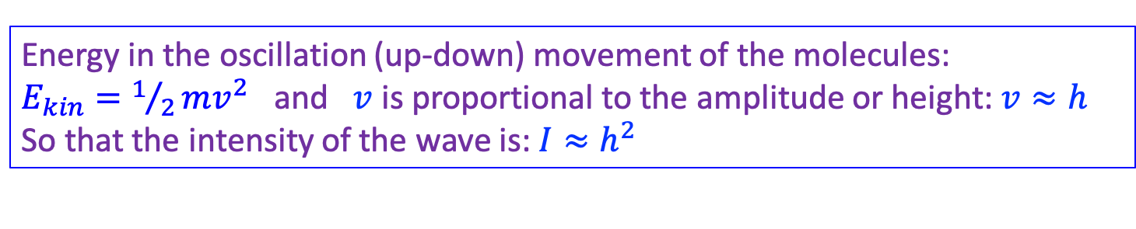

Intermezzo: Wave Oscillation & Intensity
15
Energy in the oscillation (up-down) movement of the molecules:
$E_{kin}=1/2mv^{2}$ and $v$ is proportional to the amplitude or height: $v≈h$
So that the intensity of the wave is: $I≈h^{2}$
h
h
v
Formula for the resulting oscillation of a water molecule somewhere in the wave:
$$W\left(t\right)=h\cos\left(2πft+φ\right)$$
$f$ = frequency
$φ$ = phase
and the Intensity: $I=h^{2}$
Notes:
R is the height as a function of time.
Forget the math if you have not seen it before.

Slide 19
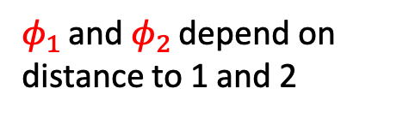


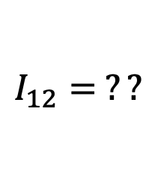

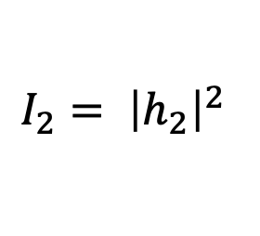

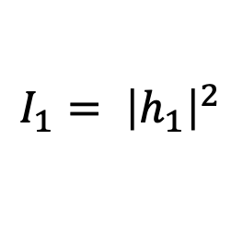

Case 2: Experiment with Waves
16
When both slits are open there are two contributions to the wave the oscillation
at the detector: $R\left(t\right)=R_{1}\left(t\right)+R_{2}\left(t\right)$
$$W_{1}\left(t\right)=h_{1}\cos\left(2πf t+φ_{1}\right)$$
$$W_{2}\left(t\right)=h_{2}\cos\left(2πf t+φ_{2}\right)$$
$$W_{1}\left(t\right)$$
$φ_{1}$ and $φ_{2}$ depend on distance to 1 and 2
$$W_{2}\left(t\right)$$
$$I_{1}= {\left|h_{1}\right|}^{2}$$
$$I_{2}= {\left|h_{2}\right|}^{2}$$
$$I_{12}= ??$$
First combine: $W\left(t\right)=W_{1}\left(t\right)+W_{2}\left(t\right)$
Afterwards look at the amplitude and intensity of the resulting wave!

Slide 20
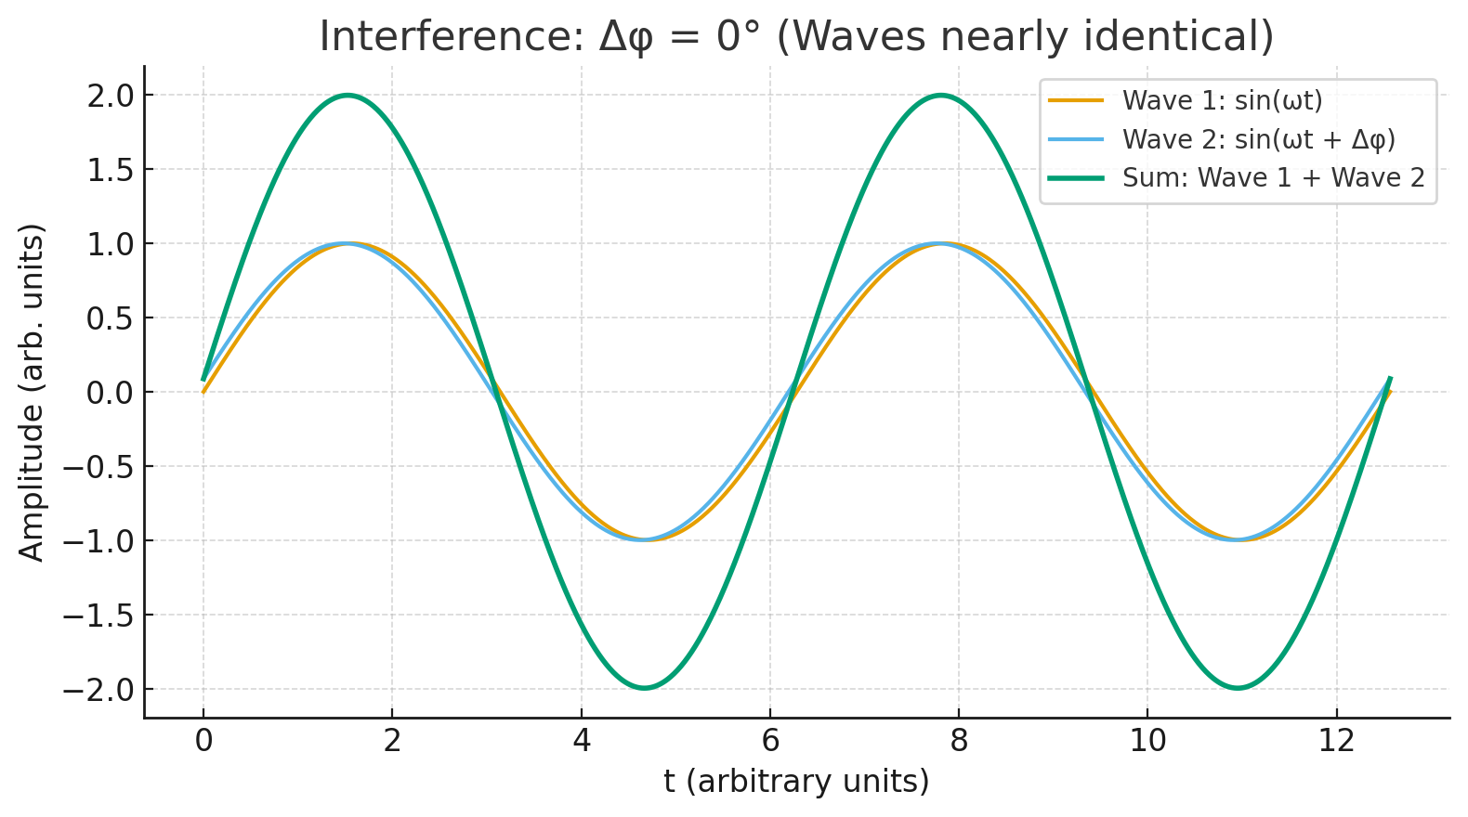
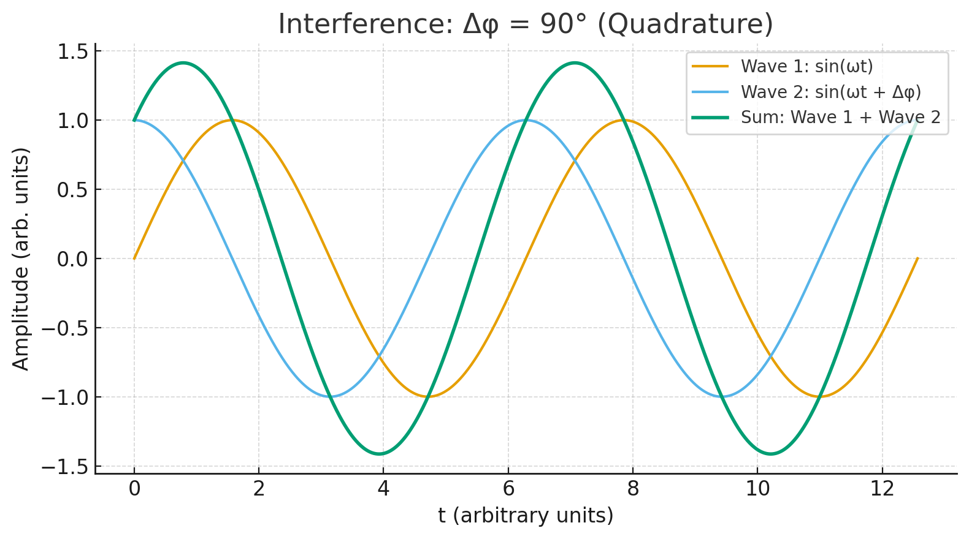
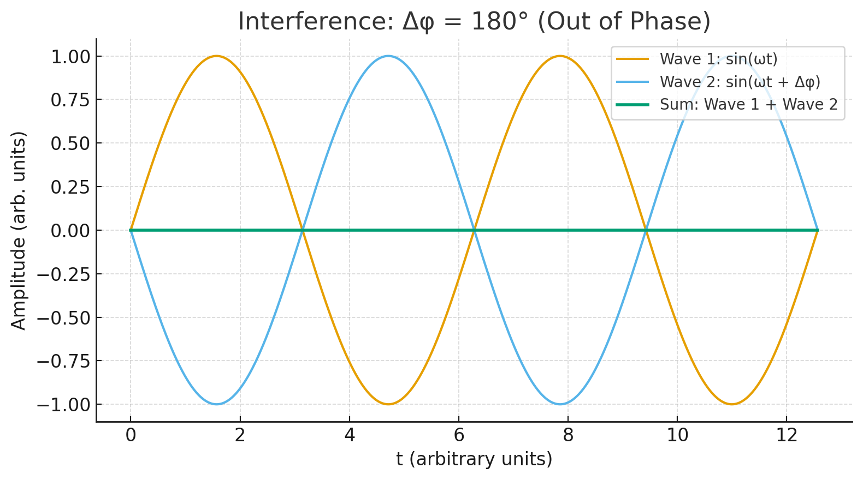
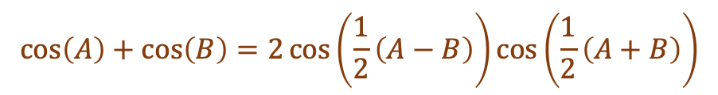
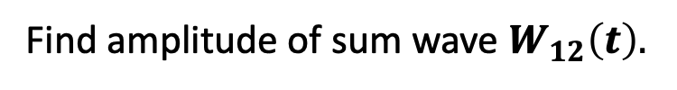
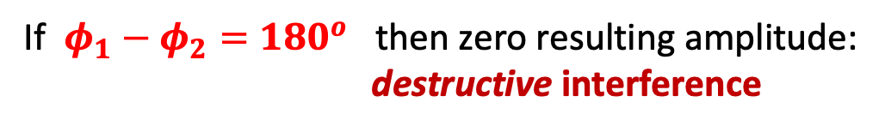

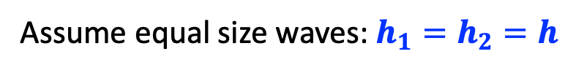
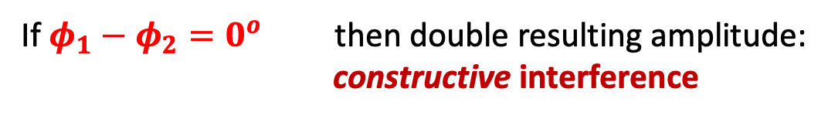

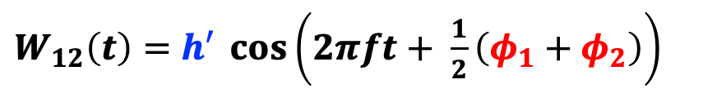
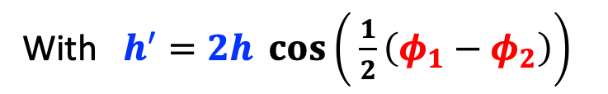

For math lovers: let’s calculate
$φ_{1}−φ_{2}=0^{o}$
17
$$W_{12}\left(t\right)=h_{1}\cos\left(2πft+φ_{1}\right)+h_{2}\cos\left(2πf t+φ_{2}\right)$$
Assume equal size waves: $h_{1}=h_{2}=h$
Find amplitude of sum wave $W_{12}\left(t\right).$
$$\cos\left(A\right)+\cos\left(B\right)=2\cos\left(\frac{1}{2}\left(A−B\right)\right)\cos\left(\frac{1}{2}\left(A+B\right)\right)$$
From math textbook:
$φ_{1}−φ_{2}={90}^{o}$
Use this to find:
$W_{12}\left(t\right)=h′ \cos\left(2πft+ \frac{1}{2}\left(φ_{1}+φ_{2}\right)\right)$
With $h^{′}=2h \cos\left( \frac{1}{2}\left(φ_{1}−φ_{2}\right)\right)$
If $φ_{1}−φ_{2}=0^{o}$ then double resulting amplitude:
constructive interference
$φ_{1}−φ_{2}={180}^{o}$
If $φ_{1}−φ_{2}=180^{o}$ then zero resulting amplitude:
destructive interference

Slide 21
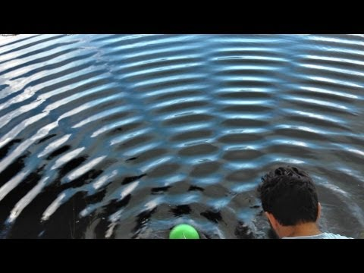



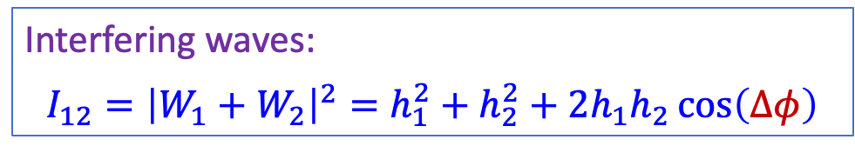




Interference of Waves
18
cos Δφ = 1
$$h_{1}$$
$$W_{1}$$
cos Δφ = -1
$$Δφ$$
$$h_{2}$$
$$W_{2}$$
Interfering waves:
$$I_{12}={\left|W_{1}+W_{2}\right|}^{2}=h_{1}^{2}+h_{2}^{2}+2h_{1}h_{2}\cos\left(Δφ\right)$$
$$Δφ=φ_{1}−φ_{2}$$
Regions of constructive interference: $I_{12}=2×\left(I_{1}+I_{2}\right)$
Regions of destructive interference: $I_{12}=0$
Notes:
Adding the waves in pictures
Constructive: amplitude x2 ==> Intensity x4
Destructive : amplitude =0 ==> intensity =0
Look at the water

Slide 22

Case 2: Experiment with Waves
19
When both slits are open there are two contributions to the wave the oscillation
at the detector: $W\left(t\right)=W_{1}\left(t\right)+W_{2}\left(t\right)$
First combine: $W\left(t\right)=W_{1}\left(t\right)+W_{2}(t)$
Afterwards look at the amplitude and intensity of the resulting wave!

Slide 23

Case 2: Experiment with Waves
20
When both slits are open there are two contributions to the wave the oscillation
at the detector: $W\left(t\right)=W_{1}\left(t\right)+W_{2}\left(t\right)$
No wave
Big wave
No wave
Big wave
No wave
Big wave
Contrary to “bullets” we can not just add up Intensities
But we have to first add the waves.
Interference pattern: $I_{12}={\left|W_{1}+W_{2}\right|}^{2}=h_{1}^{2}+h_{2}^{2}+2h_{1}h_{2}\cos\left(Δφ\right)$
Regions where waves are amplified and regions where waves are cancelled.
Notes:
Places where there are cancelled (no waves) on the screen
Places where there are amplified waves.

Slide 24
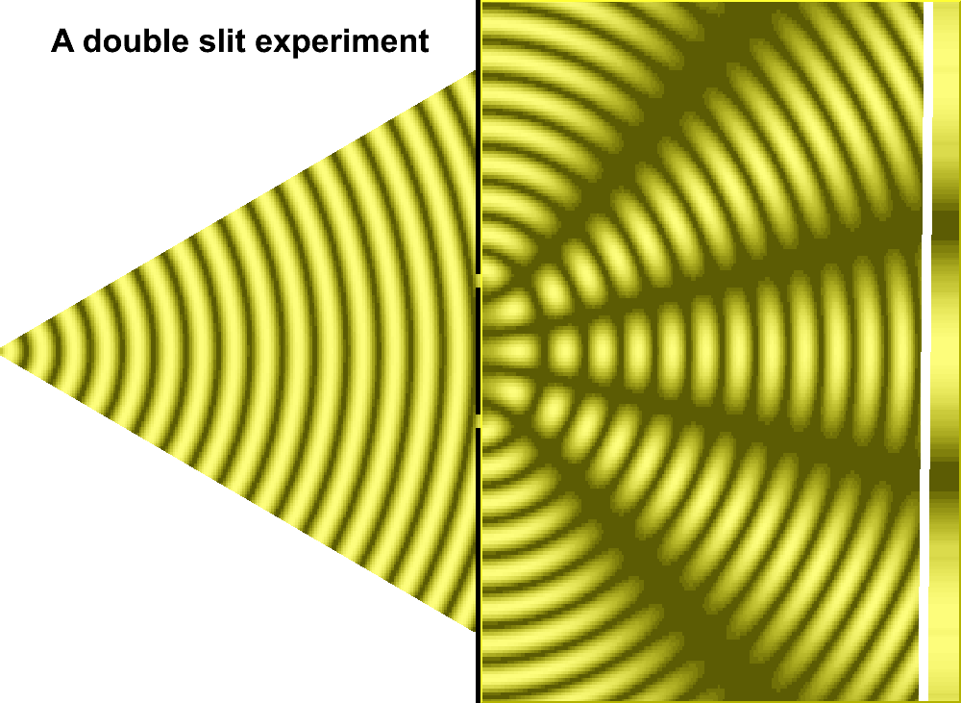
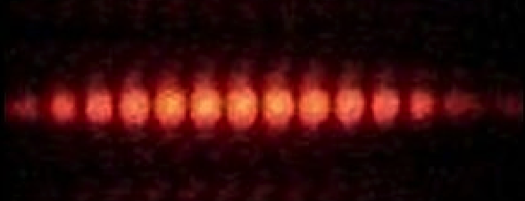
Double Slit Experiment with Light (Young)
21
Notes:
Try it out with a CD / DVD and a laser pointer.

Slide 25


The Double Slit Experiment
22
Case 3:
An Experiment with Electrons
Notes:
De knijnspiep. Old cafe in Maastricht: muntstraat

Slide 26

Case 3: Experiment with Electrons
23
From the detector counts deduce again the probabilities P₁ and P₂
Observation:
Electrons come in
“lumps”, like bullets
|ψ₁|²
|ψ₂|²
What do we expect when both slits are open?
Notes:
One by one - slowly - no interference with each other
Arrive like bullets: one by one

Slide 27

Case 3: Experiment with Electrons
24
|ψ₁|²
|ψ₂|²

Slide 28
Case 3: Experiment with Electrons
24
|ψ₁|²
|ψ₂|²

Slide 29
Case 3: Experiment with Electrons
24
|ψ₁|²
|ψ₂|²

Slide 30
Case 3: Experiment with Electrons
24
|ψ₁|²
|ψ₂|²

Slide 31
Case 3: Experiment with Electrons
24
|ψ₁|²
|ψ₂|²

Slide 32

Case 3: Experiment with Electrons
24
|ψ₁|²
|ψ₂|²

Slide 33
Case 3: Experiment with Electrons
25
An Interference pattern!
The electron wave function behaves exactly like classical waves.
De Broglie waves
Just like “waves” we can not just add up Intensities.
|ψ₁|²
|ψ₁ + ψ₂|²
|ψ₂|²
Add the wave amplitudes:
ψ₁₂ = ψ₁ + ψ₂
The probability is the square of the sum:
P₁₂ = |ψ₁₂|² = |ψ₁ + ψ₂|² = |ψ₁|² + |ψ₂|² + 2ψ₁ψ₂*
Notes:
Interference: 2 psi_1 psi_2
An electron can cancel or amplify itself, just like a wave!

Slide 34
Case 3: Experiment with Electrons
26
Perhaps the electrons interfere with each other.
Reduce the intensity, shoot electrons one by one: same result.
|ψ₁|²
|ψ₁ + ψ₂|²
|ψ₂|²
Notes:
An electron can cancel or amplify itself, just like a wave!
Light behaves like electrons.

Slide 35
Case 3: Experiment with Electrons
27
Perhaps the electrons interfere with each other.
Reduce the intensity, shoot electrons one by one: same result.
Although the electron is detected as a “lump” on the screen, apparently it has gone through both slits!
|ψ₁|²
|ψ₁ + ψ₂|²
|ψ₂|²
P.S.:
Classically, light behaves light waves. However, if you shoot light, photon per photon, it “comes in lumps”, just like electrons.
Quantum Mechanics: for photons it is the same story as for electrons.

Slide 36

Case 3: Experiment with Electrons
28
Perhaps the electrons interfere with each other.
Reduce the intensity, shoot electrons one by one: same result.
Waves
|ψ₁ + ψ₂|²
P.S.:
Classically, light behaves light waves. However, if you shoot light, photon per photon, it “comes in lumps”, just like electrons.
Quantum Mechanics: for photons it is the same story as for electrons.

Slide 37


The Double Slit Experiment
29
Case 4:
A Different Experiment with Electrons
Notes:
Vogelstruys on Vrijthof

Slide 38

Case 4: Watch the Electrons
30
Let us try to out-smart the electron: just watch through which slit it goes!
D₁
D₂
D₁ and D₂ are two “microscopes” looking at the slits 1 and 2, respectively.
Notes:
Electron goes through both slits?
Well, just watch it, that is: check it!
Light source is a lamp with which you can see the electrons.

Slide 39
Case 4: Watch the Electrons
31
When we watch through which slit the electrons go, we destroy the interference!
Now the electron behaves just like a classical particle (“bullet”).
D₁
D₂
It requires an observation to let the quantum wave function “collapse” into reality.
As long as no measurement is made the wave function keeps “all options open”.

Slide 40
Case 3: Don’t Watch the Electrons
32
When we don’t watch through through which slit the electrons go,
the electron is an object that interferes with itself!
|ψ₁|²
|ψ₁ + ψ₂|²
|ψ₂|²
It requires an observation to let the quantum wave function “collapse” into reality.
As long as no measurement is made the wave function keeps “all options open”.
If you watch half the time; you only get the interference for the cases you did not watch.
Notes:
Back to case-3: do not watch

Slide 41
Case 3: Don’t Watch the Electrons
32
When we don’t watch through through which slit the electrons go,
the electron is an object that interferes with itself!
By the act of watching a quantum object we interfere with the quantum system and force it to bring one of its possible quantum states into reality.
|ψ₁|²
|ψ₁ + ψ₂|²
|ψ₂|²
It requires an observation to let the quantum wave function “collapse” into reality.
As long as no measurement is made the wave function keeps “all options open”.
If you watch half the time; you only get the interference for the cases you did not watch.
Notes:
Back to case-3: do not watch

Slide 42

Wave Particle Duality
33
Next lecture we will try to out-smart nature one step further…
… and face the consequences.

Slide 43


Next Lecture: Wheeler’s Delayed Choice
34
John Wheeler (1911 – 2008):
Famous for work on gravitation
(Black holes – quantum gravity)
Replace detectors D₁ and D₂ with telescopes T₁ and T₂ which are focused on slits 1 and 2
What happens if we afterwards would reconstruct whether the electron went through slit 1 or slit 2?
T₁
T₂
Try to out-smart nature one step further… and face the consequences: Schrödinger’s cat.
Notes:
We first let the particles reach the detector and we only decide afterwards whether we look or not!
Interesting.
How does the particle know whether we look or not.

Slide 44

Next Lecture…
35

