Slide 1
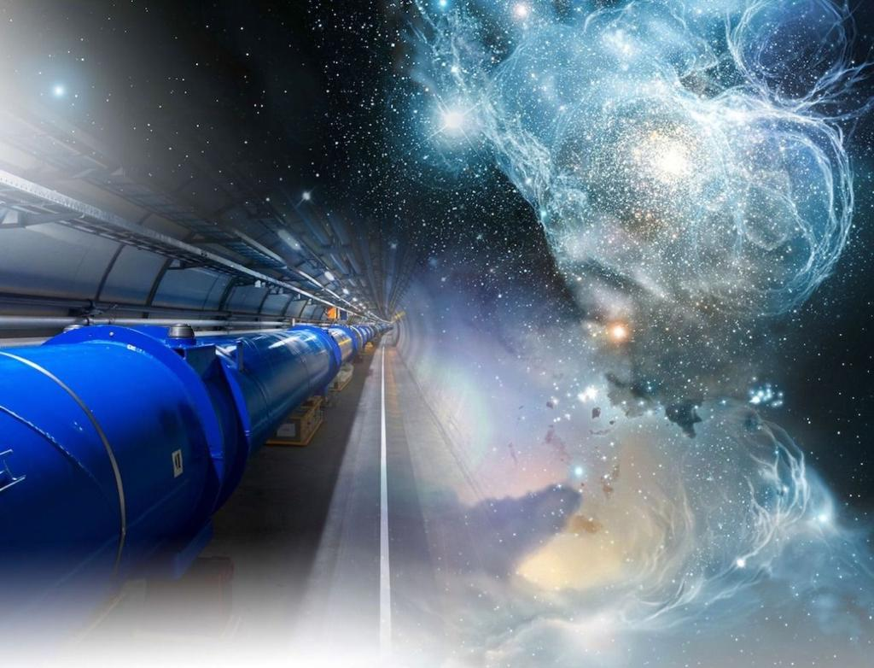

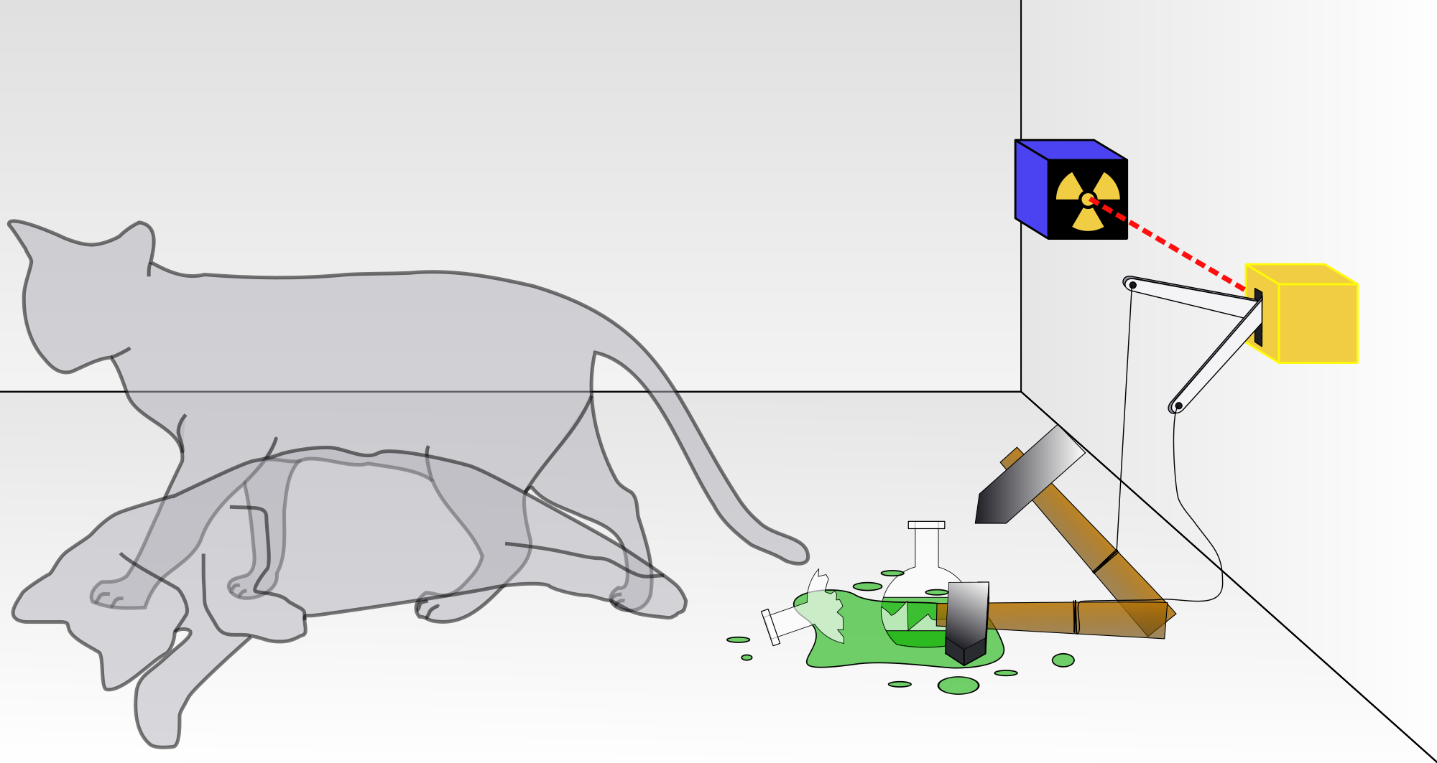
The Relativistic Quantum World
Relativity
A lecture series on
Relativity Theory and Quantum Mechanics
Before
After
Quantum
Alive
Marcel Merk
Studium Generale Maastricht
Sep 10 – Oct 8, 2025
Dead
Notes:
Explain picture. Interesting (“bizarre”) aspects of relativity and QM

Slide 2
The Relativistic Quantum World
1
Lecture 1: The Principle of Relativity and the Speed of Light
Lecture 2: Time Dilation and Lorentz Contraction
Lecture 3: The Lorentz Transformation and Paradoxes
Lecture 4: General Relativity and Gravitational Waves
Sep. 10:
Relativity
Sep. 17:
Lecture 5: The Early Quantum Theory
Lecture 6: Feynman’s Double Slit Experiment
Lecture 7: Wheeler’s Delayed Choice and Schrodinger’s Cat
Lecture 8: Quantum Reality and the EPR Paradox
Quantum
Mechanics
Sep. 24:
Oct. 1 :
Standard
Model
Lecture 9: The Standard Model and Antimatter
Lecture 10: Why is there something rather than nothing?
Oct. 8:
Lecture notes, written for this course, are available: www.nikhef.nl/~i93/Teaching/
Prerequisite for the course: High school level physics & mathematics.
Notes:
Ambitious!

Slide 3
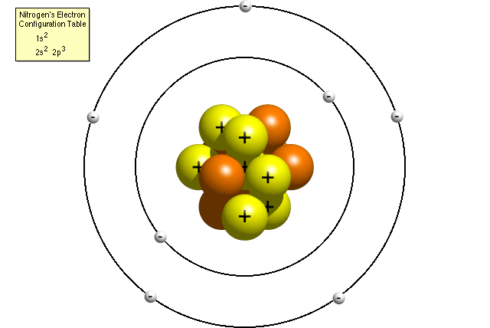
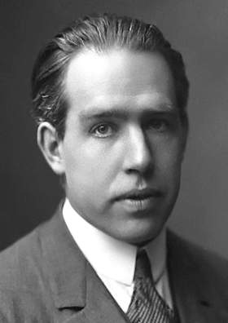
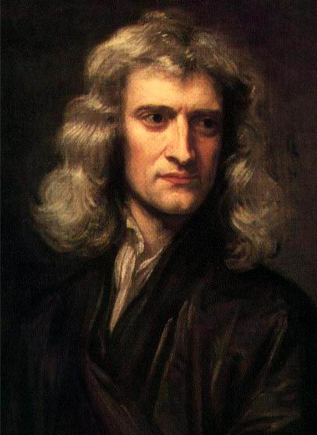
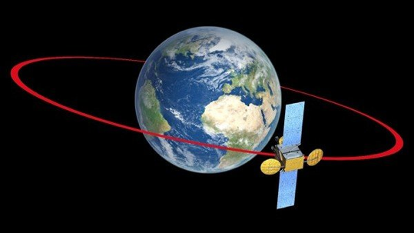
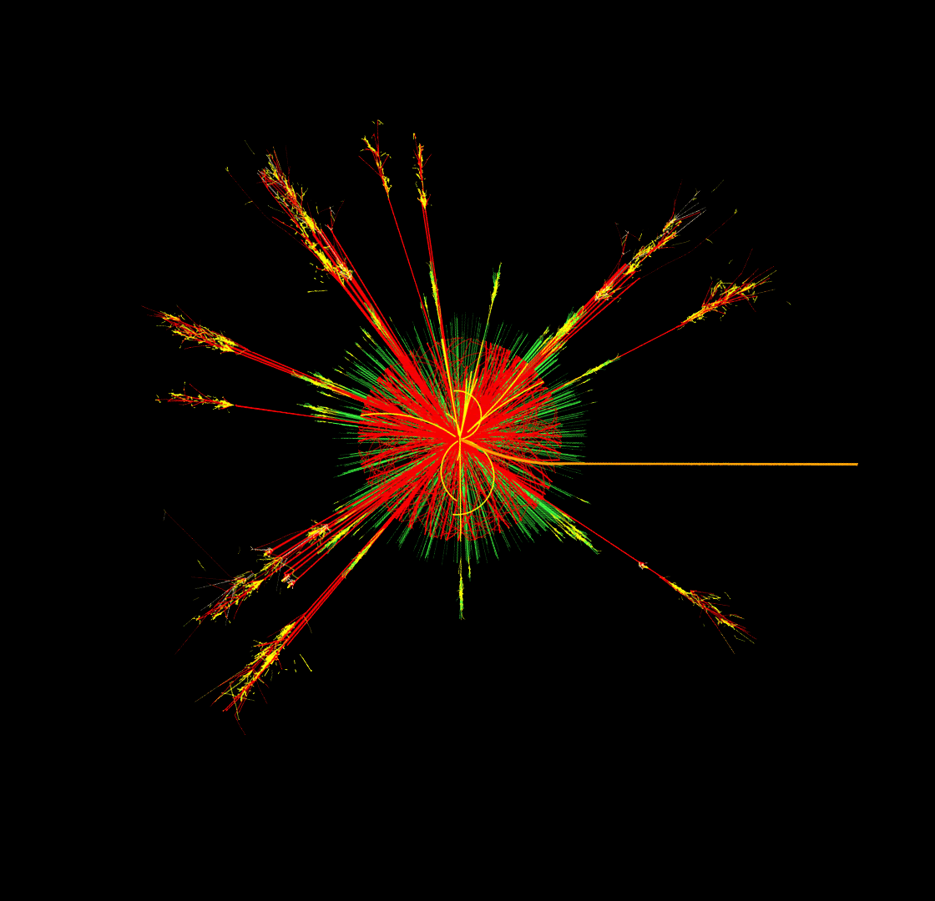
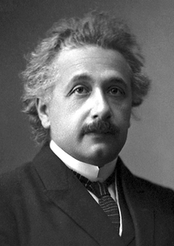
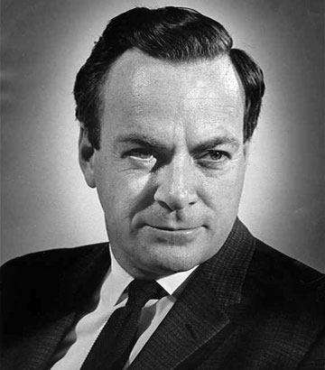

Relativity and Quantum Mechanics
2
Classical Mechanics
Quantum Mechanics
Smaller Sizes (ħ)
Newton
Bohr
From our experience we are not used to relativistic and quantum mechanical phenomena. That’s why we find it counterintuitive.
Higher Speed (c)
Dirac
Feynman
Einstein
Relativity Theory
Quantum Field Theory
Notes:
Classical physics based on daily experience. Physics of the very fast and very small is counterintuitive! c and h-bar are fundamental constants of nature. Is there something that goes beyond c and h? No. QFT combines Relativity and QM.

Slide 4
3
Lecture 5
The Early Quantum Theory
“If Quantum Mechanics hasn’t profoundly shocked you, you haven’t understood it yet.”
Niels Bohr
“Gott würfelt nicht (God does not play dice).”
Albert Einstein
”Einstein, stop telling God what to do!”
Niels Bohr
Notes:
Bohr Einstein dialogues

Slide 5
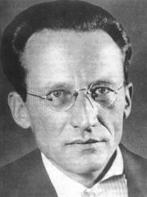
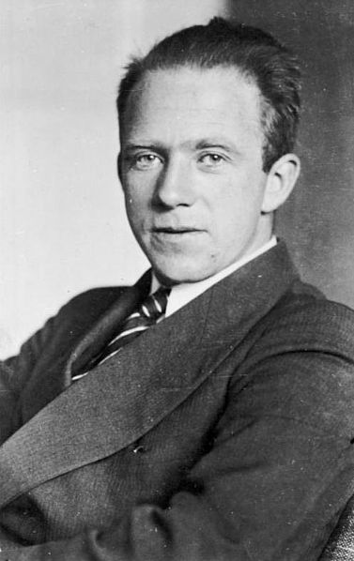
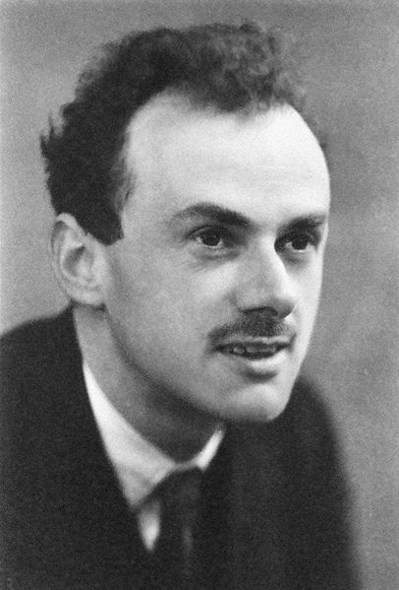
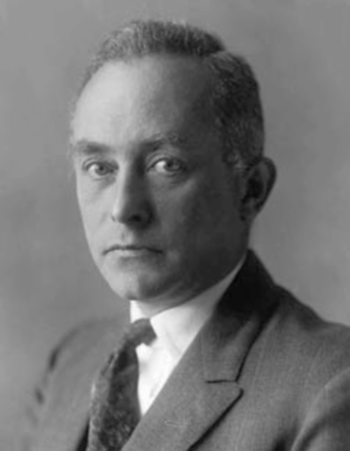

Key Persons of Quantum Mechanics
4
Niels Bohr
Erwin Schrodinger
Werner Heisenberg
Paul Dirac
Max Born
Niels Bohr: Nestor of the ”Copenhagen Interpretation”
Erwin Schrödinger: Inventor of the quantum mechanical wave equation
Werner Heisenberg: Inventor of the uncertainty relation and “matrix mechanics”
Paul Dirac: Inventor of relativistic wave equation: Antimatter!
Max Born: Inventor of the probability interpretation of the wave function
We will focus of the Copenhagen Interpretation and work with the concept of Schrödinger’s wave-function: $ψ$
Notes:
Founding fathers: Einstein, Planck, etc. Copenhagen interpretation = orthodox opinion, generally accepted.
"Collapse of the wave function"
There are more persons
Max Planck, Einstein, John von Neumann, Wolfgang Pauli, David Bohm, Louis de Broglie, John Bell …

Slide 6
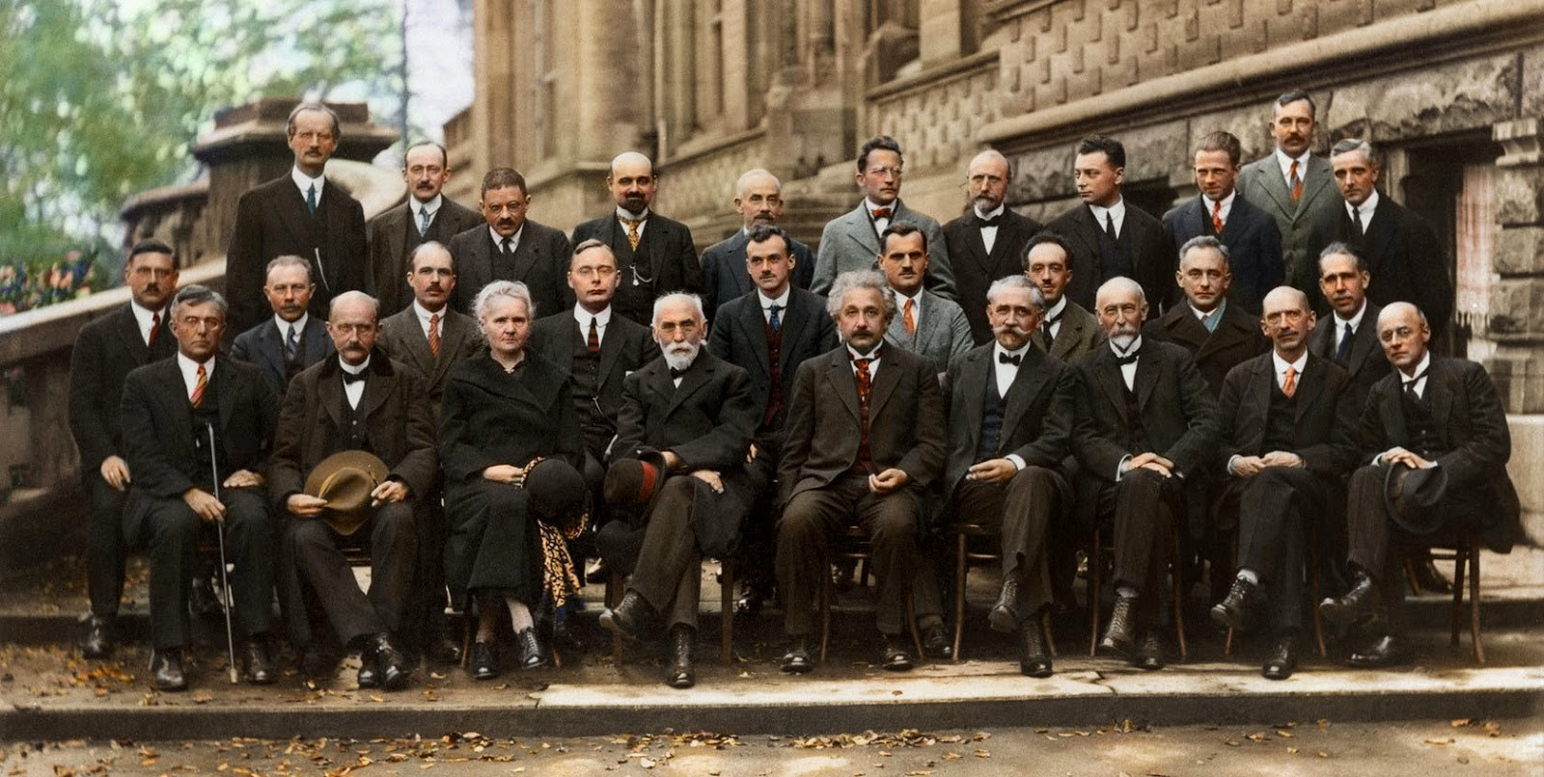
1927 Solvay Conference Brussels
5
“Possibly the most intelligent picture ever taken”
Notes:
Front row (seated, left → right) Irving Langmuir; Max Planck; Marie Curie; Hendrik Antoon Lorentz (chair); Albert Einstein; Paul Langevin; Charles-Eugène Guye; C. T. R. Wilson; Owen Willans Richardson. Wikipedia+1
Middle row (left → right) Peter Debye; Martin Knudsen; William Lawrence Bragg; Hendrik Anthony Kramers; Paul Adrien Maurice Dirac; Arthur Holly Compton; Louis de Broglie; Max Born; Niels Bohr. Wikipedia
Back row (left → right) Auguste Piccard; Émile Henriot; Paul Ehrenfest; Édouard Herzen; Théophile de Donder; Erwin Schrödinger; Jules-Émile Verschaffelt; Wolfgang Pauli; Werner Heisenberg; Ralph Howard Fowler; Léon Brillouin. Wikipedia+1

Slide 7
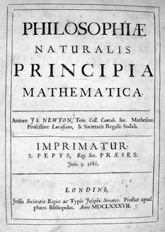
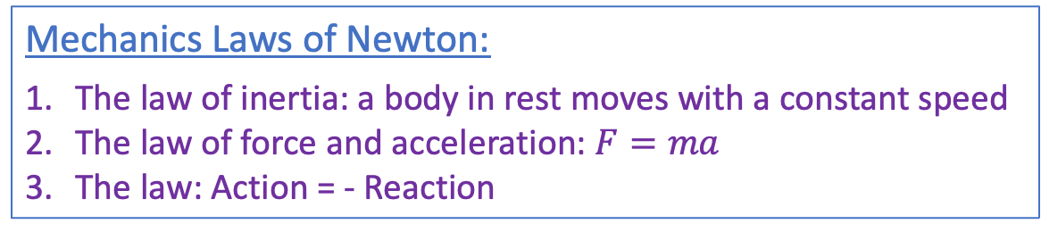
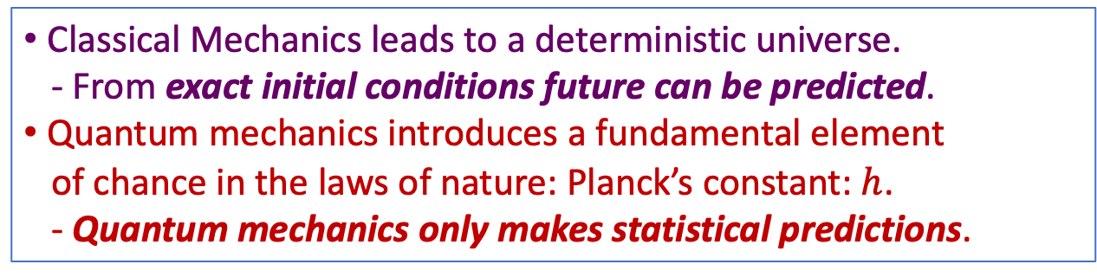
Deterministic Universe
6
Mechanics Laws of Newton:
The law of inertia: a body in rest moves with a constant speed
The law of force and acceleration: $F=ma$
The law: Action = - Reaction
“Principia” (1687)
Isaac Newton
(1642 – 1727)
Classical Mechanics leads to a deterministic universe.
- From exact initial conditions future can be predicted.
Quantum mechanics introduces a fundamental element
of chance in the laws of nature: Planck’s constant: $h$.
- Quantum mechanics only makes statistical predictions.
Notes:
Scientific revolution: Started at the renaissance until Newton’s principia. Newton’s laws and gravitation. Copernicus(1473-1543), Brahe (1546 – 1601), Galilei (1564-1642), Kepler (1571-1642), Bacon (1561-1626), Descartes (1596-1650), Leibniz (1646 – 1716), Huygens (1629 – 1695), Newton (1642 – 1726). Motion of planets and macroscopic objects are fully predictable. Even with deterministic laws.
Deep thoughts!
Note that even in classical physics Chaos Theory shows that Newtonian systems become practically unpredictable because tiny errors in in initial conditions grow exponentially.

Slide 8
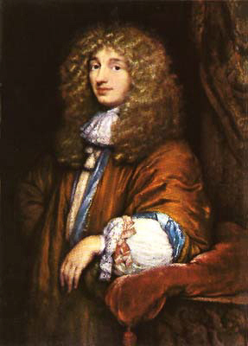
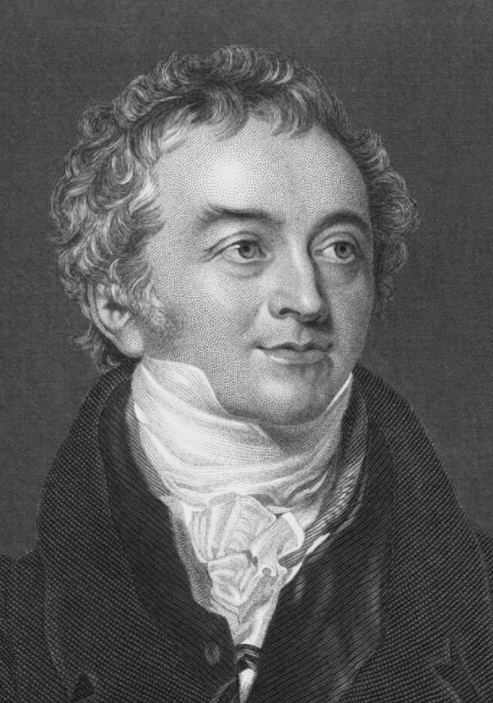
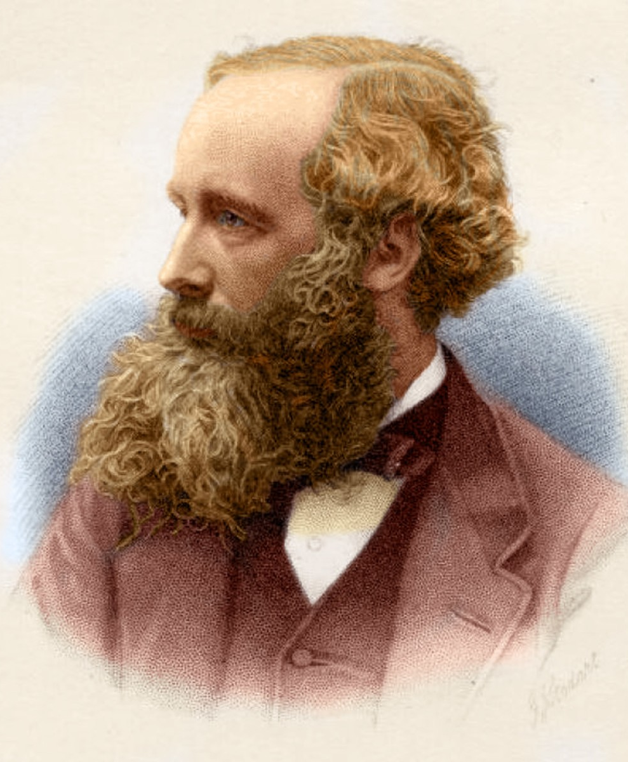
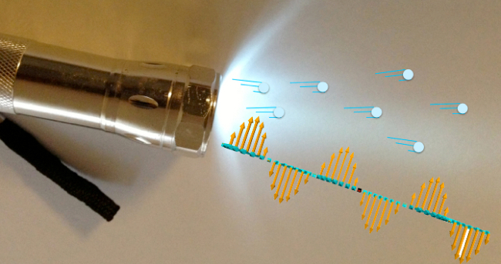
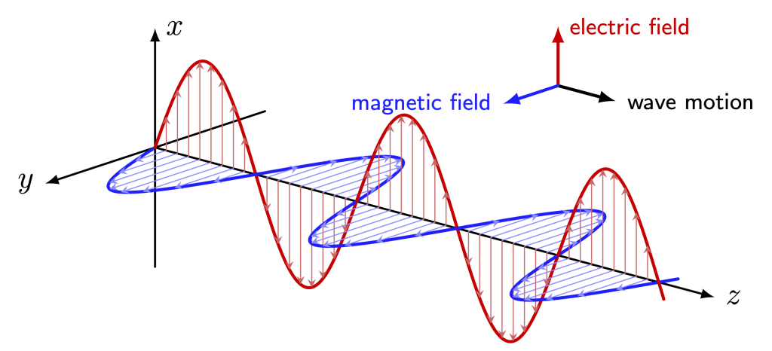
The Nature of Light
7
Isaac Newton (1642 – 1727):
Light is a stream of particles.
Christiaan Huygens (1629 – 1695):
Light consists of waves.
Thomas Young (1773 – 1829):
Interference observed: Light is waves!
James Clerk Maxwell (1831 – 1879):
Light is a wave of electromagnetic fields.
Christiaan
Huygens
Thomas
Young
James Clerk Maxwell
Isaac Newton
Newton
Huygens
Notes:
Mystery of the nature of light.
Newton in Opticks 1704: corpuscular theory particles: shadows. May depend on medium. Reflection and refraction can be explained, light going faster(!) in medium.
Refraction: snellius ; Diffraction: slit bending in media; Diffraction can not be explained
Huygens wave theory: light propapgates through medium (ether). Every point becomes a source of waves. Explains diffraction and refraction.
Young: interference can only be explained with the waves.

Slide 9
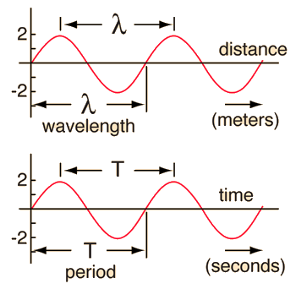
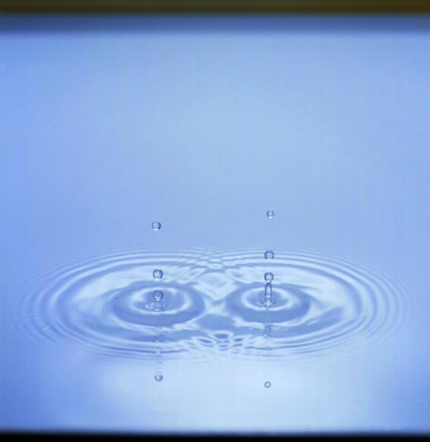
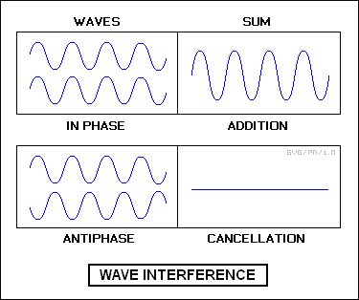
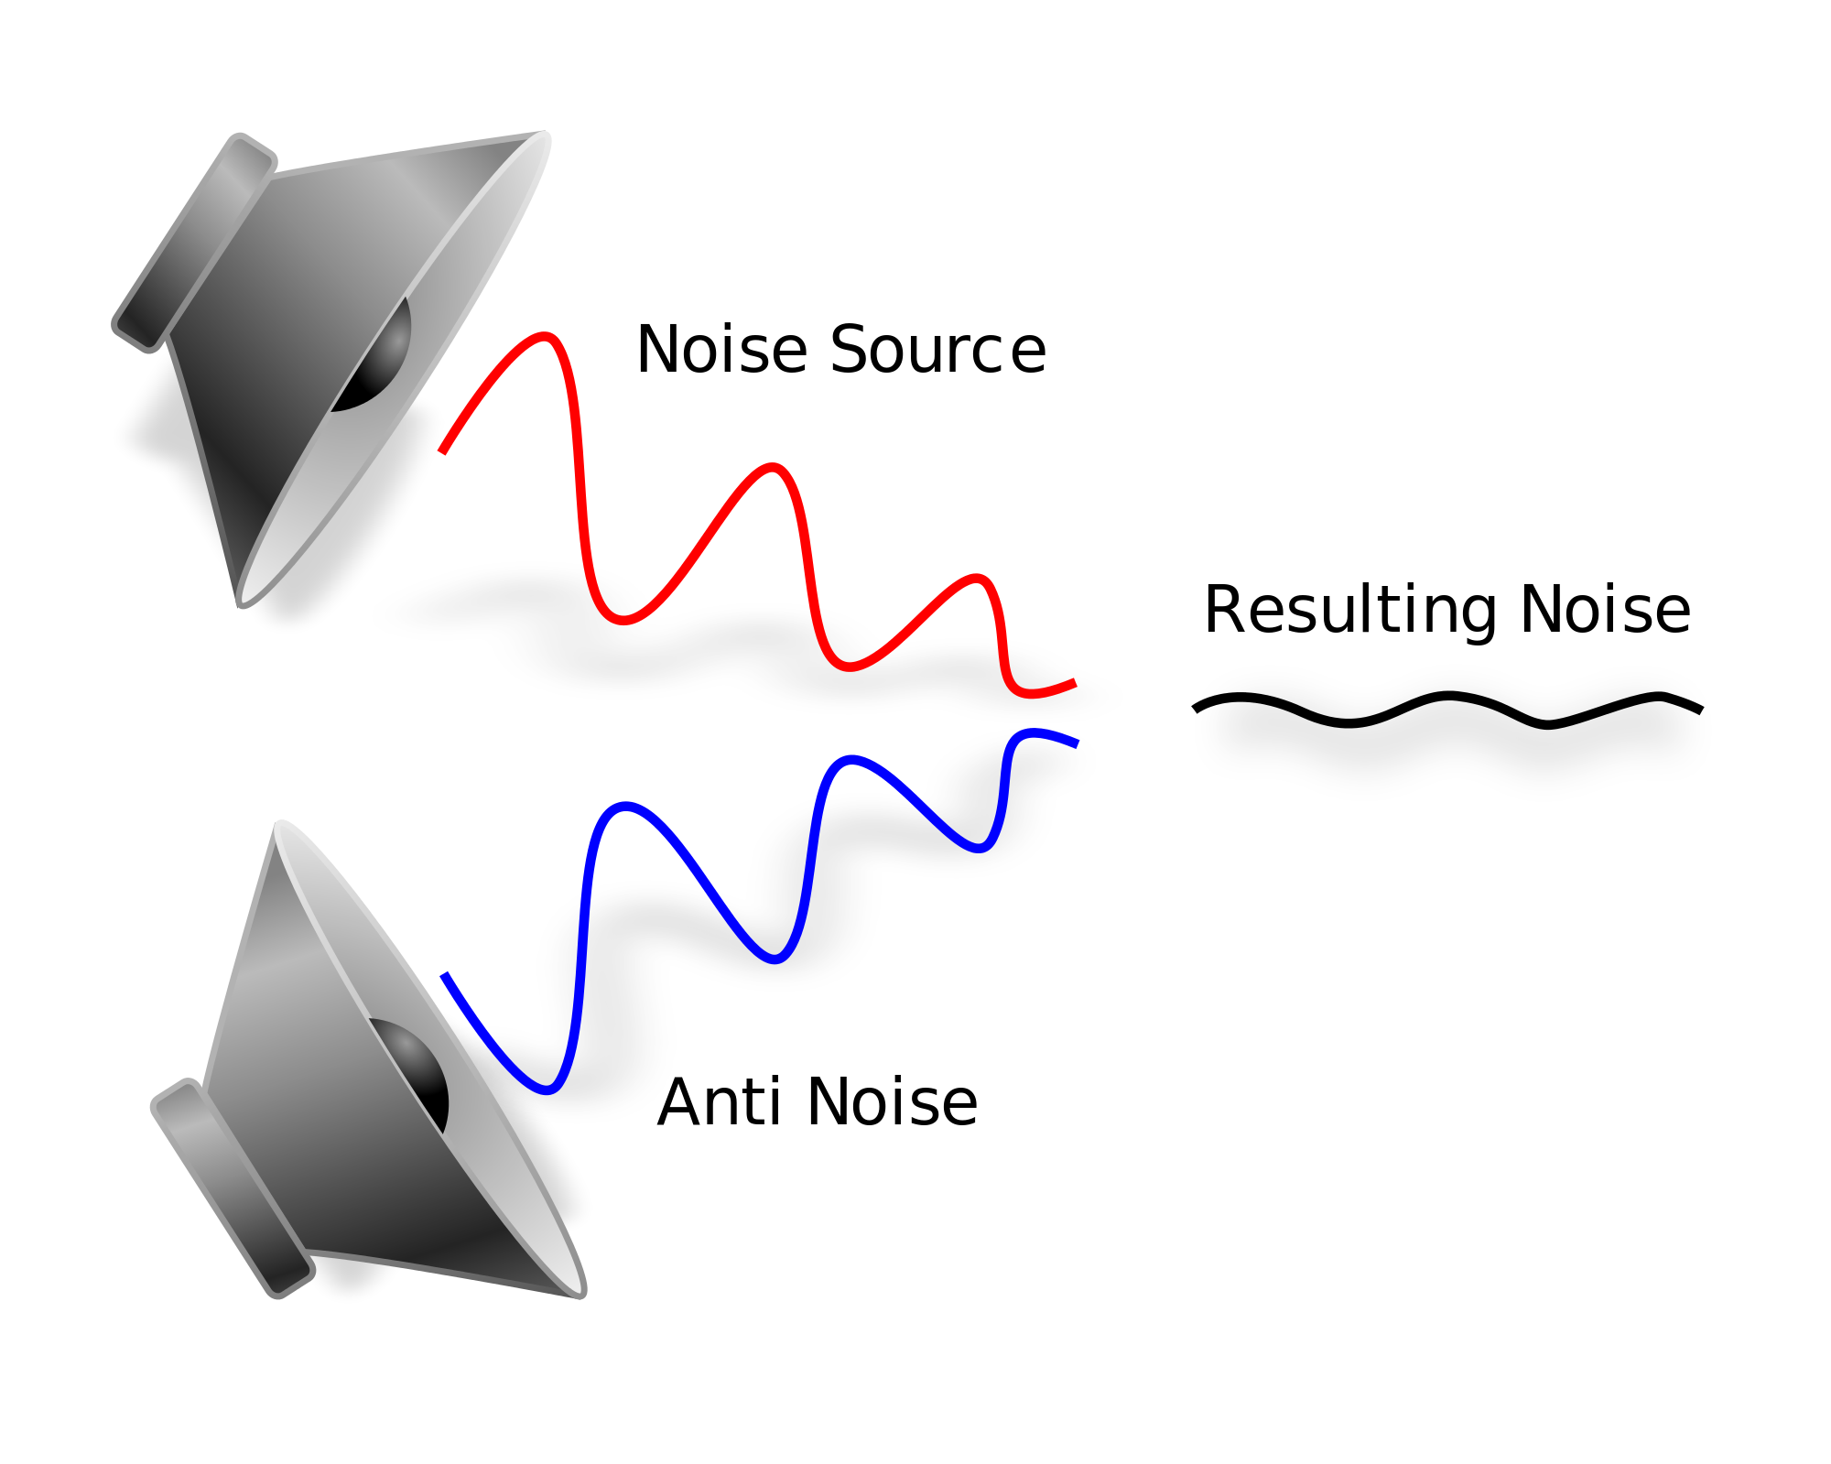
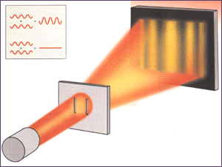


Waves & Interference : water, sound, light
8
Principle of a wave
Water: Interference pattern:
${λ=v}/f$
wave + wave can cancel each other
$$f=1/T$$
Sound: Active noise cancellation:
Light: Thomas Young experiment:
sound + sound can give silence
light + light can give darkness!
Notes:
Rope example.
S = v T → lambda = v T → lambda = v / f
Waves can cancel each other
Young: shine light on two slits: each becomes a source: light + light = darkness
This principle is also used in interferometers (Michelson-Morley, gravitational waves)

Slide 10

Interference with Water Waves
9
Notes:
Animation of interference in water waves

Slide 11
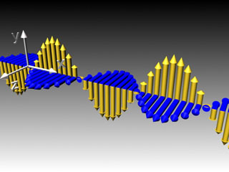
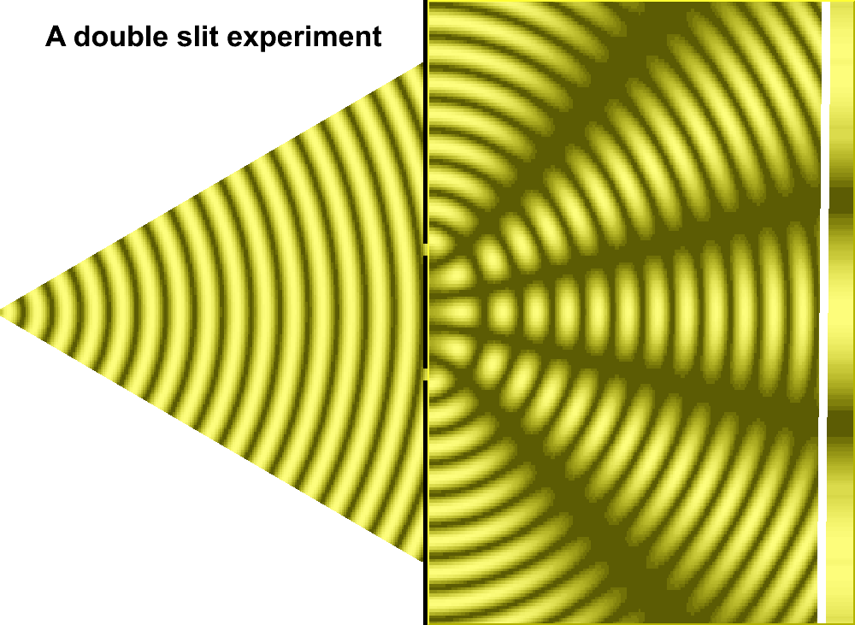
Interfering Light Waves
10
Double slit experiment:
Light consists definitely of waves! ➔ Oscillating E and B fields
E
B
Cancellation:
light + light
= dark
Maxwell
Amplification:
light + light
= more light
light + light can give darkness!
Notes:
This is how the interference works

Slide 12
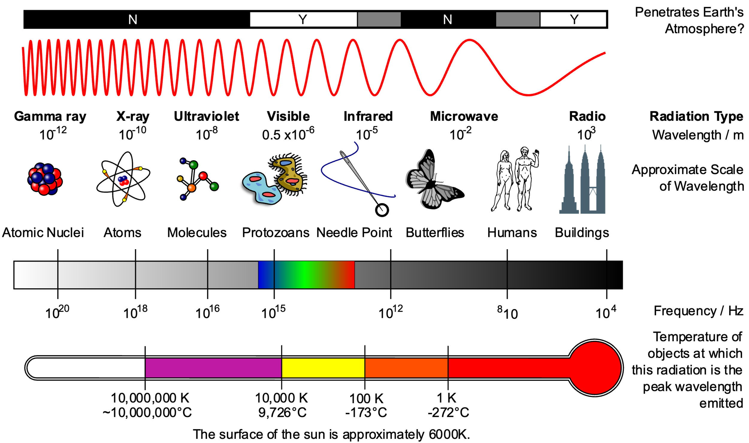
What can you see with light waves?
11

Slide 13
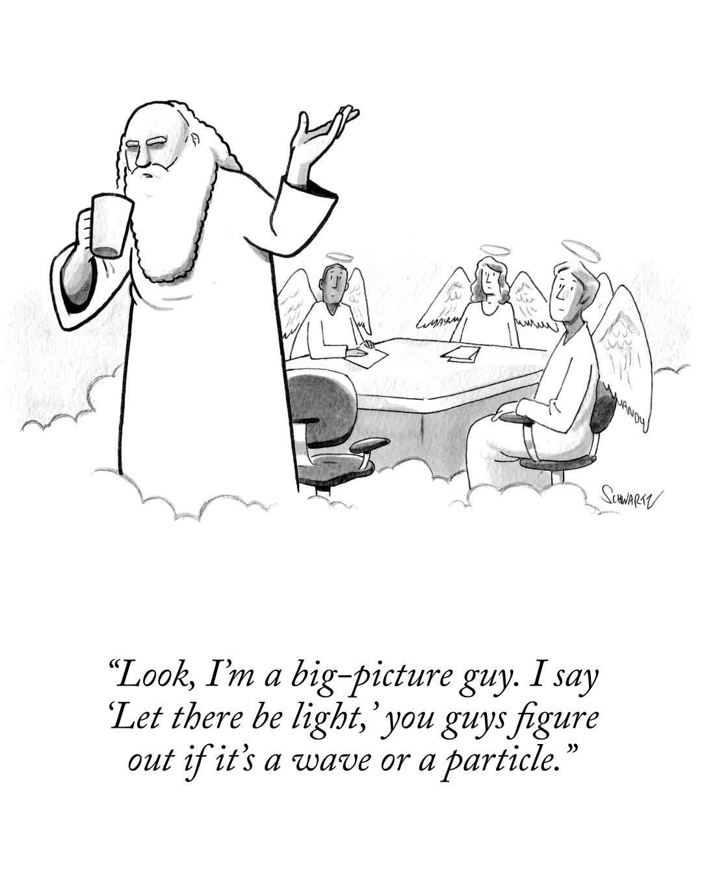
12

Slide 14
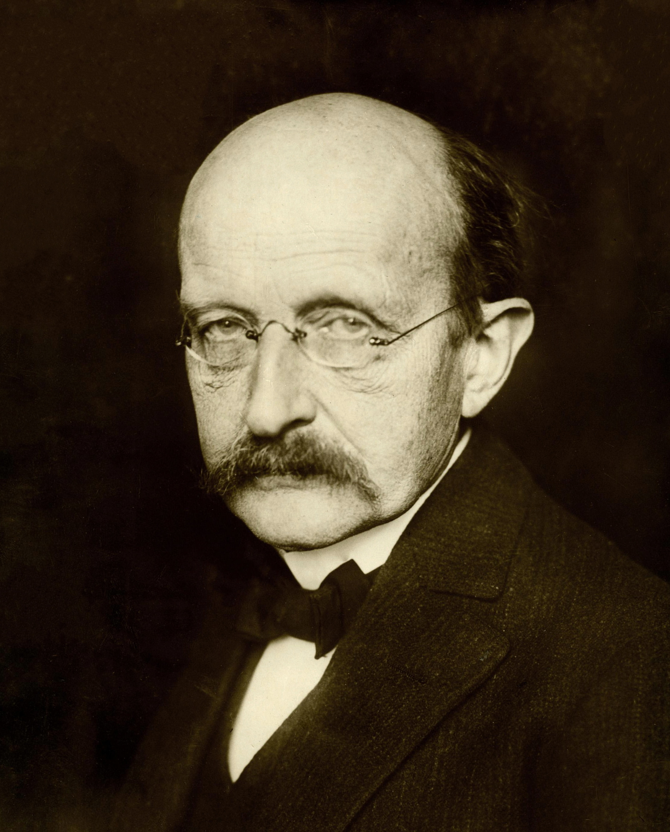
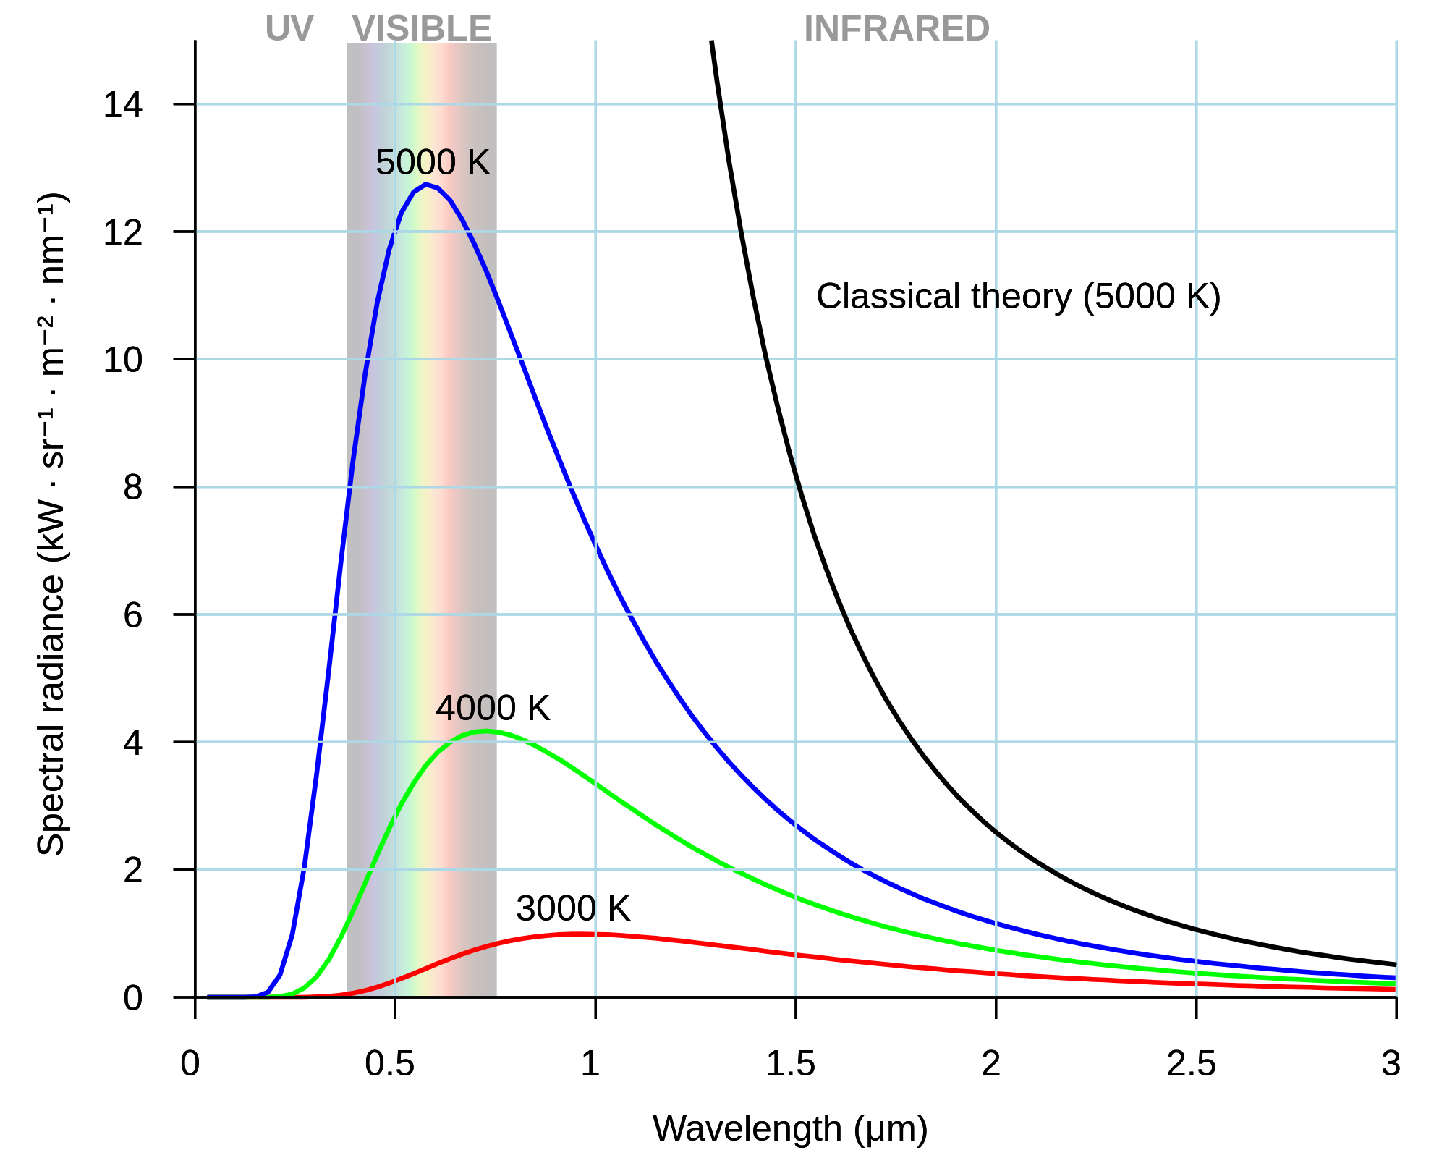
Particle nature: Quantized Light
13
Max Planck (1858 – 1947)
“UV catastrophe” in Black Body radiation spectrum:
If you heat a body it emits radiation. Classical thermodynamics predicts the amount of light at very short wavelength to be infinite!
Planck invented an ad-hoc solution:
For some reason material emitted light in “packages”.
Paul Ehrenfest
Planck’s constant: h = 6.62 ×10⁻³⁴ Js
Nobel prize 1918
Classical theory:
There are more short wavelength “oscillations” of atoms than large wavelength “oscillations”.
Quantum theory:
Light of high frequency (small wavelength) requires more energy: E = h f (h = Planck’s constant)
Notes:
A black body is idealized object that absorps all radiation, i.e. there is no reflection.
The term UV catastrophe was introduced by Paul Ehrenfest.
The number of modes of a classic oscillator in a cavity is proportional to the square of the frequency. (equipartition theorem) All modes have an energy kT. Therefore the energy is infinite.
Energy required to emit light is proportional to frequency – more difficult at high frequency.
h is a constant like the speed of light. It is the same for each observer! (action=Joule*second). Quantum of Action.
Constants: c, h, G, epsilon_0, k_B (“God units”)

Slide 15
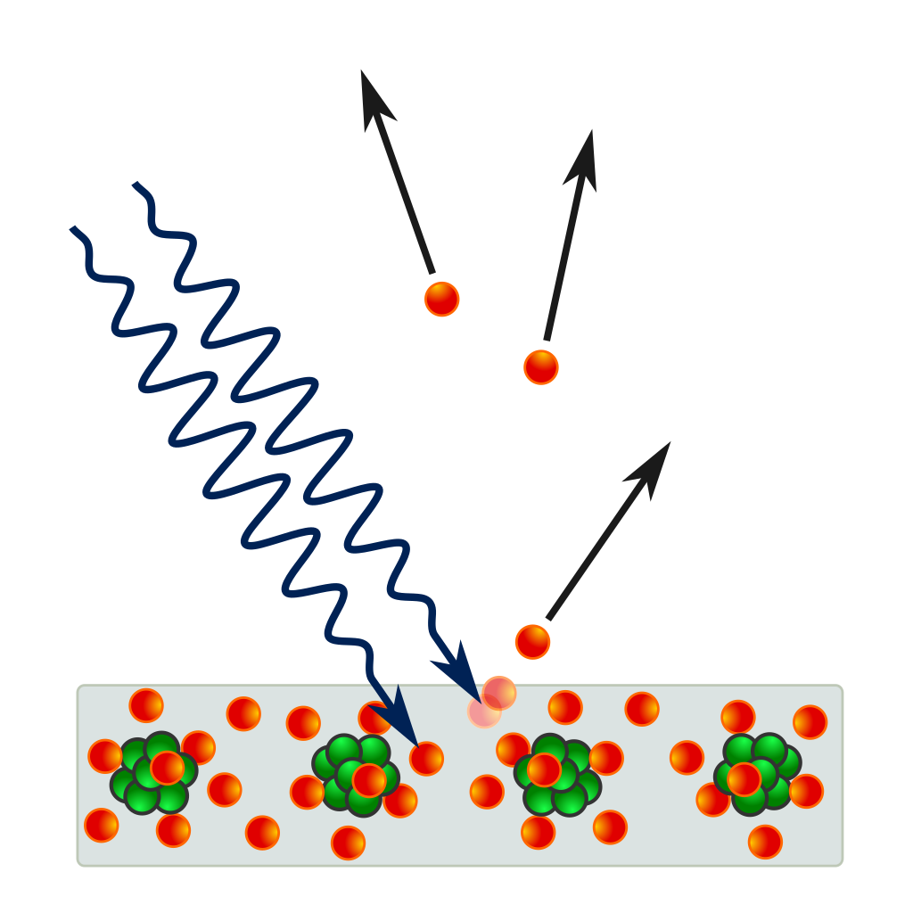
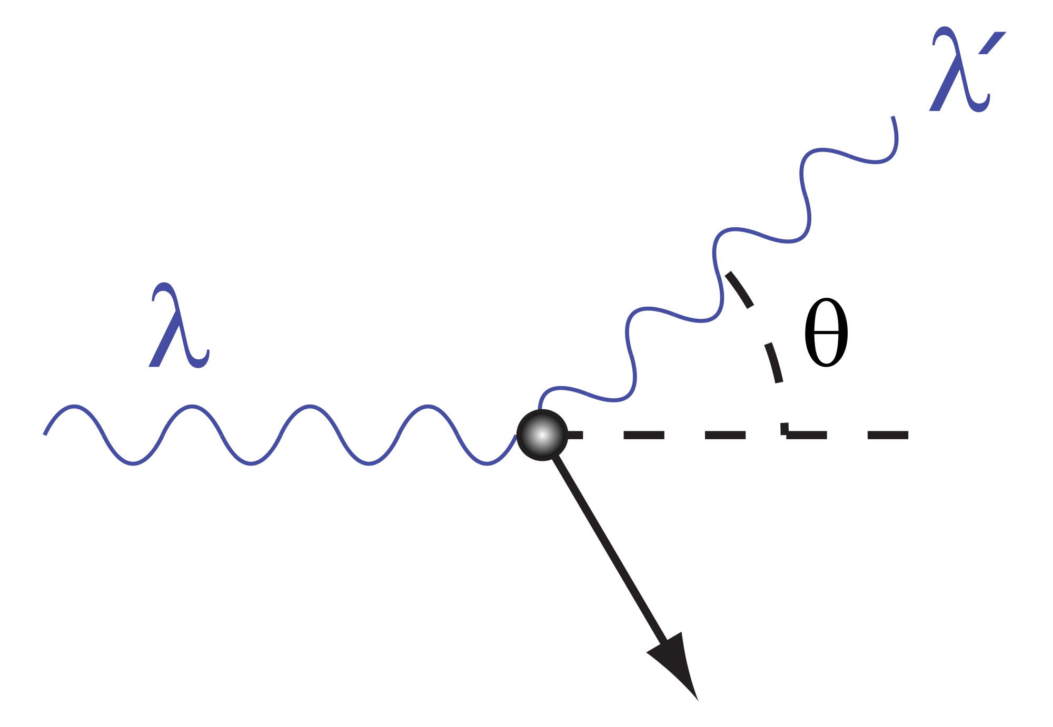
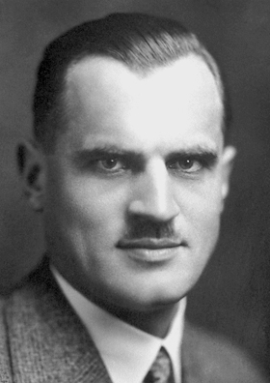
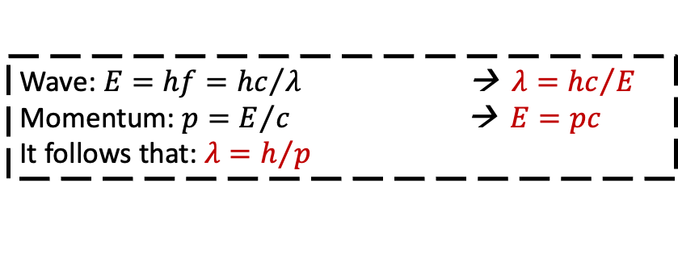
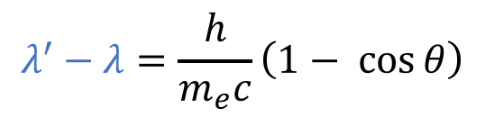
Photoelectric Effect
14
Photoelectric effect:
Light kicks out electron with E = h f
(Independent on light intensity!)
Light consists of quanta.
(Nobelprize 1921)
light
electrons
Wave: $E=hf={hc}/{λ }$ → $λ={hc}/E$
Momentum: $p=E/c$ → $E=pc$
It follows that: $λ=h/p$
Albert Einstein
$$λ^{′}−λ=\frac{h}{m_{e}c}\left(1− \cos{θ}\right)$$
Compton Scattering:
“Playing billiards” with light quanta and electrons.
Light behaves as a particle with: λ = h / p
(Nobelprize 1927)
light
electron
Arthur Compton
Notes:
Photo electric effect discovered by Heinrich Hertz in 1887.
Relation between wave aspect wavelength and particle aspect. Energy depends on frequency, not intensity!
E=mc^2 .

Slide 16

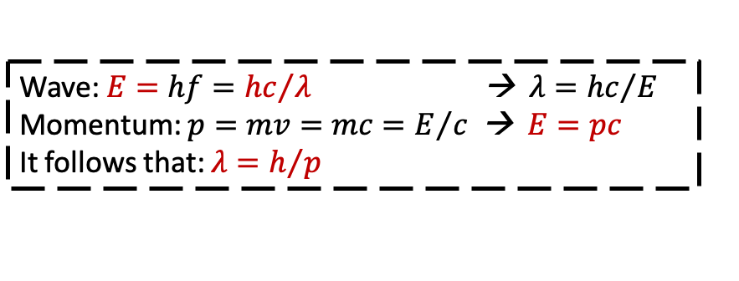
Photoelectric Effect
14
Photoelectric effect:
Light kicks out electron with E = h f
(Independent on light intensity!)
Light consists of quanta.
(Nobelprize 1921)
light
electrons
Wave: $E=hf={hc}/{λ }$ → $λ={hc}/E$
Momentum: $p=mv=mc=E/c$ → $E=pc$
It follows that: $λ=h/p$
Albert Einstein
$$λ^{′}−λ=\frac{h}{m_{e}c}\left(1− \cos{θ}\right)$$
Compton Scattering:
“Playing billiards” with light quanta and electrons.
Light behaves as a particle with: λ = h / p
(Nobelprize 1927)
light
electron
Arthur Compton
Notes:
Photo electric effect discovered by Heinrich Hertz in 1887.
Relation between wave aspect wavelength and particle aspect. Energy depends on frequency, not intensity!
E=mc^2 , Mass m = m/c p = mv = C/c

Slide 17
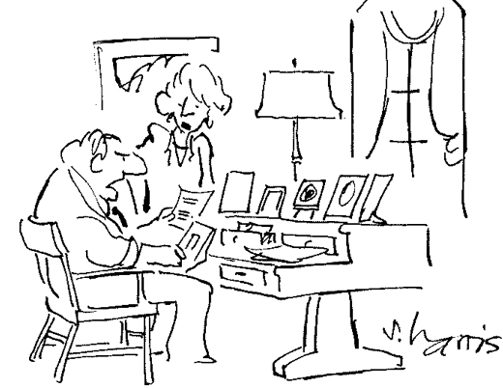
15
“Once and for all I want to know what I am paying for. When the electric company tells me whether light is a wave or a particle I’ll write my check.”

Slide 18
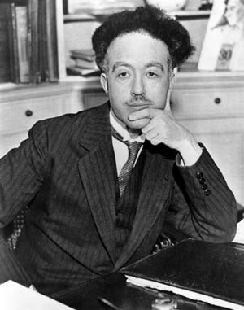
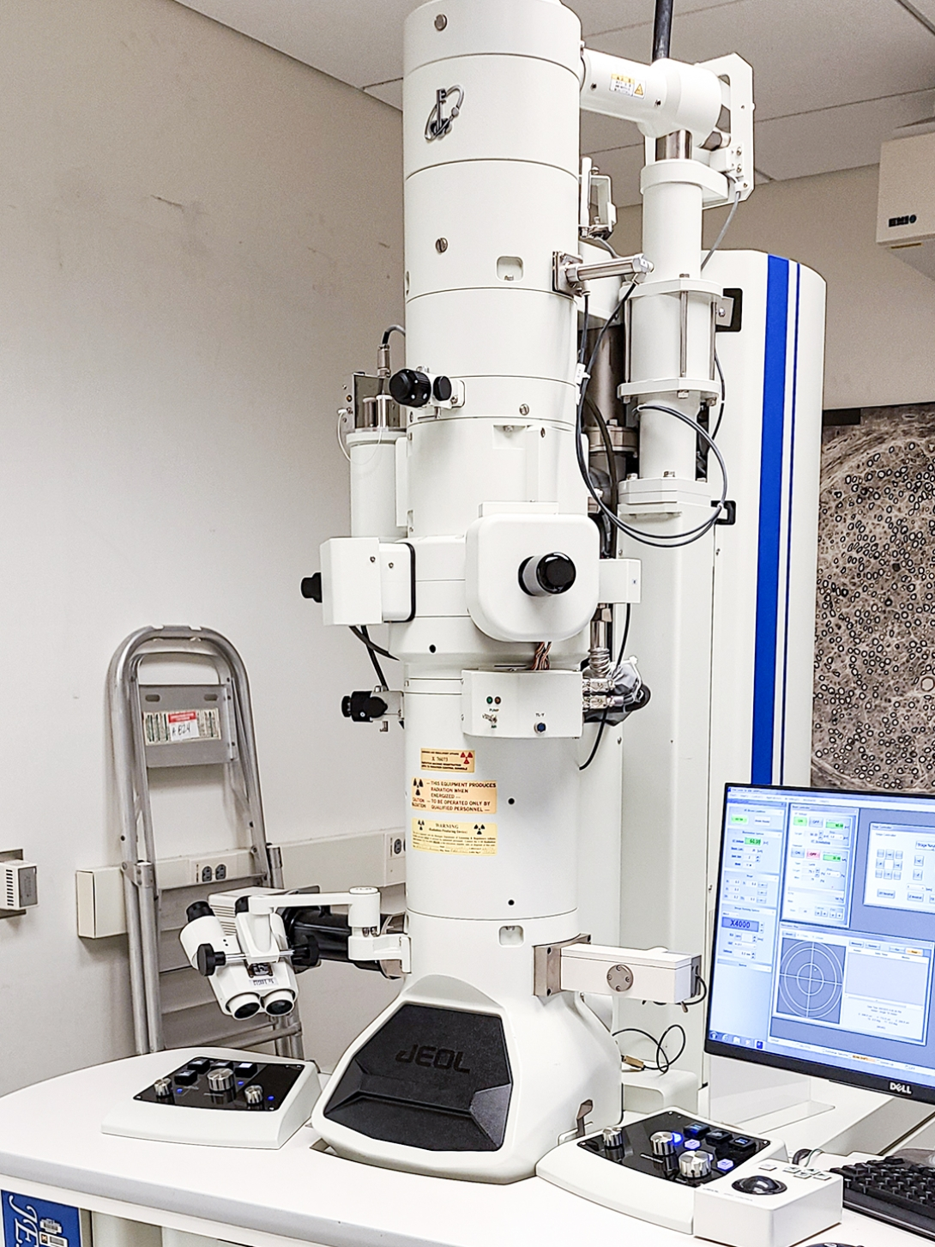
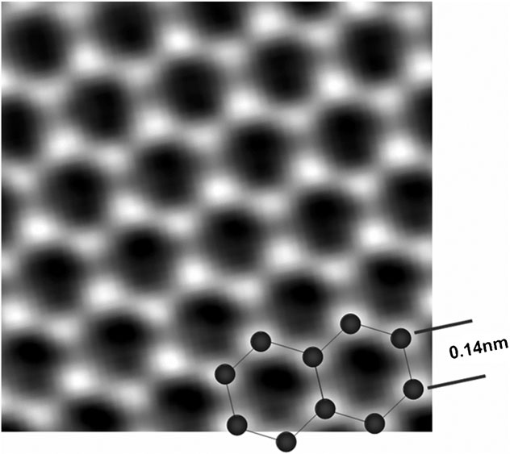
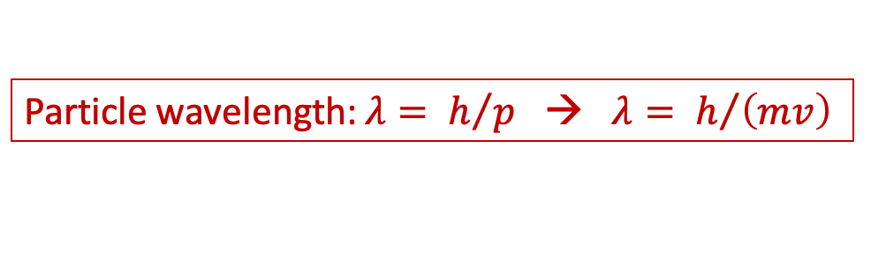
Matter Waves
16
Louis de Broglie - PhD Thesis(!) 1924 (Nobel prize 1929):
If light are particles incorporated in a wave, it suggests that particles (electrons) “are carried” by waves.
Original idea: a physical wave ➔ Quantum mechanics: probability wave!
Louis de Broglie
Nobel prize 1929
Particle wavelength: $λ= h/p$ → $λ= h/{\left(mv\right)}$
Wavelength visible light:
400 – 700 nm
Use h= 6.62 × 10⁻³⁴ Js to calculate:
Wavelength electron with v = 0.1 c:
0.024 nm
Wavelength of a fly (m = 0.01 gram,
v = 10 m/s):
0.0000000000000000000062 nm
graphene
electron microscope
Notes:
Wavelength

Slide 19
Matter Waves
16
Louis de Broglie - PhD Thesis(!) 1924 (Nobel prize 1929):
If light are particles incorporated in a wave, it suggests that particles (electrons) “are carried” by waves.
Original idea: a physical wave ➔ Quantum mechanics: probability wave!
ELECTRON
Louis de Broglie
Nobel prize 1929
Particle wavelength: $λ= h/p$ → $λ= h/{\left(mv\right)}$
Wavelength visible light:
400 – 700 nm
Use h= 6.62 × 10⁻³⁴ Js to calculate:
Wavelength electron with v = 0.1 c:
0.024 nm
Wavelength of a fly (m = 0.01 gram,
v = 10 m/s):
0.0000000000000000000062 nm
graphene
electron microscope
Notes:
Wavelength

Slide 20
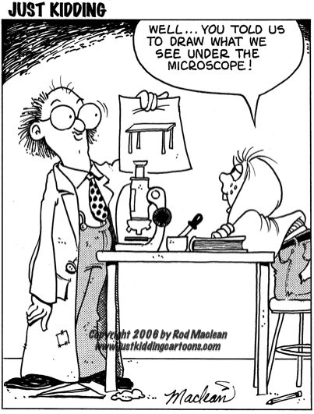
17
Speaking about
Microscopes…
Notes:
Talking about microscopes...

Slide 21
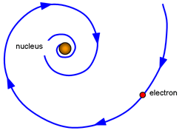
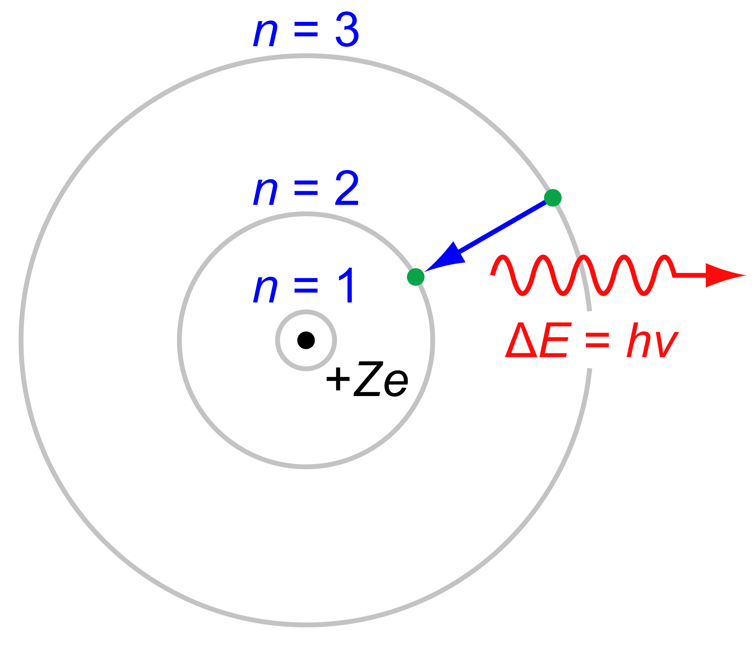
The Quantum Atom of Niels Bohr
18
The classical Atom is unstable!
Expect: t < 10⁻¹⁰ s
Niels Bohr: Atom is only stable for specific orbits: “energy levels”.
An electron can jump from a high to lower level by emitting a light quantum with corresponding energy difference.
Niels Bohr
1885 - 1962
Notes:
The Balmer spectrum from hydrogen jumping n=7→2 (397 nm), 6→2 (410 nm), 5→2 (434 nm), 4→2 (486 nm), 3→2 (656 nm).

Slide 22
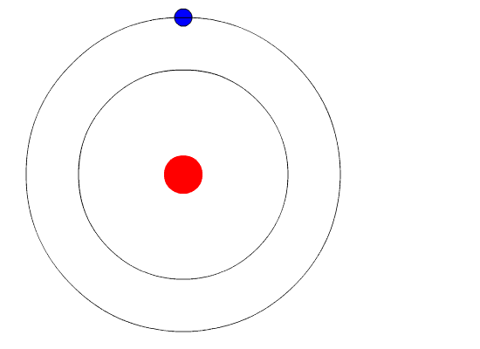

The Quantum Atom of Niels Bohr
18
The classical Atom is unstable!
Expect: t < 10⁻¹⁰ s
Niels Bohr: Atom is only stable for specific orbits: “energy levels”.
An electron can jump from a high to lower level by emitting a light quantum with corresponding energy difference.
Niels Bohr
1885 - 1962
Niels Bohr
1885 - 1962
Hydrogen “Balmer” spectrum of wavelengths: $E_{n}=−13.6 eV/n^{2}$
7→2
6→2
5→2
4→2
3→2
Notes:
The Balmer spectrum from hydrogen jumping n=7→2 (397 nm), 6→2 (410 nm), 5→2 (434 nm), 4→2 (486 nm), 3→2 (656 nm).

Slide 23
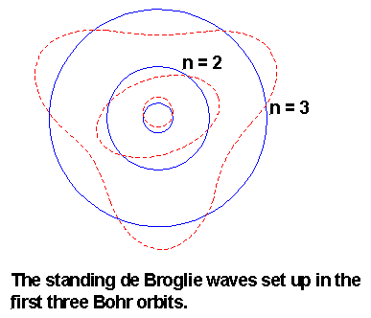
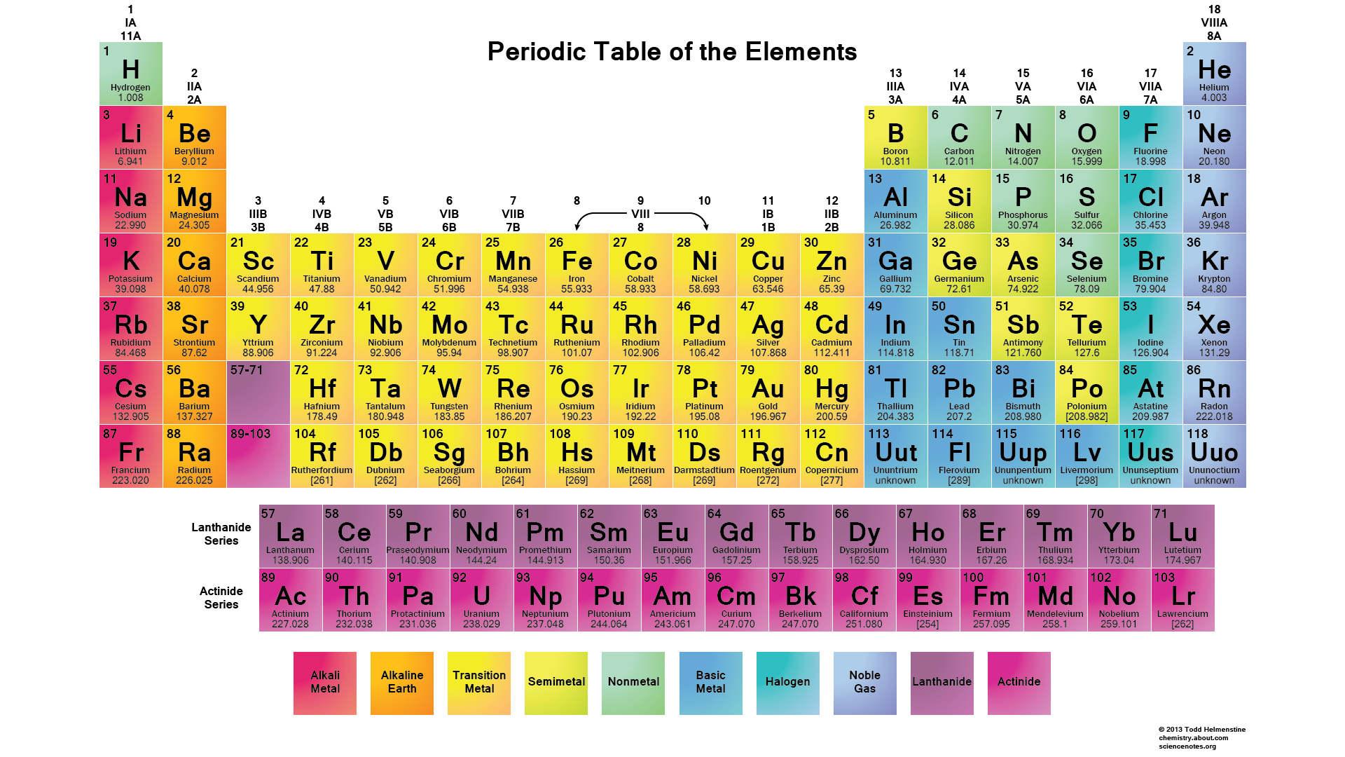

Schrödinger: Bohr atom and de Broglie waves
19
If orbit length “fits”:
2π r = n λ with n = 1, 2, 3, …
The wave positively
interferes with itself!
➔ Stable orbits!
n = 1
Erwin Schrödinger
Periodic Table of the Elements
Energy levels explained → atom explained
Outer shell electrons
→ “chemistry explained”
More realistic atom:
probability waves
Notes:
E = - Z^2 R_E / n^2. Standing waves; no “orbits” anymore.
Use relation of orbit and lambda to derive quantization of orbital angular momentum, also energy.

Slide 24
Not yet explained: “Dramming”
20
Notes:
Five main regions: Islay, speyside, highlands, lowlands, Island

Slide 25
Complementarity
21
Subatomic matter is not just waves and it is not just particles.
It is nothing we know from macroscopic world.
Niels Bohr
1885 - 1962
Copenhagen Interpretation (Niels Bohr):
One can observe wave characteristics or particle characteristics of quantum objects, never both at the same time.
Particle and Wave aspects of a physical object are complementary.
Similarly one can never determine from a quantum object at the same time:
energy and time, position and momentum (and more).
Notes:
Quanta collide like particles or interfere like waves. Depends on the measurement you do.
Complementary: spin components, angular position/m omentum, number and phase.
Just like the finite speed of light means that it is impossible to make a sharp seperation between space and time, the quantum of action (constant of Planck) implies that it it impossible to separate a system and its interaction with instruments.

Slide 26


Heisenberg Uncertainty Relation
22
A measurement of a characteristic of quantum matter affects the object.
Heisenberg’s “non-commuting” observables:
You cannot know position and momentum at the same time:
$xp−px=iℏ$
usually written in the form:
$Δx Δp ≥ ℏ/ 2$
You cannot know both energy and time:
$Et−tE=iℏ$
usually written in the form
$ΔE Δt ≥ ℏ/ 2$
Werner Heisenberg
“Matrix mechanics”
Erwin Schrödinger
“Wave Mechanics”
Paul Adrian Maurice Dirac
“q - numbers”
It is a fundamental aspect of nature.
Not related to limited technology!
Notes:
If you first measure position, then momentum or the other way around, you do not get the same.
Dirac used abstract mathematical properties of q-numbers and showed that Heisenberg and Schrodinger were representations of the same fundamental aspect
Schrodinger picture: state vectors evolve in time, operators time independent.
Heisenberg picture: operators time dependent, state vectors time independent

Slide 27





Heisenberg Uncertainty Relation
23
Energy and time:
In quantum mechanics energy is the “rate of change of a wavefunction”:
$E t ψ −t E ψ=iℏ$ $\frac{∂}{∂t}\left(tψ\right) −t iℏ\frac{∂}{∂t}\left(ψ\right)=iℏψ+iℏt\frac{∂}{∂t}ψ −iℏt\frac{∂}{∂t}ψ=iℏψ≠0$
Consequence: $ΔE Δt≥ ℏ/2$ Measuring energy means locality in time is lost.
$$Eψ→iℏ\frac{∂}{∂t}ψ$$
Position and momentum:
In quantum mechanics energy is the “rate of change of a wavefunction”:
$p x ψ−x p ψ=iℏ ψ\frac{∂}{∂x}\left(xψ\right) −x iℏ\frac{∂}{∂x}\left(ψ\right)=iℏψ+iℏx\frac{∂}{∂x}ψ −iℏx\frac{∂}{∂x}ψ=iℏψ≠0$
Consequence: $Δx Δp≤ ℏ/2$ Measuring momentum means locality in space is lost.
$$pψ→iℏ\frac{∂}{∂x}ψ$$
Paul Adrian Maurice Dirac
“q - numbers”
It is a fundamental aspect of nature.
Not related to limited technology!
Notes:
If you first measure position, then momentum or the other way around, you do not get the same.
Dirac used abstract mathematical properties of q-numbers and showed that Heisenberg and Schrodinger were representations of the same fundamental aspect
Schrodinger picture: state vectors evolve in time, operators time independent.
Heisenberg picture: operators time dependent, state vectors time independent

Slide 28




Heisenberg Uncertainty Relation: for experts
24
Energy and time:
In quantum mechanics energy is the “rate of change in time of a wavefunction”:
It fundamentally requires time to measure energy, ie. change in time.
Consequence: $ΔE Δt≥ ℏ/2$ Measuring energy means locality in time is lost.
$$Eψ→iℏ\frac{∂}{∂t}ψ$$
Position and momentum:
In quantum mechanics momentum is “rate of change in space of a wavefunction”:
It fundamentally requires space to measure momentum, ie. change in space.
Consequence: $Δx Δp≤ ℏ/2$ Measuring momentum means locality in space is lost.
$$pψ→−iℏ\frac{∂}{∂x}ψ$$
Paul Adrian Maurice Dirac
“q - numbers”
It is a fundamental aspect of nature.
Not related to limited technology!
Notes:
If you first measure position, then momentum or the other way around, you do not get the same.
Dirac used abstract mathematical properties of q-numbers and showed that Heisenberg and Schrodinger were representations of the same fundamental aspect
Schrodinger picture: state vectors evolve in time, operators time independent.
Heisenberg picture: operators time dependent, state vectors time independent

Slide 29




…and if you REALLY want to see where it comes from….
25
1. Replace $E$ by the operator $iℏ\frac{∂}{∂t}$ operating on wave function $ψ$:
$Et\left(ψ\right)=iℏ\frac{∂}{∂t}\left(tψ\right)=iℏψ+iℏt\frac{∂ψ}{∂t}$
$tE\left(ψ\right)=tiℏ\frac{∂ψ}{∂t }=iℏt$ $\frac{∂ψ}{∂t }$
$\left(Et−tE\right) ψ=iℏ ψ$
2. Replace $p$ by the operator $−iℏ\frac{∂}{∂x}$ operating on wave function $ψ$:
$px\left(ψ\right)=−iℏ\frac{∂}{∂x}\left(xψ\right)=−iℏψ−iℏx\frac{∂ψ}{∂x}$
$xp\left(ψ\right)=−xiℏ\frac{∂ψ}{∂x }=−iℏx$ $\frac{∂ψ}{∂tx }$
$\left(xp−px\right) ψ=iℏ ψ$
“Non commuting observables”
It is a fundamental aspect of nature.
Not related to limited technology!

Slide 30

…and if you REALLY want to see where it comes from….
25
1. Replace $E$ by the operator $iℏ\frac{∂}{∂t}$ operating on wave function $ψ$:
$Et\left(ψ\right)=iℏ\frac{∂}{∂t}\left(tψ\right)=iℏψ+iℏt\frac{∂ψ}{∂t}$
$tE\left(ψ\right)=tiℏ\frac{∂ψ}{∂t }=iℏt$ $\frac{∂ψ}{∂t }$
$\left(Et−tE\right) ψ=iℏ ψ$
2. Replace $p$ by the operator $−iℏ\frac{∂}{∂x}$ operating on wave function $ψ$:
$px\left(ψ\right)=−iℏ\frac{∂}{∂x}\left(xψ\right)=−iℏψ−iℏx\frac{∂ψ}{∂x}$
$xp\left(ψ\right)=−xiℏ\frac{∂ψ}{∂x }=−iℏx$ $\frac{∂ψ}{∂tx }$
$\left(xp−px\right) ψ=iℏ ψ$
“Non commuting observables”
It is a fundamental aspect of nature.
Not related to limited technology!

Slide 31
Waves and Uncertainty
26
Use the “wave-mechanics” picture of Schrödinger
A wave has an exactly defined frequency.
A particle has an exactly defined position.
Two waves: p₁ = hf₁/c , p₂ = hf₂/c
Wave Packet: sum of black and blue wave
f (p)
x
The more waves are added, the more the wave packet looks like a particle, or,
If we try to determine the position x, we destroy the frequency/momentum p and vice versa.

Slide 32

Waves and Uncertainty
26
Use the “wave-mechanics” picture of Schrödinger
A wave has an exactly defined frequency.
A particle has an exactly defined position.
Two waves: p₁ = hf₁/c , p₂ = hf₂/c
Wave Packet: sum of black and blue wave
f (p)
x
The more waves are added, the more the wave packet looks like a particle, or,
If we try to determine the position x, we destroy the frequency/momentum p and vice versa.

Slide 33


Waves and Particles
27
“Particle:”
Uncertainty Revisited
Pure waves of different frequency,
i.e. different momentum p = hf/c
Wave package,
i.e. “particle”
Measure precise momentum
You force the quantum to have a specific frequency
You lose the locality of the quantum
→ No position information.
Measure precise position
You force the quantum to have a specific position
You lose the momentum (frequency) information of the quantum
not localized
well localized
Δp

Slide 34

The uncertainty relation at work
28
Shine a beam of light through a narrow slit which has a opening size Δx.
The light comes out over an undefined angle that corresponds to Δp_{x}.
Δx Δp_{x} ~ ħ/2
Image of a laser pointer after passing through a slit:
Δp_{x}
Δx
Notes:
Use a laser pointer: dot becomes an ellipse

Slide 35







Consequence: Particles can quantum tunnel through a wall!
29
Classic: particle needs enough energy $E=\frac{1}{2}mv^{2}$ to go over barrier
Quantum explanation: particles are waves packets:
“The particles energy (or momentum) is uncertain enough to pass through if the time (or space) is short enough.”
$$E$$
Quantum: particle can tunnel through the barrier.
Even if its energy is not enough.
$$Δp$$
$$Δx$$
Notes:
Afterwards you measure the paticle either on the left or on the right → it is a probability wave.

Slide 36

The wave function ψ
30
Position fairly known
Momentum badly known
Notes:
In blue the wave function; in red the probaility!
Focus on the blue first!
The red comes later.

Slide 37
The wave function ψ
30
Position fairly known
Momentum badly known
Position badly known
Momentum fairly known

Slide 38
Imaginary Numbers
31
“Life is complex, it has both real and imaginary parts”
- Anonymous

Slide 39

32

Slide 40
The Copenhagen Interpretation: what is $ψ$ ?
33
The wave function ψ is not a real object. The only physical meaning is that its square gives the probability to find a particle at a position x and time t.
Prob(x,t) = |ψ(x,t)|² = ψ ψ∗
Niels Bohr
Max Born
Quantum mechanics allows only to calculate probabilities for possible outcomes of an experiment and is non-deterministic, contrary to classical theory.
Einstein: “Gott würfelt nicht.”
The mathematics for the probability of the quantum wave-function is the same as the mathematics of the intensity of a classical wave function.

Slide 41
The wave function ψ
34
Position fairly known
Momentum badly known
➔probability for
being at any x
➔probability for
having p
➔probability for
being at any x
➔probability for
having any p
Position badly known
Momentum fairly known
Notes:
Now look at the red (left) blue(right) lines!

Slide 42



Next Lecture: double slit experiment
35
Richard Feynman
The core of quantum mechanics illustrated by Feynman. Einstein and Schrödinger did not like it.
Wheeler later took it to the extreme.
Even today people are debating its interpretation.

