Slide 1
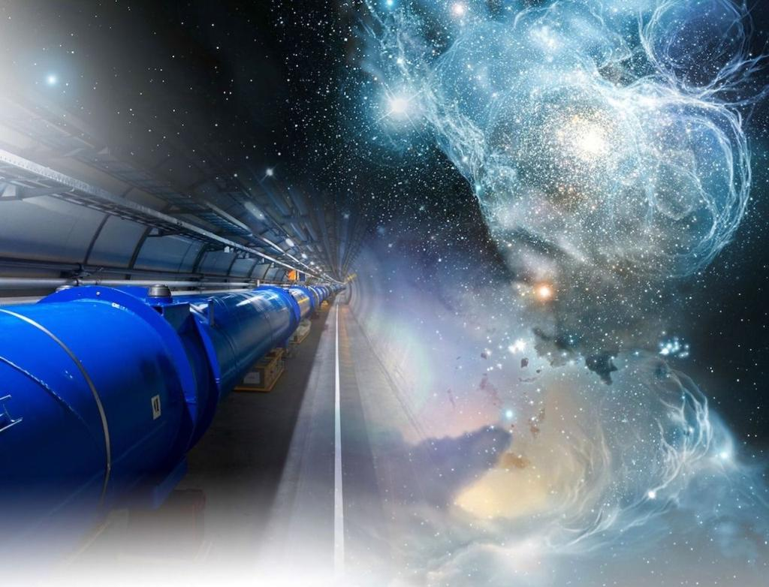
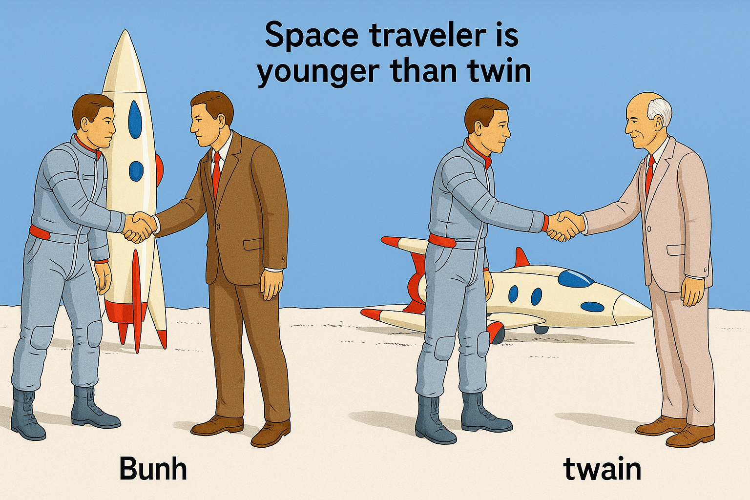
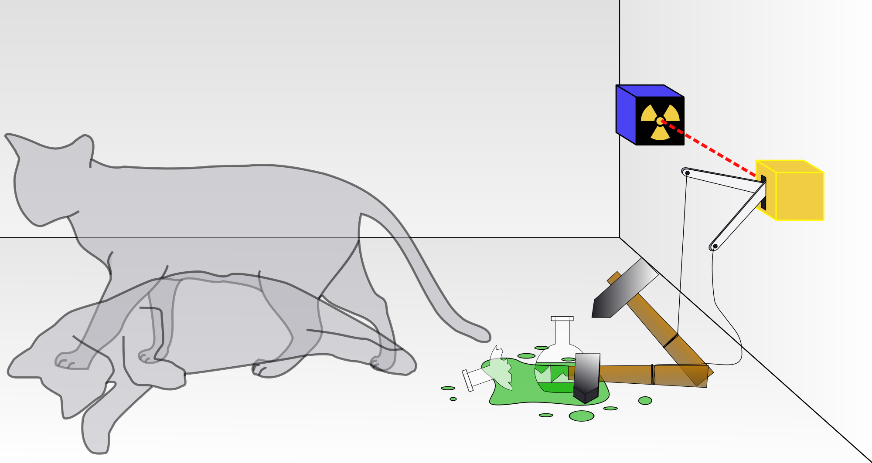
The Relativistic Quantum World
Relativity
A lecture series on
Relativity Theory and Quantum Mechanics
Before
After
Quantum
Alive
Marcel Merk
Studium Generale Maastricht
Sep 10 – Oct 8, 2025
Dead
Notes:
Welcome to cours eon relativity and QM.
Course March-April; interrupted Covid-19. Begin from the start.
Explain picture. Interesting (“bizarre”) aspects of relativity and QM

Slide 2
The Relativistic Quantum World
1
Lecture 1: The Principle of Relativity and the Speed of Light
Lecture 2: Time Dilation and Lorentz Contraction
Lecture 3: The Lorentz Transformation and Paradoxes
Lecture 4: General Relativity and Gravitational Waves
Sep. 10:
Relativity
Sep. 17:
Lecture 5: The Early Quantum Theory
Lecture 6: Feynman’s Double Slit Experiment
Lecture 7: Wheeler’s Delayed Choice and Schrodinger’s Cat
Lecture 8: Quantum Reality and the EPR Paradox
Quantum
Mechanics
Sep. 24:
Oct. 1 :
Standard
Model
Lecture 9: The Standard Model and Antimatter
Lecture 10: Why is there something rather than nothing?
Oct. 8:
Lecture notes, written for this course, are available: www.nikhef.nl/~i93/Teaching/
Prerequisite for the course: High school level physics & mathematics.
Notes:
Ambitious!

Slide 3
2
Lecture 2
Time Dilation and Lorentz Contraction
“I have no special talent. I am only passionately curious.”
Albert Einstein
Notes:
Duration of time and distances for different observers will be affected.
A somewhat peculiar quote from Einstein.
Cinder= burning piece of coal or wood. NL: sintel

Slide 4
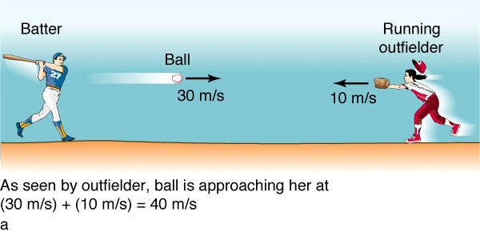
Coordinate Systems
3
Bob
Alice
A reference system or coordinate system is used to determine the time and position of an event.
Reference system S is linked to observer Bob at position (x,y,z) = (0,0,0)
An event (batter hits the ball) is fully specified by giving its coordinates in time and space: (t, x, y, z)
Reference system S’ is linked to observer Alice who moves with velocity “v” with respect to S of Bob.
How are the coordinates of the event of Bob (batter hits the ball) expressed in coordinates for Alice (t’, x’, y’, z’) (running outfielder) ?
w=
v=
S
w=?
Event
S‘
S
S’
y
y’
w = ball velocity
w.r.t. Bob
Event
w
w’ = ball velocity
w.r.t. Alice
w’
v = velocity Alice
w.r.t. Bob
v
x
x’
z
z’
eg.: Is it true that t = t’ ?
(universal time – Galilei)
How is the trajectory of the ball for Alice related to that for Bob?
Notes:
Make it a bit formal: coordinate systems.
Coordinate system S’ moves wrt S.
How to go from (t,x,y,z,) to (t,x’,y’,z’)
A “event” is a happening at specific place and time. (bat hits the ball)
Or beginning of a football match: seen by ref or by someone in airplane.
How to go from S to S’ for the same event?

Slide 5
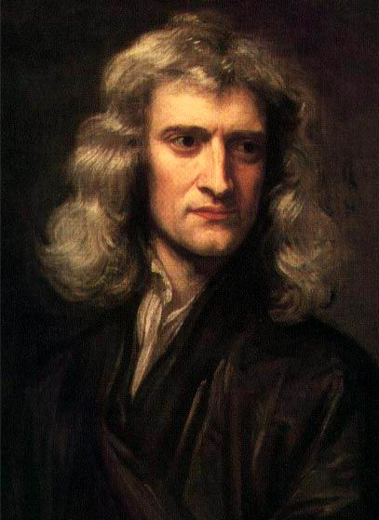
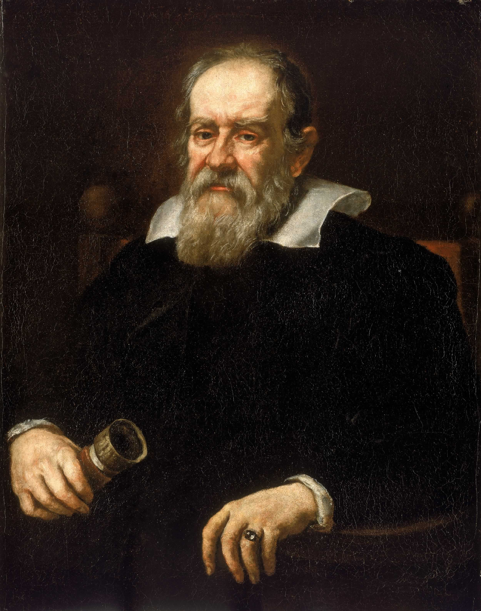
Universality of Time
4
Bob
S
Alice
S’
y
y’
w = ball velocity
w.r.t. Bob
Event
w
w’ = ball velocity
w.r.t. Alice
w’
v = velocity Alice
w.r.t. Bob
v
x
x’
z
z’
w’ = w + v
Isaac Newton (1689)
Galileo Galilei (1636)
velocity = distance / time , but are distance and time the same for Bob and Alice?
“Classical” law of adding velocities assumes time is universal for all observers.
Let us first look at the concept of “simultaneity” in the eyes of Einstein.
Notes:
Velocity = distance / time. A universal existence of time? In classical theory it is.

Slide 6
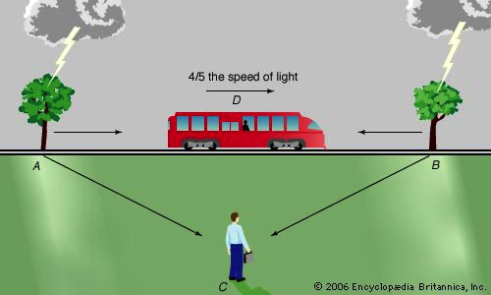
Simultaneity of moving observers (“Gedankenexperiment”)
5
Bob sees two lightning strokes at the same time. AC = BC = 10 km.
At the time of the lightning strike Alice passes Bob at position D. Also: AD=BD=10 km.
Alice sees the same events from the speeding train.
By the time the light has travelled 10 km, Alice moved a bit towards B to position D’ and the light of B reaches her before A.
Since also for Alice, the speed of light in AD’ is the same as that in BD’ she will conclude that strike B happened before strike A.
Bob says two lightnings are simultaneous,
Alice claims they are not. Who is right?
Alice
10 km
D
D’
10 km
Bob
In case Bob and Alice travelling in empty space: who is moving and who is not?
➔ Simultaneity of events depends on the speed of the observer!
Notes:
Thought experiment. Alice in the train, Bob stands on the tracks. Lightning strikes two trees exactly when Alice is at the same position as Bob.

Slide 7

Simultaneity of moving observers
6
Notes:
For different moving observers there is never agreement of simultaneity of events

Slide 8
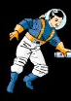

A view from two observers in space
7

Slide 9
A view from two observers in space
7

Slide 10
A view from two observers in space
7

Slide 11
A view from two observers in space
7
It is impossible to say who actually moves
Both are in an inertial frame where the speed of light is the same

Slide 12
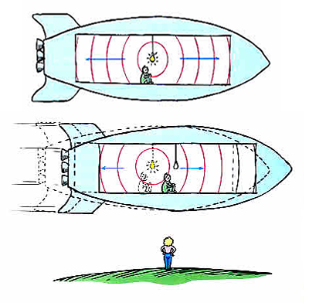
Alternative Illustration
8
Notes:
A light-bulb flashes in the middle of a rocket. Light reaches front and back at the same time.

Slide 13
Alternative Illustration
8
View from inside
View from outside
Inside the rocket the light reaches the front and back simultaneous, independent of the rocket speed. Seen from the outside this is different.
But, what changes if we let the rocket “stand still” and the earth move in the opposite direction?
Notes:
View from outside: front and back not at the same time.

Slide 14
Alternative Illustration
8
View from inside
View from outside
Simultaneity depends on the velocity of the observer.
Time is not universal!
Notes:
View from outside: front and back not at the same time.

Slide 15
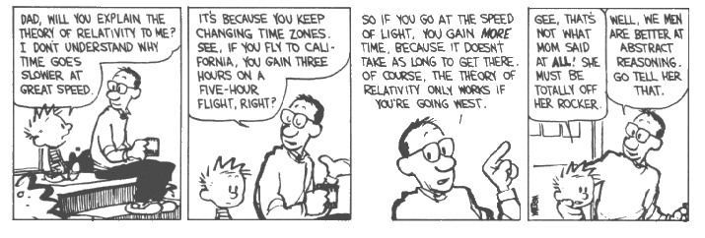
Alternative Explanation
9

Slide 16
Relativity of Length (“Gedankenexperiment”)
10
Alice: measure the length of the train by setting simultaneously two tick marks at the track at position F (front) and R (rear)
R
F
Alice
Bob: measure the length of the train by setting simultaneously two tick marks at the track corresponding to the positions F and R.
R
R
F
A
B
F
“too late”
Bob
“too early”
Since Alice and Bob don’t agree on the simultaneity of making the tick marks they will observe a different length. Alice will claim Bob puts tick mark at Front too early and rear too late such that he sees a shorter train: Lorentz contraction.
Notes:
How to measure the length of a train. Rule? Now special device to compare to Bob.
Simultaneous ticks om the track by Alice and Bob in front “F” and rear “R”
Alice will say Bob puts B too early and A too late
It is *not* an optical illusion. Why have we never seen it? Because it requires velocities of the order of the lightspeed.

Slide 17
Relativity of Length (“Gedankenexperiment”)
10
Alice: measure the length of the train by setting simultaneously two tick marks at the track at position F (front) and R (rear)
R
F
Alice
This is not a measurement artifact, but due to the nature of space and time itself, in the way it is experienced by different observers!
Bob: measure the length of the train by setting simultaneously two tick marks at the track corresponding to the positions F and R.
R
R
F
A
B
F
“too late”
Bob
“too early”
Since Alice and Bob don’t agree on the simultaneity of making the tick marks they will observe a different length. Alice will claim Bob puts tick mark at Front too early and rear too late such that he sees a shorter train: Lorentz contraction.
Notes:
How to measure the length of a train. Rule? Now special device to compare to Bob.
Simultaneous ticks om the track by Alice and Bob in front “F” and rear “R”
Alice will say Bob puts B too early and A too late
It is *not* an optical illusion. Why have we never seen it? Because it requires velocities of the order of the lightspeed.

Slide 18
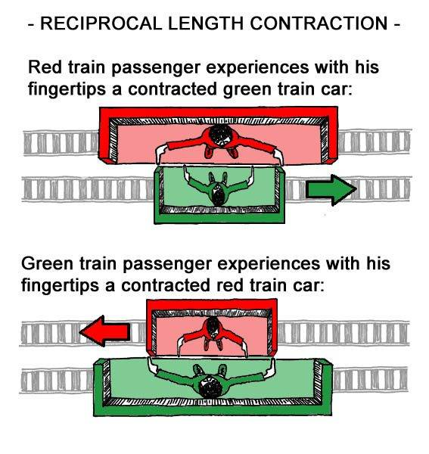
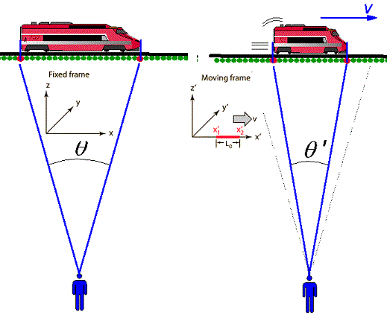
Lorentz Contraction & Relativity
11

Slide 19
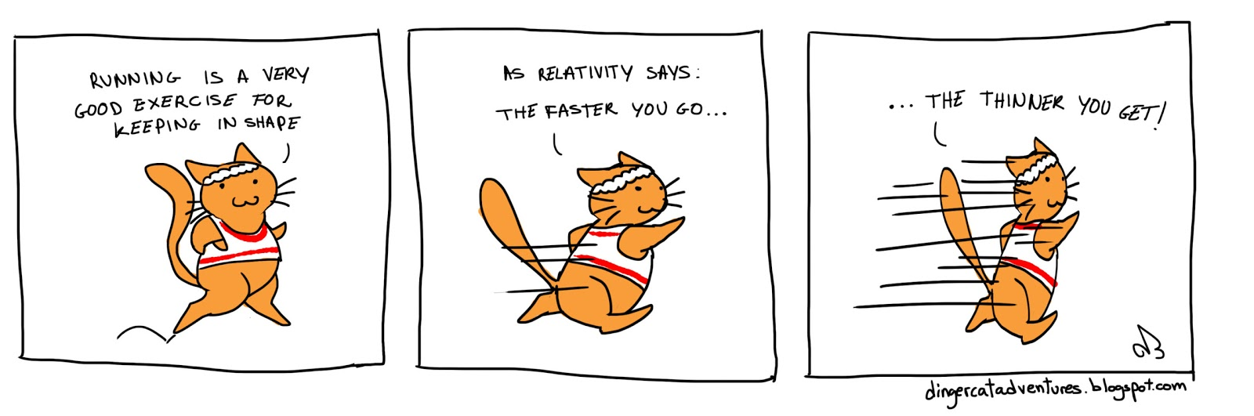
Lorentz Contraction & Relativity
12

Slide 20
Perfect clock on a Relativistic Train
13
mirror
1 m
light
mirror
Light-clock: 300 million ticks per second.
Notes:
Perfect clock = Light clock. Never runs wrong! It ticks 300 million times per second
Alice takes the clock on the train – nothing changes
Bob looks from station: longer distance, same lightspeed -> slower ticks
Calculation next slide

Slide 21
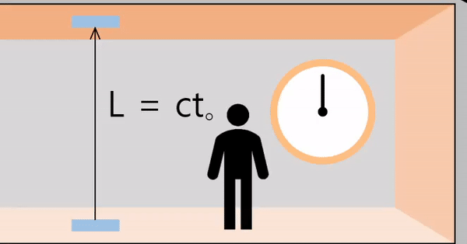
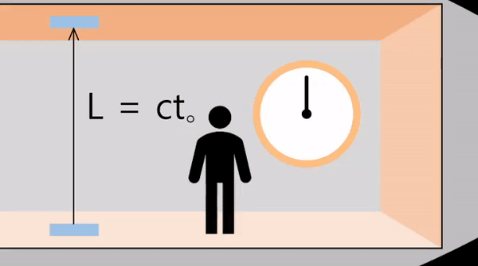
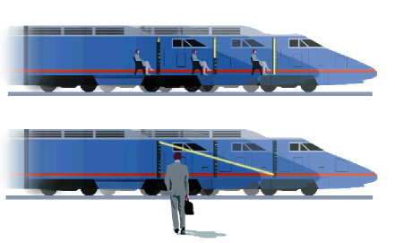
Perfect clock on a Relativistic Train
14
S: Alice in the train:
S’: Bob at the station:
Light-clock: 300 million ticks per second.
Bob sees that the ticks of Alice’s clock slow down!
Bob concludes that time runs slower for Alice than for himself:
Time Dilation!!!
Alice
v
Bob
Notes:
Perfect clock = Light clock. Never runs wrong! It ticks 300 million times per second
Alice takes the clock on the train – nothing changes
Bob looks from station: longer distance, same lightspeed -> slower ticks
Calculation next slide

Slide 22
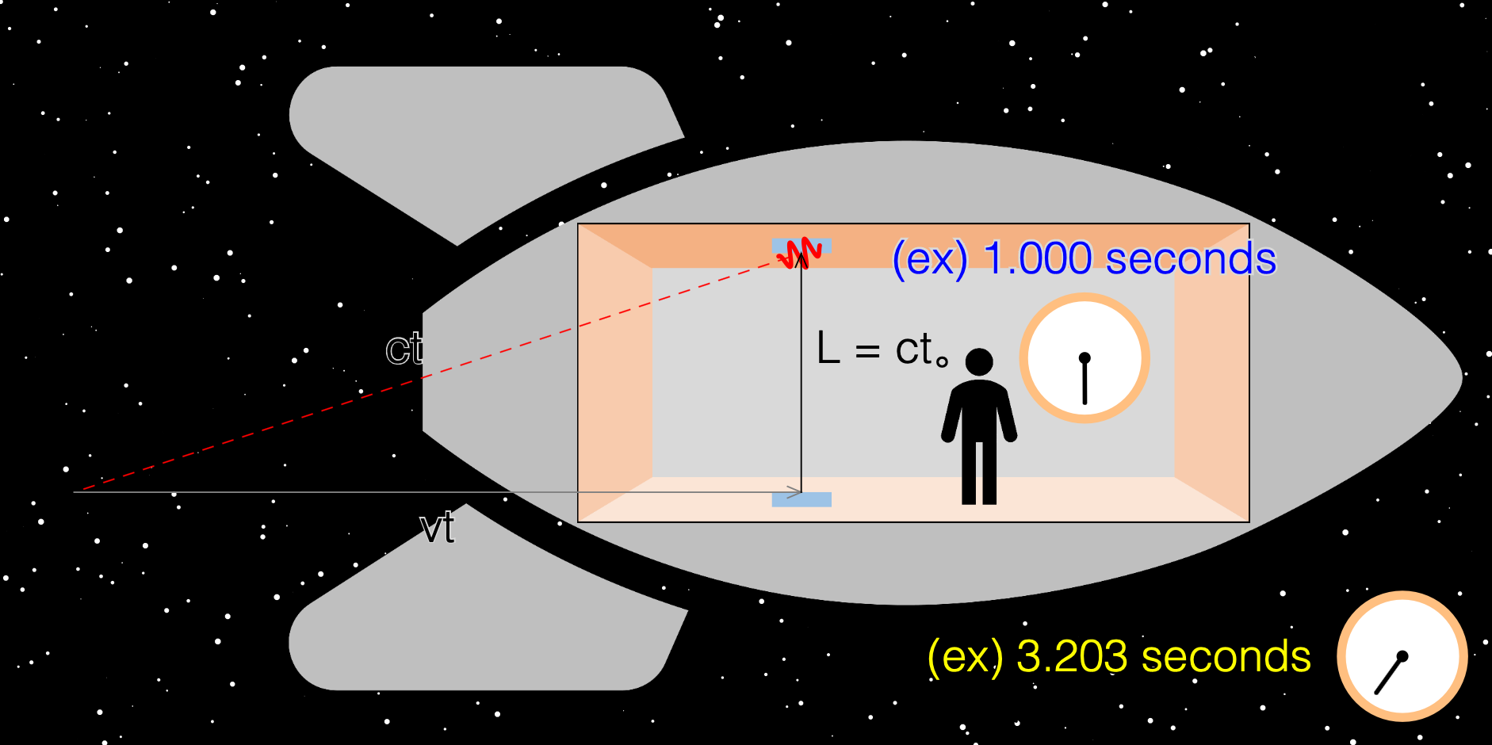
If you go very fast time slow-down is a very large effect
15
at 95% of the lightspeed…

Slide 23
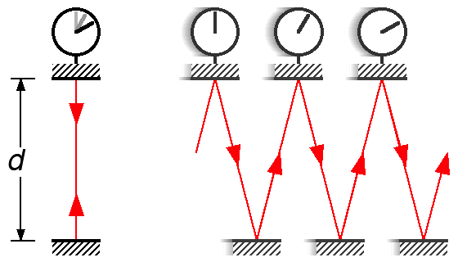

Time Dilation: Let’s calculate it!
16
S: Alice on the train:
S’: Bob at the station:
Pythagorean theorem:
$$Δx^{′}=$$
$$vΔt′$$
“juggling” with linear algebra
substitute
γ is called the time dilation factor or Lorentz factor.
Notes:
Delta_t=d/c Delta_t’=d’/c
Go through calculation.➔Time dilation
Note: Bob sees Alice’s clock slow down, does it mean that Alice sees Bob’s clock speed up? NO!!
Time goes slower on objects moving relatively to you!
Think about seeing someone smaller in the distance.

Slide 24
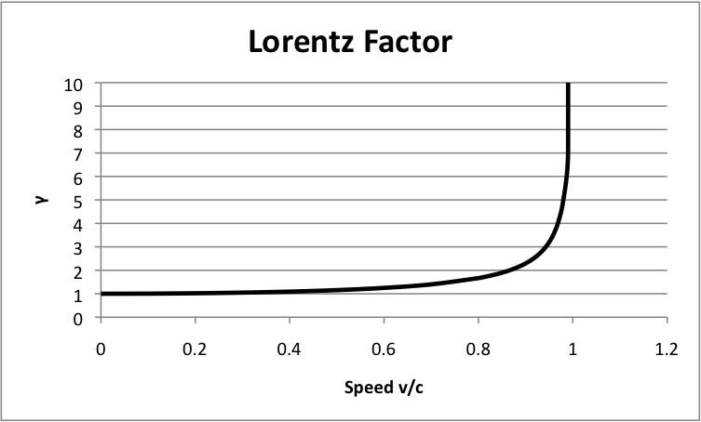
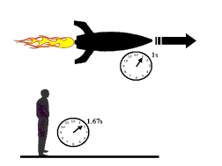
Time Dilation
17
γ
Speed v/c
For “low” (v<<c) relative speeds: no effect, time stays the same. This we know from every day life.
Example:
Rocket goes at
v=0.8 c = 4/5 c :
For “high” (v→c) relative speeds: large effect, time runs very slow! This we have never really seen in every day life.
1 second inside the rocket lasts 1.66 seconds on earth.
Notes:
Let’s look at the gamma factor.
For every day speed it is 1. That’s why we never see it.
But at high speeds it is really different!

Slide 25
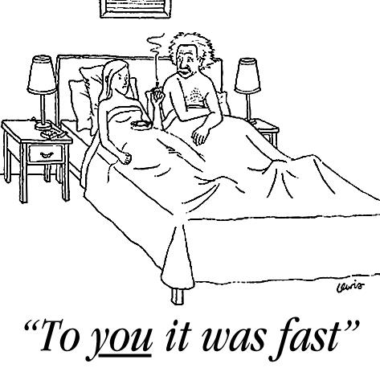
Einstein and Relativity
18

Slide 26
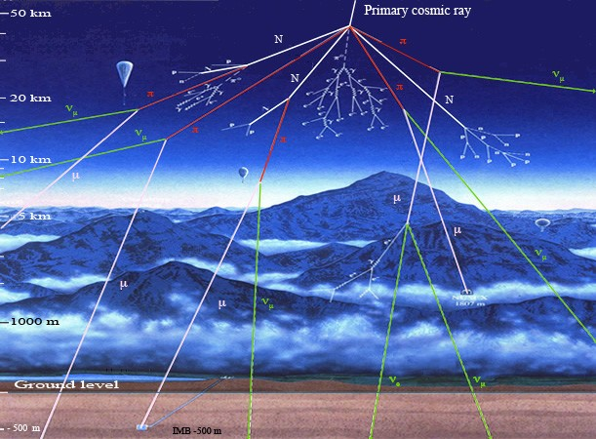
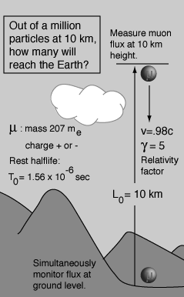
Time Dilation: Is it real? Cosmic Muons! (Real Experiment)
19
Notes:
Cosmic proton come from energetic sources in the universe (quasers etc).
High (~10 km) in the atmosphere they collide with oxygen or nitrogen atoms and make new particles: also muons.
Know them well in the lab.
Satellites go at ~ 40 000 km/h = 11km/s → correction is 60 micro sec/day -> mistake 17 km (lightspeed)

Slide 27
Time Dilation: Is it real? Cosmic Muons! (Real Experiment)
20
Muons: unstable particles with a decay life-time of: t=1.56 μs = 0.00000156 s
(After 1.56 μs 50% survive, after 2x1.56 μs 25%, …etc.: ½^{n} )
Muon particles are produced at 10 km height (by cosmic rays) with ~98% light-speed.
Expectation: even at light-speed it would take them a time:
t = 10 km / 300 000 km/s = 33 μs
to reach the ground = 21 x half-life time: ½²¹ ~ 1 / 1 000 000
Expect: only 1 in a million muons arrive on the ground!
Measurement: ~ 5% makes it to the ground!
Relativity:
→ Lifetime = 5x1.56 μs = 7.8 μs ; Takes 33/7.8 = 4.2 half-lives!
Consistent with observation! Since: ½^{(4.2)} = 0.05 →5%
➔ Also in GPS navigation devices relativity is essential!
Notes:
Cosmic proton come from energetic sources in the universe (quasers etc).
High (~10 km) in the atmosphere they collide with oxygen or nitrogen atoms and make new particles: also muons.
Know them well in the lab.
Satellites go at ~ 40 000 km/h = 11km/s → correction is 60 micro sec/day -> mistake 17 km (lightspeed)

Slide 28
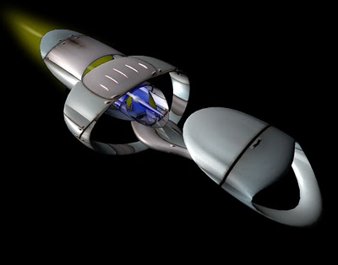
Lorentz Contraction (Gedankenexperiment)
21
Alice boards a super spaceship with her clock and travels with v=0.8c to a distant star (L = 8 light-years).
From earth, Bob calculates that the trip takes about
10 years, since: L = v t → t = L / v → t = 8 / 0.8 = 10
Bob calculates that since Alice’s clock runs slower, for her the trip takes 6 years, since γ = 1 / √(1-0.8²) = 5/3 and L = v t = v γ t’ → t’ = t / γ = 6
Since:
1) Alice and Bob agree on the velocity v=0.8c
2) Alice and Bob agree on the number of clock ticks
3) For Alice a clock tick does not change, so the trip
takes indeed 6 years
Alice observes: L’ = v t’ = 0.8 x 6 = 4.8 light-years!
Lorentz contraction: L’ = L / γ
➔ Distances shrink at high speed!
mirror
light
mirror
Notes:
Since clock ticks don’t change, it does take Alice 6 years!
Confusing: Bob sees Alice’s clock slow down. Alice does not notice time slow down but the distance, as seen by Bob, has shrunk.

Slide 29
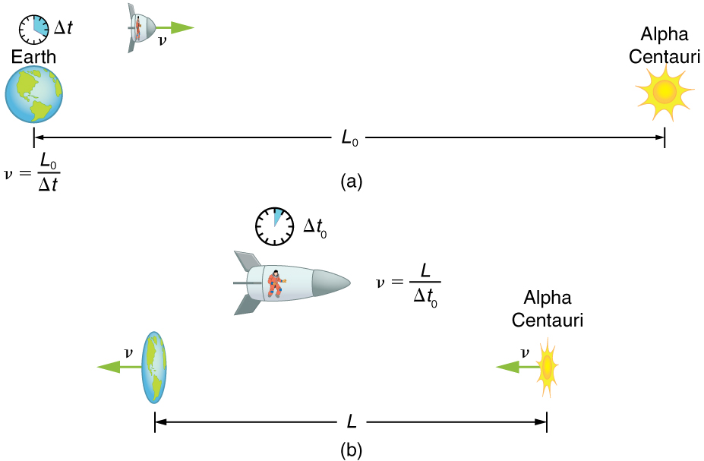
Lorentz Contraction and time dilation
22
v = 0.8 c Lorentz factor: γ = 5/3
Bob
L₀ = 8 lightyears
=3/5 Δt
Alice
L = 3/5 L₀ = 4.8 lightyears
This is called: Lorentz contraction: L’ = L / γ . Distances shrink at high velocities!
Notes:
This is the situation
Confusing: Bob sees Alice’s clock slow down.
Alice does not notice time slow down but the distance, as seen by Bob, has shrunk.

Slide 30
Lorentz Contraction
22
v = 0.8 c Lorentz factor: γ = 5/3
Bob
L₀ = 8 lightyears
Special Relativity:
The running of time and the size of distances are
different for observers moving at relative speeds!
=3/5 Δt
Alice
L = 3/5 L₀ = 4.8 lightyears
This is called: Lorentz contraction: L’ = L / γ . Distances shrink at high velocities!
Notes:
Confusing: Bob sees Alice’s clock slow down. Alice does not notice time slow down but the distance, as seen by Bob, has shrunk.

Slide 31
Lorentz Contraction
22
v = 0.8 c Lorentz factor: γ = 5/3
Bob
L₀ = 8 lightyears
If you want to travel in the universe you should go fast not to travel the same distance faster, but to shrink the distance!
Prize to pay is that time passes very fast on earth.
=3/5 Δt
Alice
L = 3/5 L₀ = 4.8 lightyears
This is called: Lorentz contraction: L’ = L / γ . Distances shrink at high velocities!
Notes:
Confusing: Bob sees Alice’s clock slow down. Alice does not notice time slow down but the distance, as seen by Bob, has shrunk.

Slide 32
Muon particles revisited
23
From the muon particle’s own point of view it does not live longer.
Its lifetime is what it is: t=1.56 μs
The distance from the atmosphere to the surface has reduced from 10 km to 2 km, such that it does not take 33 μs to reach the ground but only 6.8 μs.
The result is the consistent: many muons reach the surface!
Since also ½^{(6.8/1.56)} = 0.05 → 5%
Notes:
Revisit muons. They know how long they live: 1.56 micro sec. But they see a shorter distance.
All consistent, but different arguments by different observers.

Slide 33
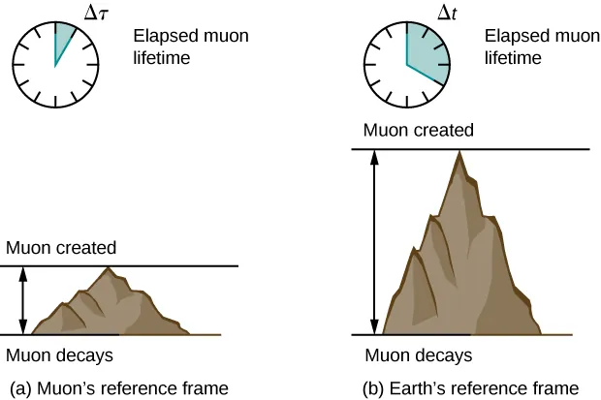
Muon particles revisited
24
muons have a shorter
distance to traverse
earth observer sees
muons to live longer
Notes:
Revisit muons. They know how long they live: 1.56 micro sec. But they see a shorter distance.
All consistent, but different arguments by different observers.

Slide 34

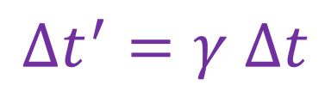

Relativistic Effects: Summary in Formula’s
25
Time dilation:
$$Δt^{′}=γ Δt$$
Two definitions:
Time in rest frame = “eigen-time” or “proper-time”
Length in rest frame = “proper length”
Lorentz contraction:
$$L′=L/γ$$
with the relativistic factor:
$$γ=\frac{1}{\sqrt{1−\frac{v^{2}}{c^{2}}}}$$

Slide 35
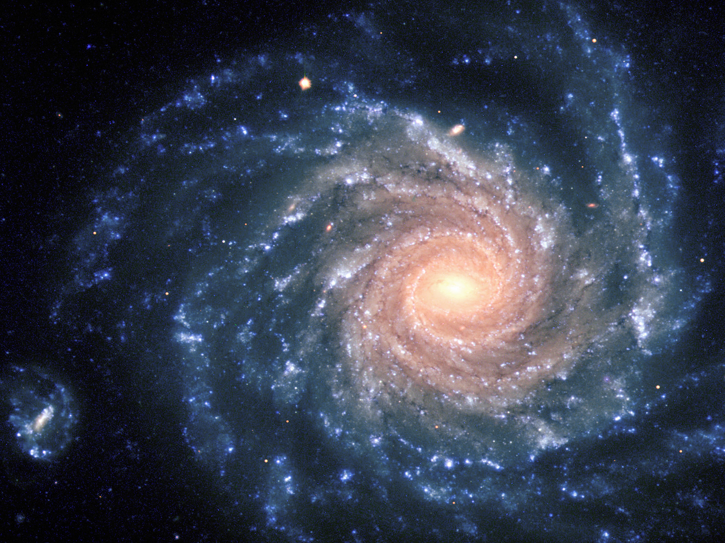
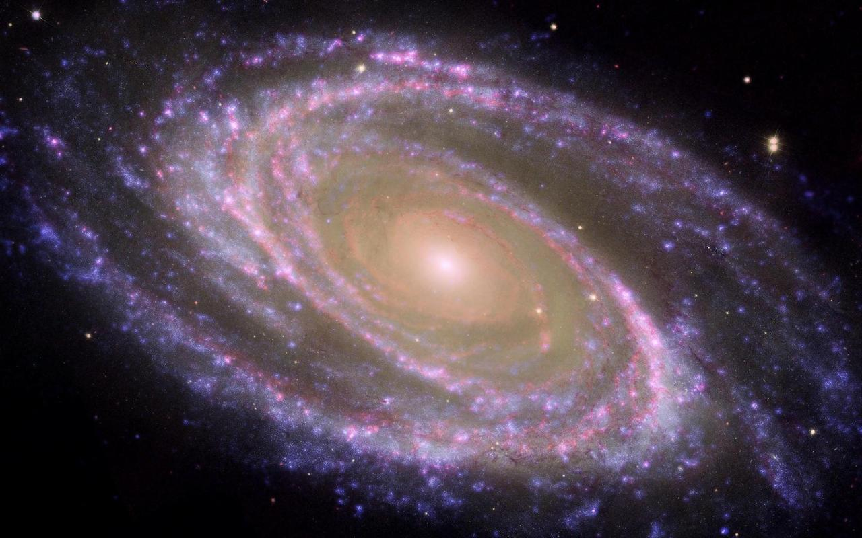
Different perspectives of the universe
26
particle
Seen by us
particle
Seen by particle
How does a photon see the universe?
For a photon time and distance do not exist!
Notes:
We see a fast article passing through the universe. It lives longer then expected (muon).
The partice sees the universe contracted in the direction of motion.
Photon?? Everywhere at the same time. Time does not exist. Longitudunal distance does not exist.

Slide 36
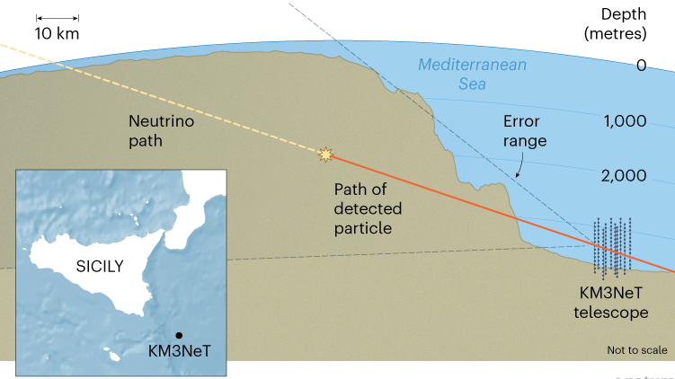
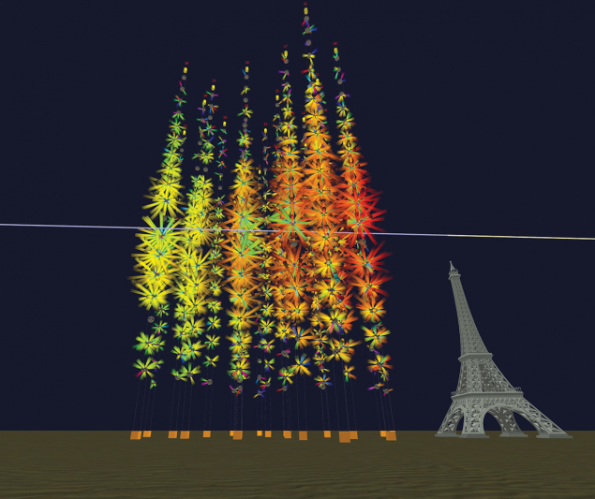
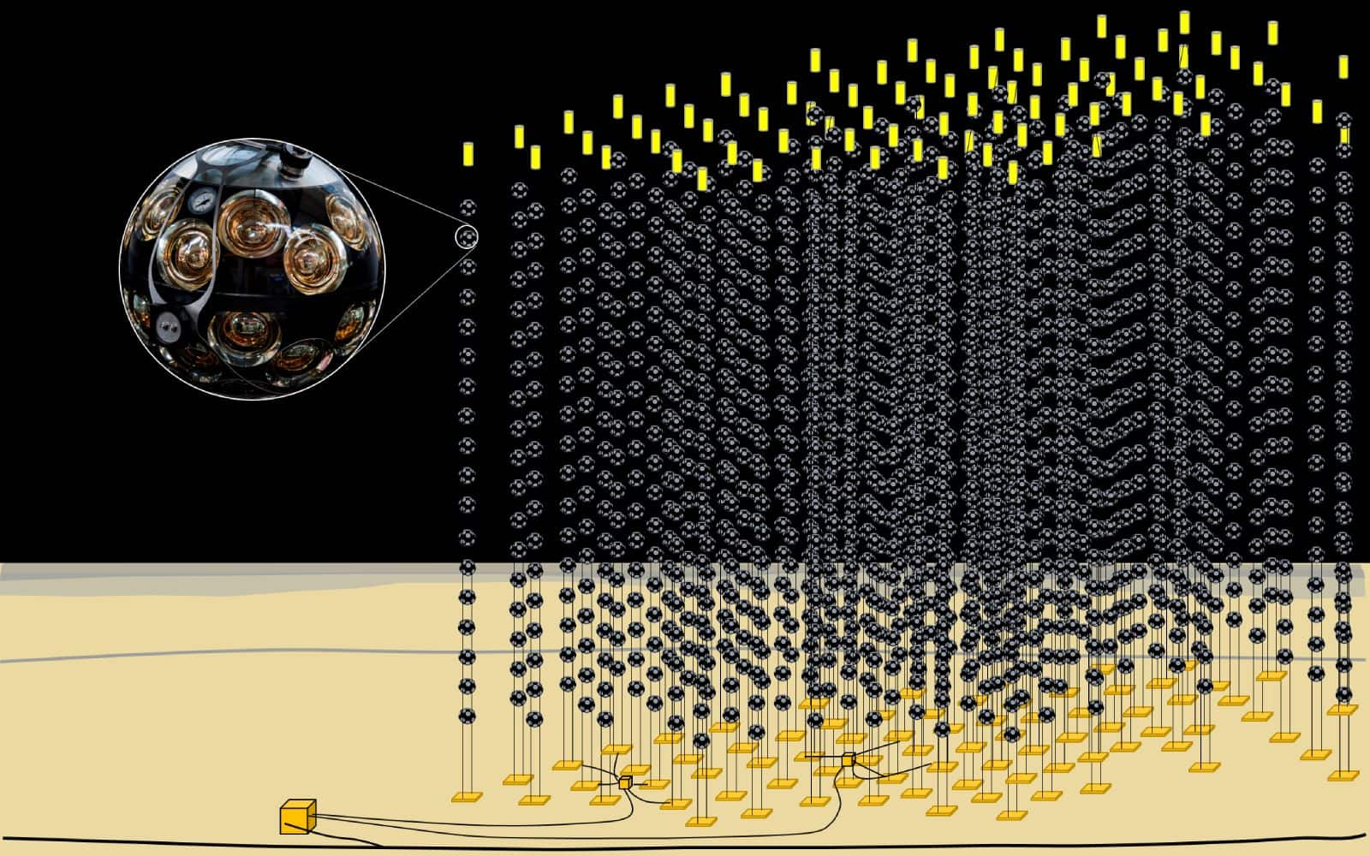
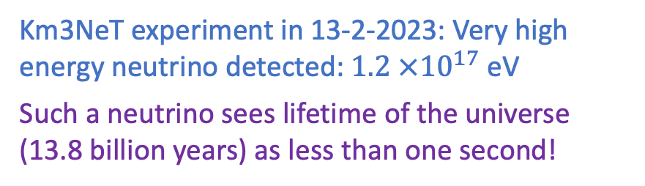
High Energy Neutrino!
27
Km3NeT experiment in 13-2-2023: Very high energy neutrino detected: $1.2 ×{10}^{17}$ eV
Such a neutrino sees lifetime of the universe (13.8 billion years) as less than one second!
Underwater
Detector (3 km)

Slide 37
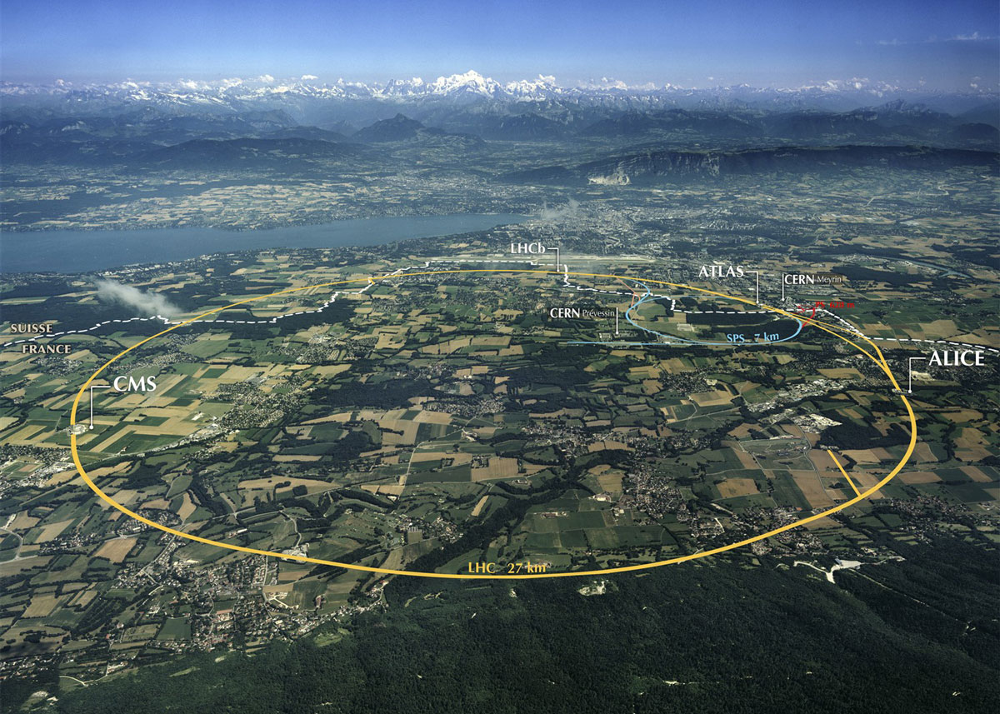
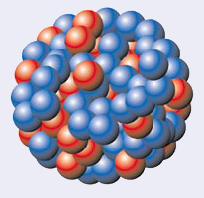
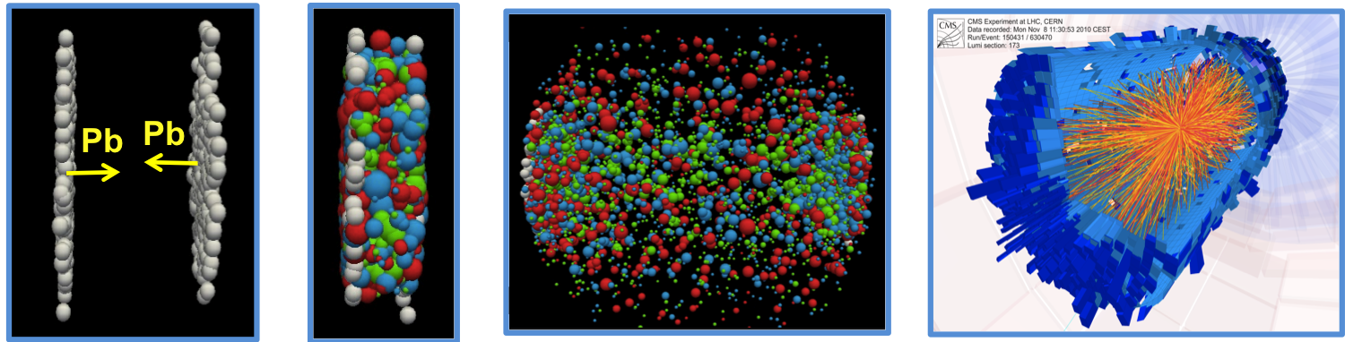
Colliding Lead Nuclei “Pancakes” at the LHC
28
Pb
Pb
Notes:
An example of LHCb physics

Slide 38
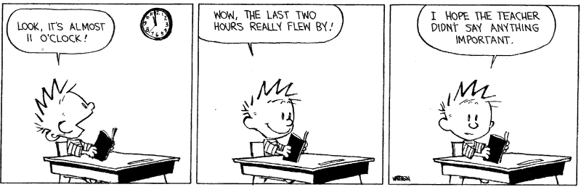
Calvin’s Relativity
29

Slide 39
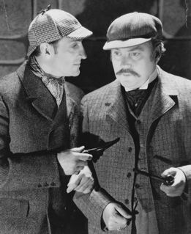
Next Lecture… Paradoxes!
30
Causality…
Travelling to the future…
Before
After
Notes:
Next time time will interesting paradoxes and also a real experiment!

