Slide 1
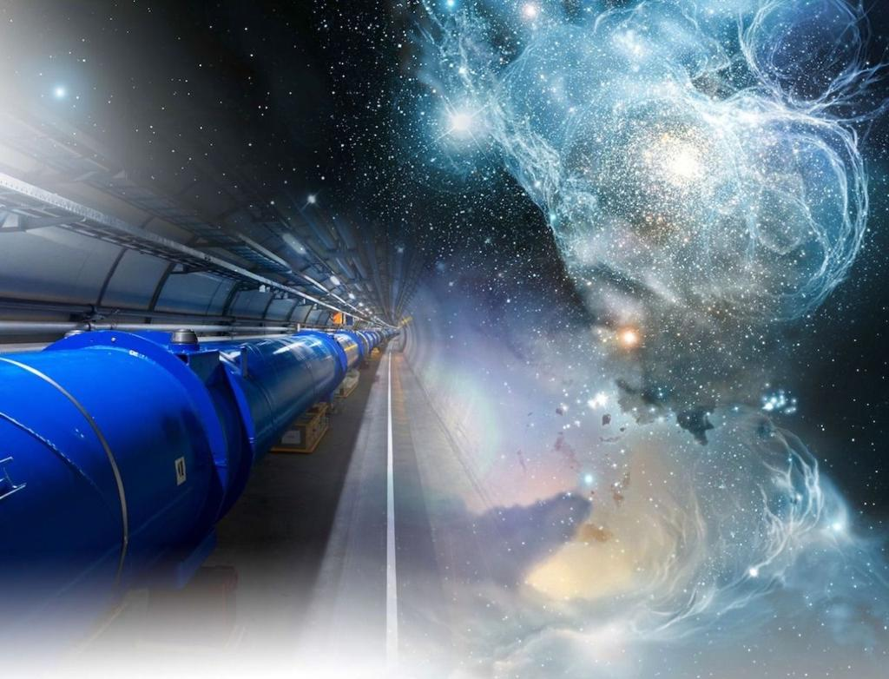
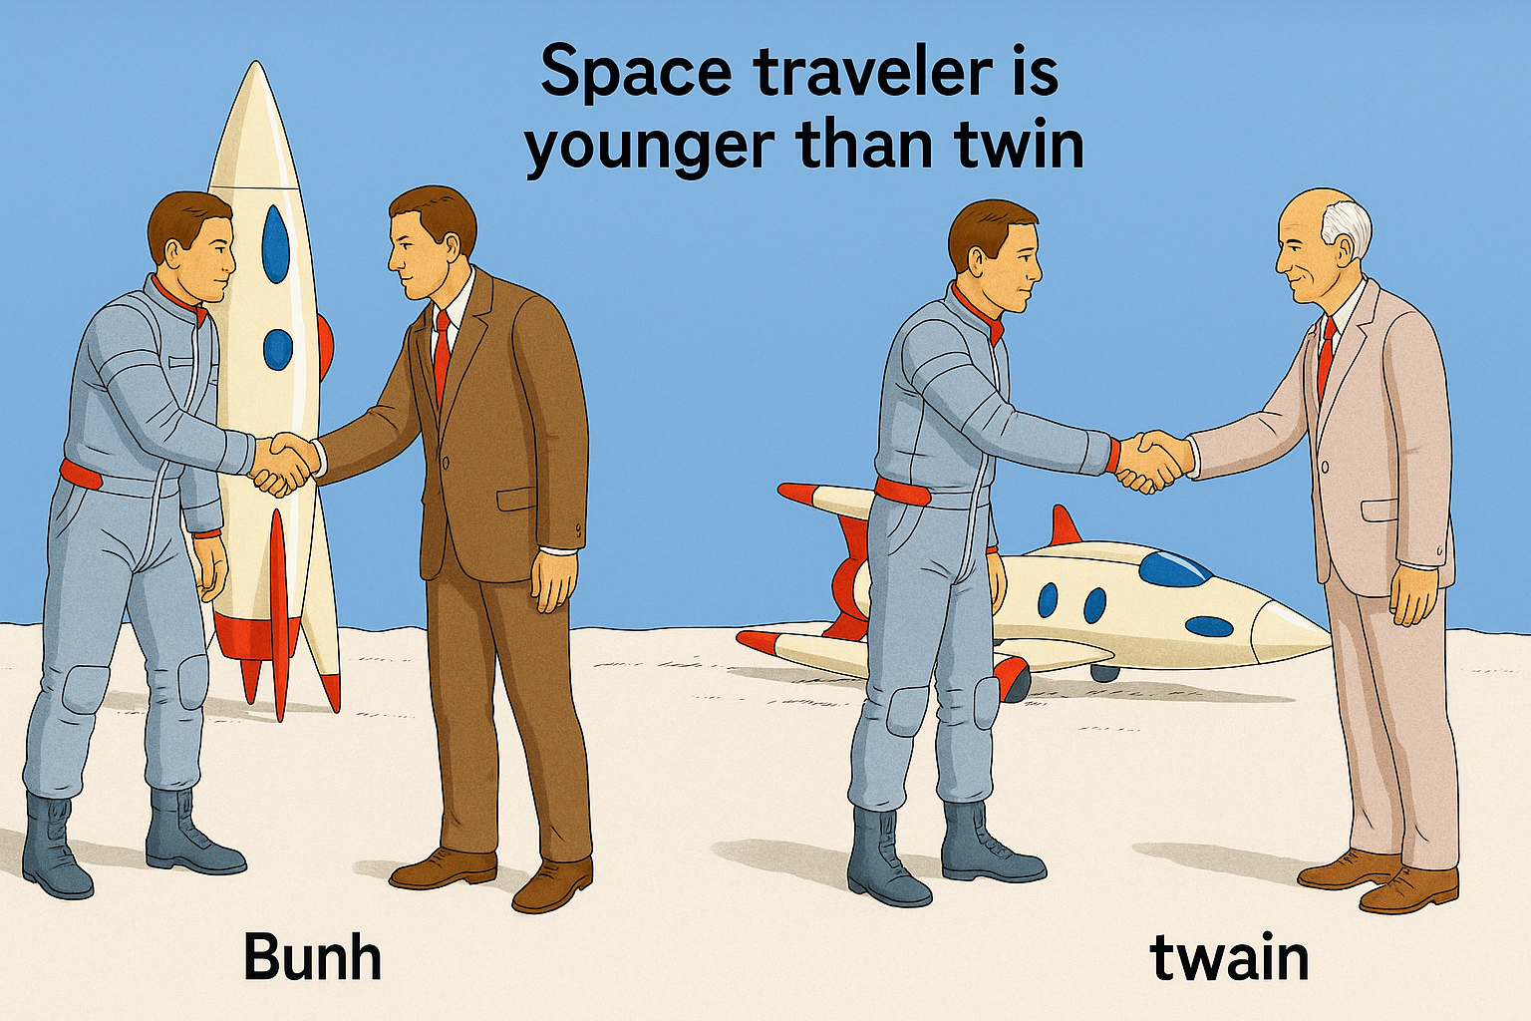
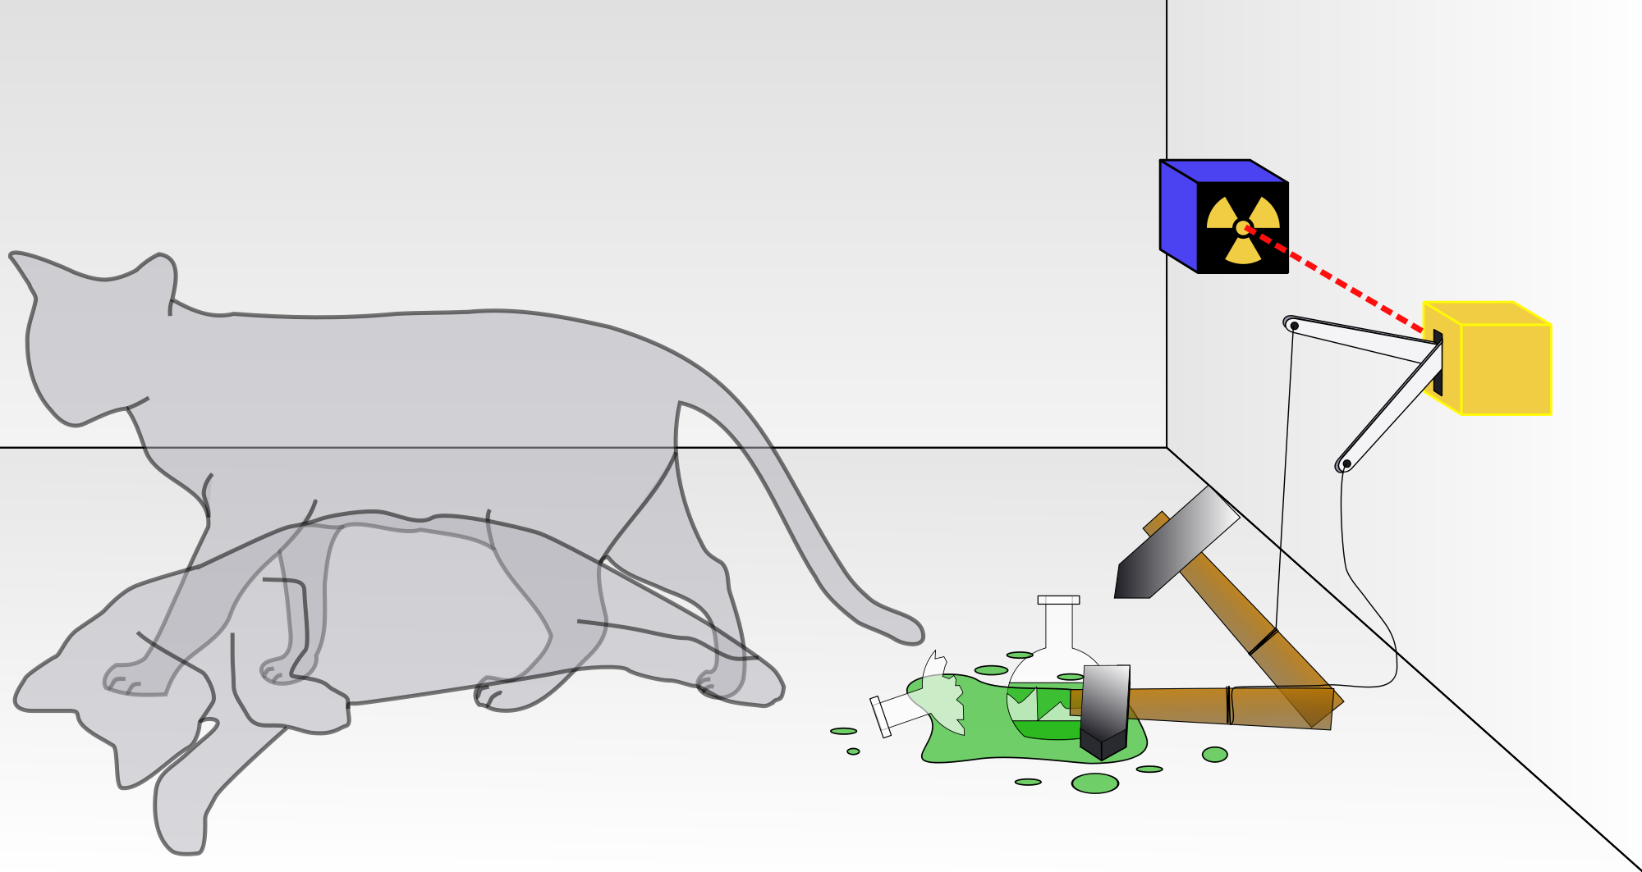
The Relativistic Quantum World
Relativity
A lecture series on
Relativity Theory and Quantum Mechanics
Before
After
Quantum
Alive
Marcel Merk
Studium Generale Maastricht
Sep 10 – Oct 8, 2025
Dead
Notes:
Explain picture. Interesting (“bizarre”) aspects of relativity and QM

Slide 2
The Relativistic Quantum World
1
Lecture 1: The Principle of Relativity and the Speed of Light
Lecture 2: Time Dilation and Lorentz Contraction
Lecture 3: The Lorentz Transformation and Paradoxes
Lecture 4: General Relativity and Gravitational Waves
Sep. 10:
Relativity
Sep. 17:
Lecture 5: The Early Quantum Theory
Lecture 6: Feynman’s Double Slit Experiment
Lecture 7: Wheeler’s Delayed Choice and Schrodinger’s Cat
Lecture 8: Quantum Reality and the EPR Paradox
Quantum
Mechanics
Sep. 24:
Oct. 1 :
Standard
Model
Lecture 9: The Standard Model and Antimatter
Lecture 10: Why is there something rather than nothing?
Oct. 8:
Lecture notes, written for this course, are available: www.nikhef.nl/~i93/Teaching/
Prerequisite for the course: High school level physics & mathematics.
Notes:
Ambitious!

Slide 3
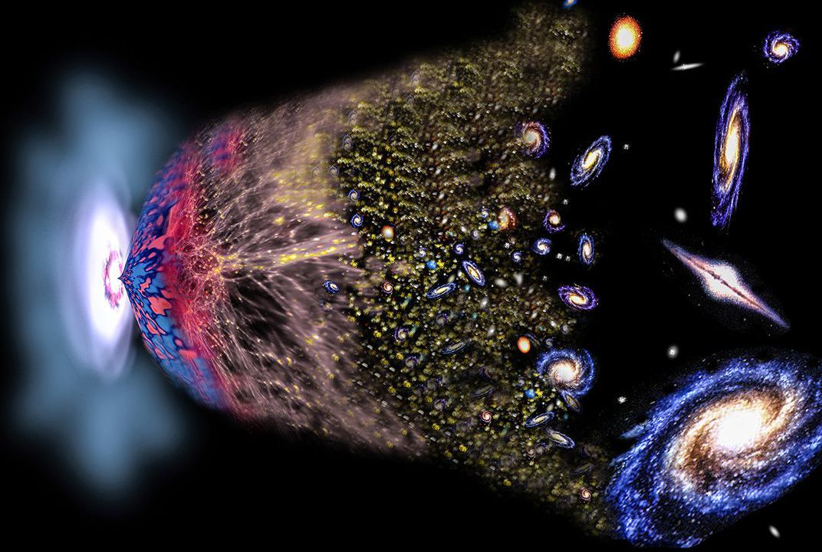
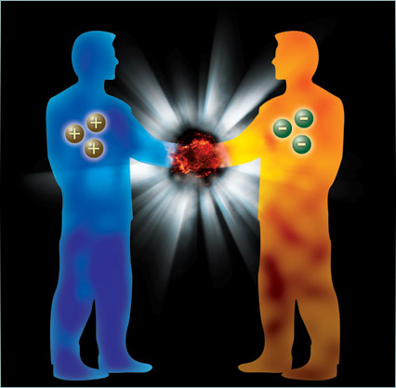
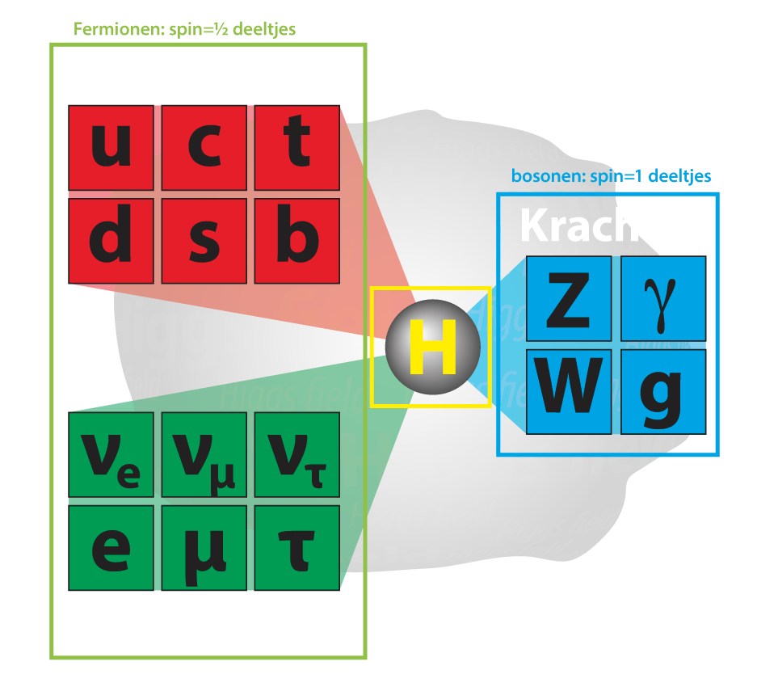
Why is there something rather than nothing?
Forces
1
2
3
s
“Flavor“ puzzle: why are there three generations of fundamental particles?

Slide 4
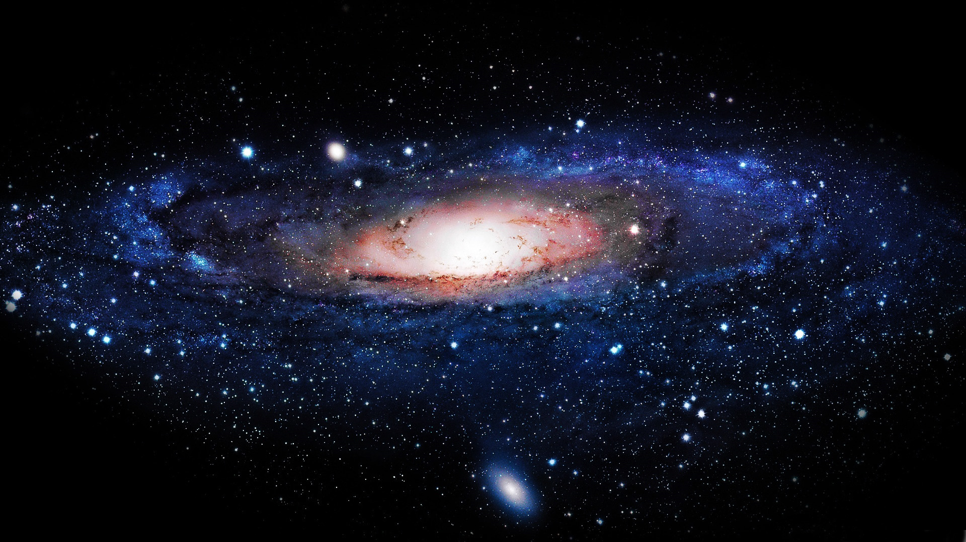
Lecture 10: Why is there something rather than nothing?
1: Discovery of the Higgs boson
2: Symmetry between Matter and Antimatter?
3: A new force of Nature?

Slide 5
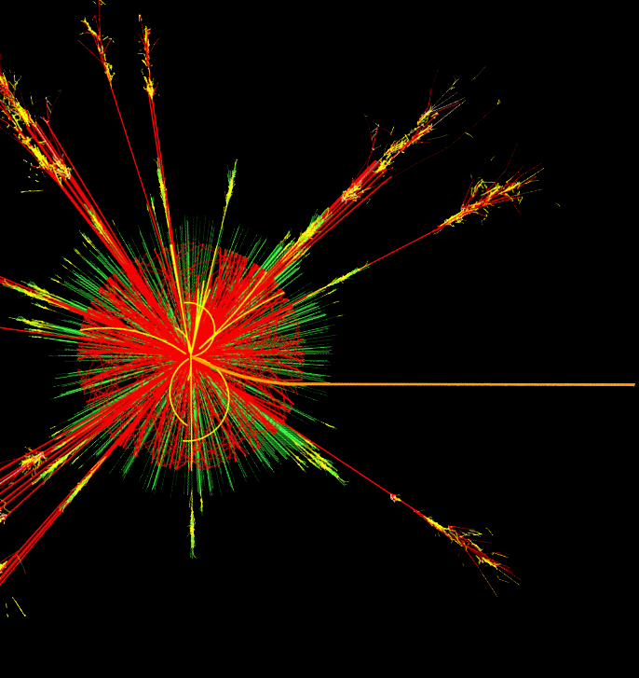

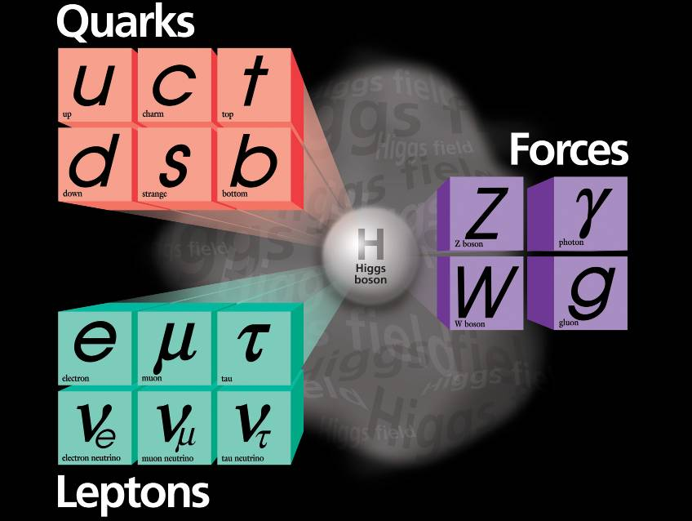
1: Discovery of the Higgs boson

Slide 6
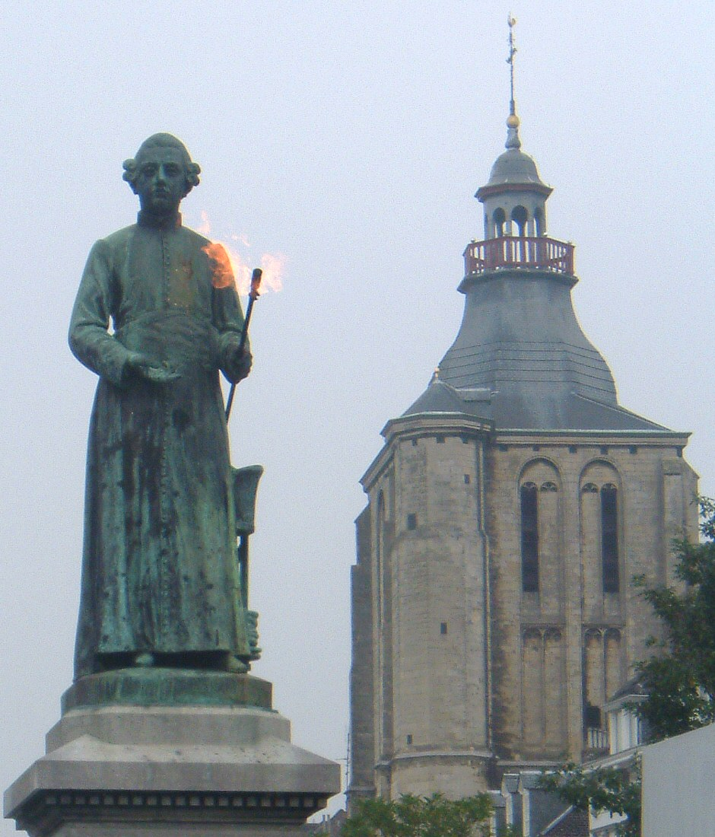
1: Discovery of the Higgs boson
Minckeleers: also discovery
Notes:
Minckelers 1785: coal gas could be used to burn with a bright flame. (Today burns on natural gas – mainly methane)
Hyfrogen + methane + carnon monoxide: H2 + CH4 + CO

Slide 7
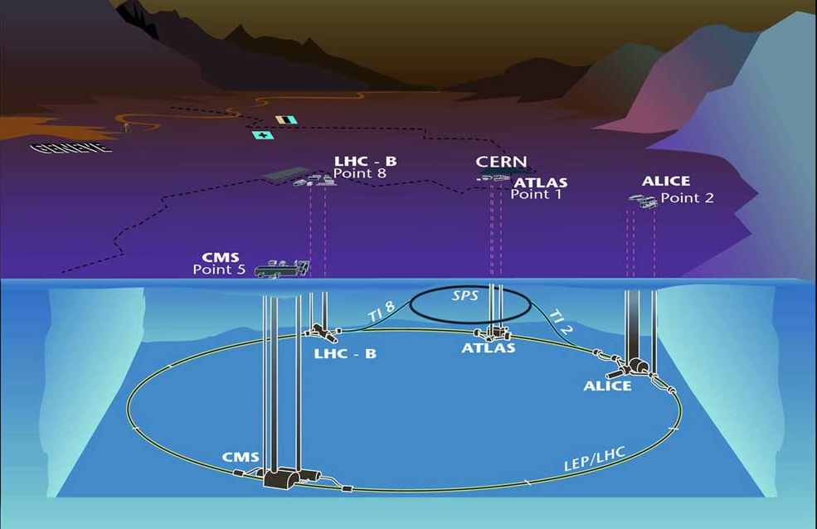
CERN: Atlas experiment at the LHC

Slide 8
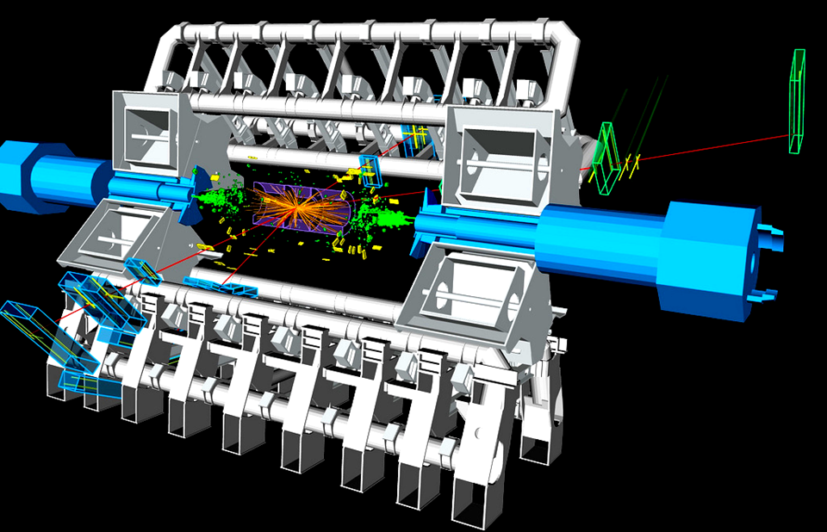
Discovery of the Higgs boson
pp→Higgs→μμμμ

Slide 9

Discovery of the Higgs boson
pp→Higgs→μμμμ

Slide 10
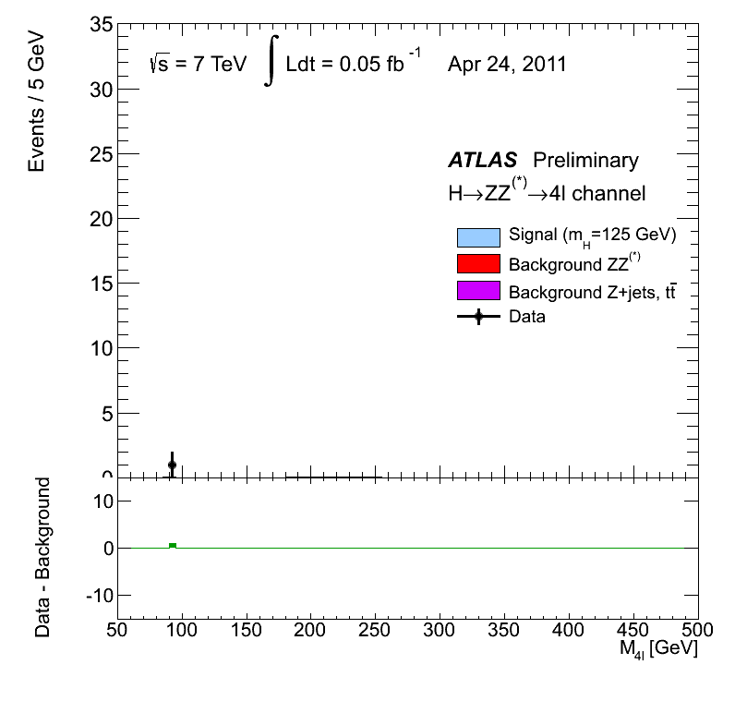
Higgs: collecting data and testing theory
Discovery of
Higgs boson!

Slide 11
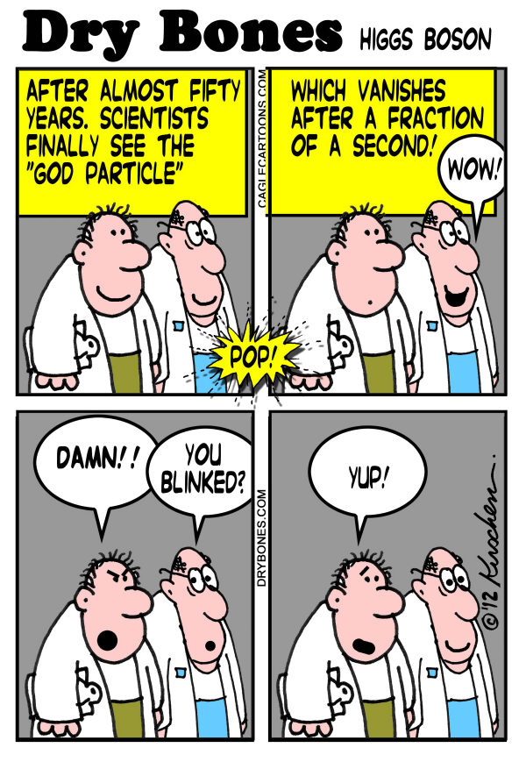
pp→Higgs→μμμμ
μ
μ
μ
μ
Atlas event

Slide 12
4 July 2012
Announcement Higgs discovery
Amsterdam
CERN
CERN
ICHEP (AUS)
Nikhef (NL)
CERN
Sydney

Slide 13
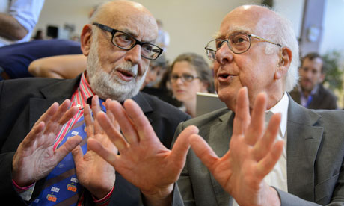
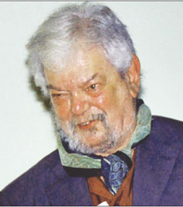
2013 Nobel prize in Physics
Robert Brout
Francois Englert
Peter Higgs

Slide 14
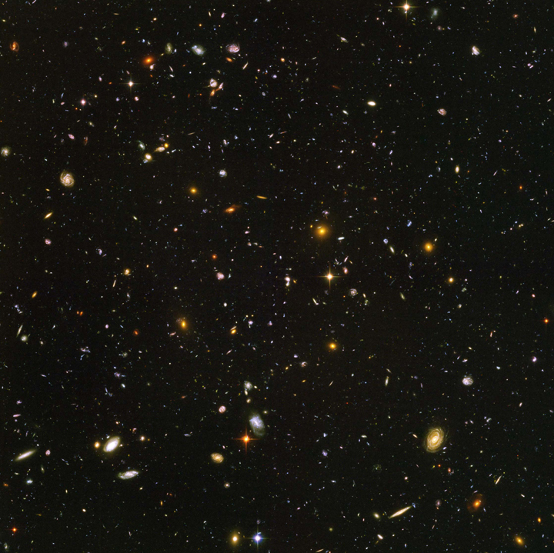
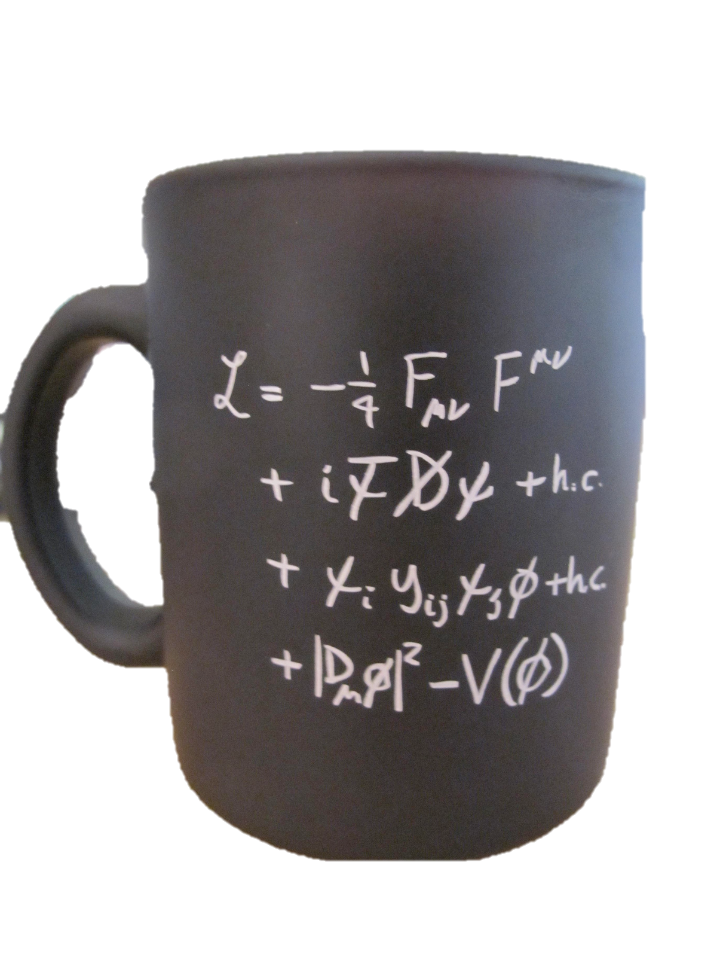
What did we discover?
“The formula”
“The building blocks”
The ‘Higgs’ field fills the vacuum

Slide 15


Higgs Field φ and Particle H
Higgs field is uniform, hard to see
Higgs boson particle is “wave” of the field
Mass results from interaction of matter particles with the Higgs field
Compare:
A photon is a quantum of electromagnetic field
Water wave
Higgs field
Higgs particle
a “field-quantum”
Notes:
Fisch, cold blooded, clear water, doesn’t know about water.

Slide 16
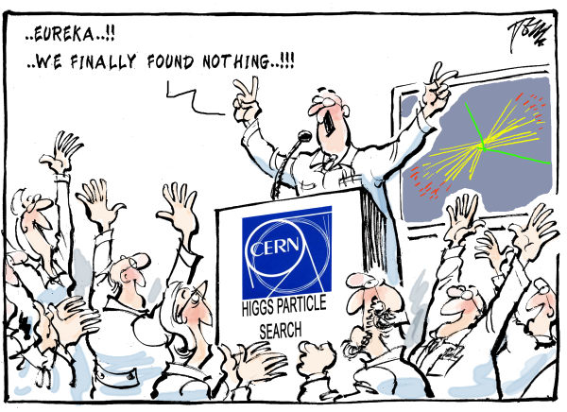
July 4, 2012: The Vacuum

Slide 17

Hence…

Slide 18
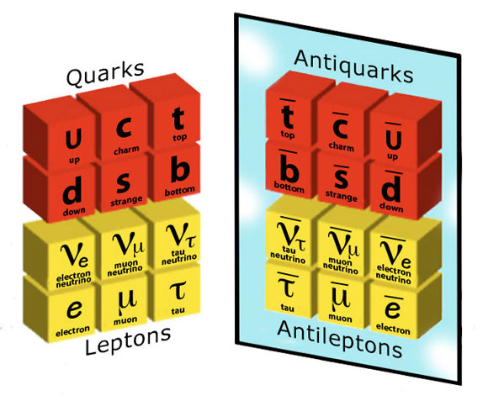
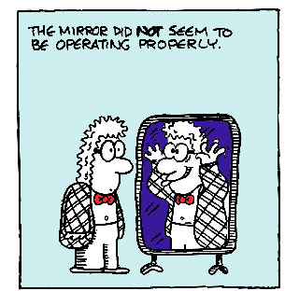
2: Symmetry between matter and antimatter?

Slide 19
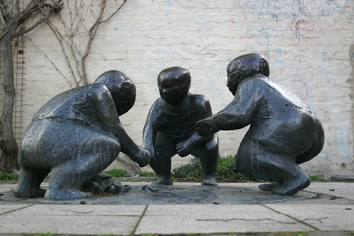
2: Symmetry between matter and antimatter?
Dreij Huivende kinder
Notes:
Witmakersstraat / Hondstraat . Oorspronkelijk bij aanlanding romeinse brug. Voor burgemeester Fons Baeten.

Slide 20
LHCb Experiment: decays of b-particles

Slide 21
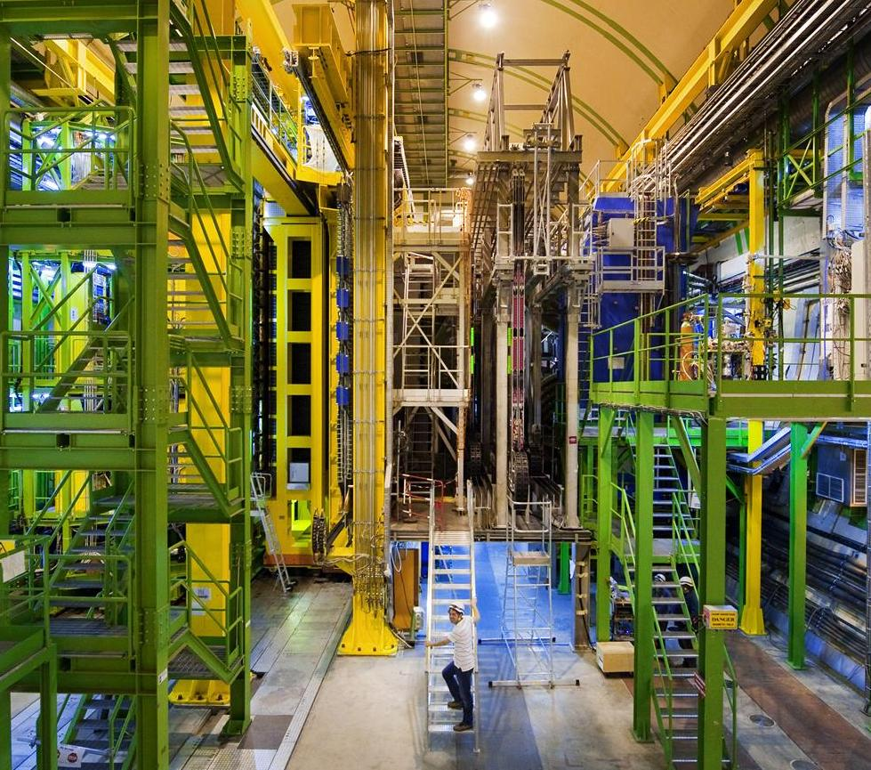
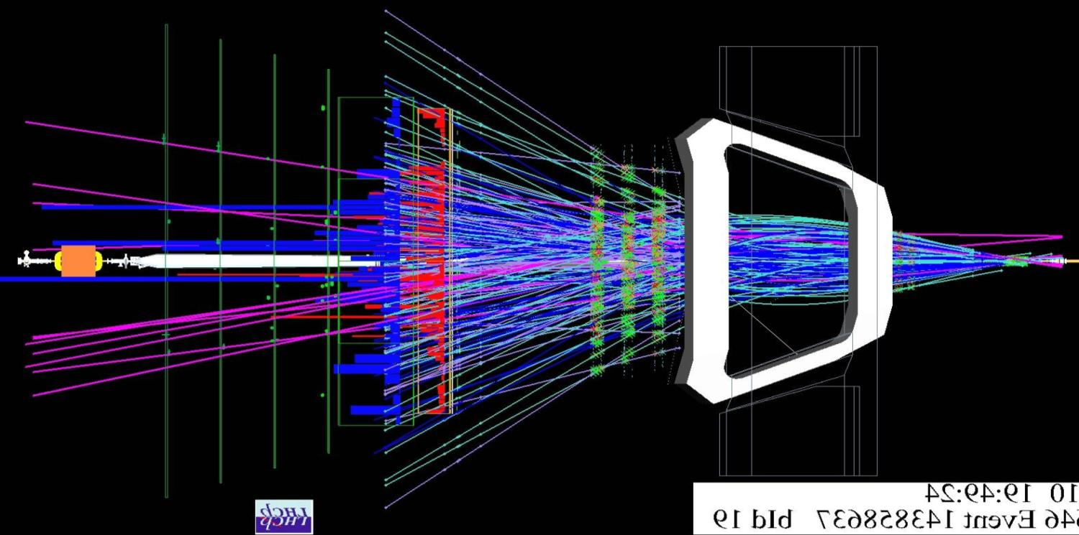
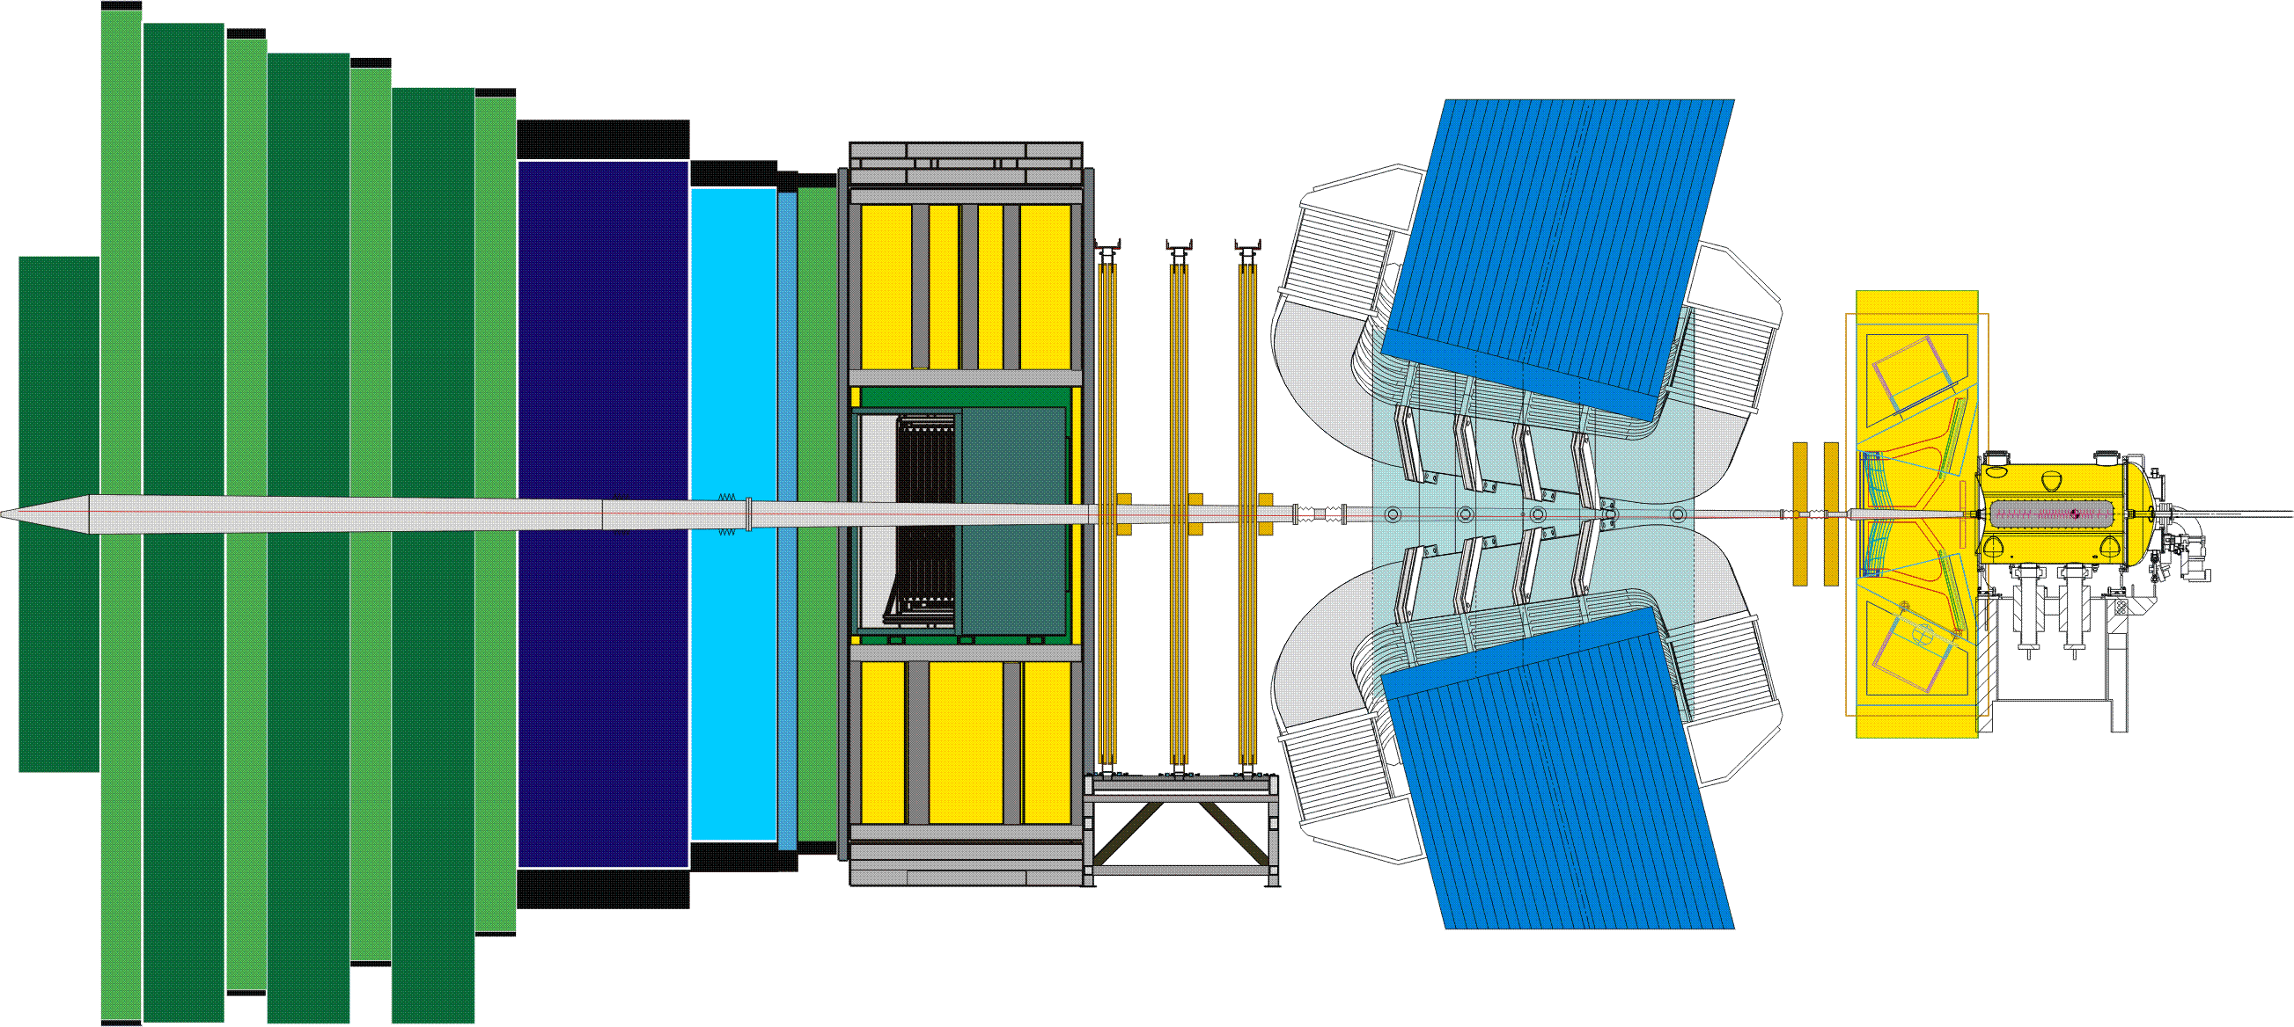
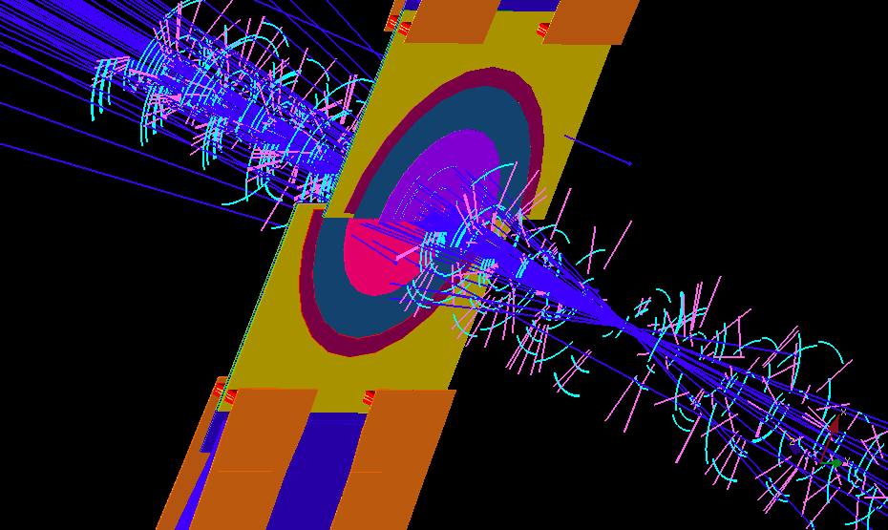
LHCb Detector: B-particles
Zoom in on collision point
Reconstruct millions of B-particle decays and select interesting cases.
Do we observe differences between matter and antimatter?
23 sep 2010 19:49:24
Run 79646 Event 143858637

Slide 22
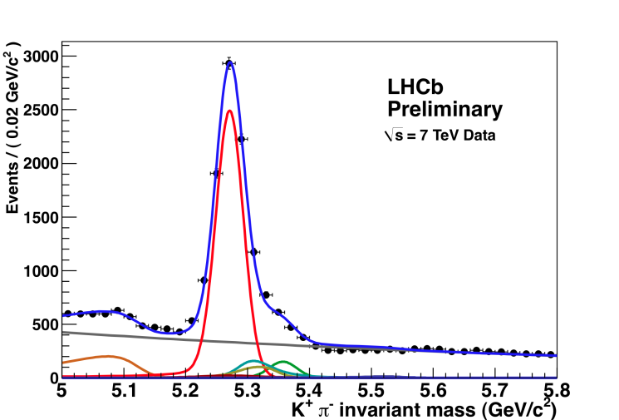
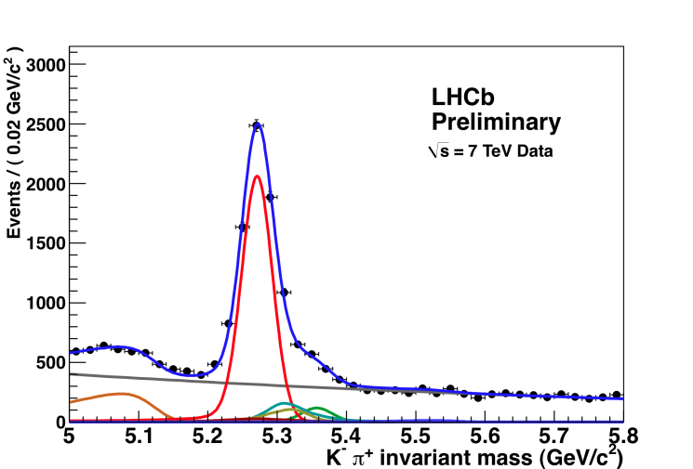

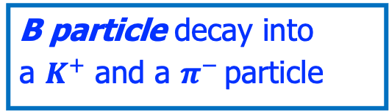




2012: B-meson decay process: matter vs antimatter
B particle decay into
a $K^{+}$ and a $π^{−}$ particle
anti-B particle decay into a $K^{−}$ and a $π^{+}$ particle
Matter process
Antimatter process
$$B^{0}→K^{+}π^{−}$$
$${\overline{B}}^{0}→K^{−}π^{+}$$
$$\left(\overline{b}d\right)→\left(\overline{s}u\right)+\left(\overline{u}d\right)$$
B⁰ → K⁻ π⁺
B⁰ → K⁺ π⁻
$$\left(b\overline{d}\right)→\left(s\overline{u}\right)+\left(u\overline{d}\right)$$
Asymmetry: matter and antimatter decay processes proceed differently! Quantum forces between particles and anti-particles not always identical!

Slide 23
2012: B-meson decay process: matter vs antimatter
B particle decay into
a $K^{+}$ and a $π^{−}$ particle
anti-B particle decay into a $K^{−}$ and a $π^{+}$ particle
Matter process
Antimatter process
$$B^{0}→K^{+}π^{−}$$
$${\overline{B}}^{0}→K^{−}π^{+}$$
$$\left(\overline{b}d\right)→\left(\overline{s}u\right)+\left(\overline{u}d\right)$$
B⁰ → K⁻ π⁺
B⁰ → K⁺ π⁻
$$\left(b\overline{d}\right)→\left(s\overline{u}\right)+\left(u\overline{d}\right)$$
Asymmetry: matter and antimatter decay processes proceed differently! Quantum forces between particles and anti-particles not always identical!

Slide 24
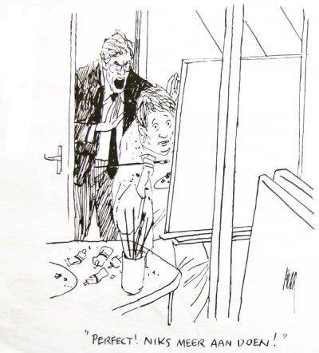
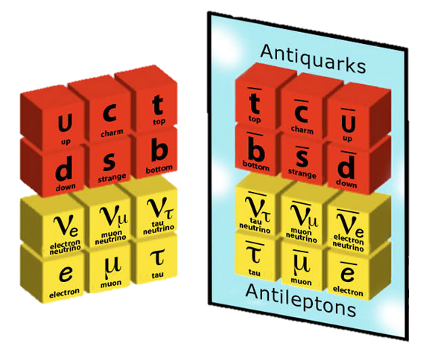
Early Universe: How did the antimatter disappear?
Asymmetry in physics laws
Little bit more matter than antimatter
Rest annihilates
Matter universe remains
Quarks
“Perfect, don’t touch it further!”
Leptons
50.000001%
49.999999%

Slide 25
Early Universe: How did the antimatter disappear?
Why are there three identical copies of all particles?
➔Is it the simplest universe that can exist?!
However: it does not work!
Asymmetry is not large enough.
Explanation requires a new force!
Quarks
Leptons
50.000001%
49.999999%

Slide 26

6: A new force of Nature?

Slide 27
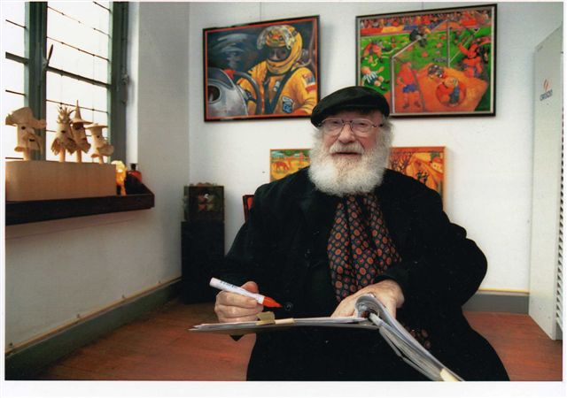
6: A new force of Nature?
Pieke Dassen: art

Slide 28
Standard Model: Universality of the Forces
Elektromagnetism
Strong Nuclear Force
1
2
3
m
m
G
m
m
Gravity
Weak Nuclear Force
Forces are identical for particles of 1st, 2nd en 3rd generation.
➔ “Universality”
Notes:
Vier fundamentele

Slide 29
LHCb: Do B-particles decay the same way to electrons and muons ?
?
23 sep 2010 19:49:24
Run 79646 Event 143858637

Slide 30


LHCb: Do B-particles decay the same way to electrons and muons ?
$$R_{K}^{∗}$$
$$R_{K}$$
2021
2021
R_{K} not exactly equal to 1??
➔ Different force for electrons and muons?!
= R_{K}
23 sep 2010 19:49:24
Run 79646 Event 143858637

Slide 31
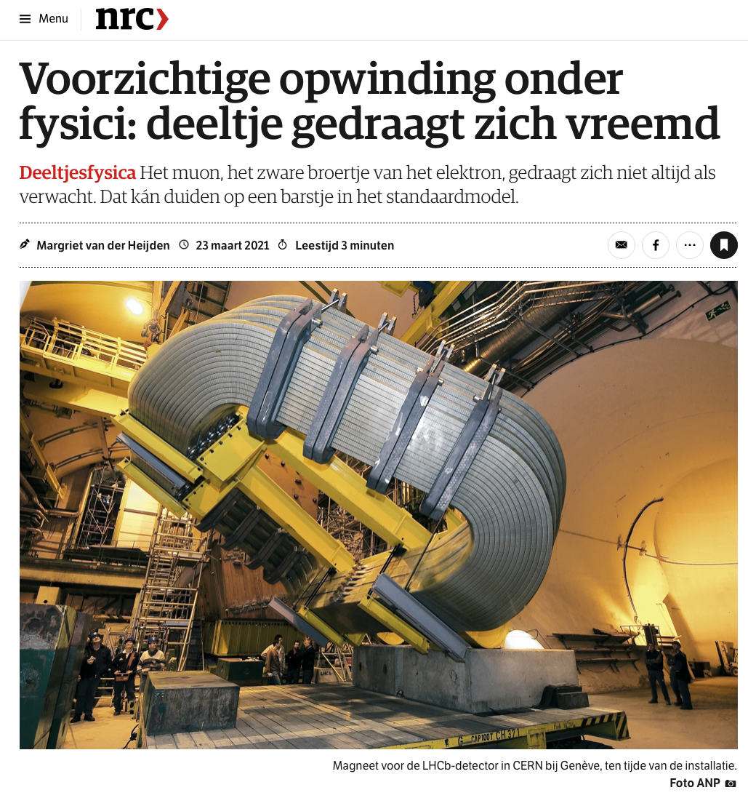
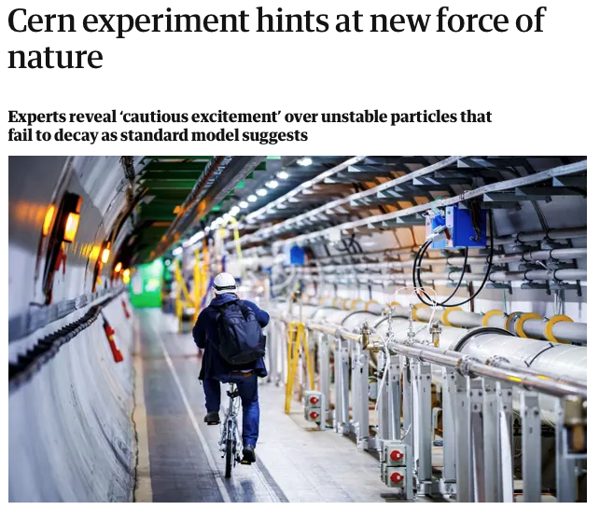
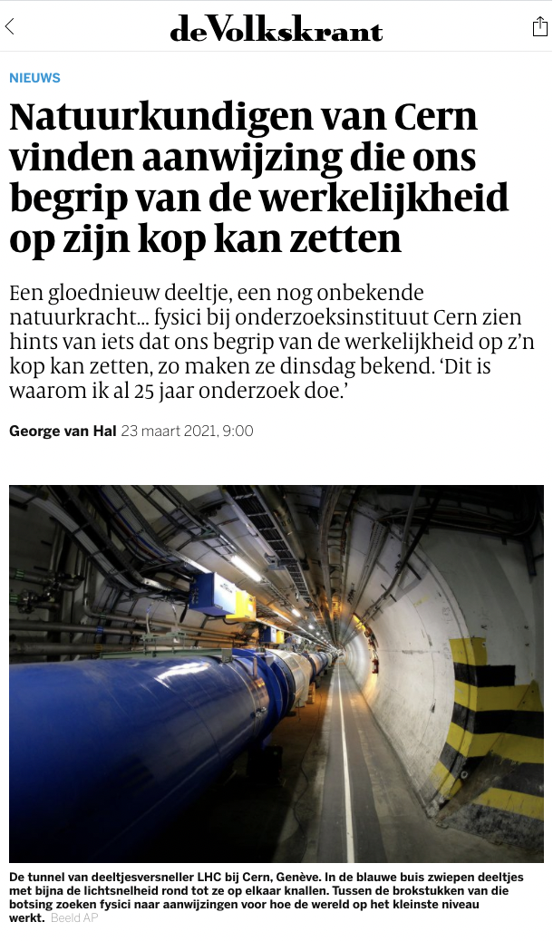
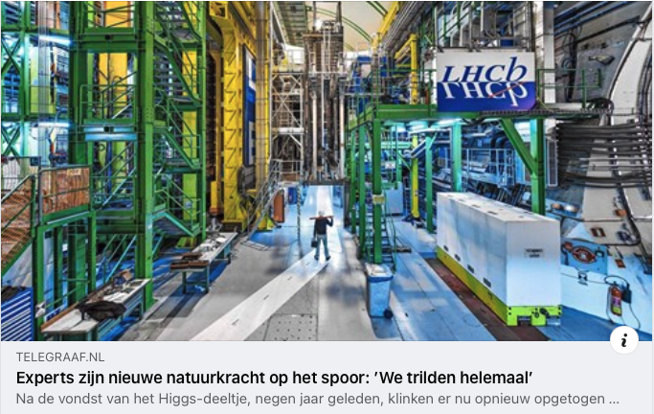
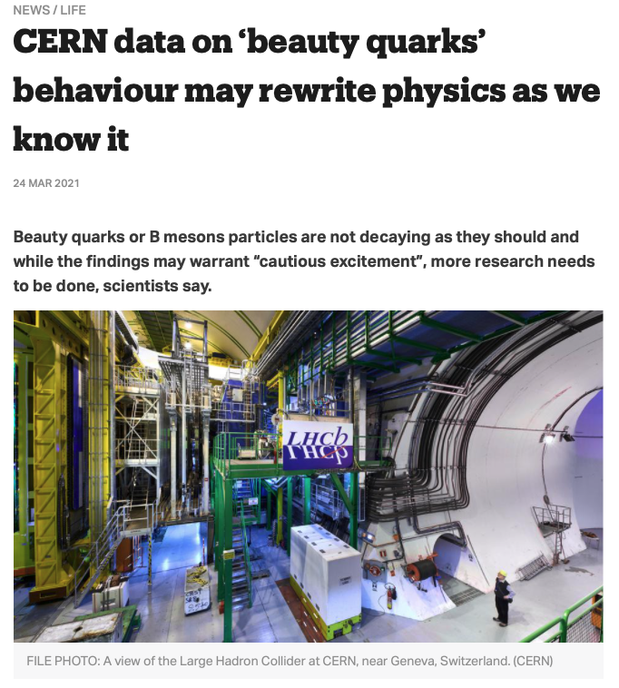
23 March 2021: Headlines… “cautious excitement”
- Guardian
Are we discovering a new force for muon particles?!

Slide 32
LHCb: Do B-particles decay the same way to electrons and muons ?
December 2022: new measurement
for electrons…
?
23 sep 2010 19:49:24
Run 79646 Event 143858637

Slide 33
LHCb: Do B-particles decay the same way to electrons and muons ?
The R_{K} value now seems to agree better with 1 ?!
December 2022: new measurement
for electrons…
?
23 sep 2010 19:49:24
Run 79646 Event 143858637

Slide 34
But for muons more and more measurements disagree with SM!
Observable
S.M.
Measured
LHCb results
Fermilab g-2 result
The puzzle deepens further!
28-8-2023

Slide 35
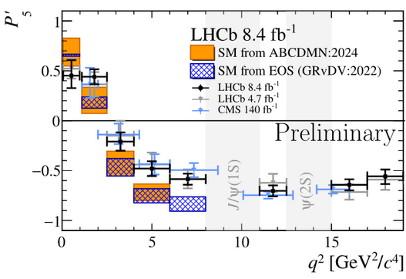
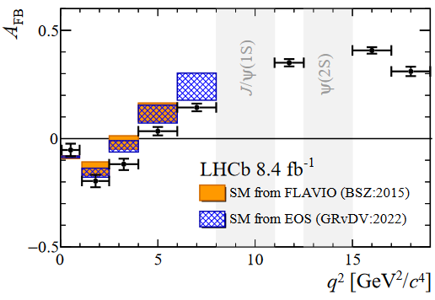
Observing deviations from the Standard Model predictions
1 Sept 2025: new LHCb results for $B→Kμμ$
The effects are not yet statistically convincing but seem to have consistent pattern pointing towars a potential new force… ?

Slide 36
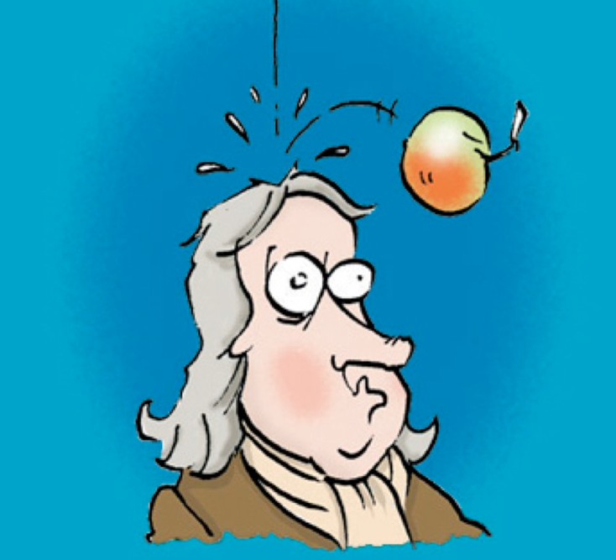
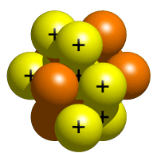
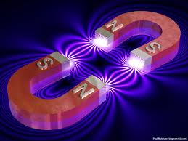

Four(?) fundamental forces of nature
Graivity:
Strong nuclear force:
Quantum
Graviton exchange?
Quantum
gluon exchange:
m
m
m
G
m
+ ???
Fifth force?
Acts on quarks
Acts on particles with mass
Electromagnetism:
Weak nuclear force:
Quantum
photon exchange:
Quantum
W, Z exchange:
Acts on all charged particles
Acts on all particles

Slide 37
How did antimatter disappear in the early universe?
Why is there something rather than nothing?
+ ???
Through a fifth force during the Big Bang…?
Quarks
Leptons
50.000001%
49.999999%

Slide 38
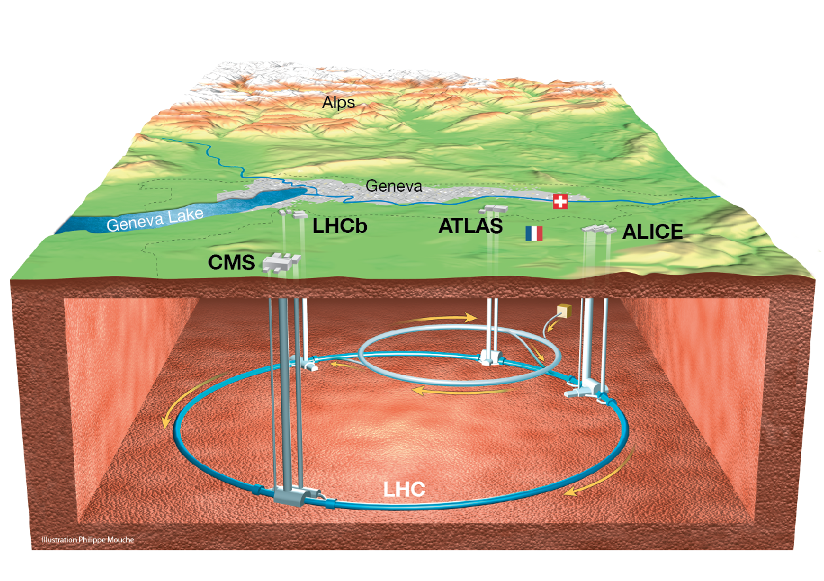
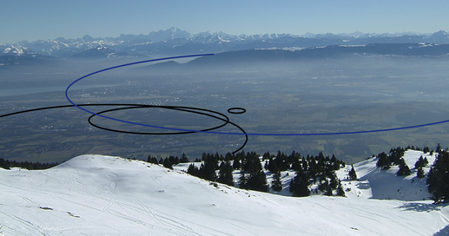
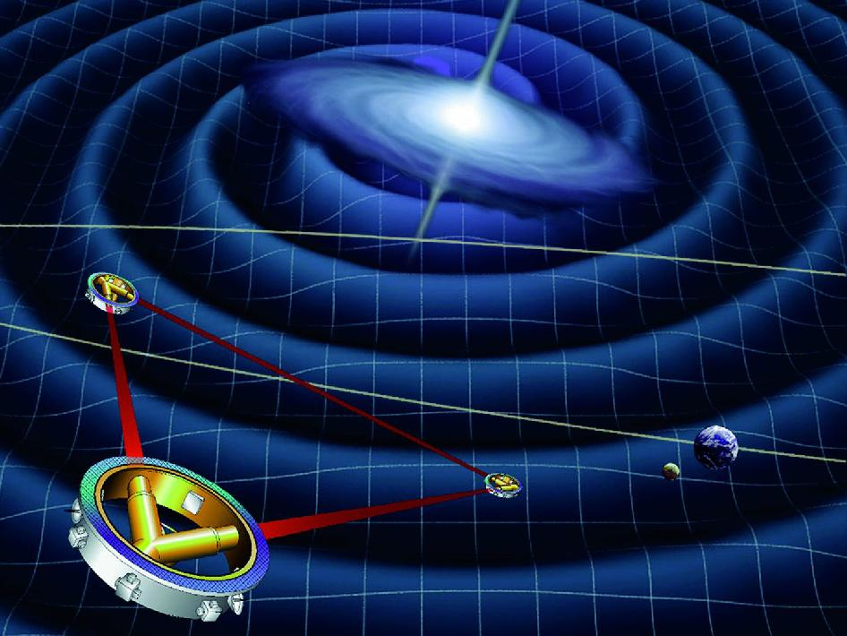
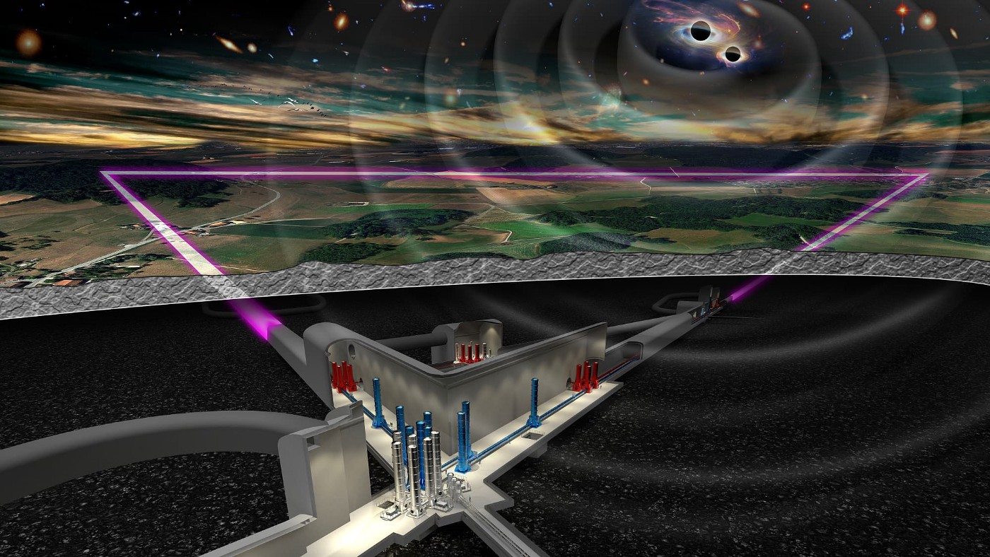
Future: “Circles and Triangles”
Particle Colliders: simulating physics of the Big Bang …
LHC
FCC
Gravitation-detectors: listening to the Big Bang…
LISA
ET

Slide 39
Future: “Circles and Triangles”
Particle Colliders: simulating physics of the Big Bang …
Lots of exciting research ongoing
LHC
FCC
Gravitation-detectors: listening to the Big Bang…
LISA
ET
Thanks for your attention!

Slide 42


Slide 43


1897
1937
1975
τ
μ
e
Electron, e
Spin ½
Charge −1
Lifetime ∞
Mass .511 MeV
Muon, μ
Spin ½
Charge −1
Lifetime 2.2 μs
Mass 106 MeV
Tau, τ
Spin ½
Charge −1
Lifetime 290 fs
Mass 1777 MeV
Notes:
Higgs coupling is the origin of mass

Slide 44
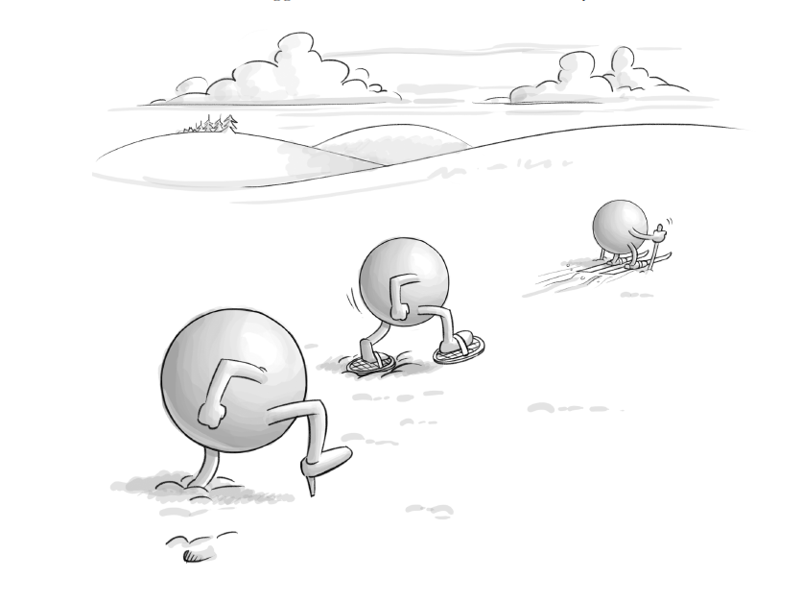
e
μ
τ
© Jean-Paul Keulen
Notes:
particles and the Higgs field

Slide 45
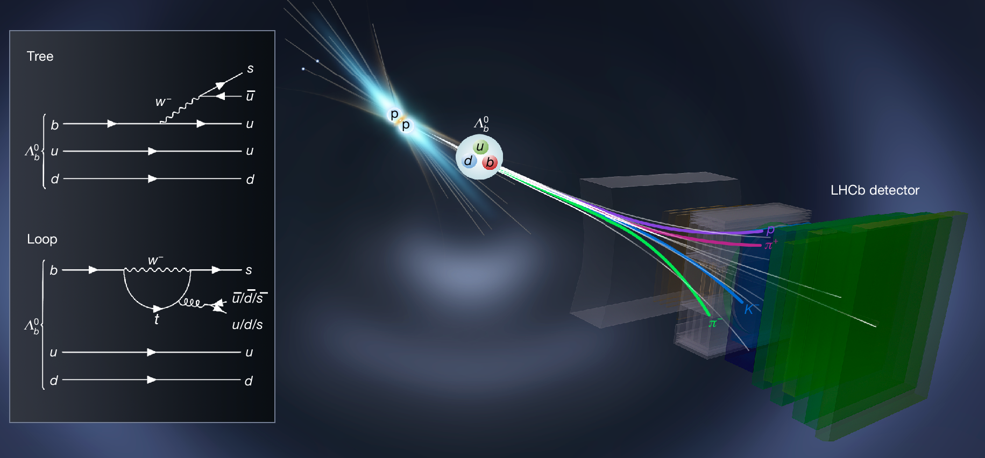
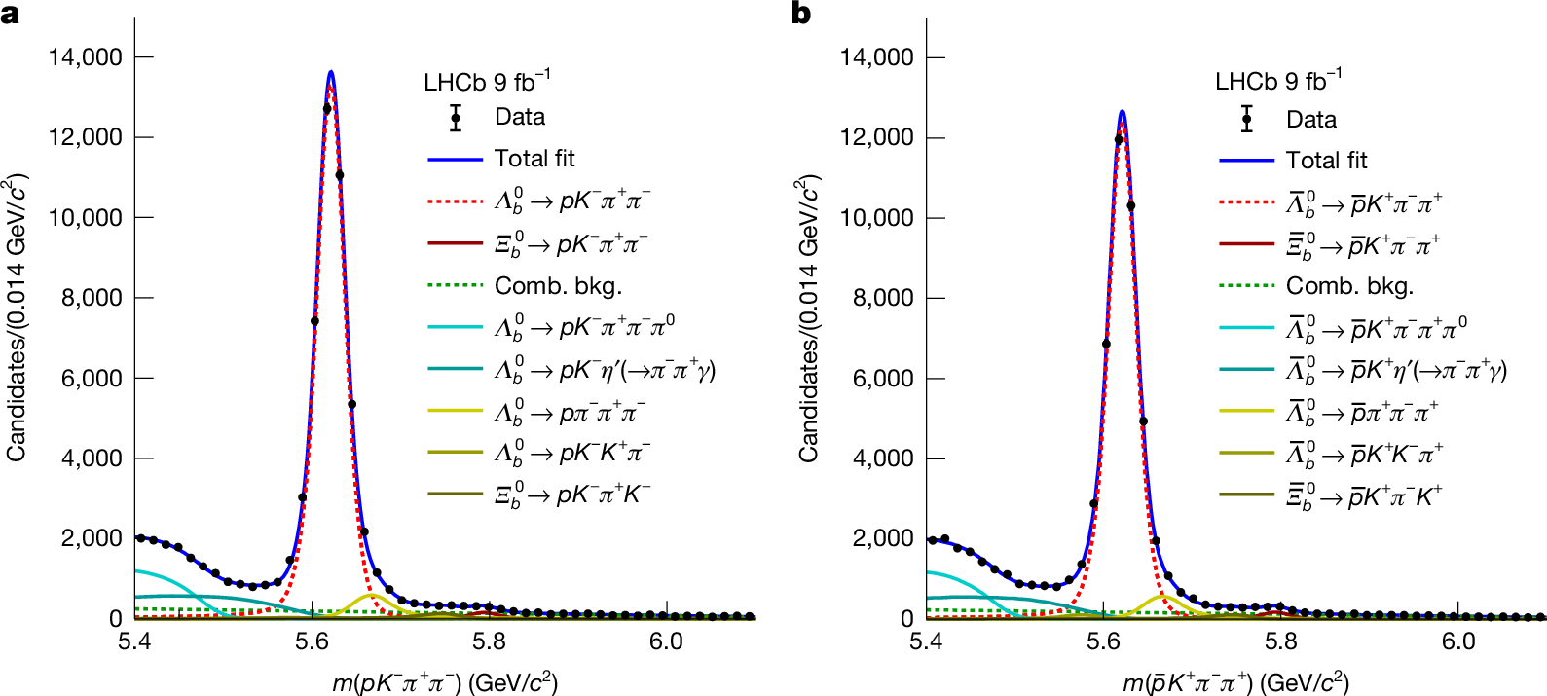

Nature: 16 July 2025 → Asymmetry in Baryons!!
Reconstruction of one of the decays
Baryons are particle like proton and neutron.
Constituetns of our atoms
Matter vs antimatter asymmetry:
A$A_{CP}=\left(2.45±0.46±0.1\right)\%$
➔ 2.5 %

Slide 46
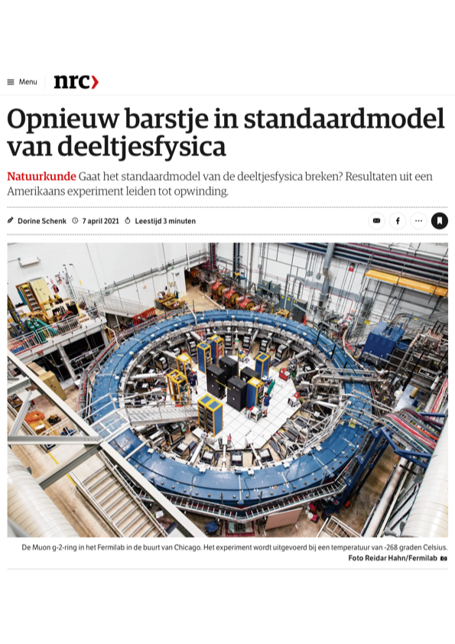


Twee weeks later in Fermilab … muon magnetic moment?!
“Again trouble in Standard model”
Standard Model cannot explain measurement
➔ A new force acting up?!
Standard Model
prediction
Experimental
measurement
“$g−2$”
Notes:
Experiment in Fermilab (earlier Brookhaven) . Spin procession in known B field.
Energy electron depends spin direction muon: neutrino direction.
Mu = -g \mu_B S = - g q S / 2 m ; mu_B = eh/2me

Slide 47

Applications of Science

Slide 48

Dark Matter

Slide 49

Visible “baryonic” matter
hydrogen (H)
helium (He)

Slide 50


Spiralarm rotation and gravitational lensing
→ v (km/s)
measured
100
expected
50
Normal matter scatters and stays behind
Dark matter moves undisturbed
5
10
→ R (kpc)

Slide 51


Dark Matter
He
H
dark energy & dark matter

Slide 52

“The Dark Side rules the Universe”

