Slide 1
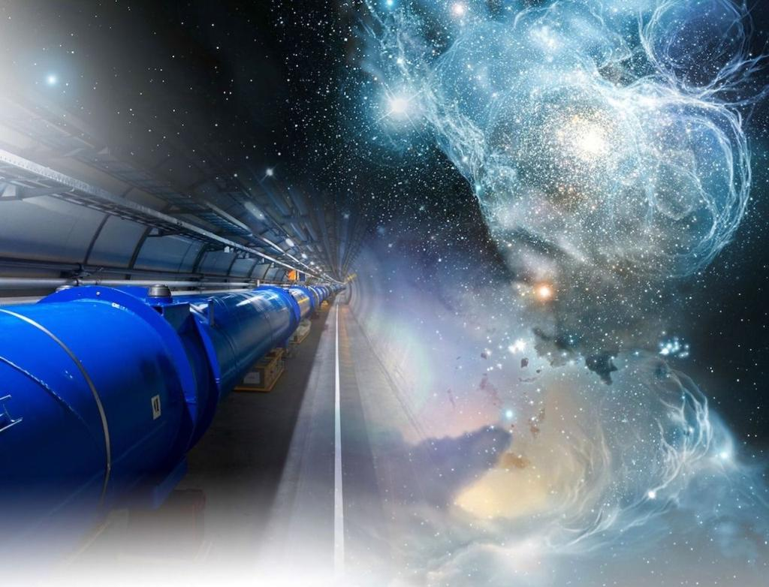
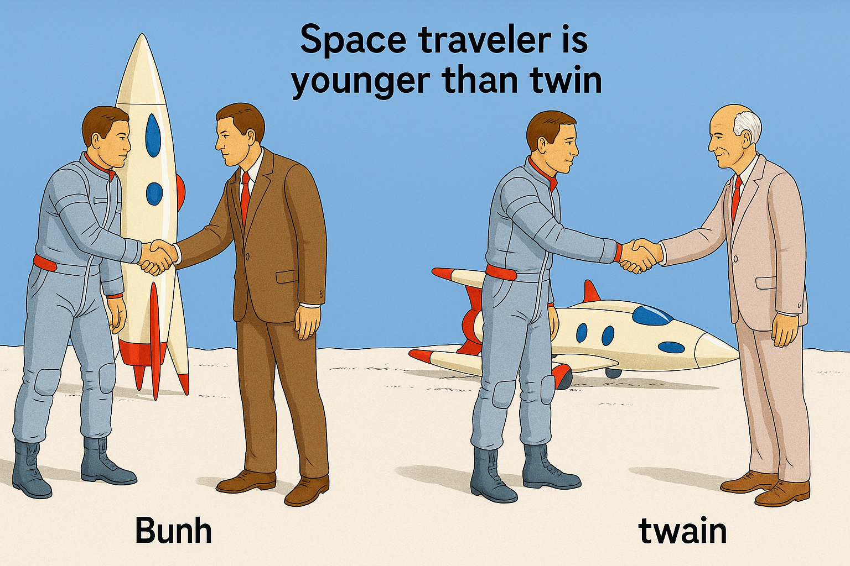
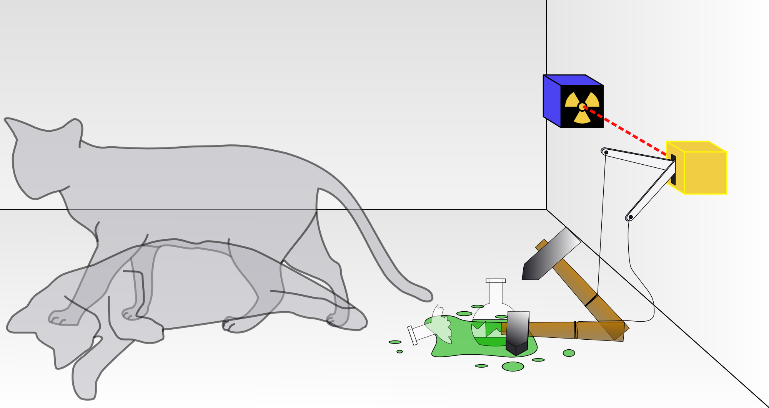
The Relativistic Quantum World
Relativity
A lecture series on
Relativity Theory and Quantum Mechanics
Before
After
Quantum
Alive
Marcel Merk
Studium Generale Maastricht
Sep 10 – Oct 8, 2025
Dead
Notes:
Explain picture. Interesting (“bizarre”) aspects of relativity and QM

Slide 2
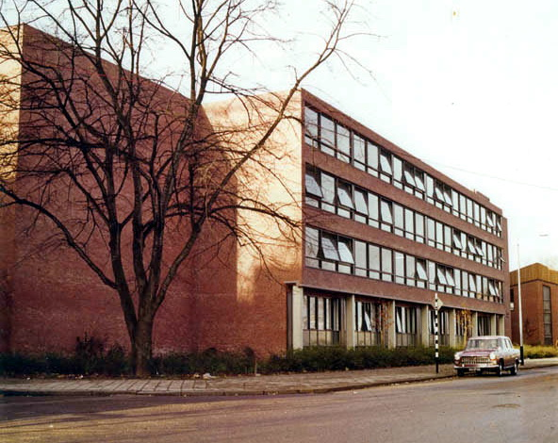
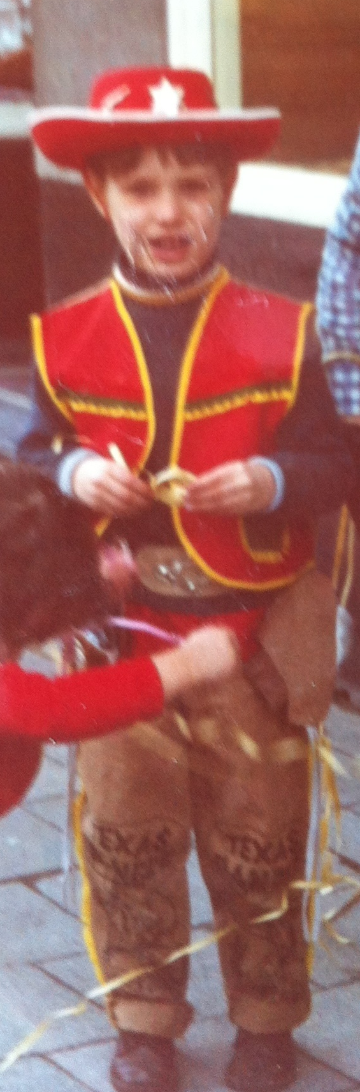
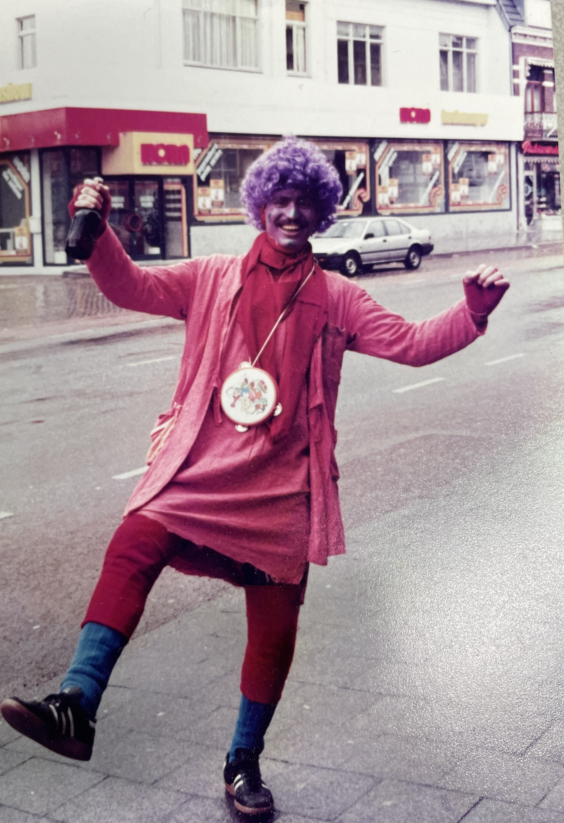
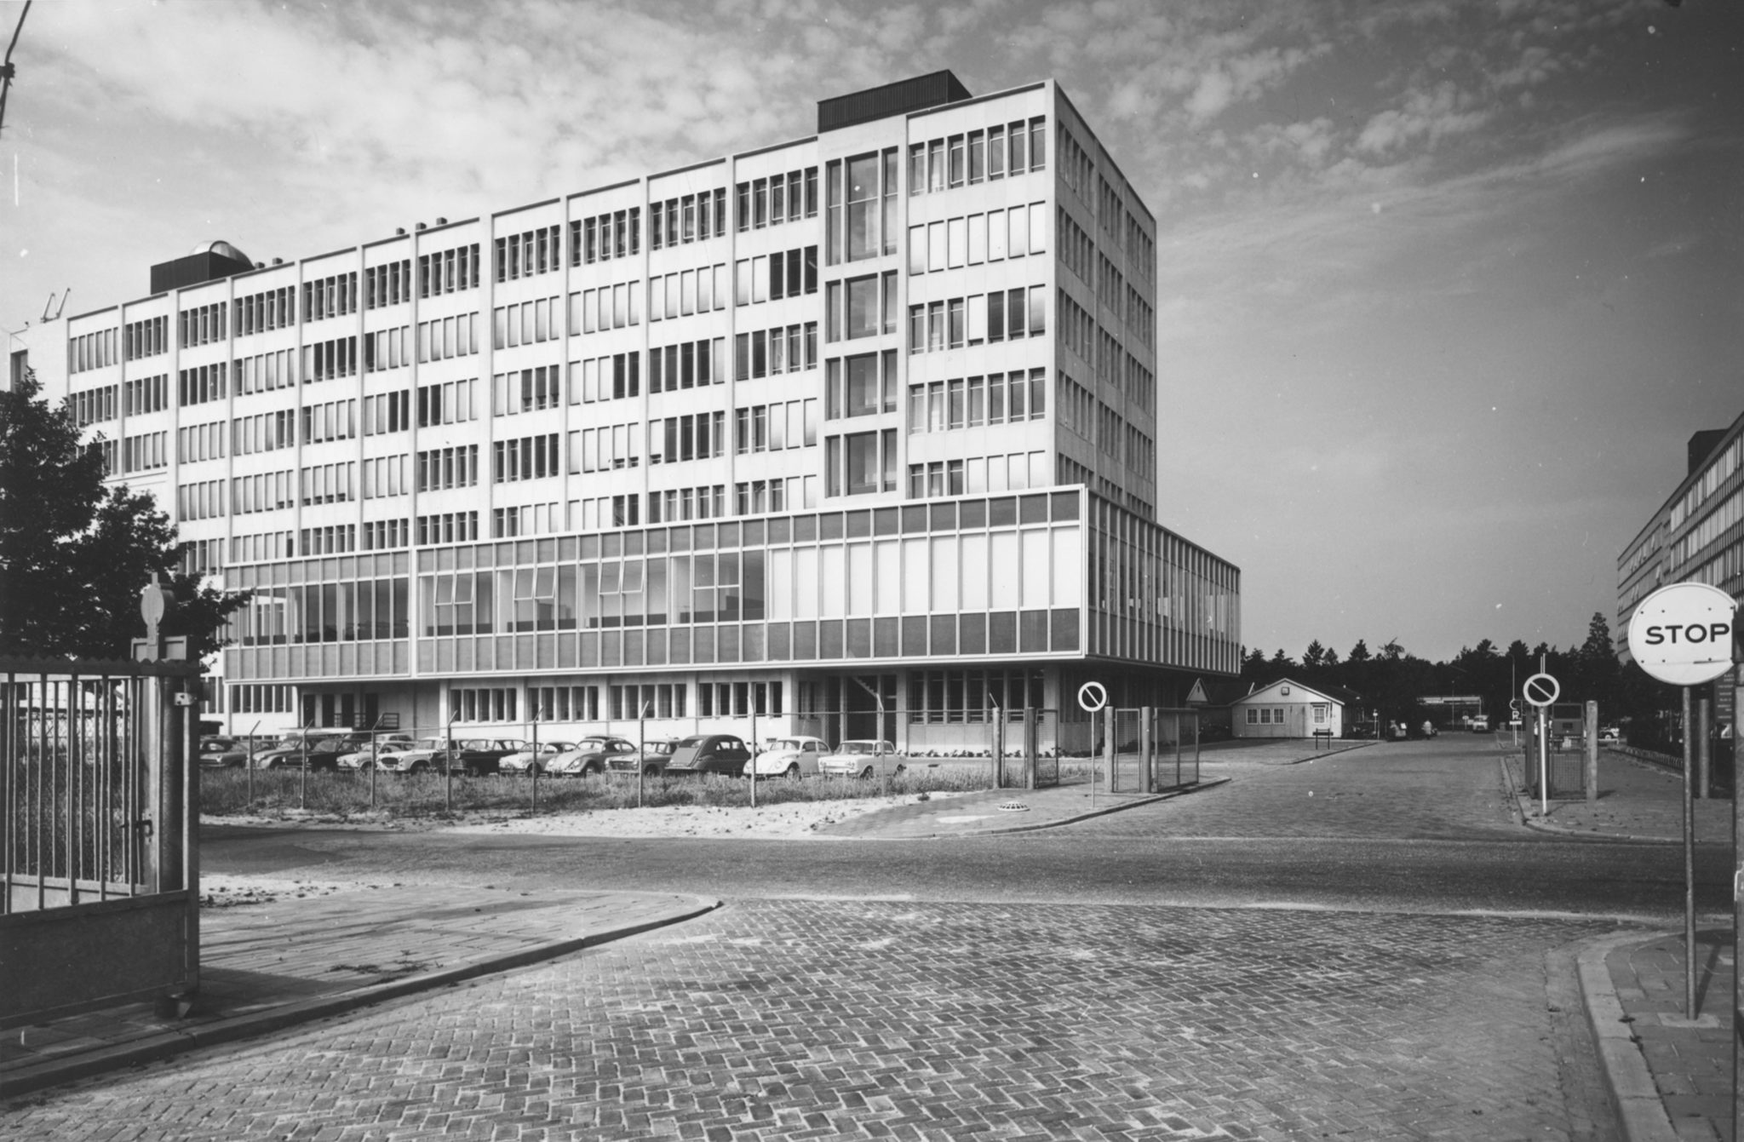
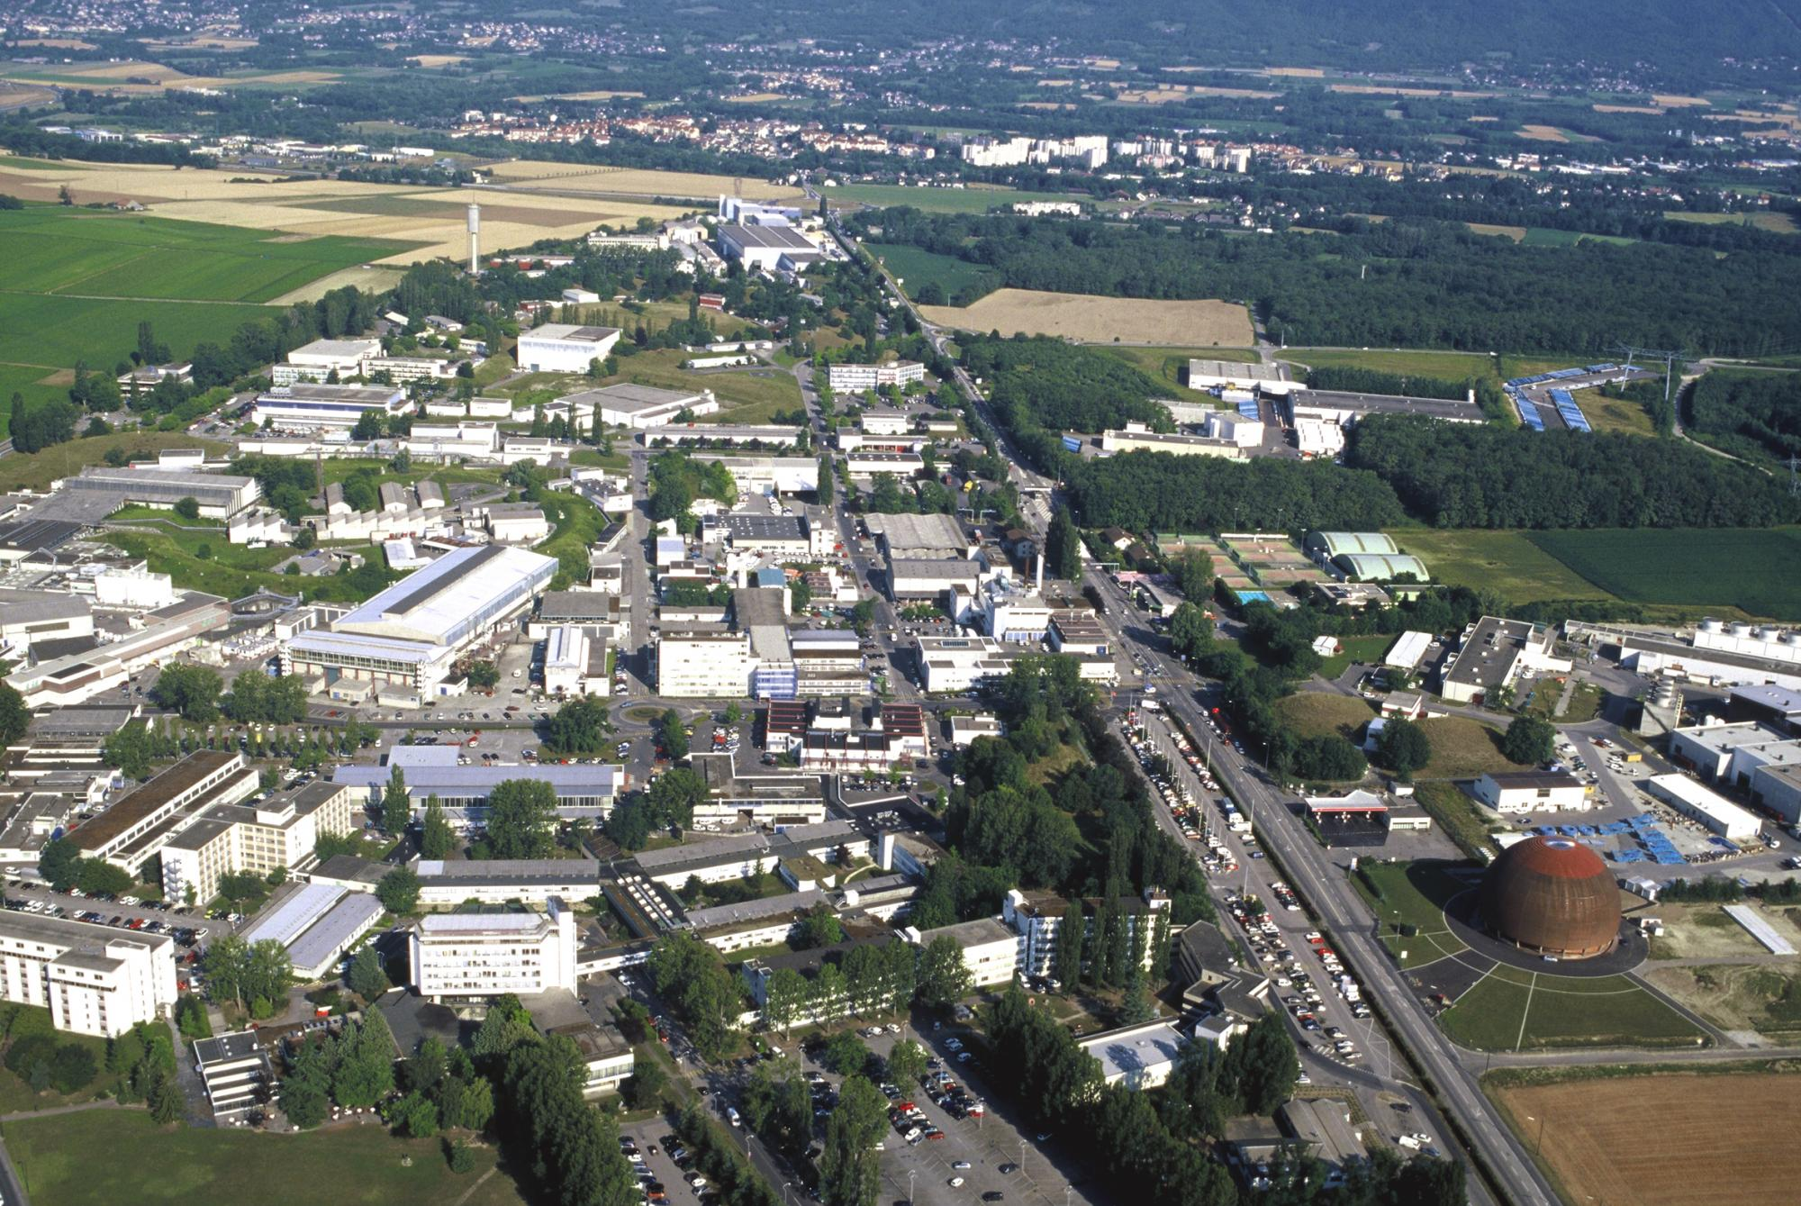
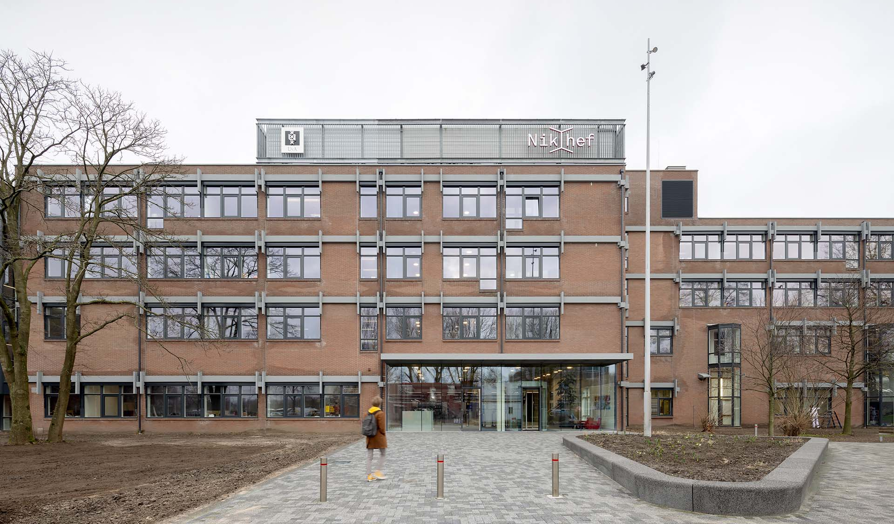
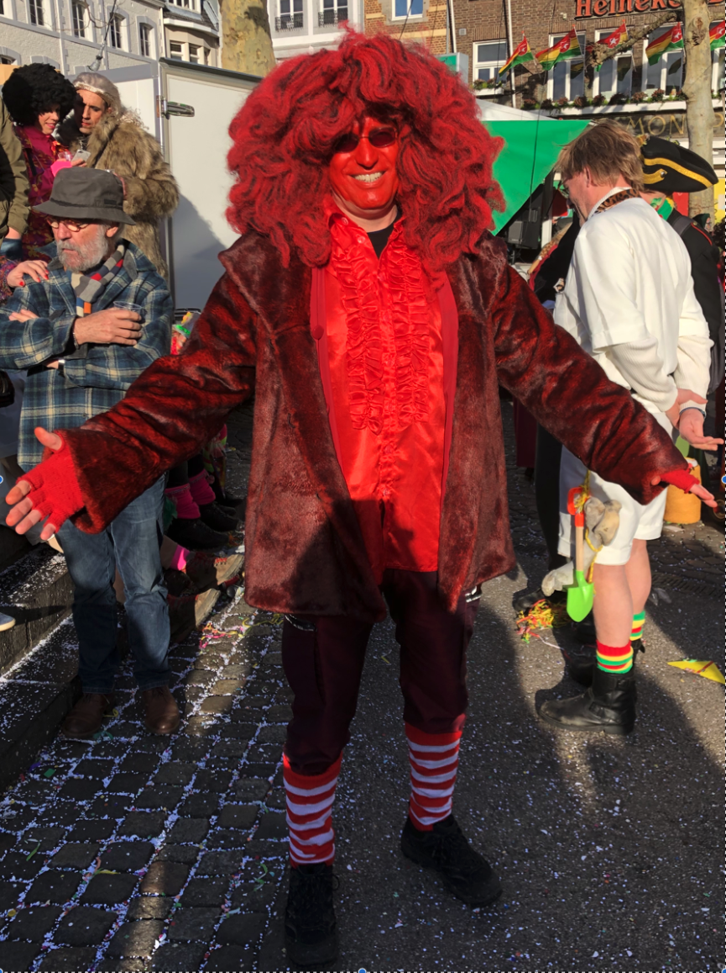
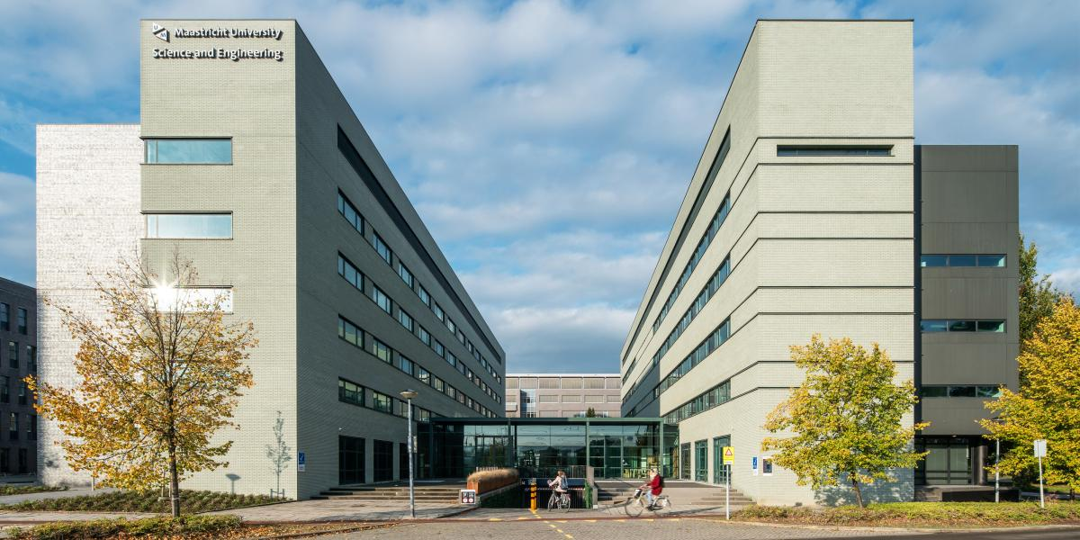
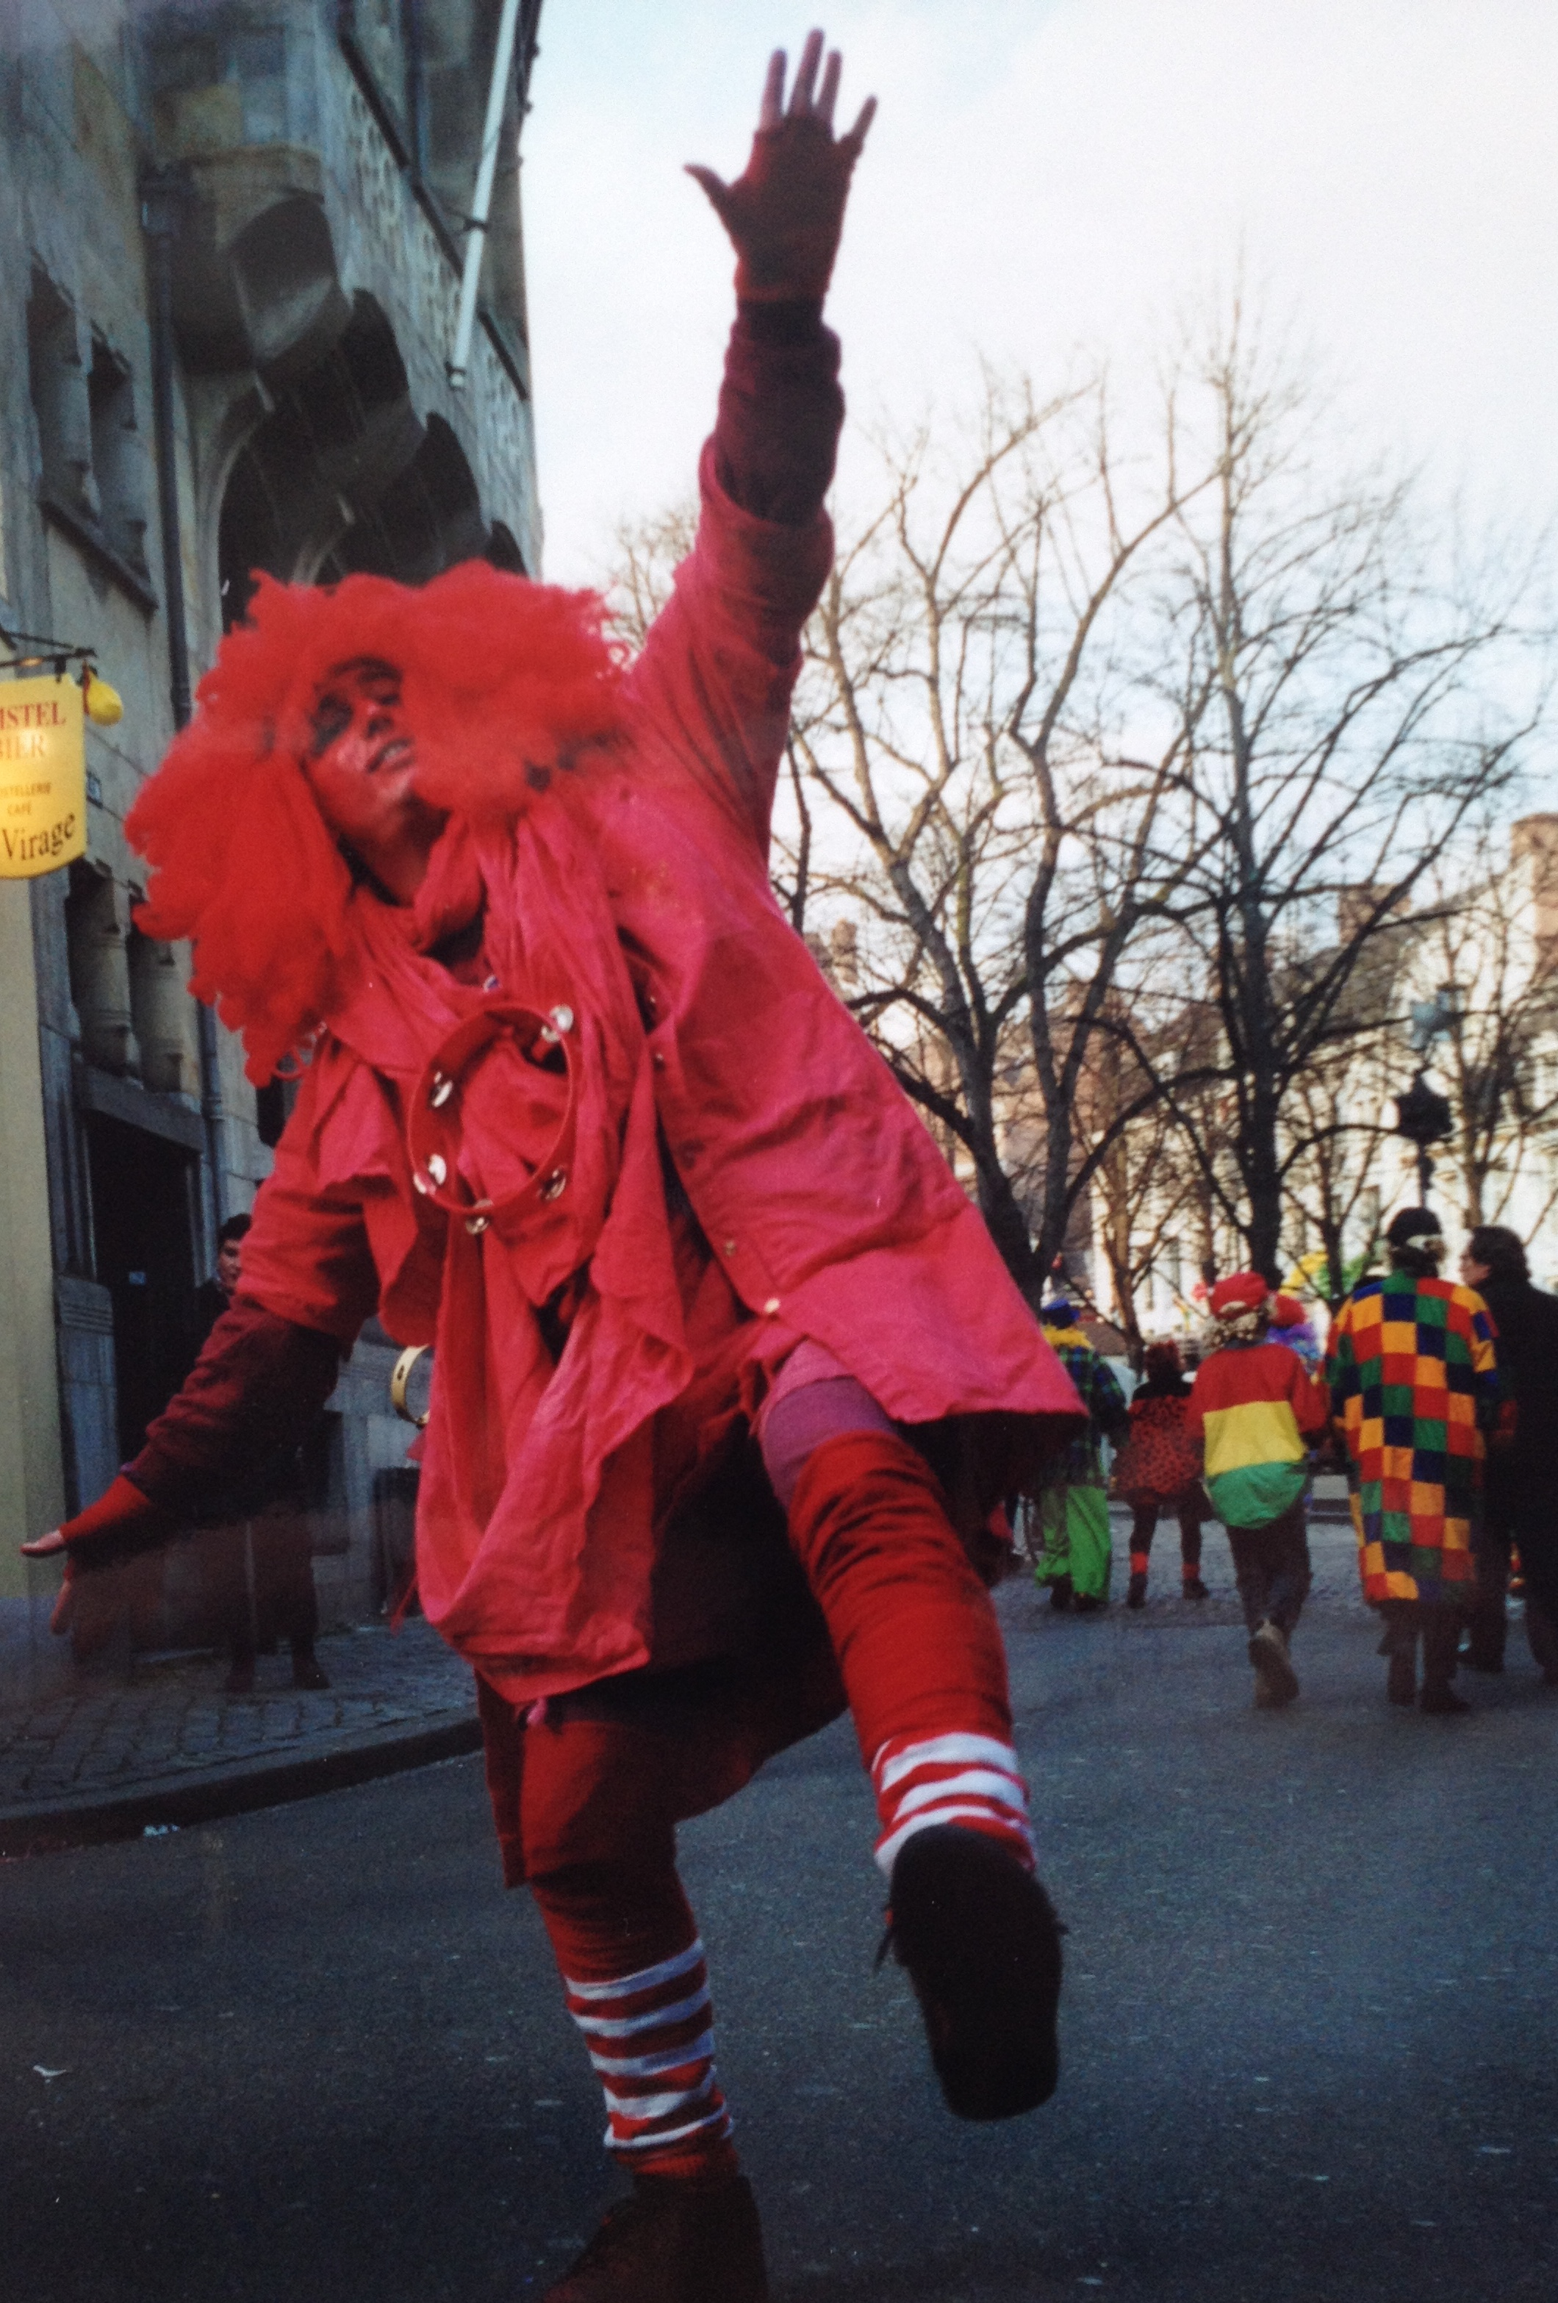
Who am I?
1
Working career
Personal career
St Maartenscollege Maastricht
University Nijmegen
CERN Geneva
Nikhef Amsterdam
1991
1970
FSE Mestreech
2000
2025

Slide 3
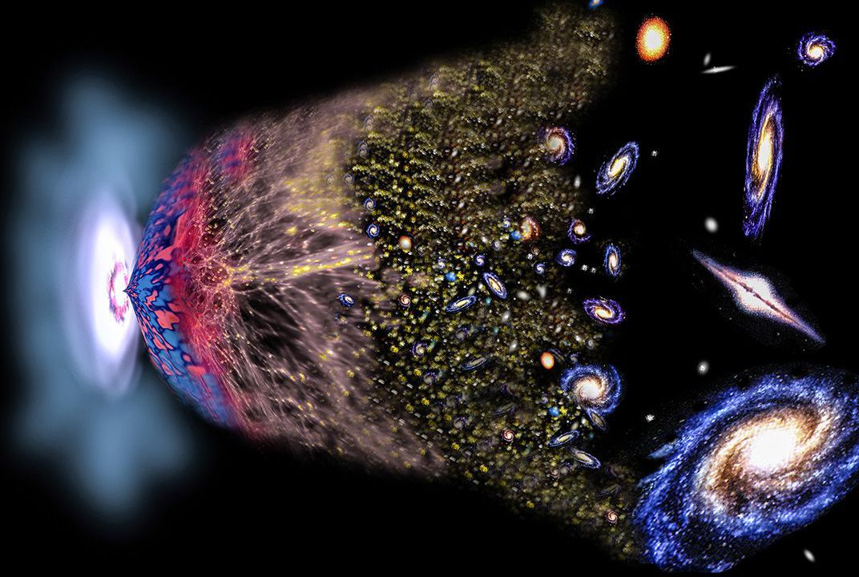
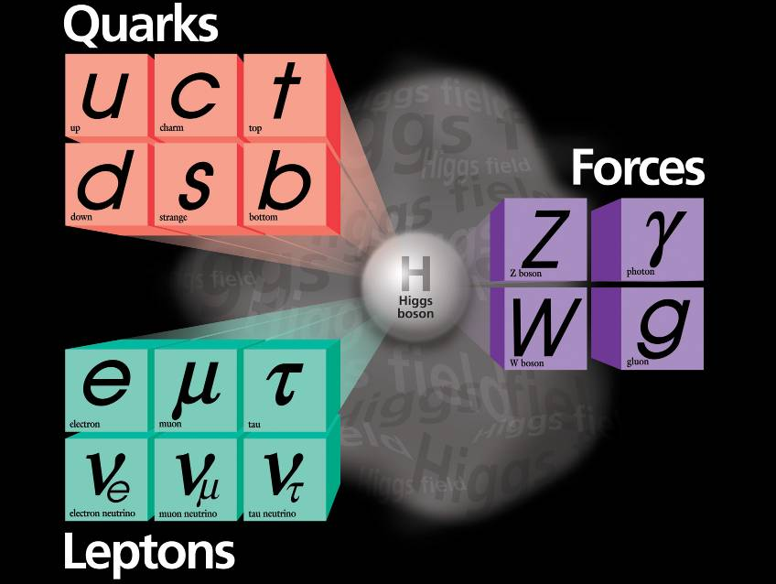
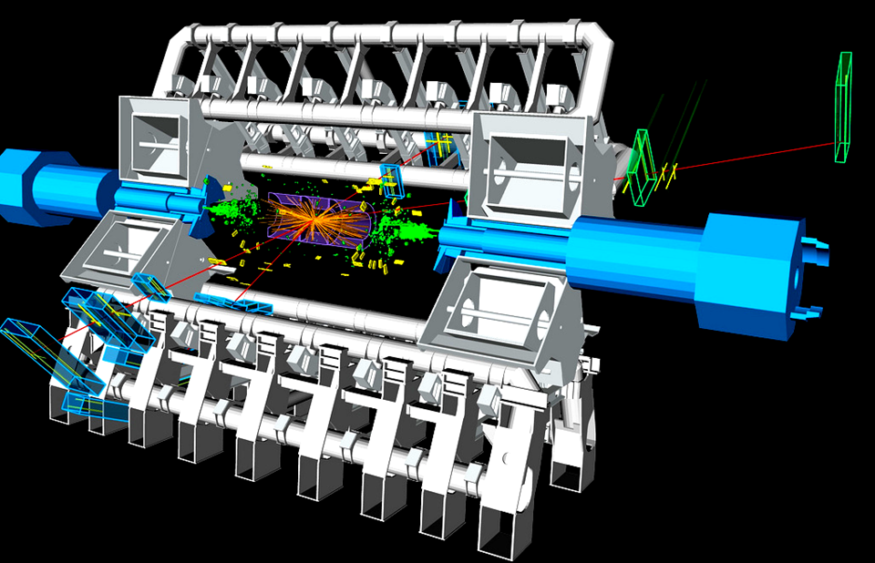
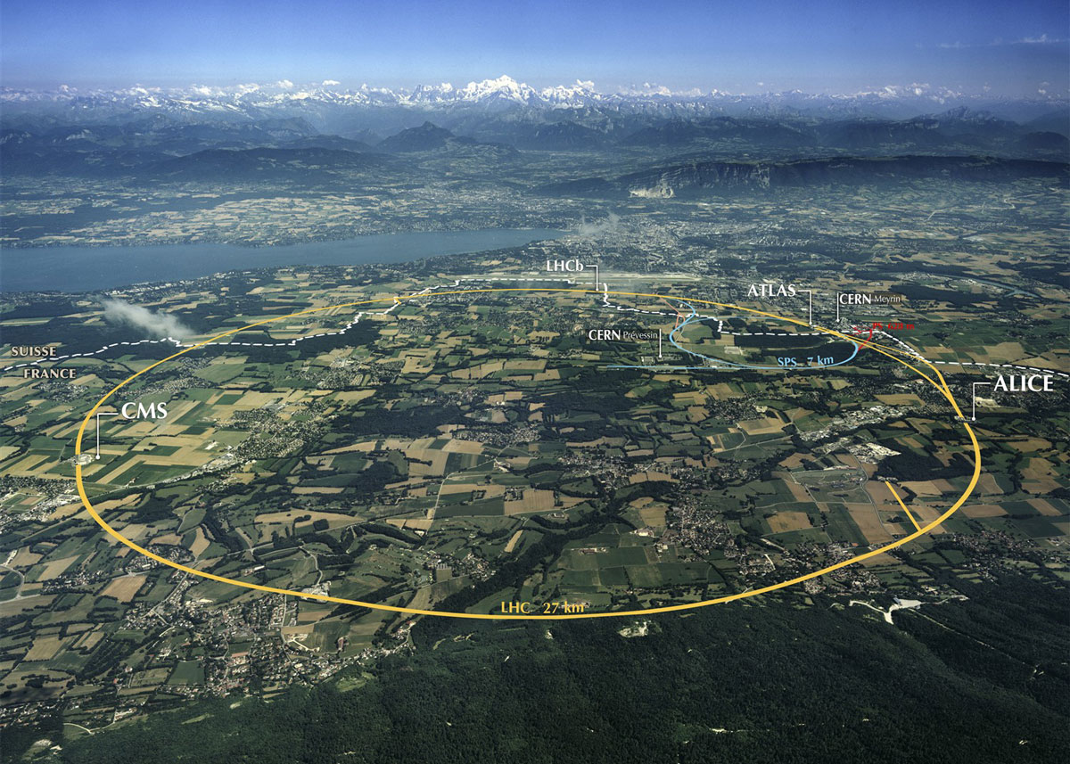
What do I do?
Website: www.nikhef.nl/~i93 Email: marcel.merk@nikhef.nl
2
Why is there something rather then nothing?
(More in the last lecture of the series)
Research with the Large Hadron Collider at CERN
Study the matter-vs-antimatter asymmetry in nature

Slide 4


The Relativistic Quantum World
3
Lecture 1: The Principle of Relativity and the Speed of Light
Lecture 2: Time Dilation and Lorentz Contraction
Lecture 3: The Lorentz Transformation and Paradoxes
Lecture 4: General Relativity and Gravitational Waves
Sep. 10:
Relativity
Sep. 17:
Lecture 5: The Early Quantum Theory
Lecture 6: Feynman’s Double Slit Experiment
Lecture 7: Wheeler’s Delayed Choice and Schrodinger’s Cat
Lecture 8: Quantum Reality and the EPR Paradox
Quantum
Mechanics
Sep. 24:
Oct. 1 :
Standard
Model
Lecture 9: The Standard Model and Antimatter
Lecture 10: Why is there something rather than nothing?
Oct. 8:
Lecture notes, written for this course, are available: www.nikhef.nl/~i93/Teaching/
Prerequisite for the course: High school level physics & mathematics.
Notes:
Ambitious!

Slide 5

The Relativistic Quantum World
3
Lecture 1: The Principle of Relativity and the Speed of Light
Lecture 2: Time Dilation and Lorentz Contraction
Lecture 3: The Lorentz Transformation and Paradoxes
Lecture 4: General Relativity and Gravitational Waves
Nov. 1:
Relativity
Nov. 8:
Lecture 5: The Early Quantum Theory
Lecture 6: Feynman’s Double Slit Experiment
Lecture 7: Wheeler’s Delayed Choice and Schrodinger’s Cat
Lecture 8: Quantum Reality and the EPR Paradox
Quantum
Mechanics
Nov. 15:
Nov 22:
Standard
Model
Lecture 9: The Standard Model and Antimatter
Lecture 10: Why is there something rather than nothing?
Nov. 29:
Lecture notes, written for this course, are available: www.nikhef.nl/~i93/Teaching/
Prerequisite for the course: High school level physics & mathematics.
Notes:
Ambitious!

Slide 6
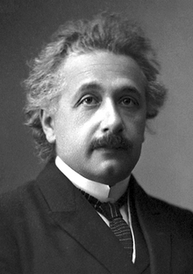
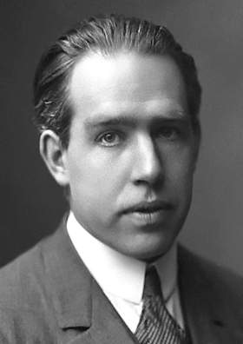
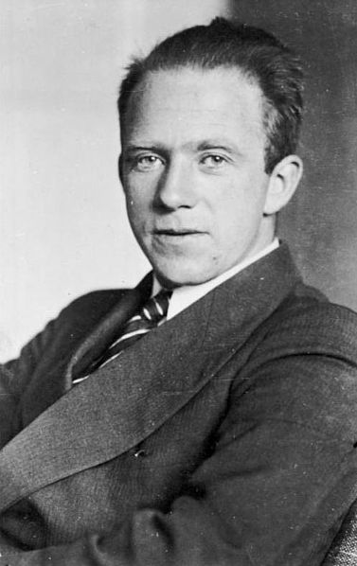
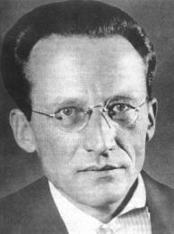
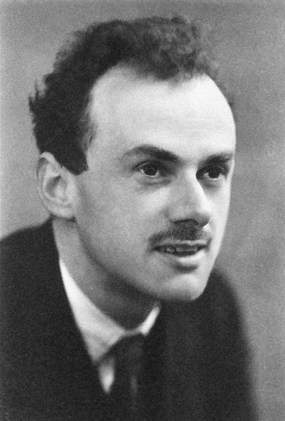
Relativity and Quantum Mechanics
4
“There is nothing new to be discovered in physics now. All that remains is more precise measurements.”
Lord Kelvin on Physics in 1900
However, there were two unsolved issues:
The existence of the mysterious ether ➔ Relativity Theory
Black-body radiation and atom stability ➔ Quantum Mechanics
Albert Einstein
Niels Bohr
Werner Heisenberg
Erwin Schrödinger
Paul Dirac
Notes:
Lord Kelvin: Willaim Thomson
Around 1900: Mechanics of Newton, E.M. by Maxwell and thermodynamics by Boltzmann
Relativity: really just one man. QM: Born, Pauli, Jordan, Sommerfeld, later Feynman etc. It went very fast in 1920’s.
Relativity theory was generally accepted, but Quantum Mechanics lead to many debates. Einstein and Schrodinger could not accept it as a fundamental theory.

Slide 7
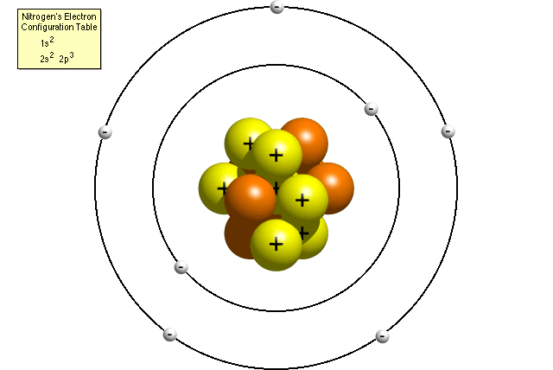
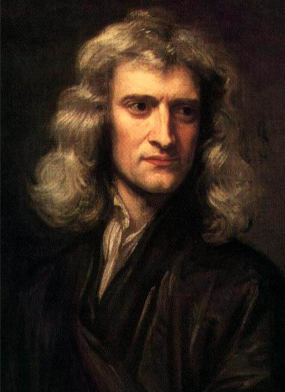
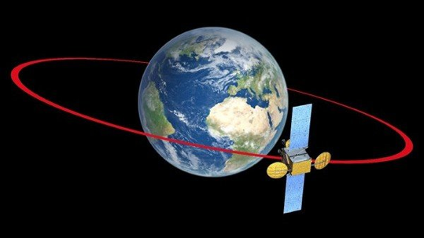
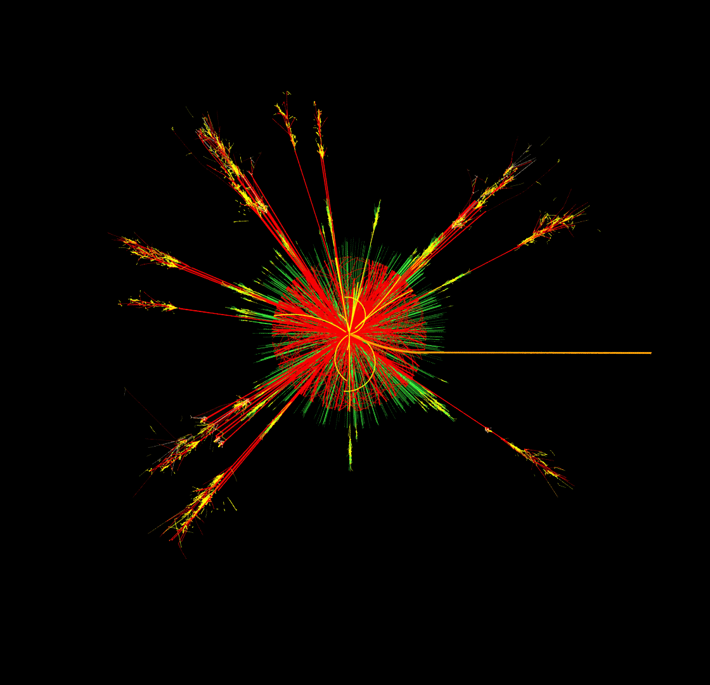
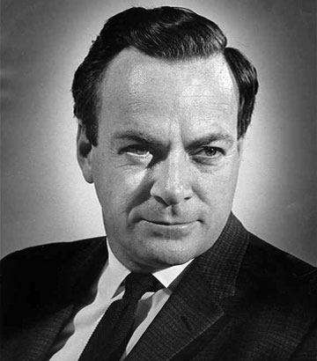

Relativity and Quantum Mechanics
5
Classical Mechanics
Quantum Mechanics
Smaller Sizes (ħ)
Newton
Bohr
Classical mechanics is not “wrong”.
It is limited to macroscopic objects and moderate velocities.
Higher Speed (c)
Dirac
Feynman
Einstein
Relativity Theory
Quantum Field Theory
Notes:
Classical physics based on daily experience. Physics of the very fast and very small is counterintuitive! c and h-bar are fundamental constants of nature. Is there something that goes beyond c and h? No. QFT combines Relativity and QM.
Planck Length: L_P = sqrt(hbar G / c^3)

Slide 8
Relativity and Quantum Mechanics
5
Classical Mechanics
Quantum Mechanics
Smaller Sizes (ħ)
Newton
Bohr
From our experience we are not used to relativistic and quantum mechanical phenomena. That’s why we find it counterintuitive.
Classical mechanics is not “wrong”.
It is limited to macroscopic objects and moderate velocities.
Higher Speed (c)
Dirac
Feynman
Einstein
Relativity Theory
Quantum Field Theory
Notes:
Classical physics based on daily experience. Physics of the very fast and very small is counterintuitive! c and h-bar are fundamental constants of nature. Is there something that goes beyond c and h? No. QFT combines Relativity and QM.

Slide 9
6
Lecture 1
The Principle of Relativity and the Speed of Light
“If you can’t explain it simply you don’t understand it well enough”
Albert Einstein
Notes:
Simple but counterintuitive!

Slide 10
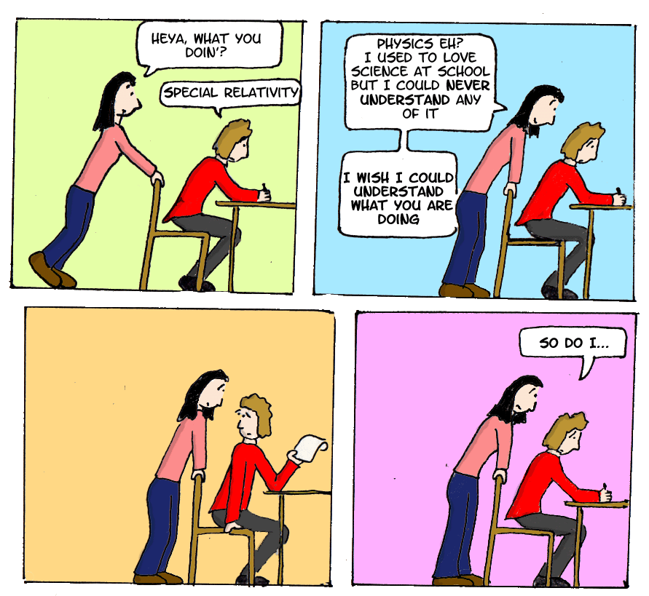
7
“Everything should be made as simple as possible, but not simpler”
- Albert Einstein
Notes:
Simple concepts, but very counterintuitive: makes it really hard to fully understand.

Slide 11
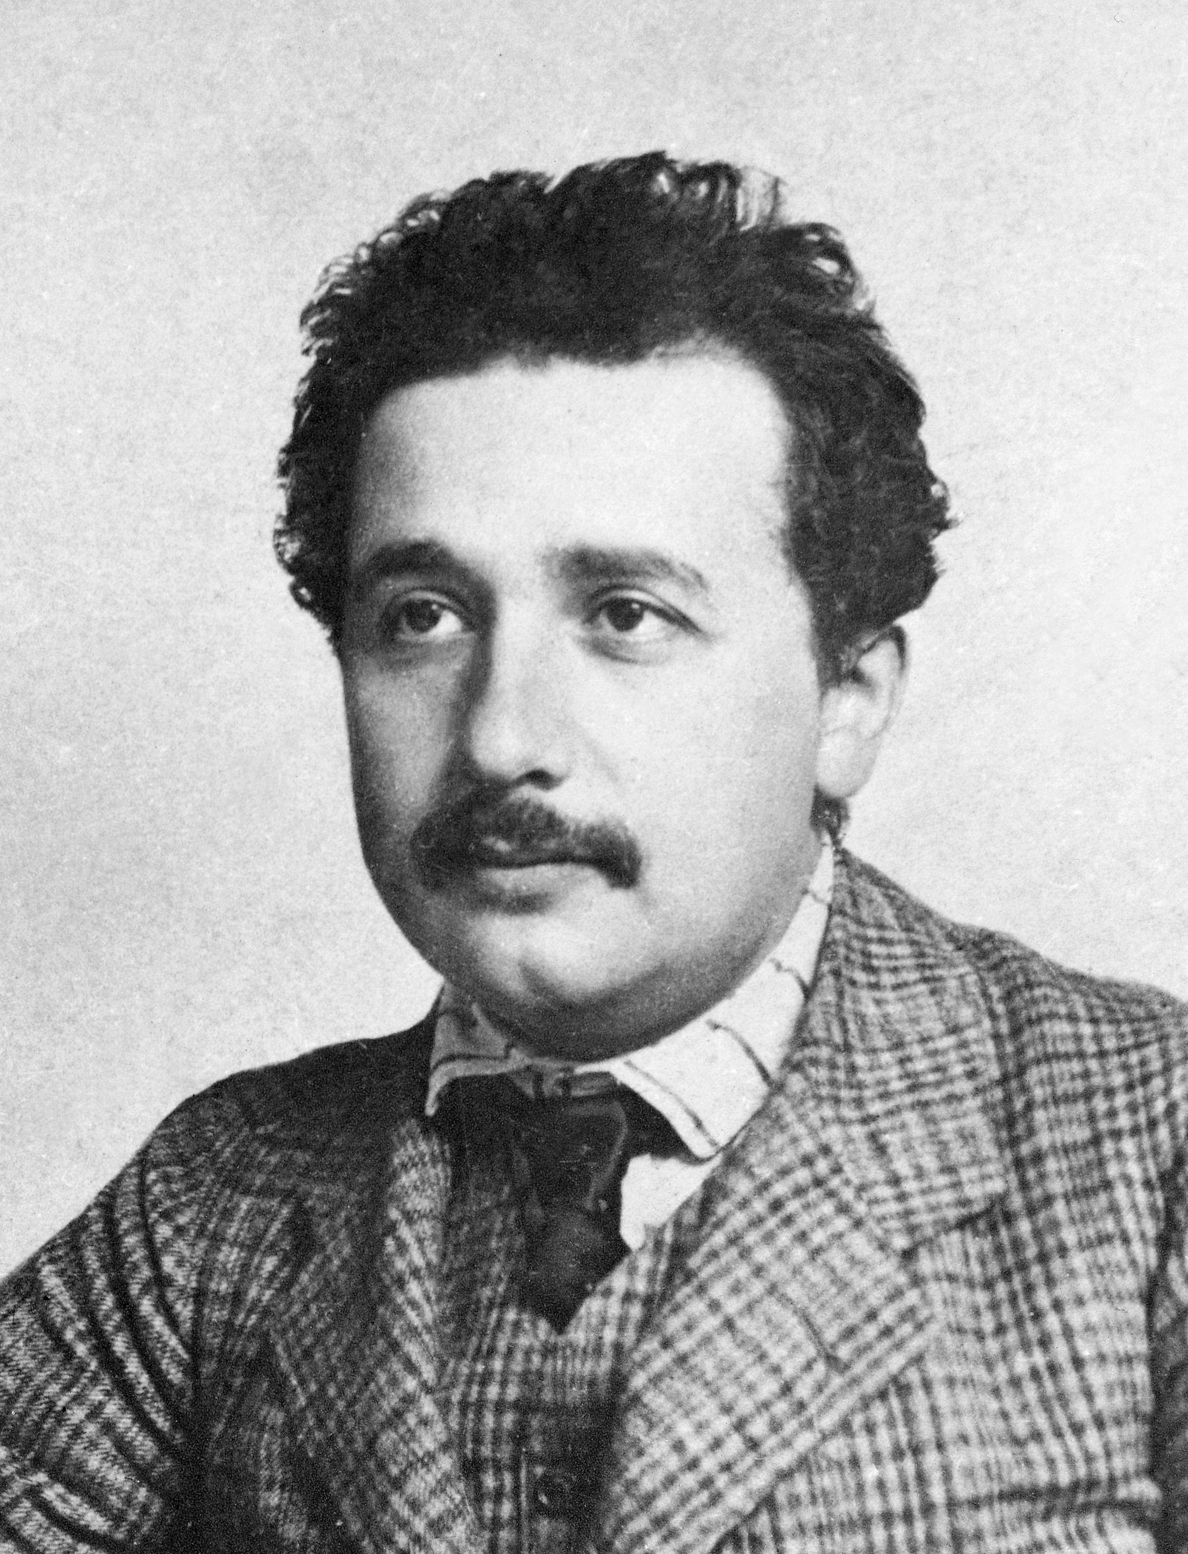
Albert Einstein (1879 – 1955)
8
“Annus Mirabilis” 1905:
  Special theory of relativity
    Fundamental change interpreting space and time
    Equivalence of mass and energy: E=mc²
  The photo electric effect
    Quantum Mechanics: light consists of photon-quanta
  Brownian Motion
    Demonstration of existence of atoms
→ Nobel prize 1921
Although these studies were motivated by curiosity, they eventually had a large impact on society:
computing and communication technology, health-care technology, navigation, military, …
Notes:
Amazing performance by Einstein while working at the patent office in Bern:
4 groundbreaking articles in Zeitschrift fur Physik.
E=mc^2 is most famous. Photo electric effect was a Noble Prize. Relativity not!
Relativity: Maxwell equationsare the same in all inertial frames.

Slide 12
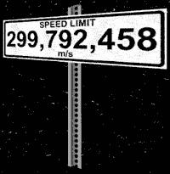
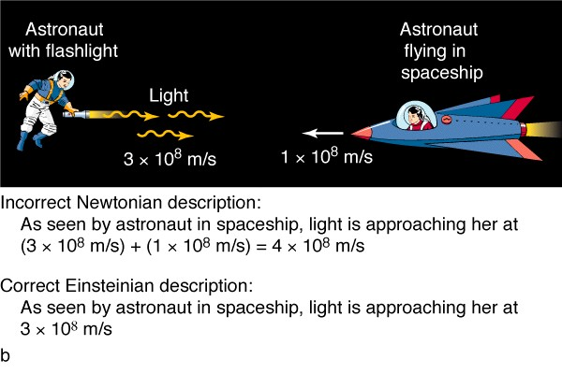
Relativity: “Nothing can move faster than the speed of light”
9
What is the speed of light?
“300 000 km/s”
Relative to what?
??
“to the vacuum”
Einstein: “The speed of light in vacuum is always the same."
c ≈ 300 000 km/s
All observers see c ≈ 300 000 km/s !
?
Notes:
We all “know” nothing can move faster than speed of light. It is actually a strange statement.

Slide 13
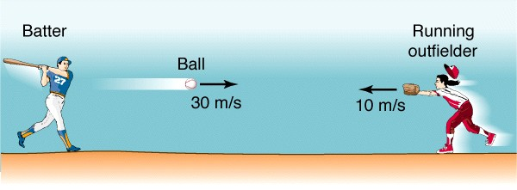
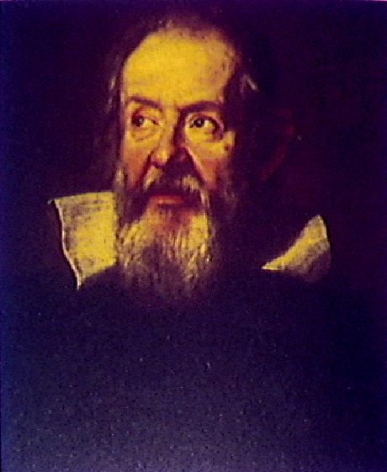
Galilei Transformation law
10
Bob
Alice
w=
v=
S
S‘
w’= ?
Galileo Galilei
(1564 – 1642)
With which speed do Alice and the ball hit by Bob approach each other?
Intuitive law (daily experience): 30 m/s + 10 m/s = 40 m/s
More formal: Observer S (Bob) observes the ball with relative velocity: w
Observer S’ (Alice) observes the ball with relative velocity: w’
The velocity of S’ with respect to S is: v
w’ = w + v
This is the Galileian law for adding velocities.
Notes:
Galilei is famous for supporting Heliocentrism of Copernicus (vs Geocentrism of Ptolemaeus and Aristotle) and was given house arrest by the inquisition.

Slide 14
Galilei Transformation law
11
Bob
Alice
w’= ?
w=
v=
Galileo Galilei
(1564 – 1642)
With which speed do Alice and the light sent by Bob approach each other?
Intuitive law: 300 000 km/s + 100 000 km/s = 400 000 km/s ???
More formal: Observer S (Bob) observes the light with relative velocity: w
Observer S’ (Alice) observes the light with relative velocity: w’
The velocity of S’ with respect to S is: v
w’ = w + v
This is the Galileian law for adding velocities.
Notes:
Now we replace the ball by light again and things go really fast. Not daily life speeds.

Slide 15
Galilei Transformation law
11
Bob
Alice
w’= ?
w=
v=
Galileo Galilei
(1564 – 1642)
With which speed do Alice and the light sent by Bob approach each other?
Intuitive law: 300 000 km/s + 100 000 km/s = 400 000 km/s ???
But nothing can move faster than the speed of light ?!
w’ = w + v
This is the Galileian law for adding velocities.
Notes:
Now we replace the ball by light again and things go really fast. Not daily life speeds.

Slide 16
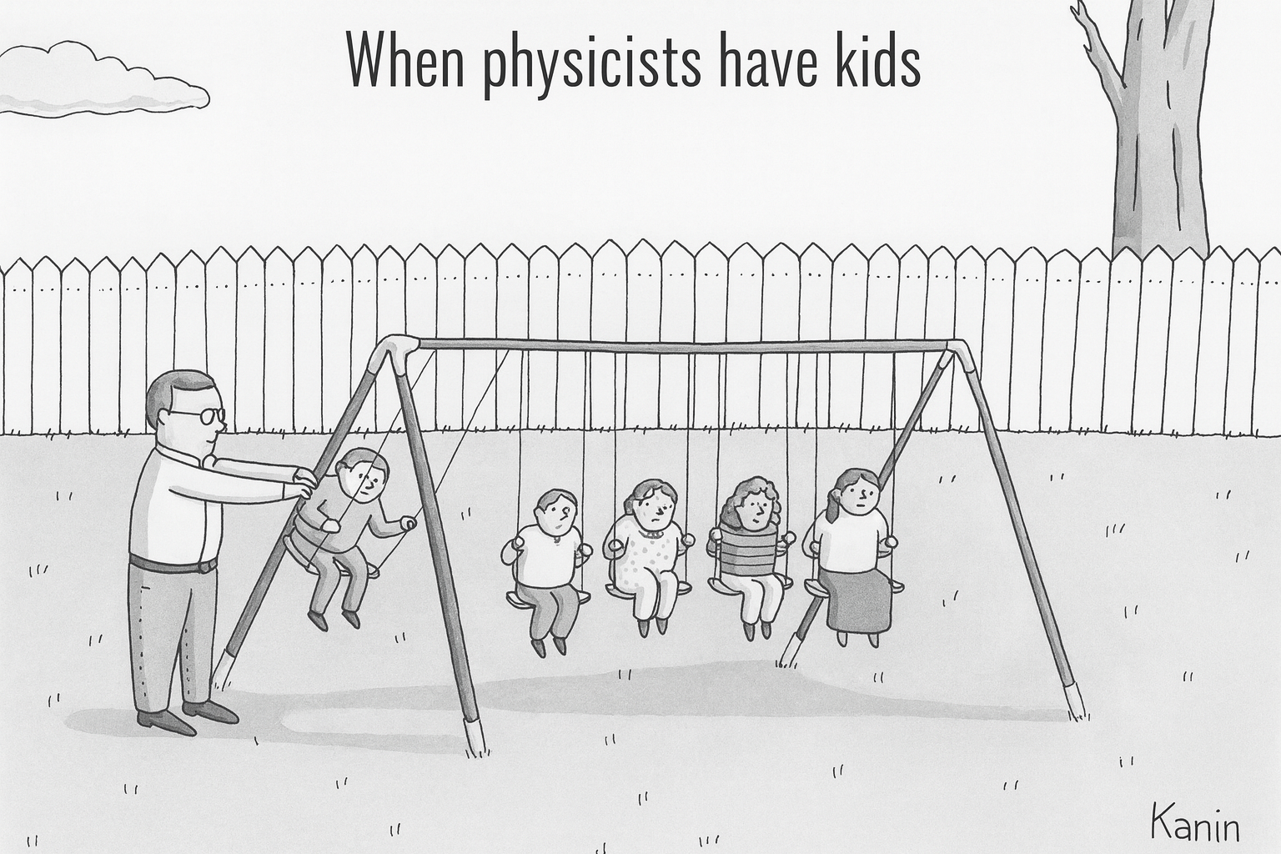
Let’s do the experiment…
12
Experiments:
If it’s green and it wiggles,
… it’s biology,
If it stinks, … it’s chemistry,
If it doesn’t work…,
… it’s physics.

Slide 17
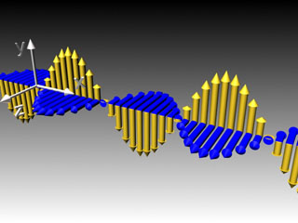
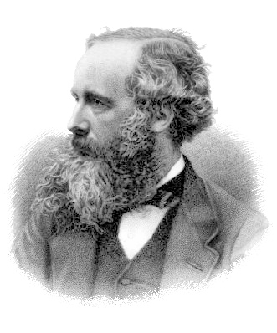
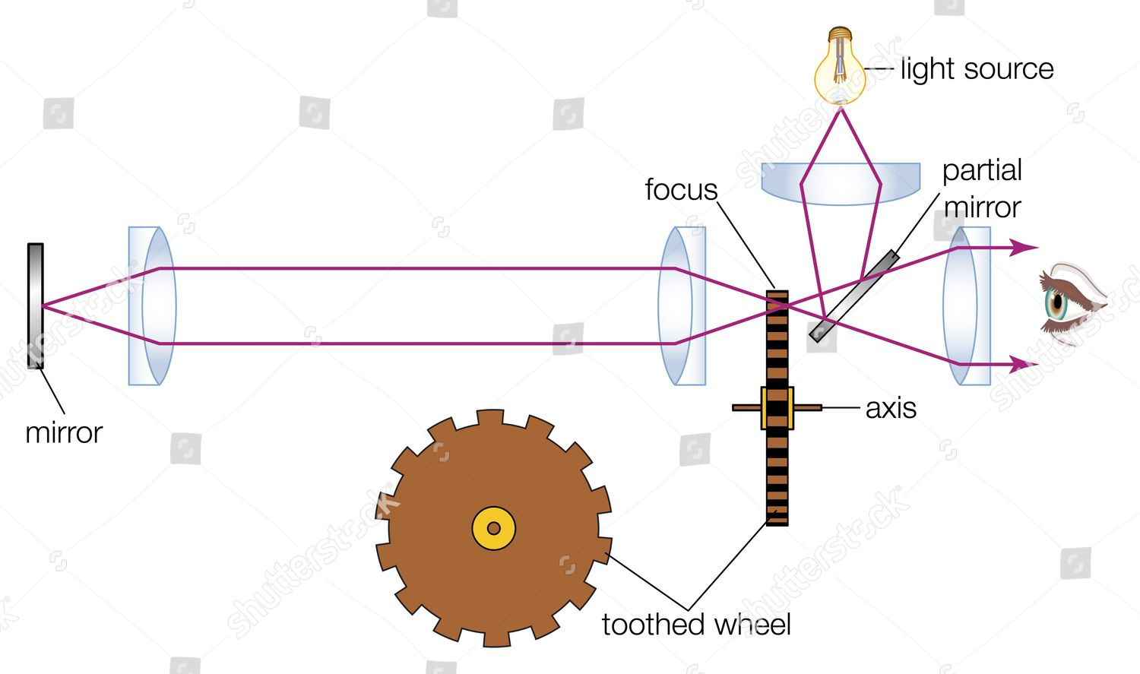
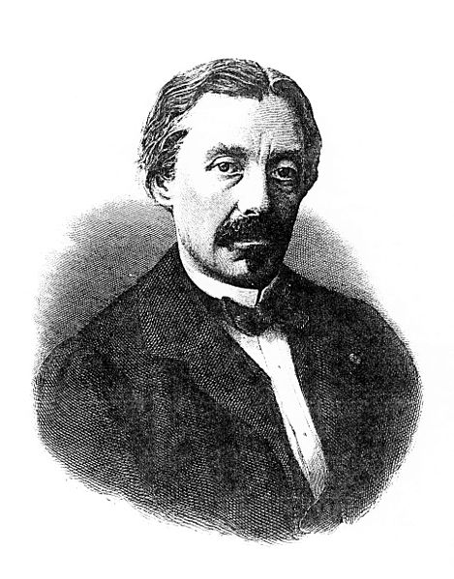
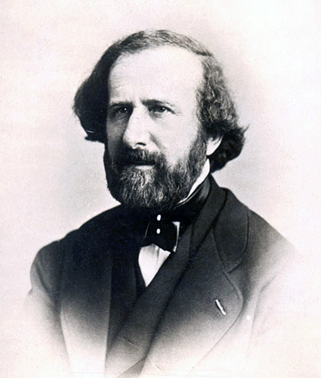
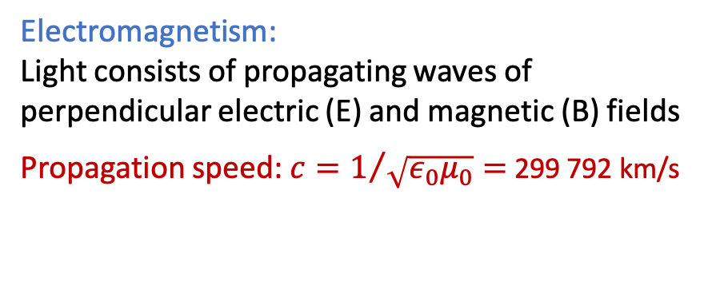
Measurement of the Speed of Light
13
James Clerk Maxwell
Electromagnetism:
Light consists of propagating waves of perpendicular electric (E) and magnetic (B) fields
Propagation speed: $c=1/{\sqrt{ε_{0}μ_{0}}=}$ 299 792 km/s
E
B
1865: “This velocity is so close to the speed of light, that it seems we have to conclude that light is an electromagnetic disturbance.”
1831-1879
Measure the speed of light directly:
20m
8 km
observer
1819-1896
1819-1868
Armand Fizeau
1849: c = 315 000 km/s
Leon Foucault
1862: c = 298 000 km/s
Notes:
What is light? EM wave. Electric and Magnetic fields.
Epsilon: electric permittivity of vacuum; Mu magnetic permeability of vacuum. No need to understand
Armand Hippolyte Fizeau: shine light through semi transparent lens. Via cogwheel to mirror at 8 km! Block the light that returns: darkness if rotation blocked. Detector can be eye.
Foucault: More precise. Shine light detector on a rotating mirror onto a distant (20 m) stationary mirror. When returns it has changed: angle=2 theta: c = 2 d omega / theta

Slide 18
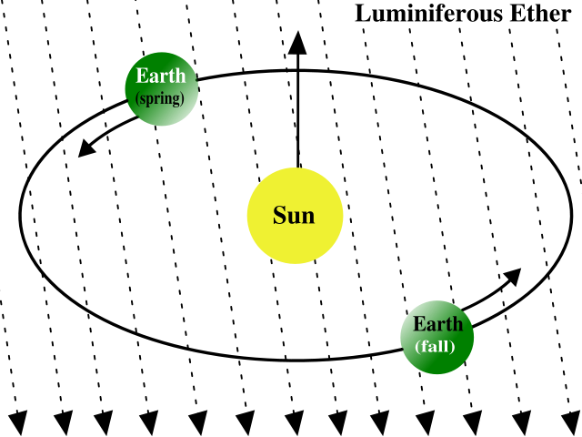

Measurement of the Speed of Light in ether
14
Light waves were believed to be carried by the “ether”.
Earth moves through the ether around sun:
E
30 km/s
B
earth
ether
Measure light speed with interferometer along two perpendicular directions: Michelson-Morley Experiment (1887)
Notes:
Here is a picture of the real set-up.
Difference of lightspeed in two arms
Experiment can be compared to swimming in a canal…

Slide 19
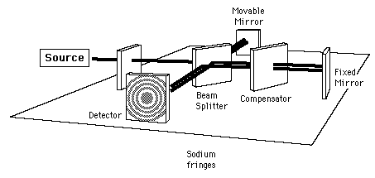
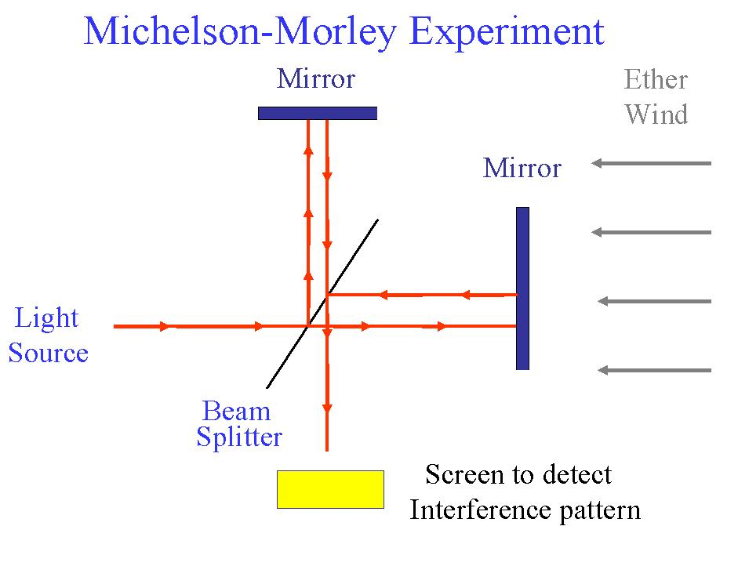
Measurement of the Speed of Light in ether
15
Light waves were believed to be carried by the “ether”.
Earth moves through the ether around sun:
E
30 km/s
B
earth
ether
Measure light speed with interferometer along two perpendicular directions: Michelson-Morley Experiment (1887)
Michelson-Morley Experiment
Mirror
Ether
wind
Mirror
What do we expect to find for the travel times?
Light
source
v
v
v
Detection screen
Interference pattern
Interferometer
Notes:
Water waves need water, air waves need air, electromagnetic waves need aether as a medium?
Universe filled with aether.
On earth eather “wind” from certain direction.
Measure precisely speed of light in different directions wrt aether.
Michelson Morley interference experiment: details do not matter. Interference comes back in lecture 5.
Beam splitter is semi transparent mirror.

Slide 20
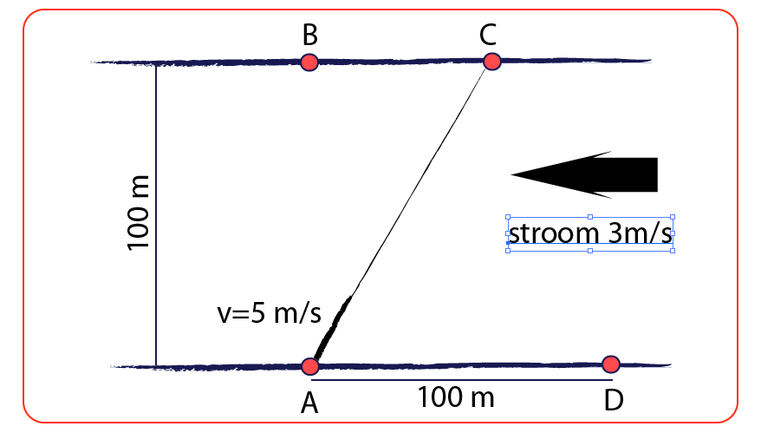
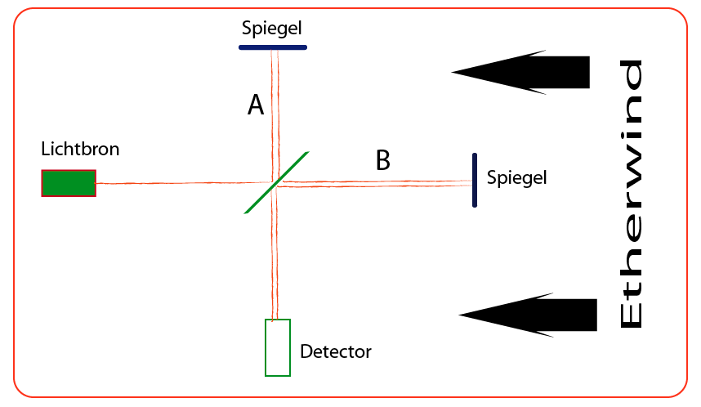
Comparison with water in a river
16
Swimmer crossing a river with flowing water
Light propagating through the ether wind
Mirror
B
Lightsource
Mirror
Flow w= 3 m/s
A
D
Flow w= 30 km/s
Detector
Compare swimming from A → B and back with swimming A → D and back.
Which one is faster?
Water flows from right to left: so swimmer needs to aim to C in order to reach B!
Lightbeam “swims” through the Ether from A → B and back, compared to A → D and back.
Which one is faster?
Suppose Ether flows from right to left.
Notes:
100 m wide canal with water flowing 3 m/s. Swim speed 5 m/s.
Swim up-and-down: A->D->A (200 m)
Swim across A->B->A (200 m)
Which is faster? We will show that across (AB) goes faster than up and down (AD).
This is the same experiment as Michelson-Morley: but they found: no difference!

Slide 21
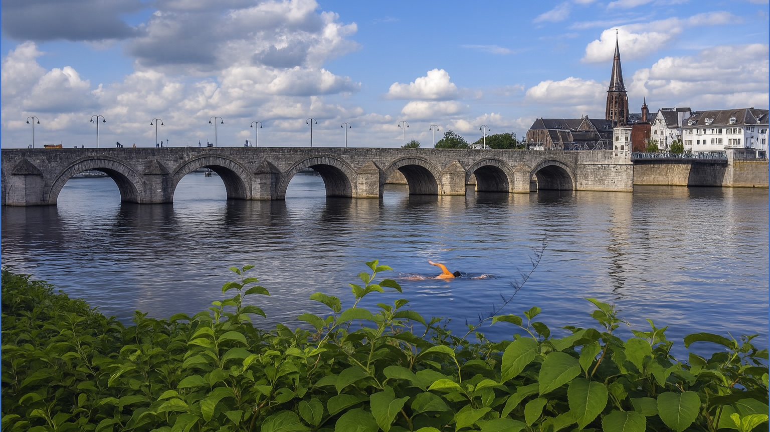
Let’s go swimming
17
“crossing” 100 m
“up and down” 100 m
Which is faster?

Slide 22



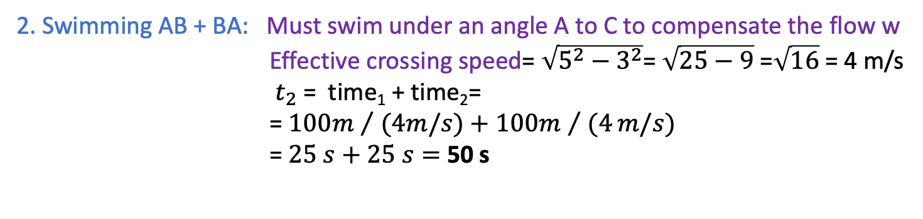
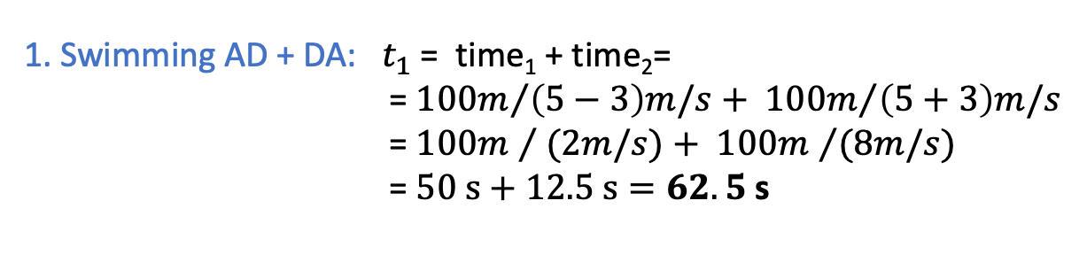
Let’s go: “Crossing” vs “Up-and-Down”
18
1. Swimming AD + DA: $t_{1}$ = time₁ + time₂=
= ${100m}/{\left(5−3\right)m/s}+ {100m}/{\left(5+3\right)m/s}$
= ${100m }/{ (2m/s)+ {100m }/{(8m/s)}}$
= $50 s+12.5 s=62.5$ s
25 s
$$t_{2}$$
v = 5 m/s
w = 3 m/s
$$d$$
Flow w= 3 m/s
12.5 s
50 s
$$t_{1}$$
2. Swimming AB + BA: Must swim under an angle A to C to compensate the flow w
Effective crossing speed= $\sqrt{5^{2}−3^{2}}$= $\sqrt{25−9}$ =$\sqrt{16}$ = 4 m/s
$t_{2}$ = time₁ + time₂=
= ${100m }/{ (4m/s)+{100m }/{ (4}}m/s)$
=$25 s+25 s=$50 s
3m/s
v = 5 m/s
w = 3 m/s
4m/s
5m/s
Pythagoras
Notes:
Here is the proof for the canal!
First AD+DA
Against the stream: v=2 ; with the spream v=8
Then AB+BA
In order to end up at B, you have to swim in direction to C “against” the stream: net speed v=4 m/s
Michelson Morley used L = 11m lambda = 500 x 10^(-9)m = 500 nm. They should have expected for v=30 km/s a shift of 0.1 wave.

Slide 23
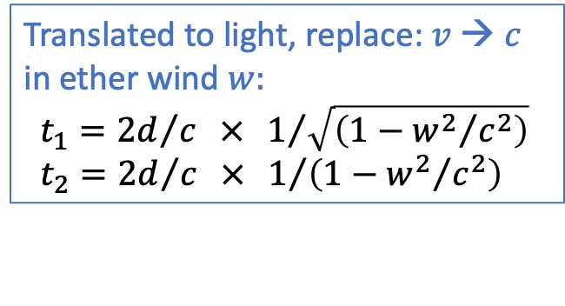
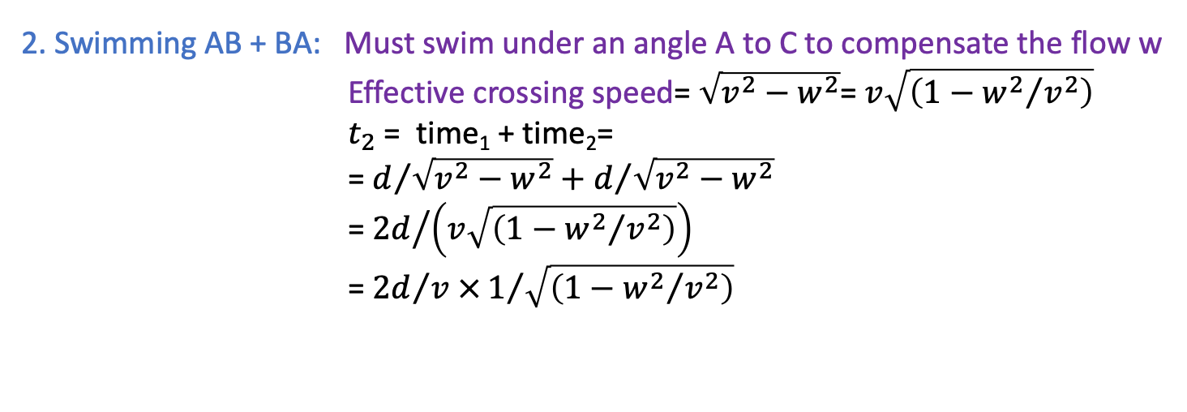
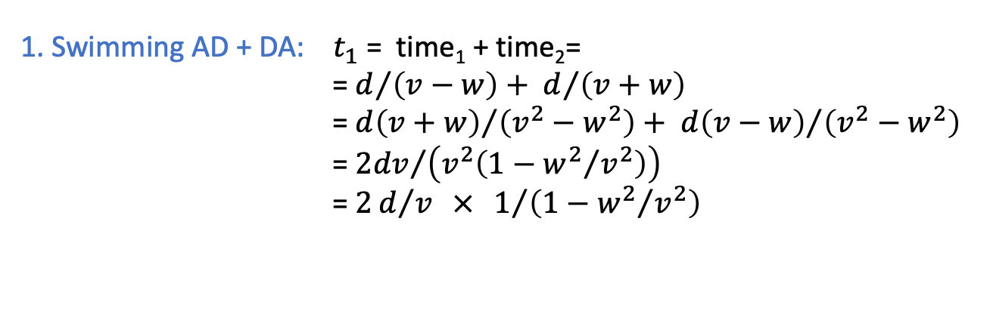
Let’s go: “Crossing” vs “Up-and-Down”
19
1. Swimming AD + DA: $t_{1}$ = time₁ + time₂=
= $d/{\left(v−w\right)}+ d/{\left(v+w\right)}$
= ${d\left(v+w\right)}/{\left(v^{2}−w^{2}\right)+ {d\left(v−w\right)}/{\left(v^{2}−w^{2}\right)}}$
= ${2dv}/{\left(v^{2}\left(1−{w^{2}}/{v^{2}}\right)\right)}$
= $2d/v × 1/{\left(1−{w^{2}}/{v^{2}}\right)}$
$$d$$
Flow w= 3 m/s
2. Swimming AB + BA: Must swim under an angle A to C to compensate the flow w
Effective crossing speed= $\sqrt{v^{2}−w^{2}}$= $v\sqrt{\left(1−{w^{2}}/{v^{2}}\right)}$
$t_{2}$= time₁ + time₂=
= $d/{\sqrt{v^{2}−w^{2}}+d/{\sqrt{v^{2}−w^{2}}}}$
= ${2d}/{\left(v\sqrt{\left(1−{w^{2}}/{v^{2}}\right)}\right)}$
= ${2d}/{v ×1/{\sqrt{\left(1−{w^{2}}/{v^{2}}\right)}}}$
Mirror
B
Lightsource
Translated to light, replace: $v$→ $c$
in ether wind $w:$
$t_{1}={2d}/c × 1/{\sqrt{\left(1−{w^{2}}/{c^{2}}\right)}}$
$t_{2}={2d}/c × 1/{\left(1−{w^{2}}/{c^{2}}\right)}$
Michelson-Morley
measure:
Which is faster?
Mirror
A
D
Detector
Notes:
Let’s write it in formula’s and do some high-school math for fun.
Note that end result is not the same
Michelson Morley used L = 11m lambda = 500 x 10^(-9)m = 500 nm. They should have expected for v=30 km/s a shift of 0.1 wave.
Exactly the same would be true for the light wrt the aether.
But there is no difference seen ➔ no aether.

Slide 24
Comparison of two cases
20
Swimmer crossing a river with flowing water
Light propagating through the ether wind
Mirror
B
Lightsource
Mirror
Flow w= 3 m/s
A
D
Detector
The time traversing 100 meter is shorter than the time for 100 meter up- and downstream.
Measurement with light: no effect, travel times of A→D→A and A→B→A are the same!
The speed of light is always constant!
“The vacuum is the same for any observer”
There is no ether!
Notes:
100 m wide canal with water flowing 3 m/s. Swim speed 5 m/s.
Swim up-and-down: A->D->A (200 m)
Swim across A->B->A (200 m)
Which is faster? We will show that across (AB) goes faster than up and down (AD).
This is the same experiment as Michelson-Morley: but they found: no difference!

Slide 25


A “Gedanken” Experiment…
21
Bohr and Einstein at Ehrenfest’s home in Leiden
A useful tool: Thought experiments:
Consider an experiment that is not limited by our level of technology.
Assume the apparatus works so perfectly that we only test the limits of the laws of nature!
Notes:
Concept that we will use a lot. Bohr and Einstein in their famous dialogues used it a lot.
Einstein could not accept the consequences of quantum theory. Nature could not be like that! The lord does not play dice.
This one invented by einstein to prove QM wrong. Bohr used Einstein relativity to prove that QM was correct!

Slide 26


Absolute velocity?
5
The Sun and earth move in space
with a speed of 828000 km/h.
We do not notice it!
You may ask: speed with respect to what?
- Average of all other galaxies together?
- Cosmic Microwave Background?
But does “absolute velocity” make sense?

Slide 27


22
What is absolute velocity?
v ?

Slide 28
22
What is absolute velocity?
v ?

Slide 29
22
What is absolute velocity?
v ?

Slide 30
22
What is absolute velocity?
v ?
v ?

Slide 31
22
What is absolute velocity?
v ?
c
v ?
v ?
c
How can we define absolute velocity for an object?
The speed of light “c” is always exactly the same for any observer !
Absolute velocity does not exist!

Slide 32



Thought experiment: Alice, Bob and Real Speed
23
Alice cycles with v = 20 km/h
The boat moves with w = 10 km/h
Bob sees 20 km/h + 10 km/h = 30 km/h
➔ What is now Alice’ “real” speed??
Alice
Alice
Alice
10 km/h
20 km/h
Alice’ cabin has no window and she wants to determine whether the boat moves by doing an experiment.
Can she find out she’s moving 30 km/h?
30 km/h
(here illustrated for an airplane)
Bob
Bob
➔ There is no way to determine absolute velocity
Astronauts in the ISS do not notice that they move with 29 000 km/h around earth!
Absolute velocity does not exist!!!
Inertial frames: Observers that move with a constant relative velocity
Notes:
Imagine new situation: Alice on a boat, Bob on shore.
What is the real speed?
First thought experiment. Throw up a ball. Can’t measure absolute speed! Only relative by looking out.
Andre Kuipers

Slide 33




Special Relativity
24
Postulates of Special Relativity
Two observers in so-called Inertial frames, i.e. they move with a constant relative speed to each other, observe that:
The laws of physics for each observer are the same,
The speed of light in vacuum for each observer is the same.
Einstein: No !
A thought experiment:
Bob measures the speed of light rays.
→ What does he find?
Alice also measures the speed of the same light rays.
→ What does she find?
Galilei:
v = 3+1 = 4 x 10⁸ m/s?
3 x 10⁸ m/s!
$$3×{10}^{8} m/s$$
Bob
Alice
$$3×{10}^{8} m/s$$
Special Relativity is in clear contradiction with the Galilei law of addition of velocities!
Notes:
During time in patent office in Bern Einstein formulated postulates.
One cannot do an experiment to determine absolute velocity
Speed of light in vacuum\

Slide 34



Galilei and Einstein Transformation law
25
Bob
Alice
w=
v=
S
S‘
w’= ?
Galileo Galilei
(1564 – 1642)
With which speed do Alice and the ball hit by Bob approach each other?
Intuitive law (daily experience): 30 m/s + 10 m/s = 40 m/s
Galilei formula: $w^{′}=w+v=30+10=40 m/s$
$$w^{′}= \frac{w+v}{1+\frac{vw}{c^{2}}}=\frac{30+10}{1+\frac{30×10}{9×{10}^{16}}}=$$
Einstein formula:
(see lecture 3)
Albert Einstein
1879 - 1955
$=39.999999999999997 m/s$
Notes:
In fact, Einstein predicts something different for baseball as well! Almost correct!. Just bit different. Nobody notices!

Slide 35




Galilei and Einstein Transformation law
26
Bob
Alice
w’= ?
w=
v=
Galileo Galilei
(1564 – 1642)
With which speed do Alice and the light sent by Bob approach each other?
Intuitive law: 300 000 km/s + 100 000 km/s = 400 000 km/s
Galilei formula: $w^{′}=w+v=3×108+1×108=4×108 m/s$
$$=400 000 km/s$$
$$w^{′}= \frac{w+v}{1+\frac{vw}{c^{2}}}=\frac{3×108+1×108}{1+\frac{\left(3×108\right) × (1×{10}^{8})}{ 9×{10}^{16}}}$$
Einstein formula:
(see lecture 3)
Albert Einstein
1879 - 1955
$$=300 000 km/s$$
The same speed of light!
Notes:
But for very high speed the differences in the same formula are large.
4 / (1 + 1/3) = 4 / ((3+1)/3) = 12 / 4 = 3!
We will later “prove” the formula! Alternative: do the experiment.

Slide 36

Absolute Velocity for Alice and Bob
27
We can never measure an absolute velocity in vacuum.
Impossible to say who is “standing still” with respect to the vacuum.
The only absolute reference is the speed of light and it is always 300 000 km/s for every one.
In special relativity absolute velocity has no meaning, only relative velocities do.
Hence: “Theory of relativity”.
c = 3 x 10⁸ m/s
Bob
Alice
“Absolute velocity” is meaningless
Notes:
Back to Alice and Bob in space (no rockets, no stars).
Imagine Alice alone in space
Imagine Bob alone in space.
Who is standing still and who is moving?
How is empty space different for Alice and Bob? It is the same!
Imagine a light beam passing by. EM waves have no memory where they come from.
Alice measures in “her vacuum” the same propagation of light than Bob in his.
Relativity is the ultimate experience when you look at a departing train from another one. Who is moving?

Slide 37

Completely Counterintuitive!
28
Shooting an arrow
Shooting laser light
Notes:
Completely counterintuitive to every day life.

Slide 38


How about the cosmic microwave background? – experts!
29
Cosmic microwave background radiation is light that is emitted in early universe and comes from all directions in space!
Dipole effect of earth movement in space visible as a sine wave.
So does the dipole define an absolute Lorentz frame in the universe?
Can we measure absolute velocity by comparing to that special reference frame?
After subtraction of the dipole effect what remains is uniform radiation spectrum of 2.7 K
Notes:
For the experts: can we measure absolute velocity as any velocity w.r.t. the dipole of the cosmic ray background.

