Slide 1
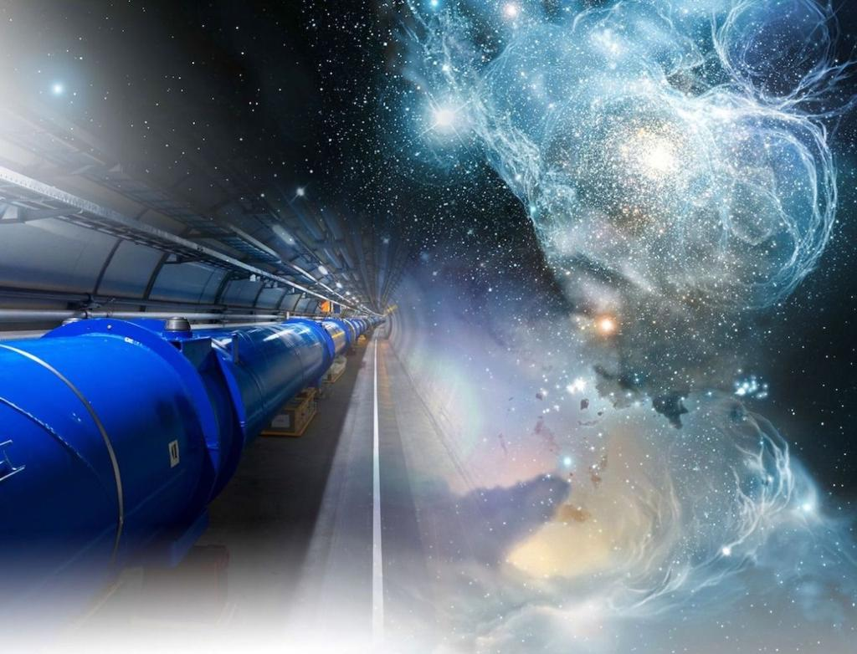
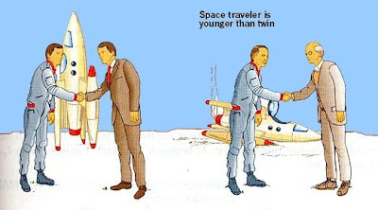
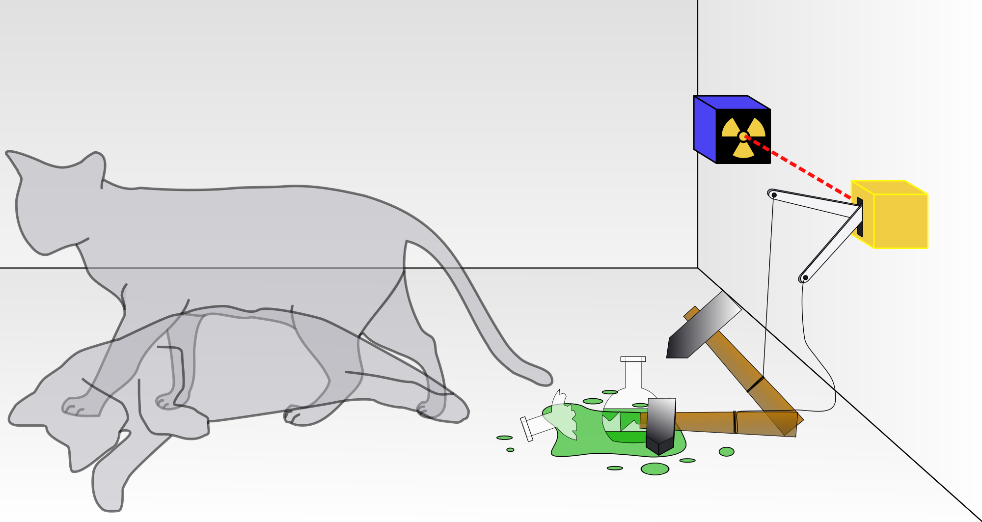
The Relativistic Quantum World
Relativity
A lecture series on
Relativity Theory and Quantum Mechanics
Quantum
Marcel Merk
Studium Generale Maastricht
Nov 1 – Nov 29, 2023
Notes:
Welcome to cours eon relativity and QM.
Course March-April; interrupted Covid-19. Begin from the start.
Explain picture. Interesting (“bizarre”) aspects of relativity and QM

Slide 2
The Relativistic Quantum World
1
Lecture 1: The Principle of Relativity and the Speed of Light
Lecture 2: Time Dilation and Lorentz Contraction
Lecture 3: The Lorentz Transformation and Paradoxes
Lecture 4: General Relativity and Gravitational Waves
Nov. 1:
Relativity
Nov. 8:
Lecture 5: The Early Quantum Theory
Lecture 6: Feynman’s Double Slit Experiment
Lecture 7: Wheeler’s Delayed Choice and Schrodinger’s Cat
Lecture 8: Quantum Reality and the EPR Paradox
Quantum
Mechanics
Nov. 15:
Nov 22:
Standard
Model
Lecture 9: The Standard Model and Antimatter
Lecture 10: Why is there something rather than nothing?
Nov. 29:
Lecture notes, written for this course, are available: www.nikhef.nl/~i93/Teaching/
Prerequisite for the course: High school level physics & mathematics.
Notes:
Ambitious!

Slide 3
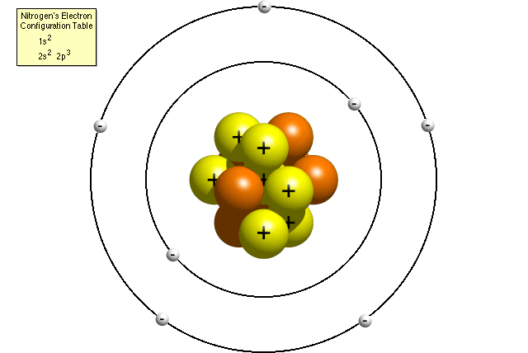
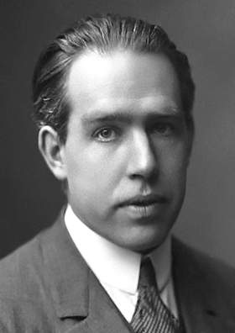

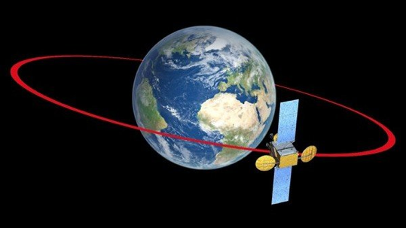


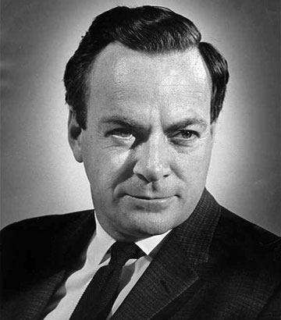

Relativity and Quantum Mechanics
2
Classical Mechanics
Quantum Mechanics
Smaller Sizes (ħ)
Newton
Bohr
From our experience we are not used to relativistic and quantum mechanical phenomena. That’s why we find it counterintuitive.
Higher Speed (c)
Dirac
Feynman
Einstein
Relativity Theory
Quantum Field Theory
Notes:
Classical physics based on daily experience. Physics of the very fast and very small is counterintuitive! c and h-bar are fundamental constants of nature. Is there something that goes beyond c and h? No. QFT combines Relativity and QM.

Slide 4
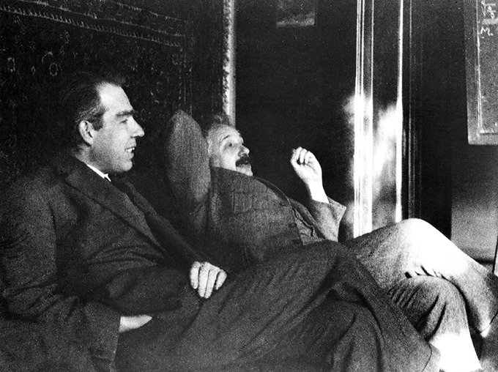
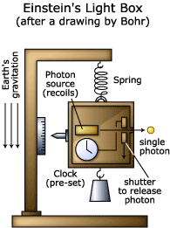
A “Gedanken” Experiment
3
Bohr and Einstein at Ehrenfest’s home in Leiden
A useful tool: Thought experiments:
Consider an experiment that is not limited by our level of technology.
Assume the apparatus works so perfectly that we only test the limits of the laws of nature!
Notes:
Concept that we will use a lot. Bohr and Einstein in their famous dialogues used it a lot.
Einstein could not accept the consequences of quantum theory. Nature could not be like that! The lord does not play dice.
This one invented by einstein to prove QM wrong. Bohr used Einstein relativity to prove that QM was correct!

Slide 5
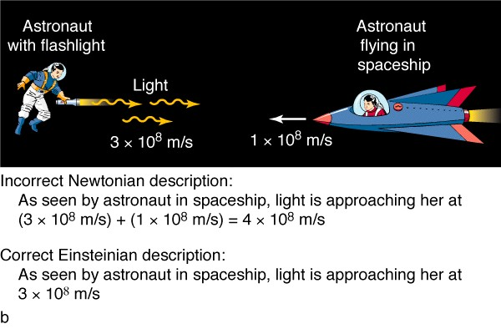
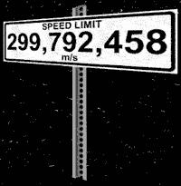
The Story Sofar
4
Postulates of Special Relativity
Two observers in so-called inertial frames, i.e. they move with a constant relative speed to each other, observe that:
The laws of physics for each observer are the same,
The speed of light in vacuum for each observer is the same.
c = 300 000 km/s
“Absolute velocity” is meaningless.
Notes:
Einstein postulates to be derived from purely thinking about the vacuum.
Light speed is measured.

Slide 6
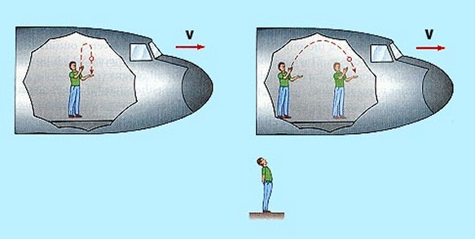
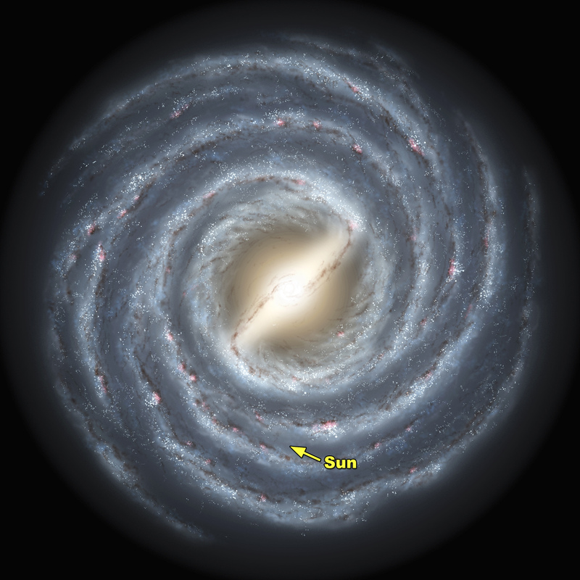
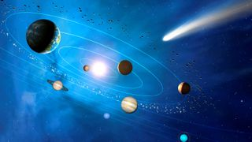
The Story Sofar: Principle of Relativity
5
The Sun and earth move in space
with a speed of 828000 km/h.
We do not notice it!

Slide 7
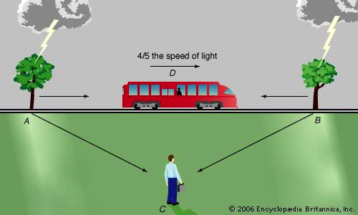
The Story Sofar: Simultaneity
6
Bob: “Strikes A and B are simultaneous”
Alice: “Strike B happens before A”
Alice
Bob
Notes:
Simultaneity of two events is not the same for moving observers.
Time clock in train: time slows down
Distances shrink

Slide 8
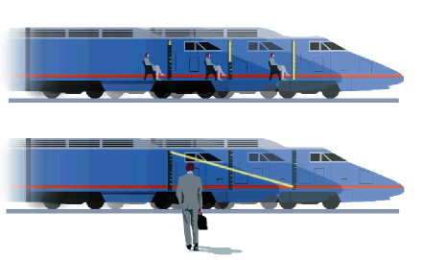
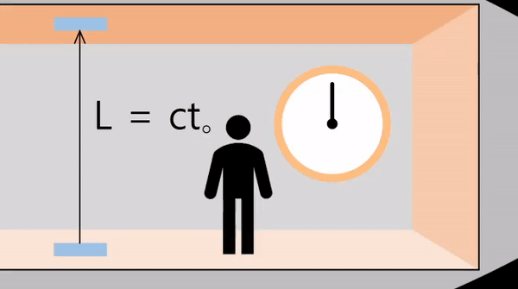
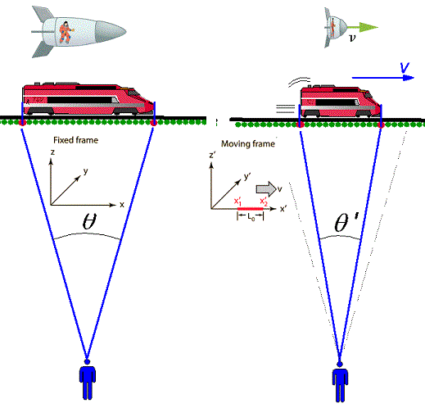
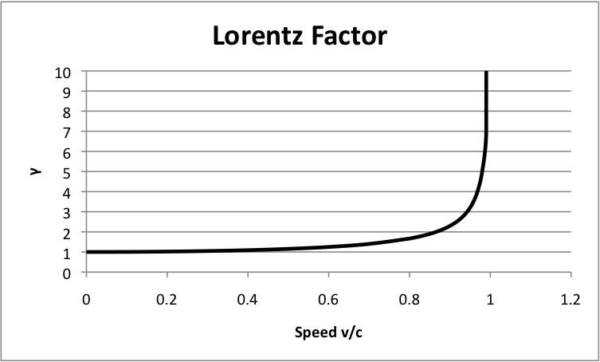
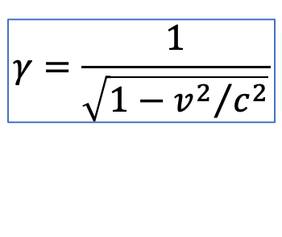
The Story Sofar: Time Dilation and Lorentz Contraction
14
7
Time Dilation
Time slows down
Alice
v
Bob
γ
$$γ=\frac{1}{\sqrt{1−{v^{2}}/{c^{2}}}}$$
Lorentz Contraction
Length shrinks
Speed v/c
Notes:
Perfect clock = Light clock. Never runs wrong! It ticks 300 million times per second
Alice takes the clock on the train – nothing changes
Bob looks from station: longer distance, same lightspeed -> slower ticks
Calculation next slide

Slide 9
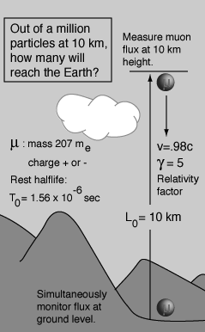
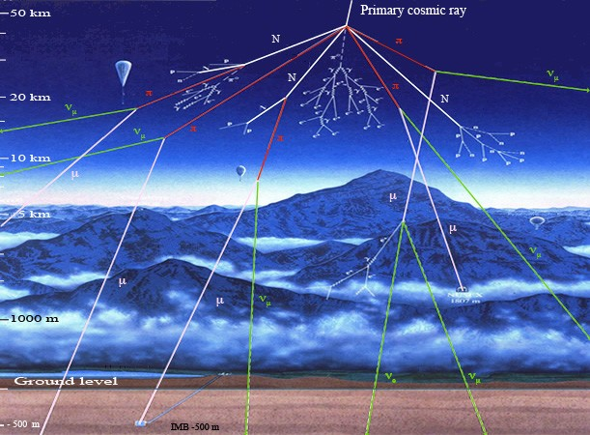
The Story Sofar: A Real Experiment
8
Muon particles are created at 10 km height. They have a half-lifetime of 1.56 μs , too short to reach the ground, but:…
Notes:
It is a real effect: muon particles can live long enough to reach earth from great height

Slide 10
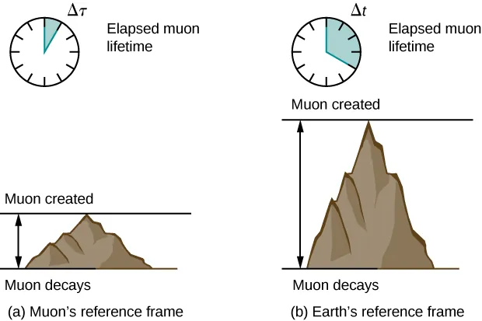
The Story Sofar: A Real Experiment
9
Muon particles are created at 10 km height. They have a half-lifetime of 1.56 μs , too short to reach the ground, but:
As seen from an observer on earth they live a factor 5 longer
As seen from the muon particle the distance is a factor 5 shorter
Notes:
It is a real effect: muon particles can live long enough to reach earth from great height

Slide 11
10
Lecture 3
The Lorentz Transformation and Paradoxes
“Imagination is more important than knowledge.”
Albert Einstein
Notes:
We will do a bit of mathematics and in a few slides derive the law of adding velocities!
Then we will encounter and solve a few funny paradoxes

Slide 12
Coordinate Systems
11
A reference system or coordinate system is used to determine the time and position of an event.
Reference system S is linked to observer Bob at position (x,y,z) = (0,0,0)
An event is fully specified by giving its coordinates and time: (t, x, y, z)
Reference system S’ is linked to observer Alice who is moving with velocity v with respect to Bob. The event has: (t’, x’, y’, z’)
How are the coordinates of an event, say a lightning strike in a tree, expressed in coordinates for Bob and for Alice?
(t, x, y, z) → (t’, x’, y’, z’)
S: “Bob”
S’: “Alice”
Notes:
A reminder of the mathematic formulation

Slide 13
Space-time diagram
12
Bob drives from Maastricht to Amsterdam with 100 km/h.
Alice drives from Maastricht to Amsterdam with 200 km/h.
t
“Events”:
12h00
Departure Alice & Bob
1 h
Arrival Bob
Arrival Alice
11h00
“World lines”:
1 h
Bob’s world-line
Alice’s world-line
10h00
(x,t)
x
200 km
Maastricht
Amsterdam
Events with space-time coordinates: (x,t)
More general: it is a 4-dimensional coordinate system: (x,y,z,t)
Notes:
Minkowski diagram.
Let’s follow the classical (Galilei – intuitive) way first:

Slide 14


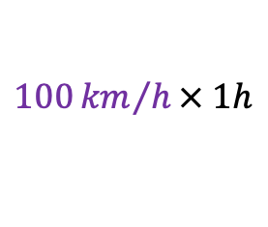


Coordinate transformation
13
How does Alice’s trip look like in the coordinates of the reference system of Bob?
t
t’
12h00
12h00
$$t_{2}^{′}=t_{2}$$
1 h
1 h
$1h=1h$
(100km,1h)
(x₂,t₂)
(x₂’,t₂’)
11h00
11h00
$$x_{2}^{′}=x2−vt$$
(200km,1h)
$$100 km=200 km −$$
1 h
1 h
$100{km}/h× 1h$
(x₁’,t₁’)
10h00
(x₁,t₁)
10h00
(0,0)
x
(0,0)
x’
200 km
100 km
Alice as seen from Maastricht
S = fixed reference system in Maastricht
Alice as seen from Bob
S’ = fixed reference to Bob
Bob’s reference frame moves with velocity v (100km/h) with respect to Maastricht

Slide 15
Coordinate transformation
14
How does Alice’s trip look like in the coordinates of the reference system of Bob?
t
t’
12h00
12h00
$$t_{2}^{′}=t_{2}$$
1 h
1 h
$1h=1h$
(100km,1h)
(x₂,t₂)
(x₂’,t₂’)
11h00
11h00
$$x_{2}^{′}=x2−vt$$
(200km,1h)
$$100 km=200 km −$$
1 h
1 h
$100{km}/h× 1h$
(x₁’,t₁’)
10h00
(x₁,t₁)
10h00
(0,0)
x
(0,0)
x’
200 km
100 km
Classical (Gallilei Transformation):

Slide 16




Coordinate transformation
14
How does Alice’s trip look like in the coordinates of the reference system of Bob?
t
t’
12h00
12h00
$$t_{2}^{′}= ?$$
1 h
1 h
$1h → ?$
(100km,1h)
(x₂,t₂)
(x₂’,t₂’)
11h00
11h00
$$x_{2}^{′}= ?$$
(200km,1h)
$$100 km→ ?$$
1 h
1 h
(x₁’,t₁’)
10h00
(x₁,t₁)
10h00
(0,0)
x
(0,0)
x’
200 km
100 km
Classical (Gallilei Transformation):
Relativistic (Lorentz Transformation):
with:

Slide 17
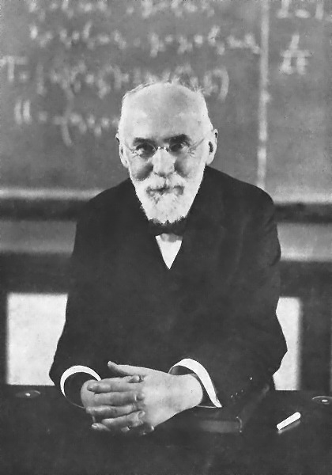
Lorentz Transformations
15
Hendrik Anton Lorentz (1853 – 1928)
Dutch Physicist in Leiden
(Nobelprize 1902 with Pieter Zeeman)
To explain the Michelson-Morley experiment he assumed that bodies contracted due to intermolecular forces as they were moving through the aether.
(He believed in the existence if the aether)
Einstein derived it from the relativity principle and also saw that time has to be modified.
Notes:
Zeeman effect: splitting of spectral lines in the presence of a magnetic field (NMR -> MRI)
(Stark effect: splitting of spectral lines in the presence of an electric field)
Most influential person in Einstein’s life and career. Einstein was present at Lorentz’ funeral in Haarlem.
Einstein was offered Lorentz position in Leiden, but had just accepted a chair in Zurich at ETH. Paul Ehrenfest took the position in Leiden.

Slide 18





Let’s go crazy and derive the Lorentz Transformation…
16
Start with classical Galilei Transformation:
$$x^{′}=x−vt$$
$$x=x^{′}+vt′$$
Let’s try relativity by including a factor f:
$$x^{′}=f\left(x−vt\right)$$
$$x=f\left(x^{′}+vt′\right)$$
For light: $x=ct$ and $x^{′}=ct^{′}$
c = 300 000 km/s
Notes:
Also time transformation: again there is no universal time.

Slide 19


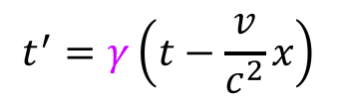

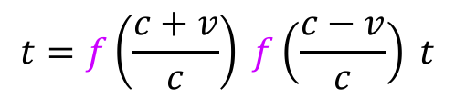

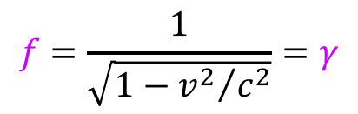

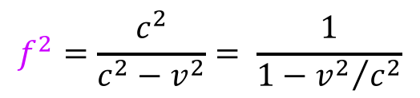
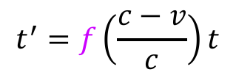



Let’s go crazy and derive the Lorentz Transformation…
17
Start with classical Galilei Transformation:
Divide by $t$:
$1=\left(\frac{c+v}{c}\right)\left(\frac{c−v}{c}\right)f^{2}=\left(\frac{c^{2}−v^{2}}{c^{2}}\right)f^{2}$
$$x^{′}=x−vt$$
$$x=x^{′}+vt′$$
$$f^{2}=\frac{c^{2}}{c^{2}−v^{2}}= \frac{1}{1−{v^{2}}/{c^{2}}}$$
It follows then that:
Let’s try relativity by including a factor f:
$$x^{′}=f\left(x−vt\right)$$
$$x=f\left(x^{′}+vt′\right)$$
$$f=\frac{1}{\sqrt{1−{v^{2}}/{c^{2}}}}=γ$$
So that we find:
For light: $x=ct$ and $x^{′}=ct^{′}$, so:
$${ct}^{′}=f\left(ct−vt\right)$$
Therefor we have derived the Lorentz transformation:
$$ct=f\left({ct}^{′}+vt′\right)$$
$$x^{′}=γ\left(x−vt\right)$$
Then:
$$t^{′}=f\left(\frac{c−v}{c}\right)t$$
Similarly we find the Lorentz transformation for time:
(see lecture notes)
$$t^{′}=γ\left(t−\frac{v}{c^{2}}x\right)$$
$$t=f\left(\frac{c+v}{c}\right)t′$$
Substitute first into second:
whereas the Galilei
translation was:
$$t^{′}=t$$
$$t=f\left(\frac{c+v}{c}\right) f\left(\frac{c−v}{c}\right) t$$
Notes:
Also time transformation: again there is no universal time.

Slide 20
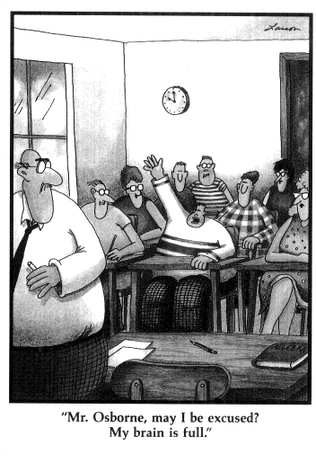
Let’s go crazy and derive the Lorentz Transformation…
17
Start with classical Galilei Transformation:
Divide by $t$:
$1=\left(\frac{c+v}{c}\right)\left(\frac{c−v}{c}\right)f^{2}=\left(\frac{c^{2}−v^{2}}{c^{2}}\right)f^{2}$
$$x^{′}=x−vt$$
$$x=x^{′}+vt′$$
$$f^{2}=\frac{c^{2}}{c^{2}−v^{2}}= \frac{1}{1−{v^{2}}/{c^{2}}}$$
It follows then that:
Let’s try relativity by including a factor f:
$$x^{′}=f\left(x−vt\right)$$
$$x=f\left(x^{′}+vt′\right)$$
$$f=\frac{1}{\sqrt{1−{v^{2}}/{c^{2}}}}=γ$$
So that we find:
For light: $x=ct$ and $x^{′}=ct^{′}$, so:
$${ct}^{′}=f\left(ct−vt\right)$$
Therefor we have derived the Lorentz transformation:
$$ct=f\left({ct}^{′}+vt′\right)$$
$$x^{′}=γ\left(x−vt\right)$$
Then:
$$t^{′}=f\left(\frac{c−v}{c}\right)t$$
Similarly we find the Lorentz transformation for time:
(see lecture notes)
$$t^{′}=γ\left(t−\frac{v}{c^{2}}x\right)$$
$$t=f\left(\frac{c+v}{c}\right)t′$$
Substitute first into second:
whereas the Galilei
translation was:
$$t^{′}=t$$
$$t=f\left(\frac{c+v}{c}\right) f\left(\frac{c−v}{c}\right) t$$
Notes:
Also time transformation: again there is no universal time.

Slide 21
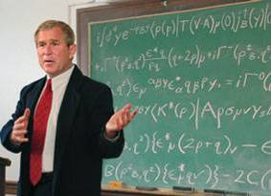
Mathematics isn’t too hard…
18

Slide 22










The classical limit (everyday life experience)
19
Lorentz transformation:
With new variables:
Daily life experience: speed
much lower than lightspeed:
$$t^{′}=\frac{t−\frac{v}{c^{2}}x}{\sqrt{1−\frac{v^{2}}{c^{2}}}}$$
$$β=\frac{v}{c}$$
Fraction of
lightspeed
$v≪c$ , $β≪1$
$$γ≈1$$
$$γ=\frac{1}{\sqrt{1−\frac{v^{2}}{c^{2}}}}$$
$$x^{′}=\frac{x−vt}{\sqrt{1−\frac{v^{2}}{c^{2}}}}$$
Relativistic
factor
$$ct^{′}=γ\left(ct−βx\right)$$
$$t^{′}≈t$$
$$x′=γ\left(x−βct\right)$$
$$x^{′}≈x−vt$$
(Einstein)
(Galilei)
Notes:
Looks complicated.
By doing some more mathematical substitutions we can make it more elegant (and simpler)

Slide 23
The classical limit (everyday life experience)
19
Lorentz transformation:
With new variables:
Daily life experience: speed
much lower than lightspeed:
$$t^{′}=\frac{t−\frac{v}{c^{2}}x}{\sqrt{1−\frac{v^{2}}{c^{2}}}}$$
$$β=\frac{v}{c}$$
Fraction of
lightspeed
$v≪c$ , $β≪1$
$$γ≈1$$
$$γ=\frac{1}{\sqrt{1−\frac{v^{2}}{c^{2}}}}$$
$$x^{′}=\frac{x−vt}{\sqrt{1−\frac{v^{2}}{c^{2}}}}$$
Relativistic
factor
$$ct^{′}=γ\left(ct−βx\right)$$
$$t^{′}≈t$$
In everyday life we do not see the difference between the classical and relativity theory!
$$x′=γ\left(x−βct\right)$$
$$x^{′}≈x−vt$$
(Einstein)
(Galilei)

Slide 24

Paradoxes
20

Slide 25
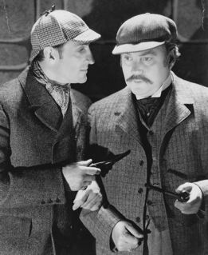
Paradoxes Case 1: Sherlock & Watson
21
A murder scene is being investigated.
Alice enters a room and from the doorstep shoots Bob, who dies. (Thought experiment!)
Sherlock (S) stands at the doorstep (next to Alice) and observes the events.
Alice shoots at t = t_{A} from position x = x_{A}
Bob dies at t = t_{B} at position x = x_{B}
Watson (S’) passes by on a fast train and sees the same scene. He sees:
• Alice shoots at t’ = t_{A}’ from position x’ = x_{A}’
• Bob dies at t’ = t_{B}’ at position x’ = x_{B}’

Slide 26
Paradoxes Case 1: Sherlock & Watson
22
A murder scene is being investigated.
Alice enters a room and from the doorstep shoots Bob, who dies. (Thought experiment!)
Sherlock (S) stands at the doorstep (next to Alice) and observes the events.
Alice shoots at t = t_{A} from position x = x_{A}
Bob dies at t = t_{B} at position x = x_{B}
Watson (S’) passes by on a fast train and sees the same scene. He sees:
• Alice shoots at t’ = t_{A}’ from position x’ = x_{A}’
• Bob dies at t’ = t_{B}’ at position x’ = x_{B}’
Sherlock: Alice shoots at Bob from x_{A} at time t_{A}
Bob dies on position x_{B} and time t_{B}
ct
(x_{B},ct_{B})
ct_{B}
0
(x_{A},ct_{A})
x
0
x_{B}

Slide 27
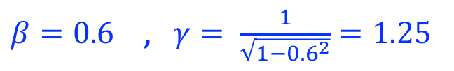
Causality
23
Sherlock: Alice shoots at Bob from x_{A} at time t_{A}
Bob dies on position x_{B} and time t_{B}
What does Watson see at v=0.6c?
$β=0.6$ , $γ= \frac{1}{\sqrt{1−{0.6}^{2}}}=1.25$
ct
(x_{B},ct_{B})
ct_{B}
0
(x_{A},ct_{A})
x
To make the calculation easy let’s take
x_{A} = 0 and t_{A} = 0 :
0
x_{B}
ct’
This is what Watson sees:
?
(x_{A}’,ct_{A}’)
(x_{B}’,ct_{B}’)
0
ct_{B}’
x’
If distance x_{B} > ct_{B}/0.6 then ct_{B}‘ < 0 :
Bob dies before Alice shoots the gun!
0
x_{B}’

Slide 28

What is wrong?
24
The situation was not possible to begin with!
Light-speed
Nothing can travel faster than the speed of light, also not the bullet of gun!
The requirement: x_{B} > c t_{B} / 0.6 implies a bullet speed of :
v = x_{B}/t_{B} > c / 0.6 = 1.67 c !
Faster than speed of light!
Travelling faster than light would imply you go back in time.
ct
Time-like
Space-like
(x_{B},ct_{B})
0
(x_{A},ct_{A})
x
0
Causality is not affected by the relativity theory!
Notes:
The optimal situation is when Alice uses a laser gun: at the 45 degree light cone. If Watson passes with the speed of light he observes the events simultaneously.

Slide 29
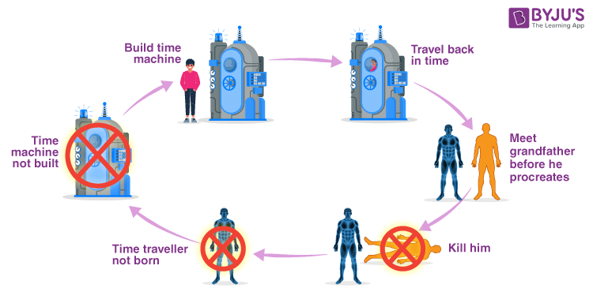
“Grandfather Paradox”
25

Slide 30
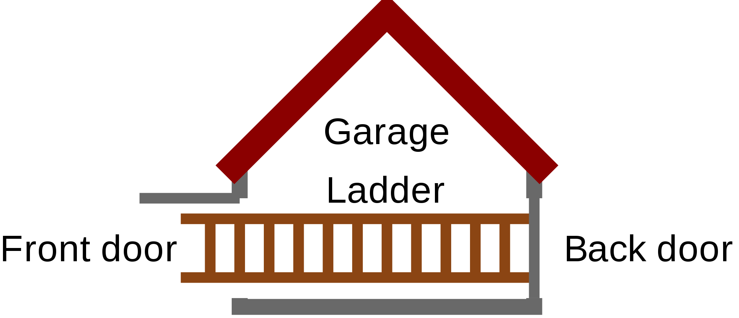
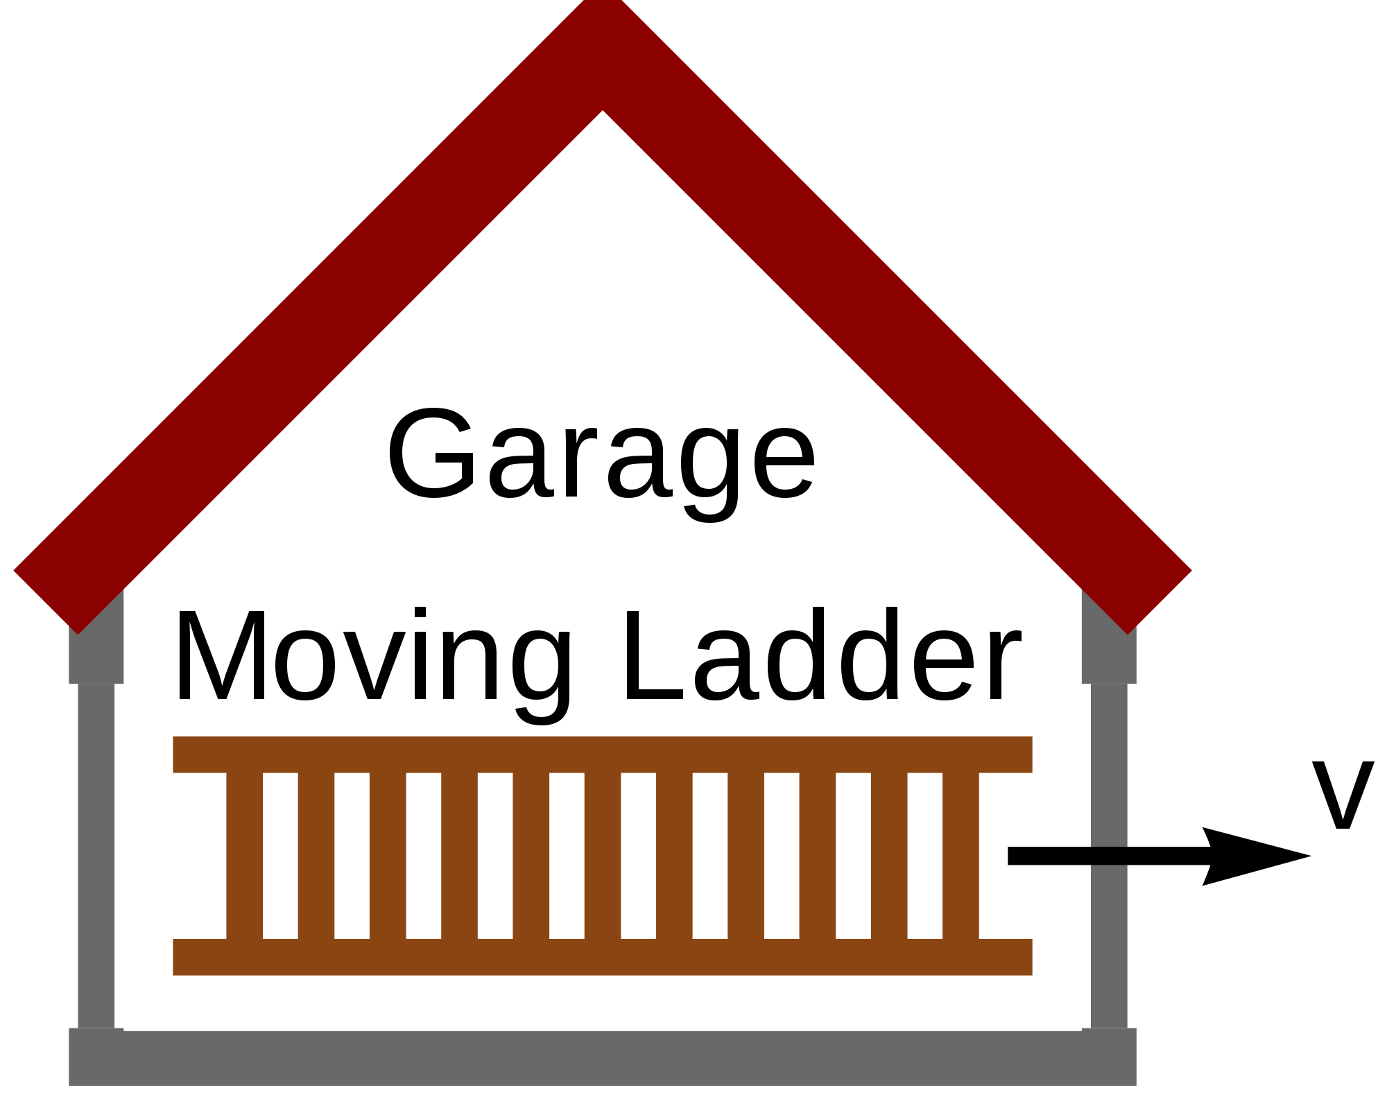
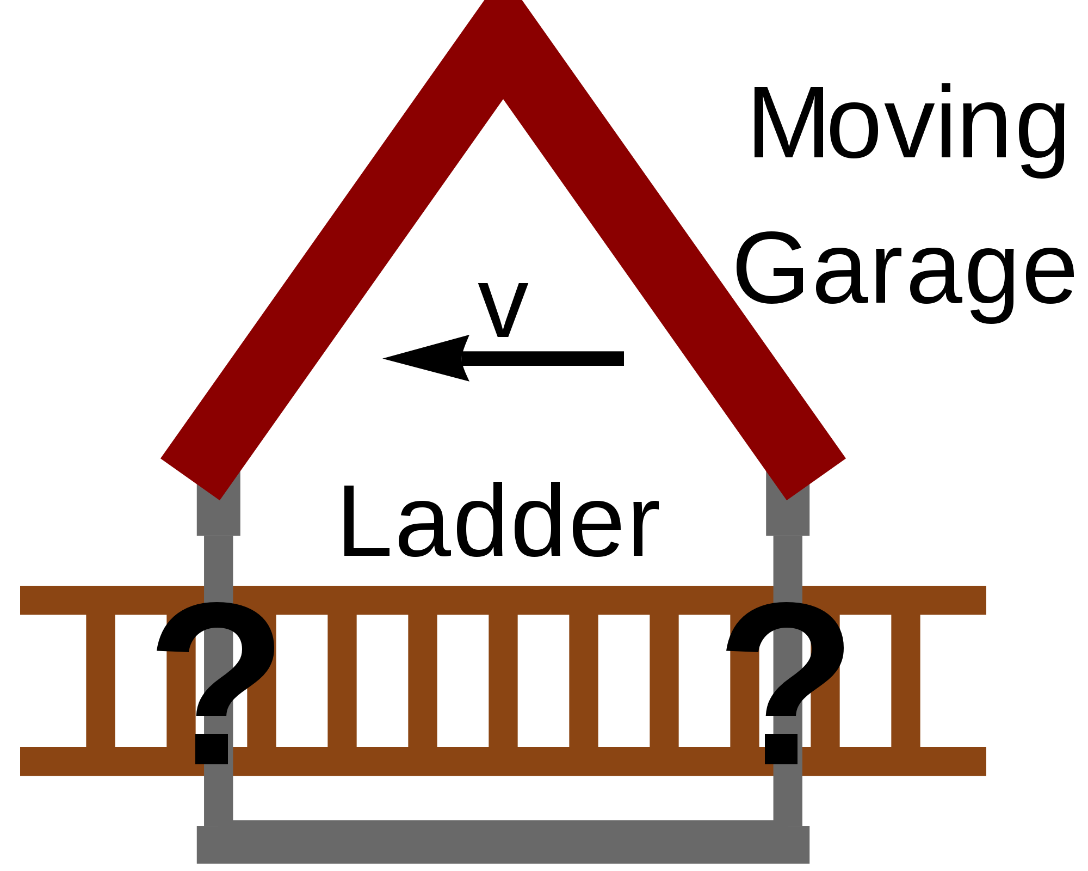
Paradox 2: A ladder in a barn?
26
Alice runs towards a barn with
v = 0.8 c (γ =1.66).
She carries a 5 m long ladder.
Bob stands next to 4 m deep barn.
Will the ladder fit inside?
4 meters
5 meters
Bob: sure, no problem!
He sees a L/γ = 3 m long ladder
Alice: no way!
She sees a L/γ = 2.4 m deep barn

Slide 31
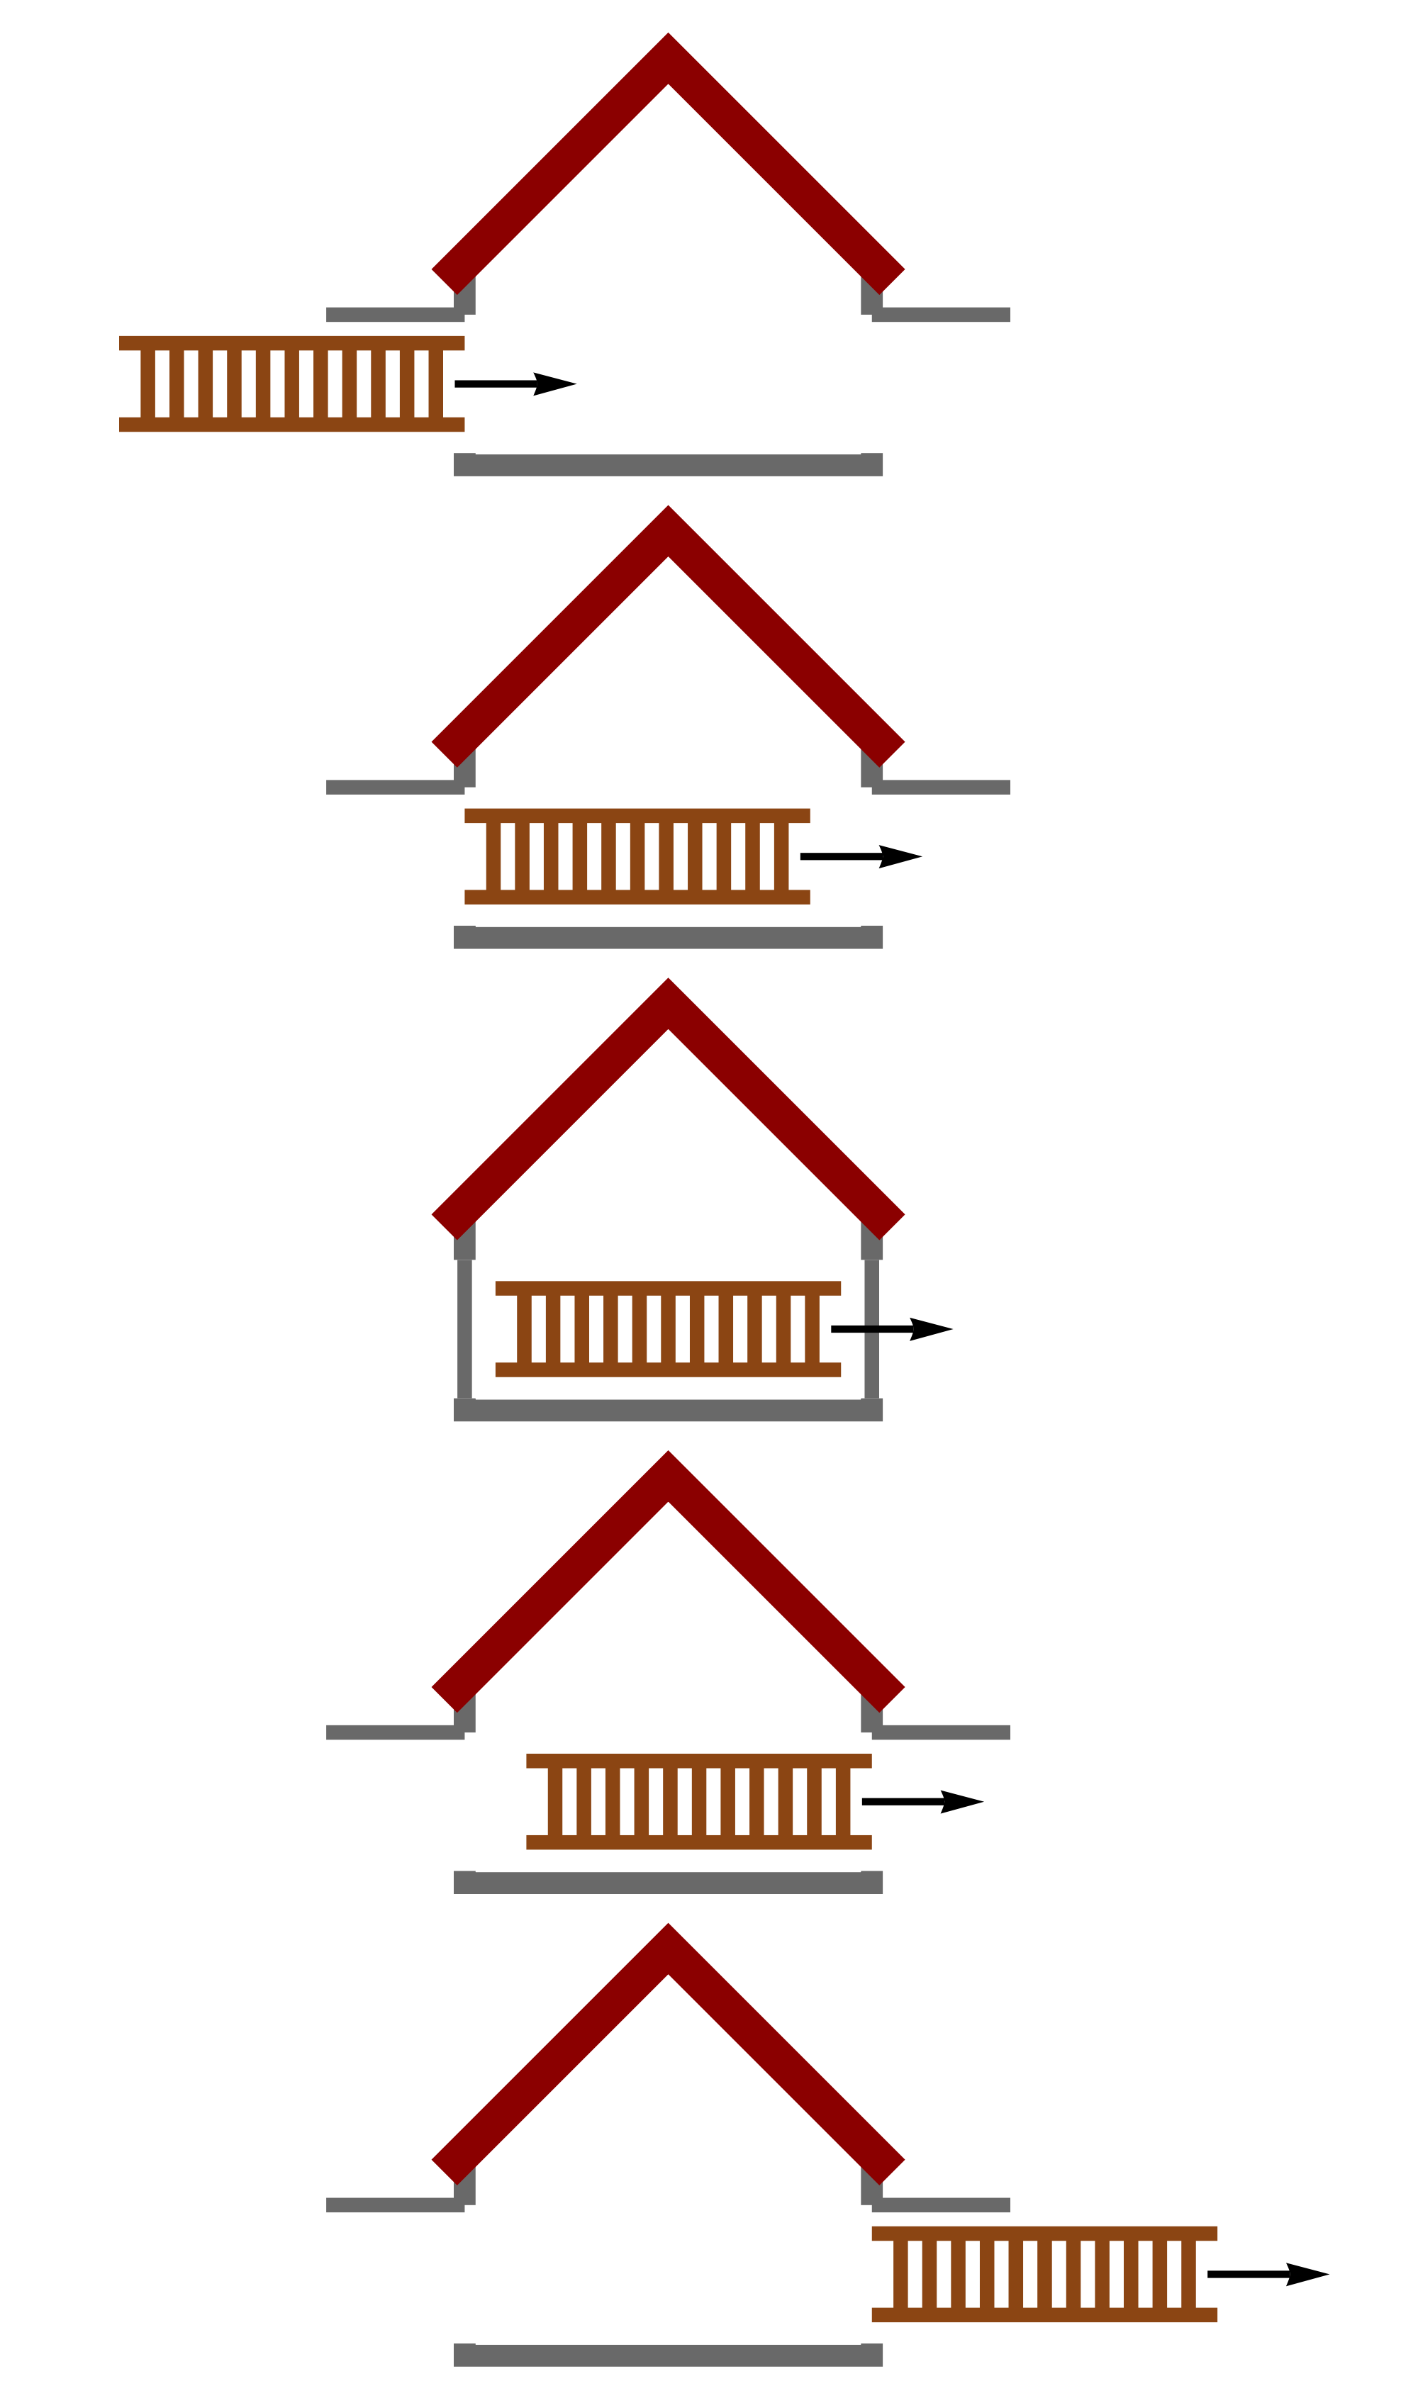
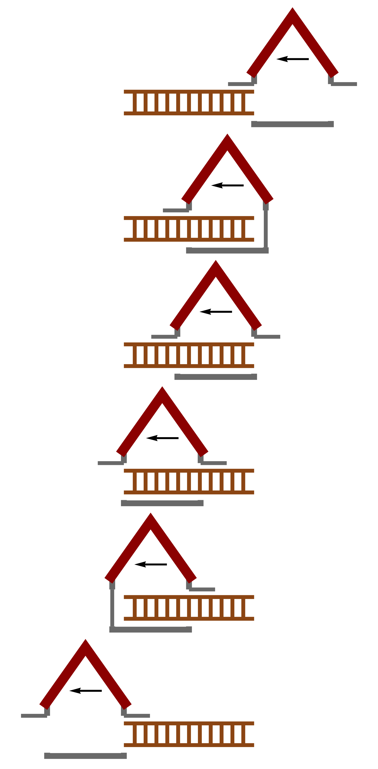
Paradox 2: A ladder in a barn?
27
Bob’s experiment:
Alice’s experiment:
Bob and Alice don’t agree on simultaneity of events.
Alice claims the back door is opened before the front door is closed.
Bob claims both doors are closed at the same time.
Ladder = 3m
Barn = 4m
Ladder = 5m
Barn = 2.4m
*But will it stay inside?!
To stay inside the ladder must stop (negative accelleration)
Compressibility → lightspeed
The ladder has been fully inside
The ladder has not been fully inside

Slide 32
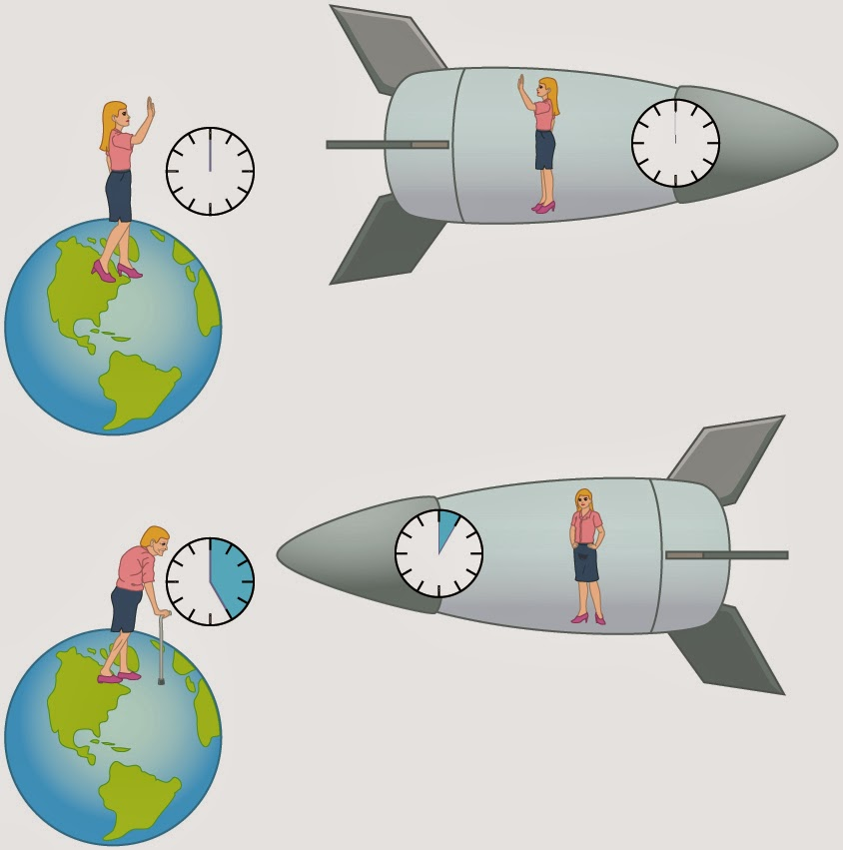
Paradox 3: The Twin Paradox
28
Meet identical twins: Jane and Julie
Jane
Julie travels to a star with v = 99.5% of c (γ = 10) and returns to Jane on earth after one year travel.
Jane has aged 10 years, Julie only 1 year.
Julie
Jane understands this. Due to Julie’s high speed
time went slower by a factor of 10 and therefore
Jane has aged more than Julie.
“Jane+10y”
“Julie+1y”
But Julie argues: the only thing that matters is our relative speed!
From her spaceship time goes slower on earth! She claims Jane should be younger!
Who is right?
Answer: special relativity holds for constant relative velocities.
When Julie turns around she slows down, turns and accelerates back.
At that point time on earth progresses fast for her, so that Jane is right in the end.

Slide 33
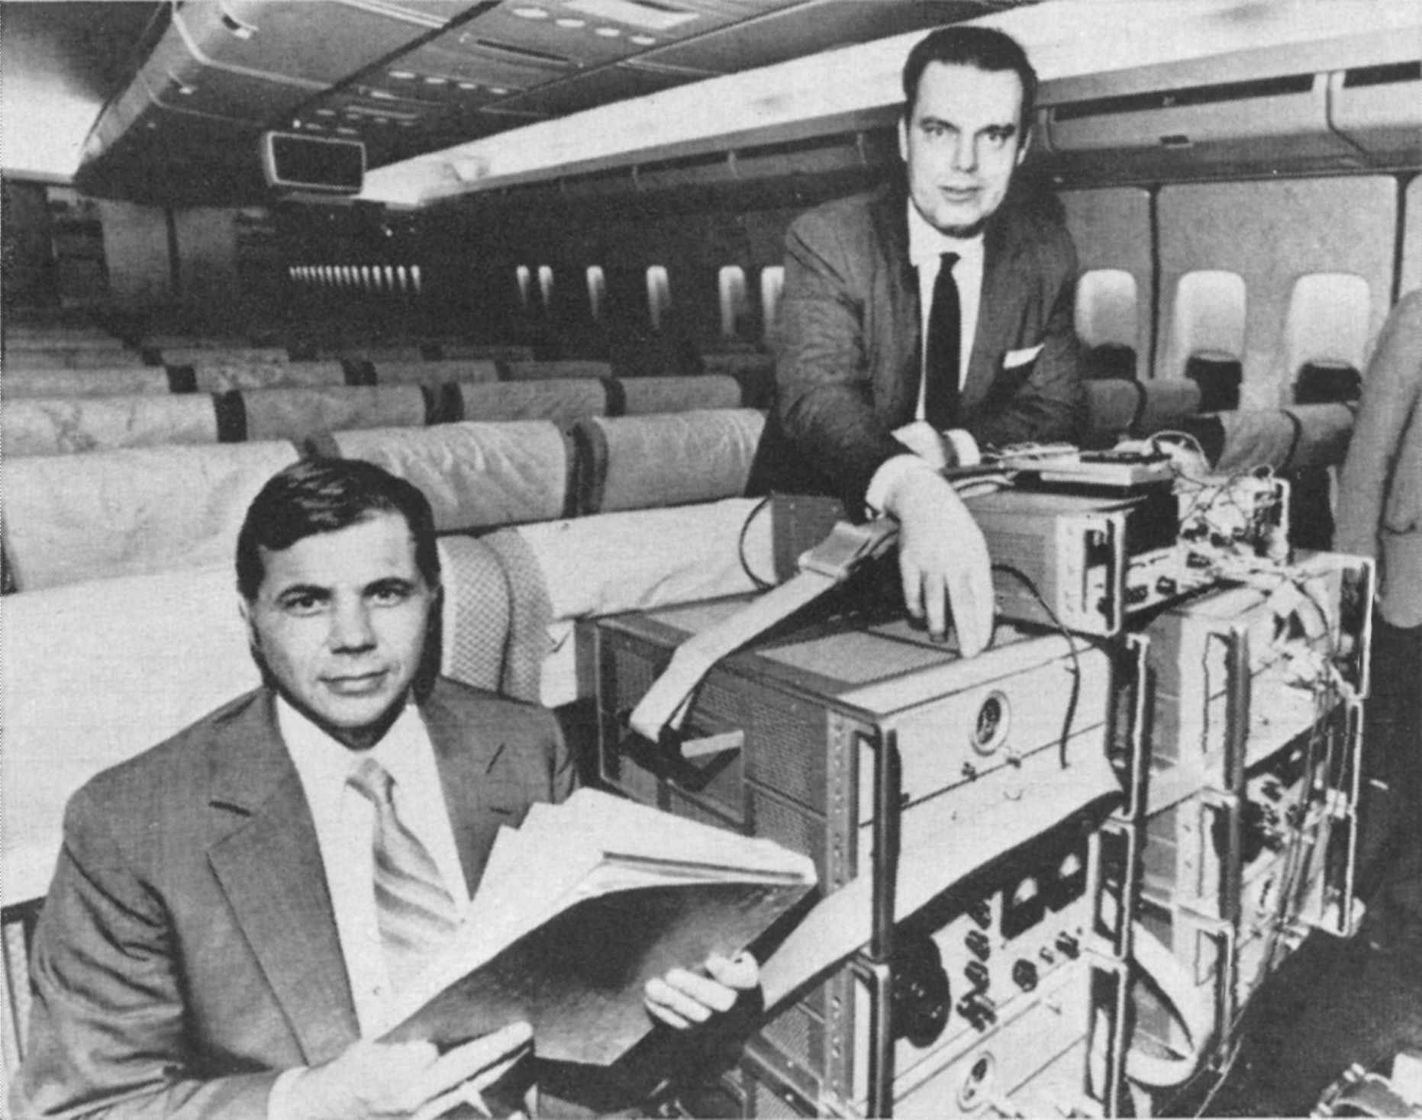
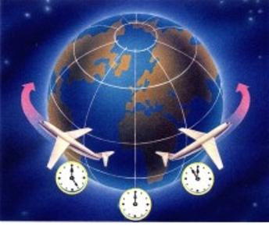
Paradox 3: The Twin Paradox
29
1971: A real experiment!
Joseph Hafele & Richard Keating tested it with 3 atomic cesium clocks.
One clock in a plane westward around the earth (against earth rotation)
One clock in a plane eastward around the earth (with earth rotation)
One clock stayed behind in the lab.
The clock that went eastward was 300 nsec behind, in agreement with relativity.

Slide 34
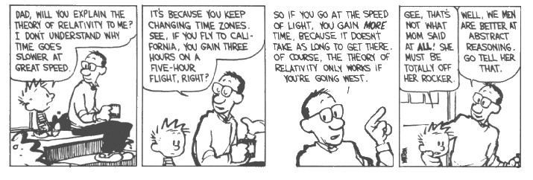
Remember Calvin’s father
30
`
?

Slide 35


Galilei and Einstein Transformation law
31
Bob
Alice
w=
v=
S
S‘
w’= ?
Galileo Galilei
(1564 – 1642)
With which speed do Alice and the ball hit by Bob approach each other?
Intuitive law (daily experience): 30 m/s + 10 m/s = 40 m/s
Galilei formula: $w^{′}=w+v=30+10=40 m/s$
$$w^{′}= \frac{w+v}{1+\frac{vw}{c^{2}}}=\frac{30+10}{1+\frac{30×10}{9×{10}^{16}}}=$$
Einstein formula:
(see lecture 3)
Albert Einstein
1879 - 1955
$=39.999999999999997 m/s$
Notes:
In fact, Einstein predicts something different for baseball as well! Almost correct!. Just bit different. Nobody notices!

Slide 36










Derive the laws for adding speed
32
Galilei Transformation:
Lorentz Transformation:
$$x^{′}=x+vt$$
$$x^{′}=γ\left(x+vt\right)$$
$$t^{′}=γ\left(t+\frac{v}{c^{2}}x\right)$$
$$t^{′}=t$$
In the frame of S we have:
S
S’
$$x=w t$$
Then it follows:
$$x=w t′$$
w
$$x^{′}− v t= w t′$$
w’
$$x^{′}−v t^{′}=w t′$$
v
$$x^{′}= \left(v+w\right) t′$$
Therefore in S’:
$$w′=w+v$$
Notes:
As promised we will derive the “strange” counterintuitive law of adding velocities

Slide 37











Derive the laws for adding speed
33
Galilei Transformation:
Lorentz Transformation:
$$x^{′}=x+vt$$
$$x^{′}=γ\left(x+vt\right)$$
$$t^{′}=γ\left(t+\frac{v}{c^{2}}x\right)$$
$$t^{′}=t$$
Re-write the laws:
$$x^{′}=γx+γv t$$
S
S’
$$t^{′}=γt+γ\frac{v}{c^{2}}x$$
Substitute in frame S: $x=wt$ to find:
$$x^{′}=γwt+γv t$$
w
$$t^{′}=γt+γ\frac{vw}{c^{2}}t$$
w’
$$t=\frac{1 }{γ}\left(\frac{1}{1+\frac{vw}{c^{2}}} \right)t′$$
I$nvert the equation for t′$:
v
$$x^{′}=γ\left(v+w\right)\frac{1}{γ} \left(\frac{1}{1+\frac{vw}{c^{2}}}\right) t′$$
Put into the expression for $x′$:
$$w^{′}=\frac{w+v}{1+\frac{vw}{c^{2}}}$$
Which should be: $x^{′}=w^{′}t′$ , therefor:

Slide 38


Derive the laws for adding speed
33
Galilei Transformation:
Lorentz Transformation:
$$x^{′}=x+vt$$
$$x^{′}=γ\left(x+vt\right)$$
$$t^{′}=γ\left(t+\frac{v}{c^{2}}x\right)$$
$$t^{′}=t$$
In the frame of S we have:
Re-write the laws:
$$x^{′}=γx+γv t$$
$$x=w t$$
$$t^{′}=γt+γ\frac{v}{c^{2}}x$$
Then it follows:
Substitute in frame S: $x=wt$ to find:
$$x^{′}=γwt+γv t$$
$$x=w t′$$
$$t^{′}=γt+γ\frac{vw}{c^{2}}t$$
$$x^{′}− v t= w t′$$
$$t=\frac{1 }{γ}\left(\frac{1}{1+\frac{vw}{c^{2}}} \right)t′$$
$$x^{′}−v t^{′}=w t′$$
I$nvert the equation for t′$:
$$x^{′}= \left(v+w\right) t′$$
$$x^{′}=γ\left(v+w\right)\frac{1}{γ} \left(\frac{1}{1+\frac{vw}{c^{2}}}\right) t′$$
Put into the expression for $x′$:
Therefore in S’:
$$w′=w+v$$
$$w^{′}=\frac{w+v}{1+\frac{vw}{c^{2}}}$$
Which should be: $x^{′}=w^{′}t′$ , therefor:

Slide 39




Large effects at relativistic speeds
34
0.8c
0.6c
Bob in a rocket passes a star with 0.8 c
Alice in a rocket passes a star with 0.6 c
In opposite directions.
What is their relative speed?
$$w^{′}=\frac{0.8c+0.6c}{1+\left(0.8×0.6\right)}=0.95c$$
Very different than w’ = 0.8 c + 0.6 c = 1.4 c !!
Without relativity theory GPS technology would make mistakes of the order of 10 km/day !

Slide 40

How about Alice seeing light coming from Bob?
35
How fast does the light go for Alice?
➔ Just put $w=c$ into Einstein’s formula:
$$w^{′}=\frac{c+v}{1+\frac{cv}{c^{2}}}=\frac{c+v}{1+\frac{v}{c}}=\frac{c+v}{\frac{1}{c}\left(c+v\right)}=\frac{1}{\frac{1}{c}}=c$$
The speed of light is always the same for each observer!

Slide 41

E=mc² : see lecture notes
36
Consider a box with length L and mass M floating in deep space.
A photon is emitted from the left wall and a bit later absorbed in the right wall.
Center of Mass of box + photon must stay unchanged.
Action = - Reaction: photon momentum is balanced with box momentum
Time it takes the photon
Distance that the box has moved
C.O.M. does not move: box compensated by photon C.O.M.
Substitute the above equations
Equivalence of mass and energy!
Notes:
More complicated.

Slide 42
E=mc² : see lecture notes
37
Consider a box with length L and mass M floating in deep space.
A photon is emitted from the left wall and a bit later absorbed in the right wall.
Center of Mass of box + photon must stay unchanged.
Action = - Reaction: photon momentum is balanced with box momentum
Time it takes the photon
Distance that the box has moved
C.O.M. does not move: box compensated by photon C.O.M.
Substitute the above equations
Equivalence of mass and energy!

Slide 43


Conclusions Special Relativity
38
Simple principle:
Laws of physics of inertial frames are the same.
Speed of light is the same for all observers.
Big Consequences:
Space and time are seen differently for different observers.
Alice’s time is a mixture of Bob’s time and space and vice versa.
Alice’s space is a mixture of Bob’s time and space and vice versa.
$$ct^{′}=γ\left(ct−βx\right)$$
Time dilation and Lorentz contraction
Energy and mass are equivalent
$$x′=γ\left(x−βct\right)$$
Notes:
Gravity is curved space-time!

Slide 44


Next Lecture: General Relativity
39
General Relativity: inertial mass = gravitational mass

