Slide 1
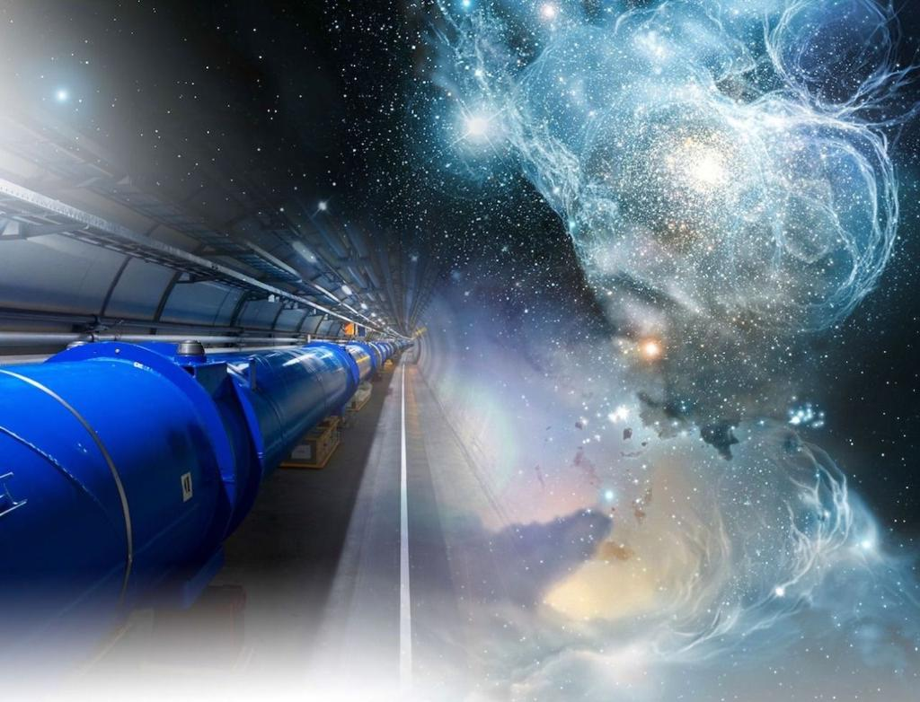
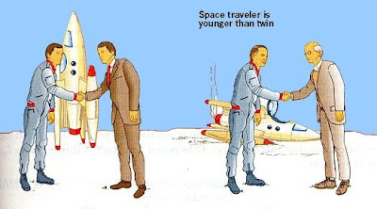
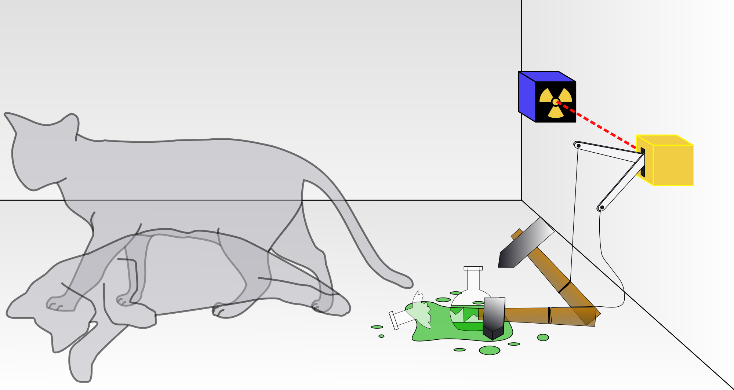
The Relativistic Quantum World
Relativity
A lecture series on
Relativity Theory and Quantum Mechanics
Quantum
Marcel Merk
Studium Generale Maastricht
Nov 1 – Nov 29, 2023
Notes:
Welcome to cours eon relativity and QM.
Course March-April; interrupted Covid-19. Begin from the start.
Explain picture. Interesting (“bizarre”) aspects of relativity and QM

Slide 2
The Relativistic Quantum World
1
Lecture 1: The Principle of Relativity and the Speed of Light
Lecture 2: Time Dilation and Lorentz Contraction
Lecture 3: The Lorentz Transformation and Paradoxes
Lecture 4: General Relativity and Gravitational Waves
Nov. 1:
Relativity
Nov. 8:
Lecture 5: The Early Quantum Theory
Lecture 6: Feynman’s Double Slit Experiment
Lecture 7: Wheeler’s Delayed Choice and Schrodinger’s Cat
Lecture 8: Quantum Reality and the EPR Paradox
Quantum
Mechanics
Nov. 15:
Nov 22:
Standard
Model
Lecture 9: The Standard Model and Antimatter
Lecture 10: Why is there something rather than nothing?
Nov. 29:
Lecture notes, written for this course, are available: www.nikhef.nl/~i93/Teaching/
Prerequisite for the course: High school level physics & mathematics.
Notes:
Ambitious!

Slide 3
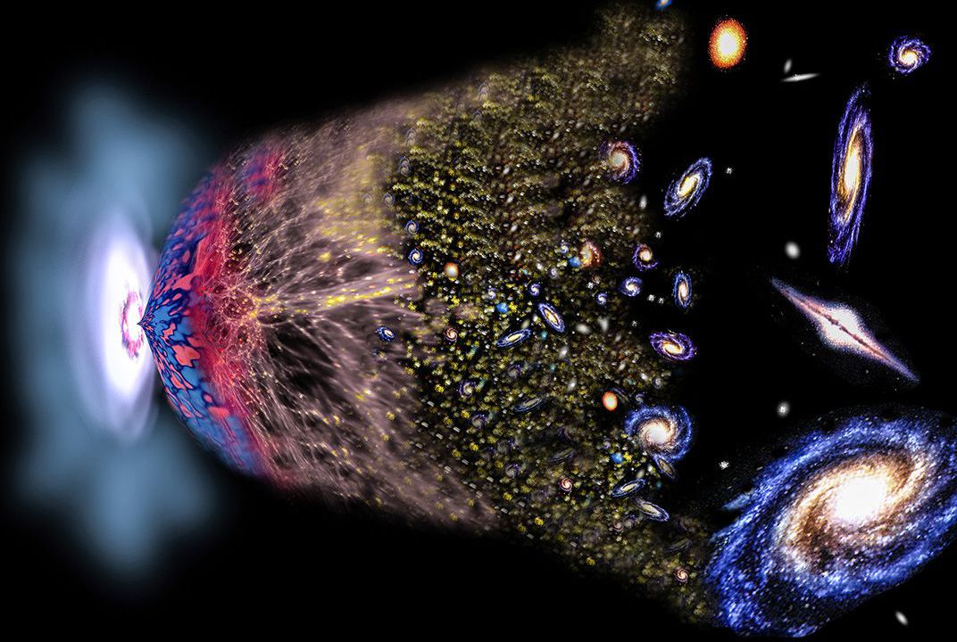


Why is there something rather than nothing?
1
2
3
“Flavor“ puzzle: why are there three generations of fundamental particles?

Slide 4
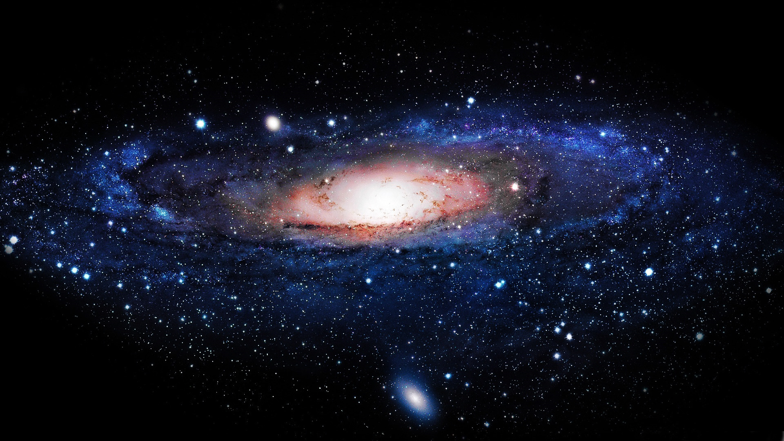
Lecture 10: Why is there something rather than nothing?
1: Discovery of the Higgs boson
2: Symmetry between Matter and Antimatter?
3: A new force of Nature?

Slide 5

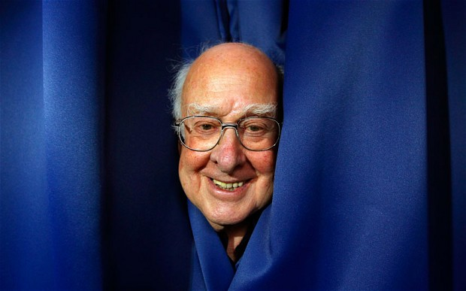

1: Discovery of the
Higgs boson

Slide 6
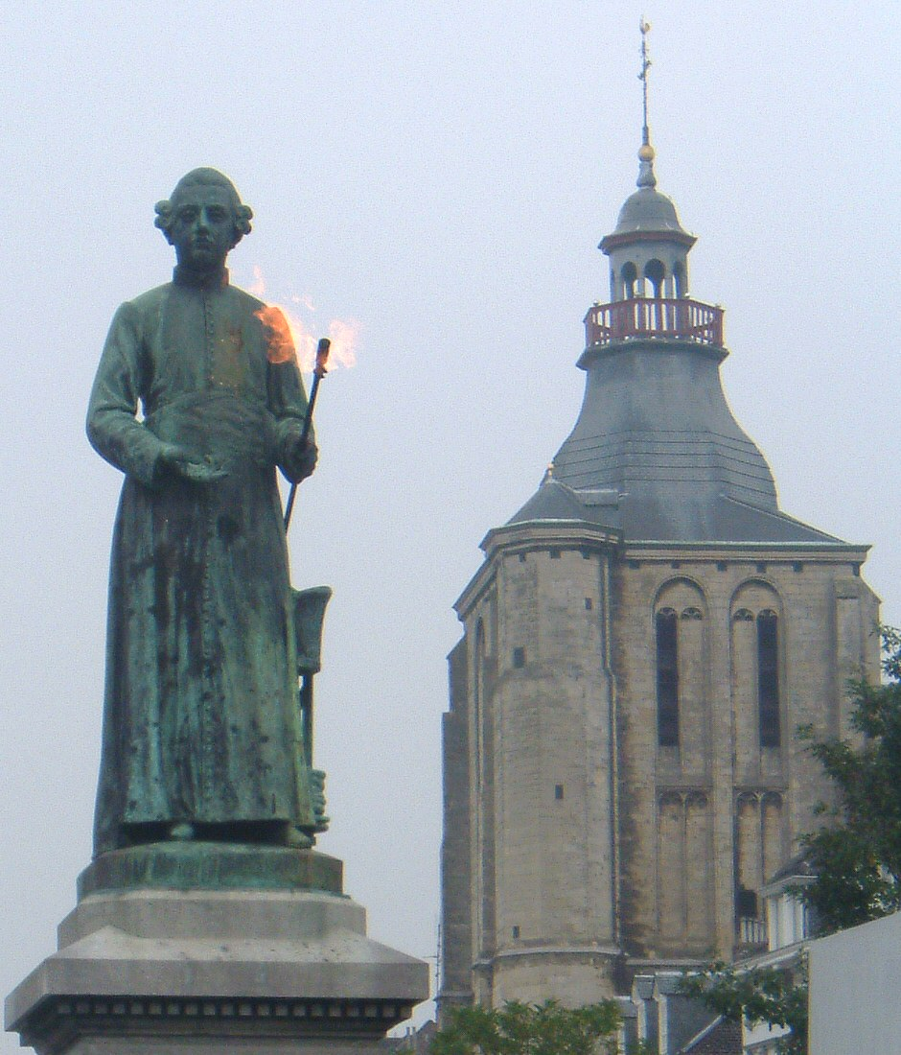
1: Discovery of the
Higgs boson
Minckeleers: also discovery

Slide 7

CERN: Atlas experiment at the LHC

Slide 8

Discovery of the Higgs boson
pp→Higgs→μμμμ

Slide 9

Discovery of the Higgs boson
pp→Higgs→μμμμ

Slide 10

Higgs: collecting data and testing theory
Discovery of
Higgs boson!

Slide 11
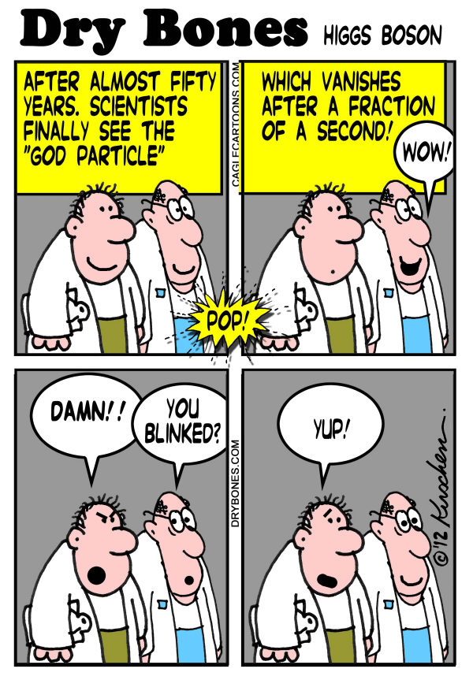
pp→Higgs→μμμμ
μ
μ
μ
μ
Atlas event

Slide 12
4 July 2012
Announcement Higgs discovery
Amsterdam
CERN
CERN
ICHEP (AUS)
Nikhef (NL)
CERN
Sydney

Slide 13
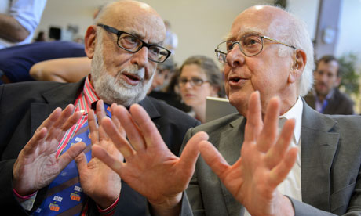
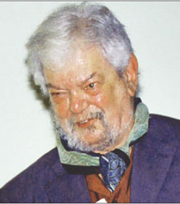
2013 Nobel prize in Physics
Robert Brout
Francois Englert
Peter Higgs

Slide 14


What did we discover?
“The formula”
“The building blocks”
The ‘Higgs’ field
fills the vacuum

Slide 15


Higgs Field φ and Particle H
Higgs field is uniform, hard to see
Higgs boson particle is “wave” of the field
Mass results from interaction of matter particles with the Higgs field
Compare:
  A photon is a quantum of electromagnetic field
  Water wave
Higgs field
Higgs particle
a “field-quantum”
Notes:
Fisch, cold blooded, clear water, doesn’t know about water.

Slide 16
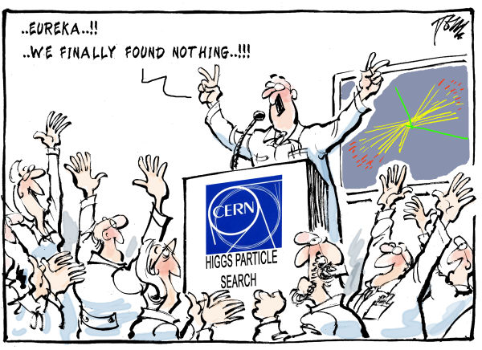
July 4, 2012: The Vacuum

Slide 17
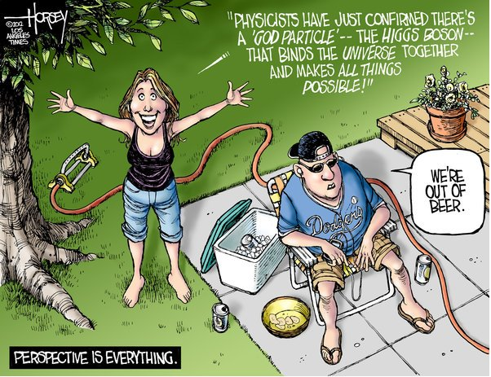

Slide 18


1897
1937
1975
τ
μ
e
Electron, e
Spin ½
Charge −1
Lifetime ∞
Mass .511 MeV
Muon, μ
Spin ½
Charge −1
Lifetime 2.2 μs
Mass 106 MeV
Tau, τ
Spin ½
Charge −1
Lifetime 290 fs
Mass 1777 MeV
Notes:
Higgs coupling is the origin of mass

Slide 19
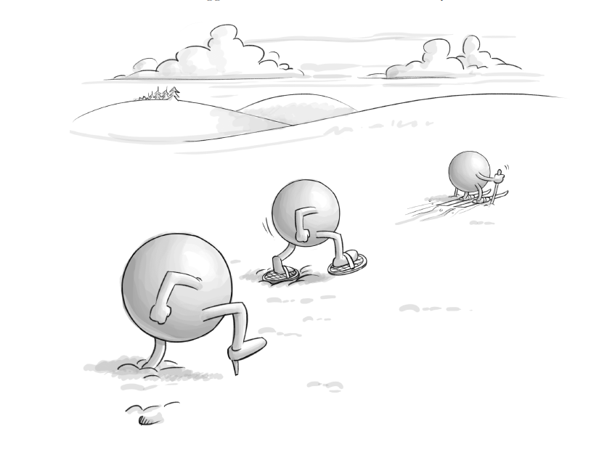
e
μ
τ
© Jean-Paul Keulen
Notes:
particles and the Higgs field

Slide 20

Hence…

Slide 21
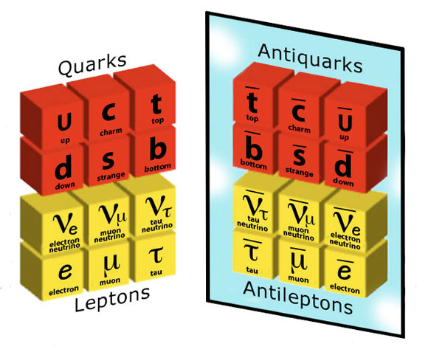

2: Symmetry between matter and antimatter?

Slide 22
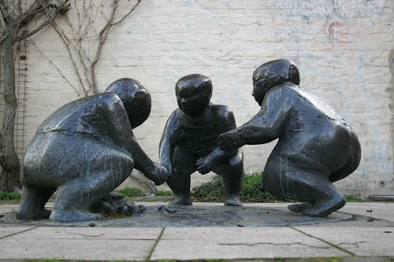
2: Symmetry between matter and antimatter?
Dreij Huivende kinder
Notes:
Witmakersstraat / Hondstraat . Oorspronkelijk bij aanlanding romeinse brug. Voor burgemeester Fons Baeten.

Slide 23
LHCb Experiment: decays of b-particles

Slide 24




LHCb Detector: B-particles
Zoom in on collision point
Reconstruct millions of B-particle decays and select interesting cases.
Do we observe differences between matter and antimatter?
23 sep 2010 19:49:24
Run 79646 Event 143858637

Slide 25



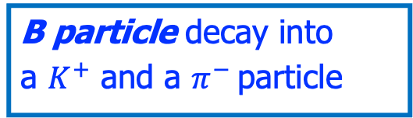


B-decay process: matter vs antimatter
B particle decay into
a $K^{+}$ and a $π^{−}$ particle
anti-B particle decay into a $K^{−}a$nd a $π^{+}$ particle
Matter process
Antimatter process
$$B^{0}→K^{+}π^{−}$$
$${\overline{B}}^{0}→K^{−}π^{+}$$
B⁰ → K⁺ π⁻
B⁰ → K⁻ π⁺
Asymmetrie: matter and antimatter decay processes proceed differently! Quantum forces between particles and anti-particles not always identical!

Slide 26


B-decay process:
matter vs antimatter
B particle decay into
a $K^{+}$ and a $π^{−}$ particle
anti-B particle decay into a $K^{−}a$nd a $π^{+}$ particle
Matter process
Antimatter process
$$B^{0}→K^{+}π^{−}$$
$$B^{0}→K^{−}π^{+}$$
B⁰ → K⁺ π⁻
B⁰ → K⁻ π⁺
The matter – antimatter symmetry is broken
Ths only happens if there are at least three generations of particles !!!

Slide 27
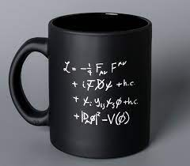

B-decay process:
matter vs antimatter
B particle decay into
a $K^{+}$ and a $π^{−}$ particle
anti-B particle decay into a $K^{−}a$nd a $π^{+}$ deeltje
Matter process
Antimatter process
$$B^{0}→K^{+}π^{−}$$
$$B^{0}→K^{−}π^{+}$$
B⁰ → K⁺ π⁻
B⁰ → K⁻ π⁺
The matter – antimatter symmetry is broken
Ths only happens if there are at least three generations of particles !!!

Slide 28
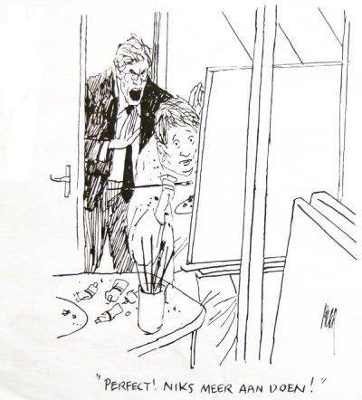
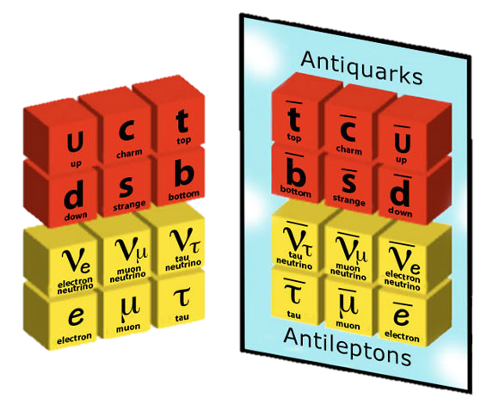
Early Universe: What happened to antimatter?
Asymmetry in physics laws
Little bit more matter than antimatter
Rest annihilates
Matter universe remains
Quarks
Leptons
50.000001%
49.999999%

Slide 29
Early Universe: What happened to antimatter?
Why are there three identical copies of all particles?
➔Is it the simplest universe that can exist?!
However: it does not work!
Asymmetry is not large enough.
Explanation requires a new force!
Quarks
Leptons
50.000001%
49.999999%

Slide 30

6: A new force of Nature?

Slide 31
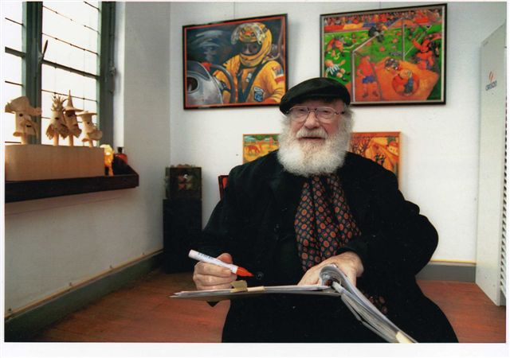
6: A new force of Nature?
Pieke Dassen: art

Slide 32
Standard Model: Universality of the Forces
Elektromagnetism
Strong Nuclear Force
1
2
3
m
m
G
m
m
Gravity
Weak Nuclear Force
Forces are identical for particles of 1st, 2nd en 3rd generation.
➔ “Universality”
Notes:
Vier fundamentele

Slide 33
LHCb: Do B-particles decay the same way to electrons and muons ?
?
23 sep 2010 19:49:24
Run 79646 Event 143858637

Slide 34


LHCb: Do B-particles decay the same way to electrons and muons ?
$$R_{K}^{∗}$$
$$R_{K}$$
2021
2021
R not exactly equal to 1??
➔ Different force for electrons and muons?!
= R
23 sep 2010 19:49:24
Run 79646 Event 143858637

Slide 35
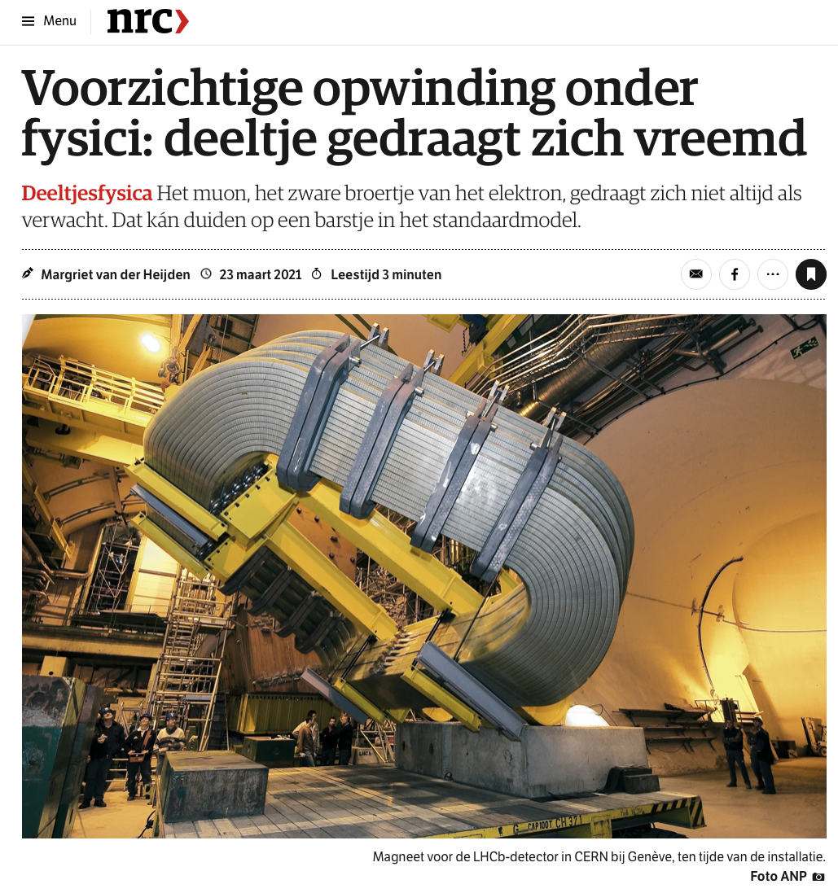
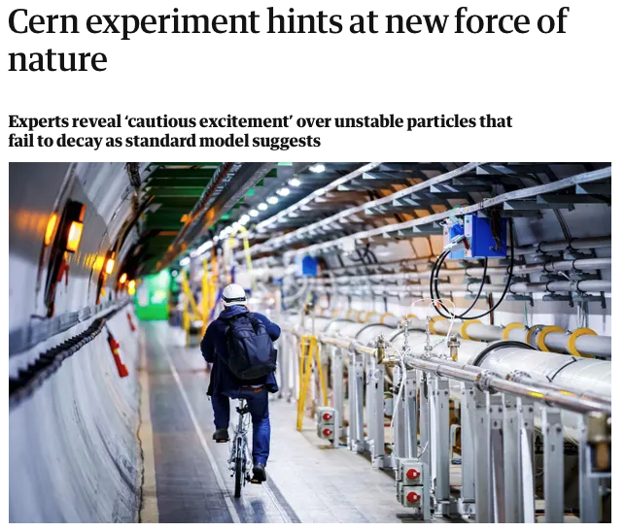
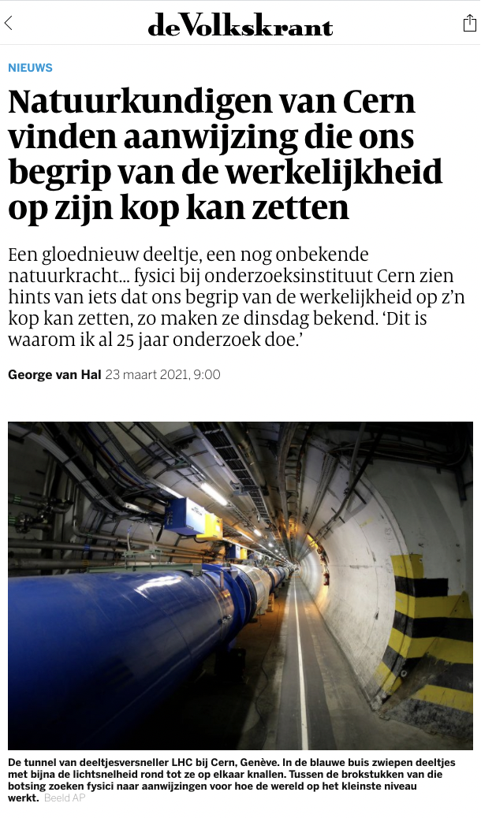
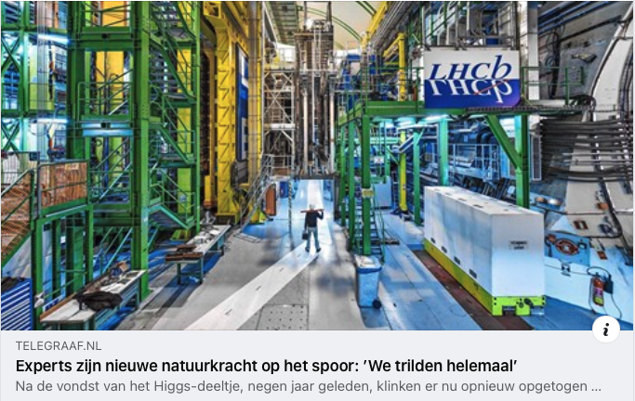
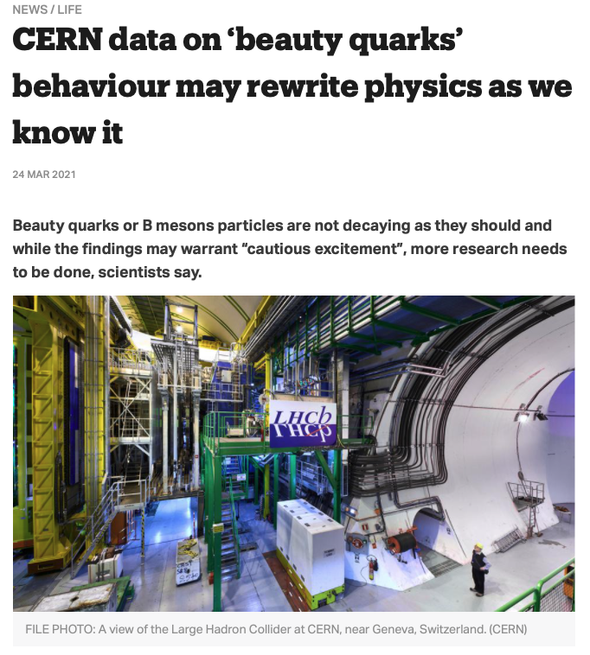
23 March 2021: Headlines… “cautious excitement”
- Guardian
Are we discovering a new force for muon particles?!

Slide 36
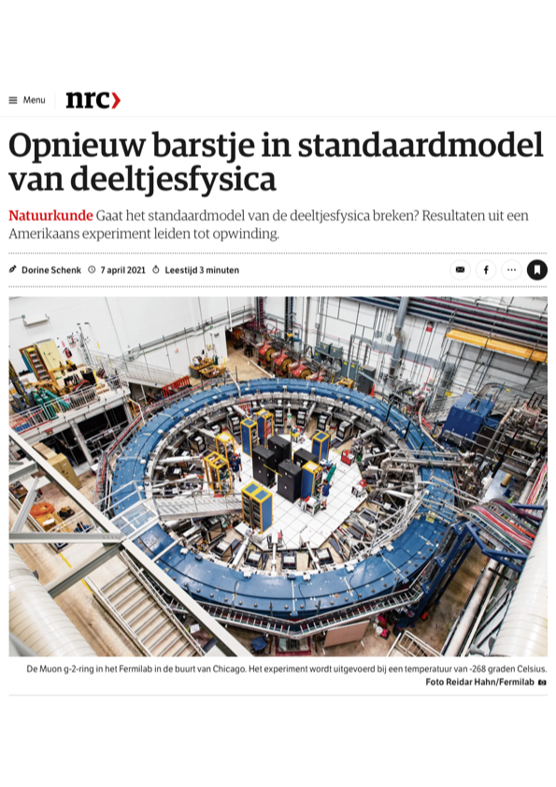
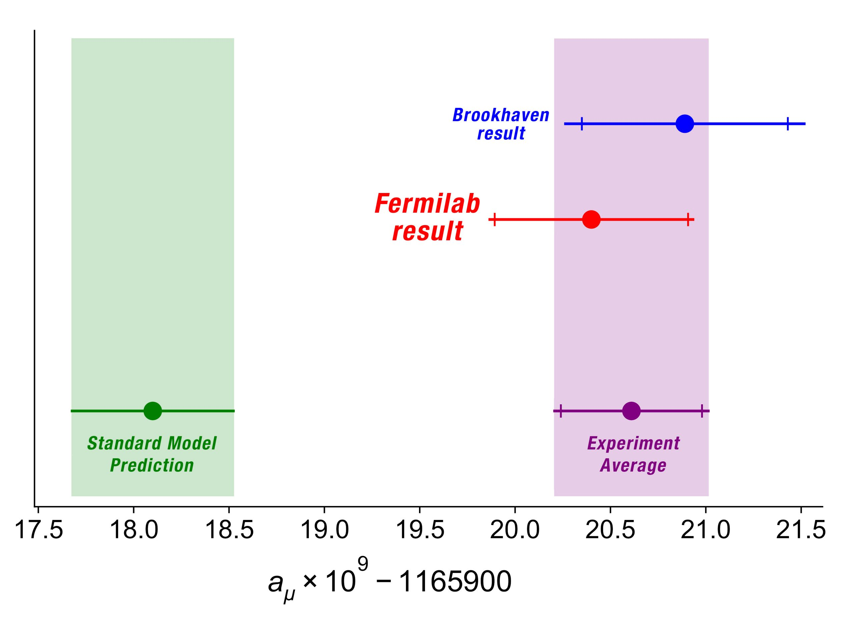

Twee weeks later in Fermilab … muon magnetic moment?!
Standard Model cannot explain measurement
➔ A new force acting up?!
Standard Model
prediction
Experimental
measurement
“$g−2$”
Notes:
Experiment in Fermilab (earlier Brookhaven) . Spin procession in known B field.
Energy electron depends spin direction muon: neutrino direction.
Mu = -g \mu_B S = - g q S / 2 m ; mu_B = eh/2me

Slide 37
LHCb: Do B-particles decay the same way to electrons and muons ?
December 2022: new measurement
for electrons…
?
23 sep 2010 19:49:24
Run 79646 Event 143858637

Slide 38
LHCb: Do B-particles decay the same way to electrons and muons ?
The R value now seems to agree with 1 ?!
December 2022: new measurement
for electrons…
?
23 sep 2010 19:49:24
Run 79646 Event 143858637

Slide 39
But for muons more and more measurements disagree!
Observable
S.M.
Measured
LHCb results
Fermilab g-2 result
The puzzle deepens further!
28-8-2023

Slide 40




Four(?) fundamental forces of nature
Graivity:
Strong nuclear force:
Quantum
Graviton exchange?
Quantum
gluon exchange:
m
m
m
G
m
+ ???
Fifth force?
Acts on quarks
Acts on particles with mass
Electromagnetism:
Weak nuclear force:
Quantum
photon exchange:
Quantum
W, Z exchange:
Acts on all charged particles
Acts on all particles

Slide 41
How did antimatter disappear in the early universe?
Why is there something rather than nothing?
+ ???
Through a fifth force during the Big Bang…?
Quarks
Leptons
50.000001%
49.999999%

Slide 42
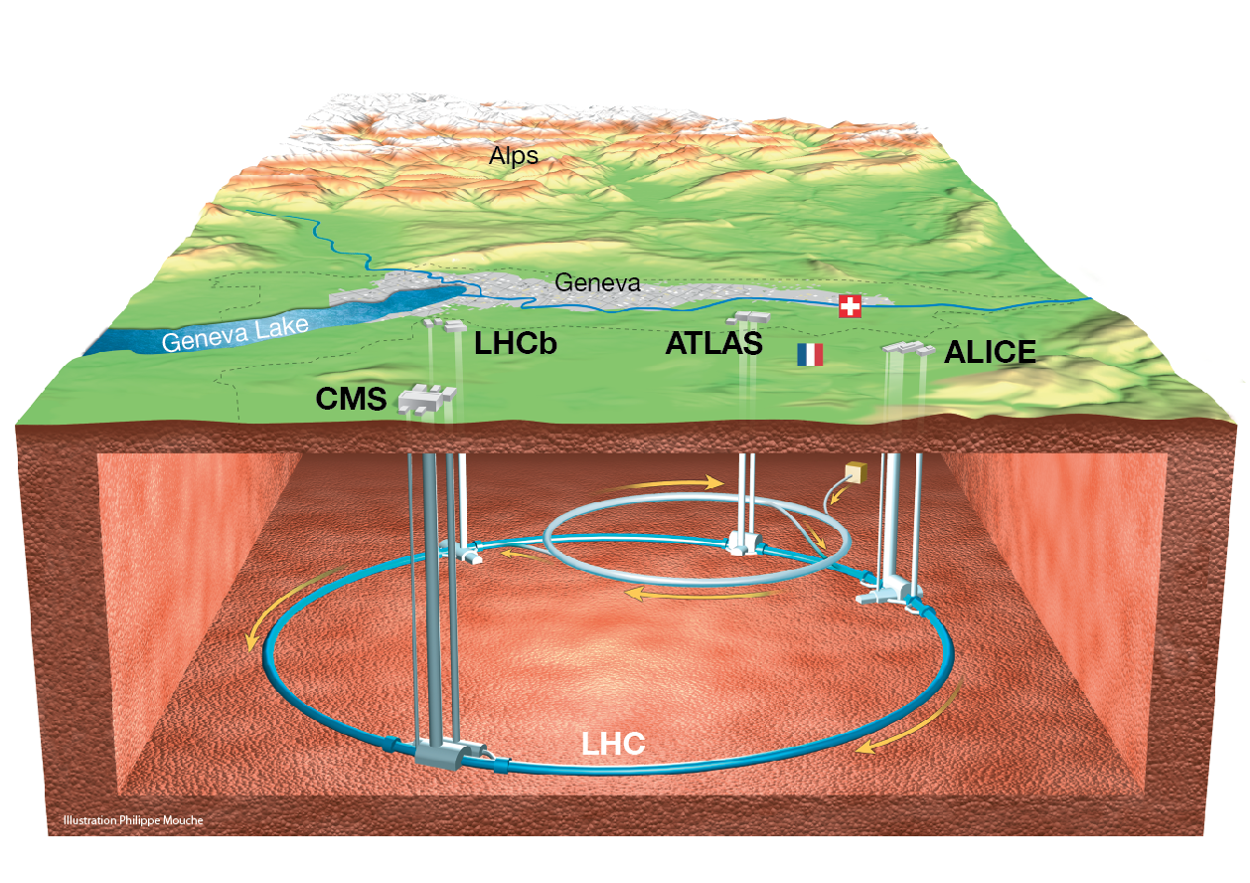
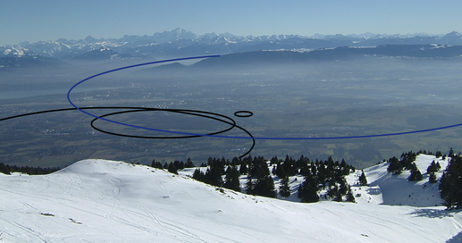
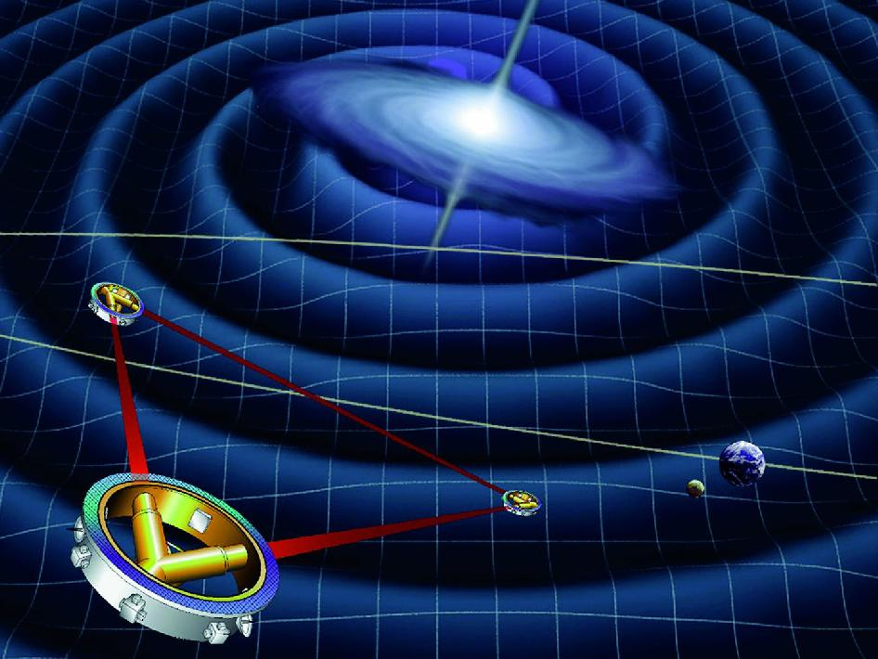
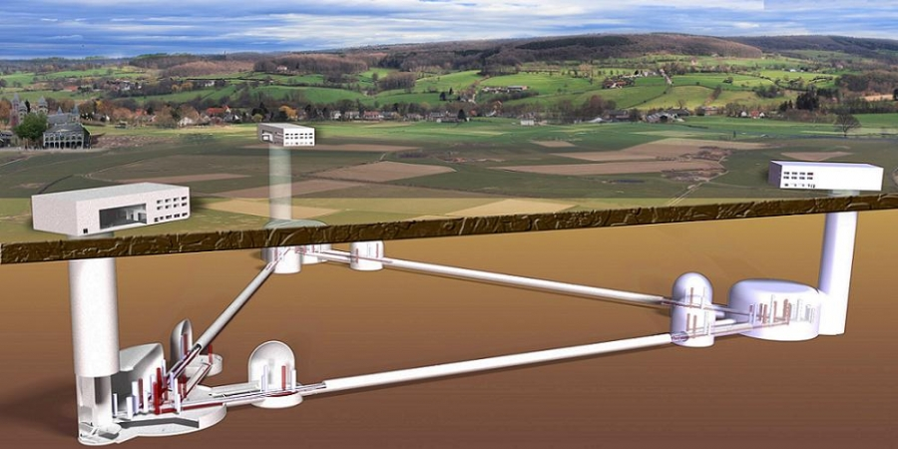
Future: “Circles and Triangles”
Particle Colliders: simulate physics of the Big Bang …
LHC
FCC
Gravitation-detectors: listening to the Big Bang…
LISA
ET

Slide 43
Future: “Circles and Triangles”
Particle Colliders: simulating physics of the Big Bang …
Lots of exciting research ongoing
LHC
FCC
Gravitation-detectors: listening to the Big Bang…
LISA
ET
Thanks for your attention!

Slide 46
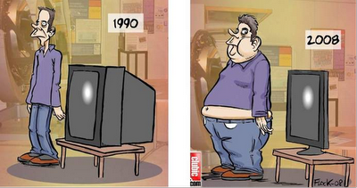
Applications of Science

Slide 47
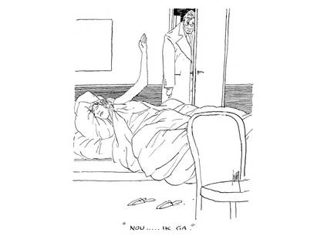

Slide 48

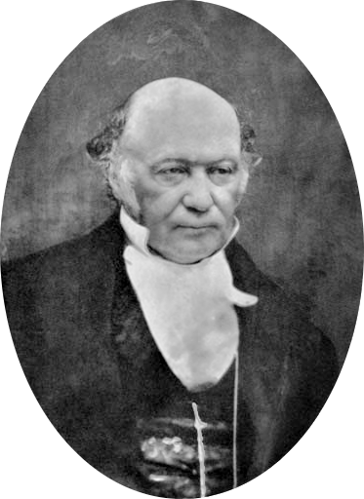
Quantum Velden Theorie
Deeltjes en Krachten zijn “velden” denk aan quantum golffuncties: ψ(x,t)
De fundamentele grootheid is de Lagrangiaan
(Klassieke mechanica: Bewegingsvergelijkingen volgen)
L = T - V
T = Kinetische energie
V = Potentiele energie
Lagrange
1736 - 1813
Hamilton
1805 - 1865
Standaardmodel van Quantum Velden Theorie (Recept voor experts):
Schrijf de Lagrangiaan voor alle bestaande deeltjes en krachten
(Elektromagnetisme + Zwakke kracht + Sterke kracht, vergeet Zwaartekracht)
Eis dat de Lagrangiaan een aantal wiskundige symmetrieën heeft.
De rest volgt vanzelf: het gedrag van alle deeltjes en hun interacties!
Notes:
Joseph Louis Lagrange: Italiaans mathematicus en astronoom. William Rowen Hamilton: fysicus en astronoom, inventor quaternions.

Slide 49
Het Standaard Model van elementaire deeltjes
Werkt bij zeer kleine afstanden
(Kwantummechanica)
Werkt bij zeer hoge energie (Speciale Relativeitstheorie)
(en tegelijkertijd)
Beschrijft alle
natuurkrachten
behalve zwaartekracht
Beschrijft alle
bekende materie
(behalve donkere)
Onduidelijk theorie
ook voor Big Bang
natuurkunde geldig is
17 onvoorspelde parameters
(dus niet heel erg predictive?)
Beschrijft maar verklaart niet tal
van opvallende strukturen in de natuurwetten

Slide 50
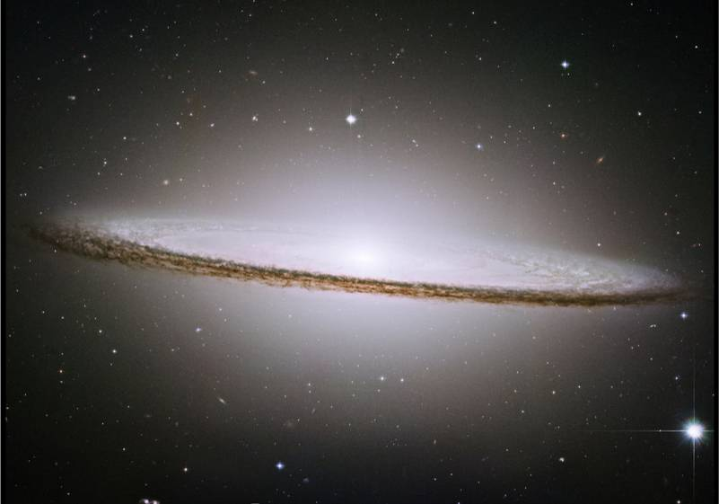
Donkere Materie

Slide 51
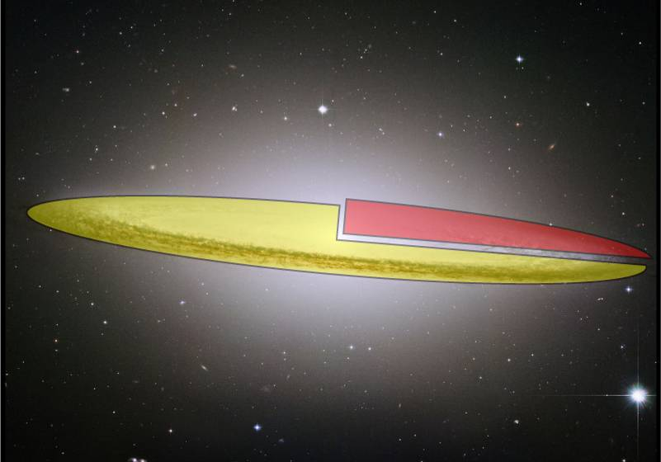
Zichtbare “baryonische” materie
waterstof (H)
helium (He)

Slide 52
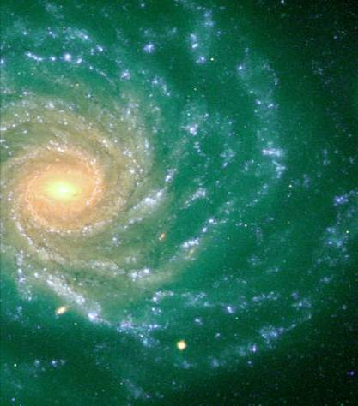

Spiraalarm rotatie en gravitationele lensen
→ v (km/s)
gemeten
100
verwacht
50
Gewone materie verstrooit en blijft achter
Donkere materie beweegt ongestoord verder
5
10
→ R (kpc)

Slide 53
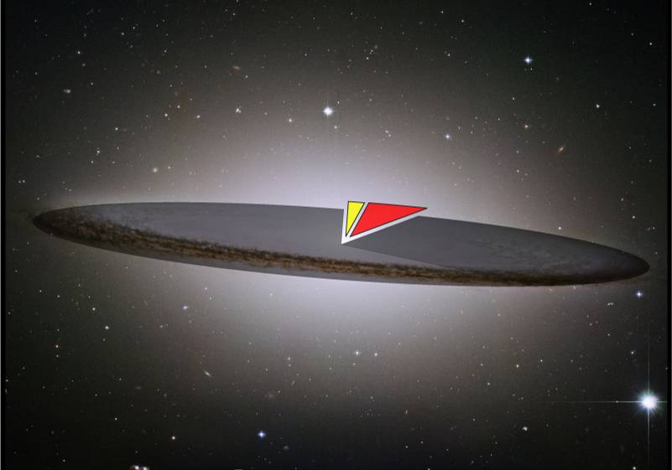

Donkere Materie
He
H
donkere energie & donkere materie

Slide 54

“The Dark Side rules the Universe”

