Slide 1

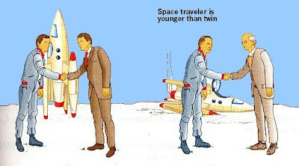
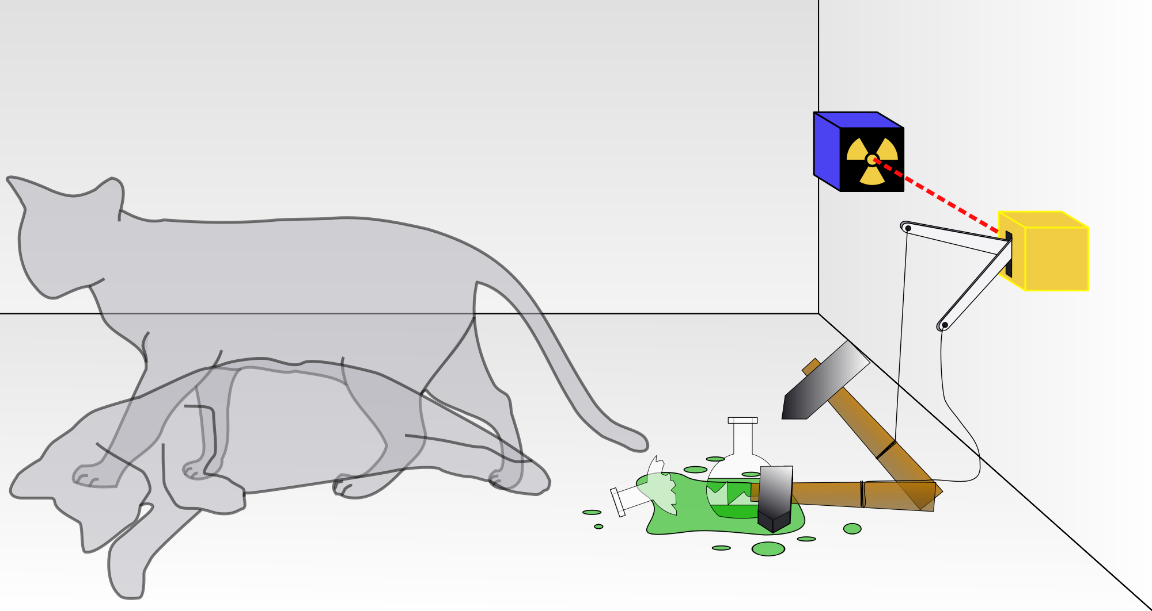
The Relativistic Quantum World
A lecture series on Relativity Theory and Quantum Mechanics
Marcel Merk
University of Maastricht, Sept 16 – Oct 14, 2020

Slide 2
The Relativistic Quantum World
1
Lecture 1: The Principle of Relativity and the Speed of Light
Lecture 2: Time Dilation and Lorentz Contraction
Lecture 3: The Lorentz Transformation and Paradoxes
Lecture 4: General Relativity and Gravitational Waves
Sept. 16:
Relativity
Sept. 23:
Lecture 5: The Early Quantum Theory
Lecture 6: Feynman’s Double Slit Experiment
Lecture 7: Wheeler’s Delayed Choice and Schrodinger’s Cat
Lecture 8: Quantum Reality and the EPR Paradox
Quantum
Mechanics
Sept. 30:
Oct. 7:
Standard
Model
Lecture 9: The Standard Model and Antimatter
Lecture 10: The Large Hadron Collider
Oct. 14:
Lecture notes, written for this course, are available: www.nikhef.nl/~i93/Teaching/
Prerequisite for the course: High school level physics & mathematics.
Notes:
Discuss a few quantum experiments with mind-boggling consequences

Slide 3
Nobel Prize in Physics (Oct 6, 2020) – Black Holes
2
½ :
Roger Penrose
¼ :
Reinhard Genzel
¼ :
Andrea Ghez
For the discovery that black hole formation is a robust prediction of the general theory of relativity.
For the discovery of a supermassive compact object at the centre of our galaxy.

Slide 4
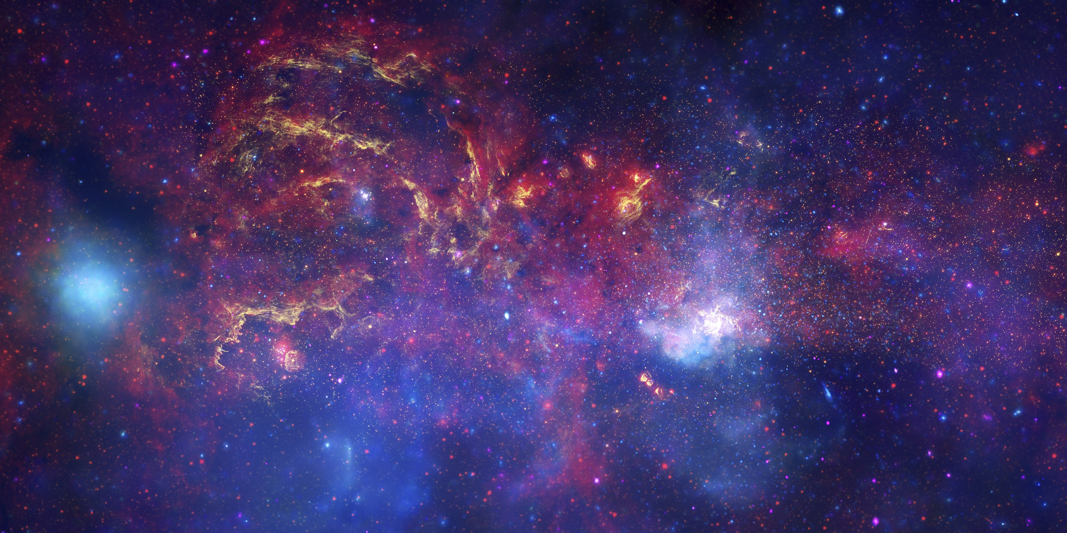
Center of our Milky Way Galaxy
3

Slide 5
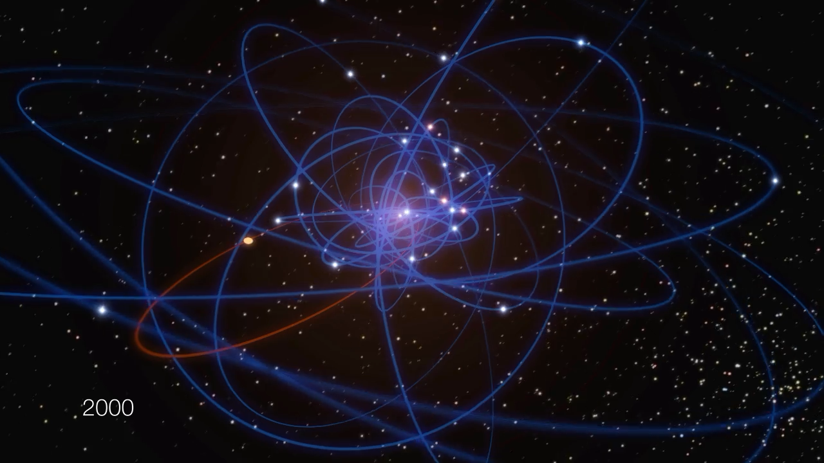
Supermassive Black Hole in the center of our Galaxy
4
Notes:
Supermassive black hole: 4.100.000 mass of the sun

Slide 6

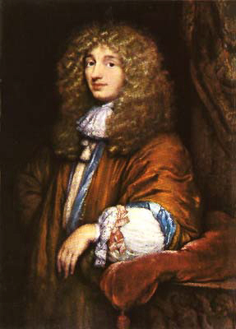
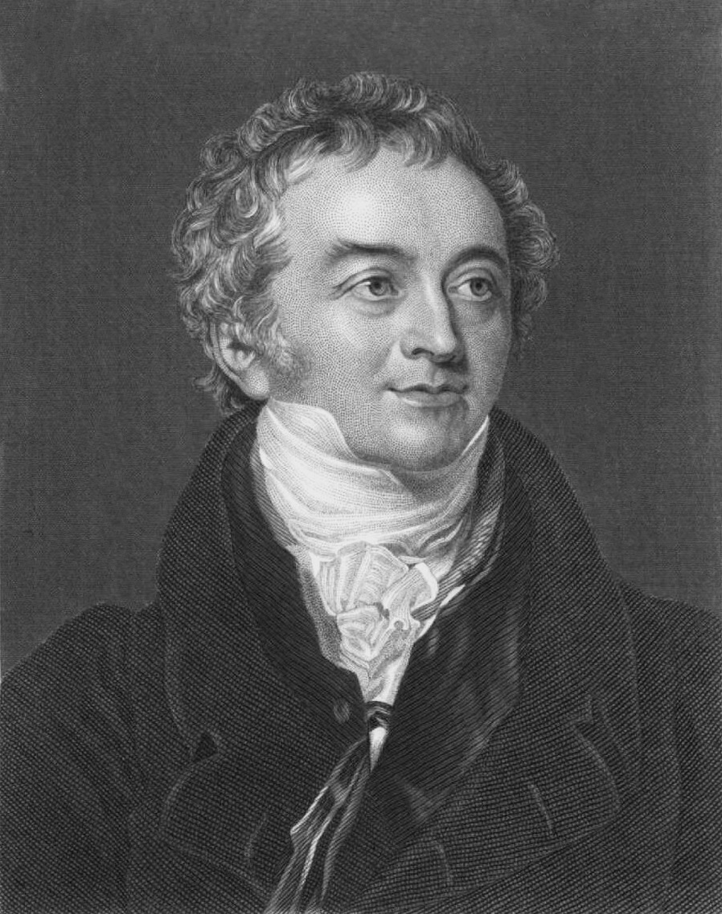
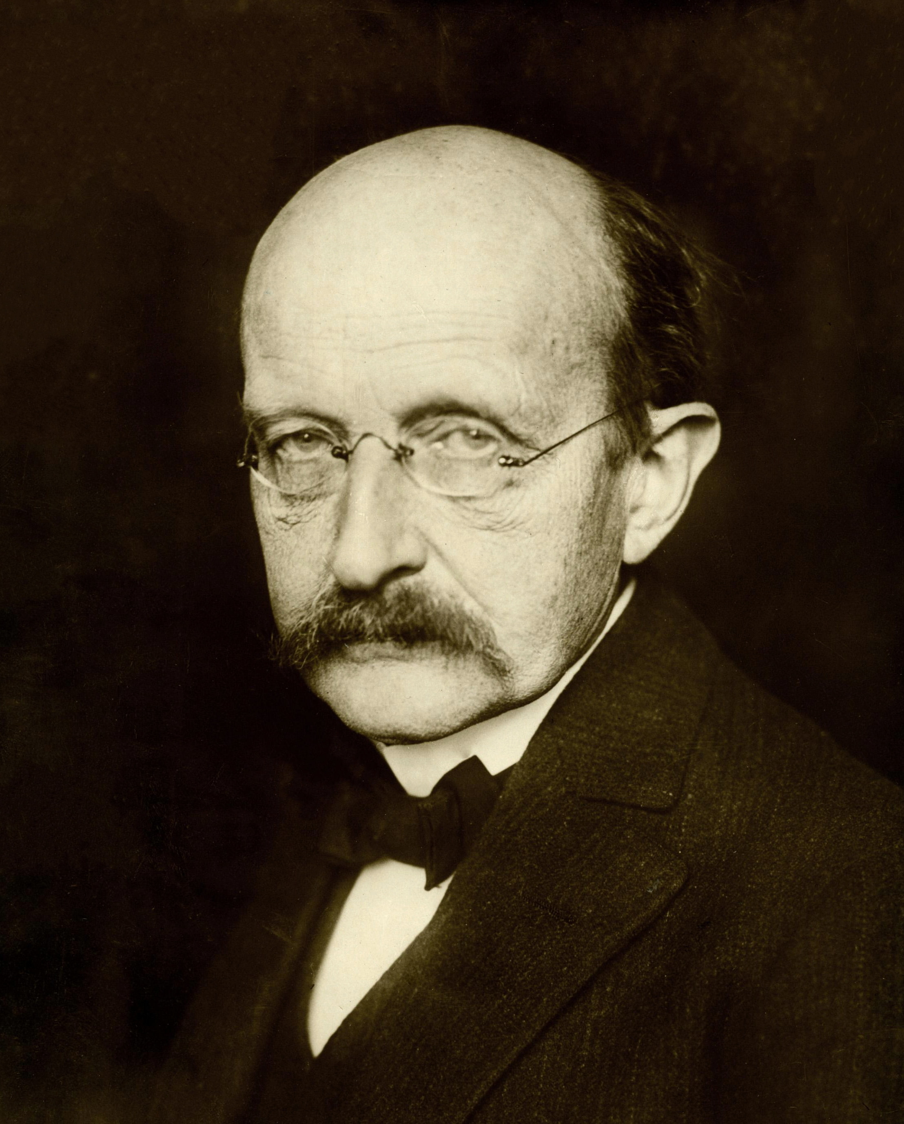

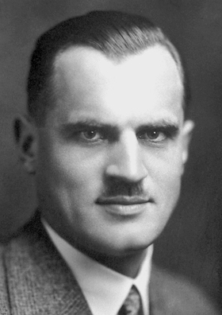
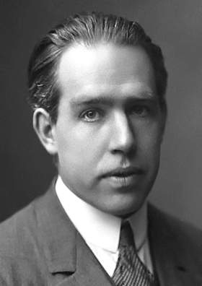
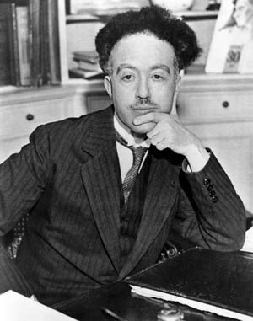
Quantum Mechanics
5
No, similar to
sound light consists
of waves
Yes, because
it interferes
Light is a stream
of particles
Light is emitted
in quanta
Isaac Newton
Christiaan Huygens
Thomas Young
Max Planck
The nature of light is quanta
Particles have a
wave nature:
λ = h/p
Yes, because
photons collide!
Particles are probability waves
Albert Einstein
Arthur Compton
Louis de Broglie
Niels Bohr
Notes:
Summary of Quantum Mechanics sofar.

Slide 7
Quantum Mechanics
5
No, similar to
sound light consists
of waves
Yes, because
it interferes
Light is a stream
of particles
Light is emitted
in quanta
Isaac Newton
“Particle” and “Wave” are
complementary aspects.
Christiaan Huygens
Thomas Young
Max Planck
The nature of light is quanta
Particles have a
wave nature:
λ = h/p
Yes, because
photons collide!
Particles are probability waves
Albert Einstein
Arthur Compton
Louis de Broglie
Niels Bohr

Slide 8
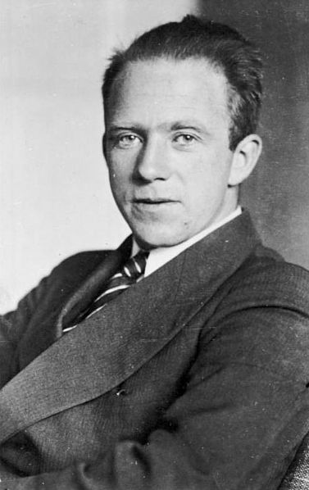
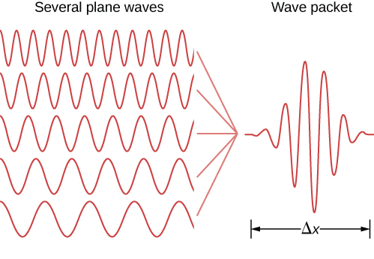
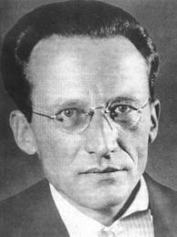
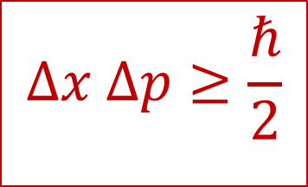
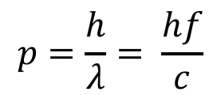
Uncertainty Relation
6
$$Δx Δp≥\frac{ℏ}{2}$$
It is not possible to determine position and momentum at the same time:
Δp
Erwin Schrödinger
Werner Heisenberg
$$p=\frac{h}{λ}= \frac{hf}{c}$$
A particle does not have well defined position and momentum at the same time.
Notes:
Heisenberg and Schrodinger also had to complementary ways to describe it ;-)

Slide 9
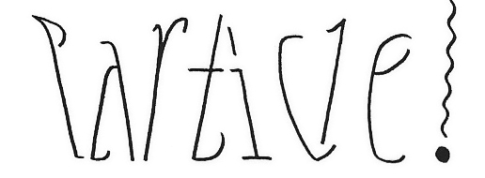
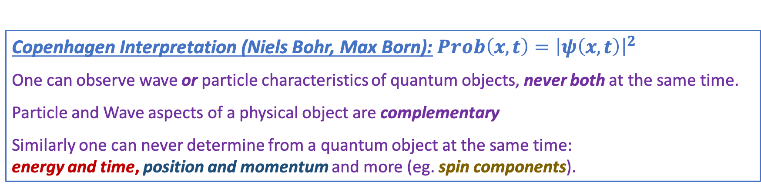
Complementarity
7
Subatomic matter is not just waves and it is not just particles.
It is nothing we know from macroscopic world.
Niels Bohr
1885 - 1962
Copenhagen Interpretation (Niels Bohr, Max Born):$Prob\left(x,t\right)={\left|ψ\left(x,t\right)\right|}^{2}$
One can observe wave or particle characteristics of quantum objects, never both at the same time.
Particle and Wave aspects of a physical object are complementary
Similarly one can never determine from a quantum object at the same time:
energy and time, position and momentum and more (eg. spin components).
Notes:
Niels Bohr: Nestor of the Copenhagen interpretation of Quantum Mechanics

Slide 10
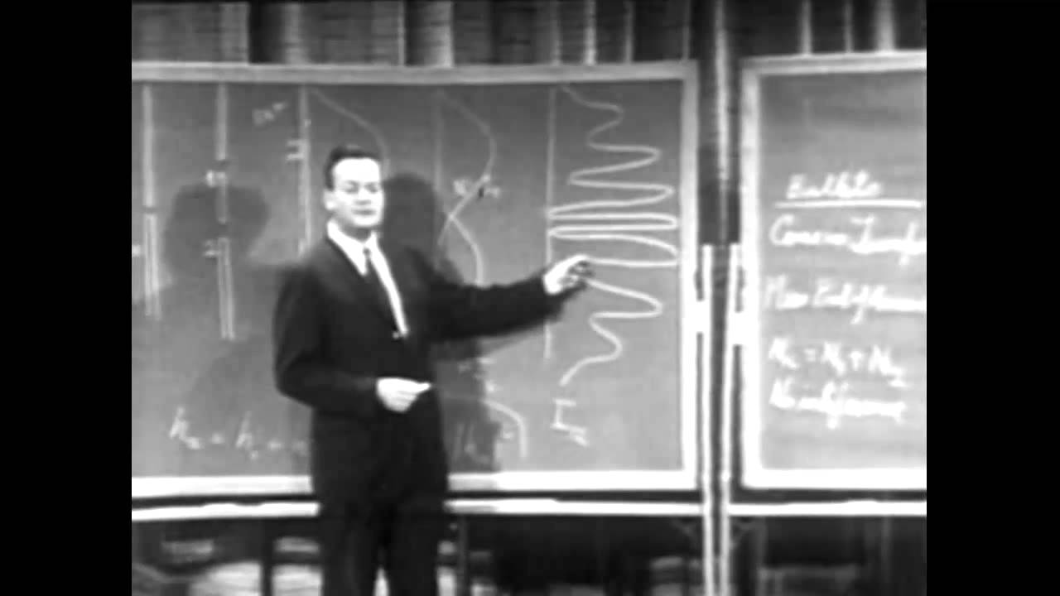
Richard Feynman and the double slit experiment
8
The double slit experiment demonstrates the fundamental aspect of the quantum world.
Notes:
We will take it further today

Slide 11
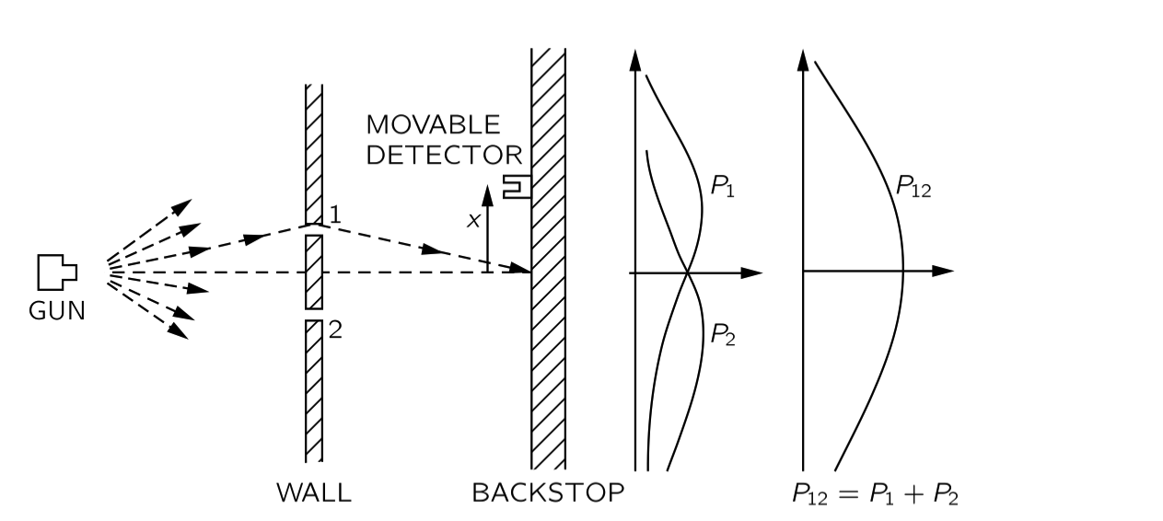
Case 1: Experiment with Bullets
9
A gun fires bullets in random direction. Slits 1 and 2 are openings through which bullets can pass. A moveable detector “collects” bullets and counts them.
P₁ is the probability curve when only slit 1 is open
P₂ is the probability curve when only slit 2 is open
When both slits are open: P₁₂ = P₁ + P₂
We can just add up the probabilities.
Notes:
Last week

Slide 12
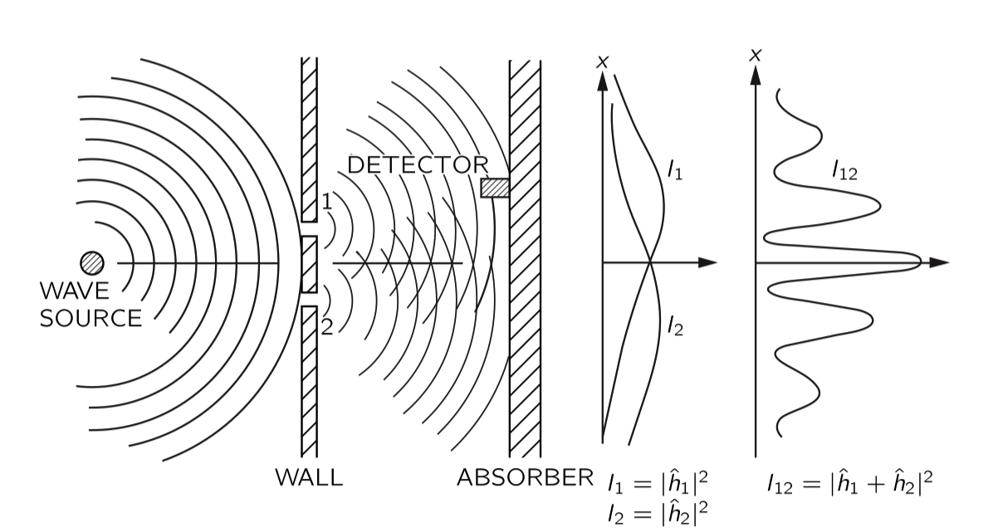

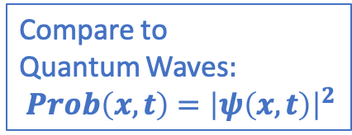
Case 2: Experiment with Waves
10
When both slits are open there are two contributions to the wave the oscillation
at the detector: $R\left(t\right)=R_{1}\left(t\right)+R_{2}\left(t\right)$
Compare to
Quantum Waves$:$
$Prob\left(x,t\right)={\left|ψ\left(x,t\right)\right|}^{2}$
Contrary to “bullets” we can not just add up Intensities.
Interference pattern: $I_{12}={\left|R_{1}+R_{2}\right|}^{2}=h_{1}^{2}+h_{2}^{2}+2h_{1}h_{2}\cos\left(Δφ\right)$
Regions where waves are amplified and regions where waves are cancelled.
Notes:
Add up the waves and then square the result for the intensity. Similar to quantum probability which is the square of the wave function.

Slide 13
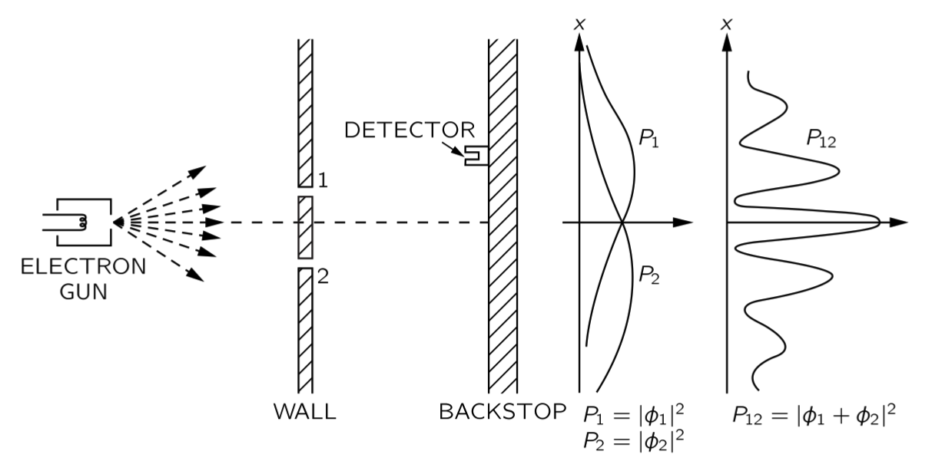
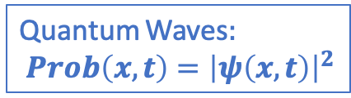
Case 3: Experiment with Electrons
11
Perhaps the electrons interfere with each other.
Reduce the intensity, shoot electrons one by one: same result.
Quantum Waves$:$
$Prob\left(x,t\right)={\left|ψ\left(x,t\right)\right|}^{2}$
|ψ₁|²
|ψ₁ + ψ₂|²
|ψ₂|²
P.S.:
Classically, light behaves light waves. However, if you shoot light, photon per photon, it “comes in lumps”, just like electrons.
Quantum Mechanics: for photons it is the same story as for electrons.

Slide 14
Case 3: Experiment with Electrons
11
Perhaps the electrons interfere with each other.
Reduce the intensity, shoot electrons one by one: same result.
Quantum Waves$:$
$Prob\left(x,t\right)={\left|ψ\left(x,t\right)\right|}^{2}$
Although the electron is detected as a “lump” on the screen, apparently it has gone through both slits!
|ψ₁|²
|ψ₁ + ψ₂|²
|ψ₂|²
P.S.:
Classically, light behaves light waves. However, if you shoot light, photon per photon, it “comes in lumps”, just like electrons.
Quantum Mechanics: for photons it is the same story as for electrons.

Slide 15
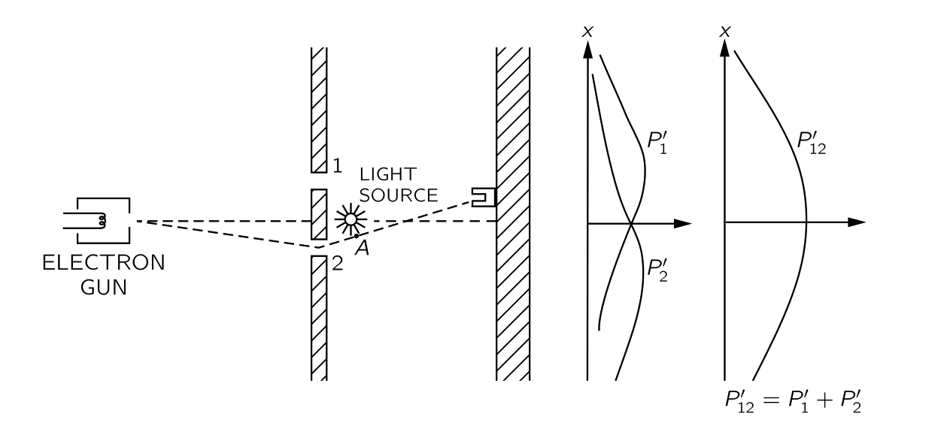
Case 4: Watch the Electrons
12
When we watch through which slit the electrons go, we destroy the interference!
Now the electron behaves just like a classical particle (“bullet”).
D₁
D₂
If you watch half the time; you only get the interference for the cases you did not watch.
It requires an observation to let the quantum wave function “collapse” into reality.
As long as no measurement is made the wave function keeps “all options open”.

Slide 16
13
Lecture 7
Wheeler’s Delayed Choice Experiment
“Your theory is crazy, but not crazy enough to be true.”
Niels Bohr
“Nothing exists, until it is measured.”
Niels Bohr
“I don’t like it, and I’m sorry I ever had anything to do with it.”
Erwin Schrödinger

Slide 17
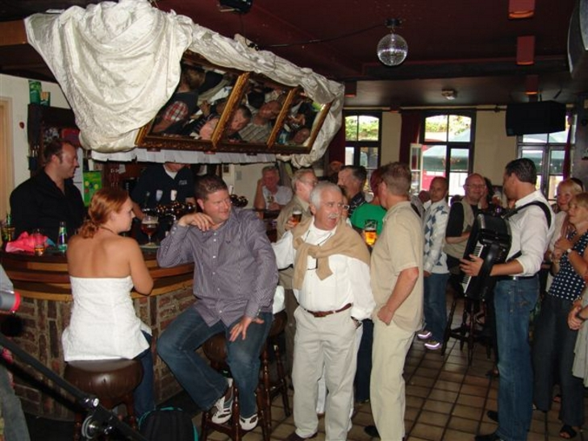
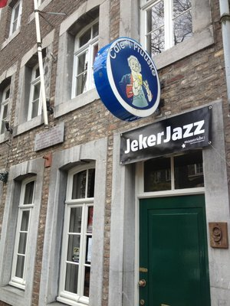
The Double Slit Experiment
14
Case 5:
The Delayed Choice Experiment
Notes:
Café ‘t Pruuske in Wijck

Slide 18
Case 4: Watch the Electrons
15
Consider again the double slit experiment in which we watch the electrons.
D₁
D₂
Can we try to “fool” the electron?

Slide 19
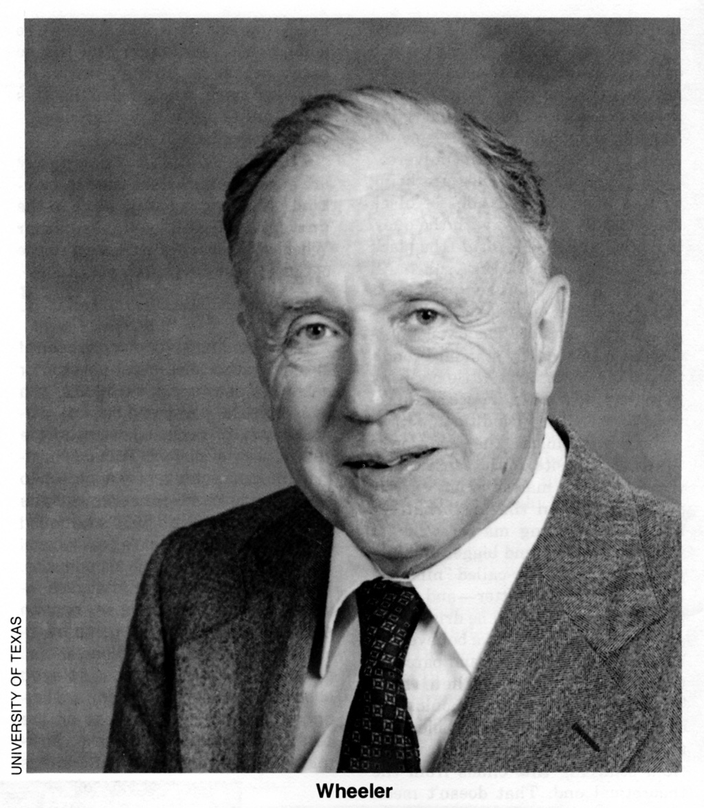
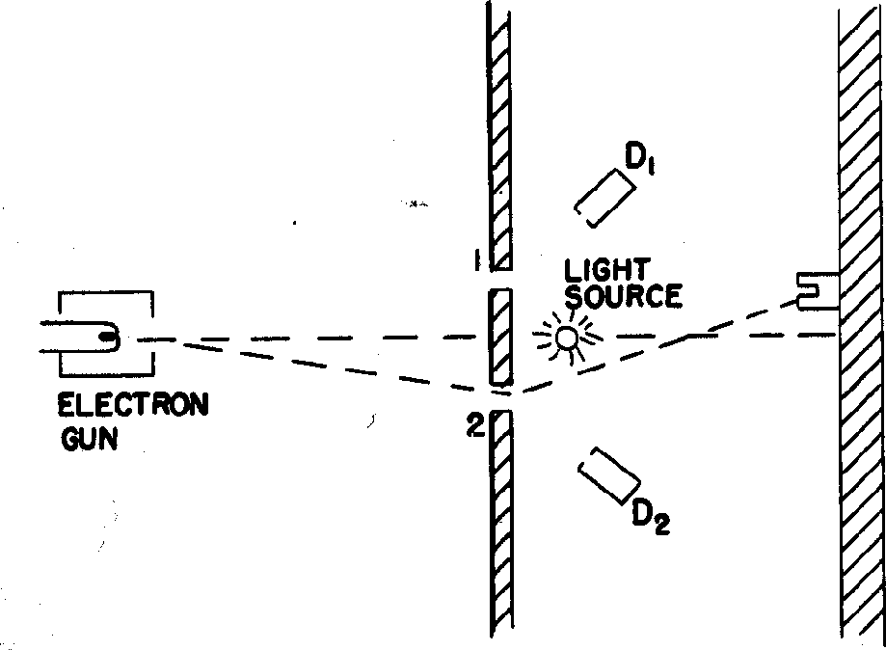
Wheeler’s Suggestion (1978)
16
“The real reason universities have students is to educate the professors”
- John Archibald Wheeler
John Wheeler (1911 – 2008):
Famous for work on gravitation
(Black holes – quantum gravity)
Replace detectors D₁ and D₂ with telescopes T₁ and T₂ which are focused on slits 1 and 2
T₁
T₂
What happens if we afterwards check whether the electron went through slit 1 or slit 2?
Notes:
Same set-up, but move the microscopes very far away……

Slide 20
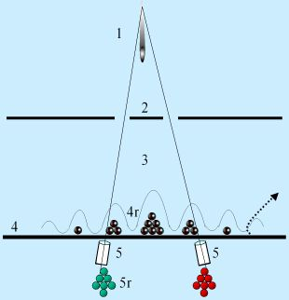
Wheeler’s Delayed Choice Experiment
17
Even better: we can suddenly decide to look at the electrons or not.
We decide whether or not to look after the electrons passed the slits!
T₁
T₂
What will we see?
An wave interference (black) pattern or a bullet-like non-interference (red-green) pattern?
Notes:
At Right:
Do we see “bullets” distribution in green and red, or
Do we see “waves”, distributions in black?

Slide 21
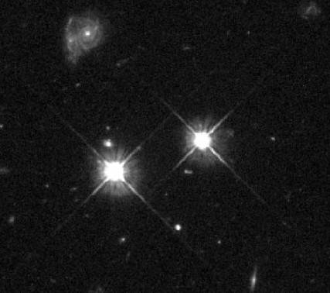
Thought Experiment with Gravitational Lensing
18
What if we make the distance from slits to screen very long?
John Archibald Wheeler
Light beams bend in gravitation field.
Two different light-paths can arrive in the same position in our eyes/telescope.
We then see the same object in two locations.
➔ We can make a “double slit” experiment
Notes:
Gravitational lensing: light bends around galaxies.
The galaxies now work as a “double slit”
Example right bottom: two images of the same galaxy with lensing.

Slide 22
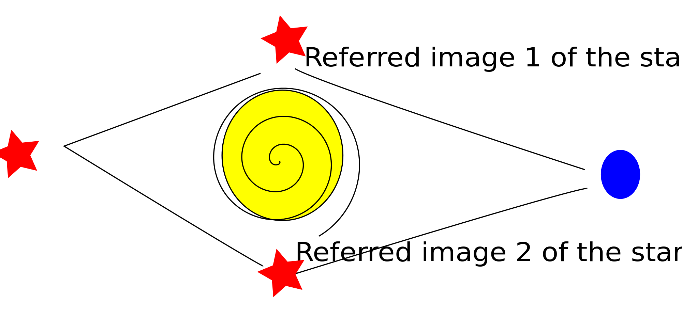
Wheeler’s idea
19
What if we make the distance from slits to screen very long?
Wheeler uses “gravitational lensing” as a “double slit”.
In this case the electrons are replaced by photons.
Star
T₁
One screen or two screens
Galaxy
T₂
Then, either: Project image of T₁ and T₂ on separate screens,
Or: Combine the image of T₁ and T₂ on one screen
→ QM: no interference!
→ QM: interference!
Notes:
Elecrons or photons is not important: “quanta”.
Count the photons “left” and “right” or make an interference:
Each photon goes both ways!!

Slide 23
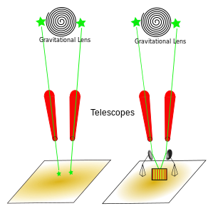
Wheeler’s idea
20
What if we make the distance from slits to screen very long?
Wheeler uses “gravitational lensing” as a “double slit”.
In this case the electrons are replaced by photons.
Star
T₁
One screen or two screens
Galaxy
T₂
Then, either: Project image of T₁ and T₂ on separate screens,
Or: Combine the image of T₁ and T₂ on one screen
→ QM: no interference!
→ QM: interference!

Slide 24
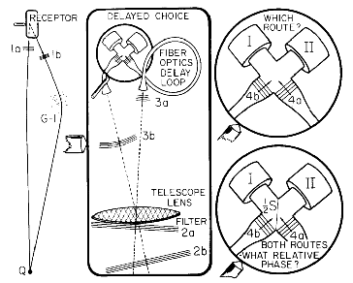
Wheeler’s idea
21
What if we make the distance from slits to screen very long?
Wheeler uses “gravitational lensing” as a “double slit”.
In this case the electrons are replaced by photons.
Star
T₁
One screen or two screens
Galaxy
T₂
Then, either: Project image of T₁ and T₂ on separate screens,
Or: Combine the image of T₁ and T₂ on one screen
→ QM: no interference!
→ QM: interference!
Crucial point: it must be impossible to know which path the photon took!

Slide 25
Wheeler’s Delayed Choice Experiment
22
Even better: we can suddenly decide to look at the electrons.
Suppose we decide (random) to look after the electrons passed the slits!
T₁
T₂
What will we see?
An wave interference (black) pattern or a bullet-like non-interference (red-green) pattern?
Answer: “Bullets”. We still have killed the interference by measuring!!!

Slide 26
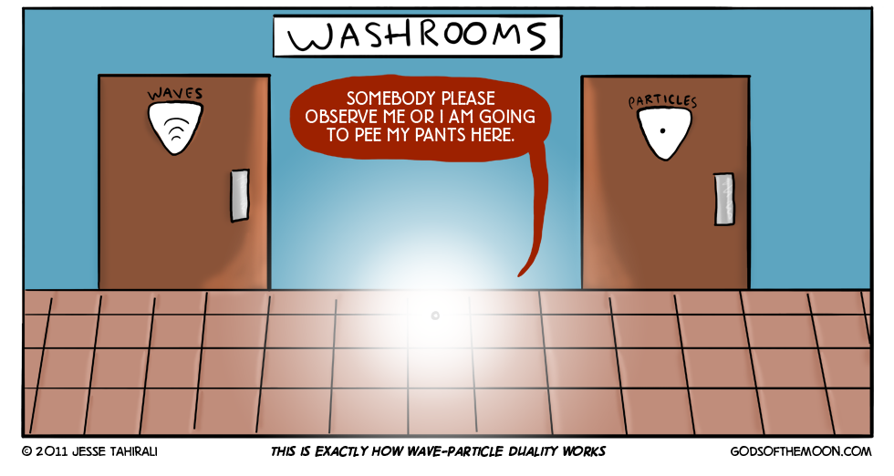
Delayed Choice…?
23

Slide 27
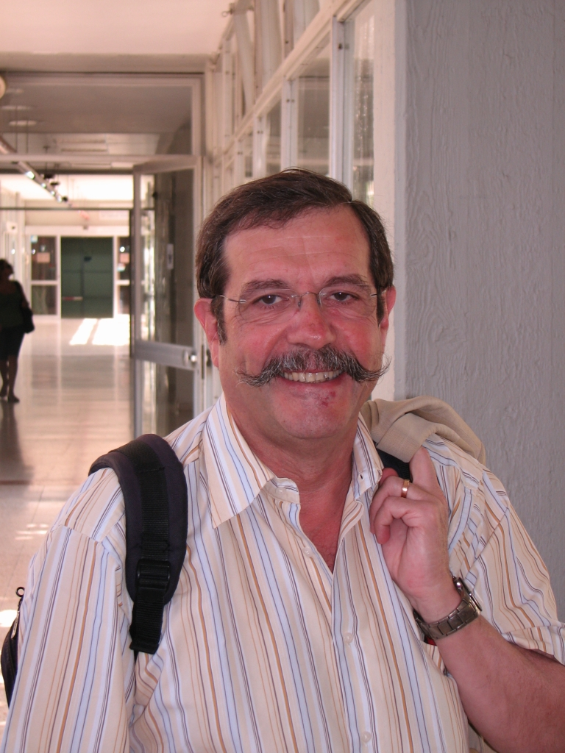
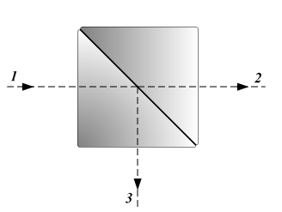
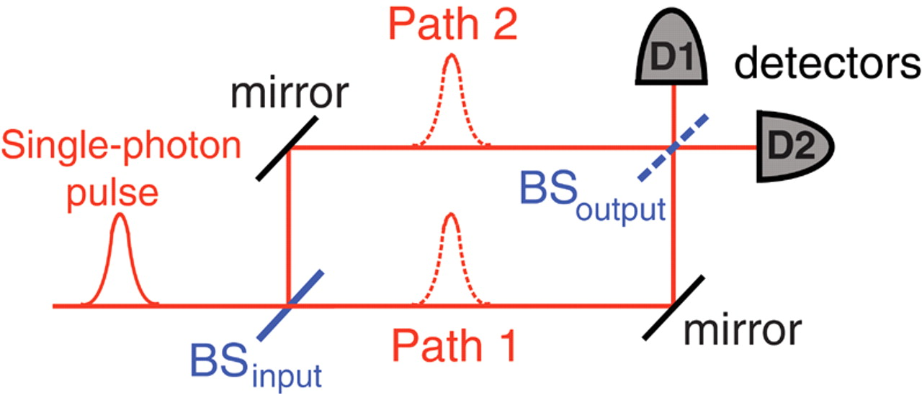
The Experiment of Aspect (2007)
24
Alain Aspect and his team have done the experiment!
In yet another way: using photons in the lab.
They used beam-splitters to create two alternative routes
for a photon to the same place. Path 1 = Path 2 = 48 m
Alain Aspect
Beam-splitter:
Photon has 50% chance to pass through and 50% chance to reflect.
Like 2-slits: the quantum can do both!
Notes:
D1=path1 D2=path2
Beam splitters: 50% light is transmitted, 50% light is reflected (also single photon waves!)

Slide 28

Three Equivalent Experiments
25
T₁
T₂

Slide 29
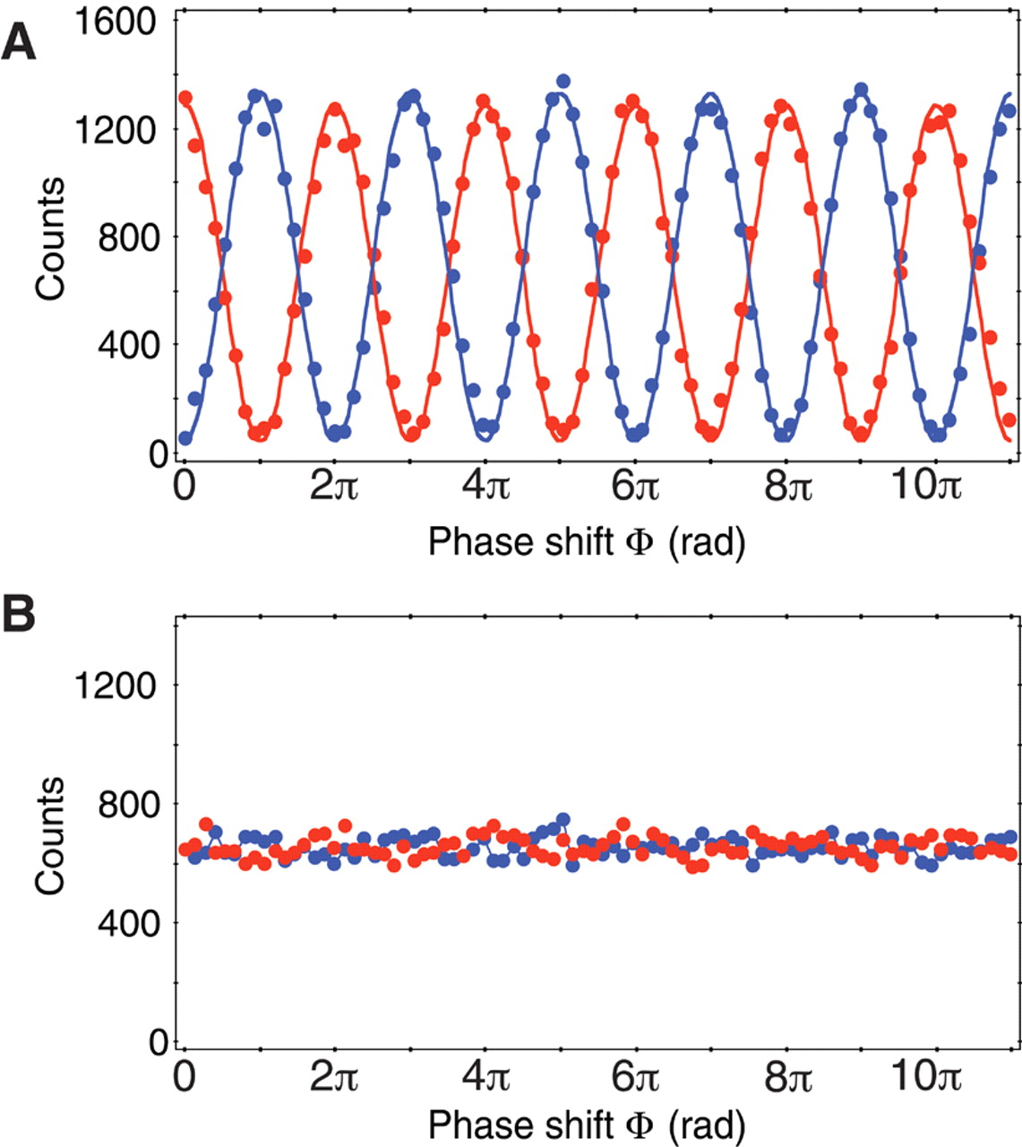
The Experiment of Aspect (2007)
26
Situation 1: “Are you a particle?” (open BS_{output})
Answer: “Yes!” (Photon never on 2 paths)
”Looking”
Make the choice to close BS_{output} well after the photon has passed BS_{input}!
Situation 2: “Are you a wave?” (closed BS_{output})
Answer: “Yes!” (Photon on 2 paths)
“Not Looking”
Notes:
Looking: D1 “looks” at path1 – D2 looks at path2
"Are you a particle?" Yes!
Not looking: mirror mixes again path1 and path2
"Are you a wave?" Yes!
Phase shift by changing the length of path1 and path2

Slide 30
The Experiment of Aspect (2007)
27
Situation 1: “Are you a particle?” (open BS_{output})
”Looking”
Make the choice to close BS_{output} well after the photon has passed BS_{input}!
Situation 2: “Are you a wave?” (closed BS_{output})
Answer: “Yes!” (Photon on 2 paths)
“Not Looking”
Notes:
Make the paths very long and decide to open or close *after* the photon chose path1 or path2.

Slide 31
The Experiment of Aspect (2007)
28
Situation 1: “Are you a particle?” (open BS_{output})
Answer: “Yes!” (Photon never on 2 paths)
”Looking”
“Thus one decides the photon shall have come by one route or by both
routes after it has already done its travel”
- John A. Wheeler
Situation 2: “Are you a wave?” (closed BS_{output})
Answer: “Yes!” (Photon on 2 paths)
“Not Looking”
Apparently the quantum wave function includes both possibilities.
The observation makes one of them a reality via the collapse of the wave function.

Slide 32

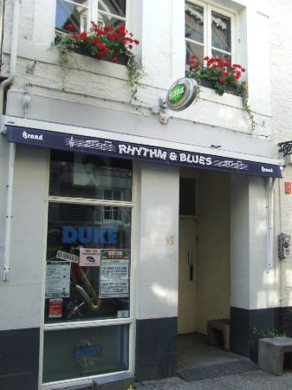
29
Schrödinger’s Cat
Notes:
Blues café the Duke in de Koestraat

Slide 33
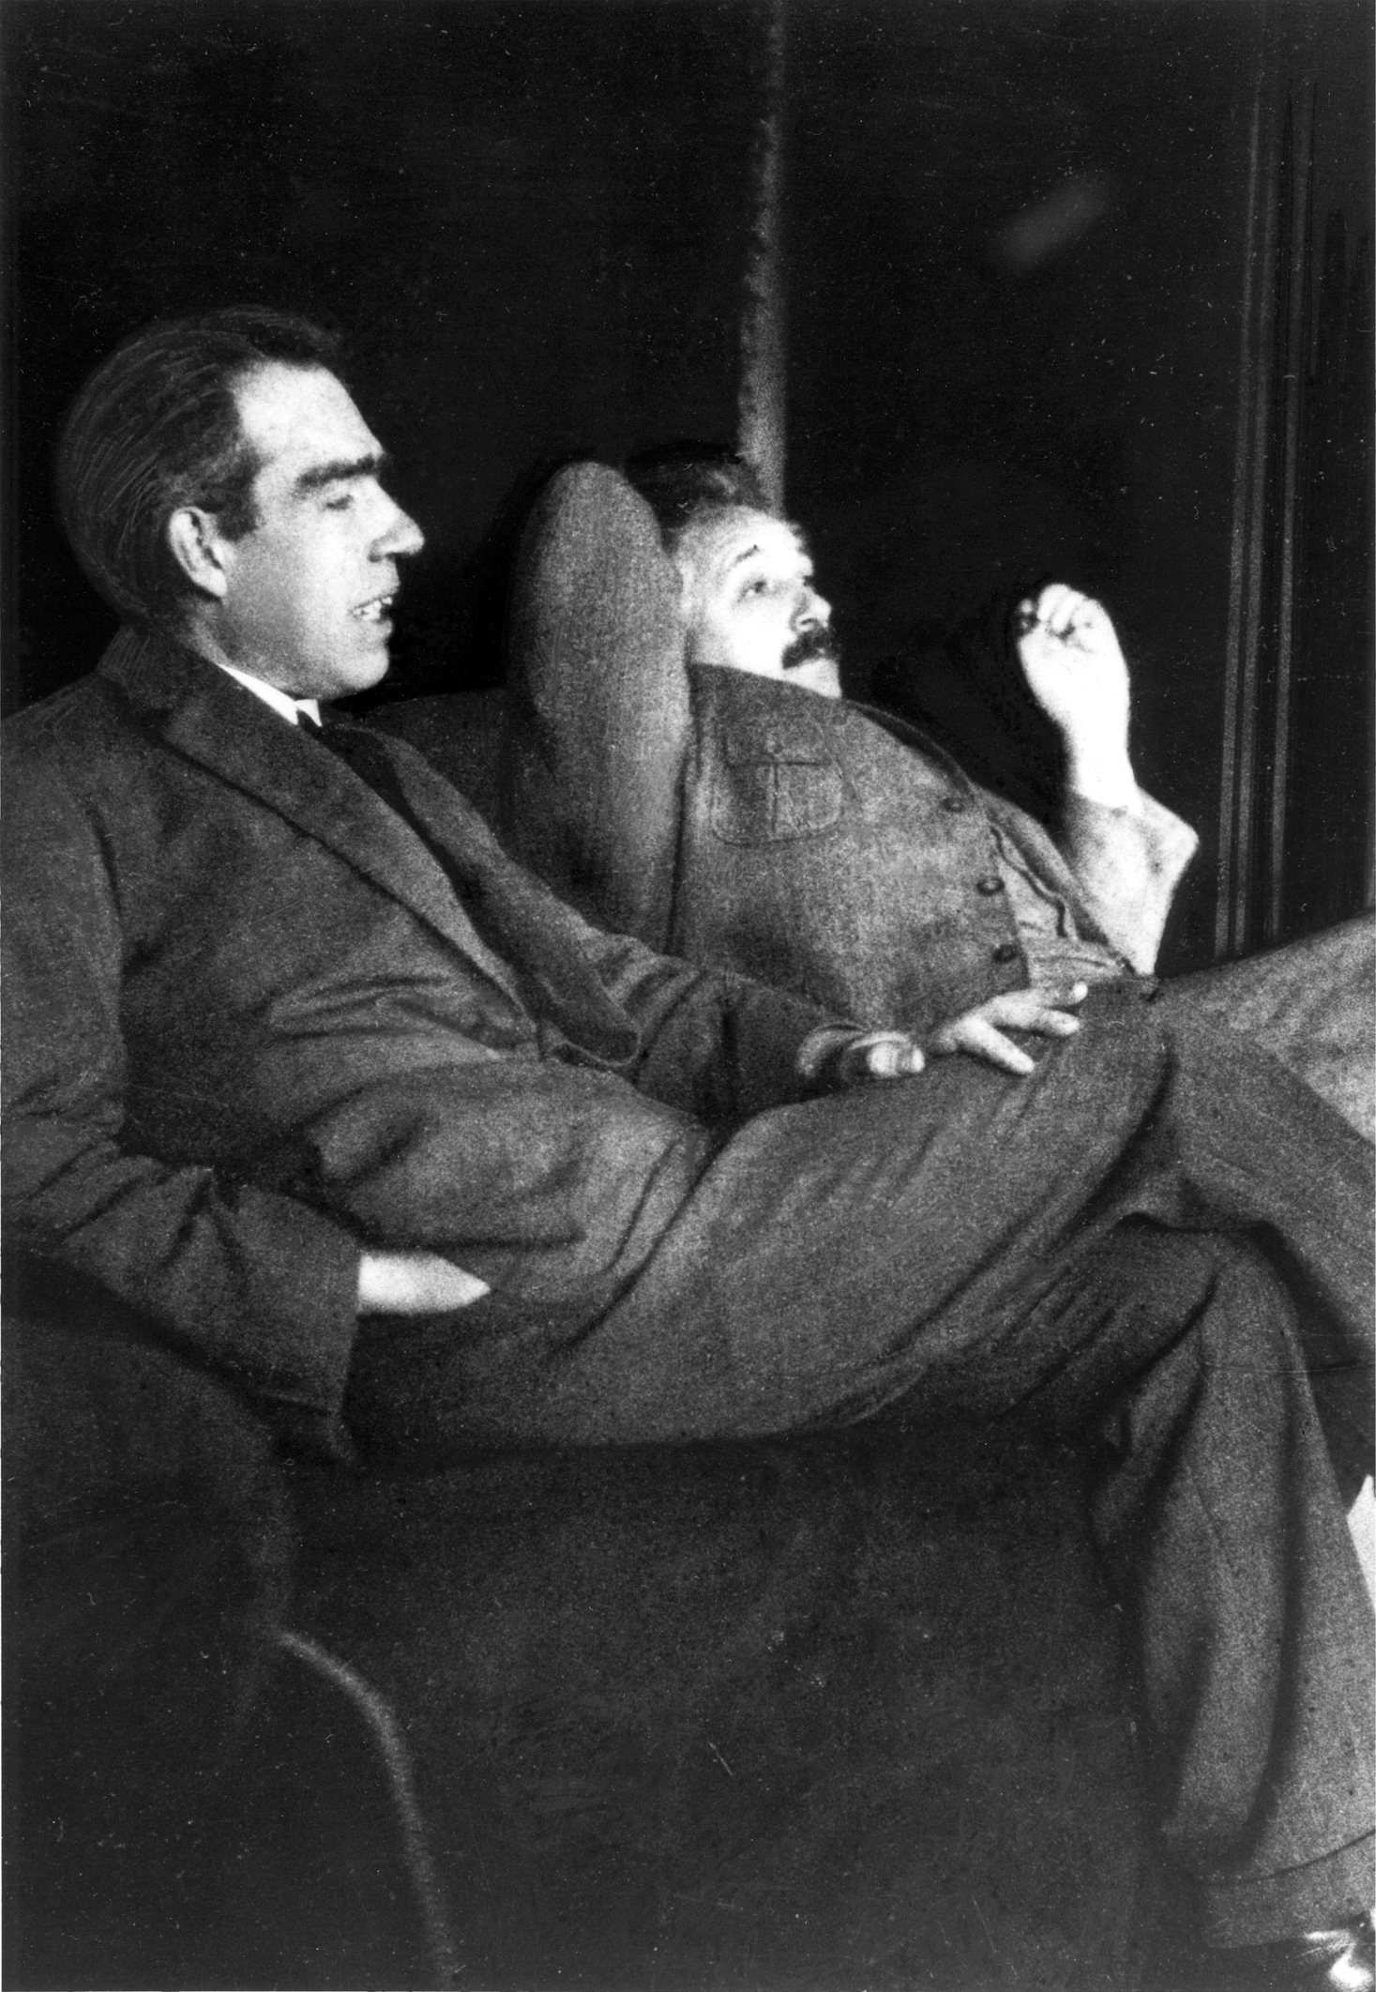
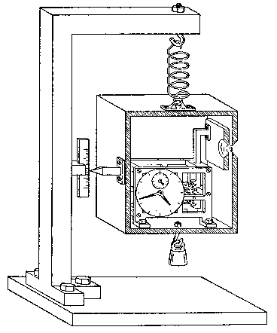
The Copenhagen Interpretation
30
Niels Bohr and Albert Einstein debates at Solvay conf.
Niels Bohr:
Uncertainty relation
Complementary, collapse of
the wave function.
1927
Albert Einstein:
“God does not play dice”
Objective Reality
Photo: Paul Ehrenfest
(December 1925)
Particle-Wave duality: one of the great mysteries of quantum mechanics.
Complementarity: A quantum object is both a particle and a wave.
A measurement can illustrate either particle or wave nature but not both at the same time, because the object is affected by the act of measurement.

Slide 34
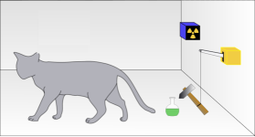
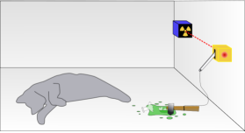
Schrodinger’s Cat
31
Paradox (thought experiment) invented by Erwin Schrödinger in 1935 to demonstrate that the Copenhagen interpretation makes no sense.
E. Schrödinger
Compare quantum choice with double slit situation.
In a radioactive source, a single random quantum event has 50% probability to trigger a lever arm and break a flask containing deadly poison.

Slide 35
Schrodinger’s Cat
32
Paradox (thought experiment) invented by Erwin Schrödinger in 1935 to demonstrate that the Copenhagen interpretation makes no sense.
E. Schrödinger
In a radioactive source, a single random quantum event has 50% probability to trigger a lever arm and break a flask containing deadly poison.
Notes:
As long as we don't look the cat is in a superposition of both states.

Slide 36
Schrodinger’s Cat
33
Paradox (thought experiment) invented by Erwin Schrödinger in 1935 to demonstrate that the Copenhagen interpretation makes no sense.
In simple mathematics: probability is 𝜓²
The wave function of the particle in 2-slit (”superposition”):
𝜓_{wave} = 𝜓_{left} + 𝜓_{right}
Probability before measurement:
(𝜓_{wave})² = (𝜓_{left} + 𝜓_{right})² = (𝜓_{left})² + (𝜓_{right})² + 2 𝜓_{left・}𝜓_{right}
Measurement: force the particle to go left or right!
E. Schrödinger
“Interference”
In a radioactive source, a single random quantum event has 50% probability to trigger a lever arm and break a flask containing deadly poison.

Slide 37
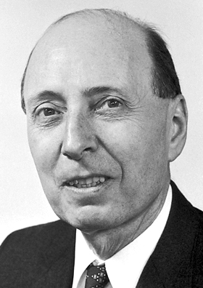
Schrodinger’s Cat
34
Paradox (thought experiment) invented by Erwin Schrödinger in 1935 to demonstrate that the Copenhagen interpretation makes no sense.
In simple mathematics: probability is 𝜓²
The wave function of the cat in the box (“superposition”):
𝜓_{cat} = 𝜓_{alive} + 𝜓_{dead}
Probability before measurement:
(𝜓_{cat})² = (𝜓_{alive} + 𝜓_{dead})² = (𝜓_{alive})² + (𝜓_{dead})² + 2 𝜓_{alive・}𝜓_{dead}
Measurement: force cat to be either dead or alive!
E. Schrödinger
“Interference”
In a radioactive source, a single random quantum event has 50% probability to trigger a lever arm and break a flask containing deadly poison.
Is the cat both dead and alive before we open the box to observe?
Eugene Wigner
”Wigner’s Friend” problem: Who is observer? When does the wave function collapse?
Is it the cat? The Experimenter? The press reporter? Or you when you hear the news?
Does it require consciousness?

Slide 38
Schrodinger’s Cat
35
Paradox (thought experiment) invented by Erwin Schrödinger in 1935 to demonstrate that the Copenhagen interpretation makes no sense.
E. Schrödinger
In a radioactive source, a single random quantum event has 50% probability to trigger a lever arm and break a flask containing deadly poison.
Is the cat both dead and alive before we open the box to observe?
Eugene Wigner
”Wigner’s Friend” problem: Who is observer? When does the wave function collapse?
Is it the cat? The Experimenter? The press reporter? Or you when you hear the news?
Does it require consciousness?

Slide 39
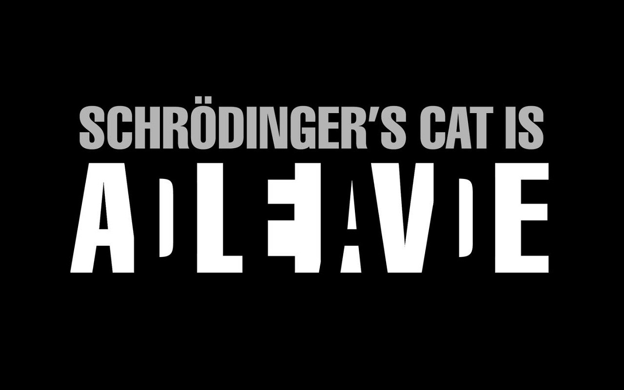
Schrodinger’s Cat
35
Paradox (thought experiment) invented by Erwin Schrödinger in 1935 to demonstrate that the Copenhagen interpretation makes no sense.
E. Schrödinger
In a radioactive source, a single random quantum event has 50% probability to trigger a lever arm and break a flask containing deadly poison.
Is the cat both dead and alive before we open the box to observe?
Eugene Wigner
”Wigner’s Friend” problem: Who is observer? When does the wave function collapse?
Is it the cat? The Experimenter? The press reporter? Or you when you hear the news?
Does it require consciousness?

Slide 40
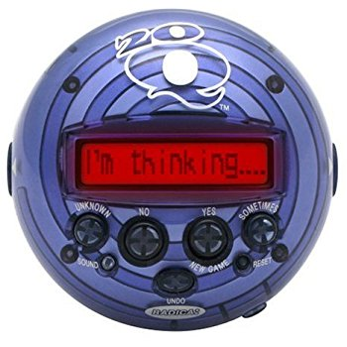
Wheeler: 20 Questions Analogy
36
A Word Game:
At a party one guest has to guess a word that is agreed upon by the others asking questions to be answered with “yes”/”no”.
➔ The pre-existing word is guessed.
The “20-Q” game
Alternative game:
No word is agreed at beginning. Each person in turn answers yes/no consistently with all previous “yes”/”no” answers.
Gets more and more difficult
Finally the person guessing says: “Is it a cloud?” Answer: “Yes!”
➔ There was no pre-existing word. The final word
was brought into being by the questions asked.
Analogy:
Nature gives consistent answers on quantum questions asked by the “collapse of the wave function”
➔ The observer creates reality by making an observation.
“No phenomenon is a real phenomenon until it is an observed phenomenon.”
- John Archibald Wheeler
Notes:
A nice game invented by Wheeler based on the 20Q game.
You have to guess a word within 20 yes/no questions.
2^20 ~ 1 million

Slide 41
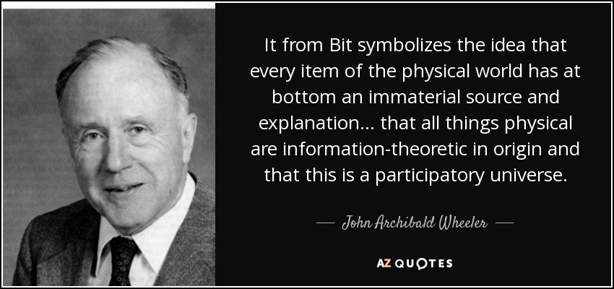

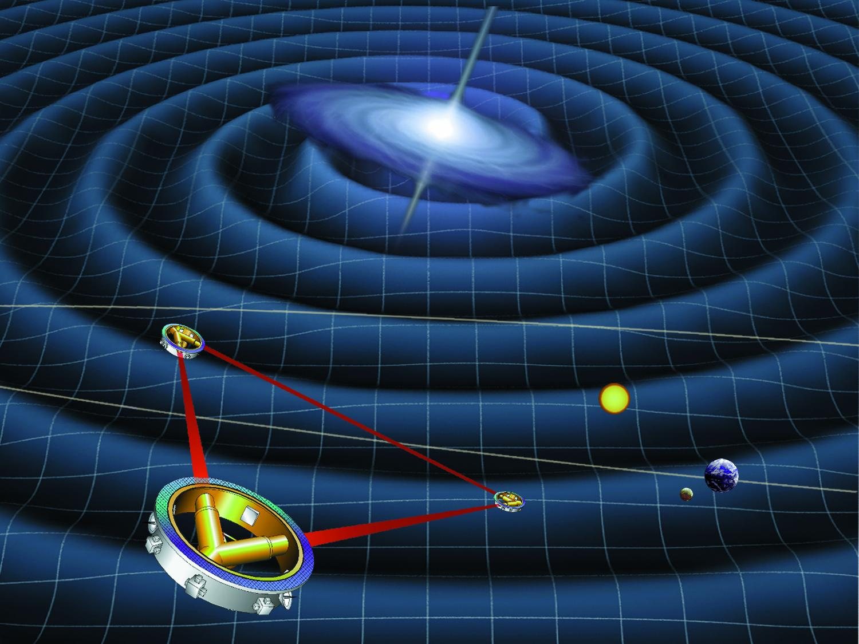
“It from Bit” and “Participatory Universe”
37
?
Build a gravitational wave detector
and look back directly at the big bang….
Notes:
Wheeler’s commented his career in three parts:
Everything is particles
Everything is fields
Everything is Information

Slide 42
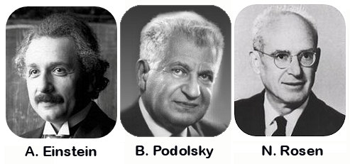
Next Lecture: Einstein’s Objection
38
The EPR paradox

