Slide 1

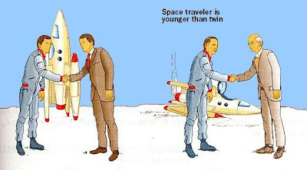
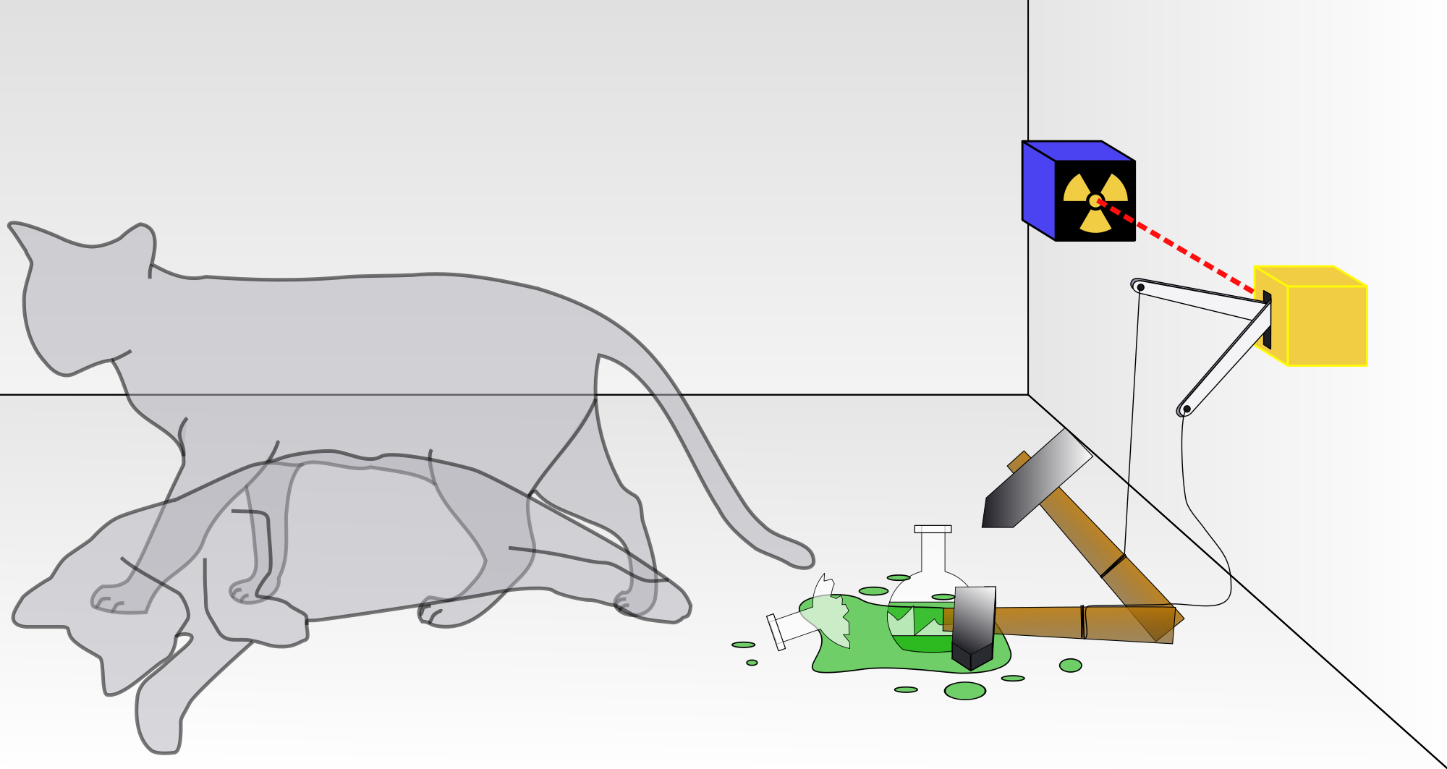
The Relativistic Quantum World
A lecture series on Relativity Theory and Quantum Mechanics
Marcel Merk
University of Maastricht, Sept 14 – Oct 12, 2017

Slide 2
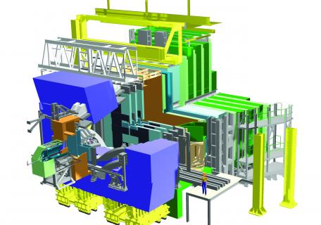
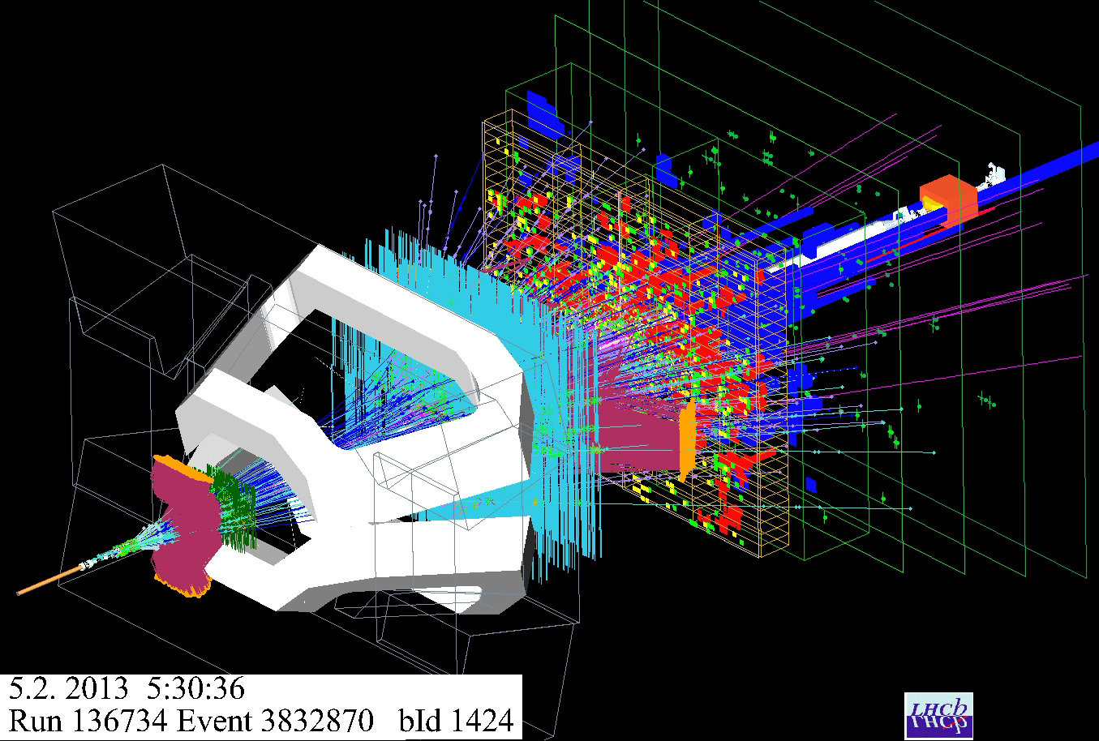
Introduction
Email: marcel.merk@nikhef.nl Website: www.nikhef.nl/~i93
CV:
1976 – 1982: High-school St. Maartenscollege, Maastricht
1982 – 1987: Study Physics at Radboud University, Nijmegen
1987 – 1991: PhD in Nijmegen and CERN
1991 – 1994: Postdoc Carnegie Mellon University, Pittsburgh
1994 – 1997: Postdoc Nikhef, Amsterdam
1997 – 2000: Fellow of Royal Dutch Academy at Utrecht
2000 – today: Research Physicist at Nikhef Amsterdam
2005 – today: Extraordinary Professor at the VU, Amsterdam
Current Research:
- The Large Hadron Collider at CERN.
- Study the matter-vs-antimatter
asymmetry in the laws of nature.
- Why do we have three generations
of fundamental particles?

Slide 3

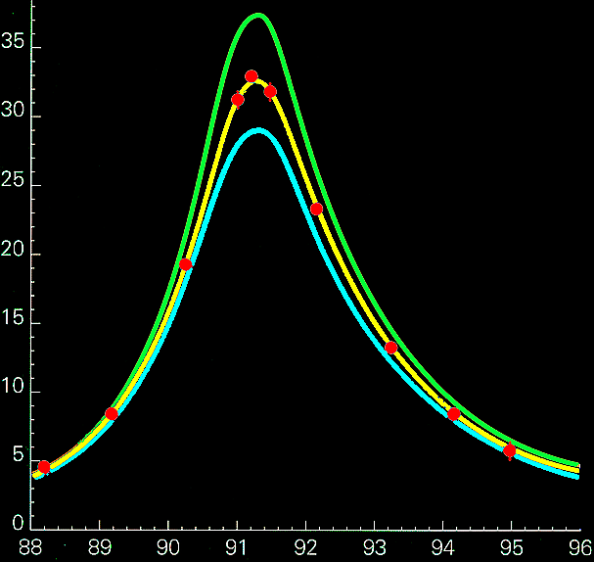
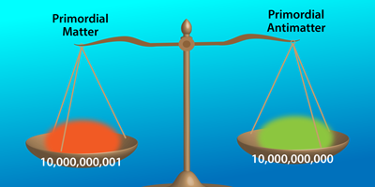
Personal Research Focus
Research:
- The Large Hadron Collider at CERN.
- Study the matter-vs-antimatter
asymmetry in the laws of nature.
Number of events
4 neutrinos
3 neutrinos
2 neutrinos
measurements
Collision Energy (GeV)
Why are there three generations of particles and where is the antimatter?
Does the Higgs particle/field perhaps play an even more fundamental role?

Slide 4
The Relativistic Quantum World
Sept 14:
Lecture 1: The Principle of Relativity and the Speed of Light
Lecture 2: Time Dilation and Lorentz Contraction
Sept 21:
Lecture 3: The Lorentz Transformation and Paradoxes
Lecture 4: General Relativity and Gravitational Waves
Relativity
Sept 28:
Lecture 5: The Early Quantum Theory
Lecture 6: Feynman’s Double Slit Experiment
Oct 5:
Lecture 7: The Delayed Choice and Schrodinger’s Cat
Lecture 8: Quantum Reality and the EPR Paradox
Quantum
Mechanics
Oct 12:
Lecture 9: The Standard Model and Antimatter
Lecture 10: The Large Hadron Collider
Standard
Model
Lecture notes, written for this course, are available: www.nikhef.nl/~i93/Teaching/
Prerequisite for the course: High school level mathematics.

Slide 5

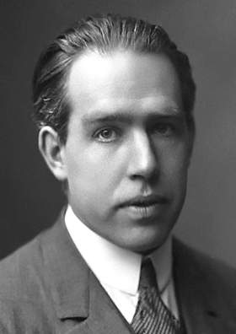
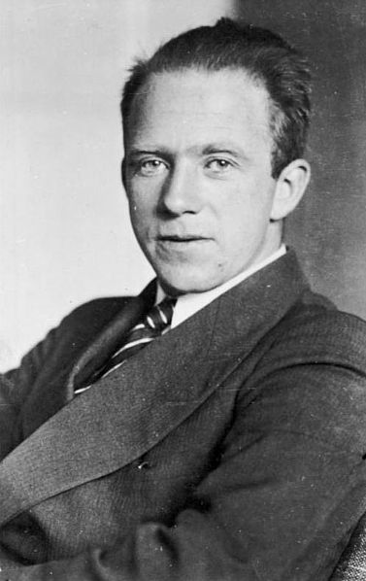
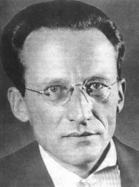
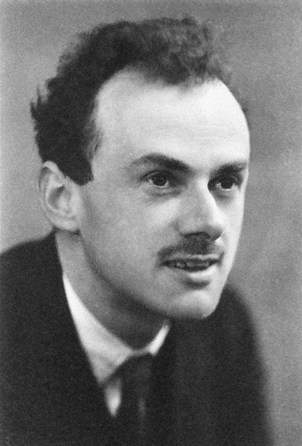
Relativity and Quantum Mechanics
“There is nothing new to be discovered in physics now. All that remain is more and more precise measurements.”
Lord Kelvin on Physics in 1900
However, two unsolved issues:
The existence of the mysterious aether ➔ Relativity Theory
The stability of the atom ➔ Quantum Mechanics
Albert Einstein
Niels Bohr
Werner Heisenberg
Erwin Schrödinger
Paul Dirac
Notes:
Newton mechanics, Maxwell electrodynamics, Boltzmann statistics. Relativity built up on the work of Lorentz, but is mainly the effort of one person: Albert Einstein.
Quantum Mechanics was developed (very fast!) by many people. Also + Born, Jordan, Pauli, Sommerfeld, later Feynman, Schwinger,….

Slide 6

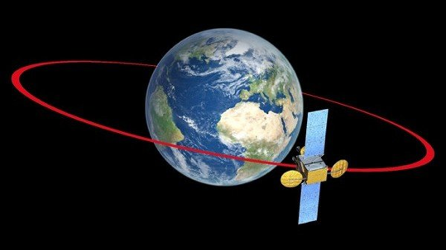
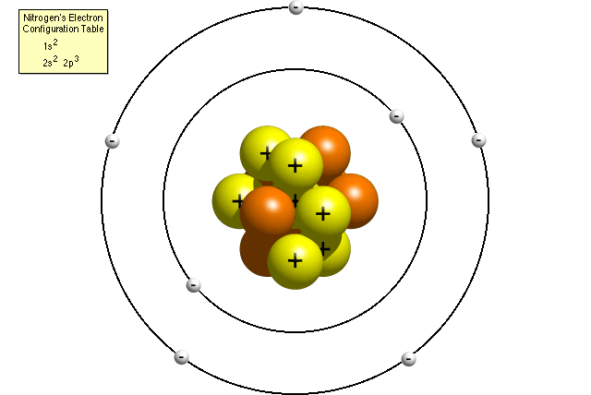


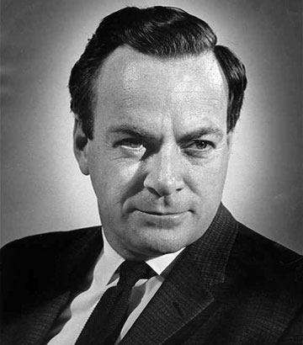
Relativity and Quantum Mechanics
Classical Mechanics
Quantum Mechanics
Smaller Sizes (ħ)
Newton
Bohr
Higher Speed (c)
Feynman
Einstein
Relativity Theory
Quantum Field Theory
Classical mechanics is not “wrong”.
It is has limited validity for macroscopic objects and for moderate velocities.
Notes:
Classical: Laws of Newton and Kepler. Quantum Mech. Niels Bohr QM, Einstein Relativity. Paul Dirac was the first to combine Quantum Mechanics and Special Relativity.

Slide 7
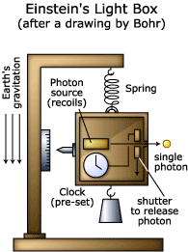
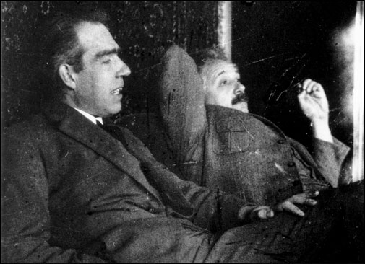
A “Gedanken” Experiment
A useful tool throughout these lectures:
Thought experiments:
Consider an experiment that is not limited by our level of technology.
Assume the apparatus works perfectly without limitations so that we test only the limits of the laws of nature!

Slide 8
Lecture 1
The Principle of Relativity and the Speed of Light
“If you can’t explain it simply you don’t understand it well enough”
Albert Einstein

Slide 9
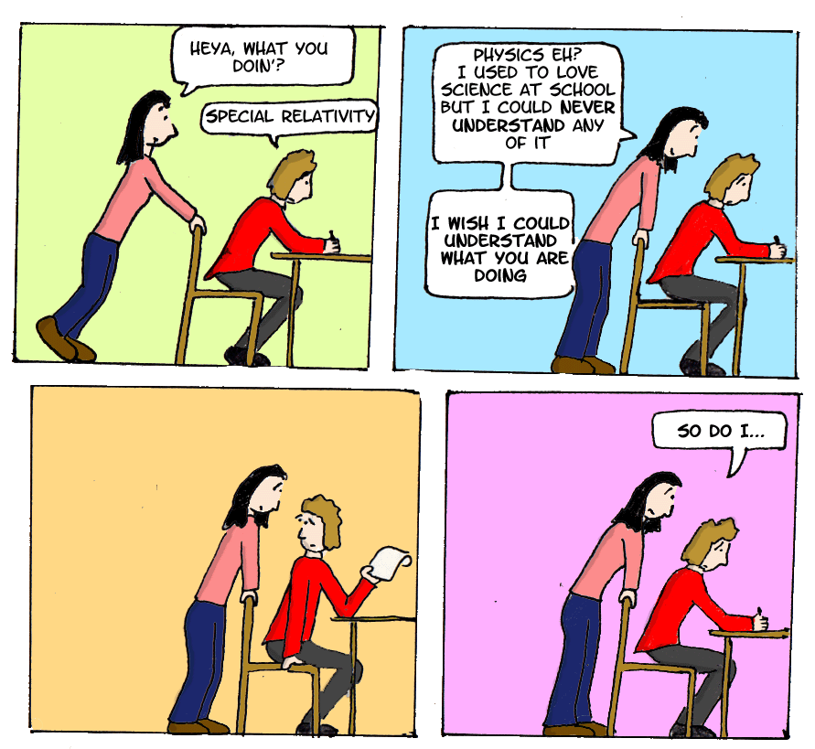
“Everything should be made as simple as possible, but not simpler”
-Albert Einstein

Slide 10
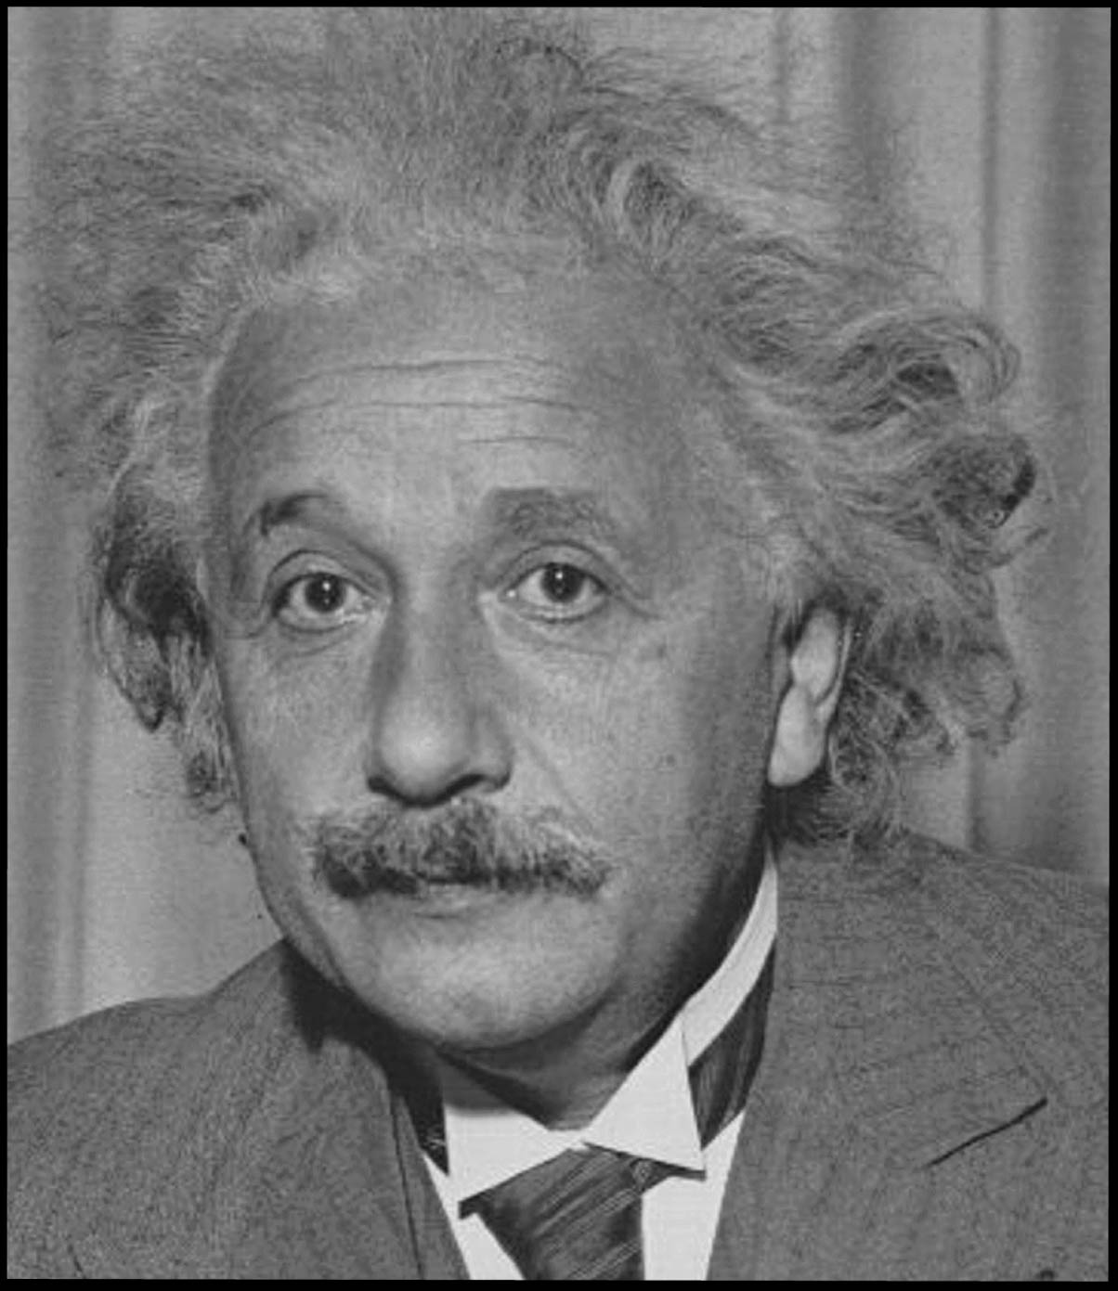
Albert Einstein (1879 – 1955)
Annus Mirabilis 1905:
Special theory of relativity:
  Fundamental change interpreting space and time. Equivalence of mass and energy: E=mc²
The Photo-Electric Effect:
  QM: light consists of photon-quanta
Brownian Motion:
  Demonstration of existence of atoms
Although these studies were motivated by curiosity, they eventually had a large impact on society:
Computing and communication technology, health-care technology, navigation, military, …
Notes:
Three articles in Zeitschrift fur Physik. Brownian motion seen in 1827 under a microscope. Einstein proved it was caused by atoms pushing things around.
Nobelprize in 1921 for Photo electric effect.

Slide 11
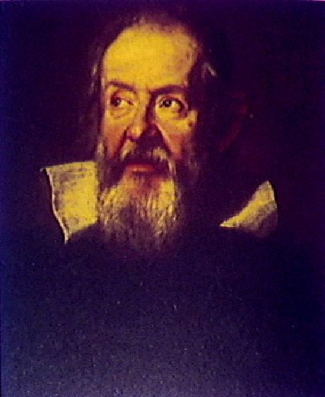
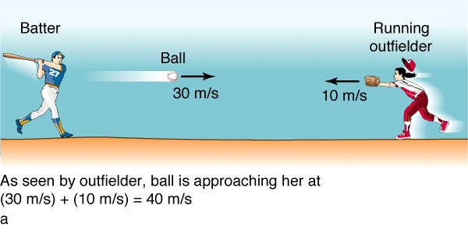
Galilei Transformation law .
(Bob)
(Alice)
w=
v=
w’= ?
S
S‘
With which speed do the ball and the outfielder approach each other?
Intuitive law (daily experience): 30 m/s + 10 m/s = 40 m/s
Galileo Galilei
(1564 – 1642)
More formal:
Observer S (the Batter) observes the ball with relative velocity: w
Observer S’ (the running Outfielder) observes the ball with relative velocity: w’
The velocity of S’ with respect to S is: v
w’ = w + v
This is the Galileian law for adding velocities.
Not exactly correct: in lecture 3 we will see: w’ = 39.999999999999997 m/s !
Notes:
Galilei is famous for supporting Heliocentrism of Copernicus (vs Geocentrism of Ptolemaeus and Aristotle) and was given house arrest by the inquisition.

Slide 12
Galilei Transformation law .
(Bob)
(Alice)
w=
v=
w’= ?
S
S‘
With which speed do the ball and the outfielder approach
each other?
Intuitive law: 250 000 km/s + 200 000 km/s = 450 000 km/s ?
Galileo Galilei
(1564 – 1642)
More formal:
Observer S (the Batter) observes the ball with relative velocity: w
Observer S’ (the running Outfielder) observes the ball with relative velocity: w’
The velocity of S’ with respect to S is: v
w’ = w + v
This is the Galileian law for adding velocities.
Not at all correct: in lecture 3 we will see: w’ = 290 000 km/s !
Einstein!
Notes:
Galilei is famous for supporting Heliocentrism of Copernicus (vs Geocentrism of Ptolemaeus and Aristotle) and was given house arrest by the inquisition.

Slide 13
Coordinate Systems
A reference system or coordinate system is used to determine the time and position of an event.
Reference system S is linked to observer Bob at position (x,y,z) = (0,0,0)
An event (batter hits the ball) is fully specified by giving its coordinates in time and space: (t, x, y, z)
Reference system S’ is linked to observer Alice who is moving with velocity v with respect to S of Bob.
How are the coordinates of the event of Bob (batter hits the ball) expressed in coordinates for Alice (t’, x’, y’, z’) (running outfielder) ?
w
eg.: Is it true that t = t’ ?
(universal time – Galilei)
How is the trajectory of the ball for Alice related to that for Bob?

Slide 14
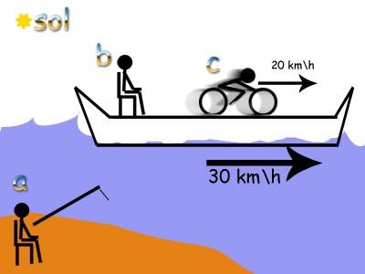
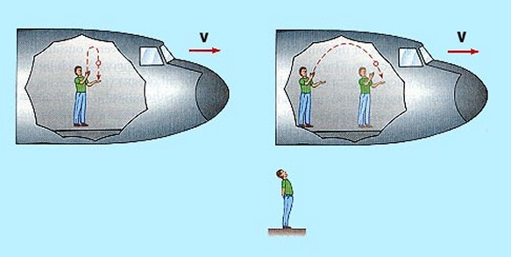
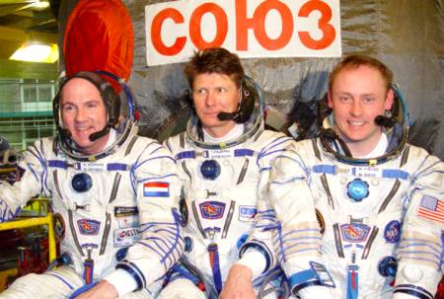
Alice, Bob and Real Speed
Alice cycles with v = 20 km/h
The boat moves with w = 10 km/h
Bob sees 20 km/h + 10 km/h = 30 km/h
What is the “real” speed?
Imagine Alice has a windowless cabine and wants to determine whether the boat moves by doing an experiment.
Can she find out she’s moving 30 km/h?
(here illustrated for an airplane)
Astronauts in the ISS don’t notice that they move with 29 000 km/h!
Absolute velocity does not exist!!!
Inertial frames: Observers that move with a constant relative velocity

Slide 15
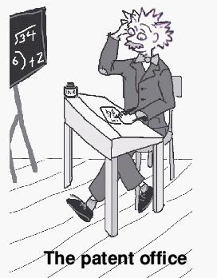
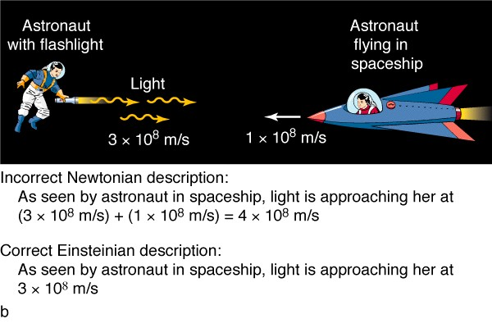
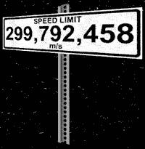
Special Relativity
Postulates of Special Relativity
Two observers in so-called Inertial frames, i.e. they move with a constant relative speed to each other, observe that:
The laws of physics for each observer are the same,
The speed of light in vacuum for each observer is the same.
A thought experiment:
Bob measures the speed of light rays.
What does he find?
Alice also measures the speed of light rays.
What does she find?
Einstein: No !
Galilei:
v = 3+1 = 4 x 10⁸ m/s?
3 x 10⁸ m/s!
Bob
Alice
A clear contradiction with the Galilei law of addition of velocities!

Slide 16
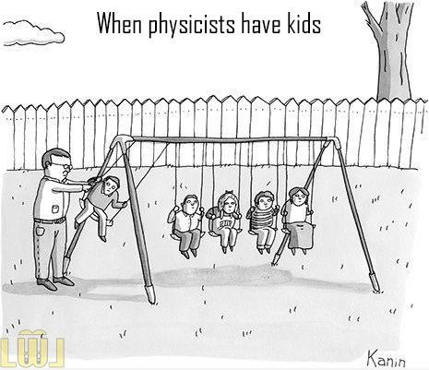
Let’s do the experiment…
Experiments: If it’s green and it wiggles, it’s biology,
If it stinks, it’s chemistry,
If it doesn’t work, it’s physics.

Slide 17

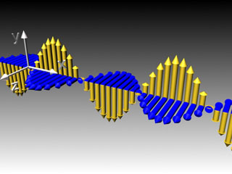
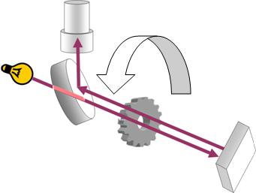
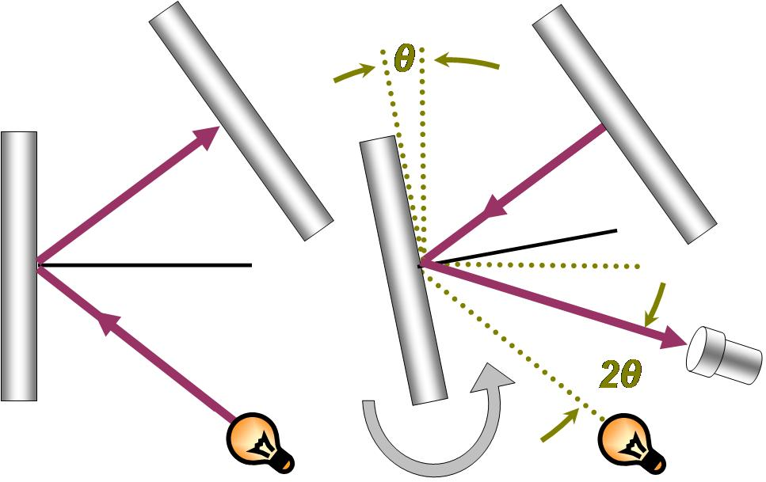
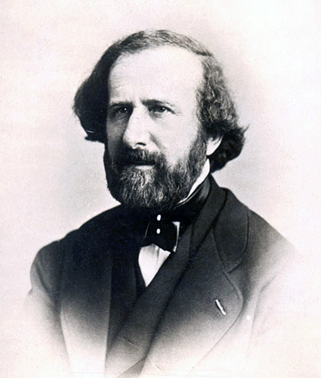
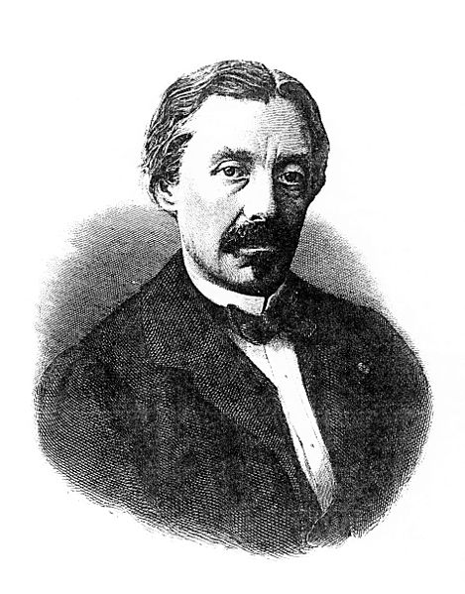
Measurement of the Speed of Light
Electromagnetism (Maxwell):
Light consists of propagating waves of perpendicular electric (E) and magnetic (B) fields
Propagation speed:
c = 299 792 km/s
E
B
Measure the speed directly:
1849: Armand Fizeau:
c = 315 000 km/s
1862: Leon Foucault:
c = 298 000 km/s

Slide 18
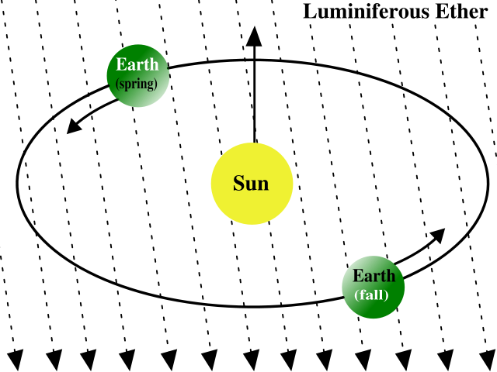

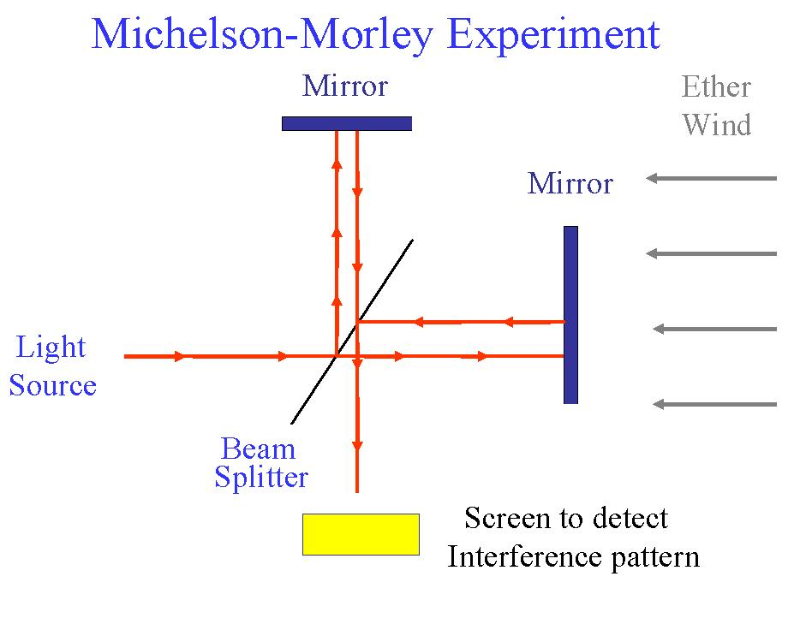
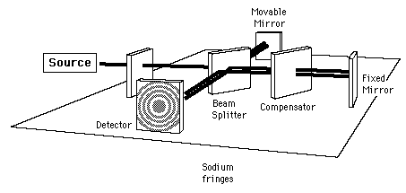
Measurement of the Speed of Light
Light waves were believed to be carried by the “aether”
Earth moves through the aether:
30 km/s
earth
aether
Measure the light speed with an interferometer along two perpendicular directions
Michelson-Morley Experiment (1887)
Interferometer
What do we expect to find for the travel times?

Slide 19
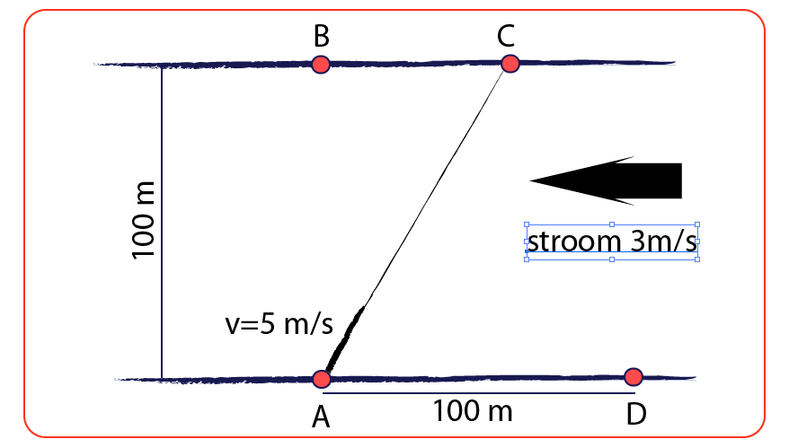
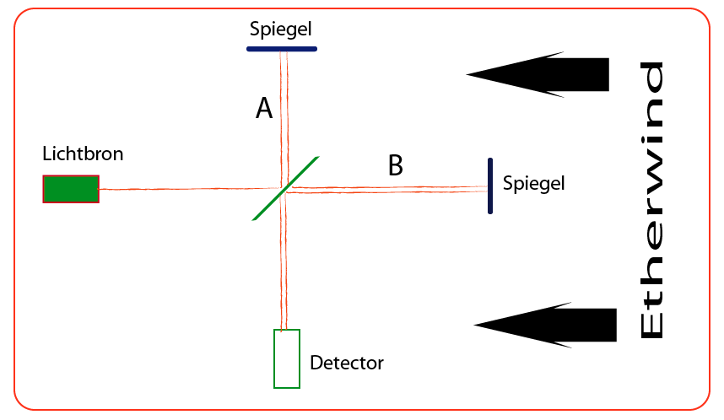
Comparison with water in a river
Swimmer crossing a river with flowing water
Light propagating through the aether wind
Flow w=
Expect that the time traversing 100 meter is shorter than the time for 100 meter up- and downstream
Measurement with light: no effect, travel times are the same!
The speed of light is always constant!
The vacuum is the same for any observer

Slide 20
“Crossing” vs “Up-and-Down”
1. Swimming AD + DA
Time = time₁ + time₂=
= 100 / (5-3) + 100 / (5+3)
= 100 /2 + 100 / 8
= 50 + 12.5 = 62.5 s
d
Flow w=
2. Swimming AB + BA
Have to swim under an angle toward AC to compensate the flow 3 m/s
Effective crossing speed= √(5²-3²) = √(25-9) = √(16) = 4 m/s
Time = time₁ + time₂=
= 100 / 4 + 100 / 4
= 25 + 25 = 50 s
3m/s
4m/s
5m/s

Slide 21
“Crossing” vs “Up-and-Down”
1. Swimming AD + DA
Time = time₁ + time₂=
= d/(v-w) + d/(v+w)
= d(v+w) / (v²-w²) + d(v-w) / (v²–w²)
= 2dv / v²(1-w²/v²)
= 2d/v * 1/(1 – w²/v²)
d
Flow w=
2. Swimming AB + BA
Have to swim under an angle toward AC to compensate the flow w
Effective crossing speed= √(v²-w²) = v * √(1-w²/v²)
Time = time₁ + time₂=
= d/√(v²-w²) + d/√(v²-w²)
= 2d / (v * √(1-w²/v²) )
= 2d/v * 1/ √(1-w²/v²)
Translated to light, replace: v→c
in aether wind w,
t_{A} = 2d/c * 1 / √(1-w²/c²)
t_{B} = 2d/c * 1 / (1-w²/c²)
Measure:
t_{A} = t_{B}
(no aether)
Notes:
Michelson Morley used L = 11m lambda = 500 x 10^(-9)m = 500 nm. They should have expected for v=30 km/s a shift of 0.1 wave.

Slide 22
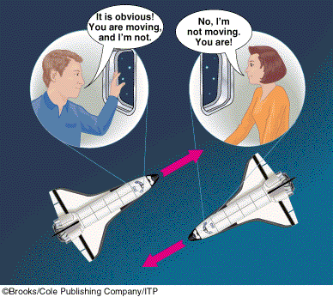
Absolute Velocity for Alice and Bob
c = 3 x 10⁸ m/s
How can we ever measure an absolute velocity in vacuum?
When are we “standing still” with respect to the vacuum?
The only absolute reference is the speed of light and it is always 300 000 km/s.
In special relativity absolute velocity has no meaning, only relative velocities do.
Hence: “Theory of relativity”.
“Absolute velocity” is meaningless

Slide 23
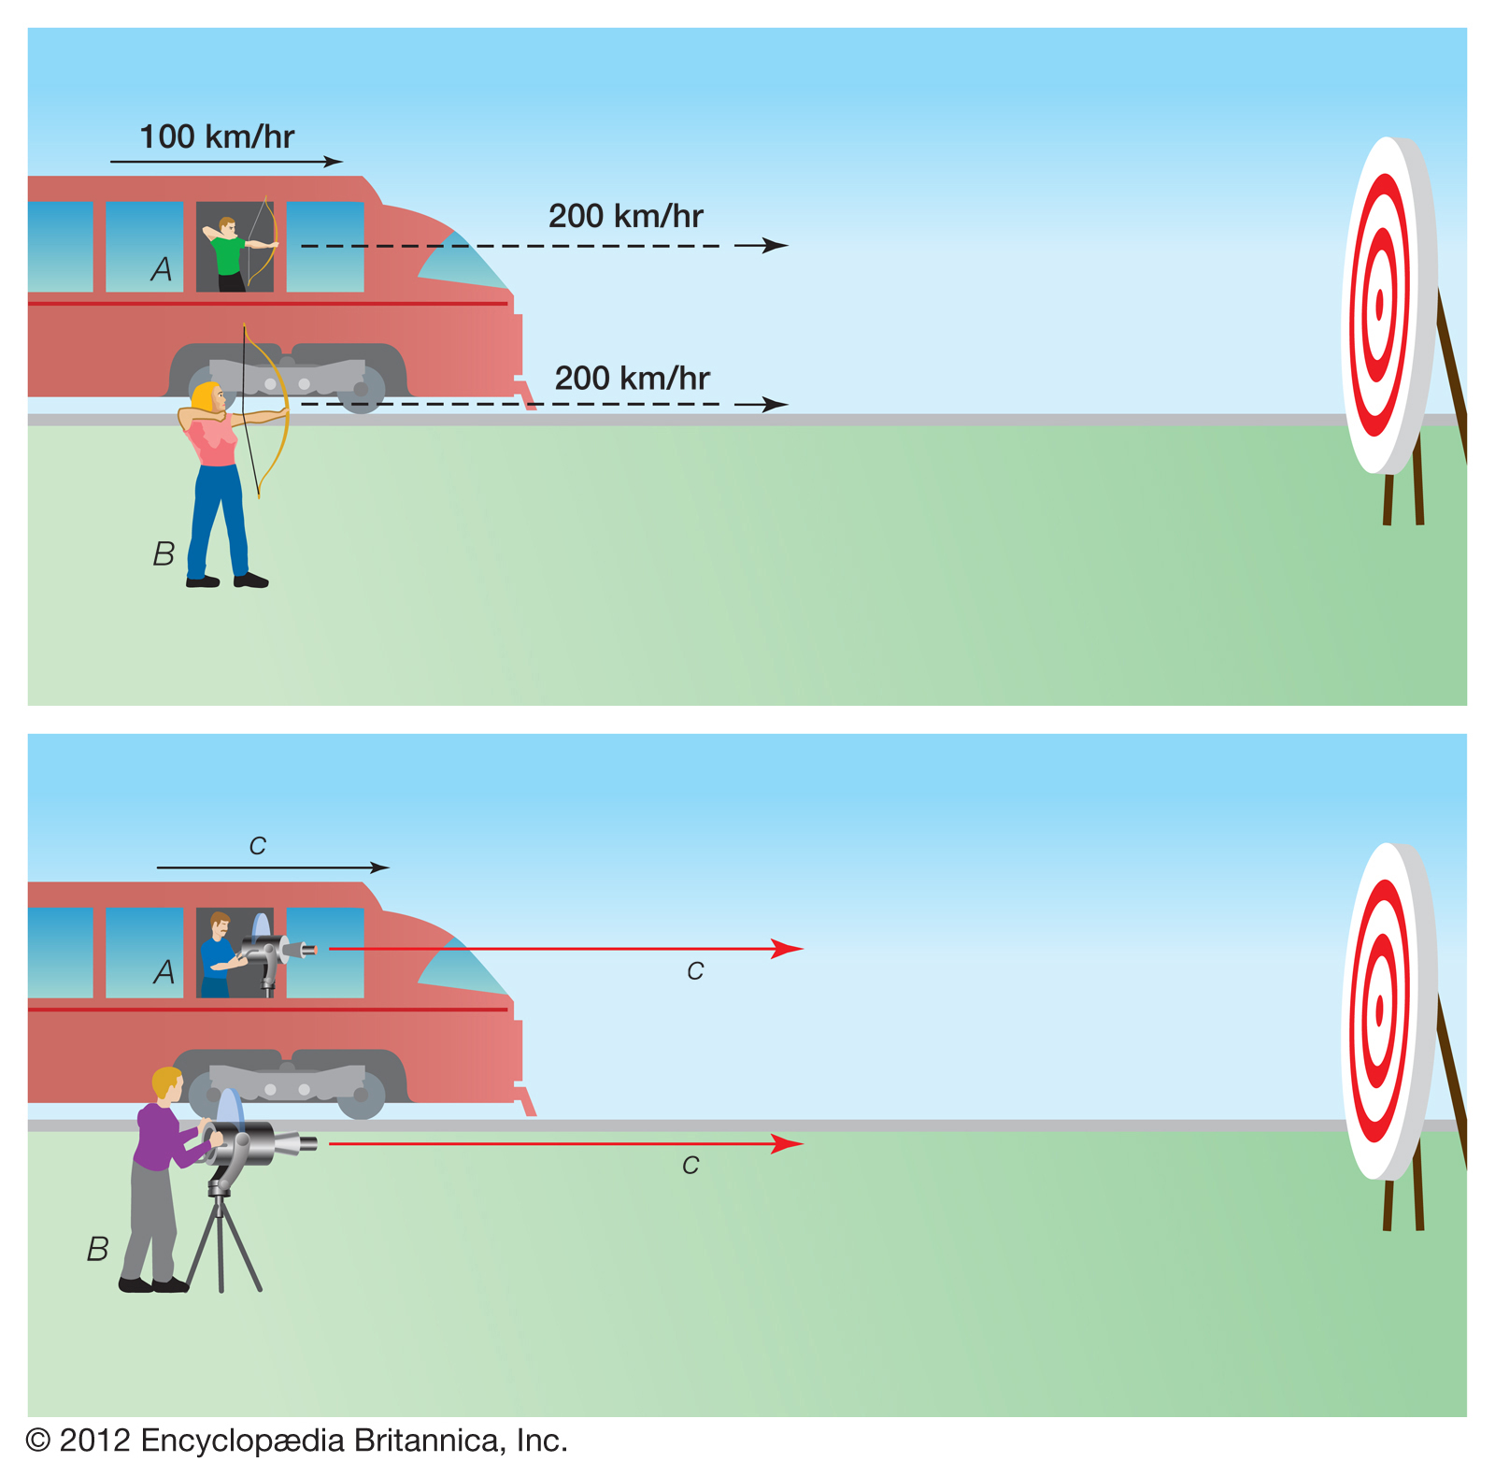
Completely Counterintuitive!

Slide 24
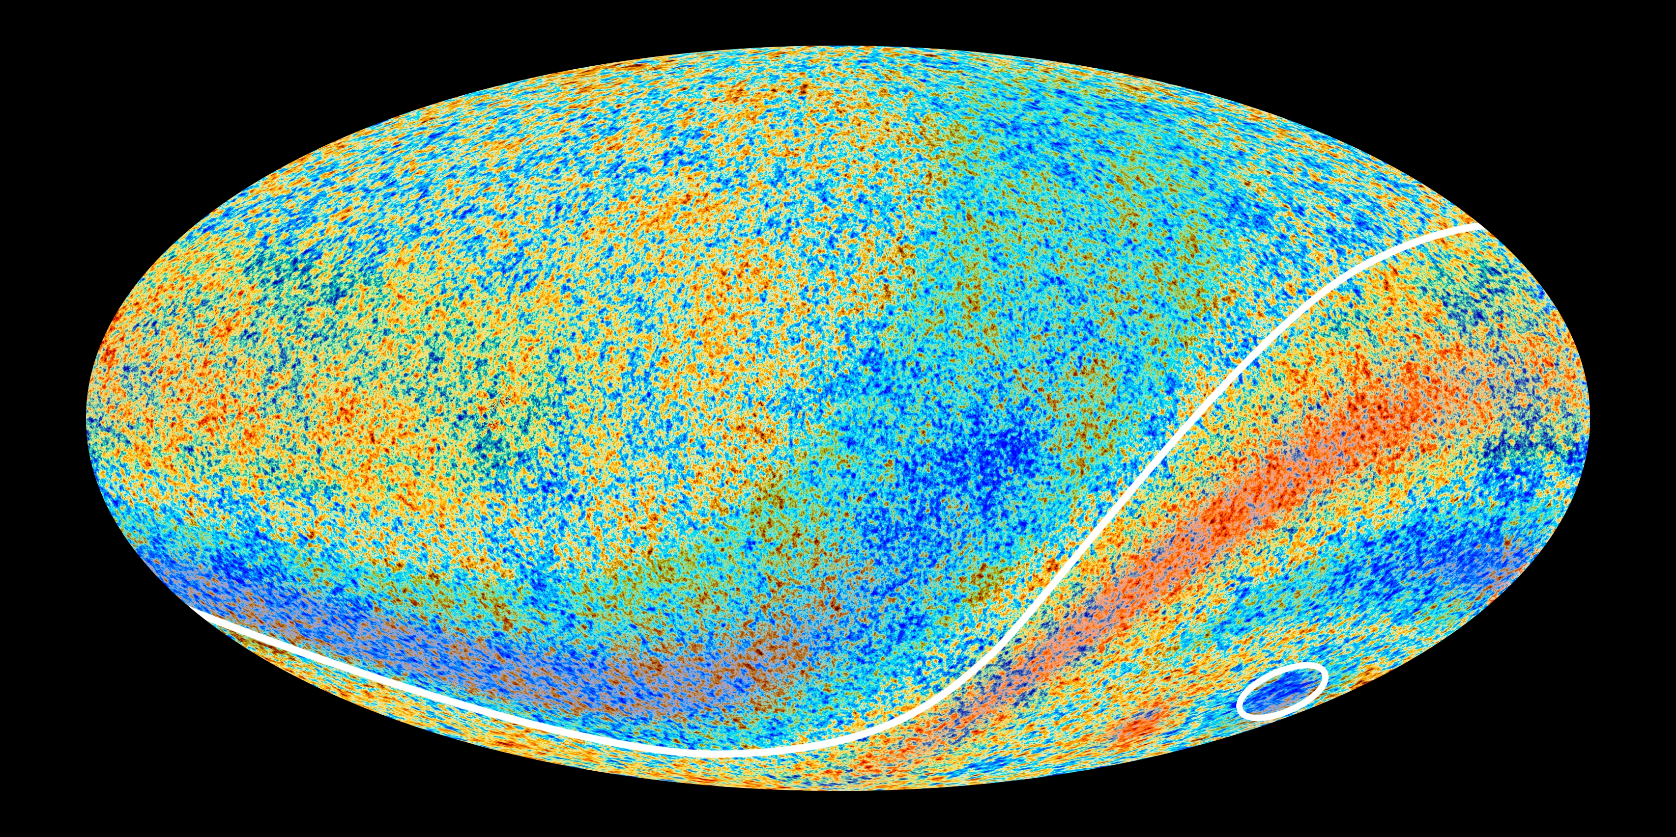
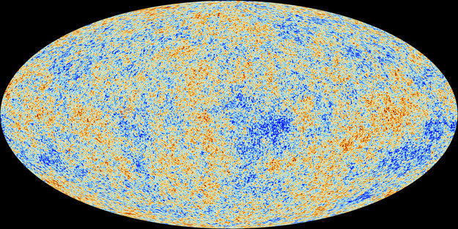
How about the cosmic microwave background?

