Slide 1
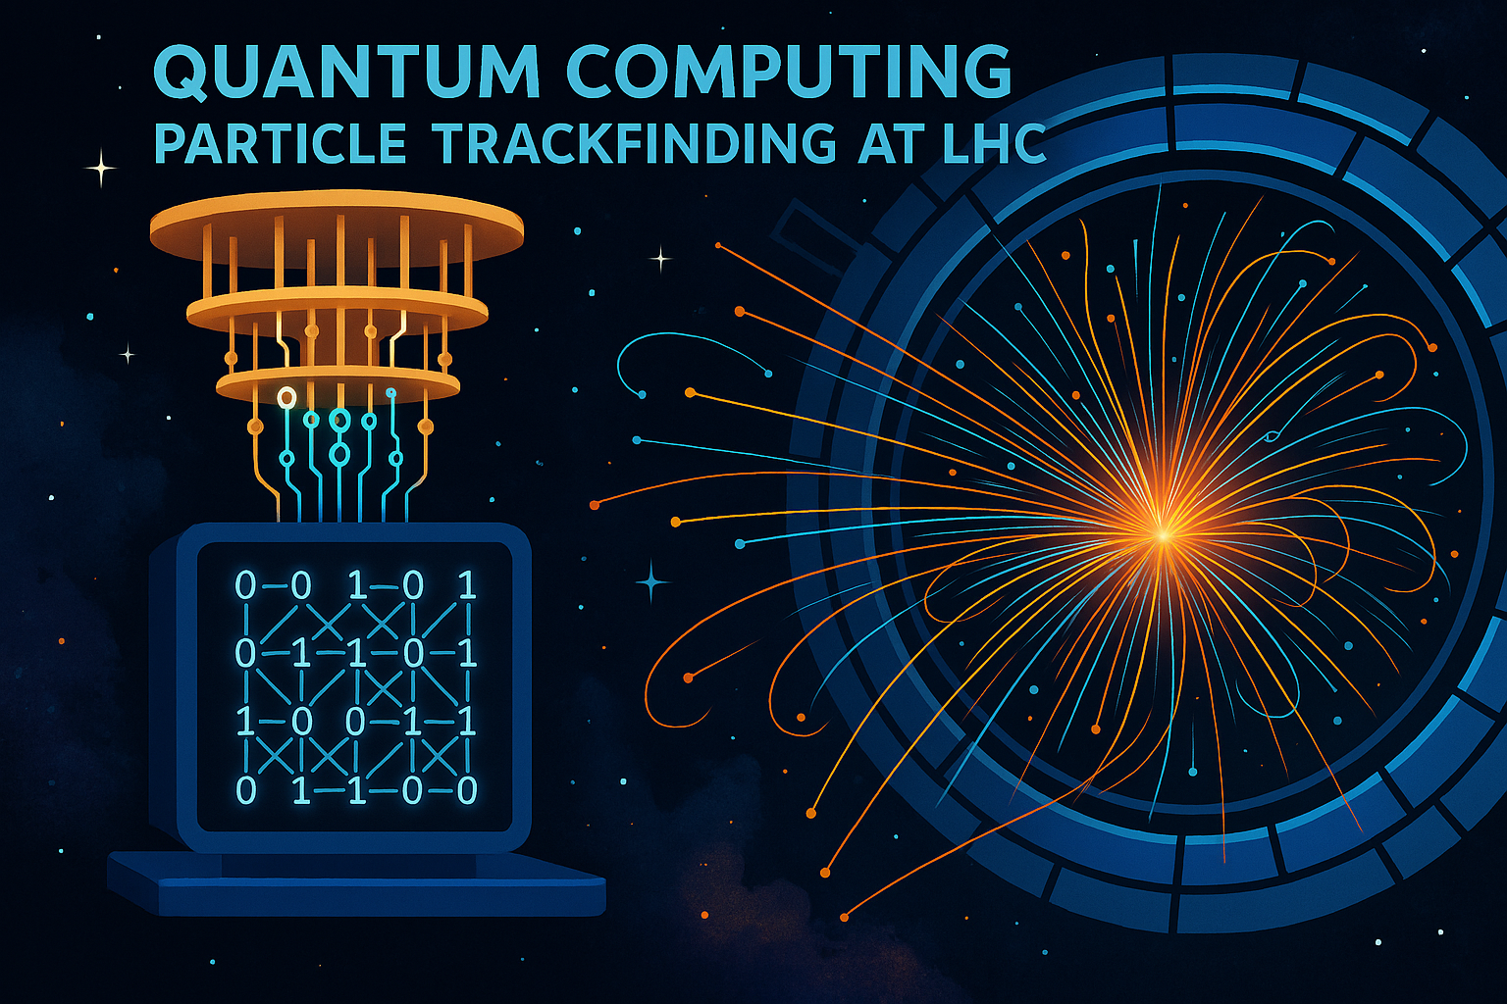
Marcel Merk
April 14, 2025
Credit: chat-GPT
Quantum & Particle Trackfinding
WORLD QUANTUM DAY 2025 – U/twente

Slide 2
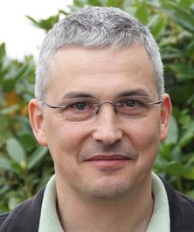
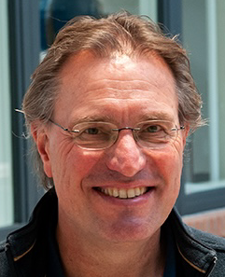
The Team
QC activity started in
1
Nikhef – Particle Physics Netherlands
Including LHCb @ CERN
CERN QTI
Hasselt University
Collab. since 2024
Univ Maastricht – LHCb – quantum activity started in 2022
PhD
PhD
PhD
Postdoc
Staff
Staff
Univ Maastricht – DACS (Department of Advanced Computing Sciences)
PhD
staff
staff
staff
staff

Slide 3
Use Case – Reconstructing Particles
2

Slide 4
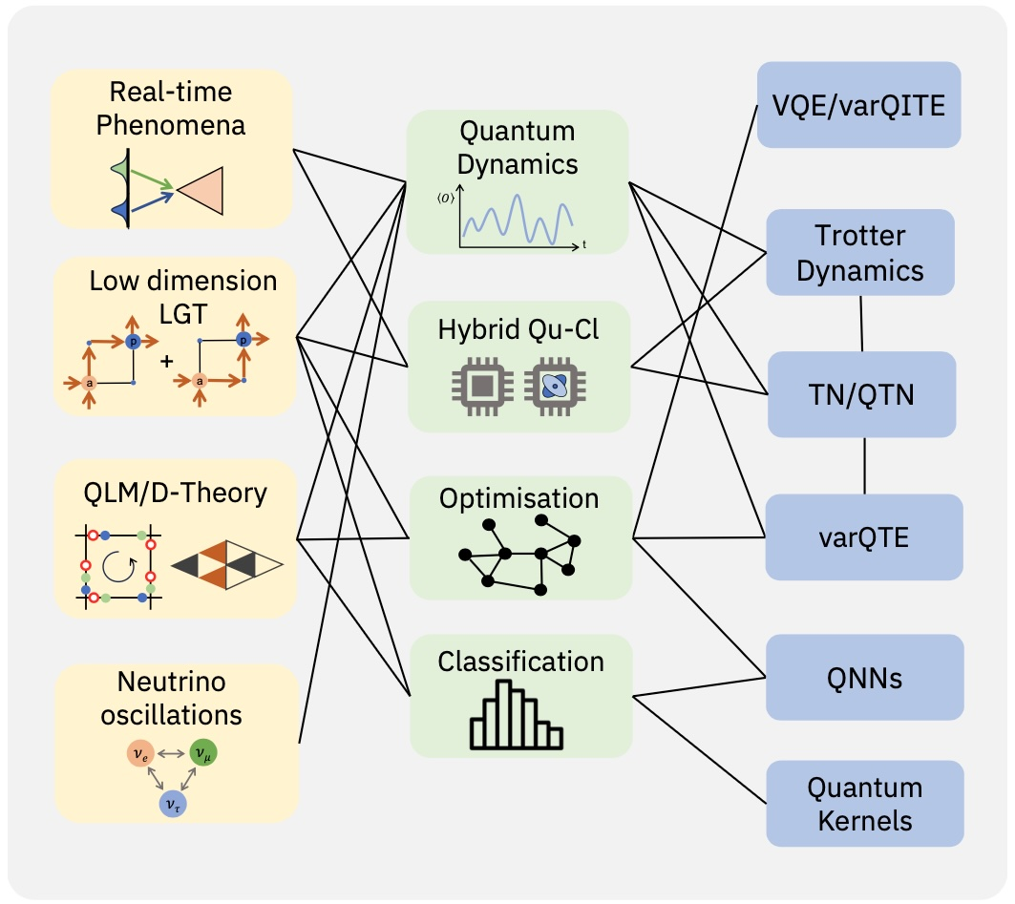
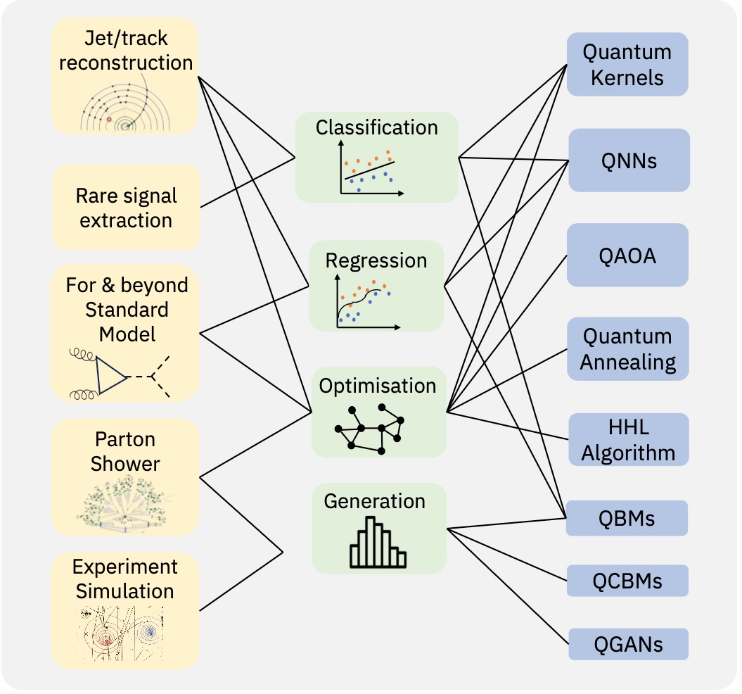
CERN QTI: QC4HEP use cases
3
“White Paper”: PRX QUANTUM 5, 037001 (2024)
Theoretical models and proposed approaches
Experimental challenges and quantum algorithms
challenges
approaches
algorithms
challenges
approaches
algorithms
Notes:
QTI: Quanum: 1) Sensing, 2) Simulation 3) Computing 4) Communication

Slide 5
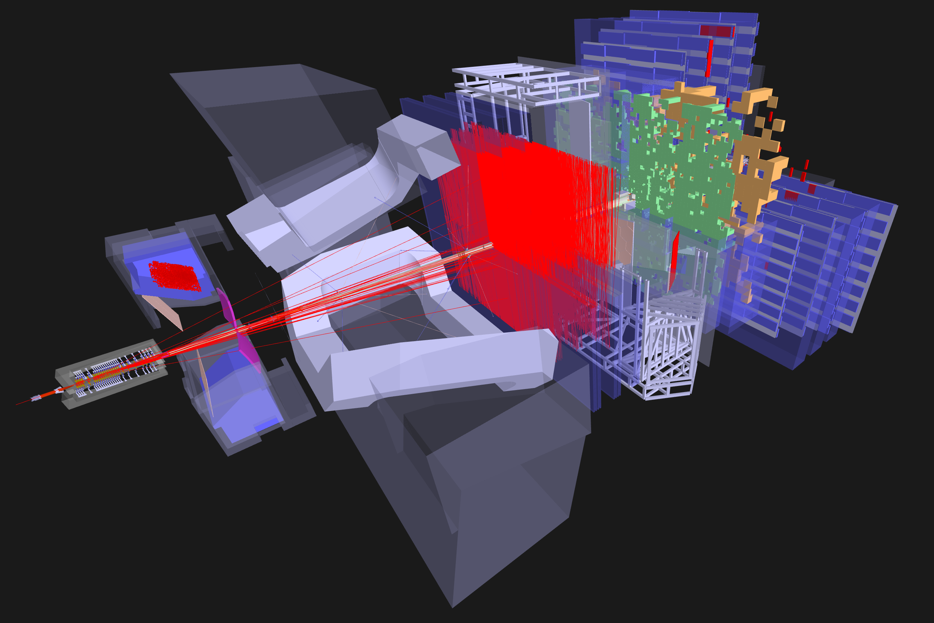
R&D: LHCb Velo detector
4
R&D: Quantum algorithm for pattern recognition in LHCb Vertex Detector:
Algorithmic use case for a small scale quantum computer
Applications long term depending also on hardware developments
R&D towards longer term with potential spin-offs
Investigated various approaches: HHL, QAOA, VQE, VQLS, annealing

Slide 6
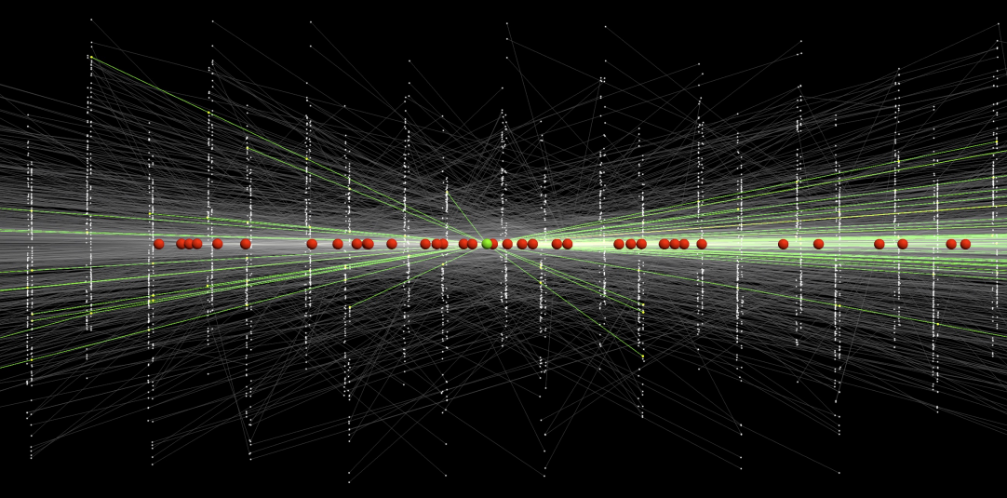
LHC: High luminosity picture
5
Current approach: massive parallel GPU-based combinatorics
R&D: Can a quantum algorithm help?

Slide 7
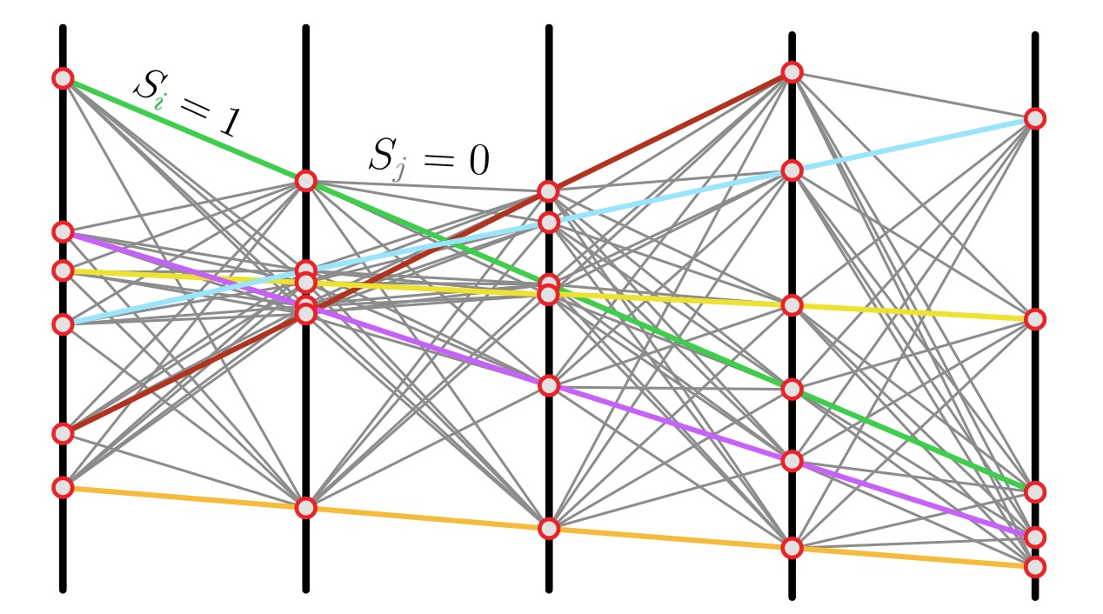
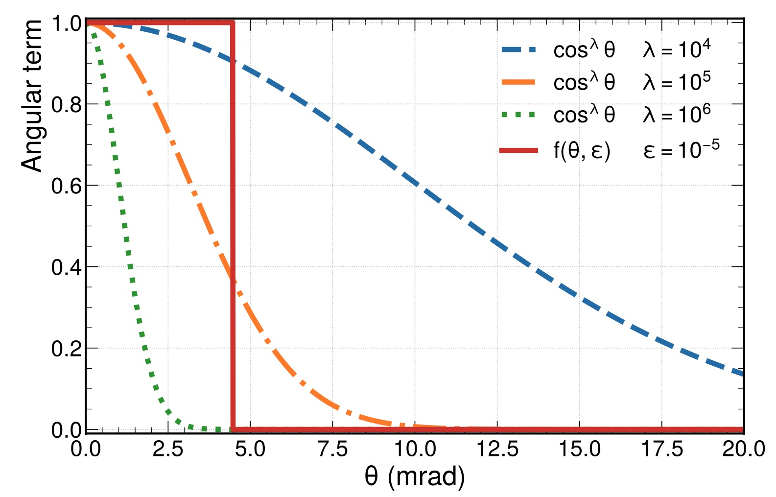
Method: “Global” algorithm for trackfinding
6
1) Build an Ising-like (quadratic) Hamiltonian
Define a Hamiltonian based on doublets of hits $S_{i}$ being ”on track” $S_{i}=1$ or “off track” $S_{j}=0$
$ℋ\left(S\right)=\sum_{abc}{f\left(θ\right)S_{ab}S_{bc}+γ\sum_{ab}{S_{ab}^{2}}+δ\sum_{ab}{{\left(1−2S_{ab}\right)}^{2}}}$
- Angular term:
assigns value for scattering
- Spectral term: ($γ=2.0$)
makes the spectrum of $A_{ij}$ positive
- Gap term: ($δ=1.0$)
ensures gap in the solution spectrum
$$f(θ)$$
2) Track Finding
Find the ground state of:
$$ℋ\left(S\right)=\sum_{ij}{A_{ij}S_{i}S_{j}+\sum_{i}{b_{i}S_{i}}}$$
with:
$b=\left(1, 1, 1, 1, …\right)$
Solving for $S_{i}∈\left\{0,1\right\}$
➔ QUBO problem
Notes:
QUBO: Quadratic Unconstrained Binary Optimization. Hints at QAOA or annealing approaches, but requires many qubits in our case.
Gamma: shift eigenvalue spectrum of A to make it positive definite
Gamma and delta pragmatic parameters. delta: enforce a gap in the spectrum of the solution vectors to differentiate S=0 from S=1

Slide 8
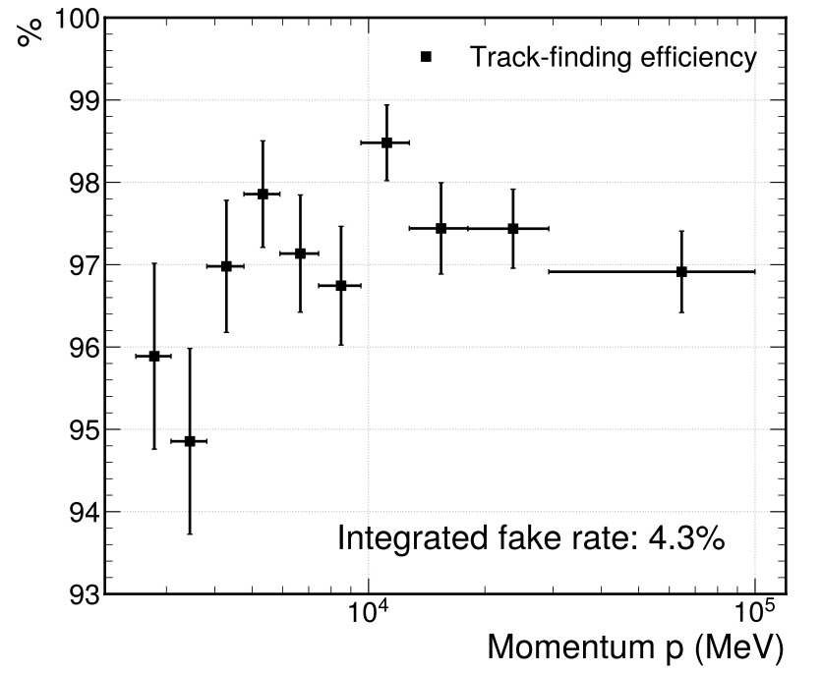
Method: “Global” algorithm for trackfinding
7
1) Build an Ising-like (quadratic) Hamiltonian
Define a Hamiltonian based on doublets of hits $S_{i}$ being ”on track” $S_{i}=1$ or “off track” $S_{j}=0$
$ℋ\left(S\right)=\sum_{abc}{f\left(θ\right)S_{ab}S_{bc}+γ\sum_{ab}{S_{ab}^{2}}+δ\sum_{ab}{{\left(1−2S_{ab}\right)}^{2}}}$
2) Find ground state of:
$$ℋ\left(S\right)=\sum_{ij}{A_{ij}S_{i}S_{j}+\sum_{i}{b_{i}S_{i}}}$$
$$S_{i}∈\left\{0,1\right\}$$
Efficiency
3) Apply a trick:
Relaxation: $S_{i}∈\left\{0,1\right\} ⇒ S_{i}∈ℝ$
Minimization: $∇_{S}ℋ=0 ⇒ AS=b$
Solve the large matrix inversion to find $S$
Discretization: $S_{i}∈ℝ ⇒ S_{i}∈\left\{0,1\right\}$
Try by solving classically
→ good performance!
The method works!
Notes:
QUBO: Quadratic Unconstrained Binary Optimization
Gamma: shift eigenvalue spectrum of A to make it positive definite
Gamma and delta pragmatic parameters. delta: enforce a gap in the spectrum of the solution vectors to differentiate S=0 from S=1

Slide 9
Simplest (trivial) case how it works classically
8
Two tracks in three layers
$∇_{S}ℋ=0 ⇒ S=A^{−1}b$
$S_{i}$ On
threshold
$S_{i}$ Off
Algorithm finds that:
$S_{1}, S_{4}, S_{5}, S_{8}$ are good segments and $S_{2}, S_{3}, S_{6}, S_{7}$ are wrong cobinations

Slide 10
More realistic: “half-detector” LHC data
9
Conclusion: the classical solution illustrates that the Hamiltonian method for trackfinding works!

Slide 11
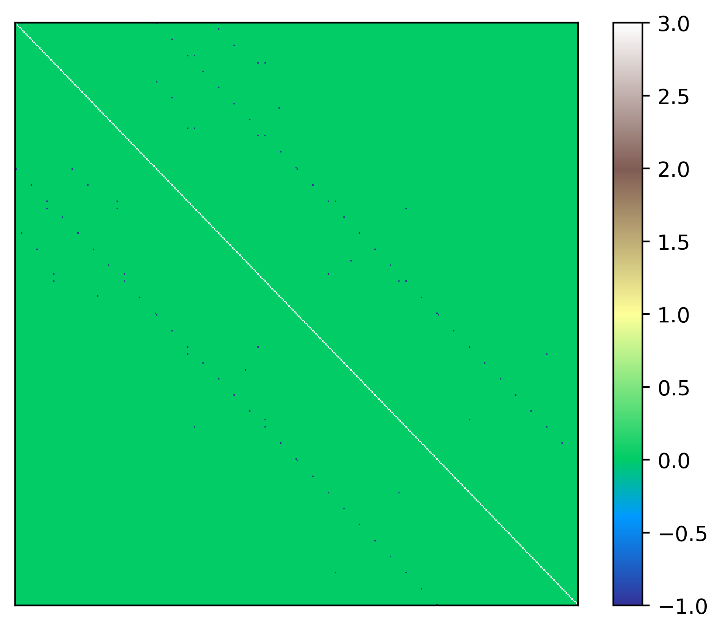
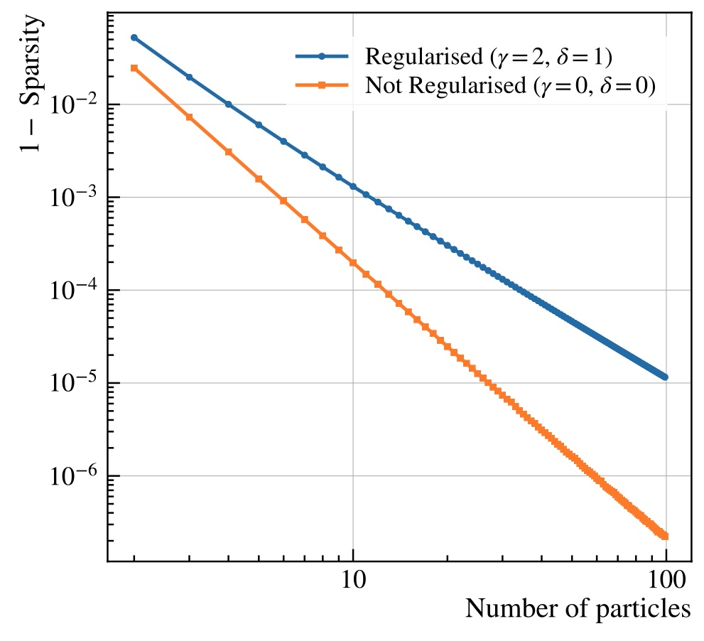
Solving the Matrix inversion
10
Particle Tracking: $∇ℋ=0 ⇒ S=A^{−1}b$
Matrix $A$ is very large: $N×N (N$ ~ 100 000)
$N∝\#particles^{2}$
But $A$ is very well behaved: very Sparse
Low condition-number: $κ\left(A\right)=\frac{|λ_{max}|}{|λ_{min}|}≈5$
Green = 0 ; white = 3 ; black = -1
$$A$$
HHL Promises $O\left(log\left(N\right)κ^{2}\right)$ runtime vs $O\left(N√κ\right)$
Notes:
The matrix A is large: extremely sparse.
Problem defined such that b is (1, 1, 1, 1, 1..)

Slide 12
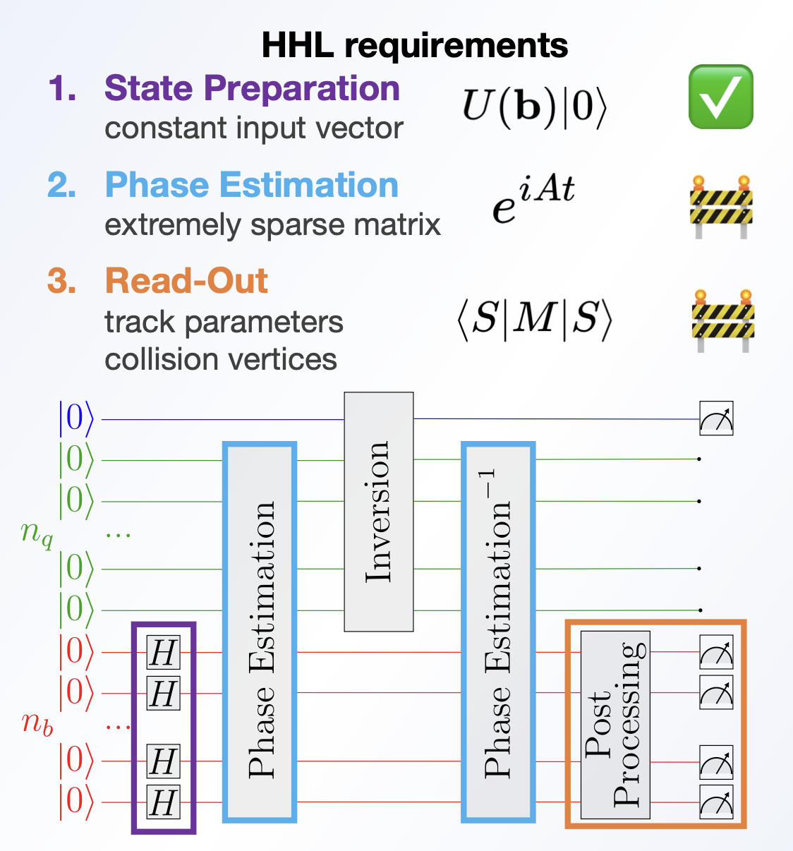
The Quantum Algorithm: Harrow-Hassadim-Lloyd
11
Solving the matrix equation to find solution $S$
$AS=b$ $⇒ S=A^{−1}b$ Solve using HHL:
State preparation
- Quantum Phase estimation
- Inversion
- Q${\text{uantum} \text{Phase} \text{Estimation}}^{†}$
3. Measurement
Quantum state: ${\left|Φ\right\rangle }_{i}{\left|Φ\right\rangle }_{b}{\left|Φ\right\rangle }_{q}$
${\left|Φ\right\rangle }_{i}$ ancilla qubit for controlled phase rotation
$n_{b}=\log_{2}{N}$ qubits to store vector $b$
Prepare $b=(1,1,1,1,1,1)$ with Hadamards
QPE: apply $U=e^{iA}$ with $n$bit precision
$n_{q}$ ancilla qubits for phase estimation
Readout $S$
1.
2.
3.
4.
5.
Notes:
Initialisation of |b> : Single Hadamard gate.
QPE: U = exp (iAt)

Slide 13
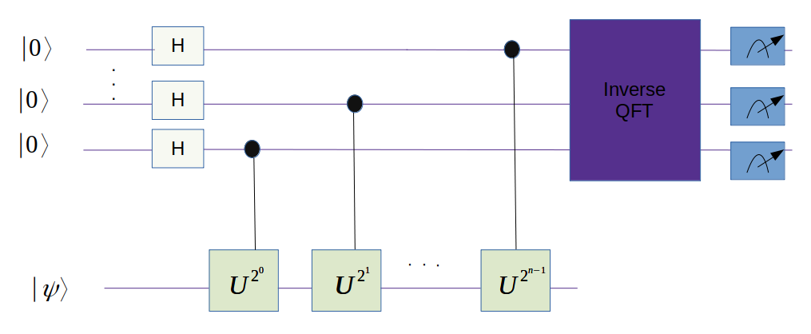
Readout issue
12
Consider the case:
Solutions “on”: $S_{i}=1$
Solutions “off”: $S_{i}=0$
Prob$≠0$
Far too many queries on the readout needed to determine which doublet is “on” and which is “off” required
n-bit QPE

Slide 14
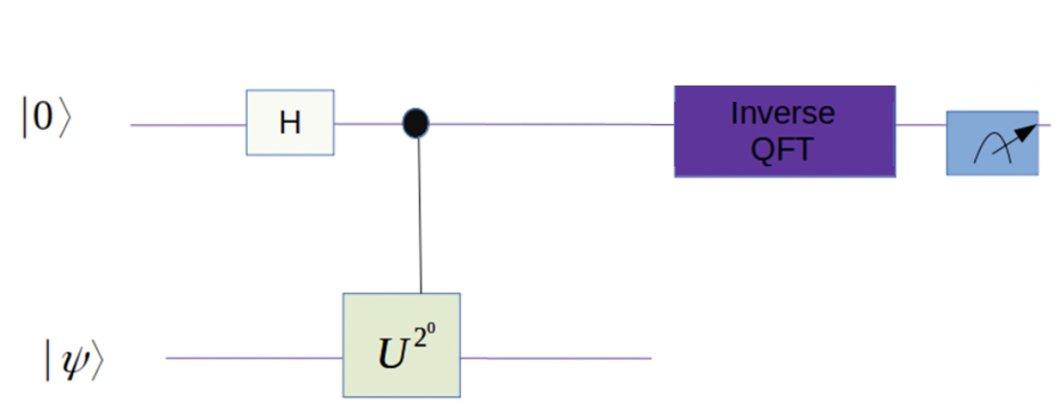
Readout issue: 1-bit QPE
13
Consider the case:
Solutions “on”: $S_{i}=1$
Probability
Solutions “off”: $S_{i}=0$
1-bit QPE: All wrong solutions have zero probability!
n-bit QPE
1-bit QPE

Slide 15
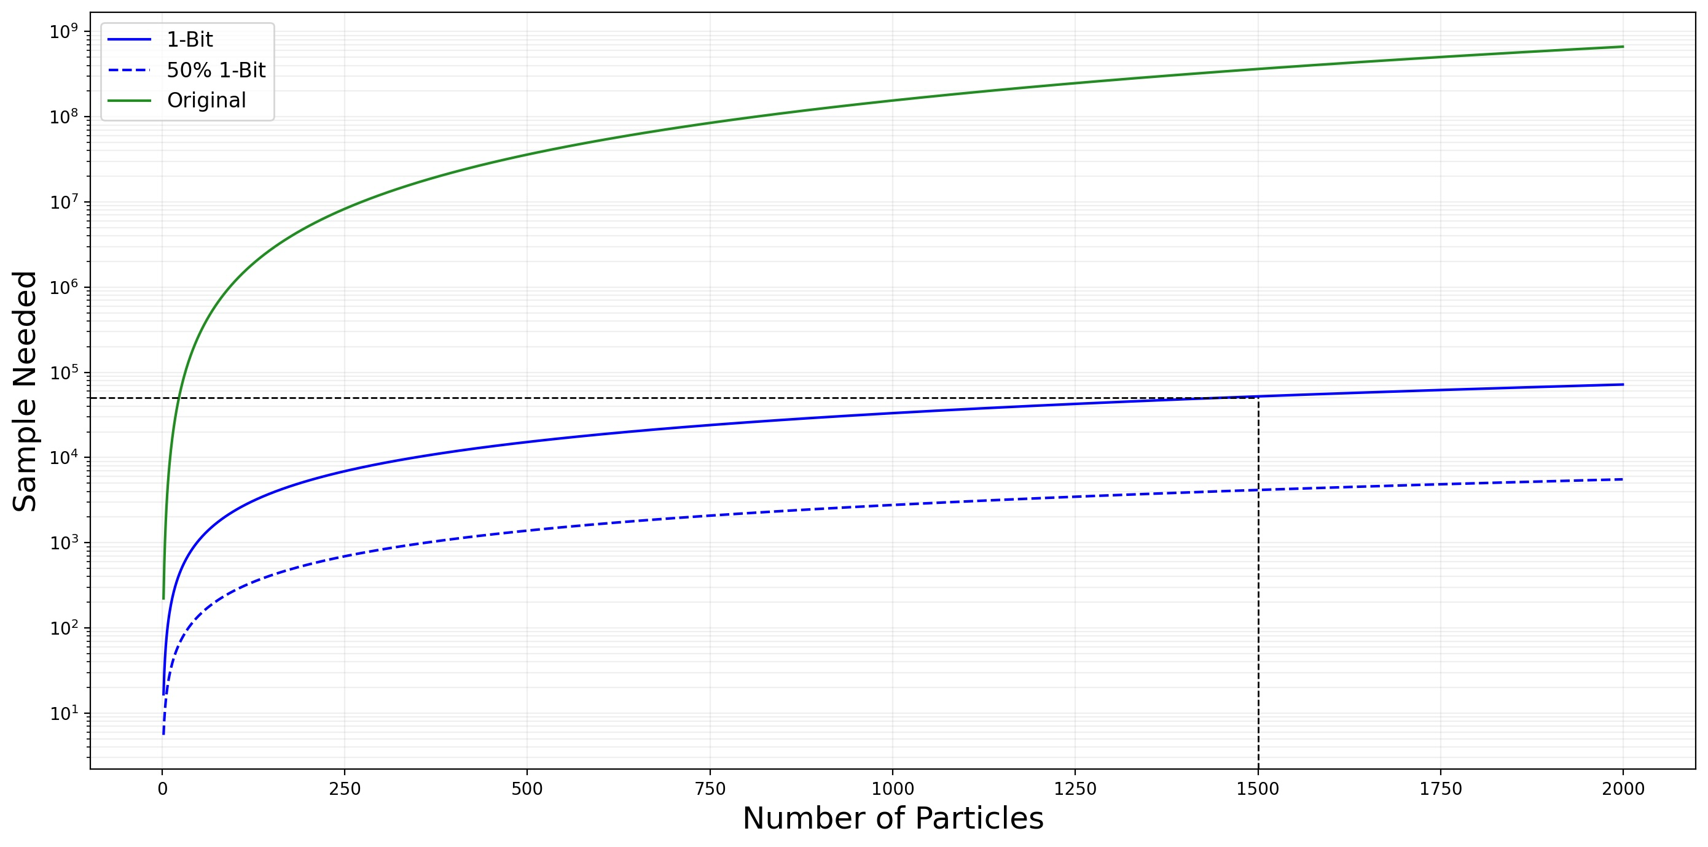
Readout issue: 1-bit QPE
14
Sampling comparison
$${10}^{9}$$
Full HHL
$${10}^{8}$$
$${10}^{7}$$
$${10}^{6}$$
$${10}^{5}$$
1-Bit HHL
$${10}^{4}$$
$${10}^{3}$$
1-Bit HHL
50% Sampling
$${10}^{2}$$
$${10}^{1}$$
0
250
500
750
1000
1250
1500
1750
2000
Instead of $\sim {10}^{8}$ readouts with 1-Bit HHL, only ${10}^{3}−{10}^{4}$ are required (sampling dependent)

Slide 16
Circuit depth issue
15
Together with a few other optimizations (Suzuki-Trotter approximation),
the 1-bit QPE strongly reduces number of gates
Multiple bit
QPE
Multiple bit
QPE
Multiple bit
QPE
1-bit QPE
1-bit QPE
1-bit QPE

Slide 17
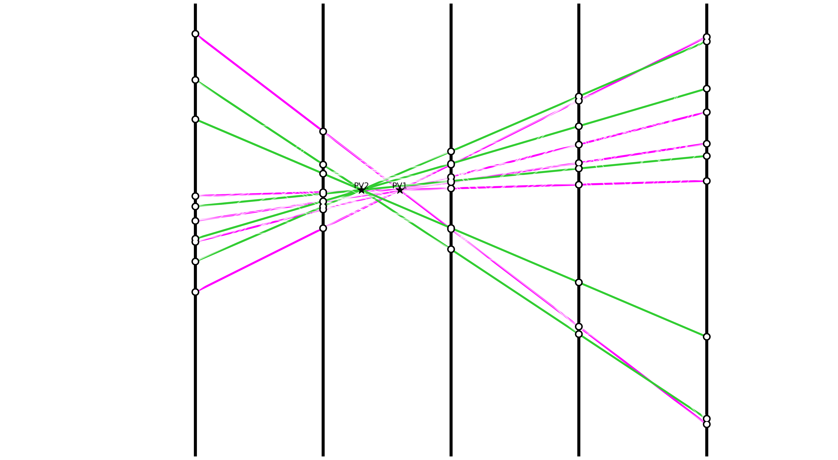
Largest Event simulated with Qiskit
16
Vertex 1
Vertex 2
Post-processing: Vertex Reconstruction
Extrapolate all segments to the beam line for direct Vertex finding via Hough Transform
Notes:
Alternatives to Qiskit: Pennylane (Xanadu), Cirq (Google), …

Slide 18
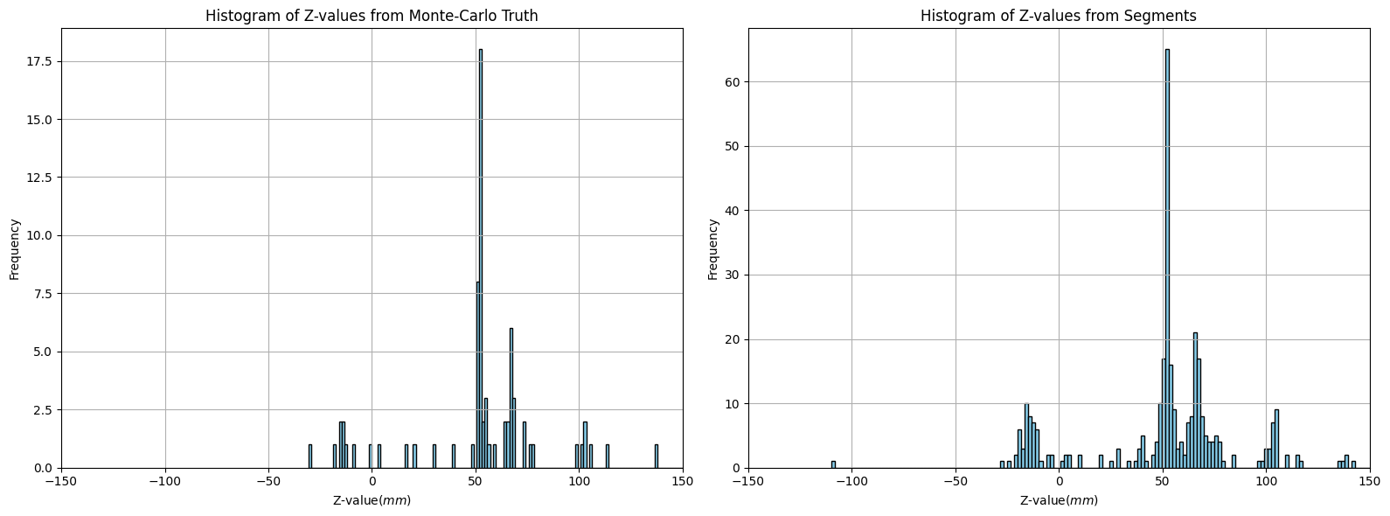
Vertex finding precision
17
Reconstructing vertices using exact extrapolation
Reconstructing vertices using segment extrapolation
Exact tracks
Found Segments
Vertex-1
Vertex-2
Vertex-1
Vertex-2

Slide 19
Vertex precision with fraction of segments
18
Distribution of precision of the
extrapolated vertex point
Mean Average Distance (MAD) of recontructed vertex
versus the fraction of segments obtained in readout
~350 $μ$m
WIP: Requiring only fraction (~50%) of all states → strong reduction of number of readouts

Slide 20
Readout issue: 1-bit QPE
19
Sampling comparison
$${10}^{9}$$
Full HHL
$${10}^{8}$$
$${10}^{7}$$
$${10}^{6}$$
$${10}^{5}$$
1-Bit HHL
$${10}^{4}$$
$${10}^{3}$$
1-Bit HHL
50% Sampling
$${10}^{2}$$
$${10}^{1}$$
0
250
500
750
1000
1250
1500
1750
2000
Instead of $\sim {10}^{8}$ readouts with 1-Bit HHL, only ${10}^{3}−{10}^{4}$ are required (sampling dependent)

Slide 21
Summary & Outlook for further study
20
Classical
Pre-processing
(Hamiltonian
Preparation “$A$”)
Quantum
Processing
($S=A^{−1}b$)
Classical
Post-processing
(Vertex Finding)
Detector
hits
Readout
Trackstates
Collision
vertices
Quantum particle tracking as R&D project
Global Hamiltonian method is a candidate
Developing HHL with 1-bit QPE and post-processing
Next steps:
Optimize Hamiltonian implementation
Perform larger simulations
Investigate QSVT
Test small system on hardware

Slide 22
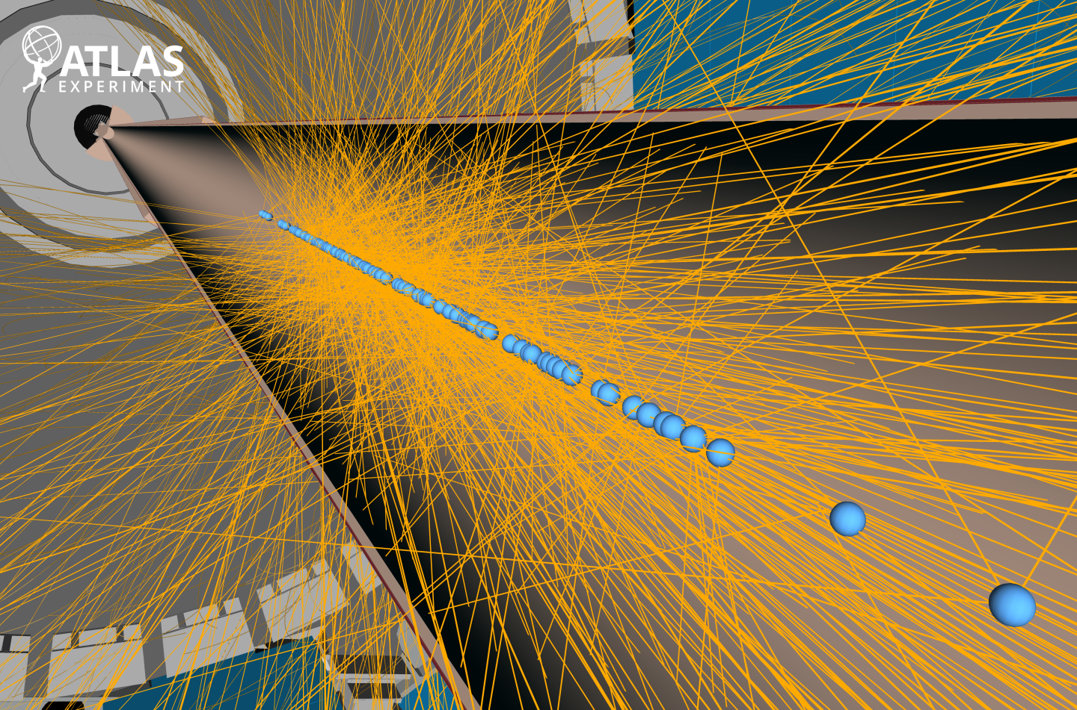
Thank you for your attention!
21
ATLAS high pile-up Event

Slide 23
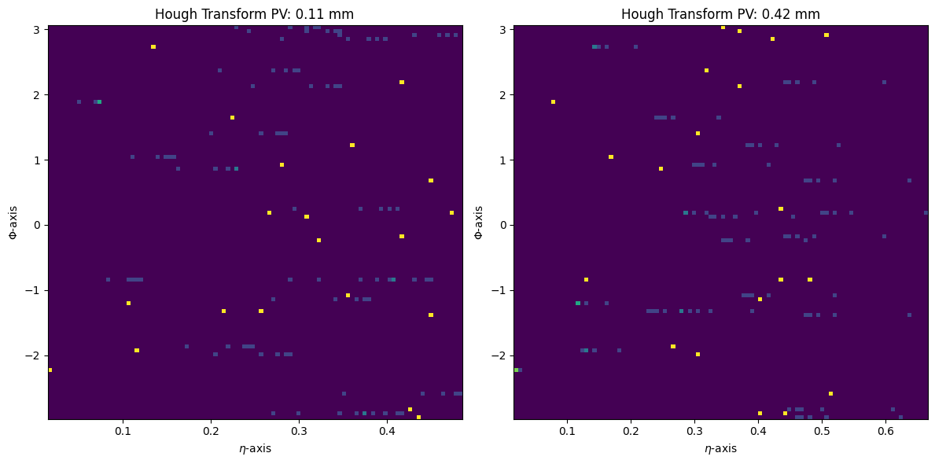
n Hough Transform
22
Track distribution seen from vertex-1
Track distribution seen from vertex-2
Yellow points: multiple matching track segments
Blue points: single matching track segments

Slide 24
3-bit HHL
23

Slide 25
1-bit HHL
24

Slide 26
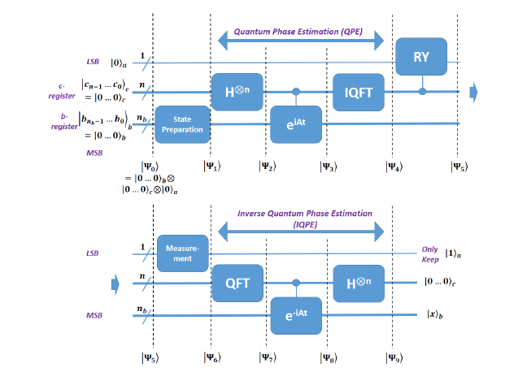
HHL in blocks
25

Slide 27
QPE – how does it work
26
Solve: $A\vec{x}=\vec{b}$
Find $\vec{x}$ such that : $A\vec{x}=\vec{b} ⇒ {\vec{x}=A}^{−1}\vec{b}$
So search a quantum state $\left|x\right\rangle ∝A^{−1}|b⟩$
Write $|b⟩=\sum_{i}{β_{i}|u_{i}⟩}$
Apply $A^{−1}$ to $|b⟩$ : $A^{−1}\left|b\right\rangle =\sum_{i}{β_{i}A^{−1}|u_{i}⟩} =\sum_{i}{β_{i}\frac{1}{λ_{i}}|u_{i}⟩}$
$$\vec{x}=\sum_{i}{\frac{β_{i}}{λ_{i}}\left|u_{i}\right\rangle }$$
So we need to apply $\frac{1}{λ_{i}}$ to each component of $\left|b\right\rangle$ , that’s how $A^{−1}$ acts.
Decompose $\left|b\right\rangle$ in eigenbasis: $|b⟩=\sum_{i}{β_{i}|u_{i}⟩}$
QPE gives: $\left|b\right\rangle$ in eigenbasis: $\left|b\right\rangle =\sum_{i}{β_{i}\left|u_{i}\right\rangle }⊗|λ_{i}⟩$
Where $|λ_{i}⟩$ is an encoded quantum binary approximation of $λ_{i}$
Apply controlled rotation on an ancilla qubit, which encodes $\frac{1}{λ_{i}}$ into the amplitude of the ancilla
So now we have: $\sum_{i}{β_{i}\left|u_{i}\right\rangle }⊗|λ_{i}⟩$ $\left(\frac{1}{λ_{i}}\left|1\right\rangle + ….\right)$
Uncompute the eigenvalue register, erasing $|λ_{i}⟩$ : $\sum_{i}{β_{i}\frac{1}{λ_{i}}\left|u_{i}\right\rangle }⊗|1⟩$ $\left(\frac{1}{λ_{i}}\left|1\right\rangle + ….\right)=A^{−1}\left|b\right\rangle =|x⟩$
We measure the ancilla: if it is $\left|1\right\rangle$ , the rest of the system is in a state proportional to $\sum_{i}{β_{i}\left|u_{i}\right\rangle }⊗|λ_{i}⟩$ $\left(\frac{1}{λ_{i}}\left|1\right\rangle + ….\right)$

Slide 28
27

Slide 29
CERN QTI
28

