Slide 1
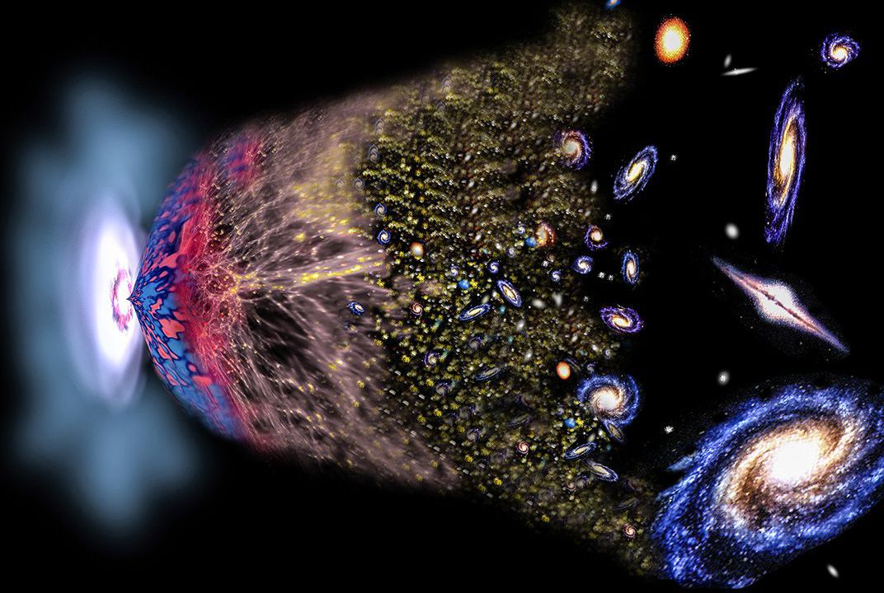
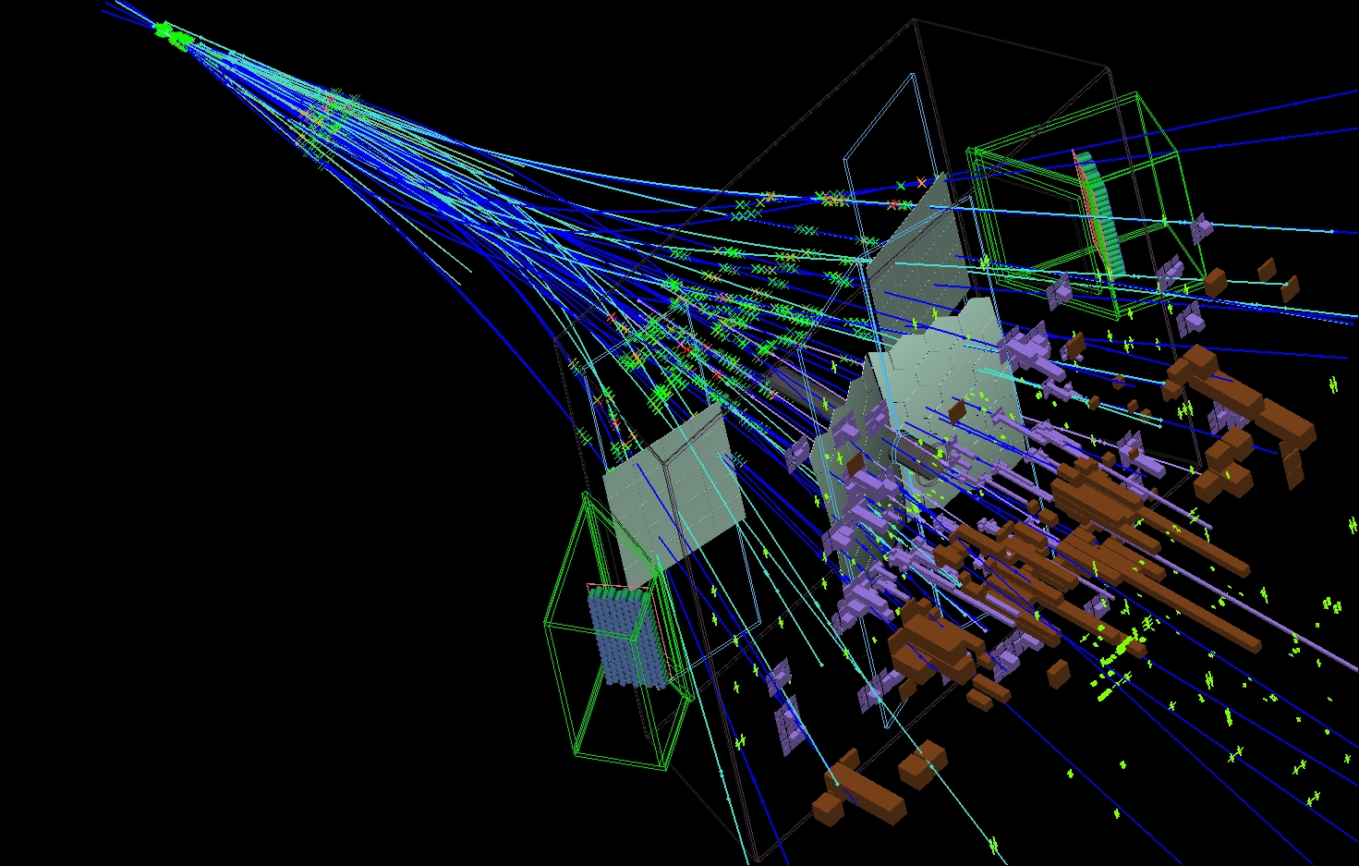
The Flavour Puzzle
OF
LHC
AND
EARLY
THE
UNIVERSE
Marcel Merk
Nikhef, UM, VU
P@V2021

Slide 2
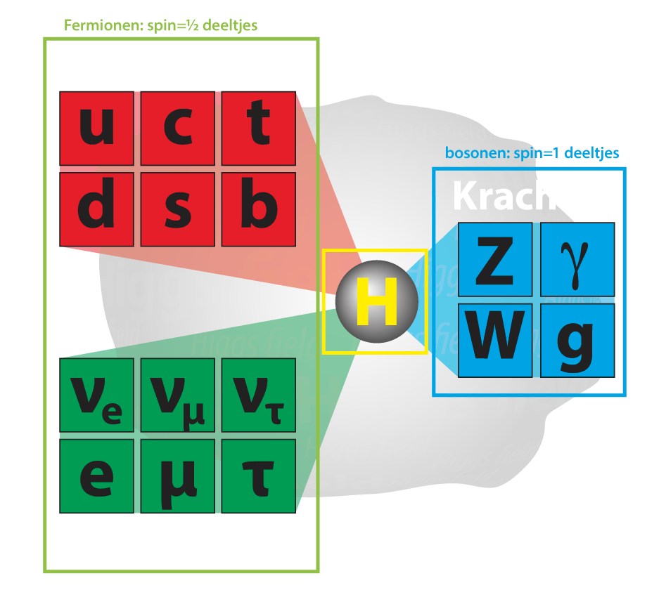
The Flavour Puzzle
OF
LHC
AND
EARLY
THE
UNIVERSE
1
2
3
Why three generations of particles?
Why is there no antimatter?
Why is an atom electric neutral?

Slide 3
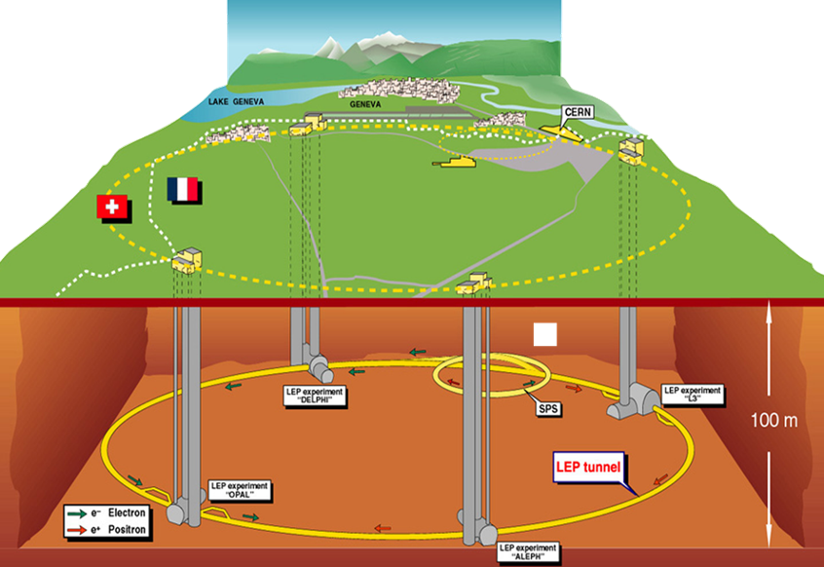
3 Generations of particles – How do we know?
2 / 21
LEP: The heavy Z boson decays into 3 light neutrino types.
LEP @ CERN:
1989-2000
  No additional weakly interacting light fermion generations.

Slide 4
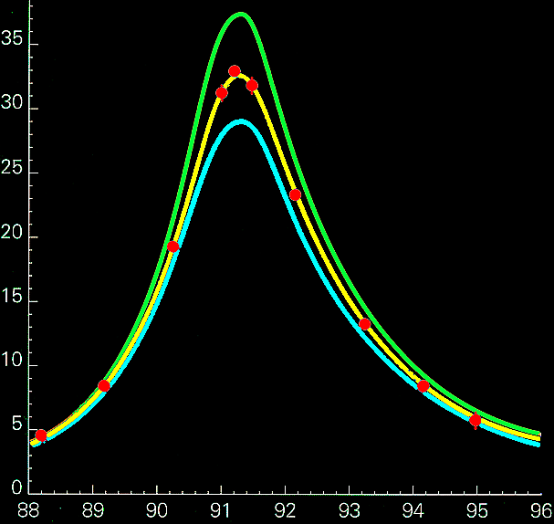
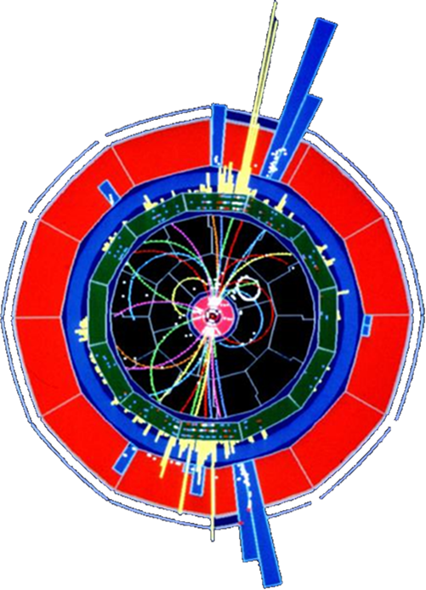
3 Generations of particles – How do we know?
3 / 21
LEP: The heavy Z boson decays into 3 light neutrino types.
LEP
4 neutrinos
3 neutrinos
Number of events
2 neutrinos
measurements
=3
Collision Energy (GeV)
  No additional weakly interacting light fermion generations.

Slide 5


3 Generations of particles – How do we know?
4 / 21
LHC: Higgs production:
Loop diagram is proportional to the mass of the heaviest fermion.
$$H→γγ$$
$$H→4μ$$
3
i = 1, 2, 3
  Top is the heaviest fermion flavour.
  3 Flavour generations

Slide 6
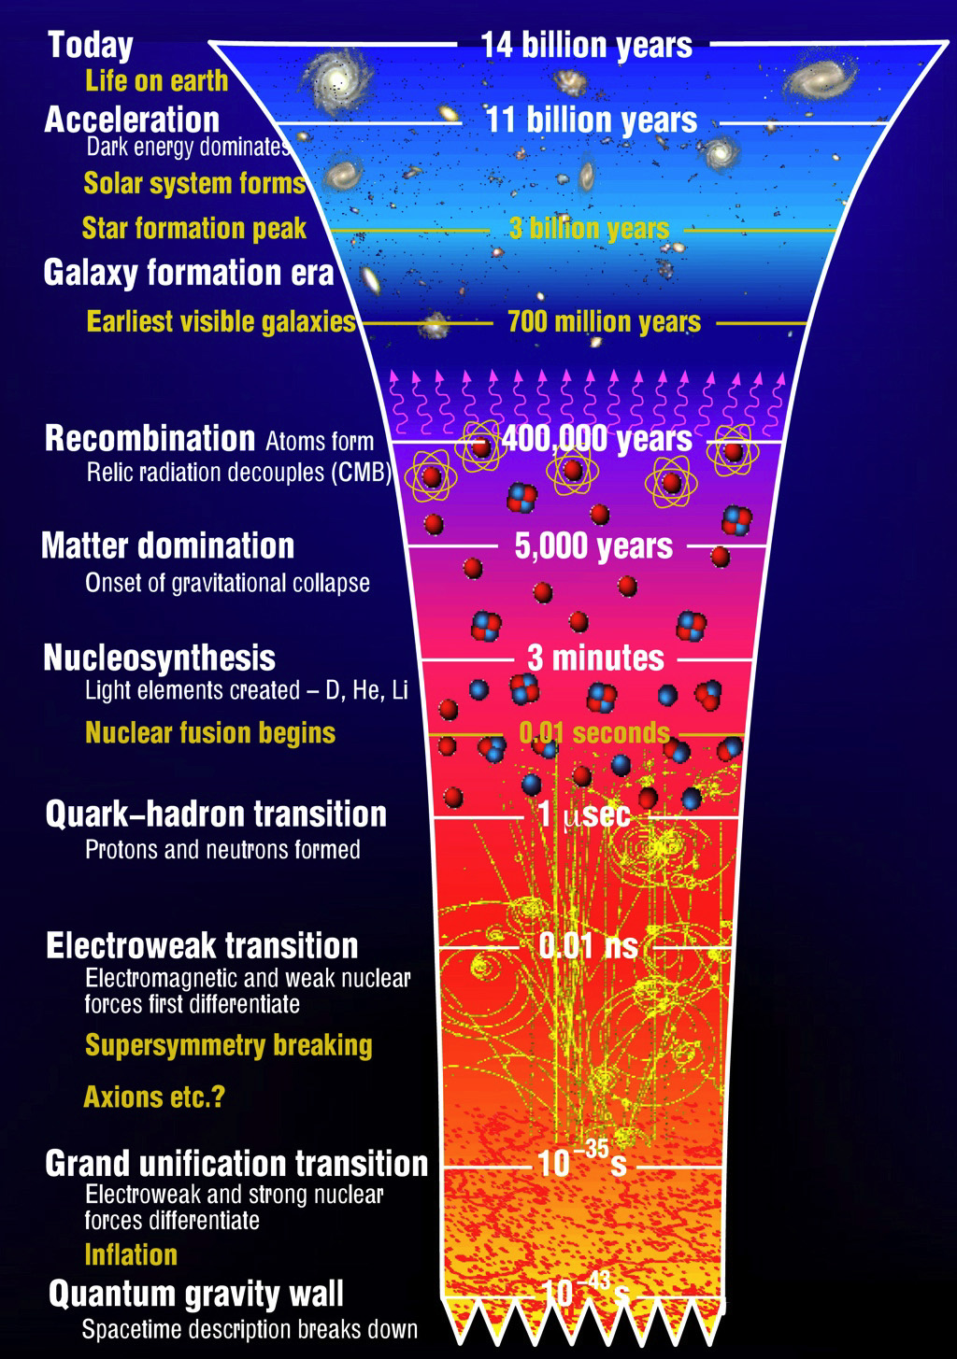

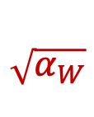


















Flavour Universality in very Early Universe
5 / 21
Quark and lepton generations interact identically
  No difference between particles of different generation?
  No matter – antimatter asymmetry (CP Violation)?
$$q_{i}$$
$$q_{i}$$
$$\sqrt{α}$$
$$\sqrt{α_{s}}$$
Electromagnetic:
Strong:
$$q_{i}$$
$$γ$$
$$q_{i}$$
$$g$$
$$q_{i}$$
$$q_{i}^{d}$$
$$\sqrt{α_{W}}$$
$$\sqrt{α_{Z}}$$
Weak NC:
Weak CC:
$$q_{i}$$
$$Z$$
$$q_{i}^{u}$$
$$W^{+}$$
Universality violation: Higgs !
  Higgs coupling is not universal, and mixes generations
  Complex couplings: allows for CP Violation!
$$q_{j}$$
$$Y_{ij}$$
$${\overline{q}}_{j}$$
$$Y_{ij}^{∗}$$
CP
$$q_{i}$$
$$H$$
$${\overline{q}}_{i}$$
$$H$$

Slide 7












Flavour Universality
6 / 21
Weak charged current interaction:
($i↔i$)
$$i=1$$
$$i=2$$
$$i=3$$
$$d$$
$$s$$
$$b$$
$$u$$
$$W^{+}$$
$$c$$
$$W^{+}$$
$$t$$
$$W^{+}$$
Universality violation: Higgs !
  Higgs coupling is not universal, and mixes generations
  Complex couplings: allows for CP Violation!
($i↔j$)
$$q_{j}$$
Massless particles
$$Y_{ij}$$
$${\overline{q}}_{j}$$
$$Y_{ij}^{∗}$$
CP
$$q_{i}$$
$$H$$
$${\overline{q}}_{i}$$
$$H$$

Slide 8
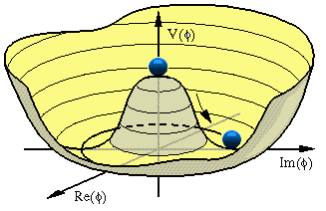







Flavour Universality → Symmetry Breaking
7 / 21
Weak charged current interaction:
($i↔i$)
$$i=1$$
$$i=2$$
$$i=3$$
$$d$$
$$s$$
$$b$$
$$u$$
$$W^{+}$$
$$c$$
$$W^{+}$$
$$t$$
$$W^{+}$$
vev$≠0$
Massive particles
redefines quark states in mass eigenstates:
Higgs:
($i↔i$)
$$q_{j}$$
$$Y_{ij}$$
$$q_{i}^{m}$$
$$m_{i}$$
$$q_{i}$$
$$H$$
$$q_{i}^{m}$$
$$H$$

Slide 9
























Flavour Universality → Symmetry Breaking → Flavour Mixing
8 / 21
Weak charged current interaction:
($i↔j$)
$$d^{m}$$
$$s^{m}$$
$$V_{us}$$
$$b^{m}$$
$$V_{ub}$$
$$V_{ud}$$
$$u^{m}$$
$$W^{+}$$
$$u^{m}$$
$$W^{+}$$
$$u^{m}$$
$$W^{+}$$
$$d^{m}$$
$$V_{cd}$$
$$s^{m}$$
$$V_{cs}$$
$$b^{m}$$
$$V_{cb}$$
$$c^{m}$$
$$W^{+}$$
$$c^{m}$$
$$W^{+}$$
$$c^{m}$$
$$W^{+}$$
vev$≠0$
$$d^{m}$$
$$V_{td}$$
$$s^{m}$$
$$V_{ts}$$
$$b^{m}$$
$$V_{tb}$$
$$t^{m}$$
$$W^{+}$$
$$t^{m}$$
$$W^{+}$$
$$t^{m}$$
$$W^{+}$$
Massive particles
redefines quark states in mass eigenstates:
Higgs:
($i↔i$)
$$q_{j}$$
$$Y_{ij}$$
$$q_{i}^{m}$$
$$m_{i}$$
$$q_{i}$$
$$H$$
$$q_{i}^{m}$$
$$H$$

Slide 10
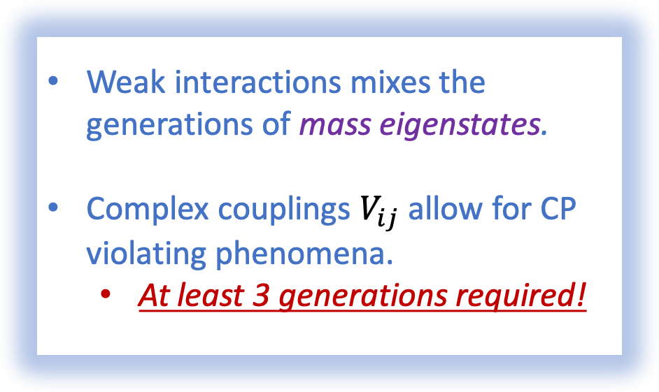
Flavour Universality → Symmetry Breaking → Flavour Mixing
8 / 21
Weak charged current interaction:
$$d^{m}$$
$$s^{m}$$
$$V_{us}$$
$$b^{m}$$
$$V_{ub}$$
$$V_{ud}$$
Weak interactions mixes the generations of mass eigenstates.
Complex couplings $V_{ij}$ allow for CP violating phenomena.
  At least 3 generations required!
$$u^{m}$$
$$W^{+}$$
$$u^{m}$$
$$W^{+}$$
$$u^{m}$$
$$W^{+}$$
$$d^{m}$$
$$V_{cd}$$
$$s^{m}$$
$$V_{cs}$$
$$b^{m}$$
$$V_{cb}$$
$$c^{m}$$
$$W^{+}$$
$$c^{m}$$
$$W^{+}$$
$$c^{m}$$
$$W^{+}$$
vev$≠0$
$$d^{m}$$
$$V_{td}$$
$$s^{m}$$
$$V_{ts}$$
$$b^{m}$$
$$V_{tb}$$
$$t^{m}$$
$$W^{+}$$
$$t^{m}$$
$$W^{+}$$
$$t^{m}$$
$$W^{+}$$
Massive particles
redefines quark states in mass eigenstates:
Higgs:
$$q_{j}$$
$$Y_{ij}$$
$$q_{i}^{m}$$
$$m_{i}$$
$$q_{i}$$
$$H$$
$$q_{i}^{m}$$
$$H$$

Slide 11
CP violating phenomena have been well established
9 / 21

Slide 12

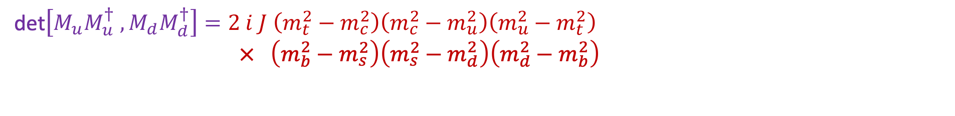
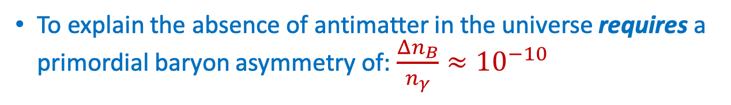
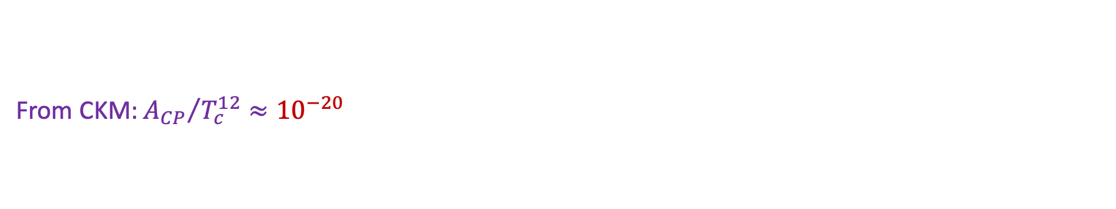
CP violation vs matter – antimatter asymmetry
10 / 21
To explain the absence of antimatter in the universe requires a primordial baryon asymmetry of: $\frac{Δn_{B}}{n_{γ}}≈{10}^{−10}$
Cecilia Jarlskog
Jarlskog criterion (1987) for amount of CP violation in SM:
det$\left[M_{u}M_{u}^{†} , M_{d}M_{d}^{†}\right]=2 i J \left(m_{t}^{2}−m_{c}^{2}\right)\left(m_{c}^{2}−m_{u}^{2}\right)\left(m_{u}^{2}−m_{t}^{2}\right)$
$× \left(m_{b}^{2}−m_{s}^{2}\right)\left(m_{s}^{2}−m_{d}^{2}\right)\left(m_{d}^{2}−m_{b}^{2}\right)$
  From CKM: ${A_{CP}}/{T_{c}^{12}}≈{10}^{−20 }$
→ Too small
Explanation requires existence of new massive particles.

Slide 13
How to search for new massive particles?
11 / 21
Direct searches: produce the particles on-shell in the LHC collisions:
Indirect searches via quantum fluctuations: low energy precision measurements:
Atlas
@LHC
CMS
@LHC
LHCb
@LHC
Belle II
@KEK
+ g-2, EDM, …

Slide 14
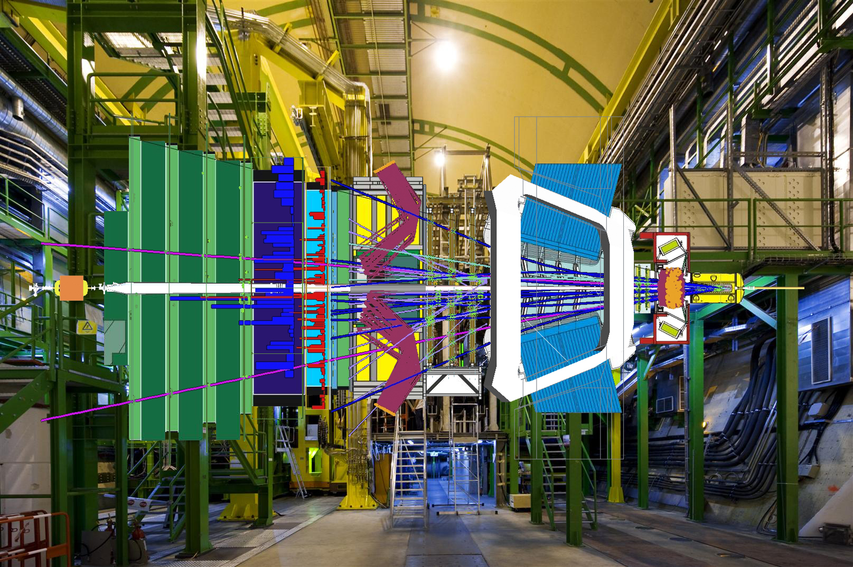
The LHCb experiment: $B$-decay precision measurements
12 / 21

Slide 15



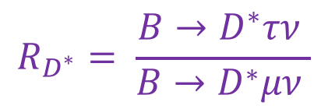
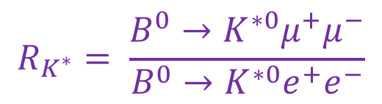

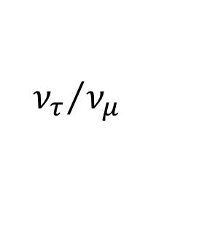


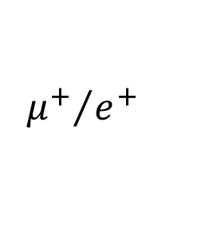
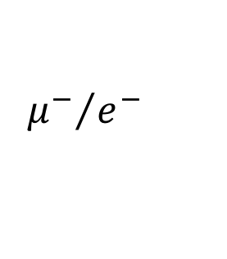
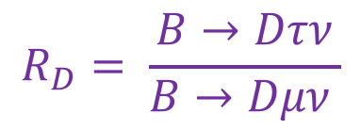
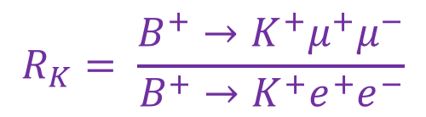

Quantum Effects: universality violation in $B$-decays
13 / 21
$b→c l ν$ charged current: ”Allowed” → large decay rates
$$c$$
$$R_{D}= \frac{B→Dτν}{B→Dμν }$$
$$b$$
$$τ/μ$$
i=3/2
$$R_{D^{∗}}= \frac{B→D^{∗}τν }{B→D^{∗}μν }$$
$${ν_{τ}}/{ν_{μ}}$$
$b→sl^{+}l^{−}$ neutral current: “Suppressed” → rare decays
$$R_{K}= \frac{B^{+}→K^{+}μ^{+}μ^{−}}{B^{+}→K^{+}e^{+}e^{−}}$$
$$s$$
$$b$$
$${μ^{+}}/{e^{+}}$$
$$R_{K^{∗}}= \frac{B^{0}→K^{∗0}μ^{+}μ^{−}}{B^{0}→K^{∗0}e^{+}e^{−}}$$
i=2/1
$${μ^{−}}/{e^{−}}$$

Slide 16


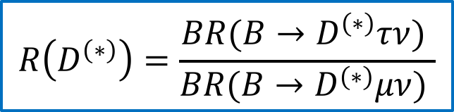
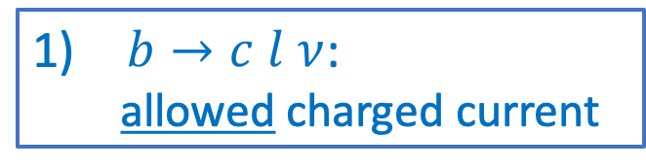
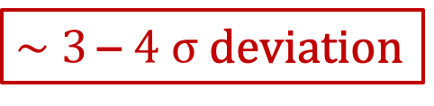
$R_{D}$ and $R_{D^{∗}}$
14 / 21
$b→c l ν$:
allowed charged current
$$R_{D^{∗}}$$
$$R\left(D^{\left(∗\right)}\right)=\frac{BR(B→D^{\left(∗\right)}τν) }{BR(B→D^{\left(∗\right)}μν) }$$
$\sim 3$ –$4 σ$ deviation
$$c$$
SM
$$b$$
$$τ/μ$$
$${ν_{τ}}/{ν_{μ}}$$
$$R_{D}$$
Potential large effect ➔ Involves particles of 2nd and 3rd generation

Slide 17


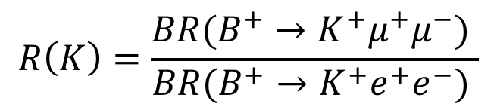
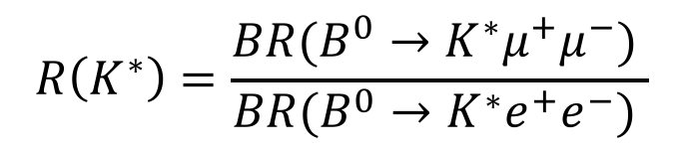
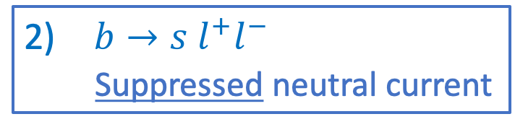
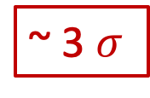
$R_{K}$ and $R_{K^{∗}}$
15 / 201
39/51
$$R_{K}$$
$b→s l^{+}l^{−}$
Suppressed neutral current
$$R\left(K\right)=\frac{BR(B^{+}→K^{+}μ^{+}μ^{−}) }{BR(B^{+}→K^{+}e^{+}e^{−}) }$$
$$s$$
$$b$$
$${μ^{+}}/{e^{+}}$$
~ 3 $σ$
$${μ^{−}}/{e^{−}}$$
$$R\left(K^{∗}\right)=\frac{BR(B^{0}→K^{∗}μ^{+}μ^{−}) }{BR(B^{0}→K^{∗}e^{+}e^{−}) }$$
$$R_{K^{∗}}$$
Small effect ➔ Particles of 1st and 2nd generation

Slide 18
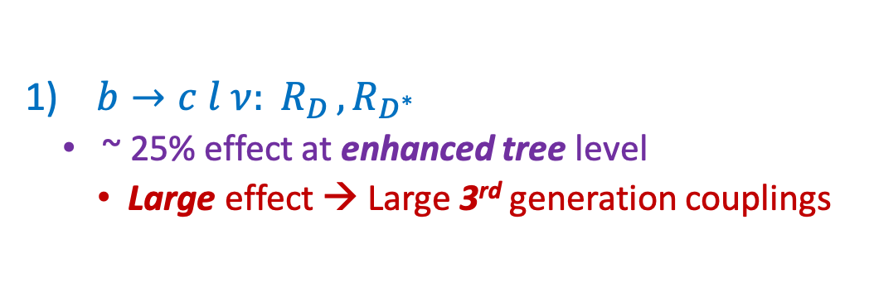
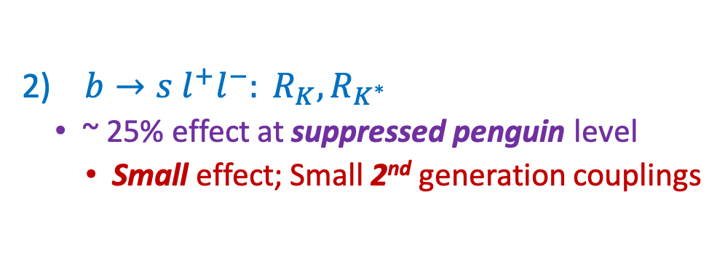
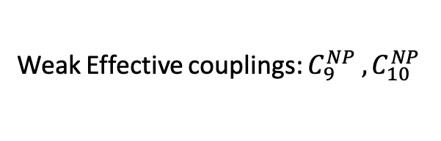

Interpretation as a single cause: contradicting effects?
16 / 21
$b→c l ν{: R}_{D}, R_{D^{∗}}$
  ~ 25% effect at enhanced tree level
    Large effect → Large 3rd generation couplings
$b→s l^{+}l^{−}: R_{K}, R_{K^{∗}}$
  ~ 25% effect at suppressed penguin level
    Small effect; Small 2nd generation couplings
Weak Effective couplings: $C_{9}^{NP} , C_{10}^{NP}$
$$R_{D^{∗}}$$
SM
SM
$$R_{D}$$
Similar to Higgs couplings: large for 3rd generation, small for 2nd generation, tiny for 1st generation.
➔ New particle perhaps has similar flavour structure as the Higgs?

Slide 19


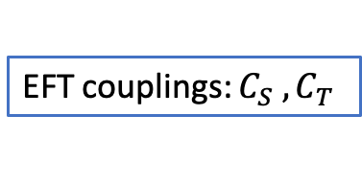
What could it be?
• LQ = LeptoQuark
17 / 21
Effective Field Theory analysis (see Focus FM02)
  Many observations; compare data fits with model predictions
See arXiv:1706.07808 for overview.
Couples leptons to quarks!
EFT couplings: $C_{S} , C_{T}$
Best single mediator model: LeptoQuark particle U1 with a flavour hierarchy related to the Higgs boson
  Vector LQ U1(3,1,2/3)
  Mass ~2 TeV
$$(Singlet)$$
LQ relates charge of leptons to quarks!
Towards understanding why atoms are neutral?
$$(Triplet)$$

Slide 20
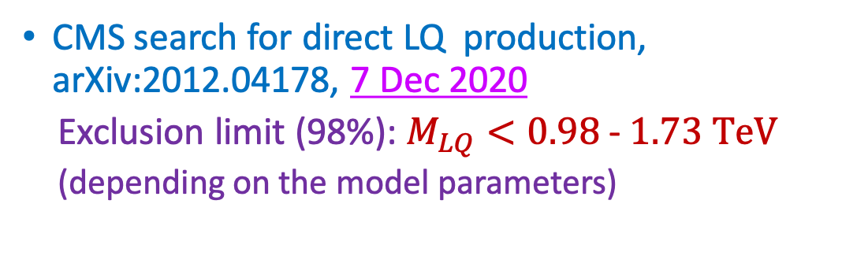
Recent: direct search for specific 3rd generation leptoquarks
18 / 21
CMS search for direct LQ production, arXiv:2012.04178, 7 Dec 2020
  Exclusion limit (98%): $M_{LQ}<0.98$- $1.73 TeV$
  (depending on the model parameters)
LQ production at LHC:
“Single LQ”
“Double LQ”
  arXiv:2012.04178, Dec 2020
Allowed
Excluded

Slide 21










Recent: variable $P_{5}^{′}$ in $B^{0}→K^{∗0}μ^{+}μ^{−}$
19 / 21
$$d$$
$$K$$
$$d$$
$$s$$
$$B^{0}→K^{∗0}μ^{+}μ^{−}$$
$$B$$
$$b$$
$$μ^{+}$$
$$μ^{−}$$
LHCb: Study angular distribution of the produced particles
~3σ from SM
  $P_{5}^{′}:$ count blue minus red:
$$\cos{θ_{K}}$$
$$φ$$

Slide 22

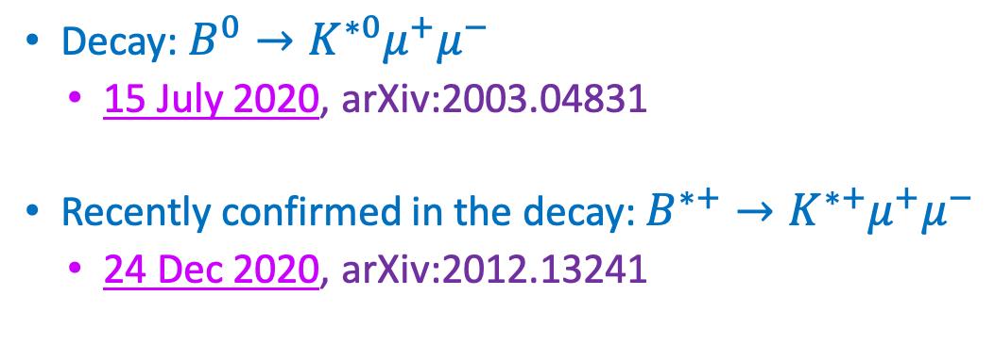
Recent: variable $P_{5}^{′}$ in $B^{0}→K^{∗0}μ^{+}μ^{−}$
20 / 21
$$d$$
$$K$$
$$d$$
$$s$$
$$B^{0}→K^{∗0}μ^{+}μ^{−}$$
$$B$$
$$b$$
$$μ^{+}$$
$$μ^{−}$$
LHCb: Study angular distribution of the produced particles
~3σ from SM
: confirmed.
Decay: $B^{0}→K^{∗0}μ^{+}μ^{−}$
  15 July 2020, arXiv:2003.04831
Recently confirmed in the decay: $B^{∗+}→K^{∗+}μ^{+}μ^{−}$
  24 Dec 2020, arXiv:2012.13241
$$B^{+}→K^{∗+}μ^{+}μ^{−}$$
~2σ from SM

Slide 23


Conclusions
21 / 21
CP Violation requires three generations of particles.
  Does not explain the matter antimatter asymmetry in the universe
  LHC has not yet directly observed new massive particles
Forces are flavour universal across particle generations.
Higgs is strongly non-universal, coupling mainly to 3rd generation
Precision measurements hint at the existence of new particles with non-universal couplings:
  LeptoQuark candidate; couples to quarks and leptons
  LeptoQuarks are a long sought particles that may address:
    The matter - antimatter asymmetry of the universe,
    Why proton has equal but opposite charge wrt electron.
Updates expected in winter conferences.

Slide 24
The Flavour Puzzle
OF
LHC
AND
EARLY
THE
UNIVERSE
Thank you for your attention
1
2
3
Why three generations of particles?
Why is there no antimatter?
Why is an atom electric neutral?

Slide 25
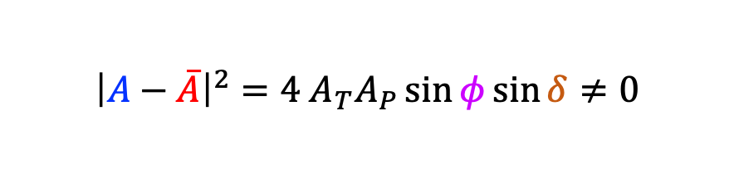










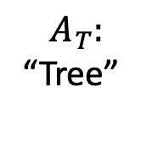
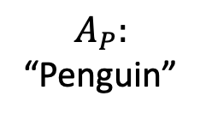

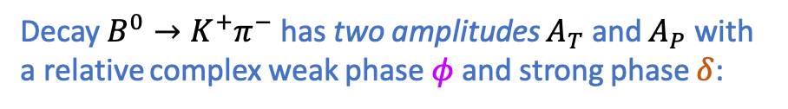






CP Violation in B-meson decays
LHCb measurement 2020: arXiv:2012.05319
Decay $B^{0}→K^{+}π^{−}$ has two amplitudes $A_{T}$ and $A_{P}$ with a relative complex weak phase $φ$ and strong phase $δ$:
$$B^{0}→K^{+}π^{−}$$
CP violation !
$${\overline{B}}^{0}→K^{−}π^{+}$$
$$φ$$
$$A_{T}:$$
“Tree”
$$A_{P}:$$
“Penguin”
CP Violation
$B^{0}→K^{+}π^{−}$ :
${\overline{B}}^{0}→K^{−}π^{+}$ :
$$A_{T}$$
$$K^{+}$$
$$\overline{A_{T}}$$
$$K^{−}$$
$$A=A_{T}+A_{P}e^{iφ}e^{iδ}$$
$$\overline{A}=A_{T}+A_{P}e^{−iφ}e^{iδ}$$
$$B^{0}$$
$$\overline{B^{0}}$$
$${\left|A\right|}^{2}={\left|A_{T}\right|}^{2}+{\left|A_{P}\right|}^{2}+A_{T}A_{P}\left(e^{iφ}e^{iδ}+e^{−iφ}e^{−iδ}\right)$$
$$A_{P}$$
$$π^{−}$$
$$π^{+}$$
$${\left|\overline{A}\right|}^{2}={\left|A_{T}\right|}^{2}+{\left|A_{P}\right|}^{2}+A_{T}A_{P}\left(e^{−iφ}e^{iδ}+e^{iφ}e^{−iδ}\right)$$
$$\overline{A_{P}}$$
$${\left|A−\overline{A}\right|}^{2}=4 A_{T}A_{P}\sin{φ}\sin{δ}≠0$$
CP violation is a pure quantum interference effect

Slide 26
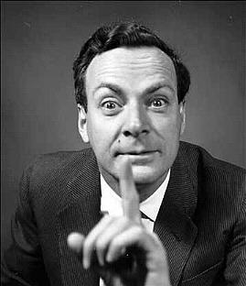
A deeper connection?
Feynman: “In the end all quantum phenomena are manifestations of the double slit experiment.”
Assuming CPT symmetry: CP violation → T violation Quantum interference ←→ arrow of time?

Slide 27

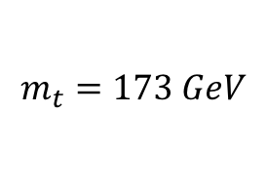
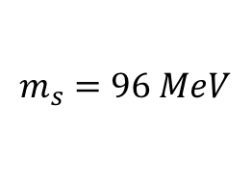
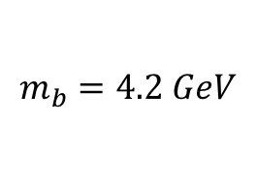





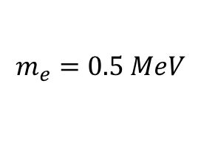
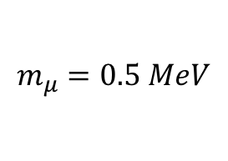
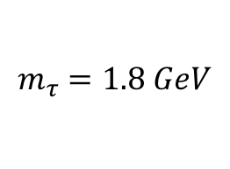
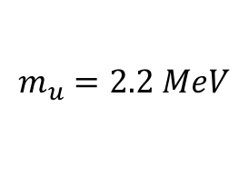
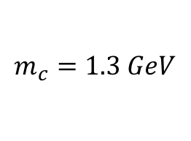
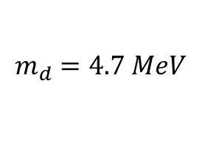
Flavour Structure: Forces vs Higgs
Forces are flavour universal
Higgs interaction almost purely 3rd generation
e
μ
τ
$$q_{i}^{m}$$
$$m_{i}=Y_{tt}$$
$$m_{e}=0.5 MeV$$
$$m_{μ}=0.5 MeV$$
$$m_{τ}=1.8 GeV$$
$$q_{i}^{m}$$
$$H$$
top-Yukawa: $Y_{tt}=$ 1.0 ?!
Flavour Puzzle: What is the origin of these Higgs couplings across generations?
Higgs coupling is large for 3rd generation, small for 2nd generation, tiny for 1st generation
Perhaps new particles/forces may show a similar deviation from flavour universality?
u
c
t
$$m_{u}=2.2 MeV$$
$$m_{c}=1.3 GeV$$
$$m_{t}=173 GeV$$
d
s
b
$$m_{d}=4.7 MeV$$
$$m_{s}=96 MeV$$
$$m_{b}=4.2 GeV$$

