Slide 1
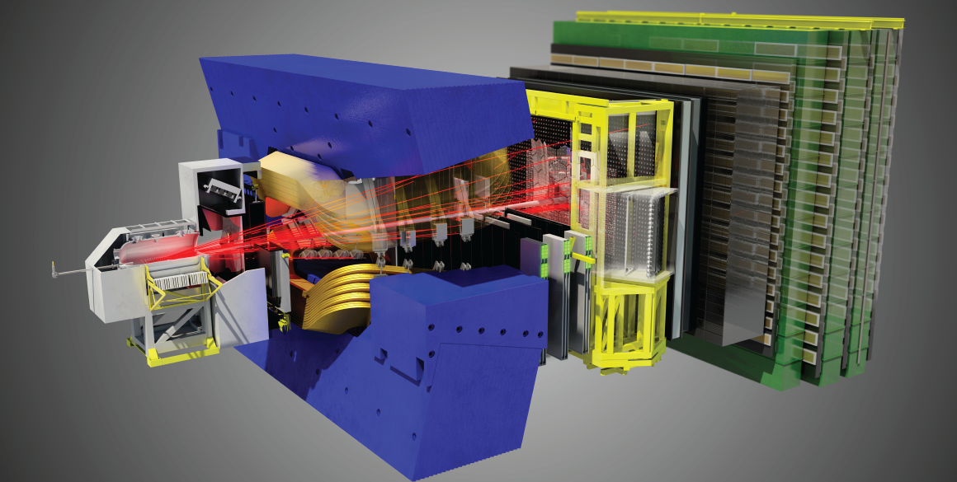
LHCb
Mission: To search for new particles and interactions that affect the observed matter-antimatter asymmetry in the Universe, by making precision measurements of B-meson decays.

Slide 2
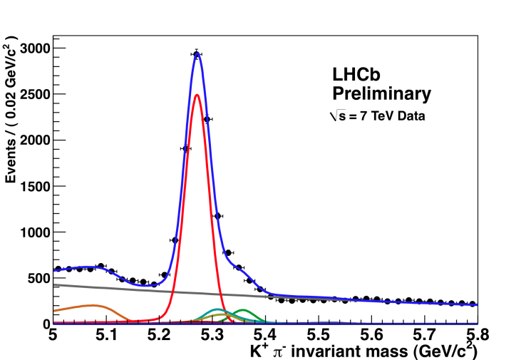
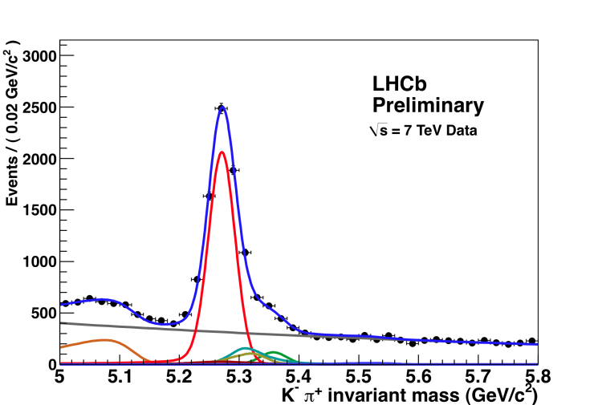
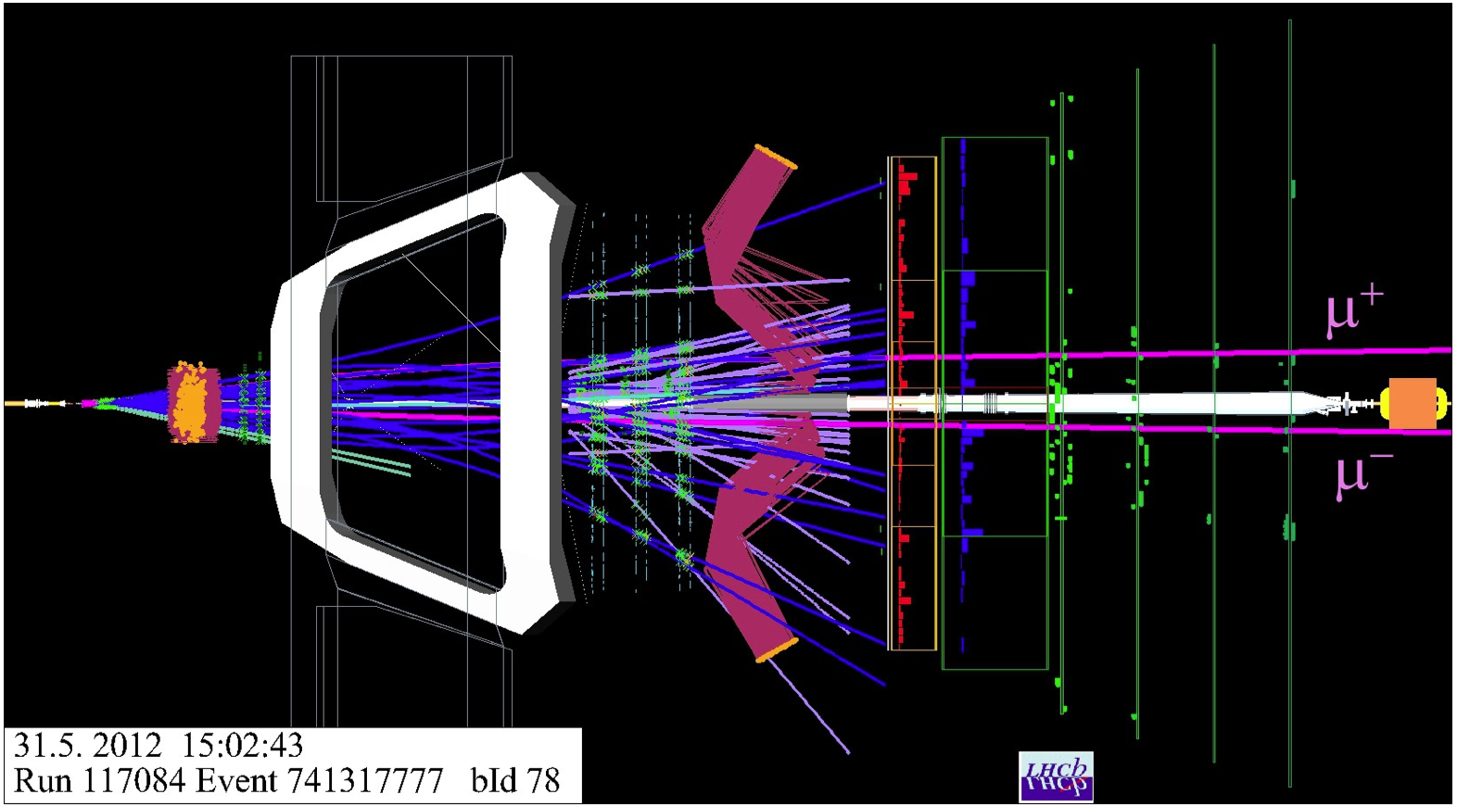
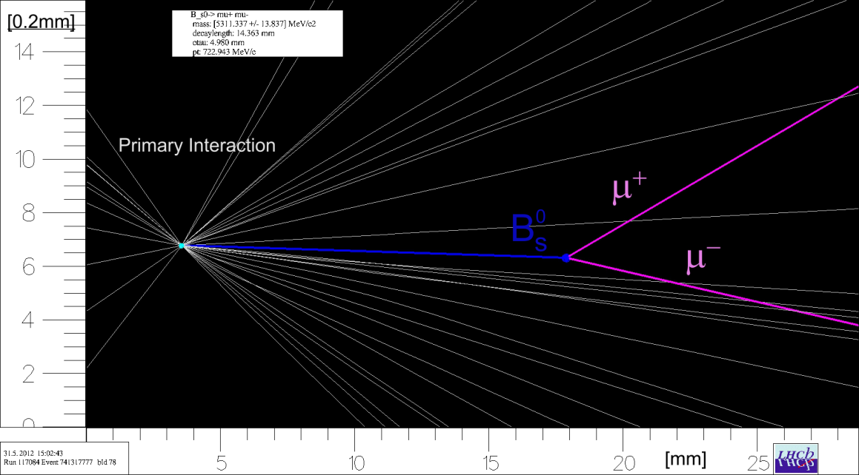
LHCb – Physics Observations
Matter and antimatter
behave differently
B⁰ → K⁺ π⁻
B⁰ → K⁻ π⁺
2) Forbidden decay found

Slide 3
LHCb Physics

Slide 4
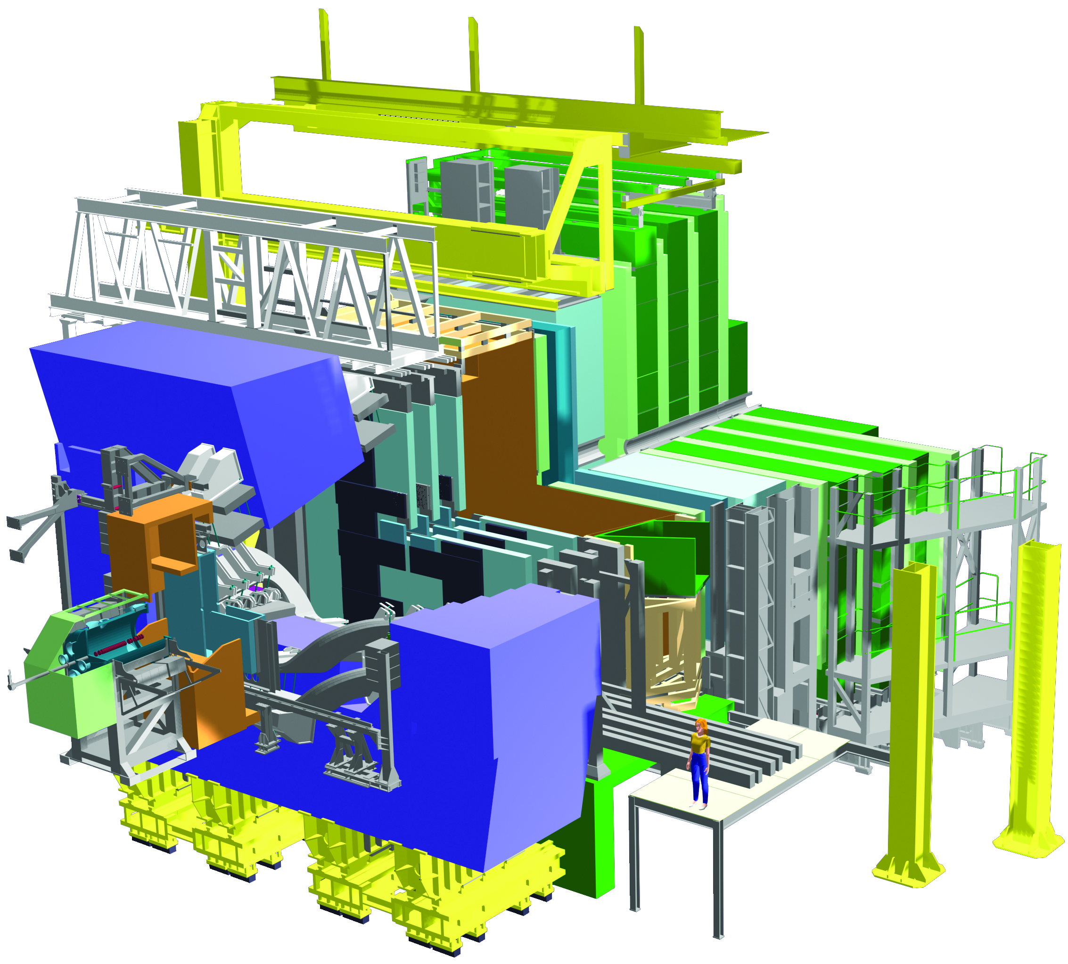
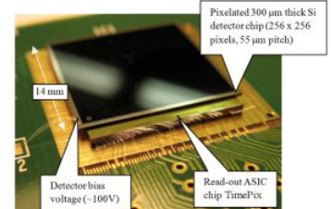
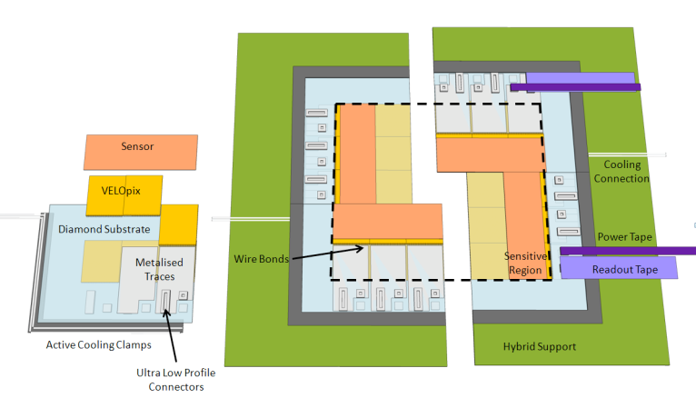
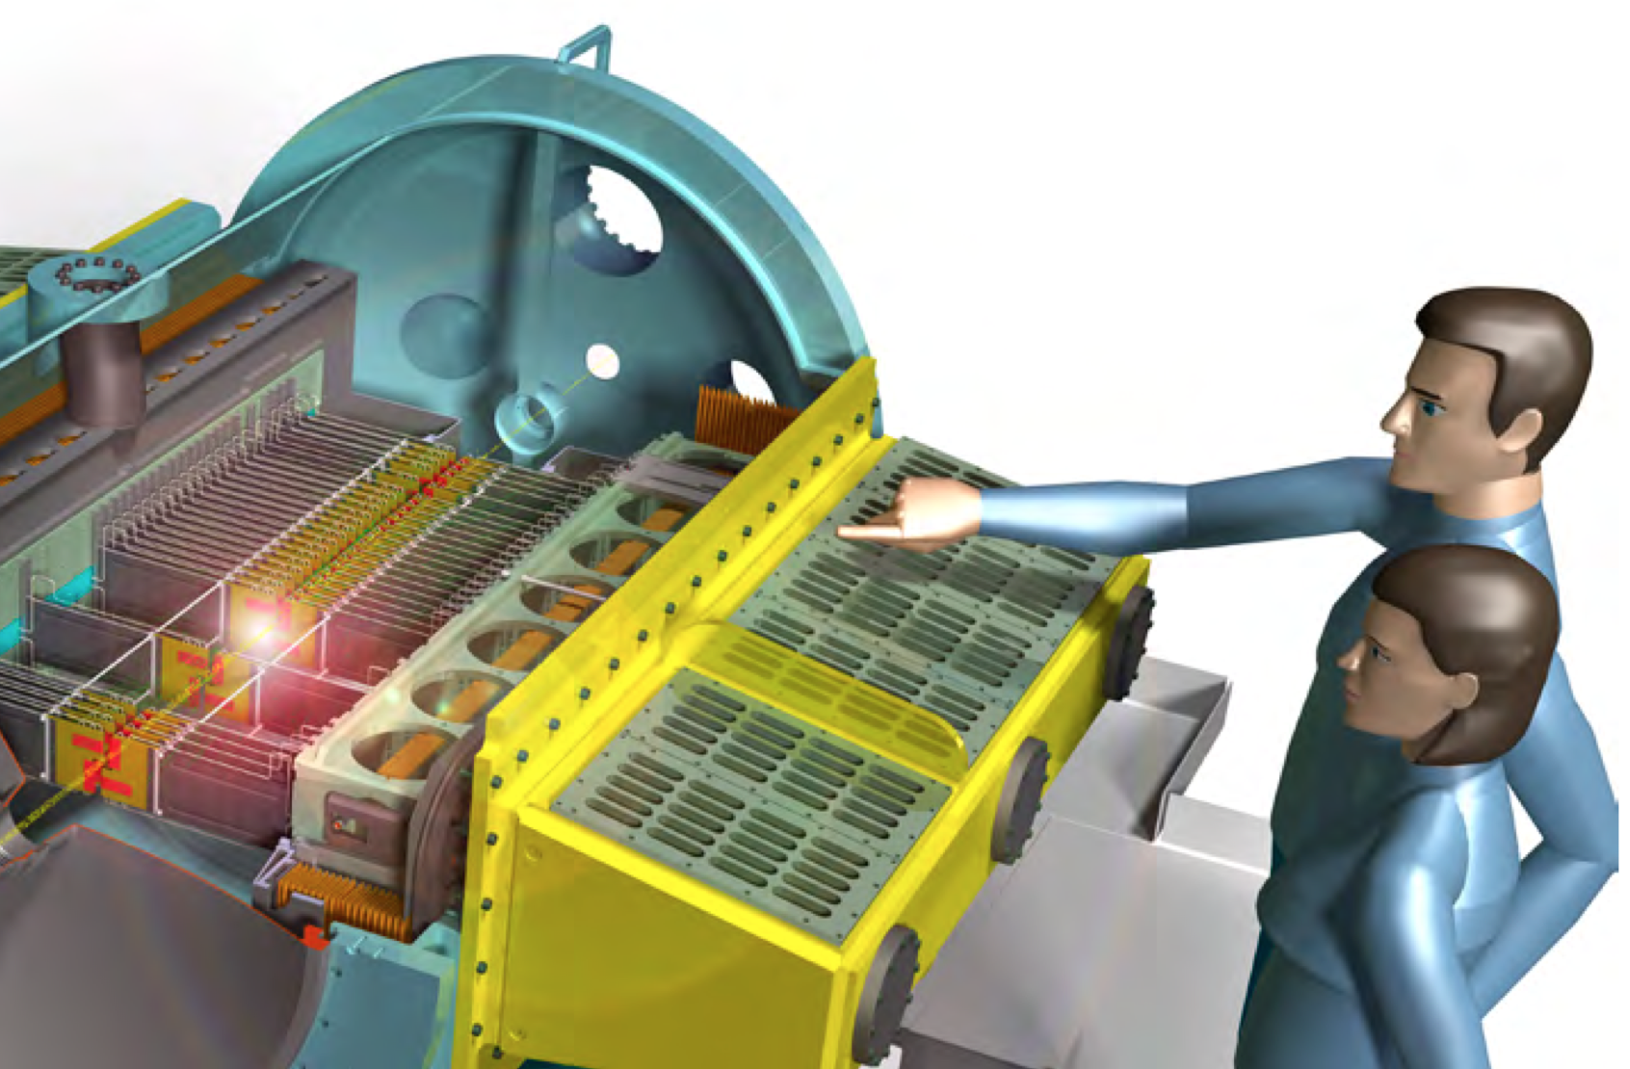
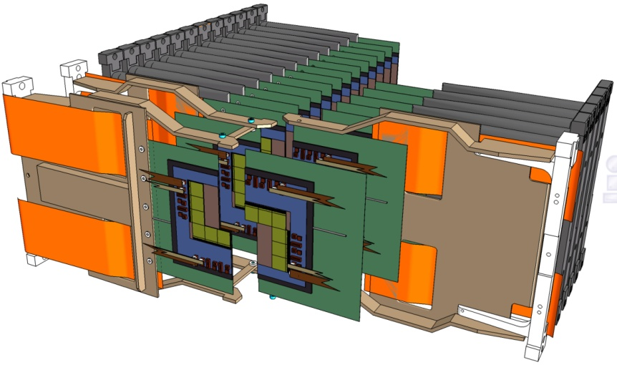
Vertex Detector
4

Slide 5
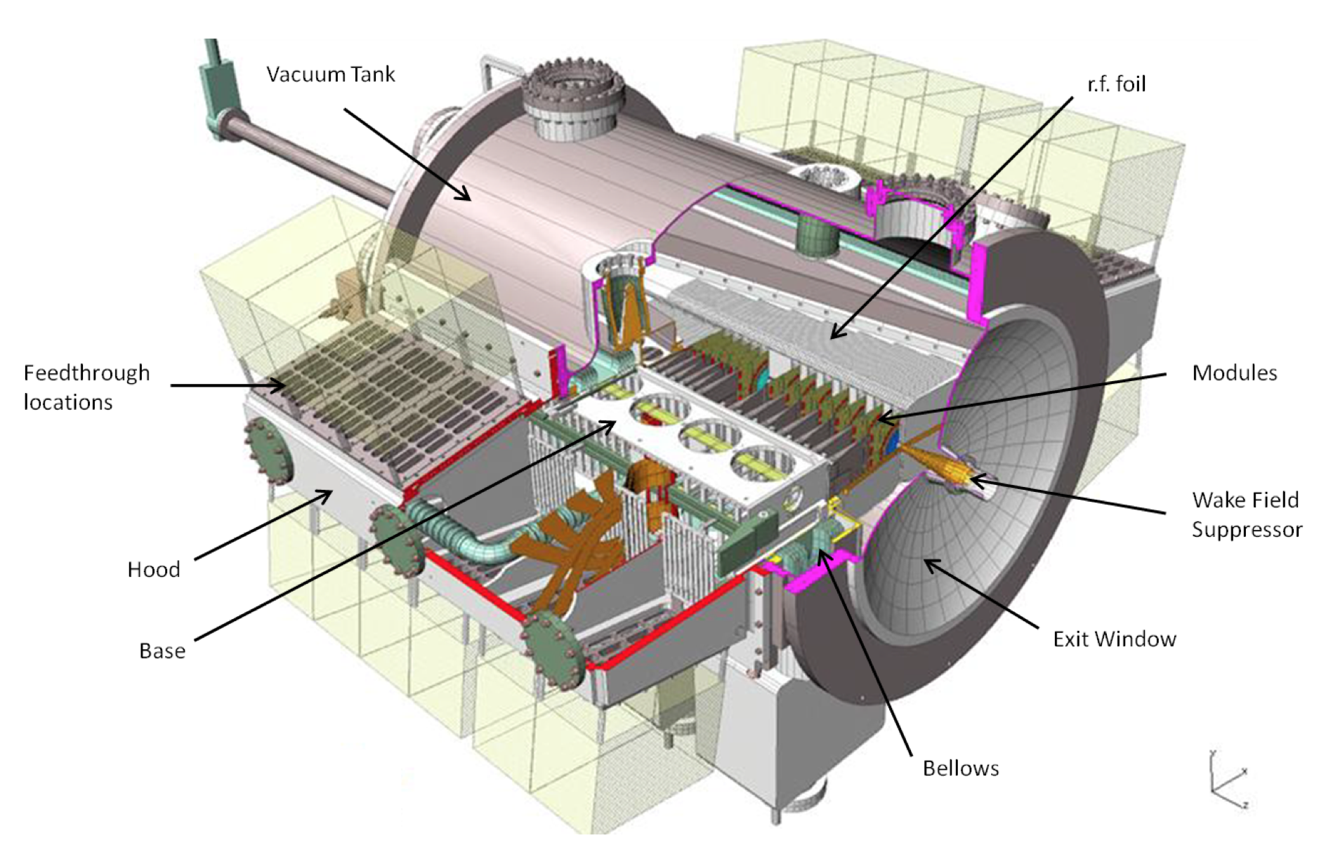
Velo – Vacuum Vessel

Slide 6
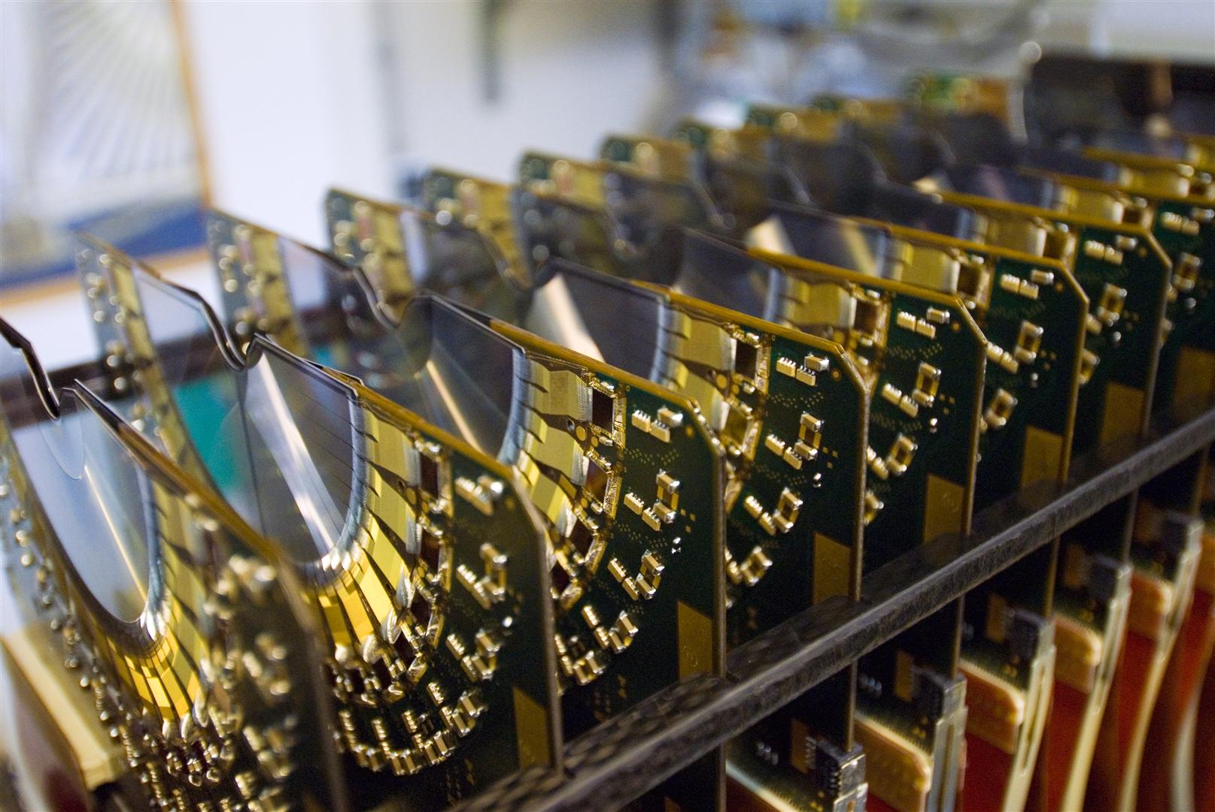
Velo Sensors

Slide 7
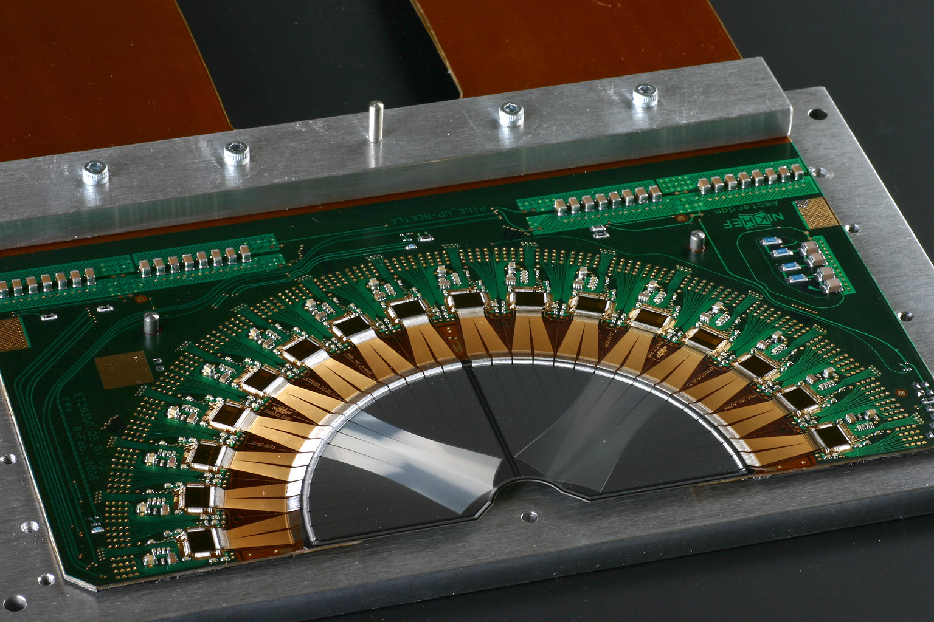
Velo Electronics – PileUp Detector

Slide 8
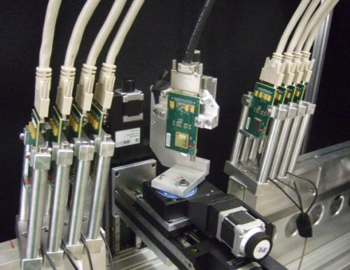
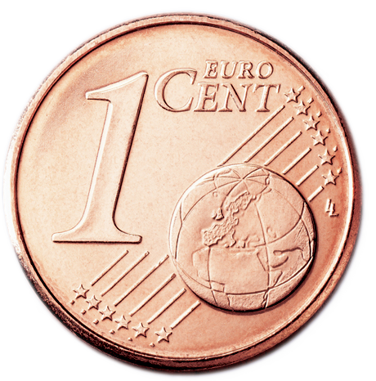
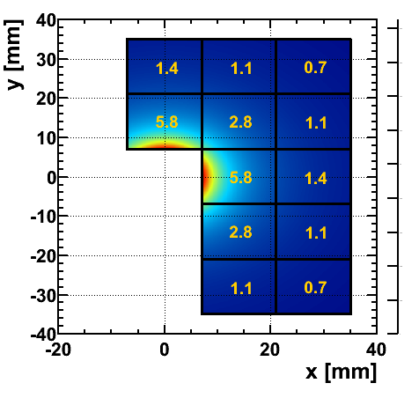
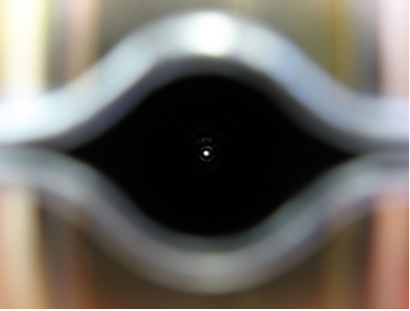
Velo Electronics – VeloPix
VeloPix Detector (⬅ MediPix)
Matrix: 256 x 256 pixels
Pixel size: 55 by 55 μm
Data: 12 Gbits/s per chip
Detectors very close to beam
5.5 mm (!)
5.0mm

Slide 9
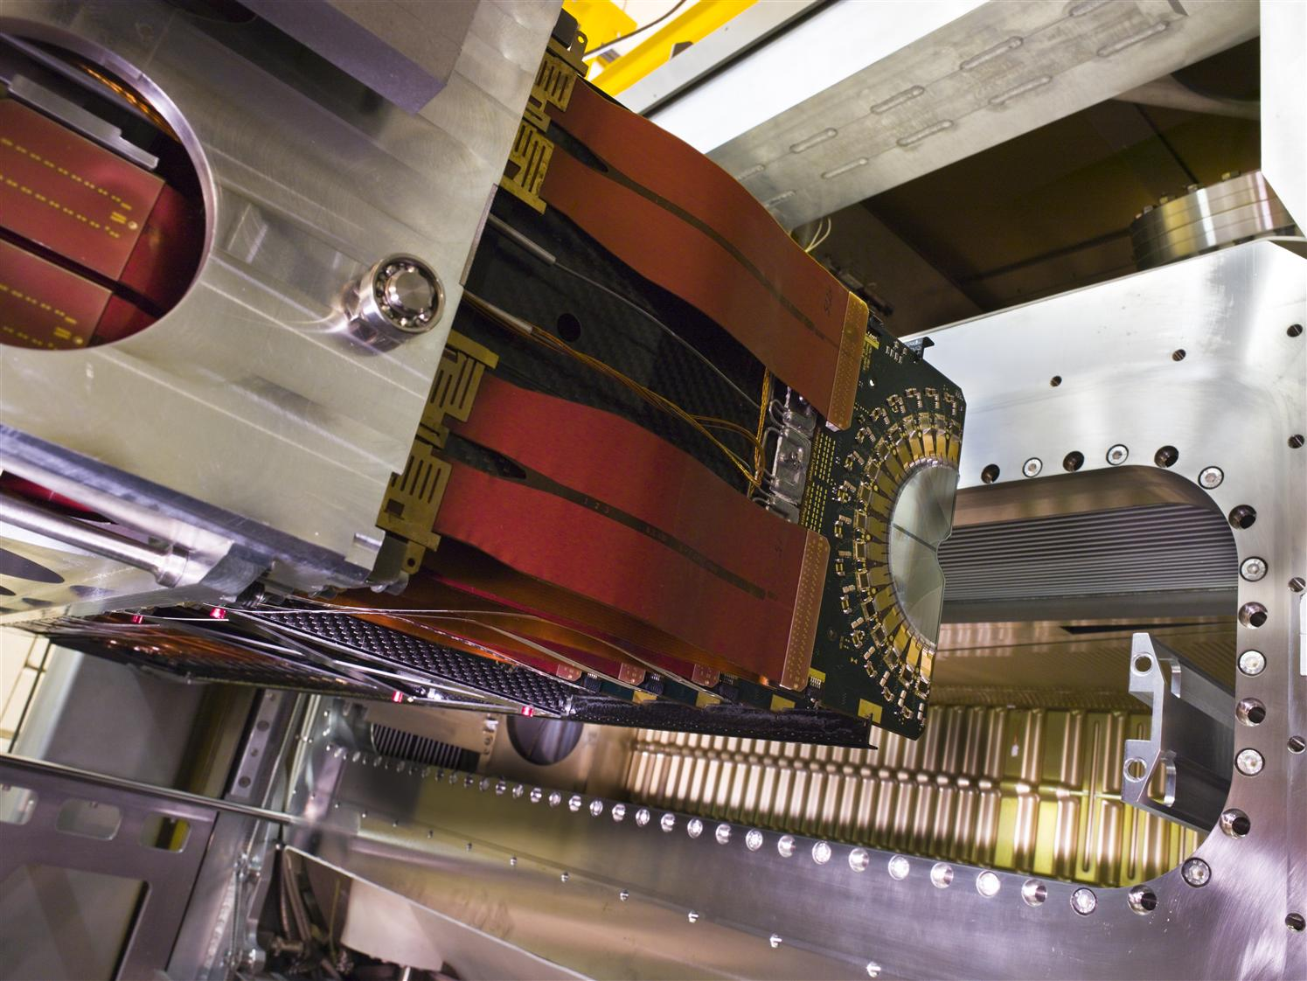
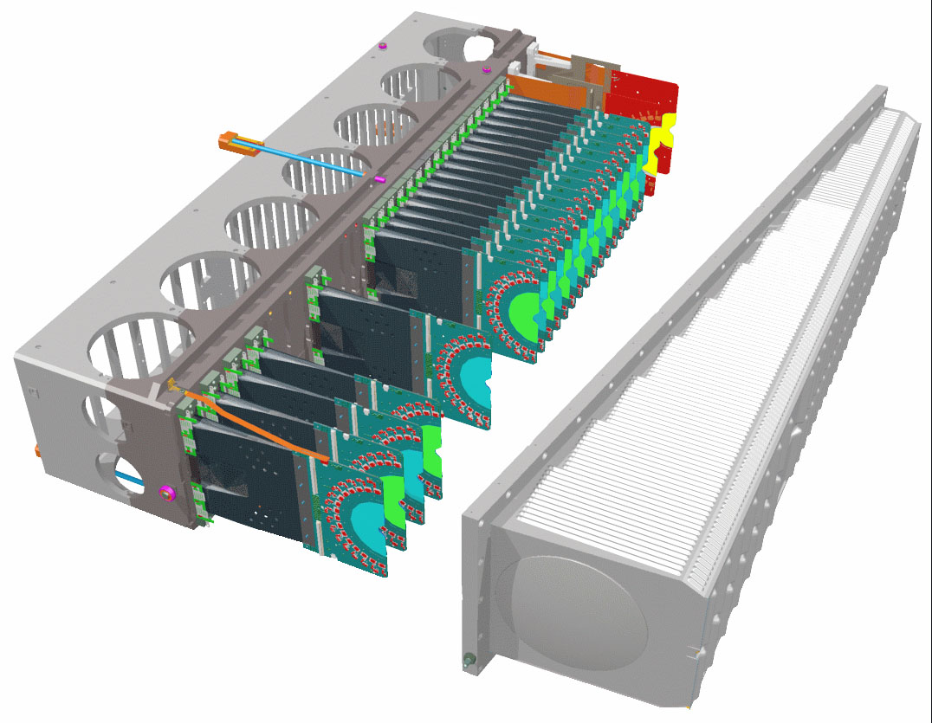
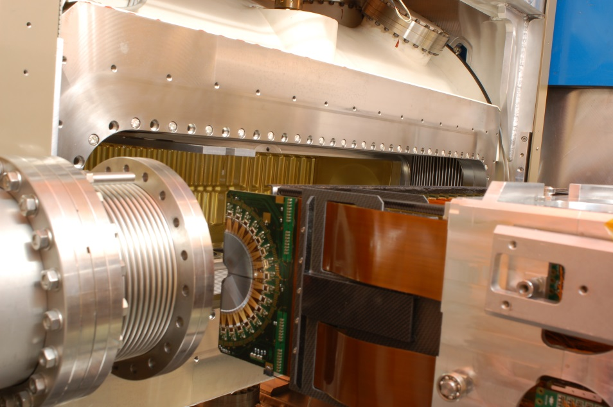
Velo Mechanics – Vacuum Enclosure
Vacuum enclosure
shield sensors from beam
~< 300 micron foil
Tight mechanical tolerances during venting and pump-down
Milling & welding technology

Slide 10
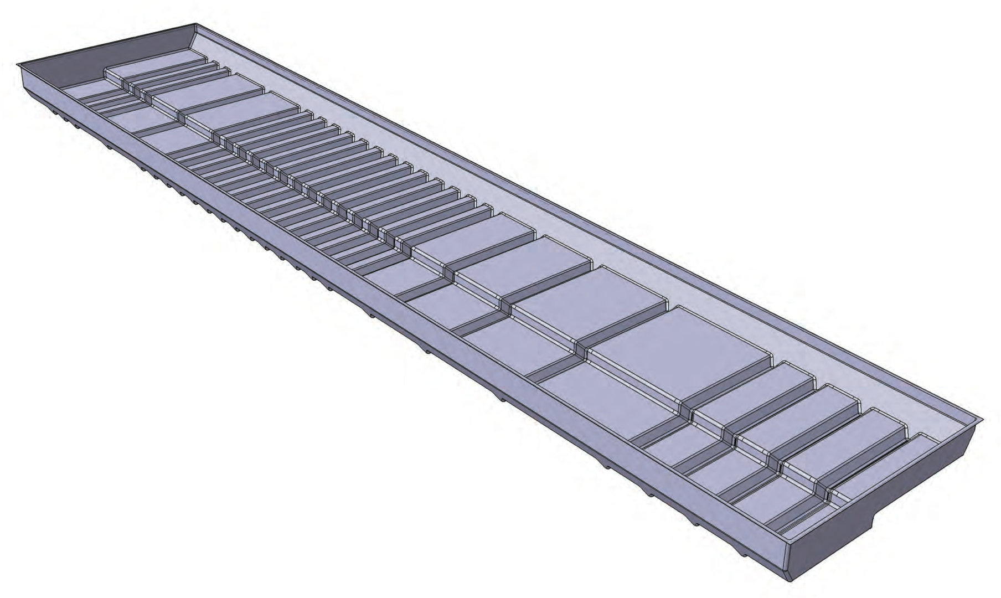
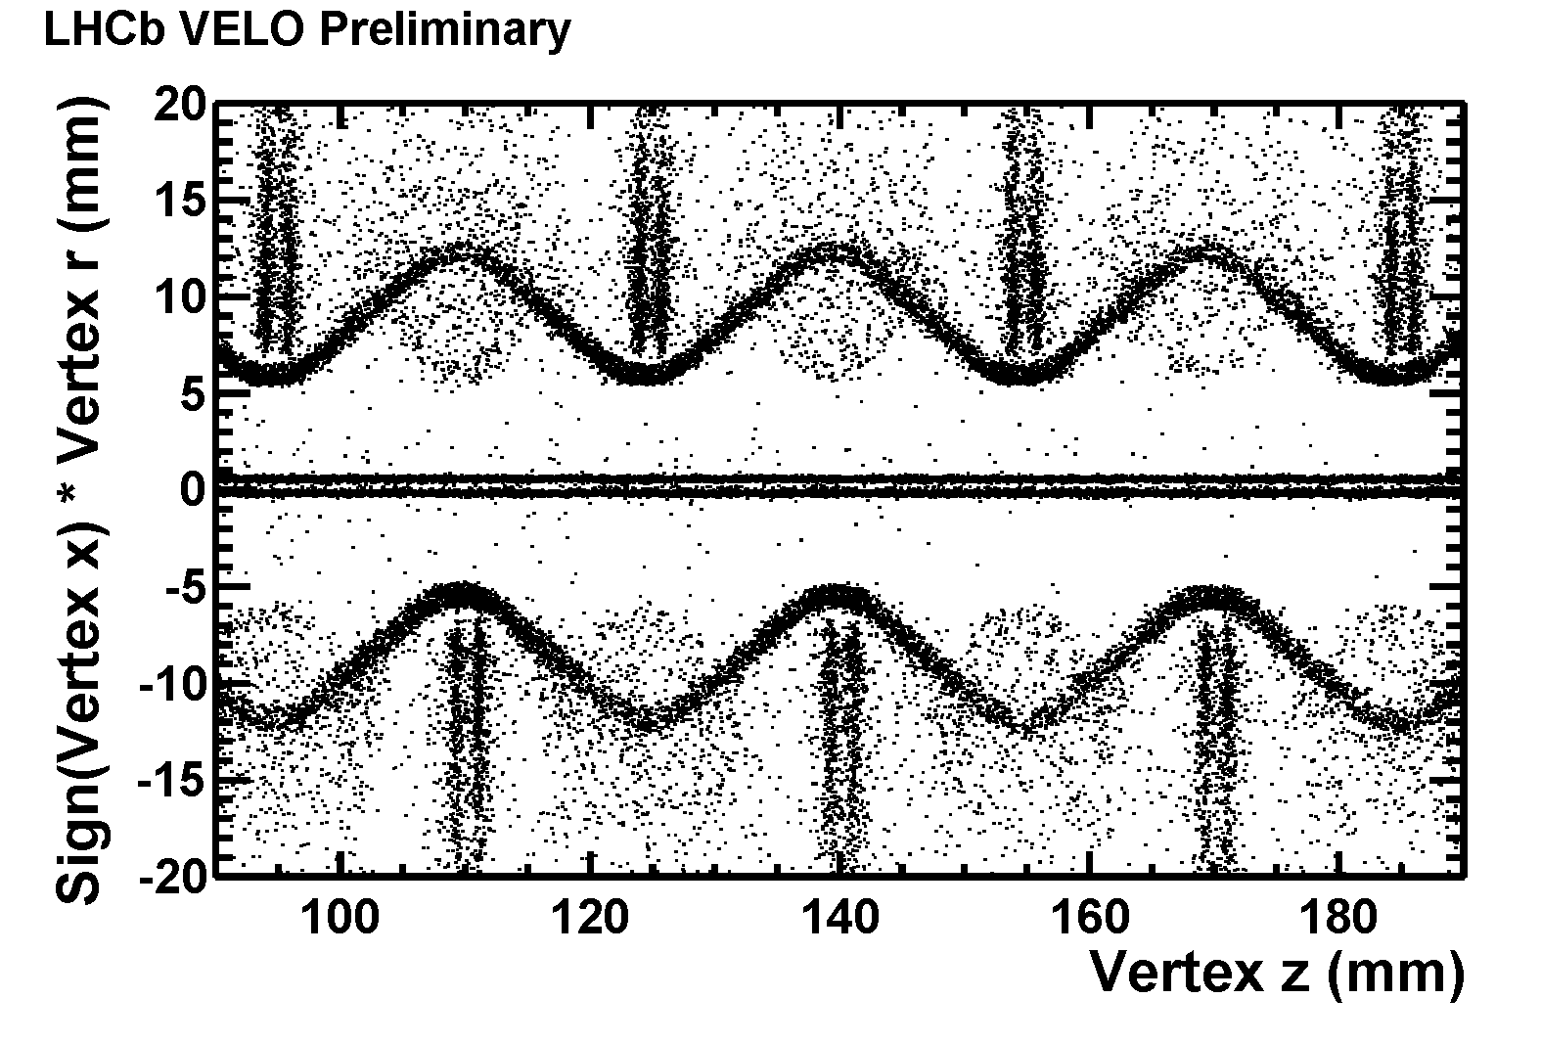
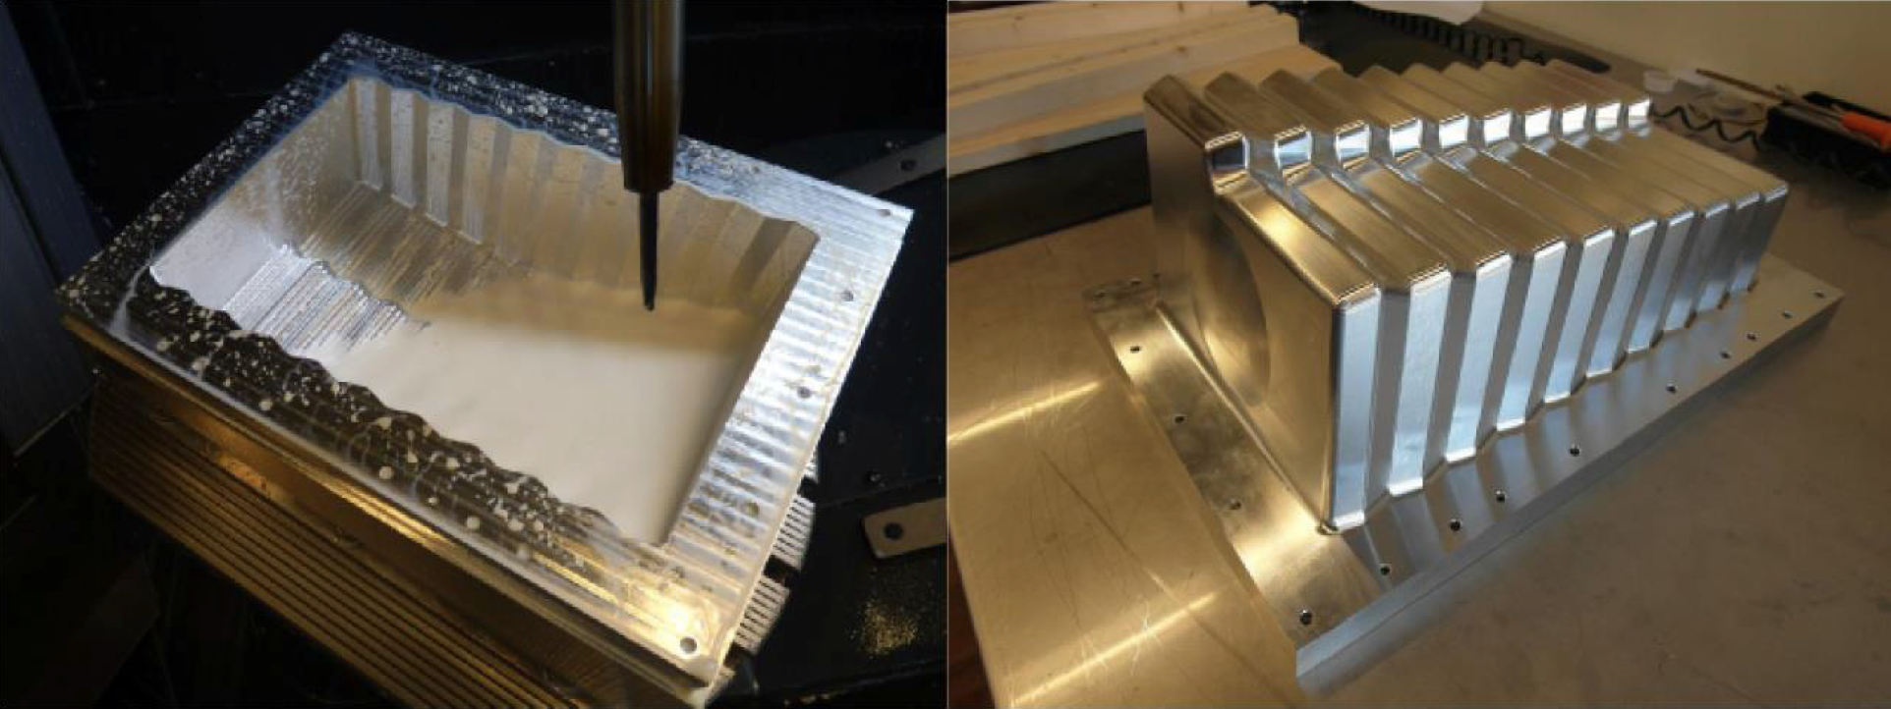
Velo Mechanics- Vacuum Enclosure
RF-box:
crucial for physics

Slide 11
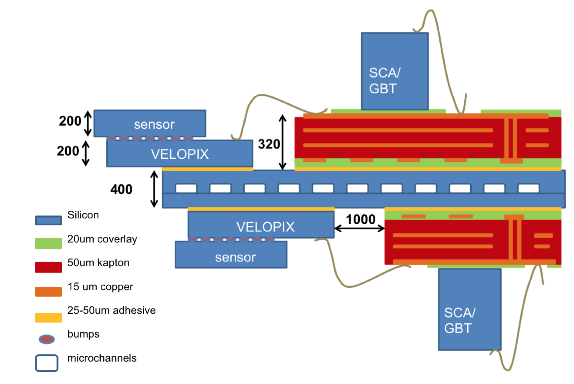
Velo – Module Construction
Module construction
CO2 cooling capillaries

Slide 12
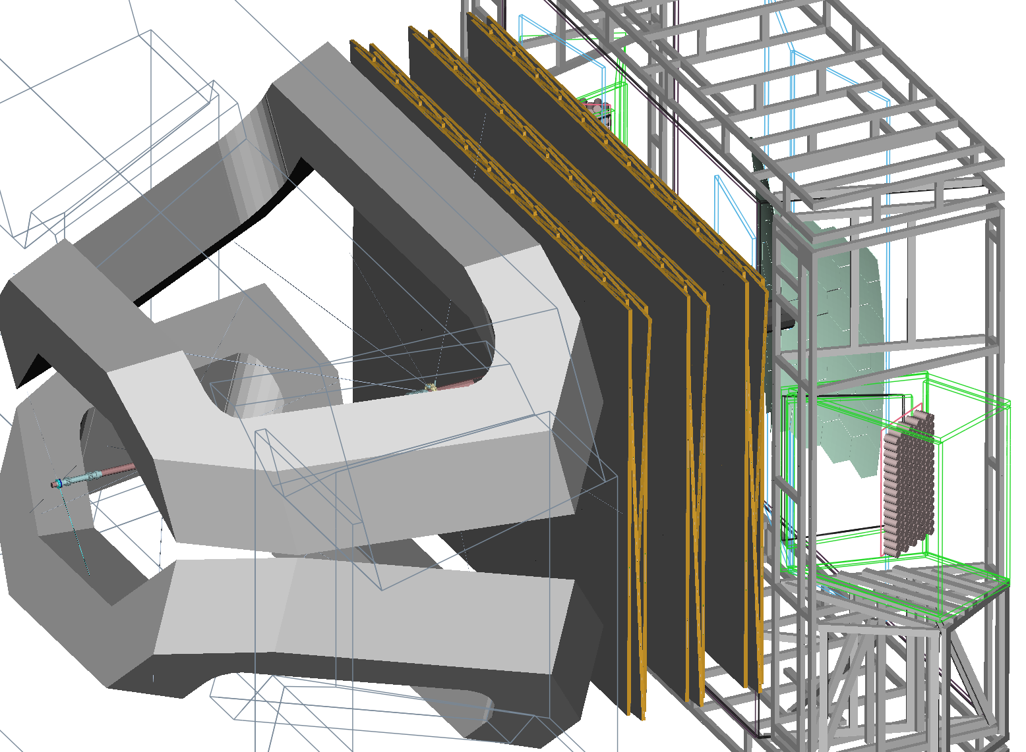
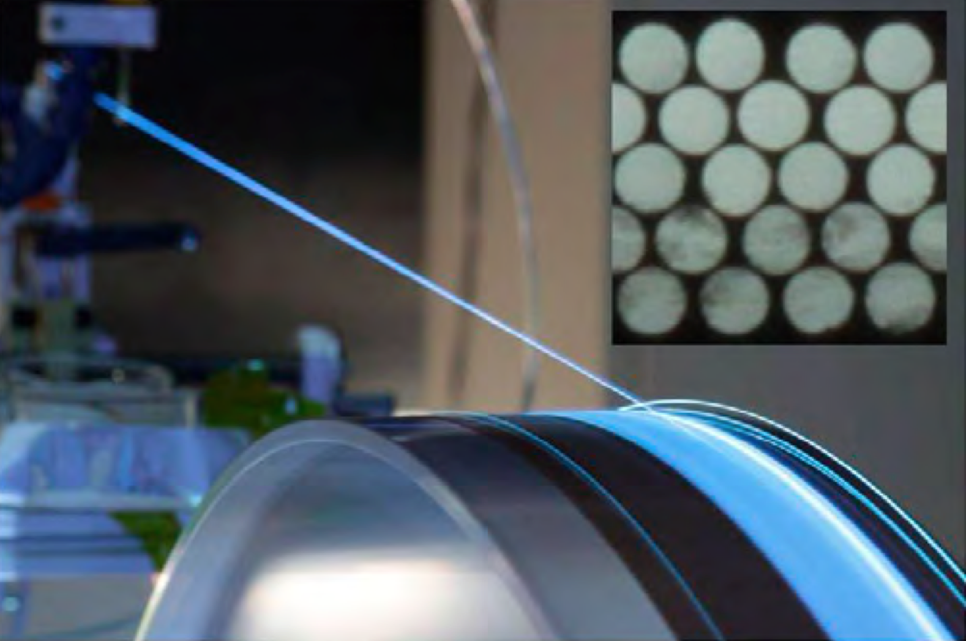
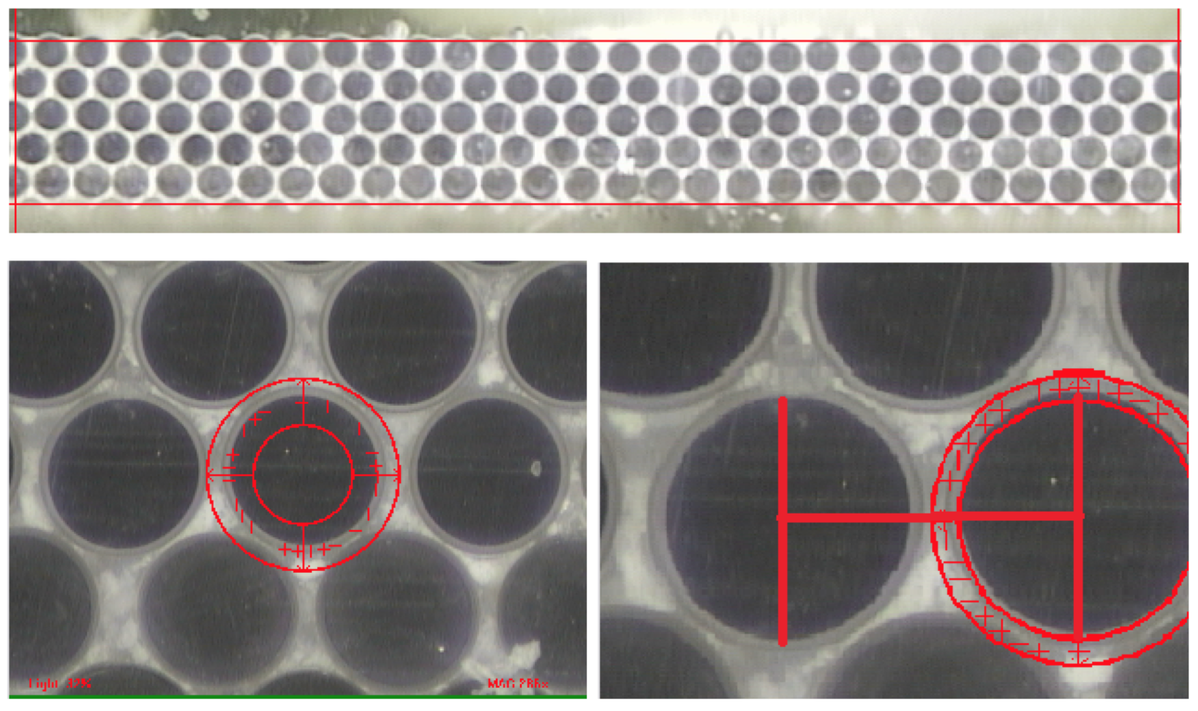
Scintillating Fiber detector
Novel detector with scintillating fibers
250 μm diameter
Modules with fiber “mats”
6 meter long modules
<100 μm precision

Slide 13
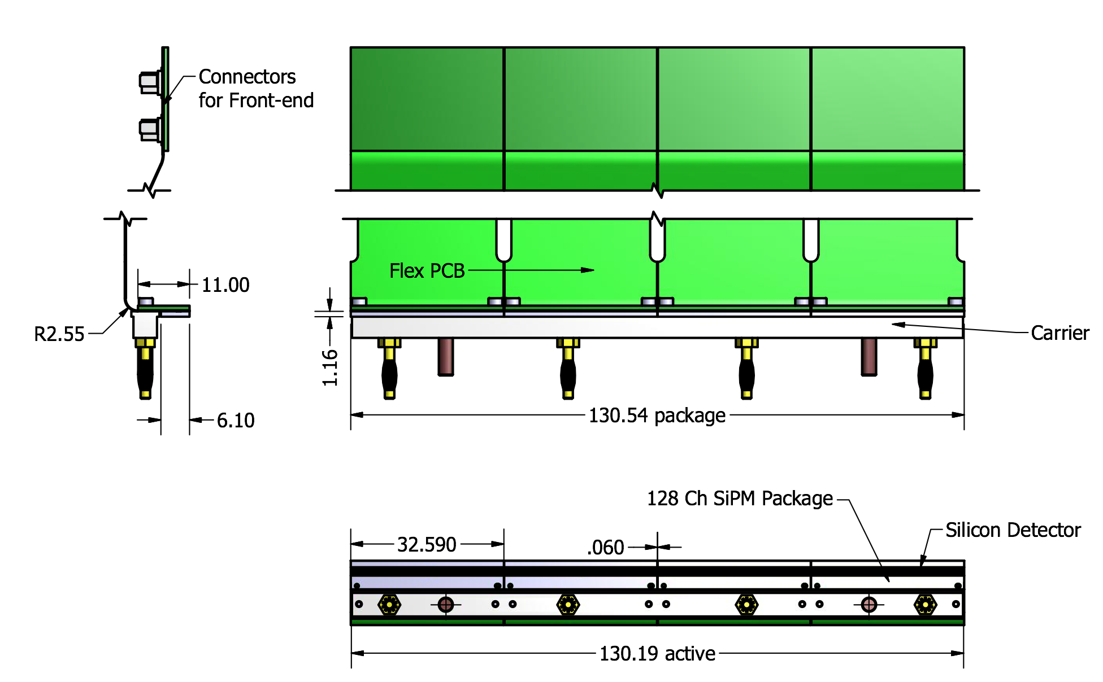
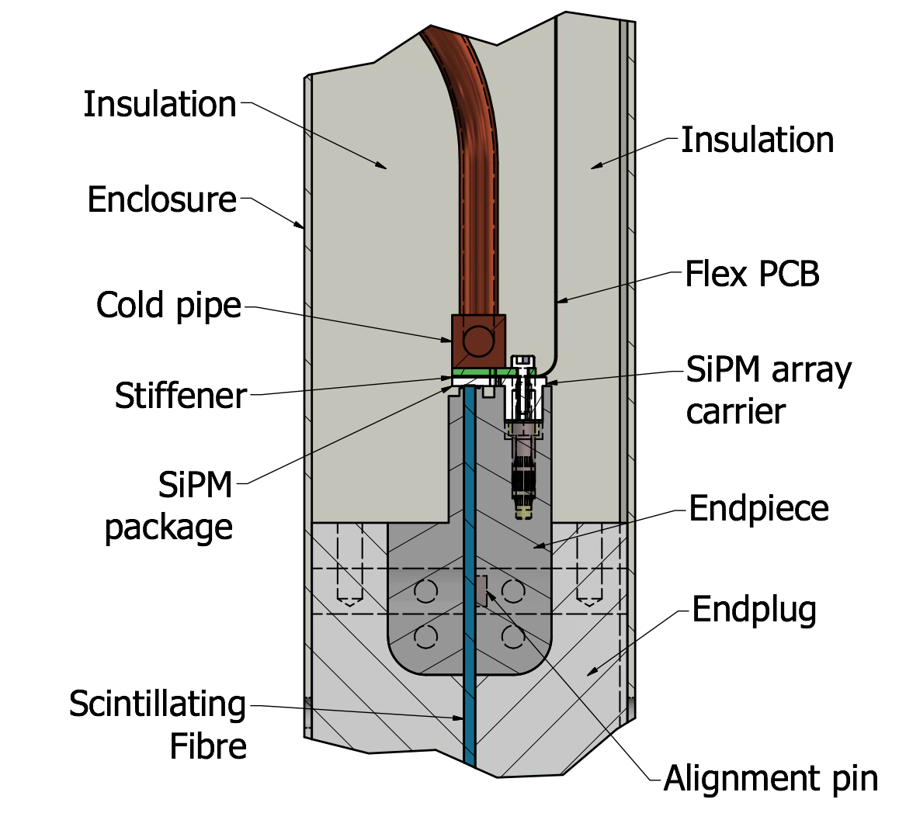
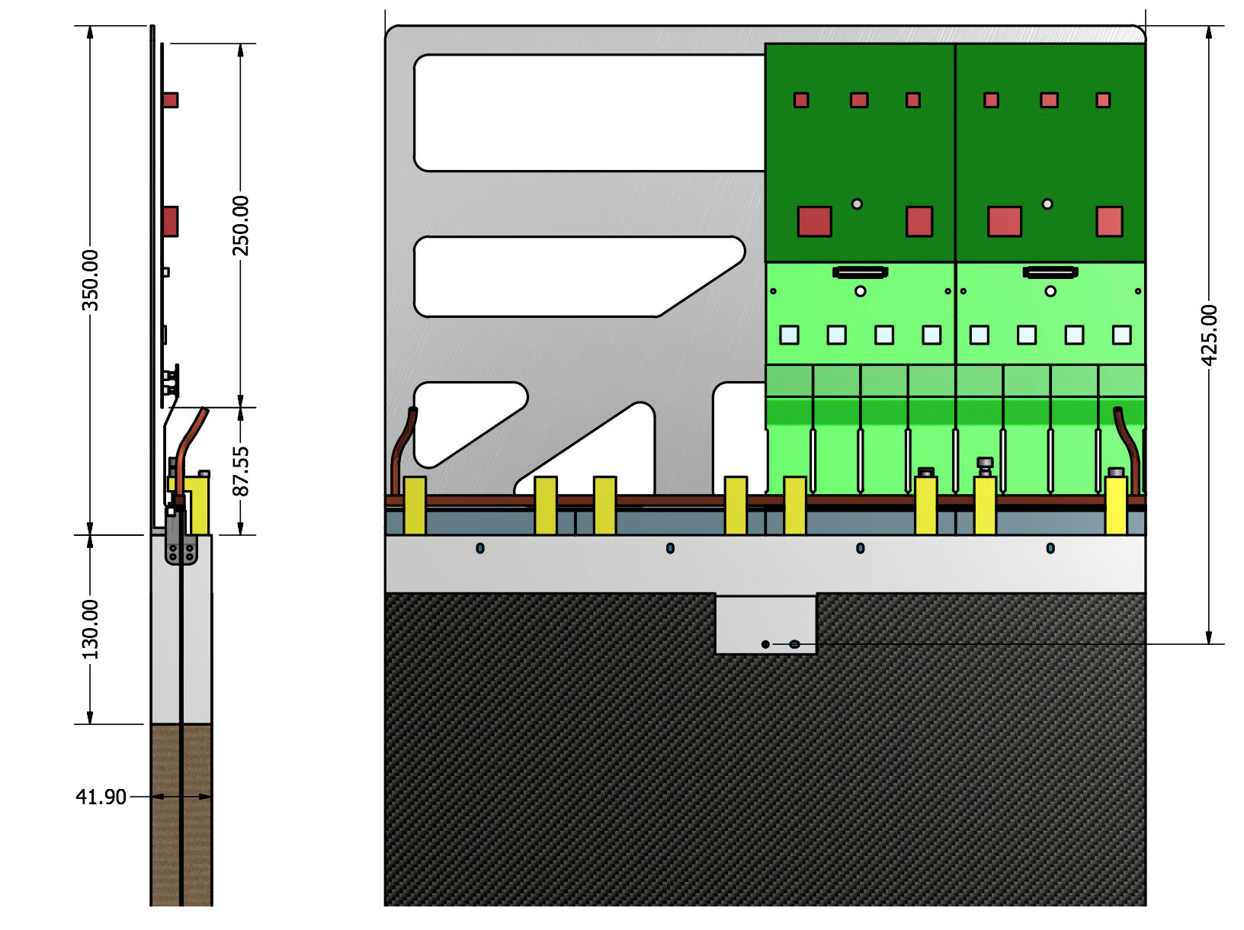
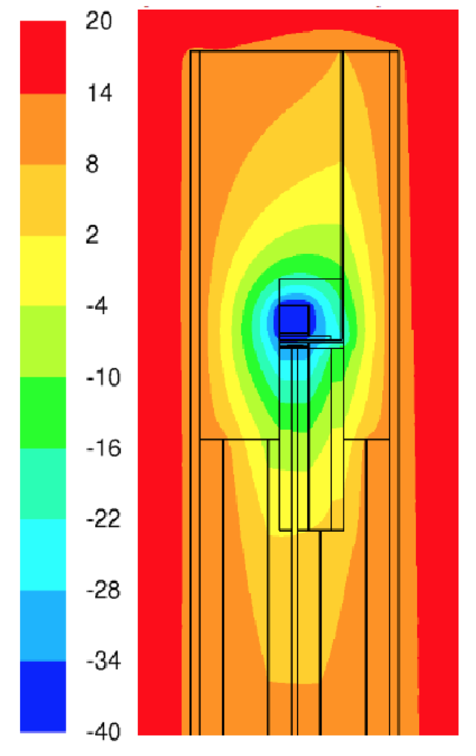
SciFi Module End: SiPM Cooling
Read-out:
SiPM photo-detectors
To prevent radiation damage: operate at -40º C
Thermal cooling simulations

Slide 14
Contacts with dutch industry
Vertex Detector
Scintillating Fiber Tracker
Support Structures:
Amstel Engineering BV, Amsterdam
Van Halteren Metaal BV , Bunschoten
Module frames:
Beltman Mechanisering BV, Hengelo
Alignment jigs and panel supports:
DutchAero BV, Eindhoven
Mechanics parts:
Jeveka BV, Amsterdam,
Rimas Technology Group, Beringe,
Hamel Metaal, Almere,
Metalo BV, Zaandam
Clean-room infrastructure:
ClimaTech BV, Nijkerk
PCB Design and asembly:
QPI Group, Helmond
Neways Electronics International, Eindhoven
Connectors and components:
ELPROMA Electronics BV, Nijendal
Cooling system:
Hoefnagel en Meijn BV, Zaandam
Swagelok Nederalnd BV
Wagenaar Koeltechniek, Zwaagdijk
Vacuum:
LouwersHanique, Hapert
RF-Box Milling:
VDL
RF-Box Welding:
Thalens PPS, Drouwenermond
Not yet specified:
Pick-and place machine
Cooling test system
VeloPix Bump bonding
Chip submission (IBM)
Trigger
GPU programming framework
Esaote Benelux, Maastricht

