Slide 1
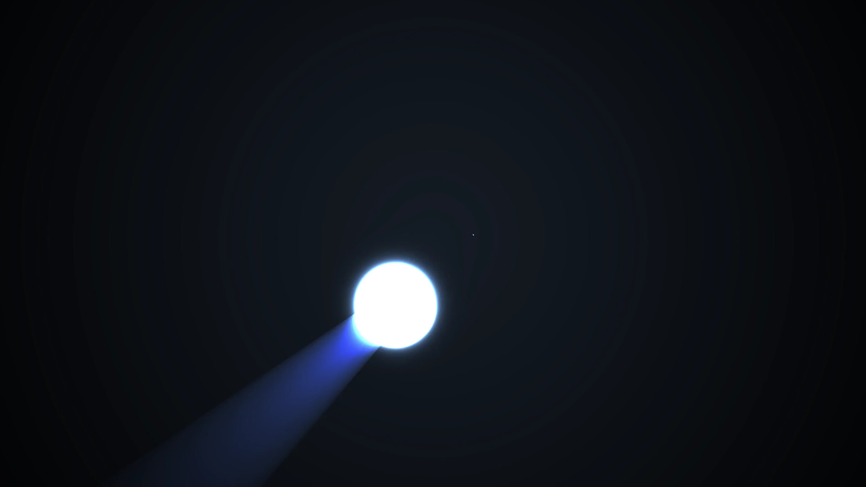
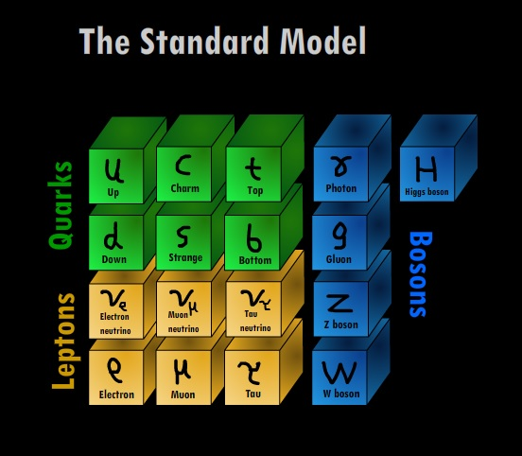
PHY3004: Nuclear and Particle Physics
Marcel Merk, Jacco de Vries

Slide 2
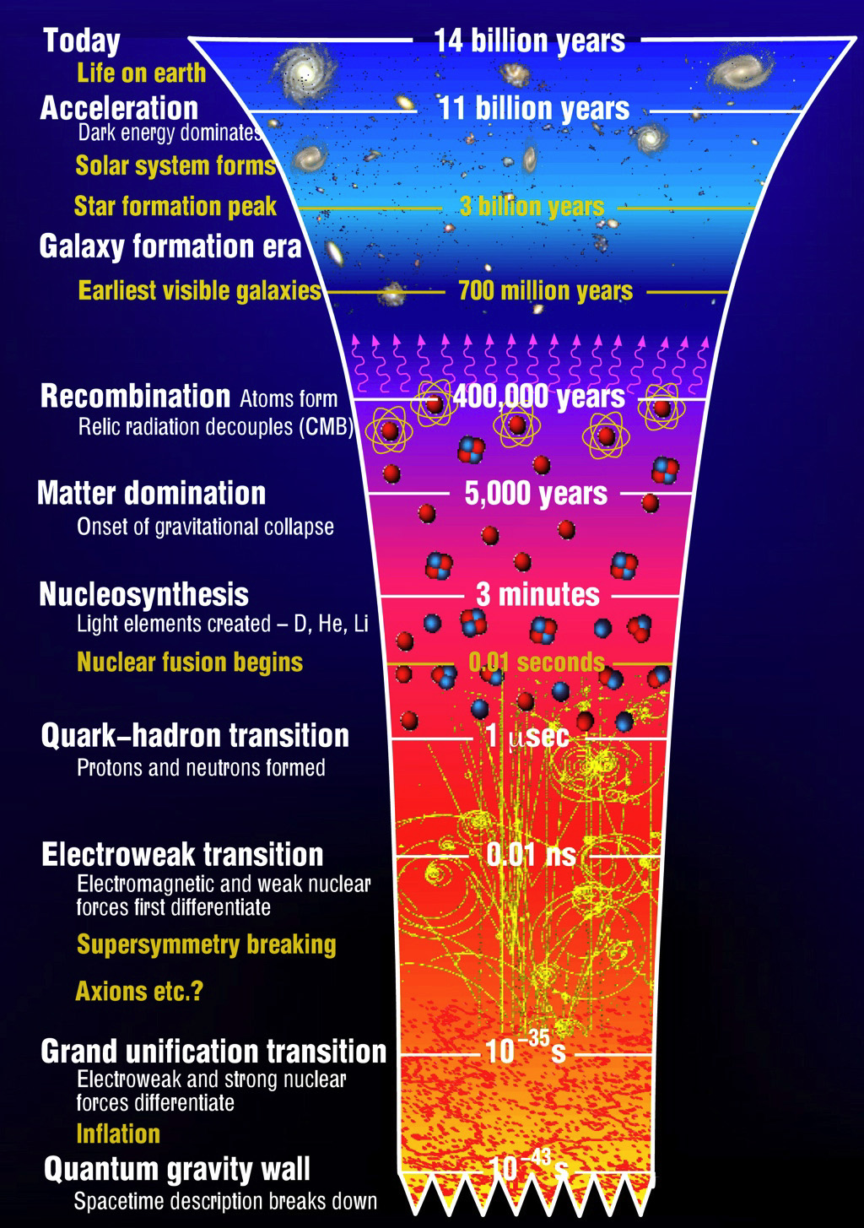
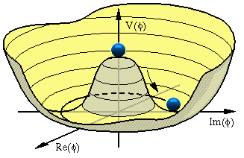
Recap: “Seeing the wood for the trees”
Lecture 1: “Particles”
  Zooming into constituents of matter
  Skills: distinguish particle types, Spin
Lecture 2: “Forces”
  Exchange of quanta: EM, Weak, QCD
  Skills: 4-vectors, Feynman diagrams
Lecture 3: “Waves”
  Quantum fields and gauge invariance
  Dirac algebra, Lagrangian, co- & contra variant
Lecture 4: “Symmetries”
  Standard Model, Higgs, Discrete Symmetries
  Skills: Lagrangians, Chirality & Helicity
Lecture 5: “Scattering”
  Cross section, decay, perturbation theory
  Skills: Dirac-delta function, Feynman Calculus
Lecture 6: “Detectors”
  Energy loss mechanisms, detection technologies
$$g_{Z}$$
$$Z$$
$$g_{Z}$$
$$\frac{1}{q^{2}−M_{Z}^{2}}$$

Slide 3
Lecture 1: “Particles”
Griffiths chapter 1
Classification of particles
Lepton: fundamental particle
Hadron: consist of quarks
  Meson: 1 quark + 1 antiquark (${π^{+}\text{,}B}_{s}^{0}$, …)
  Baryon: 3 quarks ($p$ ,$n$ , $Λ$, …)
    Anti-baryon: 3 anti-quarks
Fermion: particle with half-integer spin.
  Antisymmetric wave function: obeys Pauli-exclusion principle and Pauli-Dirac statistics
  All fundamental quarks and leptons are spin-½
  Baryons (S=$1/2$, $3/2$)
Boson: particle with integer spin
  Symmetric wave function: Bose-Einstein statistics
  Mesons: (S=$0$, $1$), Higgs (S=$0$)
  Force carriers: $γ$, $W$, $Z$, $g$ (S=$1$); graviton(S=$2$)

Slide 4


Lecture 2: “Forces”
Griffiths chapter 2
EM (QED)
Weak
Propagator:
$\frac{1}{{{ M}_{W}^{2}−q}^{2}}$
ElectroWeak
Vertex: $e$
Vertex: $e$
Propagator: $\frac{1}{q^{2}}$
Vertex:$\frac{g}{2\sqrt{2}}$
Vertex:$\frac{g}{2\sqrt{2}}$
Strong (QCD)
$$g_{r\overline{b}}$$
$$g_{g\overline{b}}$$
$$g_{r\overline{g}}$$
$$g_{b\overline{r}}$$
QCD
$$g_{r\overline{b}}$$
$$q$$
$$g_{r\overline{g}}$$
$$g_{g\overline{r}}$$
$$q$$
$$g_{r\overline{b}}$$

Slide 5
Lecture 3: “Waves” – wave equations
Probability interpretation
(Continuity equation)
Quantum Mechanics:
$E→\hat{E}=iℏ\frac{∂}{∂t}$ ; $p→\hat{p}=−iℏ\vec{∇}$
$$\frac{∂ρ}{∂t}+\vec{∇}⋅\vec{j}=0$$
Non-relativistic spin 0:
Schrödinger:
$ρ≡ψ^{∗}ψ={\left|N\right|}^{2}$
$\vec{j}≡\frac{iℏ}{2m }\left(ψ\vec{∇}ψ^{∗}−ψ^{∗}\vec{∇}ψ\right)=\frac{{\left|N\right|}^{2}}{m}\vec{p}$
$$E= \frac{{\vec{p}}^{2}}{2m }$$
  $$iℏ\frac{∂}{∂t}ψ=−\frac{ℏ^{2}}{2m}∇^{2}ψ$$
$$ψ=Ne^{i\left(\vec{p}\vec{x}−Et\right)}$$
Relativistic spin 0:
Klein-Gordon:
  $$−\frac{1}{c^{2}}\frac{∂^{2}}{∂t^{2}}φ=−∇^{2}φ+\frac{m^{2}c^{2}}{ℏ^{2}}φ$$
$$j^{μ}\left(ρ,\vec{j}\right)=i\left[φ^{∗}\left(∂^{μ}φ\right)−φ\left(∂^{μ}φ^{∗}\right)\right]$$
$$E^{2}=p^{2}c^{2}+m^{2}c^{4}$$
$$ρ=2{\left|N\right|}^{2}E$$
$$\vec{j}=2{\left|N\right|}^{2}\vec{p}$$
$$j^{μ}=2{\left|N\right|}^{2}p^{μ}$$
Example: pions
$$∂_{μ}∂^{μ}φ+m^{2}φ=0$$
$$φ=Ne^{i\left(\vec{p}\vec{x}−Et\right)}$$
Relativistic spin- ½:
Dirac:
$$i\frac{∂}{∂t}ψ=\left(−i \vec{α}⋅\vec{∇}+βm\right)ψ$$
$$ψ=u(p)e^{i\left(\vec{p}\vec{x}−Et\right)}$$
$$j^{μ}=\overline{ψ}γ^{μ}ψ$$
$$H=\left(\vec{α}⋅\vec{p}+βm\right)$$
$$u\left(p\right)=\left(\begin{aligned}. \\ . \\ . \\ .\end{aligned}\right)$$
  $$j^{0}=\overline{ψ}γ^{0}ψ=ψ^{†}ψ=\sum_{i=1 }^{4}{{\left|ψ_{i}\right|}^{2}}$$
Fundamental
quarks and leptons
  $$\left(iγ^{μ}∂_{μ}−m\right)ψ=0$$
$$γ^{μ}=\left(β,β\vec{α}\right)$$
Relativistic spin-1:
Proca:
EM: $A^{μ}=γ$ → $m=0$
QCD: $A^{μ}=g$ → $m=0$
Weak: $A^{μ}=W,Z$ → $m≠0$
EM: Maxwell equations
for $\vec{E}$ and $\vec{B}$ fields
Fundamental
force carriers
$$∂_{μ}∂^{μ}A^{ν}+m^{2}A^{ν}=j^{ν}$$

Slide 6
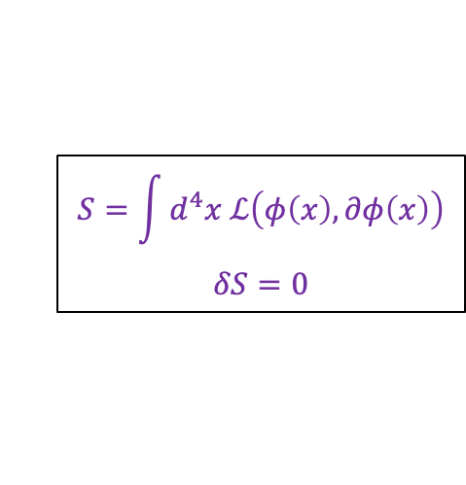
Lecture 3: “Waves” – gauge invariance
$$S=\int{d^{4}x ℒ\left(φ\left(x\right),∂φ\left(x\right)\right)}$$
$$δS=0$$
Lagrangians:
Spin 0 Scalar field: $ℒ=\frac{1}{2}\left(∂_{μ}φ\right)\left(∂^{μ}φ\right)−{\frac{1}{2}m}^{2}φ^{2}$
Spin ½ Dirac fermion $ℒ=i\overline{ψ}γ_{μ}∂^{μ}ψ−m\overline{ψ}ψ$
Spin 1 gauge boson (photon) :$ℒ=−\frac{1}{4}\left(∂^{μ}A^{ν}−∂^{ν}A^{μ}\right)\left(∂_{μ}A_{ν}−∂_{ν}A_{μ}\right)−j^{μ}A_{μ}$
$$\frac{∂ℒ}{∂φ\left(x\right)}=∂_{μ}\frac{∂ℒ}{∂\left(∂_{μ}φ\left(x\right)\right)}$$
Euler Lagrange lead to the wave equations: (stationary action in field theory)
All forces result from requiring a symmetry principle: Lagrangian should stay invariant under transformations
1) QED = U(1) symmetry
$$ℒ=i\overline{ψ}γ_{μ}∂^{μ}ψ−m\overline{ψ}ψ$$
$$ℒ=i\overline{ψ}γ_{μ} D^{μ}ψ−m\overline{ψ}ψ$$
$ψ\left(x\right)→{ ψ}^{′}\left(x\right) =e^{iqα\left(x\right)}ψ\left(x\right)$
$$A^{μ}\left(x\right)→A^{′μ}\left(x\right)=A^{μ}\left(x\right)−∂^{μ}α\left(x\right)$$
Covariant derivative:
$$∂^{μ}→D^{μ}≡∂^{μ}+iqA^{μ}$$
$$ℒ=i\overline{ψ}γ_{μ}{ ∂}^{μ}ψ−m\overline{ψ}ψ −q{\overline{ψ}γ_{μ}ψA}^{μ}$$
➔ 1 E.M. photon field: $A^{μ}\left(x\right)$
“interaction”
“free”
3) QCD = SU(3) symmetry $ψ=\left(\begin{matrix}ψ_{r} \\ ψ_{g} \\ ψ_{b}\end{matrix}\right)$
2) Weak = SU(2) symmetry $ψ=\left(\begin{matrix}ψ_{u} \\ ψ_{d} \end{matrix}\right)$
$ψ\left(x\right)→ψ^{′}\left(x\right)=exp\left(\frac{i}{2}g_{s}\vec{λ}⋅\vec{α}\left(x\right)\right)$ $\left(\begin{matrix}ψ_{r} \\ ψ_{g} \\ ψ_{b}\end{matrix}\right)$
$ψ\left(x\right)→ψ^{′}\left(x\right)=exp\left(\frac{i}{2}g\vec{τ}⋅\vec{α}\left(x\right)\right)$ $\left(\begin{matrix}ψ_{u} \\ ψ_{d} \end{matrix}\right)$
➔ 3 weak fields: $W^{μ+}\left(x\right),{ W^{μ}}^{−}\left(x\right), Z^{μ}\left(x\right)$
➔ 8 colored gluon fields: $g^{μ}\left(x\right)$

Slide 7





Lecture 4: “Symmetries” – Standard Model
The Lagrangian of the Standard Model includes electromagnetic, weak and strong interactions according to the gauge field principle
Construction of the Lagrangian: $ℒ=ℒ_{free}−ℒ_{interaction}=ℒ_{Dirac}−{gJ}^{μ}A_{μ}$
  With $g$ a coupling constant, $J^{μ}$ a current ($\overline{ψ}Ο_{i}ψ$) and $A_{μ}$ a force field
  Local $U\left(1\right)$ gauge invariance: symmetry under complex phase rotations
    Conserved quantum number: (hyper-) charge
    Lagrangian: $ℒ=\overline{ψ}\left(iγ^{μ}D_{μ}−m\right)ψ=\overline{ψ}\left(iγ^{μ}∂_{μ}−m\right)ψ−q\underset{J_{EM}^{μ}}{\underbrace{\overline{ψ}γ^{μ}ψ}}A_{μ}$
  Local $SU\left(2\right)$ gauge invariance: symmetry under transformations in isospin doublet space.
    Conserved quantum number: weak isospin
    Lagrangian: $ℒ=\overline{Ψ}\left(iγ^{μ}D_{μ}−m\right)Ψ=\overline{Ψ}\left(iγ^{μ}∂_{μ}−m\right)Ψ−\frac{g}{2}\underset{J_{Weak}^{μ}}{\underbrace{\overline{Ψ}γ^{μ}\vec{τ}Ψ}{\vec{b}}_{μ}}$
  Local $SU\left(3\right)$ gauge invariance: symmetry under transformations in colour triplet space
    Conserved quantum number: color
    Lagrangian: $ℒ=\overline{Φ}\left(iγ^{μ}D_{μ}−m\right)Φ=\overline{Φ}\left(iγ^{μ}∂_{μ}−m\right)Φ−\frac{g_{s}}{2}\underset{{\vec{J}}_{QCD}^{μ}}{\underbrace{\overline{Φ}γ^{μ}\vec{λ}Φ}}{\vec{c}}_{μ}$
$$\left(∂_{μ}→D_{μ}≡∂_{μ}+iqA_{μ}\right)$$
$\left(I∂_{μ}→D_{μ}=I∂_{μ}+igB_{μ}\right)$
$$B_{μ}=\frac{1}{2}\vec{τ}⋅{\vec{b}}_{μ}=\frac{1}{2}τ_{1}^{a}b_{μ}^{a}=\frac{1}{2}\left(\begin{matrix}b_{3} & b_{1}−ib_{2} \\ b_{1}+ib_{2} & −b_{3}\end{matrix}\right)$$
$$\left(I∂_{μ}→D_{μ}=I∂_{μ}+ig_{s}C_{μ}\right)$$
$C_{μ}$are 3x3 matrices →gluon fields
Notes:
Forget gravity

Slide 8
Lecture 4: “Symmetries” – Standard Model
$$ℒ=\overline{ψ}\left(iγ^{μ}D_{μ}−m\right)ψ=\overline{ψ}\left(iγ^{μ}∂_{μ}−m\right)ψ−qJ_{EM}^{μ}A_{μ} −\frac{g}{2}J_{Weak}^{μ}{\vec{b}}_{μ}−\frac{g_{s}}{2}J_{QCD }^{μ}{\vec{c}}_{μ}$$
QED U(1) $ℒ_{int }=−J_{μ}A^{μ}$ with $J_{μ}=q\overline{ψ}γ_{μ}ψ$
$$A^{μ}$$
Electromagnetic
interaction
Weak SU(2) : $ℒ_{int }=−{\vec{J}}_{μ}{\vec{b}}^{μ}$ with ${\vec{J}}_{μ}=\frac{g}{2} \overline{Ψ} γ_{μ}\vec{τ} Ψ$
$$W_{μ}^{±}≡\frac{1}{\sqrt{2}}\left(b_{μ}^{1}∓ib_{μ}^{2}\right)$$
$J_{μ}^{±}=\frac{1}{\sqrt{2}}\overline{Ψ}γ_{μ}τ^{±}Ψ$ with $τ^{±}=\frac{1}{2}\left(τ_{1}±iτ_{2}\right)$
Weak
interaction
$$Z_{μ}\sim b_{μ}^{3}$$
$J_{μ}^{3}=\frac{1}{2}\overline{Ψ}γ_{μ}τ^{3}Ψ$ with $τ^{±}=\frac{1}{2}\left(τ_{1}±iτ_{2}\right)$
Electroweak mixing SU(2)xU(1):
${ γ}_{μ} = A_{μ}\cos{θ_{W} +{ b}_{μ}^{3}\sin{θ_{W}}}$
$Z_{μ}=−A_{μ}\sin{θ_{W} +{ b}_{μ}^{3}\cos{θ_{W}}}$
$$q$$
Strong
interaction
$$g_{g\overline{b}}$$
Standard Model:
$$SU{\left(3\right)}_{color}×SU{\left(2\right)}_{L}×U{\left(1\right)}_{Y}$$
$$q$$

Slide 9
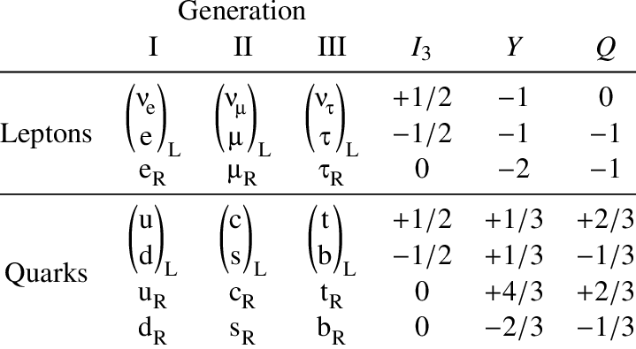
Lecture 4: Electroweak Quantum Numbers
For weak isospin some people write $T_{3}$ while others write $I_{3}$
With : $Q=T_{3}+\frac{1}{2}Y$
Or : $Q= I_{3}+\frac{1}{2}Y$

Slide 10
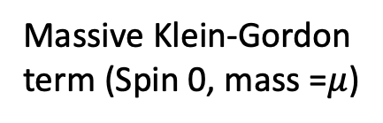
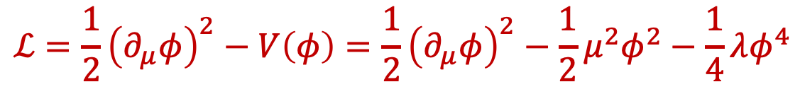
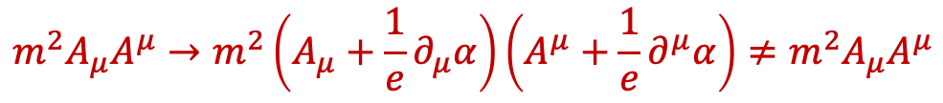
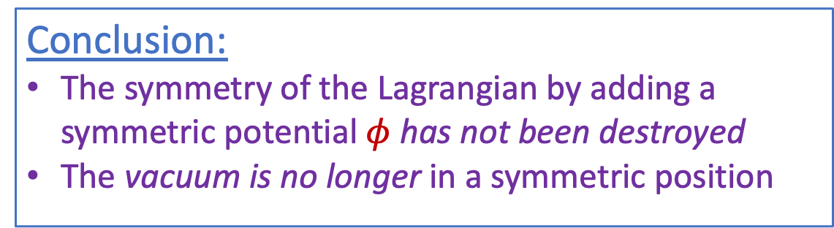
Symmetry breaking with a real field $φ$
Griffiths §10.9
Explicit mass terms violate the symmetry:
Add a new field to the Lagrangian:
$$m^{2}A_{μ}A^{μ}→m^{2}\left(A_{μ}+\frac{1}{e}∂_{μ}α\right)\left(A^{μ}+\frac{1}{e}∂^{μ}α\right)≠m^{2}A_{μ}A^{μ}$$
$$ℒ=\frac{1}{2}{\left(∂_{μ}φ\right)}^{2}−V\left(φ\right)=\frac{1}{2}{\left(∂_{μ}φ\right)}^{2}−\frac{1}{2}μ^{2}φ^{2}−\frac{1}{4}λφ^{4}$$
Massive Klein-Gordon
term (Spin 0, mass =$μ$)
Interaction term
$$v$$
The Lagrangian has a minimum for $φ_{0}= \sqrt{−\frac{μ^{2}}{λ}}=v$or $μ^{2}=−λv^{2}$
Conclusion:
The symmetry of the Lagrangian by adding a symmetric potential $φ$ has not been destroyed
The vacuum is no longer in a symmetric position

Slide 11

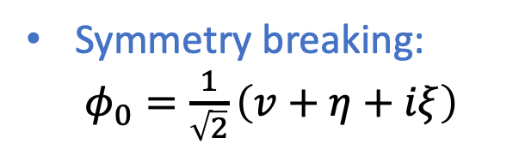
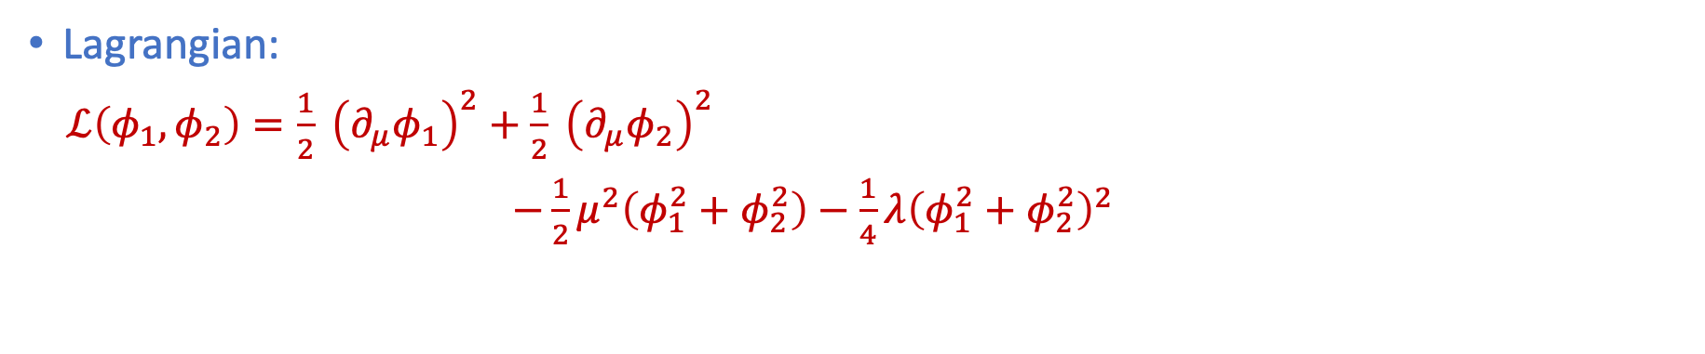
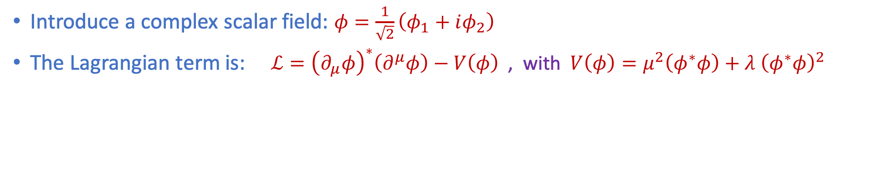
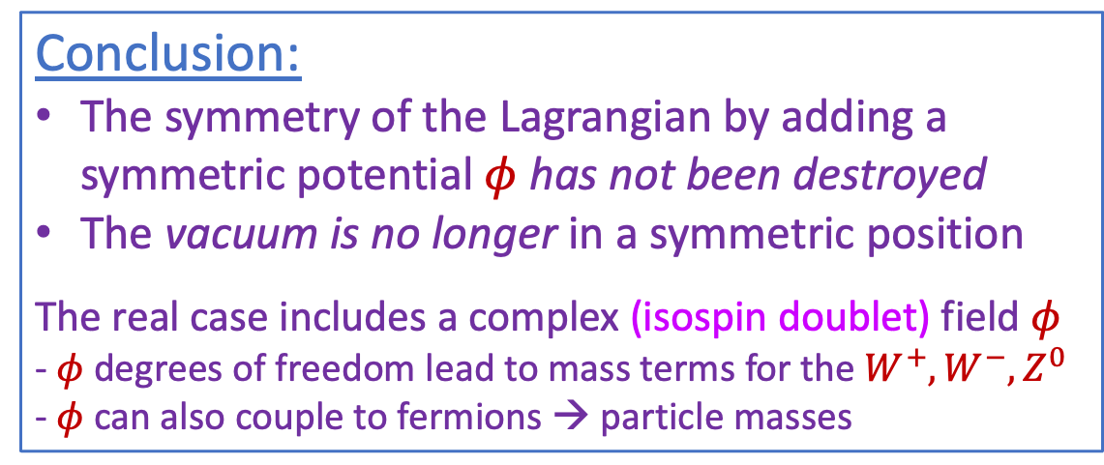
Symmetry breaking with a complex field $φ$
Griffiths §10.9
Introduce a complex scalar field: $φ=\frac{1}{\sqrt{2}}\left(φ_{1}+iφ_{2}\right)$
The Lagrangian term is: $ℒ={\left(∂_{μ}φ\right)}^{∗}\left(∂^{μ}φ\right)−V\left(φ\right)$ , with $V\left(φ\right)=μ^{2}\left(φ^{∗}φ\right)+λ {\left(φ^{∗}φ\right)}^{2}$
Lagrangian:
$ℒ\left(φ_{1},φ_{2}\right)=\frac{1}{2} {\left(∂_{μ}φ_{1}\right)}^{2}+\frac{1}{2} {\left(∂_{μ}φ_{2}\right)}^{2}$
$−\frac{1}{2}μ^{2}\left(φ_{1}^{2}+φ_{2}^{2}\right)−\frac{1}{4}λ{\left(φ_{1}^{2}+φ_{2}^{2}\right)}^{2}$
$$μ^{2}<0$$
Conclusion:
The symmetry of the Lagrangian by adding a symmetric potential $φ$ has not been destroyed
The vacuum is no longer in a symmetric position
The real case includes a complex (isospin doublet) field $φ$
- $φ$ degrees of freedom lead to mass terms for the $W^{+}, W^{−}, Z^{0}$
- $φ$ can also couple to fermions → particle masses
Symmetry breaking:
$φ_{0}=\frac{1}{\sqrt{2}}\left(v+η+iξ\right)$

Slide 12
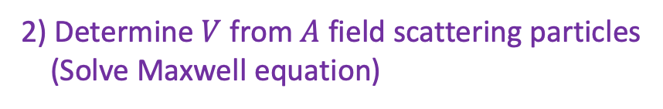
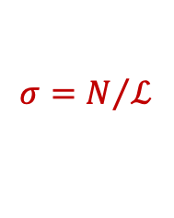
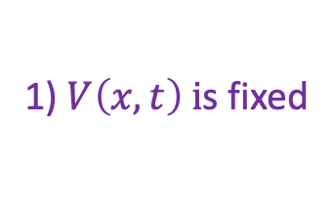

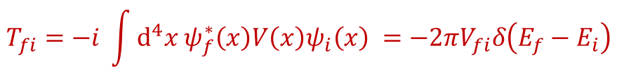
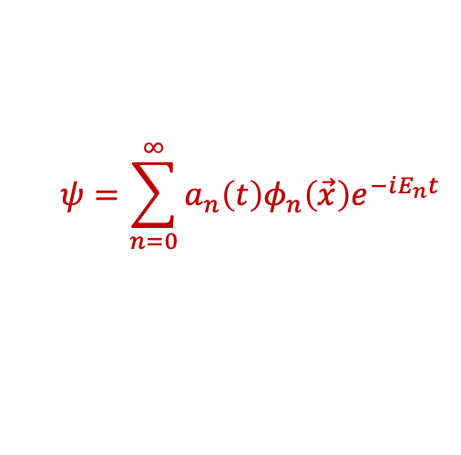
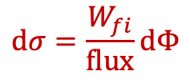
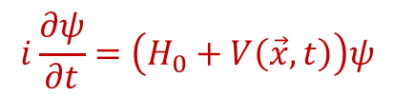
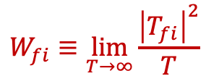
Lecture 5 : “Scattering” – non-Rel.
1) Scattering in external potential
Perturbation theory
1) $V\left(x,t\right) i$s fixed
Solve wave equation
Iteratively…
$$i\frac{∂ψ}{∂t}=\left(H_{0}+V\left(\vec{x},t\right)\right)ψ$$
$$ψ=\sum_{n=0}^{∞}{a_{n}\left(t\right)φ_{n}\left(\vec{x}\right)e^{−iE_{n}t}}$$
…use plane waves
2) Scattering in each particle’s field
$$dσ=\frac{W_{fi}}{flux}dΦ$$
$$W_{fi}≡\lim_{T→∞}{\frac{{\left|T_{fi}\right|}^{2}}{T}}$$
$$σ=N/ℒ$$
$$T_{fi}=−i \int{d^{4}x ψ_{f}^{∗}\left(x\right)V\left(x\right)ψ_{i}\left(x\right) }=−2πV_{fi}δ\left(E_{f}−E_{i}\right)$$
Energy conservation
2) Determine $V$ from $A$ field scattering particles
(Solve Maxwell equation)
Relativistic: $V_{fi}➔ ℳ$ “matrix element”

Slide 13
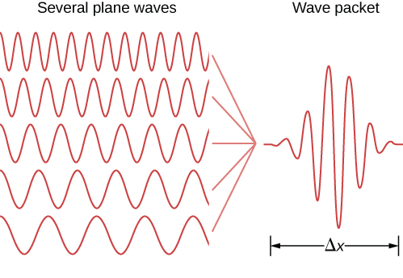
Lecture 5 : “Scattering” – non-Relativistic
Perturbation theory
1) $V\left(x,t\right) i$s fixed
$$i\frac{∂ψ}{∂t}=\left(H_{0}+V\left(\vec{x},t\right)\right)ψ$$
“particle”
Solve wave equation
Iteratively…
$$ψ=\sum_{n=0}^{∞}{a_{n}\left(t\right)φ_{n}\left(\vec{x}\right)e^{−iE_{n}t}}$$
…use plane waves
Δp
2) Scattering in each particle’s field
$$dσ=\frac{W_{fi}}{flux}dΦ$$
$$W_{fi}≡\lim_{T→∞}{\frac{{\left|T_{fi}\right|}^{2}}{T}}$$
$$σ=N/ℒ$$
$$T_{fi}=−i \int{d^{4}x ψ_{f}^{∗}\left(x\right)V\left(x\right)ψ_{i}\left(x\right) }=−2πV_{fi}δ\left(E_{f}−E_{i}\right)$$
Energy conservation
2) Determine $V$ from $A$ field scattering particles
(Solve Maxwell equation)
Relativistic: $V_{fi}➔ ℳ$ “matrix element”

Slide 14






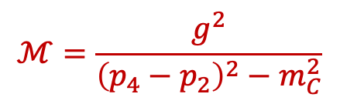


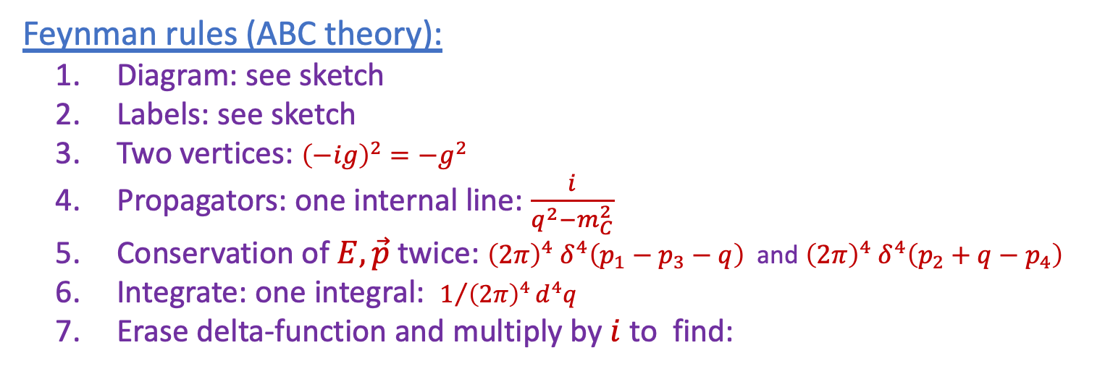

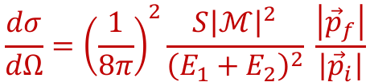




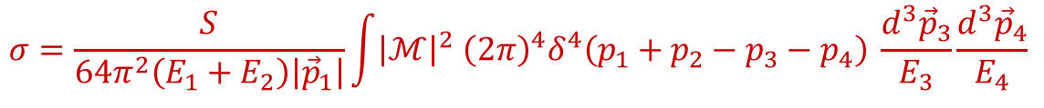




Lecture 5 : “Scattering” - Relativistic
Cross section:
$$σ=\frac{S}{4\sqrt{{\left(p_{1}⋅p_{2}\right)}^{2}−{\left(m_{1}m_{2}\right)}^{2}}} \int{{\left|ℳ\right|}^{2} {\left(2π\right)}^{4}δ^{4}\left(p_{1}+p_{2}−p_{3}…−p_{n}\right) × \prod_{j=3}^{n}{\frac{1}{2E_{j}} \frac{d^{3}{\vec{p}}_{j}}{{\left(2π\right)}^{3}}}}$$
$$p_{3}$$
C
$θ$
$$p_{1}$$
$$p_{4}$$
Eg: “2-to-2” scattering:
A
$$p_{2}$$
B
D
Before
After
$$σ=\frac{S}{64π^{2}\left(E_{1}+E_{2}\right)\left|{\vec{p}}_{1}\right|}\int{{\left|ℳ\right|}^{2} {\left(2π\right)}^{4}δ^{4}\left(p_{1}+p_{2}−p_{3}−p_{4}\right) \frac{d^{3}{\vec{p}}_{3}}{E_{3}}\frac{d^{3}{\vec{p}}_{4}}{E_{4}} }$$
$$\frac{dσ}{dΩ}={\left(\frac{1}{8π}\right)}^{2}\frac{S{\left|ℳ\right|}^{2}}{{\left(E_{1}+E_{2}\right)}^{2}} \frac{\left|{\vec{p}}_{f}\right|}{\left|{\vec{p}}_{i}\right|}$$
How to determine $ℳ$? → Feynman rules (depend on actual theory/interaction):
Feynman rules (ABC theory):
  Diagram: see sketch
  Labels: see sketch
  Two vertices: ${\left(−ig\right)}^{2}=−g^{2}$
  Propagators: one internal line: $\frac{i}{q^{2}−m_{C}^{2}}$
  Conservation of $E, \vec{p}$ twice: ${{\left(2π\right)}^{4} δ}^{4}\left(p_{1}−p_{3}−q\right)$ and ${{\left(2π\right)}^{4} δ}^{4}\left(p_{2}+q−p_{4}\right)$
  Integrate: one integral: $1/{{\left(2π\right)}^{4}}d^{4}q$
  Erase delta-function and multiply by $i$ to find:
$$p_{1}$$
$$p_{3}$$
Example diagram:
$$A+A→B+B$$
$$A$$
$$−ig$$
$$B$$
From ABC → Standard Model theory:
More complicated rules and spin objects
→ Master level education
$$q$$
$$C$$
$$A$$
$$−ig$$
$$B$$
$$p_{2}$$
$$p_{4}$$
$$t$$
$$ℳ=\frac{g^{2}}{{\left(p_{4}−p_{2}\right)}^{2}−m_{C}^{2}}$$

Slide 15

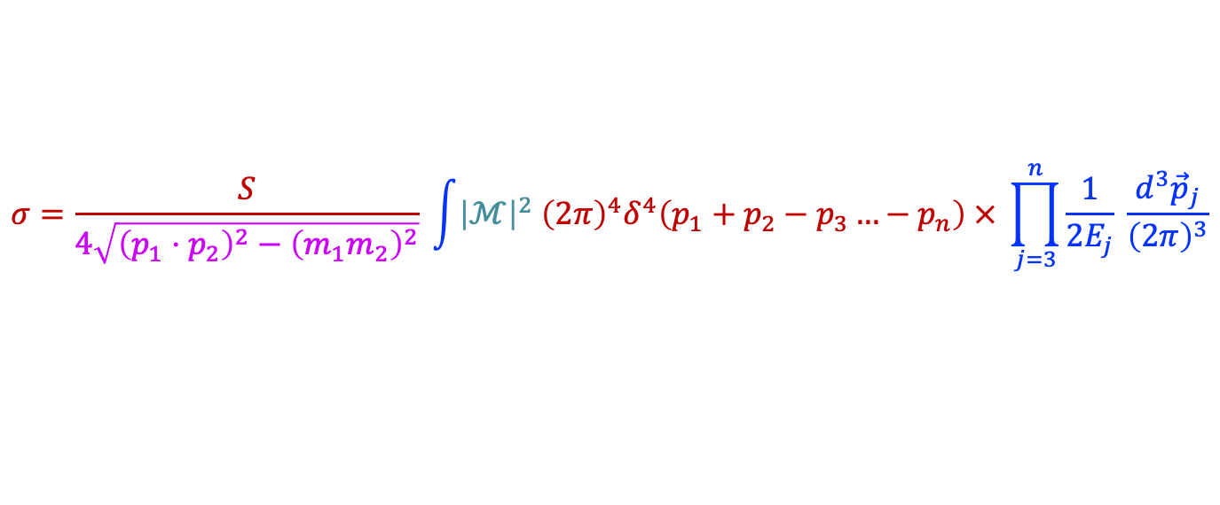

Lecture 5 : “Scattering” - Relativistic
$$dσ=\frac{W_{fi}}{flux}dΦ ⇒ σ= \frac{1}{flux } \int{W_{fi} dΦ}$$
Cross section:
Flux
Matrix element
Energy momentum conservation
Phase space
$$σ=\frac{S}{4\sqrt{{\left(p_{1}⋅p_{2}\right)}^{2}−{\left(m_{1}m_{2}\right)}^{2}}} \int{{\left|ℳ\right|}^{2} {\left(2π\right)}^{4}δ^{4}\left(p_{1}+p_{2}−p_{3}…−p_{n}\right) × \prod_{j=3}^{n}{\frac{1}{2E_{j}} \frac{d^{3}{\vec{p}}_{j}}{{\left(2π\right)}^{3}}}}$$
$$p_{3}$$
C
$θ$
$$p_{1}$$
$$p_{4}$$
Eg: “2-to-2” scattering:
A
$$p_{2}$$
B
D
Before
After
$$σ=\frac{S}{64π^{2}\left(E_{1}+E_{2}\right)\left|{\vec{p}}_{1}\right|}\int{{\left|ℳ\right|}^{2} {\left(2π\right)}^{4}δ^{4}\left(p_{1}+p_{2}−p_{3}−p_{4}\right) \frac{d^{3}{\vec{p}}_{3}}{E_{3}}\frac{d^{3}{\vec{p}}_{4}}{E_{4}} }$$
$$\frac{dσ}{dΩ}={\left(\frac{1}{8π}\right)}^{2}\frac{S{\left|ℳ\right|}^{2}}{{\left(E_{1}+E_{2}\right)}^{2}} \frac{\left|{\vec{p}}_{f}\right|}{\left|{\vec{p}}_{i}\right|}$$
How to determine $ℳ$? → Feynman rules (depend on actual theory/interaction):
Feynman rules (ABC theory):
  Diagram: see sketch
  Labels: see sketch
  Two vertices: ${\left(−ig\right)}^{2}=−g^{2}$
  Propagators: one internal line: $\frac{i}{q^{2}−m_{C}^{2}}$
  Conservation of $E, \vec{p}$ twice: ${{\left(2π\right)}^{4} δ}^{4}\left(p_{1}−p_{3}−q\right)$ and ${{\left(2π\right)}^{4} δ}^{4}\left(p_{2}+q−p_{4}\right)$
  Integrate: one integral: $1/{{\left(2π\right)}^{4}}d^{4}q$
  Erase delta-function and multiply by $i$ to find:
$$p_{1}$$
$$p_{3}$$
Example diagram:
$$A+A→B+B$$
$$A$$
$$−ig$$
$$B$$
From ABC → Standard Model theory:
More complicated rules and spin objects
→ Master level education
$$q$$
$$C$$
$$A$$
$$−ig$$
$$B$$
$$p_{2}$$
$$p_{4}$$
$$t$$
$$ℳ=\frac{g^{2}}{{\left(p_{4}−p_{2}\right)}^{2}−m_{C}^{2}}$$
+ diagram $p_{3}↔p_{4}$

Slide 16
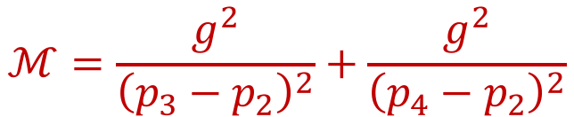
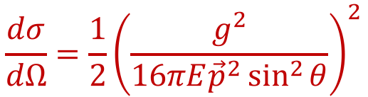


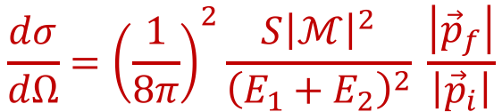
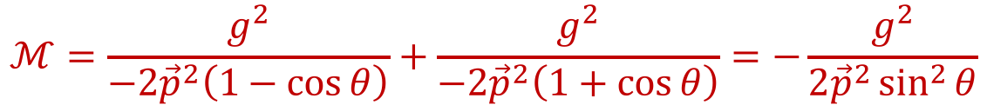


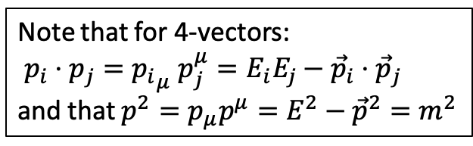
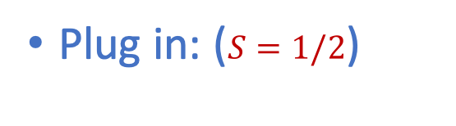

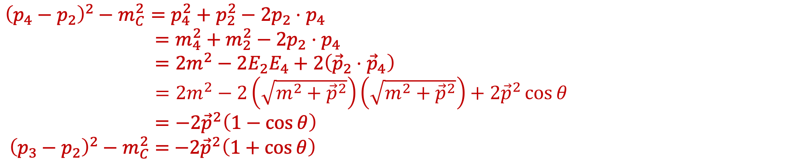
$A+A→B+B$ Scattering: $dσ/dΩ$
$$p_{3}$$
$$B$$
$θ$
$$p_{1}$$
$$p_{4}$$
$$A$$
$$p_{2}$$
$$A$$
$$B$$
Before
After
Look at the matrix element and assume that $m_{A}=m_{B}=m$ and $m_{C}=0$ (eg. a photon):
$$ℳ=\frac{g^{2}}{{\left(p_{3}−p_{2}\right)}^{2}}+\frac{g^{2}}{{\left(p_{4}−p_{2}\right)}^{2}}$$
${\left(p_{4}−p_{2}\right)}^{2}−m_{C}^{2}=p_{4}^{2}+p_{2}^{2}−2p_{2}⋅p_{4}$
$=m_{4}^{2}+m_{2}^{2}−2p_{2}⋅p_{4}$
$=2m^{2}−2E_{2}E_{4}+2\left({\vec{p}}_{2}⋅{\vec{p}}_{4}\right)$
$=2m^{2}−2\left(\sqrt{m^{2}+{\vec{p}}^{2}}\right)\left(\sqrt{m^{2}+{\vec{p}}^{2}}\right)+2{\vec{p}}^{2}\cos{θ}$
$=−2{\vec{p}}^{2}\left(1−\cos{θ}\right)$
${\left(p_{3}−p_{2}\right)}^{2}−m_{C}^{2}=$ $−2{\vec{p}}^{2}\left(1+\cos{θ}\right)$
Note that for 4-vectors:
$p_{i}⋅p_{j}={p_{i}}_{μ} p_{j}^{μ}=E_{i}E_{j}−{\vec{p}}_{i}⋅{\vec{p}}_{j}$
and that $p^{2}=p_{μ}p^{μ}=E^{2}−{\vec{p}}^{2}=m^{2}$
(Invariant mass)
Plug in: ($S=1/2$)
$$\frac{dσ}{dΩ}={\left(\frac{1}{8π}\right)}^{2}\frac{S{\left|ℳ\right|}^{2}}{{\left(E_{1}+E_{2}\right)}^{2}} \frac{\left|{\vec{p}}_{f}\right|}{\left|{\vec{p}}_{i}\right|}$$
$$ℳ=\frac{g^{2}}{−2{\vec{p}}^{2}\left(1−\cos{θ}\right)}+\frac{g^{2}}{−2{\vec{p}}^{2}\left(1+\cos{θ}\right)}=−\frac{g^{2}}{{2\vec{p}}^{2}\sin^{2}{θ}}$$
$$\frac{dσ}{dΩ}=\frac{1}{2}{\left(\frac{g^{2}}{16πE{\vec{p}}^{2}\sin^{2}{θ}}\right)}^{2}$$

Slide 17

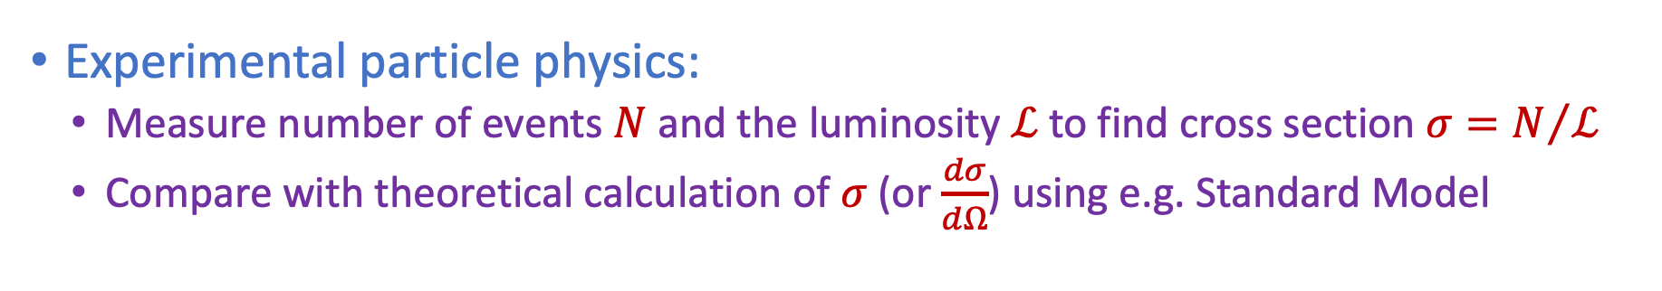
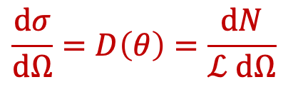
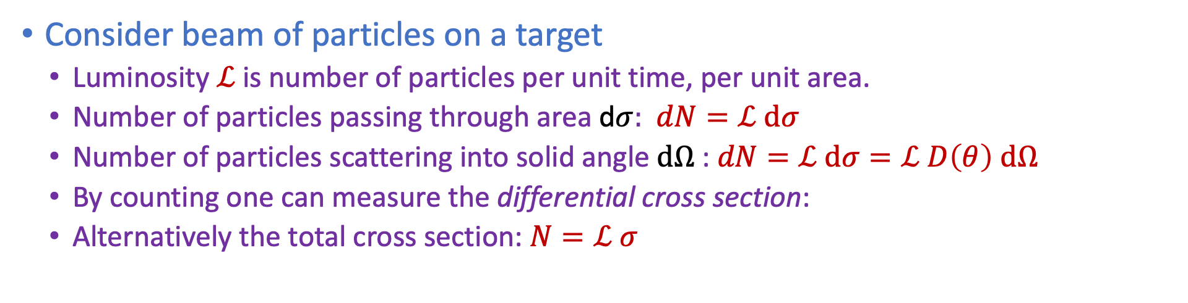
Lecture 5 : Towards Experimental
Griffiths §6.1
Consider beam of particles on a target
  Luminosity $ℒ$ is number of particles per unit time, per unit area.
  Number of particles passing through area d$σ:$ $dN=ℒ dσ$
  Number of particles scattering into solid angle $dΩ$: $dN=ℒ dσ=ℒ D\left(θ\right) dΩ$
  By counting one can measure the differential cross section:
  Alternatively the total cross section: $N=ℒ σ$
$$\frac{dσ}{dΩ}=D\left(θ\right)=\frac{dN}{ℒ dΩ}$$
$$ℒ$$
These aspects are
needed when you
Compare theory
with experiments.
Experimental particle physics:
  Measure number of events $N$and the luminosity $ℒ$to find cross section $σ=N/ℒ$
  Compare with theoretical calculation of $σ$ (or $\frac{dσ}{dΩ}$) using e.g. Standard Model
Notes:
d\sigma = D(theta)d|Omega
These aspects are needed when you make comparison

Slide 18
Lecture 6 : “Detectors” - Technologies
Drift straws/chambers
Scintillating Fibers
Silicon semiconductors
Magnets
Cherenkov Detectors
Calorimeters

Slide 19
Lecture 6 : “Detectors” - Combination
Charged particle tracking:
  Position & Momentum measurement
Particle Identification:
  Energy, Time-of-Flight, Cherenkov

Slide 20
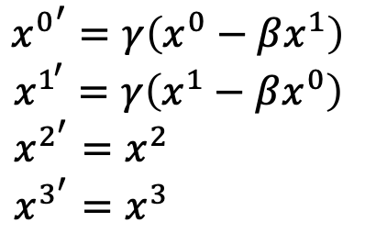
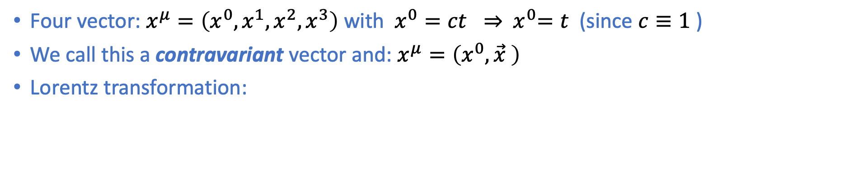
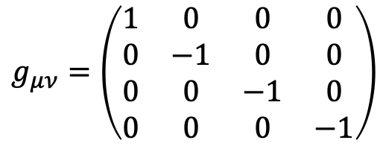
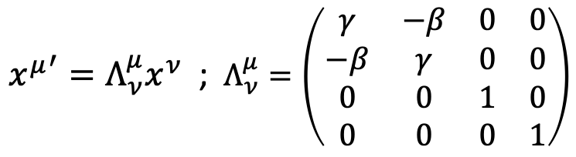
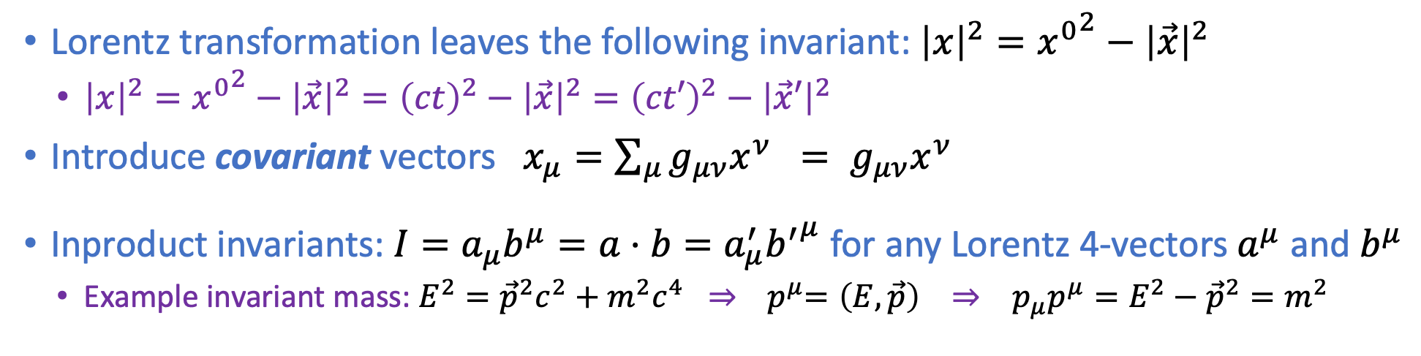
Skill: Four vectors & co- and contra-variance
Griffiths: chapter 3
Four vector: $x^{μ}=\left(x^{0},x^{1},x^{2},x^{3}\right)$ with $x^{0}=ct ⇒{ x}^{0}=t$ (since $c≡1$ )
We call this a contravariant vector and: $x^{μ}=\left(x^{0},\vec{x} \right)$
Lorentz transformation:
$${x^{0}}^{′}=γ\left(x^{0}−βx^{1}\right)$$
$x^{1^{′}}=γ\left(x^{1}−βx^{0}\right)$
$x^{2^{′}}=x^{2}$
$x^{3^{′}}=x^{3}$
$$g_{μν}=\left(\begin{matrix}1 & 0 & 0 & 0 \\ 0 & −1 & 0 & 0 \\ 0 & 0 & −1 & 0 \\ 0 & 0 & 0 & −1\end{matrix}\right)$$
${x^{μ}}^{′}=Λ_{ν}^{μ}x^{ν}$ ; $Λ_{ν}^{μ}=\left(\begin{matrix}γ & −β & 0 & 0 \\ −β & γ & 0 & 0 \\ 0 & 0 & 1 & 0 \\ 0 & 0 & 0 & 1\end{matrix}\right)$
Lorentz transformation leaves the following invariant: ${\left|x\right|}^{2}={x^{0}}^{2}−{\left|\vec{x}\right|}^{2}$
  ${\left|x\right|}^{2}={x^{0}}^{2}−{\left|\vec{x}\right|}^{2}={\left(ct\right)}^{2}−{\left|\vec{x}\right|}^{2}={\left(ct′\right)}^{2}−{\left|\vec{x}′\right|}^{2}$
Introduce covariant vectors $x_{μ}={\sum_{μ}{g_{μν}x^{ν}} = g}_{μν}x^{ν}$
Inproduct invariants: $I=a_{μ}b^{μ}=a⋅b=a_{μ}^{′}{b^{′}}^{μ}$ for any Lorentz 4-vectors $a^{μ}$ and $b^{μ}$
  Example invariant mass: $E^{2}={\vec{p}}^{2}c^{2}+m^{2}c^{4} ⇒$ ${ p}^{μ}=\left(E,\vec{p}\right) ⇒ p_{μ}p^{μ}=E^{2}−{\vec{p}}^{2}=m^{2}$
Note the Einstein summation convention

Slide 21
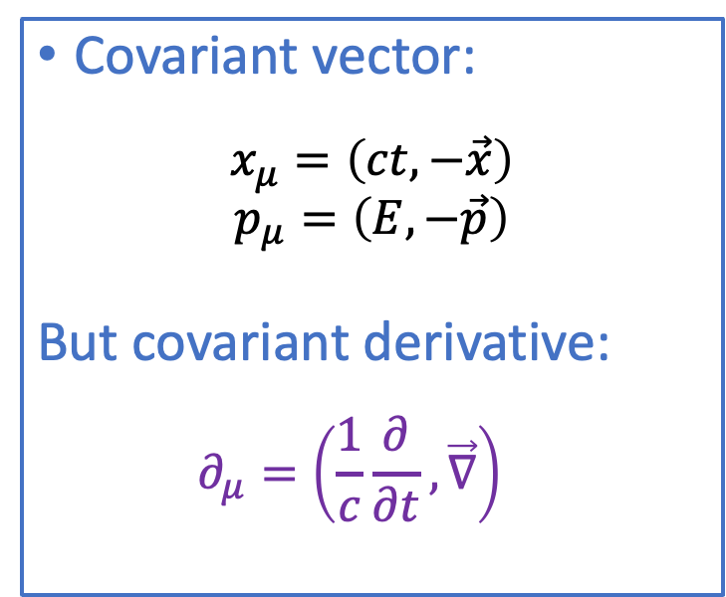
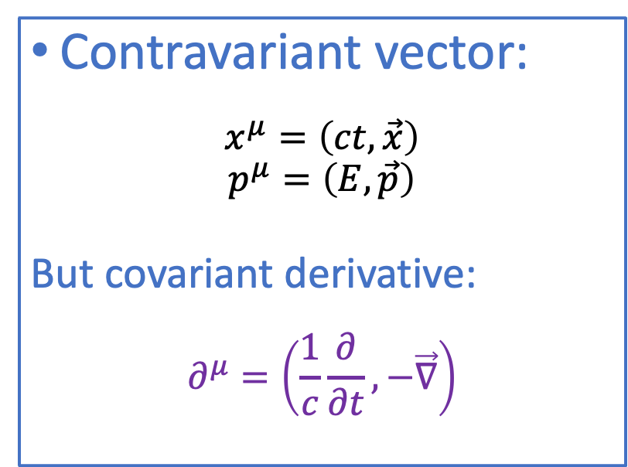
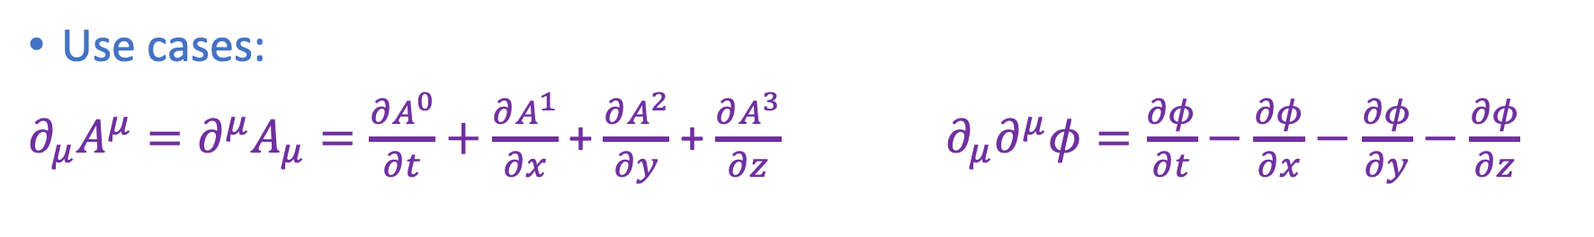
Skill: Four vectors & co- and contra-variance
Contravariant vector:
$$x^{μ}=\left(ct,\vec{x}\right)$$
$$p^{μ}=\left(E,\vec{p}\right)$$
But covariant derivative:
$$∂^{μ}=\left(\frac{1}{c}\frac{∂}{∂t},−\vec{∇}\right)$$
Covariant vector:
$$x_{μ}=\left(ct,−\vec{x}\right)$$
$$p_{μ}=\left(E,−\vec{p}\right)$$
But covariant derivative:
  $$∂_{μ}=\left(\frac{1}{c}\frac{∂}{∂t},\vec{∇}\right)$$
Note that the minus sign is “opposite” to the case of the coordinate four-vectors.
Use cases:
$∂_{μ}A^{μ}=∂^{μ}A_{μ}=\frac{∂A^{0}}{∂t}+\frac{∂A^{1}}{∂x}$ + $\frac{∂A^{2}}{∂y}$ + $\frac{∂A^{3}}{∂z}$ $∂_{μ}∂^{μ}φ=\frac{∂φ}{∂t}−\frac{∂φ}{∂x}−\frac{∂φ}{∂y}−\frac{∂φ}{∂z}$

Slide 22
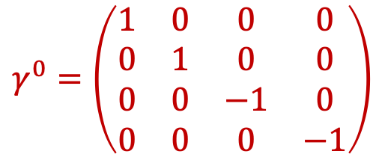






Skill: Dirac Gamma Matrices
Dirac $γ$ matrices: $\left\{γ^{μ},γ^{ν}\right\}=2g^{μν}$ in 4x4 matrices.
  We will use the Dirac-Pauli representation
Note the indices:
(confusing!)
$μ, ν=0,1,2,3$ are the
Lorentz indices in space-time:
Dirac matrix indices: 1,2,3,4
Have to do with the row and
column indices of the matrix
(and spinors)
$$γ^{0}=\left(\begin{matrix}1 & 0 & 0 & 0 \\ 0 & 1 & 0 & 0 \\ 0 & 0 & −1 & 0 \\ 0 & 0 & 0 & −1\end{matrix}\right)$$
$$γ^{1}=\left(\begin{matrix}0 & 0 & 0 & 1 \\ 0 & 0 & 1 & 0 \\ 0 & −1 & 0 & 0 \\ −1 & 0 & 0 & 0\end{matrix}\right)$$
$$γ^{2}=\left(\begin{matrix}0 & 0 & 0 & −i \\ 0 & 0 & i & 0 \\ 0 & i & 0 & 0 \\ −i & 0 & 0 & 0\end{matrix}\right)$$
$$γ^{3}=\left(\begin{matrix}0 & 0 & 1 & 0 \\ 0 & 0 & 0 & −1 \\ −1 & 0 & 0 & 0 \\ 0 & 1 & 0 & 0\end{matrix}\right)$$
Or: $γ^{0}=β=\left(\begin{matrix}𝟙_{2} & 0 \\ 0 & −𝟙_{2}\end{matrix}\right)$ and $γ^{k}=βα_{k}=\left(\begin{matrix}0 & σ_{k} \\ −σ_{k} & 0\end{matrix}\right)$ with Pauli matrices $σ_{k}$
Define also the chirality matrix: $γ^{5}=iγ^{0}γ^{1}γ^{2}γ^{3}$
Note: although the gamma indices are Lorentz-indices (“space-time”, the gamma-matrices are not 4-vectors! (They are simply constants.)
Notes:
(Beta alpha)(beta alpha) = - beta^2 alpha^2 → g^munu

Slide 23




Skills: Dirac delta function
See Griffiths Appendix A
Consider a function defined by the following prescription:
The integral of this function is normalized:
For a function $f\left(x\right)$ we have: $f\left(x\right)δ\left(x\right)=f\left(0\right)δ\left(x\right)$
…and therefore:
An important representation of the Dirac delta function is:
$$δ\left(x\right)=\lim_{Δ→0 }\left\{\begin{matrix}1/Δ for \left|x\right|<Δ/2 \\ 0 otherwise\end{matrix}\right.$$
$$\int_{−∞}^{∞}{δ\left(x\right) dx}=1$$
$$\int_{−∞}^{∞}{f\left(x\right)δ\left(x\right) dx}=f\left(0\right)\int_{−∞}^{∞}{δ\left(x\right) dx}=f\left(0\right)$$
$$δ\left(x\right)=\frac{1}{2π}\int_{−∞}^{∞}{e^{ikx} dk}$$
Notes:
Introduce a very special function;
Infitine at 0 and 0 everywhere else
Surface = 1

