Slide 1
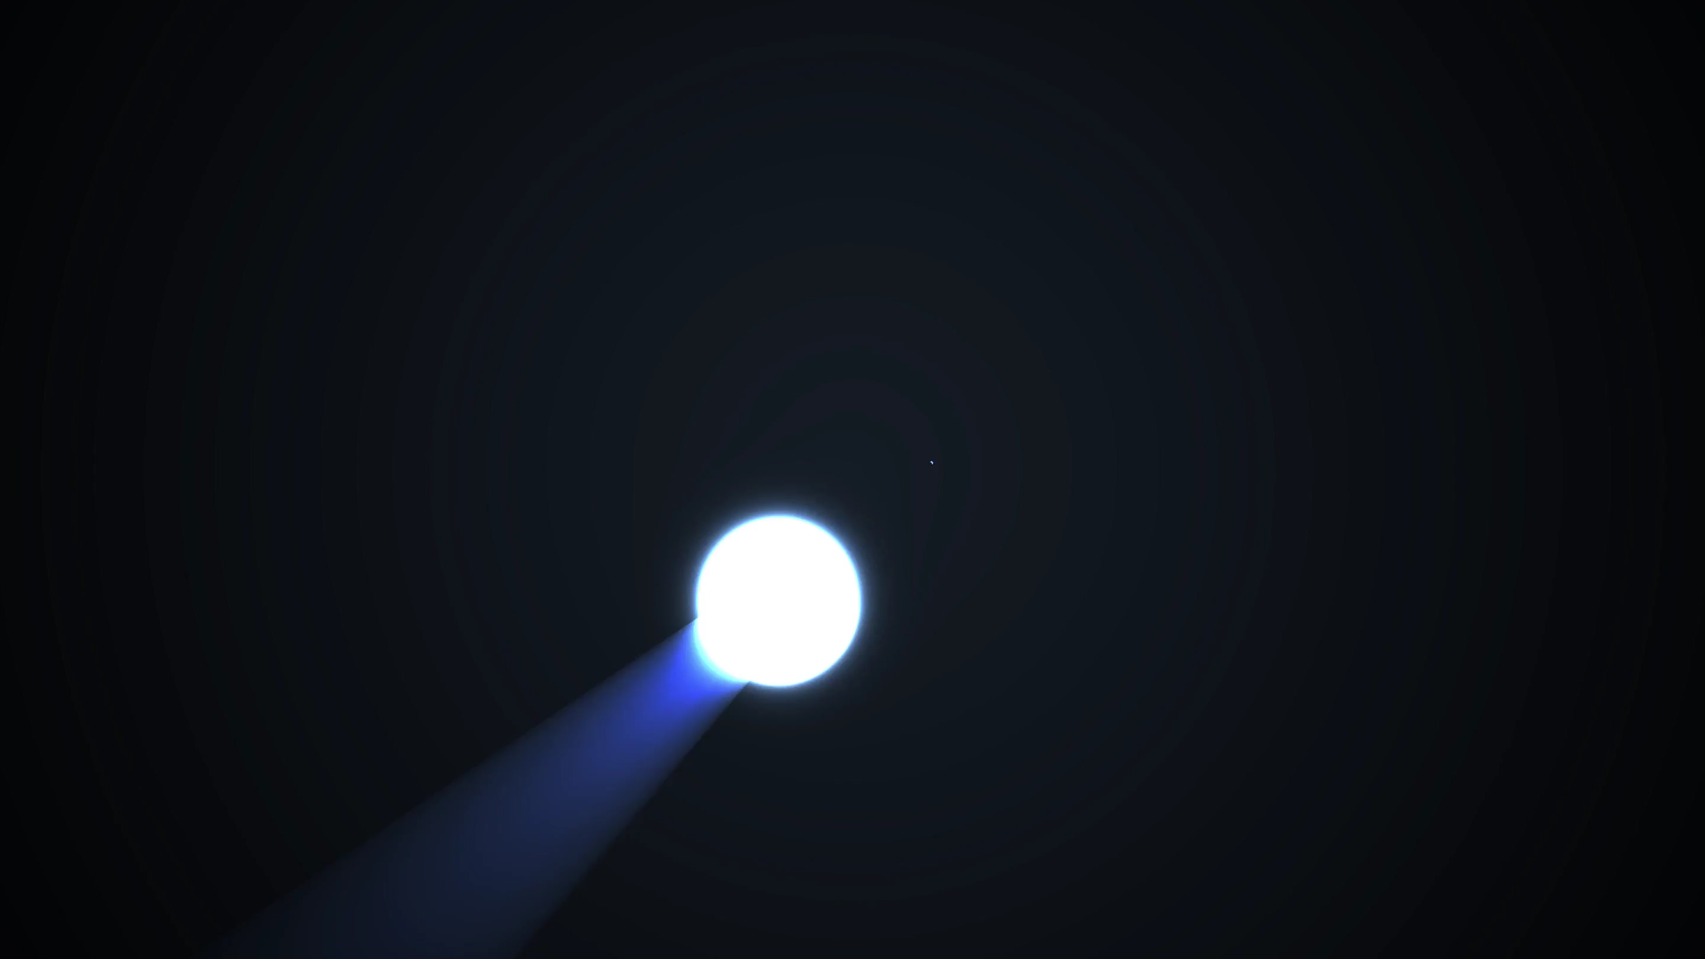
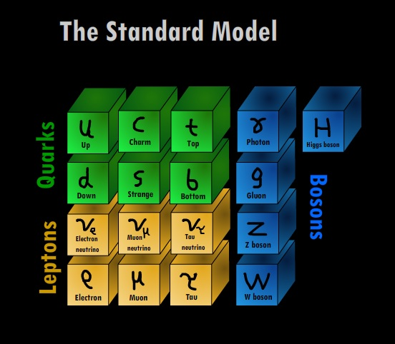
PHY3004: Nuclear and Particle Physics
Marcel Merk, Jacco de Vries

Slide 2
Lecture 1: “Particles”
Griffiths chapter 1
Classification of particles
Lepton: fundamental particle
Hadron: consist of quarks
  Meson: 1 quark + 1 antiquark (${π^{+}\text{,}B}_{s}^{0}$, …)
  Baryon: 3 quarks ($p$ ,$n$ , $Λ$, …)
    Anti-baryon: 3 anti-quarks
Fermion: particle with half-integer spin.
  Antisymmetric wave function: obeys Pauli-exclusion principle and Pauli-Dirac statistics
  All fundamental quarks and leptons are spin-½
  Baryons (S=$1/2$, $3/2$)
Boson: particle with integer spin
  Symmetric wave function: Bose-Einstein statistics
  Mesons: (S=$0$, $1$), Higgs (S=$0$)
  Force carriers: $γ$, $W$, $Z$, $g$ (S=$1$); graviton(S=$2$)

Slide 3


Lecture 2: “Forces”
Griffiths chapter 2
EM (QED)
Weak
Propagator:
$\frac{1}{{{ M}_{W}^{2}−q}^{2}}$
ElectroWeak
Vertex: $e$
Vertex: $e$
Propagator: $\frac{1}{q^{2}}$
Vertex:$\frac{g}{2\sqrt{2}}$
Vertex:$\frac{g}{2\sqrt{2}}$
Strong (QCD)
$$g_{r\overline{b}}$$
$$g_{g\overline{b}}$$
$$g_{b\overline{r}}$$
$$g_{b\overline{r}}$$
QCD
$$g_{r\overline{b}}$$
$$q$$
$$g_{r\overline{g}}$$
$$g_{g\overline{r}}$$
$$q$$
$$g_{g\overline{r}}$$

Slide 4

Lecture 3: “Waves” – wave equations
Probability interpretation
(Continuity equation)
Quantum Mechanics:
$E→\hat{E}=iℏ\frac{∂}{∂t}$ ; $p→\hat{p}=−iℏ\vec{∇}$
$$\frac{∂ρ}{∂t}+\vec{∇}⋅\vec{j}=0$$
Non-relativistic spin 0:
Schrödinger:
$ρ≡ψ^{∗}ψ={\left|N\right|}^{2}$
$\vec{j}≡\frac{iℏ}{2m }\left(ψ\vec{∇}ψ^{∗}−ψ^{∗}\vec{∇}ψ\right)=\frac{{\left|N\right|}^{2}}{m}\vec{p}$
$$E= \frac{{\vec{p}}^{2}}{2m }$$
  $$iℏ\frac{∂}{∂t}ψ=−\frac{ℏ^{2}}{2m}∇^{2}ψ$$
$$ψ=Ne^{i\left(\vec{p}\vec{x}−Et\right)}$$
Relativistic spin 0:
Klein-Gordon:
  $$−\frac{1}{c^{2}}\frac{∂^{2}}{∂t^{2}}φ=−∇^{2}φ+\frac{m^{2}c^{2}}{ℏ^{2}}φ$$
$$j^{μ}\left(ρ,\vec{j}\right)=i\left[φ^{∗}\left(∂^{μ}φ\right)−φ\left(∂^{μ}φ^{∗}\right)\right]$$
$$E^{2}=p^{2}c^{2}+m^{2}c^{4}$$
$$ρ=2{\left|N\right|}^{2}E$$
$$\vec{j}=2{\left|N\right|}^{2}\vec{p}$$
$$j^{μ}=2{\left|N\right|}^{2}p^{μ}$$
Example: pions
$$∂_{μ}∂^{μ}φ+m^{2}φ=0$$
$$φ=Ne^{i\left(\vec{p}\vec{x}−Et\right)}$$
Relativistic spin- ½:
Dirac:
(The Master in action)
$$i\frac{∂}{∂t}ψ=\left(−i \vec{α}⋅\vec{∇}+βm\right)ψ$$
$$ψ=u(p)e^{i\left(\vec{p}\vec{x}−Et\right)}$$
$$j^{μ}=\overline{ψ}γ^{μ}ψ$$
$$H=\left(\vec{α}⋅\vec{p}+βm\right)$$
$$u\left(p\right)=\left(\begin{aligned}. \\ . \\ . \\ .\end{aligned}\right)$$
  $$j^{0}=\overline{ψ}γ^{0}ψ=ψ^{†}ψ=\sum_{i=1 }^{4}{{\left|ψ_{i}\right|}^{2}}$$
Fundamental
quarks and leptons
  $$\left(iγ^{μ}∂_{μ}−m\right)ψ=0$$
$$γ^{μ}=\left(β,β\vec{α}\right)$$
Relativistic spin-1:
Proca:
EM: $A^{μ}=γ$ → $m=0$
QCD: $A^{μ}=g$ → $m=0$
Weak: $A^{μ}=W,Z$ → $m≠0$
EM: Maxwell equations
for $\vec{E}$ and $\vec{B}$ fields
Fundamental
force carriers
$$∂_{μ}∂^{μ}A^{ν}+m^{2}A^{ν}=j^{ν}$$

Slide 5

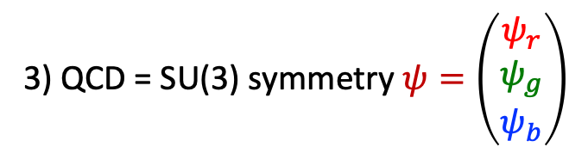


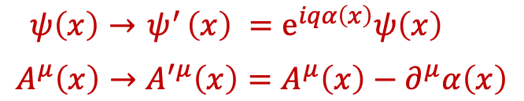
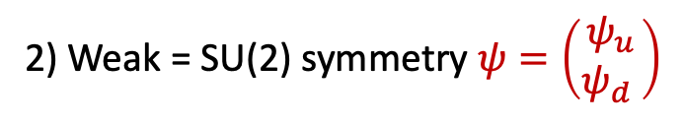


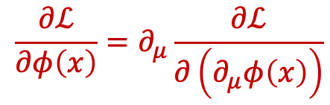

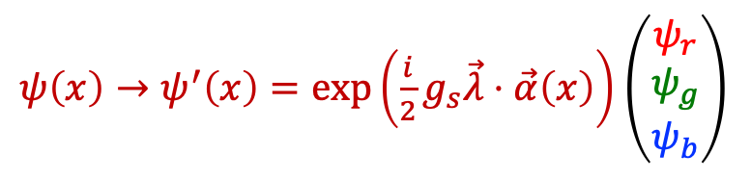



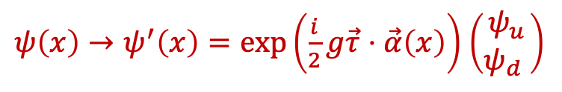
Lecture 3: “Waves” – gauge invariance
Lagrangians:
Spin 0 Scalar field: $ℒ=\frac{1}{2}\left(∂_{μ}φ\right)\left(∂^{μ}φ\right)−{\frac{1}{2}m}^{2}φ^{2}$
Spin ½ Dirac fermion $ℒ=i\overline{ψ}γ_{μ}∂^{μ}ψ−m\overline{ψ}ψ$
Spin 1 gauge boson (photon) :$ℒ=−\frac{1}{4}\left(∂^{μ}A^{ν}−∂^{ν}A^{μ}\right)\left(∂_{μ}A_{ν}−∂_{ν}A_{μ}\right)−j^{μ}A_{μ}$
$$\frac{∂ℒ}{∂φ\left(x\right)}=∂_{μ}\frac{∂ℒ}{∂\left(∂_{μ}φ\left(x\right)\right)}$$
Euler Lagrange lead to the wave equations: (from field theory)
All forces result from requiring a symmetry principle: Lagrangian should stay invariant under transformations
1) QED = U(1) symmetry
$$ℒ=i\overline{ψ}γ_{μ}∂^{μ}ψ−m\overline{ψ}ψ$$
$$ℒ=i\overline{ψ}γ_{μ} D^{μ}ψ−m\overline{ψ}ψ$$
$ψ\left(x\right)→{ ψ}^{′}\left(x\right) =e^{iqα\left(x\right)}ψ\left(x\right)$
$$A^{μ}\left(x\right)→A^{′μ}\left(x\right)=A^{μ}\left(x\right)−∂^{μ}α\left(x\right)$$
Covariant derivative:
$$∂^{μ}→D^{μ}≡∂^{μ}+iqA^{μ}$$
$$ℒ=i\overline{ψ}γ_{μ}{ ∂}^{μ}ψ−m\overline{ψ}ψ −q{\overline{ψ}γ_{μ}ψA}^{μ}$$
➔ 1 E.M. photon field: $A^{μ}\left(x\right)$
“interaction”
“free”
3) QCD = SU(3) symmetry $ψ=\left(\begin{matrix}ψ_{r} \\ ψ_{g} \\ ψ_{b}\end{matrix}\right)$
2) Weak = SU(2) symmetry $ψ=\left(\begin{matrix}ψ_{u} \\ ψ_{d} \end{matrix}\right)$
$ψ\left(x\right)→ψ^{′}\left(x\right)=exp\left(\frac{i}{2}g_{s}\vec{λ}⋅\vec{α}\left(x\right)\right)$ $\left(\begin{matrix}ψ_{r} \\ ψ_{g} \\ ψ_{b}\end{matrix}\right)$
$ψ\left(x\right)→ψ^{′}\left(x\right)=exp\left(\frac{i}{2}g\vec{τ}⋅\vec{α}\left(x\right)\right)$ $\left(\begin{matrix}ψ_{u} \\ ψ_{d} \end{matrix}\right)$
➔ 3 weak fields: $W^{μ+}\left(x\right),{ W^{μ}}^{−}\left(x\right), Z^{μ}\left(x\right)$
➔ 8 colored gluon fields: $g^{μ}\left(x\right)$

Slide 6
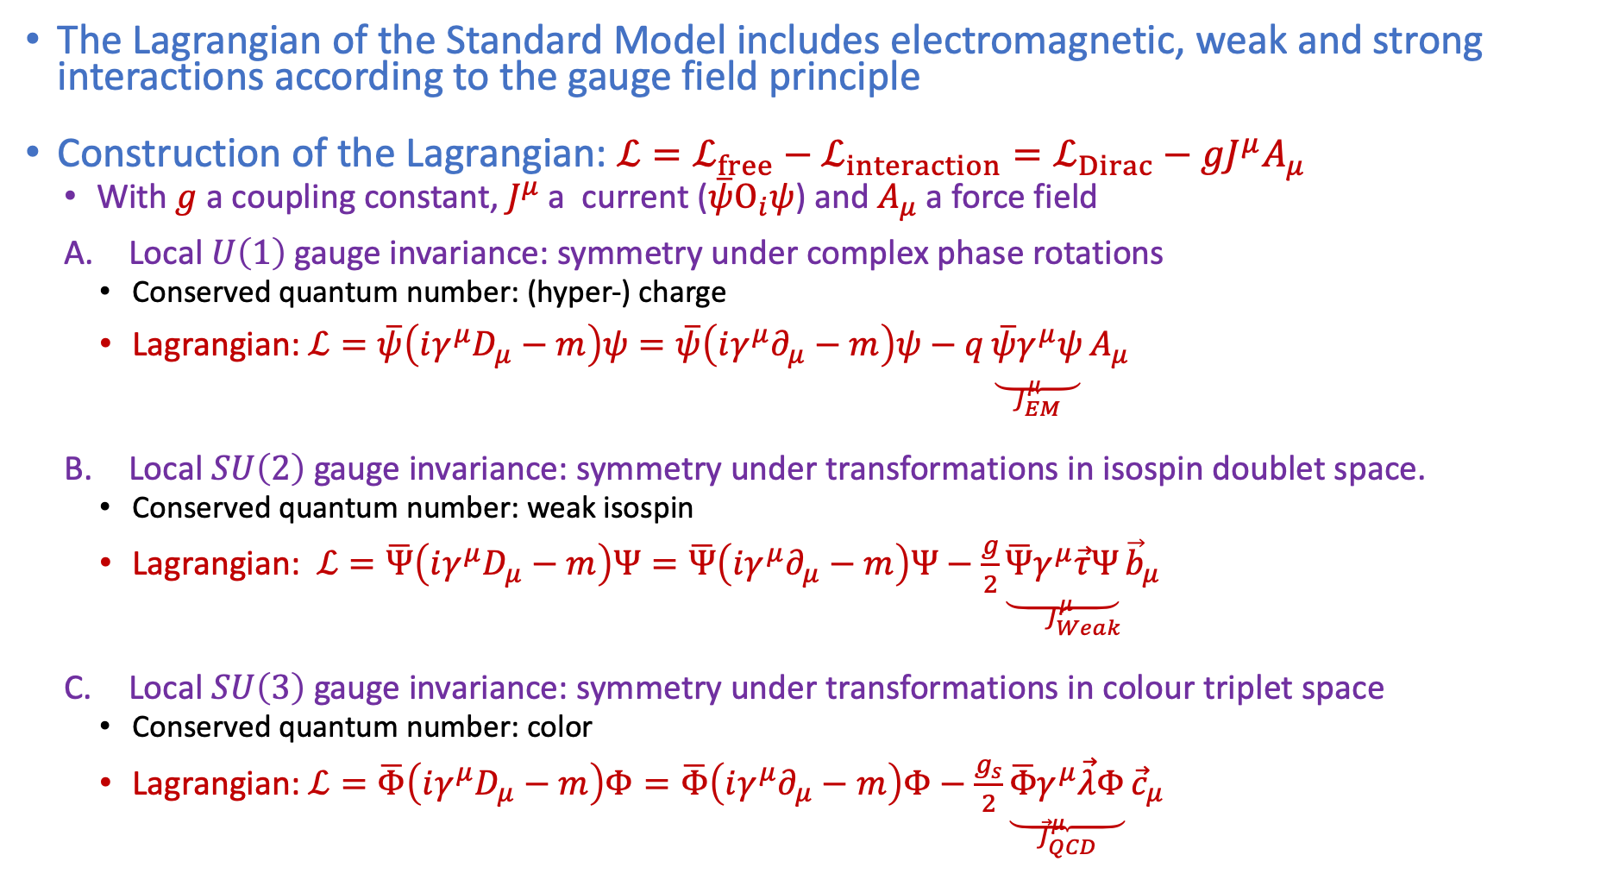
Lecture 4: “Symmetries” – Standard Model
The Lagrangian of the Standard Model includes electromagnetic, weak and strong interactions according to the gauge field principle
Construction of the Lagrangian: $ℒ=ℒ_{free}−ℒ_{interaction}=ℒ_{Dirac}−{gJ}^{μ}A_{μ}$
  With $g$ a coupling constant, $J^{μ}$ a current ($\overline{ψ}Ο_{i}ψ$) and $A_{μ}$ a force field
  Local $U\left(1\right)$ gauge invariance: symmetry under complex phase rotations
    Conserved quantum number: (hyper-) charge
    Lagrangian: $ℒ=\overline{ψ}\left(iγ^{μ}D_{μ}−m\right)ψ=\overline{ψ}\left(iγ^{μ}∂_{μ}−m\right)ψ−q\underset{J_{EM}^{μ}}{\underbrace{\overline{ψ}γ^{μ}ψ}}A_{μ}$
  Local $SU\left(2\right)$ gauge invariance: symmetry under transformations in isospin doublet space.
    Conserved quantum number: weak isospin
    Lagrangian: $ℒ=\overline{Ψ}\left(iγ^{μ}D_{μ}−m\right)Ψ=\overline{Ψ}\left(iγ^{μ}∂_{μ}−m\right)Ψ−\frac{g}{2}\underset{J_{Weak}^{μ}}{\underbrace{\overline{Ψ}γ^{μ}\vec{τ}Ψ}{\vec{b}}_{μ}}$
  Local $SU\left(3\right)$ gauge invariance: symmetry under transformations in colour triplet space
    Conserved quantum number: color
    Lagrangian: $ℒ=\overline{Φ}\left(iγ^{μ}D_{μ}−m\right)Φ=\overline{Φ}\left(iγ^{μ}∂_{μ}−m\right)Φ−\frac{g_{s}}{2}\underset{{\vec{J}}_{QCD}^{μ}}{\underbrace{\overline{Φ}γ^{μ}\vec{λ}Φ}}{\vec{c}}_{μ}$
Notes:
Forget gravity

Slide 7
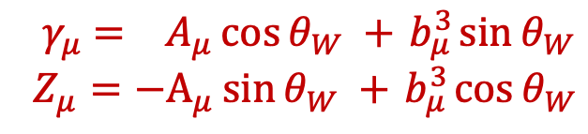




Lecture 4: “Symmetries” – Standard Model
$$ℒ=\overline{ψ}\left(iγ^{μ}D_{μ}−m\right)ψ=\overline{ψ}\left(iγ^{μ}∂_{μ}−m\right)ψ−qJ_{EM}^{μ}A_{μ} −\frac{g}{2}J_{Weak}^{μ}{\vec{b}}_{μ}−\frac{g_{s}}{2}J_{QCD }^{μ}{\vec{c}}_{μ}$$
QED U(1) $ℒ_{int }=−J_{μ}A^{μ}$ with $J_{μ}=q\overline{ψ}γ_{μ}ψ$
$$A^{μ}$$
Electromagnetic
interaction
Weak SU(2) : $ℒ_{int }=−{\vec{J}}_{μ}{\vec{b}}^{μ}$ with ${\vec{J}}_{μ}=\frac{g}{2} \overline{Ψ} γ_{μ}\vec{τ} Ψ$
$$W_{μ}^{±}≡\frac{1}{\sqrt{2}}\left(b_{μ}^{1}∓ib_{μ}^{2}\right)$$
$J_{μ}^{±}=\frac{1}{\sqrt{2}}\overline{Ψ}γ_{μ}τ^{±}Ψ$ with $τ^{±}=\frac{1}{2}\left(τ_{1}±iτ_{2}\right)$
Weak
interaction
$$Z_{μ}\sim b_{μ}^{3}$$
$J_{μ}^{3}=\frac{1}{2}\overline{Ψ}γ_{μ}τ^{3}Ψ$ with $τ^{±}=\frac{1}{2}\left(τ_{1}±iτ_{2}\right)$
Electroweak mixing SU(2)xU(1):
${ γ}_{μ} = A_{μ}\cos{θ_{W} +{ b}_{μ}^{3}\sin{θ_{W}}}$
$Z_{μ}=−A_{μ}\sin{θ_{W} +{ b}_{μ}^{3}\cos{θ_{W}}}$
$$q$$
Strong
interaction
$$g_{g\overline{b}}$$
Standard Model:
$$SU{\left(3\right)}_{color}×SU{\left(2\right)}_{L}×U{\left(1\right)}_{Y}$$
$$q$$

Slide 8
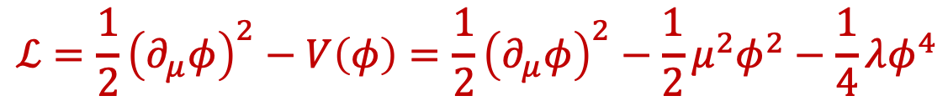
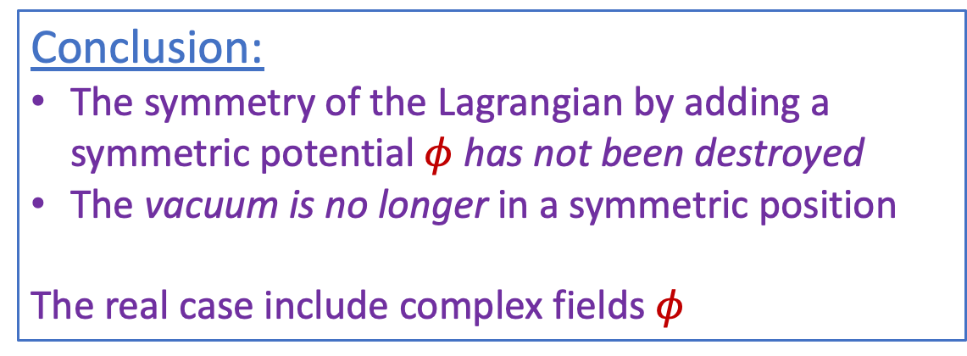
Lecture 4: “Symmetries” – Symmetry breaking
$$ℒ=\frac{1}{2}{\left(∂_{μ}φ\right)}^{2}−V\left(φ\right)=\frac{1}{2}{\left(∂_{μ}φ\right)}^{2}−\frac{1}{2}μ^{2}φ^{2}−\frac{1}{4}λφ^{4}$$
Massive Klein-Gordon
term (Spin 0, mass =$μ$)
Interaction term
$$v$$
The Lagrangian has a minimum for $φ_{0}= \sqrt{−\frac{μ^{2}}{λ}}=v$or $μ^{2}=−λv^{2}$
Conclusion:
The symmetry of the Lagrangian by adding a symmetric potential $φ$ has not been destroyed
The vacuum is no longer in a symmetric position
The real case include complex fields $φ$

Slide 9
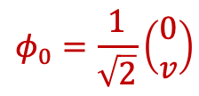
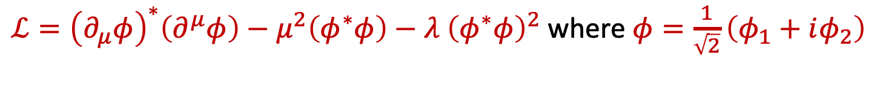
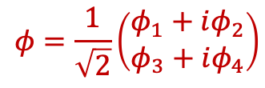
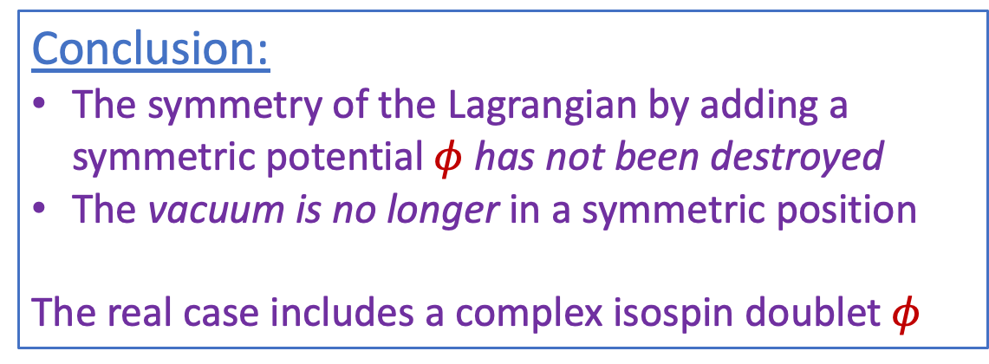

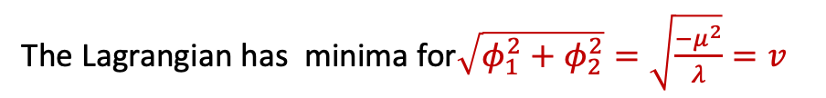

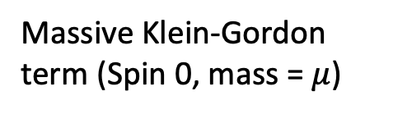
Lecture 4: “Symmetries” – Symmetry breaking
$ℒ={\left(∂_{μ}φ\right)}^{∗}\left(∂^{μ}φ\right)−μ^{2}\left(φ^{∗}φ\right)−λ {\left(φ^{∗}φ\right)}^{2}$ where $φ=\frac{1}{\sqrt{2}}\left(φ_{1}+iφ_{2}\right)$
Massive Klein-Gordon term (Spin 0, mass =$μ$)
Interaction term
$$μ^{2}<0$$
The Lagrangian has minima for$\sqrt{φ_{1}^{2}+φ_{2}^{2}}=\sqrt{\frac{−μ^{2}}{λ}}=v$
Conclusion:
The symmetry of the Lagrangian by adding a symmetric potential $φ$ has not been destroyed
The vacuum is no longer in a symmetric position
The real case includes a complex isospin doublet $φ$
$$φ=\frac{1}{\sqrt{2}}\left(\begin{matrix}φ_{1}+iφ_{2} \\ φ_{3}+iφ_{4}\end{matrix}\right)$$
$$φ_{0}=\frac{1}{\sqrt{2}}\left(\begin{matrix}0 \\ v\end{matrix}\right)$$
massless $γ$ + massive $W^{+}$, $W^{+}$, $Z$

Slide 10
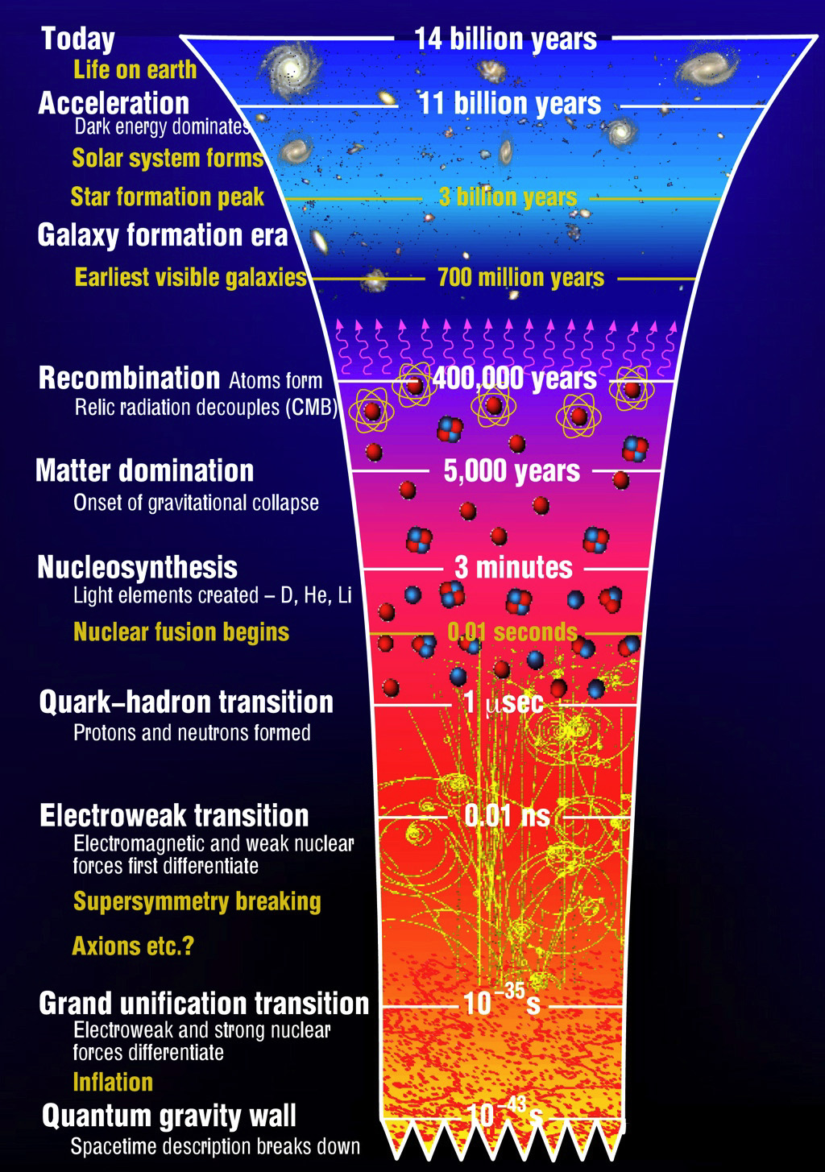
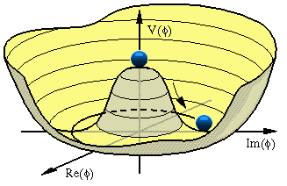
Recap: “Seeing the wood for the trees”
Lecture 1: “Particles”
  Zooming into constituents of matter
  Skills: distinguish particle types, Spin
Lecture 2: “Forces”
  Exchange of quanta: EM, Weak, QCD
  Skills: 4-vectors, Feynman diagrams
Lecture 3: “Waves”
  Quantum fields and gauge invariance
  Dirac algebra, Lagrangian, co- & contra variant
Lecture 4: “Symmetries”
  Standard Model, Higgs, Discrete Symmetries
  Skills: Lagrangians, Chirality & Helicity
Lecture 5: “Scattering”
  Cross section, decay, perturbation theory
  Skills: Dirac-delta function, Feynman Calculus
Lecture 6: “Detectors”
  Energy loss mechanisms, detection technologies
$$g_{Z}$$
$$Z$$
$$g_{Z}$$
$$\frac{1}{q^{2}−M_{Z}^{2}}$$

Slide 11
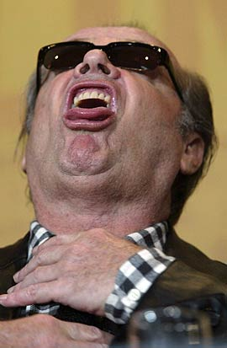
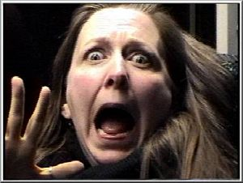
Today: Scattering Theory and Feynman Calculus
Griffiths Chapter 6
Part 1 : Decay and Cross Section
Part 2 : Perturbation Theory and the Golden Rule
Part 3 : Feynman Calculus
Griffiths §6.1
Griffiths §6.2 and PP1 Chapter 2
Griffiths §6.3
“Let’s play around with physics and math”
Notes:
We have discussed:
- Particles
- Forces
- Waves
- Symmetries --> Standard Model
Today:
- Scattering

Slide 12

Scattering Theory and Feynman Calculus
Griffiths Chapter 6
Part 1
Decay and Cross Section
Griffiths §6.1

Slide 13
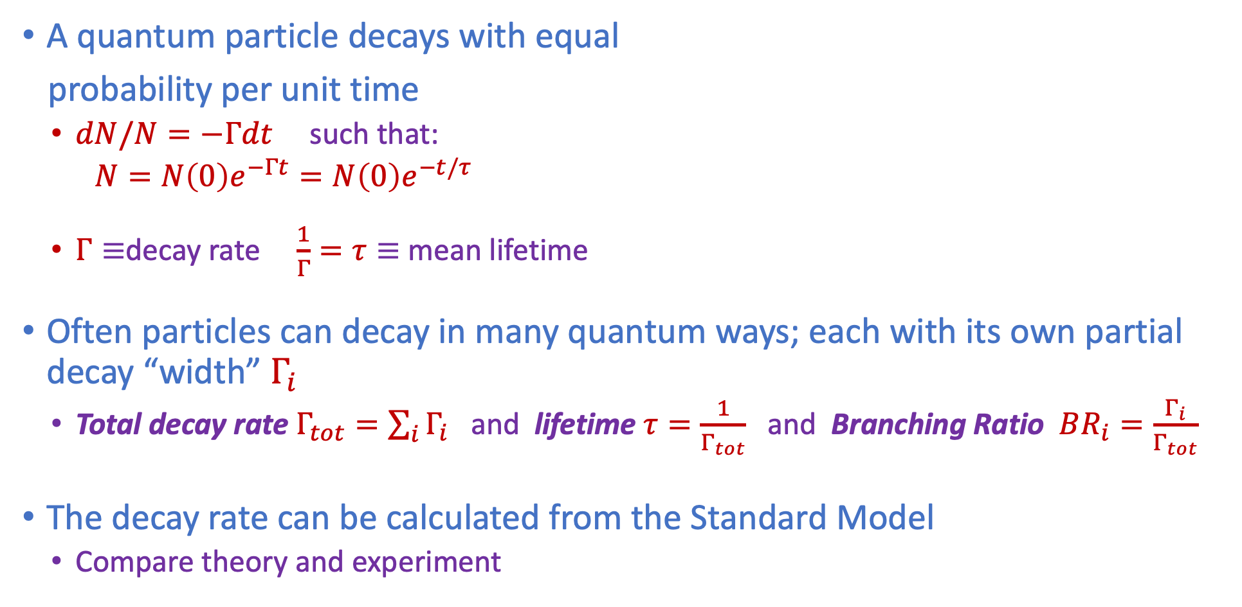
Terminology: Decays
A quantum particle decays with equal
probability per unit time
  $dN/N=−Γdt$ such that:
  $N=N\left(0\right)e^{−Γt}=N\left(0\right)e^{−t/τ}$
  $Γ≡$decay rate $\frac{1}{Γ}=τ≡$ mean lifetime
Often particles can decay in many quantum ways; each with its own partial decay “width” $Γ_{i}$
  Total decay rate $Γ_{tot}=\sum_{i}{Γ_{i}}$ and lifetime $τ=\frac{1}{Γ_{tot}}$ and Branching Ratio $BR_{i}=\frac{Γ_{i}}{Γ_{tot}}$
The decay rate can be calculated from the Standard Model
  Compare theory and experiment
Notes:
Gamma = probability per unit time that one particle will decay

Slide 14







Terminology: Cross Section
A scattering process is measured using “cross section”; the effective surface seen by a particle colliding with a target. We use the same for collisions:
  e.g. proton-proton colliders.
For colliding protons many processes may happen:
  Exclusive cross section $σ_{i}$: cross section for one specific process “$i$”
  Inclusive cross section $σ_{tot}$: sum all possible exclusive cross sections: $σ_{tot}=\sum_{i}^{N}{σ_{i}}$
The cross section can for example depend on the energy of the collision
Look at the process $e^{+}e^{−}→q\overline{q}$
  There is a resonance at 91 GeV; the mass of the $Z$- boson
  And there is a peak near 0 GeV; the photon resonance
  “Electroweak process”
$$e$$
q
$$e$$
q
$$γ$$
$$Z$$
$$e$$
q
$$e$$
q
$$e^{+}+e^{−}→q \overline{q}$$
Notes:
Exclusive: produce two muons, two pions etc
Which force us active

Slide 15

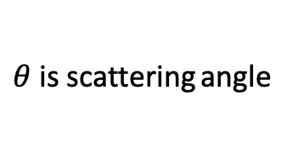
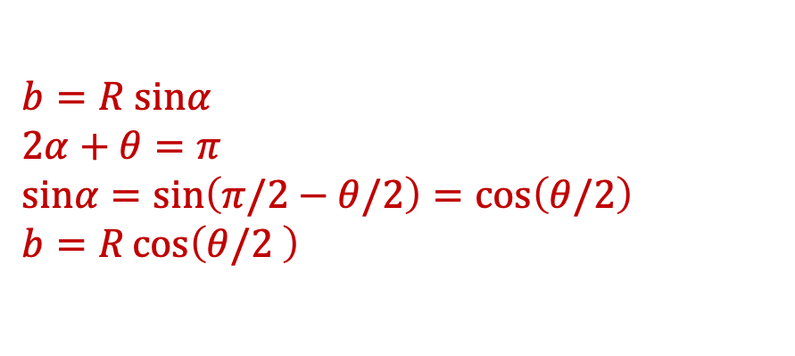
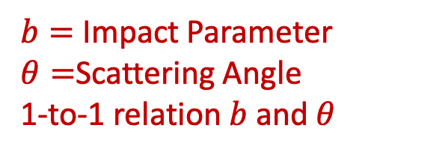
Scattering
Griffiths §6.1
Scattering of particles with Coulomb interaction
Scattering on a “hard sphere”
$$F$$
$θ$is scattering angle
$b=$ Impact Parameter
$θ=$Scattering Angle
1-to-1 relation $b$ and $θ$
$b=R sinα$
$2α+θ=π$
$sinα=\sin\left(π/2−θ/2\right)=\cos\left(θ/2\right)$
$b=R\cos\left(θ/2 \right)$

Slide 16
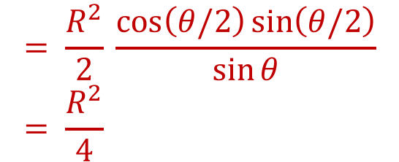
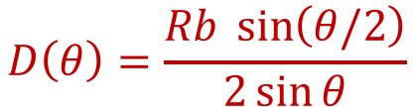

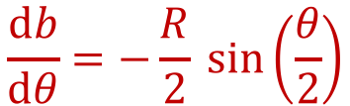
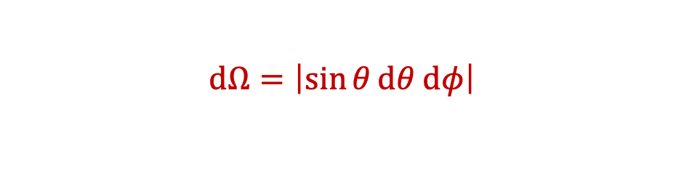
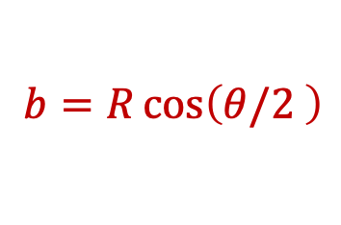
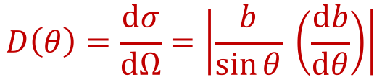
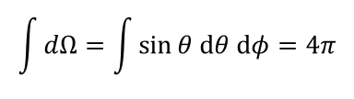
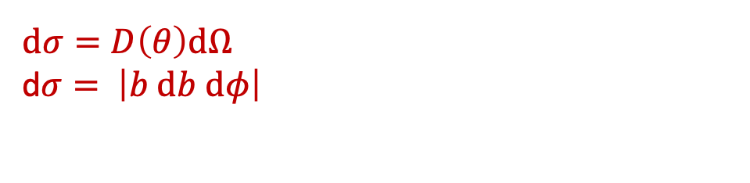
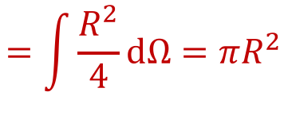
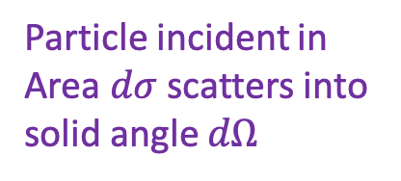
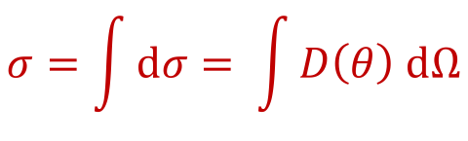
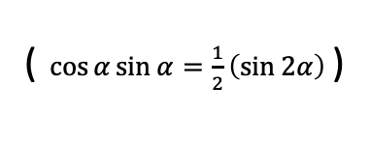
A) Hard Sphere Scattering
Griffiths §6.1
Calculation of hard sphere scattering
Then:
If particle goes through $dσ$ it will scatter through solid angle $dΩ :$
$$D\left(θ\right)=\frac{Rb \sin\left(θ/2\right)}{2\sin{θ}}$$
$dσ=D\left(θ\right)dΩ$
d$σ= \left|b db dφ\right|$
$$dΩ=\left|\sin{θ}dθ dφ\right|$$
$$= \frac{R^{2}}{2} \frac{\cos\left(θ/2\right)\sin\left(θ/2\right)}{\sin{θ}}= \frac{R^{2}}{4}$$
Hard scattering:
$$D\left(θ\right)=\frac{dσ}{dΩ}=\left|\frac{b}{\sin{θ}} \left(\frac{db}{dθ}\right)\right|$$
$b=R\cos\left(θ/2 \right)$
( $\cos{α}\sin{α=\frac{1}{2}\left(\sin{2α}\right)}$ )
$$\frac{db}{dθ}=−\frac{R}{2} \sin\left(\frac{θ}{2}\right)$$
“Differential cross-section”
$$\int{dΩ=\int{\sin{θ dθ dφ}}=4π}$$
$$σ=\int{dσ}= \int{D\left(θ\right) dΩ}$$
$$=\int{\frac{R^{2}}{4}dΩ}=πR^{2}$$
Particle incident in
Area $dσ$ scatters into
solid angle $dΩ$
$$R$$
This corresponds to the projected
surface of the circle seen by the particle
Notes:
D(theta)= cross section
At the end: hence the name cross section.

Slide 17
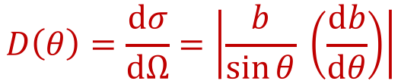


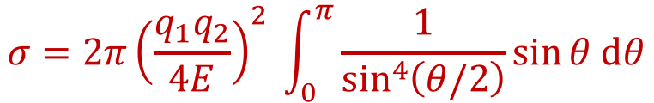

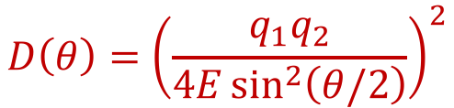

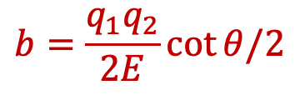
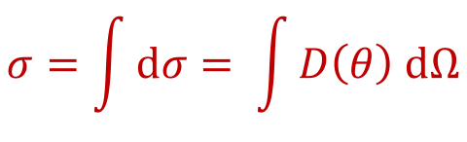
B) Rutherford Scattering (point charge)
Griffiths §6.1
Scattering of charged particles with Coulomb force
  Eg alpha particles on nucleus target
Coulomb Force law:
$$D\left(θ\right)=\frac{dσ}{dΩ}=\left|\frac{b}{\sin{θ}} \left(\frac{db}{dθ}\right)\right|$$
$$D\left(θ\right)={\left(\frac{q_{1}q_{2}}{4E\sin^{2}\left(θ/2\right)}\right)}^{2}$$
$$F=\frac{q_{1}q_{2}}{r^{2}}$$
Consider as given (see Griffiths):
$$σ=\int{dσ}= \int{D\left(θ\right) dΩ}$$
$$b=\frac{q_{1}q_{2}}{2E}\cot{θ/2}$$
$$F$$
$$σ=2π{\left(\frac{q_{1}q_{2}}{4E}\right)}^{2} \int_{0}^{π}{\frac{1}{\sin^{4}\left(θ/2\right)}\sin{θ dθ}}$$
$$q_{1}$$
The integral turns out to be infinite!
Particle sees an infinitely large scattering surface?
Reason is that Coulomb force has infinite range.
Most “collisions” will happen at large distance,
which is what Rutherford observed.
$$q_{2}$$
Notes:
Funny: infinite surface!

Slide 18

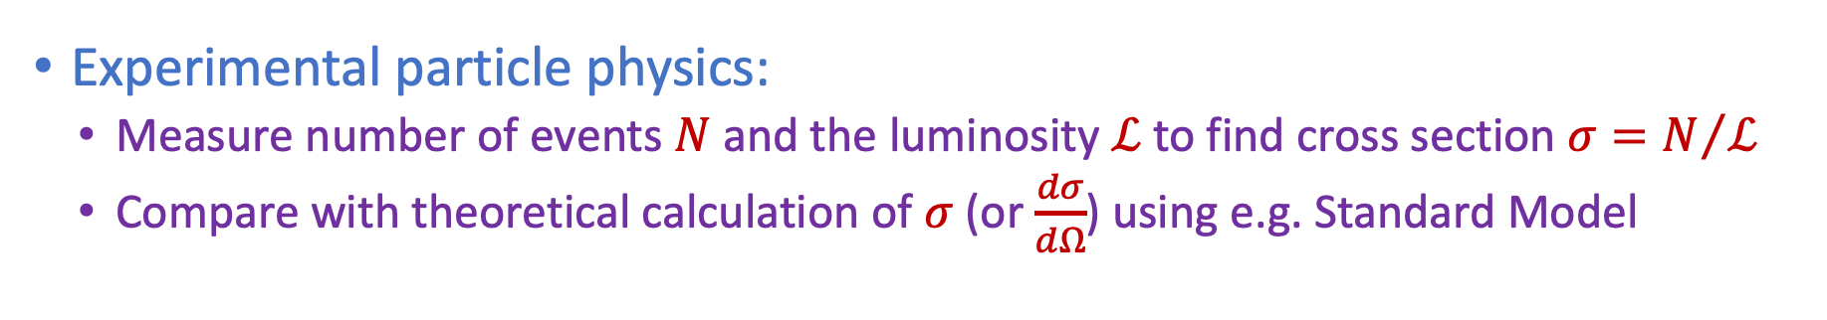
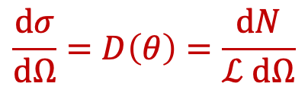
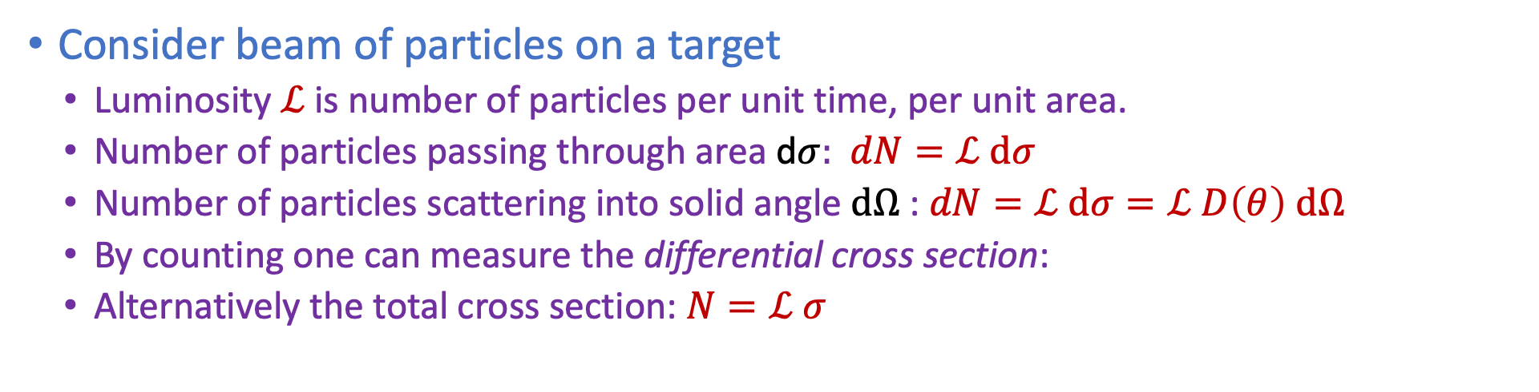
Luminosity
Griffiths §6.1
Consider beam of particles on a target
  Luminosity $ℒ$ is number of particles per unit time, per unit area.
  Number of particles passing through area d$σ:$ $dN=ℒ dσ$
  Number of particles scattering into solid angle $dΩ$: $dN=ℒ dσ=ℒ D\left(θ\right) dΩ$
  By counting one can measure the differential cross section:
  Alternatively the total cross section: $N=ℒ σ$
$$\frac{dσ}{dΩ}=D\left(θ\right)=\frac{dN}{ℒ dΩ}$$
$$ℒ$$
These aspects are
needed when you
Compare theory
with experiments.
Experimental particle physics:
  Measure number of events $N$and the luminosity $ℒ$to find cross section $σ=N/ℒ$
  Compare with theoretical calculation of $σ$ (or $\frac{dσ}{dΩ}$) using e.g. Standard Model
Notes:
d\sigma = D(theta)d|Omega
These aspects are needed when you make comparison

Slide 19

Scattering Theory and Feynman Calculus
Griffiths Chapter 6
Part 2
Perturbation Theory and the Golden Rule
Griffiths §6.2 and PP1 Chapter 2
“How to calculate the cross section $σ”$
Griffiths only states the “Golden Rule”.
In next 7 slides we will try to understand it!
For the exam only Griffith level is required.

Slide 20


Fermi’s Golden Rule
To calculate decay rates and cross section in relativistic scattering we use a general formula that we cannot fully derive within the scope of these lectures
  For a fully relativistic derivation: quantum field theory
  We will ”make it plausible” using non-relativistic single particle theory
    see also the book of Thomsom §2.3.6 and chapter 3, or Nikhef PP1 lecture notes chapter 2
Here is the end-result:
  Golden Rule for decays: $1→2+3+4+…n$
  Golden Rule for scattering: $1+2→3+4+5+…n$
$$Γ=\frac{S}{2m_{1}}\int{{\left|ℳ\right|}^{2} {\left(2π\right)}^{4}δ^{4}\left(p_{1}−p_{2}−p_{3}…−p_{n}\right) × \prod_{j=2}^{n}{2πδ\left(p_{j}^{2}−m_{j}^{2}\right)θ\left(p_{j}^{0}\right) \frac{d^{4}p_{j}}{{\left(2π\right)}^{4}}}}$$
$$σ=\frac{S}{4\sqrt{{\left(p_{1}⋅p_{2}\right)}^{2}−{\left(m_{1}m_{2}\right)}^{2}}} \int{{\left|ℳ\right|}^{2} {\left(2π\right)}^{4}δ^{4}\left(p_{1}+p_{2}−p_{3}…−p_{n}\right) × \prod_{j=3}^{n}{2πδ\left(p_{j}^{2}−m_{j}^{2}\right)θ\left(p_{j}^{0}\right) \frac{d^{4}p_{j}}{{\left(2π\right)}^{4}}}}$$
OK, let’s go….
Notes:
Integral over momenta of produced particles
We will discuss the terms.
But first have some fun with maths.

Slide 21
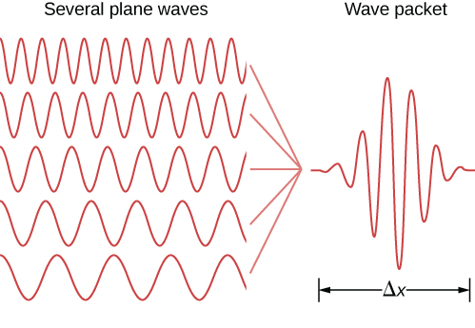




Scattering with waves
An incoming particle is represented by a wave packet of incoming plane waves:
Example 1:
  Calculate the scattering of these waves in an external potential
Example 2:
  For collisions the scattering potential $A^{μ}$ of particle $A$ is determined by the field of particle $B$ and vice versa.
Free particle
Hamiltonian
$$ψ(x)=Ne^{−ipx}$$
“perturbation”
$A^{μ}$=$\left(V,\vec{A}\right)$
$$A^{μ}$$
Δp
Notes:
1. eg incoming electrons
2. eg. e- e- scattering

Slide 22









Perturbation Theory
$$i\frac{∂ψ}{∂t}=H_{0}ψ$$
Consider the free Schrödinger equation
  $H_{0}$ is time-independent Hamiltonian
  Eigenstates orthogonal:
  where $φ_{m}\left(\vec{x}\right)$ form orthonormal basis for any solution and
Hamiltonian with time-dependent perturbation
  Solutions are of the form can be written as
  Substituting gives:
$${H_{0}φ}_{m}\left(\vec{x}\right)=E_{m}φ_{m}\left(\vec{x}\right)$$
$$\int{φ_{m}^{∗}\left(\vec{x}\right)φ_{n}\left(\vec{x}\right)d^{3}x}=δ_{mn}$$
$$ψ_{m}\left(\vec{x},t\right)=φ_{m}\left(\vec{x}\right)e^{−iE_{m}t}$$
(Particle = wave packet)
$$i\frac{∂ψ}{∂t}=\left(H_{0}+V\left(\vec{x},t\right)\right)ψ$$
$$ψ\left(\vec{x},t\right)=\sum_{n=0}^{∞}{a_{n}\left(t\right)φ_{n}\left(\vec{x}\right)e^{−iE_{n}t}}$$
$$i\sum_{n=0 }^{∞}{\frac{da_{n}\left(t\right) }{dt}}φ_{n}\left(\vec{x}\right)e^{−iE_{n}t}=\sum_{n=0}^{∞}{V\left(\vec{x},t\right)a_{n}\left(t\right)φ_{n}\left(\vec{x}\right)e^{−iE_{n}t}}$$
$$i\sum_{n=0 }^{∞}{\frac{da_{n}\left(t\right) }{dt}}φ_{n}\left(\vec{x}\right)e^{−iE_{n}t}+i\left(−iE_{n}\right)\sum_{n=0 }^{∞}{a_{n}\left(t\right)}φ_{n}\left(\vec{x}\right)e^{−iE_{n}t}=\sum_{n=0}^{∞}{E_{n}a_{n}\left(t\right)φ_{n}\left(\vec{x}\right)e^{−iE_{n}t}}+\sum_{n=0}^{∞}{V\left(\vec{x},t\right)a_{n}\left(t\right)φ_{n}\left(\vec{x}\right)e^{−iE_{n}t}}$$
Notes:
No field
time *independent* perturbation
complete set: all solutions. Sum of plane waves.
Need to know a_n

Slide 23








Perturbation Theory
$$i\sum_{n=0 }^{∞}{\frac{da_{n}\left(t\right) }{dt}}φ_{n}\left(\vec{x}\right)e^{−iE_{n}t}=\sum_{n=0}^{∞}{V\left(\vec{x},t\right)a_{n}\left(t\right)φ_{n}\left(\vec{x}\right)e^{−iE_{n}t}}$$
Multiply the equation:
… from the left by with
to find:
$$\int{ψ_{f}^{∗}d^{3}x}$$
$$ψ_{f}^{∗}=φ_{f}^{∗}e^{iE_{f}t}$$
$$i\sum_{n=0}^{∞}{\frac{da_{n}\left(t\right) }{dt}}\underset{δ_{fn}}{\underbrace{\int{d^{3}xφ_{f}^{∗}\left(\vec{x}\right)φ_{n}\left(\vec{x}\right)}}} e^{−i\left(E_{n}−E_{f}\right)t}=\sum_{n=0}^{∞}{a_{n}\left(t\right)}\int{d^{3}x φ_{f}^{∗}\left(\vec{x}\right)V\left(\vec{x}, t\right)φ_{n}\left(\vec{x}\right)e^{−i\left(E_{n}−E_{f}\right)t} }$$
$$i\frac{da_{f}\left(t\right)}{dt}=\sum_{n=0}^{∞}{a_{n}\left(t\right)}\int{d^{3}x φ_{f}^{∗}\left(\vec{x}\right)V\left(\vec{x}, t\right)φ_{n}\left(\vec{x}\right)e^{−i\left(E_{n}−E_{f}\right)t} }$$
Using orthonormality gives:
or in short: with
and the transition matrix element:
$$i\frac{da_{f}\left(t\right) }{ dt}=\sum_{n=0 }^{∞}{a_{n}\left(t\right)V_{fn} e^{iω_{fn}t}}$$
$$ω_{fn}=\left(E_{f}−E_{n}\right)$$
$$V_{fn}=\int{d^{3}x φ_{f}^{∗} V\left(\vec{x},t\right) φ_{n}\left(\vec{x}\right)}$$
Notes:
Use orthonormality

Slide 24










Perturbation Theory
$$V_{fn}=\int{d^{3}x φ_{f}^{∗} V\left(\vec{x},t\right) φ_{n}\left(\vec{x}\right)}$$
$$i\frac{da_{f}\left(t\right) }{ dt}=\sum_{n=0 }^{∞}{a_{n}\left(t\right)V_{fn} e^{iω_{fn}t}}$$
$$ω_{fn}=\left(E_{f}−E_{n}\right)$$
Solving differential equation:
Start with some assumption of zero-th order for $a_{n}$ and then for each order $o$:
First order: assume one step interaction: “during” interaction: $a_{f}^{\left(0\right)}(t)=δ_{fi}$ :
Perturbation theory:
$$i\frac{da_{f}^{\left(o+1\right)}\left(t\right) }{ dt}=\sum_{n=0 }^{∞}{a_{n}^{\left(o\right)}\left(t\right)V_{fn} e^{iω_{fn}t}}$$
$a_{i}\left(−∞\right)=1$ and $a_{f}\left(−∞\right)=0$ (for $f≠i$)
$$i\frac{da_{f}^{\left(1\right)}\left(t\right) }{ dt}=V_{fi}\left(t\right)e^{iω_{fi}t }$$
$$a_{f}^{\left(1\right)}\left(t\right)=\int_{−∞}^{t}{\frac{da_{f}\left(t^{′}\right)}{dt}dt^{′}=−i\int_{−∞}^{t}{V_{fi}\left(t^{′}\right)e^{iω_{fi}t^{′}}dt^{′} }}$$
for $f≠i$
$$ψ_{i}\left(\vec{x},t\right)=a_{i}\left(t\right)φ_{i}\left(\vec{x}\right)e^{−iE_{i}t}$$
with $a_{i}\left(−∞\right)=1$

Slide 25






Perturbation Theory
First order perturbation:
Results in (“Born approximation”) “transition amplitude” $T_{fi}$:
If the potential is time independent (“static”) we find:
Where we have used an implementation
of the Dirac delta function:
$$ω_{fi}=\left(E_{f}−E_{i}\right)$$
$$a_{f}^{\left(1\right)}\left(t\right)=\int_{−∞}^{t}{\frac{da_{f}\left(t^{′}\right)}{dt}dt^{′}=−i\int_{−∞}^{t}{V_{fi}\left(t^{′}\right)e^{iω_{fi}t^{′}}dt^{′} }}$$
( $V_{fi}=\int{d^{3}x φ_{f}^{∗} V\left(\vec{x},t\right) φ_{i}\left(\vec{x}\right)}$ )
$$T_{fi}≡a_{f}\left(t→∞\right)=−i \int_{−∞}^{∞}{dt\int{d^{3}xψ_{f}^{∗}\left(\vec{x},t\right)V\left(\vec{x},t\right)ψ_{i}\left(\vec{x},t\right)=−i \int{d^{4}x ψ_{f}^{∗}\left(x\right)V\left(x\right)ψ_{i}\left(x\right) }}}$$
Note: co-variant form!
“cheat relativity theory”
$$T_{fi}≡a_{f}\left(t→∞\right)=−i V_{fi}\int_{−∞}^{∞}{e^{iω_{fi}t}dt=−2πV_{fi}δ\left(E_{f}−E_{i}\right)}$$
Energy conservation!
$$δ\left(x\right)=\frac{1}{2π}\int_{−∞}^{∞}{e^{ikx}dk}$$

Slide 26







Golden Rule – non-relativistic
$$W_{fi}≡\lim_{T→∞}{\frac{{\left|T_{fi}\right|}^{2}}{T}}$$
Transition rate is defined as:
After squaring of the delta function (not trivial, see PP1) results in transition probability per unit time:
  Where the delta function takes care of energy conservation
  The name $V_{fi}$ was used here since it relates to the potential $V$
  We adapt the more common name for the matrix element $ℳ$
Waves → particles: The differential cross section is:
  Where flux represents the “density” of the number of incoming states per particle: states →particle
  The phase space factor $Φ$ (also ‘LIPS’) is the density of outgoing states (final state “realisation possibilities”)
$$T_{fi}=−2πV_{fi}δ\left(E_{f}−E_{i}\right)$$
$$W_{fi}=2π {\left|V_{fi}\right|}^{2}δ\left(E_{f}−E_{i}\right)$$
( $V_{fi}=\int{d^{3}x φ_{f}^{∗} V\left(\vec{x},t\right) φ_{i}\left(\vec{x}\right)}$ )
$$σ=\frac{W_{fi}}{flux}Φ$$
For more, see Chapter 2 of the Nikhef PP1 Lectures
Next extend it to relativistic scattering using the matrix element $ℳ$
Notes:
Cross section per particle

Slide 27

Golden Rule – non-relativistic
$$W_{fi}≡\lim_{T→∞}{\frac{{\left|T_{fi}\right|}^{2}}{T}}$$
Transition rate is defined as:
After squaring of the delta function (not trivial, see PP1) results in transition probability per unit time:
  Where the delta function takes care of energy conservation
  The name $V_{fi}$ was used here since it relates to the potential $V$
  We adapt the more common name for the matrix element $ℳ$
Waves → particles: The differential cross section is:
  Where flux represents the “density” of the number of incoming states per particle: states →particle
  The phase space factor $Φ$ (also ‘LIPS’) is the density of outgoing states (final state “realisation possibilities”)
$$T_{fi}=−2πV_{fi}δ\left(E_{f}−E_{i}\right)$$
$$W_{fi}=2π {\left|V_{fi}\right|}^{2}δ\left(E_{f}−E_{i}\right)$$
( $V_{fi}=\int{d^{3}x φ_{f}^{∗} V\left(\vec{x},t\right) φ_{i}\left(\vec{x}\right)}$ )
$$σ=\frac{W_{fi}}{flux}Φ$$
For more, see Chapter 2 of the Nikhef PP1 Lectures
Next extend it to relativistic scattering using the matrix element $ℳ$
Notes:
Cross section per particle

Slide 28




Fermi’s Golden Rule - Relativistic
Back to Griffiths
Griffiths §6.2
In Griffiths the relativistic Golden Rule for decay and scattering are just stated.
  Try to gain understanding by considering each of the terms qualitatively.
Golden Rule for decays: $1→2+3+4+…n$
Golden Rule for scattering (cross section): $1+2→3+4+5+…n$
We will discuss them in turn…
  $Γ≡$decay rate $\frac{1}{Γ}=τ≡$ mean lifetime
$$Γ=\frac{S}{2m_{1}}\int{{\left|ℳ\right|}^{2} {\left(2π\right)}^{4}δ^{4}\left(p_{1}−p_{2}−p_{3}…−p_{n}\right) × \prod_{j=2}^{n}{2πδ\left(p_{j}^{2}−m_{j}^{2}\right)θ\left(p_{j}^{0}\right) \frac{d^{4}p_{j}}{{\left(2π\right)}^{4}}}}$$
$$σ=\frac{S}{4\sqrt{{\left(p_{1}⋅p_{2}\right)}^{2}−{\left(m_{1}m_{2}\right)}^{2}}} \int{{\left|ℳ\right|}^{2} {\left(2π\right)}^{4}δ^{4}\left(p_{1}+p_{2}−p_{3}…−p_{n}\right) × \prod_{j=3}^{n}{2πδ\left(p_{j}^{2}−m_{j}^{2}\right)θ\left(p_{j}^{0}\right) \frac{d^{4}p_{j}}{{\left(2π\right)}^{4}}}}$$

Slide 29






A. Decay
2
3
$θ\left(p_{j}^{0}\right)=$
“Heavyside function”
$$1$$
1
5
Golden Rule for Decay:
  $S$ is a quantum factor to prevent double counting for identical particles
    Each species with s particles in the final state gives factor $1/s!$
    Eg.: decay $a→b+b+c+c+c$ gets factor $\left(1/2!\right)×\left(1/3!\right)=1/12$
  $2m_{1}=2E$: density of incoming states (see lecture 3: $ρ=2{\left|N\right|}^{2}E$).
  $ℳ$ is the Matrix Element: contains the dynamics (the interesting particle physics). It is given by the Feynman rules. See later.
  implements the integral over all realization possibilities to obtain the final state.
  $δ$ is the Dirac delta function. $δ^{4}$ implements energy-momentum conservation and $\prod{δ}$ assures produced particles are on-mass shell: $p^{2}=m^{2}→E^{2}−{\vec{p}}^{2}=m^{2}$ .
  $θ$ step function so that only $E>0$ .
  Each $δ$-function comes with a factor $2π$ and each $d^{4}p$ with $1/{\left(2π\right)}$ .
4
$$0$$
$$Γ=\frac{S}{2m_{1}} \int{ {\left|ℳ\right|}^{2} {\left(2π\right)}^{4}δ^{4}\left(p_{1}−p_{2}−p_{3}…−p_{n}\right) × \prod_{j=2}^{n}{2πδ\left(p_{j}^{2}−m_{j}^{2}\right)θ\left(p_{j}^{0}\right) \frac{d^{4}p_{j}}{{\left(2π\right)}^{4}}}}$$
Phase Space $Φ$:
Realize each possibility
with equal probability
underlying reason:
$ℏ=h/2π$
Notes:
2m=2E probability density

Slide 30















A. Decay
2
3
$θ\left(p_{j}^{0}\right)=$
“Heavyside function”
$$1$$
1
Decay:
Using the mathematical characteristics of Dirac $δ$ functions (optional exercise, Griffiths page 205: “the $θ\left(p_{j}^{0}\right)$-function kills the $δ\left(p_{j}^{0}\right)$”), the second part can be shortened into:
5
4
$$0$$
$$Γ=\frac{S}{2m_{1}} \int{ {\left|ℳ\right|}^{2} {\left(2π\right)}^{4}δ^{4}\left(p_{1}−p_{2}−p_{3}…−p_{n}\right) × \prod_{j=2}^{n}{2πδ\left(p_{j}^{2}−m_{j}^{2}\right)θ\left(p_{j}^{0}\right) \frac{d^{4}p_{j}}{{\left(2π\right)}^{4}}}}$$
Use: $δ\left(x^{2}−a^{2}\right)=\frac{1}{2a}\left[δ\left(x−a\right)+δ\left(x+a\right) \right]$
$$Γ=\frac{S}{2m_{1}} \int{ {\left|ℳ\right|}^{2} {\left(2π\right)}^{4}δ^{4}\left(p_{1}−p_{2}−p_{3}…−p_{n}\right) × \prod_{j=2}^{n}{\frac{1}{2E_{j}} \frac{d^{3}{\vec{p}}_{j}}{{\left(2π\right)}^{3}}}}$$
Eg.: $K→π^{+}+π^{−}$
Consider the example $A→B+C$
  Kinematics for the two-particle case……
$$A$$
$$C$$
$$B$$
$$Γ=\frac{S}{32π^{2}m_{1}} \int{ {\left|ℳ\right|}^{2} δ^{4}\left(p_{1}−p_{2}−p_{3}\right) \frac{d^{3}{\vec{p}}_{2}}{E_{2}} \frac{d^{3}{\vec{p}}_{3}}{E_{3}}}$$
$$A: p_{1}^{μ}= \left(m_{1}, 0, 0, 0\right)$$
$${B: p}_{2}^{μ}= \left(E_{2}, p_{2}, 0, 0\right)$$
$$C: p_{3}^{μ}= \left(E_{3} p_{3}, 0, 0\right)$$

Slide 31












Two-particle decay … calculate…
$$A$$
$$C$$
$$B$$
$$Γ=\frac{S}{32π^{2}m_{1}} \int{ {\left|ℳ\right|}^{2} δ^{4}\left(p_{1}−p_{2}−p_{3}\right) \frac{d^{3}{\vec{p}}_{2}}{E_{2}} \frac{d^{3}{\vec{p}}_{3}}{E_{3}}}$$
$$A: p_{1}^{μ}= \left(m_{1}, 0, 0, 0\right)$$
$$δ^{4}\left(p_{1}−p_{2}−p_{3}\right)=δ\left(p_{1}^{0}−p_{2}^{0}−p_{3}^{0}\right)δ^{3}\left({\vec{p}}_{1}−{\vec{p}}_{2}−{\vec{p}}_{3}\right)$$
$${B: p}_{2}^{μ}= \left(E_{2}, p_{2}, 0, 0\right)$$
$$C: p_{3}^{μ}= \left(E_{3} p_{3}, 0, 0\right)$$
Now: $p_{1}^{0}=m_{1}$ and ${\vec{p}}_{1}=0$
$$Γ=\frac{S}{32π^{2}m_{1}} \int{ {\left|ℳ\right|}^{2} \frac{δ\left(m_{1}−\sqrt{{\vec{p}}_{2}^{2}+m_{2}^{2}}−\sqrt{{\vec{p}}_{3}^{2}+m_{3}^{2}}\right)}{\sqrt{{\vec{p}}_{2}^{2}+m_{2}^{2}}\sqrt{{\vec{p}}_{3}^{2}+m_{3}^{2}}}δ^{3}\left({\vec{p}}_{2}+{\vec{p}}_{3}\right)d^{3}{\vec{p}}_{2}d^{3}{\vec{p}}_{3}}$$
Next: use ${\vec{p}}_{3}=−{\vec{p}}_{2}$
$$Γ=\frac{S}{32π^{2}m_{1}} \int{ {\left|ℳ\right|}^{2} \frac{δ\left(m_{1}−\sqrt{{\vec{p}}_{2}^{2}+m_{2}^{2}}−\sqrt{{\vec{p}}_{2}^{2}+m_{3}^{2}}\right)}{\sqrt{{\vec{p}}_{2}^{2}+m_{2}^{2}}\sqrt{{\vec{p}}_{2}^{2}+m_{3}^{2}}}d^{3}{\vec{p}}_{2}}$$
Next, go to spherical coordinates:
$${\vec{p}}_{2}→\left(p,θ,φ\right)$$
$$Γ=\frac{S}{32π^{2}m_{1}} \int{ {\left|ℳ\right|}^{2} \frac{δ\left(m_{1}−\sqrt{{p^{2}+m}_{2}^{2}}−\sqrt{{p^{2}+m}_{3}^{2}}\right)}{\sqrt{p^{2}+m_{2}^{2}}\sqrt{p^{2}+m_{3}^{2}}} p^{2}dp\underset{4π}{\underbrace{\int{\sin{θ dθ dφ}}}}}$$

Slide 32





Two-particle decay … calculate…
Griffiths pages 207 - 208
The integral over $dp$ is not easy to calculate. Make the substitution: $u≡\sqrt{p^{2}+m_{2}^{2}}+\sqrt{p^{2}+m_{3}^{2}}$
$$\frac{du}{dp}=\frac{up}{\sqrt{p^{2}+m_{2}^{2}} \sqrt{p^{2}+m_{3}^{2}}}$$
$$pdp=\frac{du}{u}\sqrt{p^{2}+m_{2}^{2}}\sqrt{p^{2}+m_{3}^{2}}$$
Then: ;
Such that we recognize:
$$Γ=\frac{S}{8πm_{1}}\int_{\left(m_{2}+m_{3}\right)}^{∞}{{\left|ℳ\right|}^{2} δ\left(m_{1}−u\right) \frac{p}{u}du}$$
which only has a contribution for $u=m_{1}$ ($δ$-function):
Note: $m_{1}>m_{2}+m_{3}$
Inverting the equation for $u$ and $p$ and putting $u=m_{1}$ gives (exercise):
$$p=\left|\vec{p}\right|=\frac{1}{2m_{1}} \sqrt{m_{1}^{4}+m_{2}^{4}+m_{3}^{4}−2m_{1}^{2}m_{2}^{2}−2m_{1}^{2}m_{3}^{2}−2m_{2}^{2}m_{3}^{2}}$$
$Γ=\frac{S\left|\vec{p}\right|}{8πm_{1}^{2}}$ ${\left|ℳ\right|}^{2}$
and putting $u=m_{1}$ gives finally :
Note that the $δ$-functions were enough to do all the integrals and put the required kinematic value for $\vec{p}$
Notes:
No need to reproduce it, just make sure you follow and understand what is going on.

Slide 33


Exercise (Optional): Kinematics relation
Show explicitly that by inverting the equation:
$m_{1}=\sqrt{p^{2}+m_{2}^{2}}+\sqrt{p^{2}+m_{3}^{2}}$
it follows that:
$p=\frac{1}{2m_{1}} \sqrt{m_{1}^{4}+m_{2}^{4}+m_{3}^{4}−2m_{1}^{2}m_{2}^{2}−2m_{1}^{2}m_{3}^{2}−2m_{2}^{2}m_{3}^{2}}$
Solution: (put $c=1)$

Slide 34









B. Cross Section (Scattering)
4
3
1
2
Remember NR: $σ=\frac{W_{fi}}{flux}Φ$
Golden rule for cross section:
Can be shortened, just as for decay, by doing the integrals over $p^{0}$ requiring on-mass relation: $p_{j}^{0}=\sqrt{p_{j}^{2}+m_{j}^{2}}=E_{j}$ to find:
5
6
$$σ=\frac{S}{4\sqrt{{\left(p_{1}⋅p_{2}\right)}^{2}−{\left(m_{1}m_{2}\right)}^{2}}} \int{{\left|ℳ\right|}^{2} {\left(2π\right)}^{4}δ^{4}\left(p_{1}+p_{2}−p_{3}…−p_{n}\right) × \prod_{j=3}^{n}{2πδ\left(p_{j}^{2}−m_{j}^{2}\right)θ\left(p_{j}^{0}\right) \frac{d^{4}p_{j}}{{\left(2π\right)}^{4}}}}$$
Flux
Phase Space $Φ$
$$σ=\frac{S}{4\sqrt{{\left(p_{1}⋅p_{2}\right)}^{2}−{\left(m_{1}m_{2}\right)}^{2}}} \int{{\left|ℳ\right|}^{2} {\left(2π\right)}^{4}δ^{4}\left(p_{1}+p_{2}−p_{3}…−p_{n}\right) × \prod_{j=3}^{n}{\frac{1}{2E_{j}} \frac{d^{3}{\vec{p}}_{j}}{{\left(2π\right)}^{3}}}}$$
Consider the (“2-to-2”) example $A+B→C+D$
  Kinematics for the two-particle case……
$$p_{3}$$
C
$θ$
$$p_{1}$$
$$p_{4}$$
A
$$p_{2}$$
B
D
Before
After

Slide 35










Two-to-Two cross section …
$$p_{3}$$
C
$θ$
$A+B→C+D$
$$p_{1}$$
$$p_{4}$$
A
$$p_{2}$$
B
D
Before
After
  Kinematics for the two-particle case in Center-of-Mass: ${\vec{p}}_{2}=−{\vec{p}}_{1}$
$$σ=\frac{S}{4\sqrt{{\left(p_{1}⋅p_{2}\right)}^{2}−{\left(m_{1}m_{2}\right)}^{2}}} \int{{\left|ℳ\right|}^{2} {\left(2π\right)}^{4}δ^{4}\left(p_{1}+p_{2}−p_{3}−p_{4}\right) × \prod_{j=3}^{n}{\frac{1}{2E_{j}} \frac{d^{3}{\vec{p}}_{j}}{{\left(2π\right)}^{3}}}}$$
Use: $p_{1}^{μ}= \left(E_{1},\left|{\vec{p}}_{1}\right|,0,0\right)$ and $p_{2}^{μ}= \left(E_{2},−\left|{\vec{p}}_{1}\right|,0,0\right)$ to see that, after kinematic calculation’s – see Griffiths…
$$σ=\frac{S}{64π^{2}\left(E_{1}+E_{2}\right)\left|{\vec{p}}_{1}\right|}\int{{\left|ℳ\right|}^{2} {\left(2π\right)}^{4}δ^{4}\left(p_{1}+p_{2}−p_{3}−p_{4}\right) \frac{d^{3}{\vec{p}}_{3}}{E_{3}}\frac{d^{3}{\vec{p}}_{4}}{E_{4}} }$$
Again, split up the $δ^{4}\left(p_{1}+p_{2}−p_{3}−p_{4}\right)$ into $δ\left(E_{1}+E_{2}−E_{3}−E_{4}\right) ×$ $δ^{3}\left({\vec{p}}_{3}+{\vec{p}}_{4}\right)$ …etc… similar as decay.
Complication: there is an angle $θ$ in the game and we cannot carry out the integral , since $ℳ$can depend on it.
(Q: Why was there no $θ$ in the case of decay?).
$$\frac{dσ}{dΩ}={\left(\frac{1}{8π}\right)}^{2}\frac{S{\left|ℳ\right|}^{2}}{{\left(E_{1}+E_{2}\right)}^{2}} \frac{\left|{\vec{p}}_{f}\right|}{\left|{\vec{p}}_{i}\right|}$$
Determine the angle dependent cross section:

Slide 36


Two-to-Two cross section …
$$p_{3}$$
C
If you really want to know…
$θ$
$A+B→C+D$
$$p_{1}$$
$$p_{4}$$
A
$$p_{2}$$
B
D
Before
After
  Kinematics for the two-particle case in Center-of-Mass: ${\vec{p}}_{2}=−{\vec{p}}_{1}$
$$σ=\frac{S}{4\sqrt{{\left(p_{1}⋅p_{2}\right)}^{2}−{\left(m_{1}m_{2}\right)}^{2}}} \int{{\left|ℳ\right|}^{2} {\left(2π\right)}^{4}δ^{4}\left(p_{1}+p_{2}−p_{3}−p_{4}\right) × \prod_{j=3}^{n}{\frac{1}{2E_{j}} \frac{d^{3}{\vec{p}}_{j}}{{\left(2π\right)}^{3}}}}$$
Use: $p_{1}^{μ}= \left(E_{1},\left|{\vec{p}}_{1}\right|,0,0\right)$ and $p_{2}^{μ}= \left(E_{2},−\left|{\vec{p}}_{1}\right|,0,0\right)$ to see that, after kinematic calculation’s – see Griffiths…
$$σ=\frac{S}{64π^{2}\left(E_{1}+E_{2}\right)\left|{\vec{p}}_{1}\right|}\int{{\left|ℳ\right|}^{2} {\left(2π\right)}^{4}δ^{4}\left(p_{1}+p_{2}−p_{3}−p_{4}\right) \frac{d^{3}{\vec{p}}_{3}}{E_{3}}\frac{d^{3}{\vec{p}}_{4}}{E_{4}} }$$
Again, split up the $δ^{4}\left(p_{1}+p_{2}−p_{3}−p_{4}\right)$ into $δ\left(E_{1}+E_{2}−E_{3}−E_{4}\right) ×$ $δ^{3}\left({\vec{p}}_{3}+{\vec{p}}_{4}\right)$ …etc… similar as decay.
Complication: there is an angle $θ$ in the game and we cannot carry out the integral , since $ℳ$can depend on it.
(Q: Why was there no $θ$ in the case of decay?).
$$\frac{dσ}{dΩ}={\left(\frac{1}{8π}\right)}^{2}\frac{S{\left|ℳ\right|}^{2}}{{\left(E_{1}+E_{2}\right)}^{2}} \frac{\left|{\vec{p}}_{f}\right|}{\left|{\vec{p}}_{i}\right|}$$
Determine the angle dependent cross section:

Slide 37
How are you doing?

Slide 38
How are you doing?

Slide 39

How are you doing?

Slide 40

Scattering Theory and Feynman Calculus
Griffiths Chapter 6
Part 3
Feynman Calculus
Griffiths §6.3
Or: how to find the matrix element $ℳ$
This is the dynamics: the interesting bit!

Slide 41





Feynman Rules: ABC Toy Theory
All the “real” particle physics is in the calculation of the matrix $ℳ.$
A full derivation of QED is not in the scope of the lectures. We give a “recipe”.
Consider ABC example theory
  ABC model is simplest possible “theory”.
  Particles have no spin
  Particles are their own antiparticle
    No “arrows” needed
    Think of $π^{0}, K^{0},η$particles etc
  No real forces, just “particles”
$$B$$
$$A$$
$$C$$
Only one fundamental vertex
For the following recipe keep perturbation theory and the golden rule in mind.

Slide 42





















Feynman Rules: ABC Toy Theory for $A+B→A+B$
Recipe to find $ℳ$:
  Draw all the possible diagrams
  Label the external 4-momenta $p_{i}^{μ}$ and put an arrow for the direction forward in time for external lines
  For each vertex write a factor $−ig$
  Propagators: for each internal line write: $\frac{i}{q_{j}^{2}−m_{j}^{2}}$
    Note that for an internal line: $q_{j}^{2}≠m_{j}^{2}$
$$p_{1}$$
$$p_{3}$$
$$−ig$$
$$B$$
$$p_{1}$$
$$p_{3}$$
$$A$$
$$A$$
$$B$$
$$q$$
$$C$$
$$C$$
$$−ig$$
$$−ig$$
$$B$$
$$−ig$$
$$A$$
$$q$$
$$B$$
$$A$$
$$p_{2}$$
$$p_{4}$$
$$p_{2}$$
$$p_{4}$$
$$t$$
  Conservation of energy and momentum:
    For each vertex write a $δ$-function of the form: ${\left(2π\right)}^{4} δ^{4}\left(k_{1}+k_{2}+k_{3}\right)$ , with a positive sign for momenta $k_{i}$ going into the vertex. This $δ$ makes sure that no momentum is “disappearing into a vertex”
  Integrate over all internal momenta. For each internal line write a factor $\frac{1}{{\left(2π\right)}^{4}}d^{4}q_{i}$
  Result will include a delta function: ${\left(2π\right)}^{4}δ^{4}\left(p_{1}+p_{2}−p_{3}…−p_{n}\right)$ reflecting overall energy and momentum conservation. Erase this delta function factor and multiply by $i$. → $ℳ$

Slide 43



Decay: Lifetime of $A→B+C$
$$p_{2}$$
$$B$$
Feynman rules:
  Diagrams: see sketch
  Labels: see sketch
  One vertex: $−ig$
  Propagators: no internal lines
  Conservation of energy and momentum: ${{\left(2π\right)}^{4} δ}^{4}\left(p_{1}−p_{2}−p_{3}\right)$
  Integrate: no internal momenta
  Discard delta-function and multiply by $i$.
Result for the amplitude: $ℳ=g$
We obtain: $Γ=\frac{S\left|\vec{p}\right|}{8πm_{A}^{2}} {\left|ℳ\right|}^{2}=\frac{\left|\vec{p}\right|}{8πm_{A}^{2}}g^{2}$ (no identical particles: $S=1$)
where $\left|\vec{p}\right|=\frac{1}{2m_{A}}\sqrt{m_{A}^{4}+m_{B}^{4}+m_{C}^{4}−2m_{A}^{2}m_{B}^{2}−2m_{A}^{2}m_{C}^{2}−2m_{B}^{2}m_{C}^{2}}$ (see before)
So that the lifetime is: $τ=\frac{1}{Γ}=\frac{8πm_{A}^{2}}{g^{2}\left|\vec{p}\right|}$
$$A$$
  $$−ig$$
$$p_{1}$$
$$C$$
$$p_{3}$$

Slide 44

Exercise: Pion Decay
Griffiths exercise 6.6
Calculate the lifetime of the neutral pion $π^{0}$
  The neutral pion decays mainly via: $π^{0}→ γγ$. Assume that the amplitude has dimensions $\left[mass\right]× \left[velocity\right]$. Griffiths: $π^{0}=\frac{1}{\sqrt{2}}\left(u\overline{u}−d\overline{d}\right)$
  Motivate the reason that the amplitude should be proportional to the coupling constant: $ℳ∝α=e^{2}/4π.$ Sketch a diagram of the decay.
  For dimensional reasons $ℳ$is of the form $ℳ=αm_{π}$
  Use Fermi’s golden rule for two-body decays to estimate the decay width $Γ$ of the pion. What are $S, m_{A}, \left|\vec{p}\right|?$Express $Γ$ in GeV.
  Use the conversion table to calculate the lifetime of the $π^{0}$ and compare it with the experimental value. What do you think?

Slide 45







$A+A→B+B$ Scattering: $ℳ$
$$p_{3}$$
$$B$$
$θ$
Feynman rules:
  Diagram: see sketch
  Labels: see sketch
  Two vertices: ${\left(−ig\right)}^{2}=−g^{2}$
  Propagators: one internal line: $\frac{i}{q^{2}−m_{C}^{2}}$
  Conservation of energy and momentum twice: ${{\left(2π\right)}^{4} δ}^{4}\left(p_{1}−p_{3}−q\right)$ and ${{\left(2π\right)}^{4} δ}^{4}\left(p_{2}+q−p_{4}\right)$
  Integrate: one integral: $\frac{1}{{\left(2π\right)}^{4}}d^{4}q$
  Result so far:
  $${−\left(2π\right)}^{4}g^{2}\int{\frac{i}{q^{2}−m_{C}^{2}}δ^{4}\left(p_{1}−p_{3}−q \right)δ^{4}\left(p_{2}+q −p_{4}\right)d^{4}q}$$
  Doing integral over 2nd $δ^{4}$ sets $q=p_{4}−p_{2}$ . Into first $δ^{4}$ to find
  $$−g^{2}\frac{i}{q^{2}−m_{C}^{2}}{{ \left(2π\right)}^{4}δ}^{4}\left(p_{1}+p_{2}−p_{3}−p_{4} \right)$$
  Erase delta-function and multiply by $i$ to find:
$$p_{4}$$
$$A$$
$$p_{1}$$
$$p_{2}$$
$$A$$
Before
$$B$$
After
$$p_{1}$$
$$p_{3}$$
$$A$$
$$−ig$$
$$B$$
$$q$$
$$C$$
$$A$$
$$−ig$$
$$B$$
$$p_{2}$$
$$p_{4}$$
$$t$$
$$ℳ=\frac{g^{2}}{{\left(p_{4}−p_{2}\right)}^{2}−m_{C}^{2}}$$

Slide 46


$A+A→B+B$ Scattering: $ℳ$
$$p_{3}$$
$$B$$
$θ$
$$p_{1}$$
$$p_{4}$$
$$A$$
$$p_{2}$$
$$A$$
$$B$$
Before
After
There is a second diagram: see sketch
Repeat the computation?
  No, just replace: $p_{3}↔p_{4}$ and fill in the end result:
  Note: $ℳ$does not depend on Lorentz frame: it is a
  Lorentz invariant (scalar) quantity.
$$p_{1}$$
$$A$$
$$−ig$$
$$p_{3}$$
$$B$$
$$q$$
$$C$$
$$ℳ=\frac{g^{2}}{{\left(p_{3}−p_{2}\right)}^{2}−m_{C}^{2}}+\frac{g^{2}}{{\left(p_{4}−p_{2}\right)}^{2}−m_{C}^{2}}$$
$$A$$
$$−ig$$
$$B$$
$$p_{4}$$
$$p_{2}$$
$$t$$

Slide 47








$A+A→B+B$ Scattering: $dσ/dΩ$
$$p_{3}$$
$$B$$
$θ$
$$p_{1}$$
$$p_{4}$$
$$A$$
$$p_{2}$$
$$A$$
$$B$$
Before
After
Look at the matrix element and assume that $m_{A}=m_{B}=m$ and $m_{C}=0$ (eg. a photon):
$$ℳ=\frac{g^{2}}{{\left(p_{3}−p_{2}\right)}^{2}}+\frac{g^{2}}{{\left(p_{4}−p_{2}\right)}^{2}}$$
${\left(p_{4}−p_{2}\right)}^{2}−m_{C}^{2}=p_{4}^{2}+p_{2}^{2}−2p_{2}⋅p_{4}$
$=m_{4}^{2}+m_{2}^{2}−2p_{2}⋅p_{4}$
$=2m^{2}−2E_{2}E_{4}+2\left({\vec{p}}_{2}⋅{\vec{p}}_{4}\right)$
$=2m^{2}−2\left(\sqrt{m^{2}+{\vec{p}}^{2}}\right)\left(\sqrt{m^{2}+{\vec{p}}^{2}}\right)+2{\vec{p}}^{2}\cos{θ}$
$=−2{\vec{p}}^{2}\left(1−\cos{θ}\right)$
${\left(p_{3}−p_{2}\right)}^{2}−m_{C}^{2}=$ $−2{\vec{p}}^{2}\left(1+\cos{θ}\right)$
Note that for 4-vectors:
$p_{i}⋅p_{j}={p_{i}}_{μ} p_{j}^{μ}=E_{i}E_{j}−{\vec{p}}_{i}⋅{\vec{p}}_{j}$
and that $p^{2}=p_{μ}p^{μ}=E^{2}−{\vec{p}}^{2}=m^{2}$
(Invariant mass)
Plug in: ($S=1/2$)
$$\frac{dσ}{dΩ}={\left(\frac{1}{8π}\right)}^{2}\frac{S{\left|ℳ\right|}^{2}}{{\left(E_{1}+E_{2}\right)}^{2}} \frac{\left|{\vec{p}}_{f}\right|}{\left|{\vec{p}}_{i}\right|}$$
$$ℳ=\frac{g^{2}}{−2{\vec{p}}^{2}\left(1−\cos{θ}\right)}+\frac{g^{2}}{−2{\vec{p}}^{2}\left(1+\cos{θ}\right)}=−\frac{g^{2}}{{2\vec{p}}^{2}\sin^{2}{θ}}$$
$$\frac{dσ}{dΩ}=\frac{1}{2}{\left(\frac{g^{2}}{16πE{\vec{p}}^{2}\sin^{2}{θ}}\right)}^{2}$$

Slide 48

Exercise: Two-to-Two Scattering
Griffiths exercise 6.15
Consider the process: $A+B→A+B$ in the ABC theory
  Draw the (two) lowest-order Feynman diagrams, and calculate the amplitudes
  Find the differential cross-section in the CM frame, assuming $m_{A}=m_{B}=m , m_{C}=0,$ in terms of the (incoming) energy $E$ and the scattering angle $θ$.
  Assuming next that $B$ is much heavier than $A$, calculate the differential cross-section in the lab frame.
  For case c), find the total cross-section.

Slide 49
Feynman Rules: ABC Toy Theory for $A+B→A+B$
Recipe to find $ℳ$:
  Draw all the possible diagrams
  Label the external 4-momenta $p_{i}^{μ}$ and put an arrow for the direction forward in time for external lines
  For each vertex write a factor $−ig$
  Propagators: for each internal line write: $\frac{i}{q_{j}^{2}−m_{j}^{2}}$
    Note that for an internal line: $q_{j}^{2}≠m_{j}^{2}$
$$p_{1}$$
$$p_{3}$$
$$−ig$$
$$B$$
$$p_{1}$$
$$p_{3}$$
$$A$$
$$A$$
$$B$$
$$q$$
$$C$$
$$C$$
$$−ig$$
$$−ig$$
$$B$$
$$−ig$$
$$A$$
$$q$$
$$B$$
$$A$$
$$p_{2}$$
$$p_{4}$$
$$p_{2}$$
$$p_{4}$$
$$t$$
  Conservation of energy and momentum:
    For each vertex write a $δ$-function of the form: ${\left(2π\right)}^{4} δ^{4}\left(k_{1}+k_{2}+k_{3}\right)$ , with a positive sign for momenta $k_{i}$ going into the vertex. This $δ$ makes sure that no momentum is “disappearing into a vertex”
  Integrate over all internal momenta. For each internal line write a factor $\frac{1}{{\left(2π\right)}^{4}}d^{4}q_{i}$
  Result will include a delta function: ${\left(2π\right)}^{4}δ^{4}\left(p_{1}+p_{2}−p_{3}…−p_{n}\right)$ reflecting overall energy and momentum conservation. Erase this delta function factor and multiply by $i$. → $ℳ$

Slide 50
Solution Exercise

Slide 51



From ABC to QED
ABC does not describe electrodynamics in the real world
  We have charged particles and photons
  Fermions have spin=½, forces have spin=1
    Spin is a complication, we will leave that for a course at master level
How to get the matrix element and Feynman rules for QED scattering?
  This section will be quite “dense” but try to get the gist of it…

Slide 52















A taste of Relativistic QED Scattering
$$\left(γ_{μ}p^{μ}−m\right)ψ+eγ_{μ}A^{μ}ψ=0$$
Dirac equation in QED:
Perturbation theory:
Transition amplitude: no spin (see before):
spin ½ (Dirac):
Remember
To determine $A^{μ}$ insert the electromagnetic field that one particle $A$ observes from the other particle $B$ and vice versa.
$∂^{μ}→∂^{μ}−ieA^{μ}$ ;
$$∂^{μ}→ip^{μ} ;$$
$$p^{μ}→p^{μ}+eA^{μ}$$
$$\left(H_{0}+V\right)ψ=Eψ$$
$$H_{0}=\vec{α}⋅\vec{p}+βm=γ^{0}γ^{k}p^{k}+γ^{0}m$$
Scatter charged particles
in each-others $A$-field
➔ $V=−eγ^{0}γ_{μ}A^{μ}$
$$T_{fi}= −i \int{d^{4}x ψ_{f}^{∗}\left(x\right)V\left(x\right)ψ_{i}\left(x\right) }$$
$$T_{fi}= −i \int{d^{4}x ψ_{f}^{†}\left(x\right)V\left(x\right)ψ_{i}\left(x\right) }$$
$j_{μ}^{fi}=$ “transition current”
$$=−i\int{d^{4}x {\overline{ψ}}_{f}\left(x\right){\left(−e\right)γ}_{μ}A^{μ}\left(x\right)ψ_{i}\left(x\right)=−i}\int{j_{μ}^{fi}A^{μ}d^{4}x}$$
$$ℒ_{QED}={ℒ_{free}−ℒ_{int }=ℒ}_{Dirac}−q{\overline{ψ}γ_{μ}A}^{μ}ψ$$
→
$$ℒ_{int }=−J_{μ}A^{μ}$$
with
$$J_{μ}=q\overline{ψ}γ_{μ}ψ$$

Slide 53





A taste of Relativistic QED Scattering
Particle $BD$ scatters in the field $A^{μ}$ of particle $AC$
The field $A^{μ}$ is obtained from Maxwell: ${∂_{ν}∂^{ν}A}^{μ}=j_{AC}^{μ}$
Solution: $A^{μ}={−\frac{1}{q^{2}}j}_{AC}^{μ}$
Remember: $j^{μ}=−e\overline{ψ}γ^{μ}ψ$
Transition current: $j_{AC}^{μ}={−e\overline{ψ}}_{C}γ^{μ}ψ_{A}$
Transition amplitude becomes:
  $T_{fi}=−i\int{j_{fi}^{μ}A_{μ}}d^{4}x=$ $−i\int{j_{μ}^{\left(BD\right)}}\frac{−1}{q^{2}}j_{\left(AC\right)}^{μ}=−i\int{j_{μ}^{\left(BD\right)}}\frac{−1}{q^{2}}j_{\left(AC\right)}^{μ}$
Inserting plane wave solutions: $ψ\left(x\right)=u\left(p\right)e^{−ipx}$
into the current gives: $j_{(AC)}^{μ}=−e{\overline{u}}_{C}γ^{μ}u_{A} e^{i\left(p_{C}−p_{A}\right)x}$
and: $j_{(BD)}^{μ}=−e{\overline{u}}_{D}γ^{μ}u_{B} e^{i\left(p_{D}−p_{B}\right)x}$
Hence: $T_{fi}=−i{\left(2π\right)}^{4}δ^{4}\left(p_{D}+p_{C}−p_{B}−p_{A}\right) ℳ$
with:
$$−iℳ=\underset{vertex}{\underbrace{ie \left({\overline{u}}_{C}γ^{μ}u_{A}\right)}}\underset{propagator}{\underbrace{\frac{−ig_{μν}}{q^{2}}}}\underset{vertex}{\underbrace{ie\left({\overline{u}}_{D}γ^{ν}u_{B}\right)}}$$
“Matrix element”

Slide 54


A taste of Relativistic QED Scattering
Note that the current is of the form:
$$j_{fi}^{μ}=\left( {\overline{ψ}}_{f} \right)\left(\begin{matrix} & ⋯ & \\ ⋮ & γ^{μ} & ⋮ \\ & ⋯ & \end{matrix}\right)\left(\begin{aligned} \\ ψ_{i} \\ \end{aligned}\right)$$
It is a 4-vector in Lorentz space (t, x, y, z) ; $μ=0,1,2,3$
It is a scalar in Dirac space (1, 2, 3, 4)
Finally:
  Feynman rules for QED are given in Griffiths section 7.5
  To calculate cross sections with spin-½ particles is mathematically involved; it requires taking the square of the matrix element and summation over spin states of spinor objects.
  We leave this fun for a topic of a master level course
  Section 7.6, 7.7 and 7.8 of Griffiths give you an idea
    It goes beyond the scope of this course
Next week: “Detectors”, measuring the particle processes

Slide 55


Slide 56
Lecture 5: Exercises
Exercises belonging to Lecture 5

Slide 57
Exercise – 17: Pion Decay
Griffiths exercise 6.6
Calculate the lifetime of the neutral pion $π^{0}$
  The neutral pion decays mainly via: $π^{0}→ γγ$. Assume that the amplitude has dimensions $\left[mass\right]× \left[velocity\right]$. Griffiths: $π^{0}=\frac{1}{\sqrt{2}}\left(u\overline{u}−d\overline{d}\right)$
  Motivate the reason that the amplitude should be proportional to the coupling constant: $ℳ∝α=e^{2}/4π.$ Sketch a diagram of the decay.
  For dimensional reasons $ℳ$is of the form $ℳ=αm_{π}$
  Use Fermi’s golden rule for two-body decays to estimate the decay width $Γ$ of the pion. What are $S, m_{A}, \left|\vec{p}\right|?$Express $Γ$ in GeV.
  Use the conversion table to calculate the lifetime of the $π^{0}$ and compare it with the experimental value. What do you think?

Slide 58
Exercise – 18: Two-to-Two Scattering
Griffiths exercise 6.15
Consider the process: $A+B→A+B$ in the ABC theory
  Draw the (two) lowest-order Feynman diagrams, and calculate the amplitudes
  Find the differential cross-section in the CM frame, assuming $m_{A}=m_{B}=m , m_{C}=0,$ in terms of the (incoming) energy $E$ and the scattering angle $θ$.
  Assuming next that $B$ is much heavier than $A$, calculate the differential cross-section in the lab frame.
  For case c), find the total cross-section.

