Slide 1
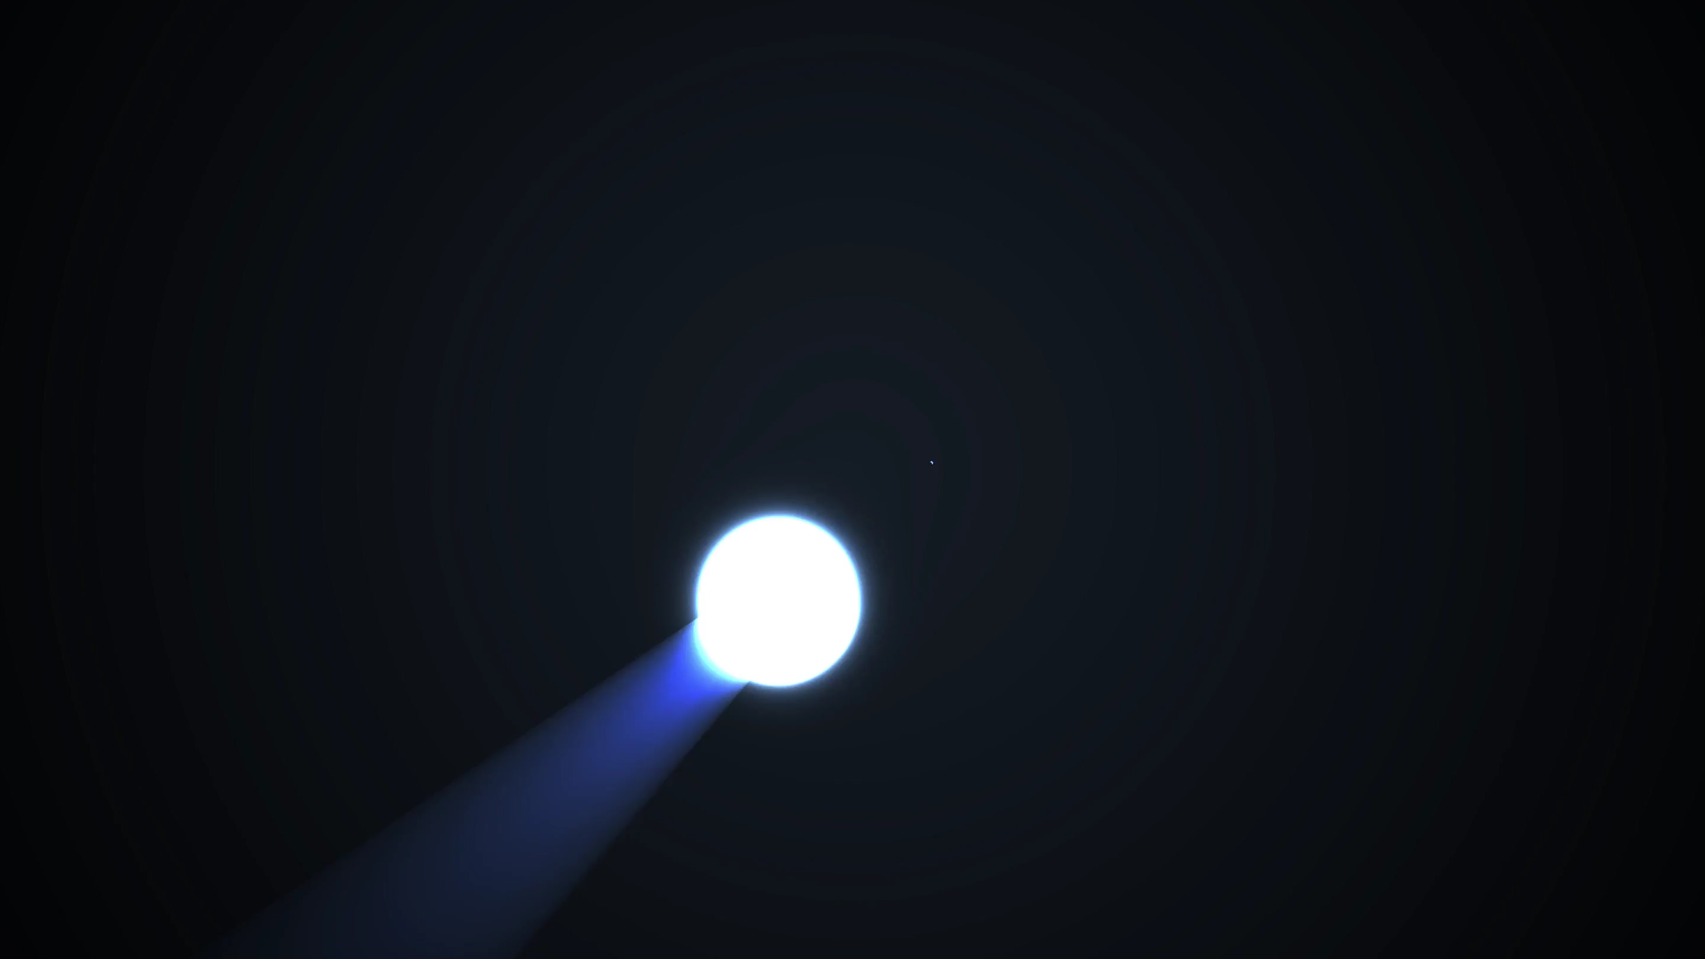
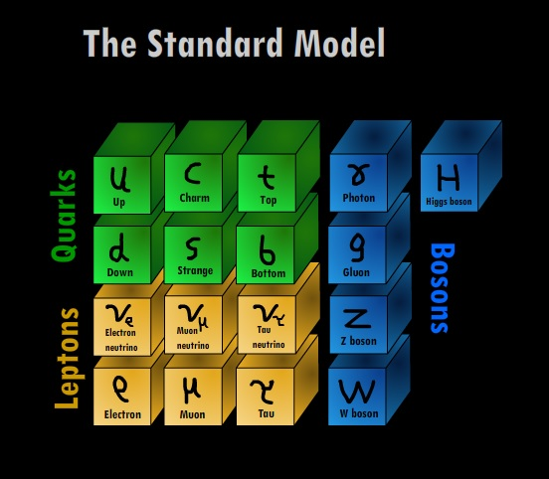
PHY3004: Nuclear and Particle Physics
Marcel Merk, Jacco de Vries, …

Slide 2
Lecture 1: “Particles”
Griffiths chapter 1
Classification of particles
Lepton: fundamental particle
Hadron: consist of quarks
  Meson: 1 quark + 1 antiquark (${π^{+}\text{,}B}_{s}^{0}$, …)
  Baryon: 3 quarks ($p$ ,$n$ , $Λ$, …)
    Anti-baryon: 3 anti-quarks
Fermion: particle with half-integer spin.
  Antisymmetric wave function: obeys Pauli-exclusion principle and Pauli-Dirac statistics
  All fundamental quarks and leptons are spin-½
  Baryons (S=$1/2$, $3/2$)
Boson: particle with integer spin
  Symmetric wave function: Bose-Einstein statistics
  Mesons: (S=$0$, $1$), Higgs (S=$0$)
  Force carriers: $γ$, $W$, $Z$, $g$ (S=$1$); graviton(S=$2$)

Slide 3
Lecture 2: “Forces”
Griffiths chapter 2
EM (QED)
Weak
Propagator:
$\frac{1}{{{ M}_{W}^{2}−q}^{2}}$
ElectroWeak
Vertex: $e$
Vertex: $e$
Propagator: $\frac{1}{q^{2}}$
Vertex:$\frac{g}{2\sqrt{2}}$
Vertex:$\frac{g}{2\sqrt{2}}$
Strong (QCD)
$$g_{r\overline{b}}$$
$$g_{g\overline{b}}$$
$$g_{r\overline{b}}$$
$$g_{b\overline{r}}$$
QCD
$$g_{r\overline{b}}$$
$$q$$
$$g_{r\overline{g}}$$
$$g_{g\overline{r}}$$
$$q$$
$$g_{g\overline{r}}$$

Slide 4
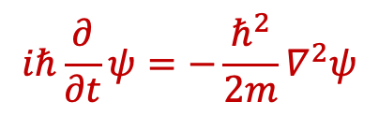
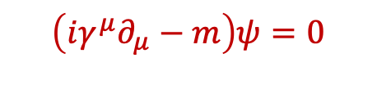




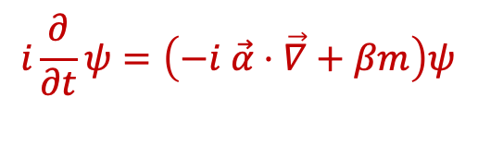
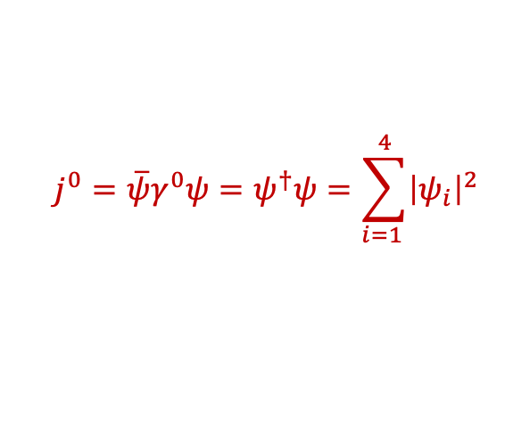


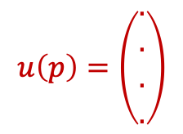
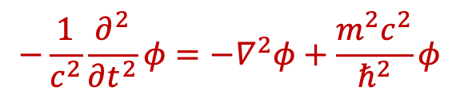

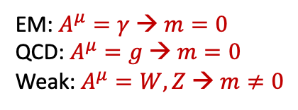

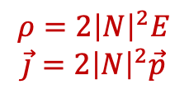
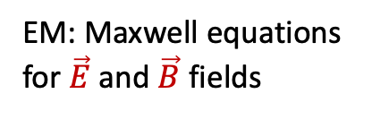
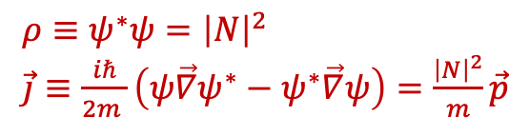

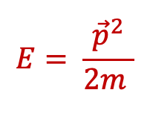
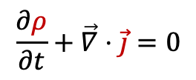


Lecture 3: “Waves” – wave equations
Probability interpretation
(Continuity equation)
Quantum Mechanics:
$E→\hat{E}=iℏ\frac{∂}{∂t}$ ; $p→\hat{p}=−iℏ\vec{∇}$
$$\frac{∂ρ}{∂t}+\vec{∇}⋅\vec{j}=0$$
Non-relativistic spin 0:
Schrödinger:
$ρ≡ψ^{∗}ψ={\left|N\right|}^{2}$
$\vec{j}≡\frac{iℏ}{2m }\left(ψ\vec{∇}ψ^{∗}−ψ^{∗}\vec{∇}ψ\right)=\frac{{\left|N\right|}^{2}}{m}\vec{p}$
$$E= \frac{{\vec{p}}^{2}}{2m }$$
  $$iℏ\frac{∂}{∂t}ψ=−\frac{ℏ^{2}}{2m}∇^{2}ψ$$
$$ψ=Ne^{i\left(\vec{p}\vec{x}−Et\right)}$$
Relativistic spin 0:
Klein-Gordon:
  $$−\frac{1}{c^{2}}\frac{∂^{2}}{∂t^{2}}φ=−∇^{2}φ+\frac{m^{2}c^{2}}{ℏ^{2}}φ$$
$$j^{μ}\left(ρ,\vec{j}\right)=i\left[φ^{∗}\left(∂^{μ}φ\right)−φ\left(∂^{μ}φ^{∗}\right)\right]$$
$$E^{2}=p^{2}c^{2}+m^{2}c^{4}$$
$$ρ=2{\left|N\right|}^{2}E$$
$$\vec{j}=2{\left|N\right|}^{2}\vec{p}$$
$$j^{μ}=2{\left|N\right|}^{2}p^{μ}$$
Example: pions
$$∂_{μ}∂^{μ}φ+m^{2}φ=0$$
$$φ=Ne^{i\left(\vec{p}\vec{x}−Et\right)}$$
Relativistic spin- ½:
Dirac:
$$i\frac{∂}{∂t}ψ=\left(−i \vec{α}⋅\vec{∇}+βm\right)ψ$$
$$ψ=u(p)e^{i\left(\vec{p}\vec{x}−Et\right)}$$
$$j^{μ}=\overline{ψ}γ^{μ}ψ$$
$$H=\left(\vec{α}⋅\vec{p}+βm\right)$$
$$u\left(p\right)=\left(\begin{aligned}. \\ . \\ . \\ .\end{aligned}\right)$$
  $$j^{0}=\overline{ψ}γ^{0}ψ=ψ^{†}ψ=\sum_{i=1 }^{4}{{\left|ψ_{i}\right|}^{2}}$$
Fundamental
quarks and leptons
  $$\left(iγ^{μ}∂_{μ}−m\right)ψ=0$$
Relativistic spin-1:
Proca:
EM: $A^{μ}=γ$ → $m=0$
QCD: $A^{μ}=g$ → $m=0$
Weak: $A^{μ}=W,Z$ → $m≠0$
EM: Maxwell equations
for $\vec{E}$ and $\vec{B}$ fields
Fundamental
force carriers
$$∂_{μ}∂^{μ}A^{ν}+m^{2}A^{ν}=j^{ν}$$

Slide 5

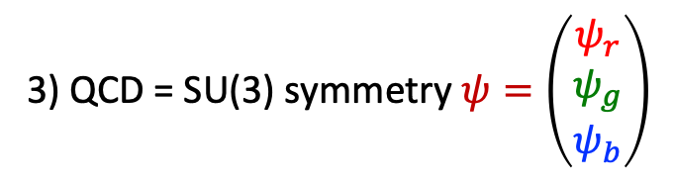

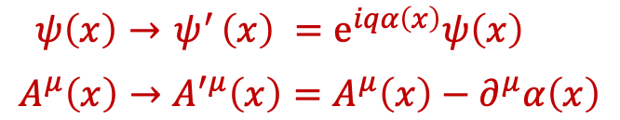
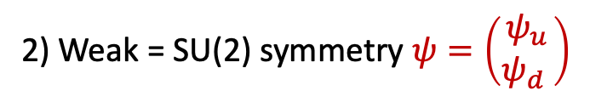


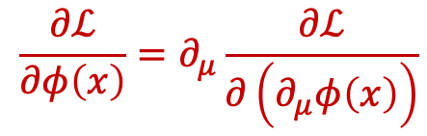

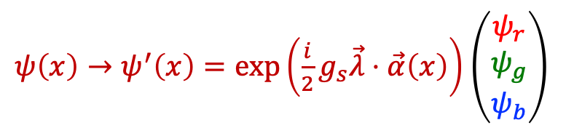


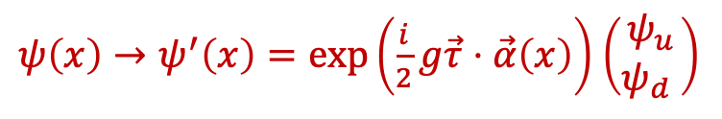
Lecture 3: “Waves” – gauge invariance
Lagrangians:
Spin 0 Scalar field (“pion”): $ℒ=\frac{1}{2}\left(∂_{μ}φ\right)\left(∂^{μ}φ\right)−{\frac{1}{2}m}^{2}φ^{2}$
Spin ½ Dirac fermion: $ℒ=i\overline{ψ}γ_{μ}∂^{μ}ψ−m\overline{ψ}ψ$
Spin 1 gauge boson (“photon”) :$ℒ=−\frac{1}{4}\left(∂^{μ}A^{ν}−∂^{ν}A^{μ}\right)\left(∂_{μ}A_{ν}−∂_{ν}A_{μ}\right)−j^{μ}A_{μ}$
Euler Lagrange lead to the wave equations:
$$\frac{∂ℒ}{∂φ\left(x\right)}=∂_{μ}\frac{∂ℒ}{∂\left(∂_{μ}φ\left(x\right)\right)}$$
All forces result from requiring a symmetry principle: Lagrangian should stay invariant
1) QED = U(1) symmetry
$$ℒ=i\overline{ψ}γ_{μ}∂^{μ}ψ−m\overline{ψ}ψ$$
$$ℒ=i\overline{ψ}γ_{μ} D^{μ}ψ−m\overline{ψ}ψ$$
$ψ\left(x\right)→{ ψ}^{′}\left(x\right) =e^{iqα\left(x\right)}ψ\left(x\right)$
$$A^{μ}\left(x\right)→A^{′μ}\left(x\right)=A^{μ}\left(x\right)−∂^{μ}α\left(x\right)$$
Covariant derivative:
$$∂^{μ}→D^{μ}≡∂^{μ}+iqA^{μ}$$
$$ℒ=i\overline{ψ}γ_{μ}{ ∂}^{μ}ψ−m\overline{ψ}ψ −q{\overline{ψ}γ_{μ}ψA}^{μ}$$
➔ 1 E.M. photon field: $A^{μ}\left(x\right)$
“interaction”
“free”
3) QCD = SU(3) symmetry $ψ=\left(\begin{matrix}ψ_{r} \\ ψ_{g} \\ ψ_{b}\end{matrix}\right)$
2) Weak = SU(2) symmetry $ψ=\left(\begin{matrix}ψ_{u} \\ ψ_{d} \end{matrix}\right)$
$ψ\left(x\right)→ψ^{′}\left(x\right)=exp\left(\frac{i}{2}g_{s}\vec{λ}⋅\vec{α}\left(x\right)\right)$ $\left(\begin{matrix}ψ_{r} \\ ψ_{g} \\ ψ_{b}\end{matrix}\right)$
$ψ\left(x\right)→ψ^{′}\left(x\right)=exp\left(\frac{i}{2}g\vec{τ}⋅\vec{α}\left(x\right)\right)$ $\left(\begin{matrix}ψ_{u} \\ ψ_{d} \end{matrix}\right)$
➔ 3 weak fields: $W^{μ+}\left(x\right),{ W^{μ}}^{−}\left(x\right), Z^{μ}\left(x\right)$
➔ 8 colored gluon fields: $g^{μ}\left(x\right)$

Slide 6
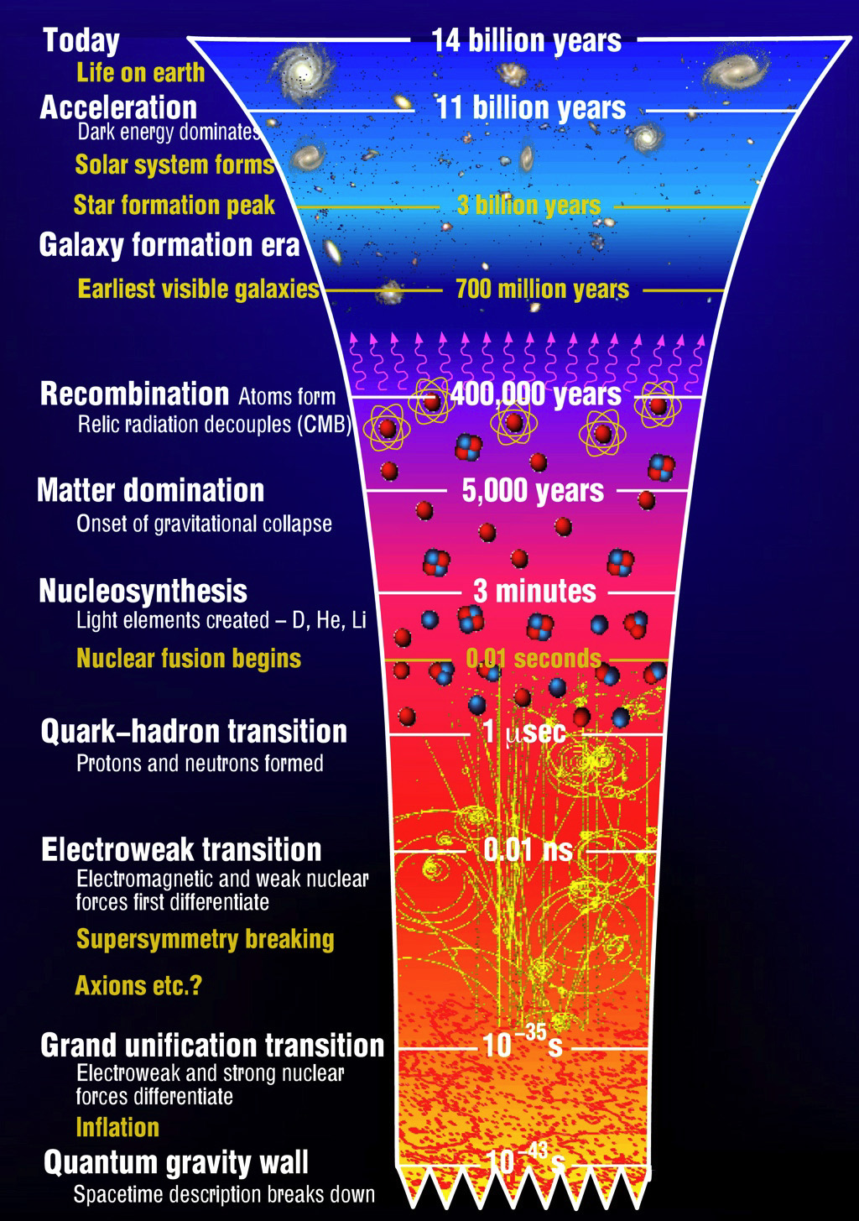
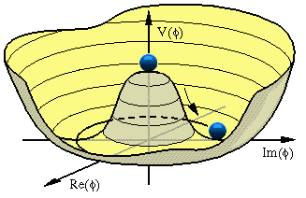
Recap: “Seeing the wood for the trees”
Lecture 1: “Particles”
  Zooming into constituents of matter
  Skills: distinguish particle types, Spin
Lecture 2: “Forces”
  Exchange of quanta: EM, Weak, QCD
  Skills: 4-vectors, Feynman diagrams
Lecture 3: “Waves”
  Quantum fields and gauge invariance
  Dirac algebra, Lagrangian, co- & contra variant
Lecture 4: “Symmetries”
  Standard Model, Higgs, Discrete Symmetries
  Skills: Lagrangians, Chirality & Helicity
Lecture 5: “Scattering”
  Cross section, decay, perturbation theory
  Skills: Dirac-delta function, Feynman Calculus
Lecture 6: “Detectors”
  Energy loss mechanisms, detection technologies
$$g_{Z}$$
$$Z$$
$$g_{Z}$$
$$\frac{1}{q^{2}−M_{Z}^{2}}$$

Slide 7
Lecture 4: “Symmetries”
Gauge Symmetries: Standard Model
Symmetry Breaking: Higgs Mechanism
Discrete Symmetries
Griffiths 9.7, PP1 Lect 9
Griffiths 10.7-9, PP1 Lect 11
Griffiths chapter 4

Slide 8
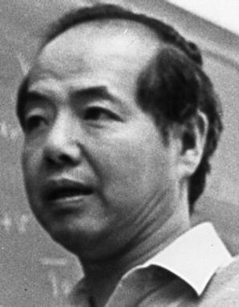
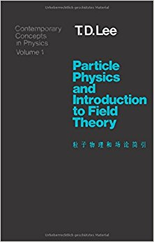
Symmetry and non-observables
T.D.Lee: “The root to all symmetry principles lies in the assumption that it is impossible to observe certain basic quantities; the non-observables”
There are four main types of symmetry:
Permutation symmetry:
Bose-Einstein and Fermi-Dirac Statistics
Continuous space-time symmetries:
translation, rotation, velocity, acceleration,…
Discrete symmetries:
space inversion, time reversal, charge conjugation,…
Unitary symmetries: gauge invariances:
U₁(charge), SU₂(isospin), SU₃(color),…
If a quantity is fundamentally non-observable it is related to an exact symmetry
If it could in principle be observed by an improved measurement; the symmetry is said to be broken
Noether Theorem:
symmetry
conservation law
Notes:
Symmetries are fundamental. Relation between symmetries and non-observables: mention each. 1) identity of QM particle 2) absolute position, direction 3) handedness, directionof time, sign of charge 4)internal symmetries: phase of a wave function, rotation in SU(N) (p-n) differenc.e
Space-time symmetry: supersymmetry??
Broken Symmetries: Discrete

Slide 9
Symmetry and non-observables
Non-observables | Symmetry Transformations | Conservation Laws or Selection Rule
Difference between identical particles | Permutation | B.-E. or F.-D. statistics
Absolute spatial position | Space translation: $\vec{r}→\vec{r}+\vec{Δ}$ | momentum
Absolute time | Time translation: $t→t+ τ$ | energy
Absolute spatial direction | Rotation: $\vec{r}→\vec{r}′$ | angular momentum
Absolute velocity | Lorentz transformation | generators of the Lorentz group
Absolute right (or left) | $$\vec{r}→−\vec{r}$$ | parity
Absolute sign of electric charge | $$e→−e$$ | charge conjugation
Relative phase between states of different charge Q | $$ψ→e^{iθQ}ψ$$ | charge
Relative phase between states of different baryon number B | $$ψ→e^{iθN}ψ$$ | baryon number
Relative phase between states of different lepton number L | $$ψ→e^{iθL}ψ$$ | lepton number
Difference between different coherent mixture of p and n states | $$\left({p \atop n}\right)→U\left({p \atop n}\right)$$ | isospin
Notes:
Non-observable: acceleration vs gravity

Slide 10
Symmetry and non-observables: example
Simple example: potential energy $V$ between two charged particles:
Absolute position is a non-observable:
The interaction is independent on the choice of the origin 0.
Symmetry:
V is invariant under arbitrary
space translations:
0’
0
Consequently:
Total momentum is conserved:
Notes:
Gradient is zero because dr_1(V)=-dr_2(V)

Slide 11
Lecture 4: “Symmetries”
Part 1
Gauge Symmetries in
The Standard Model
Griffiths 9.7, PP1 Lect 9

Slide 12


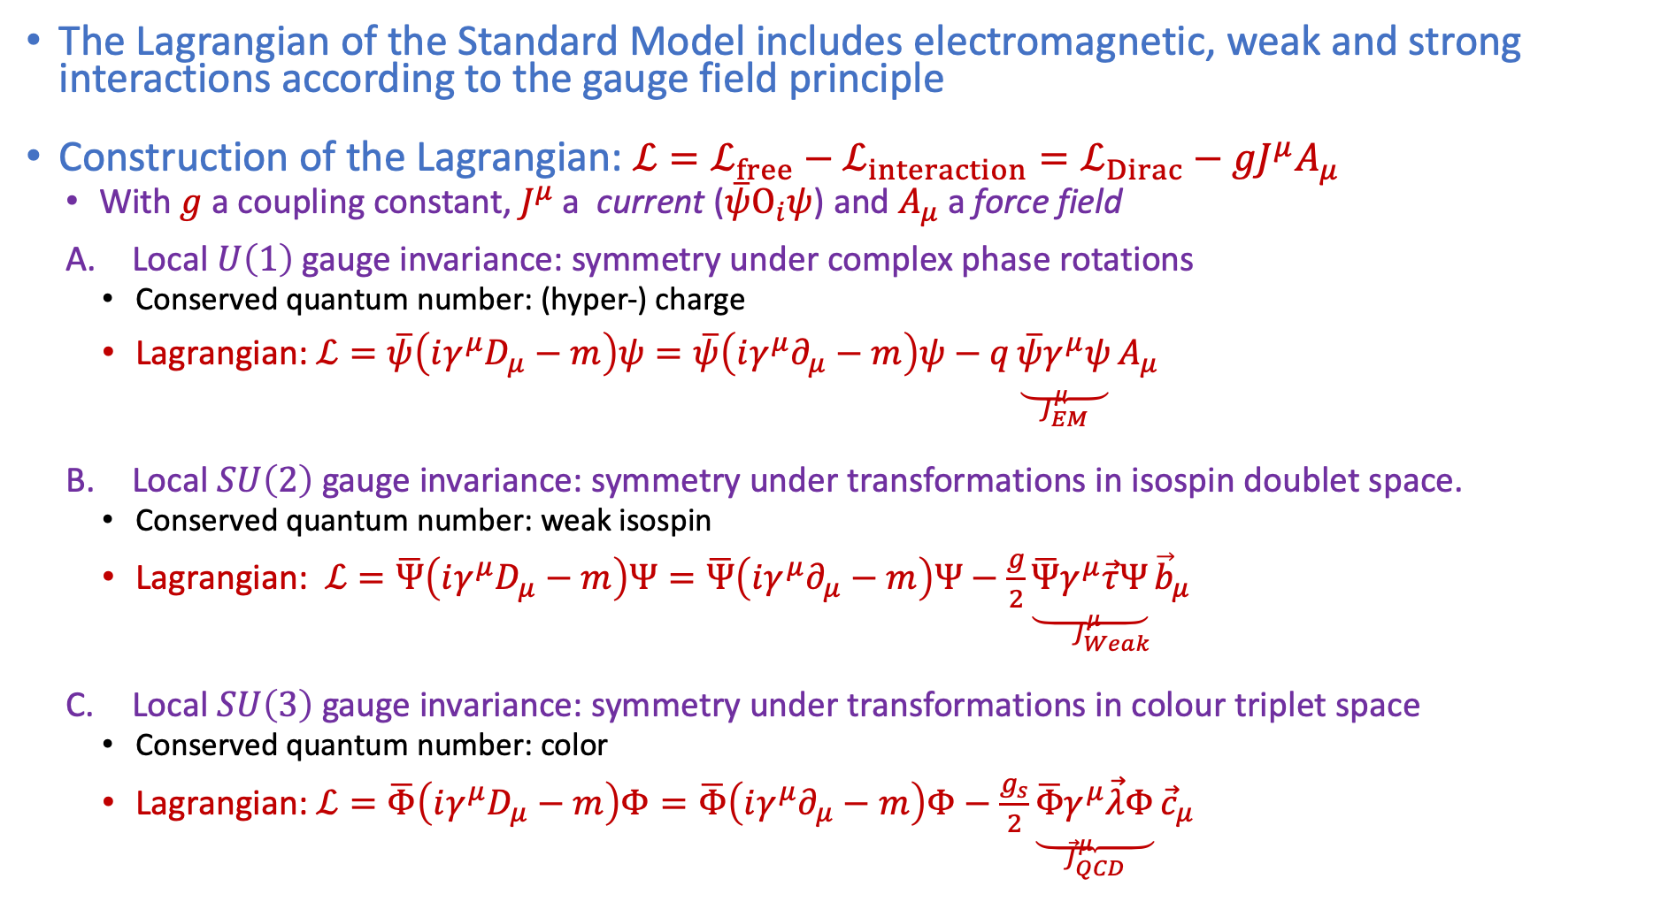




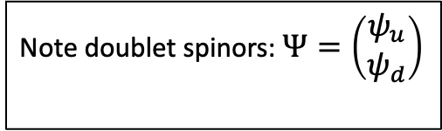

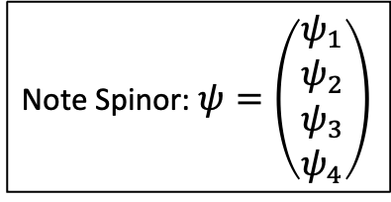

Standard Model
Griffiths §10.3, §10.4, §10.5
The Lagrangian of the Standard Model includes electromagnetic, weak and strong interactions according to the gauge field principle
Construction of the Lagrangian: $ℒ=ℒ_{free}−ℒ_{interaction}=ℒ_{Dirac}−{gJ}^{μ}A_{μ}$
  With $g$ a coupling constant, $J^{μ}$ a current ($\overline{ψ}Ο_{i}ψ$) and $A_{μ}$ a force field
  Local $U\left(1\right)$ gauge invariance: symmetry under complex phase rotations
    Conserved quantum number: (hyper-) charge
    Lagrangian: $ℒ=\overline{ψ}\left(iγ^{μ}D_{μ}−m\right)ψ=\overline{ψ}\left(iγ^{μ}∂_{μ}−m\right)ψ−q\underset{J_{EM}^{μ}}{\underbrace{\overline{ψ}γ^{μ}ψ}}A_{μ}$
  Local $SU\left(2\right)$ gauge invariance: symmetry under transformations in isospin doublet space.
    Conserved quantum number: weak isospin
    Lagrangian: $ℒ=\overline{Ψ}\left(iγ^{μ}D_{μ}−m\right)Ψ=\overline{Ψ}\left(iγ^{μ}∂_{μ}−m\right)Ψ−\frac{g}{2}\underset{J_{Weak}^{μ}}{\underbrace{\overline{Ψ}γ^{μ}\vec{τ}Ψ}{\vec{b}}_{μ}}$
  Local $SU\left(3\right)$ gauge invariance: symmetry under transformations in colour triplet space
    Conserved quantum number: color
    Lagrangian: $ℒ=\overline{Φ}\left(iγ^{μ}D_{μ}−m\right)Φ=\overline{Φ}\left(iγ^{μ}∂_{μ}−m\right)Φ−\frac{g_{s}}{2}\underset{{\vec{J}}_{QCD}^{μ}}{\underbrace{\overline{Φ}γ^{μ}\vec{λ}Φ}}{\vec{c}}_{μ}$
Note Spinor: $ψ=\left(\begin{matrix}ψ_{1} \\ \begin{aligned}ψ_{2} \\ ψ_{3} \\ ψ_{4}\end{aligned}\end{matrix}\right)$
$$\left(∂_{μ}→D_{μ}≡∂_{μ}+iqA_{μ}\right)$$
Note doublet spinors: $Ψ=\left(\begin{matrix}ψ_{u} \\ ψ_{d}\end{matrix}\right)$
with $ψ_{u}, ψ_{d}$ spinors
$\left(I∂_{μ}→D_{μ}=I∂_{μ}+igB_{μ}\right)$ ;
$$B_{μ}=\frac{1}{2}\vec{τ}⋅{\vec{b}}_{μ}=\frac{1}{2}τ_{1}^{a}b_{μ}^{a}=\frac{1}{2}\left(\begin{matrix}b_{3} & b_{1}−ib_{2} \\ b_{1}+ib_{2} & −b_{3}\end{matrix}\right)$$
Note triplet spinors: $Φ=\left(\begin{matrix}ψ_{r} \\ \begin{aligned}ψ_{g} \\ ψ_{b}\end{aligned}\end{matrix}\right)$
$$\left(I∂_{μ}→D_{μ}=I∂_{μ}+ig_{s}C_{μ}\right)$$
$C_{μ}$are 3x3 matrices →gluon fields
$ψ_{r}, ψ_{g}, ψ_{b}$ spinors
Notes:
Forget gravity

Slide 13

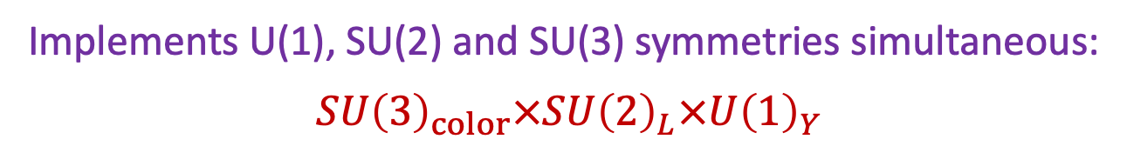
Standard Model
Griffiths §10.3, §10.4, §10.5
The Lagrangian of the Standard Model includes electromagnetic, weak and strong interactions according to the gauge field principle
Construction of the Lagrangian: $ℒ=ℒ_{free}−ℒ_{interaction}=ℒ_{Dirac}−{gJ}^{μ}A_{μ}$
  With $g$ a coupling constant, $J^{μ}$ a current ($\overline{ψ}Ο_{i}ψ$) and $A_{μ}$ a force field
  Local $U\left(1\right)$ gauge invariance: symmetry under complex phase rotations
    Conserved quantum number: (hyper-) charge
    Lagrangian: $ℒ=\overline{ψ}\left(iγ^{μ}D_{μ}−m\right)ψ=\overline{ψ}\left(iγ^{μ}∂_{μ}−m\right)ψ−q\underset{J_{EM}^{μ}}{\underbrace{\overline{ψ}γ^{μ}ψ}}A_{μ}$
  Local $SU\left(2\right)$ gauge invariance: symmetry under transformations in isospin doublet space.
    Conserved quantum number: weak isospin
    Lagrangian: $ℒ=\overline{Ψ}\left(iγ^{μ}D_{μ}−m\right)Ψ=\overline{Ψ}\left(iγ^{μ}∂_{μ}−m\right)Ψ−\frac{g}{2}\underset{J_{Weak}^{μ}}{\underbrace{\overline{Ψ}γ^{μ}\vec{τ}Ψ}{\vec{b}}_{μ}}$
  Local $SU\left(3\right)$ gauge invariance: symmetry under transformations in colour triplet space
    Conserved quantum number: color
    Lagrangian: $ℒ=\overline{Φ}\left(iγ^{μ}D_{μ}−m\right)Φ=\overline{Φ}\left(iγ^{μ}∂_{μ}−m\right)Φ−\frac{g_{s}}{2}\underset{{\vec{J}}_{QCD}^{μ}}{\underbrace{\overline{Φ}γ^{μ}\vec{λ}Φ}}{\vec{c}}_{μ}$
Standard Model symmetry
Standard Model Lagrangian:
$$ℒ=\overline{ψ}\left(iγ^{μ}D_{μ}−m\right)ψ=\overline{ψ}\left(iγ^{μ}∂_{μ}−m\right)ψ−qJ_{EM}^{μ}A_{μ} −\frac{g}{2}J_{Weak}^{μ}{\vec{b}}_{μ}−\frac{g_{s}}{2}J_{QCD }^{μ}{\vec{c}}_{μ}$$
Implements U(1), SU(2) and SU(3) symmetries simultaneous:
$$SU{\left(3\right)}_{color}×SU{\left(2\right)}_{L}×U{\left(1\right)}_{Y}$$
Requiring the Lagrangian to be invariant (symmetry) implies that the EM, Weak and Strong force fields must exist and the interactions respectively conserve charge, weak isospin, and color.
Notes:
Forget gravity

Slide 14

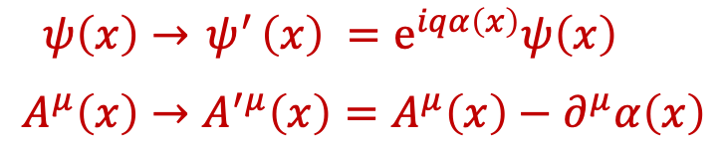


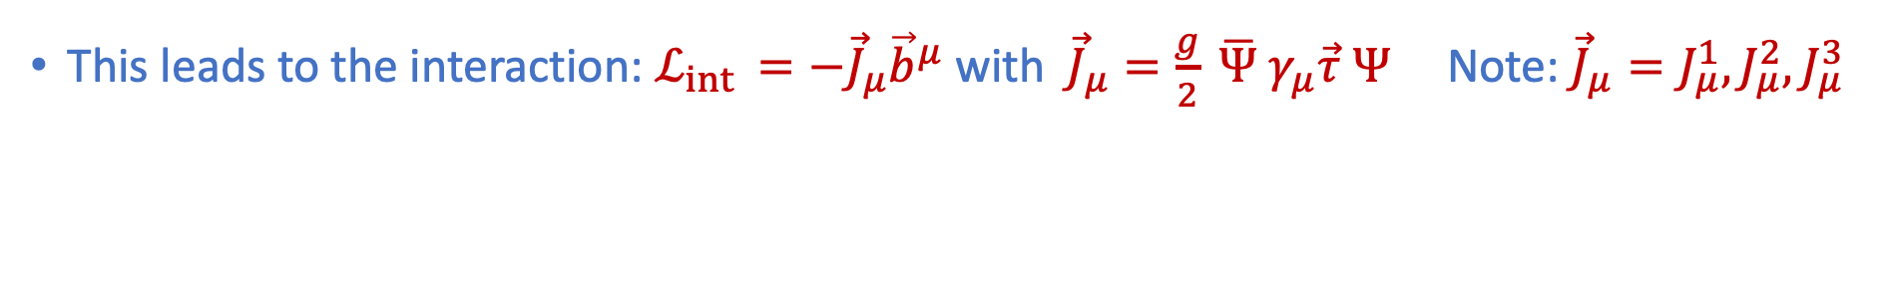




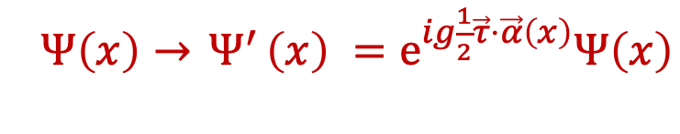

Electromagnetism and Weak force
U(1) gauge transformations require that the laws of physics (i.e. the Lagrangian) is invariant under:
$ψ\left(x\right)→{ ψ}^{′}\left(x\right) =e^{iqα\left(x\right)}ψ\left(x\right)$
$$A^{μ}\left(x\right)→A^{′μ}\left(x\right)=A^{μ}\left(x\right)−∂^{μ}α\left(x\right)$$
Electromagnetic field gauge transformation
$$\left(∂_{μ}→D_{μ}≡∂_{μ}+iqA_{μ}\right)$$
$$A^{μ}$$
$$q$$
This leads to the interaction: $ℒ_{int }=−J_{μ}A^{μ}$ with $J_{μ}=q\overline{ψ}γ_{μ}ψ$
SU(2) gauge transformations require that the laws of physics (i.e. the Lagrangian) is invariant under:
$Ψ\left(x\right)→{ Ψ}^{′}\left(x\right) =e^{ig\frac{1}{2}\vec{τ}⋅\vec{α}\left(x\right)}Ψ\left(x\right)$
With doublets $Ψ=\left({ψ_{u} \atop ψ_{d}}\right)$ and $\overline{Ψ}=\left(ψ_{u} , ψ_{d}\right)$
$\left(I∂_{μ}→D_{μ}=I∂_{μ}+igB_{μ}\right)$ ;
$$B_{μ}=\frac{1}{2}\vec{τ}⋅{\vec{b}}_{μ}=\frac{1}{2}τ_{1}^{a}b_{μ}^{a}=\frac{1}{2}\left(\begin{matrix}b_{3} & b_{1}−ib_{2} \\ b_{1}+ib_{2} & −b_{3}\end{matrix}\right)$$
This leads to the interaction: $ℒ_{int }=−{\vec{J}}_{μ}{\vec{b}}^{μ}$ with ${\vec{J}}_{μ}=\frac{g}{2} \overline{Ψ} γ_{μ}\vec{τ} Ψ$ Note: ${{\vec{J}}_{μ}=J}_{μ}^{1}, J_{μ}^{2},J_{μ}^{3}$
Weak Isospin: $T_{i}=\frac{1}{2}τ_{i}$
$\vec{τ}= τ_{1}, τ_{2}, τ_{3}$ are the Pauli matrices: $τ_{1}=\left(\begin{matrix}0 & 1 \\ 1 & 0\end{matrix}\right)$ , $τ_{2}=\left(\begin{matrix}0 & −i \\ i & 0\end{matrix}\right)$ , $τ_{3}=\left(\begin{matrix}1 & 0 \\ 0 & −1\end{matrix}\right)$

Slide 15


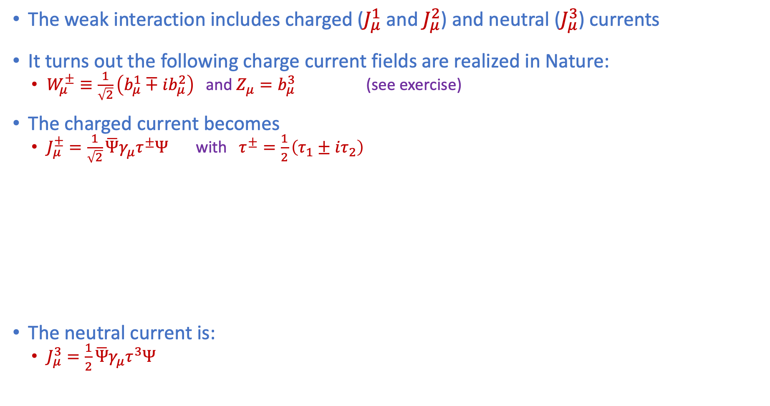










The weak force
Griffiths §9.5
The weak interaction includes charged ($J_{μ}^{1}$ and $J_{μ}^{2}$) and neutral ($J_{μ}^{3}$) currents
It turns out the following charge current fields are realized in Nature:
  $W_{μ}^{±}≡\frac{1}{\sqrt{2}}\left(b_{μ}^{1}∓ib_{μ}^{2}\right)$ and $Z_{μ}=b_{μ}^{3}$ (see exercise)
The charged current becomes
  $J_{μ}^{±}=\frac{1}{\sqrt{2}}\overline{Ψ}γ_{μ}τ^{±}Ψ$ with $τ^{±}=\frac{1}{2}\left(τ_{1}±iτ_{2}\right)$
The neutral current is:
  $J_{μ}^{3}=\frac{1}{2}\overline{Ψ}γ_{μ}τ^{3}Ψ$
$$τ^{+}=\left(\begin{matrix}0 & 1 \\ 0 & 0\end{matrix}\right)$$
$$τ^{−}=\left(\begin{matrix}0 & 0 \\ 1 & 0\end{matrix}\right)$$
Charge raising interaction:
$$J_{μ}^{+}=\frac{g}{2\sqrt{2}} \overline{ν} γ_{μ} e$$
$$J_{μ}^{+}=\frac{g}{2\sqrt{2}} \overline{u}{ γ}_{μ} d$$
$$\frac{g}{2\sqrt{2}}$$
$$\frac{g}{2\sqrt{2}}$$
Charge lowering interaction:
$$J_{μ}^{−}=\frac{g}{2\sqrt{2}} \overline{e} γ_{μ} ν$$
$$J_{μ}^{−}=\frac{g}{2\sqrt{2}}\overline{ d} γ_{μ} u$$
$$\frac{g}{2\sqrt{2}}$$
$$\frac{g}{2\sqrt{2}}$$
$$τ^{3}=\left(\begin{matrix}1 & 0 \\ 0 & −1\end{matrix}\right)$$
$$g_{Z}$$
Notes:
W_mu+- : note the reason for this….
Isospin highering and isosping lowering operators

Slide 16

Exercise – 18 : Charge Current
Show that the definition $W_{μ}^{±}=\frac{b_{μ}^{1}∓ib_{μ}^{2}}{\sqrt{2}}$ leads to the charged current:
$ℒ=−W_{μ}^{+}J^{μ^{+}}−W_{μ}^{−}{J^{μ}}^{−}$ with ${J^{μ}}^{+}=$ $\frac{g}{\sqrt{2}}\overline{Ψ}γ_{μ}τ^{+}Ψ$and ${J^{μ}}^{−}=$ $\frac{g}{\sqrt{2}}\overline{Ψ}γ_{μ}τ^{−}Ψ$

Slide 17
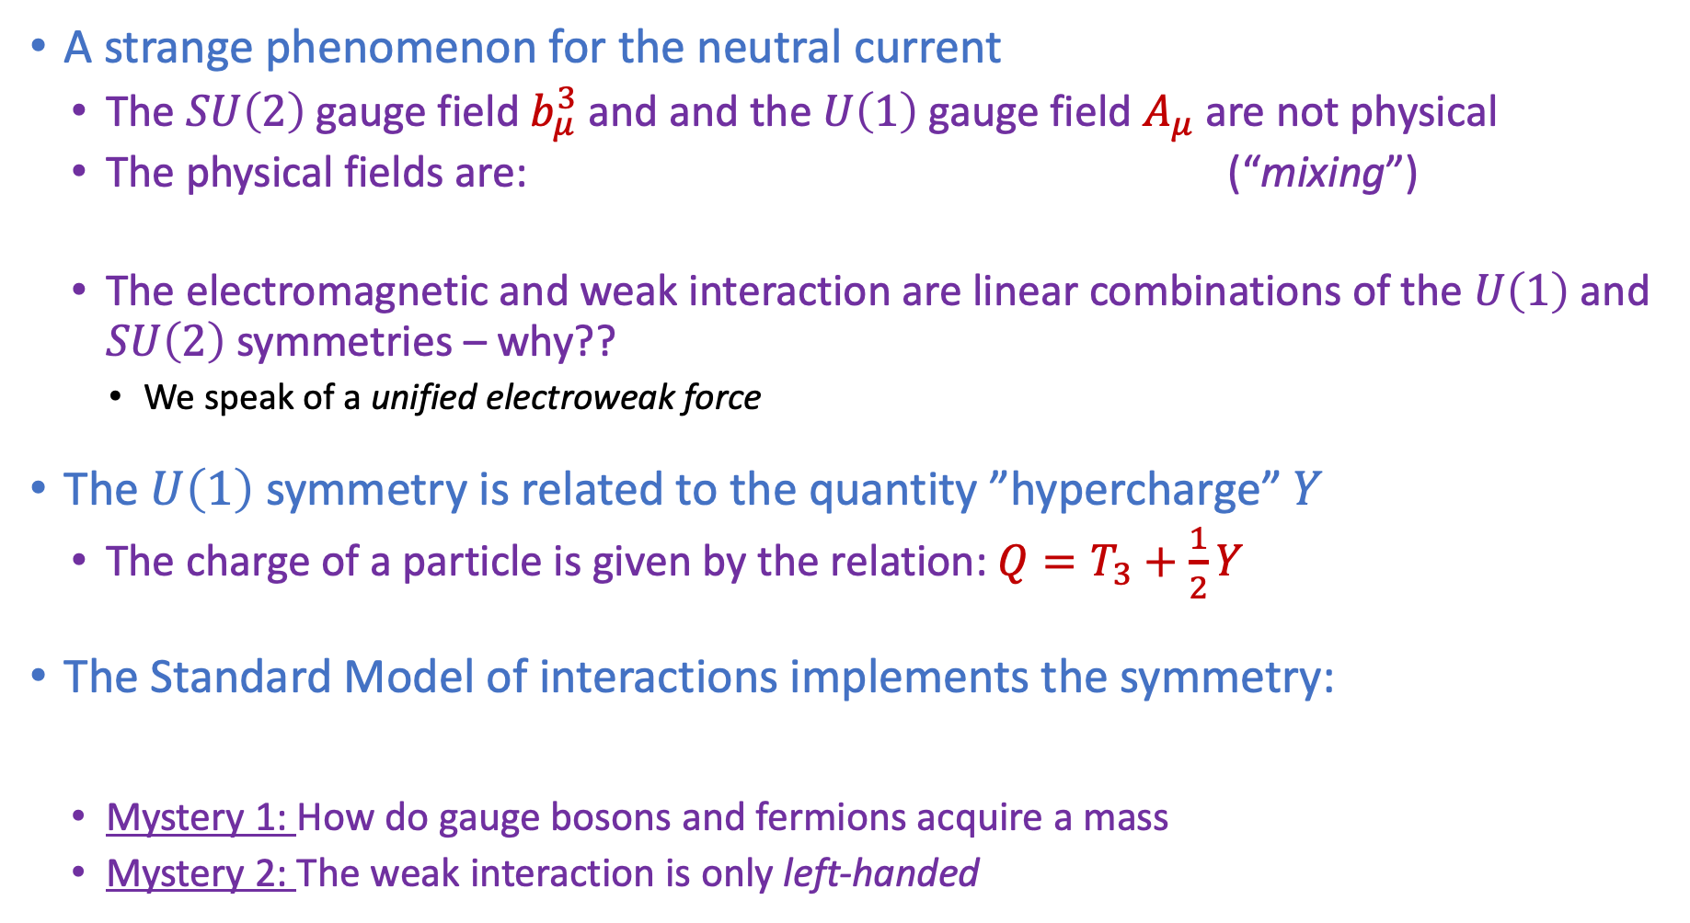

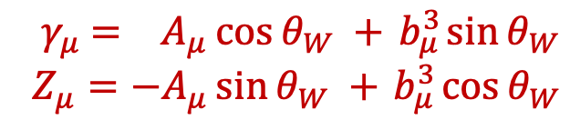
Electroweak unification
Griffiths §9.5 and §9.7
A strange phenomenon for the neutral current
  The $SU\left(2\right)$gauge field $b_{μ}^{3}$and and the $U\left(1\right)$gauge field $A_{μ}$ are not physical
  The physical fields are: (“mixing”)
  The electromagnetic and weak interaction are linear combinations of the $U\left(1\right)$ and $SU\left(2\right)$symmetries – why??
    We speak of a unified electroweak force
The $U\left(1\right)$ symmetry is related to the quantity ”hypercharge” $Y$
  The charge of a particle is given by the relation: $Q=T_{3}+\frac{1}{2}Y$
The Standard Model of interactions implements the symmetry:
  Mystery 1: How do gauge bosons and fermions acquire a mass
  Mystery 2: The weak interaction is only left-handed
${ γ}_{μ} = A_{μ}\cos{θ_{W} +{ b}_{μ}^{3}\sin{θ_{W}}}$
$Z_{μ}=−A_{μ}\sin{θ_{W} +{ b}_{μ}^{3}\cos{θ_{W}}}$
$$SU{\left(3\right)}_{color}×SU{\left(2\right)}_{L}×U{\left(1\right)}_{Y}$$

Slide 18
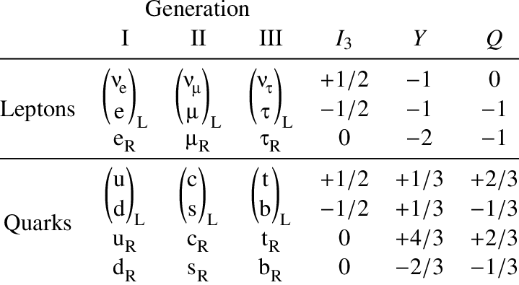
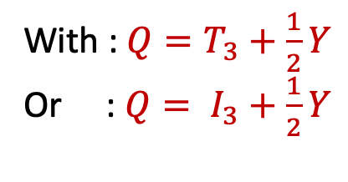
Electroweak Quantum Numbers
For weak isospin some people write $T_{3}$ while others write $I_{3}$
With : $Q=T_{3}+\frac{1}{2}Y$
Or : $Q= I_{3}+\frac{1}{2}Y$

Slide 19
Lecture 4: ”Symmetries”
Part 2
Electroweak Symmetry Breaking
The Higgs Mechanism
Griffiths 10.7-9, PP1 Lect 11

Slide 20
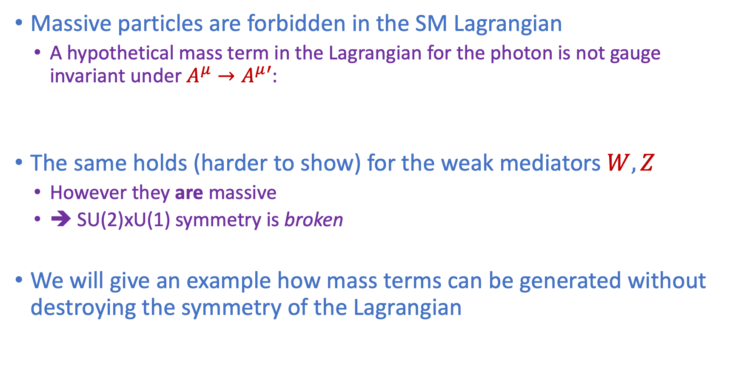
Symmetry breaking
Griffiths §10.7
Massive particles are forbidden in the SM Lagrangian
  A hypothetical mass term in the Lagrangian for the photon is not gauge invariant under $A^{μ}→A^{μ}′$:
The same holds (harder to show) for the weak mediators $W, Z$
  However they are massive
  ➔ SU(2)xU(1) symmetry is broken
We will give an example how mass terms can be generated without destroying the symmetry of the Lagrangian
$$m^{2}A_{μ}A^{μ}→m^{2}\left(A_{μ}+\frac{1}{e}∂_{μ}α\right)\left(A^{μ}+\frac{1}{e}∂^{μ}α\right)≠m^{2}A_{μ}A^{μ}$$

Slide 21
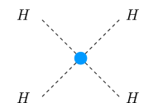
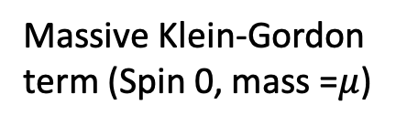
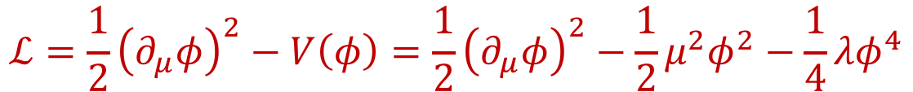


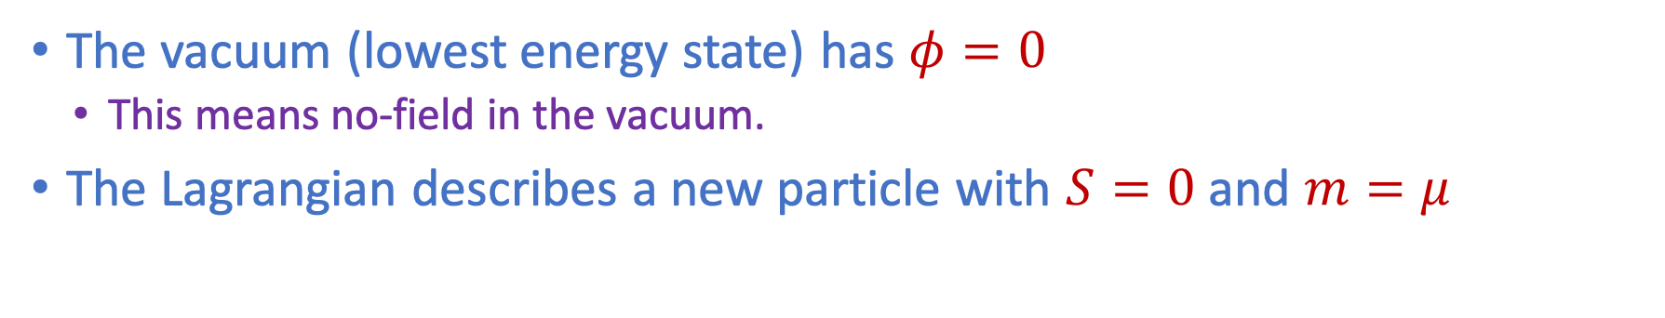
The idea of symmetry breaking with a new field $φ$
Griffiths §10.8
Add a new field $φ$ to the Lagrangian
  Chose a scalar field ($S=0$)
  Include a potential $V\left(φ\right):$ $ℒ=T−V$
Case A)
$$φ=$$
$$ℒ=\frac{1}{2}{\left(∂_{μ}φ\right)}^{2}−V\left(φ\right)=\frac{1}{2}{\left(∂_{μ}φ\right)}^{2}−\frac{1}{2}μ^{2}φ^{2}−\frac{1}{4}λφ^{4}$$
Massive Klein-Gordon
term (Spin 0, mass =$μ$)
Interaction term
The vacuum (lowest energy state) has $φ=0$
  This means no-field in the vacuum.
The Lagrangian describes a new particle with $S=0$ and $m=μ$
Notes:
... and it has dome phi^4 interaction

Slide 22


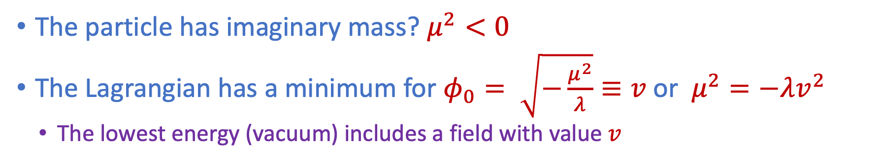

The idea of symmetry breaking with a new field $φ$
Griffiths §10.8
Add a new field $φ$ to the Lagrangian
  Chose a scalar field ($S=0$)
  Include a potential $V\left(φ\right):$ $ℒ=T−V$
Case B)
$$φ=$$
$$ℒ=\frac{1}{2}{\left(∂_{μ}φ\right)}^{2}−V\left(φ\right)=\frac{1}{2}{\left(∂_{μ}φ\right)}^{2}−\frac{1}{2}μ^{2}φ^{2}−\frac{1}{4}λφ^{4}$$
$$v$$
$$φ$$
Massive Klein-Gordon
term (Spin 0, mass =$μ$)
Interaction term
The particle has imaginary mass? $μ^{2}<0$
The Lagrangian has a minimum for $φ_{0}= \sqrt{−\frac{μ^{2}}{λ}}≡v$or $μ^{2}=−λv^{2}$
  The lowest energy (vacuum) includes a field with value $v$
Just do: $\frac{∂V}{∂φ}=0$
Notes:
Now the vacuum has a field!

Slide 23


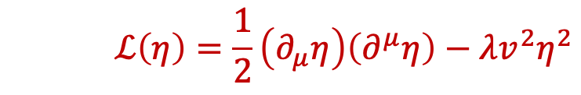
Exercise – 19 : Symmetry breaking
Griffiths §10.8
$$ℒ=\frac{1}{2}{\left(∂_{μ}φ\right)}^{2}−V\left(φ\right)=\frac{1}{2}{\left(∂_{μ}φ\right)}^{2}−\frac{1}{2}μ^{2}φ^{2}−\frac{1}{4}λφ^{4}$$
Case B)
Redefine coordinates: $η≡φ−v$
Exercise: re-write the Lagrangian in $η$and $v$ to show:
  Ignore the constant term $\frac{1}{4}λv^{4}$ and neglect higher order $η^{3}$:
  This describes a new scalar field $η$ with a mass $\frac{1}{2}m_{η}^{2}=λv^{2} ⇒ m_{η}=\sqrt{2λv^{2}}$($=\sqrt{−2μ^{2}}$)
  Price to pay: Lagrangian is no longer symmetric under $η→−η$ in the new field.
($η$ is the “shifted” field )
$$v$$
$$ℒ\left(η\right)=\frac{1}{2}\left(∂_{μ}η\right)\left(∂^{μ}η\right)−λv^{2}η^{2}−λvη^{3}−\frac{1}{4}λη^{4}−\frac{1}{4}λv^{4}$$
$$φ$$
$$ℒ\left(η\right)=\frac{1}{2}\left(∂_{μ}η\right)\left(∂^{μ}η\right)−λv^{2}η^{2}$$
mass
Notes:
Let's look at the vacuum around the minimum!
Instead of phi a new scalar field \eta
Symmetry is spontaneously broken because lowest energy state is not symmetric.

Slide 24



The idea of symmetry breaking with a new field $φ$
Griffiths §10.8
$$ℒ=\frac{1}{2}{\left(∂_{μ}φ\right)}^{2}−V\left(φ\right)=\frac{1}{2}{\left(∂_{μ}φ\right)}^{2}−\frac{1}{2}μ^{2}φ^{2}−\frac{1}{4}λφ^{4}$$
Case B)
Redefine coordinates: $η≡φ−v$
Exercise re-write the Lagrangian in $φ$and $v$ to show:
  Ignore the constant term $\frac{1}{4}λv^{4}$ and neglect higher order $η^{3}$:
  This describes a new scalar field $η$ with a mass $\frac{1}{2}m_{η}^{2}=λv^{2} ⇒ m_{η}=\sqrt{2λv^{2}}$($=\sqrt{−2μ^{2}}$)
  Price to pay: Lagrangian is no longer symmetric under $η→−η$ in the new field.
$$v$$
Conclusion:
The symmetry of the Lagrangian by adding a symmetric potential $φ$ has not been destroyed
The vacuum is no longer in a symmetric position
➔ The physical case includes a complex field $φ$
$$ℒ\left(η\right)=\frac{1}{2}\left(∂_{μ}η\right)\left(∂^{μ}η\right)−λv^{2}η^{2}−λvη^{3}−\frac{1}{4}λη^{4}−\frac{1}{4}λv^{4}$$
$$φ$$
$$ℒ\left(η\right)=\frac{1}{2}\left(∂_{μ}η\right)\left(∂^{μ}η\right)−λv^{2}η^{2}$$

Slide 25





Symmetry breaking with a complex field $φ$
Griffiths §10.9
Introduce a complex scalar field: $φ=\frac{1}{\sqrt{2}}\left(φ_{1}+iφ_{2}\right)$
The Lagrangian term is: $ℒ={\left(∂_{μ}φ\right)}^{∗}\left(∂^{μ}φ\right)−V\left(φ\right)$ , with $V\left(φ\right)=μ^{2}\left(φ^{∗}φ\right)+λ {\left(φ^{∗}φ\right)}^{2}$
Lagrangian:
$ℒ\left(φ_{1},φ_{2}\right)=\frac{1}{2} {\left(∂_{μ}φ_{1}\right)}^{2}+\frac{1}{2} {\left(∂_{μ}φ_{2}\right)}^{2}$
$−\frac{1}{2}μ^{2}\left(φ_{1}^{2}+φ_{2}^{2}\right)−\frac{1}{4}λ{\left(φ_{1}^{2}+φ_{2}^{2}\right)}^{2}$
Case A)
Lagrangian:
$ℒ\left(φ_{1},φ_{2}\right)=\frac{1}{2} {\left(∂_{μ}φ_{1}\right)}^{2}−\frac{1}{2}μ^{2}\left(φ_{1}^{2}\right) +\frac{1}{2} {\left(∂_{μ}φ_{2}\right)}^{2}−\frac{1}{2}μ^{2}\left(φ_{2}^{2}\right)$
$+$interaction terms
Particle $φ_{1}$, mass $μ$
Particle $φ_{2}$, mass $μ$

Slide 26


Symmetry breaking with a complex field $φ$
Griffiths §10.9
Introduce a complex scalar field: $φ=\frac{1}{\sqrt{2}}\left(φ_{1}+iφ_{2}\right)$
The Lagrangian term is: $ℒ={\left(∂_{μ}φ\right)}^{∗}\left(∂^{μ}φ\right)−V\left(φ\right)$ , with $V\left(φ\right)=μ^{2}\left(φ^{∗}φ\right)+λ {\left(φ^{∗}φ\right)}^{2}$
Lagrangian:
$ℒ\left(φ_{1},φ_{2}\right)=\frac{1}{2} {\left(∂_{μ}φ_{1}\right)}^{2}+\frac{1}{2} {\left(∂_{μ}φ_{2}\right)}^{2}$
$−\frac{1}{2}μ^{2}\left(φ_{1}^{2}+φ_{2}^{2}\right)−\frac{1}{4}λ{\left(φ_{1}^{2}+φ_{2}^{2}\right)}^{2}$
Case B)
$$μ^{2}<0$$
We now have a whole circle of vacua to chose from:
$\sqrt{φ_{1}^{2}+φ_{2}^{2}}=\sqrt{\frac{−μ^{2}}{λ}}=v$
Symmetry breaking: chose [1]: $φ_{0}=\frac{1}{\sqrt{2}}\left(v+η+iξ\right)$

Slide 27



Symmetry breaking with a complex field $φ$
Griffiths §10.9
Redefine coordinates: $η=φ_{1}−v , ξ=φ_{2}$ , $φ_{0}=\frac{1}{\sqrt{2}}\left(v+η+iξ\right)$
Exercise: rewrite the Lagrangian ignoring constant terms and higher order terms:
$ℒ=\frac{1}{2}{\left(∂_{μ}η\right)}^{2}−\left(λv^{2}\right)η^{2}$ + $\frac{1}{2}{\left(∂_{μ}ξ\right)}^{2}−0⋅ξ^{2}$ + higher order terms
Case B)
massive scalar particle $μ$
massless scalar particle $ξ$
The Lagrangian is still symmetric
The vacuum is no longer symmetric
We have a massive scalar and a massless scalar
  The latter is called a Goldstone boson.
Symmetry breaking: chose [1]: $φ_{0}=\frac{1}{\sqrt{2}}\left(v+η+iξ\right)$

Slide 28






Higgs Mechanism
Griffiths §10.9
The Higgs mechanism breaks the symmetry of the (electro-)weak interaction
  Works along the lines as described in previous slides; introduce a complex SU(2) doublet
  Details beyond the scope these lectures, idea as follows:
Electroweak Lagrangian:
  Where the covariant derivatives:
  U(1): and SU(2):
Higgs field is weak isospin doublet: ;
  With the potential: $V\left(φ\right)=μ^{2}\left(φ^{†}φ\right)+λ{\left(φ^{†}φ\right)}^{2}$ where: $μ^{2}<0$
$$ℒ=\overline{ψ}\left(iγ^{μ}D_{μ}−m\right)ψ+{\left(D_{μ}φ\right)}^{†}\left(D^{μ}φ\right)−V\left(φ\right)$$
$ψ\left(x\right)→{ ψ}^{′}\left(x\right) =e^{iα\left(x\right)}ψ\left(x\right)$
$$A^{μ}\left(x\right)→A^{′μ}\left(x\right)=A^{μ}\left(x\right)−\frac{1}{q}∂^{μ}α\left(x\right)$$
$⇒{ D}^{μ} =∂^{μ}+iqA^{μ}$
$ψ\left(x\right)→ψ^{′}\left(x\right)=G\left(x\right)ψ\left(x\right)$
with $G\left(x\right) =exp\left(\frac{i}{2}\vec{τ}⋅\vec{α}\left(x\right)\right)$
$B_{μ}^{′}=GB_{μ}G^{−1}+\frac{i}{g} \left(∂_{μ}G\right)G^{−1}$
$⇒{ D}_{μ}=I∂_{μ}+igB_{μ}$
$$φ=\left(\begin{matrix}φ^{+} \\ φ^{0}\end{matrix}\right)=\frac{1}{\sqrt{2}}\left(\begin{matrix}φ_{1}+iφ_{2} \\ φ_{3}+iφ_{4}\end{matrix}\right)$$
$$φ_{0}=\frac{1}{\sqrt{2}}\left(\begin{matrix}0 \\ v\end{matrix}\right)$$

Slide 29

Higgs Mechanism : Resulting phenomenology
Griffiths §10.9
The Higgs mechanism breaks the symmetry of the (electro-)weak interaction
  The Higgs choses a preferred direction in weak isospin space
  One massive Higgs scalar field remains – due to field excitations around $v$; the earlier $η$ term
  Three massless Goldstone bosons appear, but they are re-written as massterms for the gauge fields of the broken symmetry.
    The $W^{+}, W^{−}, Z^{0}$ bosons acquire mass.
  The photon remains massless
Higgs and fermions:
  The SM allows to couple the Higgs field to fermion isospin doublets:
    The vacuum expectation value of the Higgs gives rise the fermion masses
    Mass term: $m_{f}=Y_{f}⋅\frac{1}{\sqrt{2}}v$ where $Y_{f}$ is a particle constant.
      For the top quark: $Y_{f}=1$ ?!
Mass eigenstates and interaction eigenstates:
  The Higgs and the $W$ boson do not agree on the ”generation” eigenstates, see lecture 2.
  The Higgs couplings give rise to the $CKM$ elements

Slide 30
Exercise – 20 : Mass of the proton
Besides giving mass to the weak vector bosons, it was briefly flashed that the same Higgs mechanism is responsible for giving mass to the fermion masses in the Standard Model, through ad-hoc Yukawa couplings. The mass of a 'naked' quark can be estimated through models of soft QCD, where it enters as a parameter for e.g. the binding energy of a meson. For up and down, they are found to be roughly 2 resp. 5 MeV/c .
What fraction of the proton mass is due to the Higgs mass of the constituent quarks?
Can you find out where the other part of the proton mass comes from?

Slide 31
See also:
https://en.wikipedia.org/wiki/Mathematical_formulation_of_the_Standard_Model

Slide 32
Lecture 4: ”Symmetries”
Part 3
Discrete Symmetries
Griffiths chapter 4

Slide 33
Discrete Symmetries
Is nature invariant if we look at it through a mirror?

Slide 34
Discrete C, P, T Symmetries
6
Parity, P: unobservable: (absolute handedness)
  Reflects a system through the origin.
  Converts right-handed to left-handed.
    $\vec{x}→−\vec{x}$ , $\vec{p}→−\vec{p }$ (vectors) but $\vec{L}=\vec{x} × \vec{p}$ (axial vectors)
Charge Conjugation, C: unobservable: (absolute charge)
  Turns internal charges to opposite sign.
    $e^{+}→e^{−} , K^{−}→K^{+ }$
Time Reversal, T: unobservable: (direction of time)
  Changes direction of motion of particles
    $t→−t$
CPT Theorem:
  All interactions are invariant under combined C, P and T operation
  A particle is an antiparticle travelling backward in time
  Implies e.g. particle and anti-particle have equal masses and lifetimes
+
−
Notes:
CPT → Lagrangian is Hermitian L(x)=>L-dagger(-x)

Slide 35

Parity: Helicity and Chirality
Parity image
  $\vec{L}=\vec{r}×\vec{p} → −\vec{r}×−\vec{p}=\vec{L}$
  Same for spin $\vec{S}$
Helicity: spin projection on momentum
  $λ=\vec{σ}⋅\vec{p} → \vec{σ}⋅−\vec{p}=−λ$
  The mirror of left-handed = right-handed
Chirality:
  If you, as observer overtake the electron, it changes from left handed to right-handed
  How is it for a neutrino – zero mass?
    You cannot overtake it.
    Chirality is the helicity in the relativistic limit: $m→ 0 ; v→c$

Slide 36




Exercise – 21 : Helicity vs Chirality
Write out the chirality operator $γ^{5}$ in the Dirac-Pauli representation.
The helicity operator is defined as $λ=\frac{1}{2}\vec{Σ}⋅\hat{p}$ . Show that helicity operator and the chirality operator have the same effect on a spinor solution, i.e.
in the relativistic limit where $E≫m$
Show explicitly that for a Dirac spinor:
$\overline{ψ}γ^{μ}ψ=\overline{ψ_{L}}γ^{μ}ψ_{L}+\overline{ψ_{R}}γ^{μ}ψ_{R}$ making use of $ψ=ψ_{L}+ψ_{R}$ and the
projection operators: $ψ_{L}=\frac{1}{2}\left(1−γ^{5}\right)$ and $ψ_{R}=\frac{1}{2}\left(1+γ^{5}\right)$
Explain why the weak interaction is called left-handed.
$$γ^{5}ψ=γ^{5}\left(\begin{matrix}χ^{(s)} \\ \frac{\vec{σ}⋅\vec{p}}{E+m}χ^{(s)}\end{matrix}\right)≈λ\left(\begin{matrix}χ^{\left(s\right)} \\ \frac{\vec{σ}⋅\vec{p}}{E+m}χ^{(s)}\end{matrix}\right)=λψ$$
with: $χ^{(1)}=\left(\begin{matrix}1 \\ 0\end{matrix}\right)$ ; $χ^{(2)}=\left(\begin{matrix}0 \\ 1\end{matrix}\right)$
Wolfgang Pauli
  “I cannot believe God is a weak left-hander.”

Slide 37


The weak interaction of particles is “left-handed”
Look at the weak pion decay: $π^{−}→μ^{−}{\overline{ν}}_{μ}$ in the pion:
  $π^{−}→μ^{−}\overline{ν} :$ muon spin was found right handed: anti-neutrino is also right handed (R.H.)
Spin = ½
Spin = 0
Spin = ½
R.H. helicity
R.H. helicity
Compare to the decay: $π^{+}→μ^{+}ν$and measure the spin of the muon:
  $π^{+}→μ^{+}ν :$ anti-muon spin was found left-handed: neutrino is also left handed (L.H.)
Since neutrino’s are ultra-relativistic ($m≈0$): neutrino’s are always left-handed
anti-neutrino’s are always right handed
➔ The weak interaction maximally violates parity symmetry!

Slide 38



Classical Mirror Worlds
→ Invariant!
Parity P: $\vec{x}→−\vec{x}$ , $\vec{p}→−\vec{p}$
  Mass $m$ $P m=m$ : scalar
  Force $\vec{F}$ $(\vec{F}=d\vec{p}/dt)$ $P \vec{F}=P{d\vec{p}}/{dt}=−{d\vec{p}}/{dt=−\vec{F}}$ : vector
  Acceleration $\vec{a}$ $(\vec{a}={d^{2}\vec{x}}/{dt^{2})}$ $P \vec{a}=−{d^{2}x}/{dt^{2}}=−\vec{a}$ : vector
  Angular momentum $\vec{L}, \vec{S}, \vec{J}$ $(\vec{L}=\vec{x}×\vec{p})$ $P \vec{L}=−\vec{x} × −\vec{p}= \vec{L}$ : axial vector
Parity: Newton’s law is invariant under P-operation (i.e. the same in the mirror world):
$\vec{F}=m \vec{a} \underset{→}{ P } −\vec{F}=−m\vec{a} ⇔ \vec{F}=m\vec{ a}$
Charge: Lorentz Force in the C-mirror world is invariant:
$$\vec{F}=q \left[\vec{E}+\vec{v}×\vec{B}\right] \underset{→}{ C } \vec{F}=−q\left[−\vec{E}+\vec{v}×−\vec{B}\right]$$
Time: laws of physics are also invariant unchanged under T-reversal, since:
$\vec{F}=m \vec{a}=m \frac{d^{2}\vec{x}}{dt^{2}} \underset{→}{ T } \vec{F}=m\frac{d^{2}\vec{x}}{d{\left(−t\right)}^{2}} ⇔ \vec{F}=m\vec{ a}$
$$iℏ\frac{∂ψ}{∂t}=−\frac{ℏ^{2}}{2m}{\vec{∇}}^{2}ψ$$
QM: Consider Schrodinger’s equation $(t→−t$) :
Complex conjugation is required to stay invariant:
$$ψ\underset{→}{ T }ψ^{∗}$$
Notes:
Unitary U^dagger U = 1 or U ^dagger = U^-1.
Eigenvalues of unitary matrices are orthogonal, but not necessarily real (like Hermitean matrices).
P\psi(r) = e^iphi/2 \psi(-r) , since an overall phase is unobservable.

Slide 39
C-, P-, T- Symmetry
Classical Theory is invariant under C, P, T operations; i.e. they conserve C, P, T symmetry
  Newton mechanics, Maxwell electrodynamics.
Suppose we watch some physical event. Can we determine unambiguously whether:
  We are watching the event where all charges are reversed or not?
  We are watching the event in a mirror or not?
    Macroscopic biological asymmetries are considered accidents of evolution rather than fundamental asymmetry in the laws of physics.
  We are watching the event in a film running backwards or not?
    The arrow of time is due to thermodynamics: i.e. the realization of a macroscopic final state is statistically more probable than the initial state
Notes:
Macroscopic: human body, left handed molecules etc.
Second law of thermodynamics

Slide 40

Macroscopic time reversal (T.D. Lee)
At each crossing: 50% - 50% choice to go left or right
After many decisions: reverse the velocity of the final state and return
Do we end up with the initial state?
Notes:
But the microscopic laws of physics for each decision (50%-50% choice) are time inversion invariant.

Slide 41
Macroscopic time reversal (T.D. Lee)
Very unlikely!
At each crossing: 50% - 50% choice to go left or right
After many decisions: reverse the velocity of the final state and return
Do we end up with the initial state?
Notes:
But the microscopic laws of physics for each decision (50%-50% choice) are time inversion invariant.

Slide 42

Macroscopic time reversal

Slide 43
Parity Violation
9
Before 1956 physicists were convinced that the laws of nature were left-right symmetric. Strange?
A “gedanken” experiment: consider two perfectly mirror symmetric cars:
Gas pedal
Gas pedal
driver
driver
“L” and “R” are fully symmetric,
Each nut, bolt, molecule etc.
However the engine is a black box
“L”
“R”
Person “L” gets in, starts, ….. 60 km/h
Person “R” gets in, starts, ….. What happens?
What happens in case the ignition mechanism uses, say, Co⁶⁰ β decay?

Slide 44

The weak interaction is left handed
Look again at pion decay
Both Parity $P$ as well as charge conjugation $C$ symmetry are violated
  But happens if we do both: $CP$?

Slide 45
Weak Force breaks C and P, is CP really OK?
Weak interaction breaks C and P symmetry maximally!
  Nature is left-handed for matter and right-handed for antimatter.
Despite maximal violation of C and P, combined CP seemed conserved…
But in 1964, Christenson, Cronin, Fitch and Turlay observed CP violation in decays of neutral kaons!
C
e⁺_{R}
e⁻_{R}
W⁺
W⁻
ν_{L}
ν_{L}
e⁺_{L}
e⁻_{L}
P
W⁺
W⁻
ν_{R}
ν_{R}

Slide 46



Discovery of CP-Violation with Kaons
15
$K_{S}$: Short-lived is CP even:
$K_{1}^{0}→π^{+}π^{−}$ (fast)
$K_{L}$: Long-lived is CP odd:
$K_{2}^{0}→π^{+}π^{−}π^{0}$ (slow)
Create a pure $K_{L}$ beam (“wait” for $K_{S}$ to decay)
If CP is conserved, should not see $K_{L}→π^{+}π^{−}$
$$K^{0}$$
$$K_{L}→π^{+}π^{−}$$
James Cronin
Val Fitch
Effect is tiny:
about 2/1000
mass, $θ$
CPV Signal: $K_{L}→π^{+}π^{−}$
Expected Background: $K_{L}→π^{+}π^{−}π^{0}$
θ
cos θ
Notes:
Pion parity=-1. Signal will appear in Kaon mass window and zero theta angle.

Slide 47

Discovery of CP-Violation with Kaons
15
$K_{S}$: Short-lived is CP even:
$K_{1}^{0}→π^{+}π^{−}$ (fast)
$K_{L}$: Long-lived is CP odd:
$K_{2}^{0}→π^{+}π^{−}π^{0}$ (slow)
Create a pure $K_{L}$ beam (“wait” for $K_{S}$ to decay)
If CP is conserved, should not see $K_{L}→π^{+}π^{−}$
$$K^{0}$$
$$K_{L}→π^{+}π^{−}$$
James Cronin
Val Fitch
Effect is tiny:
about 2/1000
mass, $θ$
CPV Signal: $K_{L}→π^{+}π^{−}$
Expected Background: $K_{L}→π^{+}π^{−}π^{0}$
θ
cos θ
Notes:
Pion parity=-1. Signal will appear in Kaon mass window and zero theta angle.

Slide 48

Alternative: Charge Asymmetry in $K^{0}$ decays
Measure $A= \frac{N^{+}−N^{−}}{N^{+}+N^{−}}$ with $\begin{matrix}N^{+}=K^{0}→π^{−}e^{+}ν \\ N^{−}= \overline{K^{0}}→π^{+}e^{−}\overline{ν}\end{matrix}$ vs the $K^{0}$ decay time
$$A$$
Thesis Vera Luth, CERN 1974
$$K_{S}$$
$$K_{L}$$
$K^{0}→π^{−}e^{+}ν$ happens a bit
($ε$) more than $\overline{K^{0}}→π^{+}e^{−}\overline{ν}$
$$\left.|K_{L}\right\rangle = \frac{1}{\sqrt{2}}\frac{1}{\sqrt{1+{\left|ε\right|}^{2}}} \left[\left(1+ε\right)|\left.K^{0}\right\rangle +\left(1−ε\right)|\left.\overline{K^{0}}\right\rangle \right]$$
CP violation in meson mixing.
$→π^{−}e^{+}ν$
$$→π^{+}e^{−}\overline{ν}$$
Notes:
Create K0, particles, after time K_s has decayed and K_L remains. CPV in mixing. Thesis work at Heidelberg/CERN!

Slide 49



Contact with Aliens !
Are they made of matter or anti-matter?
Compare $K_{L}^{0}→π^{+}e^{−}\overline{ν}$ to $K_{L}^{0}→π^{−}e^{+}ν$
Compare the charge of the most abundantly produced electron with that of the electrons in your body:
If opposite: matter If equal: anti-matter

Slide 50








CP Violation & B-mesons
Example: $B^{0}→K^{+}π^{−}$
  Two quantum amplitudes (Feynman diagrams)
  Interference gives rise to CP violation
    Requires “strong” and “weak” phases
$$B^{0}/{\overline{B}}^{0}→K^{+}π^{−}$$
$${{\overline{B}}^{0}/B}^{0}→K^{−}π^{+}$$
$$A=A_{1}+A_{2}e^{iφ}e^{iδ}$$
$$\overline{A}=A_{1}+A_{2}e^{−iφ}e^{iδ}$$
$${\left|A\right|}^{2}={\left|A_{1}\right|}^{2}+{\left|A_{2}\right|}^{2}+A_{1}A_{2}\left(e^{iφ}e^{iδ}+e^{−iφ}e^{−iδ}\right)$$
“Tree”= $A_{1}$
“Penguin”= $A_{2}$
$${\left|\overline{A}\right|}^{2}={\left|A_{1}\right|}^{2}+{\left|A_{2}\right|}^{2}+A_{1}A_{2}\left(e^{−iφ}e^{iδ}+e^{iφ}e^{−iδ}\right)$$
$${\left|A−\overline{A}\right|}^{2}=4 A_{1}A_{2}\sin{φ}\sin{δ}$$

Slide 51
CP Violation is a hot topic at the LHCb experiment

Slide 52

CPT Violation…
CPT symmetry implies that an antiparticle is identical to a particle travelling backwards in time.

Slide 53
Symmetry breaking in the early universe
Higgs mechanism generates mass
  For the weak bosons
  For the fermions
Higgs couplings lead to CKM couplings
3 generations allow for CP violation
Can it explain the matter anti-matter asymmetry?
  So far: no!

Slide 54
Exercise – 22 : Symmetries
What do you think is the difference between an exact and a broken symmetry?
Can you explain the name spontaneous symmetry breaking means?
Which symmetry is involved in the gauge theories below? Which of these gauge symmetries are exact? Why/Why not?
  U1(Q) symmetry
  SU2(u-d-flavour) symmetry
  SU3(u-d-s-flavour) symmetry
  SU6(u-d-s-c-b-t) symmetry
  SU3(colour) symmetry
  SU5(Grand unified) symmetry
  SuperSymmetry

Slide 55
Lecture 4: Discussion Topics
Discussions Topics belonging to Lecture 4

Slide 56
Topic-10: Symmetry and non-observables
Explain the idea behind non observables
What are the symmetries and non-observables related to:
  Electromagnetism
  Weak interaction
  Strong interaction
  C-violation
  P-Violation
  T-Violation

Slide 57
Topic-10: Symmetry and non-observables
T.D.Lee: “The root to all symmetry principles lies in the assumption that it is impossible to observe certain basic quantities; the non-observables”
There are four main types of symmetry:
Permutation symmetry:
Bose-Einstein and Fermi-Dirac Statistics
Continuous space-time symmetries:
translation, rotation, velocity, acceleration,…
Discrete symmetries:
space inversion, time reversal, charge conjugation,…
Unitary symmetries: gauge invariances:
U₁(charge), SU₂(isospin), SU₃(color),…
If a quantity is fundamentally non-observable it is related to an exact symmetry
If it could in principle be observed by an improved measurement; the symmetry is said to be broken
Noether Theorem:
symmetry
conservation law
Notes:
Symmetries are fundamental. Relation between symmetries and non-observables: mention each. 1) identity of QM particle 2) absolute position, direction 3) handedness, directionof time, sign of charge 4)internal symmetries: phase of a wave function, rotation in SU(N) (p-n) differenc.e
Space-time symmetry: supersymmetry??
Broken Symmetries: Discrete

Slide 58
Topic-10: Symmetry and non-observables
Non-observables | Symmetry Transformations | Conservation Laws or Selection Rule
Difference between identical particles | Permutation | B.-E. or F.-D. statistics
Absolute spatial position | Space translation: $\vec{r}→\vec{r}+\vec{Δ}$ | momentum
Absolute time | Time translation: $t→t+ τ$ | energy
Absolute spatial direction | Rotation: $\vec{r}→\vec{r}′$ | angular momentum
Absolute velocity | Lorentz transformation | generators of the Lorentz group
Absolute right (or left) | $$\vec{r}→−\vec{r}$$ | parity
Absolute sign of electric charge | $$e→−e$$ | charge conjugation
Relative phase between states of different charge Q | $$ψ→e^{iθQ}ψ$$ | charge
Relative phase between states of different baryon number B | $$ψ→e^{iθN}ψ$$ | baryon number
Relative phase between states of different lepton number L | $$ψ→e^{iθL}ψ$$ | lepton number
Difference between different coherent mixture of p and n states | $$\left({p \atop n}\right)→U\left({p \atop n}\right)$$ | isospin
Notes:
Non-observable: acceleration vs gravity

Slide 59
Topic-10: Symmetry and non-observables: example
Simple example: potential energy $V$ between two charged particles:
Absolute position is a non-observable:
The interaction is independent on the choice of the origin 0.
Symmetry:
V is invariant under arbitrary
space translations:
0’
0
Consequently:
Total momentum is conserved:
Notes:
Gradient is zero because dr_1(V)=-dr_2(V)

Slide 60
Topic-11: Broken symmetries
What do you think is the difference between an exact and a broken symmetry?
Can you explain the name spontaneous symmetry breaking means?
Which symmetry is involved in the gauge theories below? Which of these gauge symmetries are exact? Why/Why not?
  U1(Q) symmetry
  SU2(u-d-flavour) symmetry
  SU3(u-d-s-flavour) symmetry
  SU6(u-d-s-c-b-t) symmetry
  SU3(colour) symmetry
  SU5(Grand unified) symmetry
  SuperSymmetry

Slide 61
Lecture 4: Exercises
Exercises belonging to Lecture 4

Slide 62
Exercise – 13 : Charge Current
Show that the definition $W_{μ}^{±}=\frac{b_{μ}^{1}∓ib_{μ}^{2}}{\sqrt{2}}$ leads to the charged current:
$ℒ=−W_{μ}^{+}J^{μ^{+}}−W_{μ}^{−}{J^{μ}}^{−}$ with ${J^{μ}}^{+}=$ $\frac{g}{\sqrt{2}}\overline{Ψ}γ_{μ}τ^{+}Ψ$and ${J^{μ}}^{−}=$ $\frac{g}{\sqrt{2}}\overline{Ψ}γ_{μ}τ^{−}Ψ$

Slide 63
Exercise – 14 : Symmetry breaking
$$ℒ=\frac{1}{2}{\left(∂_{μ}φ\right)}^{2}−V\left(φ\right)=\frac{1}{2}{\left(∂_{μ}φ\right)}^{2}−\frac{1}{2}μ^{2}φ^{2}−\frac{1}{4}λφ^{4}$$
Case B)
Redefine coordinates: $η≡φ−v$
Exercise: re-write the Lagrangian in $η$and $v$ to show:
  Ignore the constant term $\frac{1}{4}λv^{4}$ and neglect higher order $η^{3}$:
  This describes a new scalar field $η$ with a mass $\frac{1}{2}m_{η}^{2}=λv^{2} ⇒ m_{η}=\sqrt{2λv^{2}}$($=\sqrt{−2μ^{2}}$)
  Price to pay: Lagrangian is no longer symmetric under $η→−η$ in the new field.
$$v$$
$$ℒ\left(η\right)=\frac{1}{2}\left(∂_{μ}η\right)\left(∂^{μ}η\right)−λv^{2}η^{2}−λvη^{3}−\frac{1}{4}λη^{4}−\frac{1}{4}λv^{4}$$
$$φ$$
$$ℒ\left(η\right)=\frac{1}{2}\left(∂_{μ}η\right)\left(∂^{μ}η\right)−λv^{2}η^{2}$$

Slide 64
Exercise – 15 : Mass of the proton
Besides giving mass to the weak vector bosons, it was briefly flashed that the same Higgs mechanism is responsible for giving mass to the fermion masses in the Standard Model, through ad-hoc Yukawa couplings. The mass of a 'naked' quark can be estimated through models of soft QCD, where it enters as a parameter for e.g. the binding energy of a meson. For up and down, they are found to be roughly 2 resp. 5 MeV/c .
What fraction of the proton mass is due to the Higgs mass of the constituent quarks?
Can you find out where the other part of the proton mass comes from?

Slide 65




Exercise – 16: Dirac delta function (1)
See Griffiths Appendix A
Consider a function defined by the following prescription:
The integral of this function is normalized:
For a function $f\left(x\right)$ we have: $f\left(x\right)δ\left(x\right)=f\left(0\right)δ\left(x\right)$
…and therefore:
Exercise:
  Prove that: $δ\left(kx\right)=\frac{1}{\left|k\right|}δ\left(x\right)$
  Prove that: $δ\left(g\left(x\right)\right)=\sum_{i=1}^{n}{\frac{1}{\left|g^{′}\left(x_{i}\right)\right|}}δ\left(x−x_{i}\right)$ , where $g\left(x_{i}\right)=0$ are the zero-points
    Hint: make a Taylor expansion of $g$ around the 0-points.
$$δ\left(x\right)=\lim_{Δ→0 }\left\{\begin{matrix}1/Δ for \left|x\right|<Δ/2 \\ 0 otherwise\end{matrix}\right.$$
$$\int_{−∞}^{∞}{δ\left(x\right) dx}=1$$
$$\int_{−∞}^{∞}{f\left(x\right)δ\left(x\right) dx}=f\left(0\right)\int_{−∞}^{∞}{δ\left(x\right) dx}=f\left(0\right)$$
Notes:
Introduce a very special function;
Infitine at 0 and 0 everywhere else
Surface = 1

Slide 66





Exercise – 16: Dirac delta function (2)
$$δ\left(x\right)= \lim_{α→∞ }{\frac{1}{π}\frac{\sin^{2}{αx}}{αx^{2}}}$$
The delta function has many forms. One of them is:
  Make this plausible by sketching the function $\sin^{2}\left(αx\right)/(παx^{2})$ for two relevant values of $α$
Remember the Fourier transform:
  Use this to show that another (important!) representation of the Dirac delta-function is given by:
$$f\left(x\right)=\frac{1}{2π}\int_{−∞}^{∞}{g\left(k\right) e^{ikx} dk}$$
$$g\left(k\right)=\int_{−∞}^{∞}{f\left(x\right) e^{−ikx} dx}$$
$$δ\left(x\right)=\frac{1}{2π}\int_{−∞}^{∞}{e^{ikx} dk}$$
⬅ We will use this later in the lecture!

