Slide 1
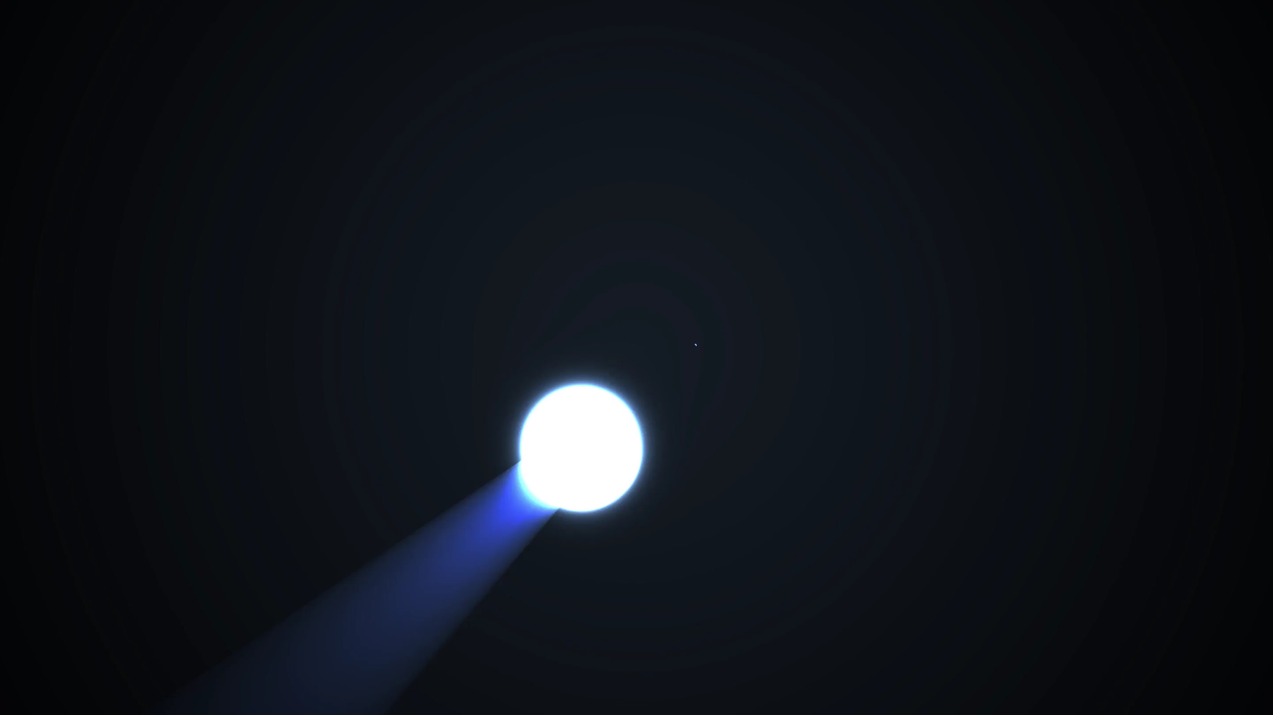
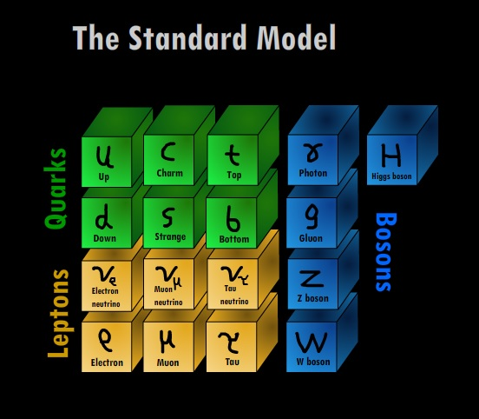
PHY3004: Nuclear and Particle Physics
Marcel Merk, Jacco de Vries

Slide 2
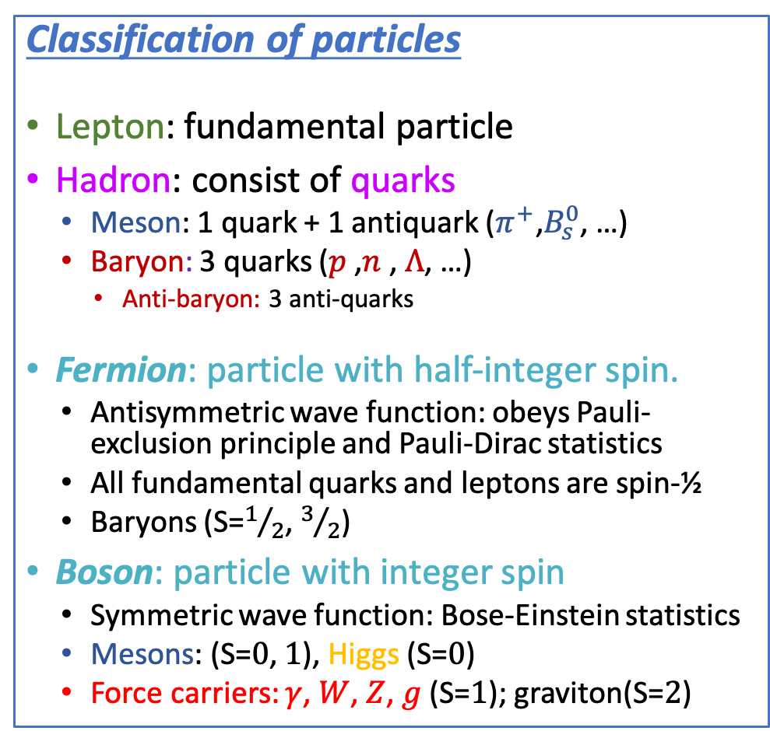
Lecture 1: “Particles”
Griffiths chapter 1
Classification of particles
Lepton: fundamental particle
Hadron: consist of quarks
  Meson: 1 quark + 1 antiquark (${π^{+}\text{,}B}_{s}^{0}$, …)
  Baryon: 3 quarks ($p$ ,$n$ , $Λ$, …)
    Anti-baryon: 3 anti-quarks
Fermion: particle with half-integer spin.
  Antisymmetric wave function: obeys Pauli-exclusion principle and Pauli-Dirac statistics
  All fundamental quarks and leptons are spin-½
  Baryons (S=$1/2$, $3/2$)
Boson: particle with integer spin
  Symmetric wave function: Bose-Einstein statistics
  Mesons: (S=$0$, $1$), Higgs (S=$0$)
  Force carriers: $γ$, $W$, $Z$, $g$ (S=$1$); graviton(S=$2$)

Slide 3
Lecture 2: “Forces”
Griffiths chapter 2
EM (QED)
Weak
Propagator:
$\frac{1}{{{ M}_{W}^{2}−q}^{2}}$
ElectroWeak
Vertex: $e$
Vertex: $e$
Propagator: $\frac{1}{q^{2}}$
Vertex:$\frac{g}{2\sqrt{2}}$
Vertex:$\frac{g}{2\sqrt{2}}$
Strong (QCD)
$$g_{r\overline{b}}$$
$$g_{g\overline{b}}$$
$$g_{r\overline{b}}$$
$$g_{b\overline{r}}$$
QCD
$$g_{r\overline{b}}$$
$$q$$
$$g_{r\overline{g}}$$
$$g_{g\overline{r}}$$
$$q$$
$$g_{g\overline{r}}$$

Slide 4
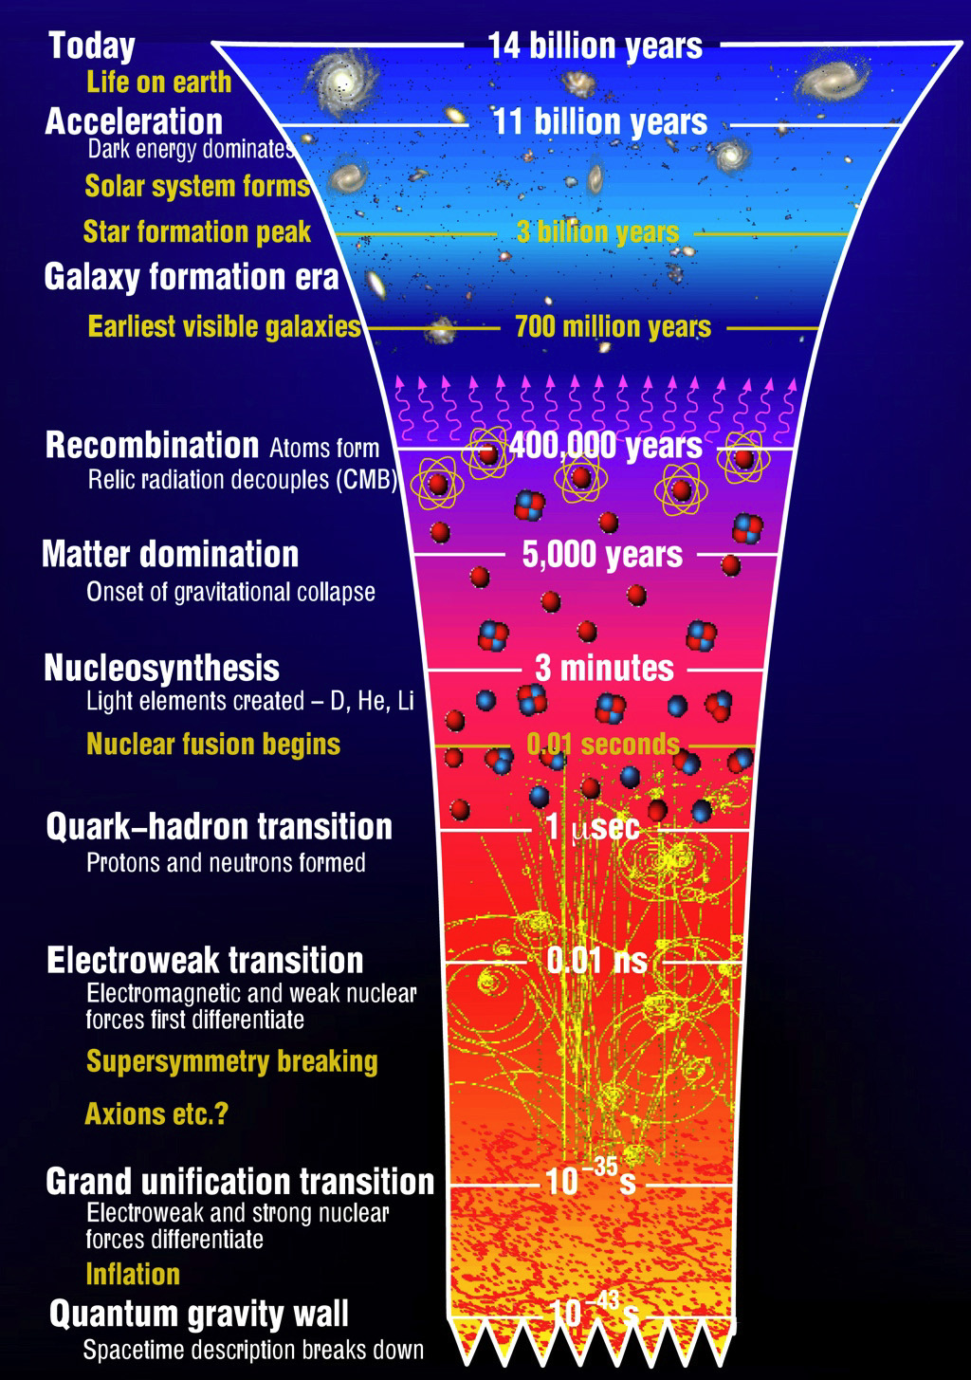
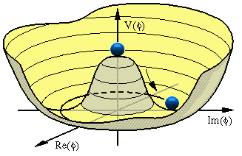
Recap: “Seeing the wood for the trees”
Lecture 1: “Particles”
  Zooming into constituents of matter
  Skills: distinguish particle types, Spin
Lecture 2: “Forces”
  Exchange of quanta: EM, Weak, QCD
  Skills: 4-vectors, Feynman diagrams
Lecture 3: “Waves”
  Quantum fields and gauge invariance
  Dirac algebra, Lagrangian, co- & contra variant
Lecture 4: “Symmetries”
  Standard Model, Higgs, Discrete Symmetries
  Skills: Lagrangians, Chirality & Helicity
Lecture 5: “Scattering”
  Cross section, decay, perturbation theory
  Skills: Dirac-delta function, Feynman Calculus
Lecture 6: “Detectors”
  Energy loss mechanisms, detection technologies
$$g_{Z}$$
$$Z$$
$$g_{Z}$$
$$\frac{1}{q^{2}−M_{Z}^{2}}$$

Slide 5
Wave Equations
Contents:
Wave equations and Probability
  Wave equations for spin-0 fields
    Schrödinger (non relativistic), Klein-Gordon (relativistic)
  Wave equation for spin-½ fields
    Dirac equation (relativistic)
    Fundamental fermions
  Wave equations for spin-1 fields
    Gauge boson fields; eg. electromagnetic field
Gauge field theory
  Variational Calculus and Lagrangians
  Local Gauge invariance
    QED
    Yang-Mills Theory (Weak, Strong)
Griffiths chapter 7
If you are unfamiliar with the math, just focus on the concepts.
The math requires some practice, but is less tricky then it may look.
➔ Also, check the recorded videos.
Griffiths chapter 10
Required Quantum Mechanics knowledge:
  Angular momentum and spin: study Griffiths sections 4.2 ,4.3, In particular Pauli Matrices
Notes:
Spin 0:
Pion particle for example
Gauge Principle:
Uniform formalism of quantum mechanical interaction between particles and forces
Electromagnetic, Weak, Strong

Slide 6
Griffiths §7.1 – §7.3
Part 1
Wave Equations and Probability
1a) Spin-0

Slide 7
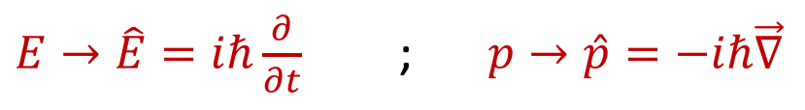
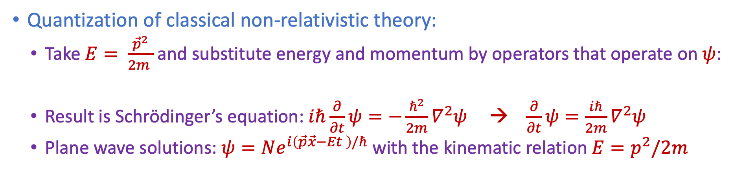





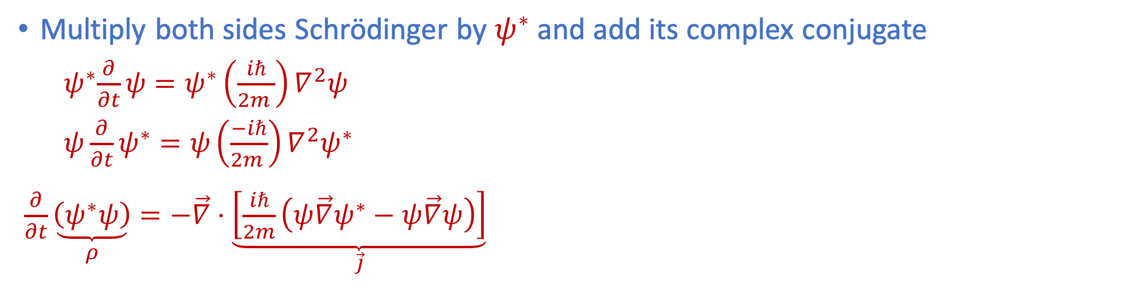
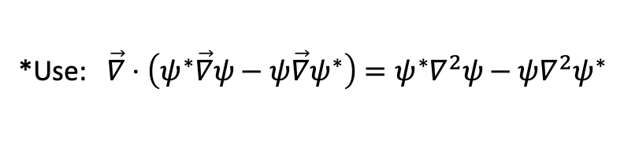
Schrödinger Equation and Probability
$$i\frac{∂}{∂t}\left(tψ\right)−it\frac{∂ψ}{∂t}=iψ+it\frac{∂ψ}{∂t}−it\frac{∂ψ}{∂t}=iψ$$
Quantization of classical non-relativistic theory:
  Take $E= \frac{{\vec{p}}^{2}}{2m }$ and substitute energy and momentum by operators that operate on $ψ$:
  Result is Schrödinger’s equation: $iℏ\frac{∂}{∂t}ψ=−\frac{ℏ^{2}}{2m}∇^{2}ψ$ → $\frac{∂}{∂t}ψ=\frac{iℏ}{2m}∇^{2}ψ$
  Plane wave solutions: $ψ=Ne^{i\left(\vec{p}\vec{x}−Et \right)/ℏ}$ with the kinematic relation $E=p^{2}/2m$
$E→\hat{E}=iℏ\frac{∂}{∂t}$ ; $p→\hat{p}=−iℏ\vec{∇}$
$$\left(\left[E,t\right]=−iℏ \text{ , }\left[x,p\right]=−iℏ\right)$$
Multiply both sides Schrödinger by $ψ^{∗}$ and add its complex conjugate
${ ψ}^{∗}\frac{∂}{∂t}ψ=ψ^{∗}\left(\frac{iℏ}{2m }\right)∇^{2}ψ$
$ψ\frac{∂}{∂t}ψ^{∗}=ψ\left(\frac{−iℏ}{2m }\right)∇^{2}ψ^{∗}$
$\frac{∂}{∂t}\underset{ρ}{\underbrace{\left(ψ^{∗}ψ\right)}}=−\vec{∇}⋅\underset{\vec{j}}{\underbrace{\left[\frac{iℏ}{2m}\left(ψ\vec{∇}ψ^{∗}−ψ\vec{∇}ψ\right)\right]}}$
$$\vec{∇}⋅\vec{j }$$
Recognize “continuity” equation:
$$\frac{∂ρ}{∂t}+\vec{∇}⋅\vec{j}=0$$
Law of conserved currents, with:
$ρ≡ψ^{∗}ψ={\left|N\right|}^{2}$
$\vec{j}≡\frac{iℏ}{2m }\left(ψ\vec{∇}ψ^{∗}−ψ^{∗}\vec{∇}ψ\right)=\frac{{\left|N\right|}^{2}}{m}\vec{p}$
$$\frac{∂ρ}{∂t}$$
+
*Use: $\vec{∇}⋅\left(ψ^{∗}\vec{∇}ψ−ψ\vec{∇}ψ^{∗}\right)=ψ^{∗}∇^{2}ψ−ψ∇^{2}ψ^{∗}$
Interpret: probability waves!
Notes:
QM observables --> Operators that act on wave-function
[E,t]=-I hbar [x,p]=-ihbar
Continuity:
probability : amount of "stuff"

Slide 8

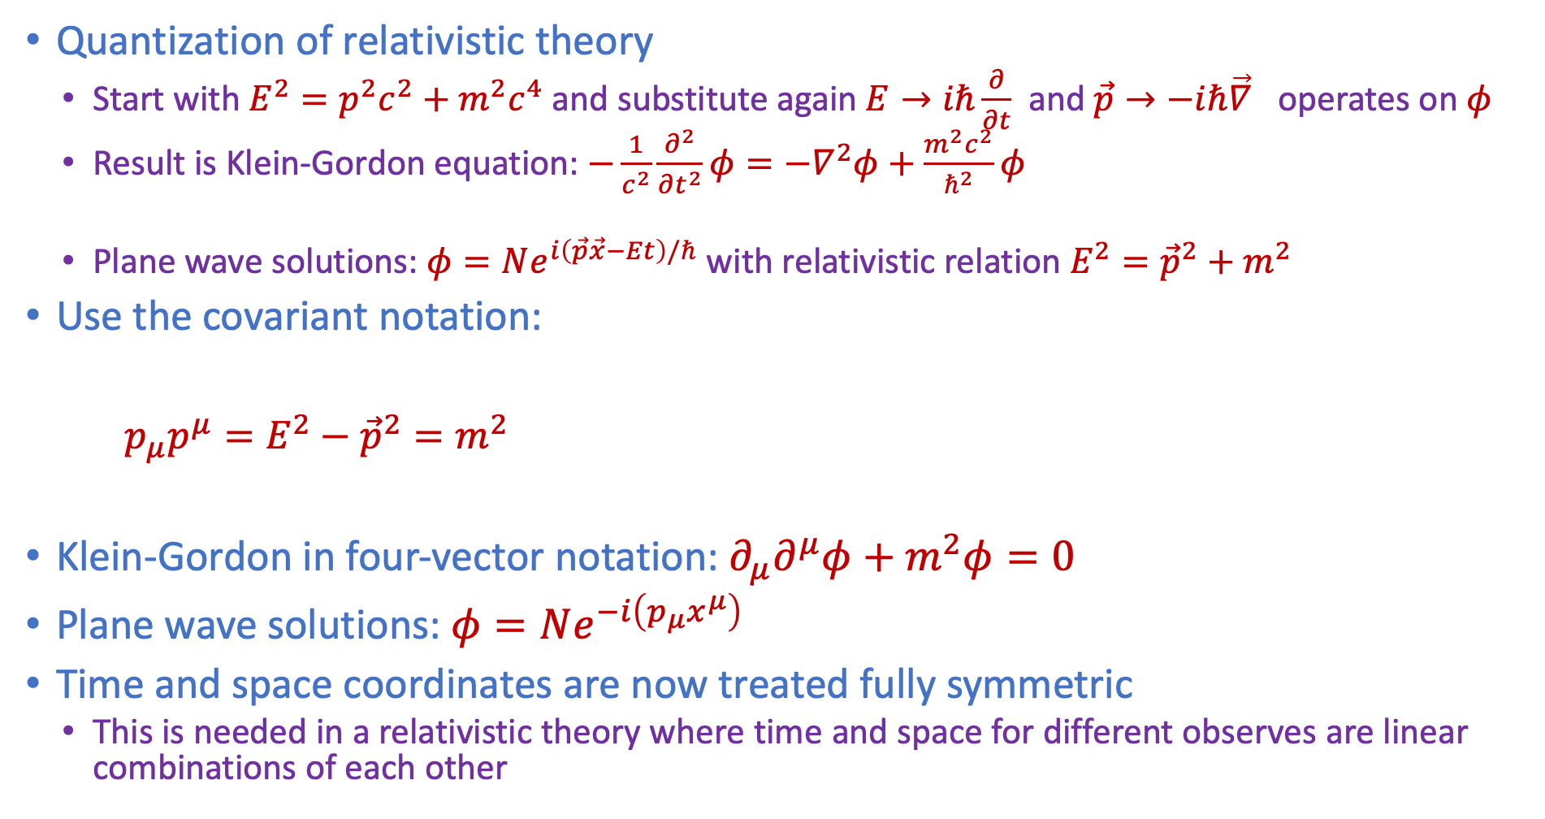


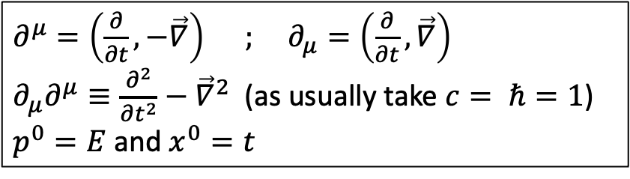
Relativistic: Klein-Gordon equation
Note: $p_{μ}→−iℏ∂_{μ}$
Quantization of relativistic theory
  Start with $E^{2}=p^{2}c^{2}+m^{2}c^{4}$ and substitute again $E→iℏ\frac{∂}{∂t}$ and $\vec{p}→−iℏ\vec{∇}$ operates on $φ$
  Result is Klein-Gordon equation: $−\frac{1}{c^{2}}\frac{∂^{2}}{∂t^{2}}φ=−∇^{2}φ+\frac{m^{2}c^{2}}{ℏ^{2}}φ$
  Plane wave solutions: $φ=Ne^{i\left(\vec{p}\vec{x}−Et\right)/ℏ}$ with relativistic relation $E^{2}={\vec{p}}^{2}+m^{2}$
Use the covariant notation:
$p_{μ}p^{μ}={E^{2}−{\vec{p}}^{2}=m}^{2}$
Klein-Gordon in four-vector notation: $∂_{μ}∂^{μ}φ+m^{2}φ=0$
Plane wave solutions: $φ=Ne^{−i\left(p_{μ}x^{μ}\right)}$
Time and space coordinates are now treated fully symmetric
  This is needed in a relativistic theory where time and space for different observes are linear combinations of each other
Use now: $ℏ=c=1$
$∂^{μ}=\left(\frac{∂}{∂t}, −\vec{∇}\right)$ ; $∂_{μ}=\left(\frac{∂}{∂t}, \vec{∇}\right)$
$∂_{μ}∂^{μ}≡\frac{∂^{2}}{∂t^{2}}−{\vec{∇}}^{2}$ (as usually take $c= ℏ=1$)
$p^{0}=E$ and $x^{0}=t$
$$\left(\text{Remember} \text{this} \text{is}\text{: }φ=Ne^{−i(Et−\vec{p}\vec{x})}\right)$$

Slide 9
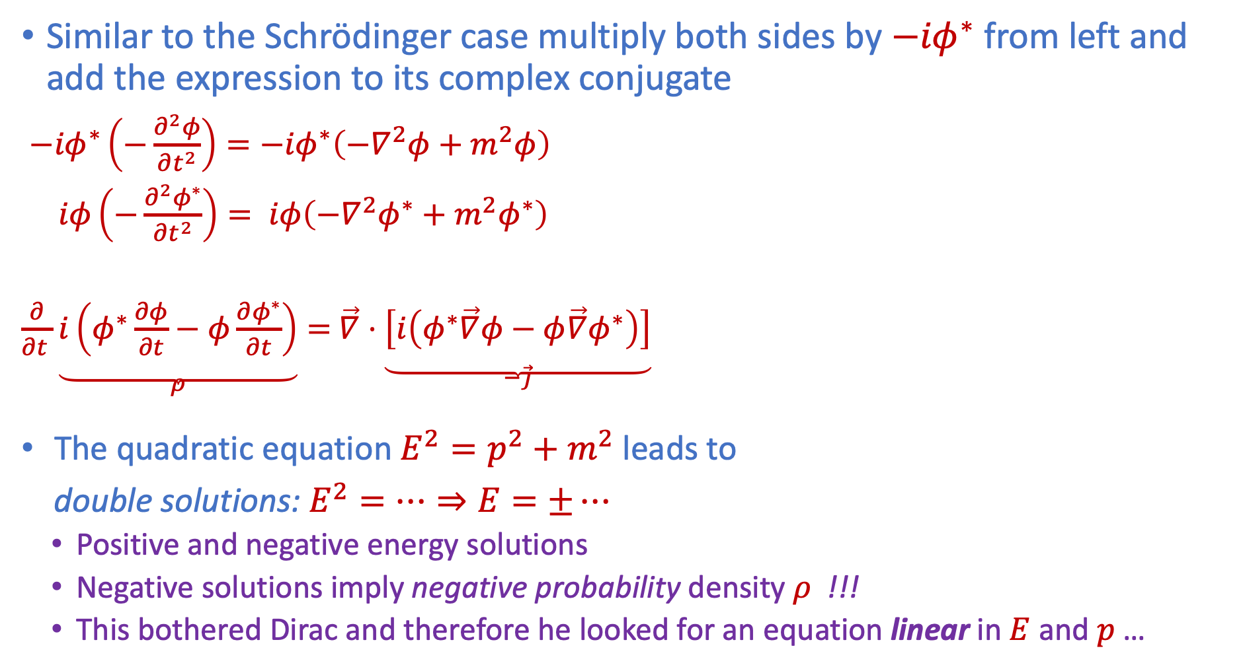

Klein-Gordon conserved currents
Similar to the Schrödinger case multiply both sides by ${−iφ}^{∗}$ from left and add the expression to its complex conjugate
${−iφ}^{∗}\left(−\frac{∂^{2}φ}{∂t^{2}}\right)={−iφ}^{∗}\left(−∇^{2}φ+m^{2}φ\right)$
$iφ\left(−\frac{∂^{2}φ^{∗}}{∂t^{2}}\right)= iφ\left(−∇^{2}φ^{∗}+m^{2}φ^{∗}\right)$
$\frac{∂}{∂t }\underset{ρ}{\underbrace{i\left(φ^{∗}\frac{∂φ}{∂t}−φ\frac{∂φ^{∗}}{∂t}\right)}}=$ $\vec{∇}⋅\underset{−\vec{j}}{\underbrace{\left[i\left(φ^{∗}\vec{∇}φ−φ\vec{∇}φ^{∗}\right)\right]}}$
The quadratic equation $E^{2}=p^{2}+m^{2}$leads to
double solutions: $E^{2}=…⇒E=±…$
  Positive and negative energy solutions
  Negative solutions imply negative probability density $ρ$ !!!
  This bothered Dirac and therefore he looked for an equation linear in $E$ and $p$ …
Again recognize “continuity” equation, the law of conserved currents:
$\frac{∂ρ}{∂t}+\vec{∇}⋅\vec{j}=0 ⇒ ∂_{μ}j^{μ}=0$
With now:
$$j^{μ}= \left(ρ, \vec{j}\right)=i\left[φ^{∗}\left(∂^{μ}φ\right)−φ\left(∂^{μ}φ^{∗}\right)\right]$$
It gives for plane waves: $φ=Ne^{−i\left(p_{μ}x^{μ}\right)}$
$$ρ=2{\left|N\right|}^{2}E$$
$$\vec{j}=2{\left|N\right|}^{2}\vec{p}$$
Or in 4-vector: $j^{μ}=2{\left|N\right|}^{2}p^{μ}$
+
Notes:
Continuity allows for interpretation of quantum waves as "stuff".
Why introduce “i”?
The reason is to make the density real, not imaginary.

Slide 10
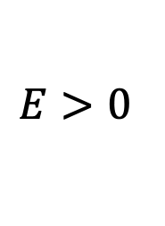
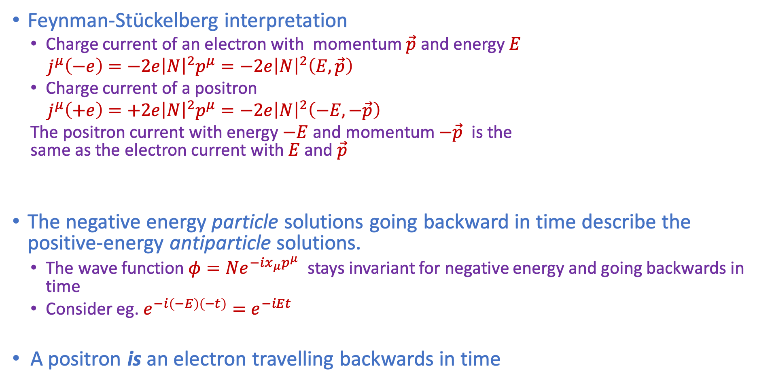
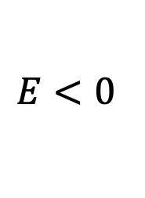



Antiparticles
Feynman-Stückelberg interpretation
  Charge current of an electron with momentum $\vec{p}$ and energy $E$
  $j^{μ}\left(−e\right)=−2e{\left|N\right|}^{2}p^{μ}=−2e{\left|N\right|}^{2}\left(E,\vec{p}\right)$
  Charge current of a positron
  $j^{μ}\left(+e\right)=+2e{\left|N\right|}^{2}p^{μ}=−2e{\left|N\right|}^{2}\left(−E,−\vec{p}\right)$
  The positron current with energy $−E$ and momentum $−\vec{p}$ is the same as the electron current with $E$ and $\vec{p}$
The negative energy particle solutions going backward in time describe the positive-energy antiparticle solutions.
  The wave function $φ=Ne^{−ix_{μ}p^{μ}}$ stays invariant for negative energy and going backwards in time
  Consider eg. $e^{−i\left(−E\right)\left(−t\right)}=e^{−iEt}$
A positron is an electron travelling backwards in time
$$e^{+}$$
$$e^{−}$$
$$≡$$
$$E<0$$
$$E>0$$
Notes:
FS works only for charged particles.

Slide 11
Wave Equations
Contents:
Wave equations and Probability
  Wave equations for spin-0 fields
    Schrödinger (non relativistic), Klein-Gordon (relativistic)
  Wave equation for spin-½ fields
    Dirac equation (relativistic)
    Fundamental fermions
  Wave equations for spin-1 fields
    Gauge boson fields; eg. electromagnetic field
Gauge field theory
  Variational Calculus and Lagrangians
  Local Gauge invariance
    QED
    Yang-Mills Theory (Weak, Strong)
Griffiths chapter 7 and PP1 chapter 1
Griffiths chapter 10 and PP1 chapter 1
Required Quantum Mechanics knowledge:
  Angular momentum and spin: study Griffiths sections 4.2 ,4.3, In particular Pauli Matrices
Notes:
Spin 0:
Pion particle for example
Gauge Principle:
Uniform formalism of quantum mechanical interaction between particles and forces
Electromagnetic, Weak, Strong

Slide 12
Griffiths §7.1 – §7.3
Part 1
Wave Equations and Probability
1b) Spin-½

Slide 13

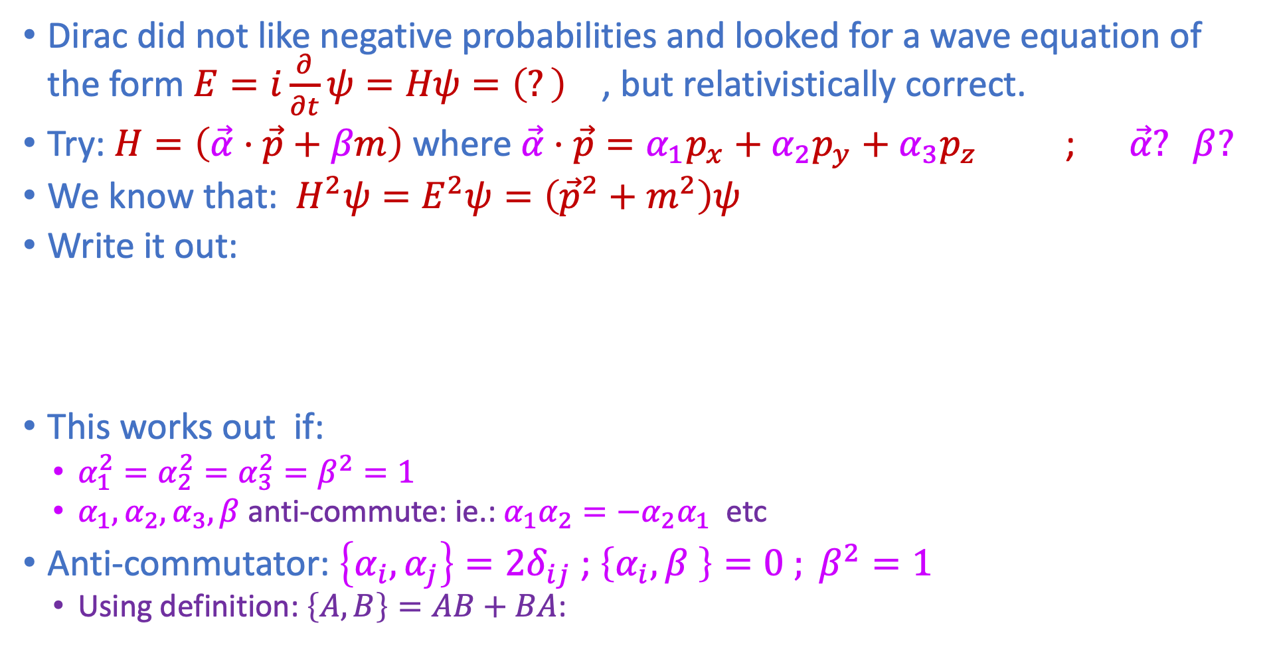



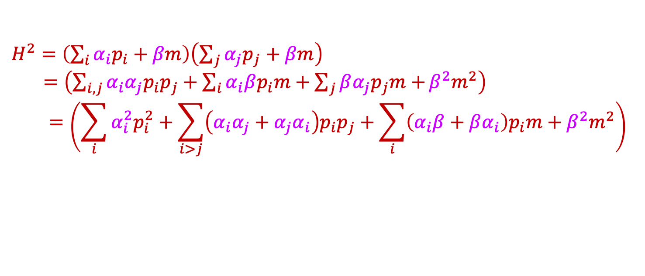
Dirac Equation
Instead of $E^{2}=p^{2}c^{2}+m^{2}c^{4}$
Dirac did not like negative probabilities and looked for a wave equation of the form $E=i\frac{∂}{∂t}ψ=Hψ=\left(?\right)$ , but relativistically correct.
Try: $H=\left(\vec{α}⋅\vec{p}+βm\right)$ where $\vec{α}⋅\vec{p}=α_{1}p_{x}+α_{2}p_{y}+α_{3}p_{z}$ ; $\vec{α}? β?$
We know that: $H^{2}ψ=E^{2}ψ=\left({\vec{p}}^{2}+m^{2}\right)ψ$
Write it out:
This works out if:
  $α_{1}^{2}=α_{2}^{2}=α_{3}^{2}=β^{2}=1$
  $α_{1}, α_{2}, α_{3},β$ anti-commute: ie.:${α_{1}α}_{2}=−α_{2}α_{1}$ etc
Anti-commutator: $\left\{α_{i},α_{j}\right\}=2δ_{ij}$ ; $\left\{α_{i},β \right\}=0$ $; β^{2}=1$
  Using definition: $\left\{A,B\right\}=AB+BA$:
$H^{2}=\left(\sum_{i}{α_{i}p_{i}+βm}\right)\left(\sum_{j}{α_{j}p_{j}+βm}\right)$
$=\left(\sum_{i,j}{α_{i}α_{j}p_{i}p_{j}+\sum_{i}{α_{i}βp_{i}m+\sum_{j}{βα_{j}p_{j}m}+}β^{2}m^{2}}\right)$
$$=\left(\sum_{i}{α_{i}^{2}p_{i}^{2}}+\sum_{i>j}{\left(α_{i}α_{j}+α_{j}α_{i}\right)p_{i}p_{j}}+\sum_{i}{\left(α_{i}β+βα_{i}\right)p_{i}m}+β^{2}m^{2}\right)$$
$$={\vec{p}}^{2}$$
$$=0$$
$$=m^{2}$$

Slide 14
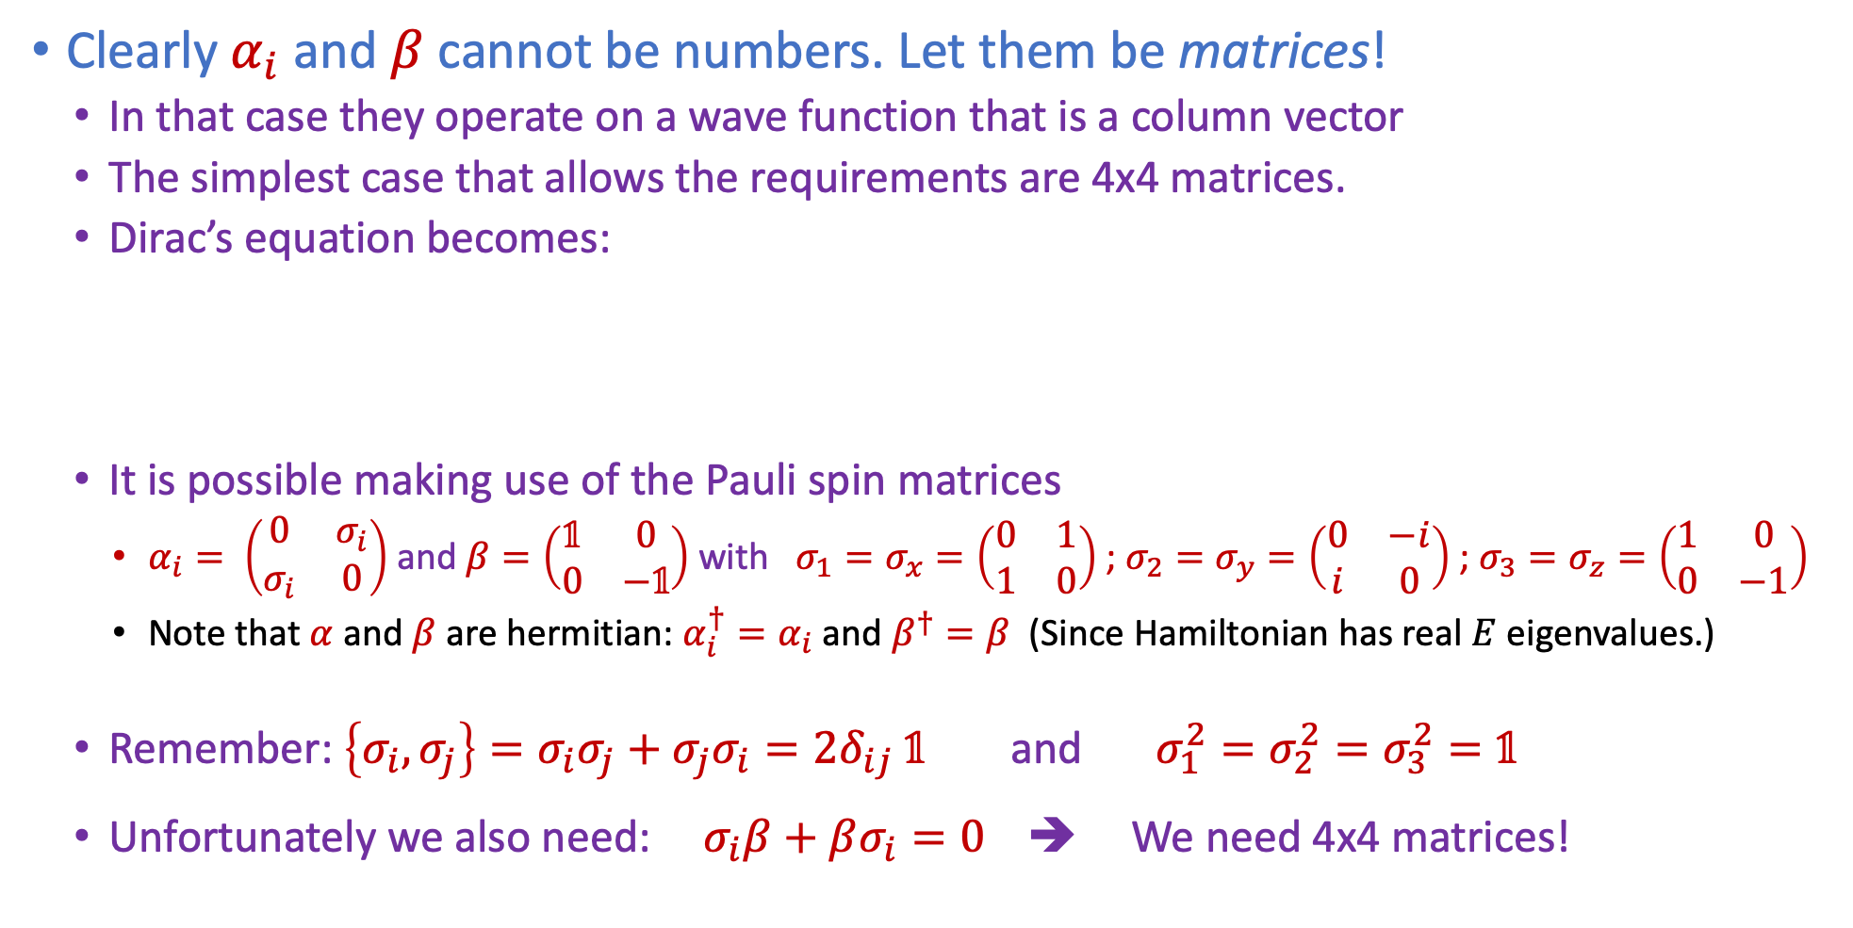


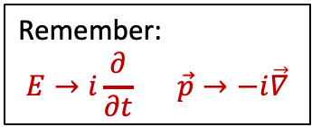
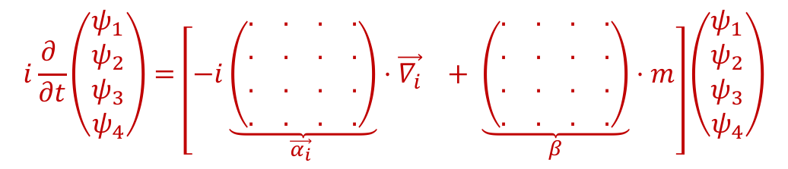
Dirac’s idea
$\left\{α_{i},α_{j}\right\}=2δ_{ij}$ ; $\left\{α_{i},β \right\}=0$ $; β^{2}=1$
Clearly $α_{i}$ and $β$ cannot be numbers. Let them be matrices!
  In that case they operate on a wave function that is a column vector
  The simplest case that allows the requirements are 4x4 matrices.
  Dirac’s equation becomes:
  It is possible making use of the Pauli spin matrices
    $α_{i}= \left(\begin{matrix}0 & σ_{i} \\ σ_{i} & 0\end{matrix}\right)$ and $β=\left(\begin{matrix}𝟙 & 0 \\ 0 & −𝟙\end{matrix}\right)$ with $σ_{1}=σ_{x}=\left(\begin{matrix}0 & 1 \\ 1 & 0\end{matrix}\right)$ ; $σ_{2}=σ_{y}=\left(\begin{matrix}0 & −i \\ i & 0\end{matrix}\right)$ ; $σ_{3}=σ_{z}=\left(\begin{matrix}1 & 0 \\ 0 & −1\end{matrix}\right)$
    Note that $α$ and $β$ are hermitian: $α_{i}^{†}=α_{i}$ and $β^{†}=β$ (Since Hamiltonian has real $E$ eigenvalues.)
  Remember: $\left\{σ_{i},σ_{j}\right\}=σ_{i}σ_{j}+σ_{j}σ_{i}=2δ_{ij} 𝟙$ and $σ_{1}^{2}=σ_{2}^{2}=σ_{3}^{2}=𝟙$
  Unfortunately we also need: $σ_{i}β+βσ_{i}=0$ ➔ We need 4x4 matrices!
$$Eψ=Hψ=\left(\vec{α}\vec{p}+βm\right)ψ$$
$$i\frac{∂ }{∂t}\left(\begin{matrix}ψ_{1} \\ \begin{aligned}ψ_{2} \\ ψ_{3} \\ ψ_{4}\end{aligned}\end{matrix}\right)=\left[−i\underset{\vec{α_{i}} }{\underbrace{\left(\begin{matrix}. & . & . & . \\ . & . & . & . \\ . & . & . & . \\ . & . & . & .\end{matrix}\right)}}⋅\vec{∇_{i}} + \underset{β}{\underbrace{\left(\begin{matrix}. & . & . & . \\ . & . & . & . \\ . & . & . & . \\ . & . & . & .\end{matrix}\right)}}⋅m\right]\left(\begin{matrix}ψ_{1} \\ \begin{aligned}ψ_{2} \\ ψ_{3} \\ ψ_{4}\end{aligned}\end{matrix}\right)$$
Remember:
$$E→i\frac{∂}{∂t} \vec{p}→−i\vec{∇}$$
Notes:
Confusion: \psi is not a space-time 4-vector!
Indices are not space and time!
What else --> see later

Slide 15
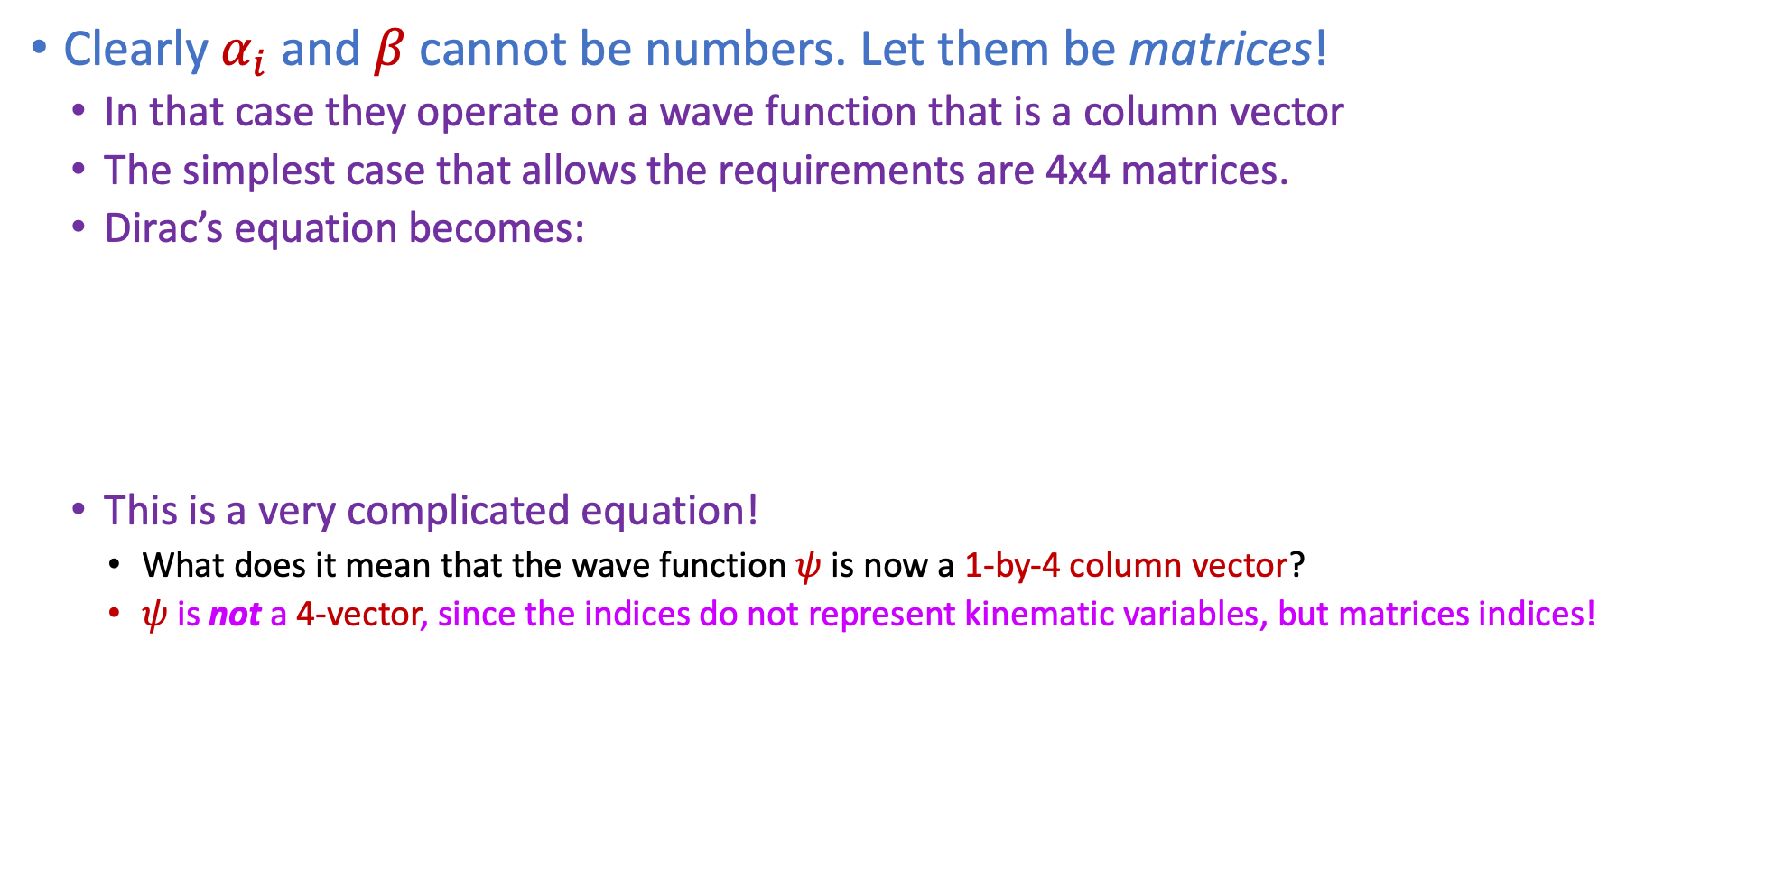
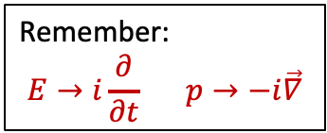
Dirac’s idea
Clearly $α_{i}$ and $β$ cannot be numbers. Let them be matrices!
  In that case they operate on a wave function that is a column vector
  The simplest case that allows the requirements are 4x4 matrices.
  Dirac’s equation becomes:
  This is a very complicated equation!
    What does it mean that the wave function $ψ$ is now a 1-by-4 column vector?
    $ψ$ is not a 4-vector, since the indices do not represent kinematic variables, but matrices indices!
$$i\frac{∂ }{∂t}\left(\begin{matrix}ψ_{1} \\ \begin{aligned}ψ_{2} \\ ψ_{3} \\ ψ_{4}\end{aligned}\end{matrix}\right)=\left[−i\underset{\vec{α_{i}} }{\underbrace{\left(\begin{matrix}. & . & . & . \\ . & . & . & . \\ . & . & . & . \\ . & . & . & .\end{matrix}\right)}}⋅\vec{∇_{i}} + \underset{β}{\underbrace{\left(\begin{matrix}. & . & . & . \\ . & . & . & . \\ . & . & . & . \\ . & . & . & .\end{matrix}\right)}}⋅m\right]\left(\begin{matrix}ψ_{1} \\ \begin{aligned}ψ_{2} \\ ψ_{3} \\ ψ_{4}\end{aligned}\end{matrix}\right)$$
Remember:
$$E→i\frac{∂}{∂t} p→−i\vec{∇}$$
Notes:
Confusion: \psi is not a space-time 4-vector!
Indices are not space and time!
What else --> see later

Slide 16
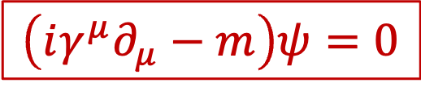

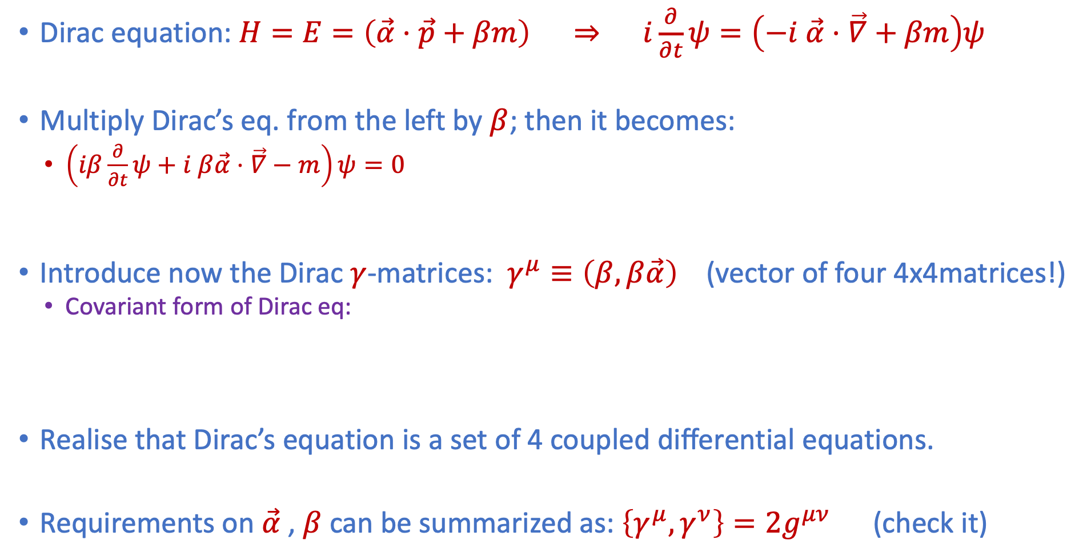


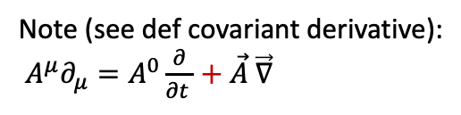
Covariant form of Dirac’s equation
Dirac equation: $H=E=\left(\vec{α}⋅\vec{p}+βm\right) ⇒ i\frac{∂}{∂t}ψ=\left(−i \vec{α}⋅\vec{∇}+βm\right)ψ$
Multiply Dirac’s eq. from the left by $β$; then it becomes:
  $\left(iβ\frac{∂}{∂t}ψ+i β\vec{α}⋅\vec{∇}−m\right)ψ=0$
Introduce now the Dirac $γ$-matrices: $γ^{μ}≡\left(β,β\vec{α}\right)$ (vector of four 4x4matrices!)
  Covariant form of Dirac eq:
Realise that Dirac’s equation is a set of 4 coupled differential equations.
Requirements on $\vec{α}$ , $β$ can be summarized as: $\left\{γ^{μ},γ^{ν}\right\}=2g^{μν}$ (check it)
(Remember $β^{2}=1$)
$$γ^{0}$$
$$γ^{1},γ^{2},γ^{3}$$
  $$\left(iγ^{μ}∂_{μ}−m\right)ψ=0$$
Note (see def covariant derivative):
$A^{μ}∂_{μ}=A^{0}\frac{∂}{∂t }+\vec{A} \vec{∇}$

Slide 17
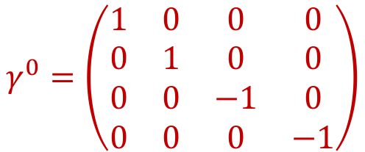

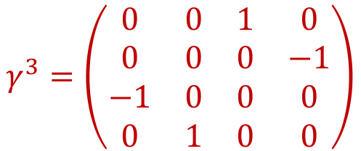
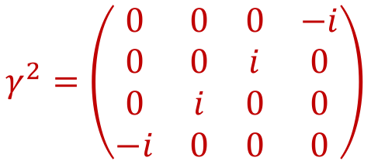
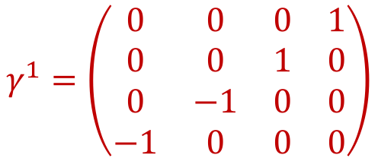
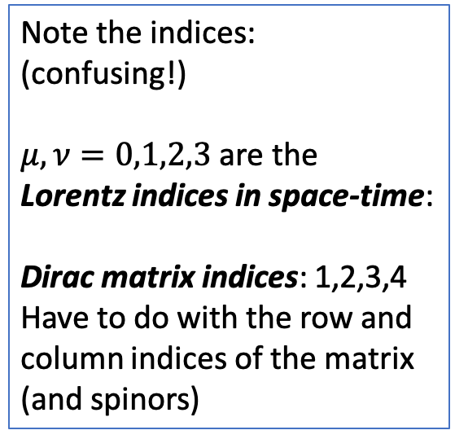
Dirac Gamma Matrices
There is some freedom to implement: $\left\{γ^{μ},γ^{ν}\right\}=2g^{μν}$ in 4x4 matrices.
  We will use the Dirac-Pauli representation
$$γ^{0}=\left(\begin{matrix}1 & 0 & 0 & 0 \\ 0 & 1 & 0 & 0 \\ 0 & 0 & −1 & 0 \\ 0 & 0 & 0 & −1\end{matrix}\right)$$
$$γ^{1}=\left(\begin{matrix}0 & 0 & 0 & 1 \\ 0 & 0 & 1 & 0 \\ 0 & −1 & 0 & 0 \\ −1 & 0 & 0 & 0\end{matrix}\right)$$
Note the indices:
(confusing!)
$μ, ν=0,1,2,3$ are the
Lorentz indices in space-time:
Dirac matrix indices: 1,2,3,4
Have to do with the row and
column indices of the matrix
(and spinors)
$$γ^{2}=\left(\begin{matrix}0 & 0 & 0 & −i \\ 0 & 0 & i & 0 \\ 0 & i & 0 & 0 \\ −i & 0 & 0 & 0\end{matrix}\right)$$
$$γ^{3}=\left(\begin{matrix}0 & 0 & 1 & 0 \\ 0 & 0 & 0 & −1 \\ −1 & 0 & 0 & 0 \\ 0 & 1 & 0 & 0\end{matrix}\right)$$
Or: $γ^{0}=β=\left(\begin{matrix}𝟙_{2} & 0 \\ 0 & −𝟙_{2}\end{matrix}\right)$ and $γ^{k}=βα_{k}=\left(\begin{matrix}0 & σ_{k} \\ −σ_{k} & 0\end{matrix}\right)$ with Pauli matrices $σ_{k}$
Note: although the gamma indices are Lorentz-indices (“space-time”, the gamma-matrices are not 4-vectors! (They are simply constants.)
Notes:
(Beta alpha)(beta alpha) = - beta^2 alpha^2 → g^munu

Slide 18
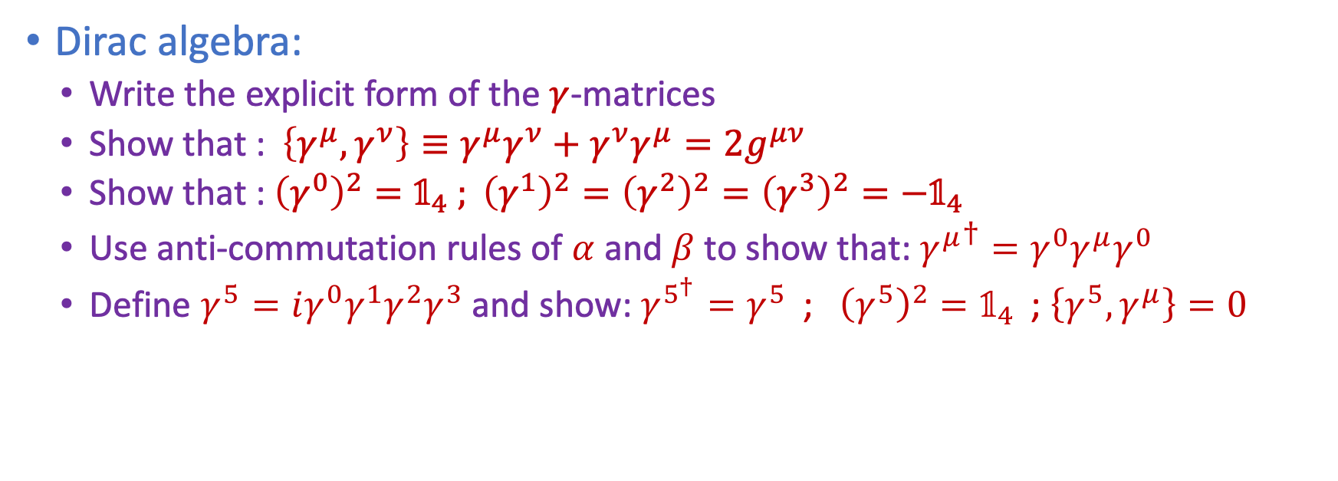
Exercises: Dirac Algebra
Dirac algebra:
  Write the explicit form of the $γ$-matrices
  Show that : $\left\{γ^{μ},γ^{ν}\right\}≡γ^{μ}γ^{ν}+γ^{ν}γ^{μ}=2g^{μν}$
  Show that : ${\left(γ^{0}\right)}^{2}=𝟙_{4}$ $; {\left(γ^{1}\right)}^{2}={\left(γ^{2}\right)}^{2}={\left(γ^{3}\right)}^{2}={−𝟙}_{4}$
  Use anti-commutation rules of $α$ and $β$ to show that: ${γ^{μ}}^{†}=γ^{0}γ^{μ}γ^{0}$
  Define $γ^{5}=iγ^{0}γ^{1}γ^{2}γ^{3}$ and show: $γ^{5^{†}}=γ^{5}$ ; ${\left(γ^{5}\right)}^{2}=𝟙_{4}$ ; $\left\{γ^{5}, γ^{μ}\right\}=0$

Slide 19
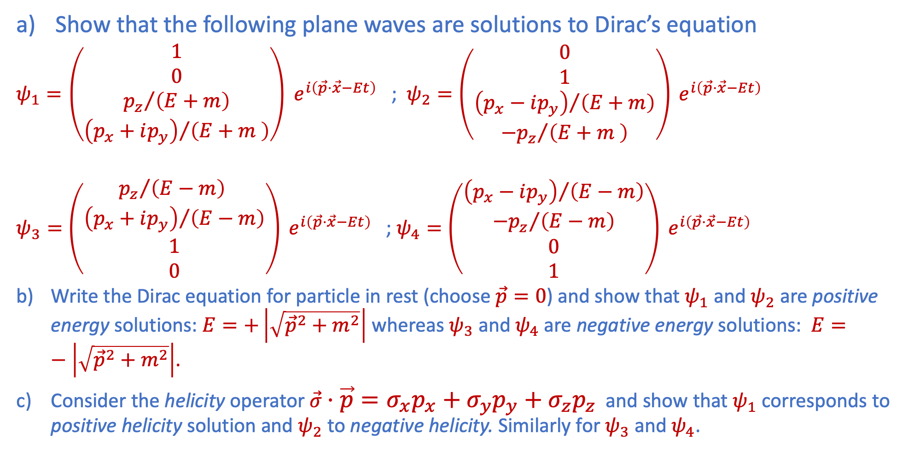
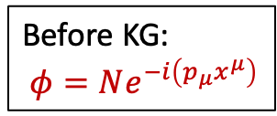
Exercise: Solutions of free Dirac equation
See Griffiths for a derivation of the solutions
Show that the following plane waves are solutions to Dirac’s equation
$ψ_{1}=\left(\begin{matrix}1 \\ 0 \\ {p_{z}}/{\left(E+m\right)} \\ {\left(p_{x}+ip_{y}\right)}/{\left(E+m \right)}\end{matrix}\right) e^{i\left(\vec{p}⋅\vec{x}−Et\right)}$ ; $ψ_{2}=\left(\begin{matrix}0 \\ 1 \\ {\left(p_{x}−ip_{y}\right)}/{\left(E+m\right)} \\ {−p_{z}}/{\left(E+m \right)}\end{matrix}\right) e^{i\left(\vec{p}⋅\vec{x}−Et\right)}$
$ψ_{3}=\left(\begin{matrix}{p_{z}}/{\left(E−m\right) } \\ {\left(p_{x}+ip_{y}\right)}/{\left(E−m\right)} \\ 1 \\ 0\end{matrix}\right) e^{i\left(\vec{p}⋅\vec{x}−Et\right)}$ ; $ψ_{4}=\left(\begin{matrix}{\left(p_{x}−ip_{y}\right)}/{\left(E−m\right)} \\ {−p_{z}}/{\left(E−m\right)} \\ 0 \\ 1\end{matrix}\right) e^{i\left(\vec{p}⋅\vec{x}−Et\right)}$
Write the Dirac equation for particle in rest (choose $\vec{p}=0$) and show that $ψ_{1}$ and $ψ_{2}$are positive energy solutions: $E=+\left|\sqrt{{\vec{p}}^{2}+m^{2}}\right|$ whereas $ψ_{3}$ and $ψ_{4}$are negative energy solutions: $E=−\left|\sqrt{{\vec{p}}^{2}+m^{2}}\right|$.
Consider the helicity operator $\vec{σ}⋅\vec{p}=σ_{x}p_{x}+σ_{y}p_{y}+σ_{z}p_{z}$ and show that $ψ_{1}$ corresponds to positive helicity solution and $ψ_{2}$ to negative helicity. Similarly for $ψ_{3}$and $ψ_{4}$.
Before KG:
$φ=Ne^{−i\left(p_{μ}x^{μ}\right)}$

Slide 20
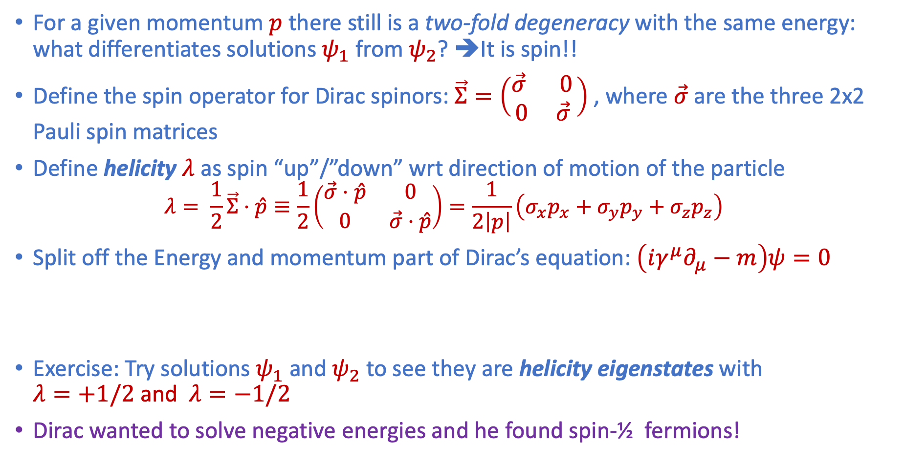
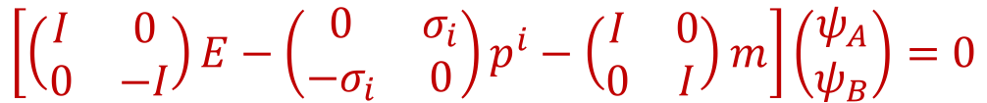
Spin and Helicity – hint for exercise c)
For a given momentum $p$ there still is a two-fold degeneracy with the same energy: what differentiates solutions $ψ_{1}$ from $ψ_{2}$? ➔It is spin!!
Define the spin operator for Dirac spinors: $\vec{Σ}=\left(\begin{matrix}\vec{σ} & 0 \\ 0 & \vec{σ} \end{matrix}\right)$, where $\vec{σ}$ are the three 2x2 Pauli spin matrices
Define helicity $λ$ as spin “up”/”down” wrt direction of motion of the particle
  $$λ= \frac{1}{2}\vec{Σ}⋅\hat{p}≡\frac{1}{2}\left(\begin{matrix}\vec{σ}⋅\hat{p} & 0 \\ 0 & \vec{σ}⋅\hat{p}\end{matrix}\right)=\frac{1}{2\left|p\right|}\left(σ_{x}p_{x}+σ_{y}p_{y}+σ_{z}p_{z}\right)$$
Split off the Energy and momentum part of Dirac’s equation: $\left(iγ^{μ}∂_{μ}−m\right)ψ=0$
Exercise: Try solutions $ψ_{1}$ and $ψ_{2}$ to see they are helicity eigenstates with $λ=+1/2$ and $λ=−1/2$
Dirac wanted to solve negative energies and he found spin-½ fermions!
$$\left[\left(\begin{matrix}I & 0 \\ 0 & −I\end{matrix}\right)E−\left(\begin{matrix}0 & σ_{i} \\ −σ_{i} & 0\end{matrix}\right)p^{i}−\left(\begin{matrix}I & 0 \\ 0 & I\end{matrix}\right)m\right]\left(\begin{matrix}ψ_{A} \\ ψ_{B}\end{matrix}\right)=0$$
Notes:
with the

Slide 21
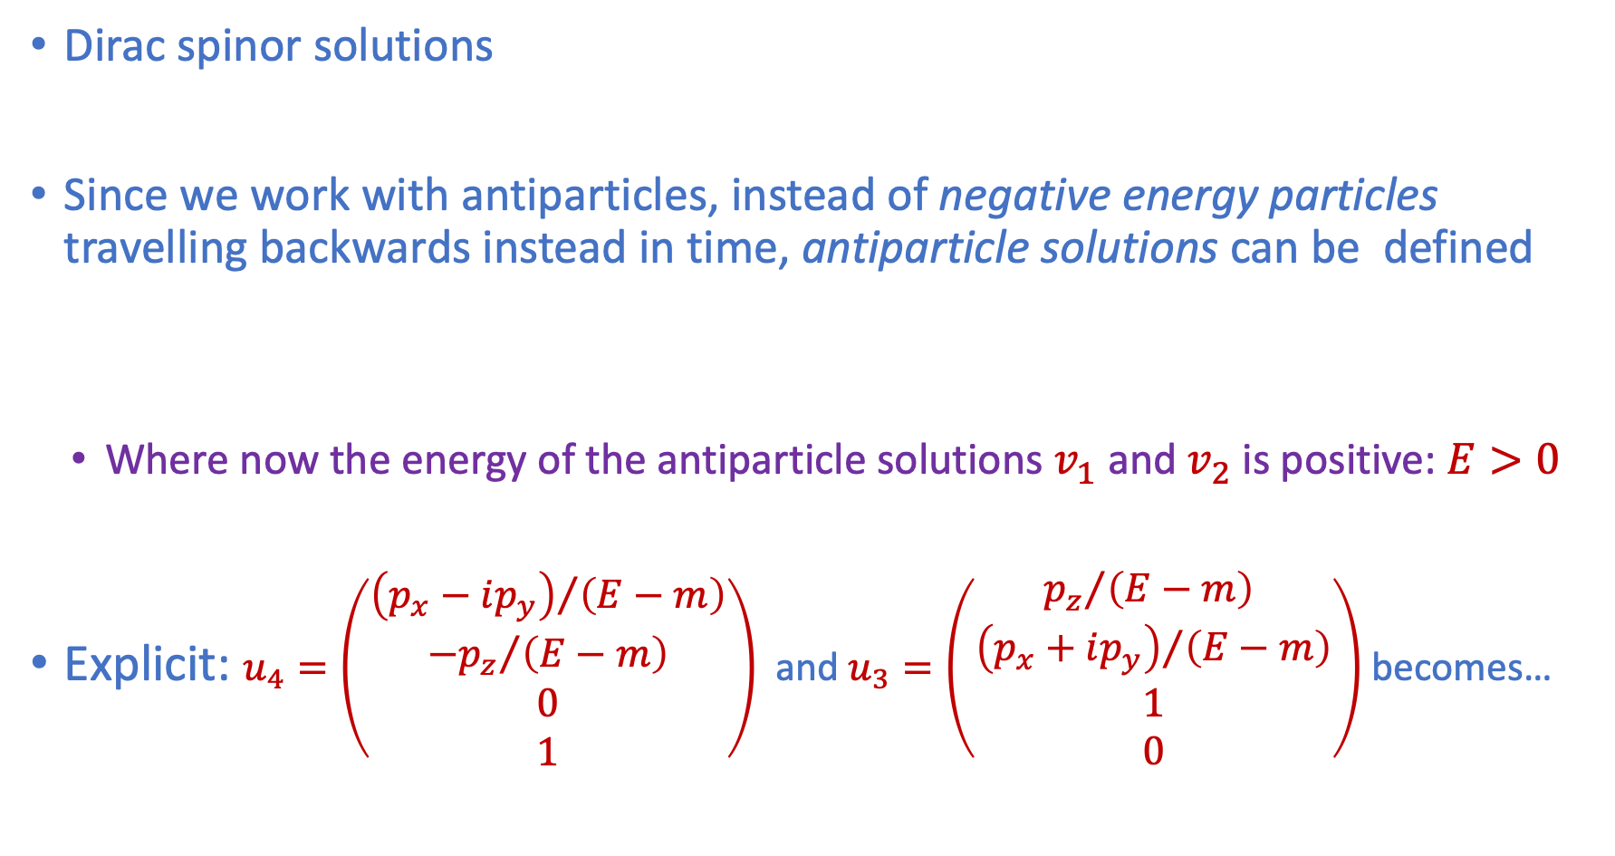
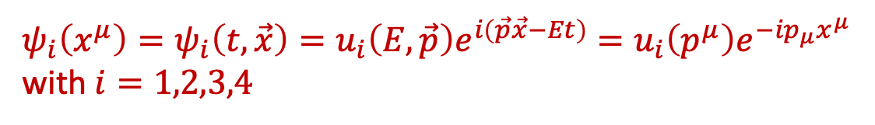
Antiparticles: positive and negative energy solutions
Dirac spinor solutions
Since we work with antiparticles, instead of negative energy particles travelling backwards instead in time, antiparticle solutions can be defined
  Where now the energy of the antiparticle solutions $v_{1}$ and $v_{2}$ is positive: $E>0$
Explicit: $u_{4}=\left(\begin{matrix}{\left(p_{x}−ip_{y}\right)}/{\left(E−m\right)} \\ {−p_{z}}/{\left(E−m\right)} \\ 0 \\ 1\end{matrix}\right)$ and $u_{3}=\left(\begin{matrix}{p_{z}}/{\left(E−m\right) } \\ {\left(p_{x}+ip_{y}\right)}/{\left(E−m\right)} \\ 1 \\ 0\end{matrix}\right)$ becomes…
${ψ_{i}\left(x^{μ}\right)=ψ}_{i}\left(t,\vec{x}\right)=u_{i}\left(E,\vec{p}\right)e^{i\left(\vec{p}\vec{x}−Et\right)}=u_{i}\left(p^{μ}\right)e^{−ip_{μ}x^{μ}}$
with $i=1,2,3,4$
$$u_{3}\left(−E,−\vec{p}\right)e^{i\left(\left(−\vec{p}\right)\vec{x}−\left(−E\right)t\right)}=v_{2}\left(E,\vec{p}\right)e^{−i\left(\vec{p}\vec{x}−Et\right)}=v_{2}\left(p^{μ}\right)e^{ip_{μ}x^{μ}}$$
$$u_{4}\left(−E,−\vec{p}\right)e^{i\left(\left(−\vec{p}\right)\vec{x}−\left(−E\right)t\right)}=v_{1}\left(E,\vec{p}\right)e^{−i\left(\vec{p}\vec{x}−Et\right)}=v_{1}\left(p^{μ}\right)e^{ip_{μ}x^{μ}}$$
Notes:
Verify v_1 and v_2 yourself

Slide 22
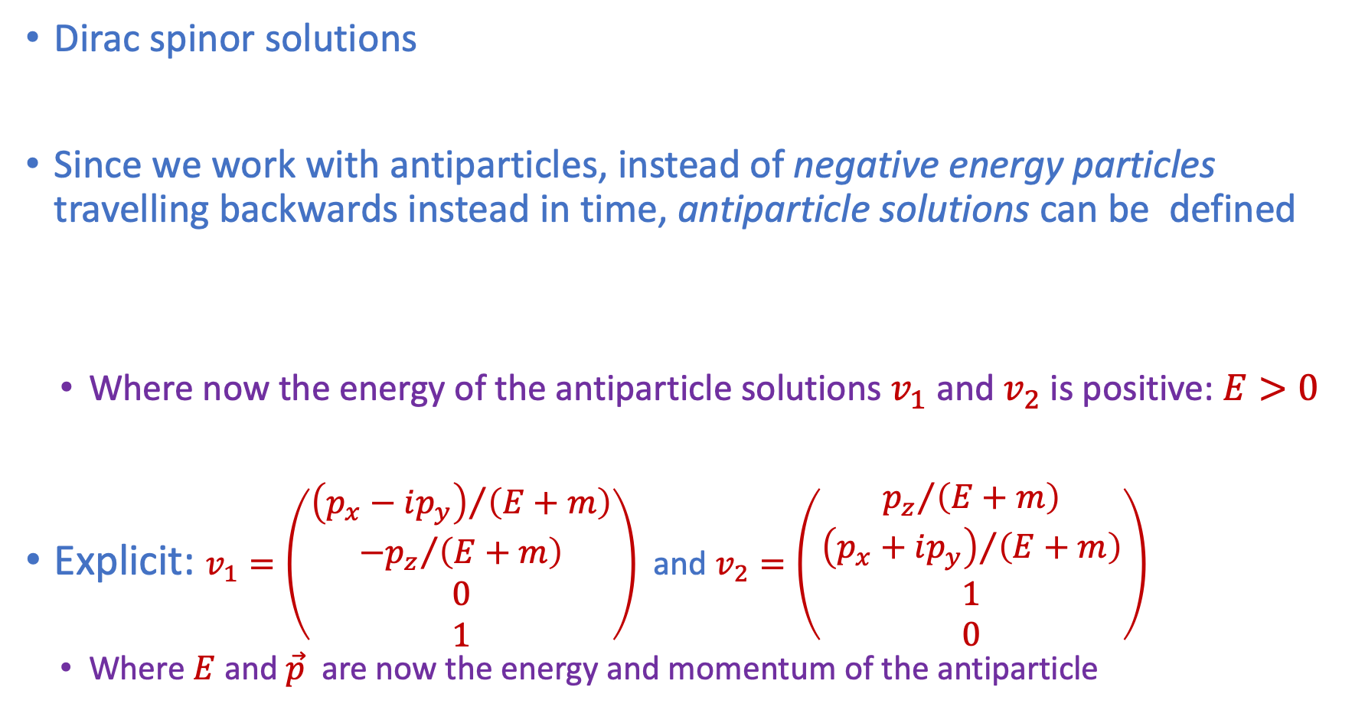
Antiparticles: positive and negative energy solutions
Dirac spinor solutions
Since we work with antiparticles, instead of negative energy particles travelling backwards instead in time, antiparticle solutions can be defined
  Where now the energy of the antiparticle solutions $v_{1}$ and $v_{2}$ is positive: $E>0$
Explicit: $v_{1}=\left(\begin{matrix}{\left(p_{x}−ip_{y}\right)}/{\left(E+m\right)} \\ {−p_{z}}/{\left(E+m\right)} \\ 0 \\ 1\end{matrix}\right)$ and $v_{2}=\left(\begin{matrix}{p_{z}}/{\left(E+m\right)} \\ {\left(p_{x}+ip_{y}\right)}/{\left(E+m\right)} \\ 1 \\ 0\end{matrix}\right)$
  Where $E$ and $\vec{p}$ are now the energy and momentum of the antiparticle
${ψ_{i}\left(x^{μ}\right)=ψ}_{i}\left(t,\vec{x}\right)=u_{i}\left(E,\vec{p}\right)e^{i\left(\vec{p}\vec{x}−Et\right)}=u_{i}\left(p^{μ}\right)e^{−ip_{μ}x^{μ}}$
with $i=1,2,3,4$
$$u_{3}\left(−E,−\vec{p}\right)e^{i\left(\left(−\vec{p}\right)\vec{x}−\left(−E\right)t\right)}=v_{2}\left(E,\vec{p}\right)e^{−i\left(\vec{p}\vec{x}−Et\right)}=v_{2}\left(p^{μ}\right)e^{ip_{μ}x^{μ}}$$
$$u_{4}\left(−E,−\vec{p}\right)e^{i\left(\left(−\vec{p}\right)\vec{x}−\left(−E\right)t\right)}=v_{1}\left(E,\vec{p}\right)e^{−i\left(\vec{p}\vec{x}−Et\right)}=v_{1}\left(p^{μ}\right)e^{ip_{μ}x^{μ}}$$
Notes:
Verify v_1 and v_2 yourself

Slide 23

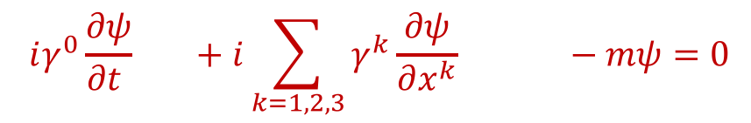
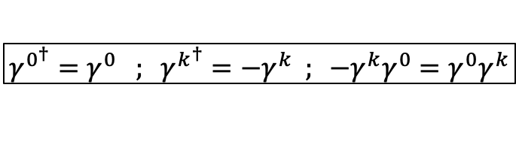
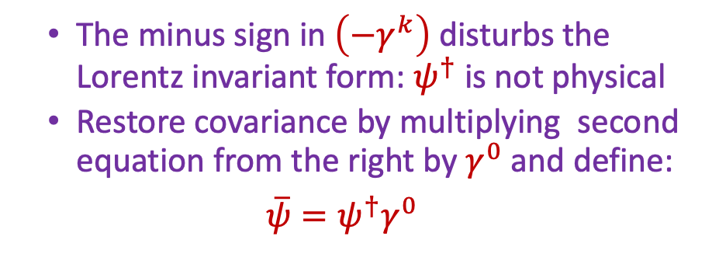
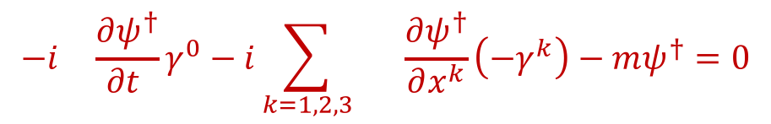
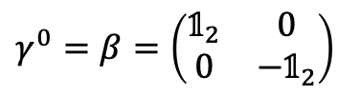
Adjoint spinors
Adjoint spinors
  Solutions of the Dirac equation are called spinors
  Current density and continuity equation require adjoints instead of complex conjugates
Remember: ${\left(AB\right)}^{†}=B^{†}A^{†}$
$$iγ^{0}\frac{∂ψ}{∂t } +i\sum_{k=1,2,3}{γ^{k}\frac{∂ψ}{∂x^{k}} −mψ=0}$$
  The minus sign in $\left(−γ^{k}\right)$ disturbs the Lorentz invariant form: $ψ^{†}$ is not physical
  Restore covariance by multiplying second equation from the right by $γ^{0}$ and define:
  $$\overline{ψ}=ψ^{†}γ^{0}$$
$$−i \frac{∂ψ^{†}}{∂t }γ^{0}−i\sum_{k=1,2,3}{ \frac{∂ψ^{†}}{∂x^{k}}\left(−γ^{k}\right)−mψ^{†}=0}$$
$$γ^{0^{†}}=γ^{0} ; γ^{k^{†}}=−γ^{k} ; {−γ}^{k}γ^{0}=γ^{0}γ^{k}$$
$γ^{0}=β=\left(\begin{matrix}𝟙_{2} & 0 \\ 0 & −𝟙_{2}\end{matrix}\right)$
Notes:
We cannot use \psi^† to represent a physics object, because it does follow Lorentz invariance as an object.
However \psi-bar does!

Slide 24
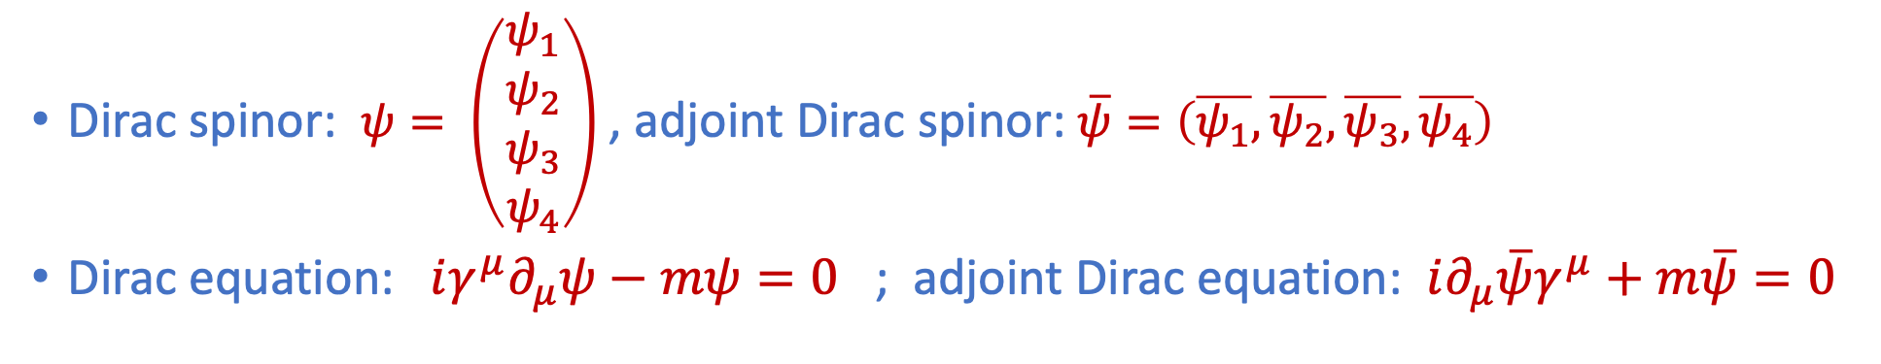
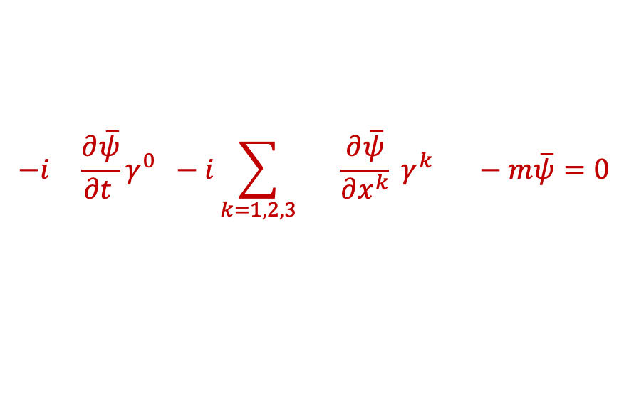
Adjoint spinors
Adjoint spinors
  Solutions of the Dirac equation are called spinors
  Current density and continuity equation require adjoints instead of complex conjugates
Remember: ${\left(AB\right)}^{†}=B^{†}A^{†}$
$$iγ^{0}\frac{∂ψ}{∂t } +i\sum_{k=1,2,3}{γ^{k}\frac{∂ψ}{∂x^{k}} −mψ=0}$$
  The minus sign in $\left(−γ^{k}\right)$ disturbs the Lorentz invariant form: $ψ^{†}$ is not physical
  Restore covariance by multiplying second equation from the right by $γ^{0}$ and define:
  $$\overline{ψ}=ψ^{†}γ^{0}$$
$$−i \frac{∂\overline{ψ}}{∂t }γ^{0} −i\sum_{k=1,2,3}{ \frac{∂\overline{ψ}}{∂x^{k}} γ^{k} −m\overline{ψ}=0}$$
$$γ^{0^{†}}=γ^{0} ; γ^{k^{†}}=−γ^{k} ; {−γ}^{k}γ^{0}=γ^{0}γ^{k}$$
$γ^{0}=β=\left(\begin{matrix}𝟙_{2} & 0 \\ 0 & −𝟙_{2}\end{matrix}\right)$
  Dirac spinor: $ψ= \left(\begin{aligned}ψ_{1} \\ ψ_{2} \\ ψ_{3} \\ ψ_{4}\end{aligned}\right)$ , adjoint Dirac spinor: $\overline{ψ}=\left(\overline{ψ_{1}},\overline{ψ_{2}},\overline{ψ_{3}},\overline{ψ_{4}}\right)$
  Dirac equation: $iγ^{μ}∂_{μ}ψ−mψ=0$ ; adjoint Dirac equation: $i∂_{μ}\overline{ψ}γ^{μ}+m\overline{ψ}=0$
Notes:
We cannot use \psi^† to represent a physics object, because it does follow Lorentz invariance as an object.
However \psi-bar does!

Slide 25
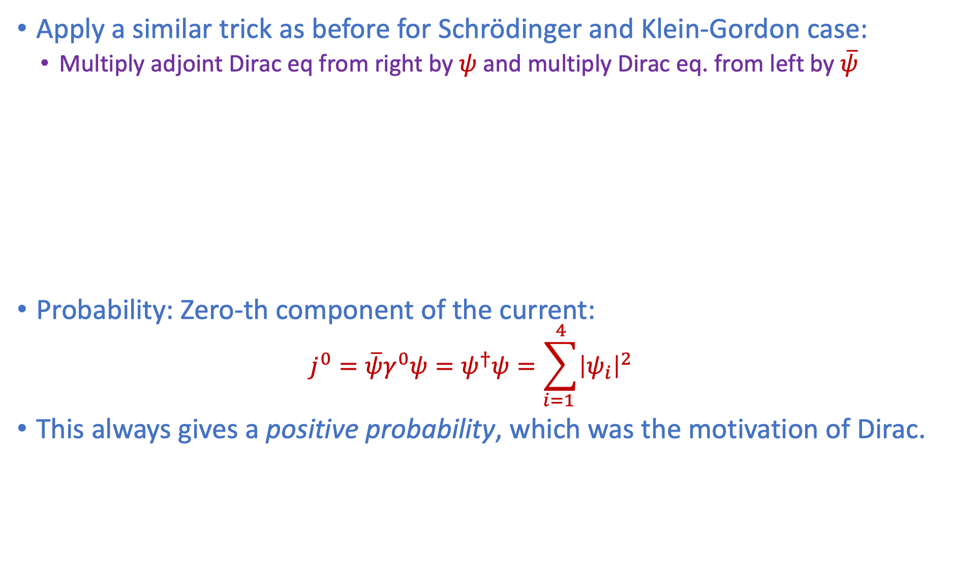


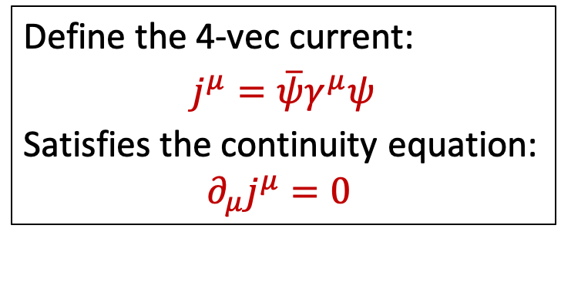

Dirac Current density and conserved current
Apply a similar trick as before for Schrödinger and Klein-Gordon case:
  Multiply adjoint Dirac eq from right by $ψ$ and multiply Dirac eq. from left by $\overline{ψ}$
Probability: Zero-th component of the current:
  $$j^{0}=\overline{ψ}γ^{0}ψ=ψ^{†}ψ=\sum_{i=1 }^{4}{{\left|ψ_{i}\right|}^{2}}$$
This always gives a positive probability, which was the motivation of Dirac.
$\left(i∂_{μ}\overline{ψ}γ^{μ}+m\overline{ψ}\right) ψ=0$
$\overline{ψ} \left(iγ^{μ}∂_{μ}ψ−mψ\right) =0$
$$\overline{ψ} γ^{μ}\left(∂_{μ}ψ\right) + \left(∂_{μ}\overline{ψ}\right) γ^{μ}ψ=0$$
Define the 4-vec current:
$$j^{μ}=\overline{ψ}γ^{μ}ψ$$
Satisfies the continuity equation:
$$∂_{μ}j^{μ}=0$$
+
$$∂_{μ}\left(\overline{ψ}γ^{μ}ψ\right)=0$$
$$\frac{∂ρ}{∂t}+\vec{∇}⋅\vec{j}=0$$

Slide 26
Dirac in summary
Dirac was looking for an explanation for positive and negative energy solutions by linearising Klein-Gordon equation
  He found that his solutions described spin-½ particles
  He predicted, based on symmetry, that for each particle there should exist an antiparticle (the negative energy solution).
We had relativistic fields:
  Spin-0: Klein-Gordon: e.g. pion particles
  Spin-1/2: Dirac : e.g. quarks and leptons
  How about forces? Spin=1

Slide 27
Wave Equations
Contents:
Wave equations and Probability
  Wave equations for spin-0 fields
    Schrödinger (non relativistic), Klein-Gordon (relativistic)
  Wave equation for spin-½ fields
    Dirac equation (relativistic)
    Fundamental fermions
  Wave equations for spin-1 fields
    Gauge boson fields; eg. electromagnetic field
Gauge field theory
  Variational Calculus and Lagrangians
  Local Gauge invariance
    QED
    Yang-Mills Theory (Weak, Strong)
Griffiths chapter 7 and PP1 chapter 1
Griffiths chapter 10 and PP1 chapter 1
Required Quantum Mechanics knowledge:
  Angular momentum and spin: study Griffiths sections 4.2 ,4.3, In particular Pauli Matrices
Notes:
Spin 0:
Pion particle for example
Gauge Principle:
Uniform formalism of quantum mechanical interaction between particles and forces
Electromagnetic, Weak, Strong

Slide 28
Griffiths §7.1 – §7.3
Part 1
Wave Equations and Probability
1c) Spin-1

Slide 29








The Electromagnetic Field
Griffiths §7.4
Maxwell equations describe electric and magnetic fields induced by charges and currents: (used Heavyside-Lorentz units: $c=1, ε_{0}=1, μ_{0}=1$)
1. Gauss’ law: $\vec{∇}⋅\vec{E}=ρ$
From 1. and 4. derive continuity
$\vec{∇}⋅\vec{j}=−\frac{∂ρ}{∂t}$
➔ charge conservation
This was the motivation for Maxwell to modify Ampère’s law
2. No magnetic charges: $\vec{∇}⋅\vec{B}=0$
3. Faraday’s law of induction: $\vec{∇}×\vec{E}+\frac{∂\vec{B}}{∂t}=0$
4. Modified Ampère’s law: $\vec{∇}×\vec{B}−\frac{∂\vec{E}}{∂t}=\vec{j}$
Define a Lorentz covariant 4-vector field $A^{μ}=\left(V,\vec{A}\right)$ as follows:
  $\vec{B}=\vec{∇}×\vec{A}$ (then automatically 2. follows)
  $\vec{E}=−\frac{∂\vec{A}}{∂t }−\vec{∇}V$ with $V=A^{0}$ (then automatically 3. follows)
Show Maxwell equations can be summarized in covariant form:
$∂_{μ}∂^{μ}A^{ν}−∂^{ν}∂_{μ}A^{μ}=j^{ν}$ (Derive expressions for $ρ$ and $\vec{j}$ and use: $\vec{∇}×\left(\vec{∇}×\vec{A}\right)=−∇^{2} \vec{A}+\vec{∇}\left(\vec{∇}⋅\vec{A}\right)$

Slide 30


The Antisymmetric tensor $F^{μν}$
Maxwell’s equation $∂_{μ}∂^{μ}A^{ν}−∂^{ν}∂_{μ}A^{μ}=j^{ν}$ can be further shortened by introducing the antisymmetric tensor: $F^{μν }≡∂^{μ}A^{ν}−∂^{ν}A^{μ}$:
Show that Maxwell’s equations become: $∂_{μ}F^{μν}=j^{ν}$
Hint: derive the expressions for charge ($q=j^{0}$) and current ($\vec{I}=\vec{j}$) separately.
Use the identity: $\vec{∇}×\left(\vec{∇}×\vec{A}\right)=−∇^{2}\vec{A}+\vec{∇}\left(\vec{∇}⋅\vec{A}\right)$. Remember the definitions:
$A_{μ}= \left(A_{0},−\vec{A}\right){ ; ∂}_{μ}=\left(\frac{∂}{∂t},\vec{∇}\right) ; g^{μν}=g_{μν}=diag\left(1, −1,−1,−1\right)$
$$F^{μν}=\left(\begin{matrix}0 & −E_{x} & −E_{y} & −E_{z} \\ E_{x} & 0 & −B_{z} & B_{y} \\ E_{y} & B_{z} & 0 & −B_{x} \\ E_{z} & −B_{y} & B_{x} & 0\end{matrix}\right)$$

Slide 31
Wave Equations
Contents:
Wave equations and Probability
  Wave equations for spin-0 fields
    Schrödinger (non relativistic), Klein-Gordon (relativistic)
  Wave equation for spin-½ fields
    Dirac equation (relativistic)
    Fundamental fermions
  Wave equations for spin-1 fields
    Gauge boson fields; eg. electromagnetic field
Gauge field theory
  Variational Calculus and Lagrangians
  Local Gauge invariance
    QED
    Yang-Mills Theory (Weak, Strong)
Griffiths chapter 7 and PP1 chapter 1
Griffiths chapter 10 and PP1 chapter 1
Required Quantum Mechanics knowledge:
  Angular momentum and spin: study Griffiths sections 4.2 ,4.3, In particular Pauli Matrices
Notes:
Spin 0:
Pion particle for example
Gauge Principle:
Uniform formalism of quantum mechanical interaction between particles and forces
Electromagnetic, Weak, Strong

Slide 32
Griffiths chapter 10
Part 2
Gauge Theory
2a) Variational Calculus and Lagrangians

Slide 33





Lagrange Formalism in field theory
Griffiths §10.2
Relativistic Field theory: fields replace the generalized coordinates
  Also time and space will be treated symmetric
  Replace $L\left(q,\dot{q}\right)$ for classical particles by a Lagrange density $ℒ\left(φ\left(x\right),∂φ\left(x\right)\right)$ in terms of fields and gradients such that $L≡\int{d^{3}xℒ\left(φ,∂φ\right)}$
Principle of least actions becomes:
Euler Lagrange Equations of motion becomes:
  Classical was:
Classical was:
$$S=\int_{t_{1}}^{t_{2}}{dt L\left(q,\dot{q}\right)⇒δS=0}$$
S = $\int_{t_{1}}^{t_{2}}{d^{4}x}ℒ\left(φ\left(x\right),∂φ\left(x\right)\right)$ and again $δS=0$
$t_{1}, t_{2}$are endpoints of the path
$$\frac{∂ℒ}{∂φ\left(x\right)}=∂_{μ}\frac{∂ℒ}{∂\left(∂_{μ}φ\left(x\right)\right)}$$
$$\frac{∂L}{∂q_{i}}=\frac{d}{dt}\left(\frac{∂L}{∂\dot{q_{i}}}\right)$$

Slide 34

Exercise: Lagrangians and wave equations
Griffiths §10.2
Scalar Field (spin 0 “pion”)
  Show that the Euler-Lagrange equations for $ℒ=\frac{1}{2}\left(∂_{μ}φ\right)\left(∂^{μ}φ\right)−\frac{1}{2}m^{2}φ^{2}$ results in the Klein-Gordon equation
Dirac Field (spin ½ Fermion)
  Show that the Euler-Lagrange equations for $ℒ=i\overline{ψ}γ_{μ}∂^{μ}ψ−m\overline{ψ}ψ$ results in the Dirac equation
Electromagnetic field (spin 1 photon)
  Show that $ℒ=−\frac{1}{4}\left(∂^{μ}A^{ν}−∂^{ν}A^{μ}\right)\left(∂_{μ}A_{ν}−∂_{ν}A_{μ}\right)−j^{μ}A_{μ}$ results in Maxwell’s equations
These Lagrangians are the fundamental objects in quantum field theory
Descriptions of interactions follow from symmetry principles on these objects.

Slide 35
Wave Equations
Contents:
Wave equations and Probability
  Wave equations for spin-0 fields
    Schrödinger (non relativistic), Klein-Gordon (relativistic)
  Wave equation for spin-½ fields
    Dirac equation (relativistic)
    Fundamental fermions
  Wave equations for spin-1 fields
    Gauge boson fields; eg. electromagnetic field
Gauge field theory
  Variational Calculus and Lagrangians
  Local Gauge invariance
    QED
    Yang-Mills Theory (Weak, Strong)
Griffiths chapter 7 and PP1 chapter 1
Griffiths chapter 10 and PP1 chapter 1
Required Quantum Mechanics knowledge:
  Angular momentum and spin: study Griffiths sections 4.2 ,4.3, In particular Pauli Matrices
Notes:
Spin 0:
Pion particle for example
Gauge Principle:
Uniform formalism of quantum mechanical interaction between particles and forces
Electromagnetic, Weak, Strong

Slide 36
Griffiths chapter 10
Part 2
Gauge Theory
2b) Local Gauge Invariance
i) QED

Slide 37



The Gauge Principle: Interactions from symmetries
Griffiths §10.3
global gauge invariance: the phase of the wave function is not observable: Changing the wave function $ψ\left(x\right)→ψ^{′}\left(x\right)=e^{iα}ψ\left(x\right)$ should not change the Lagrangian for an electron
  Look at Dirac Lagrangian: $ℒ= i\overline{ψ}γ^{μ}∂_{μ}ψ−m\overline{ψ}ψ$
  It should not change for $ψ→ψ^{′}$ and $\overline{ψ}→\overline{ψ′}=ψ^{′†}γ^{0}$ ; $\overline{ψ^{′}}=e^{−iα}\overline{ψ}$ ➔ OK.
local gauge invariance: invariance under changing phases in space and time
  An electron wave function can have a different phases at different places and times
    $ψ\left(x\right)→ψ^{′}\left(x\right)=e^{iα\left(x\right)}ψ\left(x\right)$ and $\overline{ψ}\left(x\right)→\overline{ψ^{′}}\left(x\right)=e^{−iα\left(x\right)}\overline{ψ}\left(x\right)$
  Check this for the Dirac Lagrangian
    Problem in the term: ${∂_{μ}ψ\left(x\right)→∂}_{μ}ψ^{′\left(x\right)}=e^{iα\left(x\right)}\left(∂_{μ}ψ\left(x\right)+i∂_{μ}α\left(x\right)ψ\left(x\right)\right)$
    Hence: $ℒ →{ ℒ}^{′} + i∂_{μ}α\left(x\right) \overline{ψ}\left(x\right) γ^{μ} ψ\left(x\right)$
It seems that the Lagrangian will change, but this is not allowed!
$$e^{−iα}\overline{ψ}e^{iα}ψ=\overline{ψ}ψ$$
$${ ℒ}^{′}\sim ie^{−iα\left(x\right)}\overline{ψ}e^{iα\left(x\right)}\left(∂_{μ}ψ+i∂_{μ}\left(α\right)ψ\right)$$
trouble

Slide 38


Covariant Derivative
Griffiths §10.3
We insist that the Lagrangian does not change and invent a “covariant” derivative:
  Replace in $i\overline{ψ}γ_{μ}∂^{μ}ψ−m\overline{ψ}ψ$ the derivative by: $∂^{μ}→D^{μ}≡∂^{μ}+iqA^{μ}$
  Require that the vector field $A^{μ}$ transforms together with the particle wave $ψ$
  ➔ Exercise: check that the Lagrangian now is invariant!
What have we done?
  We insist the electron can have a local phase factor $α\left(x\right)$ without changing the physics
  We then must at the same time introduce a photon field $A^{μ}\left(x\right)$, which couples to charge!
  ➔ Gauge invariance implies interactions!
Remember gauge transformations EM field: $A^{μ}→{A^{′}}^{μ}=A^{μ}+∂^{μ}λ$ is same photon
  $λ$is coupled to the phase of the wave function of the electrons
The same principle can also be used for weak and strong interactions: implement other symmetries
$ψ\left(x\right)→{ ψ}^{′}\left(x\right) =e^{iα\left(x\right)}ψ\left(x\right)$
$$A^{μ}\left(x\right)→A^{′μ}\left(x\right)=A^{μ}\left(x\right)−\frac{1}{q}∂^{μ}α\left(x\right)$$

Slide 39







Quantum Electrodynamics (QED)
The free Dirac Lagrangian is:
$$ℒ_{free}=i\overline{ψ}γ_{μ}∂^{μ}ψ−m\overline{ψ}ψ$$
Introducing electromagnetism implies:
$$∂^{μ}→D^{μ}≡∂^{μ}+iqA^{μ}$$
Resulting in:
$$ℒ_{EM}=i\overline{ψ}γ_{μ} D^{μ}ψ−m\overline{ψ}ψ$$
$$ℒ_{EM}=i\overline{ψ}γ_{μ}{ ∂}^{μ}ψ−m\overline{ψ}ψ −q{\overline{ψ}γ_{μ}A}^{μ}ψ$$
and
$$ℒ_{EM}=ℒ_{free}−ℒ_{int }$$
with
$$ℒ_{int }=−J_{μ}A^{μ}$$
$$J_{μ}=q\overline{ψ}γ_{μ}ψ$$
Remember that the Dirac probability current was $J_{μ}= \overline{ψ}γ_{μ}ψ$such that we now have a charge current: $J_{μ}=q\overline{ψ}γ_{μ}ψ$
The system is described as free Lagrangian plus an interaction Lagrangian of the form: “current $×$ field” $ℒ_{int }=−J_{μ}A^{μ}$

Slide 40
Griffiths §10.4 - §10.5
Part 2
Gauge Theory
2b) Local Gauge Invariance
ii) Yang-Mills theories* (Weak, Strong)
* Note: this is a more technical part: focus on the concept involved; the precise mathematics is less important for now

Slide 41

Yang Mills Theories
QED is called a U(1) symmetry. It means that a 1-dimensional unitary transformation (the phase factor $e^{iα\left(x\right)}$) does not change the physics.
  The unitary symmetry couples to the charge quantum number
Let us require that the weak interaction can not differentiate between rotations in the space of “up-down”: Isospin.
Rewrite $ℒ=\overline{u}\left(iγ^{μ}∂_{μ}−m\right)u+\overline{d}\left(iγ^{μ}∂_{μ}−m\right)d$ where $u$ (isospin up) and $d$ (isospin down) are a doublet of spinor waves as follows:
$ℒ=\overline{ψ}\left(iγ^{μ} I ∂_{μ}−I m\right)ψ$ with $ψ=\left(\begin{matrix}u \\ d\end{matrix}\right)$ and $I=\left(\begin{matrix}1 & 0 \\ 0 & 1\end{matrix}\right)$
  We think of the “up” and “down” directions in weak isospin space

Slide 42






SU2 Gauge Invariance
EM was: $ψ\left(x\right)→ψ^{′}\left(x\right)={G_{EM}ψ\left(x\right)= e}^{iα(x)}ψ\left(x\right)$
$ψ\left(x\right)→ψ^{′}\left(x\right)=G\left(x\right)ψ\left(x\right)$ with $G\left(x\right)=exp\left(\frac{i}{2}\vec{τ}⋅\vec{α}\left(x\right)\right)$
We require gauge invariance:
  $\vec{τ}=τ_{1}, τ_{2}, τ_{3}$ are the Pauli Matrices
  This is now a rotation in isospin space generated by 2x2 Pauli matrices!
Just like QED there is the problem that the Lagrangian does not automatically stay invariant (just write it out), because:
To solve this a corresponding covariant derivative must be introduced to keep the Lagrangian invariant:
  $g$ is the coupling constant that replaces charge $q$ in QED and $B_{μ}$ is now a new vector force field that replaces $A_{μ}$ of QED.
  The object $B_{μ}$ is now a 2x2 matrix:
  ${\vec{b}}_{μ}=\left(b_{1},b_{2},b_{3}\right)$ are now three new gauge fields
  We need 3 instead of one, because there are three generators of 2x2 rotations
We now get the desired behaviour if :
$$∂_{μ}ψ\left(x\right)→{∂_{μ}ψ}^{′}\left(x\right)=G\left(x\right)\left(∂_{μ}ψ\right)+\left(∂_{μ}G\right)ψ$$
trouble
$$I∂_{μ}→D_{μ}=I∂_{μ}+igB_{μ}$$
$$I=\left(\begin{matrix}1 & 0 \\ 0 & 1\end{matrix}\right)$$
$$B_{μ}=\frac{1}{2}\vec{τ}⋅{\vec{b}}_{μ}=\frac{1}{2}τ_{1}^{a}b_{μ}^{a}=\frac{1}{2}\left(\begin{matrix}b_{3} & b_{1}−ib_{2} \\ b_{1}+ib_{2} & −b_{3}\end{matrix}\right)$$
$$D_{μ}ψ\left(x\right)→{{D′}_{μ}ψ}^{′}\left(x\right)=G\left(x\right)\left(D_{μ}ψ\right)$$

Slide 43







Gauge transformation for $B_{μ}$ field – (for experts)
We get the desired behaviour if:
The left side of this equation is:
While the right hand side is:
So the required transformation of the field is:
Multiply the equation by $G^{−1}$ on the right (and omitting $ψ$):
Compare this to the case of electromagnetism where $G_{em}=e^{iα\left(x\right)}$gives:
… which is exactly what we had before.
$$D_{μ}ψ\left(x\right)→{{D′}_{μ}ψ}^{′}\left(x\right)=G\left(x\right)\left(D_{μ}ψ\right)$$
$${{D′}_{μ}ψ}^{′}\left(x\right)=\left(∂_{μ}+igB_{μ}^{′}\right)ψ′$$
$=G\left(∂_{μ}ψ\right)+ \left(∂_{μ}G\right)ψ+ig{ B}_{μ}^{′} \left(Gψ\right)$
$G\left(D_{μ}ψ\right)=G\left(∂_{μ}ψ\right)+ ig G B_{μ} ψ$
$igB_{μ}^{′}\left(Gψ\right)=igG\left(B_{μ}ψ\right)− \left(∂_{μ}G\right)ψ$
$B_{μ}^{′}=GB_{μ}G^{−1}+\frac{i}{g} \left(∂_{μ}G\right)G^{−1}$
$A_{μ}^{′}=G_{em}AG_{em}^{−1}+\frac{i}{g} \left(∂_{μ}G_{em}\right)G_{em}^{−1}=A_{μ}−\frac{1}{q}∂_{μ}α$

Slide 44

Interpretation: weak Interaction
We try to describe an interaction with a symmetry between two states:
  “up” and “down” states with invariance under SU2 rotations
To do this requires the existence of three force fields, related to the gauge field: ${\vec{B}}_{μ}$
  What are they?
  They must be three massless bosons, similar to the photon, that couple to “up” and “own” states.
    They are the $W^{−}, Z^{0}, W^{+}$ bosons.
    How come they have a mass (unlike the photon?) → Higgs mechanism
Again the interaction Lagrangian will be of the form “current $×$ field:” ${{\vec{J}}_{μ}\vec{b}}^{μ}$, where the current is now: $J_{μ}={\frac{g}{2}\overline{ψ}γ}_{μ}\vec{τ}ψ$ (for EM it was: $J_{μ}=q\overline{ψ}γ_{μ}ψ$)
The “up” and “down” states are $ψ=\left(\begin{matrix}u \\ d \end{matrix}\right)$ and $ψ=\left(\begin{matrix}ν \\ e \end{matrix}\right)$ and we describe the weak interaction.
How about the strong interaction?

Slide 45









The strong interaction
The “charge” of the strong interaction is “colour”
The wave function of a quark has three components:
  $ψ=\left(\begin{matrix}ψ_{r} \\ ψ_{g} \\ ψ_{b}\end{matrix}\right)$ ; Require a symmetry generated by 3x3 rotations in 3-dim color space: SU(3)
There are 8 generator matrices $λ_{i}$ and as a consequence there are 8 vector fields needed to keep the Lagrangian invariant
  There exist 8 gluons, related to:
$$λ_{1}=\left(\begin{matrix}0 & 1 & 0 \\ 1 & 0 & 0 \\ 0 & 0 & 0\end{matrix}\right)$$
$$λ_{2}=\left(\begin{matrix}0 & −i & 0 \\ i & 0 & 0 \\ 0 & 0 & 0\end{matrix}\right)$$
$$λ_{3}=\left(\begin{matrix}1 & 0 & 0 \\ 0 & −1 & 0 \\ 0 & 0 & 0\end{matrix}\right)$$
$$λ_{4}=\left(\begin{matrix}0 & 0 & 1 \\ 0 & 0 & 0 \\ 1 & 0 & 0\end{matrix}\right)$$
$$λ_{5}=\left(\begin{matrix}0 & 0 & −i \\ 0 & 0 & 0 \\ i & 0 & 0\end{matrix}\right)$$
$$λ_{6}=\left(\begin{matrix}0 & 0 & 0 \\ 0 & 0 & 1 \\ 0 & 1 & 0\end{matrix}\right)$$
$$λ_{7}=\left(\begin{matrix}0 & 0 & 0 \\ 0 & 0 & −i \\ 0 & −i & 0\end{matrix}\right)$$
$$λ_{8}=\frac{1}{\sqrt{3}}\left(\begin{matrix}0 & 0 & 0 \\ 0 & 1 & 0 \\ 0 & 0 & −2\end{matrix}\right)$$

Slide 46

The Standard Model
The Standard Model implements local gauge invariance at the same time to
  Electromagnetism (U(1) symmetry transformations) → 1 photon
  Weak interaction (SU(2) symmetry transformations) → 3 weak bosons
  Strong interaction (SU(3) symmetry transformations) → 8 gluons
The SM gauge group is $SU\left(3\right)⊗SU\left(2\right)⊗U(1)$
For an exact symmetry the force particles should be massless.
  $SU\left(3\right)$ is exact → massless gluons
  $SU\left(2\right)⊗U(1)$ is an approximate (ie “broken”) symmetry.
    It is broken in the Higgs mechanism such that there remains one massless boson (photon) and three massive particles (W– , Z⁰, W⁺).

Slide 47
Lecture 3: Discussion Topics
Discussions Topics belonging to Lecture 3

Slide 48

Topic-7: Lorentz and Dirac indices
Griffiths §4.2 – §4.3
Explain the difference between Lorentz indices and Dirac indices
Is $γ^{μ}$ a four-vector? Why (not)?
Is $j^{μ}=\overline{ψ}γ^{μ}ψ$ a four-vector? Why (not)?

Slide 49
Topic-8: Helicity and Chirality
Griffiths §4.2 – §4.3
Explain the difference between helicity and chirality
  How is each one defined?
Which of the two is Lorentz invariant?
Which one of the two do we refer to when talking about the left or right handedness of a particle?

Slide 50

Topic-8: Helicity vs Chirality – background information
Write out the chirality operator $γ^{5}$ in the Dirac-Pauli representation.
The helicity operator is defined as $λ=\frac{1}{2}\vec{Σ}⋅\hat{p}$ . Show that helicity operator and the chirality operator have the same effect on a spinor solution, i.e.
in the relativistic limit where $E≫m$
Show explicitly that for a Dirac spinor:
$\overline{ψ}γ^{μ}ψ=\overline{ψ_{L}}γ^{μ}ψ_{L}+\overline{ψ_{R}}γ^{μ}ψ_{R}$ making use of $ψ=ψ_{L}+ψ_{R}$ and the
projection operators: $ψ_{L}=\frac{1}{2}\left(1−γ^{5}\right)$ and $ψ_{R}=\frac{1}{2}\left(1+γ^{5}\right)$
Explain why the weak interaction is called left-handed.
$$γ^{5}ψ=γ^{5}\left(\begin{matrix}χ^{(s)} \\ \frac{\vec{σ}⋅\vec{p}}{E+m}χ^{(s)}\end{matrix}\right)≈λ\left(\begin{matrix}χ^{\left(s\right)} \\ \frac{\vec{σ}⋅\vec{p}}{E+m}χ^{(s)}\end{matrix}\right)=λψ$$
with: $χ^{(1)}=\left(\begin{matrix}1 \\ 0\end{matrix}\right)$ ; $χ^{(2)}=\left(\begin{matrix}0 \\ 1\end{matrix}\right)$
Wolfgang Pauli
  “I cannot believe God is a weak left-hander.”

Slide 51

Topic-9: Maxwell’s equation
Maxwell’s equations can be described relativistically with the 4-vector field $A^{μ}$.
Show how you get $E$ and $B$ fields from $A^{μ}$
Explain the concept of gauge invariance.
Is the $A^{μ}$field physical or not?
The photon is a spin-1 quantum, but why can it not have a spin-0 component?

Slide 52



Topic-9: The photon field and gauge invariance
Field $A^{μ}$ is just introduced as a mathematical tool
  Gauge freedom: you are free to choose any $A^{μ}$ as long as $\vec{E}$ and $\vec{B}$ fields don’t change:
Choose the Lorentz gauge condition: $∂_{μ}A^{μ}=0$
Maxwell equation in Lorentz gauge becomes:
$∂_{μ}∂^{μ}A^{ν}−∂^{ν}∂_{μ}A^{μ}=j^{ν}$ ➔ $∂_{μ}∂^{μ}A^{ν}=j^{ν}$
  Very similar to Klein-Gordon equation $∂_{μ}∂^{μ}φ+m^{2}φ=0$
    But now 4-equations → 4 polarizations states of the photon field??
Photon field solutions: $A^{μ}\left(x\right)=Nε^{μ}\left(p\right)e^{−ip_{ν}x^{ν}}$
  A gauge transformation implies: $ε^{μ}→ε^{′μ}=ε^{μ}+ap^{μ}$
  Different polarization vectors which differ by multiple of $p^{μ}$ describe same photon
    Only 3 degrees of freedom remain → 3 polarization states: spin: -1, 0, 1 → choose $ε^{0}=0$
Mass of the photon is zero:
  Thus ${p^{μ}p}_{μ}=0$ → ${ε^{μ}p}_{μ}$ → $\vec{ε}⋅\vec{p}=0$
  Now only two transverse polarization states remain: Chose $\vec{p}=\left(0,0,p\right)$ → ${\vec{ε}}^{1}=(1,0,0)$ and ${\vec{ε}}^{2}=(0,1,0)$
$$V→V^{′}=V+\frac{∂λ}{∂t}$$
$$\vec{A}→\vec{A′}=\vec{A}−\vec{∇}λ$$
$$A^{μ}→{A^{′}}^{μ}=A^{μ}+∂^{μ}λ$$

Slide 53
Lecture 3: Exercises
Exercises belonging to Lecture 3

Slide 54
Exercise – 9: Dirac Algebra
Dirac algebra:
  Write the explicit form of the $γ$-matrices
  Show that : $\left\{γ^{μ},γ^{ν}\right\}≡γ^{μ}γ^{ν}+γ^{ν}γ^{μ}=2g^{μν}$
  Show that : ${\left(γ^{0}\right)}^{2}=𝟙_{4}$ $; {\left(γ^{1}\right)}^{2}={\left(γ^{2}\right)}^{2}={\left(γ^{3}\right)}^{2}={−𝟙}_{4}$
  Use anti-commutation rules of $α$ and $β$ to show that: ${γ^{μ}}^{†}=γ^{0}γ^{μ}γ^{0}$
  Define $γ^{5}=iγ^{0}γ^{1}γ^{2}γ^{3}$ and show: $γ^{5^{†}}=γ^{5}$ ; ${\left(γ^{5}\right)}^{2}=𝟙_{4}$ ; $\left\{γ^{5}, γ^{μ}\right\}=0$

Slide 55

Exercise – 10: Solutions of free Dirac equation
See Griffiths for a derivation of the solutions
Show that the following plane waves are solutions to Dirac’s equation
$ψ_{1}=\left(\begin{matrix}1 \\ 0 \\ {p_{z}}/{\left(E+m\right)} \\ {\left(p_{x}+ip_{y}\right)}/{\left(E+m \right)}\end{matrix}\right) e^{i\left(\vec{p}⋅\vec{x}−Et\right)}$ ; $ψ_{2}=\left(\begin{matrix}0 \\ 1 \\ {\left(p_{x}−ip_{y}\right)}/{\left(E+m\right)} \\ {−p_{z}}/{\left(E+m \right)}\end{matrix}\right) e^{i\left(\vec{p}⋅\vec{x}−Et\right)}$
$ψ_{3}=\left(\begin{matrix}{p_{z}}/{\left(E−m\right) } \\ {\left(p_{x}+ip_{y}\right)}/{\left(E−m\right)} \\ 1 \\ 0\end{matrix}\right) e^{i\left(\vec{p}⋅\vec{x}−Et\right)}$ ; $ψ_{4}=\left(\begin{matrix}{\left(p_{x}−ip_{y}\right)}/{\left(E−m\right)} \\ {−p_{z}}/{\left(E−m\right)} \\ 0 \\ 1\end{matrix}\right) e^{i\left(\vec{p}⋅\vec{x}−Et\right)}$
Write the Dirac equation for particle in rest (choose $\vec{p}=0$) and show that $ψ_{1}$ and $ψ_{2}$are positive energy solutions: $E=+\left|\sqrt{{\vec{p}}^{2}+m^{2}}\right|$ whereas $ψ_{3}$ and $ψ_{4}$are negative energy solutions: $E=−\left|\sqrt{{\vec{p}}^{2}+m^{2}}\right|$.
Optional: Consider the helicity operator $\vec{σ}⋅\vec{p}=σ_{x}p_{x}+σ_{y}p_{y}+σ_{z}p_{z}$ and show that $ψ_{1}$ corresponds to positive helicity solution and $ψ_{2}$ to negative helicity. Similarly for $ψ_{3}$and $ψ_{4}$.
Before KG:
$φ=Ne^{−i\left(p_{μ}x^{μ}\right)}$

Slide 56

Spin and Helicity – hint for exercise 10c)
For a given momentum $p$ there still is a two-fold degeneracy: what differentiates solutions $ψ_{1}$ from $ψ_{2}$?
Define the spin operator for Dirac spinors: $\vec{Σ}=\left(\begin{matrix}\vec{σ} & 0 \\ 0 & \vec{σ} \end{matrix}\right)$, where $\vec{σ}$ are the three 2x2 Pauli spin matrices
Define helicity $λ$ as spin “up”/”down” wrt direction of motion of the particle
  $$λ= \frac{1}{2}\vec{Σ}⋅\hat{p}≡\frac{1}{2}\left(\begin{matrix}\vec{σ}⋅\hat{p} & 0 \\ 0 & \vec{σ}⋅\hat{p}\end{matrix}\right)=\frac{1}{2\left|p\right|}\left(σ_{x}p_{x}+σ_{y}p_{y}+σ_{z}p_{z}\right)$$
Split off the Energy and momentum part of Dirac’s equation: $\left(iγ^{μ}∂_{μ}−m\right)ψ=0$
Exercise: Try solutions $ψ_{1}$ and $ψ_{2}$ to see they are helicity eigenstates with $λ=+1/2$ and $λ=−1/2$
Dirac wanted to solve negative energies and he found spin-½ fermions!
$$\left[\left(\begin{matrix}I & 0 \\ 0 & −I\end{matrix}\right)E−\left(\begin{matrix}0 & σ_{i} \\ −σ_{i} & 0\end{matrix}\right)p^{i}−\left(\begin{matrix}I & 0 \\ 0 & I\end{matrix}\right)m\right]\left(\begin{matrix}ψ_{A} \\ ψ_{B}\end{matrix}\right)=0$$

Slide 57
Exercise – 11 : Lagrangians and wave equations
Griffiths §10.2
Scalar Field (spin 0 “pion”)
  Show that the Euler-Lagrange equations for $ℒ=\frac{1}{2}\left(∂_{μ}φ\right)\left(∂^{μ}φ\right)−\frac{1}{2}m^{2}φ^{2}$ results in the Klein-Gordon equation
Dirac Field (spin ½ Fermion)
  Show that the Euler-Lagrange equations for $ℒ=i\overline{ψ}γ_{μ}∂^{μ}ψ−m\overline{ψ}ψ$ results in the Dirac equation
Electromagnetic field (spin 1 photon)
  Show that $ℒ=−\frac{1}{4}\left(∂^{μ}A^{ν}−∂^{ν}A^{μ}\right)\left(∂_{μ}A_{ν}−∂_{ν}A_{μ}\right)−j^{μ}A_{μ}$ results in Maxwell’s equations
These Lagrangians are the fundamental objects in quantum field theory
Descriptions of interactions follow from symmetry principles on these objects.

Slide 58
Exercise – 12 : Covariant Derivative
Griffiths §10.3
We insist that the Lagrangian does not change and invent a “covariant” derivative:
  Replace in $i\overline{ψ}γ_{μ}∂^{μ}ψ−m\overline{ψ}ψ$ the derivative by: $∂^{μ}→D^{μ}≡∂^{μ}+iqA^{μ}$
  Require that the vector field $A^{μ}$ transforms together with the particle wave $ψ$
  ➔ Exercise: check that the Lagrangian now is invariant!
$ψ\left(x\right)→{ ψ}^{′}\left(x\right) =e^{iqα\left(x\right)}ψ\left(x\right)$
$$A^{μ}\left(x\right)→A^{′μ}\left(x\right)=A^{μ}\left(x\right)−∂^{μ}α\left(x\right)$$

