Slide 1
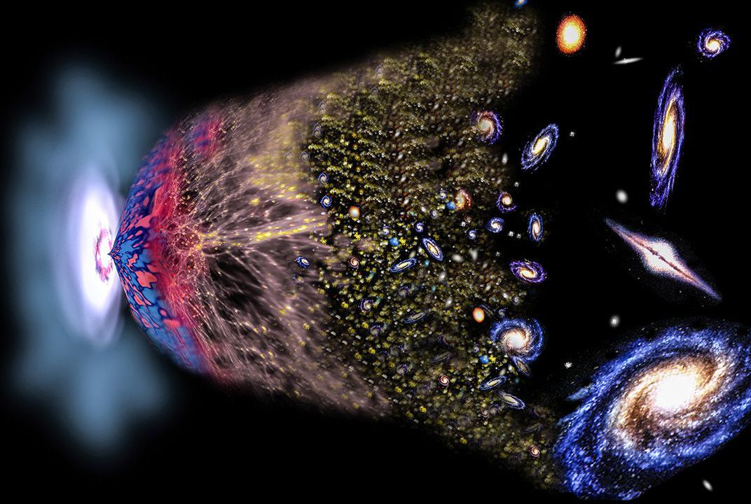
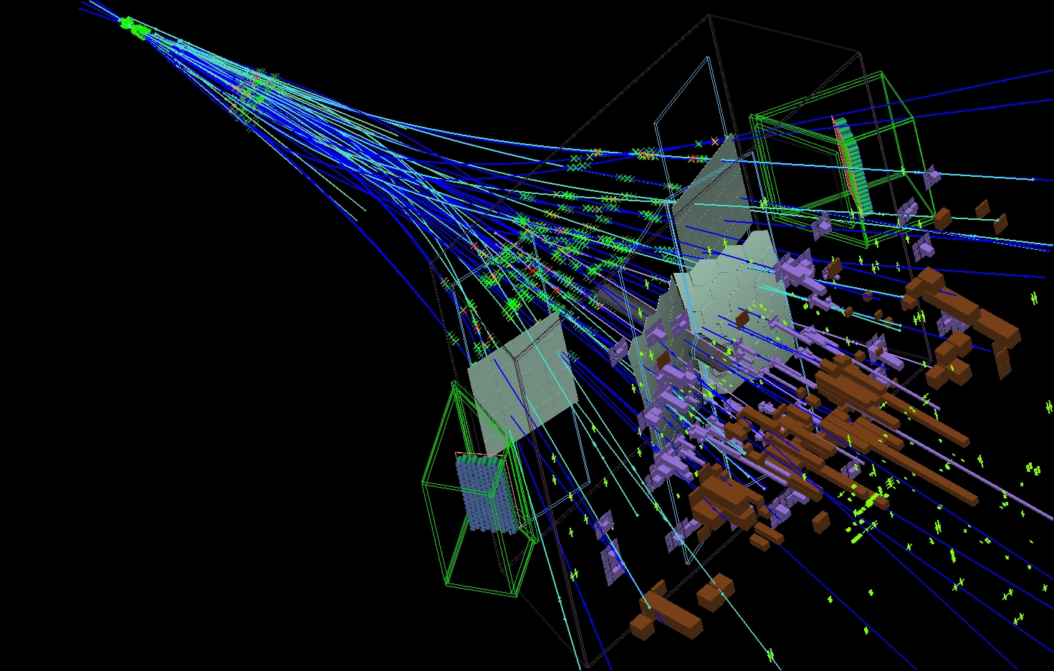
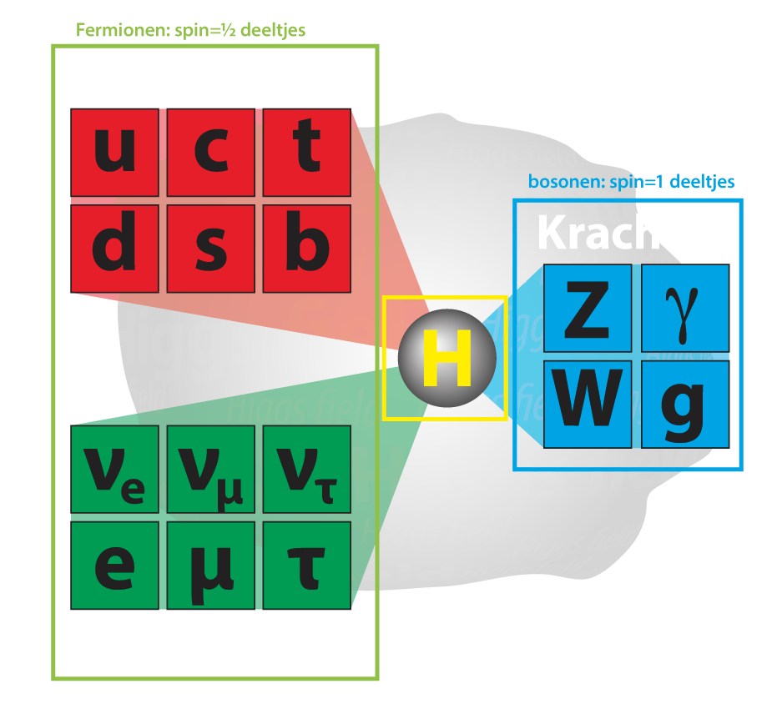
Flavour Puzzles and the LHCb Experiment
Marcel Merk
Lunteren NNV
Nov. 2, 2018

Slide 2
Flavour Puzzles and the LHCb Experiment
(Flavour) Puzzles:
Why three generations?
Why this particle mass spectrum?
Why no antimatter particles?
Why is top-Yukawa = 1?
Why metastable vacuum?
Why SU(3)_{C} x SU(2)_{L} x U(1)_{Y}

Slide 3
Contents
1/51
Three generations and the origin of CP violation
The amount of CP violation and the early universe
Measurements of CP violation with LHCb
B-decays and flavour anomalies
What could it be?

Slide 4
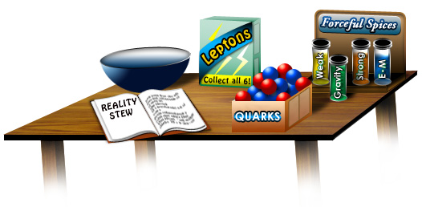
Contents
2/51
Three generations and the origin of CP violation
The amount of CP violation and the early universe
Measurements of CP violation with LHCb
B-decays and flavour anomalies
What could it be?

Slide 5
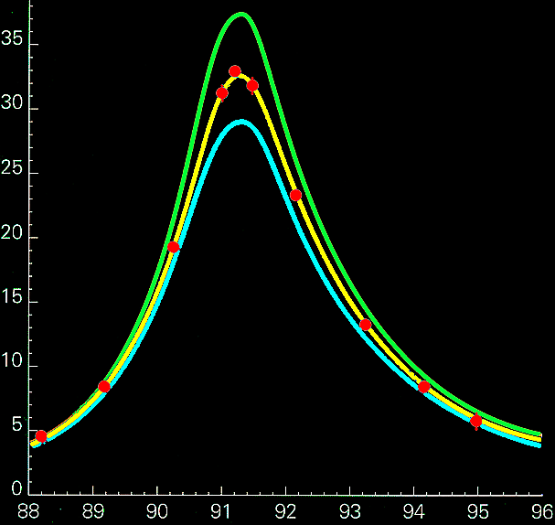
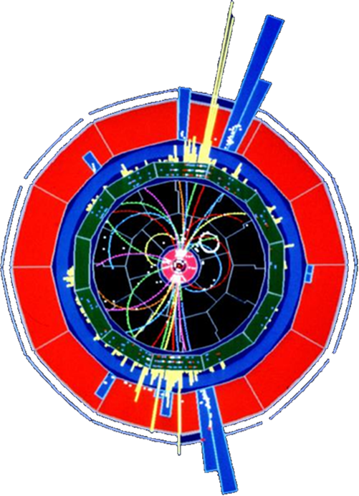
3 Generations of fundamental particles – How do we know?
3/51
LEP
4 neutrinos
3 neutrinos
Number of events
2 neutrinos
1
LEP:
Z decays into 3 light neutrino generations
  Precisely three
measurements
Collision Energy (GeV)

Slide 6


3 Generations of fundamental particles – How do we know?
4/51
$$H→γγ$$
$$H→4μ$$
LHC:
Higgs production:
  Loop diagram is proportional to the mass of the heaviest fermion

Slide 7
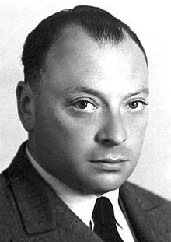




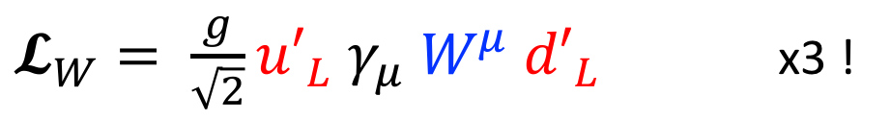






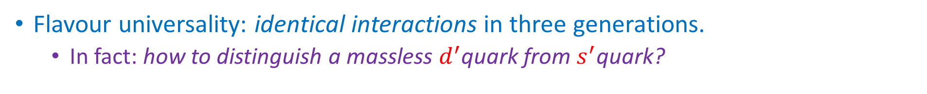
Weak interaction in three Flavour Generations
5/51
Weak Interaction is 100% parity violating.
  Wolfgang Pauli: “I cannot believe God is a weak left-hander.”
Implement an SU(2)_{L} symmetry for massless particles:
$𝓛_{W}= \frac{g}{\sqrt{2}}{u′}_{L} γ_{μ} W^{μ} {d′}_{L}$ x3 !
Wolfgang Pauli
Flavour universality: identical interactions in three generations.
  In fact: how to distinguish a massless $d^{′}$quark from $s^{′}$quark?
$$d′$$
$$s′$$
$$b′$$
$$u′$$
$$W^{+}$$
$$c′$$
$$W^{+}$$
$$W^{+}$$
$$t′$$
There is no CP violation in these massless interactions
  What happens when particles acquire mass?

Slide 8
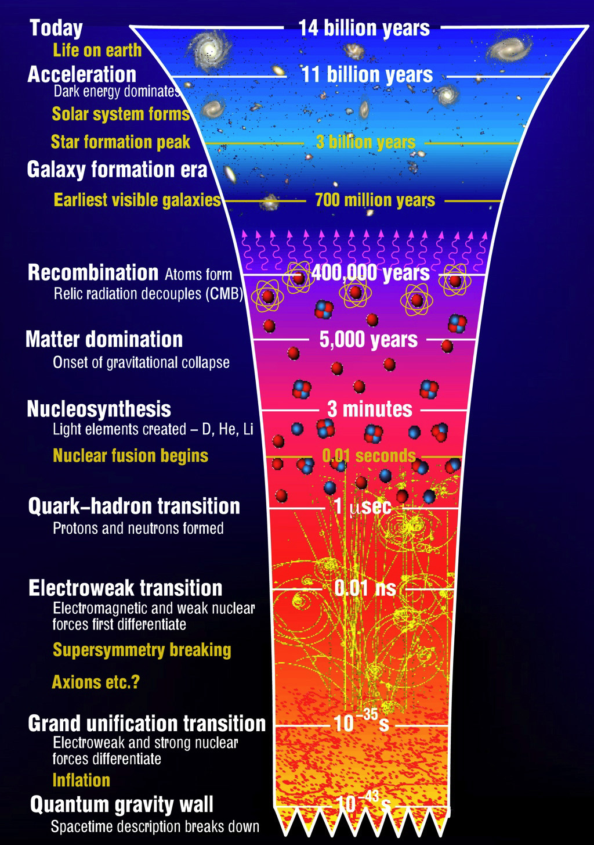
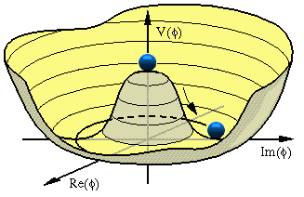
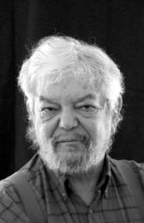
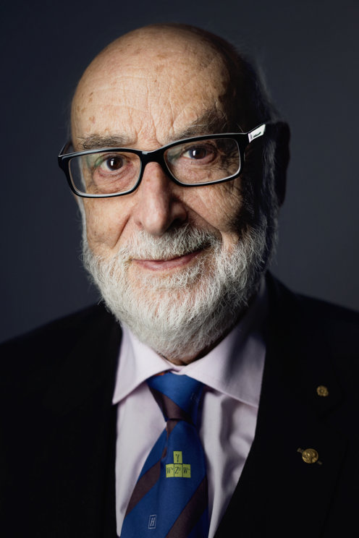
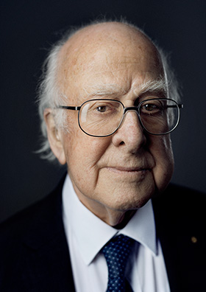

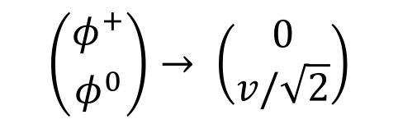
Spontaneous Symmetry Breaking→ Origin of Mass
6/51
Yukawa couplings to massless particles:
$𝓛_{Y}$ $=Y_{ij}^{d}{ \left(\overline{u_{i}^{′}},\overline{d_{i}^{′}}\right)}_{L} \left( {φ^{+} \atop φ^{0}} \right)d_{jR}^{′} + Y_{ij}^{u}{ \left(\overline{u_{i}^{′}}, \overline{d_{i}^{′}}\right)}_{L} \left( {φ^{0} \atop φ^{−}} \right) u_{jR}^{′}$
• Yukawa interaction is not flavour universal!
Unknown origin of Yukawa matrix acting on generations “i” and “j”
$$v$$
SSB: B-E-H Mechanism:
$$\left({φ^{+} \atop φ^{0}}\right)→ \left(\begin{matrix}0 \\ v/\sqrt{2}\end{matrix}\right)$$
Massive W- and
Z- bosons
Robert Brout
Francois Englert
Peter Higgs

Slide 9
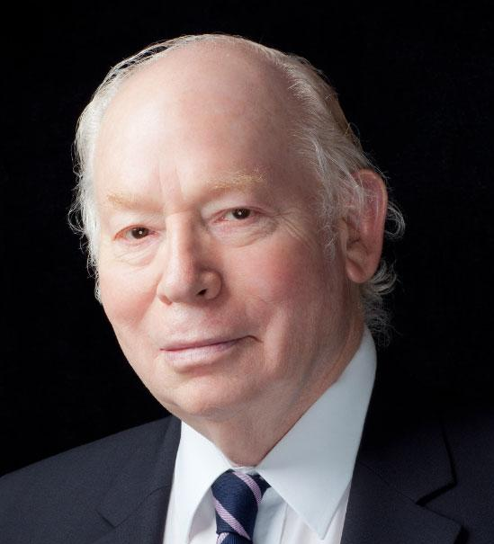
Spontaneous Symmetry Breaking→ Origin of Mass
6/51
Yukawa couplings to massless particles (Weinberg):
$𝓛_{Y}$ $=Y_{ij }^{d}{ \left(\overline{u_{i}^{′}},\overline{d_{i}^{′}}\right)}_{L} \left({0 \atop v/\sqrt{2}}\right)d_{jR}^{′} + Y_{ij }^{u} {\left(\overline{u_{i}^{′}}, \overline{d_{i}^{′}}\right)}_{L} \left({v/\sqrt{2} \atop 0}\right)u_{jR}^{′}$
• Yukawa interaction is not flavour universal!
Unknown origin of Yukawa matrix acting on generations “i” and “j”
➔Massive
fermions
$$v$$
SSB: B-E-H Mechanism:
$$\left({φ^{+} \atop φ^{0}}\right)→ \left(\begin{matrix}0 \\ v/\sqrt{2}\end{matrix}\right)$$
Massive W- and
Z- bosons
Robert Brout
Francois Englert
Peter Higgs

Slide 10

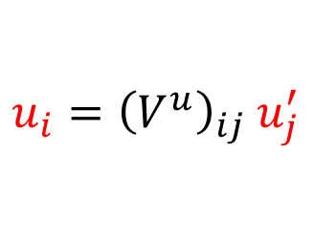

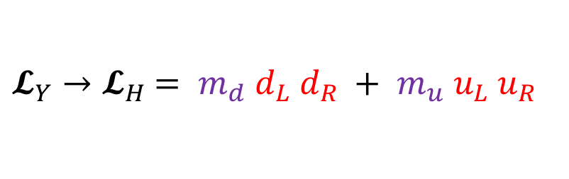


Spontaneous Symmetry Breaking→ Origin of Mass
7/51
Yukawa couplings to massless particles:
$𝓛_{Y}$ $=Y_{ij }^{d}{ \left(\overline{u_{i}^{′}},\overline{d_{i}^{′}}\right)}_{L} \left({0 \atop v/\sqrt{2}}\right)d_{jR}^{′} + Y_{ij }^{u} {\left(\overline{u_{i}^{′}}, \overline{d_{i}^{′}}\right)}_{L} \left({v/\sqrt{2} \atop 0}\right)u_{jR}^{′}$
𝑣
Diagonalize${ Y}_{ij}$:
$u_{i}={\left(V^{u}\right)}_{ij} u_{j}^{′}$
and
$d_{i}={\left(V^{d}\right)}_{ij} d_{j}^{′}$
  → mass and flavour eigenstates
$$v$$
$$M_{ij} =Y_{ij} v/\sqrt{2}$$
Mass terms:
${𝓛_{Y}→𝓛}_{H}$ $= m_{d} d_{L} d_{R} + m_{u} u_{L} u_{R}$
Physical particles
$$m_{top} =1.0 v/\sqrt{2}$$
Top quark mass:
  To first order Higgs couples only to top with coupling strength 1.0 !
    Very flavour non-universal

Slide 11

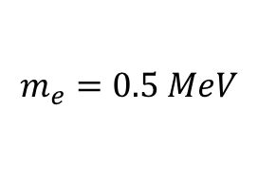
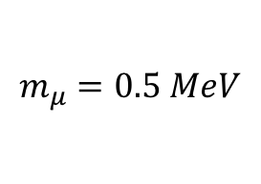
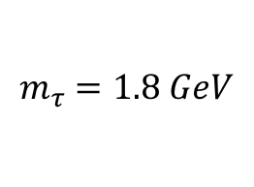
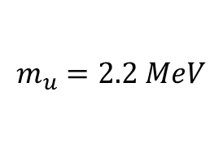
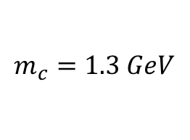
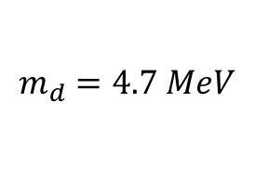
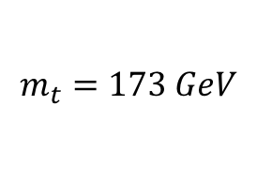
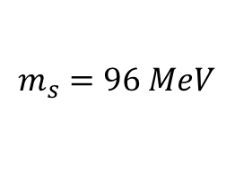
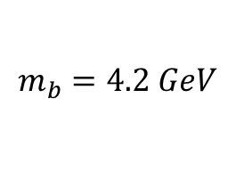
Flavour Puzzle: particle masses? Origin Yukawa couplings?
8/51
Weak interaction flavour universal
Higgs interaction almost purely 3rd generation
e
μ
τ
$$m_{e}=0.5 MeV$$
$$m_{μ}=0.5 MeV$$
$$m_{τ}=1.8 GeV$$
top-Yukawa = 1.0 ?!
u
c
t
$$m_{u}=2.2 MeV$$
$$m_{c}=1.3 GeV$$
$$m_{t}=173 GeV$$
d
s
b
$$m_{d}=4.7 MeV$$
$$m_{s}=96 MeV$$
$$m_{b}=4.2 GeV$$

Slide 12





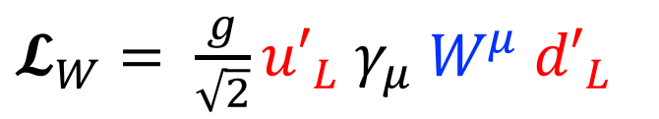




The Weak Interaction → Flavour Mixing
9/51
$𝓛_{W}= \frac{g}{\sqrt{2}}{u′}_{L} γ_{μ} W^{μ} {d′}_{L}$
No CP violation
$$d^{′}$$
$$s^{′}$$
$$b^{′}$$
$$u^{′}$$
$$W^{+}$$
$$c^{′}$$
$$W^{+}$$
$$t^{′}$$
$$W^{+}$$
Redefine: $u_{i}^{′}= {\left(V^{u}\right)}_{ij} u_{i}$ and: $d_{i}^{′}= {\left(V^{d}\right)}_{ij}^{†}d_{i}$ , such that: $V_{CKM}={\left(V^{u}V^{d†}\right)}_{ij}$ …

Slide 13





















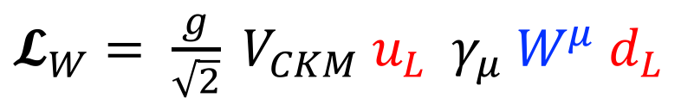












The Weak Interaction → Flavour Mixing
10/51
(Interaction basis)
(Mass basis)
$𝓛_{W}= \frac{g}{\sqrt{2}}{u′}_{L} γ_{μ} W^{μ} {d′}_{L}$
$𝓛_{W}= \frac{g}{\sqrt{2}} V_{CKM} u_{L} γ_{μ} W^{μ} d_{L}$
Redefine: $u_{i}^{′}= {\left(V^{u}\right)}_{ij} u_{i}$ and: $d_{i}^{′}= {\left(V^{d}\right)}_{ij}^{†}d_{i}$ , such that: $V_{CKM}={\left(V^{u}V^{d†}\right)}_{ij}$ …
Generation structure of weak interaction, now includes CP violation.
$$s$$
$$V_{us}$$
$$b$$
$$V_{ub}$$
$$d$$
$$V_{ud}$$
$$W^{+}$$
$$u$$
$$W^{+}$$
$$u$$
$$W^{+}$$
$$u$$
$$d$$
$$s$$
$$V_{cs}$$
$$b$$
$$V_{cb}$$
$$V_{cd}$$
$$c$$
$$W^{+}$$
$$c$$
$$W^{+}$$
$$c$$
$$W^{+}$$
$$d$$
$$s$$
$$V_{ts}$$
$$b$$
$$V_{tb}$$
$$V_{td}$$
$$t$$
$$W^{+}$$
$$t$$
$$W^{+}$$
$$t$$
$$W^{+}$$

Slide 14
Flavour Changing Quark Interactions
11/51
Flavour changing currents
3
2
1

Slide 15
Flavour Changing Quark Interactions
11/51
Flavour changing currents
3
2
1

Slide 16
Flavour Changing Quark Interactions
11/51
Flavour changing currents
3
2
1

Slide 17
Flavour Changing Quark Interactions
11/51
Flavour changing currents
3
2
1

Slide 18
Flavour Changing Quark Interactions – CP Violation
11/51
Flavour changing currents
3
2
Complex coupling constants are the source of CP viol.
1
Particles and antiparticles have complex conjugated coupling constants

Slide 19
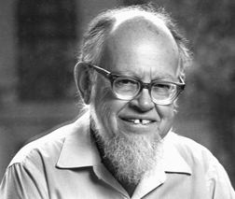


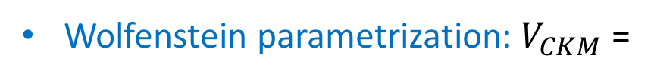
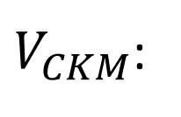
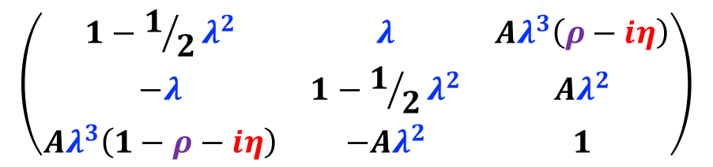

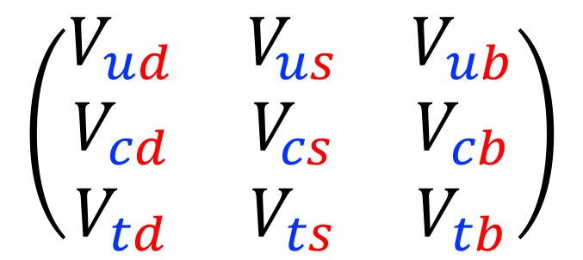
The CKM matrix $V_{CKM}$ - 3 Generations
12/51
$V_{CKM}$:
$d$ $s$ $b$
$$u$$
$$c$$
$$t$$
$$\left(\begin{matrix}V_{ud} & V_{us} & V_{ub} \\ V_{cd} & V_{cs} & V_{cb} \\ V_{td} & V_{ts} & V_{tb}\end{matrix}\right)$$
Wolfenstein parametrization: $V_{CKM}$ =
$$\left(\begin{matrix}1−1/2λ^{2} & λ & Aλ^{3}\left(ρ−iη\right) \\ −λ & 1−1/2λ^{2} & Aλ^{2} \\ Aλ^{3}\left(1−ρ−iη\right) & −Aλ^{2} & 1\end{matrix}\right)$$
Lincoln Wolfenstein
$➔$ 1 CP violating phase

Slide 20
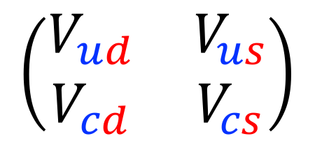


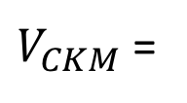
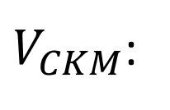
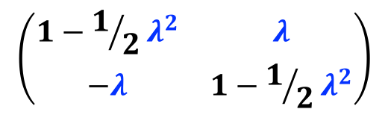
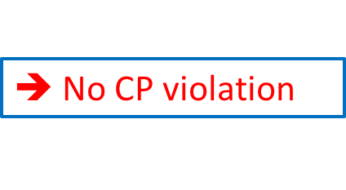
The CKM matrix $V_{CKM}$ - 3 vs 2 Generations
13/51
$V_{CKM}$:
$d$ $s$ $b$
$V_{CKM}$:
$d$ $s$
$$u$$
$$c$$
$$t$$
$$\left(\begin{matrix}V_{ud} & V_{us} & V_{ub} \\ V_{cd} & V_{cs} & V_{cb} \\ V_{td} & V_{ts} & V_{tb}\end{matrix}\right)$$
$$\left(\begin{matrix}V_{ud} & V_{us} \\ V_{cd} & V_{cs}\end{matrix}\right)$$
$$u$$
$$c$$
Wolfenstein parametrization: $V_{CKM}$ =
$V_{CKM}$ =
$$\left(\begin{matrix}1−1/2λ^{2} & λ & Aλ^{3}\left(ρ−iη\right) \\ −λ & 1−1/2λ^{2} & Aλ^{2} \\ Aλ^{3}\left(1−ρ−iη\right) & −Aλ^{2} & 1\end{matrix}\right)$$
$$\left(\begin{matrix}1−1/2λ^{2} & λ \\ −λ & 1−1/2λ^{2}\end{matrix}\right)$$
$➔$ 1 CP violating phase
$➔$No CP violation
3 generations is the minimal particle content to generate CP violation (In Standard Model).

Slide 21
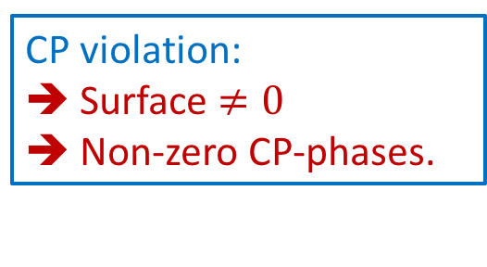
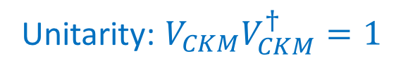
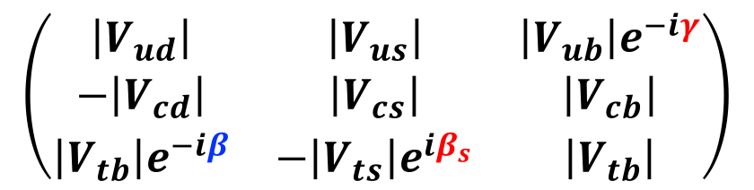
The CKM matrix $V_{CKM}$ - 3 Generations
14/51
$V_{CKM}$:
$d$ $s$ $b$
Unitarity: $V_{CKM}V_{CKM}^{†}=1$
$$u$$
$$c$$
$$t$$
$$\left(\begin{matrix}V_{ud} & V_{us} & V_{ub} \\ V_{cd} & V_{cs} & V_{cb} \\ V_{td} & V_{ts} & V_{tb}\end{matrix}\right)$$
Wolfenstein parametrization: $V_{CKM}$ =
$$\left(\begin{matrix}\left|V_{ud}\right| & \left|V_{us}\right| & \left|V_{ub}\right|e^{−iγ} \\ −\left|V_{cd}\right| & \left|V_{cs}\right| & \left|V_{cb}\right| \\ \left|V_{tb}\right|e^{−iβ} & −\left|V_{ts}\right|e^{iβ_{s}} & \left|V_{tb}\right|\end{matrix}\right)$$
CP violation:
➔ Surface $≠0$
➔ Non-zero CP-phases.

Slide 22
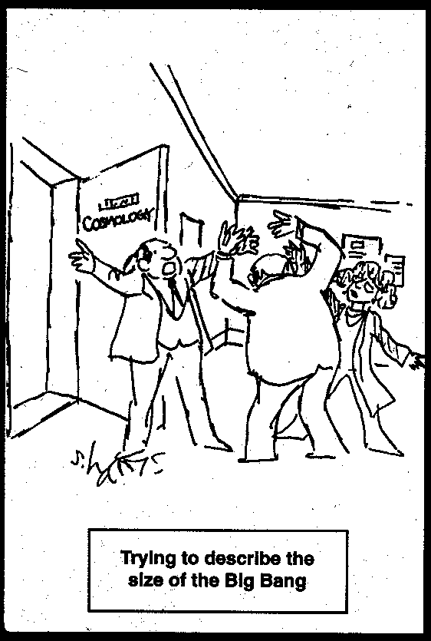
Contents
15/51
Three generations and the origin of CP violation
The amount of CP violation and the early universe
Measurements of CP violation with LHCb
B-decays and flavour anomalies
What could it be?

Slide 23
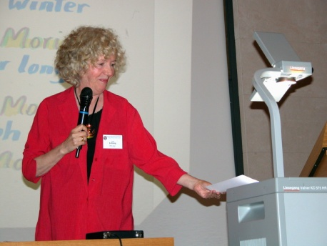
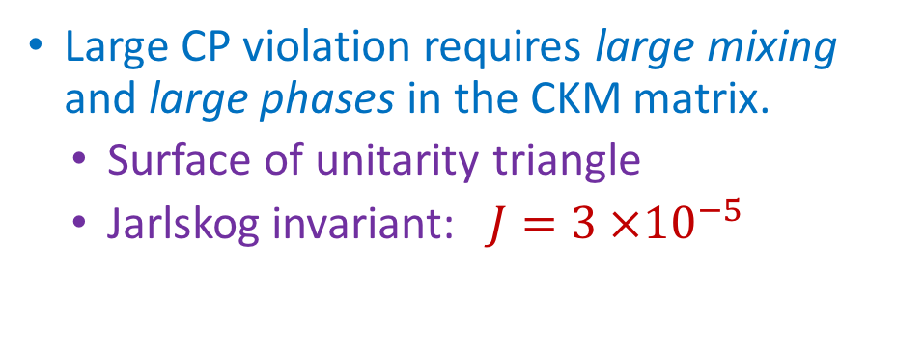
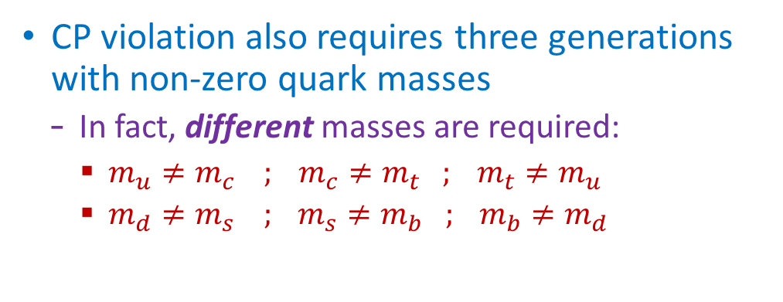
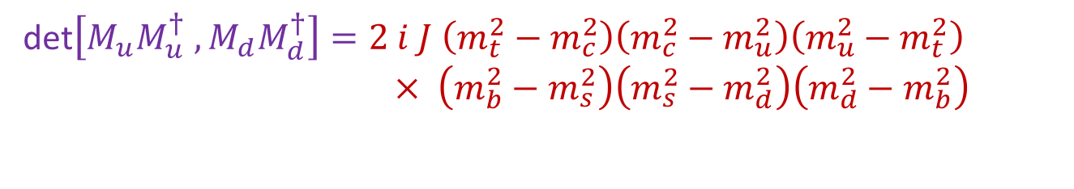
How large is CP violation?
16/51
Large CP violation requires large mixing and large phases in the CKM matrix.
  Surface of unitarity triangle
  Jarlskog invariant: $J=3 ×{10}^{−5}$
CP violation also requires three generations with non-zero quark masses
  In fact, different masses are required:
    $m_{u}≠m_{c} ; m_{c}≠m_{t} ; m_{t}≠m_{u}$
    $m_{d}≠m_{s} ; m_{s}≠m_{b} ; m_{b}≠m_{d}$
Jarlskog criterion (1987) for amount of CP violation:
det$\left[M_{u}M_{u}^{†} , M_{d}M_{d}^{†}\right]=2 i J \left(m_{t}^{2}−m_{c}^{2}\right)\left(m_{c}^{2}−m_{u}^{2}\right)\left(m_{u}^{2}−m_{t}^{2}\right)$
$× \left(m_{b}^{2}−m_{s}^{2}\right)\left(m_{s}^{2}−m_{d}^{2}\right)\left(m_{d}^{2}−m_{b}^{2}\right)$

Slide 24

SU(2)
17/51
W interaction flavour universal
$𝓛_{W}= \frac{g}{\sqrt{2}}{u′}_{L} γ_{μ} W^{μ} {d′}_{L}$
𝑣

Slide 25
SU(2) → Higgs vev
17/51
W interaction flavour universal
$𝓛_{W}= \frac{g}{\sqrt{2}}{u′}_{L} γ_{μ} W^{μ} {d′}_{L}$
Higgs interaction not flavour universal
𝑣
$𝓛_{H}$ $=Y_{ij}^{d}{ \left(\overline{u_{i}^{′}},\overline{d_{i}^{′}}\right)}_{L} \left({0 \atop v}\right){ d}_{jR}^{′} +Y_{ij}^{u} {\left(\overline{u_{i}^{′}}, \overline{d_{i}^{′}}\right)}_{L} \left({v \atop 0}\right) { u}_{jR}^{′}$
$$v$$

Slide 26
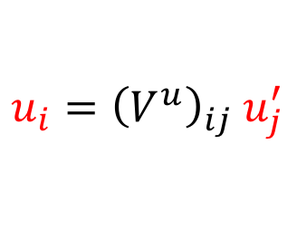

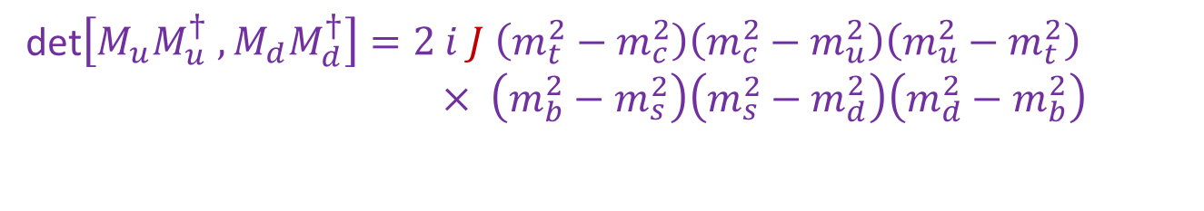
SU(2) → Higgs vev → Origin of Mass
17/51
W interaction flavour universal
$𝓛_{W}= \frac{g}{\sqrt{2}}{u′}_{L} γ_{μ} W^{μ} {d′}_{L}$
Higgs interaction not flavour universal
𝑣
$𝓛_{H}$ $=Y_{ij}^{d}{ \left(\overline{u_{i}^{′}},\overline{d_{i}^{′}}\right)}_{L} \left({0 \atop v}\right){ d}_{jR}^{′} +Y_{ij}^{u} {\left(\overline{u_{i}^{′}}, \overline{d_{i}^{′}}\right)}_{L} \left({v \atop 0}\right) { u}_{jR}^{′}$
Mass vs Interaction states:
$u_{i}={\left(V^{u}\right)}_{ij} u_{j}^{′}$
$d_{i}={\left(V^{d}\right)}_{ij} d_{j}^{′}$
$$v$$
Amount of CP violation:
det$\left[M_{u}M_{u}^{†} , M_{d}M_{d}^{†}\right]=2 i J \left(m_{t}^{2}−m_{c}^{2}\right)\left(m_{c}^{2}−m_{u}^{2}\right)\left(m_{u}^{2}−m_{t}^{2}\right)$
$× \left(m_{b}^{2}−m_{s}^{2}\right)\left(m_{s}^{2}−m_{d}^{2}\right)\left(m_{d}^{2}−m_{b}^{2}\right)$

Slide 27
SU(2) → Higgs vev → Origin of Mass → Origin of CP violation?
17/51
W interaction flavour universal
$𝓛_{W}= \frac{g}{\sqrt{2}}{u′}_{L} γ_{μ} W^{μ} {d′}_{L}$
Higgs interaction not flavour universal
𝑣
$𝓛_{H}$ $=Y_{ij}^{d}{ \left(\overline{u_{i}^{′}},\overline{d_{i}^{′}}\right)}_{L} \left({0 \atop v}\right){ d}_{jR}^{′} +Y_{ij}^{u} {\left(\overline{u_{i}^{′}}, \overline{d_{i}^{′}}\right)}_{L} \left({v \atop 0}\right) { u}_{jR}^{′}$
Mass vs Interaction states:
$u_{i}={\left(V^{u}\right)}_{ij} u_{j}^{′}$
$d_{i}={\left(V^{d}\right)}_{ij} d_{j}^{′}$
$$v$$
Amount of CP violation:
det$\left[M_{u}M_{u}^{†} , M_{d}M_{d}^{†}\right]=2 i J \left(m_{t}^{2}−m_{c}^{2}\right)\left(m_{c}^{2}−m_{u}^{2}\right)\left(m_{u}^{2}−m_{t}^{2}\right)$
$× \left(m_{b}^{2}−m_{s}^{2}\right)\left(m_{s}^{2}−m_{d}^{2}\right)\left(m_{d}^{2}−m_{b}^{2}\right)$
Does the Standard Model include CP violation before symmetry breaking?
  Is CP violation perhaps an emergent phenomenon?

Slide 28


The Baryogenesis Puzzle – Electroweak Baryogenesis?
18/51
Sacharov Conditions
  All present in S.M.
✔ Baryon Number Violation
✔ C and CP Violation
✔ Thermal non-equilibrium
Adler-Bell-
Jackiw
1st order
‘t Hooft, PRL
37 (1976) 8
V
Axial Anomaly:
f
f
tunnel
f
Quantum anomaly
Weak Interaction
φ
Higgs Phase Transition
Baryogenesis from Higgs symmetry breaking?
symmetric phase
broken phase
expanding bubble (Higgs condensates)

Slide 29



The Baryogenesis Puzzle – Electroweak Baryogenesis?
19/51
Sacharov Conditions
  All present in S.M.
  Not Enough?
✔ Baryon Number Violation
✖ C and CP Violation
✔ Thermal non-equilibrium
✖
1st order
Adler-Bell-
Jackiw
‘t Hooft, PRL
37 (1976) 8
2nd order
SM
V
V
Axial Anomaly:
f
f
tunnel
f
Quantum anomaly
Weak Interaction
φ
Higgs Phase Transition
✖ 1st order?
✔ Sphalerons
• SM: M_{H} < ~70 GeV
• THDM: M_{H} ~ 125 OK
✖ CPV from CKM
  − BAU: $\frac{Δn_{B}}{n_{γ}}≈{10}^{−10}$
− $A_{CP}=J_{inv} × \left(m_{t}^{2}−m_{c}^{2}\right)\left(m_{c}^{2}−m_{u}^{2}\right)\left(m_{u}^{2}−m_{t}^{2}\right)$
$×\left(m_{b}^{2}−m_{s}^{2}\right)\left(m_{s}^{2}−m_{d}^{2}\right)\left(m_{d}^{2}−m_{b}^{2}\right)$
    From CKM: ${A_{CP}}/{T_{c}^{12}}≈{10}^{−20 }$ → Too small
    Used $T_{c}∼100$ GeV

Slide 30
The Baryogenesis Puzzle – Electroweak Baryogenesis?
20/51
Expanding bubbles of broken phase
In a medium of symmetric phase
Baryon production in
front of bubble wall
Was the phase transition in the early universe of 1st order?
  Higgs potential?
If new physics is abundant in thermal plasma of early universe:
➔ Likely to be of TeV energy scale.

Slide 31
Contents
21/51
Three generations and the origin of CP violation
The amount of CP violation and the early universe
Measurements of CP violation with LHCb
B-decays and flavour anomalies
What could it be?
“Measurement of CP violation”
- Erwin Agasi

Slide 32









CP violation: a quantum interference experiment
22/51
Quantum process with two amplitudes $A_{1}$ and $A_{2}$:
  Eg.: $A_{1}=B^{0}→J/{ψ K_{s}}$ and $A_{2}=B^{0}→\overline{B^{0}}→J/{ψ K_{s}}$
$$A_{1}$$
$$A_{2}$$
$$e^{−i2β}$$
time
$$\overline{A_{1}}$$
$$\overline{A_{2}}$$
  $\left|A_{1}\right|= \left|\overline{A_{1}}\right|$ , $\left|A_{2}\right|$ = $\left|\overline{A_{2}}\right|$,
  but $\left|A_{1}+A_{2}\right|≠$ $\left|\overline{A_{1}+A_{2}}\right|$
$$e^{i2β}$$

Slide 33











CP violation: a quantum interference experiment
22/51
Quantum process with two amplitudes $A_{1}$ and $A_{2}$:
  Eg.: $A_{1}=B^{0}→J/{ψ K_{s}}$ and $A_{2}=B^{0}→\overline{B^{0}}→J/{ψ K_{s}}$
$$A_{1}$$
$$A_{2}$$
$$A=A_{1}+A_{2}e^{iφ}e^{iδ}$$
$$\overline{A}=A_{1}+A_{2}e^{−iφ}e^{iδ}$$
$${\left|A\right|}^{2}={\left|A_{1}\right|}^{2}+{\left|A_{2}\right|}^{2}+A_{1}A_{2}\left(e^{iφ}e^{iδ}+e^{−iφ}e^{−iδ}\right)$$
time
$$\overline{A_{1}}$$
$${\left|\overline{A}\right|}^{2}={\left|A_{1}\right|}^{2}+{\left|A_{2}\right|}^{2}+A_{1}A_{2}\left(e^{−iφ}e^{iδ}+e^{iφ}e^{−iδ}\right)$$
$$\overline{A_{2}}$$
  $\left|A_{1}\right|= \left|\overline{A_{1}}\right|$ , $\left|A_{2}\right|$ = $\left|\overline{A_{2}}\right|$,
  but $\left|A_{1}+A_{2}\right|≠$ $\left|\overline{A_{1}+A_{2}}\right|$
$${\left|A−\overline{A}\right|}^{2}=4 A_{1}A_{2}\sin{φ}\sin{δ}$$
CP violation is a pure quantum interference effect.
$$A_{1}$$
$$J/φ$$
$$\overline{A_{1}}$$
$$J/φ$$
$$B^{0}$$
CP
$$\overline{B^{0}}$$
$$A_{2}$$
$$K_{s}$$
$$K_{s}$$
$$\overline{A_{2}}$$

Slide 34

Intermezzo: CP violation and Interference
23/51
Feynman: “In the end all quantum phenomena are manifestations of the double slit experiment.”
Assuming CPT, symmetry, CP violation implies a quantum arrow of time
  Quantum interference ←→ arrow of time?

Slide 35

The LHCb experiment
24/51

Slide 36








Meson mixing: does the experiment work?
25/51
$B^{0}− \overline{B^{0}}$ mixing
$B_{s}^{0}− \overline{B_{s}^{0}}$ mixing
$D^{0}→\overline{D^{0}}$ mixing
$$B^{0}→D^{−}π^{+}$$
$$B_{s}^{0}→D_{s}^{−}π^{+}$$
$$D^{0}→K^{+}π^{−}$$
PRL.110 (2013) 101802
Phys.Lett.B719 (2013) 318
New.J.Phys.15 (2013) 053021

Slide 37
Meson mixing: does the experiment work?
25/51
$B^{0}− \overline{B^{0}}$ mixing
$B_{s}^{0}− \overline{B_{s}^{0}}$ mixing
$D^{0}→\overline{D^{0}}$ mixing
$$B^{0}→D^{−}π^{+}$$
$$B_{s}^{0}→D_{s}^{−}π^{+}$$
$$D^{0}→K^{+}π^{−}$$
PRL.110 (2013) 101802
Phys.Lett.B719 (2013) 318
New.J.Phys.15 (2013) 053021
The Experiment works extremely well!

Slide 38






Three types of observable CP violation
26/51
  “indirect” CP Violation: 1964 (CCFT)
    Prob${(K}^{0}→\overline{K^{0}}) ≠$ Prob $(\overline{K^{0}}→K^{0})$
    |ε|= (2.228 ± 0.011 ) x 10⁻³ (PDG 2014)
    Also called: CPV in mixing
  “direct” CP violation: 1999 (NA48 & KTeV):
    Decay rates $Γ\left(K^{0}→π^{+}π^{−}\right)≠Γ\left(\overline{K^{0}}→π^{+}π^{−}\right)$ Re(ε’/ε) = (1.65 ± 0.26) x 10⁻³ (PDG 2014)
    Also called: CPV in decay
  “mixing induced” CP violation: 2001 (Belle & Babar):
    Also: CPV in interference of mixing and decay
    sin 2β = 0.682 ± 0.019 (PDG 2014)
Interfere dispersive and absorptive:
$$K^{0}$$
$$\overline{K^{0}}$$
Interfere Isospin amplitudes:
Interfere direct and mixed:
$$B$$
$$J/{ψ{ K}_{s}}$$
$$\overline{B}$$

Slide 39
Three types of observable CP violation
26/51
  “indirect” CP Violation: 1964 (CCFT)
    Prob${(K}^{0}→\overline{K^{0}}) ≠$ Prob $(\overline{K^{0}}→K^{0})$
    |ε|= (2.228 ± 0.011 ) x 10⁻³ (PDG 2014)
    Also called: CPV in mixing
  “direct” CP violation: 1999 (NA48 & KTeV):
    Decay rates $Γ\left(K^{0}→π^{+}π^{−}\right)≠Γ\left(\overline{K^{0}}→π^{+}π^{−}\right)$ Re(ε’/ε) = (1.65 ± 0.26) x 10⁻³ (PDG 2014)
    Also called: CPV in decay
  “mixing induced” CP violation: 2001 (Belle & Babar):
    Also: CPV in interference of mixing and decay
    sin 2β = 0.682 ± 0.019 (PDG 2014)
Interfere dispersive and absorptive:
$$K^{0}$$
$$\overline{K^{0}}$$
All CP violation processes result from quantum interference including three generations of fermions.
Interfere Isospin amplitudes:
Interfere direct and mixed:
$$B$$
$$J/{ψ{ K}_{s}}$$
$$\overline{B}$$

Slide 40






Type-1: CP violation in mixing: $a_{SL}\left(B_{d}\right)$ en $a_{SL}\left(B_{s}\right)$
27/51
Interfere dispersive and absorptive:
$$𝒜_{meas}= \frac{Γ_{{(B}_{s}^{0}→D_{s}^{−}μ^{+})}−Γ_{(B_{s}^{0}→D_{s}^{+}μ^{−})}}{Γ_{{(B}_{s}^{0}→D_{s}^{−}μ^{+})}+Γ_{(B_{s}^{0}→D_{s}^{+}μ^{−})}}=\frac{1}{2} a_{SL}(B_{s}^{0})$$
$$B_{s}^{0}$$
$$\overline{B_{s}^{0}}$$
$$B_{s}^{0}→D_{s}^{+}μ^{−}$$
CP violation in mixing does not happen in $B_{d}^{0}$ and $B_{s}^{0}$ mesons:
  $B→\overline{B}$ goes at same rate as $\overline{B}→B$
  Contrary to $ε$ in kaons.
$$B_{d}^{0}→D^{+}μ^{−}$$

Slide 41










Type-2: Direct CP violation: $B_{d}^{0}→Kπ$ and $B_{s}^{0}→Kπ$
28/51
Interfere two decay amplitudes:
$$\left(\begin{matrix}\left|V_{ud}\right| & \left|V_{us}\right| & \left|V_{ub}\right|e^{−iγ} \\ −\left|V_{cd}\right| & \left|V_{cs}\right| & \left|V_{cb}\right| \\ \left|V_{tb}\right|e^{−iβ} & −\left|V_{ts}\right|e^{iβ_{s}} & \left|V_{tb}\right|\end{matrix}\right)$$
γ
+
$$B_{d}^{0}→Kπ$$
Quarks from three generations involved
Large interference
Large CP violation!
  Contrary to $ε^{′}$ in the kaon system
PRL 110.221601
A_{CP} = -0.080 ± 0.007 ± 0.003
$$B^{0}→K^{+}π^{−}$$
$${\overline{B}}^{0}→K^{−}π^{+}$$
$$B_{s}^{0}→Kπ$$
PRL 110.221601
$${\overline{B_{s}}}^{0}→K^{+}π^{−}$$
$$B_{s}^{0}→K^{−}π^{+}$$
A_{CP} = 0.27 ± 0.04 ± 0.01
First observation of CP violation
CP asymmetry in B_{s} decays
$A_{CP}\left(B^{+}\right)−A_{CP}\left(B^{0}\right)$puzzle?
Fleischer et al. arXiv:1806.08783
Notes:
Kpi anomaly

Slide 42

Type-2: Direct CP violation: $B→DK$
29/51
Interfere two decay amplitudes (many decays):
$$\left(\begin{matrix}\left|V_{ud}\right| & \left|V_{us}\right| & \left|V_{ub}\right|e^{−iγ} \\ −\left|V_{cd}\right| & \left|V_{cs}\right| & \left|V_{cb}\right| \\ \left|V_{tb}\right|e^{−iβ} & −\left|V_{ts}\right|e^{iβ_{s}} & \left|V_{tb}\right|\end{matrix}\right)$$
Average:
$$γ= {\left(74.0\begin{matrix}+5.0 \\ −5.8\end{matrix}\right)}^{o}$$
Notes:
Contrary to epsilon’

Slide 43






Type-3: CP violation in interference of mixing and decay
30/51
Decay-time dependent
CP violation:
$$A_{CP}\left(t\right)=\frac{Γ_{\overline{B}→f}\left(t\right)−Γ_{B→f}(t)}{Γ_{\overline{B}→f}\left(t\right)+Γ_{B→f}(t)}$$
Interfere direct and mixed
$$B^{0}$$
$$J/ψ K_{s}$$
$$e^{i2β}$$
$$\overline{B^{0}}$$
LHCb
$$\left(\begin{matrix}\left|V_{ud}\right| & \left|V_{us}\right| & \left|V_{ub}\right|e^{−iγ} \\ −\left|V_{cd}\right| & \left|V_{cs}\right| & \left|V_{cb}\right| \\ \left|V_{tb}\right|e^{−iβ} & −\left|V_{ts}\right|e^{iβ_{s}} & \left|V_{tb}\right|\end{matrix}\right)$$

Slide 44












Type-3: CP violation in interference of mixing and decay
31/51
Decay-time dependent CP violation:
$$A_{CP}\left(t\right)=\frac{Γ_{{\overline{B}}_{(s)}→f}\left(t\right)−Γ_{B_{(s)}→f}(t)}{Γ_{B_{(s)}→f}\left(t\right)+Γ_{B_{(s)}→f}(t)}$$
$$B^{0}$$
$$J/ψ K_{s}$$
$$e^{i2β}$$
$$\overline{B^{0}}$$
$$\sin{2β}$$
$$\left(\begin{matrix}\left|V_{ud}\right| & \left|V_{us}\right| & \left|V_{ub}\right|e^{−iγ} \\ −\left|V_{cd}\right| & \left|V_{cs}\right| & \left|V_{cb}\right| \\ \left|V_{tb}\right|e^{−iβ} & −\left|V_{ts}\right|e^{iβ_{s}} & \left|V_{tb}\right|\end{matrix}\right)$$
$$B_{s}^{0}$$
$$J/ψφ$$
$$e^{i{2β}_{s}}$$
$$\overline{B_{s}^{0}}$$
$2β_{s}$ (rad)

Slide 45


















Type-3: CP violation in interference of mixing and decay
32/51
Decay-time dependent CP violation:
$$\left(\begin{matrix}\left|V_{ud}\right| & \left|V_{us}\right| & \left|V_{ub}\right|e^{−iγ} \\ −\left|V_{cd}\right| & \left|V_{cs}\right| & \left|V_{cb}\right| \\ \left|V_{tb}\right|e^{−iβ} & −\left|V_{ts}\right|e^{iβ_{s}} & \left|V_{tb}\right|\end{matrix}\right)$$
Note: $α= π−(β+γ$)
$$B^{0}$$
$$π^{+}π^{−}$$
$$B_{s}^{0}$$
$$B_{s}^{0}$$
$${D_{s}^{∓}K}^{±}$$
$$K^{+}K^{−}$$
$$e^{i2β}$$
$$e^{i2β_{s}}$$
$$e^{i2β_{s}}$$
$$\overline{B^{0}}$$
$$e^{i2γ}$$
$$\overline{B_{s}^{0}}$$
$$e^{i2γ}$$
$$\overline{B_{s}^{0}}$$
$$e^{iγ}$$
$(t−t_{0})$mod$({2π}/{Δm_{s}) }$[ps]
$(t−t_{0})$mod$({2π}/{Δm_{s}) }$[ps]

Slide 46
CKM triangle: putting all measurements together
33/51
 | Measured | CKMfitter prediction | UTfit prediction
β | 22.7 ± 0.7 | 23.7 ^{+1.1} _{-1.0} | 23.8 ± 1.4
γ | 70.0 ± 4.2 | 65.3 ^{+1.0} _{-2.5} | 65.8 ± 2.2
α | 93.1 ± 5.6 | 92.1 ^{+1.5}_{-1.1} | 90.1 ± 2.2

Slide 47

Contents
34/51
Three generations and the origin of CP violation
The amount of CP violation and the early universe
Measurements of CP violation with LHCb
B-decays and flavour anomalies
What could it be?

Slide 48





S.M.: No Flavour Changing Neutral Currents (FCNC)
35/51
CKM: Flavour changing charged currents
SM does not have Flavour changing neutral currents
Neutral currents are possible via higher order processes:
Decay via
“Penguin diagram”:
$$B→K^{∗}μ^{+}μ^{−}$$
Flavour Oscillation
via “Box diagram”:
$$\overline{B_{s}}→B_{s}$$

Slide 49

Intermezzo: Penguins & Trees
36/51
“Trees”
“Penguins”
Trees?

Slide 50













B-decays and lepton universality
37/51
$b→c l ν$ charged current: ”Allowed” → large decay rates
$$c$$
$$R_{D}= \frac{B→Dτν}{B→Dμν }$$
$$b$$
$$τ/μ$$
$$R_{D^{∗}}= \frac{B→D^{∗}τν }{B→D^{∗}μν }$$
$${ν_{τ}}/{ν_{μ}}$$
$b→sl^{+}l^{−}$ neutral current: “Forbidden” → rare decays
$$R_{K}= \frac{B^{+}→K^{+}μ^{+}μ^{−}}{B^{+}→K^{+}e^{+}e^{−}}$$
$$s$$
$$b$$
$${μ^{+}}/{e^{+}}$$
$$R_{K^{∗}}= \frac{B^{0}→K^{∗0}μ^{+}μ^{−}}{B^{0}→K^{∗0}e^{+}e^{−}}$$
$${μ^{−}}/{e^{−}}$$

Slide 51



$R_{D}$ and $R_{D^{∗}}$
38/51
$b→c l ν$ allowed
charged current
$$R\left(D^{\left(∗\right)}\right)=\frac{BR(B→D^{\left(∗\right)}τν) }{BR(B→D^{\left(∗\right)}μν) }$$
$\sim 4σ$ deviation
SM
Involves leptons of 2nd and 3rd generation

Slide 52






$R_{K}$ and $R_{K^{∗}}$
39/51
$b→s l^{+}l^{−}$ suppressed neutral current
$$R\left(K\right)=\frac{BR(B^{+}→K^{+}μ^{+}μ^{−}) }{BR(B^{+}→K^{+}e^{+}e^{−}) }$$
$R\left(K\right)=0.745\begin{matrix}+0.090 \\ − 0.074 \end{matrix}\left(stat\right)$ $±0.036 \left(syst\right)$
~3.5 $σ$
$$R\left(K^{∗}\right)=\frac{BR(B^{0}→K^{∗}μ^{+}μ^{−}) }{BR(B^{0}→K^{∗}e^{+}e^{−}) }$$
$$R\left(K^{∗}\right)=\left\{\begin{matrix}0.66\begin{matrix}+0.11 \\ −0.07\end{matrix} \left(stat\right)±0.03 \left(syst\right) in bin1 \\ 0.69 \begin{matrix}+0.11 \\ −0.07\end{matrix} \left(stat\right)±0.05 \left(syst\right) in bin2 \end{matrix}\right.$$
Involves leptons of 1st and 2nd generation

Slide 53

Rare Decays: $b→s μ^{+}μ^{−}$
40/51
JHEP 06 (2014) 133
JHEP 06 (2014) 133
JHEP 06 (2014) 133
JHEP 08 (2013) 131
JHEP 09 (2015) 179
JHEP 06 (2015) 115
Branching fractions related to $b→s μ^{+}μ^{−}$transition consistently lower than predicted.

Slide 54





Variable $P_{5}^{′}$ in $B^{0}→K^{∗0}μ^{+}μ^{−}$
41/51
$$s$$
$$\cos{θ_{K}}$$
$$b$$
$$μ^{+}$$
$$μ^{−}$$
$$φ$$
  $P_{5}^{′}:$ count blue minus red:
Study angular distribution of final state particles
3-5 σ from SM

Slide 55





Interpretation: B-decays and effective couplings
42/51
Beta decay: “charged current”:
$$\frac{G_{F}}{\sqrt{2}}=\frac{g^{2}}{8M_{W}^{2}}$$
$$n→p e^{−}\overline{ν_{e}}$$
Rare B decay: “Flavour changing neutral current”:
$$B^{0}→K^{∗}μ^{+}μ^{−}$$
Eff Hamiltonian:
$$ℋ_{eff}=− \frac{4 G_{F}}{\sqrt{2}}V_{CKM}\sum_{i=1}^{10}{C_{i}O_{i}}$$
Effective Operators $O_{i}$ with Wilson coefficients${ C}_{i}$ predicted by the Standard Model.

Slide 56




Global Fit of $b→s μ^{+}μ^{−}$
43/51
$$ℋ_{eff}=− \frac{4 G_{F}}{\sqrt{2}}V_{CKM}\sum_{i=1}^{10}{C_{i}O_{i}}$$
Altmannshofer et al., arXiv:1704.05435
Semileptonic Penguin operators: $O_{9}, O_{10}$
Good fit for: $C_{9}^{NP}=−C_{10}^{NP}≃−1$
  New effective $V−A$contribution
  Suppressed $b→s μ^{+}μ^{−}$ penguin
$$s$$
$$b$$
$$μ^{+}$$
Note:
Suppressed
penguin
≠
Depressed
penguin
$$μ^{−}$$
Significance: 4-6 $σ$

Slide 57

Contents
44/51
Three generations and the origin of CP Violation
The amount of CP Violation and the early universe
Measurements of CP Violation with LHCb
B-decays and flavour anomalies
What could it be?

Slide 58


Contradicting effects?
45/51
$R_{D}, R_{D^{∗}}$
  ~ 25% effect at tree level:
    Large new physics effect
    $M\sim 3$ TeV
$R_{K}, R_{K^{∗}}$
  ~ 25% effect at penguin level:
    Small new physics effect
    $M\sim 30$TeV
Notes:
This will not be an easy talk! In fact, it will contain things I often wonder about but don’t understand myself!

Slide 59

Flavour Physics at high mass: GGL model
46/51
Effective New Physics operators point at left-handed vector coupling
New physics occurs above weak scale (~TeV)
  Before EWSB: physics that is invariant under
  SU(3)_{C} x SU(2)_{L} x U(1)_{Y}
  Operates on massless interaction states
3rd generation is special ($eg. Y_{top}$ = 1)
Glashow, Guagdagnoli, Lane (GGL) model: Operator for NP in 3rd generation:
  $G \left({\overline{b^{′}}}_{L} γ_{μ} {b′}_{L}\right) \left({\overline{τ^{′}}}_{L} γ^{μ} τ_{L}^{′}\right)$
𝑣
$$v$$

Slide 60



Where does GGL operator come from?
47/51
Glashow, Guagdagnoli, Lane (GGL) model: operator for NP:
  $G \left({\overline{b^{′}}}_{L} γ_{μ} {b′}_{L}\right) \left({\overline{τ^{′}}}_{L} γ^{μ} τ_{L}^{′}\right)$
Relate massive particles to massless states:
  $b_{L}^{′}=V_{31}^{d} d+V_{32}^{d} s+V_{33}^{d} b$ and
  $τ_{L}^{′}=V_{31}^{l} e+V_{32}^{l} μ+V_{33}^{l} τ$
CKM Hierarchy suggests:
  $V_{33}^{d}≃V_{33}^{l}≃1$ and $V_{31}^{d,l }≪V_{32}^{d,l }≪1$
GGL operator becomes:
  $G \left[V_{33}^{d} V_{32}^{∗d} {\left|V_{32}\right|}^{2}\right] \left({\overline{b}}_{L} γ_{μ}s_{L}\right)\left({\overline{μ}}_{L}γ^{μ}μ_{L} \right)$
Large effect in 3rd generation, small effect in 2nd generation
𝑣
$$V_{CKM}={\left(V^{u}V^{d†}\right)}_{ij}$$
$$V_{MNS}={\left(V^{ν}V^{l†}\right)}_{ij}$$
$$v$$

Slide 61


GGL operator – more general
48/51
Allow effective operators that are SU(2) x U(1) invariant:
  Singlet neutral current:
    $O_{S}^{NP}= G_{S} \left({\overline{Q^{′}}}_{L} γ_{μ} Q_{L}^{′}\right) \left({\overline{L^{′}}}_{L} γ^{μ} L_{L}^{′}\right)$
  Triplet neutral current + two charged currents:
    $O_{T}^{NP}= G_{T} \left({\overline{Q^{′}}}_{L} γ_{μ} σ^{I}Q_{L}^{′}\right) \left({\overline{L^{′}}}_{L} γ^{μ} σ^{I}L_{L}^{′}\right)$
These operators with CKM hierarchy “naturally” give simultaneous explanation of:
  $R_{D}$ , $R_{D^{∗}},$ charged current, 3rd generation
    → large effect
  $R_{K}$ ,$R_{K^{∗}}$ , $b→s μ^{+}μ^{−}$,neutral current, 2nd generation
    → small effect
$Q^{′}=\left(\begin{matrix}t′ \\ b′\end{matrix}\right)$ and $L′=\left(\begin{matrix}ν_{τ}′ \\ τ′\end{matrix}\right)$
𝑣
$$v$$

Slide 62




What could it be?
49/51
LFNU is currently a hot topic, many theory papers, see eg. arXiv:1706.07808 for overview.
• New gauge bosons
Z’, W’
• LeptoQuarks
LQ
Best Single LQ model:
  Vector LQ U1(3,1,2/3)
  Scale of NP should be ~1.5 TeV
  Possible UV completions:
    Pati-Salam models SU(4)
      Lepton←→4-th color
    SU(5) GUT
    4321 model
    S₁ & S_{3,} etc., etc.
  Shine light on flavour puzzles?!
$$G_{s}$$
$$G_{T}$$
Notes:
Pati Salam: Spontaneously broken SU(4): leptons are a 4-th color. Requires existence of vector like quarks.

Slide 63

50/51

Slide 64
Conclusions & Outlook
• Why 3? → no antimatter?
• Non Universality → why 3?
• EWSB super interesting
• LHCb probes deeply into
quantum (CP, rare decays)
• LHCb→Upgrade1→Upgrade2
• Belle2, Higgs factory, …

Slide 65
Extra Slides

Slide 66


Slide 67


Universality
…Indian Yoga
Russian Yoga…

Slide 68
LHCb: Future sensitivity for CP violation
36
2013
2030
Notes:
Many measurements, statistics limited

Slide 69
Future sensitivty B-B Mixing and CP violation phase
LHCb 50 fb⁻¹ & Belle 50 ab⁻¹
Phase space for NP:
After Upgrade (50 fb⁻¹):

Slide 70
S. Fajfer, ICHEP2018

Slide 71
S. Fajfer, ICHEP2018

Slide 72








Indirect searches for new particles?
K⁰ →μμ pointed to the charm quark:
B⁰ mixing pointed to heavy top quark:
(GIM, Phys.Rev.D2,1285,1970)
(ARGUS Coll, Phys.Lett.B192:245,1987)
Discovery of new particles through virtual effects
…
…
…
B⁰
B⁰
Notes:
K_L→mumu was very small. The existence of a fourth quark was needed to explain it via cancelling the up-quark virtual diagram.
Bs oscillations happen proportional to the square of the intermediate virtual quark. Very heavy top quark must exist to explain.

Slide 73
Strong Interaction causes trouble
Semileptonic decays
  Factorization!
Hadronic decays
  Factorization?
Factorizable
QCD:
Non-Factorizable
QCD:

Slide 74
Solution: Effective couplings
Operator Product Expansion:
  Integrate out heavy fields
  Separate perturbative Wilson coefficients C_{i} from non-perturbative local operators O_{i}

Slide 75
B-decays and effective couplings: $b→sq\overline{q}$
O₁
O₁
O₃ – O₆
O₇ – O₁₀

Slide 76
B-decays and effective couplings: $b→sl^{+}l^{−}$
O_{7γ}
O_{8G}
O_{9V} – O_{10A}

Slide 77
GGL Model – more general
The operator
Originates from physics that is invariant under SU(3)_{C} x SU(2)_{L} x U(1)_{Y}
Considering EW interactions: SU(2)_{L} x U(1)_{Y} work again with the doublets to see that there are two NP operators:
Where sigma are Paula matrices
Charged currents
Neutral current
Potential for simultaneous explanation of RK(*) and RD(*) puzzles

Slide 78




In fact…
Full expression is $O_{2}^{NP}=O_{ττν_{τ}ν_{τ}}+O_{bbττ}+O_{ttττ}+O_{bbν_{τ}ν_{τ}}+O_{tbτν_{τ}}$ with
  $O_{ττν_{τ}ν_{τ}}=G_{2}\left({\overline{t^{′}}}_{L}γ_{μ}t_{L}^{′}\right)\left({\overline{ν_{τ}^{′}}}_{L}γ^{μ} ν_{τ_{L}}^{′}\right)$
  $O_{bbττ}=G_{2}\left({\overline{b^{′}}}_{L}γ_{μ}b_{L}^{′}\right)\left({\overline{τ^{′}}}_{L}γ^{μ} τ_{L}^{′}\right)$
  $O_{ttττ}={−G}_{2}\left({\overline{t^{′}}}_{L}γ_{μ}t_{L}^{′}\right)\left({\overline{τ^{′}}}_{L}γ^{μ} τ_{L}^{′}\right)$
  $O_{bbν_{τ}ν_{τ}}={−G}_{2}\left({\overline{b^{′}}}_{L}γ_{μ}b_{L}^{′}\right)\left({\overline{ν_{τ}^{′}}}_{L}γ^{μ} ν_{τ_{L}}^{′}\right)$
  $O_{tbτν_{τ}}={2G}_{2}\left({\overline{t}}_{L}γ_{μ}b_{L}^{′}\right)\left({\overline{τ′}}_{L}γ^{μ} ν_{τ_{L}}^{′}\right)$
Includes GGL operator:
$G \left({\overline{s}}_{L}{ γ}_{μ} b_{L}\right) \left({\overline{l}}_{L} γ^{μ} l_{L}\right)$
$u_{i}={\left(V^{u}\right)}_{ij} u_{j}^{′}$
$d_{i}={\left(V^{d}\right)}_{ij} d_{j}^{′}$
The O_{bbττ} operator is responsible for NP in the b→s l+l- transition
When going to the mass eigenstates:

Slide 79

How could we probe the EW phase transition?
Circles!
Triangles!

Slide 80
Three types of observable CP Violation
26
  “indirect” CP Violation: 1964 (CCFT)
    Prob${(K}^{0}→\overline{K^{0}}) ≠$ Prob $(\overline{K^{0}}→K^{0})$
    |ε|= (2.228 ± 0.011 ) x 10⁻³ (PDG 2014)
    Also called: CPV in mixing
  “direct” CP violation: 1999 (NA48 & KTeV):
    Decay rates $Γ\left(K^{0}→π^{+}π^{−}\right)≠Γ\left(\overline{K^{0}}→π^{+}π^{−}\right)$ Re(ε’/ε) = (1.65 ± 0.26) x 10⁻³ (PDG 2014)
    Also called: CPV in decay
  “mixing induced” CP violation: 2001 (Belle & Babar):
    Also: CPV in interference of mixing and decay
    sin 2β = 0.682 ± 0.019 (PDG 2014)
Interfere dispersive and absorptive:
$$K^{0}$$
$$\overline{K^{0}}$$
Interfere tree and penguins:
Interfere direct and mixed:
$$B$$
$$J/{ψ{ K}_{s}}$$
$$\overline{B}$$

