Slide 1
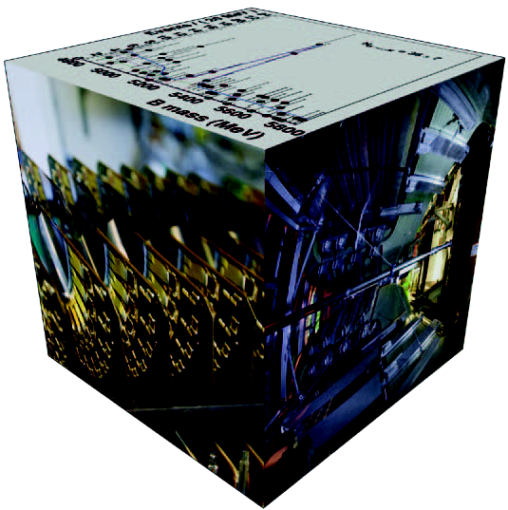
Physics with b-quarks: LHCb
Marcel Merk
Review Period: 2006-2011
LHCb Programme: 1999-2014
Group composition (current):
10 staff, 5 postdoc, 13 PhD.
Publications:
theses: 16 (LHCb) 5 (HERAB) 2 (Babar)
359 publications (2006-2011)
University partner: VU
Investment in LHCb:
4,950 kE (9% LHCb)
Additional Funding:
2 Vidi’s, 2 “Projectruimten”

Slide 2


Mission & Research Questions
Mission: To search for new particles and interactions that affect the observed matter-antimatter asymmetry in the Universe, by making precision measurements of B-meson decays.
Main Physics Topics Nikhef group:
1) Rare Decays
Branching Ratio: B_{d,s}→ μ⁺μ⁻
Lorentz structure: B→K*μ⁺μ
2) Time Dependent CP Violation
Angle γ: B_{s}→D_{s}±K±
Angle ϕ_{s} : B_{s}→J/ψϕ
Team 1:
Team 2:
Indirect sensitivity to New Physics in loops
It is all about Trees,
Penguins and Boxes
“Box” diagram: ΔB=2
“Penguin” diagram: ΔB=1
b
s
b
s
s
b
μ
μ

Slide 3

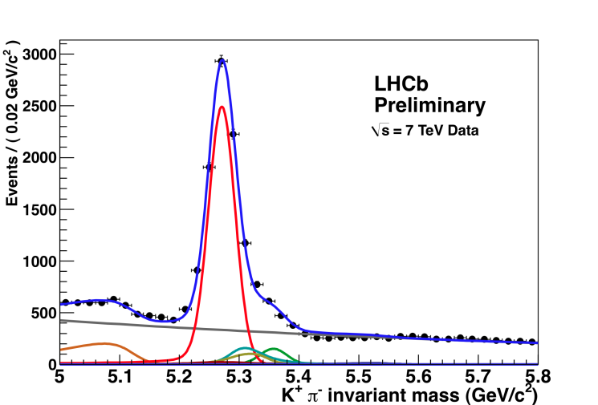
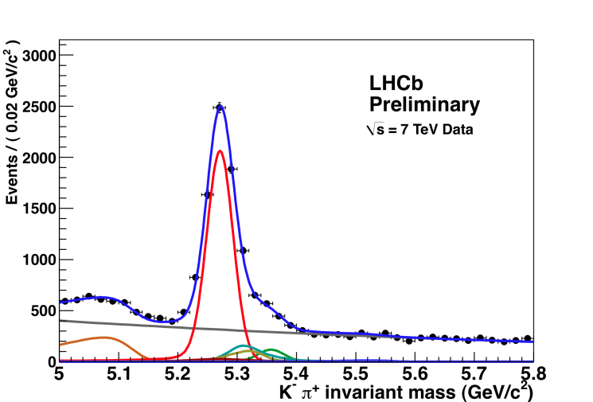
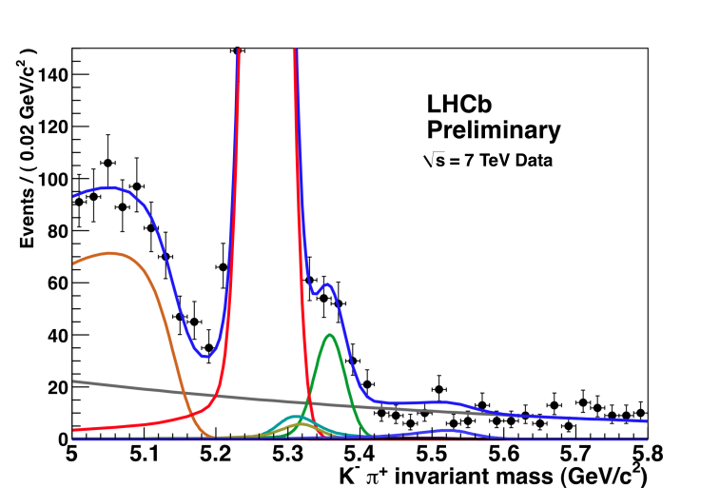
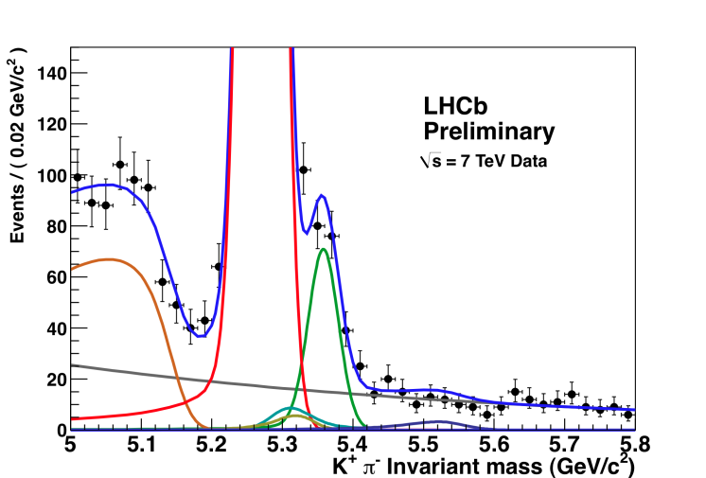
The Interference Experiment Works!
+
B⁰ → K π
B⁰ → K⁺ π⁻
B⁰ → K⁻ π⁺
A_{CP} = -0.088 ± 0.011 ± 0.008
Most precise and first 5σ
Observation of CP violation
in a hadronic machine
B_{s} → π K
B_{s} → π⁺ K⁻
B_{s} → π⁻ K⁺
A_{CP} = 0.27 ± 0.008 ± 0.02
First 3σ evidence for
CP asymmetry in Bs decays
Notes:
Direct CP Violation

Slide 4
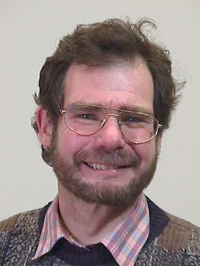
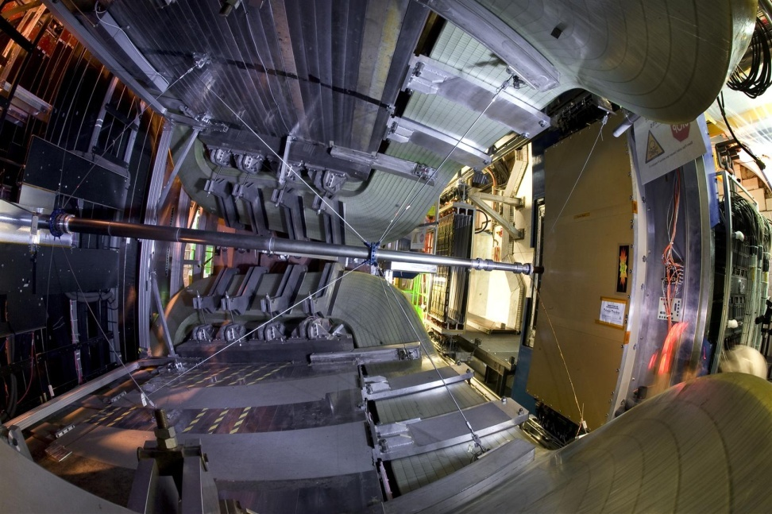
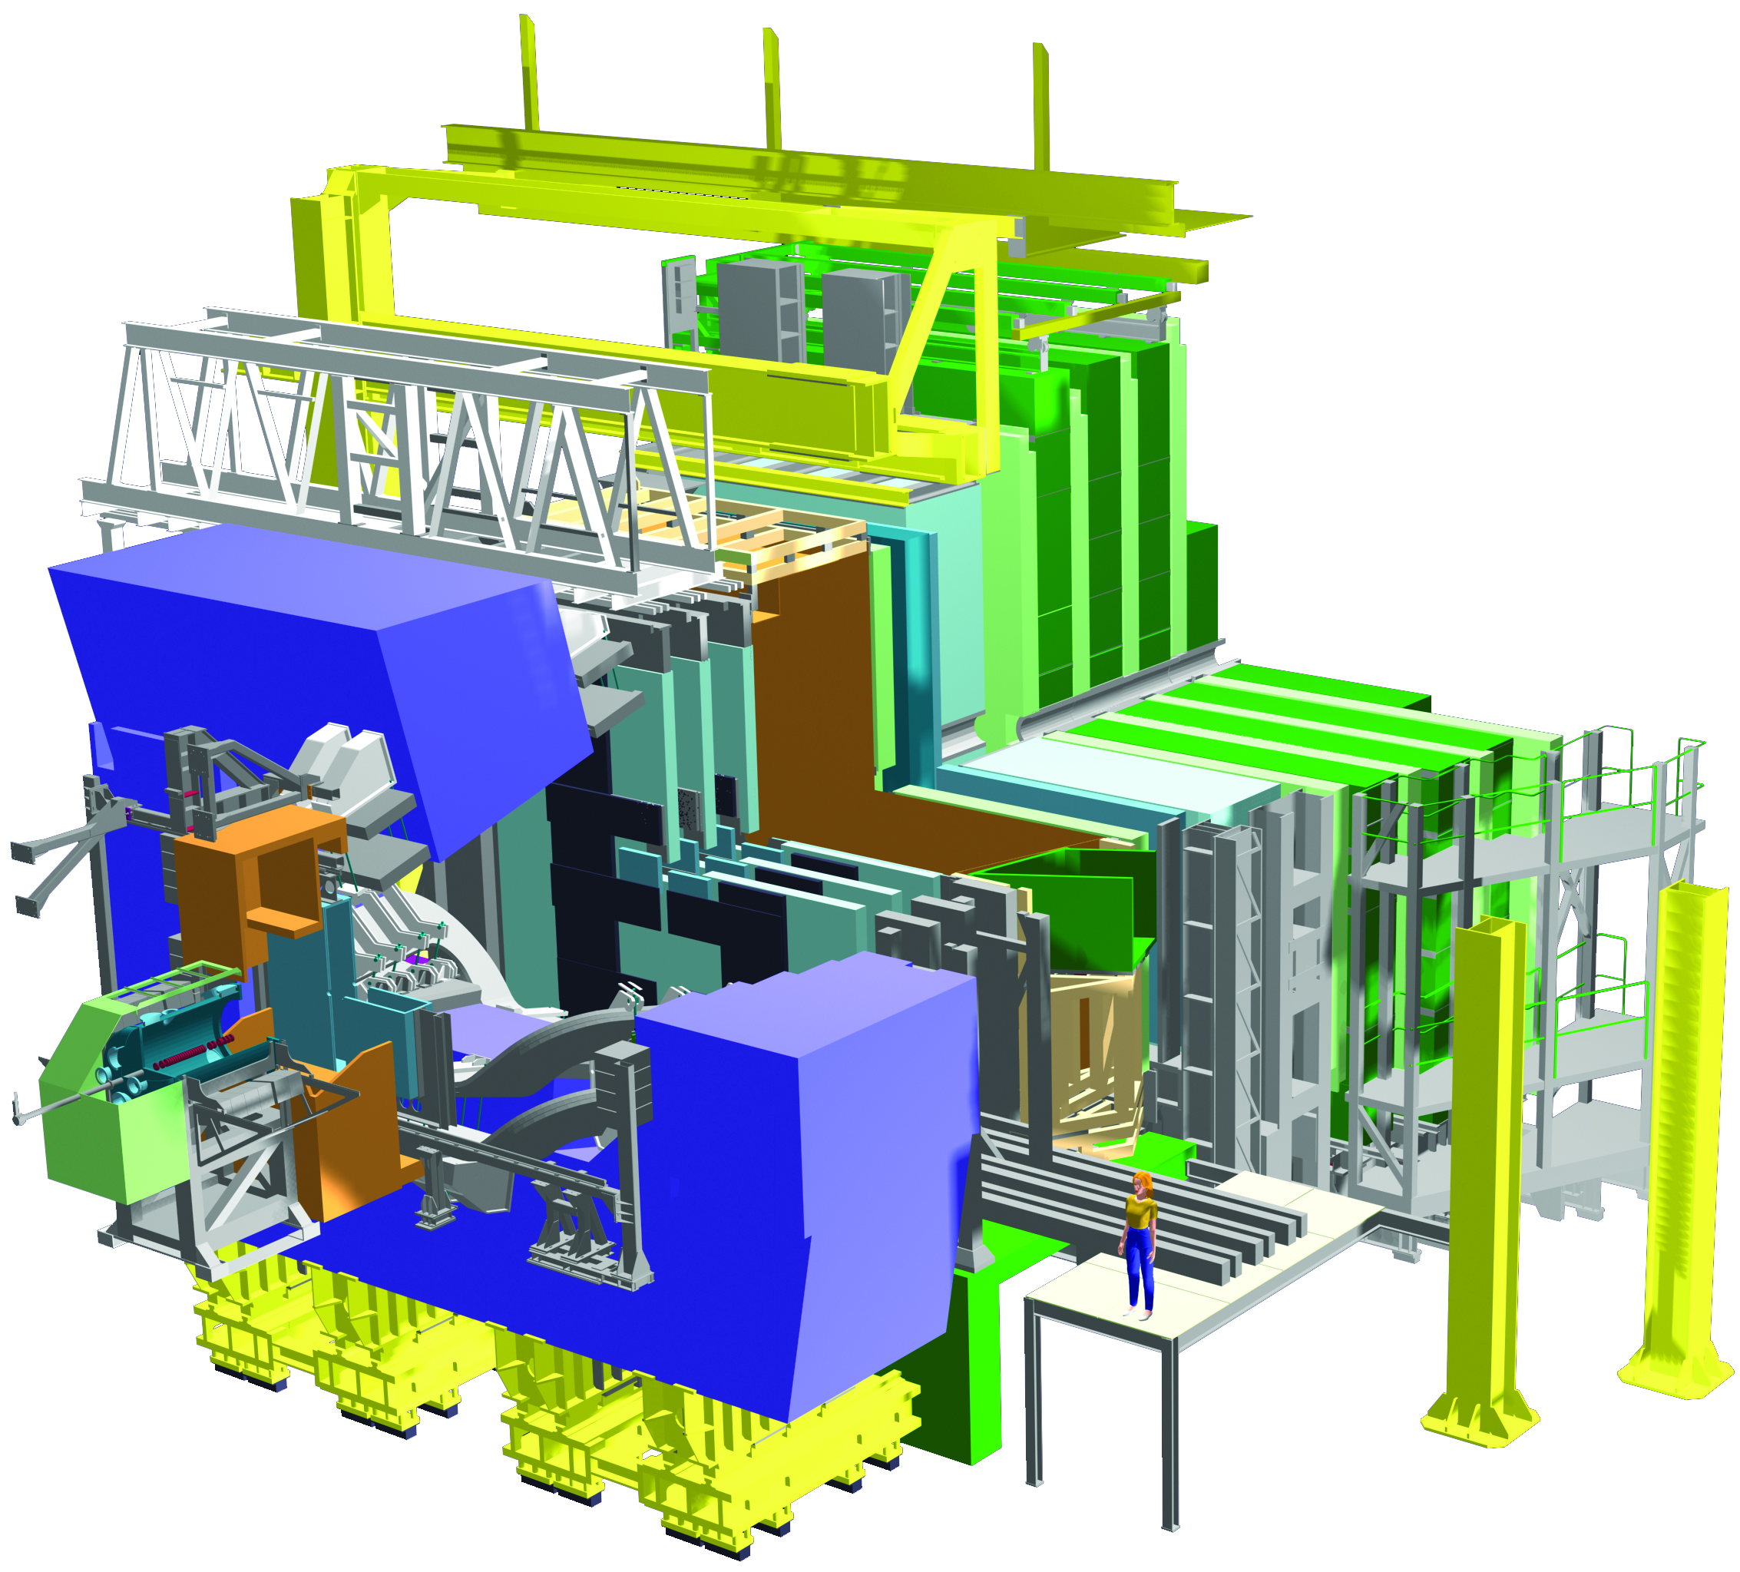
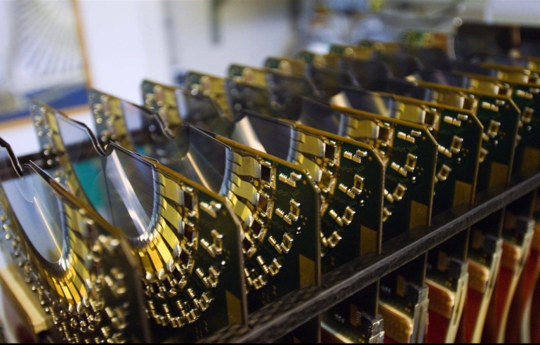
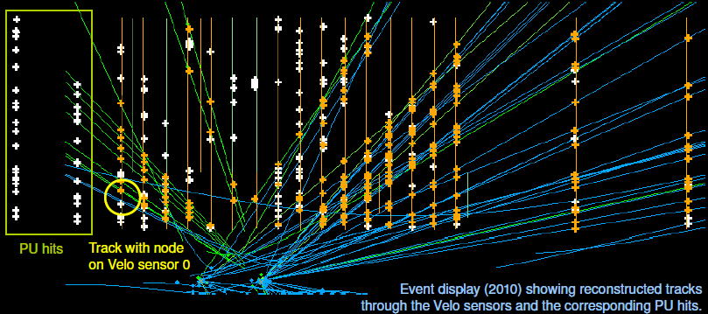
Mission & Research Questions
Form a relatively large group in LHCb with corresponding responsibilities in both hardware and physics (Werner Ruckstuhl)
VELO, Pile Up (MT, ET, CT)
OT (MT, ET, CT)

Slide 5
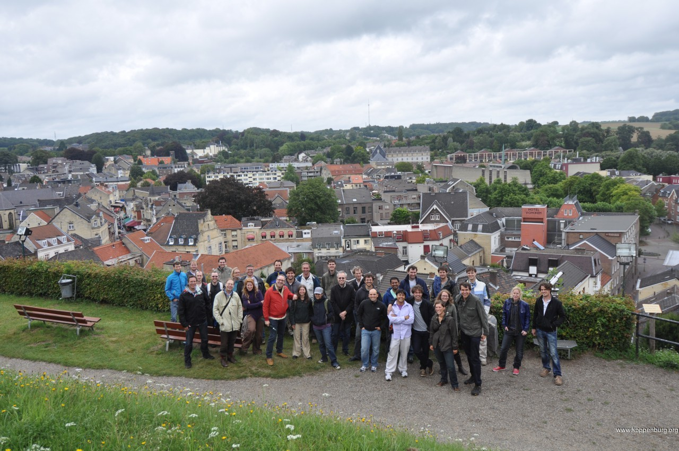
The Nikhef “bfys” Group
10 Staff members
  4 Retirements “soon” 2012, 2013, 2015, 2016
5 Postdocs
  “Positive fluctuation” due to funding situation
  Postdocs based at CERN
13 PhD Students
  PhD students spend typically one year at CERN, related to LHC operation

Slide 6

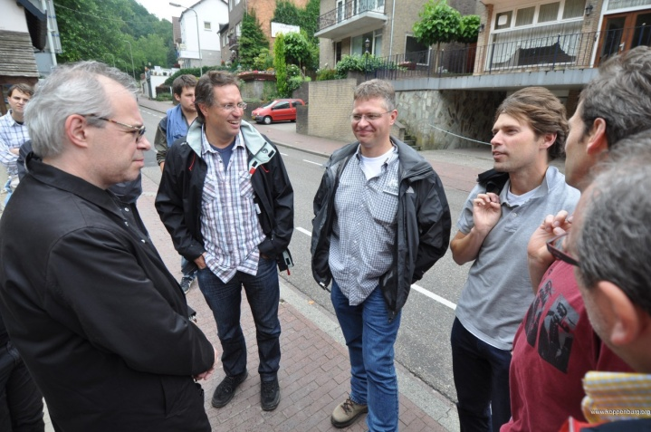
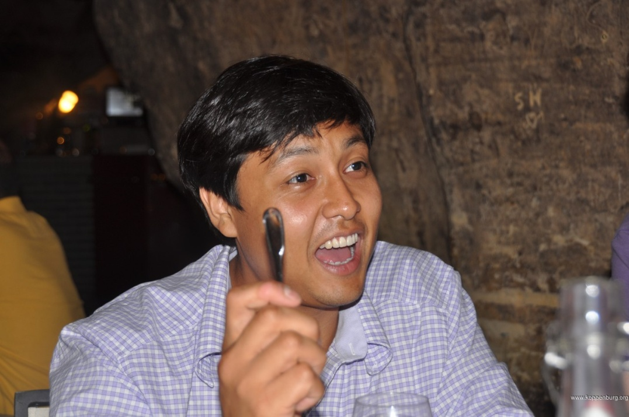
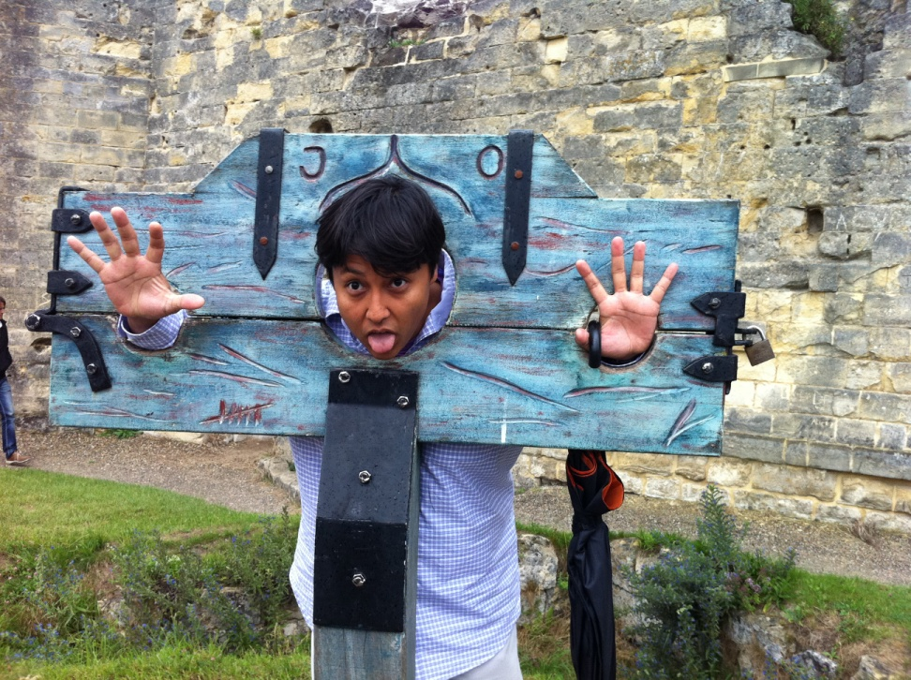

Slide 7
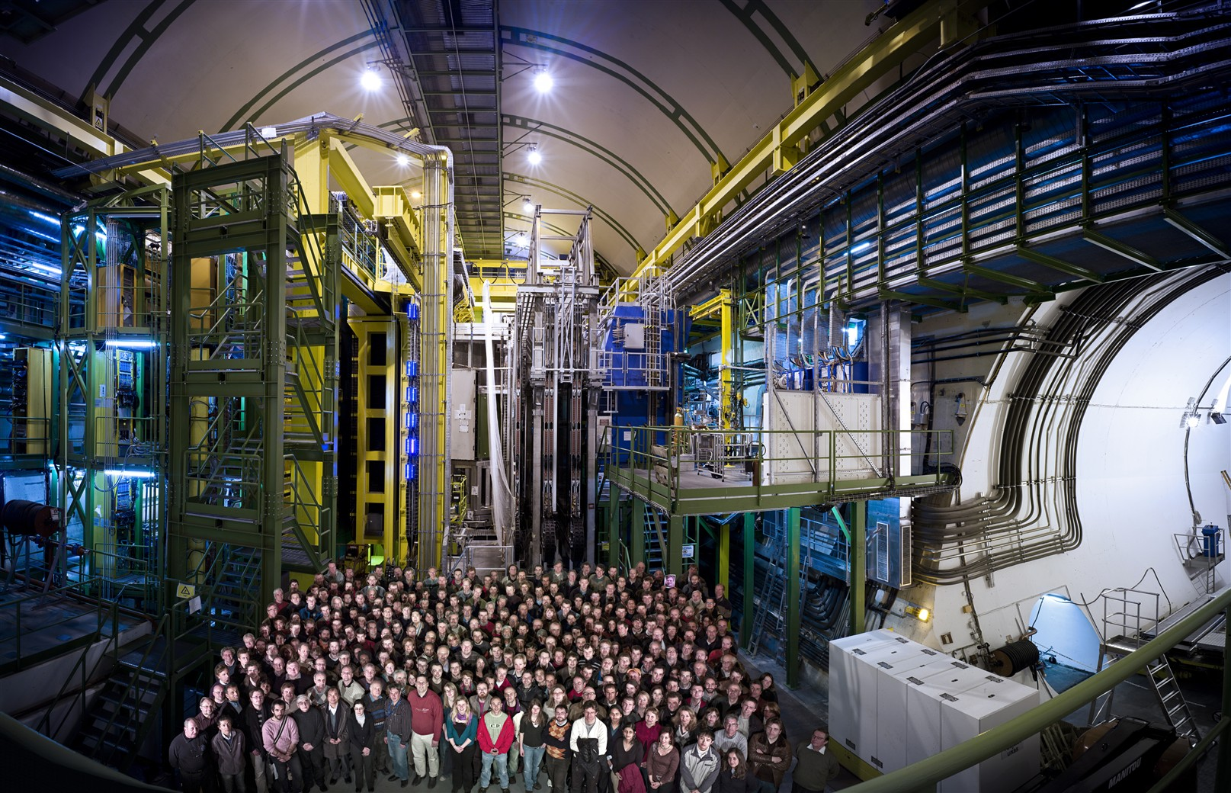
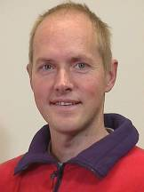
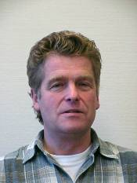
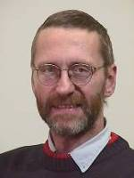
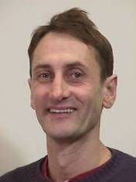
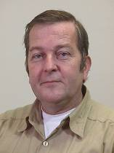
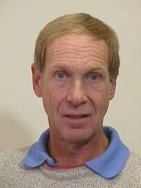
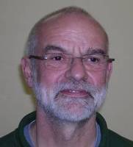
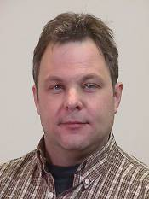
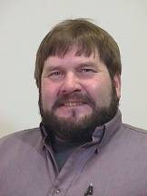
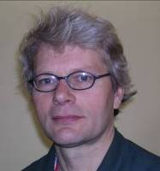
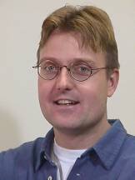
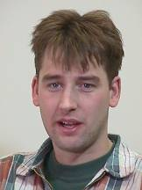
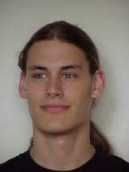
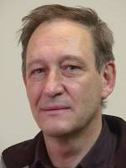
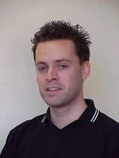
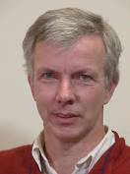
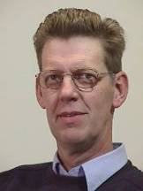
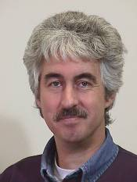
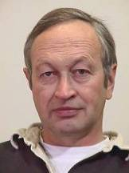
Technicians!
17-02-2012
7

Slide 8
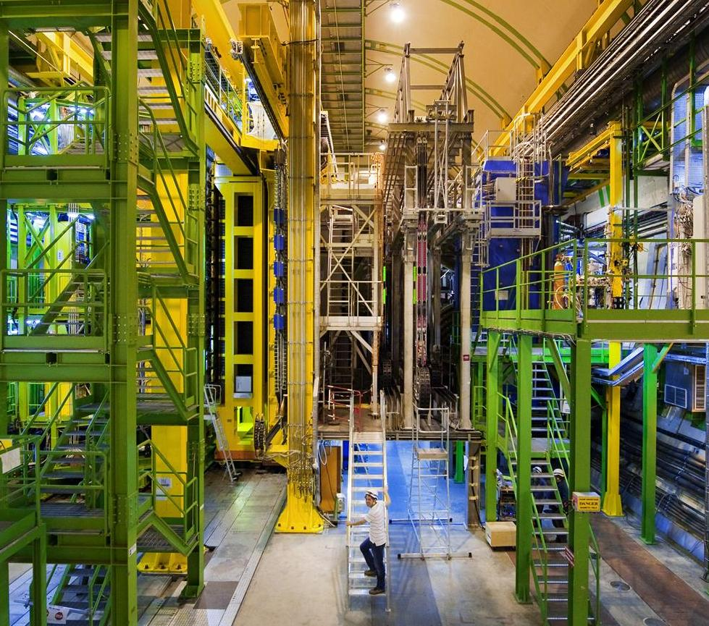
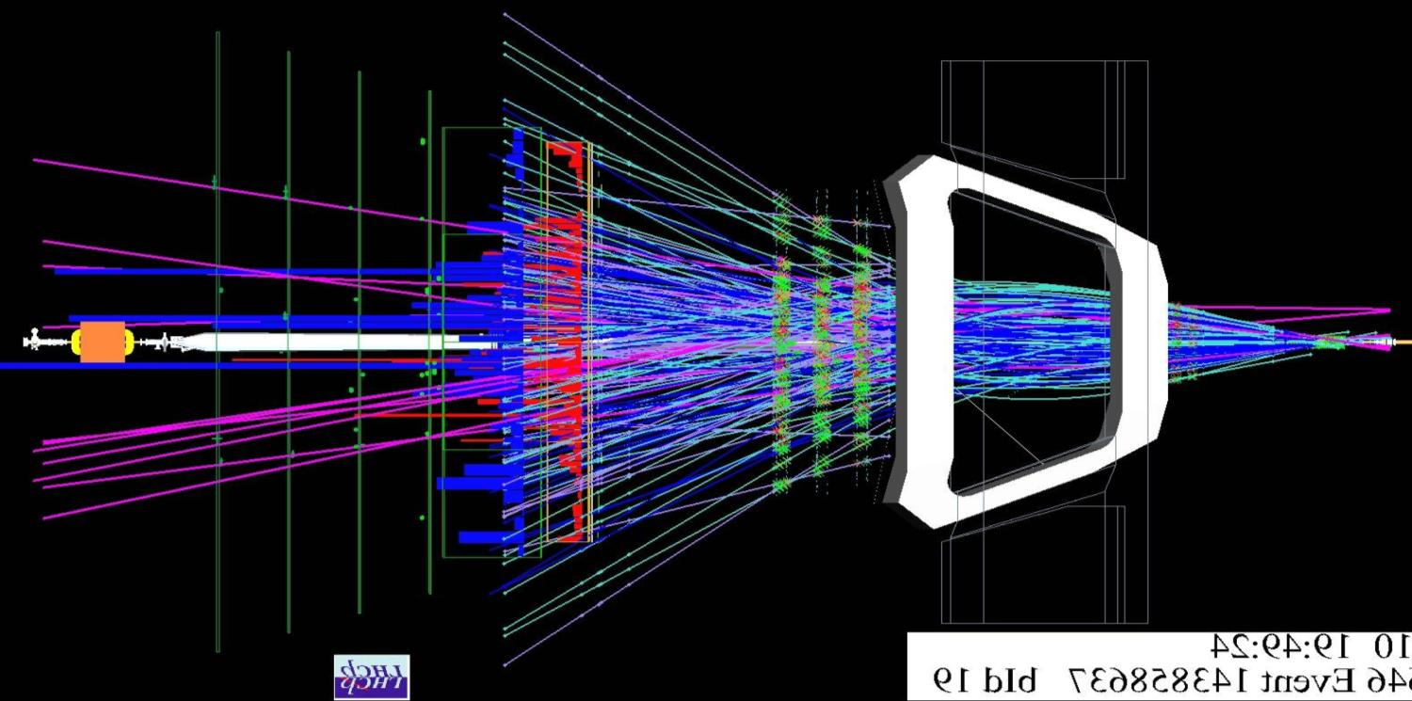
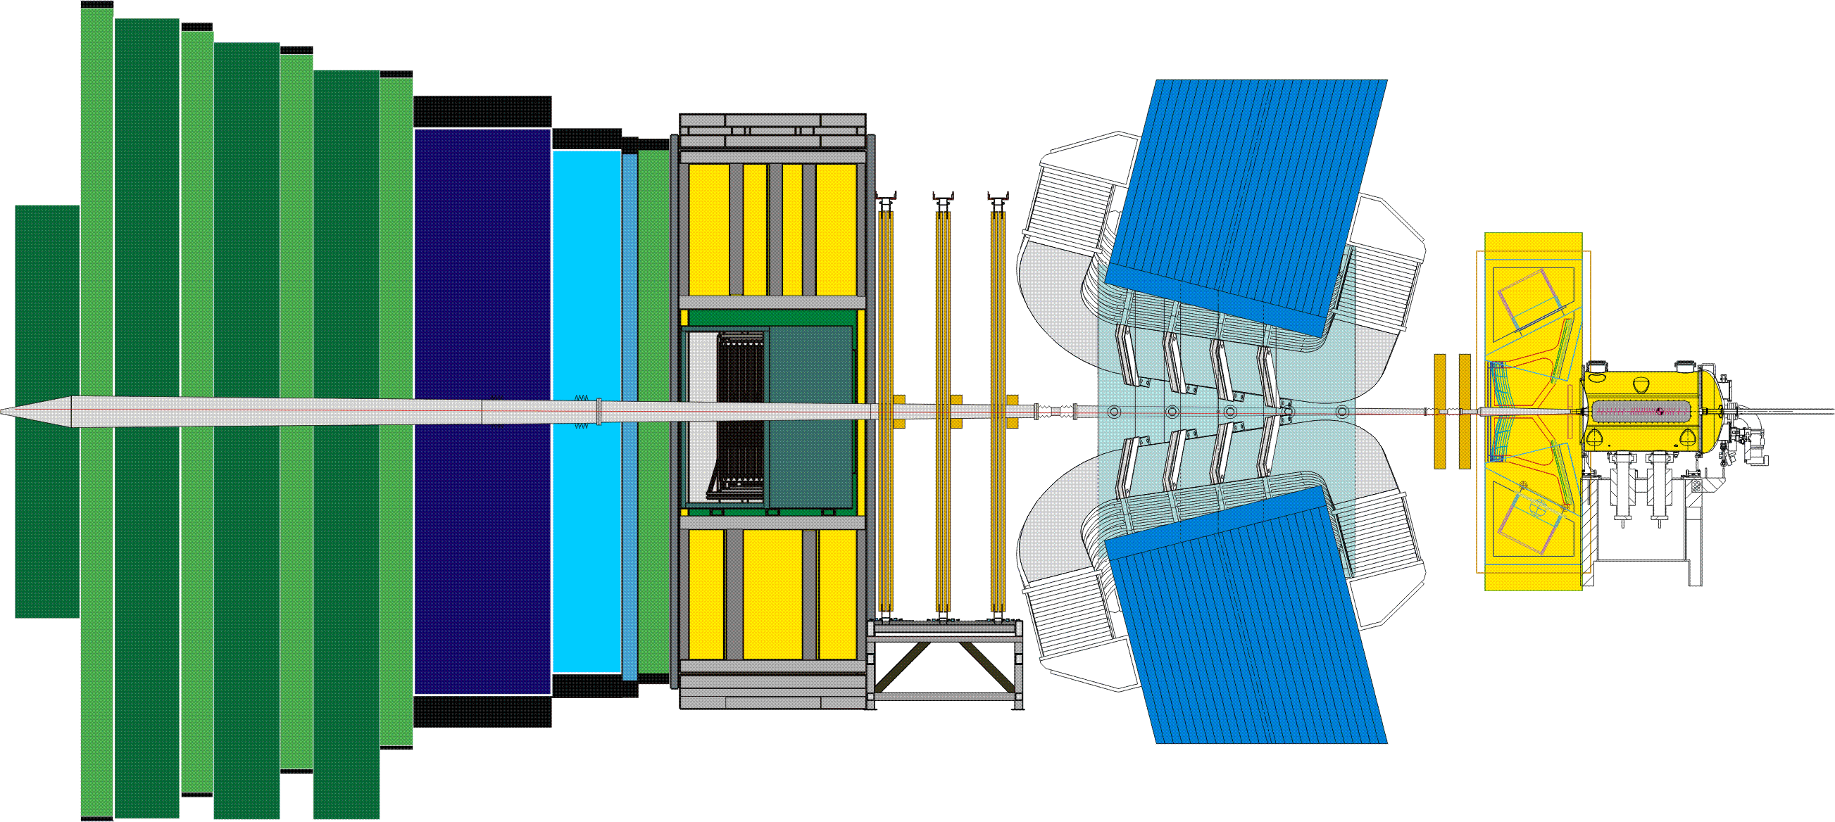
The LHCb Detector
23 sep 2010 19:49:24
Run 79646 Event 143858637
8

Slide 9
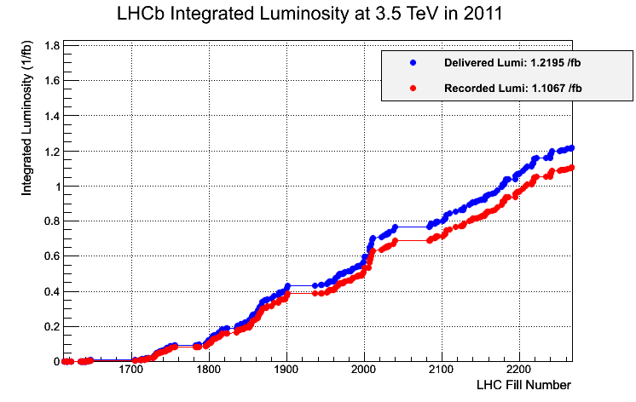
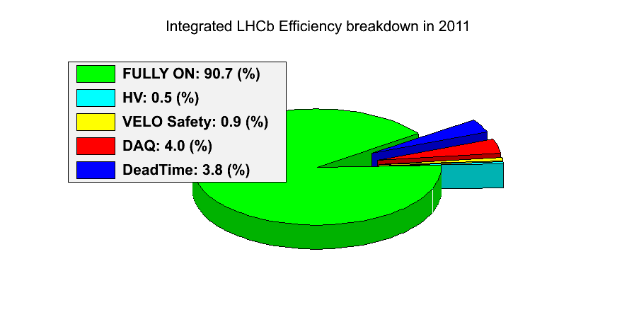
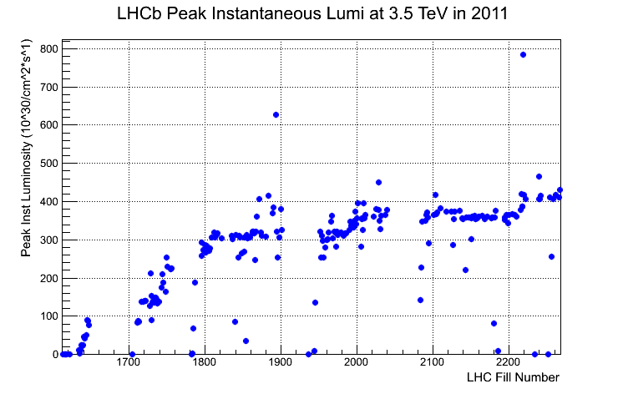
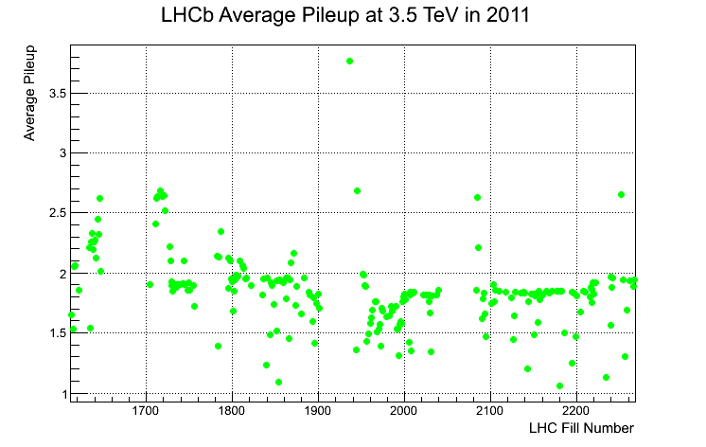
LHCb Operation in 2011
Luminosity collected = 1.1 /fb
Above design luminosity

Slide 10
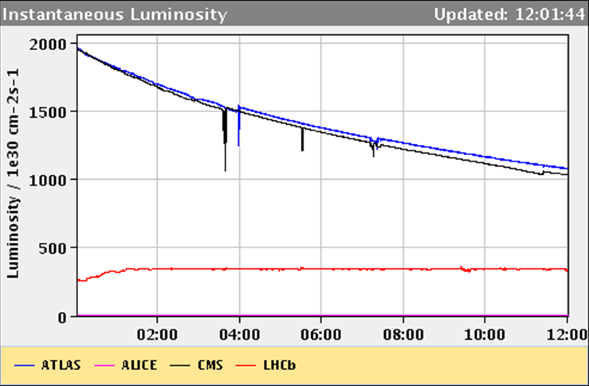
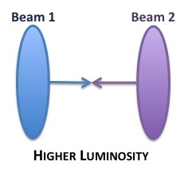
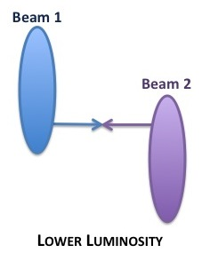
LHCb Operation in 2011
Luminosity collected = 1.1 /fb
Continuous levelling allows to keep lumi constant
Fill luminosity

Slide 11
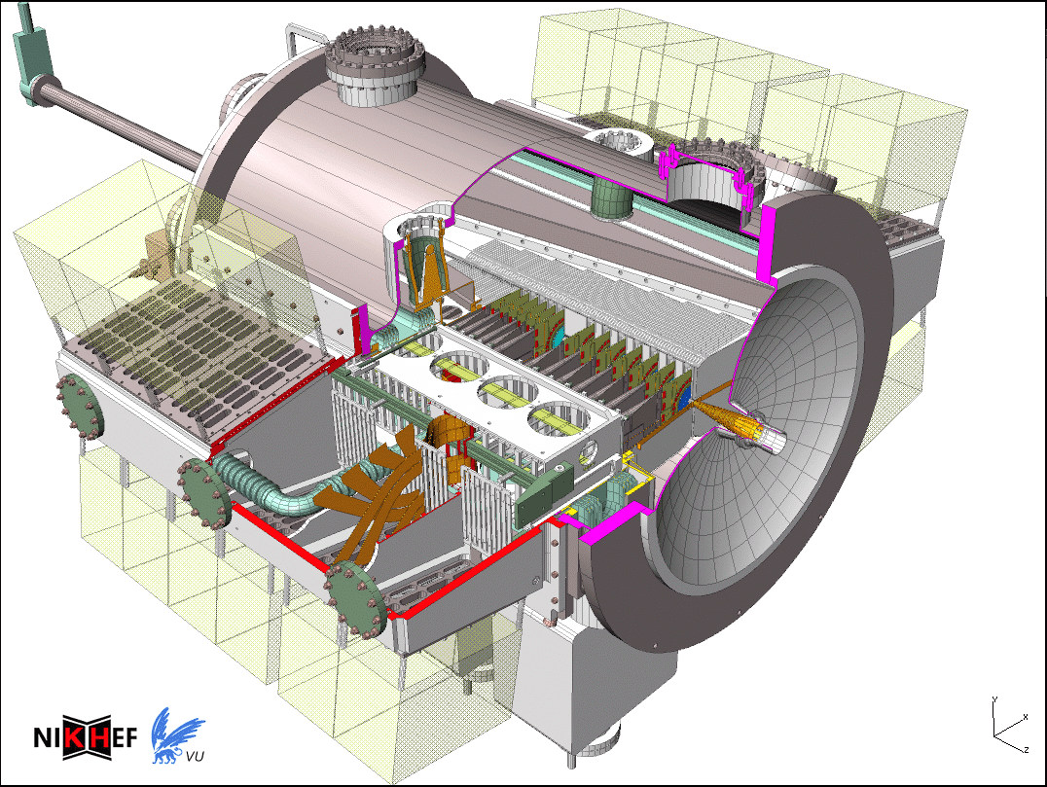
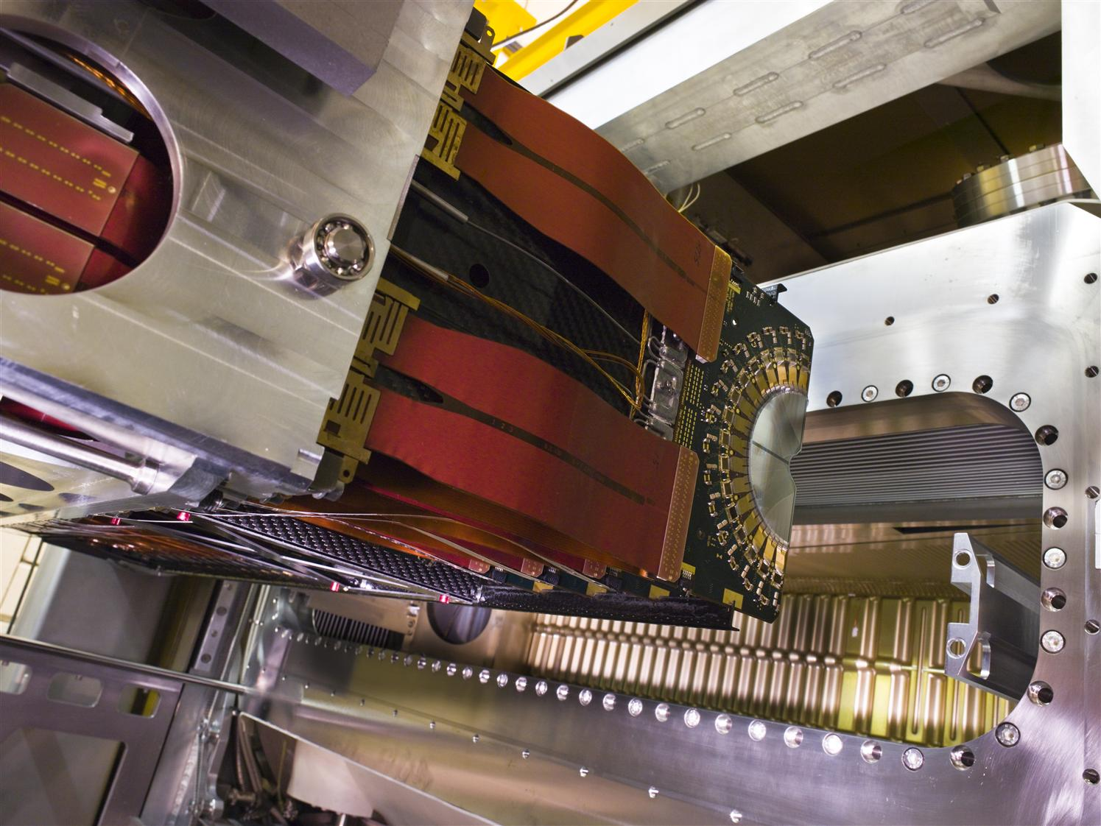
Vertex Locator (Velo)
Nikhef Hardware contributions:
Velo vessel mechanics
Vacuum Control
CO2 cooling
RF box
Detector Open-Close system
Electronics: Beetle chip
Nikhef Activities:
(Deputy) Project leadership until 2012
Installation and commisioning
  Time alignment
Quality control and monitoring
  Operation
  Data quality
Vertexing

Slide 12
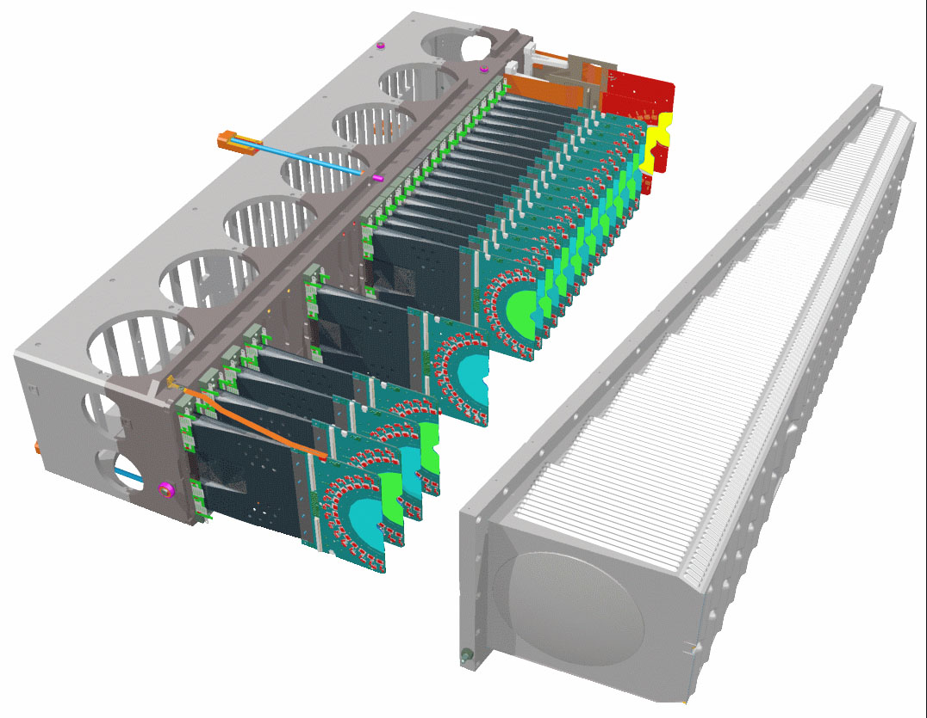
Vertex Locator (Velo)
Nikhef Hardware contributions:
Velo vessel mechanics
Vacuum Control
CO2 cooling
RF box
Detector Open-Close system
Electronics: Beetle chip
Nikhef Activities:
(Deputy) Project leadership until 2012
Installation and commisioning
  Time alignment
Quality control and monitoring
  Operation
  Data quality
Vertexing

Slide 13
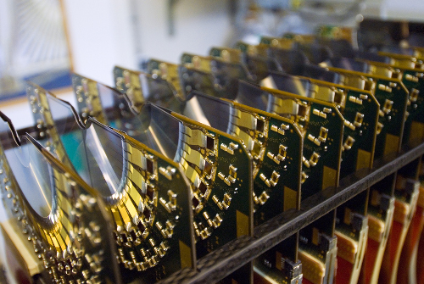
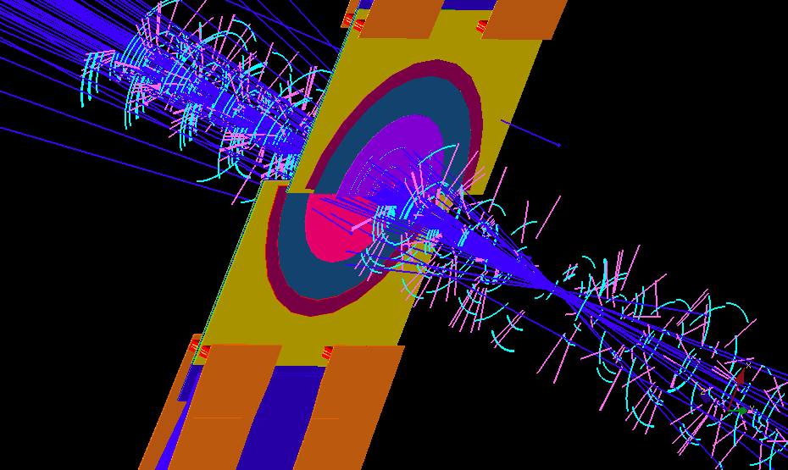
Vertex Locator
99.4% cluster
efficiency

Slide 14
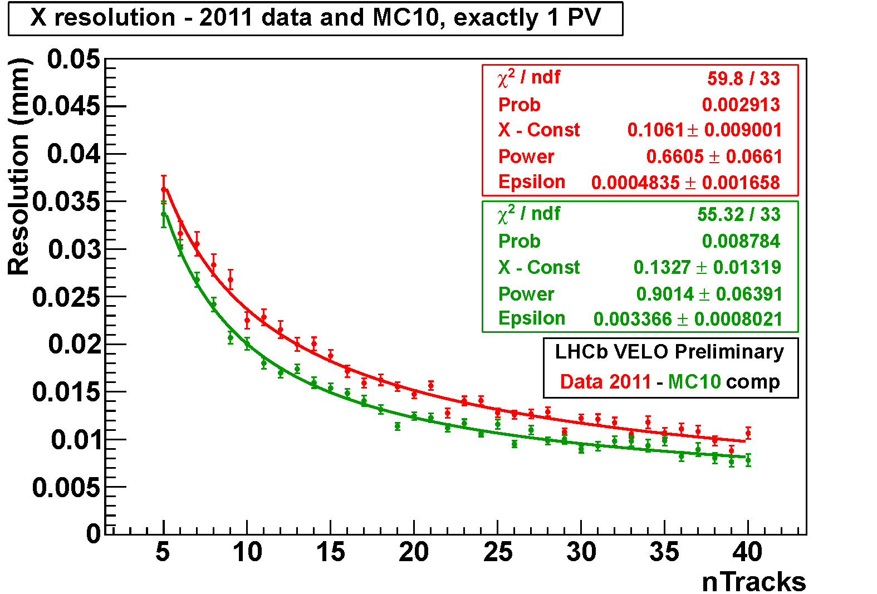


Vertex Locator
Primary
Secondary

Slide 15



Outer Tracker
Nikhef Activities:
Project leadership
Frame and Module construction
Electronics testing
Installation, commisioning, monitoring
  RT & T0 calibrations
Resolution studies
Irradiation studies and aging tests

Slide 16




OT Performance
rt-relation:
Efficiency profile:
hit resolution:
Plateau:
ε = 99.5%
σ = 211 μm

Slide 17




The Trigger
Nikhef Trigger contributions
L0 Hardware
  Pile-Up detector
HLT Software
  Deputy project leader until 2012
  Contributions
17

Slide 18


Reconstruction
Offline & Trigger Track Fitting:
  Kalman filter using hits of all tracking subdets
Track based Alignment:
  Allows to include mass constraint from any clean resonance
  Precise mass reconstruction
regions with material
are vetoed in analysis
red: without D0 mass constraint in alignment
black: with D0 mass constraint in alignment
Online Displaced Vertex determination:
  Used for Exotic particle searches

Slide 19





Proper Time Reconstruction
e.g.: Lifetime reconstruction for B_{u}, B_{d}, B_{s}, Λ_{b}:
B_{u}⁺ → J/ψ K⁺
B_{d}⁰ → J/ψ K*
B_{s}⁰ → J/ψ φ
Folded B_{s} mixing signal:
Λ_{b}⁰ → J/ψ Λ
B_{s}⁰ → D_{s}⁻ π⁺
Excellent proper time resolution: σ(τ) ~ 30 ps – 50 ps

Slide 20




Invariant Mass Reconstruction
e.g.: Mass distribution for B_{u}, B_{d}, B_{s}, Λ_{b}:
B_{u}⁺ → J/ψ K⁺
B_{d}⁰ → J/ψ K*
B_{s}⁰ → J/ψ φ
σ~11 MeV
σ~8 MeV
σ~7 MeV
Λ_{b}⁰ → J/ψ Λ
Excellent mass resolution
Very low background (comparable to e+e- machines)
σ~9 MeV
Compare: CMS: σ~16 MeV
ATLAS: σ~26 MeV

Slide 21



LHCb Preliminary 2011
Dimuon spectrum
17-02-2012

Slide 22
LHCb Preliminary 2011
Dimuon spectrum
A great year of data-taking:
Detector is performing very well
  Mass and time resolutions as predicted by MC
  Very clean reconstruction
Executing the full physics program of our TDR
Detector Ageing:
  Ageing in several subdetectors observed according to expectations
  No aging observed yet in Outer Tracker
2012: Expect stable running @ 4 x 10³²
17-02-2012

Slide 23


Nikhef Physics Program
Search physics beyond the Standard model in CP Violation and Rare Decays
Main program:
Team 1: a) B⁰_{s}→μ⁺μ⁻
b) B⁰_{s}→D_{s}±K±
Team 2: a) B⁰_{s}→J/ψ φ
b) B⁰→K* μ⁺μ⁻
Additional smaller efforts:
Team 3: “Early Data”: Open charm production cross section
Team 4: “Vidi”: Search for long lived exotic particles
Theory aspects:
SU3 symmetry
Theory aspects:
Penguin control

Slide 24



Physics (1a): B⁰_{s}→μμ
u-spin:
s↔d
Measure BR B_{s}→ μ⁺μ⁻ relative to
B_{d} decay channel (from B-factory)
Requires measurement f_{d}/f_{s}
  Use B_{d} → DK vs B_{s} → D_{s}π
U-spin breaking: error on F_{d↔s}
- Study with Nikhef Theory group
17-02-2012

Slide 25


Physics (1b): B_{d,s}→D_{(s)}±h± . . . .
B⁰→D⁻π⁺
2010: Focus on largest systematic: normalization to B⁰ decay: f_{d}/f_{s}
2011: Prepare for CKM angle gamma with B_{s}⁰→D_{s}±K±
B⁰→D⁻K⁺
B⁰_{s}→D_{s}⁻K⁺
B⁰_{s}→D_{s}⁻π⁺
25

Slide 26









Physics (2): P→VV Angular Analysis
Combined decay time and angular fitting in:
2a) B⁰_{s}→J/ψ φ
2b) B⁰→K* μ⁺μ⁻
Mass:
K* μ⁺μ⁻
A_{FB}
Mass J/ψ φ :
φ_{s}

Slide 27

Nikhef Hosted Beauty 2011

Slide 28

LHCb Upgrade
LHCb Upgrade to 40 MHz readout and full software trigger:
  Collect 5 fb⁻¹ → 50 fb⁻¹ @ L = 2x10³³ cm⁻² s⁻¹
Physics program
  Main: Heavy Flavour Physics
  Additional:
    Lepton Flavour physics
      Majorana searches; lepton flavour violating tau decays
    Electroweak physics
      Sin²θ_{eff}^{lept} via A_{FB} Z→μ⁺μ⁻
    Exotic searches
    QCD via Central Exclusive Production
“General purpose detector in the forward region”

Slide 29

Upgrade Detector design parameter
2x10³³ cm⁻² s⁻¹
at 25 ns spacing
Total: 50 fb⁻¹
s^{1/2} =14 TeV

Slide 30

Detector Upgrade to 40 MHz R/O
VELO
Si strips
(replace all)
Silicon Tracker
Si strips
(replace all)
Outer Tracker
Straw tubes
(replace R/O)
Muon MWPC
(almost compatible)
RICH
HPDs
(replace HPD & R/O)
Calo
PMTs (reduce PMT gain, replace R/O)
Estimated cost: 52 MCHF

Slide 31




Nikhef: Velo Upgrade
Velo Pixel detector
  55 by 55 μm
R&D for TimePix3→Velopix
R&D for detector cooling
High speed data transmission
Testbeam
Vladimir Gromov ,
Francesco Zappon

Slide 32






Current RF-box and Upgrade
RF Foil from secondary interactions:
1) Improved RF box by welding:
Si
2) Upgrade: milling from massive Al block:
Leak tight!
Notes:
Comment on Nikhef pictures…

Slide 33




Nikhef: Outer Tracker Upgrade
Outer Tracker 40 MHz electronics R&D “halfway”
ASDBLRs
40MHz TDC implemented in Actel FPGA
Stratix IV (readout and GBT emulator)
Outer Tracker requires shorter straw-modules in central region
# Outer Tracker hits in trigger:
Without spillover
With spillover
Notes:
The OT is currently operating at limit with pileUp. Plot show multiplicity cuts that we make in the HLT to be able to deal with the events (real data) selecting spills.
Readout of Sci Fi is Silicon Photomultipliers SiPM (20 p.e. per mip) – radiation protection. Alternative MAPMT a la RICH – same readout.

Slide 34
Conclusions
LHCb Detector in good shape:
  Taking data above the design luminosity
  Flavour Physics is strong alternative to direct searches for NP
Nikhef LHCb group:
  Exploiting physics with charged particle final states
    Synergy with Nikhef theory B-physics
  New program funding needed after 2014
  Replacement of retiring staff
Upgrade:
  Extended physics program for LHCb upgrade
  Nikhef active in R&D for Velo and OT
  Required investment funding: 4 MEuro

Slide 35







Carnaval
Alaaf !

Slide 36
Additional Material
(Backup Slides)

Slide 37

Points of attention
Manpower
  Funding FOM program ends in January 1, 2015
  Replacement of retiring staff members
    Upgrade (hardware) expertise
  Balance Postdocs vs PhDs
    Postdocs are vital
Upgrade
  Requires Investment Funding
Current Detector
  Outer Tracker aging: monitoring
  Velo RF box replacement: vacuum tightness

Slide 38


Upgrade Motivation
Lumi dependence of L0 trigger yields:
  Muon trigger profits from higher lumi
  E_{T} trigger channels fill up bandwidth; higher E_{T} cuts cost efficiency
40 MHz
Level -0
L0
e, γ
L0
had
L0
μ
≤1 MHz
HLT1
High p_{T} track with non-zero Impact Parameter
High-Level Trigger
30 kHz
Global reconstruction
Inclusive selections
μ, μ+track, μμ, topological, charm, ϕ
HLT2
& Exclusive selections
Solution:
  Increase the bandwidth for L0 or remove completely
  Requires new front end electronics
~3 kHz
Storage: “nominal” event size ~35kB

Slide 39

LHC schedule
Not yet approved!
2022
LS3
Installation of the HL-LHC hardware (accelerator and detector)
LHCb upgrade
Shown by Steve and by DG at EPS 2011 in Grenoble!
Plan to continue
until around 2030

Slide 40




Upgrade of LHCb
flexible software trigger with up to 40 MHz input rate and 20 kHz output rate
run at ~ 5-10 times nominal LHCb luminosity → L ~ 1-2 ∙ 10³³ cm⁻² s⁻¹
big gain in signal efficiency (up to x7 for hadron modes)
upgrade electronics & DAQ architecture
collect ≥ 5/fb per year and ~ 50/fb in 10 years
LLT custom electronics
CPU Event Filter Farm

Slide 41
Sensitivities to key quark flavour channels
LHCb
Upgrade

Slide 42





OT Ageing: in the Lab
It’s the di-isopropyl-naphthalene (CAS 38640-62-9) inside the glue AY103-1
  AY105 does not contain any plastifier
  Produced one module with AY105
Added 1.5% O₂ to counting gas in 2010
Large currents cure!
  HV=1900V : large dark currents / discharges
  HV=1800V, with source scanning over damage
  Increase argon
  Heating also cures → same process?
After
HV scan area
N,.Tuning et al., NIMA
Ageing in the LHCb Outer Tracker:
Aromatic Hydrocarbons and Wire Cleaning
S.Bachmann et al., NIM A617, 202 (2010)
Ageing in the LHCb Outer Tracker:
Phenomenon, Culprit and Effect of Oxygen

Slide 43


OT Ageing: in Situ
OT readout measures drift time, not pulse height
Monitor gain loss in two ways:
Scan with source in situ
  Need access
  Slow
Vary amplifier threshold and measure drop in hit efficiency
  During physics run
2 ⁹⁰Sr sources (74MBq)
?
Scanning Frame
Current-meter connectors
740 mV

Slide 44


OT Ageing: in Situ
OT readout measures drift time, not pulse height
Monitor gain loss in two ways:
Scan with source in situ
  Need access
  Slow
Vary amplifier threshold and measure drop in hit efficiency
  During physics run
⁹⁰Sr response:
Hit efficiency at high threshold:
Aug 2010
Oct 2011
No gain loss detected
17-02-2012

Slide 45



Radiation Damage in the Velo
n⁺-on-n sensors at -28ºC
Innermost fluence: 6x10¹³ 1 MeV n_{eq}/cm² per fb⁻¹
Leakage current closely monitored
Velo replacement detector being assembled
LHCb Velo Preliminary
Leakage current vs time
Detector heated
in shutdown
time
Effective depletion voltage ratio different detector zones.
ratio = V_{dep}(@160 pb⁻¹ )/V_{dep}(@ 0 pb⁻¹)
Effective depletion voltage vs R for various integrated Lumi’s:

Slide 46

Velo Upgrade
L-shape pixel modules, 4 sensors with 3 pixel readout chips each
VELOPix chip will be based on Timepix3, design ongoing, submission expected Q3-2012
Big challenges in heat transport, cooling interfaces
  Hybrid with either diamond or TPG core
High speed data transmission
Radiation hardness: 400 Mrad TID, 10¹⁶ 1 MeV n_{eq} / cm²

Slide 47


VeloPix
Matrix of 256x256 pixels of 55x55 um²
  Active chip area 14x14 mm²
  < 2 mm inactive periphery
Each pixel measures time-of-arrival (25 ns resolution)
and charge (0.5 - 1ke- resolution) of hits
No trigger, prompt transmission of zero-suppressed hit data
~ 500 Million hits per chip in hottest region
  5.8 tracks / bunch crossing, 2-3 hits/track
Grouping of hits in 4x4 super-pixel packets
  to reduce (redundant) address and ToA information
  to simplify clustering of hits offline
Output bandwidth ~ 12 Gbit/s per chip
Power consumption < 3 Watts
Chip development collaboration: Nikhef & CERN
Based on Timepix3, 130 nm (or 65) technology
14.1
2.0
17-02-2012

Slide 48
Other Activities
Testbeam analysis (timepix, radiation hard sensors)
Geant4 simulations
Slim edge sensor characterisation/design (if FP7 proposal is granted)
Readout for TPX3 (called SPIDR)
Contributions to TPX3/VELOPix telescope (trigger, DAQ)

Slide 49


Auto-imaging of the Velo

Slide 50
Nikhef-FOM Group
Team Leaders:
  Marcel Merk, Antonio Pellegrino
Staff:
  Thomas Bauer, Martin van Beuzekom, Wouter Hulsbergen, Eddy Jans, Patrick Koppenburg, Niels Tuning, Leo Wiggers
Postdocs:
  Victor Coco, Maurizio Martinelli
OIOs:
  Roel Aaij, Kristof de Bruyn, Pieter David, Daan van Eijk, Veerle Heijne, Alexandr Kozlinskiy, Jeroen van Leerdam, Serena Oggero, Barbara Storaci

Slide 51
Nikhef-VU Group
Team Leader: Gerhard Raven (VU)
Staff: Tjeerd Ketel (FOM-BUW)
Postdocs:
  Manuel Schiller (FOM-BUW)
  Rob Lambert (FOM-BUW)
  Francesco Dettori (FOM-BUW)
AIOs: -
OIOs (FOM-BUW):
  Chiara Farinelli, Rose Koopman, Suvayu Ali, Siim Tolk

Slide 52
PhD’s and Theses
HERA-B (5)
  Wouter Hulsbergen (2002), Maarten Bruinsma(2002), Maaijke Mevius(2003), Hernan Wahlberg(2005), Antonelli Sbrizzi(2006)
Babar (2)
  Max Baak (2009), Hella Snoek(2009)
LHCb (16 + 2 unfinished)
  Nikolai Zaitsev (L0+PA 2000), Rutger van der Eijk (OT+TR 2002), Rutger Hierck(TR 2003), Niels van Bakel (VL 2004), Sander Klous (VL 2005), Jeroen van Tilburg (TR 2005), Bart Hommels (OT 2006), Jacopo Nardulli (OT+PA 2007), Peter Vankov (OT 2008), Aras Papadelis (VL 2009), Edwin Bos (TR 2010), Gabriel Ybeles Smit (PA 2010), Eduard Simioni (OT 2010), Tristan du Pree (PA 2010), Jan Amoraal (TR 2011), Fabian Jansen (OT+PA 2011)
Current PhD Students – LHCb (14)
  Ivan Mous (VL), Barbara Storaci (OT+PA), Daan van Eijk (PA), Chiara Farinelli (VL), Alexandr Kozlinskiy (OT+PA), Serena Oggero (L0+PA), Roel Aaij (HLT), Jeroen van Leerdam (PA), Veerle Heijne (PA), Rose Koopman (PA), Kristof de Bruyn (TH+PA), Suvayu Ali (PA), Pieter David (PA), Siim Tolk (PA)
VL = Velo, OT= OTR, L0=Level 0, HLT=High Level Trig, TR=Track Rec, PA=Phys Anal, TH=Theory

Slide 53


Physics (2): Penguin control with B⁰→J/ψK_{s}
With LHCb's increasing precision, penguin contributions to e.g. B→J/ψKs become relevant.
  Is this the reason for the tension in sin2β?
Study U-spin partners, both theoretically (R.Fleischer et al) and experimentally.
Observation of B⁰→J/ψK_{s} with 0.37 pb⁻¹.
More channels in the pipeline.

Slide 54


A charming surprise… ΔA_{CP}
Select self-tagging decays:
D*⁺→D⁰π⁺ and D*⁻→D⁰π⁻
ΔA_{CP} = A_{CP}(D/D→K⁺K⁻) – A_{CP}(D/D→π⁺π⁻)
Standard model: expect very close to 0
ΔA_{CP} = [-0.82 ± 0.21 (stat) ± 0.11 (sys)]%
Significance 3.5σ
Precise measurement: most systematic
effects cancel in double asymmetry
D→K⁺K⁻
D→π⁺π⁻

Slide 55
A charming surprise… ΔA_{CP}

Slide 56

BBC
LHCb
John Ellis, HCP, Paris

