Slide 1
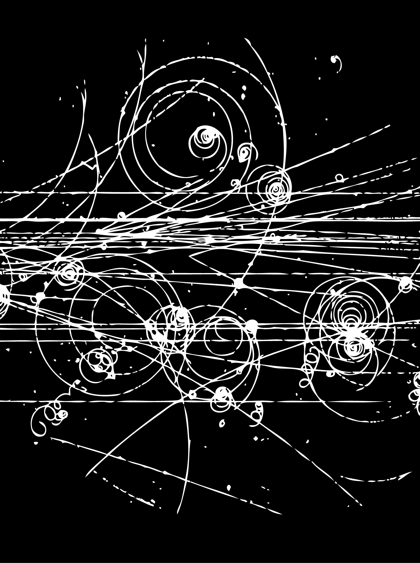



Lessons learned from LHCb about making precise flavour measurements
TUPIFP
Apr 2019
Niels Tuning

Slide 2
On the menu
Introduction: Precision measurements
Recent highlights
Where do we come from?
What brought us here?
  Lumi levelling
  Trigger
  Magnet flips
  Data driven
    Tracking
    PID
    Control channels
Lessons learned from LHCb

Slide 3
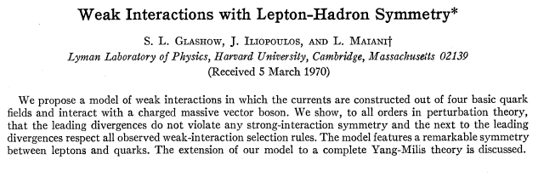
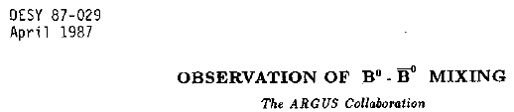


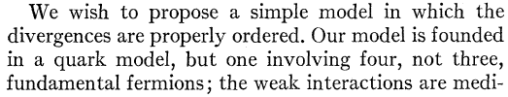
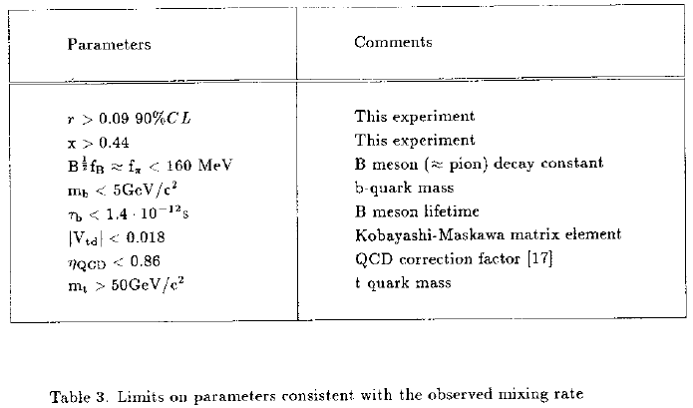
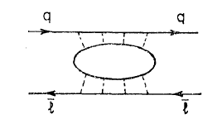
Flavour physics has a track record…
GIM mechanism in K⁰→μμ
CP violation, K_{L}⁰→ππ
B⁰←→B⁰ mixing
Glashow, Iliopoulos, Maiani,
Phys.Rev. D2 (1970) 1285
Christenson, Cronin, Fitch, Turlay,
Phys.Rev.Lett. 13 (1964) 138-140
ARGUS Coll.
Phys.Lett.B192:245,1987

Slide 4
Flavour physics has a track record…
Rare decay implies 2nd up quark
“discovery” of charm?
CP violation implies 3rd family:
“discovery” of bottom?
Mixing implies heavy quark:
“discovery” of top?

Slide 5
Precise flavour measurements
Historical record of indirect discoveries:
Particle | Indirect |  |  | Direct
ν | β decay | Fermi | 1932 | Reactor ν-CC | Cowan, Reines | 1956
W | β decay | Fermi | 1932 | W→eν | UA1, UA2 | 1983
c | K⁰→μμ | GIM | 1970 | J/ψ | Richter, Ting | 1974
b | CPV K⁰→ππ | CKM, 3rd gen | 1964/72 | Υ | Ledermann | 1977
Z | ν-NC | Gargamelle | 1973 | Z→ e⁺e⁻ | UA1 | 1983
t | B mixing | ARGUS | 1987 | t→ Wb | D0, CDF | 1995
H | e⁺e⁻ | EW fit, LEP | 2000 | H→ 4μ/γγ | CMS, ATLAS | 2012
? | What’s next ? |  | ? |  |  | ?

Slide 6

Precise flavour measurements
Direct discoveries rightfully higher valued:
Particle | Indirect |  |  | Direct
ν | β decay | Fermi | 1932 | Reactor ν-CC | Cowan, Reines | 1956
W | β decay | Fermi | 1932 | W→eν | UA1, UA2 | 1983
c | K⁰→μμ | GIM | 1970 | J/ψ | Richter, Ting | 1974
b | CPV K⁰→ππ | CKM, 3rd gen | 1964/72 | Υ | Ledermann | 1977
Z | ν-NC | Gargamelle | 1973 | Z→ e⁺e⁻ | UA1 | 1983
t | B mixing | ARGUS | 1987 | t→ Wb | D0, CDF | 1995
H | e⁺e⁻ | EW fit, LEP | 2000 | H→ 4μ/γγ | CMS, ATLAS | 2012
? | What’s next ? |  | ? |  |  | ?

Slide 7
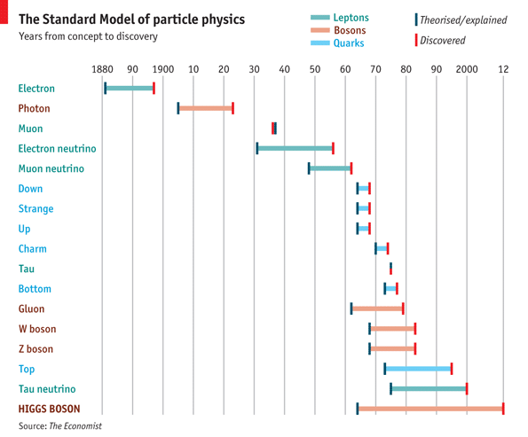
Precise flavour measurements
Compilation by F. Dettori

Slide 8
Precise flavour measurements
Depending on your model, sensitive to multi-TeV scales, eg:
μ_{B→μμ} is ratio BR^{exp}/BRSM
From Uli Haisch, 31 Aug 2016
arXiv:1510.03341

Slide 9
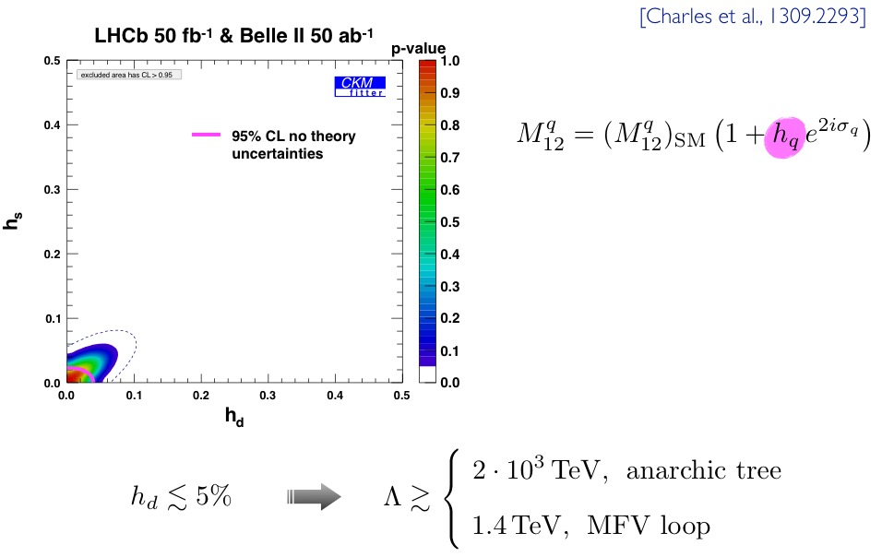
Precise flavour measurements
Depending on your model, sensitive to multi-TeV scales, eg:
h_{q} parametrizes magnitude
of NP in B_{q} mixing
From Uli Haisch, 31 Aug 2016

Slide 10

Recent highlights
φ_{s}
R_{K}
Exotic spectroscopy
ΔA_{CP}

Slide 11
φ_{s}
2015+2016
Largest systematic:
  Decay time bias
  Decay time efficiency
LHCb-PAPER-2019-013

Slide 12
R_{K}
2011-2016
Largest systematic:
  Mass model
LHCb-PAPER-2019-009, arXiv:1903.09252

Slide 13
Exotics (Pentaquark)
Largest systematic
  Background models
LHCb-PAPER-2019-014

Slide 14
Exotics (Tetraquark)
Largest systematic
  D mass
  Resolution
LHCb-PAPER-2019-005

Slide 15
ΔA_{CP}
53
Largest systematic uncertainty
  Mass model
    (Even here statistics dominated…)
PAPER-2019-006 arXiv:1903.08726

Slide 16
Lessons learned from LHCb
Lots of “lessons” learned on wide span of flavour physics
CP violation
Leptons
Charm
Exotica
No obvious experimental shortcoming emerging,
which prevents further improvements

Slide 17
On the menu
Introduction: Precision measurements
Recent highlights
Where do we come from?
What brought us here?
  Lumi levelling
  Trigger
  Magnet flips
  Data driven
    Tracking
    PID
    Control channels
Lessons learned from LHCb

Slide 18
Where do we come from
Some history

Slide 19
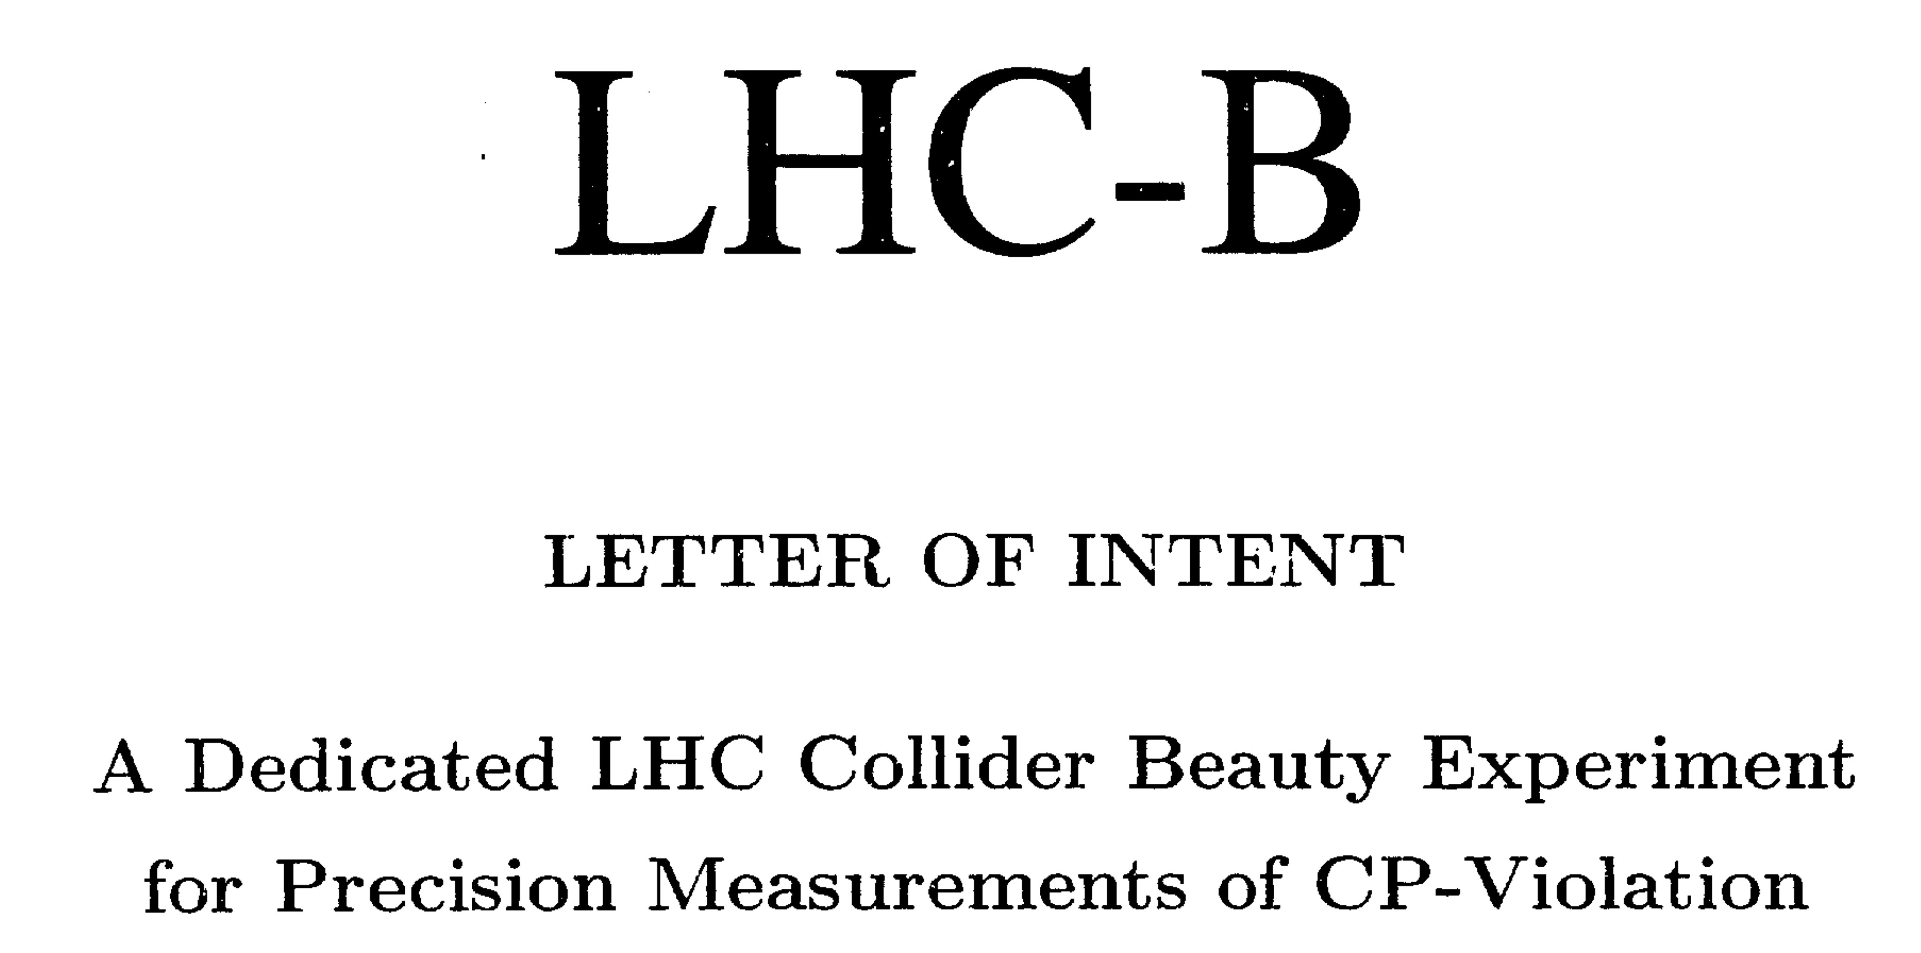
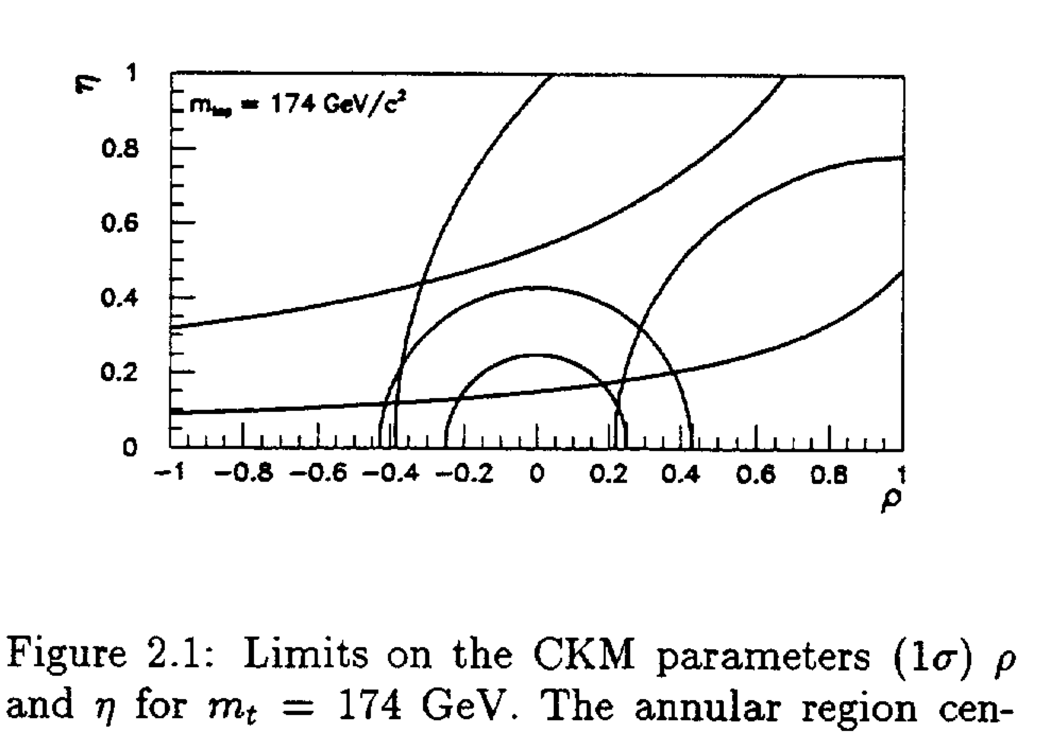
Where do we come from
LHC-B Letter-of-Intent 1995
(top not yet discovered…)

Slide 20
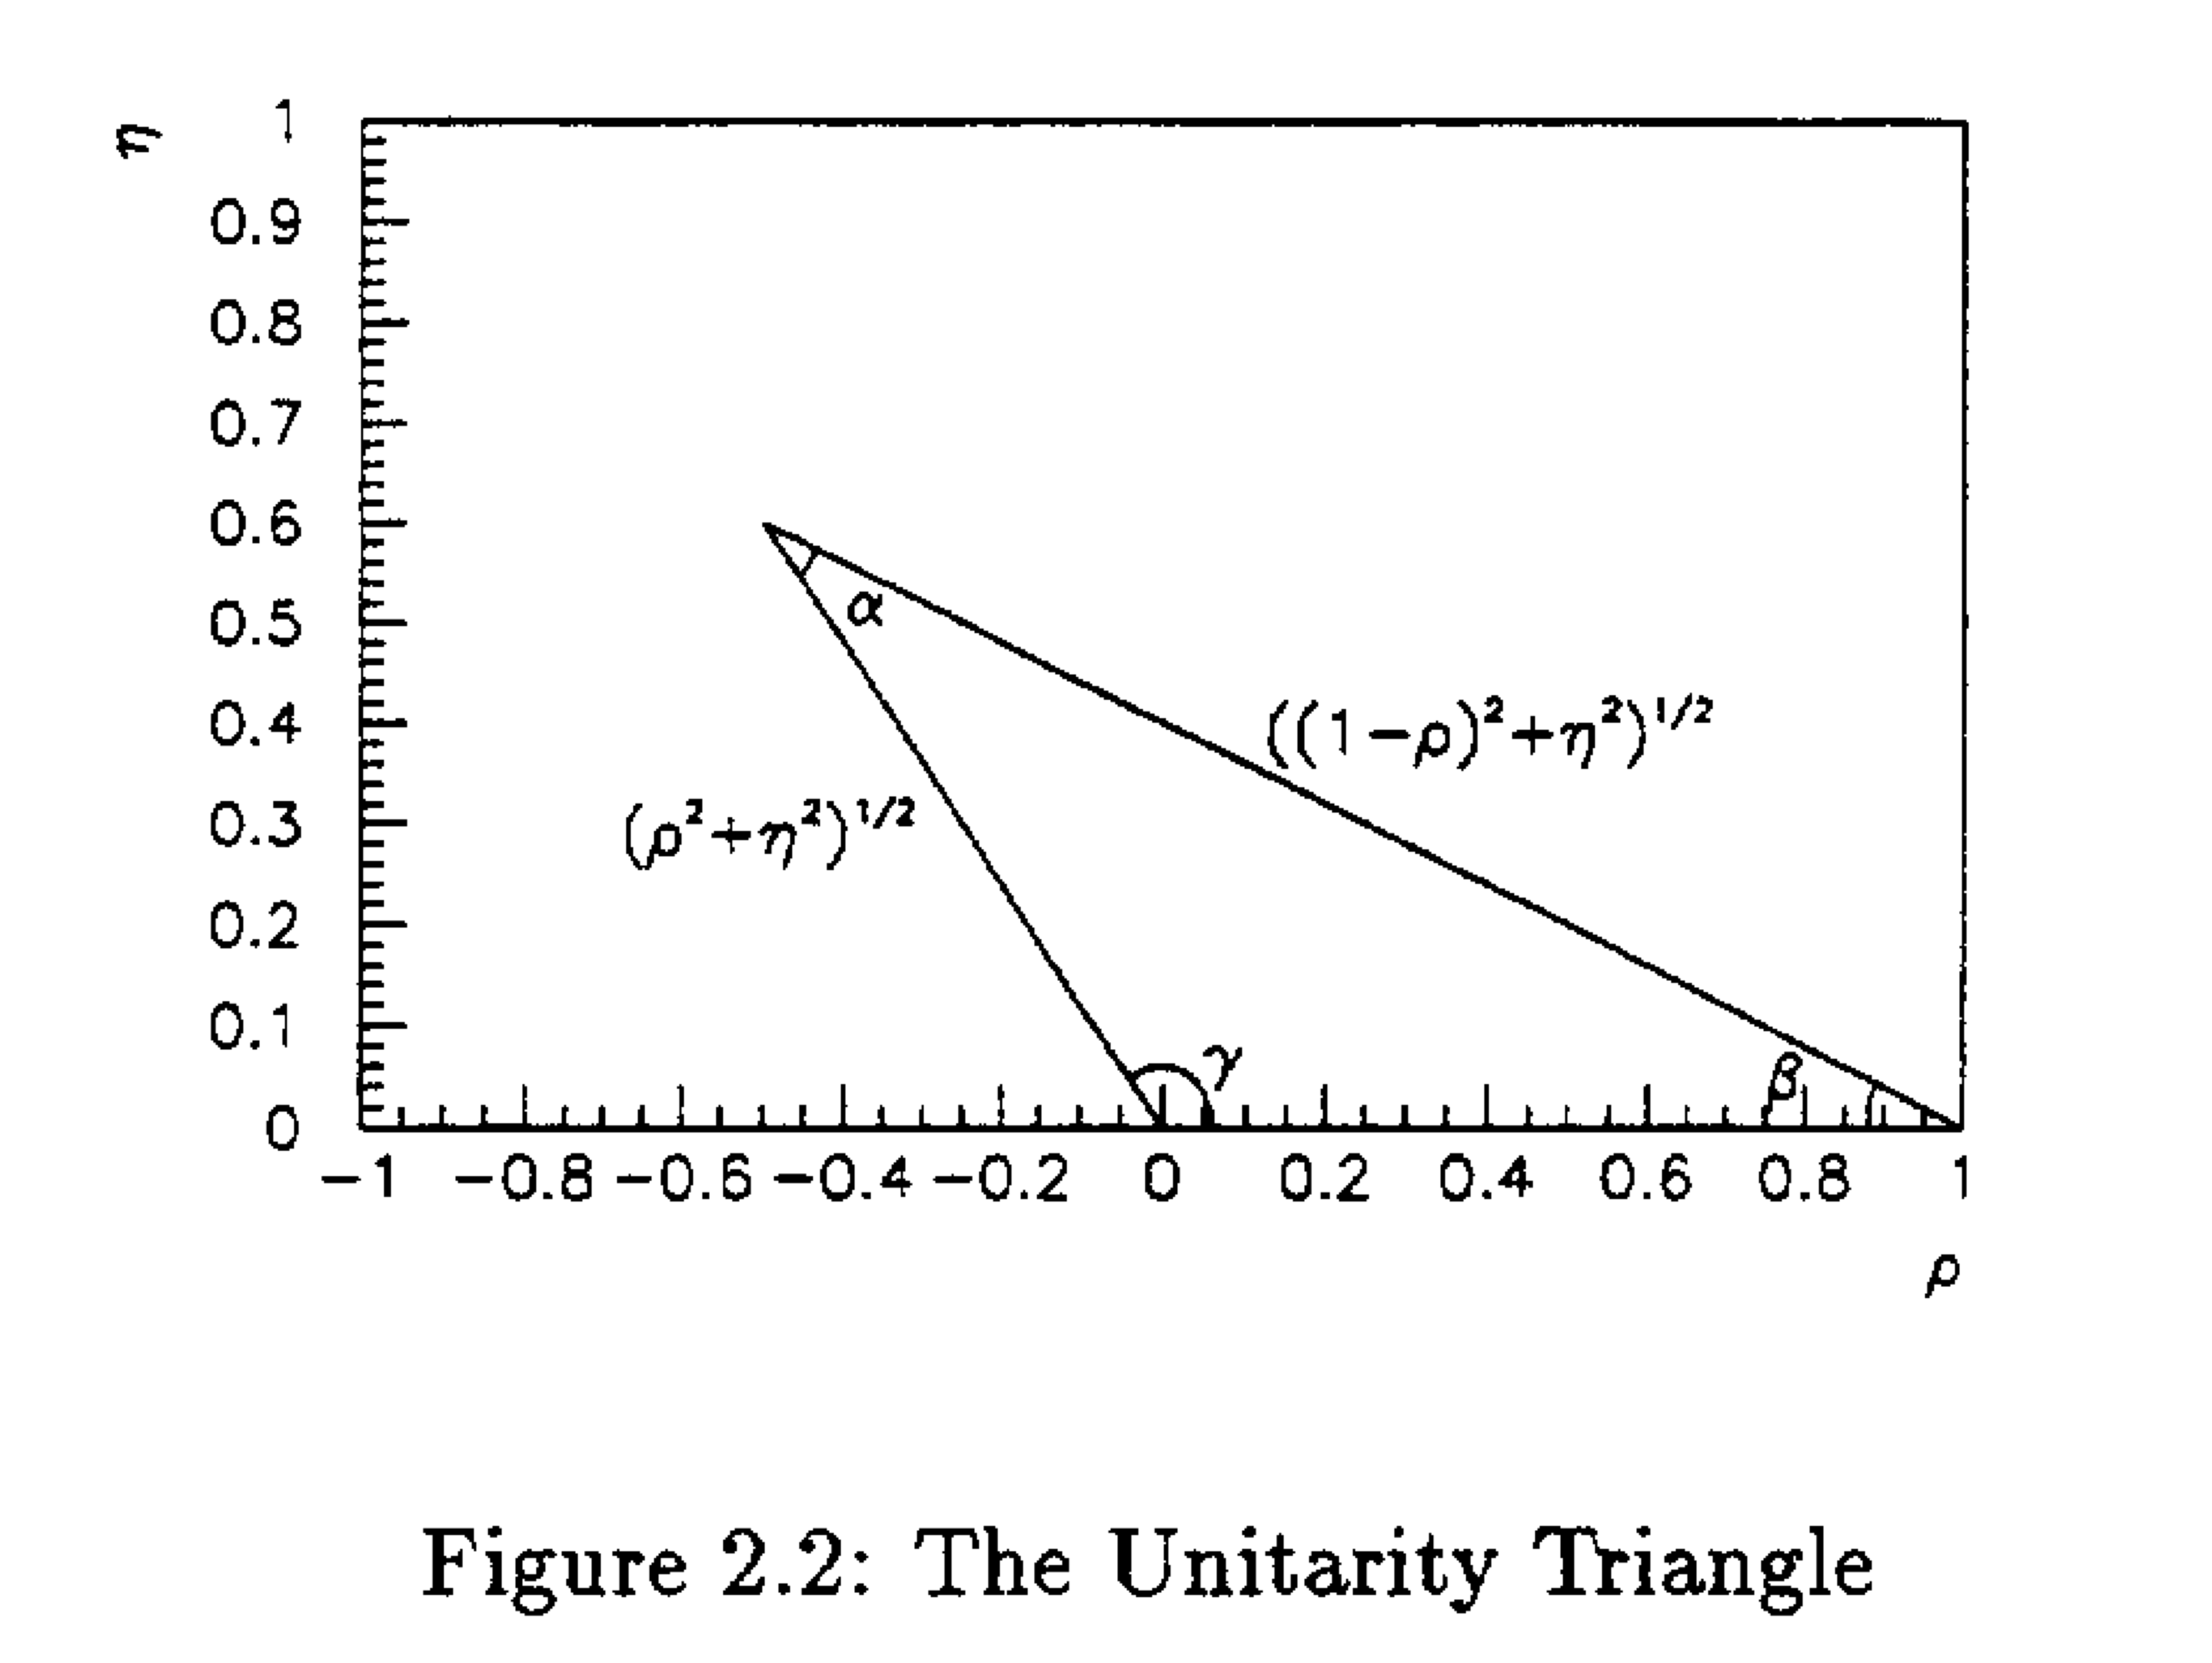
Where do we come from
Letter-of-Intent 1995
Wow…
Vintage
Triangle !?
UT → VT

Slide 21
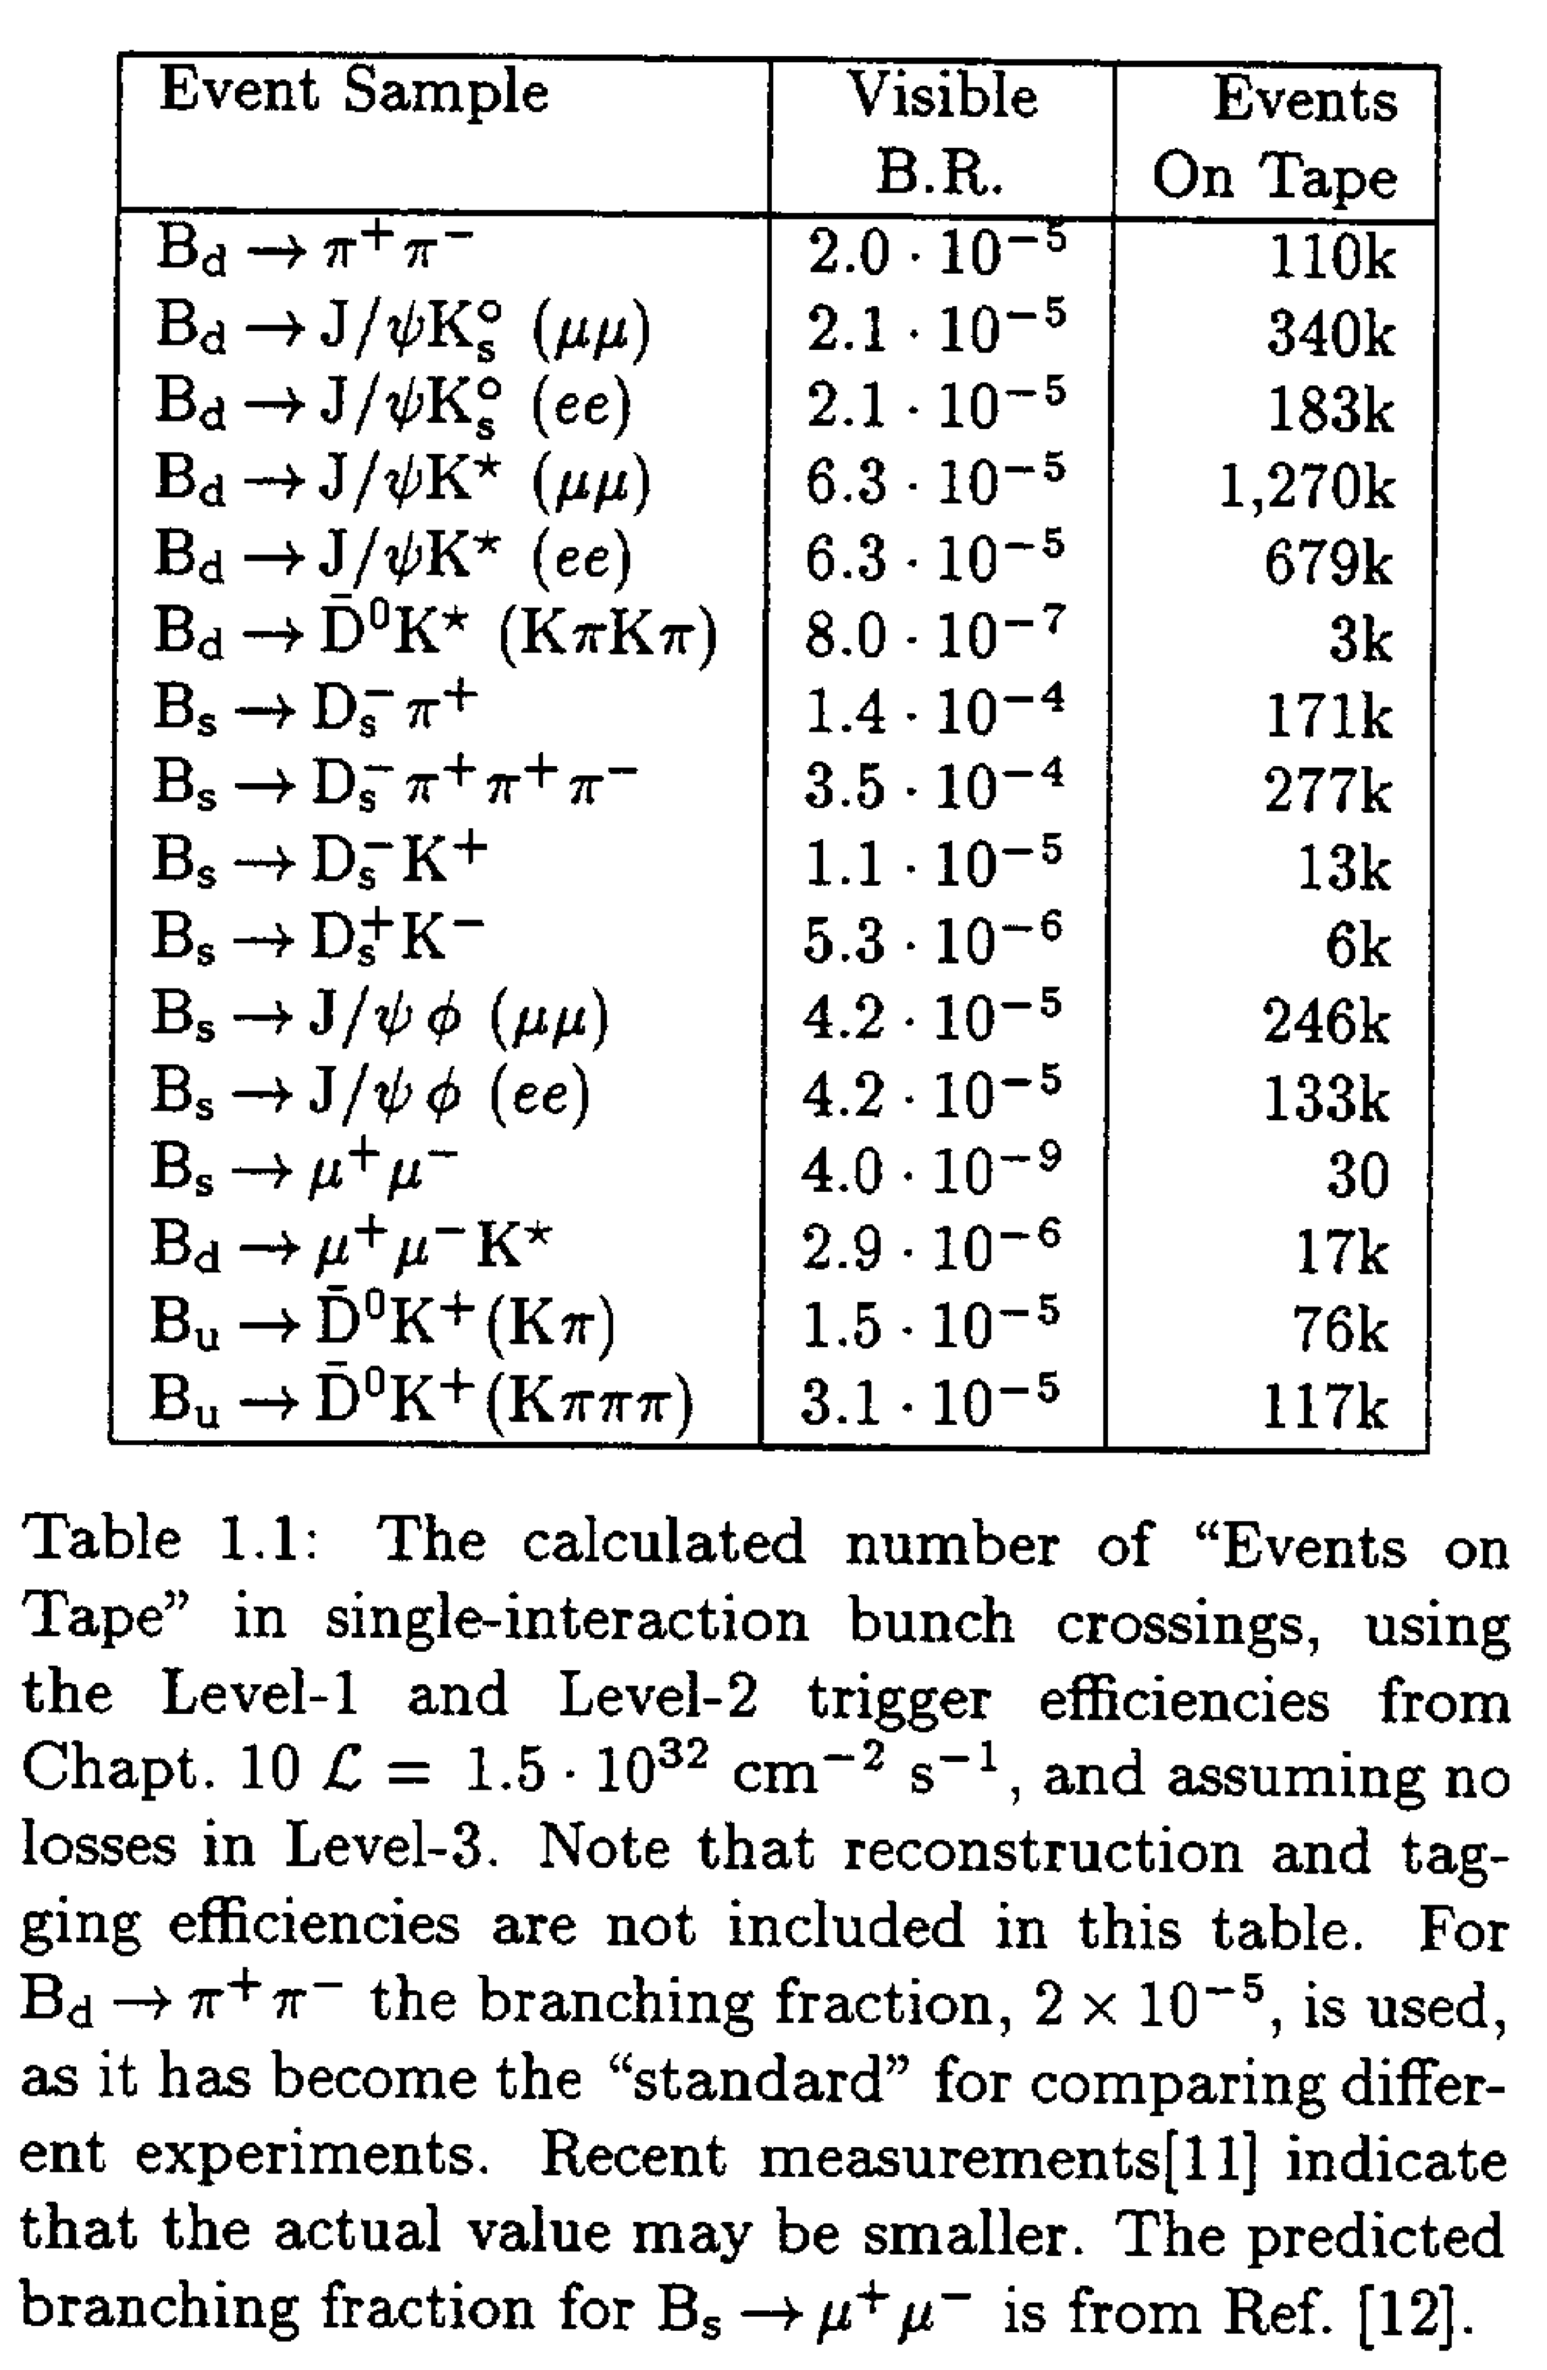
Where do we come from
0.5x10⁻⁵
Letter-of-Intent 1995:
Annual event yield estimates:
  N(B⁰_{s}→ J/ψφ) = 246k
  N(B⁰_{s}→ μ⁺μ⁻) = 30
  N(B⁰→ K*μ⁺μ⁻) = 17k
  Assuming L=1.5 x 10³² cm⁻²s⁻¹
Achieved:
  3x larger instantaneous luminosity
  2x lower event yields
?
Same?
10⁻³?

Slide 22
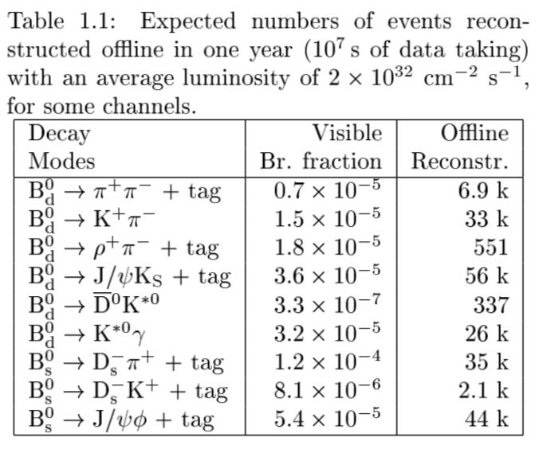
Where do we come from
Technical Proposal 1998
  Event yields closer…
  Assuming L=2 x 10³² cm⁻²s⁻¹
Reoptimized LHCb (TDR 2003)
  Assuming average L= 2 x 10³² cm⁻²s⁻¹

Slide 23
What brought us here? Lumi levelling
Trade-of between
  High L: statistics
  Low L: clean events
    + higher data rate! Network is limited by (rate x multiplicity)

Slide 24
What brought us here? Lumi levelling
Trade-of between
  High L: statistics
  Low L: clean events
Operate continuously at constant optimal L !
Richard Jacobsson, Dec 2010

Slide 25
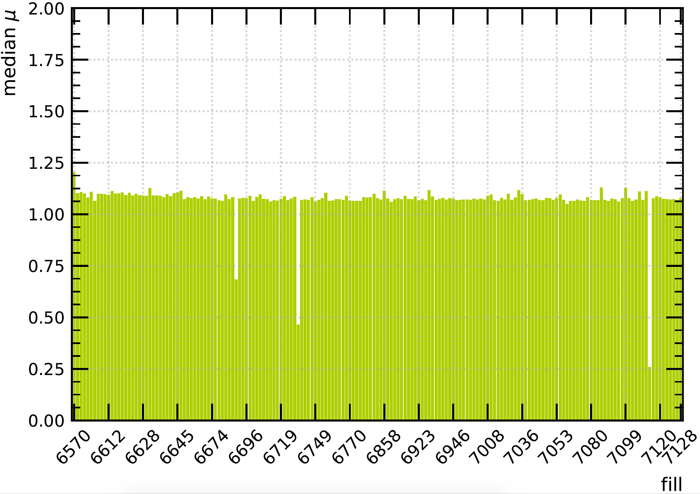
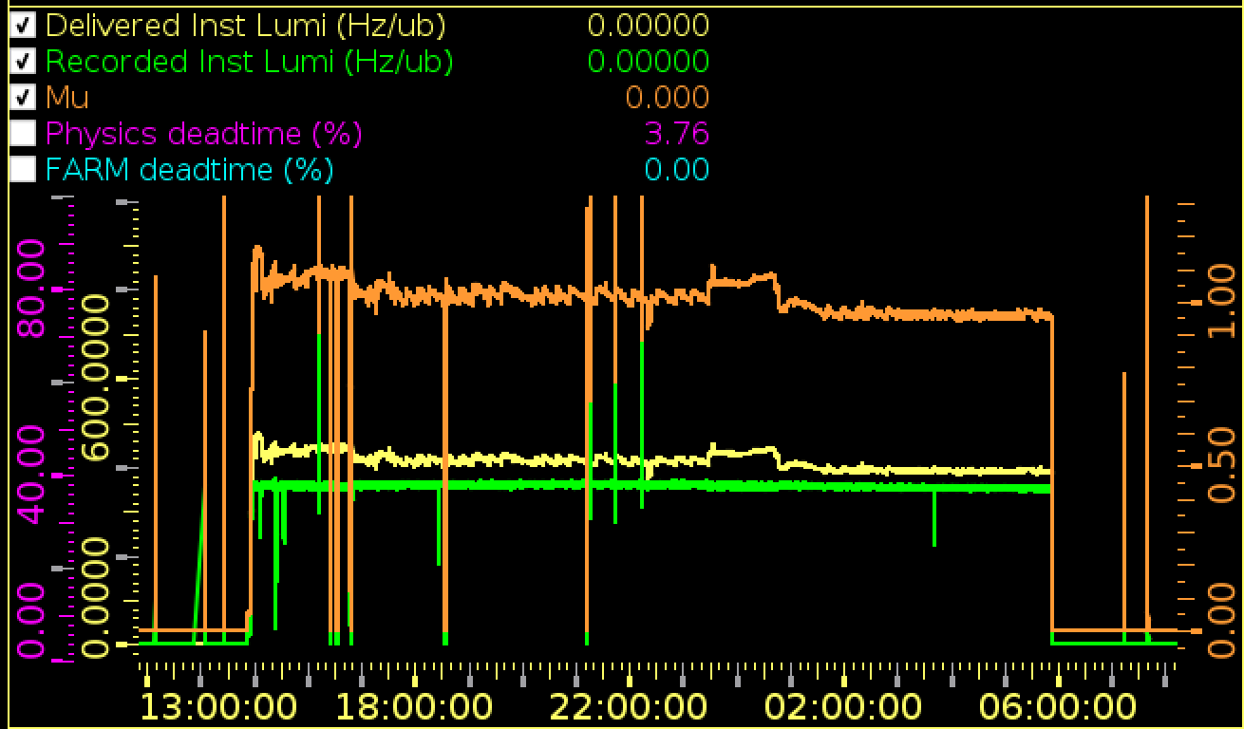
What brought us here? Lumi levelling
Trade-of between
  High L: statistics
  Low L: clean events
Operate continuously at constant optimal L !
  Displace beams at start of fill, then move closer when protons disappear
  In 2018 also employed by ATLAS/CMS
Richard Jacobsson, Dec 2010
Constant pileup during year
Constant lumi over 15hr fill

Slide 26
What brought us here? Low sys or low stats?
Main physics results dominated by statistical uncertainty (run-1) :
σ(stat)/σ(sys) | Largest source of systematic
2.5 | Mass shape & trigger eff
2.2 | MC correction & residual bkgd
3 | Δm_{s}, time res, tagging, det asymmetry
-
8 | Decay time: bias and efficiency
8 | Angular efficiency
8 | Decay time resolution
5 | Acceptance (angular and time)
1.3 | Track reco asymmetry
0.5 | External BR(Λ_{c})
6 | f_{d}/f_{s}
9 | Decay time acceptance
1 | MC sample size
1 | F(B_{c}→J/ψ) form factor
2.7 | Mass model
2.8 | Contribution from sec b→D*X decays
2 | Contribution from sec b→D*X decays
Physics Case for an LHCb Upgrade II, CERN-LHCC-2018-027

Slide 27
Event sample size, aka statistics
Sample size ~ trigger eff x luminosity
Increasing luminosity implies tighter trigger selection…
  Marginal gain…
  Trigger yield is flat:
Solution: improve the trigger
No gain in yield
Letter of Intent for the LHCb Upgrade, CERN-LHCC-2011-001

Slide 28
What brought us here? Trigger
Low level trigger: Knowledge of efficiency
High level trigger: Stability
LHCb-PUB-2011-026
Sample size per trigger setting

Slide 29
What brought us here? Magnet flips
Many precision measurements rely on asymmetries
  Charge asymmetries
  Angular asymmetries
  Differences of asymmetries
D0 could do A_{fs}, CDF not

Slide 30
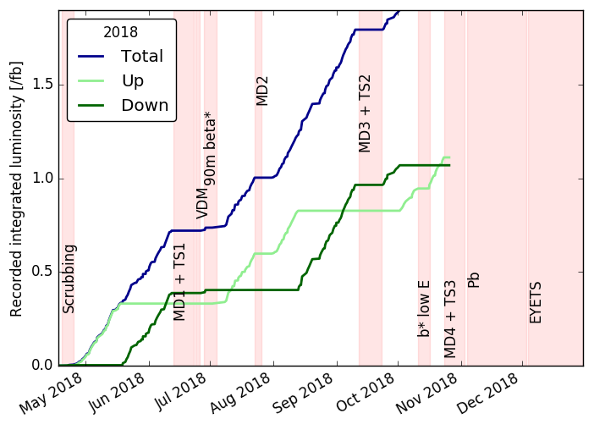
What brought us here? Magnet flips
Many precision measurements rely on asymmetries
  Charge asymmetries
  Angular asymmetries
  Differences of asymmetries
D0 could do A_{fs}, CDF not
Detector asymmetries cancel by flipping the magnet polarity
  Carefully matched the two data sets
 | Recorded Lumi (pb⁻¹)
UP | 1110
DOWN | 1070
Total | 2180

Slide 31
What brought us here? Data driven
L0 calorimeter efficiency
  Using D⁰→K⁻π⁺, B⁰→ J/ψ(ee)K*
Tracking efficiency
  Tag-and-probe with J/ψ→μ⁺μ⁻
Particle identification
  Dedicated control samples
Control channels for analyses:
  B⁰→ J/ψK* for B⁰_{s}→ J/ψφ
  B⁰→ J/ψK⁺ for B⁰→ K⁺e⁺e⁻
  B⁰→ D⁻π⁺ for B⁰_{s}→ D_{s}⁻π⁺
  B⁰_{s}→ D_{s}⁻π⁺ for B⁰_{s}→ D_{s}K
  …
LHCb-PUB-2011-026
LHCb, JINST 10 (2015) no.02, P02007, arXiv:1408.1251
LHCb, EPJ Tech.Instrum. 6 (2019) 1, arXiv:1803.00824

Slide 32
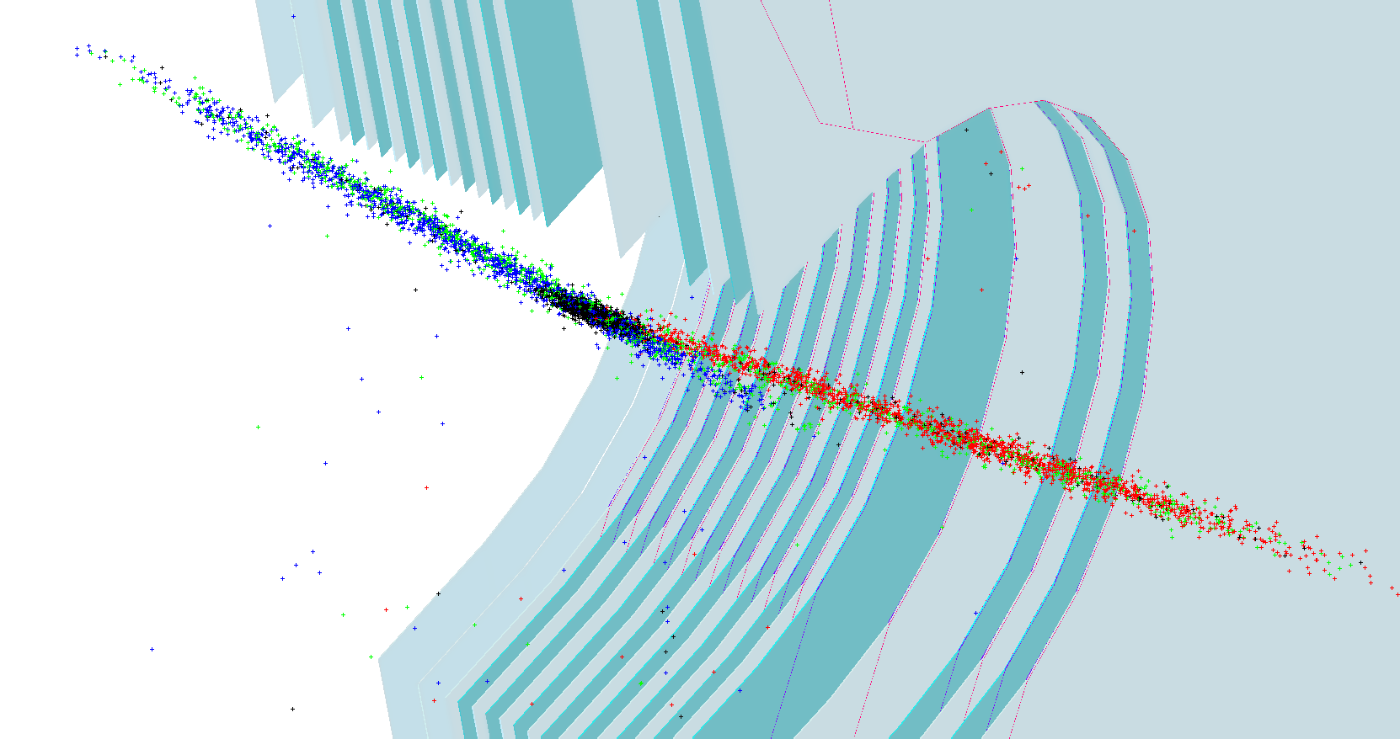
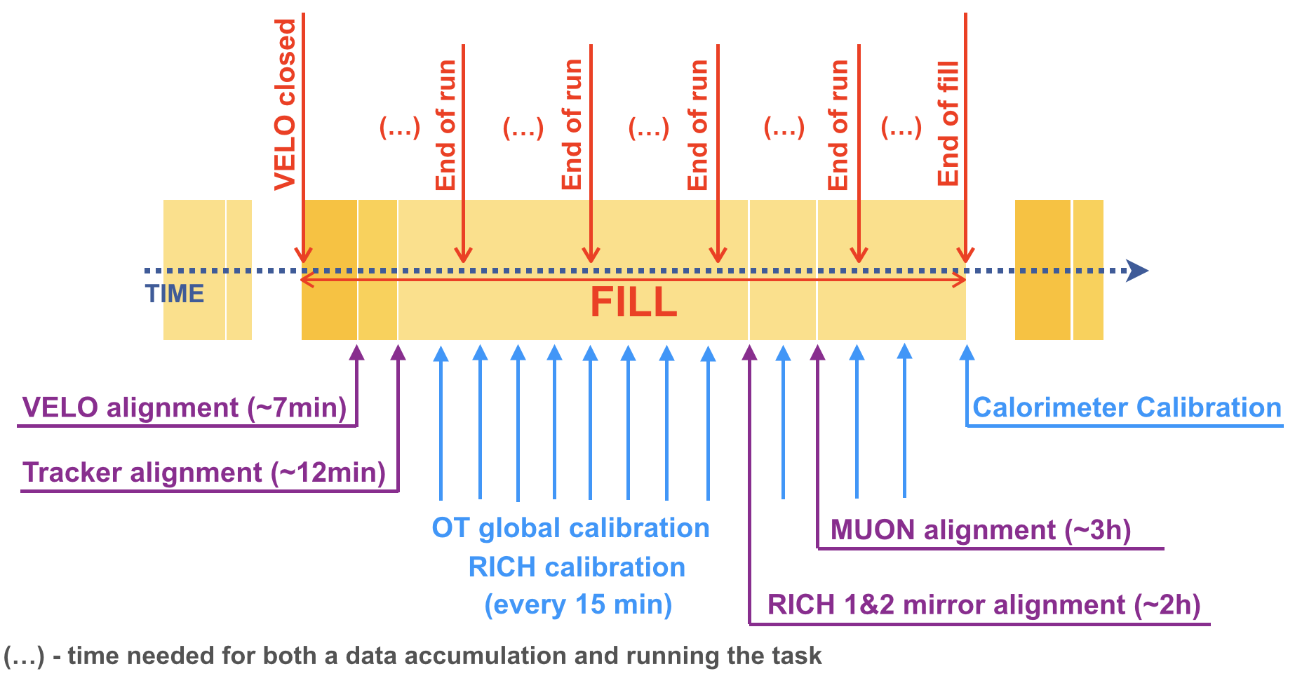
Lessons from operations
Fill 7309
Luminosity monitoring
  Dependent on single detector:
    failure requires timely understanding
  Implement more robust monitoring
Luminosity measurement
  Gas injection system extremely valuable
    ATLAS/CMS relied on LHCb for LHC satellite protons
  Keep (and improve) gas injection system
Monitoring
  Occasionally detector problems or bugs could have been caught faster
  More precise monitoring of all trigger rates
Real time alignment
  Events are parked at 100 kHz
  Selection to 5 kHz after event calibration
  1-to-1 correspondence to offline

Slide 33
Lessons from/for analysis
B→ J/ψX
  Time acceptance
B→ Ke⁺e⁻
  Bremstrahlung correction
Time-dependent B⁰_{s} analysis
  Flavour tagging:
    Incl tagging?
    OT time? PID coverage (p_{T}, eta)?
Open Charm
  magnet polarity
  Crossing angle
Electro-weak, jets
  HCAL PMT gain
Heavy-ion:
  Simultaneous operation of pp and pPb

Slide 34
Lessons from/for analysis: Decay time acc
B→ J/ψX
  Time acceptance
  Long living B mesons
    Decay off-axis
    Pattern recognition less efficient
LHCb, arXiv:1402.2554, Measurements of the B⁺, B⁰, B_{s}⁰ meson and Λ⁰_{b} baryon lifetimes

Slide 35
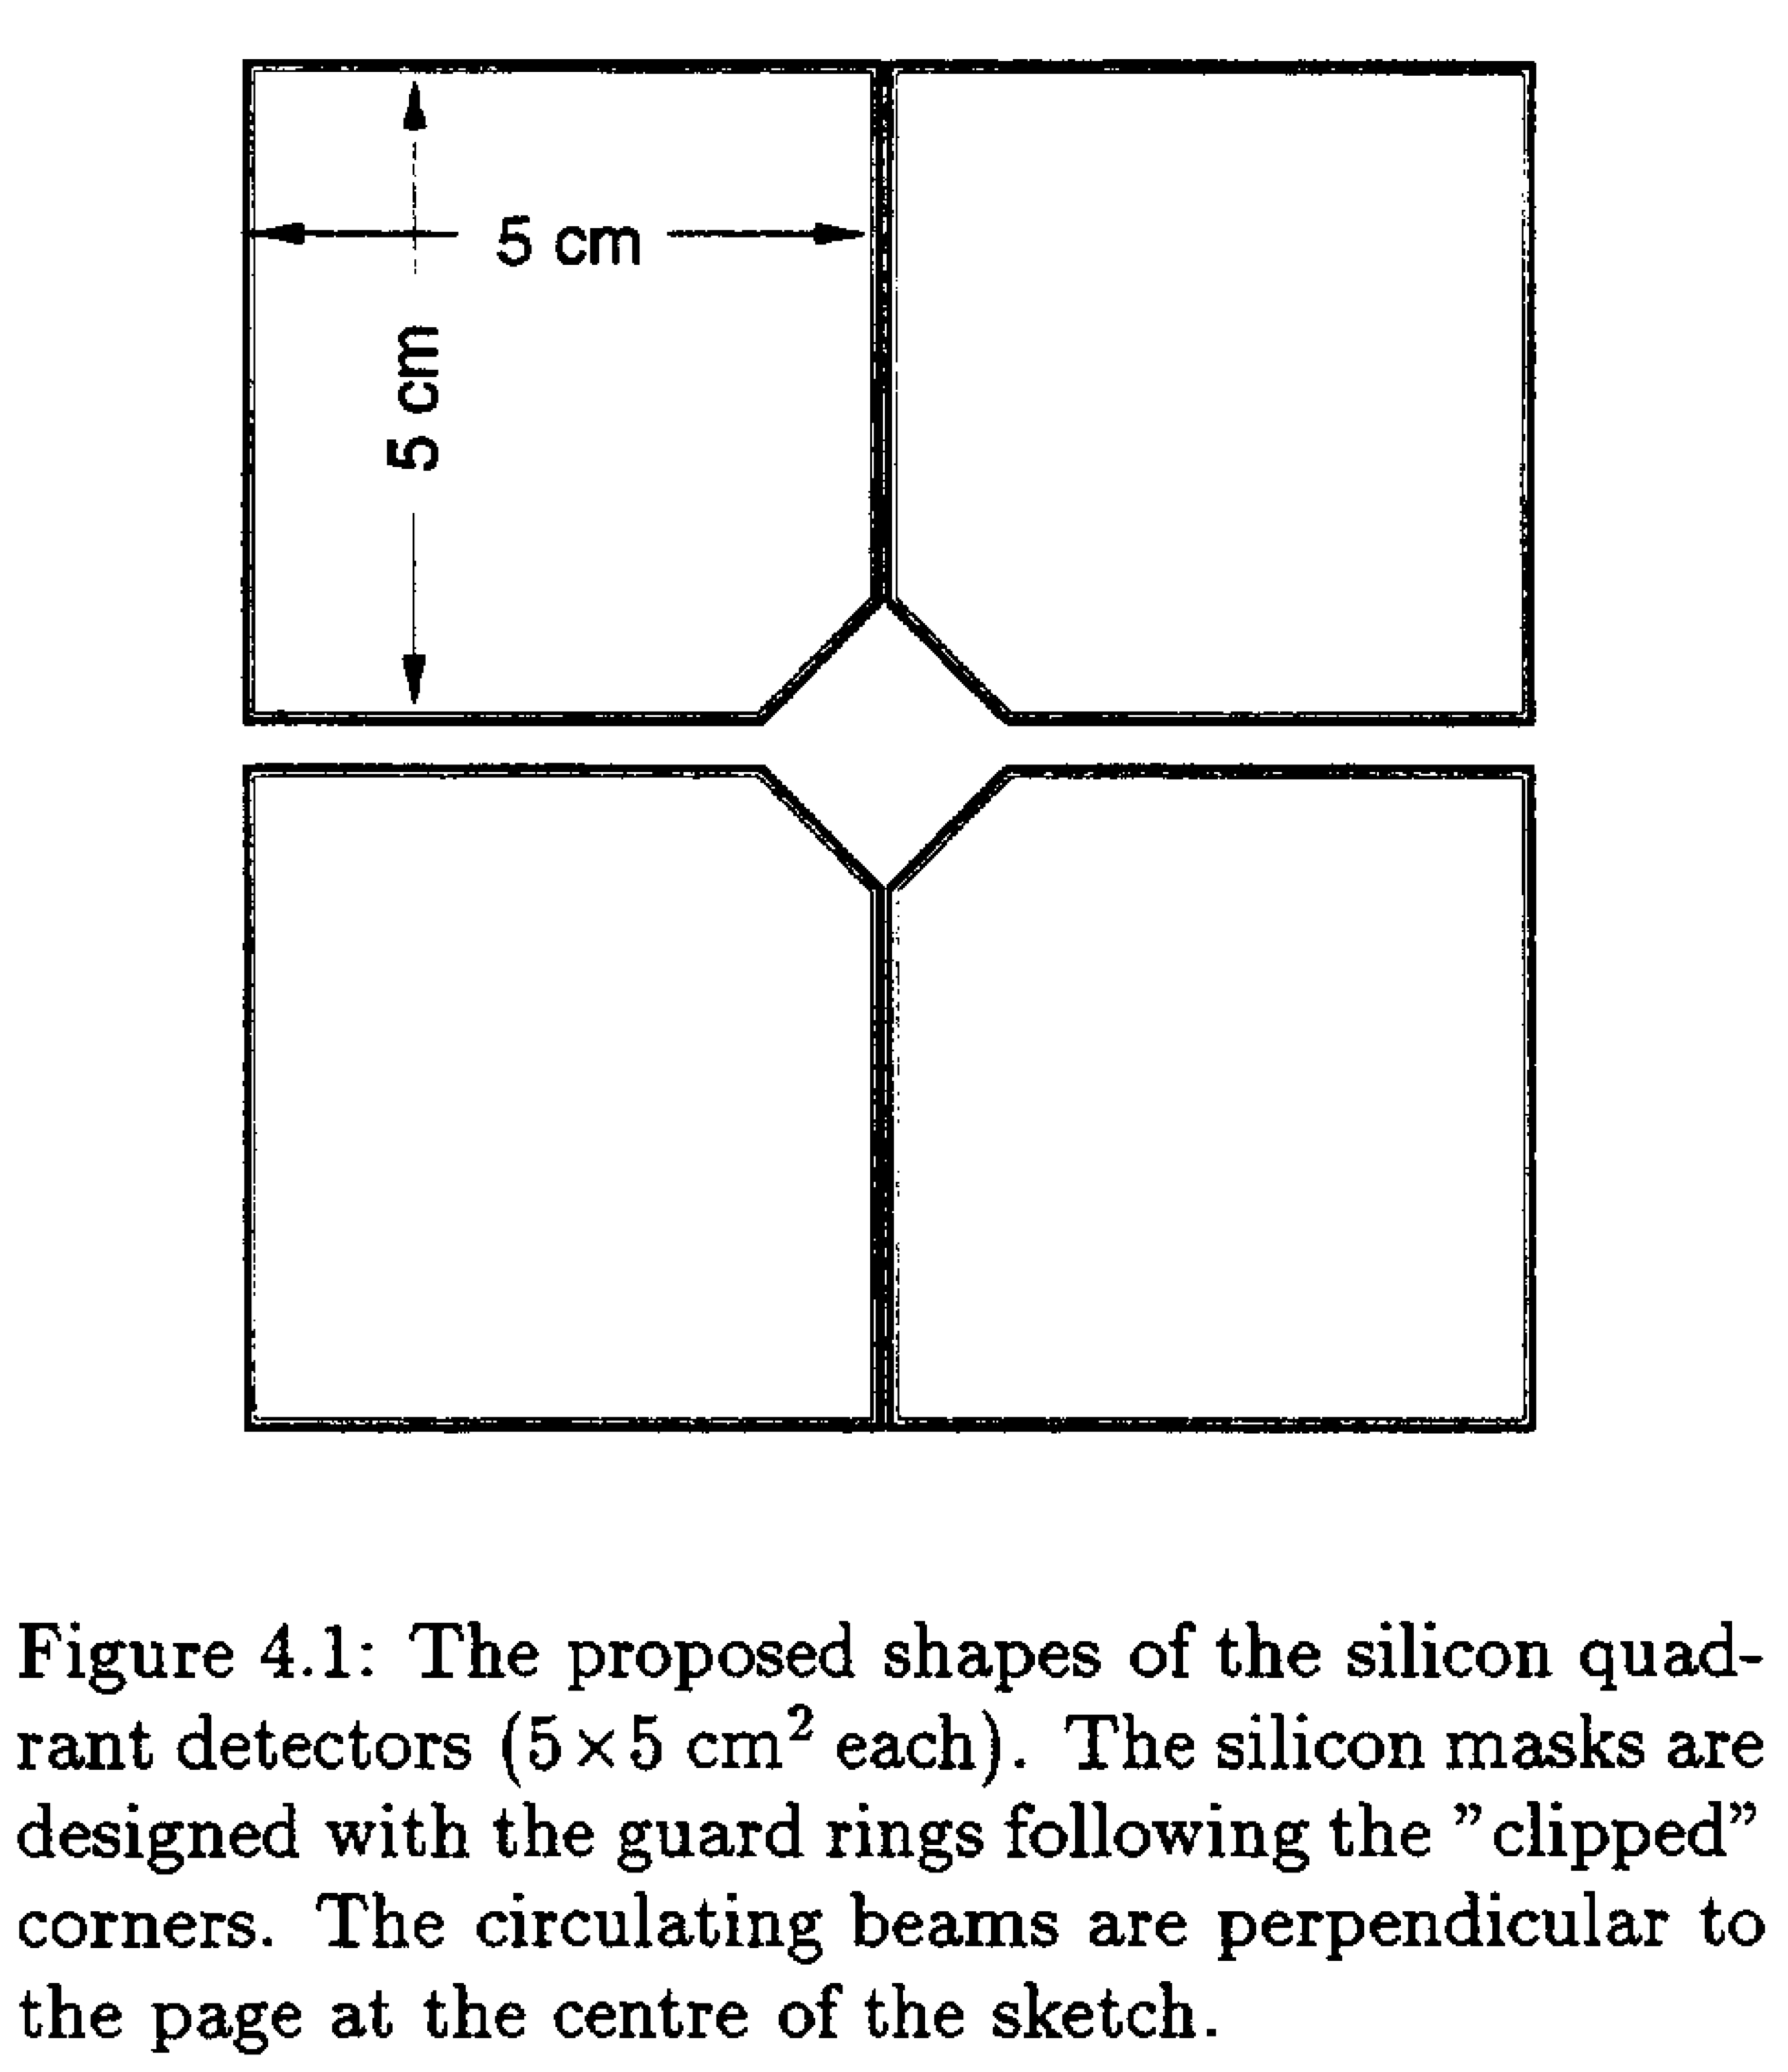
Lessons from/for analysis: Decay time acc
B→ J/ψX
  Time acceptance
  Long living B mesons
    Decay off-axis
    Pattern recognition less efficient
LHCb, arXiv:1402.2554, Measurements of the B⁺, B⁰, B_{s}⁰ meson and Λ⁰_{b} baryon lifetimes
LOI 1995
TDR 2001
TDR 2013
Pixel detector more robust

Slide 36
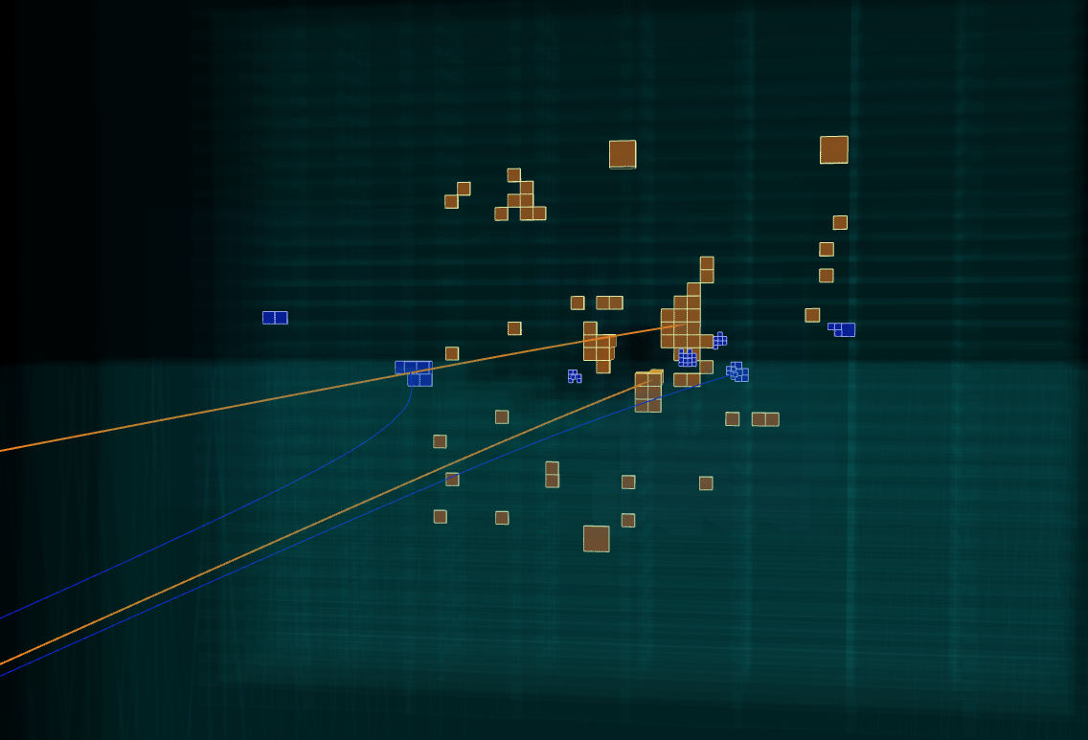
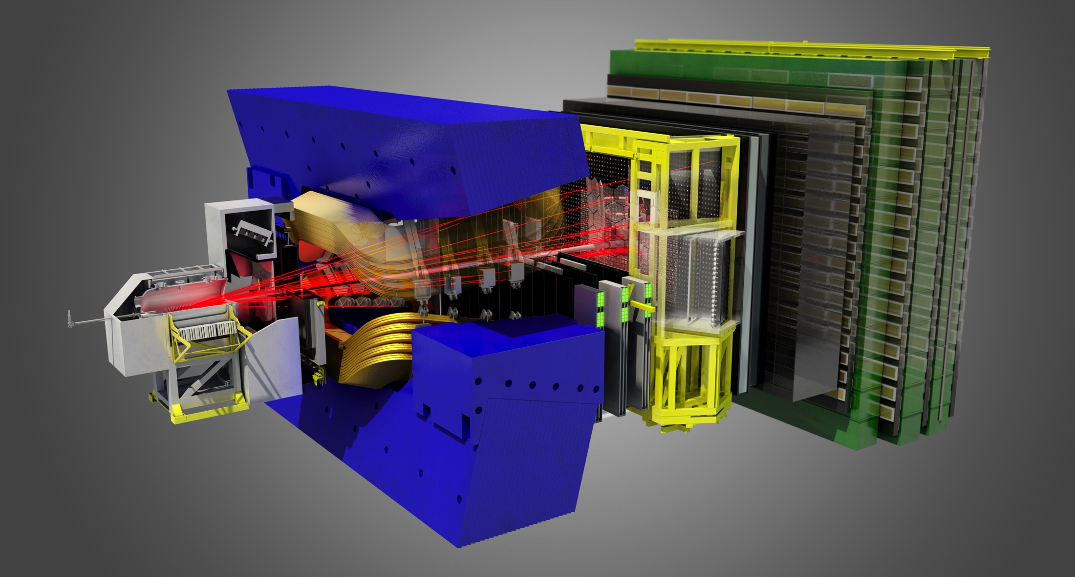
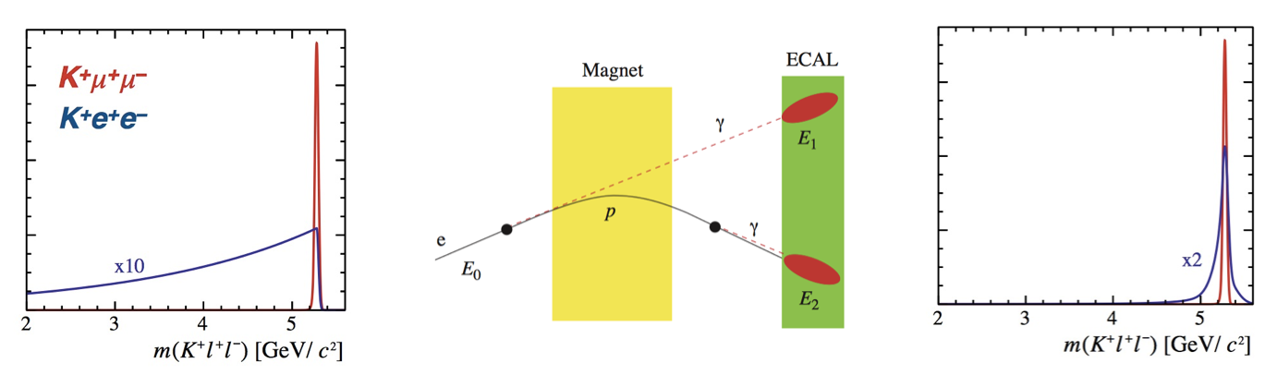
Lessons from/for analysis: Bremstrahlung
B→ Ke⁺e⁻
  Bremstrahlung correction
e⁺
e⁻

Slide 37
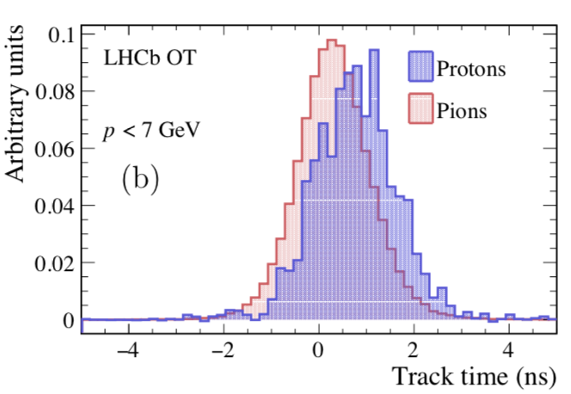
Lessons from/for analysis: Flavour tagging
Tagging: from fragmentation → low momentum
Outer Tracker time resolution: ~0.6 ns / track
  Time-of-flight difference proton vs pion at z=8m: ~1 ns
  Use of timing has the future
proton vs π t.o.f. difference (z=8m)
LHb, RICH TDR, LHCC-2000--037
LHCb coll., Ph. d’Argent et al., JINST 12 (2017) P11016
Improved performance of the LHCb Outer Tracker in LHC Run 2

Slide 38
Lessons from/for analysis: Flavour tagging
Tagging: from fragmentation → low momentum
Improve coverage for low momenta
No extra detectors in run-3 yet
Could use tracks with single hit in T stations
  Also useful for high-multiplicity decays
    D*⁺→D⁰π⁺
    D⁰→Kπππ
    B→DD
    …
LHb, RICH TDR, LHCC-2000--037

Slide 39
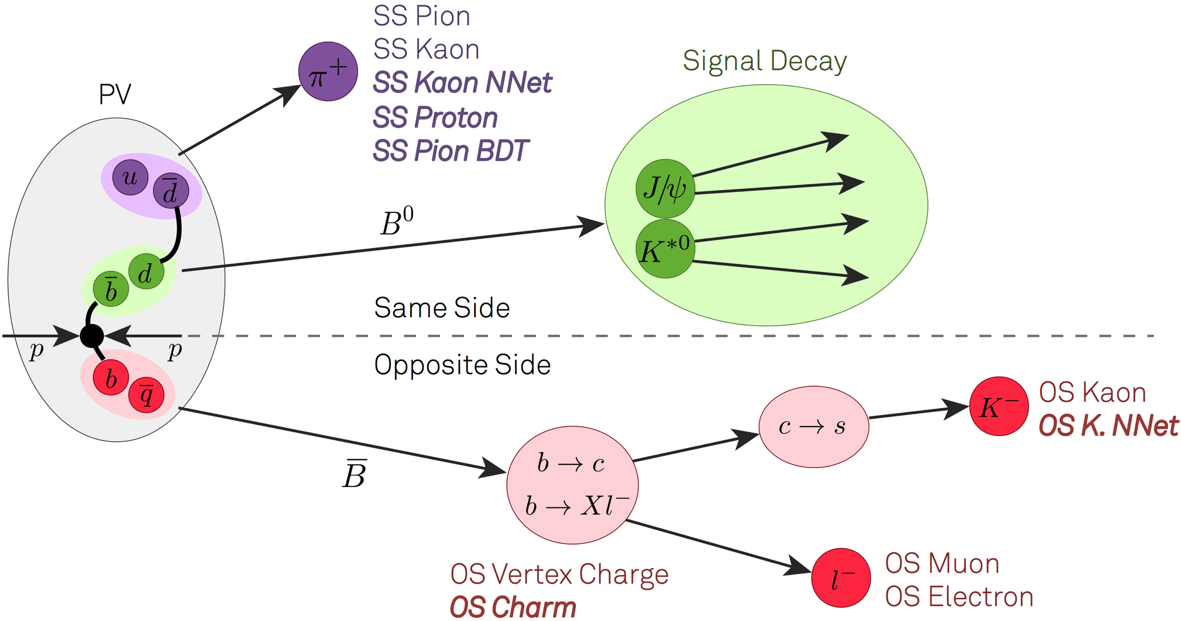
Lessons from/for analysis: Flavour tagging
D.Derkach, T.Likhomanenko, A.Rogozhnikov,
IML workshop, March 2017
Inclusive tagging
  use all (non-signal) tracks from event
  let machine guess which tracks are tagging & how charge is connected to flavour
  estimate probability
    decisionTrain uses oblivious tree
    adaptive versions of stochastic gradient descent
    Tagging with attention (by assigning weights in a softmax-like manner)
    logistic regression and isotonic regression
?

Slide 40
Lessons from/for analysis: Charm
Huge statistics
  Asymmetry of kaon interaction rate
Magnet polarity
  Take equal samples
LHCb-PUB-2018-004, Measurement of the instrumental
asymmetry for K⇡+-pairs at LHCb in Run 2

Slide 41
Lessons from/for analysis: Charm
Huge statistics
  Asymmetry of kaon interaction rate
Crossing angle
  “Internal” crossing angle flips with magnet polarity
    causes an asymmetry when averaging over magnet polarities
  Ideal scenario: change of external crossing angle to compensates internal crossing angle
    identical total angle for both polarities
LHCb-PUB-2018-004, Measurement of the instrumental
asymmetry for K⇡+-pairs at LHCb in Run 2
L. Dufour & J. van Tilburg, LHCb-INT-2018-006, Decomposition of simulated detection asymmetries in LHCb

Slide 42
Lessons from/for analysis: Jets, Heavy Ions
Jets
B decay products: lower energy scale
Jets: higher energy scale
Increase calorimeter dynamic range?
  More noise, worse Bremstrahlung recovery…
Z→e⁺e⁻
LHCb, JHEP 09 (2016) 136
Heavy Ions

Slide 43
Lessons from/for analysis: Jets, Heavy Ions
Jets
Heavy Ions
Rich programme:
  Pb-Pb collider
  P-Pb collider
  p fixed target
  Pb fixed target
    He, Ne, Ar targets
Simultaneous operation (non-)colliding bunches
E (Z TeV) | √s_{NN}
 | pp |  | Pb-p |  | Pb-Pb
 | √s=2E |  | √s=2E√r |  | √s=2Er
1.38 | 2.76 | 2013
2.51 | 5.02 | 2015 2017
3.5 | 7 | 2011 | 4.40 |  | 2.76 | 2010 LHCb off
4 | 8 | 2012 | 5.02 | 2013 2016 | 3.15
6.37 |  |  | 8.00 |  | 5.02 | 2015 2018
6.5 | 13 | 2015- 2018 | 8.16 | 2016 | 5.13

Slide 44
Lesson learned…: Errata
15 errata
  4 errata: VELO simulation mistake
  2 errata: bugs
  9 errata: minor
Only small fraction of all papers! But need to stay vigilant
Title | Erratum | Mistake | Effect
Measurement of CKM angle gamma in B→DK | JHEP 1810 (2018) 107 | Figure: label | Minor
Measurement of CP observables in B→DK* | JHEP 1805 (2018) 067 | Wrong systematics | No consequence
Measurement of the J/ψ pair production at 13 TeV | JHEP 1710 (2017) 068 | Track eff: double metal layer | Severe
Measurement of the b-quark production at 13 TeV | PRL 119 (2017) 169901 | Track eff: double metal layer | Severe
Measurement of charm mixing and CP violation | PRD96 (2017) 099907 | Swapped systematics | Minor
Measurement of S-wave fraction and B⁰→K*μμ | JHEP 1704 (2017) 142 | Eff: fast sim, and m_{Kπ} range | ~10%
Constraints on UT angle gamma from B→DKπ | PRD94 (2016) 079902 | Figure: contours | Minor
First observation of the rare B→DKπ decay | PRD93 (2016) 119902 | Value 10⁻⁴ instead of 10⁻⁶ | Typo
Measurements of prompt charm production at 13 TeV | JHEP 1705 (2017) 074 | Track eff: double metal layer | Severe
Measurement of forward J/ψ production at 13 TeV | JHEP 1705 (2017) 063 | Track eff: double metal layer | Severe
Measurement of the ratio of BR RD* | PRL 115 (2015) 159901 | Incorrect asterisk | Typo
Differential BR and angular analysis of Λ_{b}→Λμμ | JHEP 1809 (2018) 145 | Sign mistake for Λ_{b}bar | Severe
First observation and amplitude analysis of B→DKπ | PRD93 (2016) 119901 | Value 10⁻⁴ instead of 10⁻⁶ | Typo
Observation of CP violation in B→DK decays | PLB713 (2012) 351 | Publisher: twice same fig | Typo
Measurements of BR of B→Dπππ and Λ_{b}→Λ_{c}πππ | PRD85 (2012) 039904 | Typo on “%” and charges | Typo
For details on tracking efficiency: V.Gligorov, arXiv:1806.10912

Slide 45
Lessons learned from LHCb
Progress of last two decades!
Δm_{d}
sin2β

Slide 46
Lessons learned from LHCb
Progress of last two decade!
Δm_{s}
τ_{Bs}
ΔΓ_{s}/Γ_{s}

Slide 47
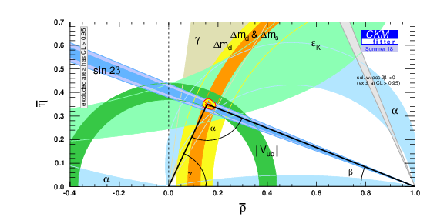
Lessons learned from LHCb
B⁺→J/ψ(ee)K⁺
B_{s}⁰→J/ψ(μμ)φ
D⁺*→D⁰(K⁺K⁻)π⁺
Precision physics is possible at forward hadronic experiment

Slide 48
Thank you

Slide 49
Lessons learned from LHCb about making precise flavour measurements
Operations:
All: Trigger stability, monitoring
Elec: L0 ECAL constants
HCAL: mu
Elec: Bremstrahlung correction July 2016
Vtx: Bunch lengthening
All: Real time alignment (Muon Null alignment Aug 2018)
All: More bugs: TISTOS, ALLSAMEBPV 2018, FT SSp Sspi
Lumi: SMOG
MC:
VELO: double metal layer, x-sec (erratum)
Muon: 2011 acceptance (?)
SL: MC stats
Analysis:
B2OC: L0 had eff
RD: ang analysis K*mumu (erratum)
B2CC: Time acceptance, beta factor (VeloPIX)
Flavour tagging: OT time? Incl tagging? PID coverage PIDCALIB pT eta?
Charm/SL: magnet polarity, DeltaACP, see Laurent!
QEE: HCAL PMT gain
IFT: Simultaneous operation of pp and pPb

Slide 52
Playing field: heavy flavour
LHCb
B_{s}⁰
K
ATLAS/CMS
D
BESIII,
NA62, KOTO
B⁰ B⁺
top
tau
Belle II
Sketch adopted from Marie-Hélène
Schune ECFA2013, 1 Oct 2013

Slide 53
LHCb = more than flavour pdfs, jets, heavy-ion, EW, exotic states…
Resolve b and c jets
Discovery of
pentaquark P(4450)
Impressive sin²θ_{w}
Improve proton pdf’s

Slide 54
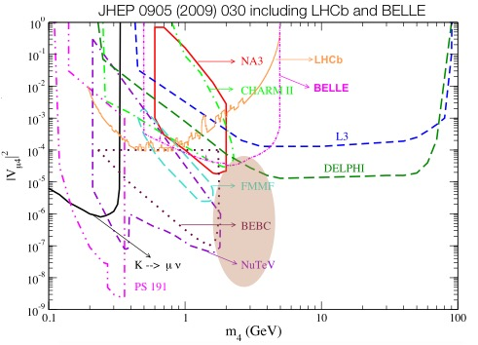
Searches
Dark photons, Majorana, light scalars
Light scalars
  A→μμ
Majorana neutrino’s
  B⁺→ π⁻μ⁺μ⁺
Dark photons
  D*⁰→D⁰γ, A→μμ
Haisch et al., PRD93 (2016) 055047
Atre et al., JHEP 0905 (2009) 030
Ph.Ilten et al PRL 116 (2016) 251803

