Slide 1
Towards Production VL-e PoC in 2008 and beyond
David Groep
VL-e SP meeting 2008-05-30

Slide 2
VL-e Scaling and Validation “P4”
The Proof of Concept Environment reminder
It is the Experimentation environment for e-Science Infrastructure
Reliable
Supportable
Secure
Implemented through three actions
PoC Software Distribution
PoC Infrastructure and Environment (central facilities, distributed and contributed installations)
Software engineering for scalability and supportability

Slide 3
BiG Grid
With the roll-out of the BiG Grid project the Netherlands gets a full scale e-Science environment
Large-scale hardware infrastructure (cluster computing, HPC, mass storage)
Support and Development (problem analysis, implementation of problem solving environments, systems and infrastructure standardisation)
Operations Support (systems help desk, focus in stability, scalability and responsiveness)

Slide 4
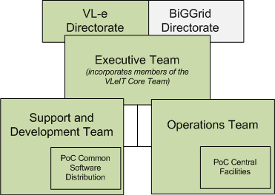
VL-e P4 and BiG Grid: a Joint Strategy
Amalgamate P4 and BiGGrid operations
Executive Team, with VLeIT core members, to oversee operations, support and development for both BiGGrid and VL-e PoC
BiGGrid environment will be fully based on the existing VL-e distribution
Applications using the VL-e PoC also ‘join’ the BiGGrid environment … ... and thus profit from larger resource base for hardware and support*

Slide 5
PoC and BiGGrid: Towards Production
PoC environment basis for the Infrastructure
Virtually all services in PoC ‘R3’ are ‘web services’
except: SRB – never
few hidden services – early 2009
Promote use by applications of services through the GAT
SRB: supported till end of VL-e project, but this ‘vertical’ will be split in components
Basic data storage through robust bulk services (GridFTP, or SRM for those applications that need that)
SRB-meta-data management (never used in VL-e!) using new components to be selected
Adding simple but robust services for ‘simple’ applications
but also remain open for communities that favour complexity and functionality over robustness

Slide 6
Towards production: stability and extensibility
‘Core’ PoC distribution focuses on stability
managed software engineering track
Components have designated maintainer and supporter
Bug and vulnerability management
Contributed Software track
interesting software that fit PoC distribution well
Made available centrally, installed with minimal effort
Possibility to extend to RESPECT (European equivalent)
Community Software Areas (‘SGM’)
Community software area on each facility (site)
Managed by the community
Interface and how-to will be more widely publicized
And ‘easier’ management facilities added

Slide 7
Towards production: central facilities
PoC facilities become integral part of BiGGrid
Support at least at current levels guaranteed
aim to improve reliability, availability and response
More support for ‘hosting’ environments
Services, repositories, portals, &c
Operation in collaboration with the user community
e.g. life-science web service hosting

Slide 8
A Sustainable Infrastructure
Joint operation, development and support
amalgamation of VL-e PoC and BiGGrid in 2008
continuity after 2009 BiGGrid continues service as before
With the goal of creating a persistent, sustainable e-science environment

Slide 9
http://www.vl-e.nl/

