Slide 1
OIDC Federation for Infrastructures
leveraging the IGTF global infrastructure trust framework with OIDC technology
David Groep
co-supported by the Dutch National e-Infrastructure coordinated by SURF, by EOSC-HUB, and by AARC

Slide 2
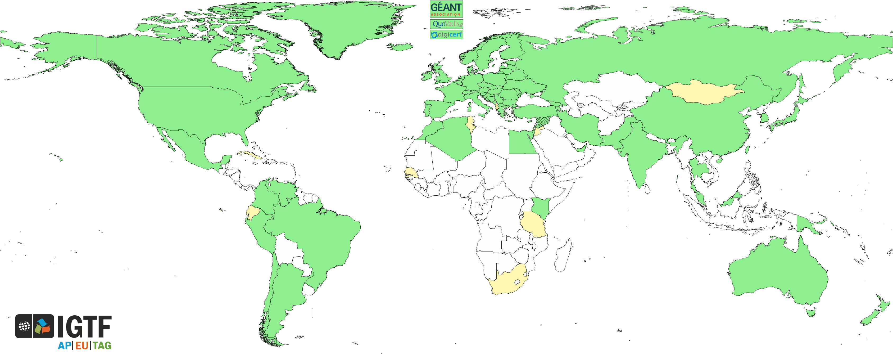
Trust for global e-Science infrastructures
“establish common policies and guidelines that enable interoperable, global trust relations between providers of e-Infrastructures and cyber-infrastructures, identity providers,
and relying parties”
EGI
PRACE
GEANT WLCG
XSEDE
OSG
HPCI
PRAGMA
RedCLARA
. . .

Slide 3
Assurance and trust frameworks
Identity Assurance Profiles for R/E-Infra risk scenarios (https://igtf.net/ap/loa/)
“BIRCH” - good quality (federated) identity,
“DOGWOOD” - identifier-only, but with traceability (R&S+Sirtfi+a few bits)
RFC 6711 Registry: https://iana.org/assignments/loa-profiles
technology-specific ‘trust anchor’ distribution services
Policy framework for Relying Parties (‘SP-IdPs-Proxies’)
Snctfi - Community Trust Framework in Federated Infras
https://igtf.net/snctfi
How can we help support RI and e-Infrastructure use cases?
technology bridges: TCS, RCauth.eu, IGTF-eduGAIN bridge, …
behind the Infrastructure Proxies for research & collaboration, OIDC gains prominence

Slide 4
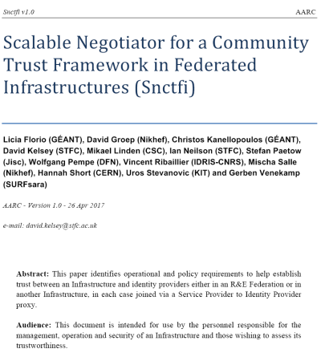

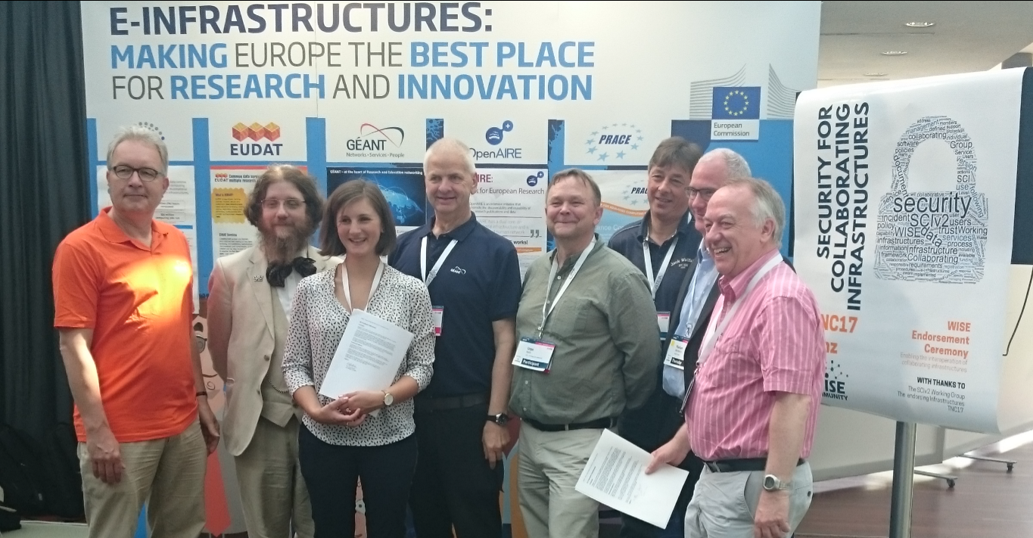
Snctfi: aiding Infrastructures achieve policy coherency
✓
allow SPIdP Proxies to assert ‘qualities’, categories, based on assessable trust
✓
Develop recommendations for an Infrastructure’s coherent policy set
Snctfi
Scalable Negotiator for a Community Trust Framework in Federated Infrastructures
Derived from SCI, the framework on
Security for Collaboration among Infrastructures
Complements Sirtfi with requirements on internal consistent policy sets for Infrastructures
Aids Infrastructures to assert existing categories to IdPs
REFEDS R&S, Sirtfi, DPCoCo, …
Graphics inset: Ann Harding and Lukas Hammerle, GEANT and SWITCH
https://igtf.net/snctfi

Slide 5
OIDC Fed use cases for research and e-Infrastructures
EOSC-HUB registration of clients
goal for EGI and EUDAT is a scalable and trusted form of OIDC usage.
Today < O(50) clients; next year maybe O(100-1000)?
cloud-based services (containers, microservices) could push that to millions
CILogon (and XSEDE) use cases see need for a set of policies and practices
that support a 'trust anchor distribution'-like service targeting OIDC OPs and RPs
and where RPs that are ‘in the community’ can be identified as such
ELIXIR (and the Life Sciences) AAI expect growth in # OIDC RPs as AAI extends beyond just ELIXIR and into other biomedical RIs – potentially dynamically created
All of these need a policy framework, on both the (infrastructure) OPs and on the RPs
This is the community that traditionally also relied on the IGTF trust anchor distribution
https://www.eugridpma.org/meetings/2018-01/summary-eugridpma-2018-01-prague.txt

Slide 6
IGTF OIDC Federation Task Force
The IGTF task force for OIDC Federation will
identify specific objectives – I2 TechEx
scope needs and requirements for R/E infrastructure OIDC Fed – Prague EUGridPMA 42
verify compatibility of IGTF Assurance Profile framework
for ‘technology-agnosticity’ with OpenID Providers (proxies) and RPs
test an OIDCFed scenario
e.g. starting with use cases: WLCG, RCauth.eu, ELIXIR/LS, EGI CheckIn, …
assess structure and needed meta-data in a ‘trust anchor service’,
  how to address RPDNC
  links it with (dynamic) client registration
liaise with OIDC Fed efforts in AARC and GN*-*, and Roland Hedberg

Slide 7
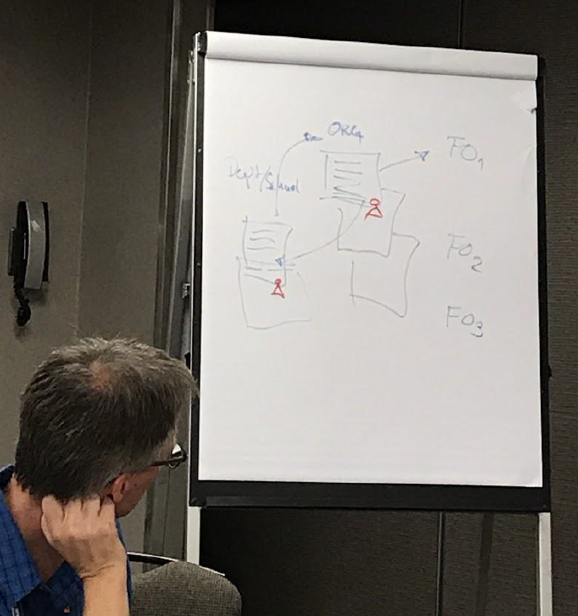
OIDC Fed pilots
Based on the spec by Roland Hedberg
scoped to the RP + Proxy
case is not very complex, actually
Infrastructures can use trusty shortcuts that would be too costly at the general R&E scale
leverage existing policy and trust framework
‘pilot’ RPs and proxies will be using scripting and glue to get integration with existing services, based on assessed trust framework
we can leverage existing trust

Slide 8
Can we do without a single one to rule them all?
today the RIs and EIs trust the IGTF trust anchors and
may (but do rarely) add their own
Can the ‘federation’ be the community and import a commonly trusted set?
Can the IGTF allow devolved registration provided that the trusted organisations implement the same policy controls Snctfi and the proper Assurance Profiles?

Slide 9
For the benefit of Research Infras …
IGTF membership process and Snctfi jointly give you the trust of Infra SPs (RPs)
use peer-reviewed (self-)assessment as foundation of the ‘scientific process’ of trust
technical details on how the IGTF FedOp will sign and distribute meta-data statements – subject to discussion at TIIME, AARC, and IGTF meetings
new communities and (proxy) operators can join IGTF any time
  there is no fee or something like that
  but we request participation in the peer-review and assessment process …

Slide 10
Information sharing
Keeping in touch
http://wiki.eugridpma.org/Main/OIDCFed
oidcfed@igtf.net
(https://igtf.net/mailman/oidcfed)
but don’t forget everyone else!
oidcre@lists.refeds.org (REFEDS)
TIIME, TNC, TechEx, …

Slide 11
Building a global trust fabric
Questions?

