Slide 1
Security services in Globus new models for authentication and authorization
David Groep, Nikhef

Slide 2
Outline
A User view on Security
Your credentials
There is more than your proxy
Leveraging federations
in Europe
Common Access to Services
A Provider view on Security
Extensible frameworks
Authorization call outs
Integrating other elements in your Globus Setup
  gLite LCAS/LCMAPS, VOMS
Extended access control
Talking to central services
Coherent authZ in your site

Slide 3
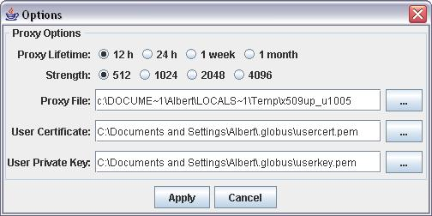
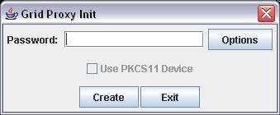
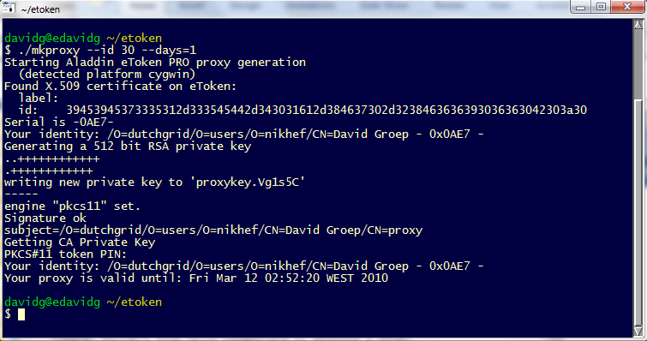
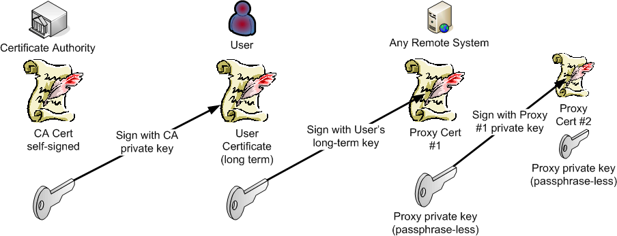
Security: the end-user view you will know
Authentication based on ‘PKI’
certificates for each user
Authorization based on mapfiles
or on attributes carried in
proxy certificates
http://wiki.cogkit.org/
Proxies support delegation
use cases and batch operations

Slide 4
There are more authentication options
VOMS enabled
GSI with proxies
Federation, AAI, and Shib
supported GSI
Shib and SAML – enhanced GSI
Well-known PKI base
Users hold certificate and private key
grid-proxy-init or voms-proxy-init
Authorization by grid-mapfile or based on VOMS attribute ACs (LCAS/LCMAPS)
Federation-enabled PKI, or GridShib CA, or MyProxy CA
Users generate certificate on demand
short-lived ‘proxy’ or long-lived cert
grid/voms proxy init
Authorization by mapfile or VOMS via LCAS/LCMAPS
Java only (for now)
SAML assertions embedded in proxies
Proxies on short-lived cert issued by GridShib or federated CA
GT Java AuthZ FW authorized and maps based on attributes from IdP

Slide 5
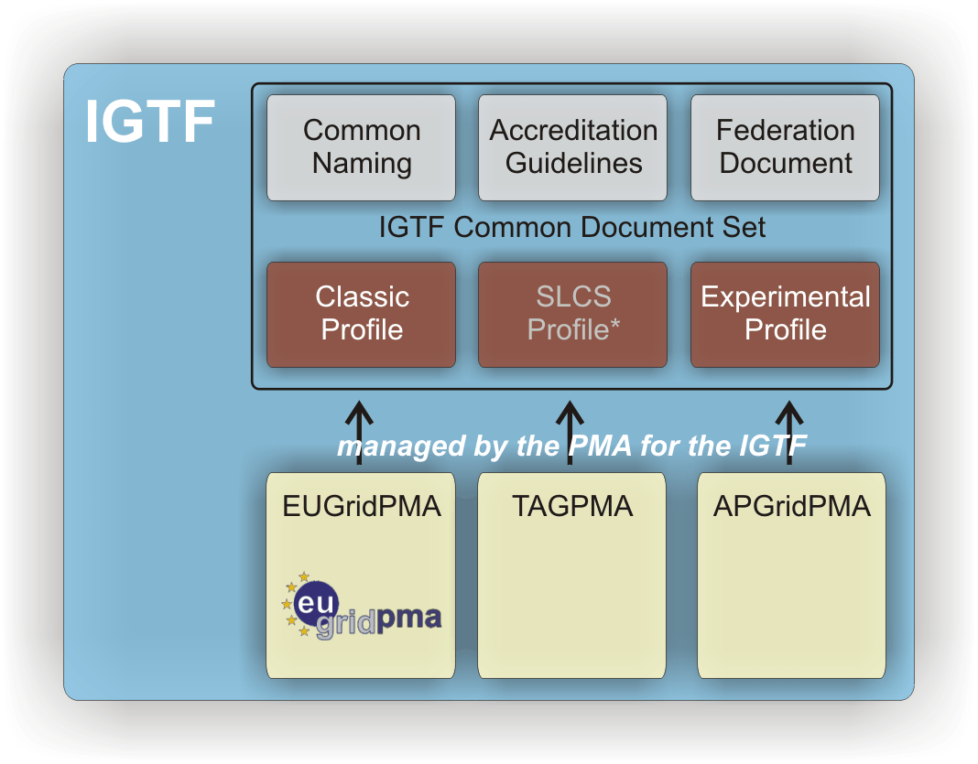
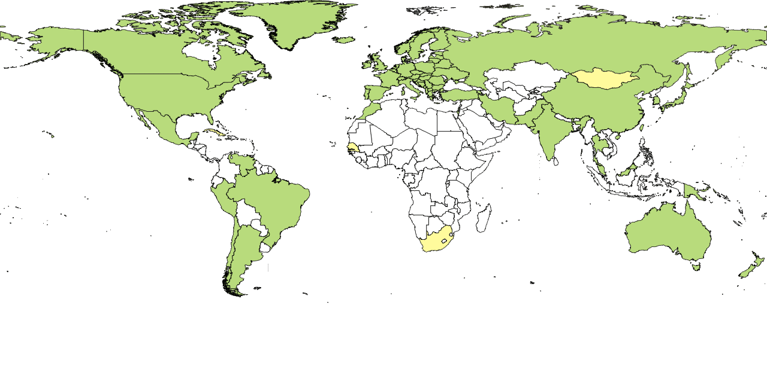

There is always a PKI close to you
Certificates and proxies work with all common middleware. Globally.
  Everyone in the world can get one
  Proxy format standardized in RFC3820
  Simplest way to support delegation, solving key grid use cases

Slide 6
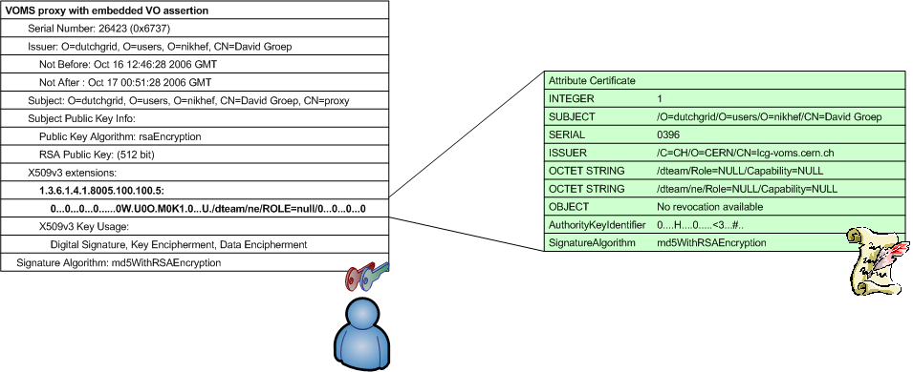

Globus with VO membership and VOMS
Access provisioning
Map-files
Map-files populated from LDAP
VOMS: Virtual Organization Mngt Service
  Supports scalable user community management
  via ‘bearer tokens’, ubiquitous in Europe
  Backward-compatible with ‘traditional’ proxies
  Supported in GT2+ via LCAS and LCMAPS

Slide 7
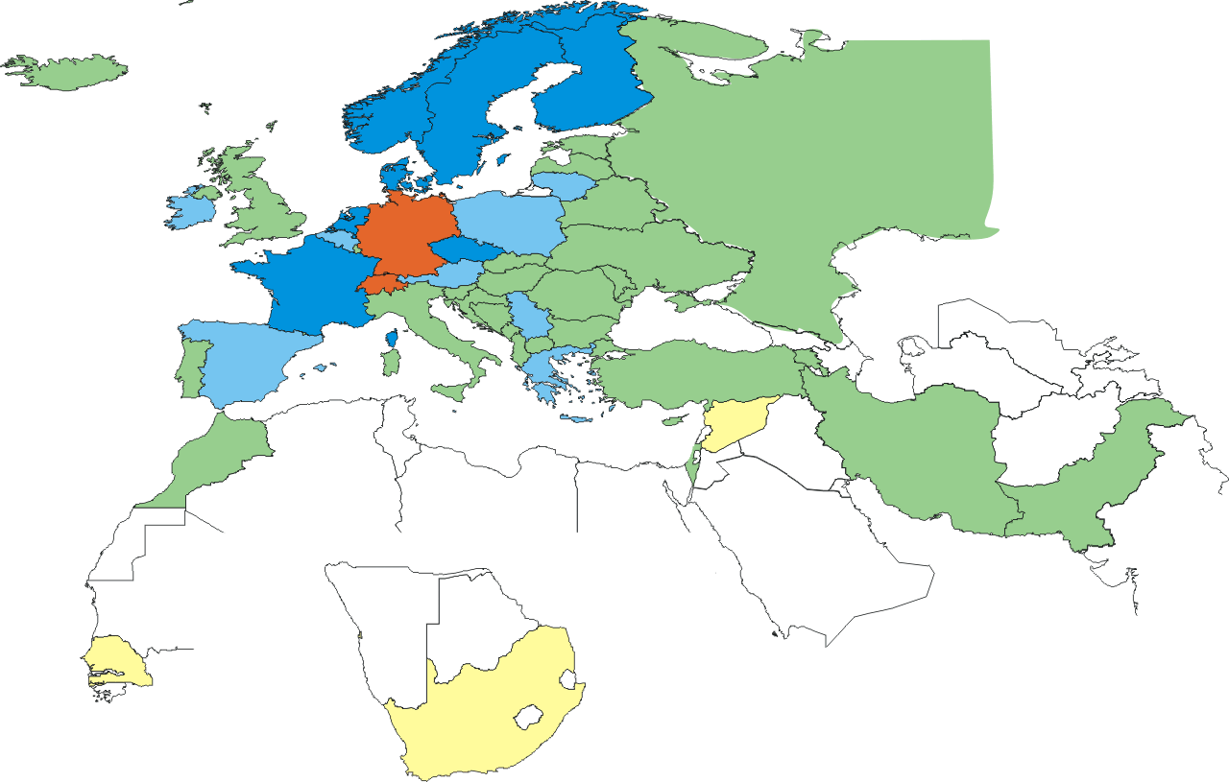



Integrating PKI in your institute or country
But end-users do not want to deal with PKI
So
  Make it simple and transparent to get credentials
  Store these in a repository invisible to the user
  Create them on demand at the back
Federated PKI uses your institution
issue grid-ready certificate in minutes
without need for any further checking
Available today
TERENA eScience Personal CA
SWITCHaai SLCS service (CH)
DFN SLCS (DE)
Comparable to nascent efforts in the US: CIlogin, Jim Basney

Slide 8

Tighter integration: MyProxy
Store and manage
credentials for users
  Traditionally used with portals
  Back-end to the proxy-renewal daemon
  Used worldwide, with VOMS support (recently added by AIST)
Or generate them
  Useful for novel scenarios where the user never touches the key material,
  but a trusted portal does that on the user’s behalf
MyProxy ships also as part of the Globus Toolkit
  but you may already have it from VDT, EPEL, …
  running a Repository needs secure environment
http://grid.ncsa.illinois.edu/myproxy/
Jim Basney, NCSA

Slide 9
Integrating with SAML federations
There is more in the world than just the VO
  Your own institute holds information about you
  Your VO may be largely web based and rely on a ‘SAML’-based federation (some cases: “Shibboleth”)
The GridShib project interlinks these world
  Embed SAML assertions (‘I say that name is a
  library walk-in’, but then in XML) in a proxy cert,
  similar to VOMS (also experimental VOMS does this)
  Java Globus libraries can natively use these assertions for access control and security
  When linked with a MyProxy or federated CA, Globus becomes a transparent extension of your federation

Slide 10
GT components levering common security
MyProxy
Gatekeeper
GRAM5
gsiSSH
GridFTP
Catalogues
OGSA-DAI
container
hosted
services
RLS
…
or hide credential management fully inside globus.org
new private key protection guidelines enable this for keys issued
by IGTF accredited CAs for such well-managed central services

Slide 11
Globus Toolkit: a flexible security model
Globus Authorization Framework
  Designed to process any kind of security assertion or policy language, local or remote:
  SAML, XACML, Proxies, VOMS, PKI, files, …
Graphic: Frank Siebenlist, Globus and ANL

Slide 12
Common Decision modules (Java A&A)
But: why would you grant access? A site’s decision needs input
Network Access Control List
GridMap Authorization
Host Or Self Authorization, IdentityAuthorization
ResourceProperties Authorization
SAML Authorization Callout
SAML Authorization Assertion PDP
Self Authorization
Username Authorization
XACML Authorization Callout (Since GT 4.2.1)
VOMS, and VOMS + AuthZ-Interop Profile (in Incubator)
When access is granted, attributes made available to the application
http://www.globus.org/toolkit/docs/4.2/4.2.1/security/wsaajava/pdp/
http://dev.globus.org/wiki/Incubator/VOMS

Slide 13

GT security services in C
For system services: GridFTP, Gatekeeper, gsiSSH, …
  Authorization call-out available since GT2.4+
  Provides access control hooks for local and remote processing
  Several backend available: LCAS/LCMAPS, PRIMA/GUMS, …
  /etc/grid-security/gsi-authz.conf
LCAS & LCMAPS
  Products from the EGEE gLite suite (based on EDG work)
  LCAS yes-or-no decisions
  LCMAPS credential mapping and procurement
  remote authZ service and call-outs
  integration with AFS and LDAP
  These tools themselves expected to be part of gLite/EMI from 2010+
  Enhancement of and integration into GT5+ expected in IGE in 2010+
http://www.nikhef.nl/grid/lcaslcmaps

Slide 14
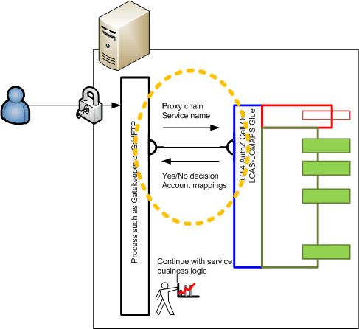
Authorization Call-out: pluggable C hooks
Globus AuthZ Call-out
  In
  proxy chain,
  service name
  Out
  yes/no decision,
  target identity
Extended GT5.x may add
more attributes
(task to execute, target resource)
depends on user, site demand
LCAS/LCMAPS may become the default Globus authorization solution for C-based services
using an enriched AuthZ callout structure

Slide 15
Leveraging the AuthZ callout in Europe
Glue ‘lcas-lcmaps-gt4-interface’ (today by EGEE gLite)
  globus_mapping
  /opt/glite/lib/liblcas_lcmaps_gt4_mapping_gcc32.so lcmaps_callout
Enables the Gatekeeper, GridFTP server, and – to some extent – gsissh to use:
  User ban lists
  GACL DN and VOMS based controls
  Pool-account credential mapping (also per VOMS group&role)
  Pool-groups and dynamic access control on GridFTP storage
  Home-directory-on-AFS support for pool accounts
  LDAP cross-cluster local account configuration
  Call site-central authorization services (Argus, SCAS, GUMS)
  And many third-party plugins
Argus: EGEE gLite, see https://twiki.cern.ch/twiki/bin/view/EGEE/AuthorizationFramework
SCAS: EGEE gLite (transitional), see http://www.nikhef.nl/grid/lcaslcmaps/
GUMS: OSG and VO Privilege, see https://www.racf.bnl.gov/Facility/GUMS

Slide 16
Granting access for GT System/C services
Mostly the grid-mapfile is auto-populated
But then, you want to ban people or actions
or do that based on GACL (‘authformat gacl’)
  Bans both users and VOMS groups, roles
  New GT callout to enable request (RSL)-based ACLs foreseen
/etc/grid-security/grid-mapfile
"/O=dutchgrid/O=users/O=nikhef/CN=David Groep" davidg
"/O=dutchgrid/O=users/O=nikhef/CN=Jan Just Keijser" .pvier
"/enmr.eu/Role=SoftwareManager" .enmrsm
# LCAS database/plugin list
#
pluginname=lcas_userban.mod,pluginargs=ban_users.db
pluginname=lcas_voms.mod,pluginargs=“... -authfile
/etc/grid-security/grid-mapfile -authformat simple -use_user_dn“
pluginname=lcas_check_executable.mod,
pluginargs=-exec /usr/bin/id:/opt/globus/libexec/grid_monitor_lite.sh
example lcas.db

Slide 17
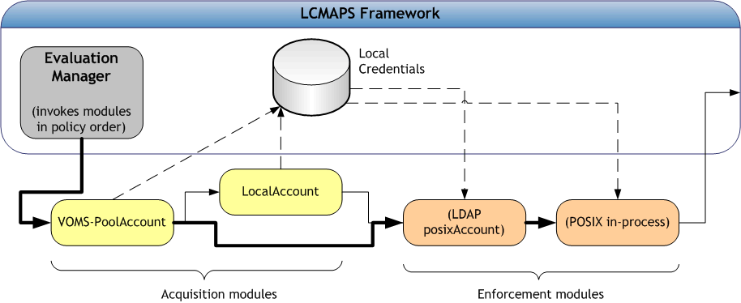
Extended capabilities in system services
Authorization and credential mapping
  Locally on each node or service
  fast, self-contained, but needs consistent fabric mngt
  Remote, as a service
  coherent management across services in the site
  allows policy management across a whole grid

Slide 18
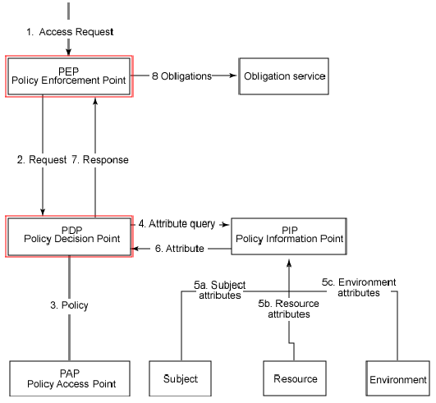
Integrated authorization solutions
New generation authorization frameworks bring coordinated management and site or grid-wide policy distribution
  Subject S requests to perform Action A on Resource R within Environment E
CE / SE / WN
XACML Request
Site Services
Gateway
PDP
PEP
XACML Response
Grid Site
  Decision Permit, but must fulfill Obligation O
Graphic: Gabriele Garzoglio, FNAL

Slide 19
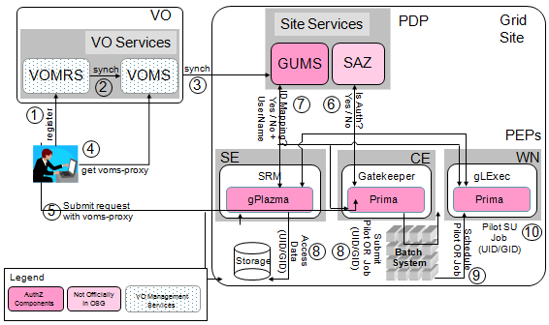
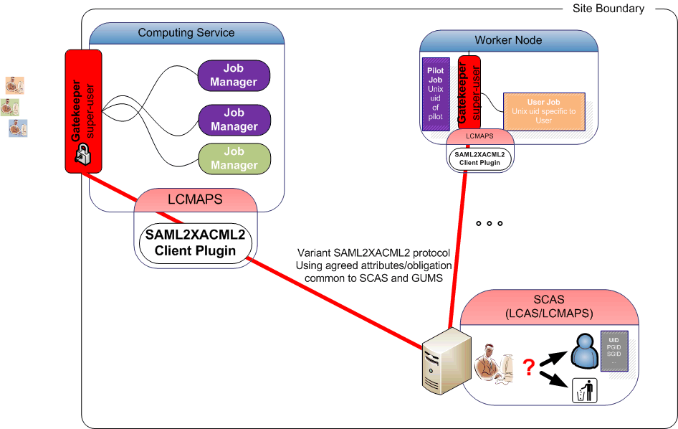
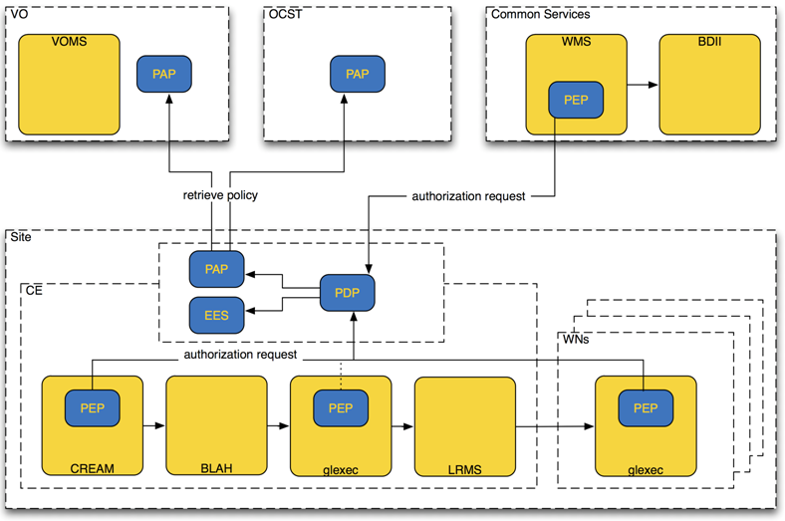
Several ‘centralised’ frameworks
  Argus
  GUMSv2/SAZ
  SCAS
  Each provides different elements or models
*
Site will want to run just one
Globus can talk too all
GUMS-SAZ graphic: Dave Dykstra, Fermi National Accelerator Laboratory, CHEP, March 2009
Argus graphic: Christoph Witzig, SWITCH, EGEE gLite 2009
* supported transitional service

Slide 20
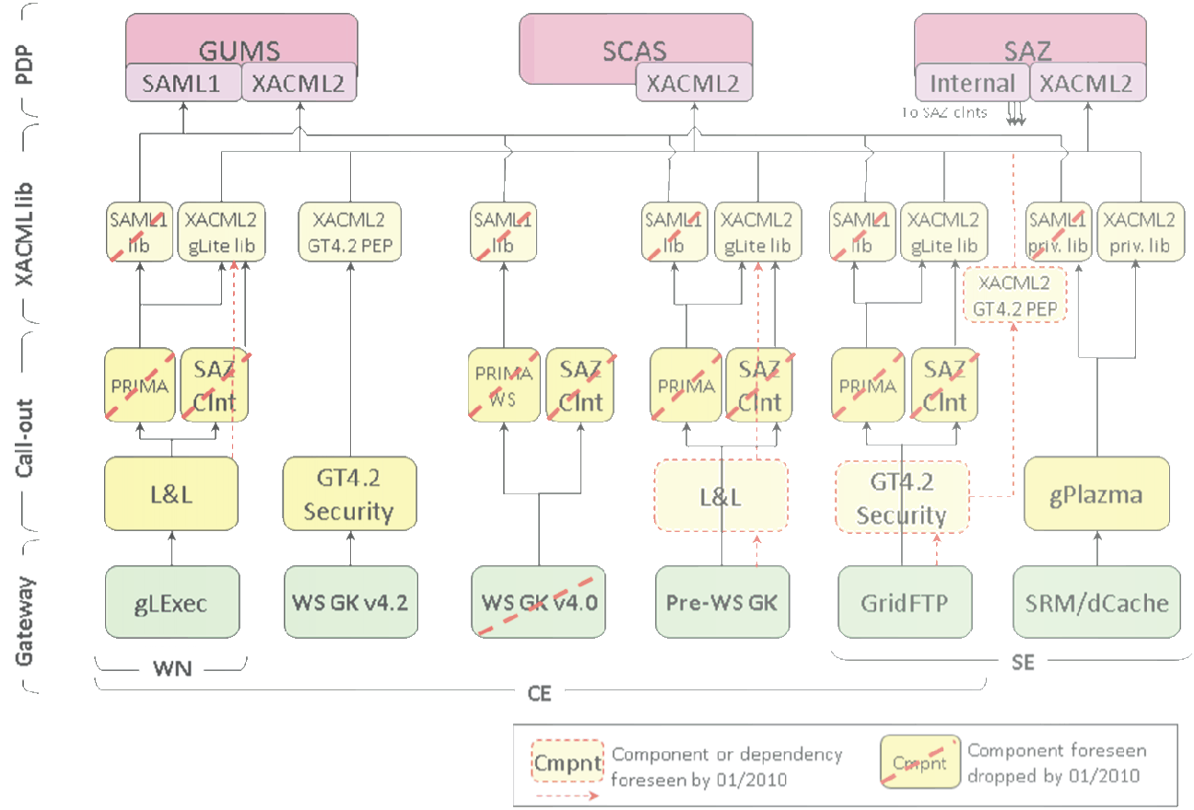


Interop for central authorization services
Globus: core library for SAML2XACML2 connection (C)
leverages third-party library for Java AuthZ FW
VO Privilege
project
Graphic: Gabriele Garzoglio, VO Privilege Project and FNAL

Slide 21
Native security flexibility in the Globus Toolkit
Usability improved by developments from many sources
Globus elements such as MyProxy facilitate access
Support for VOMS has been there for long (EGEE)
Previous ‘native’ GT limited authorization to ‘maps’
Latest and new GT releases enhance this model
  Allow more information to pass
  (like in Java Authorization Framework, or the edg-gatekeeper)
  New bridge and links to e.g. LCMAPS to provide flexible authZ and credential mapping natively to more GT services
  Obtain additional attributes or call to site central AuthZ services
  GT integrates with the site security systems
User
Provider
Summary

