Slide 1
Updates from the EUGridPMA David Groep, Oct 11th, 2011

Slide 2
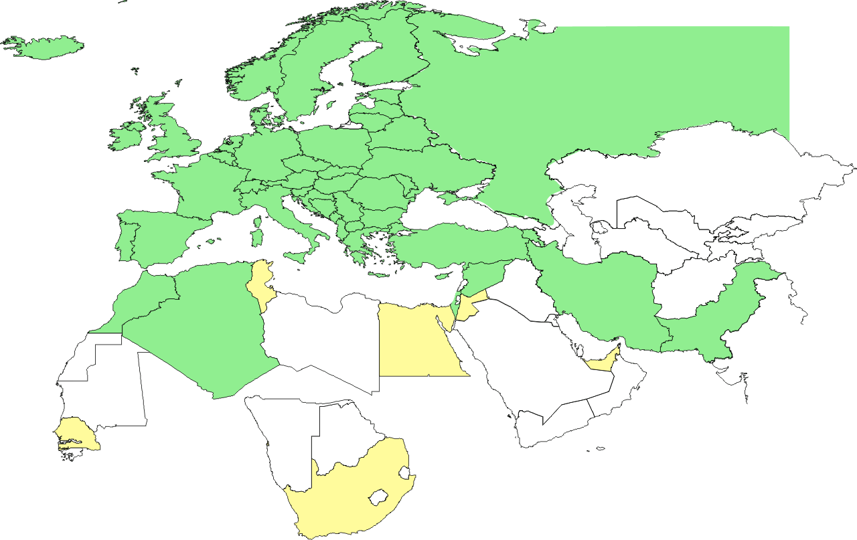
Geographical coverage of the EUGridPMA
25 of 27 EU member states (all except LU, MT)
+ AM, CH, DZ, HR, IL, IR, IS, MA, MD, ME, MK, NO, PK, RO, RS, RU, SY, TR, UA, CERN (int), DoEGrids(US)* + TCS (EU)
Pending or in progress
ZA, SN, TN, EG, AE

Slide 3
IGTF Release Process and Web
IGTF Trust Anchor Releases
Releases (preferably) last Monday of the Month
Only when there is actually new content
1.42 released on September 30th following an incident
More unit-tests added to the release build process
Process appears simple, but involves many people
E.g.: https://wiki.egi.eu/wiki/EGI_IGTF_Release_Process
Added more unit tests to validate release (SHA1FP, CRL)
New EGI probes test more aspects of the release
Use Common Source automation where possible (e.g. for SHA1 fingerprints)

Slide 4
Current Topics in the EUGridPMA
New TACAR policy (simpler!) approved
Scaling issues for host certificates and automation
More smooth portal integration
Catering to non-expert end-user needs: focus of the EEF IdM Workshop series (next: UK 2-3 Nov)
PKP Guidelines clarification: Jens to propose an orthogonal representation by November 2011
Dedication of half-day ‘technical programme’ to each meeting
e.g. on Moonshot demo, OCSP&HSM, RPDNC, release models, other PKI apps, EEF federation results, IdP interop,
Coordinated action by EGI.eu towards middleware providers for AuthN needs

Slide 5
Agenda
24rd EUGridPMA meeting Ljubljana, 16 – 18 January 2012
25rd EUGridPMA meeting Karlsruhe, May 2012
26rd EUGridPMA meeting Belgrade (tentative), September 2012
27th EUGridPMA meeting Abu Dhabi (tentative), January 2013
28rd EUGridPMA meeting Kyiv (tentative), May 2013

