Slide 1
EnCo – science engagement
aarc-community.org
David Groep
Nikhef, PDP group
EnCo monthly update
Feb 28, 2020

Slide 2
EnCo – policy and best practice update
From our last (Prague) update meeting:
SCI Security for Collaboration v2 and AARC Policy Development Kit > ‘Smplyfi’
SCCC Communications Challenges Joint Working Group
Assurance Profiles > ISGC paper
Sirtfi
Attribute Authority Operations (AARC-G048)
FIM4R - Federated Identity Management for Research
OpenID Federation for Research
Outreach for policy work

Slide 3
Policy Development Kit / SCIv2 evolution
New work is needed on the top-level policy (on which more later), since the version in the current Policy Development Kit (PDK) - when applied to a new infrastructure - depends too much on adopting the PDK as a whole.
Work on a new top-level policy that will contain directly applicable high level concepts, which is then supported by more specific implementation measures for specific target groups

Slide 4
Assurance Profiles - and RAF, SFA, and MFA
“Signalling the capability for RAF profiles as well as SFA and MFA for (a non-negligable number of) entities in an IdP, or the need for having this for SPs, is an open question”
introducing new entity categories is a challenge – and the REFEDS survey is for now inclonclusive
it was also proposed at the TIIME meeting as a topic – similarly inconclusive …
Jim Basney has also developed an assessment spreadsheet for REFEDS RAF, MFA and SFA, and both XSEDE as well as FNAL (Fermilab) have been assessed against this. It makes TAGPMA/IGTF in the US a good place to perform these peer-reviewed self-assessments
assurance paper structure discussion next week

Slide 5
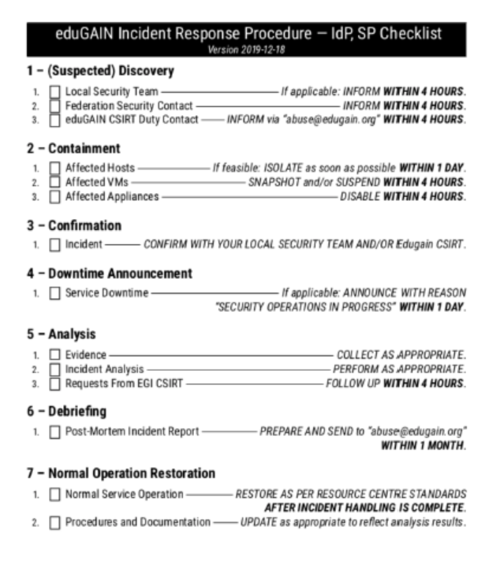
Sirtfi – towards concrete guidance for eduGAIN entities
eduGAIN Security Team is now also involved in the Sirtfi working group
aligning guidance from Sirtfi WG and the eduGAIN sec team (now good participation in Sirtfi from this side as well)
communications remains a challenge – and what is the overlap in case of crisis exercises? There are several frameworks now available for probing
Sirtfi is not the solution to everything – what about incidents on e.g. CMS platform that has a federated admin login for site management? Sirtfi gets you only those entities that are not affected anyway …

Slide 6
Attribute Authority Operations (AARC-G048)
presented to AEGIS as a means to get exposure and feedback on the guidelines
https://www.nikhef.nl/~davidg/presentations/AARC-G048-AEGIS-202002010.pdf
emphasise that is can be used in virtualised environments – and that one can rent HSMs in AWS …
AEGIS members promised to come back to see if they can evaluate and if needed help improve guidance
The final version will come later for endorsement

Slide 7
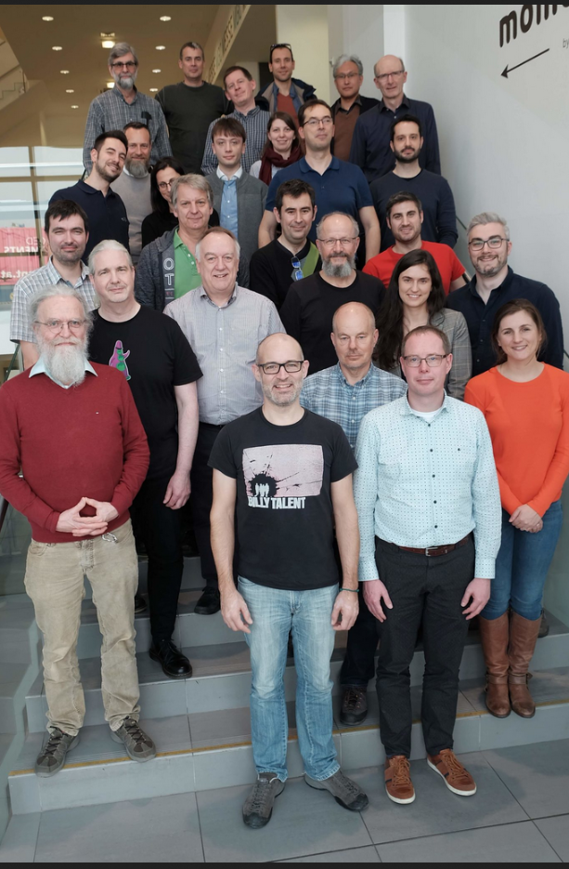
FIM4R – see the 15th FIM4R blog
https://indico.cern.ch/event/871628/
with EnCo and AEGIS overviews
review/reflection paper planned involving all communities
on a short (few weeks) time scale

Slide 8
OIDC fed for research RP collections
There is now an IGTF prototype OIDC federation service (formally: the meta-data signing service or MDSS), which for the time is a signed blob (signing by file-based key or HSM) but without entities in it.
The application of this is discussed in the session on OAuth2 federation for WLCG and others.
https://oidcfed.igtf.net/.well-known/openid-federation
https://github.com/rohe/oidcfederation
https://www.axini.com/files/2019_jouke_roorda.pdf

Slide 9
Other activities that are ticking along fine
SCCC JWG – prepare for an update at the SIGISM/WISE workshop in April 21-23 (JISC, London)
Planning for the next months!
…

Slide 10
davidg@nikhef.nl

