Slide 1
Collaborating on software exploring the framework of copyright and licensing in some projects and consortia
ESCAPE WOSSL
David Groep, Nikhef
July 2020

Slide 2
“IANAL” + “IANYL” DISCLAIMER – I Am Not A Lawyer (and certainly not your lawyer ☺)
code and source files without a license means
‘all rights reserved’

Slide 3
What do we actually want to achieve?
meet open science needs
re-use & replication
collaborative development
no ‘patent hostages’
together advance ‘state of the art’
understandable

Slide 4
A range of Open Source licenses to choose from
Apache-- family
(GEANT4, EDG)
Apache family
(Apache 2.0)
copyleft family
(GPL)
BSD family
compact licenses (BSD 3-clause, BSD 2-clause, MIT)
no patent protection
re-use friendly
re-use friendly
patent protection
re-use unfriendly
3.0+patent protection
contributions auto-imported
contributions auto-imported
contributions auto-imported: N/A
re-use friendly
no patent protection
Mozilla family
(MPL, Perl Artistic)
lesser copyleft (LGPL)
contributions unspecified
re-use friendly
patent protection
re-use unfriendly
no patent protection
contributions unspecified
contributions auto-imported: N/A
https://opensource.org/licenses

Slide 5
Listing contributors
‘a successful community has many contributors!’
‘… but listing them all will then be a challenge!’
co-shipped ‘contributors’ file, or a web page listing contributors
“members of the XXX consortium/collaboration” + a web page is commonly used
some projects list main contributors and have just given up
probably worst thing to do is to also accept changes in the copyright license statement itself (the “SymPy” case)
‘right to be identified as an author’ is a ‘moral’ right you cannot get rid of - but it can be (partially) waived, e.g. as part of employment, making it possible for an organisation to enter into an EC grant agreement
Economic rights for ‘work for hire’ anyway typically go to the employer …

Slide 6
Dealing with contributors and joint development
Amalgamate (all or most) IPR in one entity
easy to re-licensing under new terms - esp. if origin can no longer be contacted
need to transfer copyrights and patent rights explicitly
you need … … a receiving entity ☺
Collect contributors in one consortium, with IPR remaining with creators
participants requirements in consortium agreement (such as the EC’s MGA)
contributions implicitly managed
will need a contributors list ‘Copyright (c) Members of the EGEE Collaboration. 2006-2010. See http://eu-egee.org/partners/ for details on the copyright holders.’
Maintain list of all contributions online, in-file, or auto-generated
the IPR must be deeded by each contributor
through license agreement, with contributor agreement, or through both
GPL escapes this by ‘virality’
will need to maintain list
harder to re-license

Slide 7
Sure about your choice of license for the future, and forever after?
Yes
Not quite sure …
You are fine, and all three models will work for you
unless you put the IP in one entity - or can contact and get agreement from all IP owners - you cannot quite go from a ‘full copyleft’ (GPL) license to a more liberal license
you can move from a liberal to a less liberal (and even to a copyleft!) license for new code only, if the initial license was liberal

Slide 8
In an EC project context …
‘Model Grant Agreement’ covers a lot of ground (and is kind-of a ‘given’)
each beneficiary owns its own generated foreground (& retains rights to own background)
individual employees should (preferably & usually) transfer ownership to the partner org
pretty strong limits on exclusive licensing to third parties (but open source licenses are perfectly OK)
in practice, your consortium agreement will cover the specifics
https://www.iprhelpdesk.eu/sites/default/files/newsdocuments/Fact-Sheet-Foreground-in-FP7-Projects_0.pdf

Slide 9
Outside of a grant agreement, you need an alternative
typically forgotten – some LHC experiments (e.g. ATLAS) are completely silent on this (and the CERN Convention, in II.1, does not help in case of IP from contributors)
and e.g. LHCb collaboration addresses it implicitly … … but locks it within the collaboration
Memorandum of Understanding
for Collaboration in the Construction of the LHCb Detector LHCb RRB-D 2000-24 Rev.

Slide 10
Dealing with software patents in licenses
‘the LHCb MoU already mentioned patents, but these were on the detector …’
Somewhat less of a problem in Europe than the US, but software that is used to (~) create material effects may still be granted a patent (and cause a lot of debate in the process …) … like software for embedded control systems that enable industrial applications … or detectors.
Some licenses try to address that by voiding themselves if the licensee institutes patent litigation involving (parts of) the work against anyone else
Apache 2.0, GPL 3.0, Perl Artistic
while others are silent on the issue

Slide 11
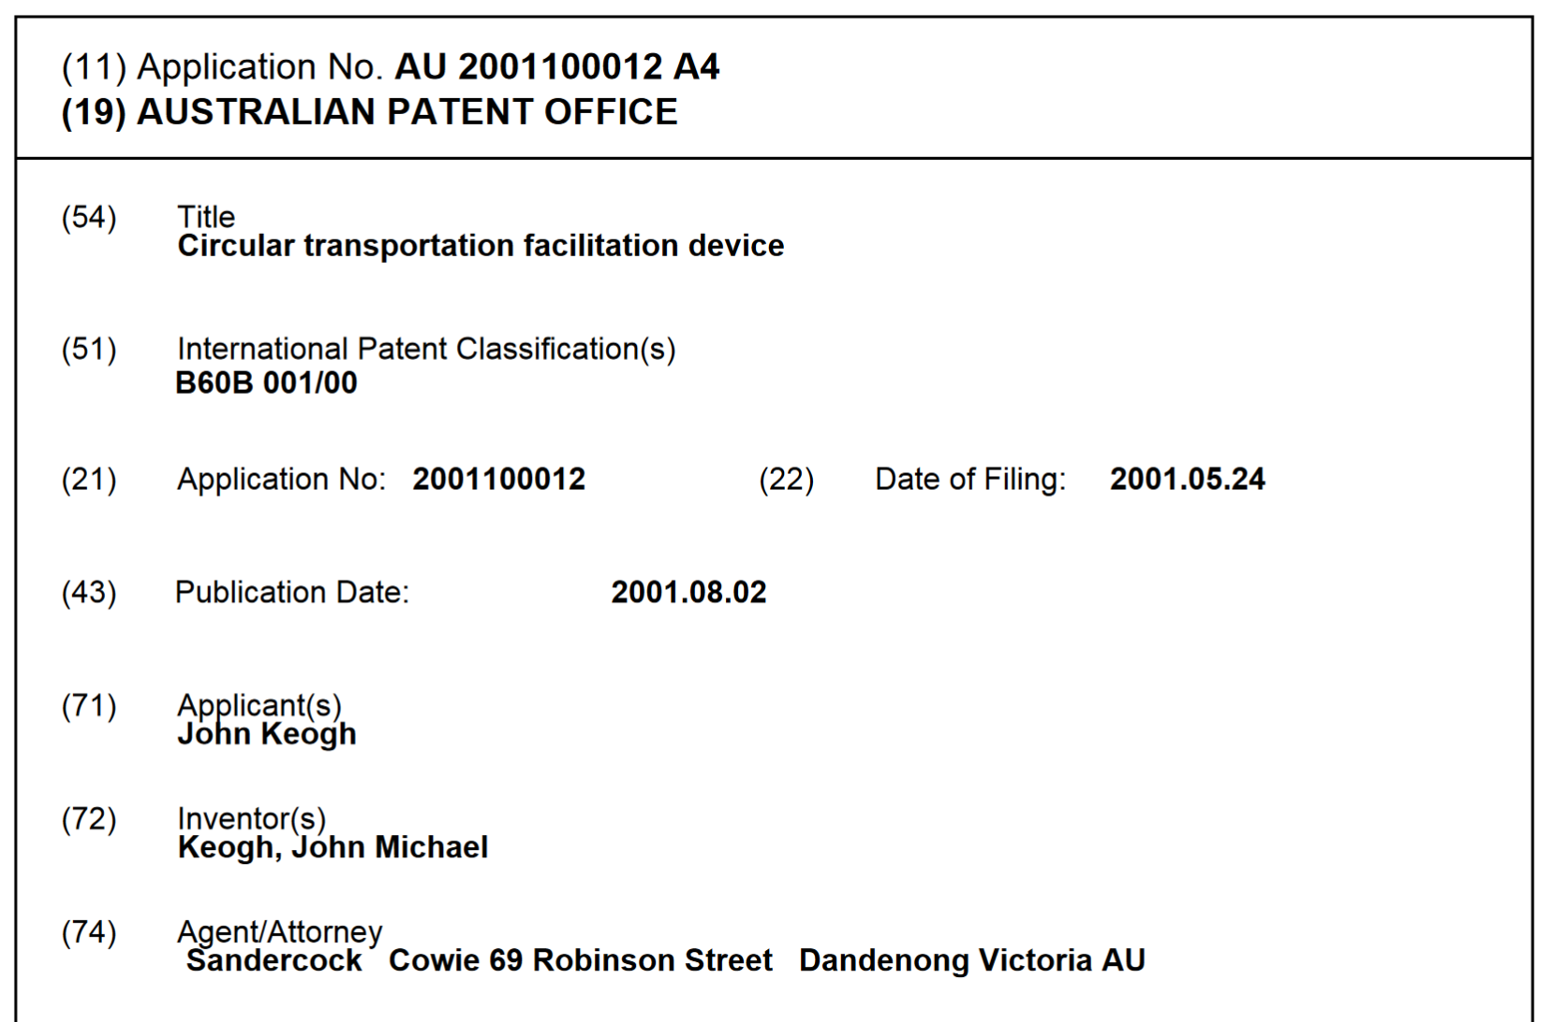
We know patents can be for anything …
… usually for mutual litigation,
but have been used against open source (although rejected)
Some licenses try to address that by voiding themselves if the licensee institutes patent litigation involving (parts of) the work against anyone else:
Apache 2.0, GPL 3.0, Perl Artistic
Australian (light-weight) Innovation Patent #2001100012,
from 2001, since voided after international upheaval ☺
http://pericles.ipaustralia.gov.au/ols/auspat/applicationDetails.do
plus the 2001 Ignobel prize, of course!

Slide 12
Beyond projects – managing a community
A (good) community brings contributions to software
reporting (small) bugs with suggestions for fixes
patches and merge requests
core contributions with new functionality
supplementary packages that could be co-distributed with the core
and your contributors may not necessarily want licensing ‘overhead’

Slide 13
Dealing with contributions
Many licenses incorporate a ‘contributions’ clause
Apache 2.0
EU DataGrid (which drafted its own license just for this in 2001)
GEANT4 (identical to EU DataGrid, given its CERN background)
Source: EU DataGrid License, via https://opensource.org/

Slide 14
GEANT4 clause – a bit larger
Implicit licensing by contributors – unless otherwise stated
whether you trust this enough is a risk analysis. On the tin, it says it’s fine - and: it has worked great for the research community ☺
Source: https://geant4.web.cern.ch/license/LICENSE.html

Slide 15
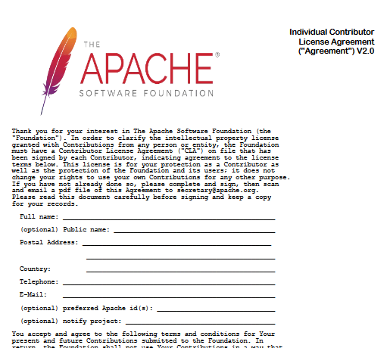
Contributor License Agreements
http://apache.org/licenses/icla.pdf
Apache Foundation is ‘better safe then sorry’
contributors retain their IPR
formally release under the license
and a central entity (the Foundation) retains proof of that
so you need a ‘central’ legal entity for this …
https://www.apache.org/licenses/icla.pdf

Slide 16
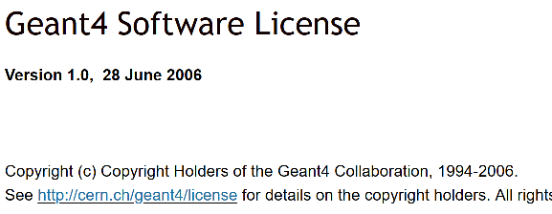
Dealing with many contributors
Source: from the GEANT4 web pages at https://geant4.web.cern.ch/license/LICENSE.html
When you have many contributors, you do get a long list
common in projects because of jointly developed foreground, (example from FP7+H2020)
but also in successful communities
And e.g. for the GEANT4 collaboration
Source: from the GEANT4 web pages at https://geant4.web.cern.ch/license/LICENSE.html

Slide 17
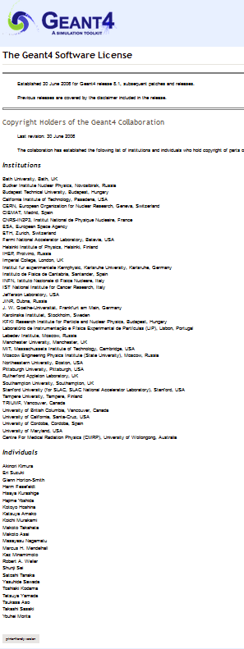
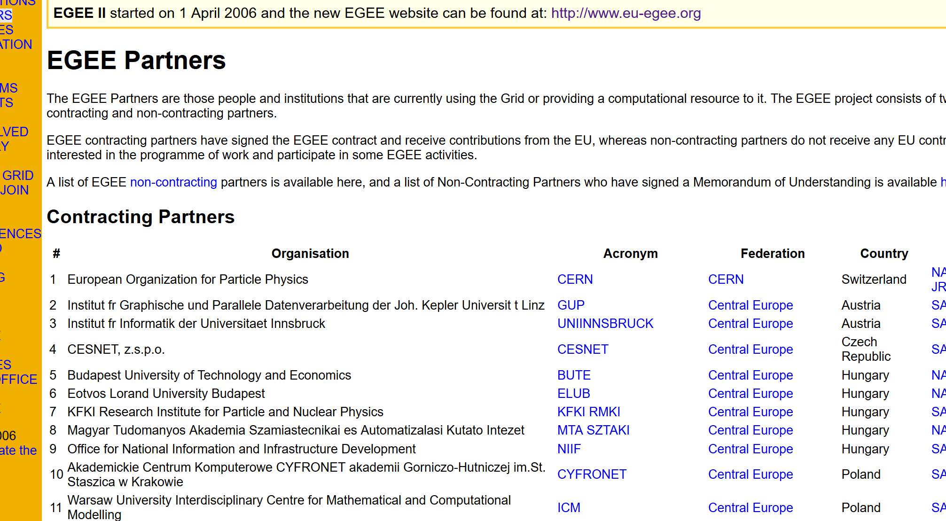
… and the long list of contributors
either you get lists like on the left (and GEANT4 is a ‘small’ project) or you become creative, like use github’s contributor log (for SimpleSAMLphp)
or link to your (EC) project page
Sources: from the GEANT4 web pages at https://geant4.web.cern.ch/license and http://eu-egee.org/partners

Slide 18
Request transfer (assignment) of software IP to a central place?
Transfer of (all transferable) rights is mainly important when
you have many contributors
and
you may desire to change license conditions later, or when you want to publish your IP under multiple licences the Perl language reference implementation, and much of CPAN, is famously double-licensed under both GNU GPL as well as under the Perl Artistic License

Slide 19
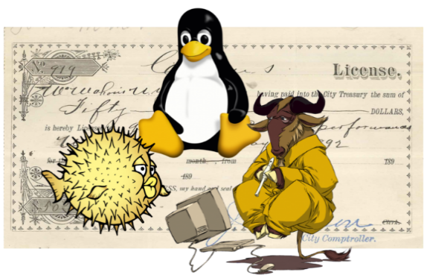
What you should transfer (or hold) centrally
Software is more than just code, also the ‘branding’ is a unique feature
when you install Eclipse, you probably want the ‘real’ IDE, not a fork
as the ‘owner’ of a brand, you want forks to be non-confusing
Likely keep your ‘brand materials’ under a private exclusive license
and if you do release them under CC, at least pick CC-BY-NC-ND to prevent them from being made intentionally confusing
BSD 3-clause include this for name of authors, but you want this probably more generally
some of the few FOSS logos that can be re-mixed, see see https://arstechnica.com/gadgets/2020/02/how-to-choose-an-open-source-license/

Slide 20
Open Source ‘aggregation’ foundations
If you have your own legal entity, it’s easier to put it all there
Otherwise, there are some ‘conservancies’ or foundations to help manage your rights and your project, with naming, and such. Non-exhaustive sample:
Apache Foundation is the most famous one https://www.apache.org/foundation/how-it-works.html
GEANT NLnet Commons Conservancy (for those in the community, can also help manage sponsor funding) https://wiki.geant.org/display/GREEN/Commons+Conservancy
Linux Foundation https://www.linuxfoundation.org/projects/hosting/

Slide 21
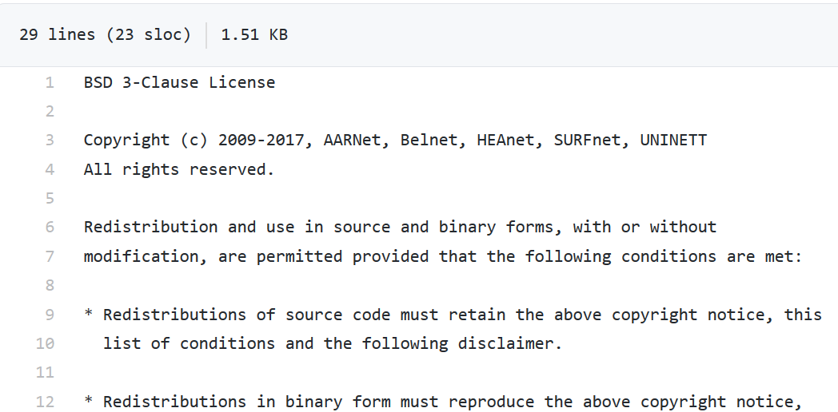
FileSender
3-clause BSD, listing all contributors in the copyright line
all rights assigned to the organisations (not individual employee)
https://github.com/filesender/filesender/

Slide 22
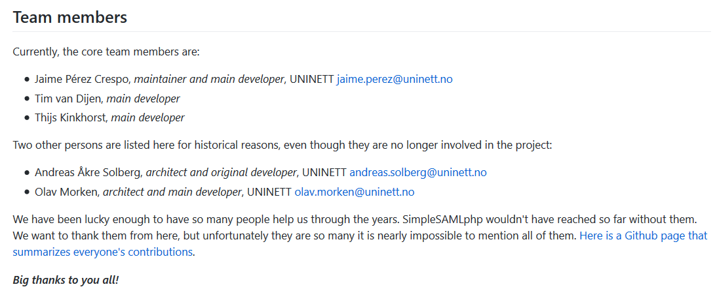
SimpleSAMLphp
LGPL 2.1 – to allow re-use of the library but force contributions back and prevent full incorporation into proprietary products
Rights stay with the developers (who are usually under contract)
List of contributors was too long already …
Source: from the SimpleSAMLphp project

Slide 23
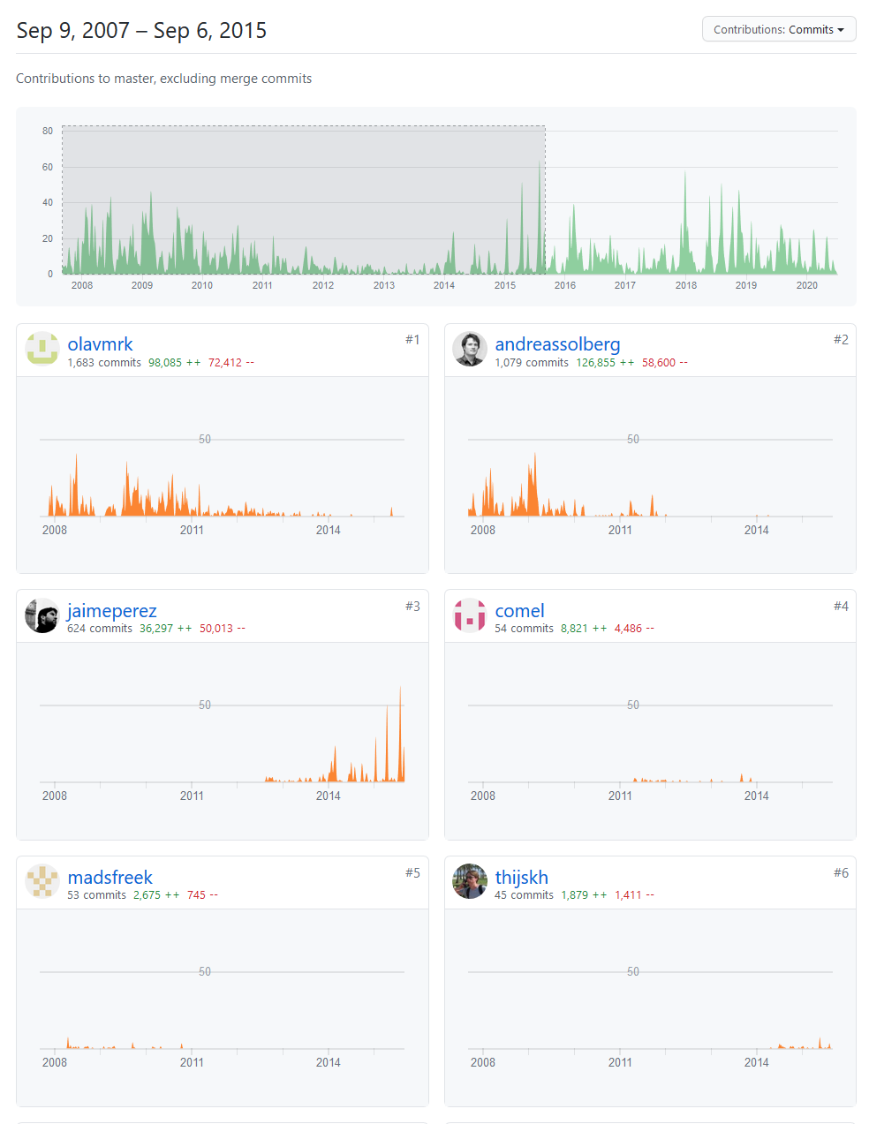
But github/gitlab do help here …
SimpleSAMLphp contributors page links to this one https://github.com/simplesamlphp/simplesamlphp/graphs/contributors
Source: github, from the SimpleSAMLphp project

Slide 24
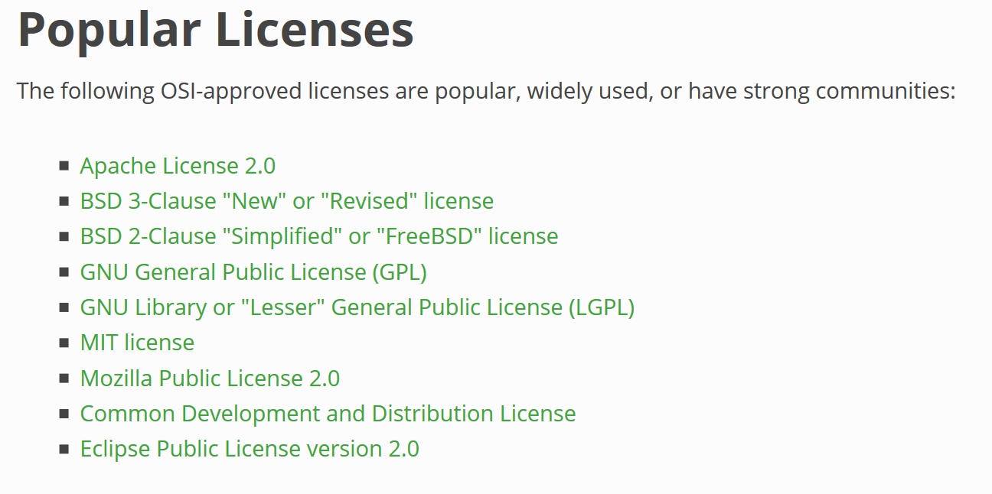
Have your pick …
from: https://opensource.org/licenses

Slide 25
Too many options?
“IANAL” + “IANYL” DISCLAIMER – I Am Not A Lawyer (and certainly not your lawyer ☺)

