Slide 1
Security for Collaboration among Infrastructures – SCI version 2 David Kelsey (STFC-RAL, UK Research and Innovation) David Groep (Nikhef)
WISE/SIGISM Kaunas April 2019
In collaboration with and co-supported by EU H2020 EOSC-HUB
In collaboration with and co-supported by EU H2020 AARC2

Slide 2
Shared threats & shared users
Infrastructures are subject to many of the same threats
Shared technology, middleware, applications and users
User communities use multiple e-Infrastructures
Often using same federated identity credentials
Security incidents often spread by following the user
E.g. compromised credentials
Several e-Infrastructure security teams decided “we should collaborate”

Slide 3
Security for Collaborating Infrastructures (SCI-WG)
A collaborative activity of information security officers from large-scale infrastructures
EGI, OSG, PRACE, EUDAT, CHAIN, WLCG, XSEDE, HBP…
Grew out of EGEE/WLCG JSPG and IGTF – from the ground up
We developed a Trust framework
Enable interoperation (security teams)
Manage cross-infrastructure security risks
Develop policy standards
Especially where not able to share identical security policies

Slide 4
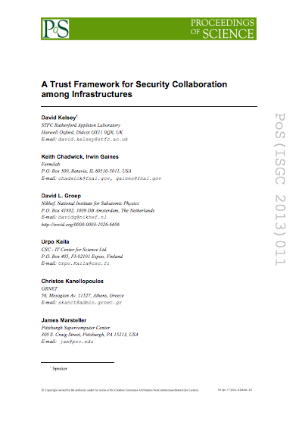
SCI Document – version 1
Proceedings of the ISGC 2013 conference
http://pos.sissa.it/archive/conferences/179/011/ISGC%202013_011.pdf
The document defined a series of numbered requirements in 6 areas

Slide 5
SCI Version 1 “children”

Slide 6
SCI version 1 (2013) - children
Both separate derivatives of SCI version 1
REFEDS Sirtfi - The Security Incident Response Trust Framework for Federated Identity
requirement in FIM4R version 1 paper
https://refeds.org/sirtfi
AARC/IGTF Snctfi – The Scalable Negotiator for a Community Trust Framework in Federated Infrastructures
For scalable policy – Research Services behind a SP/IdP proxy
https://www.igtf.net/snctfi/

Slide 7
Sirtfi

Slide 8
Snctfi

Slide 9
SCI version 2

Slide 10
WISE SCI Version 2
Aims
Involve wider range of stakeholders
GEANT, NRENS, Identity federations, …
Address any conflicts in version 1 for new stakeholders
Add new topics/areas if needed (and indeed remove topics)
Revise all wording of requirements
Simplify!
SCI Version 2 was published on 31 May 2017
https://wise-community.org/sci/

Slide 11
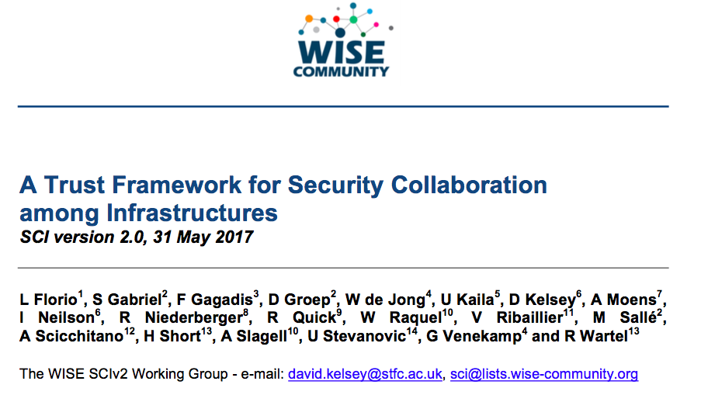
SCI Version 2 – published 31 May 2017

Slide 12
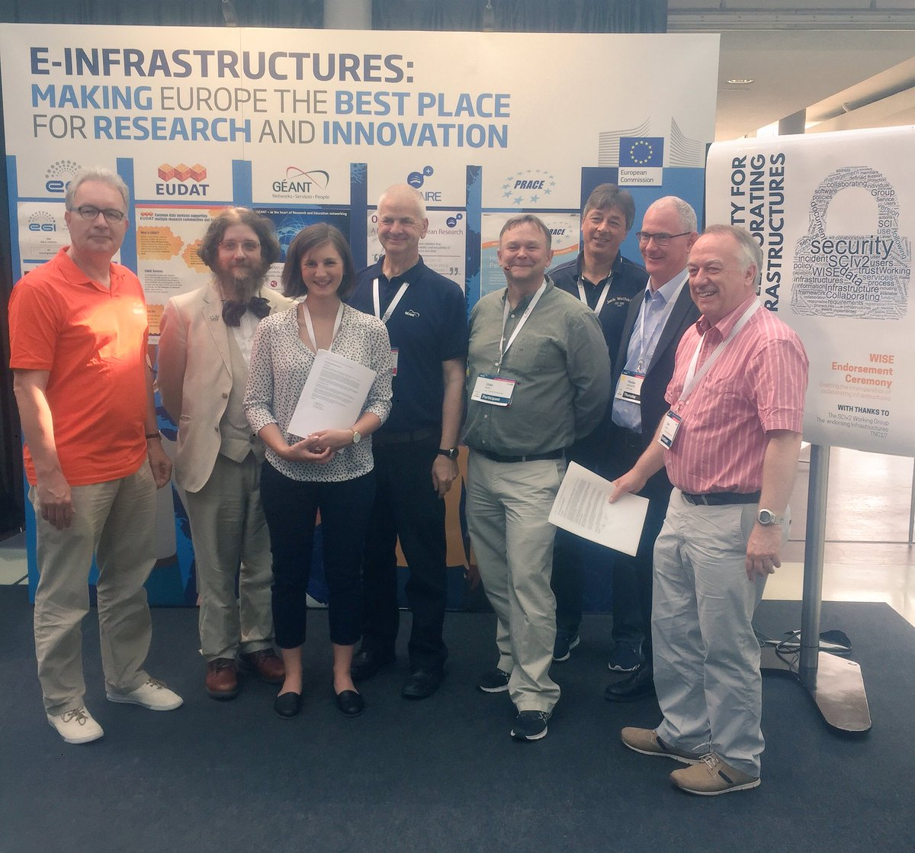
Endorsement of SCI Version 2 at TNC17 (Linz)
1st June 2017
Infrastructures endorse the governing principles and approach of SCI, as produced by WISE, as a medium of building trust between infrastructures, to facilitate the exchange of security information in the event of a cross-infrastructure incident, and the collaboration of e-Infrastructures to support the process. These Infrastructures welcome the development of an information security community for the Infrastructures, and underline that the present activities by the research and e-Infrastructures should be continued and reinforced
Endorsements have been received from the following infrastructures; EGI, EUDAT, GEANT, GridPP, MYREN, PRACE, SURF, WLCG, XSEDE, HBP
https://www.geant.org/News_and_Events/Pages/supporting-security-for-collaborating-infrastructures.aspx

Slide 13
Sections of V2 paper
In this document, we lay out a series of numbered requirements in five areas (operational security, incident response, traceability, participant responsibilities and data protection) that each Infrastructure should address as part of promoting trust between Infrastructures
Concise representation putting requirements, not specific wording (see some text from SCI V2)

Slide 15
SCI Assessment of maturity
To evaluate extent to which requirements are met, we recommend Infrastructures to assess the maturity of their implementations
According to following levels
Level 0: Function/feature not implemented
Level 1: Function/feature exists, is operationally implemented but not documented
Level 2: … and comprehensively documented
Level 3: … and reviewed by independent external body

Slide 16
Assessment spreadsheet (AARC2 development)

Slide 17
Or present graphically
example, not an actual infrastructure

Slide 18
Current SCI activities

Slide 19
SCI–WG in 2019
Work in progress
Joint work AARC2/EOSC-hub on Policy Development Kit
WISE Baseline AUP v1.0 (from AARC PDK)
On the to-do list
Produce FAQ/Guidelines & Training – how to satisfy SCI V2?
Maturity Assessments from a number of Infrastructures

Slide 20
Next steps
SCI assessment – infrastructure to self-assess and peer review (e.g. in conjunction with the IGTF)
Guidance on AUP implementation beyond AARC
Policy Development Kit evolution
Coherency of security policy development for collaborating infras
ALL welcome to the various mail lists and F2F meetings

Slide 21
Acknowledgements
Many thanks to all colleagues in AARC2 policy team for slides
Thanks to all colleagues in WISE & SCI-WG
and co-authors of SCI version 1 and version 2
For funding received from EU H2020 projects, including
AARC2
EOSC-hub
EGI, WLCG, GridPP, EUDAT, HBP, PRACE, …
The Extreme Science and Engineering Discovery Environment (XSEDE) is supported by the National Science Foundation.

Slide 22
Questions?
And discussion ….

