Slide 1
The WISE Baseline AUP
From the Taipei Accord to a augmentable common AUP
David Groep
Policy and Best Practice coordination lead
based on a lot of work by Ian Neilson, RAL-STFC (UKRI)
WISE/SIG-ISM Workshop Kaunas
April 2019

Slide 2
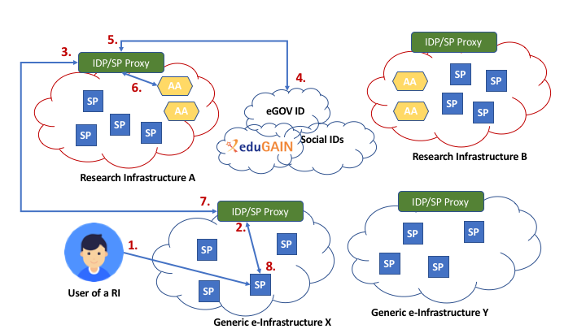
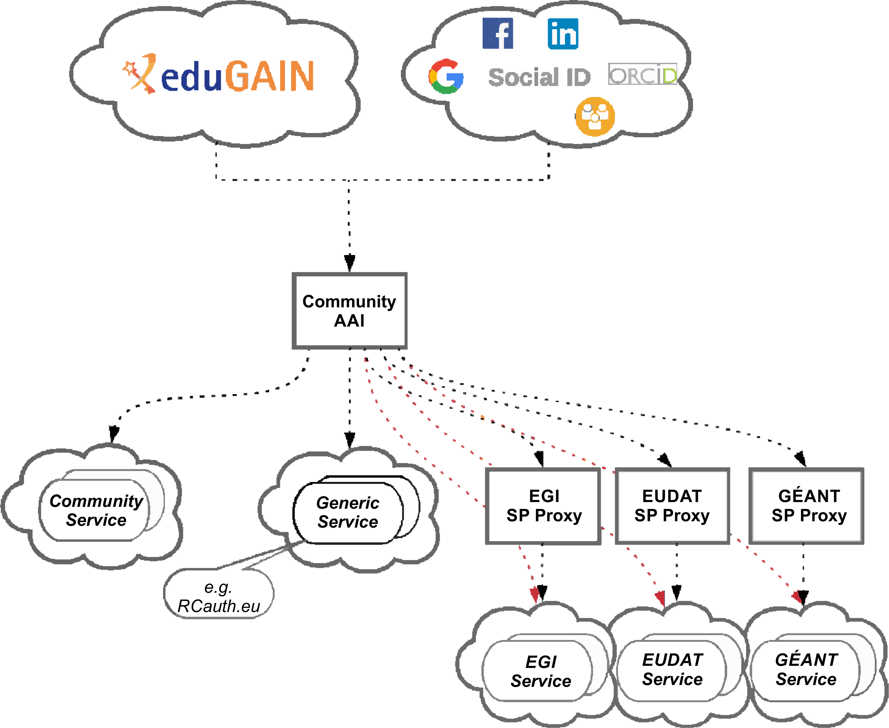
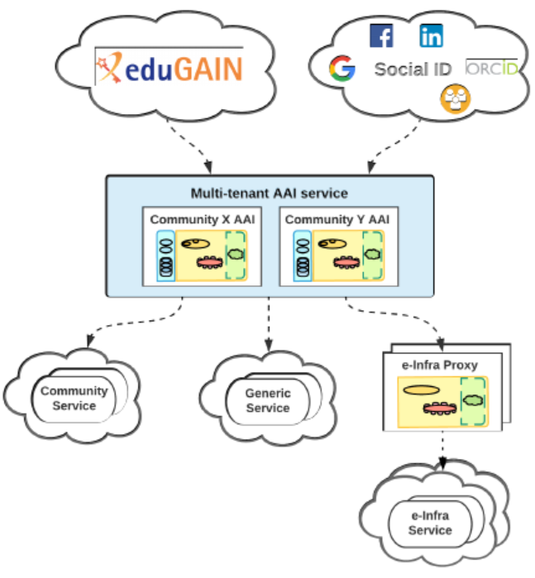
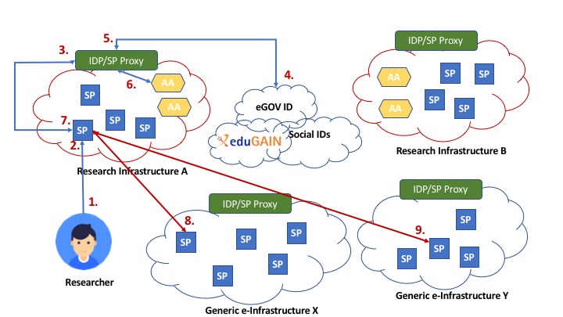
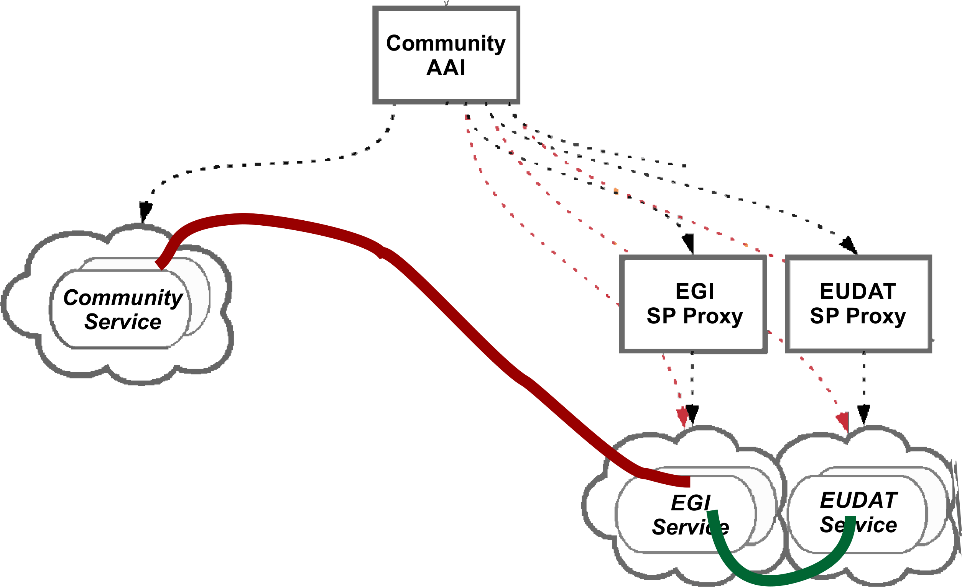
Why a common baseline AUP?
Users move across services – and making them read any AUP is already a hard proposition
impractical to present user ‘click-through’ screens on each individual service

Slide 3


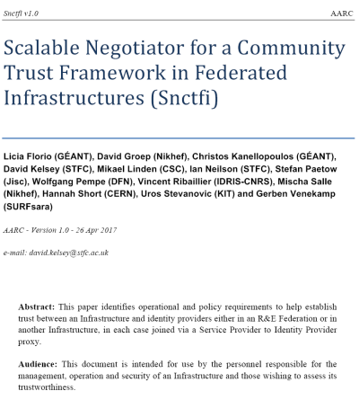
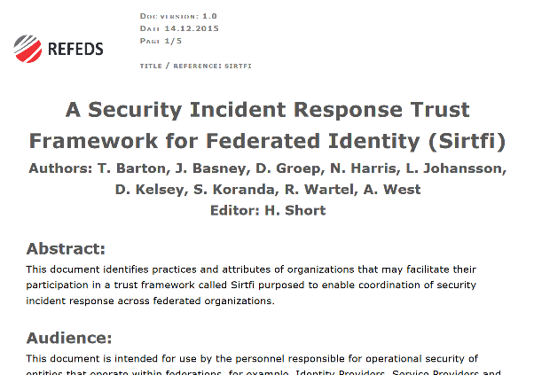
A policy framework for service providers groups and proxies
Snctfi - Scalable Negotiator for a Community Trust Framework in Federated Infrastructures
Sirtfi - Security Incident Response Trust Framework for Federated Infrastructures
igtf.net/snctfi
refeds.org/sirtfi
graphic IdP-SP bridge: Lukas Hammerle and Ann Harding, SWITCH
Derived from SCI, the framework on Security for Collaboration in Infrastructures
both need the user to adhere to acceptable use policies
Snctfi is managed for the community by the Interoperable Global Trust Federation IGTF
Sirtfi is managed for the community by the Research and Education Federations group REFEDS

Slide 4

Divergence and convergence – the AUP Alignment Study
11 infrastructures
4 individual organisations
https://docs.google.com/spreadsheets/d/1bg5I9n_DM7QcXdnja_7r0OEpTfjrb72ftq7-xHQxfxM/edit#gid=822235717
Image: Mozes en de tafelen der Wet, Rembrandt van Rijn, 1659

Slide 5
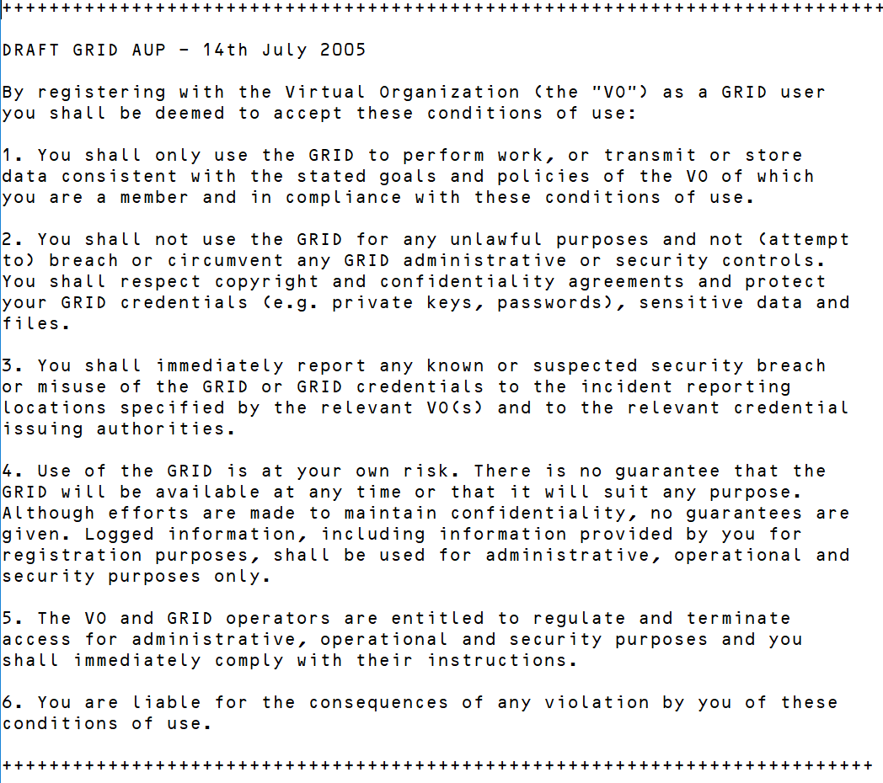
Features of the AUP clusters
Difference between ‘infrastructure’ and ‘organizational’ AUPs is clear
service provider AUPs in the Infrastructures can limit scope to professional use
many organization AUPs need ‘non-permissible’ use to govern private use & personal data
Infrastructure AUPs usually limit liability and place responsibilities on community and user
Yet there is interesting commonality
many of the Infrastructure AUPs share
a common history in the 2005 ‘Taipei Accord’
focus on permissible use and purpose-binding
short representation to encourage readability
But the challenge remains: how to prevent a bazillion AUP clicks?

Slide 6
A new common baseline AUP
Recommendation for the content of an Acceptable Use Policy (AUP)
to act as a baseline policy (or template) for adoption by research communities
and to enable access to the e-Infrastructure services
To facilitate
  a more rapid community infrastructure ‘bootstrap’
  ease the trust of users across infrastructures
  provide a consistent and more understandable enrolment for users.
Adoption of a single policy preferred to modifying a template – enables infrastructure services to have implicit trust coming from the community membership management

Slide 7
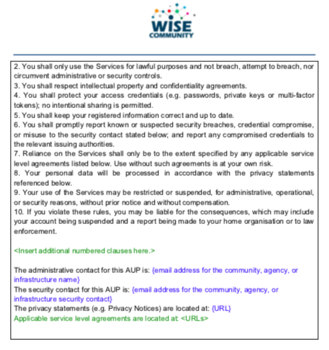
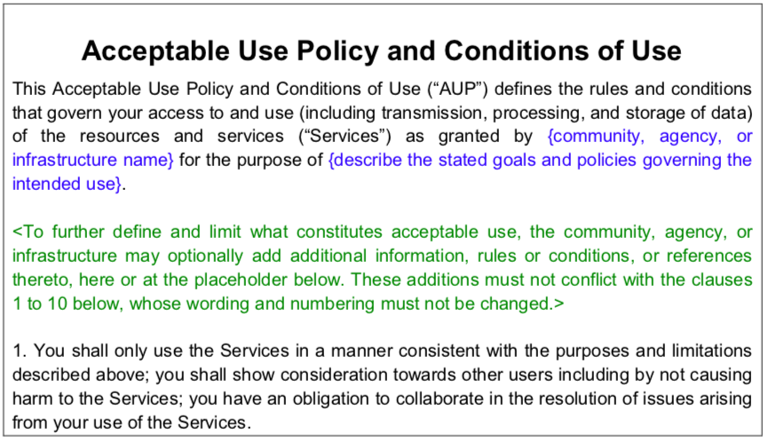
WISE Baseline AUP v1 – to be published by WISE/SCI very soon
AARC Guideline on use of baseline AUP:
https://aarc-project.eu/guidelines/aarc-i044/

Slide 8
How will this Baseline AUP used?
Forms part of the information shown to a user
during registration with his/her community
AUP provides information on expected behaviour and restrictions
‘baseline’ text can, optionally, be augmented with additional, community or infrastructure specific, clauses as required, but the numbered clauses should not be changed
Registration point where the user is presented with the AUP may be operated directly by the user's research community or by a third party on the community's behalf

Slide 9
Scaling Acceptable Use Policy and data release
impractical to present user ‘click-through’ screens on each individual service
Community conditions
Community specific terms & conditions
Community specific terms & conditions
RI Cluster-specific terms & conditions
Common baseline AUP
for e-Infrastructures and Research Communities
(current draft: JSPG Evolved AUP –
leveraging comparison study and joint e-Infrastructure work)
Also picked up by others,
e.g. FH VORARLBERG
https://wiki.geant.org/x/P4bWBQ

Slide 10
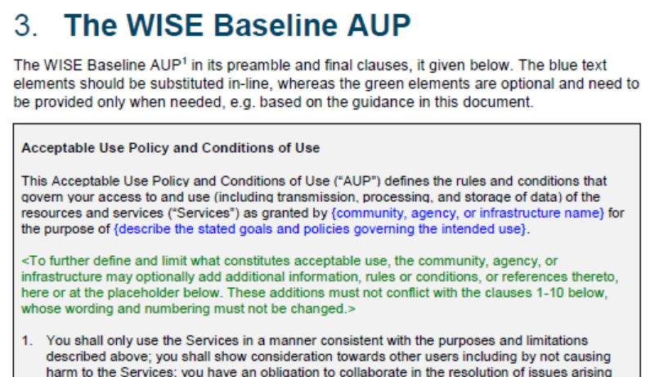
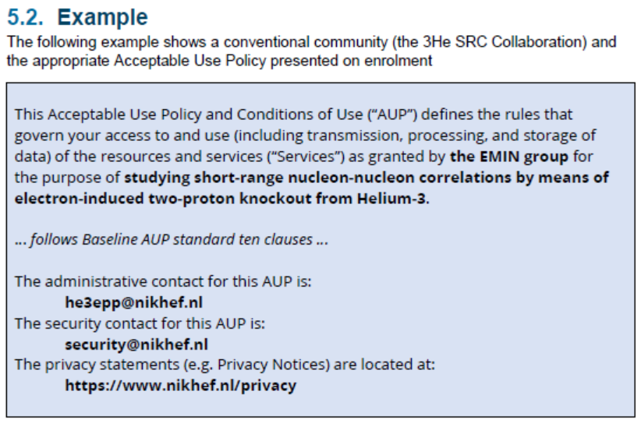
WISE Baseline AUP – and how to apply it for your Infrastructure
https://aarc-project.eu/guidelines/aarc-i044/
AARC-I044
Includes the final WISE Baseline AUP text
for both ‘community-first’ and ‘user-first’
MMS services (attribute authorities)
examples make it concrete
Seen rapid take-up
by e-Infras
(both global and national)

Slide 11
Next steps
Publication on the WISE SCI pages and Wiki
Adoption by the Infrastructures – already happened for EGI & GEANT/eduTEAMS, and will happen in others (WLCG) and for many more through its AEGIS endorsement
Take-up also in national (R&E) Infrastructures

Slide 12
davidg@nikhef.nl

