Slide 1

Grid Computing and Site Infrastructures
David Groep, NIKHEF
UvA SNE 2009

Slide 2
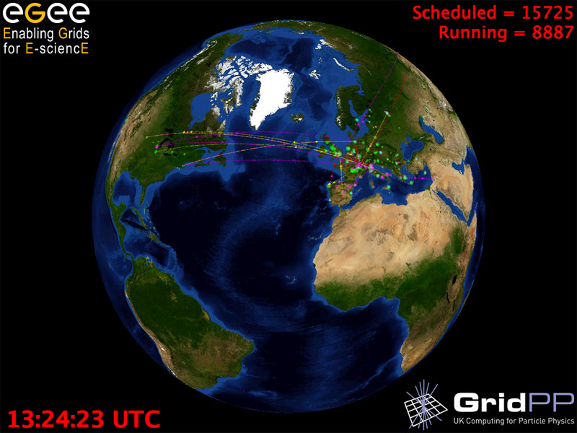
Graphics: Real Time Monitor, Gidon Moont, Imperial College London, see http://gridportal.hep.ph.ic.ac.uk/rtm/

Slide 3
Grid Computing and Infrastructures
The case for grid: applications
Security models for authN and authZ: PKI, federations and VOs
The Grid: the protocols, the information system and its anomalies
At the site: cluster architectures and networks
Scaling up the infrastructure: power, systems management
Monitoring: things that break, keeping an eye on things
Operational Security: ‘interesting’ users, policies, and the SSCs
Putting it together for growth: layering, growth, and grid models
Sustainable infrastructure: standards and EGI
What Next?

Slide 4
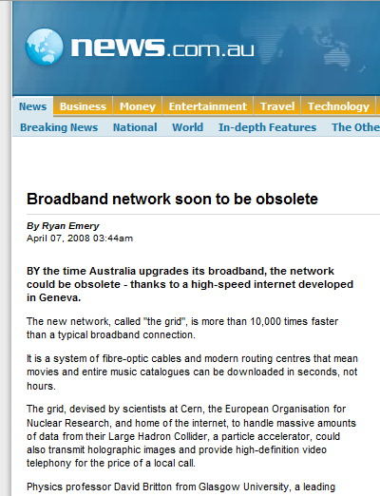
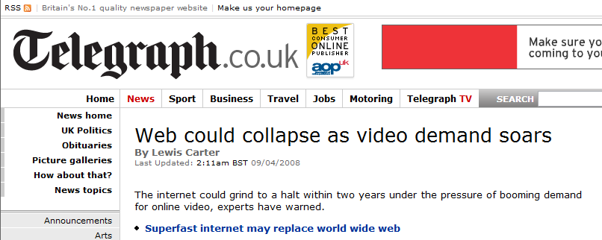
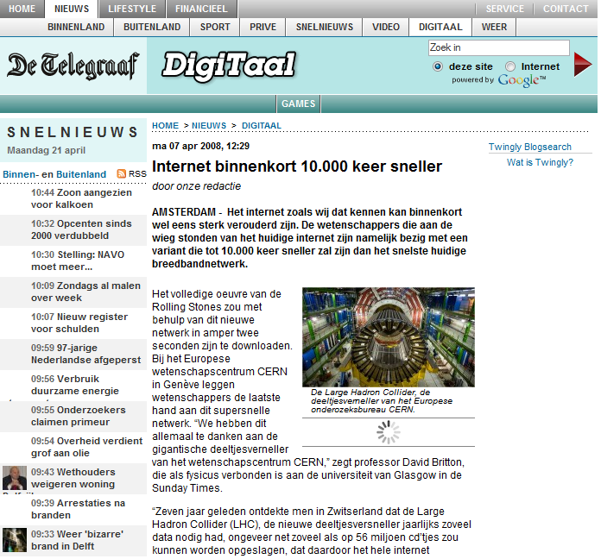
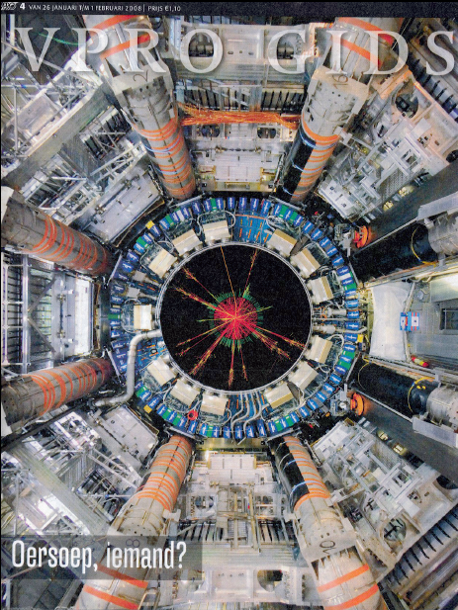
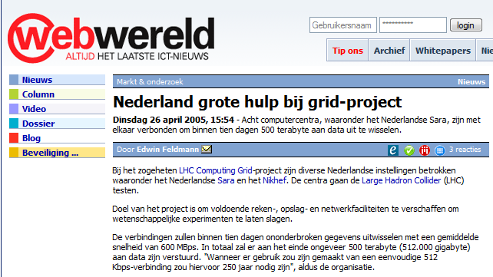
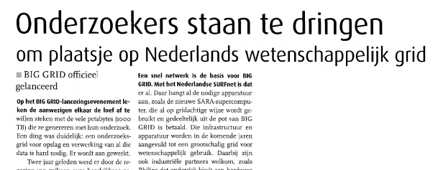

Slide 5

Name “Grid” chosen by analogy
with electric power grid
(Foster and Kesselman 1997)
Vision: plug-in computer for
processing power just like
plugging in toaster for electricity.
The idea has been around for decades
‘distributed computing’,
‘metacomputing’
and will be around: ‘Web 2.0’, ‘Virtualisation’, ‘Cloud Computing’

Slide 6
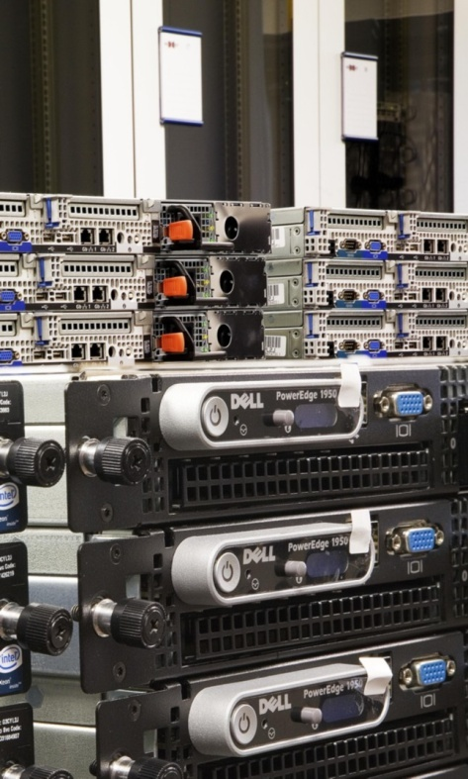
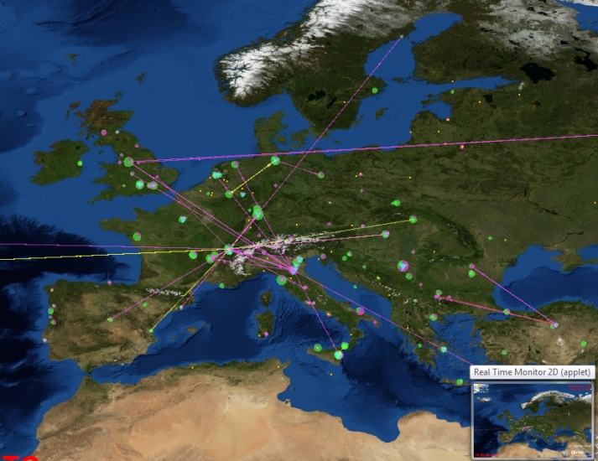
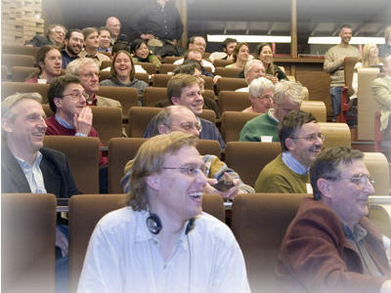
Grids in Science
The Grid is ‘more of everything’
as science struggles to deal
with ever increasing complexity
more than one place on earth
more than one computer
more than one science!
more than …

Slide 7
Why would we need it?
Enhanced Science needs more and more computations and
Collected data in science and industry grows exponentially
The Bible | 5 | MByte
X-ray image | 5 | MByte/image
Functional MRI | 1 | GByte/day
Bio-informatics databases | 500 | GByte each
Refereed journal papers | 1 | TByte/yr
Satellite world imagery | 5 | TByte/yr
US LoC contents | 20 | TByte
Internet Archive 1996-2002 | 100 | TByte
Particle Physics 2005 | 1 | PByte/yr
Particle Physics Today: LHC | 20 | PByte/yr
1 Petabyte = 1 000 000 000 Megabyte

Slide 8
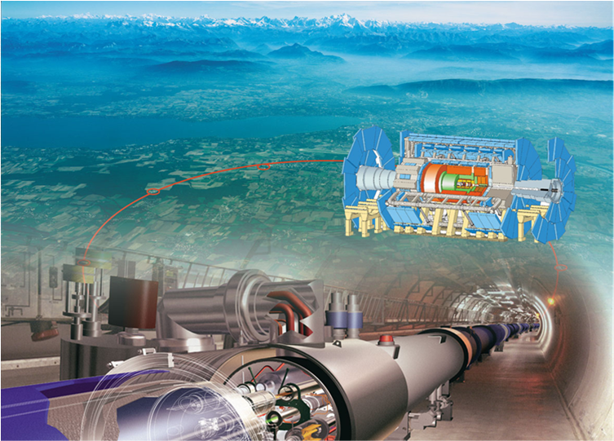


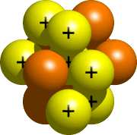

LHC Computing
Large Hadron Collider
‘the worlds largest microscope’
‘looking at the
fundamental forces of nature’
27 km circumference
Located at CERN, Geneva, CH
quarks
10⁻¹⁵ m
atom
nucleus
~ 20 PByte of data per year, ~ 60 000 modern PC style computers

Slide 9
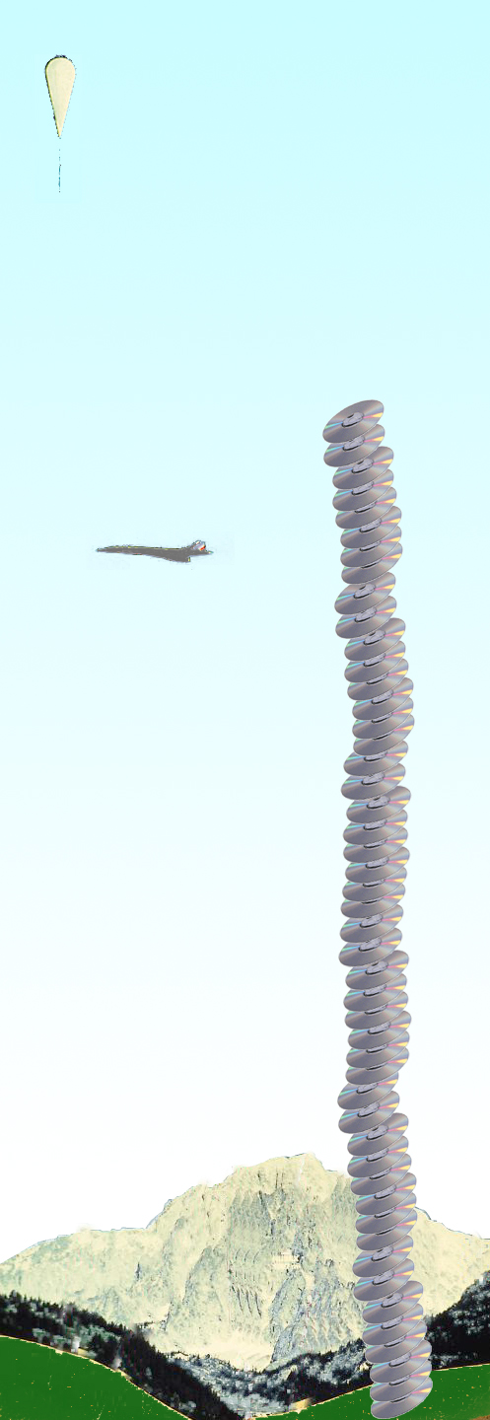
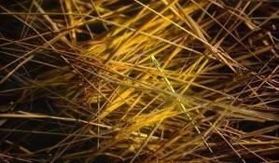
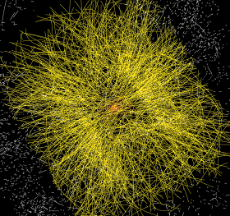
Balloon
(30 Km)
CD stack with
1 year LHC data!
(~ 20 Km)
Signal/Background 10⁻⁹
Data volume
  (high rate) X
  (large number of channels) X
  (4 experiments)
  ➔ 20 PetaBytes of new data each year
Compute power
  (event complexity) X
  (number of events) X
  (thousands of users)
  ➔ 60’000 of (today's) fastest CPUs
Concorde
(15 Km)
Mt. Blanc
(4.8 Km)

Slide 10
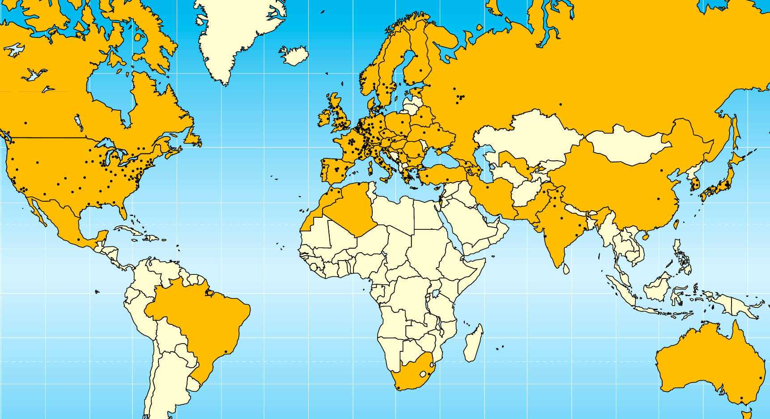

Today –
LHC Collaboration
20 years est. life span
24/7 global operations
~ 4000 person-years of
science software investment
~ 5 000 physicists
~ 150 institutes
53 countries, economic regions

Slide 11
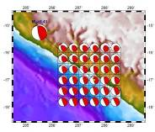


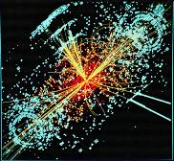

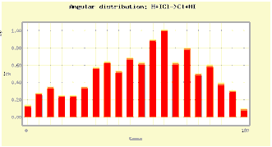
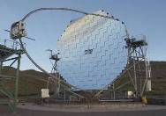

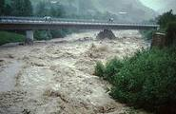
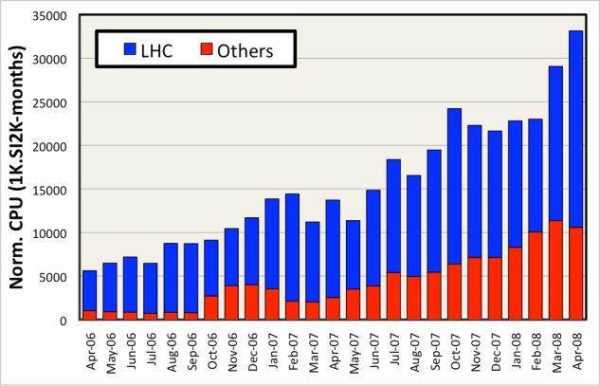
EGEE Achievements - Applications
>270 VOs from several scientific domains
  Astronomy & Astrophysics
  Civil Protection
  Computational Chemistry
  Comp. Fluid Dynamics
  Computer Science/Tools
  Condensed Matter Physics
  Earth Sciences
  Fusion
  High Energy Physics
  Life Sciences
Further applications
under evaluation
How do we match the expectations of the growing user communities?
  Will we have enough computing resources to satisfy their needs?
Applications have moved from
testing to routine and daily usage
~80-95% efficiency

Slide 12
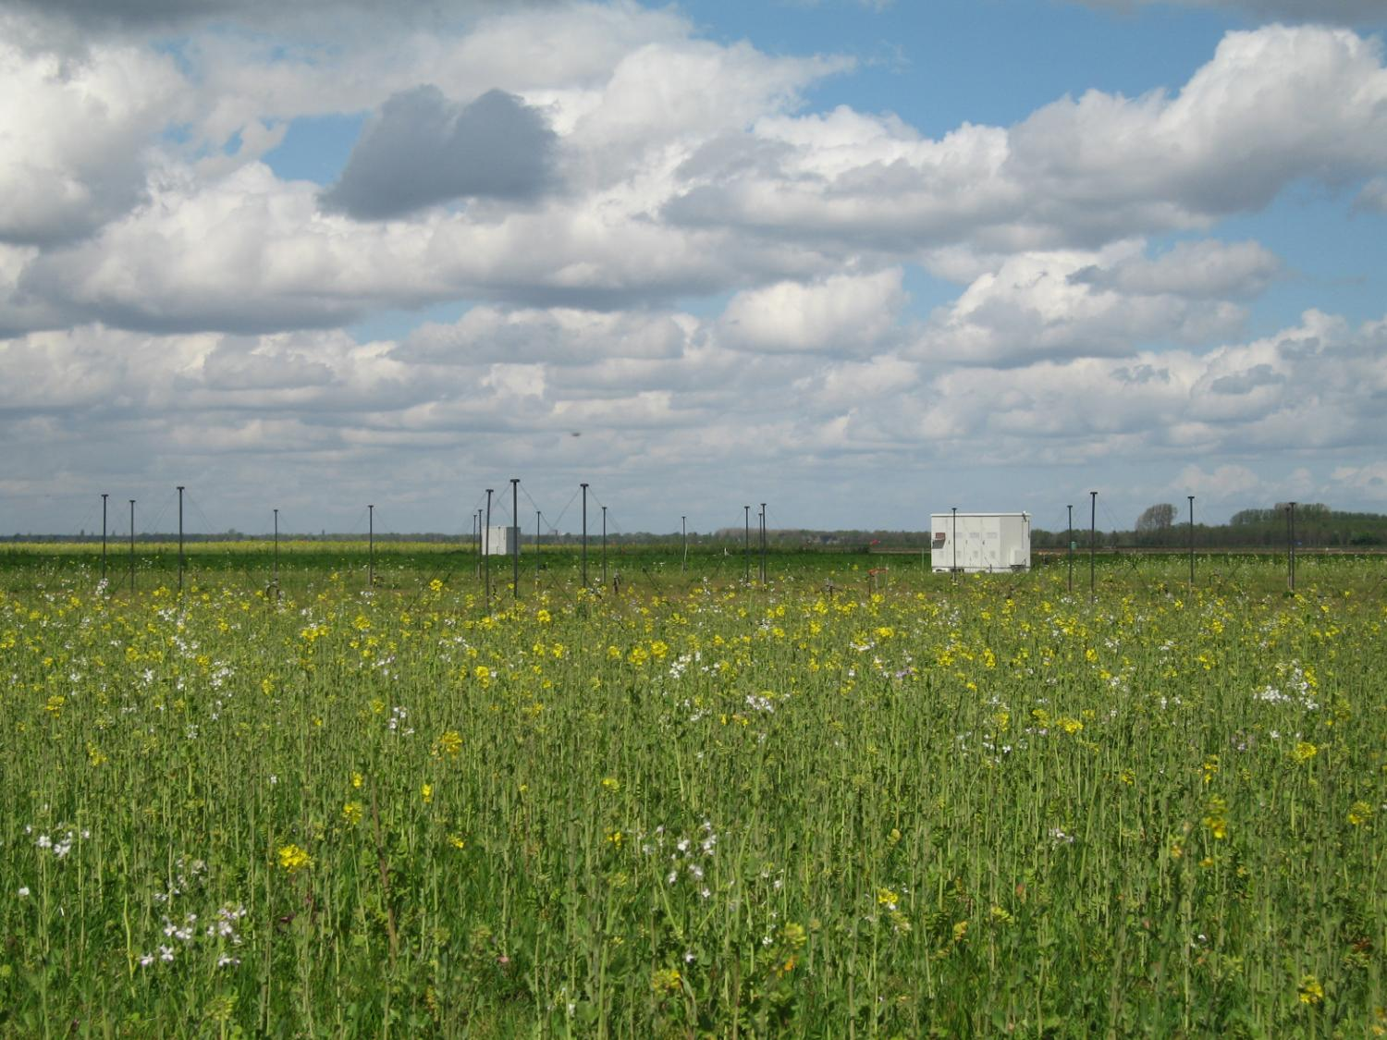
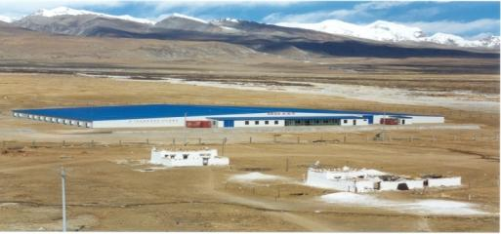
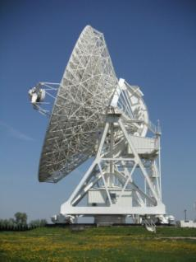
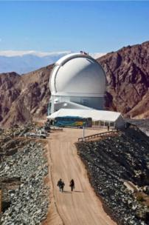
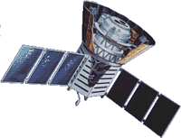
Astronomy & Astrophysics
LOFAR large distributed radio telescope
AUGER & ARGO Cosmic Ray Observatories
Notes:
LOFAR is the LOw Frequency ARray for radio astronomy.
LOFAR started as a new and innovative effort to force a breakthrough in sensitivity for astronomical observations at radio-frequencies below 250 MHz. The basic technology of radio telescopes had not changed since the 1960's: large mechanical dish antennas collect signals before a receiver detects and analyses them. Half the cost of these telescopes lies in the steel and moving structure. A telescope 100x larger than existing instruments would therefore be unaffordable. New technology was required to make the next step in sensitivity needed to unravel the secrets of the early universe and the physical processes in the centers of active galactic nuclei.
LOFAR is the first telescope of this new sort, using an array of simple omni-directional antennas instead of mechanical signal processing with a dish antenna. The electronic signals from the antennas are digitised, transported to a central digital processor, and combined in software to emulate a conventional antenna. The cost is dominated by the cost of electronics and will follow Moore's law, becoming cheaper with time and allowing increasingly large telescopes to be built. So LOFAR is an IT-telescope. The antennas are simple enough but there are a lot of them - 25000 in the full LOFAR design. To make radio pictures of the sky with adequate sharpness, these antennas are to be arranged in clusters that are spread out over an area of ultimately 350 km in diameter. (In phase 1 that is currently funded 15000 antenna's and maximum baselines of 100 km will be built). Data transport requirements are in the range of many Tera-bits/sec and the processing power needed is tens of Tera-FLOPS.
It was soon realised that LOFAR could be turned into a more generic Wide Area Sensor Network. Sensors for geophysical research and studies in precision agriculture have been incorporated in LOFAR already. Several more applications are being considered, given the increasing interest in sensor networks that “bring the environment on-line.”
The capabilities of LOFAR can be increased dramatically by broadening the scope to a European level, thus creating a European Sensor Network.
The European Gèant network is already being used to connect existing radio telescopes in the EVN program. It would be a natural next step to create a Europe-wide sensor grid for astronomy by adding LOFAR stations to these sites. As a European Sensor Grid, LOFAR could provide essential ground-based information complementary to earth-observation satellites, and would thus form an important contribution to the European Global Monitoring for the Environment and Security (GMES) program.
LOFAR contains 25.000 small antennas in the North of the
Netherlands and a part of Germany.
– LOFAR is essentially a software telescope.
• LOFAR and EGEE
– pave the path for connecting the LOFAR near-line and off-line
astronomical data reduction system to the EGEE infrastructure in
order to enable distributed computing and storage for a distributed
LOFAR community;
– enabling the astronomy VOs LOFAR and Omegac.
The Pierre Auger Cosmic Ray Observatory
is studying ultra-high energy cosmic rays, the most energetic and rarest of particles in the universe. When these particles strike the earth's atmosphere, they produce extensive air showers made of billions of secondary particles. While much progress has been made in nearly a century of research in understanding cosmic rays with low to moderate energies, those with extremely high energies remain mysterious. Results from the Pierre Auger Observatory made a lasting impression on the scientific community in 2007. The announcement by the Pierre Auger Collaboration that active galactic nuclei were the most likely source for the highest-energy cosmic rays that hit the earth made the list of breakthroughs and top science stories for several science media organizations.
The Auger Observatory will have two sites, one in the southern hemisphere and one in the north. This allows scientists to view ultra-high energy cosmic rays over the entire sky. The southern site near the city of Malargüe in Mendoza province, Argentina has been completed in 2007. The northern site is planned for southeast Colorado, USA, near the city of Lamar.
The Auger Observatory is located in a remote region far from academic or research Institutions.
The AUGERACCESS project has been designed to improve the communications link between the Auger Observatory and the CLARA network in Argentina and hence to international networks. Over 7 Tbytes of data per year are created at the Observatory site and the desired transmission rate greatly exceeds the available transmission capacity between the Observatory and the city of Mendoza, about 400 km to the north. At present some of the data must be put on disk and hand-carried to Mendoza. This makes monitoring of the status of instruments at the Observatory extremely difficult. A link of at least 10 Mbps is required.
The existing on-line software will be re-written and extended to use state-of-art Grid services to make the required remote monitoring and control access possible. In our opinion this is a natural extension of the Grid concept to remote and secure management of facilities. Interactive communication between the European Institutions and the Auger Observatory requires a reliable high bandwidth connection.
The grid is also used for offline simulations and processing of the data acquired from the Auger Observatory.
------------
The aim of the ARGO-YBJ (Astrophysical Radiation with Ground-based Observatory at YangBaJing) experiment is to study cosmic rays, mainly cosmic gamma-radiation, at an energy threshold of ~100 GeV, by means of the detection of small size air showers. This goal will be achieved by operating a full coverage array in the Yangbajing Laboratory (Tibet, P.R. China) at 4300 m a.s.l. The central array of the ARGO detector at the YangBaJing Cosmic Ray Laboratory (4300 m a.s.l., Tibet, P.R. China) has been put into operation for physics runs. It is made of 130 identical sub-units of 12 RPCs each (.cluster.) covering a surface of about 5800 m
2 with 92% active area.
ARGO was completed in spring 2007 and processing of it data is performed on the grid.
http://ieeexplore.ieee.org/iel5/23/4448435/04448452.pdf?tp=&isnumber=&arnumber=4448452

Slide 13
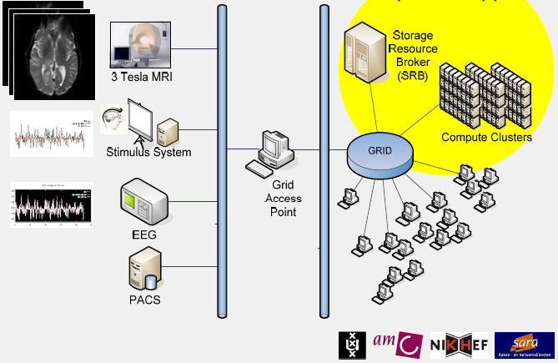
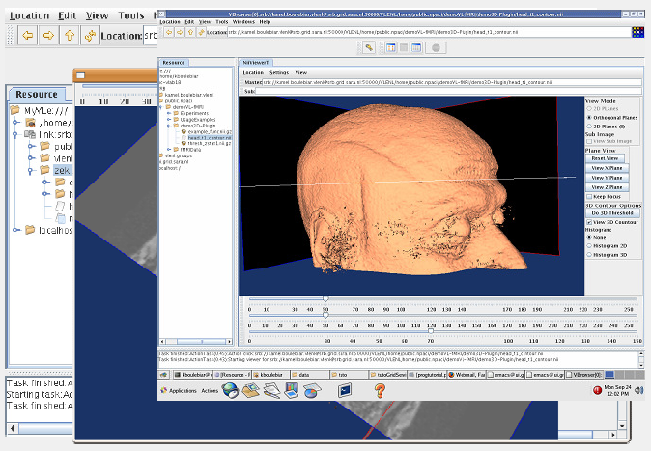
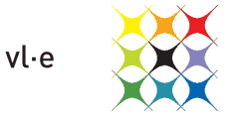
Functional MRI analysis
Research work by:
Silvia Olabarriaga (AMC, UvA)
Tristan Glatard (IvI,UvA)
Abdullah Ozsoy (IvI,UvA)
Storage of fMRI research data
for sharing between groups and
processing of image alignments

Slide 14
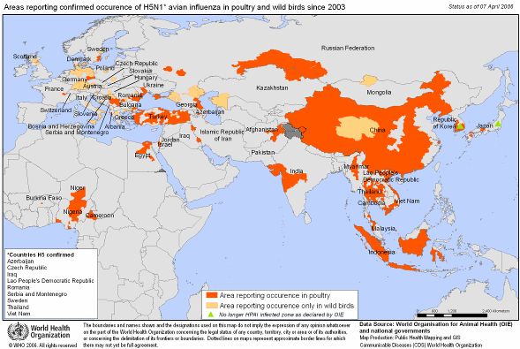

In silico drug discovery
Diseases such as HIV/AIDS, SRAS, Bird Flu, Malaria etc. are a threat to public health due to world wide exchanges and circulation of persons
Grids open new perspectives to in silico drug discovery
  Reduced cost and adding an accelerating factor in the search for new drugs
International collaboration is required for:
Early detection
Epidemiological watch
Prevention
Search for new drugs
Search for vaccines
Avian influenza:
bird casualties
Notes:
The acronym WISDOM, for Wide In Silico Docking On Malaria, comes from the first screening experiment at a large scale against malaria and is now used as a generic name for the initiative.
The WISDOM initiative runs large-scale computations for the in-silico drug discovery against emerging and neglected diseases. These virtual screening calculations determine how well certain drugs attach to specific sites on the target virus – those which dock are more likely to be active against the virus. It has been successfully deployed against malaria and avian influenza, with exciting results confirmed in vitro.
From paper “Trends in life science grid: from computing grid to knowledge grid.” Genomic Sciences Center, RIKEN, Yokohama, Japan. konagaya@gsc.riken.jp
(Dec’’2006): http://www.ncbi.nlm.nih.gov/pubmed/17254294
One of the best examples of life science high-throughput computing is the WISDOM high-throughput docking project in the Enabling Grids for E-sciencE (EGEE) project. It achieved over 46 million docking simulations, using 1700 computers distributed in 15 countries in about 6 weeks. The equivalent of 80 years on a single machine was used to find new inhibitors for a family of proteins produced by Plasmodium falciparum from 11 July 2005 to 19 August 2005 [19].
DIANE is an enhanced version of WISDOM with a light-weight framework. It was used to search for potential drugs for the predicted variants of the avian flu virus (H5N1), and produced two millions docking complexes with a size of 600 gigabytes using 2000 grid worker nodes distributed in 17 countries [20]

Slide 15
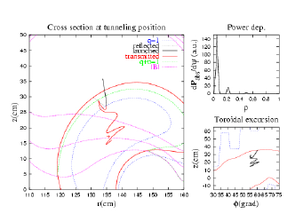
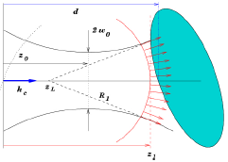
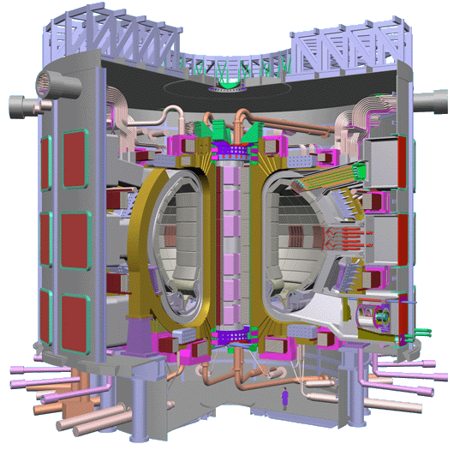
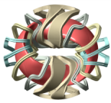
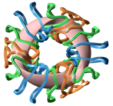
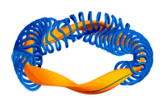
Fusion
Commercial exploitation of fusion energy still needs to solve several outstanding problems requiring exceptional computing facilities including supercomputers and cluster-based grids
Ion Kinetic Transport
Massive Ray Tracing
Stellarator Optimization
Interworking course-grained clusters and MPP systems across both the EGEE and DEISA grids
Notes:
Commercial exploitation of fusion energy still needs to solve several outstanding problems, some of which require a strong computing capacity. The International Thermonuclear Experimental Reactor (ITER), a joint international research and development project, aims to demonstrate the scientific and technical feasibility of fusion power and could potentially produce 500 MW of power by 2016. The exploitation of ITER requires a modelling capability that is at the limit of the present state of the art. Therefore, computing grids and high performance computers are basic tools for fusion research.
From EGEE-II DNA4.2.2:
The Ion Kinetic Transport application (or code ISDEP, Integrator of Stochastic Differential Equations
in Plasmas) has been run in stellarator geometry and is now in process of improvement. The new
major capability of the application is the introduction of self-consistent transport calculations with the
capability of updating the background plasma, hence performing quasi-linear calculations (the number
of CPU hours for this type of calculations is 15000). Several new features are under consideration,
being an important one to use ISDEP for tokamak configuration and, in particular, for ITER tokamak.
ISDEP code has been also used to perform divertor studies in magnetic confinement devices. The
strike points of the ions against the vacuum chamber are estimated and it is possible to develop
strategies to minimize such strikes.
The MaRaTra application is used to study plasma heating by a microwave beam simulated by a huge
number of rays. This application is useful especially for estimating the properties of Electron
Bernstein Waves, which present a quasi-electrostatic polarization and cannot be simulated with the
usual number of rays. MaRaTra can be used also to optimize the microwave launching position and
characteristics, as has been done in TJ-II stellarator. One important feature of this application is that no
result can be lost, since the beam structure must be kept. In order to guarantee this fact, the
metascheduler GridWay is used to launch the application and to pick the results, organizing the
workflow.
Another embarrassingly parallel application is the simulation of the Electrostatic Residual Ion dump
(ERID) of the Neutral Beam Injector (NBI) of ITER. The goal of these calculations is to elucidate if
the ERID or the Magnetic RID concept will be finally chosen for the NBI if ITER. So these
simulations have a direct impact on ITER design.
Stellarator Optimization Application is based on a standard fusion code, VMEC that is used to
estimate the equilibrium magnetic configuration. The Stellarator Optimization is needed to find the
magnetic configuration that is optimum with respect to a certain criterion that is described by a target
function. This application works by choosing the best configuration by using a genetic algorithm,
which imposes especial demands on the application working.
More applications are in the process of being ported, like a linear version of a turbulence gyrokinetic
code (GYSELA) or one for designing plasma diagnostics.
One important recent novelty is the possibility of using the KEPLER workflow orchestration to
organize complex workflows in the grid, among the above described or other applications.
As a result of these activities the project EUFORIA has been launched. This project is envisaged for
bringing fusion community to both high performance computers and computing grids. This project
will enable more plasma physicists to use the grid for their customary activities.
Grid demos for ITER (2003): http://www.fusiongrid.org/about/events/iter-grid-agenda-2003.pdf
DEISA/EGEE interaction scenario for fusion from OMII-Europe: http://wwwiscampos.ifca.es/users/iscampos/docs/EUFORIA/2008-04-22_OMII-EU_FactSheet_EUFORIA_InteropUseCase_v1.pdf
From DEISA digest (http://www.deisa.eu/press/Media/DEISA-Digest.pdf):
“Fusion energy is one of the rare alternatives for solving
the world’s energy problem.
It has been estimated that
the world’s energy
consumption will double or triple by the
end of the century. Even if the Western
world can achieve the goals set for
saving energy, it will not be able to
compensate for the growing energy
needs of the current developing
countries.
Fusion energy has several
advantages over nuclear fission power
or fossil fuels. Fusion energy has minor
effects on the environment, it does not
generate long-term radioactive waste
and the resources are abundant, evenly
dispersed around Earth.
“Nuclear fusion is a very
challenging research field. At the
moment, it involves three main
problems: heating, confinement and
materials’ durability. Our research deals
with the confinement of fusion plasma”,
says Timo Kiviniemi who works at the
Laboratory of Advanced Energy
Systems at Helsinki University of
Technology.
To release significant amounts
of energy in a fusion reaction under
terrestrial conditions requires a
temperature of over 100 million ◦C.
Attaining such extreme temperatures
requires efficient heating of plasma
with minimized thermal losses.
The best performance has been attained
by using tokamak-type test reactors,
where plasma is floated with the help of
strong magnets in the chamber to form
a toroidal (doughnut-shape) ring. The
magnetic field confines the plasma by
preventing charged particles from
escaping; it also keeps plasma detached
from the chamber walls, which reduces
thermal loss and stress on the reactor
wall structures. There are several
experimental devices being tested in
Europe and they continuously produce
basic information needed to advance
fusion research.
…
The key feature of European fusion
research is exact coordination, which
has made it possible to allocate the
available research resources efficiently
to essential areas of research. The
fusion plasma research at Helsinki
University of Technology is also part
of the carefully coordinated program.
The national program in Finland is
coordinated by the Finnish Funding
Agency for Technology and Innovation
(Tekes) and the program is strongly
integrated to the European fusion
program.
The ITER tokamak being built in
France will not be connected to the
mains network yet. It will be used as
a research instrument to demonstrate,
among other things, that the power
plant can actually generate more energy
than it consumes.
“This has never been proved with
any device before. However, it has been
observed that the ratio improves with
the size of the device”, says Kiviniemi.
He estimates that in the future, the
energy volumes generated by the fusion
power plants then in commercial use
will roughly match the capacities of the
largest currently used power plants,
about 1000 megawatts.
“The political decision-making
process on the ITER reactor has taken
an eternity. Had more money been
available for fusion research, the reactor
could have been built earlier”, says
Kiviniemi.
“However, I am convinced that
fusion reactors will be used for energy
production. Certainly, fusion energy will
be expensive at the beginning, but as
soon as the technology has been
improved, the prices will come down.
As other fuel resources become
depleted, their price will go up and
make fusion energy quite competitive”,
says Kiviniemi

Slide 16
Enterprise
Transaction processing
Finance (what-if analyses)
Pharma (in-silico drug design)
Aerospace (fluid dynamics)

Slide 17
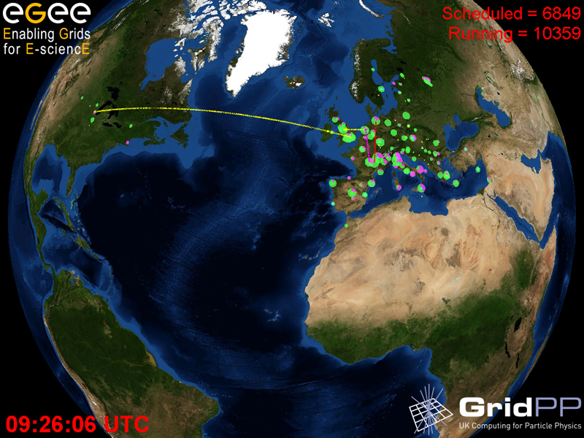
Building the Grid …
Graphics: Real Time Monitor, Gidon Moont, Imperial College London, see http://gridportal.hep.ph.ic.ac.uk/rtm/

Slide 18
Why Grid computing – today?
New applications need larger amounts of data or computation
Larger, and growing, distributed user community
Network grows faster than compute power/storage
Doubling Time
(months)
Optical Fibre
(bits per second)
Gilder’s Law
(32X in 4 yrs)
9 12 18
Data Storage
(bits per sq. inch)
Storage Law
(16X in 4yrs)
Performance per Dollar Spent
Chip capacity
(# transistors)
Moore’s Law
(5X in 4yrs)
0 1 2 3 4 5
Number of Years
Graphic: “The Triumph of Light”, Scientific American, January 2001

Slide 19
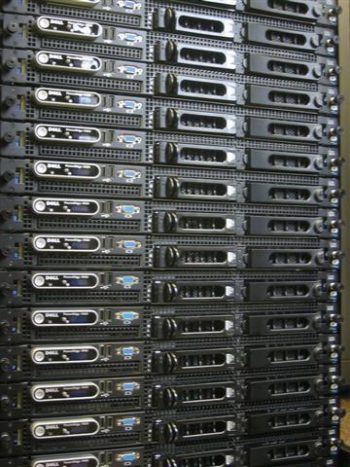
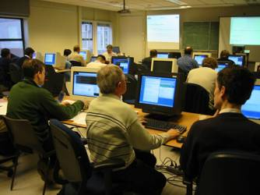
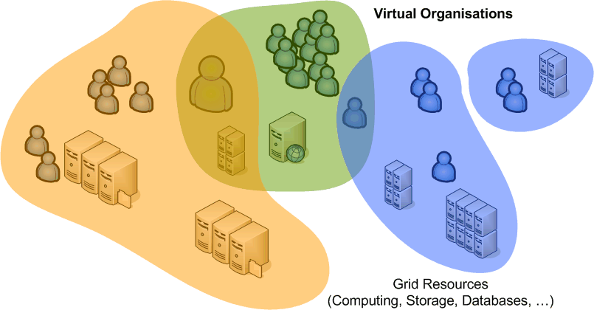
What is Grid?
Cycle scavenging
harvest idle compute power
improve RoI on desktops
Cluster computing and storage
What-if scenarios
Physics event analysis
Improve Data Centre Utilization
Cross-domain resource sharing
more than one organisation
more than one application
more than one …
open protocols
collective service

Slide 20
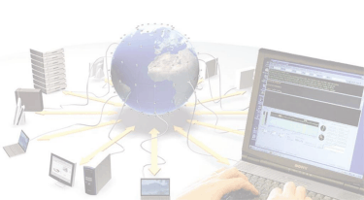
Community Building
authentication
authorization
virtual organizations
Scheduling and clustering
resource management
prioritization and fair-share
Hardware Infrastructures
compute clusters
disk and tape storage
database services
Operational Security Policy
distributed incident response
policies
Managing Complexity
systems management
scaling
multi-national infrastructures

Slide 21
Community Building
Grid Structures
Definition of inter-organizational grids
Virtual Organizations

Slide 22
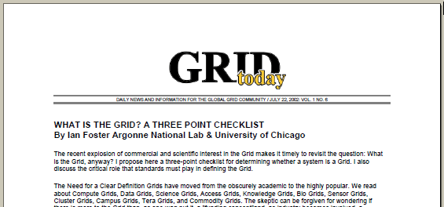
Three essential ingredients for Grid
‘inter-organizational resource sharing’
A grid combines resources that
  Are not managed by a single organization
  Use a common, open protocol … that is general purpose
  Provide additional qualities of service, i.e., are usable as a collective and transparent resource
Source: Ian Foster in Grid Today, July 22, 2002; Vol. 1 No. 6, see http://www-fp.mcs.anl.gov/~foster/Articles/WhatIstheGrid.pdf

Slide 23
Virtual Organisations
The communities that make up the grid:
not under single hierarchical control,
(temporarily) joining forces to solve a particular problem at hand,
bringing to the collaboration a subset of their resources,
sharing those at their discretion and each under their own conditions.

Slide 24
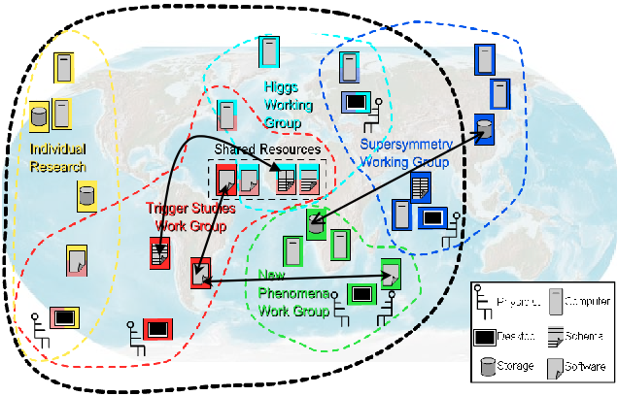
Although nothing is ever quite that neat …
graphic: Open Grid Services Architecture, © Global Grid Forum 2005, GFD.30

Slide 25
Federation in Grid Security
There is no a priori trust relationship between members
or member organisations!
  VO lifetime can vary from hours to decades
  VO not necessarily persistent
  (both long- and short-lived)
  people and resources are
  members of many VOs
but who to trust and how to federate
  at the organisation level?
  eduroam™, inCommon, SWITCHaai, UK Access Mngt Federation
  at the user and VO level?
  user AuthN and VO-centric AuthZ authorities ‘orthogonal’ to the org structure
Org. Certification
Org. Certification
Authority
Authority
Policy
Policy
Authority
Authority
Sub-Domain A1
Sub-Domain B1
Domain A
Task
Domain B
GSI
Server X
Server Y

Slide 26
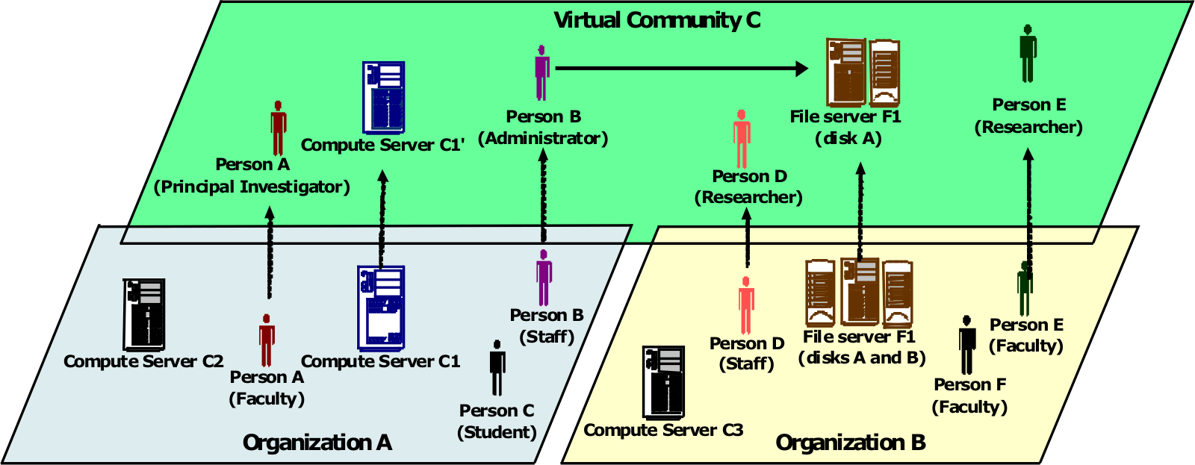
Organizing people
‘Identity is not enough’
‘virtual’ organization roles are independent of home organization roles
and authority for the VO roles rests with the VO
Graphic: Open Grid Forum OGSA Working Group, GFD.30

Slide 27
Authentication vs. Authorization
For user-centric delegation and VO-based grids
Single Authentication token (“passport”)
  issued by a party trusted by all,
  recognised by many resource providers, users, and VOs
  satisfy traceability and persistency requirement
  in itself does not grant any access, but provides
  a unique binding between an identifier and the subject
Per-VO (per ‘UHO’) Authorisations (“visa”) attributes
  granted to a person/service via a virtual organisation
  based on the ‘passport’ name
  embedded in the single-sign-on token (proxy)
  acknowledged by the resource owners
  providers can obtain lists of authorised users per VO,
  but can still ban individual users

Slide 28
Identity and authentication
Federated PKI: the IGTF policy bridge
Home-organization based federations
User centric identity

Slide 29
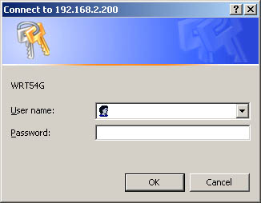
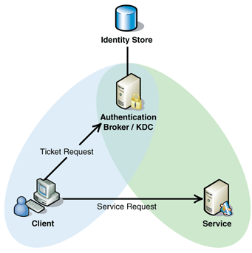

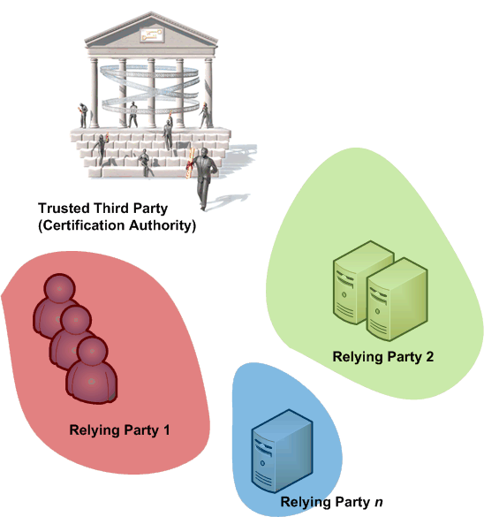
Security Trust Mechanisms
Making the order of the problem manageable …
Intra-organizational security vs. global grids
...

Slide 30
Direct (username-password) authN
Dedicated to each site where you want access
Usually strongly linked to authorization
  different accounts for different roles
In a multi-organizational problem is
O(n_{sites}) * O(n_{users})
Federation technologies (see later) help in some respects

Slide 31
Kerberos
Common trust domain around a KDC
Based on service tickets, derived from a TGT
  Encrypted with the service key from the target service
  Whether you talk to the ‘right’ server is implicit in it’s ability to decode your service ticket
Cross-domain trust by recognizing KDC tickets
  interesting in presence of symmetric crypto
  but usually, alignment mismatch between
  organizations is the limiting factor
  For multi-domain gets to be O(n²) for n sites

Slide 32
PKI
Relying parties (sites and users) all recognise a trusted third party (CA)
Problem is now O(n_{CA})
and n_{CA} is hopefully << n_{sites}
But there will be more than one CA as well …

Slide 33

Federated PKI for authentication
CA 2
CA 1
charter
relying
party n
CA n
guidelines
CA 3
acceptance
process
relying
party 1
A Federation of many independent CAs (a ‘policy bridge’)
  common minimum requirements
  trust domain as required by users and relying parties
  well-defined and peer-reviewed acceptance process
User has a single identity
  from a local CA close by
  works across VOs, with single sign-on via impersonation ‘proxies’ (RFC3820)
  certificate itself also usable outside the grid
International Grid Trust Federation and EUGridPMA, see http://www.gridpma.org/

Slide 34


Federation of 3 Regional “PMAs”, that define common guidelines and accredit credential-issuing authorities

Slide 35
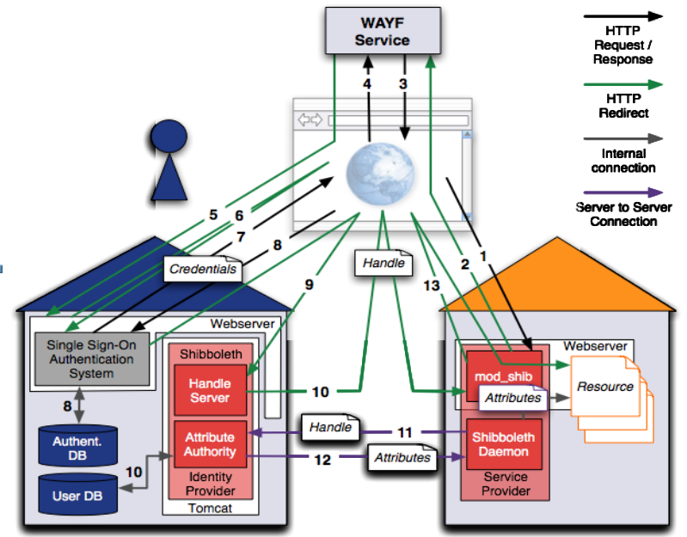

Federations rising hiding PKI from users
Archetype: shibboleth (from Internet2 Middleware Services)

Slide 36
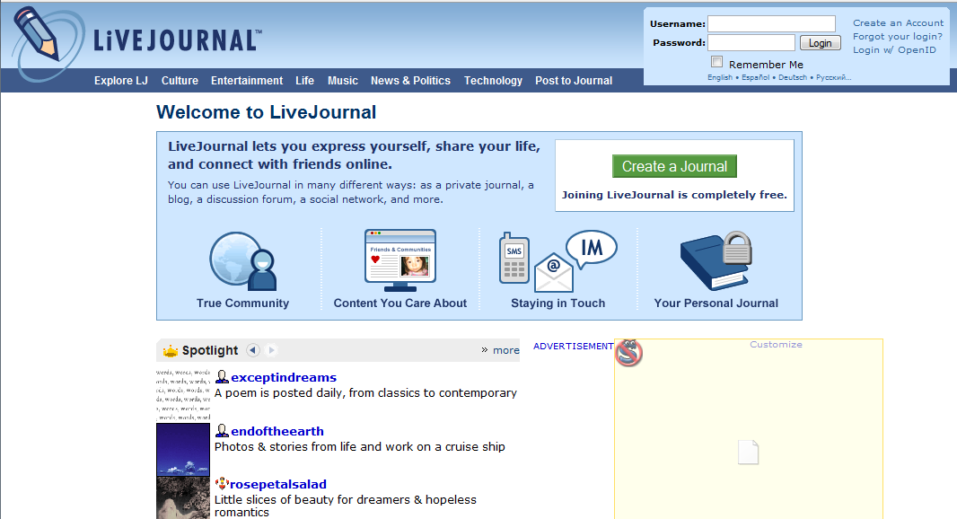





Federation techniques getting popular
based around web services security protocols and SAML assertions

Slide 37
Federated Authentication
Users authenticate to their home organization
There they have a set of attributes
  With a release policy
  Home organisation authoritative for them
Service Providers make access decision based on the attributes related to an abstract handle
  User’s name (eduPersonPrincipalName) is also an attribute
Home org cannot make assertions on VOmembership
  We need to move to a multi-authority world
  But is very good for identity: translatable to a specific PKI, where certificates derive from the federated identity (SLCS/MICS CAs)

Slide 38

User Centric Identity?
see, e.g., Burton Group’s blog
http://identityblog.burtongroup.com/
CardSpace,
project Higgins,
…
Based on Web Services
and ‘SAML’ assertions
  Self-assertions
  Assertions ‘filled in’ by trusted third parties, such as Visa, MC, etc.
Required assurance depends on the target system
Interop testing just starting, see, e.g.
http://identityblog.burtongroup.com/bgidps/2007/08/recapping-the-c.html
See Kim Cameron’s Identity blog

Slide 39
Organising Communities
Roles in communities and your home organisation
Delegation

Slide 40

Role-based access control

Slide 41

VOMS: Assertions in X.509 AC or SAML
Virtual Organisation Management System (VOMS)
push-model for signed VO membership tokens
  using the traditional X.509 ‘proxy’ certificate for shipping
  TLS/X.509 is just so a convenient carrier of data ...

Slide 42
Using the Grid
Organisations Working Together as an Infrastructure
Accessing resources
Resource Brokering
Data access
Resource Information Systems

Slide 43

Grid Usage: a snapshot

Slide 44



EGEE: ~250 sites, >45000 CPU
24% of the resources are contributed by groups external to the project
~>20k simultaneous jobs
Graphs: Ian Bird, EGEE SA1, EGEE07 Conference October 2007

Slide 45


Typical grid topology for computational jobs

Slide 46
Services in a Grid
Computing Element “front-end service for (set of) computers”
  Cluster computing: typically Linux with IP interconnect
  with a ‘head node’ that batches or forwards requests to the cluster
  Capability computing: typically shared-memory supercomputers
Storage “front-end service for disk or tape”
  Both disk and tape based
    Varying retention time, QoS, uniformity of performance
  Expressing ACLs in grid terms in challenging:
  mapping of grid authorization to e.g. POSIX ACLs
File Catalogues … naming (data) objects in the Grid
  for the really courageous people: represent computing, storage and data all as ‘named objects’ in a single ‘grid name space’
Information System … finding out resources on the Grid
  Directory-based for static information
  Monitoring and bookkeeping for real-time information
Resource Broker …
  Matching user job requirements to offers in the information system
  WMS allows disconnected operation of the user interface

Slide 47





But you are not there yet …
?
various local batch scheduling systems
Heterogeneous resources
Unknown local environment
Unknown access policies

Slide 48
A seemingly simple task
The CE seems conceptually simple
  submit a job
  wait for it to run
  retrieve the results
  or kill it prematurely …
  but: there are a bazillion ways to implement it
    with implicit or explicit data staging
    hide the entire site structure and use forwarding nodes
    or even allow automatic forwarding to another site
    policy and prioritization
the user does not want to know the difference
  and an automatic resource broker needs a backend for every type
back-end is usually just a simple old batch system

Slide 49
Example: GT4 WS GRAM Architecture
Service host(s) and compute element(s)
Job events
SEG
GT4 Java Container
Compute element
GRAM
services
Local job control
GRAM
services
Local
scheduler
Job functions
sudo
GRAM
adapter
Delegate
Client
Delegation
Transfer
request
Delegate
GridFTP
User
job
RFT File
Transfer
FTP
control
FTP data
Remote
storage
element(s)
GridFTP

Slide 50
Unicore CE Architecture
User Certificate
UNICOREPro Client
Arcon
Client Toolkit
Preparation and
Control of jobs
User Certificate
Job preparation/control
Plugins
Runtime Interface
UNICORE
Site List
AJO/UPL
Unsafe Internet (SSL)
AJO/UPL
optional firewall
UNICORE
Site List
User authentication
UNICORE Gateway
UNICORE Site
FZJ
optional firewall
Safe Intranet
(TCP)
Jobs and data transfer to other UNICORE sites
User mapping,
job incarnation,
job scheduling
Network Job Supervisor
(NJS)
NJS
IDB
IDB
IDB
UUDB
Incarnated job
Status request
Target System Interface
(TSI)
TSI
...
TSI
Commands
files
SV1
Blade
Batch Subsystem
Any cluster
management system
Graphic from: Dave Snelling, Fujitsu Labs Europe, “Unicore Technology”, Grid School July 2003

Slide 51





Interoperability – but only basics at first
HPC-BP
- BES
- JSDL
Various grid middleware interface solutions
working towards common standards
Basic Execution Service
Job submission works, but
security model, file staging, etc. still need to be resolved

Slide 52
Computing: user expectations?
Different user scenarios are possible and valid
  paratrooper mode: come in, take all your equipment (files, executable &c) with you, do your thing and go away
    you’re supposed to clean up, but the system will likely do that for you if you forget. In all cases, garbage left behind is likely to be removed
  two-stage ‘prepare’ and ‘run’
    extra services to pre-install environment and later request it
    see later on such Community Software Area services
  don’t think but just do it
    blindly assume the grid is like your local system
    expect all software to be there
    expect your results to be retained indefinitely
    … realism of this scenario is unclear for ‘production’ grids
      it does not scale to larger numbers of users
      but large user communities hold ‘power’ over the resource providers
      (or the customers run away)

Slide 53
Using these systems
As both clusters and capability systems are both ‘expensive’
(i.e. not on your desktop), they are resources that need to be scheduled
interface for scheduled access is a batch queue
  job submit, cancel, status, suspend
  sometimes: checkpoint-restart in OS, e.g. on SGI IRIX
  allocate #processors
  (and amount of memory, these may be linked!)
  as part of the job request
systems usually also have smaller interactive partition
  more a ‘user interface’, not intended for running production jobs …

Slide 54


Fair shares and estimated response time
local ‘fair shares’, used to satisfy overall SLA requirements, need to be translated to an ‘estimated response time’ for the grid VOs and groups – an unsolved problem
job slots used
seconds
GlueCEStateEstimatedResponseTime(VO, t)

Slide 55
Storage
More complex than computing
  (but will not talk about it much here …)
Also here: different types and back ends
  Simple disks: file system, GPFS, Lustre, …
  MSS: DMF, HPSS, dCache/Enstore, CASTOR, …
Separate functions of storage
  Presentation: file system view, logical naming
  Storage resource management:
  relocation, pinning, routing -- SRM
  Transfer protocols:
  GridFTP, Byte-IO, gsidcap, gsirfio
  Storage:
  file system, tape libraries
  Today, the grid interfaces expose all of these levels …
  and, e.g., NFSv4 tried to combine all of that …
  This will see a lot of change the coming time

Slide 56

Storage layering and interfaces
graphic: Peter Kunszt, EGEE DJRA1.4 gLite Architecture

Slide 57

How to you see the Grid?
Broker matches the user’s request with the site
‘information supermarket’ matchmaking (using Condor Matchmaking)
uses the information published by the site
Grid Information system
‘the only information a user ever gets about a site’
So: should be ‘reliable’, consistent* and complete*
Standard schema (GLUE) to
describe sites, queues, storage
(complex schema semantics)
Usually presented as
an LDAP directory
LDAP Browser Jarek Gawor: www.mcs.anl.gov/~gawor/ldap

Slide 58
Information system and brokering issues
Without the information system, the user is ‘blind’ on the grid
Size of information system scales with #sites and #details
  already 12 MByte of LDIF
  matching a job takes ~15 sec
  Static and dynamic information is mixed ← this is ReallyBad™
Scheduling policies are infinitely complex
  no static schema can likely express this information
  but negotiation processes take time at each request
  WS-Agreement is not really popular, at least not yet …
Much information (still) needs to be set-up manually ☹
… anything human will go wrong
Broker tries to make optimal decision based on this information
… but a `reasonable’ decision would have been better

Slide 59

GlueCE: a ‘resource description’ viewpoint
From: the GLUE Information Model version 1.2, see document for details

Slide 60
Glue Attributes Set by the Site
Cluster info
  GlueSubClusterUniqueID=gridgate.cs.tcd.ie
    HostApplicationSoftwareRunTimeEnvironment: VO-atlas-release-10.0.4
    HostBenchmarkSI00: 1300
    GlueHostNetworkAdapterInboundIP: FALSE
    GlueHostNetworkAdapterOutboundIP: TRUE
    GlueHostOperatingSystemName: RHEL
    GlueHostOperatingSystemVersion: 3
    …
Scheduler status information per VO
    GlueCEStateEstimatedResponseTime: 519
    GlueCEStateRunningJobs: 175
    GlueCEStateTotalJobs: 248
Storage has similar info
(paths, max number of files, quota, retention, …)

Slide 61

Working at scale
Grid is an error amplifier …
  ‘passive’ controls are needed
  to push work away
  from failing resources
Failure-ping-pong – or creeper and reaper revisited
Resource information systems are the
backbone of any real-life grid
Grid is much like the ‘Wild West’
  almost unlimited possibilities – but as a community plan for scaling issues, and a novel environment
  users and providers need to interact and articulate needs

Slide 62
Example: GlueServiceAccessControlRule
For your viewing pleasure: GlueServiceAccessControlRule
261 distinct values seen for GlueServiceAccessControlRule
(one of) least frequently occuring value(s):
1 instance(s) of GlueServiceAccessControlRule: /C=BE/O=BEGRID/OU=VUB/OU=IIHE/CN=Stijn De Weirdt
(one of) most frequently occuring value(s):
310 instance(s) of GlueServiceAccessControlRule: dteam
(one of) shortest value(s) seen:
GlueServiceAccessControlRule: d0
(one of) longest value(s) seen:
GlueServiceAccessControlRule: anaconda-ks.cfg configure-firewall install.log install.log.syslog j2sdk-1_4_2_08-linux-i586.rpm lcg-yaim-latest.rpm myproxy-addons myproxy-addons.051021 site-info.def site-info.def.050922 site-info.def.050928 site-info.def.051021 yumit-client-2.0.2-1.noarch.rpm

Slide 63
Example: GlueHostOperatingSystemRelease
Today's attribute: GlueHostOperatingSystemRelease
1 GlueHostOperatingSystemRelease: 3.02
1 GlueHostOperatingSystemRelease: 3.03
1 GlueHostOperatingSystemRelease: 3.2
1 GlueHostOperatingSystemRelease: 3.5
1 GlueHostOperatingSystemRelease: 303
1 GlueHostOperatingSystemRelease: 304
1 GlueHostOperatingSystemRelease: 3_0_4
1 GlueHostOperatingSystemRelease: SL
1 GlueHostOperatingSystemRelease: Sarge
1 GlueHostOperatingSystemRelease: sl3
2 GlueHostOperatingSystemRelease: 3.0
2 GlueHostOperatingSystemRelease: 305
4 GlueHostOperatingSystemRelease: 3.05
4 GlueHostOperatingSystemRelease: SLC3
5 GlueHostOperatingSystemRelease: 3.04
5 GlueHostOperatingSystemRelease: SL3
18 GlueHostOperatingSystemRelease: 3.0.3
19 GlueHostOperatingSystemRelease: 7.3
24 GlueHostOperatingSystemRelease: 3
37 GlueHostOperatingSystemRelease: 3.0.5
47 GlueHostOperatingSystemRelease: 3.0.4

Slide 64

LCG’s Most Popular Resource Centre
The Most Popular Site Location
Today's attribute: GlueSiteLatitude

Slide 65
Grid Site Infrastructure
Compute Clusters
The Impact of Scale
Data versus compute

Slide 66
High Performance or High Throughput?
Key question: max. granularity of decomposition:
Have you got one big problem or a bunch of little ones?
  To what extent can the “problem” be decomposed into sort-of-independent parts (‘grains’) that can all be processed in parallel?
Granularity
  fine-grained parallelism –
  the independent bits are small, need to exchange information, synchronize often
  coarse-grained –
  the problem can be decomposed into large chunks that can be processed independently
Practical limits on the degree of parallelism –
  how many grains can be processed in parallel?
  degree of parallelism v. grain size
  grain size limited by the efficiency of the system at synchronising grains
  IO throughput versus computation

Slide 67

Cluster architectures: Beowulf
‘Beowulf’ virtual supercomputers
  entire cluster managed by the server
  users interact only with the server to start and manage jobs
  geared towards CPU intensive application with few data
classic network architecture
  server connected to the public network
  all WNs on a cluster-local LAN
  usually using private IP space
  no communication from the
  WNs to the outside world
  optional fast interconnect (Infiniband or Myrinet)
installs can even use diskless clients*
  PXE boot refers to NFS root fs
  all IO is done remotely on the server

Slide 68

Growing your cluster
Larger clusters accommodated by more switches, but
  file I/O (headnode load) becomes bottleneck
    system booting (PXE, NFS roots)
    home directories
    cluster job management
  function separation
  (boot server, IO server)
  within the cluster helps
  only little
  Local-IO support is better
  Not for ‘global’ use

Slide 69


But NAT does not help
The NAT kludge leads to several problems
  with FTP-like protocols for data-transfer
  with the load on the NAT box
and is certainly not the solution for protecting the WNs from attacks from the public internet, as commonly perceived
  can do that easily with ‘permit tcp established’ followed by ‘deny any any’
bulld0zer
halloween
CPU load average ‘deel.nikhef.nl’
(Foundry BigIron 15k with 2x BMGR8 Mngt-IV module)

Slide 70


Data intensive jobs
ATLAS HEP jobs
retrieving input data sets

Slide 71

NDPF: Towards a fully connected system

Slide 72
Extreme Data Intensive computing
Most schemes work for mild data-intensive work
(1–10 Gbyte/hr in-job, ~100–1000 instructions/byte)
For extreme operations (FFT, noise cancellation, etc) with 0.1–1 instructions/byte, you need different things
  Data partitioning across worker nodes with large disks
  Multi-tiered storage (RAM, 1st level SSD, 2nd level SAS/SATA)
  If the application cannot be decomposed: cluster file systems (Lustre, GFS, GPFS, …)
  Extremely fast interconnect can help as well
  (block device access over QDR infiniband)
If you just need lots of compute but limited data, PS3 clusters are also nice ☺

Slide 73
Network
The LHC OPN
OPN Routing Creativity

Slide 74
Remembering the Atlas Tier-1 data flows
RAW
Tape
Real data storage, reprocessing and distribution
RAW
ESD2
1.6 GB/file
0.02 Hz
1.7K f/day
32 MB/s
2.7 TB/day
AODm2
0.044 Hz
3.74K f/day
44 MB/s
3.66 TB/day
Tier-0
disk
buffer
AODm1
AODm2
500 MB/file
0.04 Hz
3.4K f/day
20 MB/s
1.6 TB/day
500 MB/file
0.04 Hz
3.4K f/day
20 MB/s
1.6 TB/day
ESD1
AODm1
RAW
AOD2
ESD2
AOD2
AODm2
0.5 GB/file
0.02 Hz
1.7K f/day
10 MB/s
0.8 TB/day
500 MB/file
0.04 Hz
3.4K f/day
20 MB/s
1.6 TB/day
1.6 GB/file
0.02 Hz
1.7K f/day
32 MB/s
2.7 TB/day
10 MB/file
0.2 Hz
17K f/day
2 MB/s
0.16 TB/day
0.5 GB/file
0.02 Hz
1.7K f/day
10 MB/s
0.8 TB/day
10 MB/file
0.2 Hz
17K f/day
2 MB/s
0.16 TB/day
500 MB/file
0.004 Hz
0.34K f/day
2 MB/s
0.16 TB/day
Tier-2s
T1
T1
CPU
farm
Plus simulation & analysis data flow
ESD2
AODm2
0.5 GB/file
0.02 Hz
1.7K f/day
10 MB/s
0.8 TB/day
500 MB/file
0.036 Hz
3.1K f/day
18 MB/s
1.44 TB/day
ESD2
AODm2
ESD2
AODm2
0.5 GB/file
0.02 Hz
1.7K f/day
10 MB/s
0.8 TB/day
500 MB/file
0.004 Hz
0.34K f/day
2 MB/s
0.16 TB/day
0.5 GB/file
0.02 Hz
1.7K f/day
10 MB/s
0.8 TB/day
500 MB/file
0.036 Hz
3.1K f/day
18 MB/s
1.44 TB/day
Other
Tier-1s
disk
storage
Other
Tier-1s
T1
T1
T1
T1
ATLAS data flows (draft). Source: Kors Bos, NIKHEF

Slide 75



There’s always a network close to you
Doubling Time
(months)
Optical Fibre
(bits per second)
Gilder’s Law
(32X in 4 yrs)
9 12 18
Data Storage
(bits per sq. inch)
Storage Law
(16X in 4yrs)
Performance per Dollar Spent
Chip capacity
(# transistors)
Moore’s Law
(5X in 4yrs)
0 1 2 3 4 5
Number of Years
SURFnet pioneered ‘lambda’ and hybrid networks in the world
and likely contributed to the creation of
a market for ‘dark fibre’ in the Netherlands
There’s always fibre within 2 miles from you – where ever you are!
(it’s just that last mile to your home that’s missing
– and the business model of your telecom provider…)

Slide 76

Interconnecting the Grid – the Network
LHC Optical Private Network
10 000 Mbps dedicated
global networks

Slide 77

Firewall
“Firewall” by Sandy Smith, www.computersforart.org

Slide 78

Streams and Firewalls
Data transfer target:
300 MByte/s out of CERN to each of the ~10 T1s
  24 GBit/s aggregate bandwidth
  you cannot traverse firewalls at that speed
  For those of you who still believe in firewalls
OPN – an Optical Private Network for the LHC
  internal routing only (BGP)
  all participants sign up to
  a common policy
  exclusively for data transfers
  no direct connections
  to ‘The Internet’
  allow un-firewalled connection
“Firewall” by Sandy Smith, www.computersforart.org

Slide 79


Slide 80
Policy impact of the OPN
Since only storage systems (not WNs) may use the OPN,
router needs to distinguish between the two classes
  If you have a single core router in your grid cluster where you want to terminate the OPN, you are almost forced to use source-based routing
  but then you loose the features of BGP for fail-over &c
  since a single router has a single routing policy, you need a second router to get the policy right …
  With two independent OPNs, you need 3 routers
  With three independent OPNs, you need 4 routers
  ...
  you actually need virtual routers in your box ☺

Slide 81

From: BiGGrid Network Plan 2008 BIGGRID-TC-2008-015

Slide 82
Scaling up: Systems Management
Managing many heterogeneous systems
OS level tricks
Procuring your systems: Help! I’m a publicly (co)funded shop ...

Slide 83



Think BIG
Examples: CERN Computer Centre
not only systems management
but also asset mngt and facilities
and you are not even allowed to look inside Google’s data centres!

Slide 84
A undue warm and fuzzy feeling
More nodes means more power
  TCO over 3 years at Nikhef/Sara determined by
  50% investment, 10% floor space, 40% power
  (approximate figures)
  But installing power is far more time consuming than buying computers or disk
But in tender processes, vendors find ‘power’ the most difficult thing to measure
  Under what load conditions?
  What is ‘maximum load’ – or how to put a system is ‘realistic’ (~70%) utilization?
  What is measured: kVA or kW?
  What is for you the most critical factor? …

Slide 85
Installation
Installing and managing a large cluster requires a system that
Scales to O(10 000) nodes, with
  a wide variety in configuration (‘service nodes’)
  and also many instances of identical systems (‘worker nodes’)
Is predictable and consistent
Can rapidly recovery from node failures
by commissioning a new box (i.e. in minutes)
Preferably ties in with monitoring and recovery (‘self-healing’)
Popular systems include
Quattor
xCAT, NPACI Rocks
SystemImager & cfEngine
LCFGng

Slide 86




Divergent, Convergent, and Congruent Systems
Different characteristics
  Incremental: cfengine, LCFGng
  Deterministic by re-install: xCAT, Rocks
  Ordered transactional: Quattor
Can a self-modifying system reach consistent (or even stable) state without repeatable deterministic ordering of changes on a host?
See also
http://www.infrastructures.org/papers/turing/turing.html
(figures are from paper referenced)

Slide 87
Managing complexity: Quattor
Designed to manage O(10 000) systems that
  may all have different configurations
  but whose configuration is known at any time
Obeys the deterministic requirement
  different parts of a configuration have explicit dependencies
Can configure almost any kind of system today
  ~250 different configuration drivers, from Apache to Xen
  ‘Components’ ensure that the system will be pushed into the desired state, whatever its current state, autonomously
  New components are being written weekly (e.g. Nagios configuration, new grid services, …)
Fully Open Source: see quattor.sf.net
Used by industry, finance and academia

Slide 88


Slide 89


Slide 90


Slide 91


Slide 92
Things that Break
What works on one machine …
Monitoring is all that matters

Slide 93
User and system directories and maps
Large number of alternatives exists (nsswitch.conf/pam.d)
files-based (/etc/passwd, /etc/auto.home, …)
YP/NIS, NIS+
Database (MySQL/Oracle)
LDAP
We went with LDAP:
information is in a central location (like NIS)
scales by adding slave servers (like NIS)
is secure by LDAP over TLS (unlike NIS)
can be managed by external programs (also unlike NIS)
(we can even do real-time grid credential mapping to and from uid’s)
But you will need to run nscd, or a large number of slave servers
with nscd, a single server can easily handle ~200 nodes/500 cores
in rare cases, (statically linked) programs run into trouble

Slide 94



NDPF Occupancy
2007-2008
Average occupancy 2007, 2008 > 90%
2007
each colour represents a grid VO, black line is #CPUs available

Slide 95



But at times, in more detail
An unresponsive node causes the scheduler MAUI to wait for 15 minutes, then give up and start scheduling again, hitting the rotten node, and …
Auditing Indicent: a disk with less than 15% free makes the syscall-audit system panic, new processes cannot write audit entries, which is fatal, so they wait, and wait, and …
a head node has most activity & fails first!
PBS Server trying desparately to contact a
dead node who’s CPU has turned into Norit
… and unable to serve any more requests.

Slide 96

Black Holes
A mis-configured worker node accepting jobs that all die within seconds.
Not for long, the entire job population will be sucked into this black hole…

Slide 97
Clusters: what did we see?
the Grid (and your cluster) are error amplifiers
  “black holes” may eat your jobs piecemeal
  dangerous “default” values can spoil the day (“GlueERT: 0”)
Monitor! (and allow for (some) failures, and design for rapid recovery)
Users don’t have a clue about your system beforehand
(that’s the downside of those ‘autonomous organizations’)
If you want users to have clue, you push publish your clues correctly
(the information system is all they can see)
Grid middleware may effectively do a DoS on your system
  doing qstat for every job every minute, to feed the logging & bookkeeping …
And finally: all investments in documentation and tidiness pay off,
… or your colleague will not find that #$%^$*! machine
in the middle of night…

Slide 98
Logging and Auditing
Auditing and logging
syslog (also for grid gatekeeper, gsiftp, credential mapping)
process accounting (psacct)
For the paranoid – use tools included for CAPP/EAL3+: LAuS
system call auditing
highly detailed:
useful both for debugging and incident response
default auditing is critical: system will halt on audit errors ☺
  and once in a while you hit a kernel bug that cannot be reproduced, as we did in RHEL3 ☹
If your worker nodes are on private IP space
need to preserve a log of the NAT box as well

Slide 99
Grid and Cluster Logging
Grid statistics and accounting
rrdtool views from the batch system load per VO
  combine qstat and pbsnodes output via script, cron and RRD
cricket network traffic grapher
ganglia monitoring
Nagios probe-based alarms and (grid) monitoring
extract pbs accounting data in dedicated database
  grid users have a ‘generic’ uid from a dynamic pool –
  need to link this in the database to the grid DN and VO
from accounting db, upload (anonymized) records
  grid accounting system for VOs and funding agencies
  accounting db also useful to charge costs to projects locally
  but remember to consider DPA restrictions
    define data usage explicitly
    make users agree, and make sure your click-through actually holds up
    don’t expose if you don’t need to

Slide 100


Nagios display
Graph: Ian Bird

Slide 101

Nagios monitoring in a grid environment
Graph: Ian Bird

Slide 102
Security in a Distributed World
Breaking the egg shell approach
Towards policy harmonization
Open Issues: personal data in the grid

Slide 103
Hardening your cluster
A firewall feels quite secure … initially …
with grid resource sharing, the ‘eggshell’ approach breaks
  local users are no longer local:
    local exploits will be used
    malicious users will try to ‘escape’ from the worker nodes
    anyway, O(10k) systems in one go is quite attractive ;-)
    and has real market value
  if you support an ‘user interface’ system for some remote users to get onto the grid, they will the same password as everywhere else
  the most common attack on distributed clusters today is still the ssh trojans and password sniffers
you need global coordination,
or you will be re-compromised from other ‘partner’ sites
read http://www.nsc.liu.se/~nixon/stakkato.pdf
for some real-life experience

Slide 104

What A VO Community Can Do To You
Needs only out-bound connectivity…

Slide 105

Working with VO to respect policy, isolation
At least prevent stealing VO pilot job credentials
Allow cooperative policy compliance

Slide 106
Compliance
Users will usually try to circumvent policy
Enforcement (technical but mainly managerial) needed
  Do some ethical hacking against these systems
  … and escalate exploits found up to the first management level that reacts, until finally you go must go public …
  May even be fun (for some weird definitions of fun)
  Code reviews and audits
  e.g. http://pages.cs.wisc.edu/~kupsch/vuln_assessment/
  Ensure training for programmers

Slide 107
EGEE/LCG Security Policies
Incident
Response
Certification
Authorities
Audit
Requirements
User
AUP
Security & Availability
Policy
VO
AUP
User Registration
& VO Management
Application Development
& Network Admin Guide
picture: Ian Neilson
http://cern.ch/proj-lcg-security/documents.html

Slide 108

  strike balance between security and usability …

Slide 109
Example: Grid User AUP
By registering with the Virtual Organization as a GRID user
you shall be deemed to accept these conditions of use:
You shall only use the GRID to perform work, or transmit or store data consistent with the stated goals and policies of the VO of which you are a member and in compliance with these conditions of use.
You shall not use the GRID for any unlawful purpose and not (attempt to) breach or circumvent any GRID administrative or security controls. You shall respect copyright and confidentiality agreements and protect your GRID credentials (e.g. private keys, passwords), sensitive data and files.
You shall immediately report any known or suspected security breach or misuse of the GRID or GRID credentials to the incident reporting locations specified by the VO and to the relevant credential issuing authorities.
Use of the GRID is at your own risk. There is no guarantee that the GRID will be available at any time or that it will suit any purpose.
Logged information, including information provided by you for registration purposes, shall be used for administrative, operational, accounting, monitoring and security purposes only. This information may be disclosed to other organizations anywhere in the world for these purposes. Although efforts are made to maintain confidentiality, no guarantees are given.
The Resource Providers, the VOs and the GRID operators are entitled to regulate and terminate access for administrative, operational and security purposes and you shall immediately comply with their instructions.
You are liable for the consequences of any violation by you of these conditions of use.

Slide 110
What’s in a Policy
What do lawyers typically look for
  Consistency of Terminology
  Describe in exact and limitative terms
How binding is it?
    The signer must be explicitly aware of his or her action
    Use default-deny
    On web forms: at least use a pop-up box
    But this has only been marginally tested in court
What about the subjects
  Keep it simple and short
  ‘Separate the policy from the actions’ –
  but, indeed, then they’ll never read the policy
  Short lists work best (also for agreeing on policy)

Slide 111
Balancing incident response to privacy
What personal data are you allowed to keep?
There are a couple of exemption clauses, for
  Computer, communications and access control
  but limited to max 6 months
… otherwise, you actually ought to register your administration or accounting database
Write down what you keep, why, and for how long
Keep as little data as possible
Limit logs to traffic analysis, not content
But
  keep enough to trace people in case of incidents
  and to support your peers in dealing with incidents
See e.g.
http://www.cbpweb.nl/documenten/av_21_Goed_werken_in_netwerken.stm
http://www.cbpweb.nl/HvB_website_1.0/i1.htm

Slide 112

Exercising incident response: the SSCs
In a distributed multi-domain system, periodic exercises of the procedure have proved very useful
  Reminds sites about the required steps
  Finds holes and outdated contact information
  Assess site compliance and capability
  Experience: response to real incidents highly correlates with the test incidents!
Evaluation made public after tests
  Helps to get managerial backing
  for those poor site admins
https://twiki.cern.ch/twiki/bin/view/LCG/LCGSecurityChallenge
http://osct.web.cern.ch/osct/ssc.html

Slide 113
Putting together an Infrastructure
Distributed Systems Architecture
It is all about scaling
Grid-level Monitoring

Slide 114

Grid Infrastructure
Realizing ubiquitous computing requires a persistent infrastructure, based on standards
Organisation
resource providers, user communities and virtual organisation
Operational Services
execution services, workflow, resource information systems, database access, storage management, meta-data
Support and Engineering
user support and ICT experts
… with domain knowledge

Slide 115
How e-Infrastructures help e-Science
e-Infrastructures provide easier access for
  Small research groups
  Scientists from many different fields
  Remote and still developing countries
… to new technologies
  Produce, store and search massive
  amounts of data
  Transparent access to millions of files
  across different administrative domains
  Low cost access to resources
    Mobilise large amounts of CPU & storage
    on short notice (PC clusters)
  High-end facilities (supercomputers)
And help to find new ways to collaborate
  Eases distributed collaborations & provides
  new ways of community building
  Develops applications using distributed
  complex workflows
  Gives easier access to higher education
KNOWLEDGE .
INFRASTRUCTURE
GRID .
INFRASTRUCTURE
NETWORK .
INFRASTRUCTURE

Slide 116

EGEE-III
Flagship Grid infrastructure project co-funded by the European Commission
Main Objectives
  Expand/optimise existing EGEE infrastructure, include more resources and user communities
  Prepare migration from a project-based model to a sustainable federated infrastructure based on National Grid Initiatives
Duration: 2 years
Consortium: ~140 organisations across 33 countries
EC co-funding: 32Million €
Notes:
116

Slide 117


EGEE Production Grid Infrastructure
Steady growth over the lifetime of the project
Improved reliability
How can we reduce the effort required to operate this expanding infrastructure?
How can we accommodate more diverse resources?
What ‘credit’ can a site receive for contributing resources?

Slide 118


25 million SI2000 CPU hours reported/month
2004
2007
34 700 SK2k hr/hr
current core ~ 2 SI2k
So: 15 000 cores avg.
data: EGEE monitoring, RAL and CESGA, http://goc.grid-support.ac.uk/gridsite/accounting/

Slide 119

Grid Infrastructures Works!
260 VOs total in EU
~ 40 VOs use grid
>1 day/week
Number of active Vos in EU since 2004
over 40 VOs hosted
in NL
A reliable Grid Infrastructure needs operational support:
availability monitoring
reporting and follow-up
user support
data: EGEE monitoring, RAL and CESGA, http://goc.grid-support.ac.uk/gridsite/accounting/

Slide 120

Graphs: Ian Bird, EGEE SA1, EGEE07 Conference October 2007

Slide 121

Google Grid Map

Slide 122

Building Grid Infrastructures
Interoperation
Policy Coordination
Facilitation and Negotiation
Interop: common syntax and semantics for grid operations
Policy Coordination: User and VO AUPs, operations, trust
Facilitating negotiation: VO meta-data, SLAs, op. environment

Slide 123

VO-centric infrastructure (‘OSG style’)
What happens if you do not coordinate infrastructure from the beginning …
Advantages
no site management or coordination needed
VOs are self-sustainable
Disadvantages
no site management or coordination
VO establishment is more complex
infrastructure itself is transient and harder to sustain

Slide 124
Sustaining the Infrastructure
Managing Complexity and Standards
Towards a sustained infrastructure organisation

Slide 125
Interoperation and standards
Coordination of Infrastructures is a ‘must’
  stability and consistency vary widely
  self-healing and verification are largely absent
  Global issues require coordinated response (e.g. Incidents, brokering of access, etc.)
Two parallel tracks
Middleware: global standards
Europe now moving towards this persistent infrastructure with EGI

Slide 126

Interoperation – between the clouds?
Open protocols, today mostly
web services over TLS
with specific management extensions
(WS-Addressing, WS-Notification, WS-RF)

Slide 127
Introducing standards
Workload Manager Client
Native API
DRMAA/SAGA
WS-I compliant
SOAP toolkit
DRMAA/SAGA
Native API
Native API
WS-I compliant
SOAP toolkit
WS-I compliant
SOAP toolkit
proprietary
API
standard
API
standard
API
proprietary
API
proprietary
protocol
proprietary
protocol
standard
protocol
standard
protocol
standard
protocol
Native Protocol Engine
Native Protocol Engine
OGSA-BES
OGSA-BES
OGSA-BES
Workload Manager
Graphic: Open Grid Forum 2007

Slide 128
Standards
Standards, such as those by IETF, OASIS, OGF, &c
aid interoperability and reduce vendor lock-in
as you go higher up the stack, you get less synergy
  Transport: IP/TCP, HTTP, TLS/SSL, &c well agreed
  Web services: SOAP and WS-Security used to be the solution for all … but ‘Web 2.0’ shows alternatives tailored to specific applications gaining popularity
  Grid standards:
  low-level job submission (BES, JSDL), management (DRMAA), basic security (OGSA-BSP Core, SC) there
  higher-level services still need significant work …
see also http://www.ogf.org/

Slide 129
Why not standardize?
A technology might be “too new”
  ‘you stifle innovation with standardization, which focuses on commonality’
A technology might be very niched
  De-facto standards will emerge in this case and in perhaps not so niche areas like KML in Google maps
Standards take too long;
  get your product out today and grab market – then your API is the de facto standard
Organizations with a strong proprietary product might try and succeed derailing standards that would enable competition

Slide 130
European Grid Initiative
Goal:
Long-term sustainability of grid infrastructures in Europe
Approach:
Establishment of a new federated model bringing together NGIs to build the EGI Organisation
EGI Organisation:
Coordination and operation of a common multi-national, multi-disciplinary Grid infrastructure
  To enable and support international Grid-based collaboration
  To provide support and added value to NGIs
  To liaise with corresponding infrastructures outside Europe

Slide 131

European Grid Initiative timeline
Must be no gap in the support of the production grid

Slide 132





EGI Design Study proposal approved by the European Commission (started 1st September’07)
Supported by 35+ National Grid Initiatives (NGIs)
    http://web.eu-egi.eu/partners/ngi/
2 year project to prepare the setup and operation of a new organizational model for a sustainable pan-European grid infrastructure
Draft EGI Blueprint produced:
Blueprint Proposal http://www.eu-egi.eu/blueprint.pdf
Functions Description http://www.eu-egi.eu/functions.pdf
http://www.eu-egi.org

Slide 133

Amsterdam to host EGI!

Slide 134


But I Just Want it to Work!
In the end, the infrastructure will be user driven
In NL: a common infrastructure for e-Science is
provided by BiG Grid and the VL-e Proof-of-Concept
interoperable interfaces to resources
common software environment
higher-level ‘virtual lab’ services
Central Facilities:
SARA, NIKHEF, RUG-CIT, Philips
Join yourself: user-interfaces,
distributed clusters, storage
http://poc.vl-e.nl/distribution/

Slide 135
Going From here
Does it work
How can we make it better

Slide 136
Going from here
Many nice things to do:
In many cases, a single OS is a nice feature for users, since they know what they get
  but users will need SLES, Debian, Gentoo, … or specific libraries
  Guaranteed execution environment for users
  … but sites don’t want to change OS
Virtualisation (Xen, VMware) to hide user OS from system OS?
Enabling applications: the integration of software and grid!
Auditing and user tracing in this highly dynamic system
can we know for sure who is running what where? Or whether a user is DDoS-ing the White House right now?
  Out of 221 sites, we know for certain there is a compromise!

Slide 137
More things to do …
Data access: access data efficiently over the wide area
  The file system abstractions seems to have broken down
  But the storage container object (like Amazon’s S3 objects) is counter-intuitive for users)
Can we do something useful with the large disks in all worker nodes?
(our 1200 cores share ~ 48 TByte of unused space!)
There are new grid software releases every month, and the configuration comes from different sources …
how can we combine and validate all these configurations fast and easy?
Apply for a job in engineering,development @Nikhef☺

Slide 138
A Bright Future!
Imagine that you could plug your computer into the wall and have direct access to huge computing resources immediately, just as you plug in a lamp to get instant light. …
Far from being science-fiction, this is the idea the [Grid] is about to make into reality.
The EU DataGrid project brochure, 2001

Slide 139
http://www.vl-e.nl/

