Slide 1

Grid Computing and Site Infrastructures
David Groep, NIKHEF
UvA SNE 2008

Slide 2
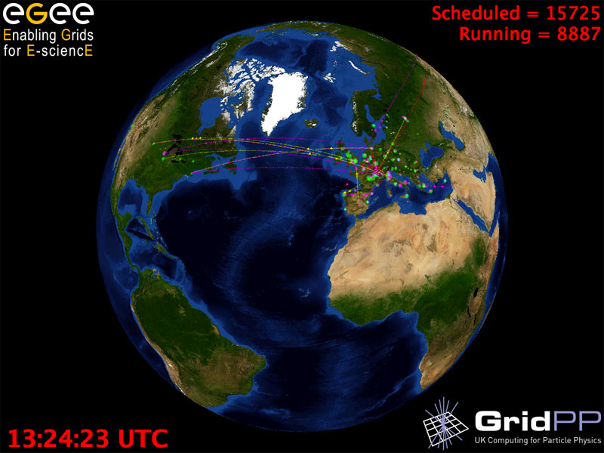
Graphics: Real Time Monitor, Gidon Moont, Imperial College London, see http://gridportal.hep.ph.ic.ac.uk/rtm/

Slide 3
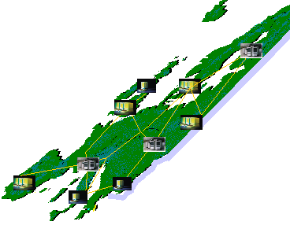

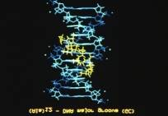
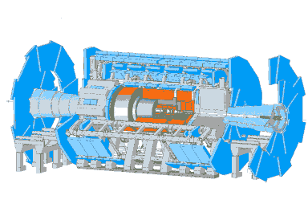
Grid from 10 000 feet
Work regardless of geographical location, interact with colleagues, share and access data
Scientific instruments, libraries and experiments provide huge amounts of data
The GRID: networked data processing centres and ”middleware” software as the “glue” of resources.
based on: Federico.Carminati@cern.ch

Slide 4
Why would we need it?
e-Science
Collected data in science and industry grows exponentially:
The Bible | 5 | MByte
X-ray image | 5 | MByte/image
Functional MRI | 1 | GByte/day
Bio-informatics databases | 500 | GByte each
Refereed journal papers | 1 | TByte/yr
Satellite world imagery | 5 | TByte/yr
US LoC contents | 20 | TByte
Internet Archive 1996-2002 | 100 | TByte
Particle Physics today | 5 | PByte/yr
LHC era physics | 20 | PByte/yr

Slide 5
Enterprise
Transaction processing
Finance (what-if analyses)
Pharma (in-silico drug design)
Aerospace (fluid dynamics)

Slide 6
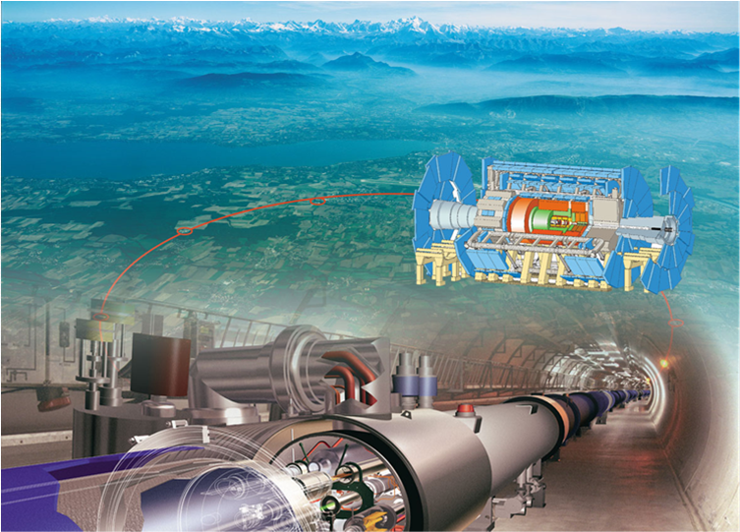


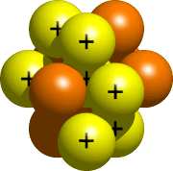

Some use cases: LHC Computing
Large Hadron Collider
‘the worlds largest microscope’
‘looking at the
fundamental forces of nature’
27 km circumference
Located at CERN, Geneva, CH
quarks
10⁻¹⁵ m
atom
nucleus
~ 20 PByte of data per year, ~ 40 000 modern PC style computers

Slide 7
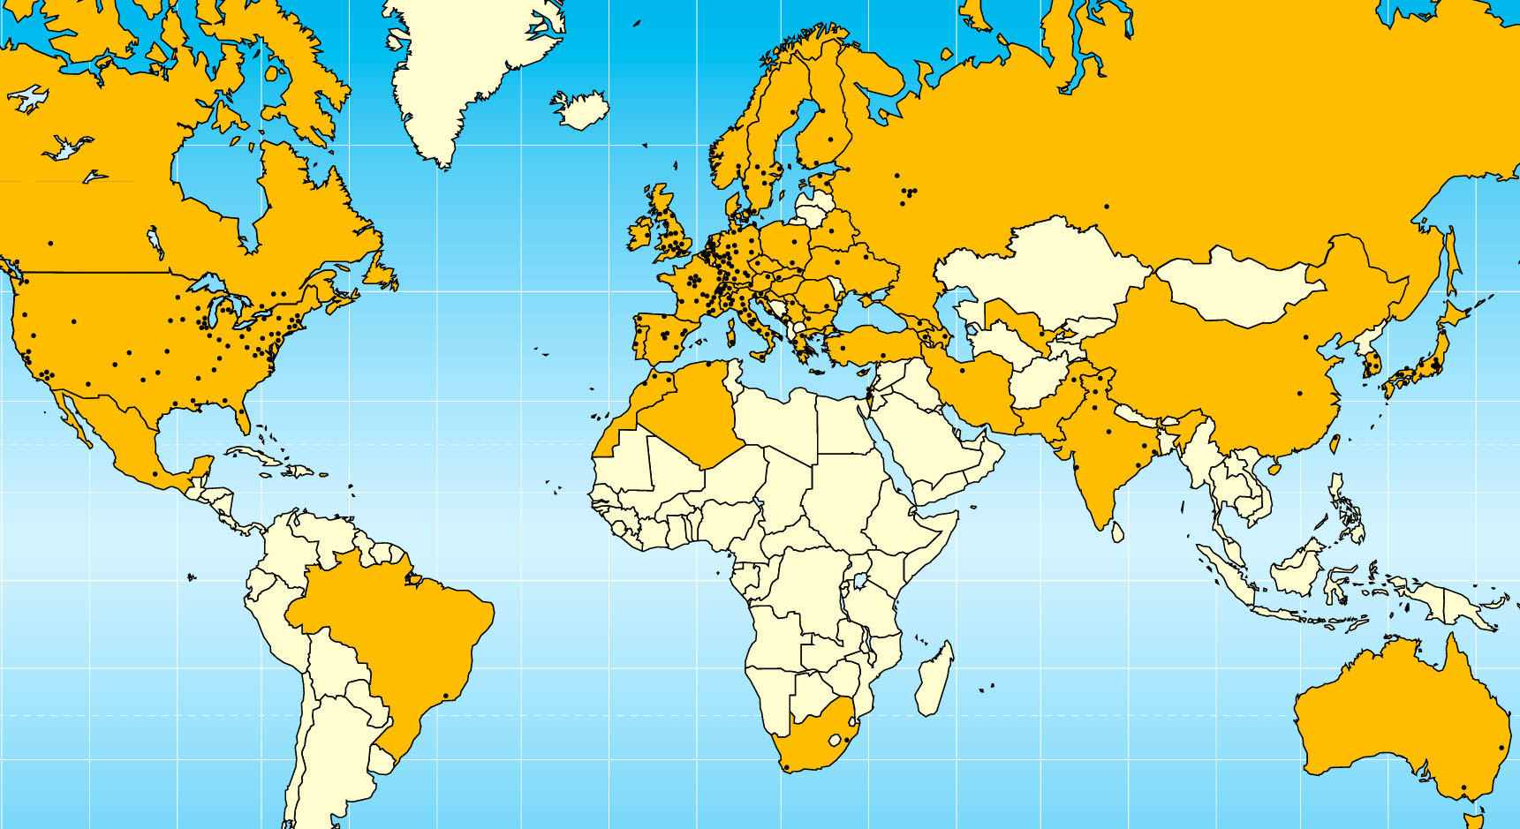

W-LCG: implementing LHC computing
20 years est. life span
24/7 global operations
~ 4000 person-years of
science software investment
~ 5 000 physicists
~ 150 institutes
53 countries, economic regions

Slide 8
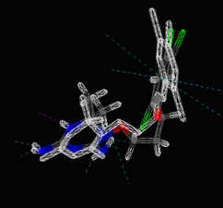
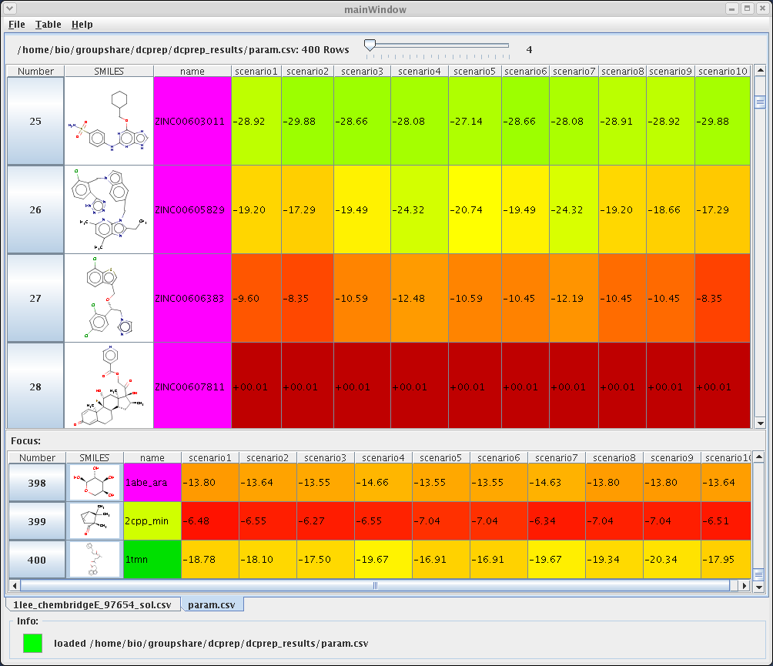

WISDOM: drug discovery
Wide-area In-Silico Docking On Malaria
over 46 million ligands virtually docked on malaria
and H5N1 avian flu viruses in less than a month
used 100 years of CPU power
speedup ~ 100 times!
  47 sites
  15 countries
  3000 CPUs
  12 TByte disk

Slide 9
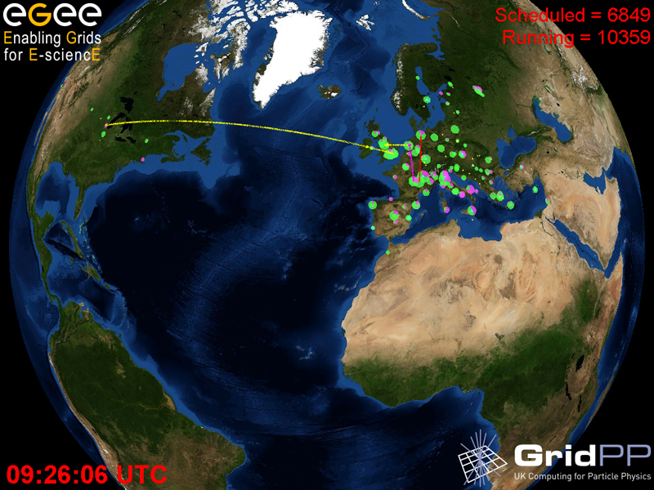
Building the Grid …
Graphics: Real Time Monitor, Gidon Moont, Imperial College London, see http://gridportal.hep.ph.ic.ac.uk/rtm/

Slide 10
Why Grid computing – today?
New applications need larger amounts of data or computation
Larger, and growing, distributed user community
Network grows faster than compute power/storage
Doubling Time
(months)
Optical Fibre
(bits per second)
Gilder’s Law
(32X in 4 yrs)
9 12 18
Data Storage
(bits per sq. inch)
Storage Law
(16X in 4yrs)
Performance per Dollar Spent
Chip capacity
(# transistors)
Moore’s Law
(5X in 4yrs)
0 1 2 3 4 5
Number of Years
Graphic: “The Triumph of Light”, Scientific American, January 2001

Slide 11
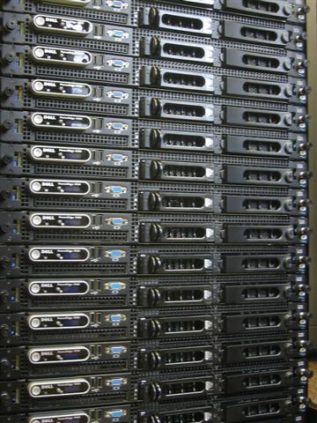
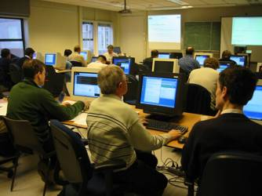
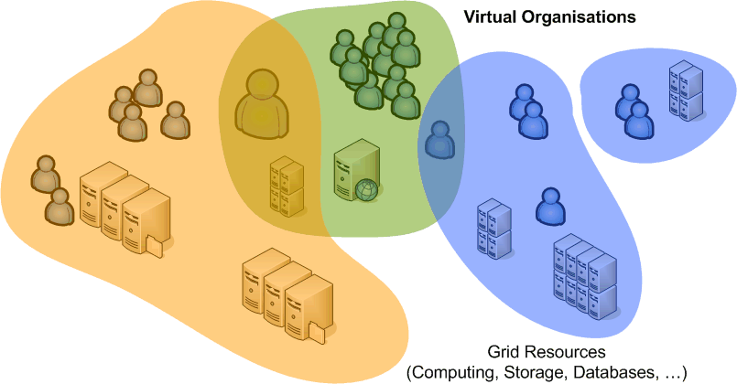
What is Grid?
Cycle scavenging
harvest idle compute power
improve RoI on desktops
Cluster computing and storage
What-if scenarios
Physics event analysis
Improve Data Centre Utilization
Cross-domain resource sharing
more than one organisation
more than one application
more than one …
open protocols
collective service

Slide 12
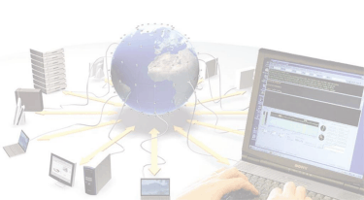
Community Building
authentication
authorization
virtual organizations
Scheduling and clustering
resource management
prioritization and fair-share
Hardware Infrastructures
compute clusters
disk and tape storage
database services
Operational Security Policy
distributed incident response
policies
Managing Complexity
systems management
scaling
multi-national infrastructures

Slide 13
Community Building
Grid Structures
Definition of inter-organizational grids
Virtual Organizations
Security model

Slide 14
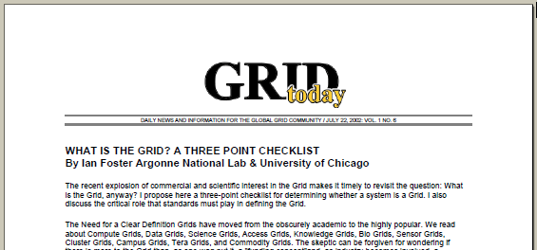
Three essential ingredients for Grid
‘inter-organizational resource sharing’
A grid combines resources that
  Are not managed by a single organization
  Use a common, open protocol … that is general purpose
  Provide additional qualities of service, i.e., are usable as a collective and transparent resource
Source: Ian Foster in Grid Today, July 22, 2002; Vol. 1 No. 6, see http://www-fp.mcs.anl.gov/~foster/Articles/WhatIstheGrid.pdf

Slide 15
Virtual Organisations
The communities that make up the grid:
not under single hierarchical control,
(temporarily) joining forces to solve a particular problem at hand,
bringing to the collaboration a subset of their resources,
sharing those at their discretion and each under their own conditions.

Slide 16
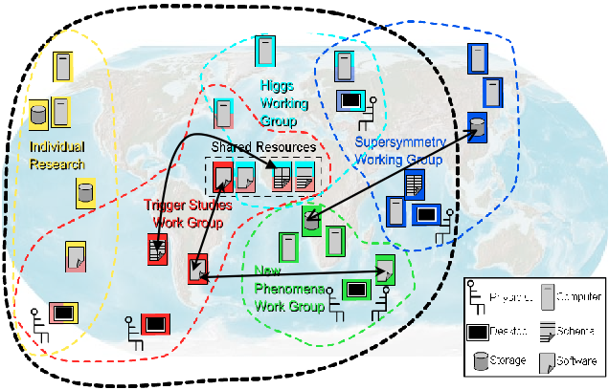
Although nothing is ever quite that neat …
graphic: Open Grid Services Architecture, © Global Grid Forum 2005, GFD.30

Slide 17
Federation in Grid Security
There is no a priori trust relationship between members
or member organisations!
  VO lifetime can vary from hours to decades
  VO not necessarily persistent
  (both long- and short-lived)
  people and resources are
  members of many VOs
but who to trust and how to federate
  at the organisation level?
  eduroam™, inCommon, SWITCHaai, UK Access Mngt Federation
  at the user and VO level?
  user AuthN and VO-centric AuthZ authorities ‘orthogonal’ to the org structure
Org. Certification
Org. Certification
Authority
Authority
Policy
Policy
Authority
Authority
Sub-Domain A1
Sub-Domain B1
Domain A
Task
Domain B
GSI
Server X
Server Y

Slide 18
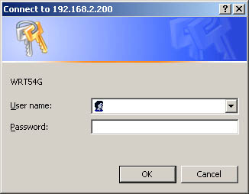
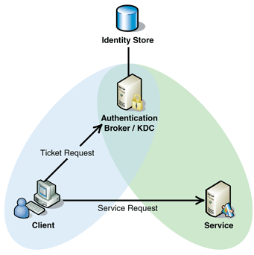

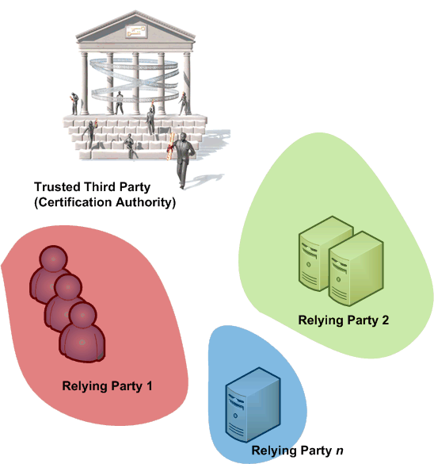
Security Trust Mechanisms
Intra-organizational security vs. global grids
...

Slide 19
Direct (username-password) authN
Dedicated to each site where you want access
Usually strongly linked to authorization
  different accounts for different roles
In a multi-organizational problem is
O(n_{sites}) * O(n_{users})
Federation technologies (see later) help in some respects

Slide 20
Kerberos
Common trust domain around a KDC
Based on service tickets, derived from a TGT
  Encrypted with the service key from the target service
  Whether you talk to the ‘right’ server is implicit in it’s ability to decode your service ticket
Cross-domain trust by recognizing KDC tickets
  interesting in presence of symmetric crypto
  but usually, alignment mismatch between
  organizations is the limiting factor
  For multi-domain gets to be O(n²) for n sites

Slide 21
PKI
Relying parties (sites and users) all recognise a trusted third party (CA)
Problem is now O(n_{CA})
and n_{CA} is hopefully << n_{sites}
But there will be more than one CA as well …

Slide 22
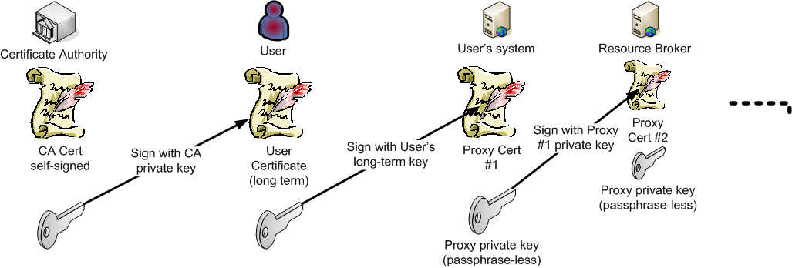
Delegation – carrying identity and rights forward
Single sign-on in a end-user PKI environment
and a carrier for VO membership information
RFC 3820 “Proxy Certificates”

Slide 23
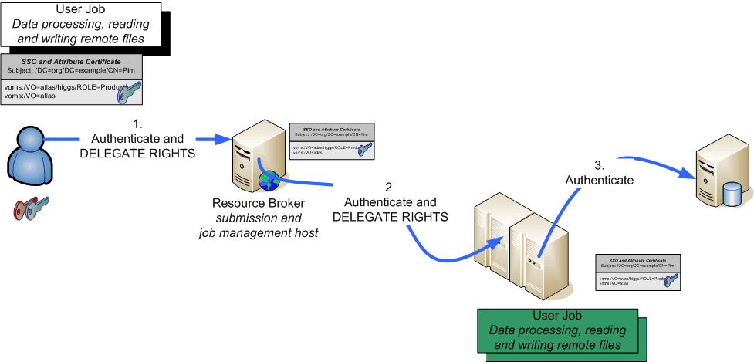
Delegation in Grid Use Cases

Slide 24
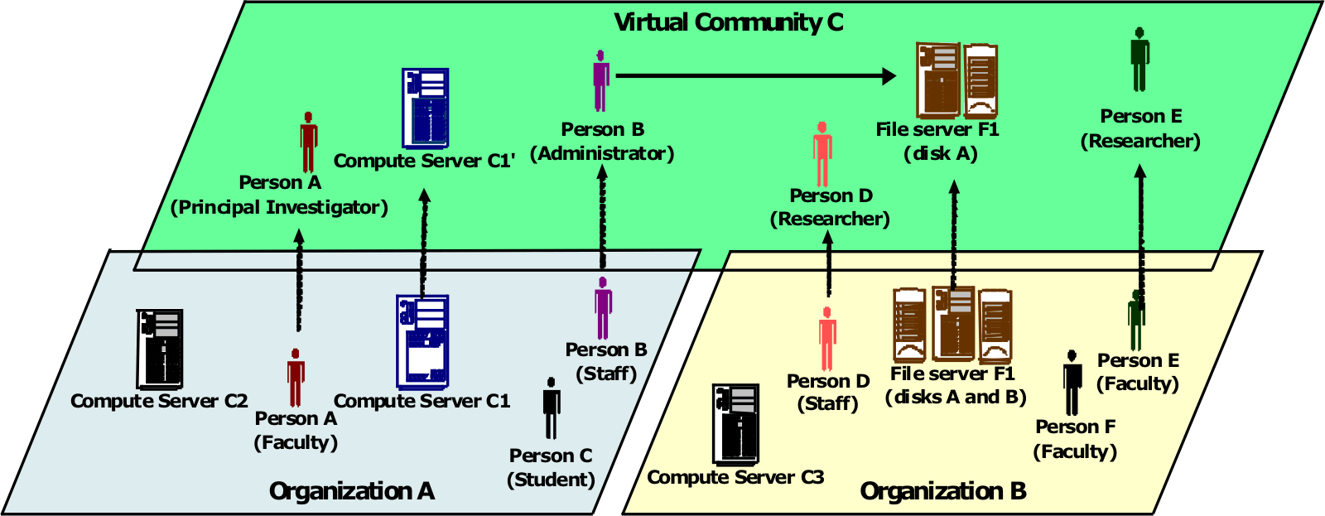
Organizing people
‘Identity is not enough’
‘virtual’ organization roles are independent of home organization roles
and authority for the VO roles rests with the VO
Graphic: Open Grid Forum OGSA Working Group, GFD.30

Slide 25
Authentication vs. Authorization
For user-centric delegation and VO-based grids
Single Authentication token (“passport”)
  issued by a party trusted by all,
  recognised by many resource providers, users, and VOs
  satisfy traceability and persistency requirement
  in itself does not grant any access, but provides
  a unique binding between an identifier and the subject
Per-VO (per ‘UHO’) Authorisations (“visa”) attributes
  granted to a person/service via a virtual organisation
  based on the ‘passport’ name
  embedded in the single-sign-on token (proxy)
  acknowledged by the resource owners
  providers can obtain lists of authorised users per VO,
  but can still ban individual users

Slide 26
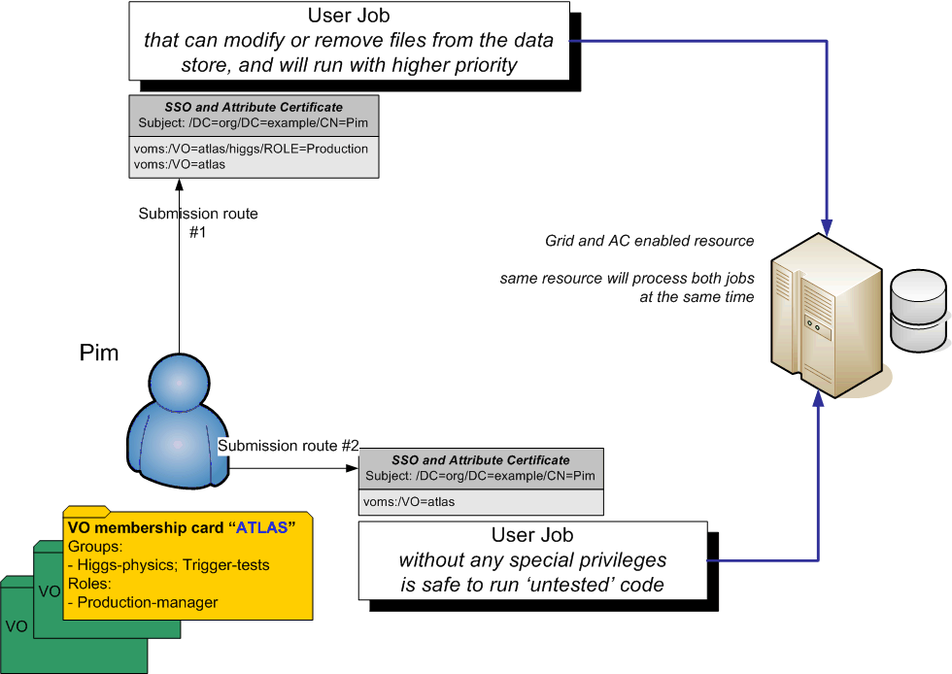
Role-based access control

Slide 27
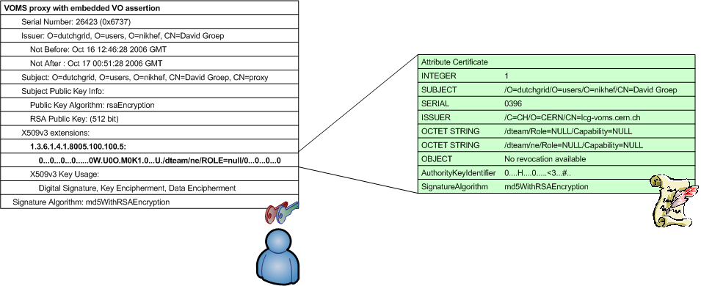
VOMS: Assertions in X.509 AC or SAML
Virtual Organisation Management System (VOMS)
push-model for signed VO membership tokens
  using the traditional X.509 ‘proxy’ certificate for shipping

Slide 28
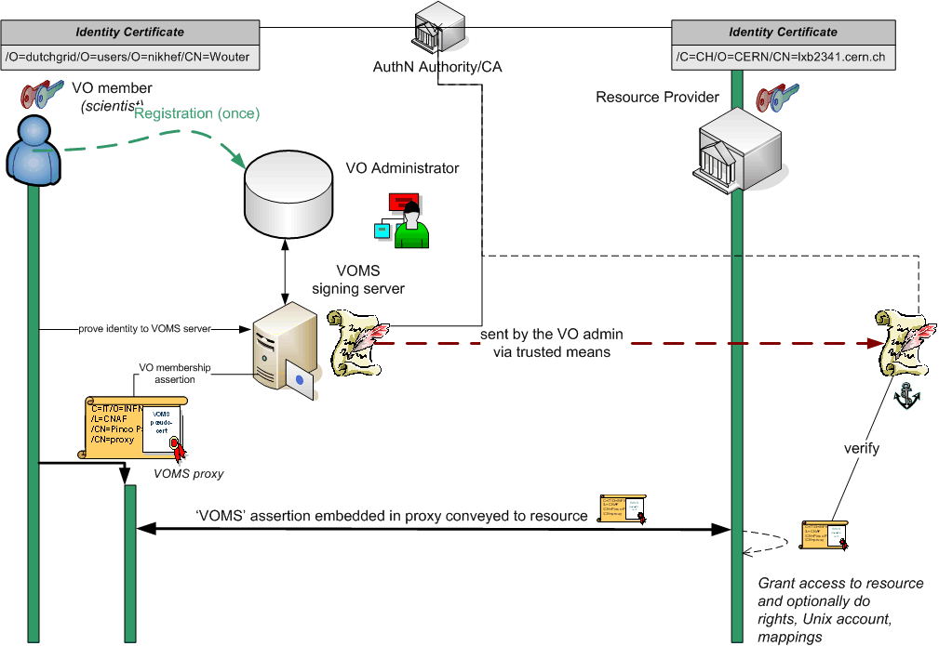

Slide 29
Federation and Confederation
Federation: the IGTF
Home-organization based
User centric

Slide 30

Federated PKI for authentication
CA 2
CA 1
charter
relying
party n
CA n
guidelines
CA 3
acceptance
process
relying
party 1
A Federation of many independent CAs (a ‘policy bridge’)
  common minimum requirements
  trust domain as required by users and relying parties
  well-defined and peer-reviewed acceptance process
User has a single identity
  from a local CA close by
  works across VOs, with single sign-on via impersonation ‘proxies’ (RFC3820)
  certificate itself also usable outside the grid
International Grid Trust Federation and EUGridPMA, see http://www.gridpma.org/

Slide 31

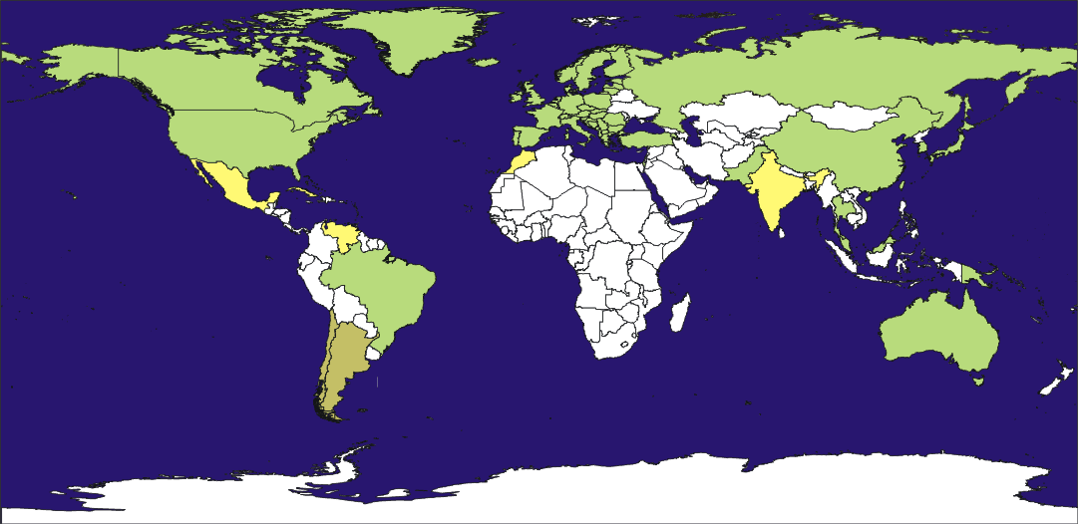
Federation of 3 Regional “PMAs”, that define common guidelines and accredit credential-issuing authorities

Slide 32
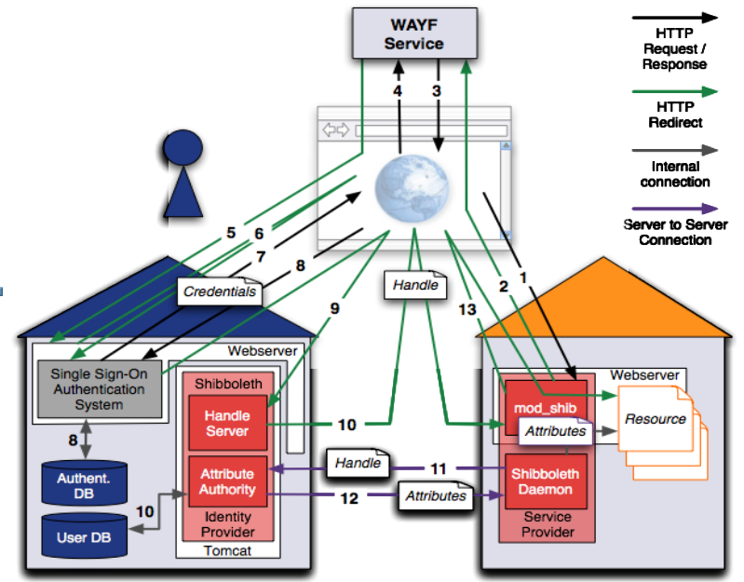

Federation alternatives hiding PKI from users

Slide 33
Federated Authentication
Users authenticate to their home organization
There they have a set of attributes
  With a release policy
  Home organisation authoritative for them
Service Providers make access decision based on the attributes related to an abstract handle
  User’s name (eduPersonPrinciple Name) is also an attribute
But the home organisation cannot make assertions about VO membership
  We need to move to a multi-authority world

Slide 34
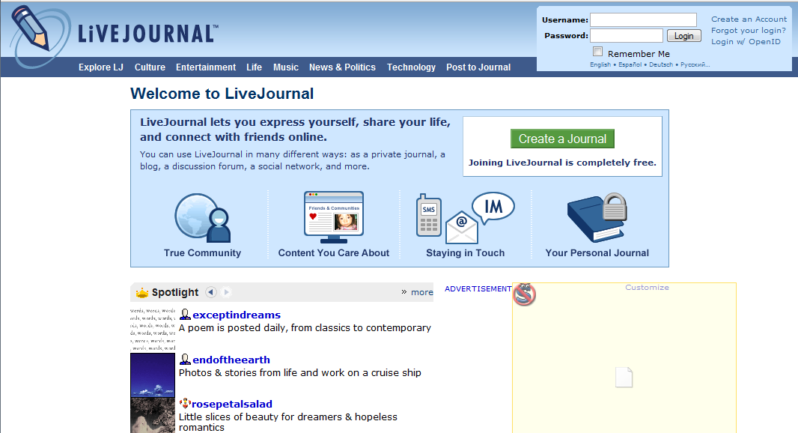
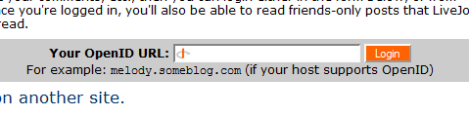
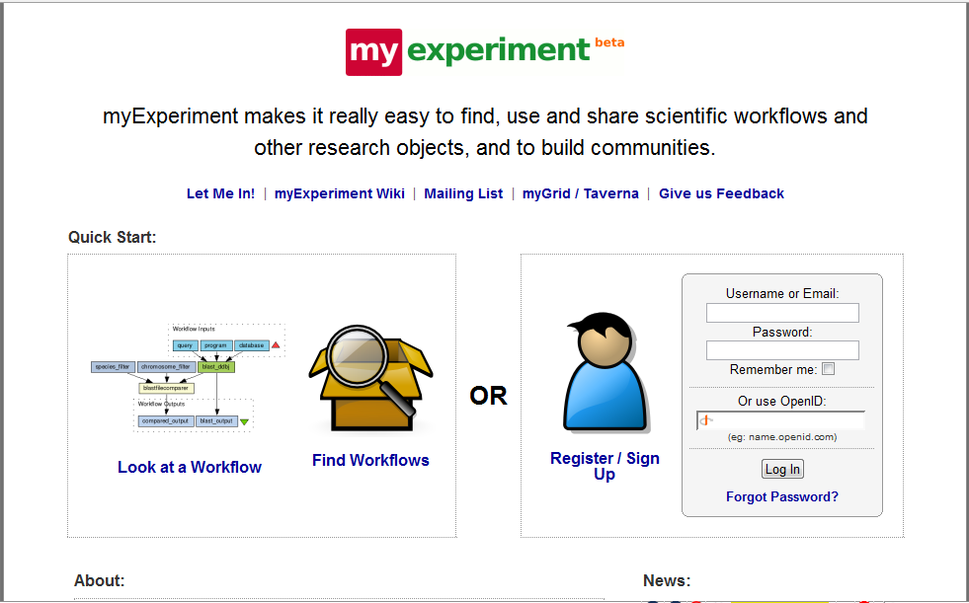
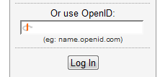


Federation techniques getting popular
based around web services security protocols and SAML assertions

Slide 35
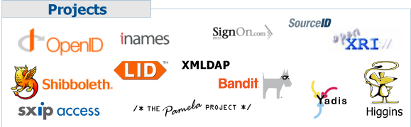
User Centric Identity?
see, e.g., Burton Group’s blog
http://identityblog.burtongroup.com/
CardSpace,
project Higgins,
…
Based on Web Services
and ‘SAML’ assertions
  Self-assertions
  Assertions ‘filled in’ by trusted third parties, such as Visa, MC, etc.
Required assurance depends on the target system
Interop testing just starting, see, e.g.
http://identityblog.burtongroup.com/bgidps/2007/08/recapping-the-c.html
Kim Cameron’s Identity blog

Slide 36
Using the Grid
Accessing resources
Resource Brokering
Data access
Resource Information Systems

Slide 37
Services in a Grid
Computing Element “front-end service for (set of) computers”
  Cluster computing: typically Linux with IP interconnect
  with a ‘head node’ that batches or forwards requests to the cluster
  Capability computing: typically shared-memory supercomputers
Storage “front-end service for disk or tape”
  Both disk and tape based
    Varying retention time, QoS, uniformity of performance
  Expressing ACLs in grid terms in challenging:
  mapping of grid authorization to e.g. POSIX ACLs
File Catalogues … naming (data) objects in the Grid
  for the really courageous people: represent computing, storage and data all as ‘named objects’ in a single ‘grid name space’
Information System … finding out resources on the Grid
  Directory-based for static information
  Monitoring and bookkeeping for real-time information
Resource Broker …
  Matching user job requirements to offers in the information system
  WMS allows disconnected operation of the user interface

Slide 38
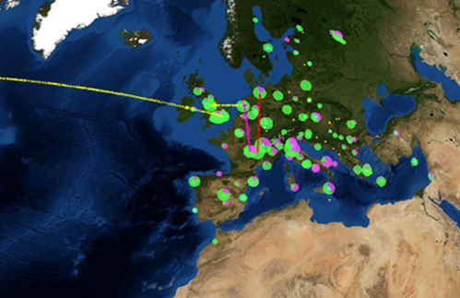
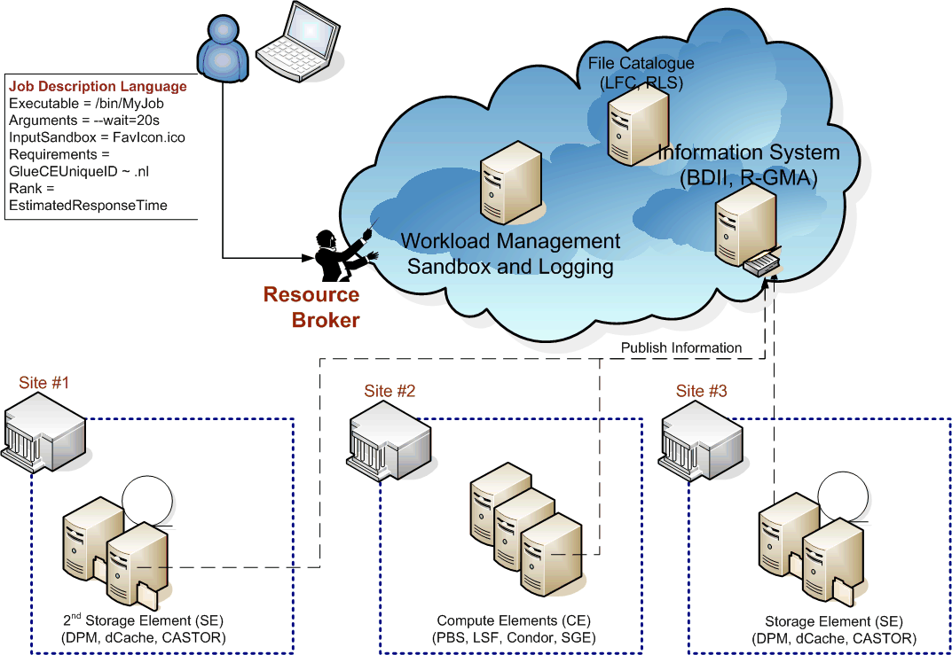
Typical grid topology for computational jobs

Slide 39





But you are not there yet …
?
Heterogeneous resources
Unknown local environment
Unknown access policies

Slide 40
Computing: user expectations?
Different user scenarios are possible and valid
  paratrooper mode: come in, take all your equipment (files, executable &c) with you, do your thing and go away
    you’re supposed to clean up, but the system will likely do that for you if you forget. In all cases, garbage left behind is likely to be removed
  two-stage ‘prepare’ and ‘run’
    extra services to pre-install environment and later request it
    see later on such Community Software Area services
  don’t think but just do it
    blindly assume the grid is like your local system
    expect all software to be there
    expect your results to be retained indefinitely
    … realism of this scenario is unclear for ‘production’ grids
      it does not scale to larger numbers of users
      but large user communities hold ‘power’ over the resource providers
      (or the customers run away)

Slide 41
Submission
Basic operations
Direct run/submit
  useless unless you have an environment already set up
Cancel
Signal
Suspend
Resume
List jobs/status
Purge (remove garbage)
  retrieve output first …
Other useful functions
Assess submission (eligibility, estimated response time)
Register & Start (needed if you have ‘sandboxes’)

Slide 42
A seemingly simple task
The CE seems conceptually simple
  submit a job
  wait for it to run
  retrieve the results
  or kill it prematurely …
  but: there are a bazillion ways to implement it
    with implicit or explicit data staging
    hide the entire site structure and use forwarding nodes
    or even allow automatic forwarding to another site
    policy and prioritization
the user does not want to know the difference
  and an automatic resource broker needs a backend for every type
back-end is usually just a simple old batch system

Slide 43
GT4 WS GRAM Architecture
Service host(s) and compute element(s)
Job events
SEG
GT4 Java Container
Compute element
GRAM
services
Local job control
GRAM
services
Local
scheduler
Job functions
sudo
GRAM
adapter
Delegate
Client
Delegation
Transfer
request
Delegate
GridFTP
User
job
RFT File
Transfer
FTP
control
FTP data
Remote
storage
element(s)
GridFTP

Slide 44
Unicore CE Architecture
User Certificate
UNICOREPro Client
Arcon
Client Toolkit
Preparation and
Control of jobs
User Certificate
Job preparation/control
Plugins
Runtime Interface
UNICORE
Site List
AJO/UPL
Unsafe Internet (SSL)
AJO/UPL
optional firewall
UNICORE
Site List
User authentication
UNICORE Gateway
UNICORE Site
FZJ
optional firewall
Safe Intranet
(TCP)
Jobs and data transfer to other UNICORE sites
User mapping,
job incarnation,
job scheduling
Network Job Supervisor
(NJS)
NJS
IDB
IDB
IDB
UUDB
Incarnated job
Status request
Target System Interface
(TSI)
TSI
...
TSI
Commands
files
SV1
Blade
Batch Subsystem
Any cluster
management system
Graphic from: Dave Snelling, Fujitsu Labs Europe, “Unicore Technology”, Grid School July 2003

Slide 45




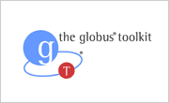
Interoperability – but only basics at first
HPC-BP
- BES
- JSDL
Basic Execution Service
Job submission works, but
security model, file staging, etc. still need to be resolved

Slide 46
Storage
Also here: different types and back ends
  Simple disks: file system, GPFS, Lustre, …
  MSS: DMF, HPSS, dCache/Enstore, CASTOR, …
Separate functions of storage
  Presentation: file system view, logical naming
  Storage resource management:
  relocation, pinning, routing -- SRM
  Transfer protocols:
  GridFTP, Byte-IO, gsidcap, gsirfio
  Storage:
  file system, tape libraries
  Today, the grid interfaces expose all of these levels …
  and, e.g., NFSv4 tried to combine all of that …
  This will see a lot of change the coming time

Slide 47
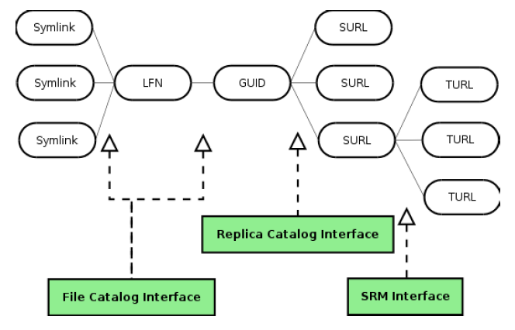
Storage layering and interfaces
graphic: Peter Kunszt, EGEE DJRA1.4 gLite Architecture

Slide 48
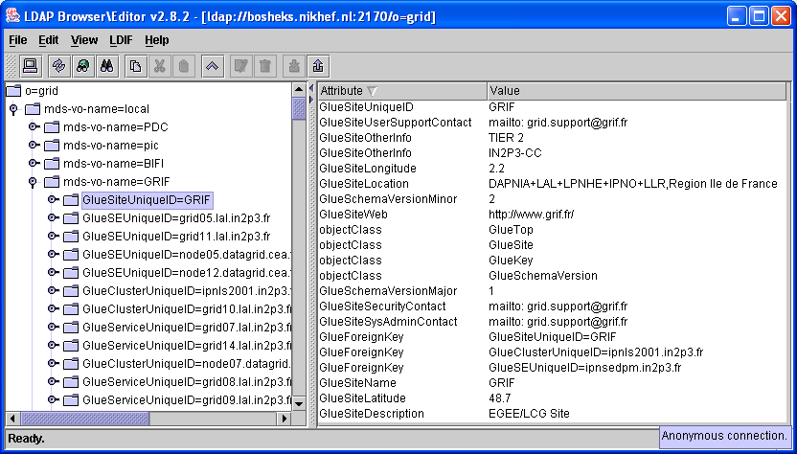
How to you see the Grid?
Broker matches the user’s request with the site
‘information supermarket’ matchmaking (using Condor Matchmaking)
uses the information published by the site
Grid Information system
‘the only information a user ever gets about a site’
So: should be ‘reliable’, consistent* and complete*
Standard schema (GLUE) to
describe sites, queues, storage
(complex schema semantics)
Usually presented as
an LDAP directory
LDAP Browser Jarek Gawor: www.mcs.anl.gov/~gawor/ldap

Slide 49
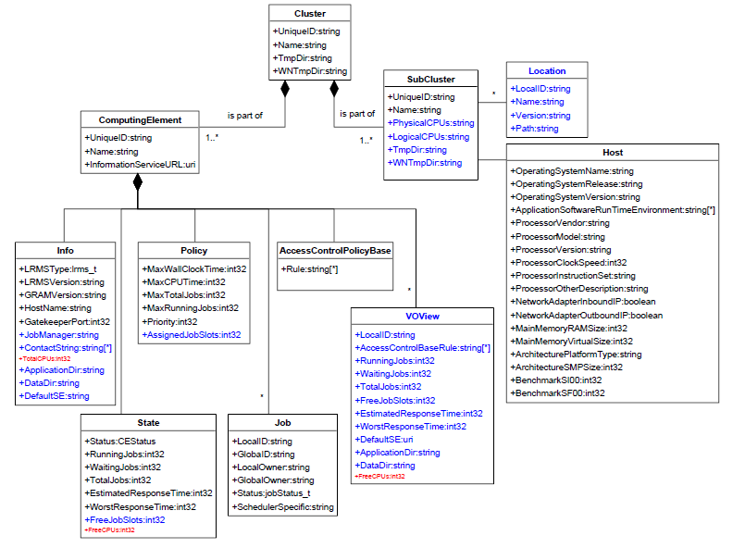
GlueCE: a ‘resource description’ viewpoint
From: the GLUE Information Model version 1.2, see document for details

Slide 50
Information system and brokering issues
Size of information system scales with #sites and #details
  already 12 MByte of LDIF
  matching a job takes ~15 sec
  Static and dynamic information is mixed ← this is ReallyBad™
Scheduling policies are infinitely complex
  no static schema can likely express this information
  but negotiation processes take time at each request
  WS-Agreement is not really popular, at least not yet …
Much information (still) needs to be set-up manually
… anything human will go wrong
⇒ The info system is the single most important grid service
Broker tries to make optimal decision based on this information
… but a `reasonable’ decision would have been better

Slide 51
Glue Attributes Set by the Site
Site information
  SiteSysAdminContact: mailto: grid-admin@example.org
  SiteSecurityContact: mailto: security@example.org
Cluster info
  GlueSubClusterUniqueID=gridgate.cs.tcd.ie
    HostApplicationSoftwareRunTimeEnvironment: LCG-2_6_0
    HostApplicationSoftwareRunTimeEnvironment: VO-atlas-release-10.0.4
    HostBenchmarkSI00: 1300
    GlueHostNetworkAdapterInboundIP: FALSE
    GlueHostNetworkAdapterOutboundIP: TRUE
    GlueHostOperatingSystemName: RHEL
    GlueHostOperatingSystemRelease: 3.5
    GlueHostOperatingSystemVersion: 3
    GlueCEStateEstimatedResponseTime: 519
    GlueCEStateRunningJobs: 175
    GlueCEStateTotalJobs: 248
Storage: similar info (paths, max number of files, quota, retention, …)

Slide 52
Typical grid topology for computational jobs

Slide 53
Grid Site Infrastructure
Example: Compute Clusters
The Impact of Scale

Slide 54
High Performance or High Throughput?
Key question: max. granularity of decomposition:
Have you got one big problem or a bunch of little ones?
  To what extent can the “problem” be decomposed into sort-of-independent parts (‘grains’) that can all be processed in parallel?
Granularity
  fine-grained parallelism –
  the independent bits are small, need to exchange information, synchronize often
  coarse-grained –
  the problem can be decomposed into large chunks that can be processed independently
Practical limits on the degree of parallelism –
  how many grains can be processed in parallel?
  degree of parallelism v. grain size
  grain size limited by the efficiency of the system at synchronising grains

Slide 55
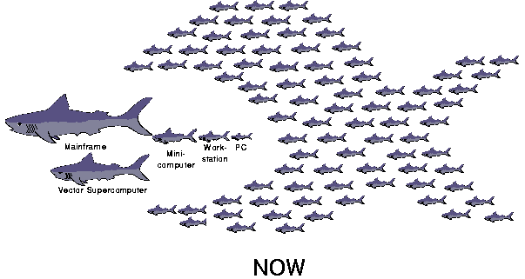
But the fact is:
‘the food chain has been reversed’, and supercomputer vendors are struggling to make a living.
Graphic: Network of Workstations, Berkeley IEEE Micro, Feb, 1995, Thomas E. Anderson, David E. Culler, David A. Patterson

Slide 56
Using these systems
As both clusters and capability systems are both ‘expensive’
(i.e. not on your desktop), they are resources that need to be scheduled
And a wide multi-purpose grid will have both types of systems
interface for scheduled access is a batch queue
  job submit, cancel, status, suspend
  sometimes: checkpoint-restart in OS, e.g. on SGI IRIX
  allocate #processors
  (and amount of memory, these may be linked!)
  as part of the job request
systems usually also have smaller interactive partition
  more a ‘user interface’, not intended for running production jobs …

Slide 57
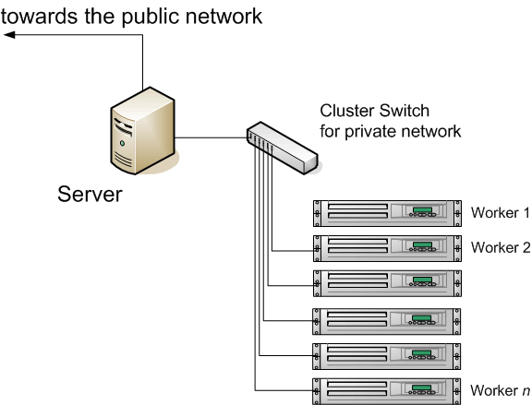
Cluster architectures
‘Beowulf’ virtual supercomputers
  entire cluster managed by the server
  users interact only with the server to start and manage jobs
  parallelism supported by MPI, PVM, OpenMosix libraries
classic network architecture
  server connected to the public network
  all WNs on a cluster-local LAN
  usually using private IP space
  no communication from the
  WNs to the outside world
installs can even use diskless clients*
  PXE boot refers to NFS root fs
  all IO is done remotely on the server
  But don’t try this for data-intensive computing!

Slide 58
Example: scheduling policies - Maui
RMTYPE[0] PBS
RMHOST[0] tbn20.nikhef.nl
...
NODEACCESSPOLICY SHARED
NODEAVAILABILITYPOLICY DEDICATED:PROCS
NODELOADPOLICY ADJUSTPROCS
FEATUREPROCSPEEDHEADER xps
BACKFILLPOLICY ON
BACKFILLTYPE FIRSTFIT
NODEALLOCATIONPOLICY FASTEST
FSPOLICY DEDICATEDPES
FSDEPTH 24
FSINTERVAL 24:00:00
FSDECAY 0.99
GROUPCFG[users] FSTARGET=1 PRIORITY=10 MAXPROC=50
GROUPCFG[dteam] FSTARGET=2 PRIORITY=5000 MAXPROC=32
GROUPCFG[alice] FSTARGET=9 PRIORITY=100 MAXPROC=200 QDEF=lhcalice
GROUPCFG[alicesgm] FSTARGET=1 PRIORITY=100 MAXPROC=200 QDEF=lhcalice
GROUPCFG[atlas] FSTARGET=54 PRIORITY=100 MAXPROC=200 QDEF=lhcatlas
QOSCFG[lhccms] FSTARGET=1- MAXPROC=10
MAUI is an open source product from ClusterResources, Inc. http://www.supercluster.org/

Slide 59
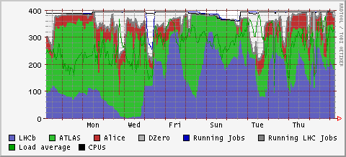
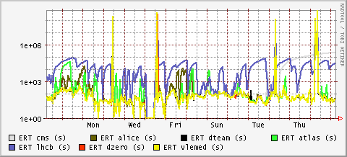
Fair shares and estimated response time
local ‘fair shares’, used to satisfy overall SLA requirements, need to be translated to an ‘estimated response time’ for the grid VOs and groups – an unsolved problem
job slots used
seconds

Slide 60
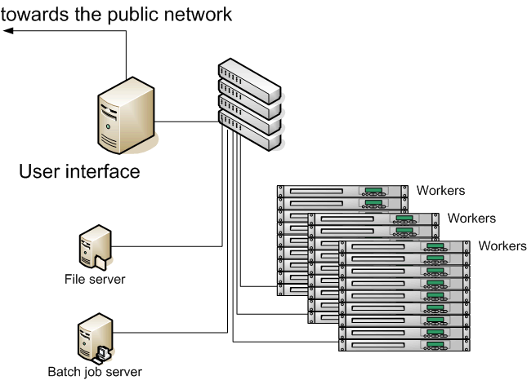
Growing your cluster
Larger clusters accommodated by more switches, but
  file I/O (headnode load) becomes bottleneck
    system booting (PXE, NFS roots)
    home directories
    cluster job management
  function separation
  (boot server, IO server)
  within the cluster helps
  only little

Slide 61
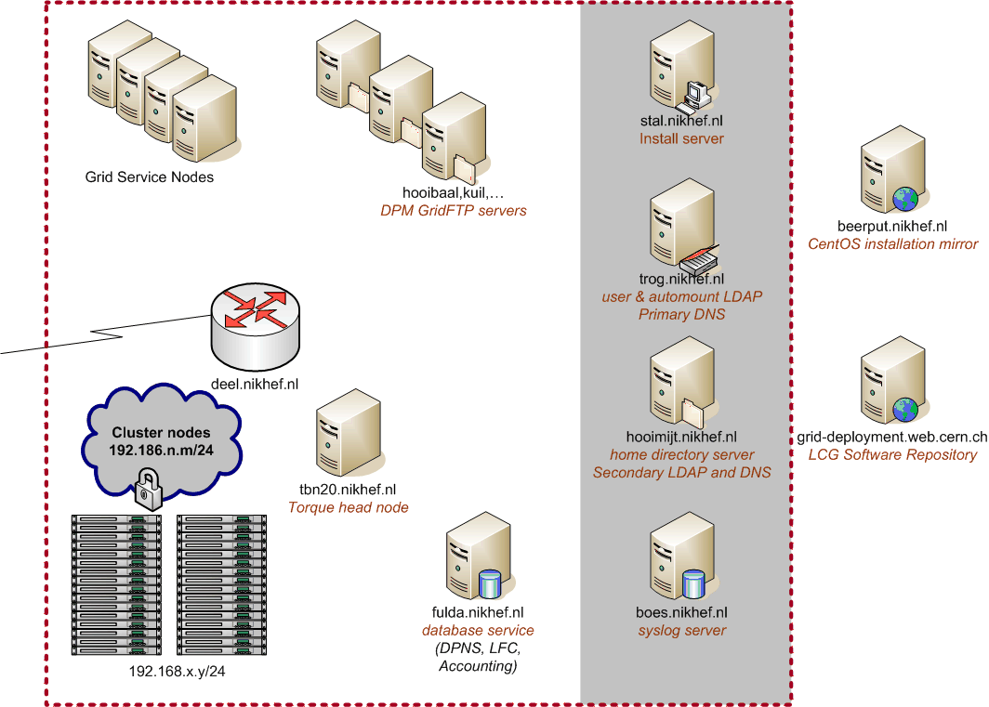
Extending your grid site
Storage, databases, information services
NAT on outbound interface
for worker node IP addresses

Slide 62
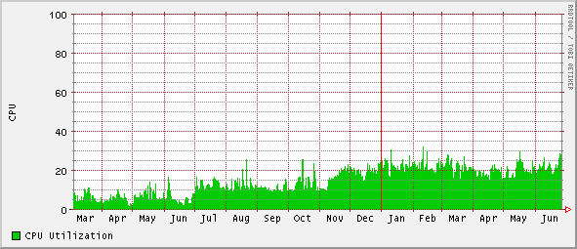
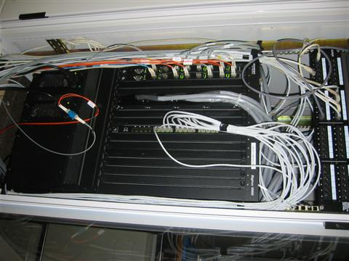
But NAT does not help
The NAT kludge leads to several problems
  with FTP-like protocols for data-transfer
  with the load on the NAT box
and is certainly not the solution for protecting the WNs from attacks from the public internet, as commonly perceived
  can do that easily with ‘permit tcp established’ followed by ‘deny any any’
bulld0zer
halloween
CPU load avearage ‘deel.nikhef.nl’
(Foundry BigIron 15k with 2x BMGR8 Mngt-IV module)

Slide 63
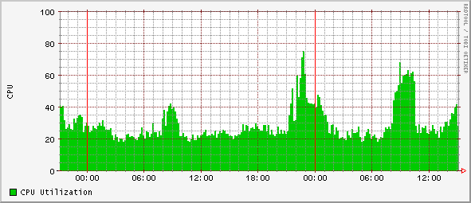
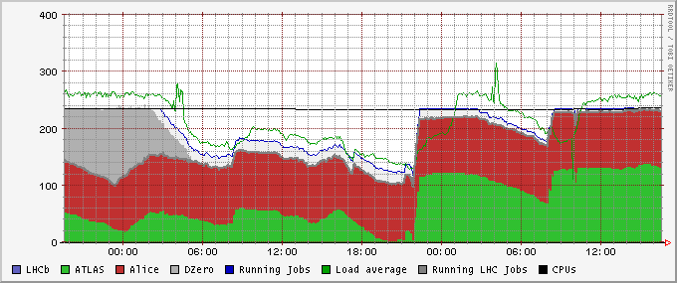
Data intensive jobs
ATLAS HEP jobs
retrieving input data sets

Slide 64
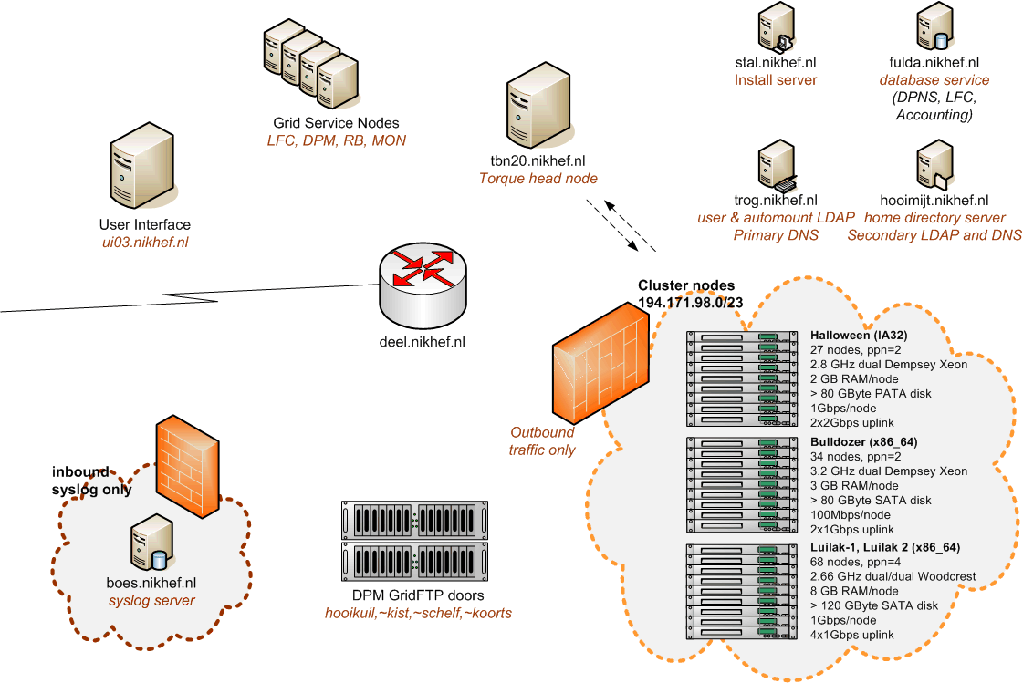
NDPF Logical Overview

Slide 65
Network
The LHC OPN
OPN Routing Creativity

Slide 66
Remembering the Atlas Tier-1 data flows
RAW
Tape
Real data storage, reprocessing and distribution
RAW
ESD2
1.6 GB/file
0.02 Hz
1.7K f/day
32 MB/s
2.7 TB/day
AODm2
0.044 Hz
3.74K f/day
44 MB/s
3.66 TB/day
Tier-0
disk
buffer
AODm1
AODm2
500 MB/file
0.04 Hz
3.4K f/day
20 MB/s
1.6 TB/day
500 MB/file
0.04 Hz
3.4K f/day
20 MB/s
1.6 TB/day
ESD1
AODm1
RAW
AOD2
ESD2
AOD2
AODm2
0.5 GB/file
0.02 Hz
1.7K f/day
10 MB/s
0.8 TB/day
500 MB/file
0.04 Hz
3.4K f/day
20 MB/s
1.6 TB/day
1.6 GB/file
0.02 Hz
1.7K f/day
32 MB/s
2.7 TB/day
10 MB/file
0.2 Hz
17K f/day
2 MB/s
0.16 TB/day
0.5 GB/file
0.02 Hz
1.7K f/day
10 MB/s
0.8 TB/day
10 MB/file
0.2 Hz
17K f/day
2 MB/s
0.16 TB/day
500 MB/file
0.004 Hz
0.34K f/day
2 MB/s
0.16 TB/day
Tier-2s
T1
T1
CPU
farm
Plus simulation & analysis data flow
ESD2
AODm2
0.5 GB/file
0.02 Hz
1.7K f/day
10 MB/s
0.8 TB/day
500 MB/file
0.036 Hz
3.1K f/day
18 MB/s
1.44 TB/day
ESD2
AODm2
ESD2
AODm2
0.5 GB/file
0.02 Hz
1.7K f/day
10 MB/s
0.8 TB/day
500 MB/file
0.004 Hz
0.34K f/day
2 MB/s
0.16 TB/day
0.5 GB/file
0.02 Hz
1.7K f/day
10 MB/s
0.8 TB/day
500 MB/file
0.036 Hz
3.1K f/day
18 MB/s
1.44 TB/day
Other
Tier-1s
disk
storage
Other
Tier-1s
T1
T1
T1
T1
ATLAS data flows (draft). Source: Kors Bos, NIKHEF

Slide 67
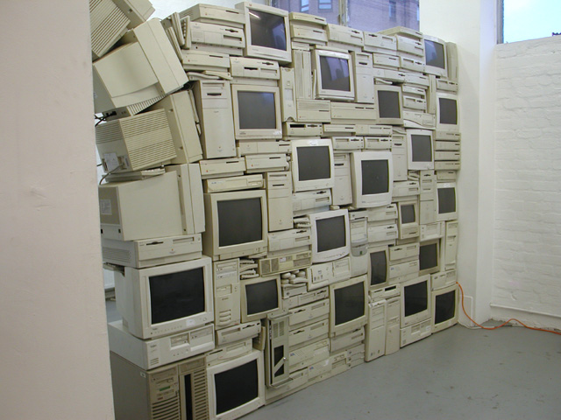
Streams and Firewalls
Data transfer target:
300 MByte/s out of CERN to each of the ~10 T1s
  24 GBit/s aggregate bandwidth
  you cannot traverse firewalls at that speed
OPN is really there to allow un-firewalled connections
  internal routing only (BGP)
  all participants sign
  a common policy
  exclusively for data transfers
  no direct connections
  to ‘The Internet’
“Firewall” by Sandy Smith, www.computersforart.org

Slide 68

Firewall (2)
“Firewall” by Sandy Smith, www.computersforart.org

Slide 69


Slide 70
Policy impact of the OPN
Since only storage systems (not WNs) may use the OPN,
router needs to distinguish between the two classes
  If you have a single core router in your grid cluster where you want to terminate the OPN, you are almost forced to use source-based routing
  but then you loose the features of BGP for fail-over &c
  since a single router has a single routing policy, you need a second router to get the policy right …
  With two independent OPNs, you need 3 routers
  With three independent OPNs, you need 4 routers
  ...
  you actually need virtual routers in your box ☺

Slide 71

From: BiGGrid Network Plan 2008 BIGGRID-TC-2008-015 (draft)

Slide 72
Remember the Market
How many OPNs are there, worldwide?
Looking for OPN/VPN capable routers, you find their primary target market is corporate VPN use
  Indeed, many independent end points
  But each end-point uses ~ 54 kpbs – 2 Mbps
  Then, try to push 10 Gbps through a CISCO VRF module ...
  ... which is kind enough to process each packet in software
  Ouch
  Effective max speed ~ 900 Mbps per router
  (still pretty good, being targeted to the VPN dial-in market)

Slide 73
Systems Management
Managing many heterogeneous systems
OS level tricks
Procuring your systems: Help! I’m a publicly (co)funded body ...

Slide 74



Think BIG
Examples: CERN Computer Centre
not only systems management
but also asset management
and you are not even allowed to look inside Google’s data centres!

Slide 75
Installation
Installing and managing a large cluster requires a system that
Scales to O(10 000) nodes, with
  a wide variety in configuration (‘service nodes’)
  and also many instances of identical systems (‘worker nodes’)
Is predictable and consistent
Can rapidly recovery from node failures
by commissioning a new box (i.e. in minutes)
Preferably ties in with monitoring and recovery (‘self-healing’)
Popular systems include
Quattor
xCAT, NPACI Rocks
SystemImager & cfEngine
LCFGng

Slide 76




Divergent, Convergent, and Congruent Systems
Different characteristics
  Incremental: cfengine, LCFGng
  Deterministic by re-install: xCAT, Rocks
  Transactional: Quattor
Can a self-modifying system reach consistent (or even stable) state without repeatable deterministic ordering of changes on a host?
See also
http://www.infrastructures.org/papers/turing/turing.html
(figures are from paper referenced)

Slide 77
Complete Node Configuration Database
GUI
CDB
S
Q
L
RDBMS
LEAF, LEMON, others
CLI
S
O
A
P
pan
Scripts
XML
H
T
T
P
Cache
Node
Management
Agents
CCM
Node
Source: German Cancio, CERN IT

Slide 78
Node Management
Software Servers
Standard nodes
Managed nodes
http
SW package
Manager (SPMA)
cache
packages
nfs
RPM, PKG
SWRep
packages
(RPM, PKG)
ftp
Installed software
kernel, system, applications..
Install server
System services
AFS,LSF,SSH,accounting..
Vendor
System installer
RHEL*, Solaris,
Fedora,…
nfs/http
Node Configuration
Manager (NCM)
CCM
base OS
dhcp
Node
(re)install
Install Manager
pxe
(s)CDB
Source: German Cancio, CERN IT

Slide 79
Miscellaneous systems configuration hints
an arbitrary selection of deployed configurations

Slide 80
User and system directories and maps
Large number of alternatives exists (nsswitch.conf/pam.d)
files-based (/etc/passwd, /etc/auto.home, …)
YP/NIS, NIS+
Database (MySQL/Oracle)
LDAP
We went with LDAP:
information is in a central location (like NIS)
scales by adding slave servers (like NIS)
is secure by LDAP over TLS (unlike NIS)
can be managed by external programs (also unlike NIS)
(we can even do real-time grid credential mapping to and from uid’s)
But you will need to run nscd, or a large number of slave servers
with nscd, a single server can easily handle ~200 nodes/500 cores
in rare cases, (statically linked) programs run into trouble

Slide 81
Logging and Auditing
Auditing and logging
syslog (also for grid gatekeeper, gsiftp, credential mapping)
process accounting (psacct)
For the paranoid – use tools included for CAPP/EAL3+: LAuS
system call auditing
highly detailed:
useful both for debugging and incident response
default auditing is critical: system will halt on audit errors ☺
  and once in a while you hit a kernel bug that cannot be reproduced, as we did in RHEL3 ☹
If your worker nodes are on private IP space
need to preserve a log of the NAT box as well

Slide 82
Grid and Cluster Logging
Grid statistics and accounting
rrdtool views from the batch system load per VO
  combine qstat and pbsnodes output via script, cron and RRD
cricket network traffic grapher
ganglia monitoring
Nagios probe-based alarms and (grid) monitoring
extract pbs accounting data in dedicated database
  grid users have a ‘generic’ uid from a dynamic pool –
  need to link this in the database to the grid DN and VO
from accounting db, upload (anonymized) records
  grid accounting system for VOs and funding agencies
  accounting db also useful to charge costs to projects locally
  but remember to consider DPA restrictions
    define data usage explicitly
    make users agree, and make sure your click-through actually holds up
    don’t expose if you don’t need to

Slide 83

Nagios display
Graph: Ian Bird

Slide 84

Nagios implementation at a site
Graph: Ian Bird

Slide 85



NDPF Occupancy
2006
Average occupancy 2006, 2007 > 90%
2007
each colour represents a grid VO, black line is #CPUs available

Slide 86



But at times, in more detail
An unresponsive node causes the scheduler MAUI to wait for 15 minutes, then give up and start scheduling again, hitting the rotten node, and …
Auditing Indicent: a disk with less than 15% free makes the syscall-audit system panic, new processes cannot write audit entries, which is fatal, so they wait, and wait, and …
a head node has most activity & fails first!
PBS Server trying desparately to contact a
dead node who’s CPU has turned into Norit
… and unable to serve any more requests.

Slide 87

Black Holes
A mis-configured worker node accepting jobs that all die within seconds.
Not for long, the entire job population will be sucked into this black hole…

Slide 88
Clusters: what did we see?
the Grid (and your cluster) are error amplifiers
  “black holes” may eat your jobs piecemeal
  dangerous “default” values can spoil the day (“GlueERT: 0”)
Monitor! (and allow for (some) failures, and design for rapid recovery)
Users don’t have a clue about your system beforehand
(that’s the downside of those ‘autonomous organizations’)
If you want users to have clue, you push publish your clues correctly
(the information system is all they can see)
Grid middleware may effectively do a DoS on your system
  doing qstat for every job every minute, to feed the logging & bookkeeping …
Power consumption is the greatest single limitation in CPU density
And finally: investment in machine room tidiness pays off,
… or your colleague will not find that #$%^$*! machine
in the middle of night…

Slide 89
Gluing things together
Having flexible cluster management tools is one thing
  keeping it manageable with a staff shortage is something different
Hardware standardization helps
  ensure strict HW compatibility with the chosen OS,
  and both it’s next and previous version
  no custom drivers
  no custom kernels &c
  standard management interfaces (IPMI)
this needs careful wording in a RfP
  or vendors will sell you quite wonderful
  but very labour-intensive stuff!
  which either works only with Windows,
  or with their custom kernel

Slide 90
Security in a Distributed World
Breaking the egg shell approach
Towards policy harmonization
Open Issues: personal data in the grid

Slide 91
Hardening your cluster
A firewall feels quite secure … initially …
with grid resource sharing, the ‘eggshell’ approach breaks
  local users are no longer local:
    local exploits will be used
    malicious users will try to ‘escape’ from the worker nodes
    anyway, O(10k) systems in one go is quite attractive ;-)
    and has real market value
  if you support an ‘user interface’ system for some remote users to get onto the grid, they will the same password as everywhere else
  the most common attack on distributed clusters today is still the ssh trojans and password sniffers
you need global coordination,
or you will be re-compromised from other ‘partner’ sites
read http://www.nsc.liu.se/~nixon/stakkato.pdf
for some real-life experience

Slide 92

What A VO Community Can Do To You
Needs only out-bound connectivity…

Slide 93

Working with VO to respect policy, isolation
At least prevent stealing VO pilot job credentials
Allow cooperative policy compliance

Slide 94

Operational model for the eInfrastructure
Facilitating sustainable infrastructures (e.g. science)
  decouple base resources from the VOs
  provide “hosting” of core (central) services for smaller VOs
but now, policy is needed to create trust between users and
‘grid service providers’ (resource owners)
‘virtual site’

Slide 95
EGEE/LCG Security Policies
Incident
Response
Certification
Authorities
Audit
Requirements
User
AUP
Security & Availability
Policy
VO
AUP
User Registration
& VO Management
Application Development
& Network Admin Guide
picture: Ian Neilson
http://cern.ch/proj-lcg-security/documents.html

Slide 96

  strike balance between security and usability …

Slide 97

Issues
Distributed security
  any computer, desktop and laptop,
  must be assumed compromised
  identity vetting and community membership assertions needed in cross-domain grids
  trust between organisations needed
    we demonstrated this in science – globally!
    federated access to a wide range of resources coming
  security, privacy policies must be coordinated
    essential for a mainstream, sustained, infrastructure
Hardware-supported security is gaining momentum

Slide 98
Balancing incident response to privacy
There are a couple of exemption clauses, for
  Computer, communications and access control
  but limited to max 6 months
… otherwise, you actually ought to register your administration or accounting database
Write down what you keep, why, and for how long
Keep as little data as possible
Limit logs to traffic analysis, not content
But
  keep enough to trace people in case of incidents
  and to support your peers in dealing with incidents
See e.g.
http://www.cbpweb.nl/documenten/av_21_Goed_werken_in_netwerken.stm
http://www.cbpweb.nl/HvB_website_1.0/i1.htm

Slide 99
What’s in a Policy
What do lawyers typically look for
  Consistency of Terminology
  Describe in exact and limitative terms
How binding is it?
    The signer must be explicitly aware of his or her action
    Use default-deny
    On web forms: at least use a pop-up box
    But this has only been marginally tested in court
What about the subjects
  Keep it simple and short
  ‘Separate the policy from the actions’ –
  but, indeed, then they’ll never read the policy
  Short lists work best (also for agreeing on policy)

Slide 100
Putting together the
Grid Infrastructure
Distributed Systems Architecture
It is all about scaling
Managing Complexity Challenges and standards

Slide 101

Grid Infrastructure
Realizing ubiquitous computing requires a persistent infrastructure, based on standards
Organisation
resource providers, user communities and virtual organisation
Operational Services
execution services, workflow, resource information systems, database access, storage management, meta-data
Support and Engineering
user support and ICT experts
… with domain knowledge

Slide 102
Building Grid Infrastructures
Interoperation
Policy Coordination
Facilitation and Negotiation
Interop: common syntax and semantics for grid operations
Policy Coordination: User and VO AUPs, operations, trust
Facilitating negotiation: VO meta-data, SLAs, op. environment

Slide 103

VO-centric infrastructure (‘OSG style’)
What happens if you do not coordinate infrastructure from the beginning …
Advantages
no site management or coordination needed
VOs are self-sustainable
Disadvantages
no site management or coordination
VO establishment is more complex
infrastructure itself is transient and harder to sustain

Slide 104
Interoperation and standards
Standards are essential for adoption
  as resource providers are not inclined to provide n different interfaces
It’s an ‘emerging system’
  GIN (Grid Interoperation Now)
  leverage existing de-facto agreements
  different grid infrastructures need to interoperate
  stability and consistency vary widely
  self-healing and verification are largely absent
GIN

Slide 105
Example: GlueServiceAccessControlRule
For your viewing pleasure: GlueServiceAccessControlRule
261 distinct values seen for GlueServiceAccessControlRule
(one of) least frequently occuring value(s):
1 instance(s) of GlueServiceAccessControlRule: /C=BE/O=BEGRID/OU=VUB/OU=IIHE/CN=Stijn De Weirdt
(one of) most frequently occuring value(s):
310 instance(s) of GlueServiceAccessControlRule: dteam
(one of) shortest value(s) seen:
GlueServiceAccessControlRule: d0
(one of) longest value(s) seen:
GlueServiceAccessControlRule: anaconda-ks.cfg configure-firewall install.log install.log.syslog j2sdk-1_4_2_08-linux-i586.rpm lcg-yaim-latest.rpm myproxy-addons myproxy-addons.051021 site-info.def site-info.def.050922 site-info.def.050928 site-info.def.051021 yumit-client-2.0.2-1.noarch.rpm

Slide 106
Example: GlueHostOperatingSystemRelease
Today's attribute: GlueHostOperatingSystemRelease
1 GlueHostOperatingSystemRelease: 3.02
1 GlueHostOperatingSystemRelease: 3.03
1 GlueHostOperatingSystemRelease: 3.2
1 GlueHostOperatingSystemRelease: 3.5
1 GlueHostOperatingSystemRelease: 303
1 GlueHostOperatingSystemRelease: 304
1 GlueHostOperatingSystemRelease: 3_0_4
1 GlueHostOperatingSystemRelease: SL
1 GlueHostOperatingSystemRelease: Sarge
1 GlueHostOperatingSystemRelease: sl3
2 GlueHostOperatingSystemRelease: 3.0
2 GlueHostOperatingSystemRelease: 305
4 GlueHostOperatingSystemRelease: 3.05
4 GlueHostOperatingSystemRelease: SLC3
5 GlueHostOperatingSystemRelease: 3.04
5 GlueHostOperatingSystemRelease: SL3
18 GlueHostOperatingSystemRelease: 3.0.3
19 GlueHostOperatingSystemRelease: 7.3
24 GlueHostOperatingSystemRelease: 3
37 GlueHostOperatingSystemRelease: 3.0.5
47 GlueHostOperatingSystemRelease: 3.0.4

Slide 107

LCG’s Most Popular Resource Centre
The Most Popular Site Location
Today's attribute: GlueSiteLatitude

Slide 108

Working at scale
Grid is an error amplifier …
  ‘passive’ controls are needed
  to push work away
  from failing resources
Failure-ping-pong – or creeper and reaper revisited
Resource information systems are the
backbone of any real-life grid
Grid is much like the ‘Wild West’
  almost unlimited possibilities – but as a community plan for scaling issues, and a novel environment
  users and providers need to interact and articulate needs

Slide 109









Monitoring Tools
1. GIIS Monitor
2. GIIS Monitor graphs
3. Sites Functional Tests
4. GOC Data Base
5. Scheduled Downtimes
6. Live Job Monitor
7. GridIce – VO view
8. GridIce – fabric view
9. Certificate Lifetime Monitor
Graphs: Ian Bird, EGEE SA1

Slide 110

Graphs: Ian Bird, EGEE SA1, EGEE07 Conference October 2007

Slide 111

Google Grid Map

Slide 112
Managing the complexity
Whatever the internals:
the different implementations offer the same service
Composition of services in to applications
will be deciding factor for adoption
Focus on service interfaces at the edge of proprietary fabrics

Slide 113

Interoperation – between the clouds?
Open protocols, today mostly
web services over TLS
with specific management extensions
(WS-Addressing, WS-Notification, WS-RF)

Slide 114
Introducing standards
Workload Manager Client
Native API
DRMAA/SAGA
WS-I compliant
SOAP toolkit
DRMAA/SAGA
Native API
Native API
WS-I compliant
SOAP toolkit
WS-I compliant
SOAP toolkit
proprietary
API
standard
API
standard
API
proprietary
API
proprietary
protocol
proprietary
protocol
standard
protocol
standard
protocol
standard
protocol
Native Protocol Engine
Native Protocol Engine
OGSA-BES
OGSA-BES
OGSA-BES
Workload Manager
Graphic: Open Grid Forum 2007

Slide 115
Standards
Standards, such as those by IETF, OASIS, OGF, &c
aid interoperability and reduce vendor lock-in
as you go higher up the stack, you get less synergy
  Transport: IP/TCP, HTTP, TLS/SSL, &c well agreed
  Web services: SOAP and WS-Security used to be the solution for all … but ‘Web 2.0’ shows alternatives tailored to specific applications gaining popularity
  Grid standards:
  low-level job submission (BES, JSDL), management (DRMAA), basic security (OGSA-BSP Core, SC) there
  higher-level services still need significant work …
see also http://www.ogf.org/

Slide 116
Why not standardize?
A technology might be “too new”
  you stifle innovation with standardization, which focuses on commonality
A technology might be very niched
  De-facto standards will emerge in this case and in perhaps not so niche areas like KML in Google maps
Standards take too long;
get your product out today and grab market – then your API is the de facto standard
Organizations with a strong proprietary product might try and succeed derailing standards that would enable competition

Slide 117
Growth
Growth of the Infrastructure in Europe

Slide 118



EGEE: ~250 sites, >45000 CPU
24% of the resources are contributed by groups external to the project
~>20k simultaneous jobs
Graphs: Ian Bird, EGEE SA1, EGEE07 Conference October 2007

Slide 119


data: EGEE monitoring, RAL and CESGA, http://goc.grid-support.ac.uk/gridsite/accounting/

Slide 120

25 million SI2000 CPU hours reported/month
2004
2007
34 700 SK2k hr/hr
current core ~ 2 SI2k
So: 15 000 cores avg.
data: EGEE monitoring, RAL and CESGA, http://goc.grid-support.ac.uk/gridsite/accounting/

Slide 121

LHC and non-LHC
Graphs: Ian Bird, EGEE SA1, EGEE07 Conference October 2007

Slide 122

Grid Infrastructures Works!
260 VOs total in EU
~ 40 VOs use grid
>1 day/week
Number of active Vos in EU since 2004
over 20 VOs hosted
in NL
A reliable Grid Infrastructure needs operational support:
availability monitoring
reporting and follow-up
user support
data: EGEE monitoring, RAL and CESGA, http://goc.grid-support.ac.uk/gridsite/accounting/

Slide 123


Common environment
Common infrastructure for e-Science in NL
provided by BiG Grid and the VL-e Proof-of-Concept
interoperable interfaces to resources
common software environment
higher-level ‘virtual lab’ services
Central Facilities:
SARA, NIKHEF, RUG-CIT, Philips
Join yourself: user-interfaces,
distributed clusters, storage
http://poc.vl-e.nl/distribution/

Slide 125
Going From here
Does it work
How can we make it better

Slide 126
Going from here
Many nice things to do:
In many cases, a single OS (mostly EL4) is a nice feature for users, since they know what they get
  but users will need SLES, Debian, Gentoo, … or specific libraries
  and sites don’t want to change OS
Virtualisation (Xen, VMware) to hide user OS from system OS?
Scheduling user jobs
  both VO and site wants to set part of the priorities …
Auditing and user tracing in this highly dynamic system
can we know for sure who is running what where? Or whether a user is DDoS-ing the White House right now?
  Out of 221 sites, we know for certain there is a compromise!

Slide 127
More things to do …
Sparse file access: access data efficiently over the wide area
Can we do something useful with the large disks in all worker nodes?
(our 425 cores share ~12 TByte of unused disk space!)
Transparent (and cheap!) storage access is unsolved!
There are new grid software releases every month, and the configuration comes from different sources …
how can we combine and validate all these configurations fast and easy?

Slide 128
A Bright Future!
Imagine that you could plug your computer into the wall and have direct access to huge computing resources immediately, just as you plug in a lamp to get instant light. …
Far from being science-fiction, this is the idea the [Grid] is about to make into reality.
The EU DataGrid project brochure, 2001

Slide 129
http://www.vl-e.nl/

