Slide 1
RedHat 9+ & FF103: the issue of sha-1 roots
David Groep
May 2023

Slide 2
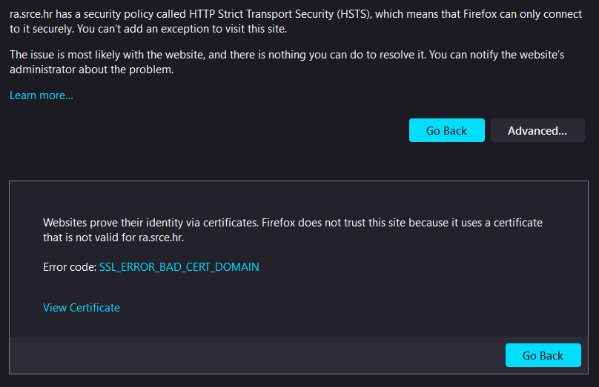
What happened in FF103?

Slide 3
Although it conceptually makes no sense …
SHA-1 is no longer secure (and all EECs and ICAs moved away)
Now, some projects and distros are uselessly deprecating SHA-1 also for self-signed (root) certificates
This affects at least
FF103+
RHEL9+ (and rebuilds)
yet … in the cases we could find only for CA certs that are not in the WebPKI (and distro) public trust list
This impacts both joint-trust and igtf-only trust when installed in a non-system location. But thy system locations are different is not obvious from the doc …

Slide 4
Firefox 103+
On 2022-08-03 16:12, Emir Imamagic wrote:
seems that Firefox removed support for SHA-1 signatures in version 103.0: https://www.mozilla.org/en-US/firefox/103.0/releasenotes/
DavidG and me did some tests and seems that you can still import SHA-1 based CA certificates (there are still 26 of those in the bundle).
However, it will not trust sites protected by host certificates issued by SHA-1 based CA certificate.
This at least holds for imported CAs (but there are still SHA-1 CAs as a built-in object that do work correctly).
For me at least, the error message FF103 produced was very unexpected: "SSL_ERROR_BAD_CERT_DOMAIN"
even through the _domain_ was perfectly fine, but the self-signed root was SHA-1, and the EEC for the server (I tried with https://ra.srce.hr/) was (correctly!) SHA_256. In FF99, this still worked as expected.
And if you have HTST enabled on a site, then an override also does not work …

Slide 5
Rocky9+, AlmaLinux9+, RHEL9+ and
With RHEL9 also deprecating SHA-1, but at the same time
still having self-signed SHA-1 based root certs in the ca-certificates
package,
unknown why that distribution treats SHA-1 certs in the X509_CERT_DIR differently
At least there is a policy override for now
(`update-crypto-policies --set DEFAULT:SHA1`),
even if that is a rather course-grained and blunt tool

Slide 6
The ca-certificates package in RH9
Interestingly, EL9 does ship with a lot of SHA-1 root CAs in ca-certificates-2022.2.54-90.2.el9.noarch.rpm
and the p11-kit sources thereof (and thus e.g. /etc/pki/tls/certs/ca-bundle.crt) contain SHA-1 self-signed roots that do work on EL9.
So p11-kit and the directories are somehow whitelisted in the crypto policies
but I have not found where that is yet.
If you do find out why system roots with SHA-1 are fine with the default policy, but for the same self-signed trust anchors in another place the LEGACY policy has to be set? please share!
Maybe, if you have the ability to file tickets with RedHat, their answer may give us some insight. (Un)fortunately, not many have a RH support contract to notify them ...

Slide 7
Mitigations?
Meanwhile,
if you still have a SHA-1 root
and you are able to re-issue with the same key (and new serial)
and your EECs do not have dirname+serial in their AKI
your CAs should probably re-issuing its root because that is easier.
But for the large ones, esp. the DigiCert Assured ID Root from 2006 for instance, that will be hard.
And migrating to another (SHA-2 rooted) signing hierarchy will take at least 395 days ... and a lot of engineering on the RP and CA side
The root cause is with RH not understanding what a self-signed trust
anchor is, but that will not help us in the short term.

Slide 8
Reissuance of roots?
ASGCCA-2007 ArmeSFo
BYGCA CESNET-CA-Root
CNIC DFN-GridGermany-Root
DZeScience DigiCertAssuredIDRootCA-Root
DigiCertGridRootCA-Root IHEP-2013
KEK LIPCA
MARGI QuoVadis-Root-CA2
RDIG RomanianGRID
SRCE SiGNET-CA
TRGrid seegrid-ca-2013
Fixed by now: GridCanada, CILogon basic/silver/OpenID, UKeScienceRoot-2007
Removed: DigiCertGridCA-1-Classic, DigiCertGridTrustCA-Classic
Will be discontinued soon: GermanGrid (GridKA)

Slide 9
Time lines?
Discussion

