Slide 1

Trust by Demonstration … in a coordinated way
Security Coordination Communications Challenges – all in it together
David Groep
WISE SCCC-JWG & AARC Community,
Nikhef Physics Data Processing, UM Dept. of Advanced Computing Sciences
TNC22 Security Day - WISE Community
June 2022

Slide 2
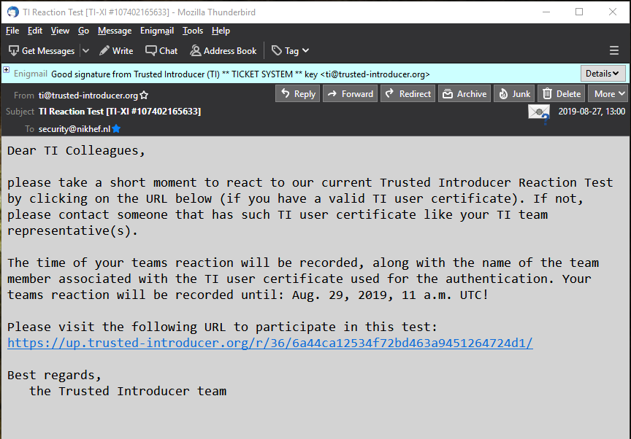
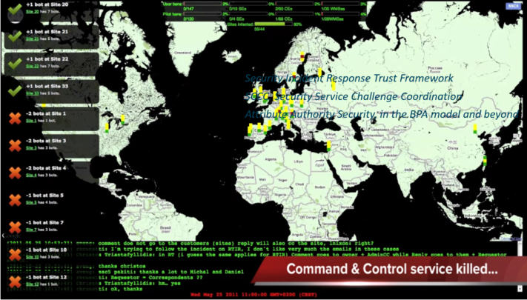
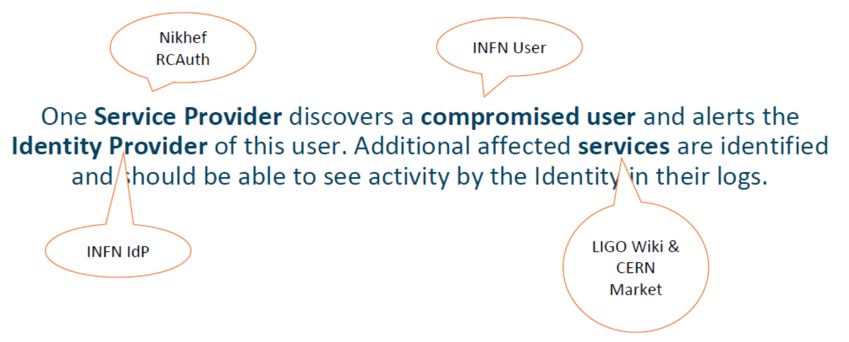


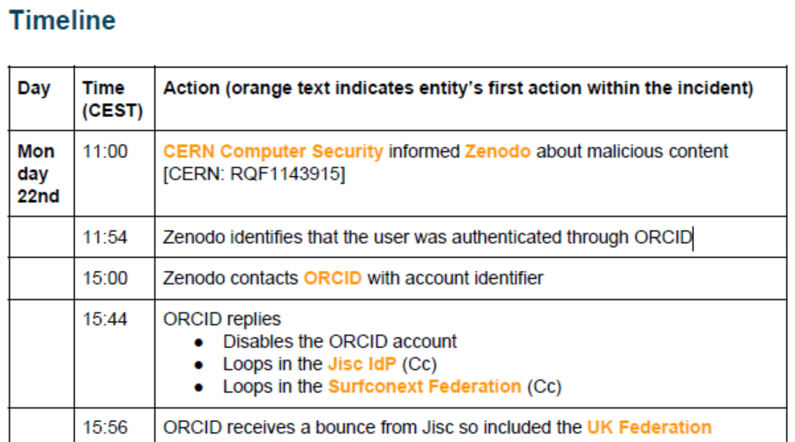



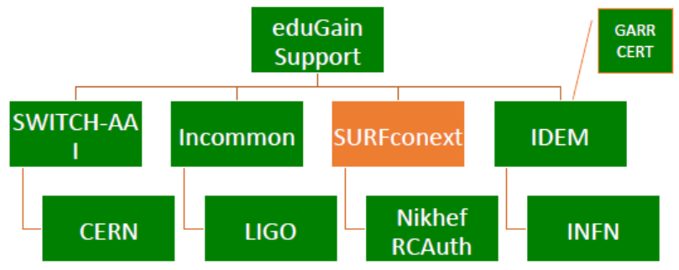
Many communities test, test, and test again

Slide 3
Not all tests are created equal … and not run equally either!
Trusted Introducer and TF-CSIRT
~3 Reaction Tests p/year, supported by web infrastructure, (team) authenticated responses
SURFcert challenges for the national (federated) contacts
annual response challenges, just reply to email to a (traceable) ticket
Communications Challenges: IGTF RAT, eduGAIN-to-federation-ops, EOSC Core providers …
periodic, from every 1-2 years, to annualy
usually in parallel with continuous operational monitoring
EGI CSIRT Security Service Challenges
every ~2 years, aiming at remediation, forensics, and response to real-life (botnet) incidents
requires much more preparation, and integration with research workflow systems costly

Slide 4




Challenge elements – what is valued or expected might differ …
A single test and challenge can answer one or more of these questions
ability to
take action
confidentiality
timeliness
investigative capability
when data available: infrastructure can set its own level of expectancy and gives deep trust
assessment supported with community controls (suspension) gives a baseline compliance
Communications challenges build ‘confidence’ and trust – an important social aspect!
different tests bring complementary results: responsiveness vs. ability act , or do forensics
unless you run the test yourself, you may not be growing more trust in the entities tested
for a ‘warm and fuzzy feeling of trust’, share results: but this is sociologically still challenging …

Slide 5
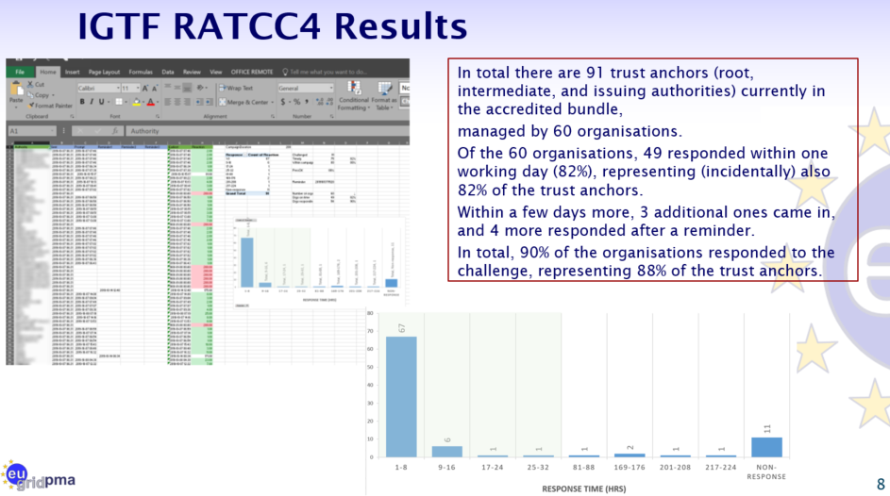
IGFT RATCC4
PS: of the non-response organisations,
4 had their public contact meta-data fixed, and 2 were withdrawn from the distribution

Slide 6

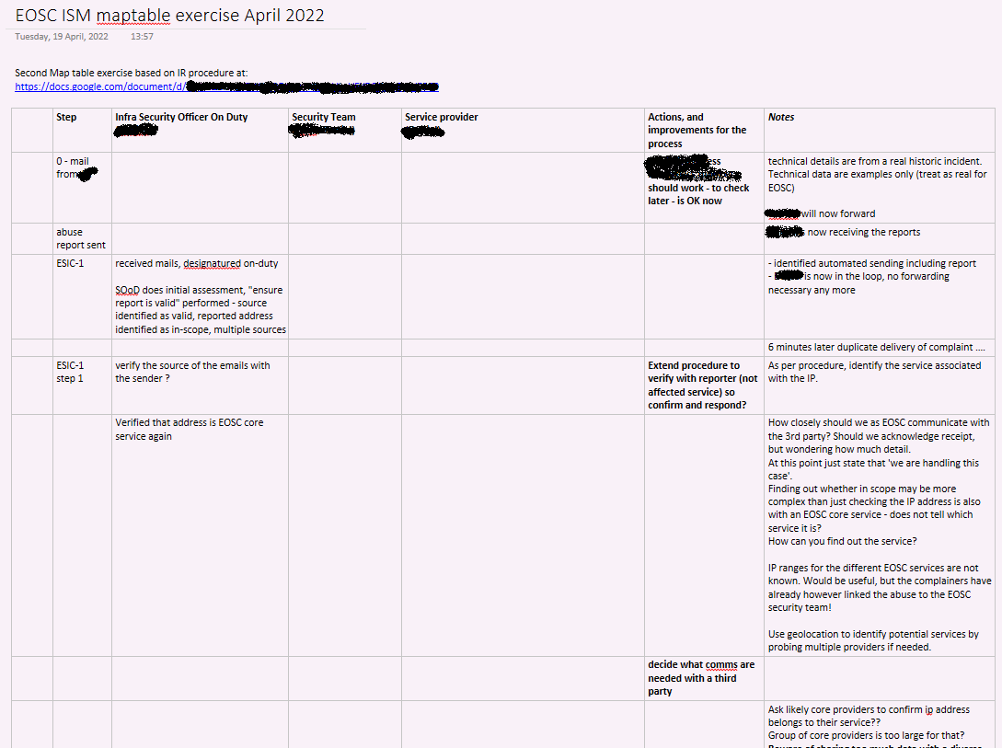
Designing challenges for new targets: the European Open Science Cloud
Distance between operational security
and (exchange) services remains large
who to target first in an open ecosystem?
raising awareness
as well as improving response
Core services easier to identify
security contact are in place
service management system is known
on-boarding process being rolled out
but designing the security scenarios is
an art in itself (thanks to Pinja Koskinen and Alf Moens!)

Slide 7
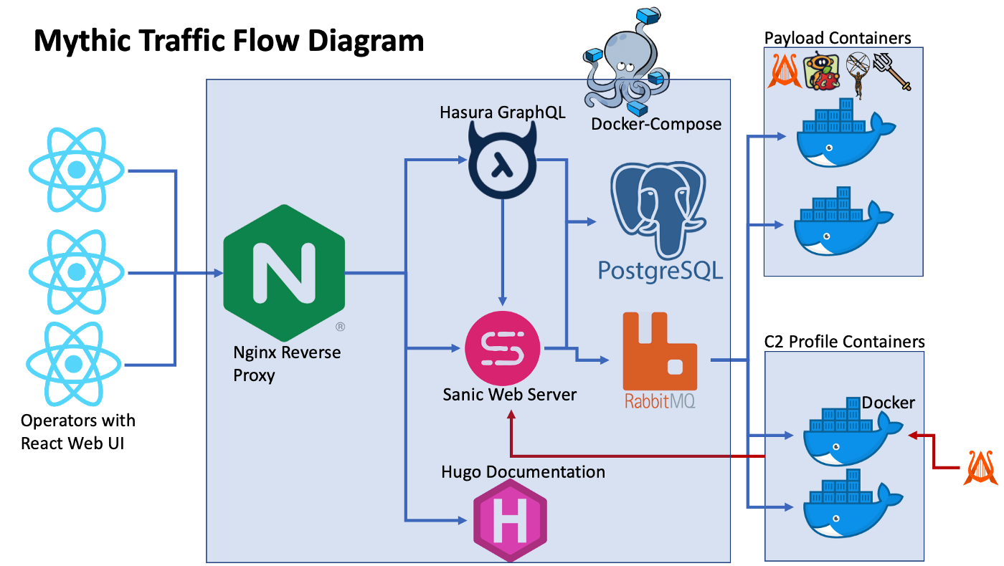
Upcoming EGI SSC challenge … simplified (with the Mythic C2)
Many RedTeaming tools
are now standard (like Mythic C2)
containerisation aids in getting the payloads working across a heterogeneous infrastructure
previous exercises ran into problems with the encrypted binaries and process hiding techniques
integration with the operational submission systems remain
as well as monitoring and report-out
https://docs.mythic-c2.net/
https://posts.specterops.io/learning-from-our-myths-45a19ad4d077

Slide 8
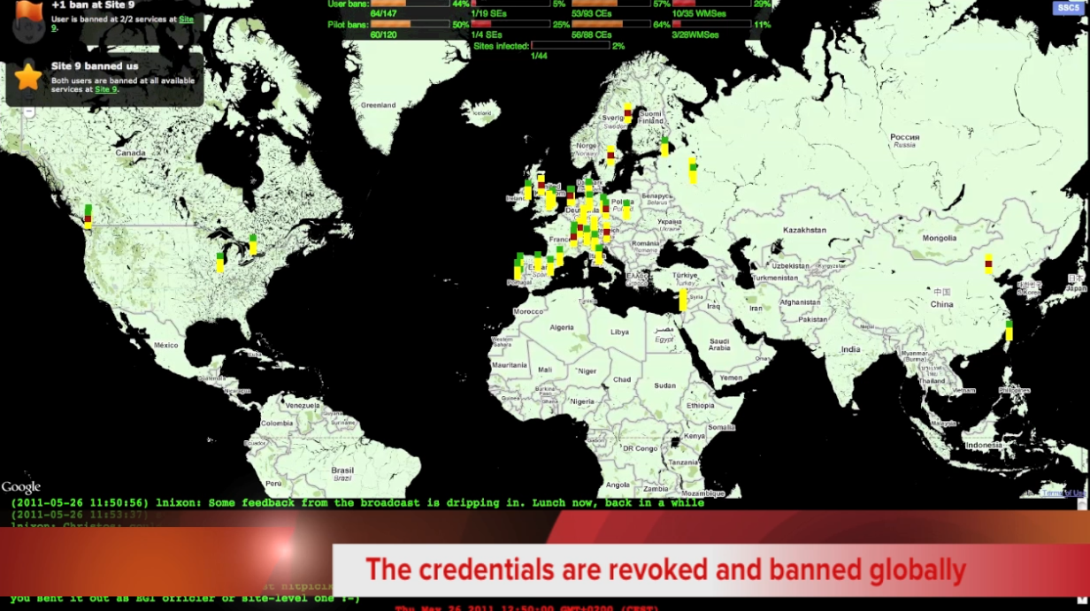
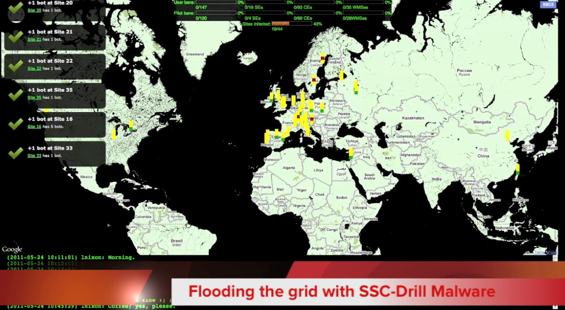
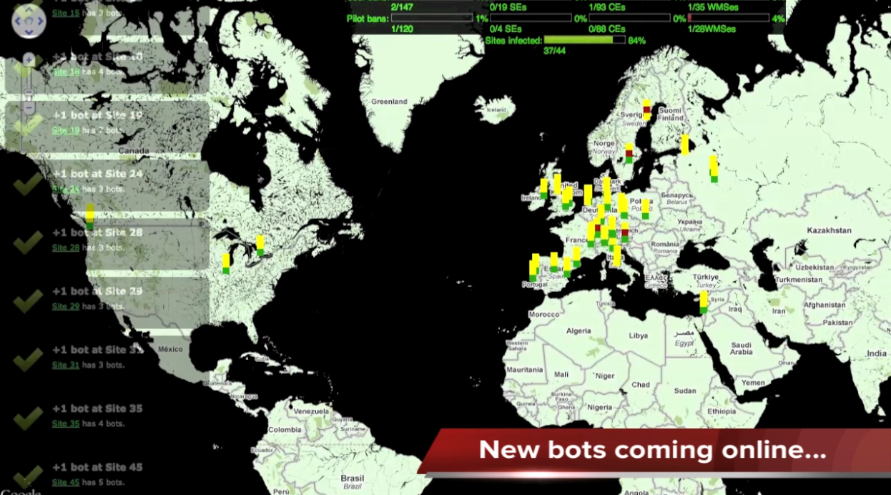
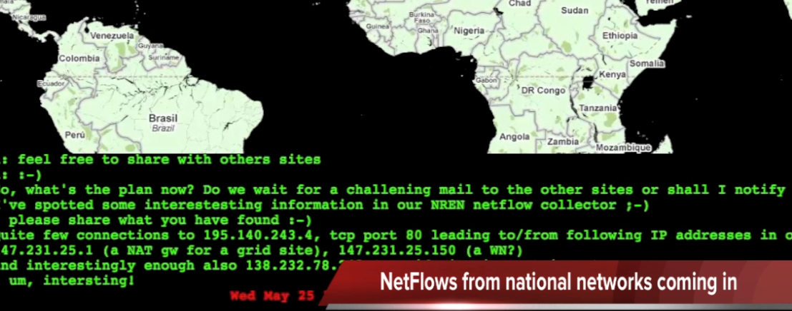
Designing forestics-oriented challenges is exhilarating in itself
imagery: SSC5 Oscar Koeroo, Graeme Stuart, EGI CSIRT team, WLCG, et al.

Slide 9
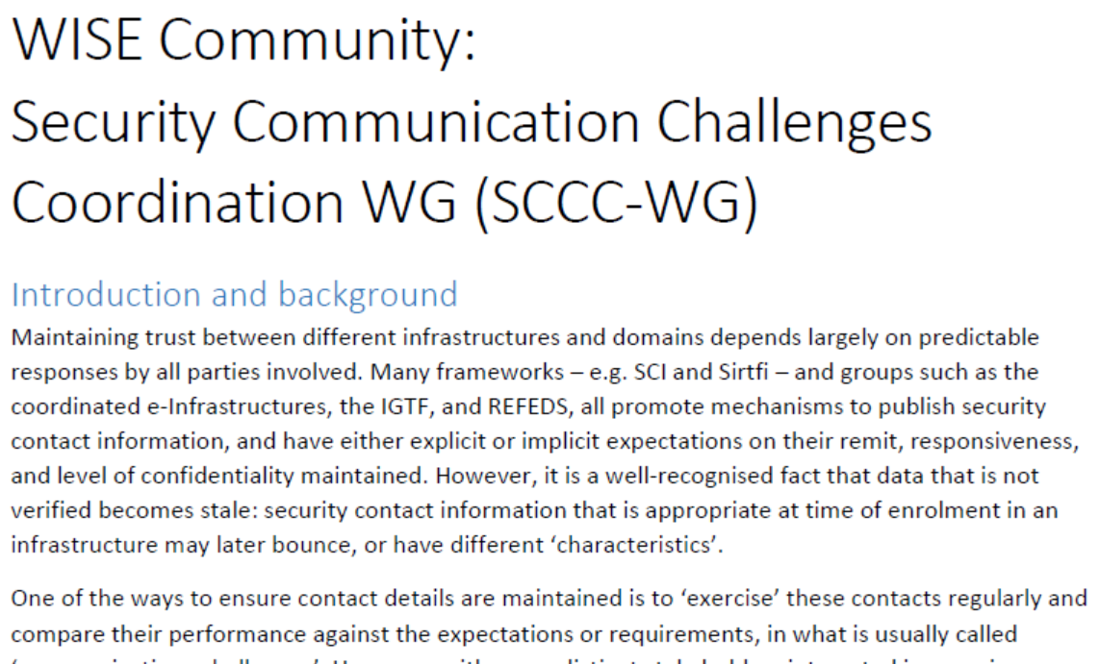
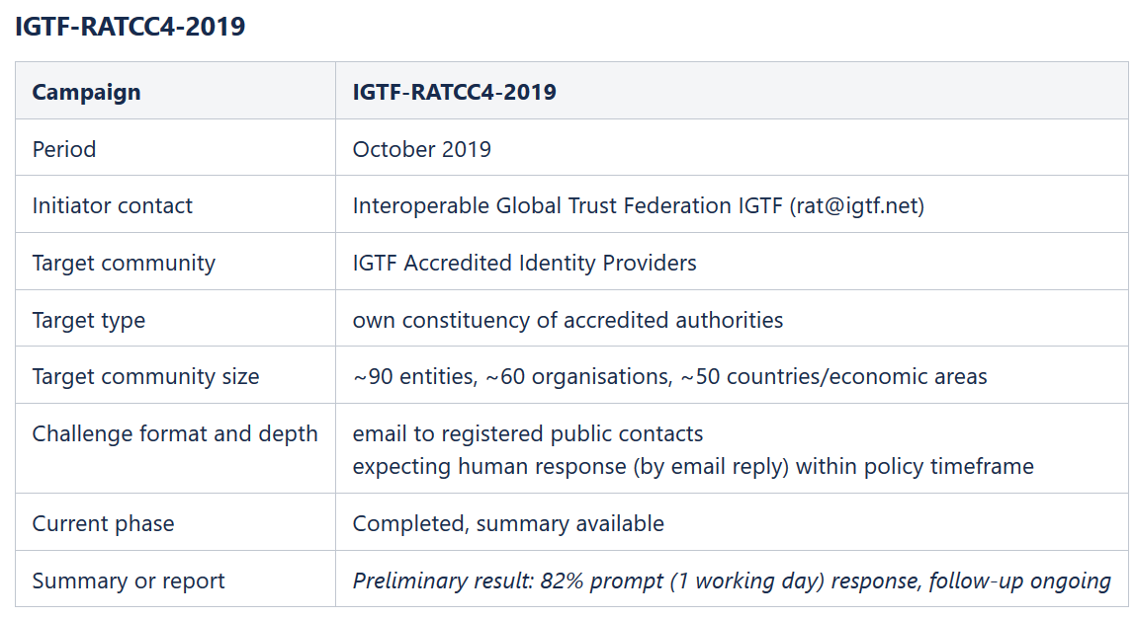
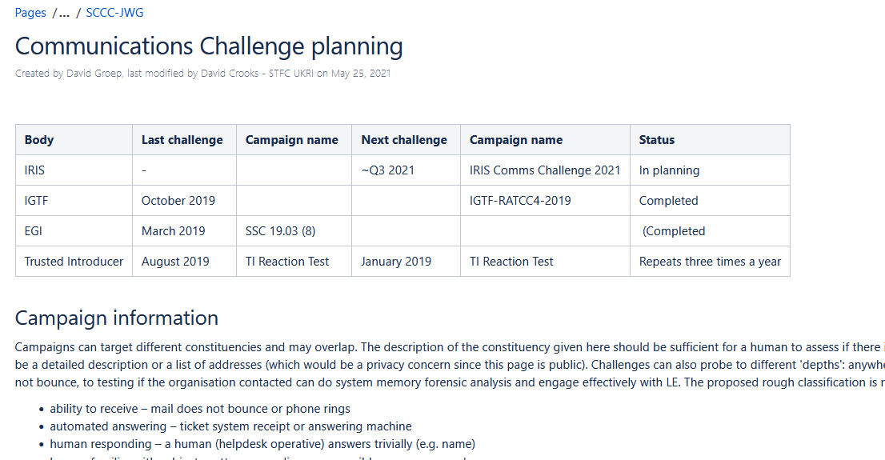
WISE SCCC-WG – participate!
WISE, SIGISM, REFEDS, TI joint working group
see wise-community.org and join!
https://wiki.geant.org/display/WISE/SCCC-JWG
co-chairs: Hannah Short (CERN) and David Groep (Nikhef)

Slide 10
Making the SCCC JWG a useful place for all
How to grow the community and leverage the trust built?
Can we use joint machinery for running challenges?
eduGAIN, EGI, TI, SURF all have tooling, and more is coming
The Wiki page is a start – evolution and completeness requires you!

Slide 11
davidg@nikhef.nl
This work is part of a project that has received funding from the European Union’s Horizon 2020 research and innovation programme under Grant Agreement No. 731122 (GN4-2).
We thank the following sources: EC Horizon 2020 projects GN4-3, EOSChub, and AARC-2; and the Dutch National e-Infrastructure coordinated by SURF

