Slide 1
AARC Blueprint Architecture and Pilots
A snapshot of the BPA implementations and its context
David Groep
AARC NA3 policy harmonisation coordinator
Nikhef
NL OpenStack Federation WS
April 4, 2017

Slide 2
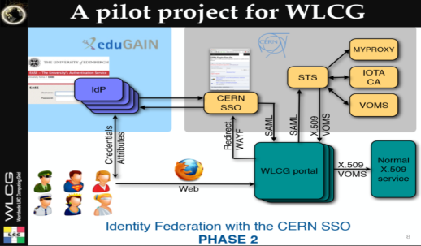
















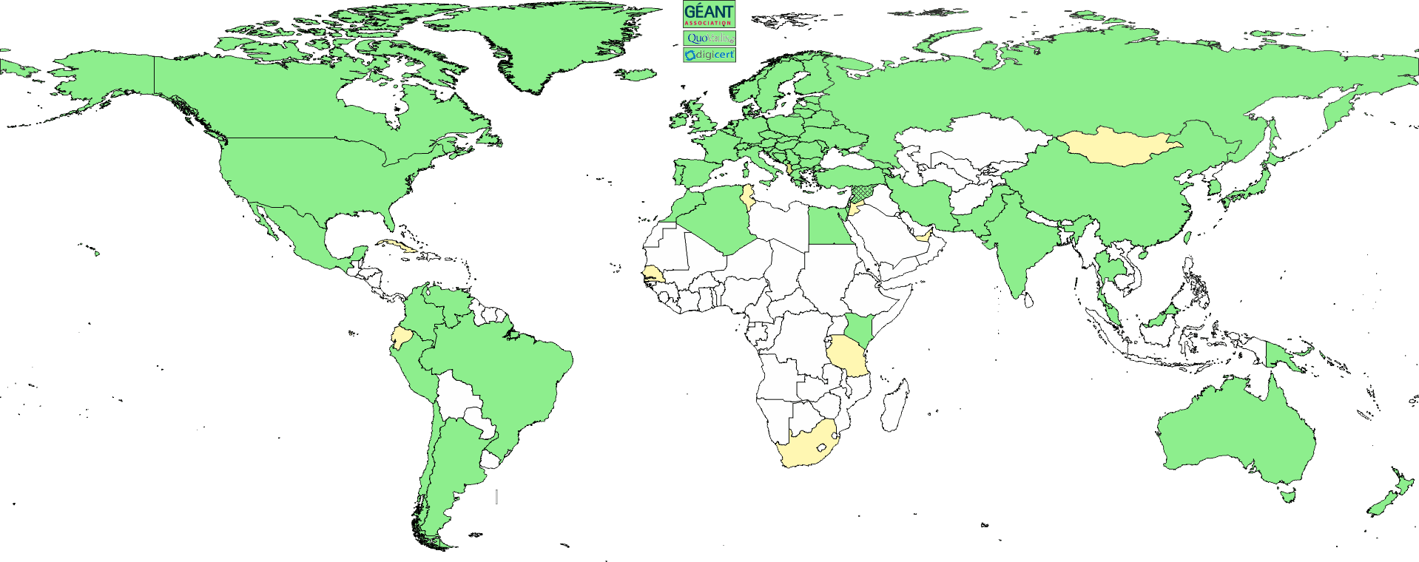





















2

Slide 3

The goals
Users should be able to access the all services using the credentials from their Home Organization
Users should have one persistent non-reassignable non-targeted unique identifier.
Attempt to retrieve user attributes from the user’s Home Organization. If this is not possible, then an alternate process should exist.
Distinguish (LOA) between self-asserted attributes and the attributes provided by the Home Organization/VO
Access to the various services should be granted based on the role(s) the users have within the collaboration
Services should not have to deal with the complexity of multiple IdPs/Federations/Attribute Authorities/technologies – and work with non-web

Slide 4
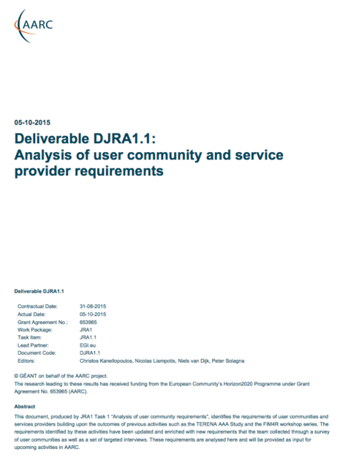
AARC: Analysis of User Communities and e-Infrastructure
Providers
Attribute Release
Attribute Aggregation
User
Friendliness
SP
Friendliness
Credential translation
Persistent Unique Id
User Managed Information
Credential Delegation
Levels of Assurance
Guest
users
Step-up AuthN
Best
Practices
Community based AuthZ
Non-web-browser
Social & e-Gov IDs
Incident Response

Slide 5
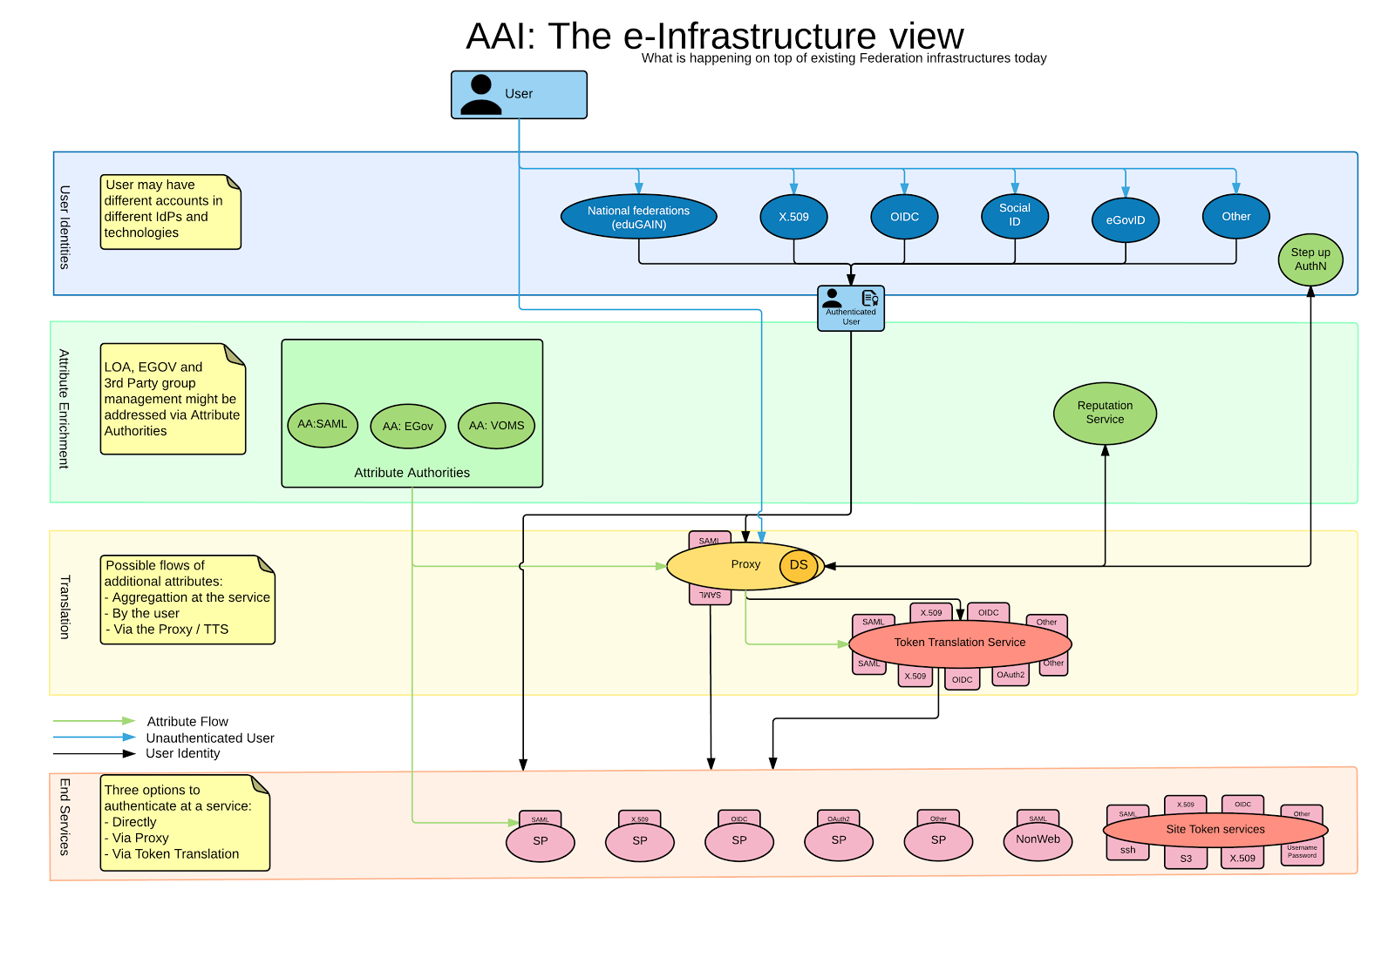
The functional Components
User Community
Requirements
https://goo.gl/kSxENp
aarc-project.eu

Slide 6
Why the proxy model?
All internal Services can have one statically configured IdP
No need to run an IdP Discovery Service on each Service
Connected SPs get consistent/harmonised user identifiers and accompanying attribute sets from one or more AAs that can be interpreted in a uniform way for authZ purposes
External IdPs only deal with a single SP proxy

Slide 7
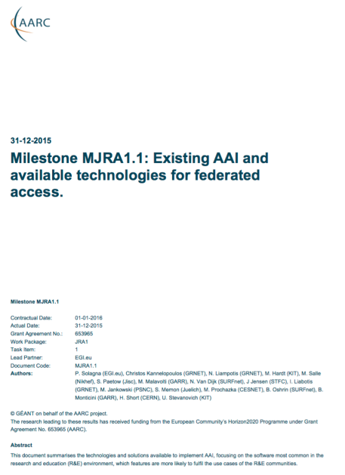
The Functional Components and available AAI tools
Analysis of
User Communities
IdPs
Available
AAI Components
Attribute Authorities
Proxies
Token Translation
And Infrastructure Providers
Service Provider
aarc-project.eu

Slide 8


eduGAIN & AARC
eduGAIN and the Identity Federations
A solid foundation for federated access in R&E
Authentication and Authorization Architecture
for Research Collaboration
A set of building blocks on top of eduGAIN
for International Research Collaboration

Slide 9
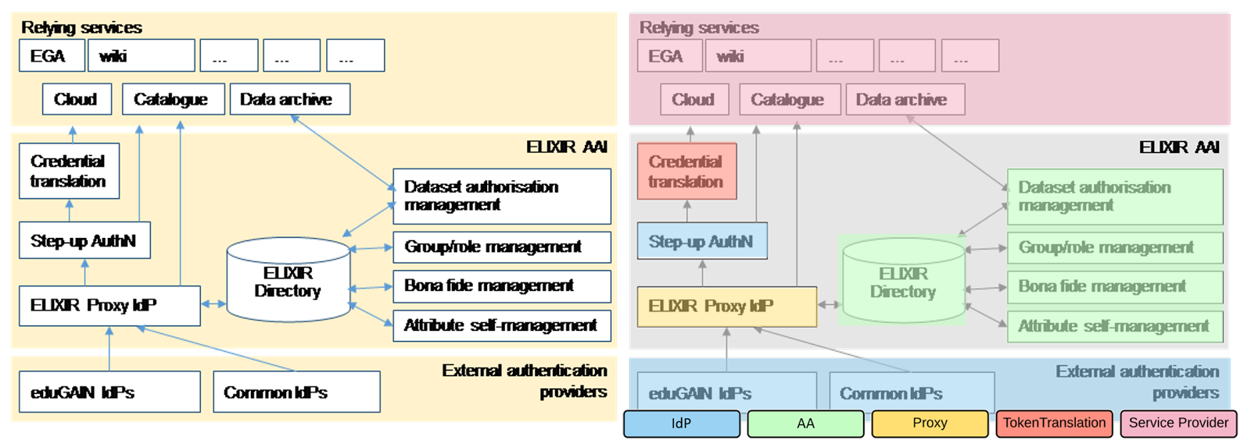
AARC Blueprint Architecture & ELIXIR

Slide 10
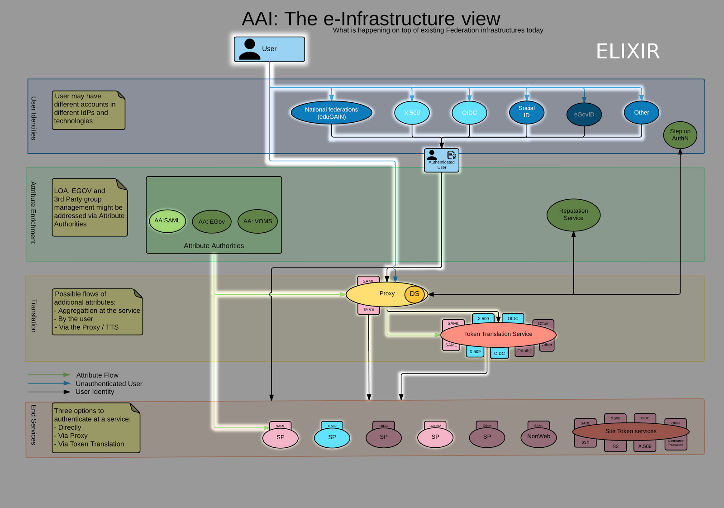
AARC Blueprint Architecture & ELIXIR

Slide 11
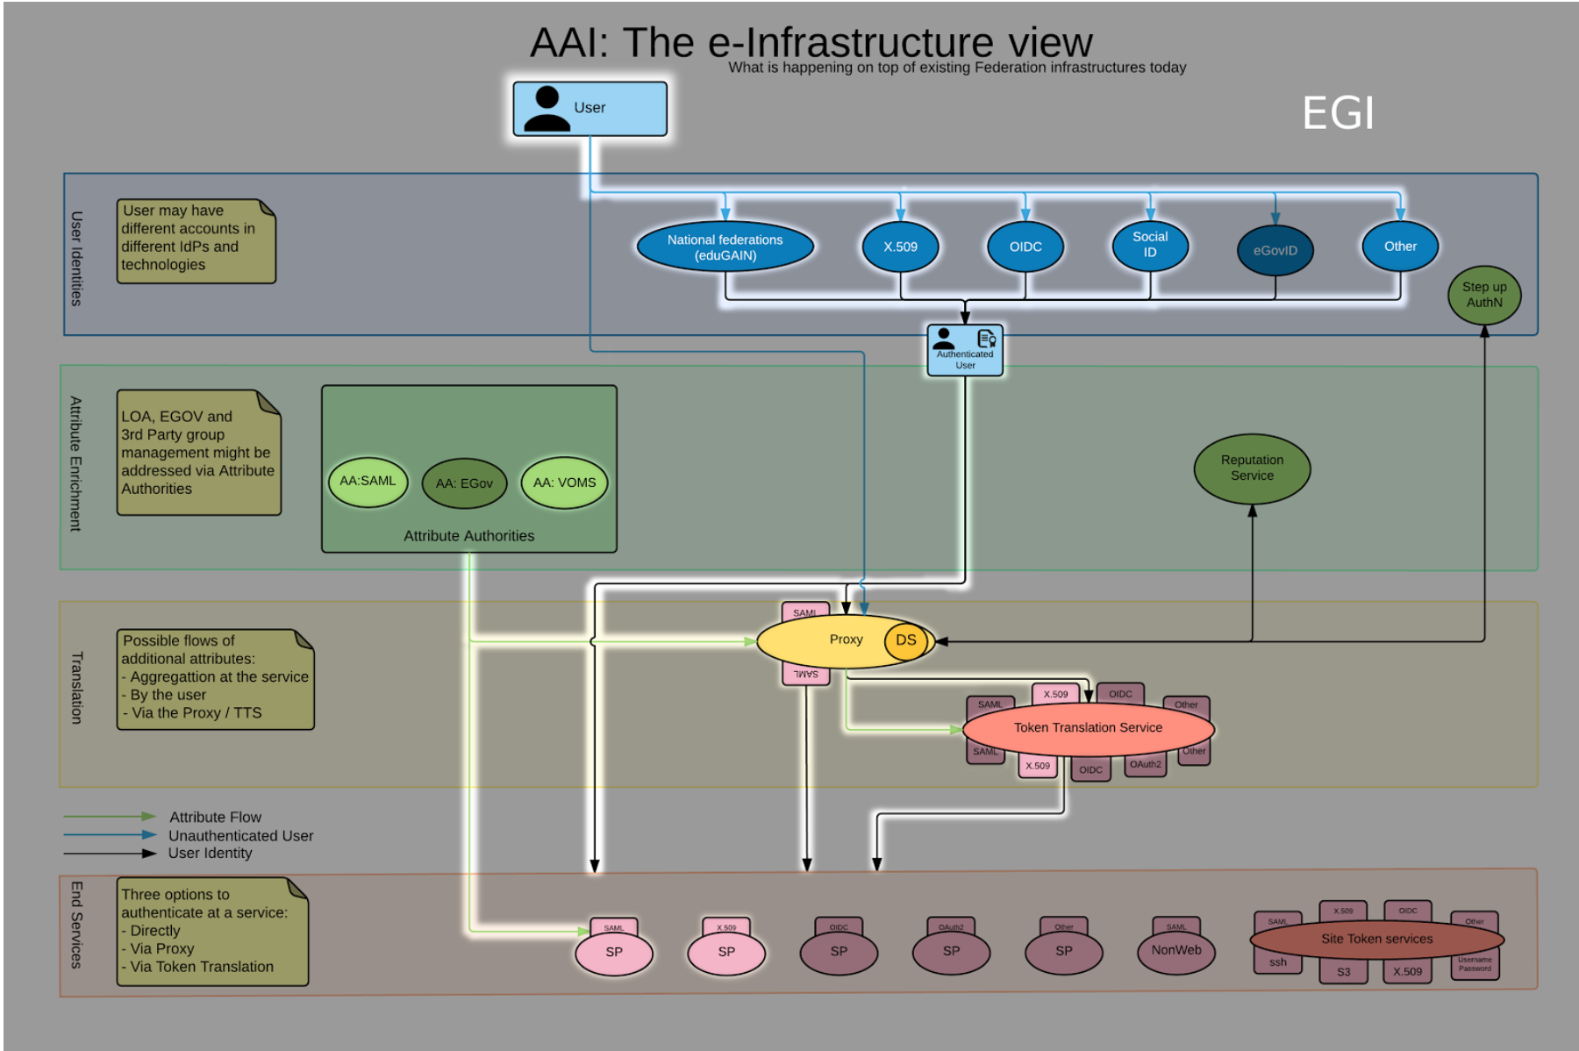
AARC Blueprint Architecture & EGI

Slide 12
Aligning policy – should be simpler ‘inside a single country’
Pushing forward best practices and like policies across many participants
  “Levels of Assurance” – baseline and differentiated profiles, capabilities and grouping
  “Incident Response” – beyond Sirtfi: a common understanding on operational security
  “Sustainability, Guest IdPs, use models” – how can a service be offered in the long run?
  “Scalable policy negotiation” – helping SPs move beyond bilateral discussion
  “Protection of (accounting) data privacy” – necessary aggregation without breaking
  the law too much
Strategy
to support and extend established and emergent groups
IGTF
FIM4R
REFEDS
WISE
GN4
AARC
. . .
SIRTFI

Slide 13
First e-Infrastructure implementations for BPA & pilots
EGI CheckIn Service
https://wiki.egi.eu/wiki/AAI
ELIXIR AAI
https://www.elixir-europe.org/services/compute/aai
EUDAT B2ACCESS
https://www.eudat.eu/services/b2access
GÉANT eduTEAMS
https://www.eduteams.org

Slide 14
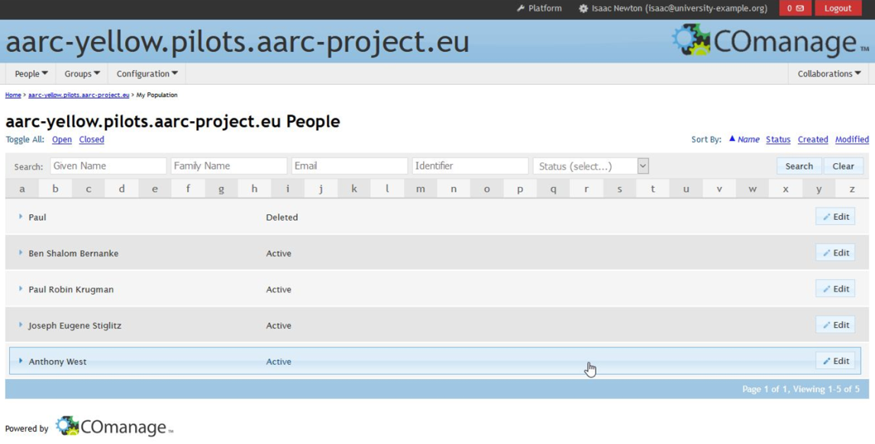
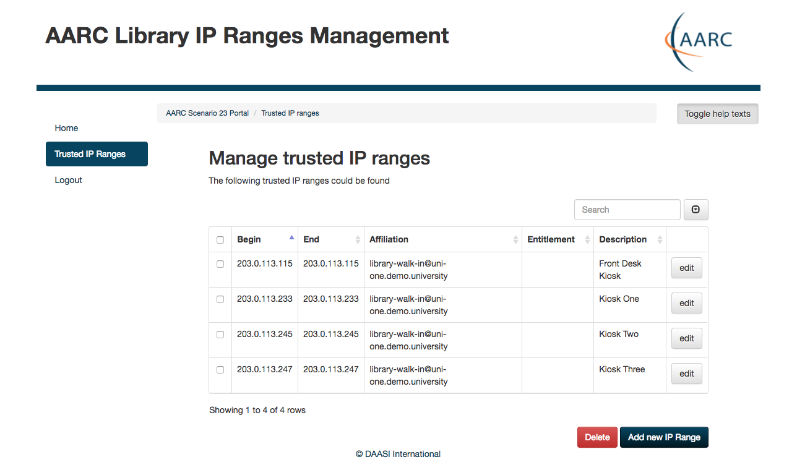
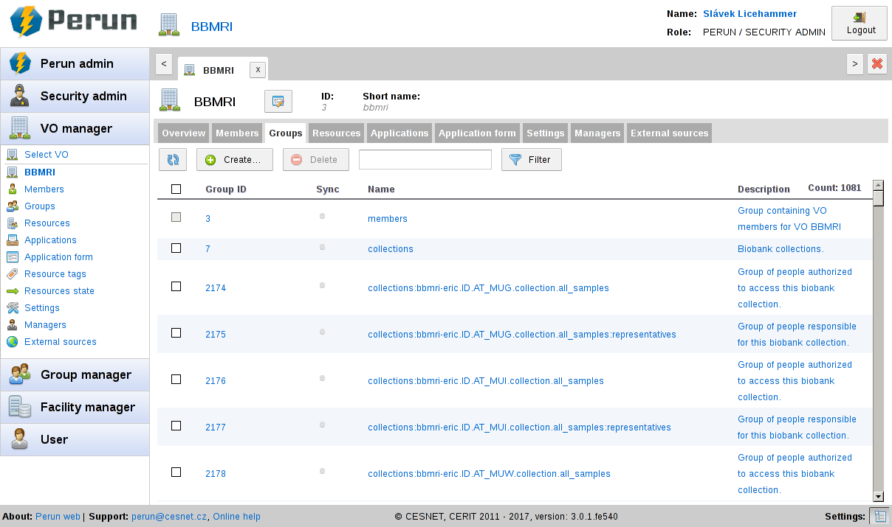
Pilots and demonstrators
AttributeManagementPilot
AuthX509toSAMLDemo
BBMRIAAIPilot
CILogon-like pilot
COmanageORCIDPilot
COmanageSSHPilot
LibrariesCockpitPanelConsortiumProxy
LibrariesCockpitPanelEZproxy
LibrariesCockpitPanelWalkInUsersPortal
ORCIDpilotCockpitPanel
PerunVOMSCILogonPilot
SocialIDCockpitPanel
https://wiki.geant.org/display/AARC/Pilot+results+and+demos

Slide 15
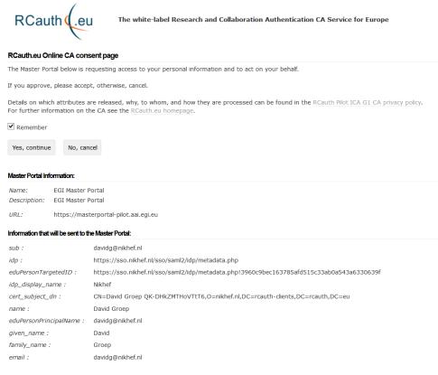
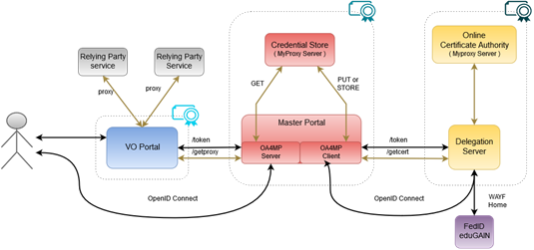

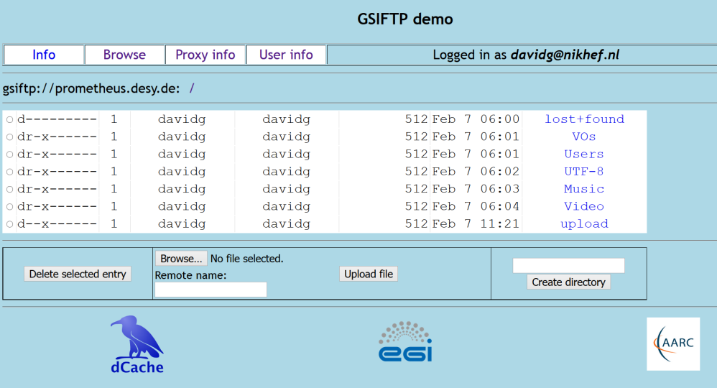
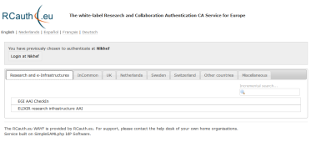
Flow for RCauth-like scenarios
Sirtfi
REFEDS “R&S”
Built on CILogon and MyProxy!
www.cilogon.org
see also https://rcdemo.nikhef.nl/
15
Notes:
VO portal can be anything even a simple shell
Certs stored only for 11 days
Master portal can add attributes via VOMS (or others in the future)

Slide 16
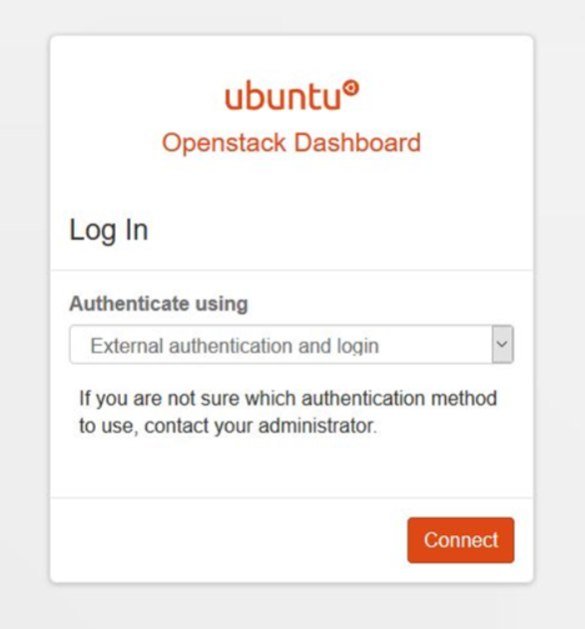
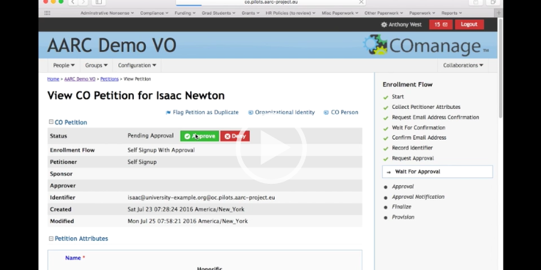
Comanage pilots – and the OS AttrMngtPilot

Slide 17
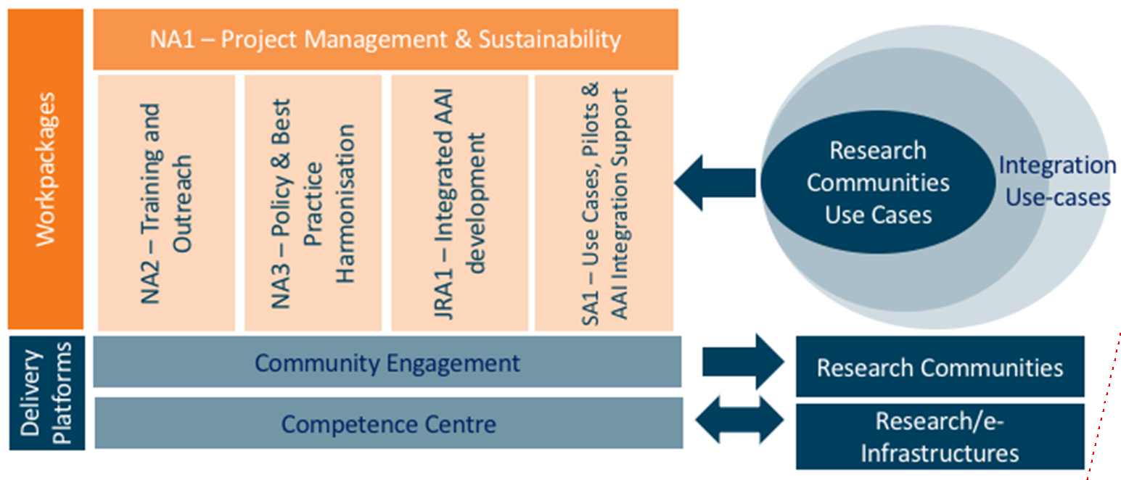
AARC2: new engagement mechanisms

Slide 18
Christos Kanellopoulos
skanct@admin.grnet.gr

