Slide 1
Building the anycasted RCauth Federated authentication proxy
a multi-domain anycasted
high availability solution
for stateful services in RCauth.eu
David Groep
Nikhef PDP programme
UM Dept. of Advanced Computing Sciences
ISGC Taipei, March 2023

Slide 2
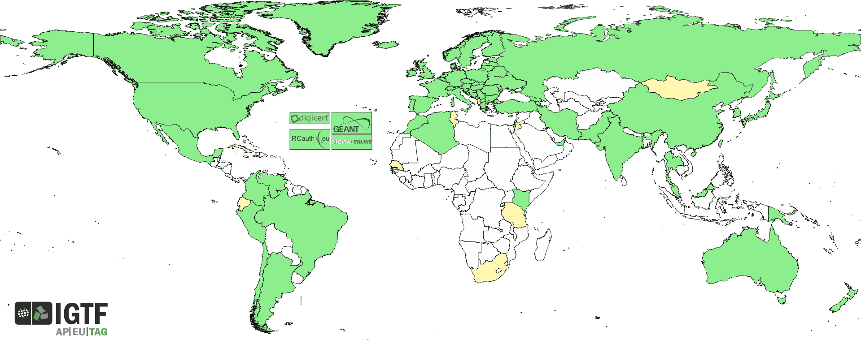




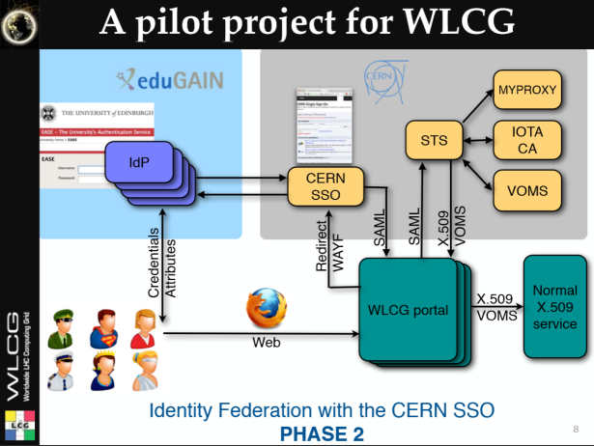
































We live in a federated world!
slide inspiration: Licia Florio, NORDUNET
2

Slide 3
But just identity federation with your home organisation is not enough
Access services using identities from their Home Organizations.
Access services based on role(s) users have in the collaboration. This info is not known to IdPs/eduGAIN.
Secure integration of guest identity solutions and support for stronger authentication mechanisms.
Requirement for one persistent identity across all the community’s services when needed and account linking.
Web and non-web resources
Hide complexity of multiple IdPs/feds/At Auth/ technologies.
slide design: Licia Florio, NORDUNET

Slide 4
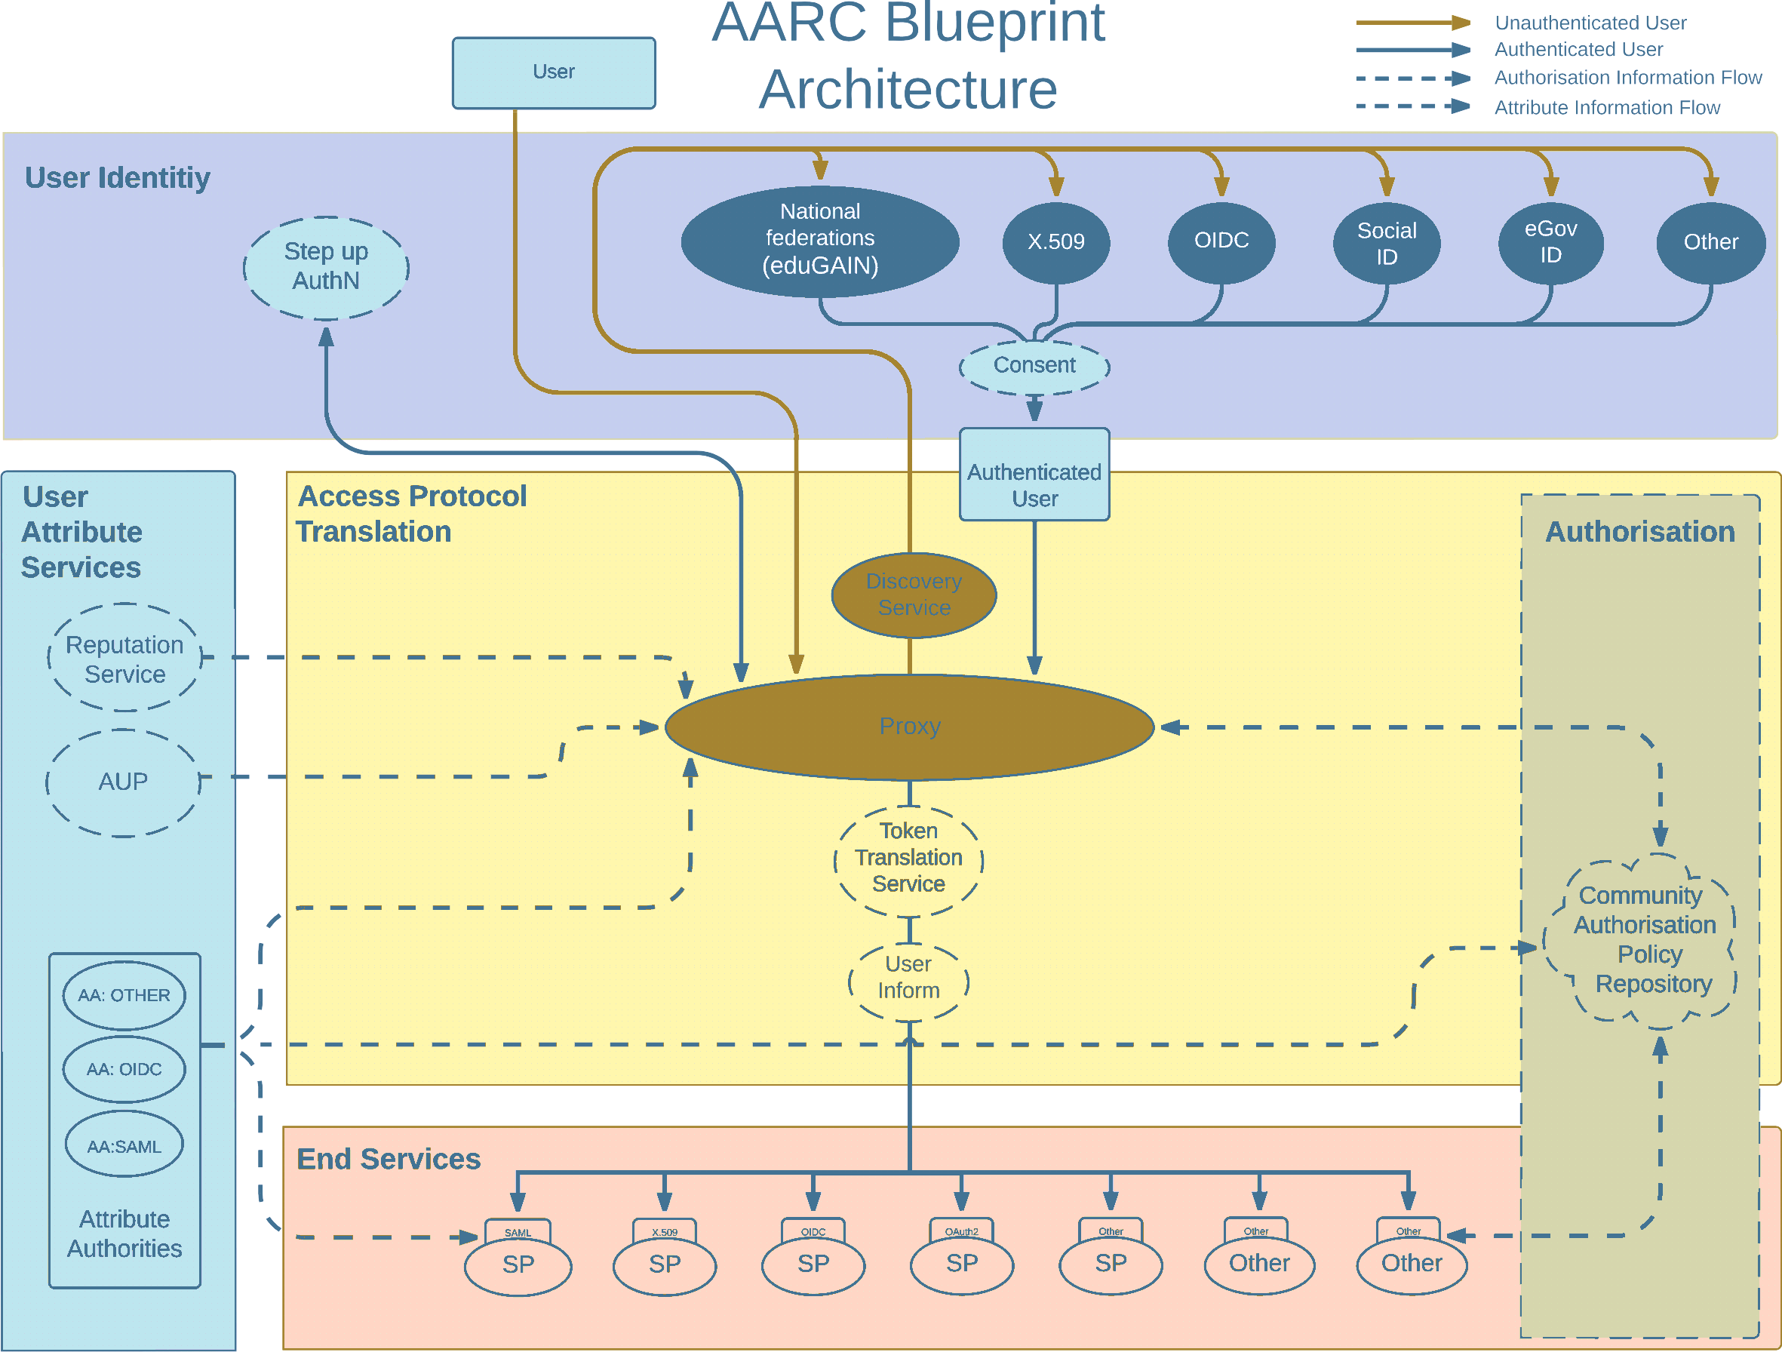
Most trust flows from the (research) community
AARC Blueprint Architecture (2019) AARC-G045 https://aarc-community.org/guidelines/aarc-g045/; stacked proxies: EOSC AAI Architecture
EOSC Authentication and Authorization Infrastructure (AAI), ISBN 978-92-76-28113-9, http://doi.org/10.2777/8702

Slide 5
Federation in research and e-Infrastructures: command-line and brokered access
CLI-based access and brokering (workflow management) for non-web services still uses
PKIX/X.509 technology and `RFC3820 proxies’ … but end-user PKI is relatively complex
Infrastructures move to hiding PKIX from the end-user and move to OIDC and Tokens
  Fewer credentials to manage, appearing ‘simpler’ to the user
Bridging and translation is a pragmatic approach for cases where PKIX worked better
  Does not require major technical changes in existing R&E federations
  Allows for community-centric identities-of-last-resort (or first resort, for that matter…)
  Allows time for introduction of other technologies, such as OIDC and OAuth2 tokens
Token translation in many infrastructures that use CLI or brokerage
  Project MinE, EGI, …
  translation in any way: SAML→OIDC, SAML→X509, X509→OIDC, X509→SAML, OIDC→X509

Slide 6

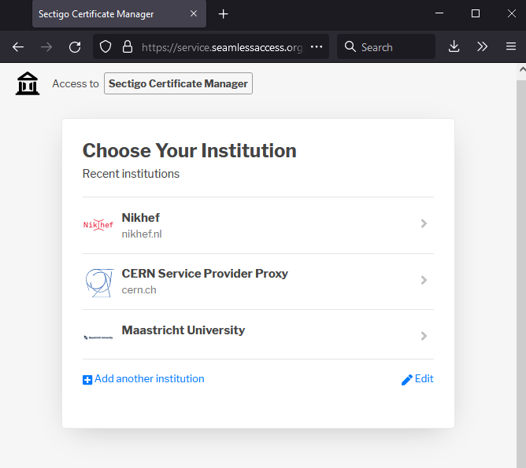
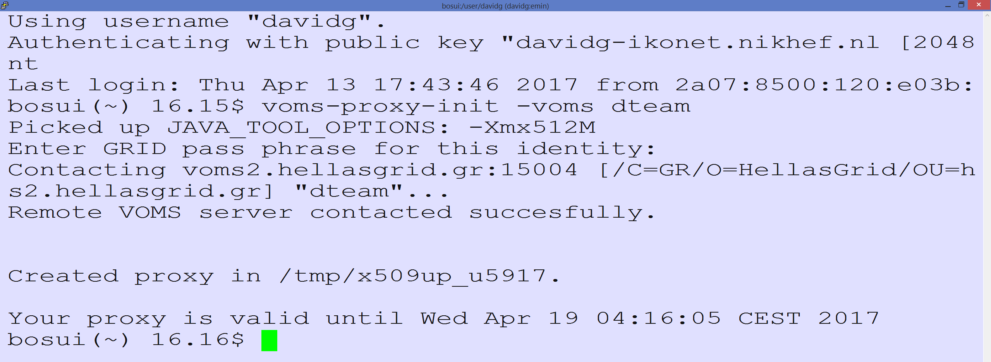
Seamless (eduGAIN) Access to (non-Web) Resources using PKIX?
Traditional workflow – using a client-held credential
Works great provided the user understand the technology – and we may have found all users that know how to manage this ☹

Slide 7
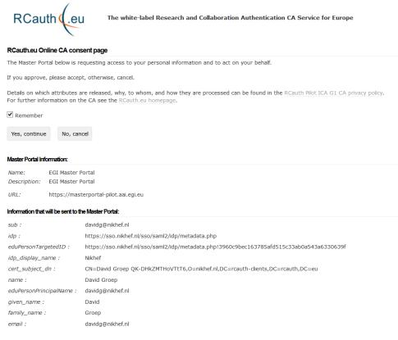
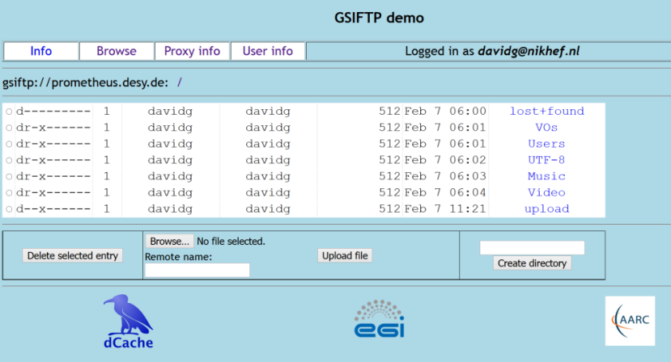
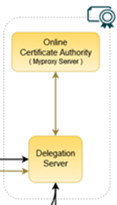
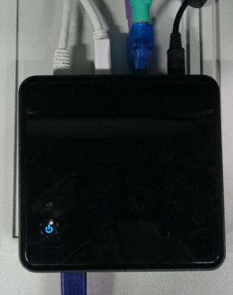

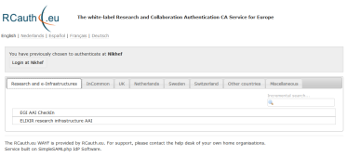

In-line token translation services SAML-to-PKIX?
Community Science Portal
Accredited
PKIX Authority
Infrastructure Master
Portal Credential Store
REFEDS R&S
Sirtfi Trust
User Home Org
or Infrastructure IdP
Policy Filtering WAYF / eduGAIN
Built on CILogon and MyProxy
www.cilogon.org
7
see also https://rcdemo.nikhef.nl/
Notes:
VO portal can be anything even a simple shell
Certs stored only for 11 days
Master portal can add attributes via VOMS (or others in the future)

Slide 8
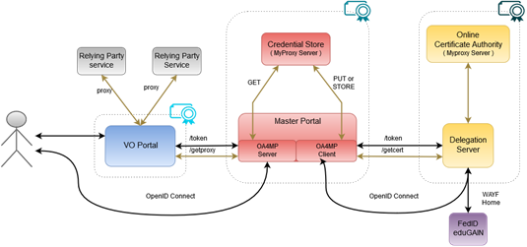
RCauth.eu and the MasterPortal OIDC credential manager

Slide 9
A ‘CILogon-like’ Token Translations Service – RCauth.eu
Ability to serve a large pan-European user base without national restrictions
  without specific national participation requirement (serve sparsely distributed users)
Use existing resources and e-Infrastructure services
  no need for review security model at resource centres or at infrastructure level
Integrate science gateways and portals with minimal effort
  only light-weight industry-standard protocols
Support attribute-cert community membership services
  support ‘VOMS’ via attribute certificates, also for science portal access to e-Infrastructure
Concentrate service elements that require security expertise
  not burden research communities with need to care for security-sensitive service components
  keep a secure credential management model
  coordinate compliance and accreditation

Slide 10

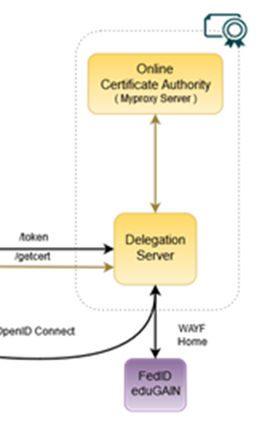

RCauth.eu – a white-label IOTA CA in Europe
Cover as much as R&E Federated (Europe++) as possible
Scoped to research and collaborative use cases
In a scalable and sustainable deployment model
https://rcauth.eu/
https://rcdemo.nikhef.nl/
Service inspired by and using components (such as the DS) from
Jim Basney’s CILogon, see https://www.cilogon.org/docs/20141030-basney-cilogon.pdf

Slide 11
The joys of global interfederation
global IdPs in eduGAIN
the quest for a reasonable, non-reassigned name

Slide 12
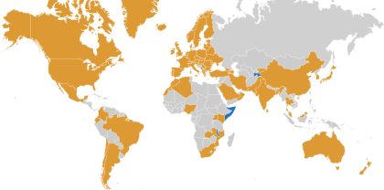
Our Registration Authorities: the Federated IdPs
RAs are the eligible IdPs connected through a
Federated Identity Management System (FIMS)
primarily: ensemble of IdPs in eduGAIN that
meet the policy requirements of this CA
Eligible applicants are all affiliated to an RA
Three eligibility models
Direct relationship CA-IdP, with agreement declaration
Rest of eduGAIN: – “Sirtfi” security incident response and OpSec capabilities plus
– REFEDS “R&S section 6” non-reassigned identifiers and applicant name
are required, and tested via statement in ‘meta-data’ and by releasing the proper attributes
within the Netherlands, SURFconext Annex IX* already ensures compliance for all IdPs
“IdPs within eduGAIN [#3] are deemed to have entered materially into an agreement with the CA”

Slide 13
Unique certificated from FIM via eduPerson and REFEDS R&S
Sources of naming and uniqueness, that work today
eduPersonPrincipalName – scoped point-in-time unique identifier, which could be, but usually is not, privacy preserving: “davidg@nikhef.nl”, “P70081609@maastrichtuniversity.nl”
eduPersonTargetedID – scoped transient non-reassigned identifier, like
urn:geant:nikhef.nl:nikidm:idp:sso!27c8d63ed42c84af2875e2984
subject-id - a scoped persistent non-reassigned identifier, which should be privacy-preserving: 44f7751265a6e8b228f9@nikhef.nl
Plus the (domain-name based) schacHomeOrganisation and a ‘representation of the real name’
/DC=eu/DC=rcauth/DC=rcauth-clients/O=orgdisplayname/CN=commonName +uniqeness
uniqueness will added to commonName via hashing of ePPN, ePTID, subject-id, so that
an enquiry via the issuer allows unique identification of the vetted entity”

Slide 14
commonName – should be readable element in printable 7-bit chars
‘REFEDS R&S’ gives a subset of attributes that should be released:
the displayName attribute from the IdP
the givenName attribute, followed by a space, followed by the sn attribute from the IdP
the commonName (cn) attribute from the IdP
but we need to make it printable in ASCII
We tried using java.text.Normalizer.Form.NFD and map the remainder to “X”, which gives:
If IdP sends us this UTF-8 | Representation in CN RDN
Jőzsi Bácsi | Jozsi Bacsi
Guðrún Ósvífursdóttir | GuXrun Osvifursdottir
Χρηστος Κανελλοπουλος | XXXXXXX XXXXXXXXXXXXX
簡禎儀 | XXX
Oops!

Slide 15
but also Νικόλας Λιαμπότης may not quite like that … and I understand …
java.text.Normalizer.Form.NFD and ‘X-ing’ the rest particularly bad for
Greeks, Bulgarians, Chinese, Georgians, Thai, Armenians, Serbians, …
ICU - International Components for Unicode (icu-project.org) appears to be better, but:
there are many options for transliteration
some code points shared between different languages, that prefer different transliterations
some code points are absent even in UTF-8 causing ambiguity
So we moved to the ICO, but even then the mapping is not trivial:
UTF-8 → Latin-1 → ASCII → IA5String (we need PrintableString + “@” and minus [:/=])
ICU
ICU
regex
thanks go to Mischa Sallé for the transliteration studies (and much more)

Slide 16
But straightforward translation is not always good
Just Any-Latin fails for Slavonic unique “sh” sounds. E.g. for ‘Миша’
with Any-Latin becomes ‘Miša’ which then translates into ‘Misa’ after the Latin-Ascii
but quite some people called ‘Миша’ want to see ‘Mischa’, but not all, so you need
first Russian-Latin/BGN, making it ‘Misha’, which is slightly better, then do Any-Latin (1-to-1)
but “Russian-Latin/BGN+Serbian-Latin/BGN” is different from the reverse …
First Any-Latin/BGN, then Any-Latin, to fix mapping to → š and the → s
Բարեւ աշխարհ → Barev ashkharh (with the /BGN, to ensure the “sh”)
ישראל → ysr'l (taken care of without the /BGN, otherwise theש never makes it)
And Unicode does not distinguish the diaeresis and the umlaut
Günter Strauß → Gunter Strauss should have been ‘Guenter Strauss’
Daniëlle → Danielle is good, you definitely don’t want ‘Danieelle’
As the so for stability, we keep Any-Latin here and treat all as a diaeresis

Slide 17
What will we get?
$ java -cp icu4j-59_1.jar:. transliterate2 [...]
"Jőzsi Bácsi" "Guðrún Ósvífursdóttir" \
"Χρηστος Κανελλοπουλος" "簡禎儀“
Input: Jőzsi Bácsi
Output: Jozsi Bacsi
Input: Guðrún Ósvífursdóttir
Output: Gudrun Osvifursdottir
Input: Χρηστος Κανελλοπουλος
Output: Christos Kanellopoulos
Input: 簡禎儀
Output: jian zhen yi

Slide 18
Building the initial RCauth.eu

Slide 19
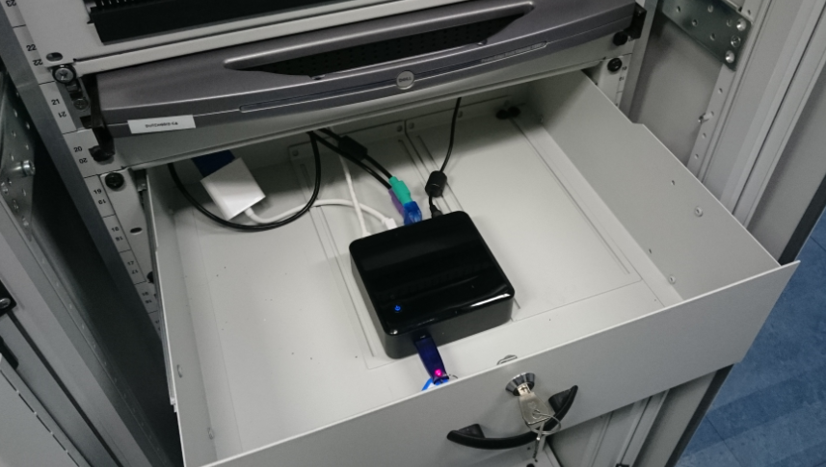



A fully compliant ‘Heath Robinson’ CA

Slide 20
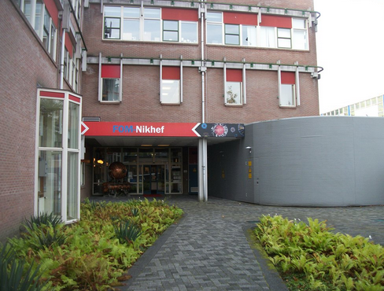
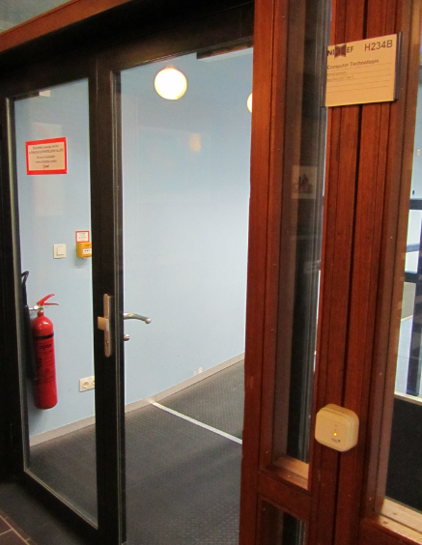
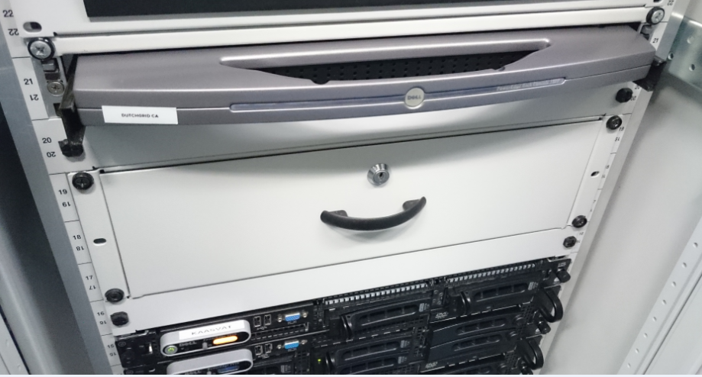
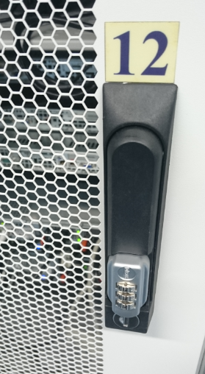
Physical controls
Located at Nikhef, Amsterdam, NL
Scientific Data Centre part of the NikhefHousing Facilities
ID based access control, 24hr guard on-site
CA and security systems in locked dedicated cabinet on 2nd floor
On-line CA signing system in locked drawer
CA signing system
Delegation Server

Slide 21
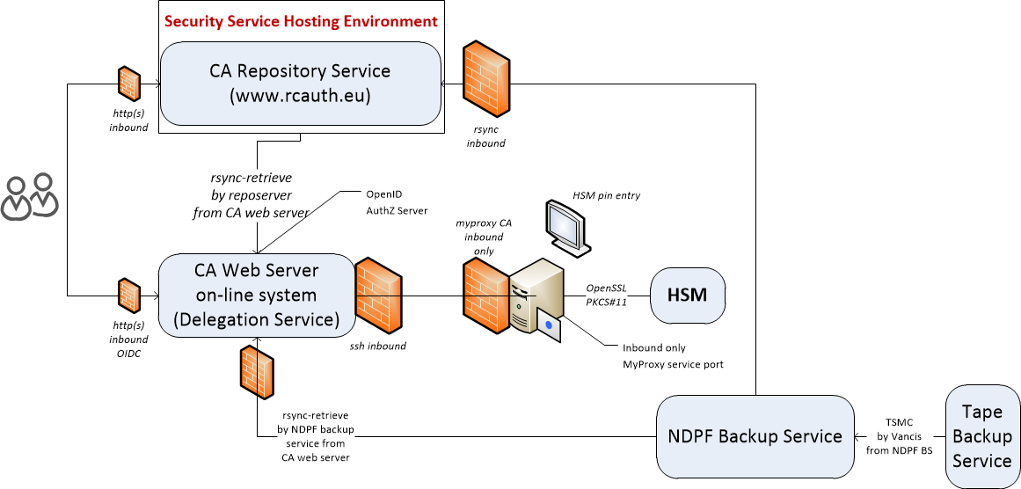
Logical set-up

Slide 22
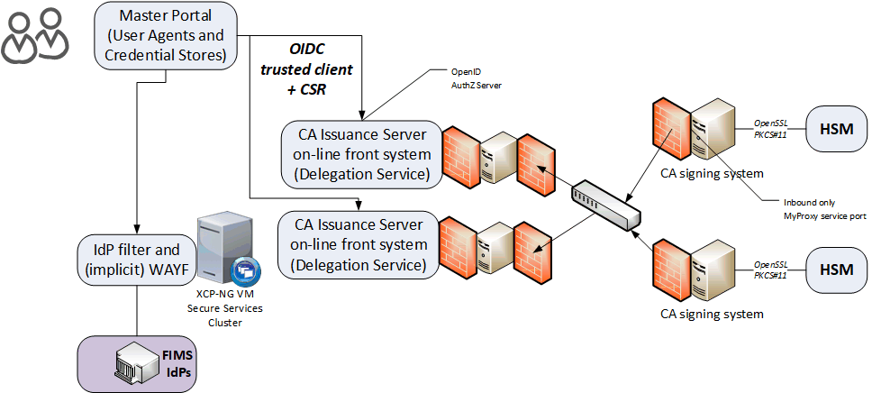
A local highly-available setup at Nikhef Amsterdam
Most ‘fault-prone’ components are
  Intel NUC (single power supply)
  HSM (can lock itself down, and the USB connection is prone to oxidation)
  DS front-end servers (they are physical hardware, albeit with redundant disks and powersupplies)
Eliminated first
using ‘local HA’
private
semi-redundant
switch

Slide 23
towards a pan-European distributed service

Slide 24
RCauth.eu Governance
Governance Board
RCauth PMA
Ops Coordination Team
Representatives (and one alternate) from
each Materially Contributing Stakeholder
EGI.eu, EUDAT (ETFC), GÉANT, Nikhef (SURF)
Individuals drawn from the wide community […]
experts in the field of identity management
for research and collaboration,
PKI technology and identity bridging
STFC
GRNET
Nikhef
Operations people from each of the hosting partners with a (copy of) the RCauth.eu signing key,
and those partners otherwise involved in OPS

Slide 25
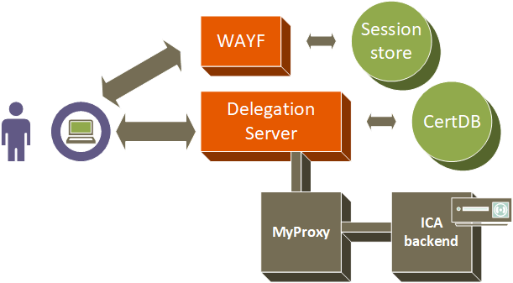
From a single instance …

Slide 26
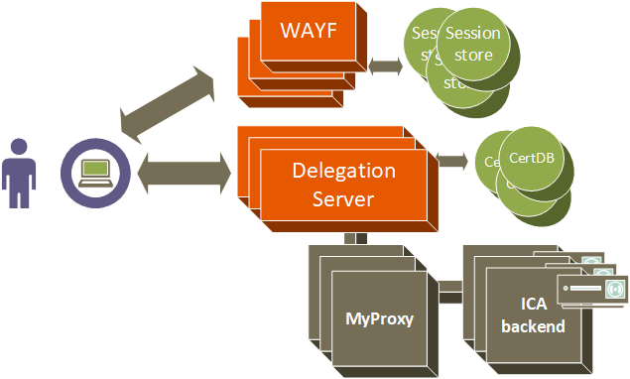
… to a 3-fold continuously-consistent setup

Slide 27
HA solutions
Local high availability, three distinct providers?
pushes account linking burden to the relying parties/service providers
users may have 3 credentials, which is confusing
a single identifier would require ‘ensured’ database synchronization – no true independence
DNS-based fail-over?
the ‘trivial’ model relies on the client not to cache answers for long,
and not to round-robin the DNS answers - since the WAYF and DS go together
short TTL is quite bad for reliance, since both service and domain name provider must be up
‘advanced’ DNS-based solutions (like for InAcademia) – with near-realtime updates of a distributed DNS may appear better, but still: need a overly-low TTL, and
move the HA problem to the DNS provider (or ccTLD), rather than solve it
So we looked at network-layer resilience, the ‘go-to’ solution for large CDN providers

Slide 28
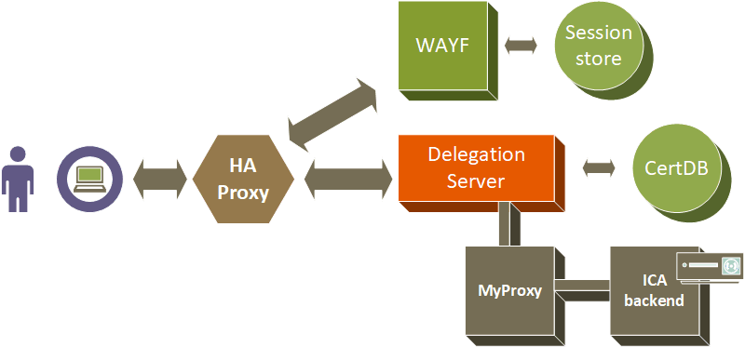
Services at a site go up and down together - adding an HAproxy
VPC or VPN interconnect

Slide 29
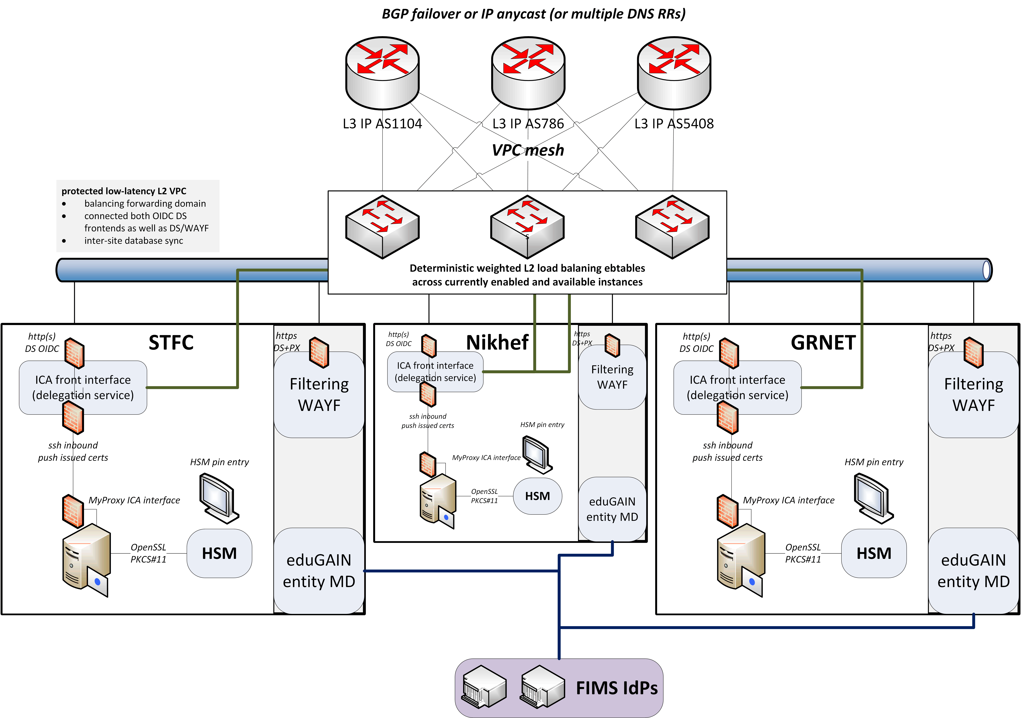
Since we do not like SPOFs …
Implement a High Availability setup
across the 3 sites
using IP anycast
L3 VPN or L2 VPC
with minimal effort
work supported by EOSC Hub and EOSC Future

Slide 30
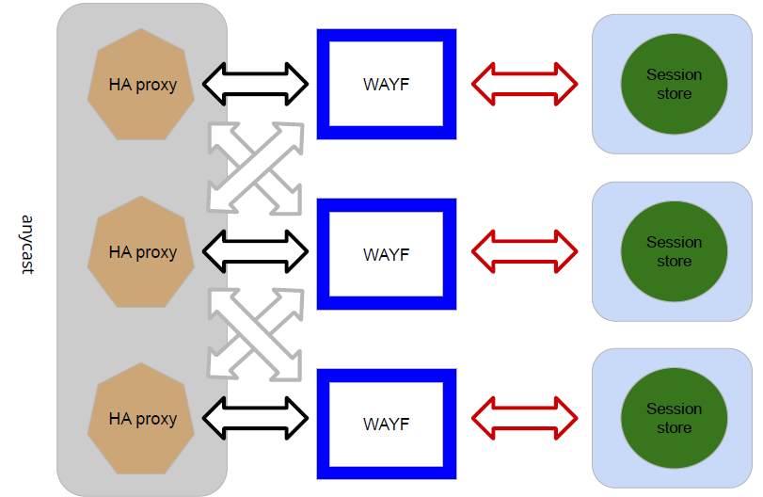
Distributed RCauth service
HA proxy
DS
DB
VPN
client
VPN server
STFC
GRNET
Nikhef
HA proxy
DS
DB
VPN client
VPN server
HA proxy
DS
DB
VPN client
VPN server
similar for the
filtering WAYF
selected imagery: Mischa Sallé, Jens Jensen, Nicolas Liampotis

Slide 31
A transparent multi-site setup
User
connects to HA proxy at {wayf,ica}.rcauth.eu
HA proxy sends users to “closest” working service
forward mainly to its own DS when available
HA proxy
HA proxy
VPC or VPN interconnect
and wherever the user is, the service is at
2a07:8504:01a0::1
and 145.116.216.1 (for legacy IP users)
HA proxy
If a HA loses its
backend DS, can still
route to another DS
over VPC/VPN backend
selected imagery: Mischa Sallé, Jens Jensen, Nicolas Liampotis

Slide 32
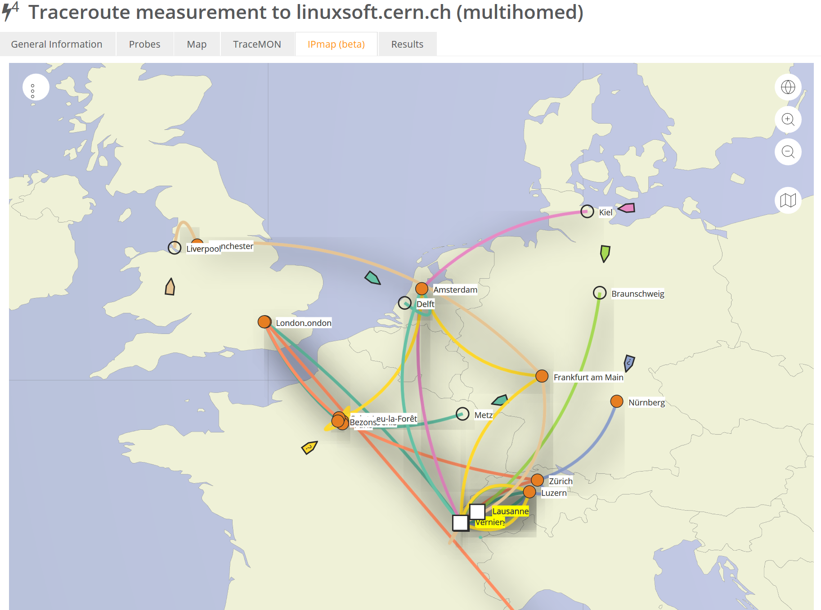

Intermezzo – BGP routing principles
Data: TraceMON IPmap
from RIPE NCC Atlas
atlas.ripe.net
measurement 9249079

Slide 33
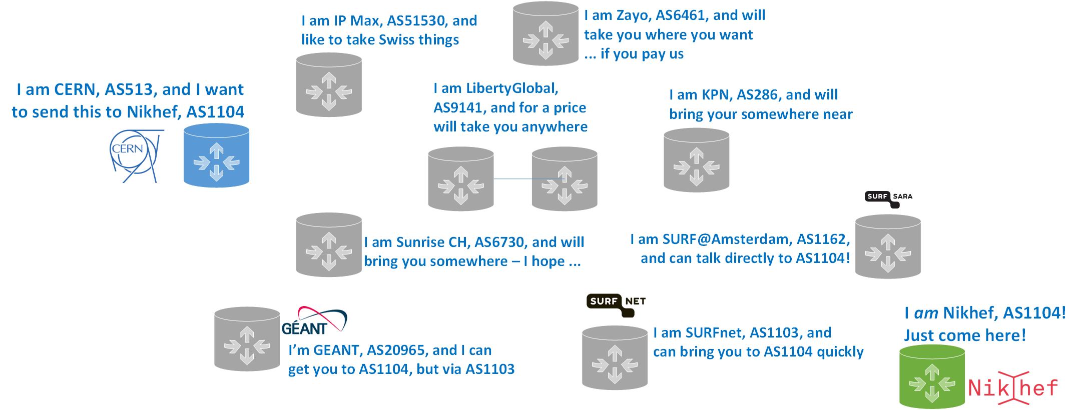
How does a packet flow?
Border Gateway Protocol (BGP) used here is based on (weighted)
path-vector traversal
I want to sent this to
e.g. 194.171.96.130
194.171.96.128/25
is here at AS1104
grey-dash lines for illustration only: may not correspond to actual peerings or transit agreements; red lines: the three existing LHCOPN and R&E fall-back routes; yellow: public internet fall-back (least preferred option)

Slide 34
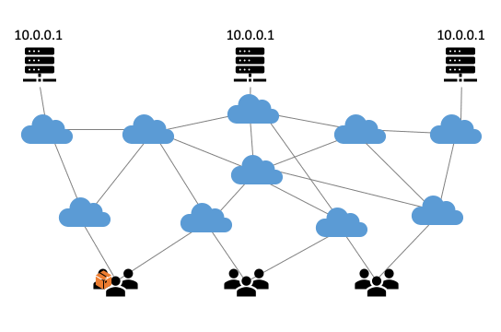
Anycast: when the same place exists many times
So we used
3 (now: 2) sites
one VM at each site
exposing 2a07:8504:01a0::1
smallest v6 subnet (/48)
bird + a service probe
each site’s own ASN
some IRR DB editing
v4 is similar, with a /24
and some monitoring
routing image: SIDNlabs - https://www.sidnlabs.nl/en/news-and-blogs/the-bgp-tuner-intuitive-management-applied-to-dns-anycast-infrastructure

Slide 35
BIRD config and probes
include "/etc/bird.d/*.conf";
router id 194.171.98.77;
define ASN_OWN = 65530;
define ASN_NEIGHBOUR = 1104;
define ADDR_NEIGHBOUR4 = 194.171.98.94;
define ADDR_NEIGHBOUR6 = 2a07:8500:120:e011::1;
protocol device { scan time 10; }
protocol direct direct1 {
interface "lo";
ipv4 { import all; export none; };
ipv6 { import all; export none; };
}
template bgp bgp_peers4 {
local as ASN_OWN;
ipv4 {
import none;
export filter match_route_filter;
};
}
template bgp bgp_peers6 {
local as ASN_OWN;
ipv6 {
import none;
export filter match_route6_filter;
};
}
protocol bgp BGP4 from bgp_peers4 { disabled no; neighbor ADDR_NEIGHBOUR4 as ASN_NEIGHBOUR; }
protocol bgp BGP6 from bgp_peers6 { disabled no; neighbor ADDR_NEIGHBOUR6 as ASN_NEIGHBOUR; }
you need
a health checker to drive
the local BGP daemon
a BGP talker, such as bird
a very simple config
# Generated 2023-02-05 14:49:36.063331
# by anycast-healthchecker (pid=1299)
# 2001:db8::1/128 is a dummy IP Prefix.
# It should NOT be used and REMOVED
# from the constant.
define ACAST6_PS_ADVERTISE =
[
2001:db8::1/128,
2a07:8504:1a0::1/128
];

Slide 36
But what is ‘healthy’?
Service status verification tool needed to ‘drive’ bird actions
anycast_healthchecker by Pavlos Parissis
with HAproxy
on the front-end host
on each site
Packager : Mischa Sallé <msalle@nikhef.nl>
Vendor : Pavlos Parissis <pavlos.parissis@gmail.com>
URL : https://github.com/unixsurfer/anycast_healthchecker
Summary : A healthchecker for Anycasted Services
Description :
Anycast-healthchecker monitors a service by doing periodic health
checks and based on the result instructs Bird daemon to either
advertise or withdraw the route to reach the monitored service. As
a result Bird will only advertise routes for healthy services.
[haproxy]
check_cmd = /usr/local/sbin/check_haproxy.sh
on_disabled = withdraw
ip_prefix = 145.116.216.1/32
[haproxy6]
check_cmd = /usr/local/sbin/check_haproxy.sh
on_disabled = withdraw
ip_prefix = 2a07:8504:1a0::1/128

Slide 37
Both Delegation Service and filtering WAYF should be up
But since Nikhef also has local HA with two back-ends, either is OK!
# Checks WAYF backends, at least one should be up or starting
# i.e. in state 2 or 3 (see Section 9.3 Unix Socket commands in
# management.txt).
check_wayf() {
echo $state_cmd |\
socat unix-connect:${haproxy_socket} stdio |\
grep $wayf_pattern |\
cut -d' ' -f${site_col},${state_col} |\
while read wayf_site wayf_state
do
if [ "$wayf_state" -ge 1 -a "$wayf_state" -le 2 ];then
# Found at least one up DS
info "WAYF $wayf_site has state $wayf_state"
return 1
else
warn "WAYF $wayf_site has state $wayf_state" >&2
fi
done
return $((1-$?))
}

Slide 38
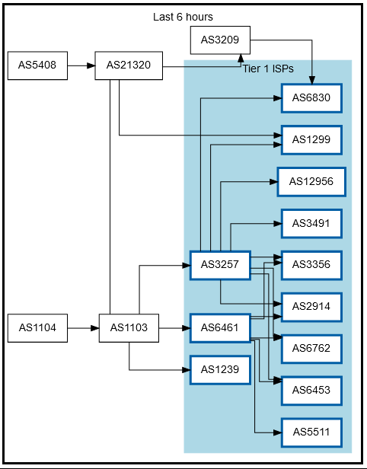
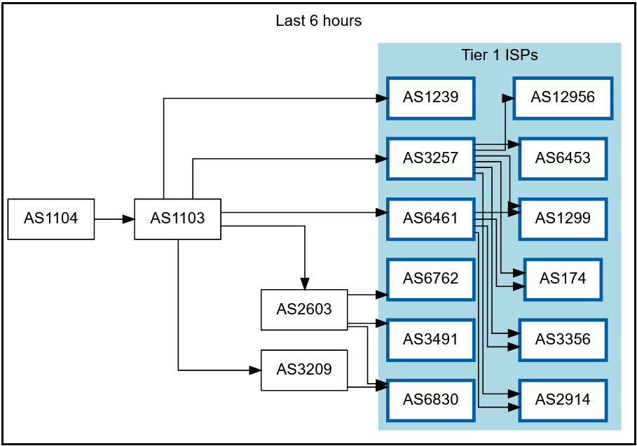
Getting 2a07:8504:01a0::/48 out there
route maps: bgp.tools for 145.116.216.0/24 – IPv6 is similar

Slide 39
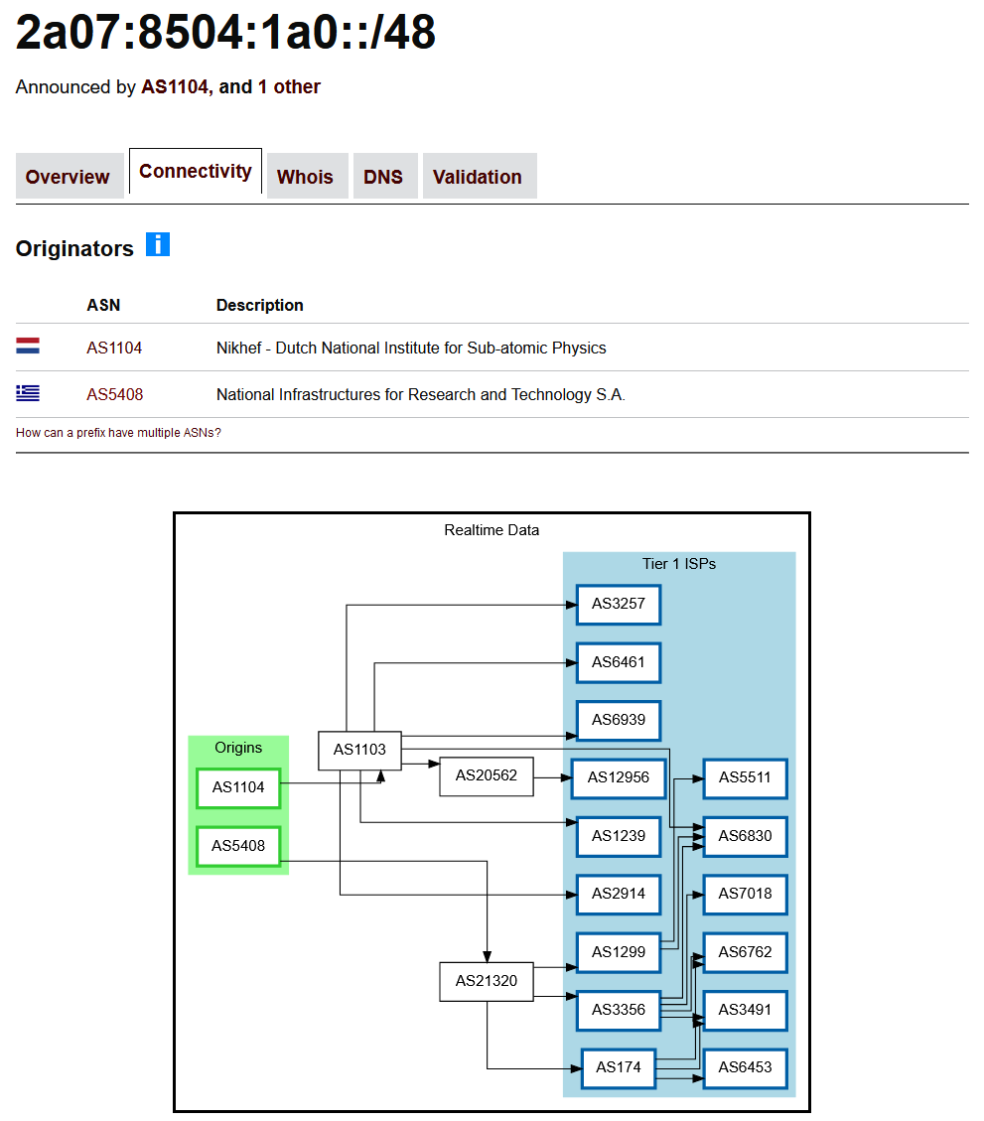
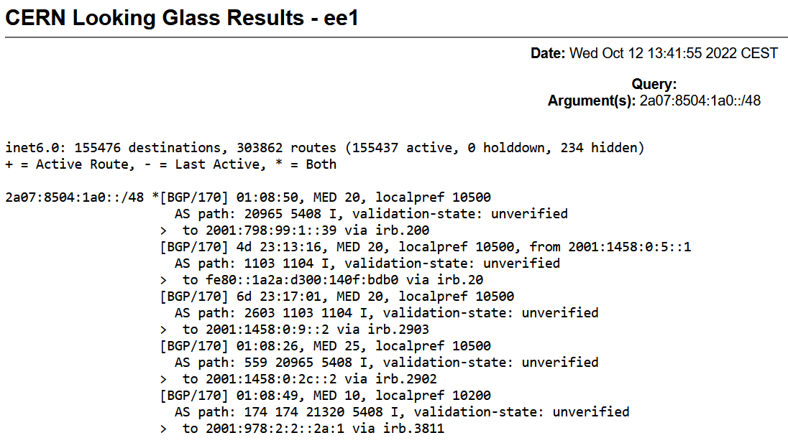

Slide 40
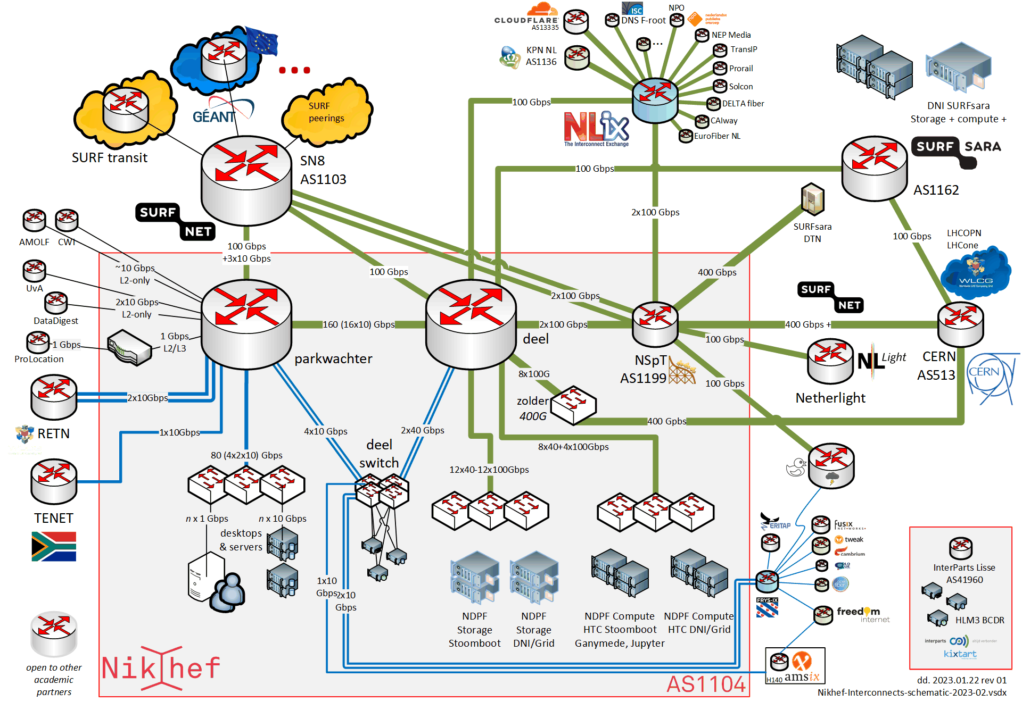
Shortest path, also when mixing with the default-free zone
[root@kwark ~]# traceroute -IA 145.116.216.1
traceroute to 145.116.216.1 (145.116.216.1), 30 hops max, 60 byte packets
1 cmbr.connected.by.freedominter.net
(185.93.175.234) [AS206238]
2 connected.by.freedom.nl
(185.93.175.240) [AS206238]
3 et-0-0-0-1002.core1.fi001.nl.freedomnet.nl
(185.93.175.208) [AS206238]
4 as1104.frys-ix.net (185.1.203.66) [*]
5 parkwachter.nikhef.nl
(192.16.186.141) [AS1104]
6 gw-anyc-01.rcauth.eu
(145.116.216.1) [AS786/AS5408/AS1104]
rcauth.eu HA proxy

Slide 41
Prerequisites are relatively simple
IPv4 /24 netblock and IPv6 /48
your own, or a friendly, ASN
a set of corresponding IRR route objects, and either none, or a correct RPKI
(easily done in your local RIR registry: APNIC, RIPE, ARIN, AfriNIC, LACNIC)
front-end service (HAproxy) for the Delegation Service and filtering WAYF
bird (or quagga) with a service health checker
But you do not per-se need …
a unique AS just for this anycast activity - it works equally well without it
a balanced AS path length - unless you want load balancing as well as redundancy
your own AS - if you have a friendly AS willing to re-announce your specific route

Slide 42
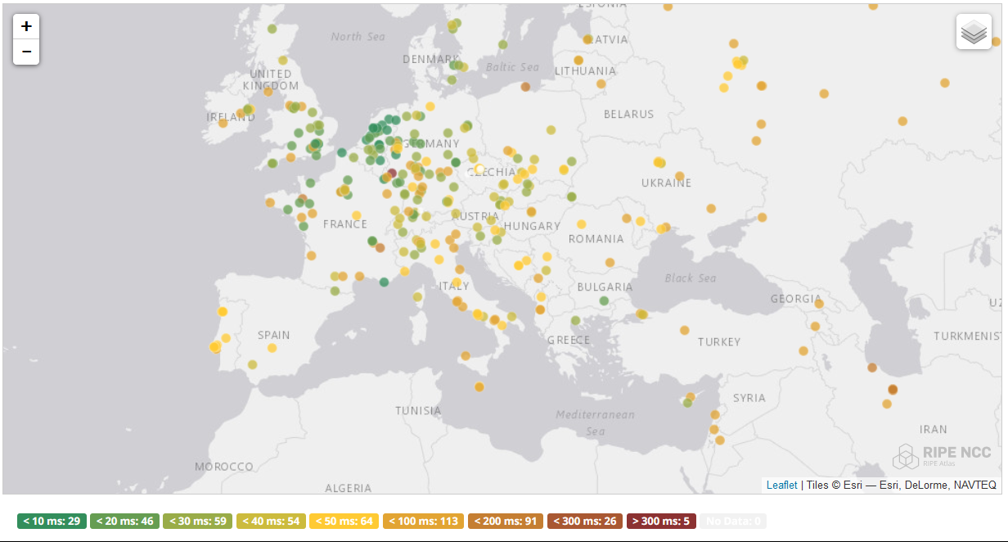
And you get reasonable load balancing
map: RIPE NCC RIPE Atlas - 500 probes, distributed across Europe (https://atlas.ripe.net/measurements/50949024/)

Slide 43
Other HA options
Local HA with an HA proxy and pacemaker/CRM failover works
on the local network – and can be meshed with two signing systems
… this is used extensively (also active/passive) for other services at Nikhef
DNS-based fast-failover – the method used for e.g. InAcademia
automatic updating of DNS a distributed set of servers, auto-updating each other
… does require that the DNS domain level operator remains available,
since you need *very* short TTLs, and still your ccTLD/gTLD needs HA as well
use dedicated HA links for the back-end database connection or ip-forwarding
e.g. multiple redundant circuits over an MPLS cloud emerging at each site

Slide 44

Current status
All sites can sign production certificates
DS databases cross-site replication using Galera over VPN
HA CRL cross site synchronisation and issuance
WAYF servers (GRNET and Nikhef)

Slide 45
Reuse the RCauth experience
All sources, Ansible playbooks, and materials are on GitHub
https://github.com/rcauth-eu
HA database and back-end VPN
  3-node peer-peer redundant VPN with automatic failover
  extensible to >3, but then topology is less clear
Web services
  HAproxy stability and flexibility and coordinated ‘up-down’ status per site
HAHAP | BGP Anycast
  ‘bog-standard’ if service admins, cloud admins, and network people can
  collaborate and investigate incidents together
secure credential sharing and moving shared secrets is still cumbersome in practice
‘the difference between theory and practice is that, in theory, there is no difference’

Slide 46

Still here? Thanks!
This work has also been co-supported by projects that have
received funding from the European Union’s Horizon research and
innovation programmes under Grant Agreement No. 856726 (GN4-3),
101017536 (EOSC Future), 777536 (EOSC-hub), 730941 (AARC2).
RCauth.eu distributed setup
in collaboration with Mischa Sallé and
Tristan Suerink (Nikhef), Nicolas Liampotis and Kyriakos Gkinis (GRNET), and Jens Jensen (STFC RAL)

