Slide 1
Physics Data Processing
A Brief Overview
David Groep

Slide 2
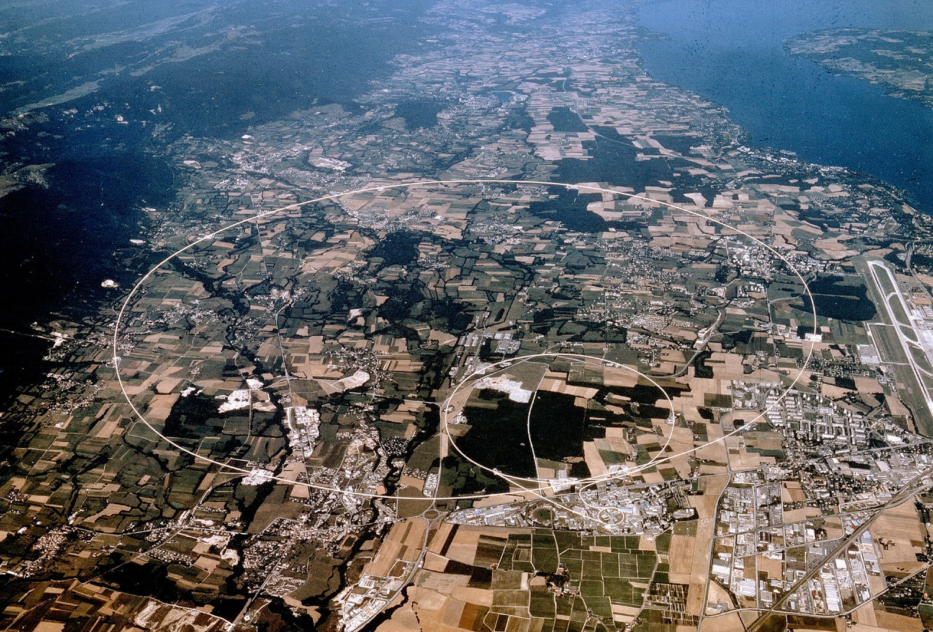




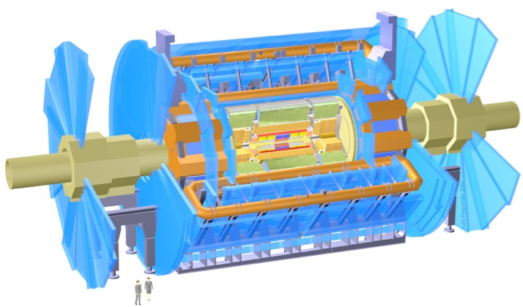

Nikhef – accelerator experiments
ATLAS
Higgs physics
Beyond the standard model
LHCb
rare decays
matter vs anti-matter
Alice
quark-gluon plasma
matter phase transitions
LHCb
ALICE
ATLAS
Atlas
protons
Haarlemse Chemische Kring
2

Slide 3
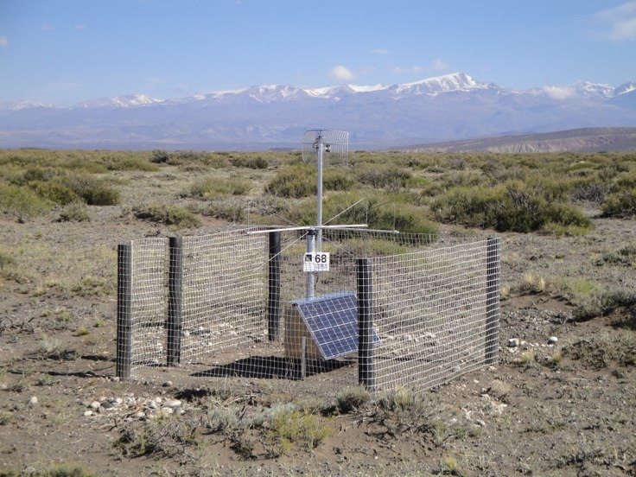
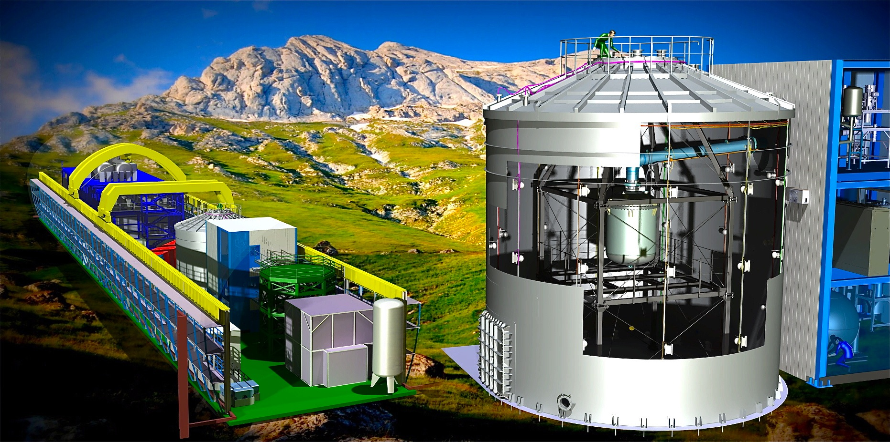
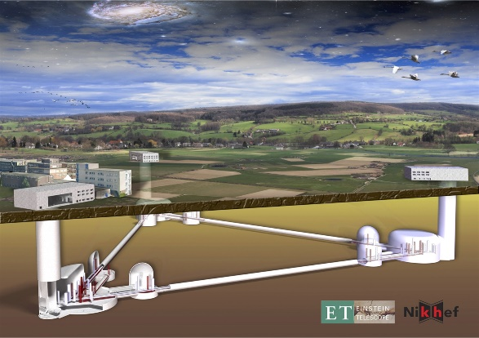
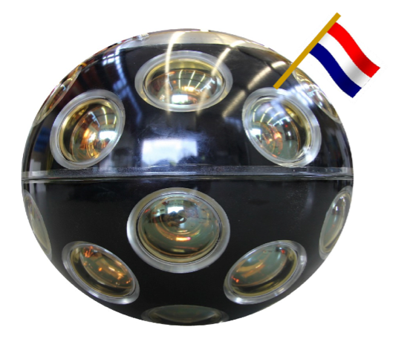
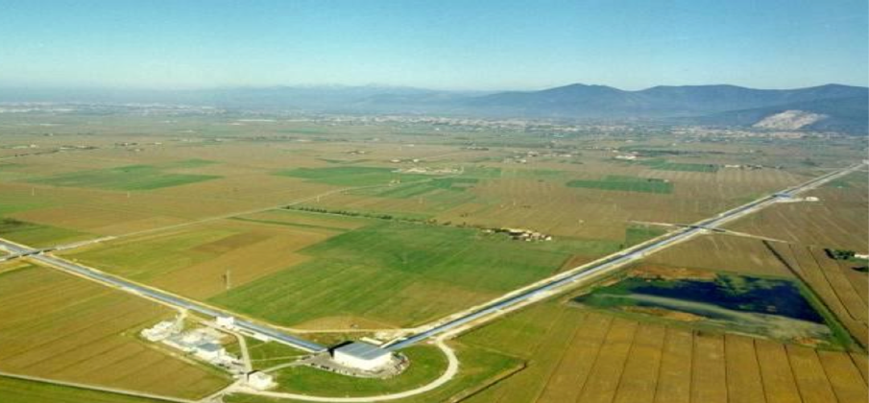
Nikhef – (astro)particle physics
KM3NET
neutrino telescope
Virgo/LIGO/ET
gravitational waves
Auger
ultra-high energy
cosmic rays
Xenon
search for dark matter
Pierre Auger - cosmic rays
Xenon1T - Dark Matter
Gravitational Waves
KM3NeT - neutrino detection

Slide 4
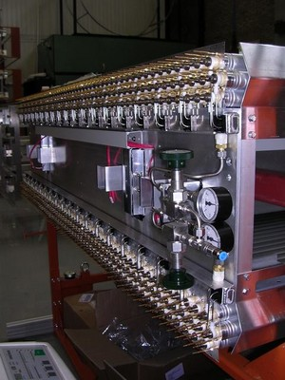
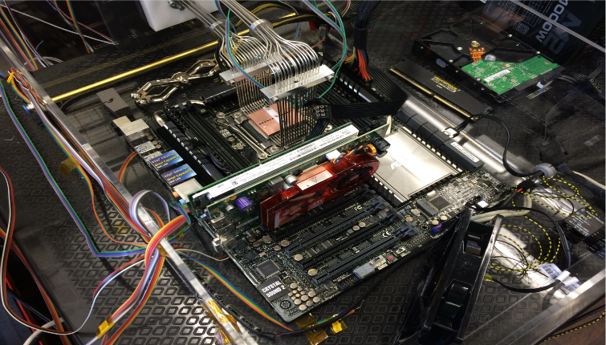
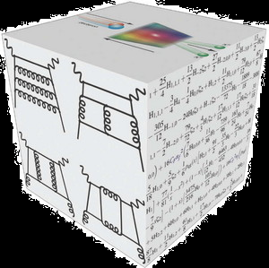
Nikhef collaboration – underpinning programmes
Theoretical Physics
Physics Data Processing
Detector R&D

Slide 5
PDP ‘Physics Data Processing’ activities and action lines
Scalable Computing
& Algorithms
algorithms for high-performance software
data organisation
accelerator throughput
rethinking code: at small scale and on large scales
Research Infrastructure
& Future Technologies
NDPF processing facility
National e-Infrastructure
coordinated by SURF
experimental next-gen systems engineering
cross-tier global networks
stressing & public/private collaborative design
Infrastructure for Secure Collaboration
authentication and authorization protocols
multi-domain federation
global trust and identity
access provisioning
operational security

Slide 6
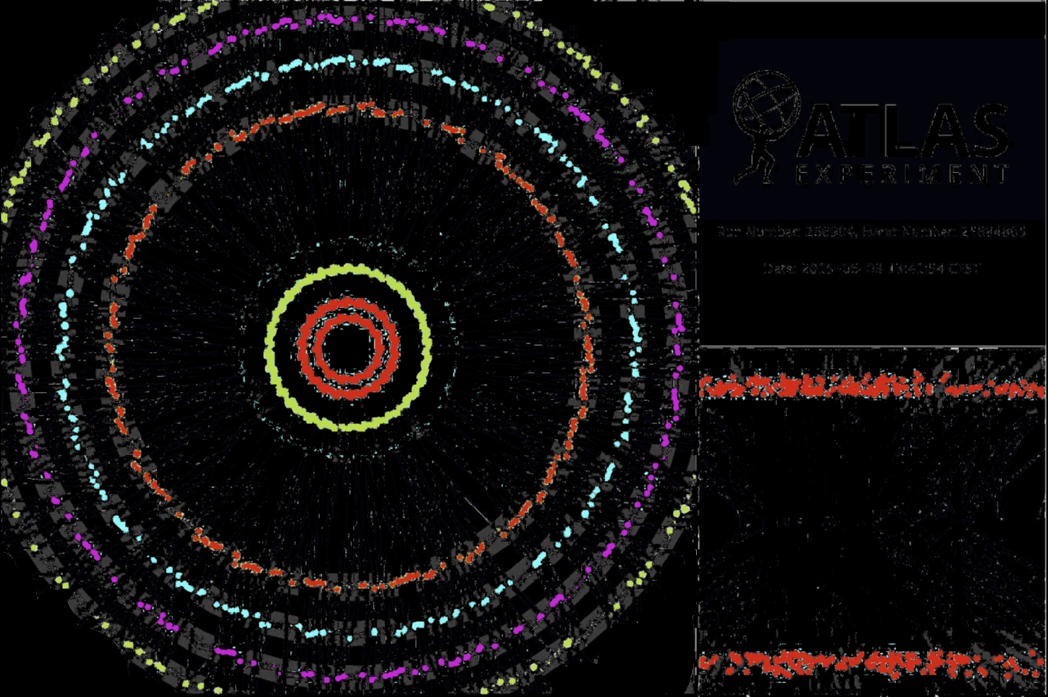
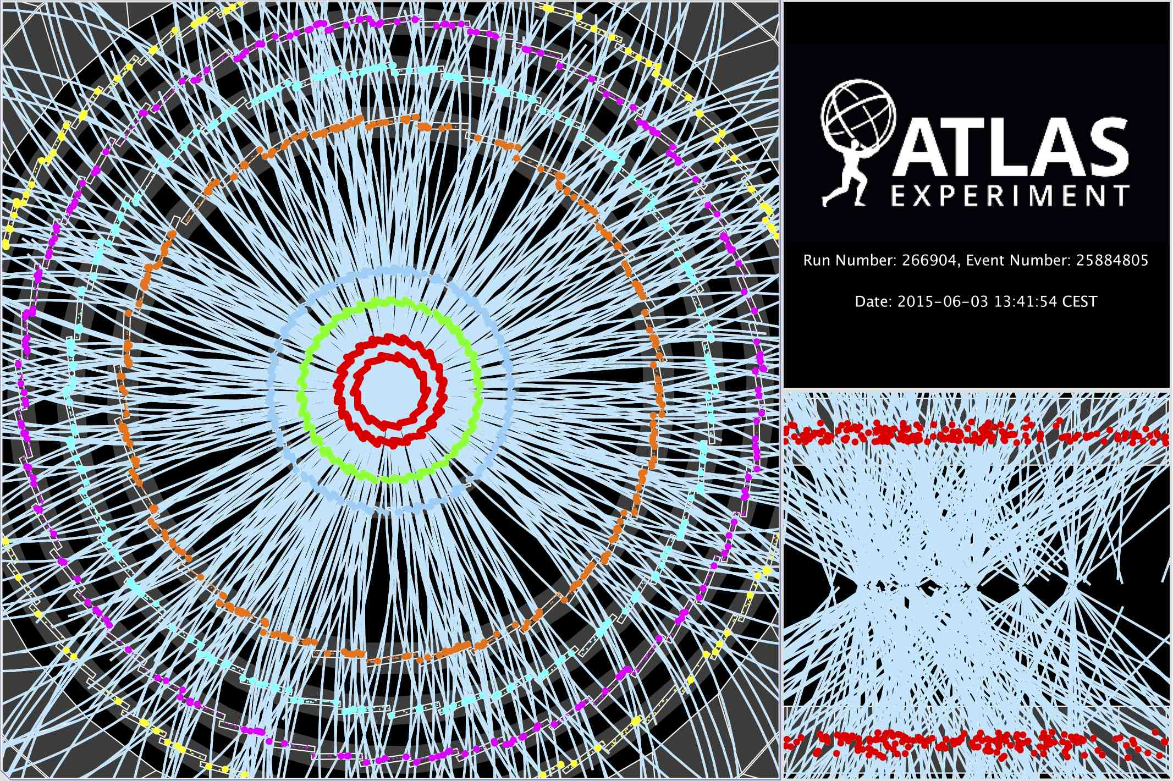
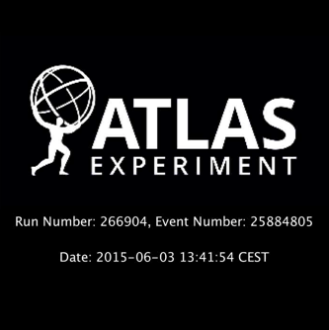
Computing on data: 40 million per second
~ 10 seconds to a compute a single event at ATLAS (as an example) for ‘jets’ containing ~30 colllisions
Display of a proton-proton collision event recorded by ATLAS on 3 June 2015, with the first LHC stable beams at a collision energy of 13 TeV
Event processing time: v19.0.1.1 as per Jovan Mitrevski and 2015 J. Phys.: Conf. Ser. 664 072034 (CHEP2015)

Slide 7
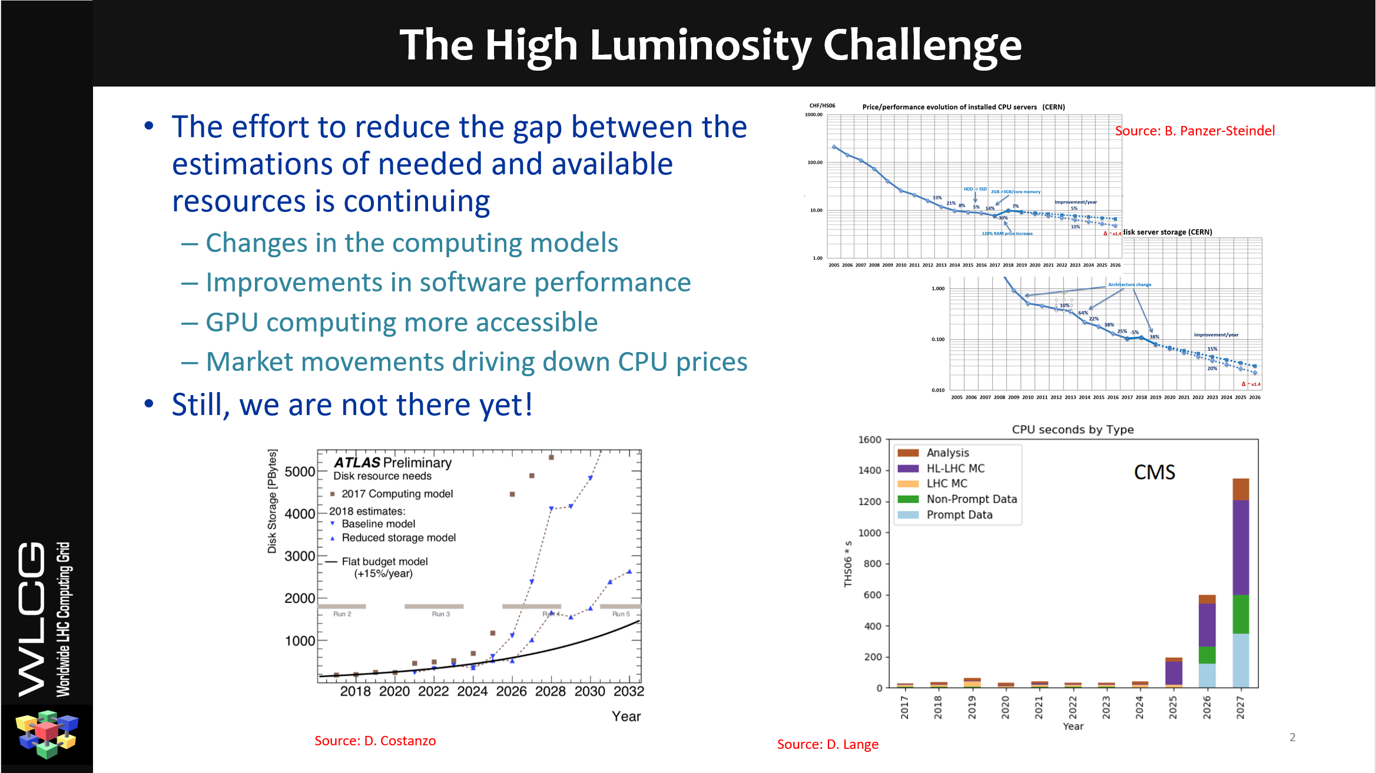
source: Andrea Sciaba et al. for the WLCG Resource Evolution WG, CHEP2019

Slide 8
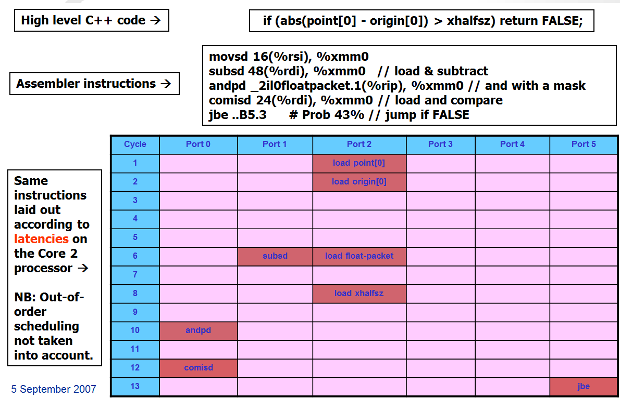
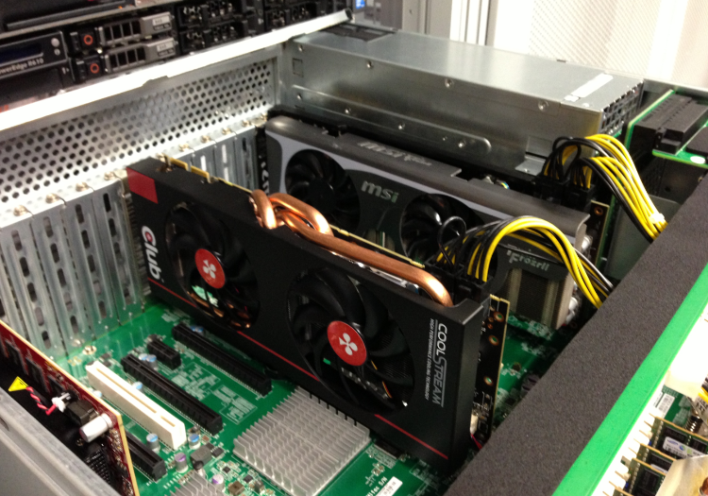
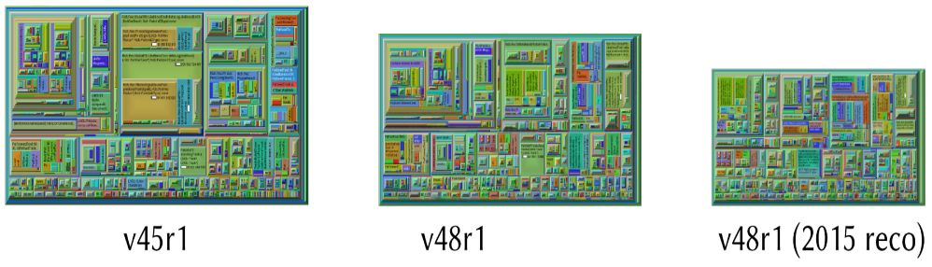
Algorithms: beyond data organisation and throughput
plofkip.nikhef.nl
2007 Core 2 efficiency: Sverre Jarp, CHEP2007 (!)
Gerhard Raven et al, 2015 for LHCb

Slide 9
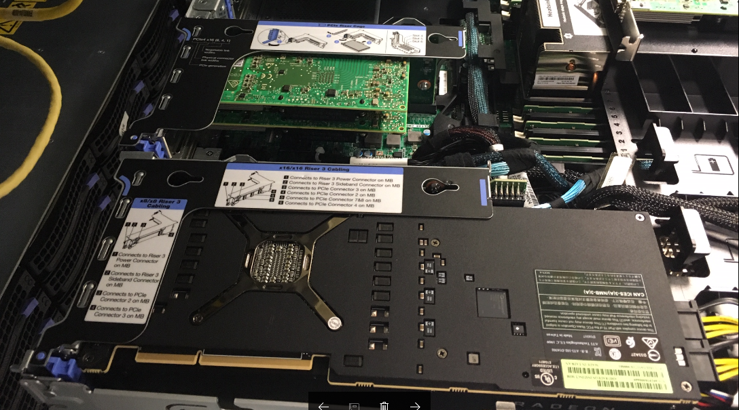
Prototype AMD MI50 GPU in the Nikhef Speeltuin last year
Image: Tristan Suerink

Slide 10
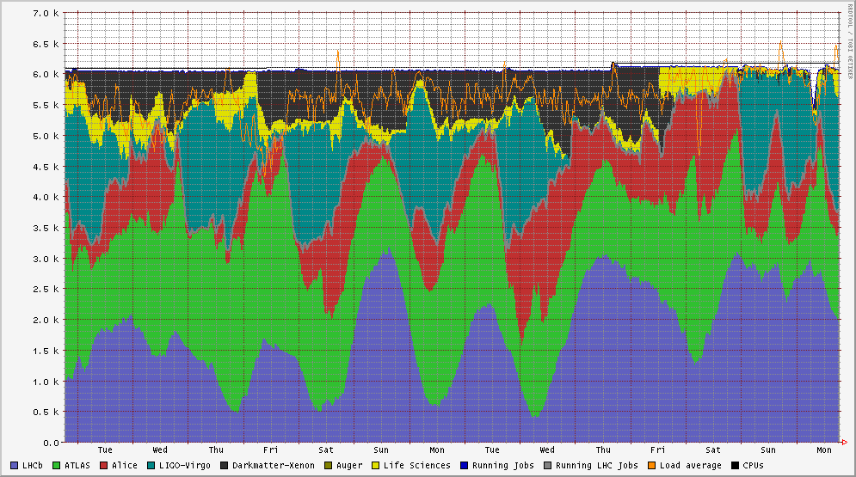
Nikhef Data Processing Facility – multi-community service
Life Sciences, MinE, WeNMR
Services in the DNI
compute in many operational sites (SURFsara, Nikhef, RUG-CIT)
high-throughput storage at SURFsara and Nikhef,
long-term storage at SURFsara,
interconnected by SURFnet, and authentication by SURFcertificaten
Dark matter search
LIGO-Virgo
LHC Alice
LHC ATLAS
NDPF voview short 1 October 2018
LHCb

Slide 11
Feeding data – tiered storage
‘Hot’ data tier at ~ 5 PiB, ‘warm’ tier of ~ 1.6PiB, interconnect to nearline
12 MiB/s/TiB - about 4 PiB configured (both DNI/NL-T1 and Stoomboot)
‘hooikanon’: 240 (4x60) spindles, 12 TByte disks, 4x100Gbps network
4x IBM SL922 Power9 PPC servers, 8x NetApp E5700 controllers, 4 trays
https://wiki.nikhef.nl/grid/100g_Storage_Box
hooikanon-01..04.nikhef.nl

Slide 12
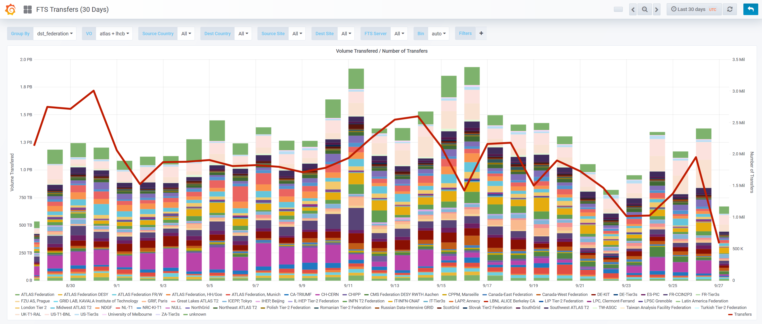
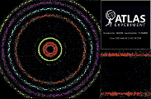
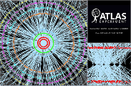

Data Distribution: LHCOPN/LHCone
2.6M
source: https://monit-grafana.cern.ch/d/000000420/fts-transfers-30-day on September 27, 2018

Slide 13
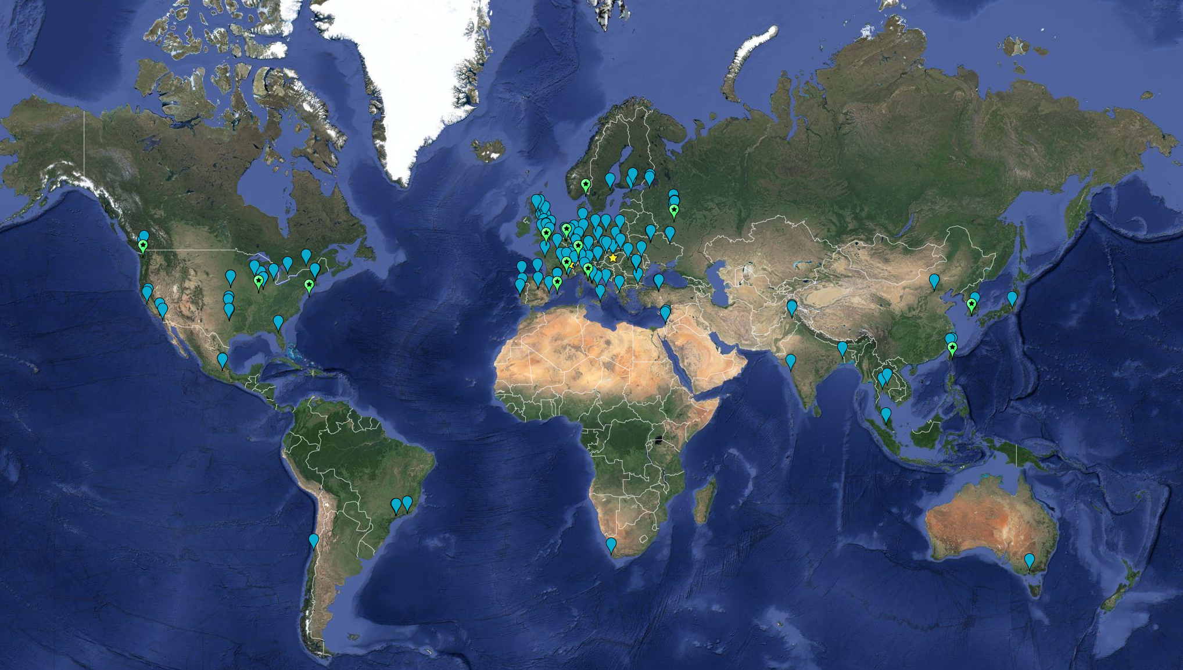


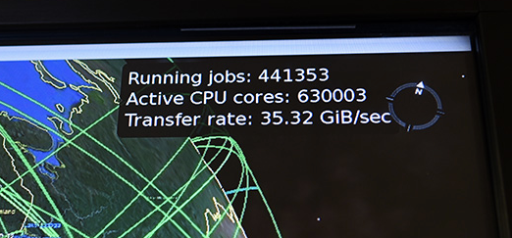

Globally distributed in EGI & WLCG
>170 institutes in >42 countries
and economic regions
Computing ~ 1,000,000 cores
On-line disks > 310 PB
Archival > 390 PB

Slide 14
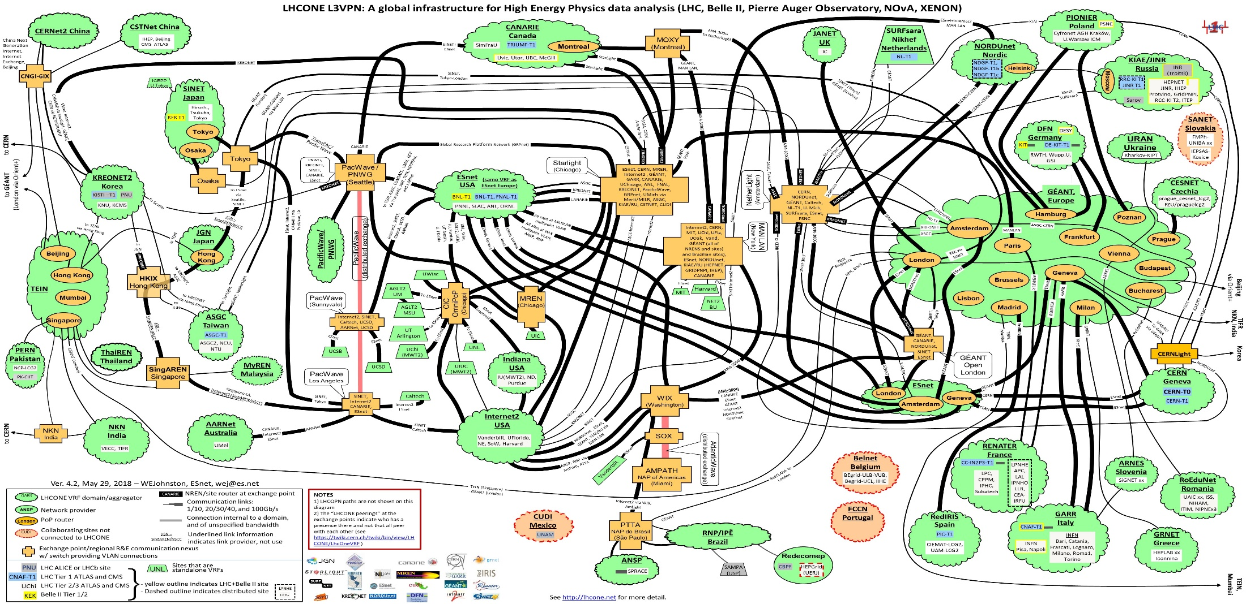
‘LHC Open Network Environment’

Slide 15
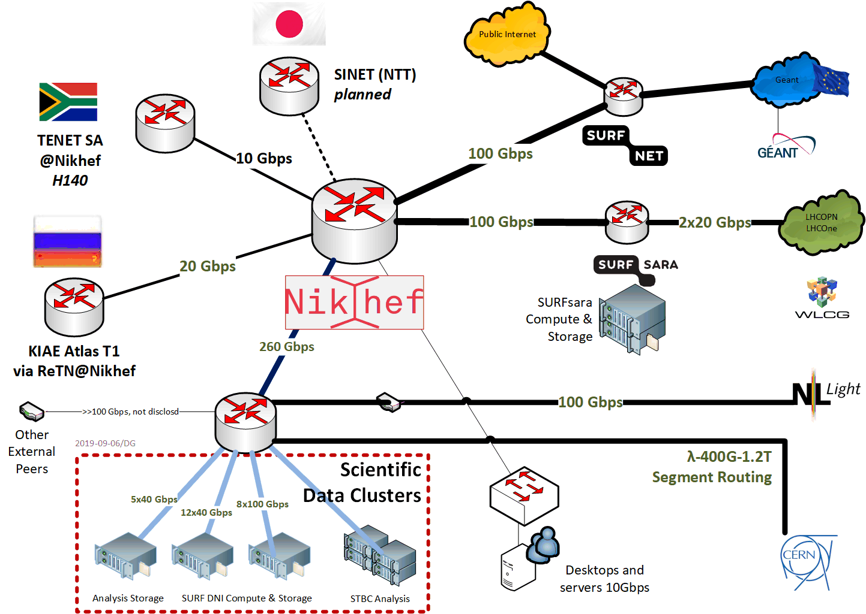
Direct peering infra for ‘big data’

Slide 16
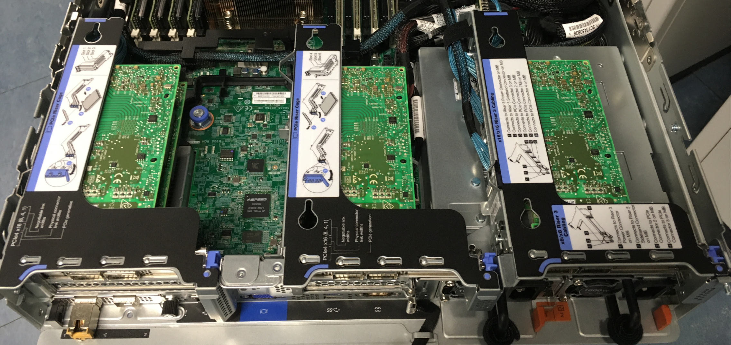
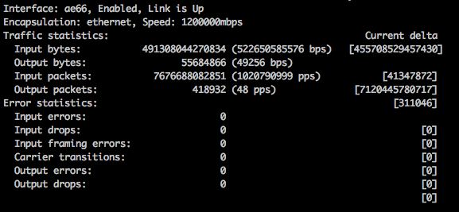
ballenbak.nikhef.nl
Image: Tristan Suerink

Slide 17
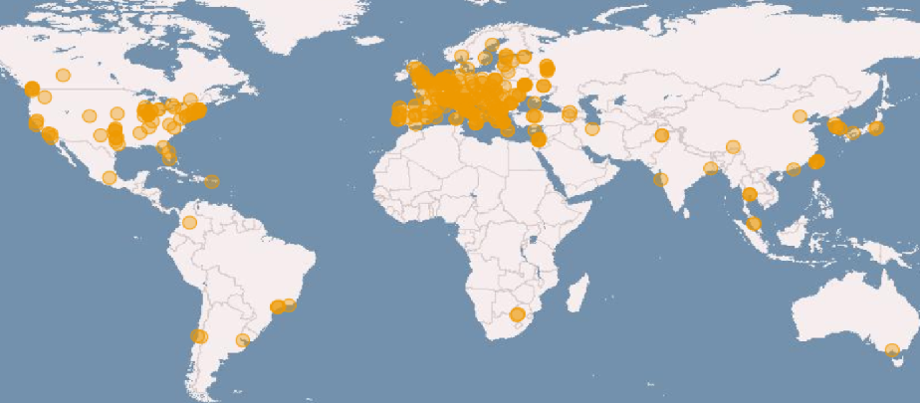
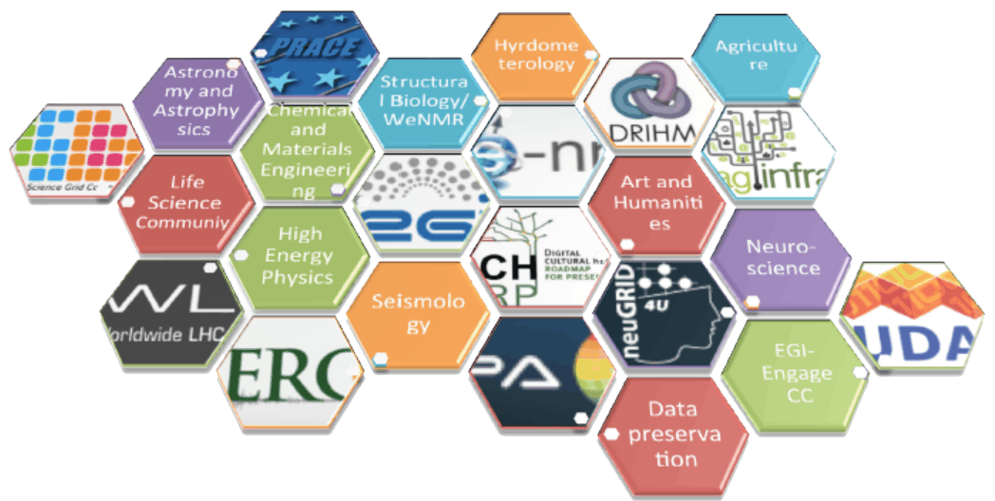
e-Infrastructures: EGI, EUDAT, GEANT, PRACE, …
imagery: EGI.eu

Slide 18
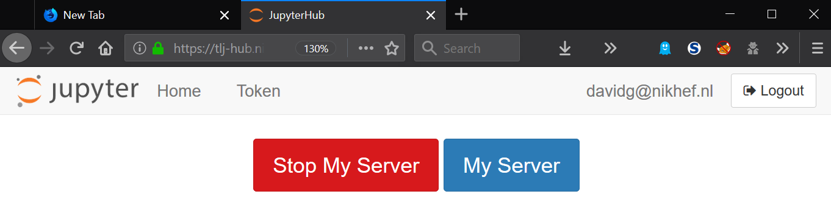
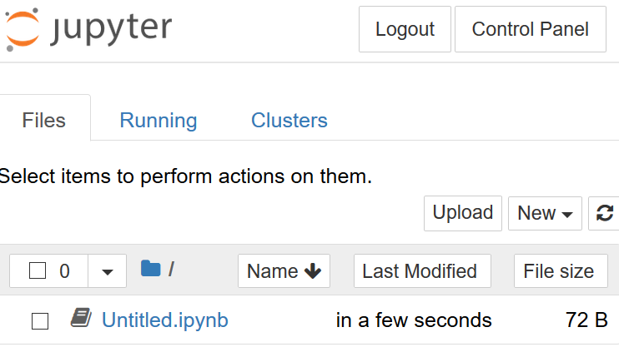
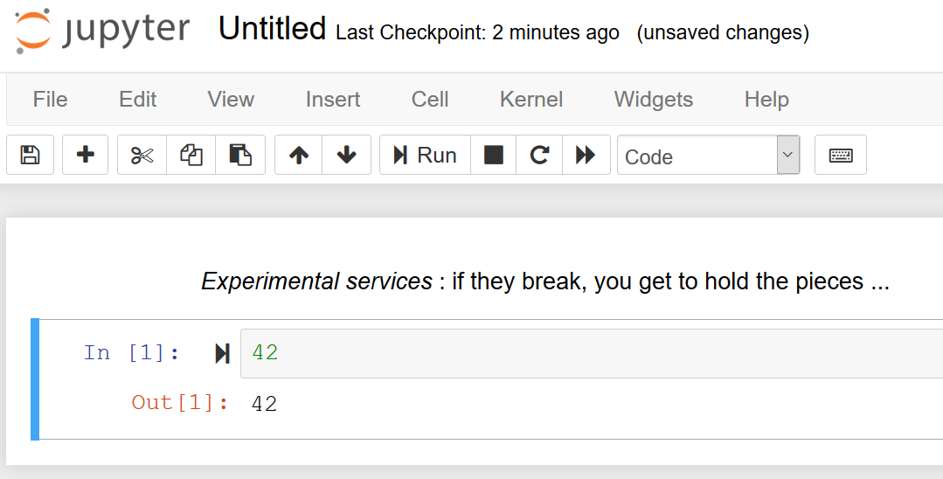
Local users, remote users, …
Login with Nikhef SSO and our brand-new OIDC provider … under test …

Slide 19
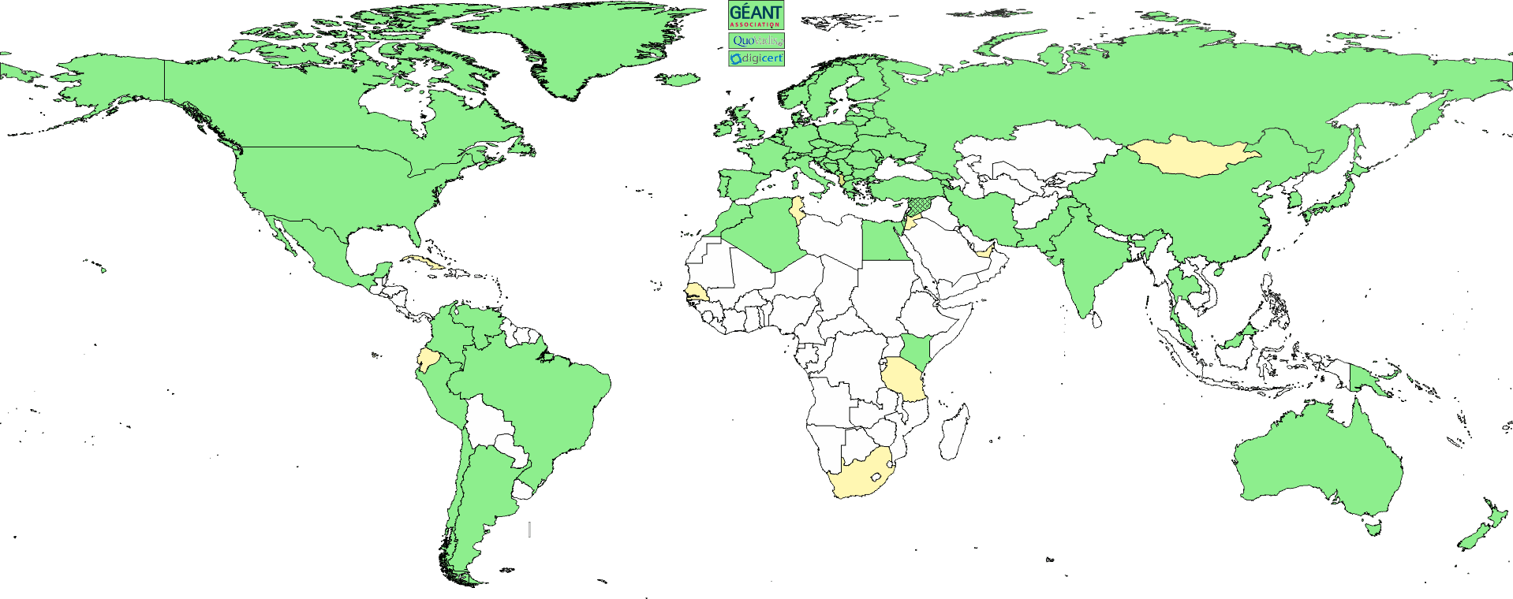
Interoperable Global Trust Federation IGTF
3 regional chapters: EMEA, Americas, AP
~ 90 Identity Providers (some leveraging a R&E federation)
~ 10 international major relying parties
~ 60 countries / economic areas / extra-territorial orgs
> 1000 relying service provider collaborations
www.igtf.net

Slide 20
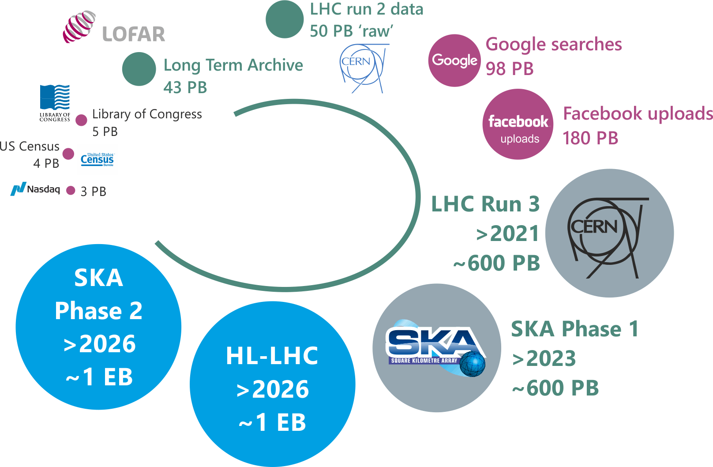
data deluge - and with data comes processing
Challenges 2020-2025:
  Bring ICT infrastructure
  to a next level
  Optimize complex
  algorithms
Prepare now for even
bigger challenges >2026
Notes:
Data deluge
Data hides treasures that unlock mysteries of our Universe
Computing is essential to find them!
by investing NOW in the FuSE effort we are able to
afford compuing 2025 onwards – the proposal states that this is “upfront”
investment to save having to do brute-force, expensive computing in the late 2020s
we cannot afford to put a gap
how much data are we talking about?
Relative volumes. What is hidden here is that the associated computing for these roadmap infrastructures is quite a bit more complex than at Google and Facebook.

Slide 21
National e-Infrastructure
Notes:
Slide visualizes the Dutch FuSE proposal in context of the European and global activities in computing and data handling of large
infrastructures. ASTRON and Nikhef have been involved in e-infrastructure for more than 20 years.
Blue color: the general scientific European e-Infrastructures developments, mainly policy and coordination, not specific to any domain
Green color: EU and global developments that have been made closer to the experiments. Escape unifies all of them
Orange: the netherlands e-Infrastructure (hardware + expertise) funding (BiG Grid contained 20% Support and Development) and LHC roadmap.
FuSE: fits in right in the middle:
LHC roadmap has stopped in 2019
SKA and KM3NeT are new infrastrtuctures
Algorithmic developments and the access mechanisms are right in the middle of all this.
(WLCG does not dictate how ATLAS organises the data).
Story: Involvement of Nikhef and ASTRON in e-infrastructures goes back 20 years: on this slide, EU-DataGrid (below left) started in 2001. Also think of ICT @ ASTRON and Nikhef 3rd WWW site.
Already in the 90s.
The Netherlands is unique in the world in that the majority of the large scale scientific computing activies are coordinated by national policy through SURF.
This can be traced back to the BiG Grid proposal in which both Nikhef and ASTRON (LOFAR) participated.
After the LHC roadmap funding has stopped, and the upcoming SKA and KM3NeT
infra’s: a gap in national computing appears that FuSE will fit in.
note: both AENEAS and ESCAPE are bigger than FuSE
Note: FuSE is needed in the context of ESCAPE like WLCG was needed in the framework of EGEE
Below repeats much of above .. can consolidate.
Nikhef and ASTRON are key players both at the national and global scale.
Leading European projects (like AENEAS), establishing the infrastructure (like
EGI), and initiating national efforts such as BiG Grid (in which the WLCG
Tier-1 and LOFAR were key science communities) The expertise spans all key
areas of the FuSE proposal, and the strong alignment of Nikhef and ASTRON is
clearly evident also on the European level (with joint participation in AENEAS
and ESCAPE).
Big GRID is more than LHC and LOFAR
ASTERICS: eerder in traject, radio astronomy and astroparticle physics
AENEAS: design study for regional centres for SKA
hardware infrastructure deel van DNI gecoordineerd door SURF (unique in world)
- combi met data analyse op Nikhef en ASTRON + universiteiten

Slide 23

Fun, but not the solution to single-core performance …
Collaboration of Intel™ and Nikhef PDP & MT (Krista de Roo) “CO2 Inside”
Image: Tristan Suerink

Slide 24
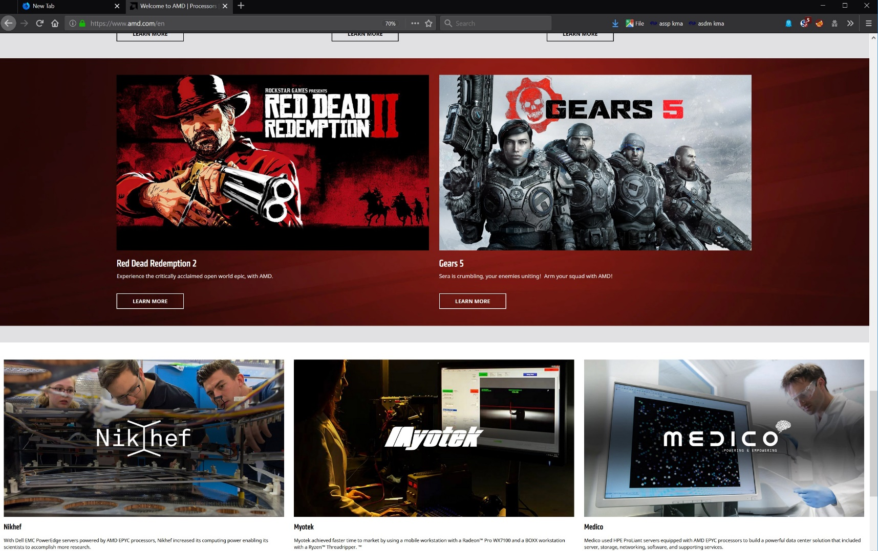
www.amd.com – homepage visited Dec 4th 2019

Slide 25

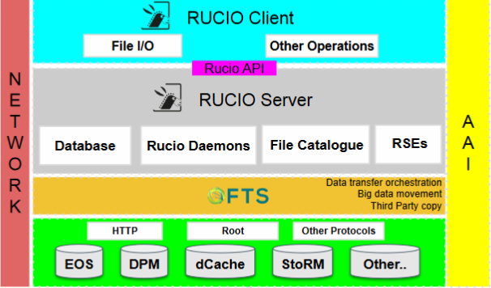
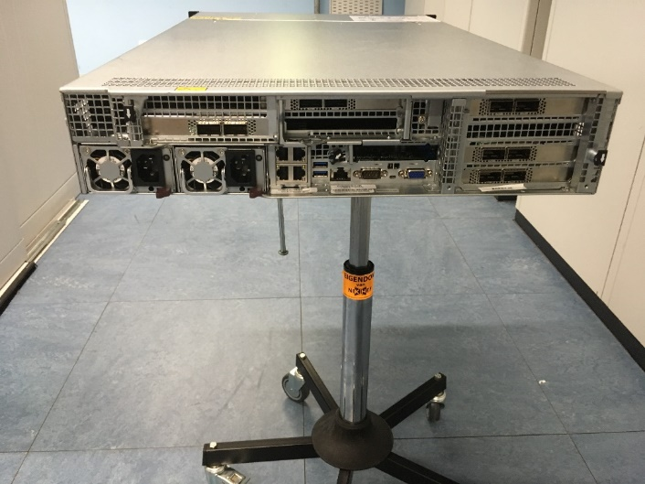
Small packets – big trouble? 1.2 Bpps system
But long-distance fat networks work fine for ‘big files’
bandwidth x delay hampers remote random access
which is why ESCAPE develops data lake caching
Some data is inherently ‘small’ and packetized
‘telemetry’ data
remote distributed event processing
but sending many packets is far more challenging
on network ASIC design – so let’s test it!
Graphic Data Lake, Simone Campana, ESCAPE WP2 DIOS
Image 1Bpps machine by Tristan ☺

Slide 26
Our world record: 1 billion packets per sec
14-06-2019: 1 billion pps i.e. 1 Gpps (and 522Gbps)
https://wiki.nikhef.nl/grid/1Bpps_Machine
Image: Tristan Suerink
Notes:
Je kan in 4 seconden het hele ipv4 internet op de deur kloppen (pingen).
Een stoomboot node kan 10 Miljoen pakketten per seconde halen.
Een laptop kan 1 Miljoen pakketten per seconde halen.

Slide 27
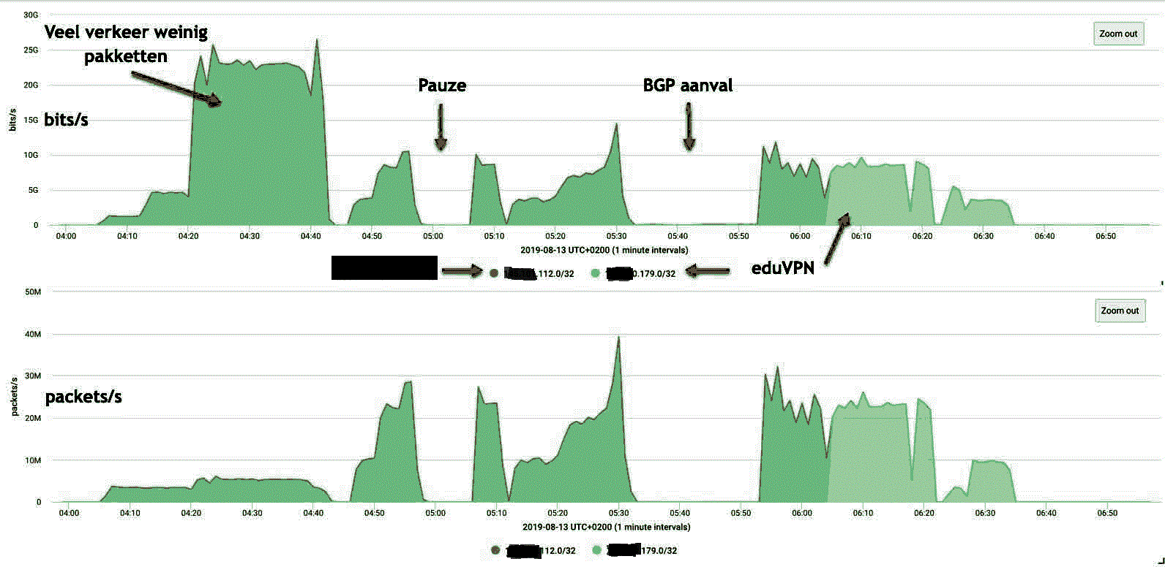
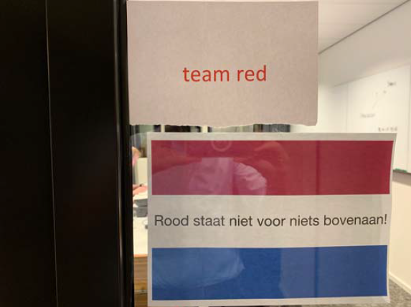
Our science data looks akin to a DDoS
evaluating resilience to cyberattack – in a cooperative way

Slide 28
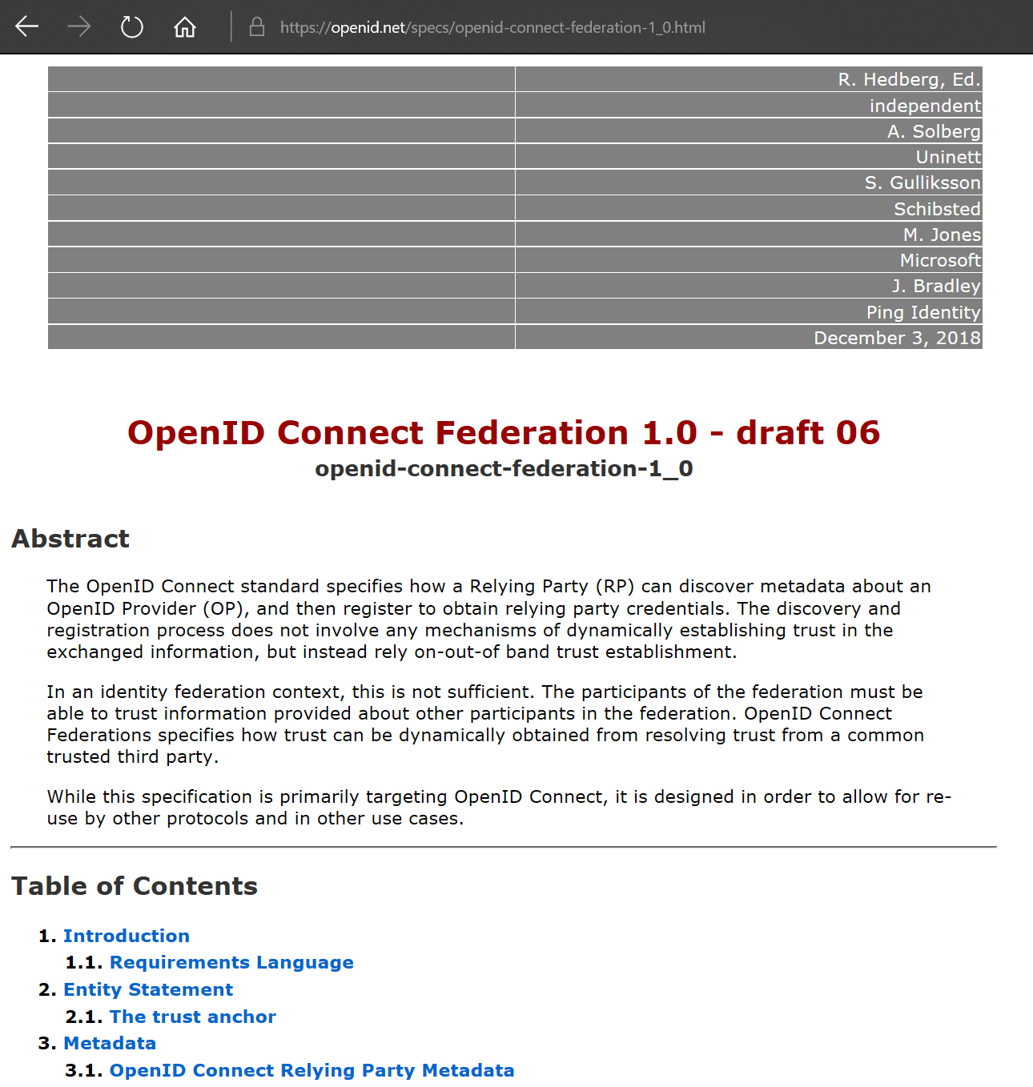
OIDC Fed – trust is technology agnostic
OpenID Connect Federation:
multilateral trust beyond GAFA
see: openid.net → Specs & Dev info
Roland Hedberg, et al., with Mischa Sallé

Slide 29
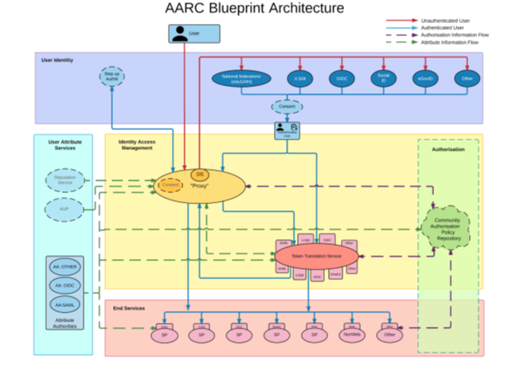

AARC BPA – coherency by proxying
https://aarc-community.org/architecture/

Slide 30
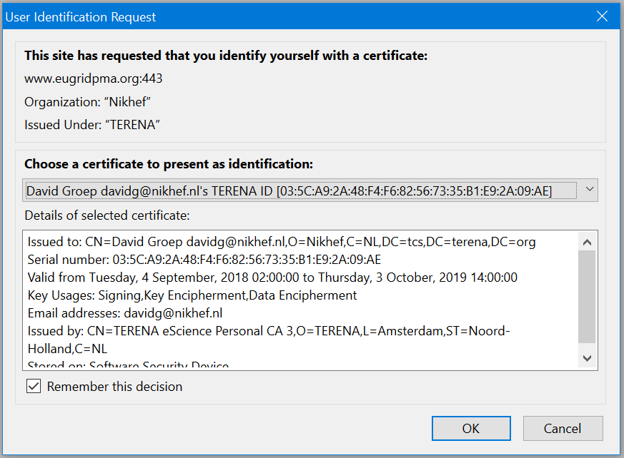
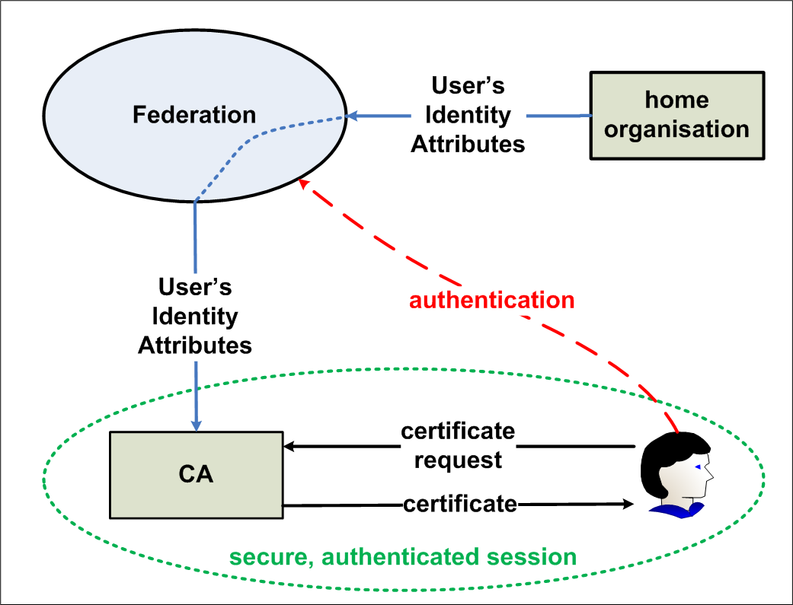
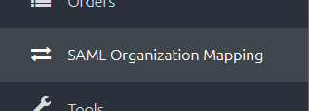
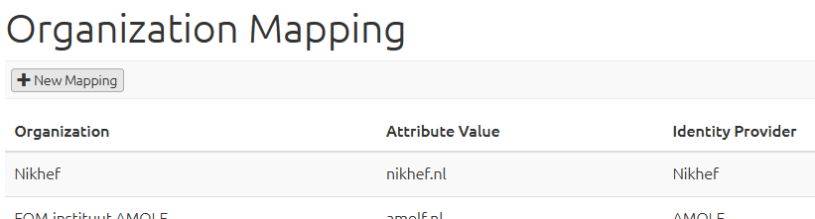
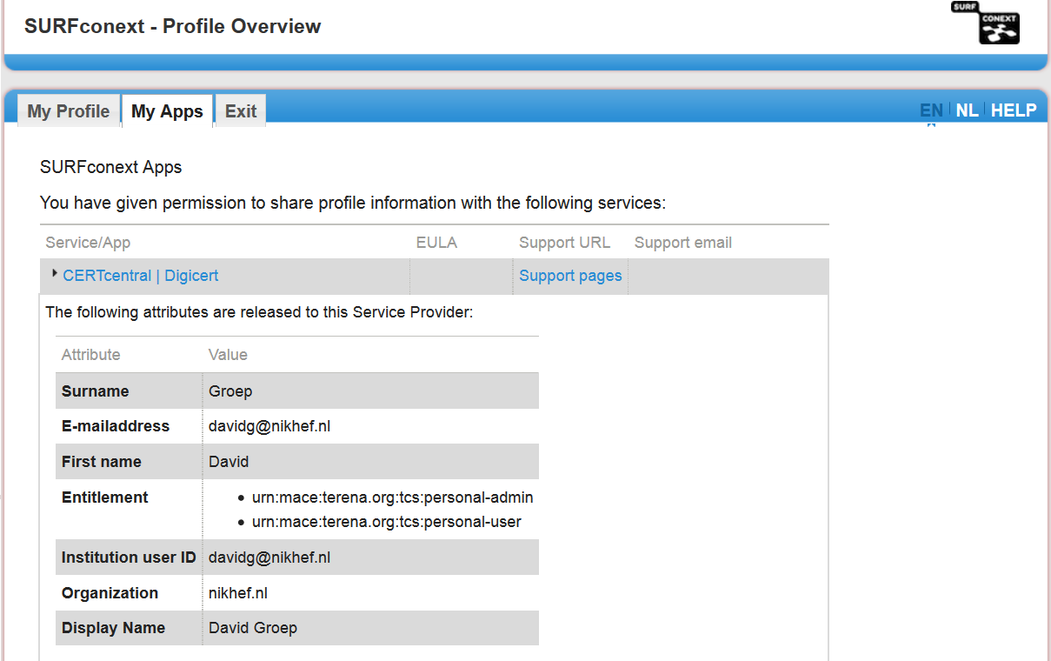
Bridges and Token Translation Services
GEANT Trusted Certificate Service
DigiCert acts as a SAML Service provider to eduGAIN
and eligible authenticated users can obtain their
own certificate for access and delegation to services

