Slide 1
And the winner is …
PDP infrastructure, algorithms, collaborative access
Nikhef Jamboree May 2022

Slide 2
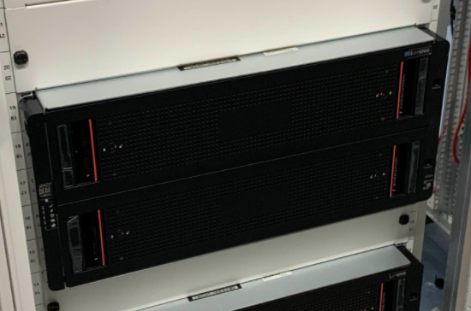
For a box full of disks … (and a fistful of euro’s)
84x16TByte gross capacity, so ~ 1PByte net after redundancy overhead

Slide 3
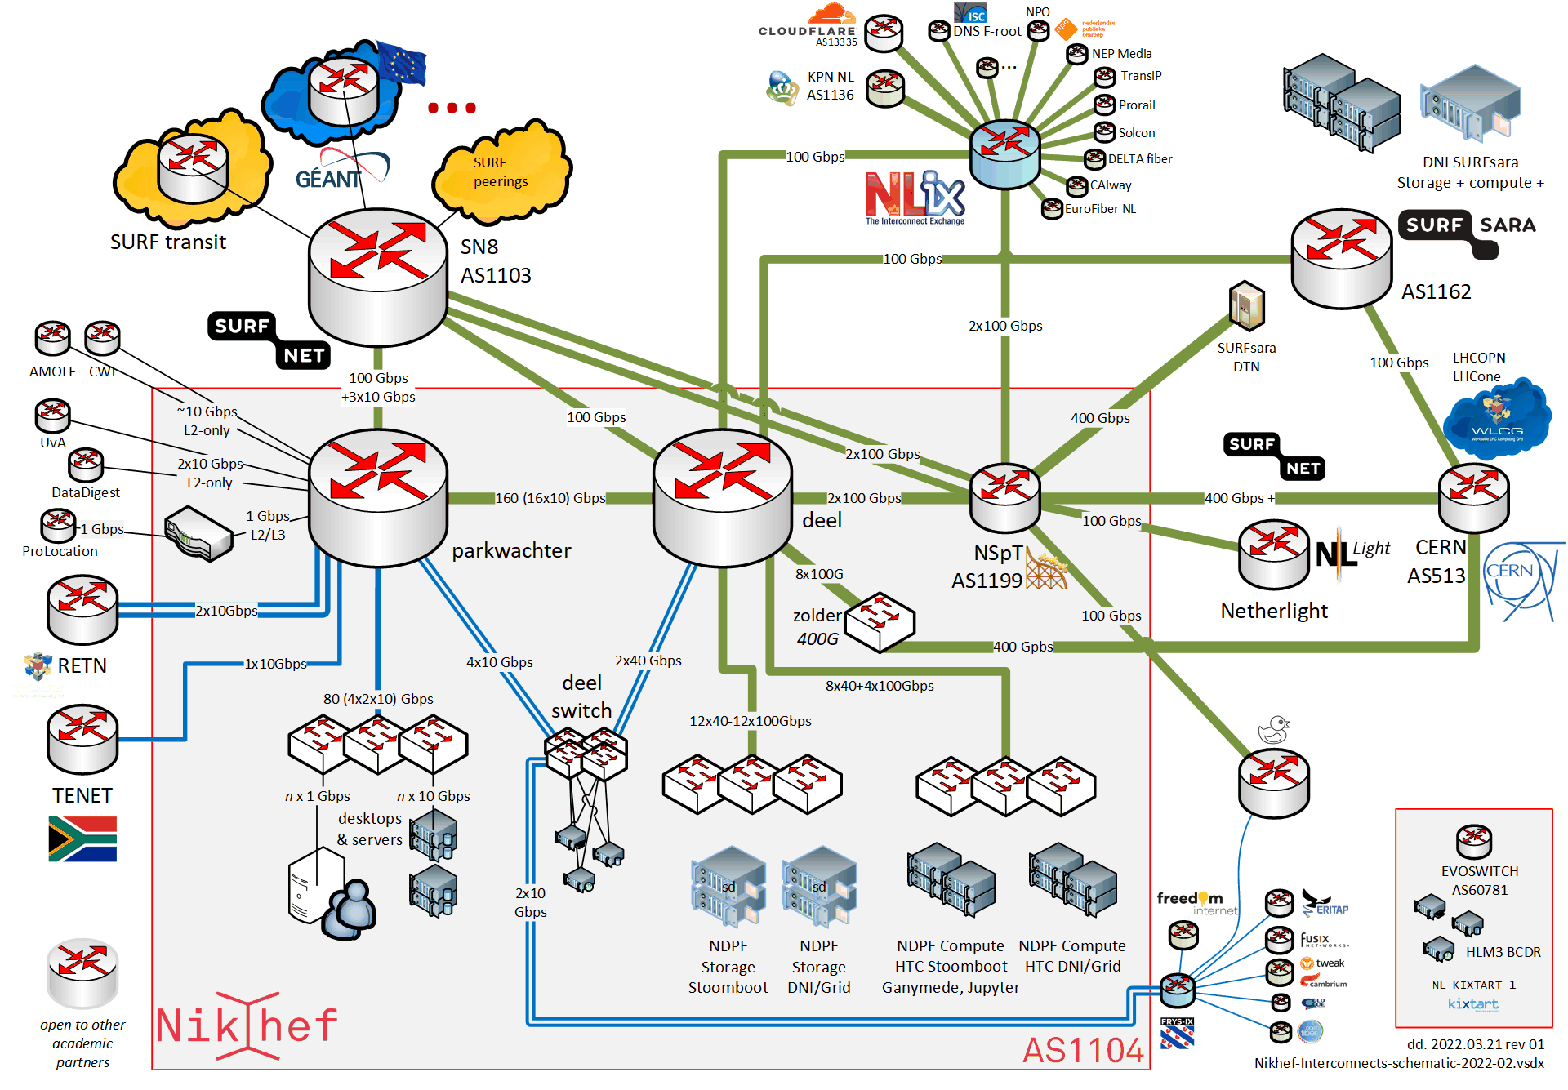
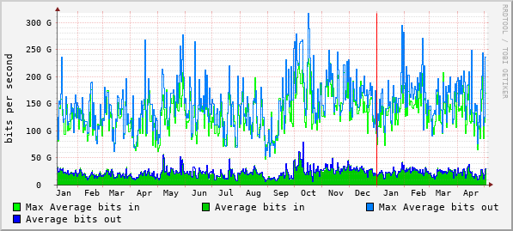
For a few boxes more…
connected to the world …
total traffic through data processing core (using harbour measurement method, 2021)
https://www.nikhef.nl/pdp/doc/facility

Slide 4
But effective usage differs …
Stoomboot
Grid (NL-T1, SURF National e-Infra @Nikhef AMS)
https://www.nikhef.nl/pdp/stats/

Slide 5
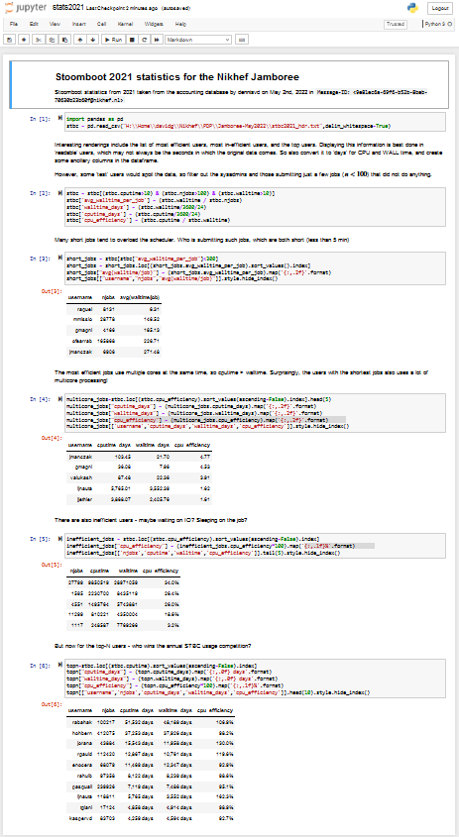
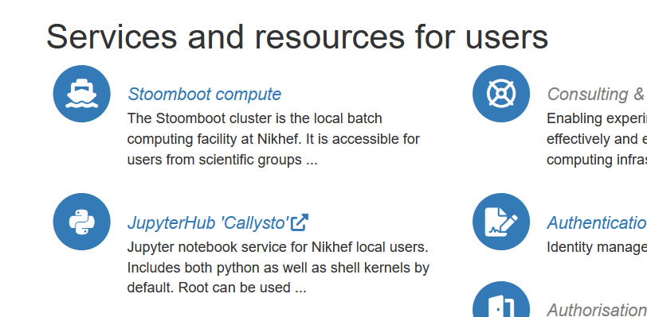
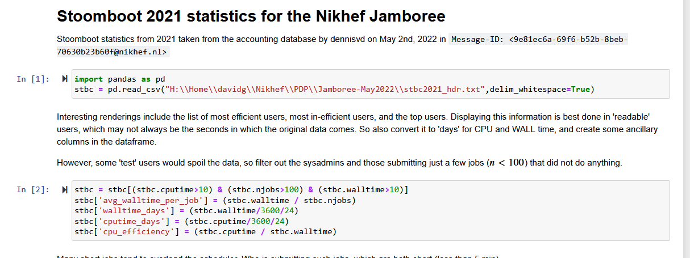
Of course you analyze small things in an executable Jupyter paper

Slide 6
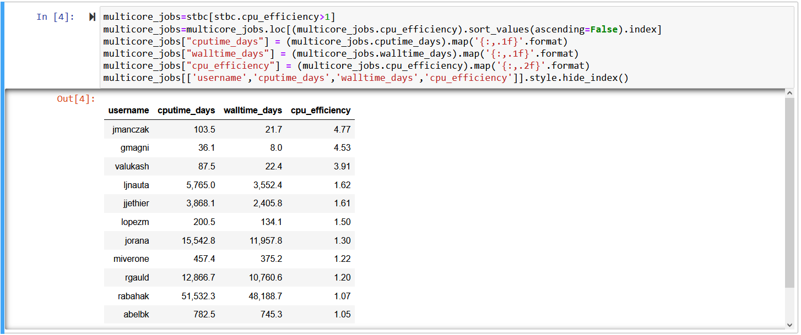
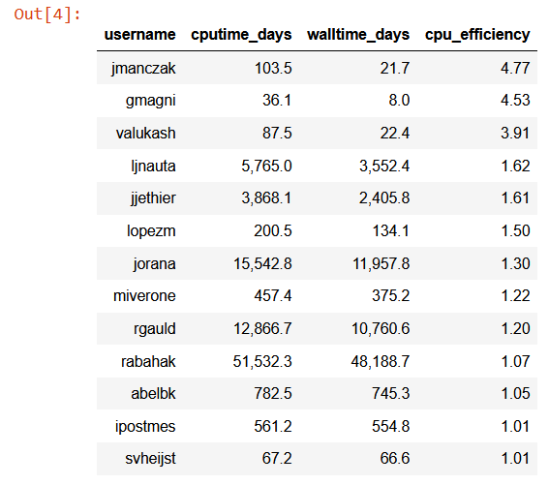
The most efficient users use more than one core!
but there are just 15 of them …
The STBC analysis facility is a collaborative environment where users learn from their peers by example. Sharing community good practice and demonstrating appropriate use to the global physics community is beneficial for Nikhef as an organization and for its collaborative mission. Sharing sufficient user information such that experts can be found by their peers who are already in the community, by username, we therefore consider as legitimate interest of Nikhef as an organization. If you object to processing your pseudonymous personal data in this way, please contact grid.sysadmin@nikhef.nl to get it removed from this presentation. Further information can be found in the Nikhef privacy notice at https://www.nikhef.nl/privacy/

Slide 7
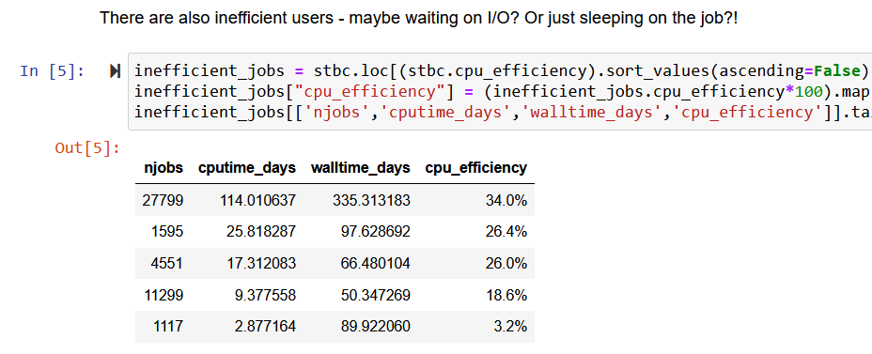
But some other statistics shall remain anonymous

Slide 8
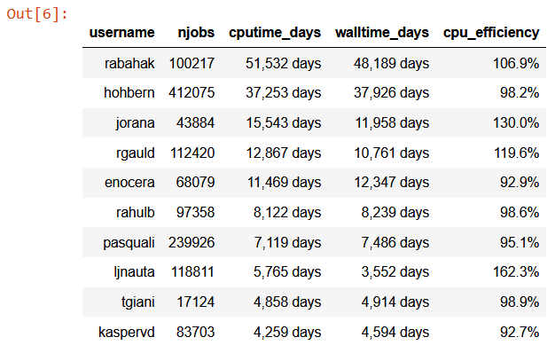
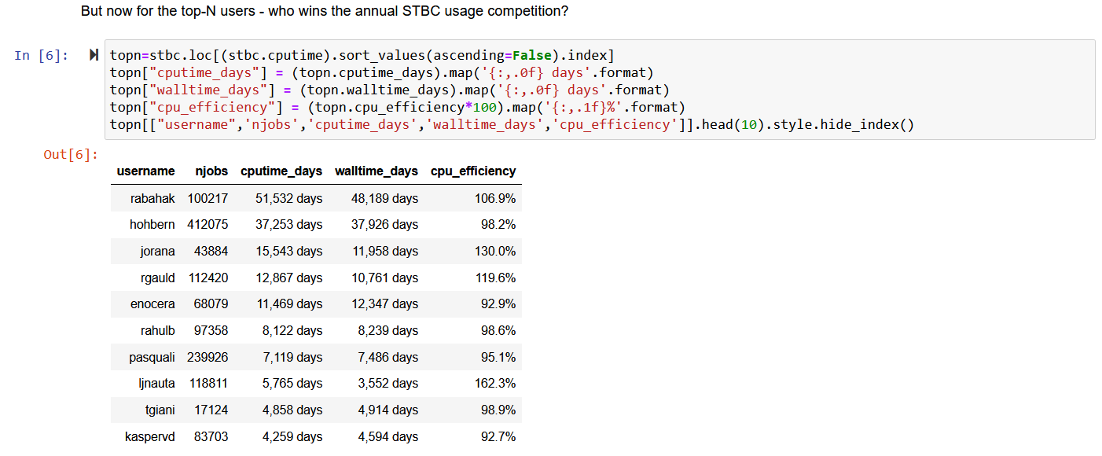
What you’ve all been waiting for … our top users in 2021!
The STBC analysis facility is a collaborative environment where users learn from their peers by example. Sharing community good practice and demonstrating appropriate use to the global physics community is beneficial for Nikhef as an organization and for its collaborative mission. Sharing sufficient user information such that experts can be found by their peers who are already in the community, by username, we therefore consider as legitimate interest of Nikhef as an organization. If you object to processing your pseudonymous personal data in this way, please contact grid.sysadmin@nikhef.nl to get it removed from this presentation. Further information can be found in the Nikhef privacy notice at https://www.nikhef.nl/privacy/

Slide 9
But there many roads that lead to … where exactly??!
‘My_Pythia_generation.log’
...
WARNING: four vector not initialized; Seed for event 1 : 345321456345
WARNING: four vector not initialized; Seed for event 2 : 143919132860
...
and you’re happy you got a few events OK!
So now, immediately:
login to stbc-i1
qsub your array-jobs of 1 million events each
write the log results to /project/*
go on holiday!
and feel rather surprised once you find out … that you killed the system for all your colleagues ☹
Photo by Maarten van den Heuvel on Unsplash

Slide 10
OK, ssh agents help keep your credentials secure, but …
> 200 ssh-agents on the same system is not 200 times more secure …
[root@stbc-i1 ~]# ps -o pid,user,comm -C ssh-agent|head -20
PID USER COMMAND
661 h****** ssh-agent
808 h****** ssh-agent
1123 h****** ssh-agent
1169 h****** ssh-agent
1460 h****** ssh-agent
3007 h****** ssh-agent
3290 h****** ssh-agent
3308 h****** ssh-agent
3417 h****** ssh-agent
...
So ~25% of the user processes on stbc-i1 are one single user’s ssh-agents:
[root@stbc-i1 ~]# ps -o pid,user,comm -C ssh-agent|grep -c hXXXXXX
202
[root@stbc-i1 ~]# ps auwwx|grep -vc root
852
https://www.nikhef.nl/pdp/computing-course/work/ssh

Slide 11
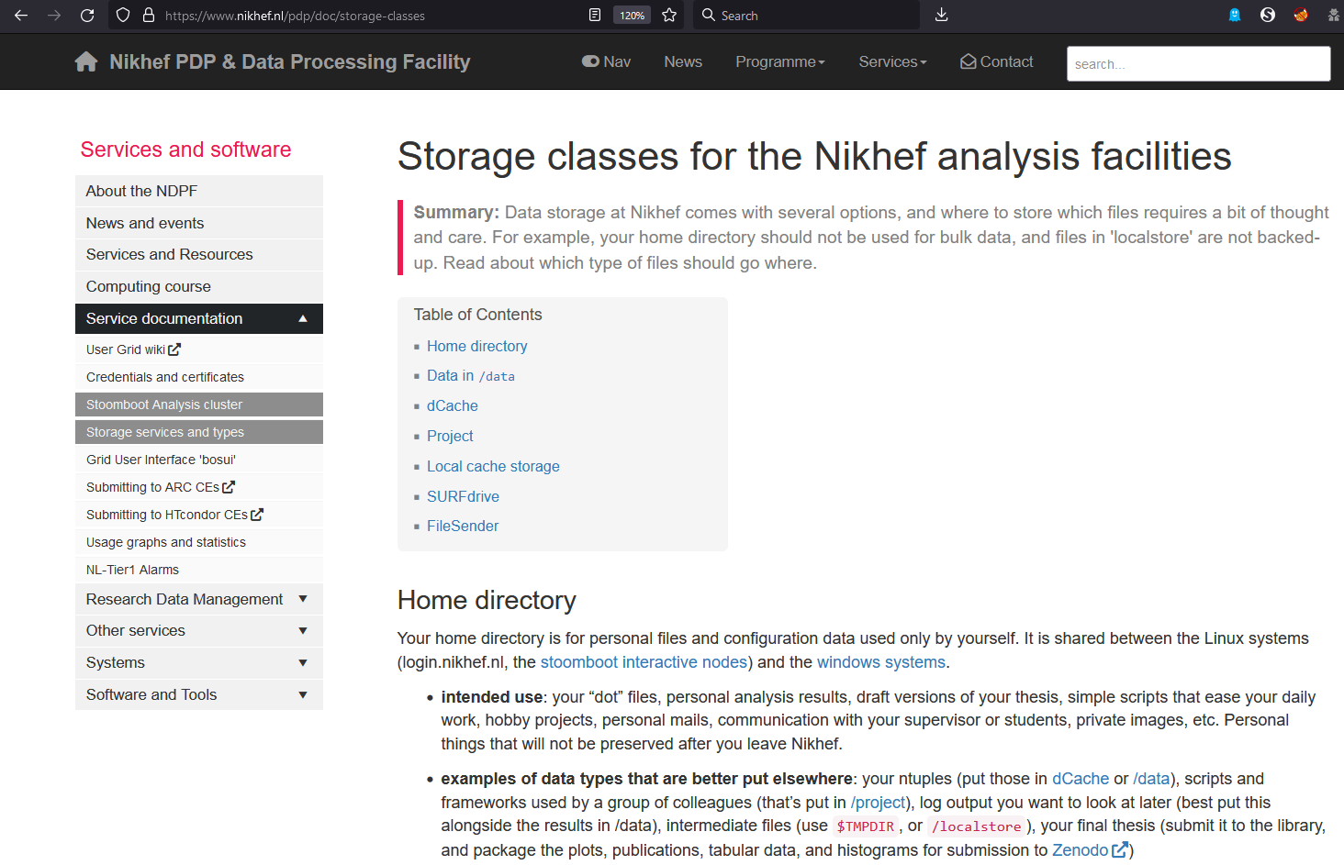
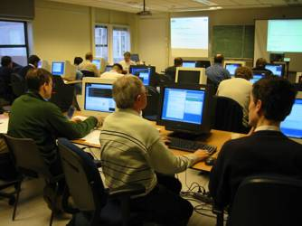
Get up there - read the docs! … https://www.nikhef.nl/pdp/
or take the computing course (coming soon again!)

Slide 12
And do ask!
Mary will tell you about all subsidiary benefits shortly :)
but it’s quite hard to answer this one …

Slide 13
Next up: Roel Aaij accelerating you Mary Hester on tokens, cake, and office hours

