Slide 1
IT Infrastructure for Research many roads on one map
PCGWI site visit Nikhef
2018-10-24

Slide 2
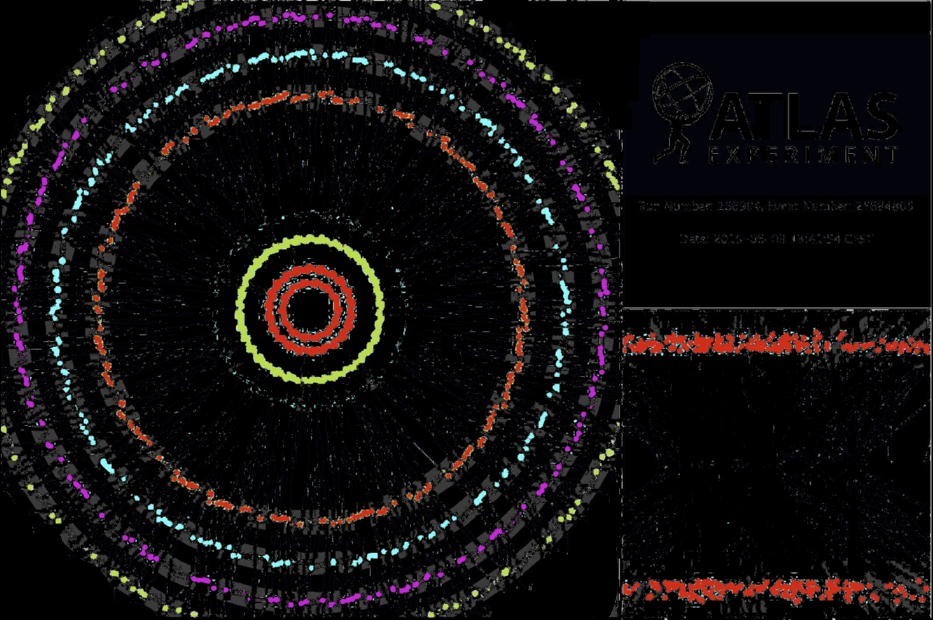
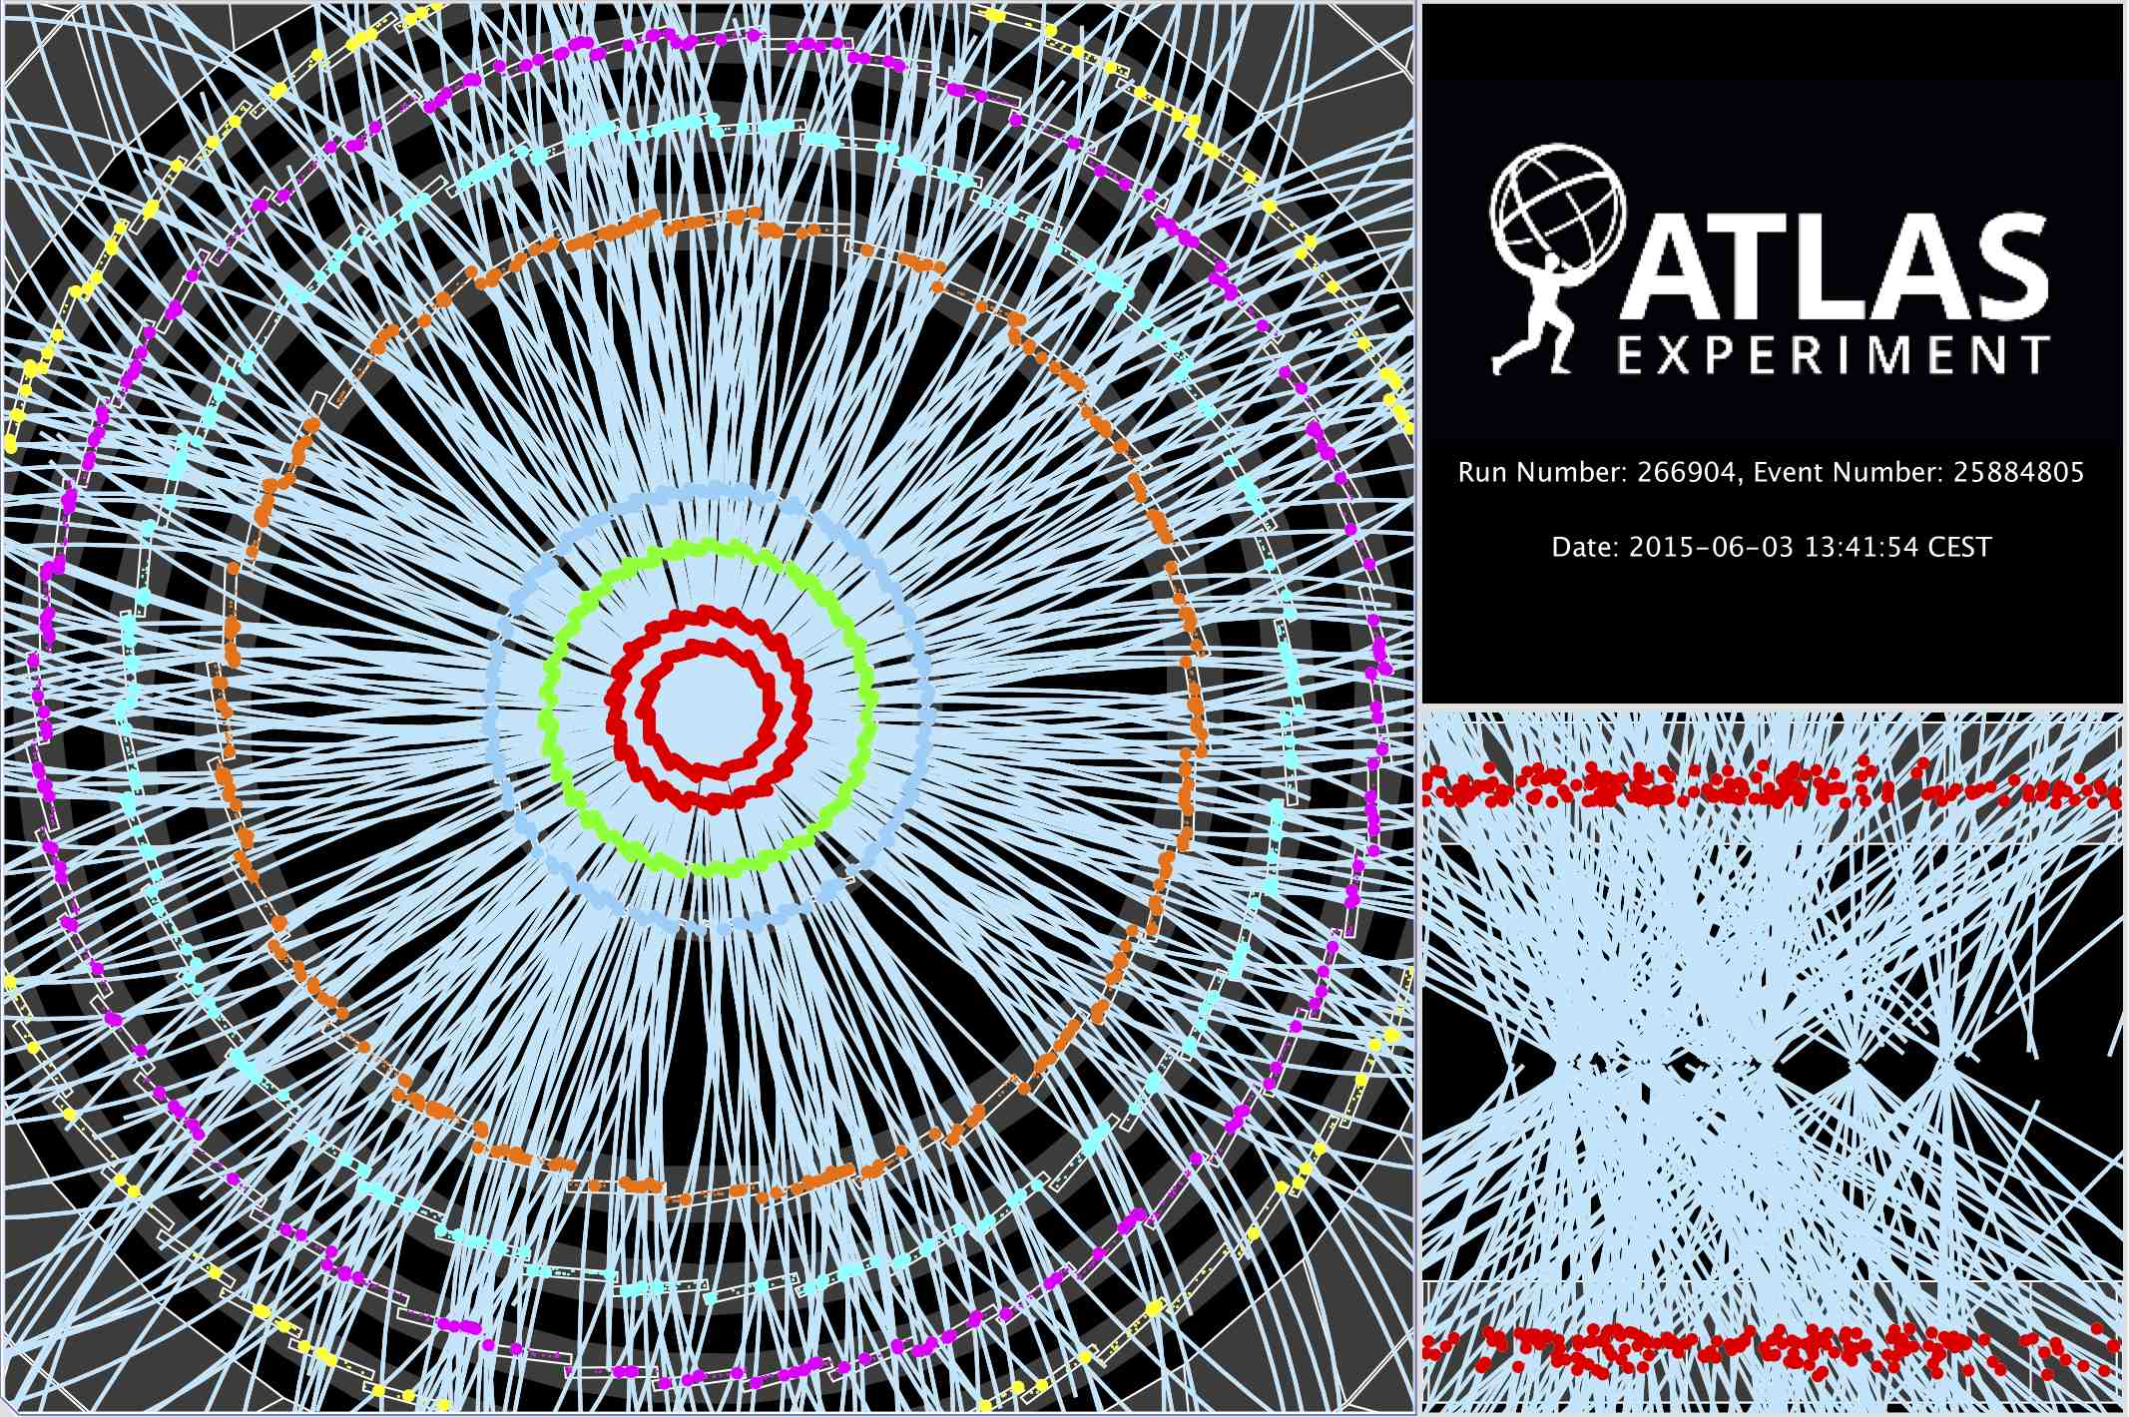
Computing: for the LHC and more
~ 10 seconds to a compute a single event at ATLAS for ‘jets’ containing ~30 colllisions
Event processing time: v19.0.1.1 as per Jovan Mitrevski and 2015 J. Phys.: Conf. Ser. 664 072034 (CHEP2015)
Display of a proton-proton collision event recorded by ATLAS on 3 June 2015, with the first LHC stable beams at a collision energy of 13 TeV

Slide 3
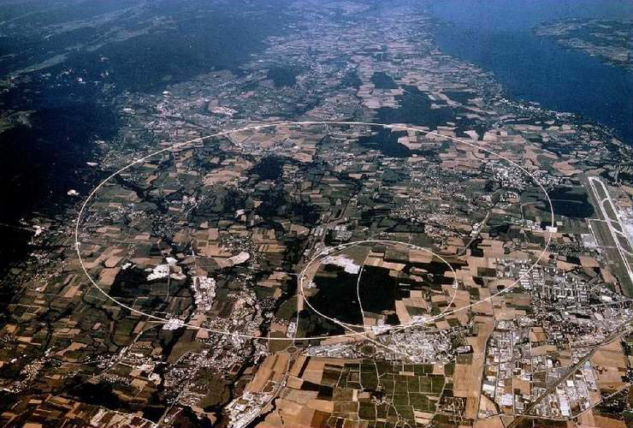
LHC computing
Today: raw data ~50 PiB/year
in NL: 23 PiB tape, 10 PiB disk, and 8000 cores
Run 3, in NL, by 2024:
at least 30 PiB tape, 20 PiB disk, and 15000 cores

Slide 4
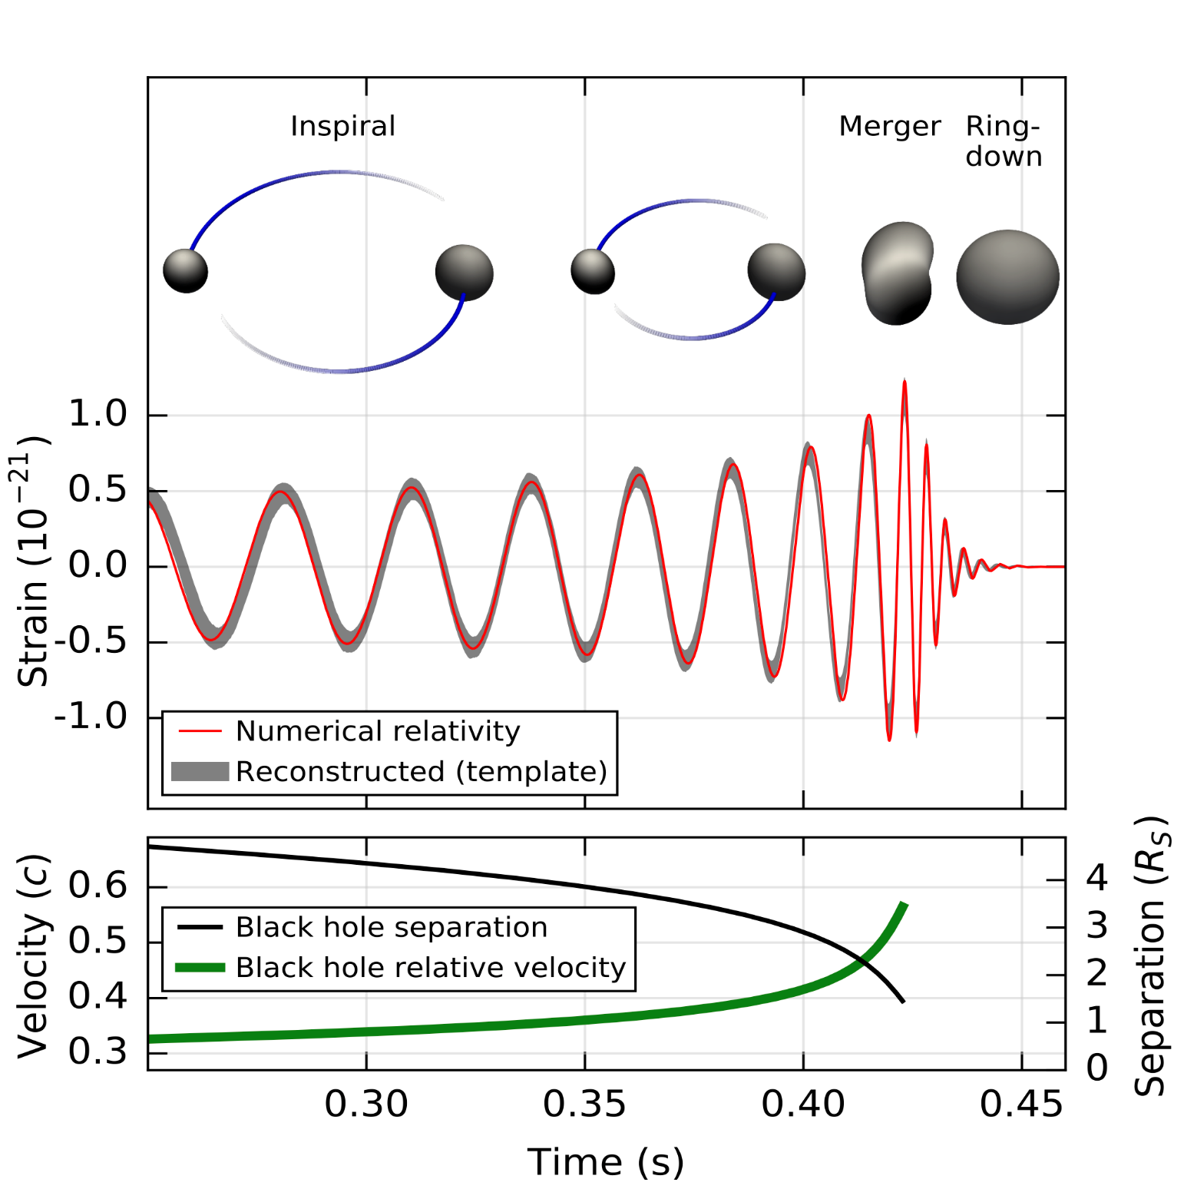
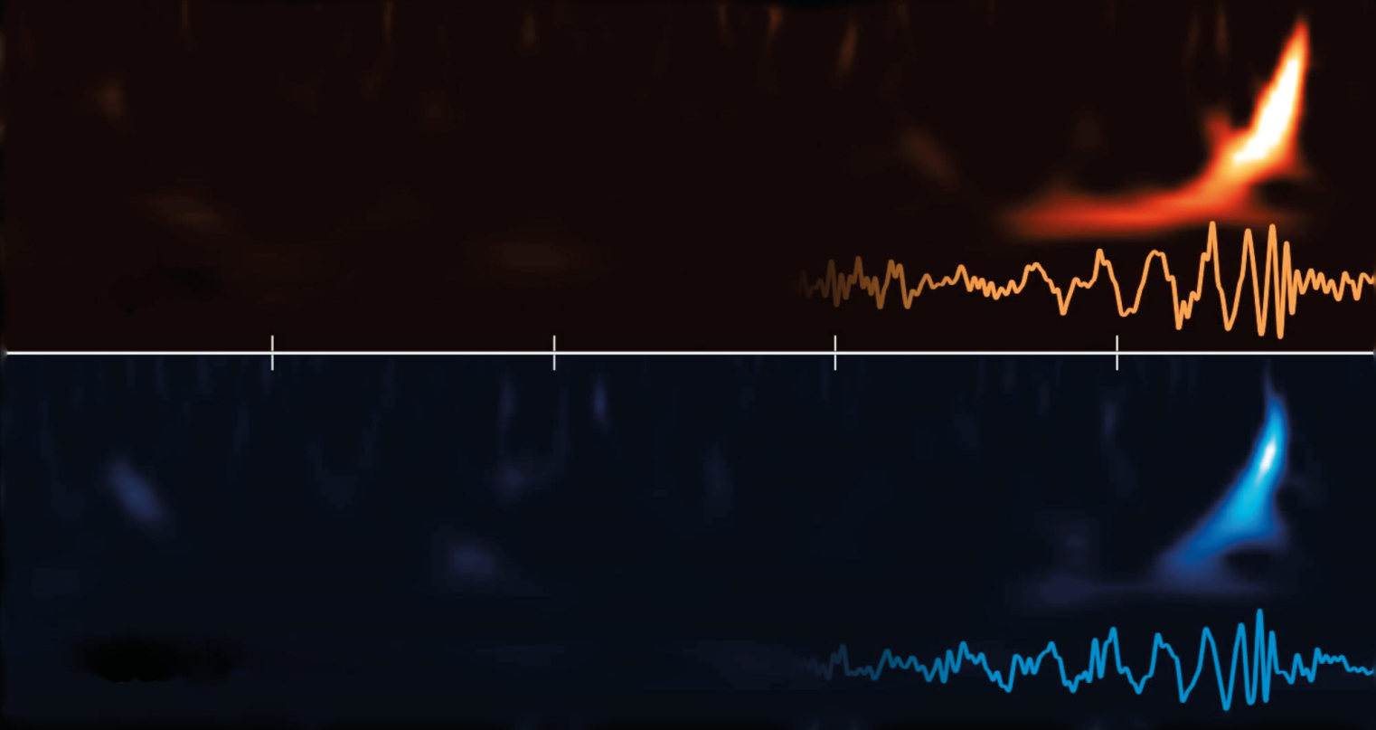
GW: compute-bound detection
wave form generation
template bank contruction
run over GW data taken
find chirps that match model
For NL means at least ~1400 cores and ~1 PiB disk (basic capability)

Slide 5
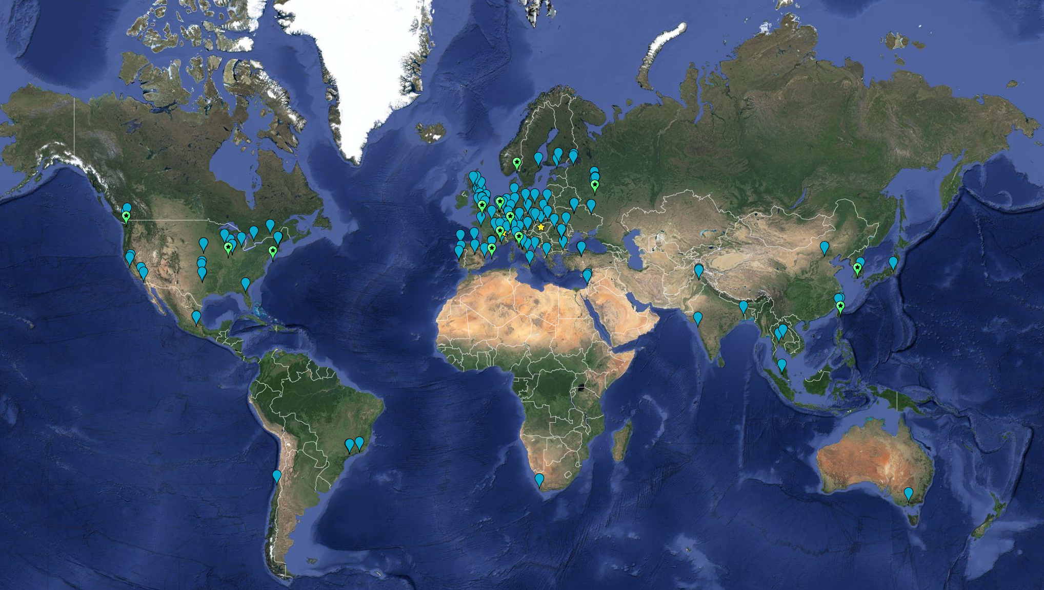


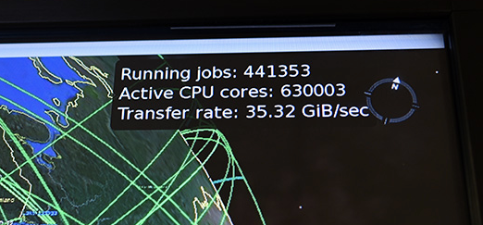

Research is global and ‘enduring’
Worldwide LHC Computing
170 institites in
42 countries and economies
growing since ~2001
CPU: ~ 350,000 cores
Disk 310 PiB
Tape 390 PiB

Slide 6
Strong together: from BiG Grid to SURF
BiG Grid (2005, 2007-2013)
from data processing ‘project’
to a national e-Infrastructure
we’re in this together: Nikhef, NWO, NBIC
solve common challenges
invest in both hardware and peopleware
Dutch National e-Infrastructure (2013-)
coordinated by SURF
national collaboration brings great results
ensure continuation of BiG Grid success
more effective and cost-efficient,
and of ensured quality

Slide 7
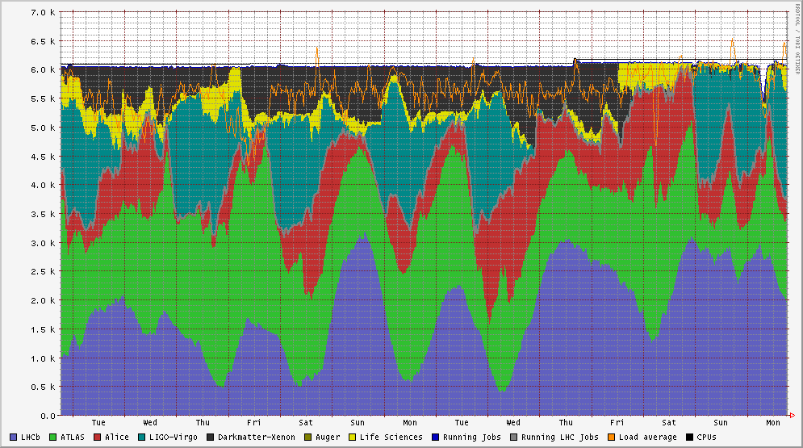
Shared computing @Nikhef
WeNMR
Xenon
LIGO & Virgo
Alice
ATLAS
NDPF voview short 1 October 2018
LHCb

Slide 8
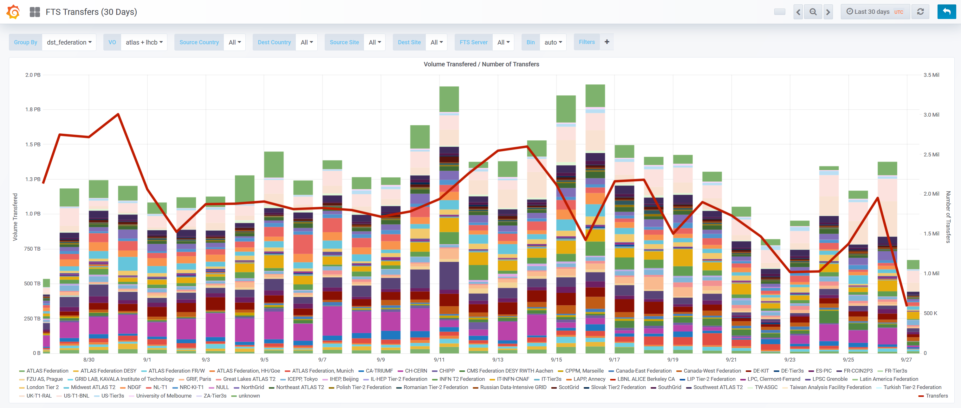
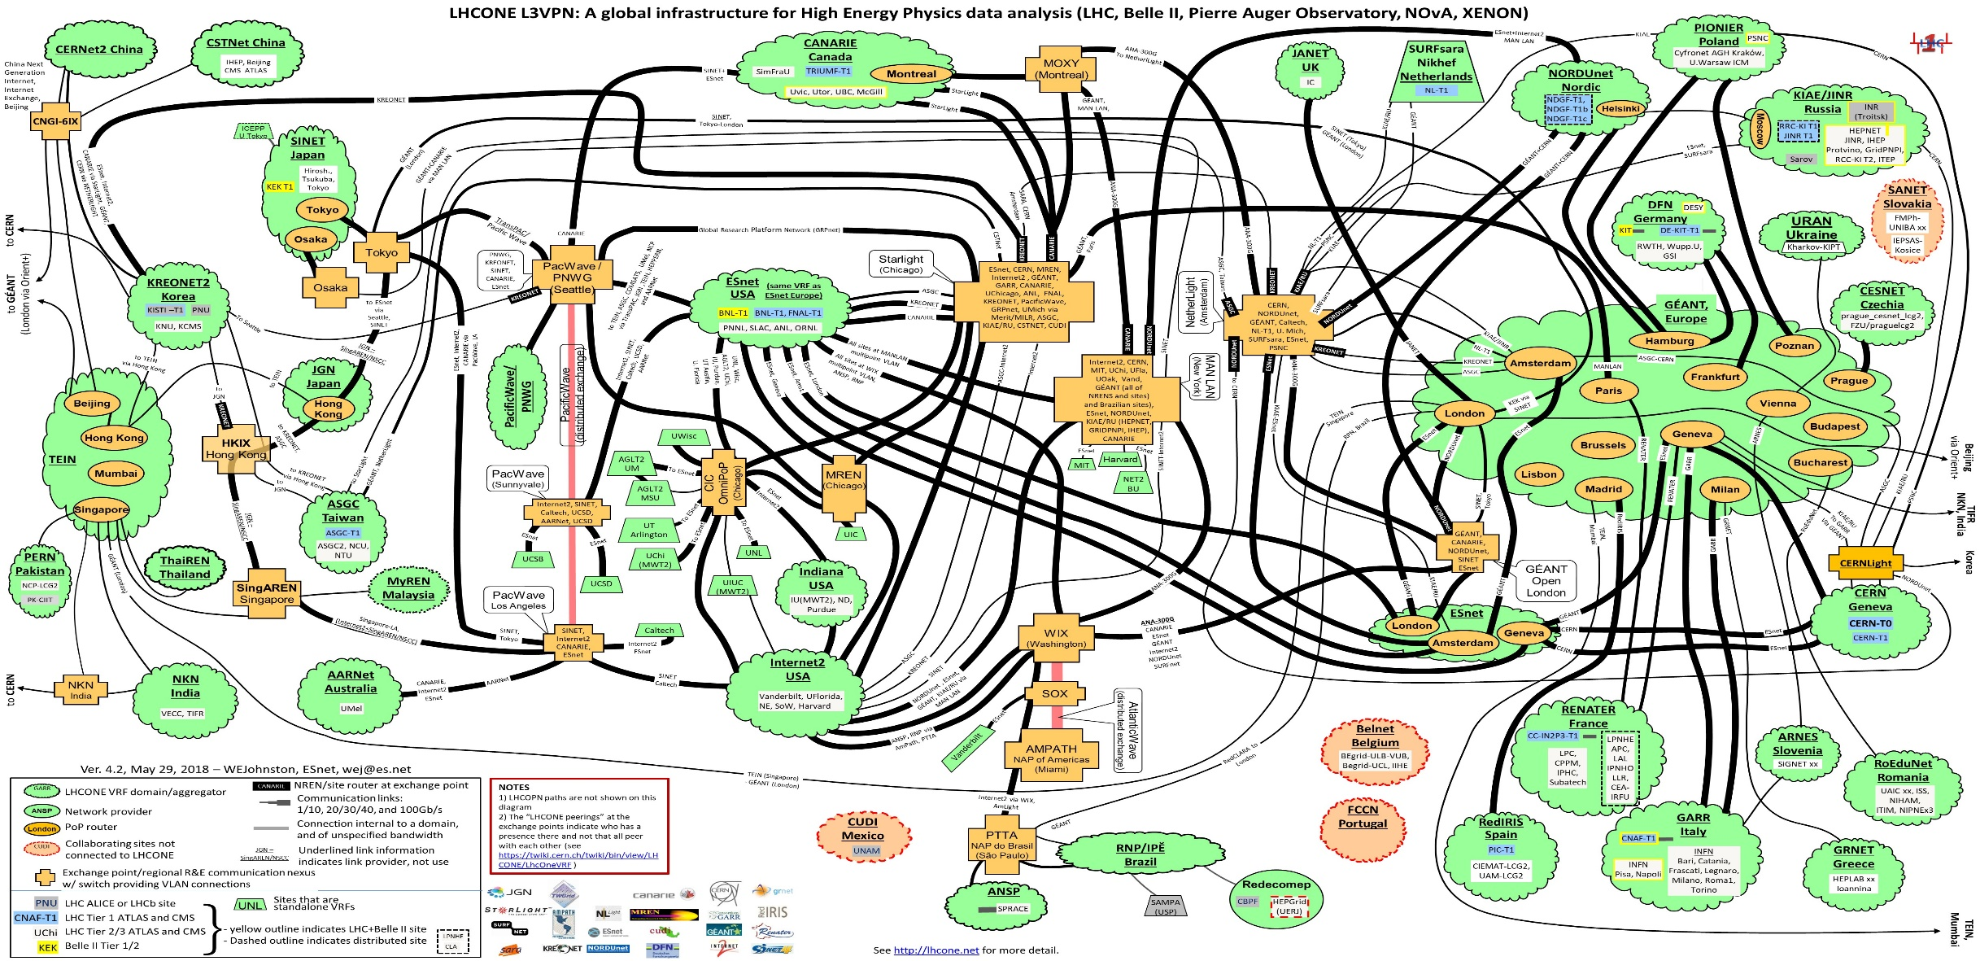
Balanced Infrastructure: disk & net
Data transfer and storage
with guaranteed throughput
able to ‘feed’ the processing algorithms
100+ Gbps networking globally
general-purpose internet expensive
LHCOne now used for more than LHC

Slide 9
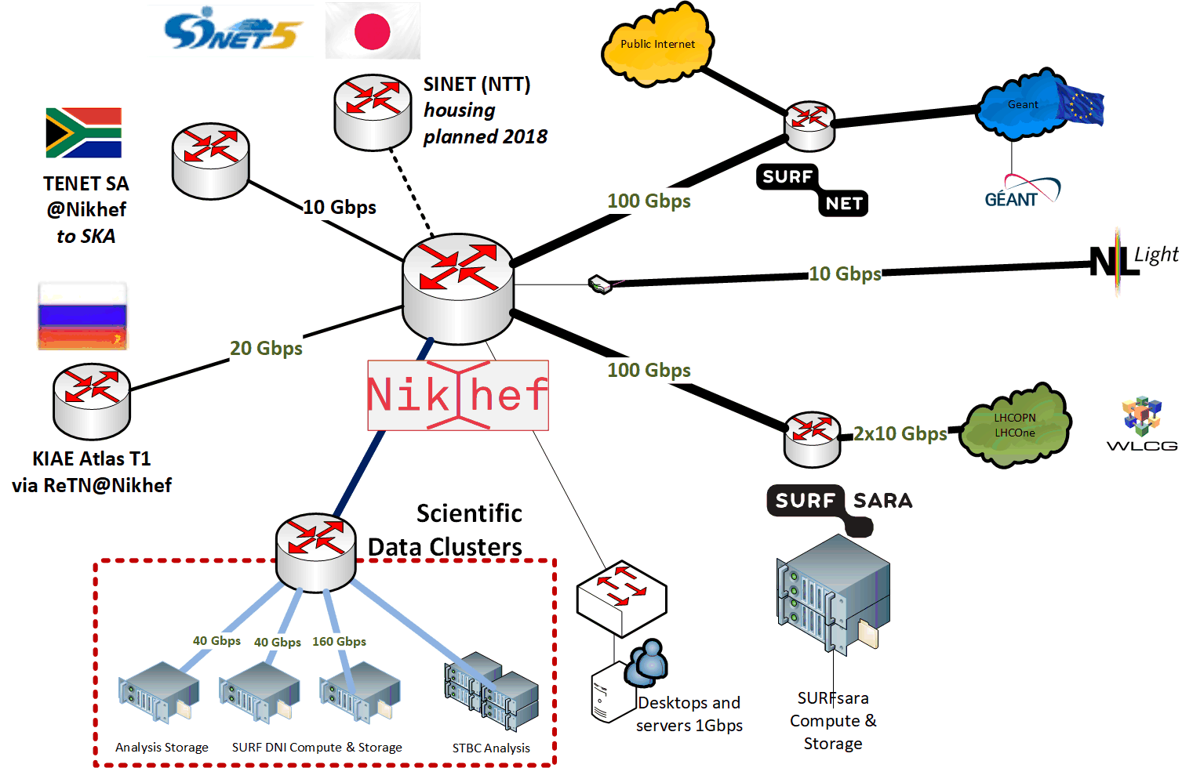

Network infra for ‘big data’

Slide 10
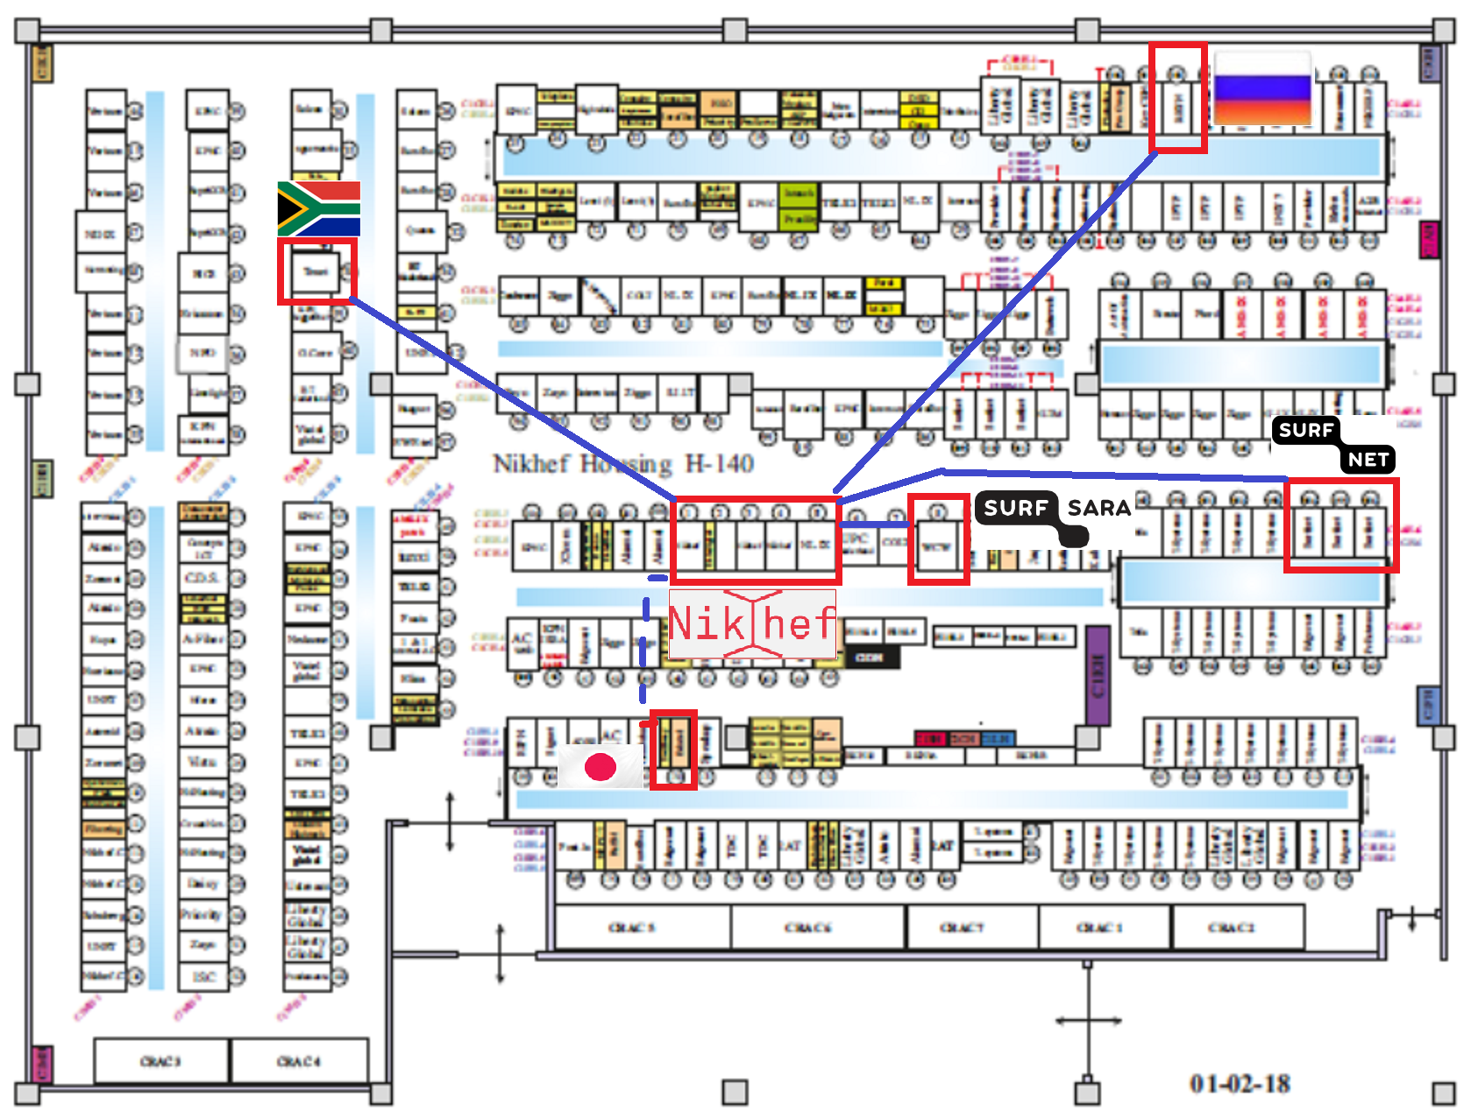
NikhefHousing’s unique capability

Slide 11
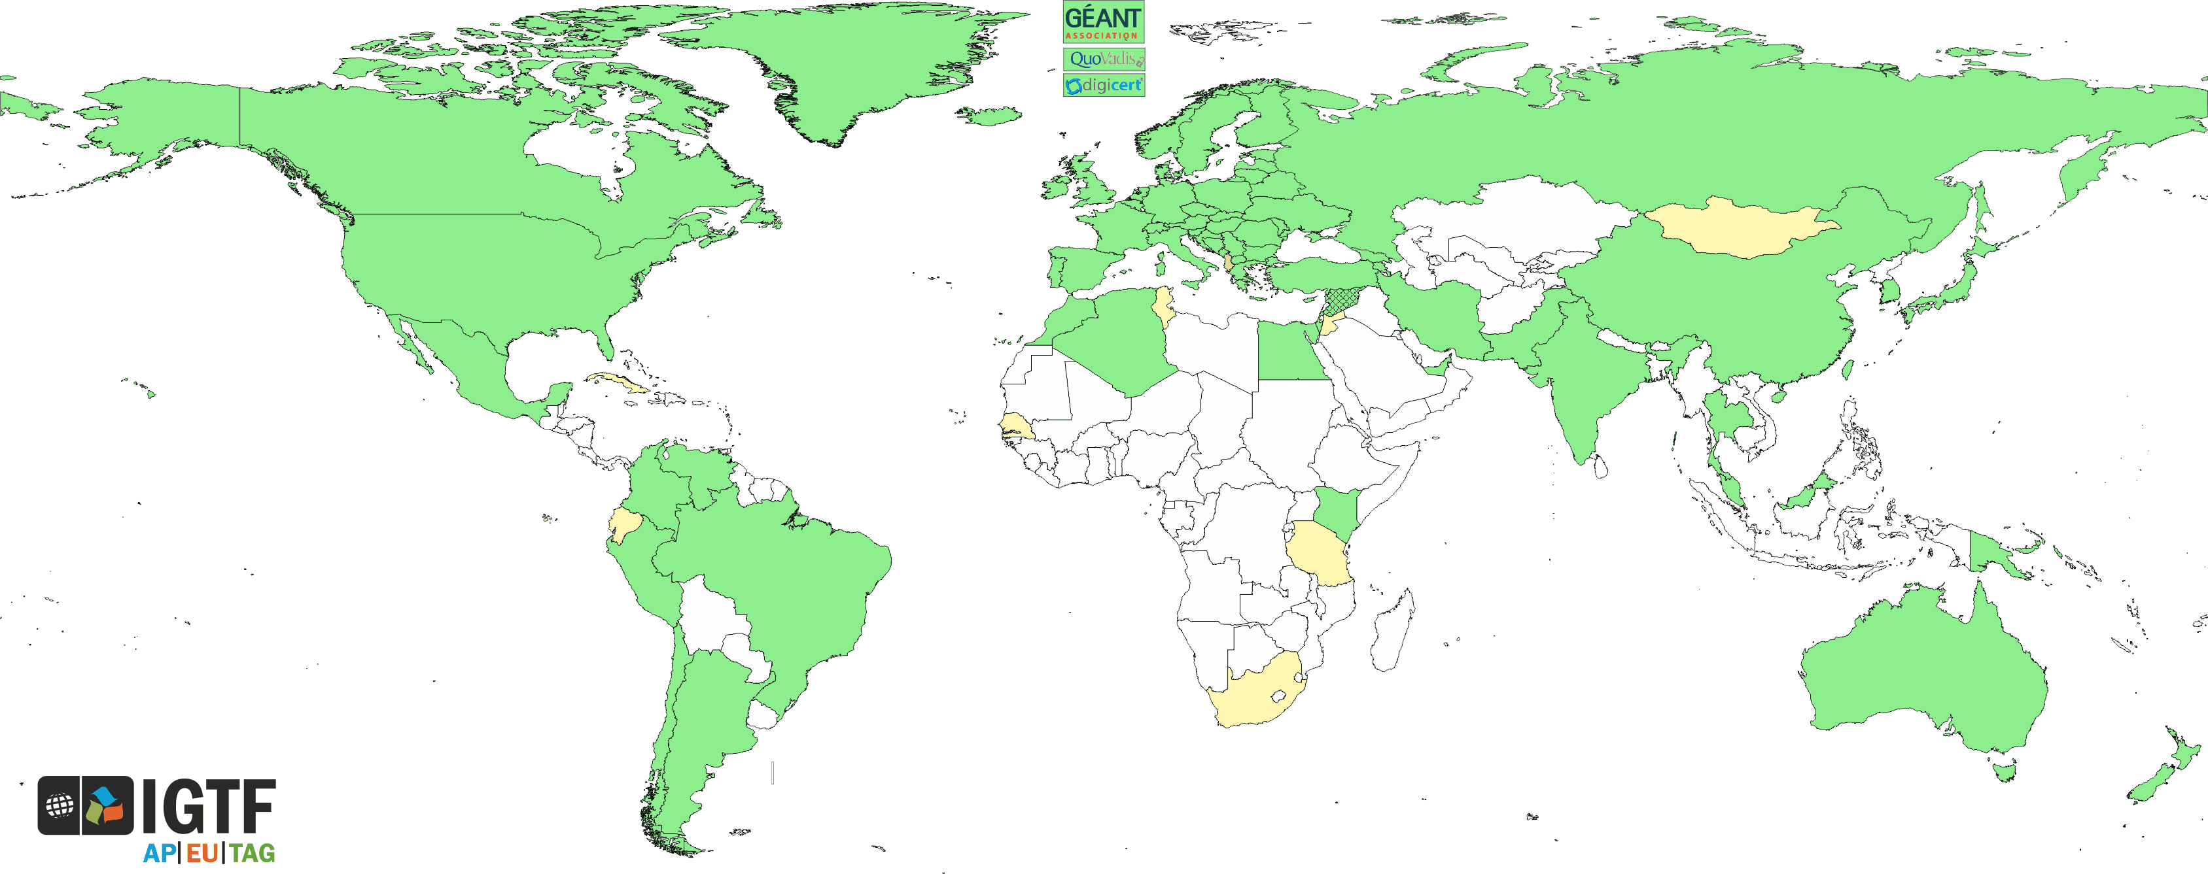
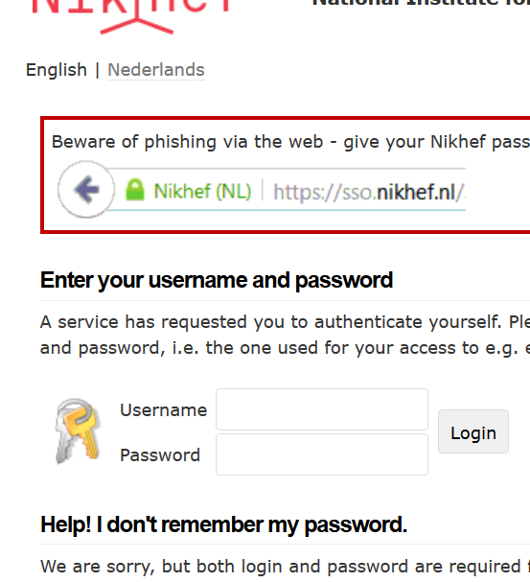
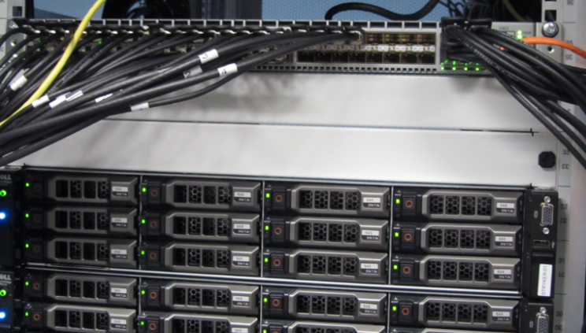
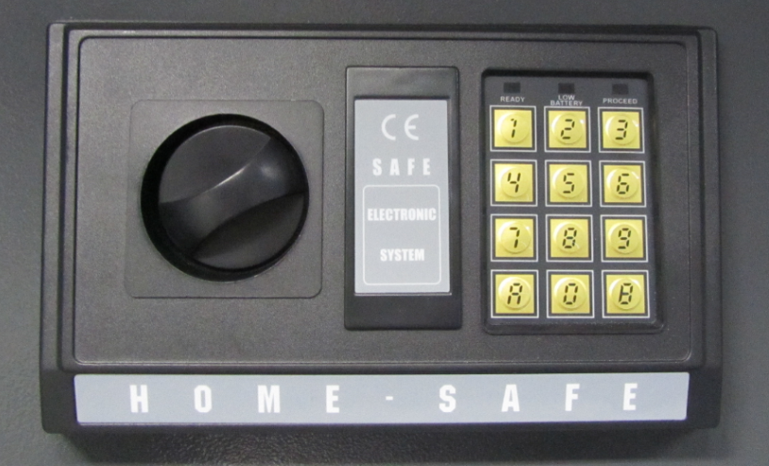

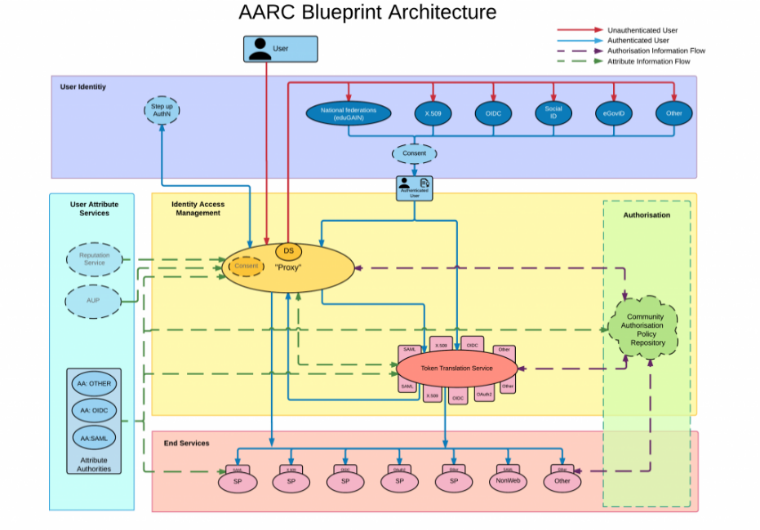

Nikhef ICT for Research: people make progress
Infrastructure for
Collaboration
Advanced Computing
Technologies
Applied Advanced
Computing
Authentication and Authorization for Research Collaboration
AAI and federation design
Operational Security
Information Security Policy Coordination
Improving physics results
by advancing computing capabilities
Resource-limited computing
Systems-Algorithm interaction
Looking ahead 3-5 years
Joint development programme with global stakeholders & vendors
Evaluate and influence

Slide 12
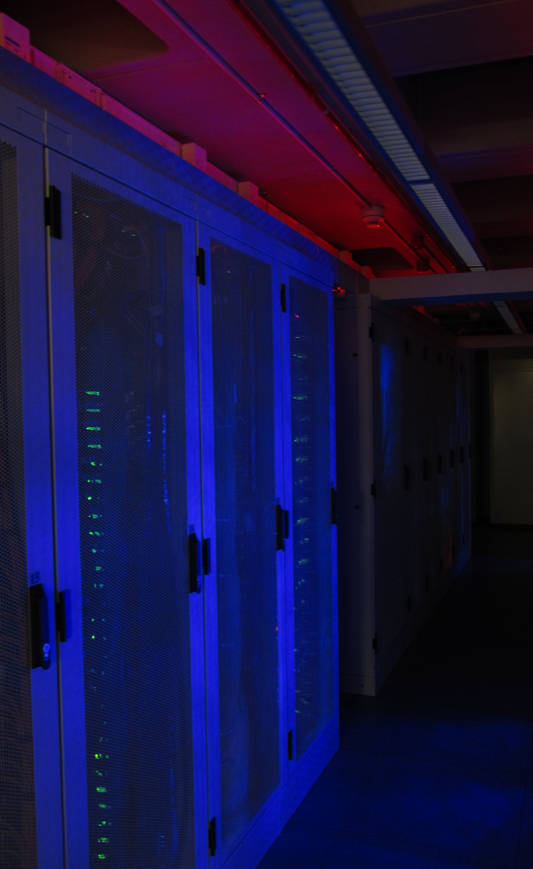
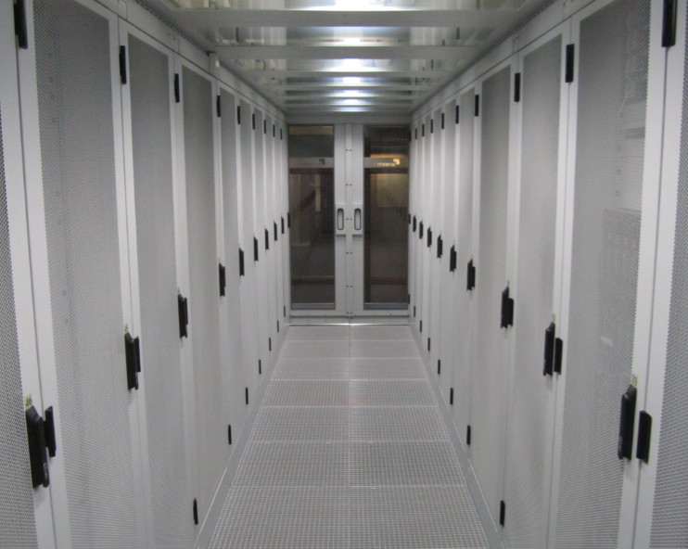
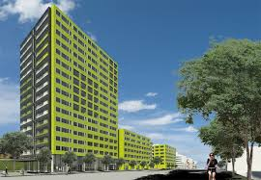
The Nikhef Data Processing Facility
Characteristics
integral part of the ‘SURF’ Dutch
National e-Infrastructure
permits ‘rapid experimentation’
environments for innovation
designed for balanced high-throughput data processing
very cost-effective at its Quality of Service level
basis for more than just LHC, GW and KM3NET
Hardware indicators:
8000 cores, 4.5 PiB disk, 1.2Tbps network, 240 Gbps global
400 kW, PUE 1.21, 3500GJ WKO capacity

Slide 13
Tour time …

