Slide 1
Nikhef RDM Policy – first experiences
Contactgroep DM NWO-I

Slide 2
Nikhef RDM Development Process
A long journey – and for long at a sufficiently abstract level
prominently present in H2020/ERC (and in NWO now)
participated in the FOM DM pilot for Projectruimte proposals (2016)
schemes were adaptable to domain-specific needs
August 2016 “NWO Institute Data Management Policy Framework” became binding
development of institute policy now must fit within this framework
flexibility needs to be found within those constraints (keeping cost in mind)
Summer 2017
decide on a hierarchical approach, separating policy and practice statements
with a sensible default for ‘small’ activities (but that is still a challenge)

Slide 3
RDM is not new
last big e⁺e⁻ machine closed years ago, and e.g. LEP, or HERA, data is not re-measurable today …
DPHEP (2008 – ICFA-DPHEP Study Group, 2013+ DPHEP MoU)
preserve experimental data and its software environment
study group, repository development (Zenodo), software curation
http://dphep.org/

Slide 4
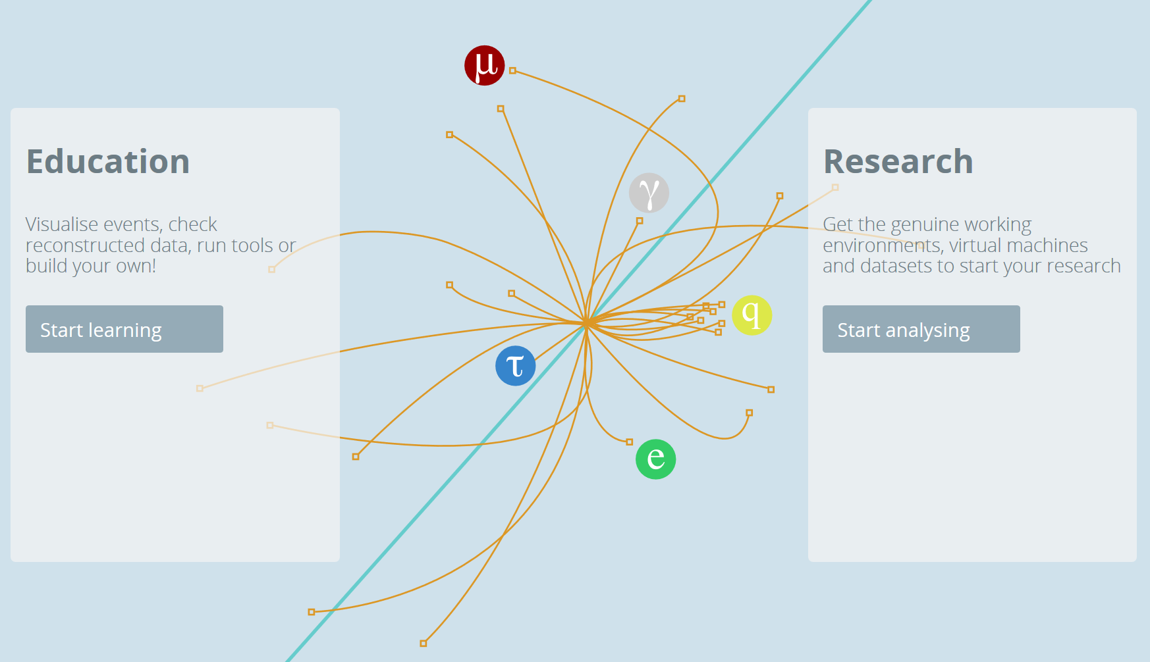
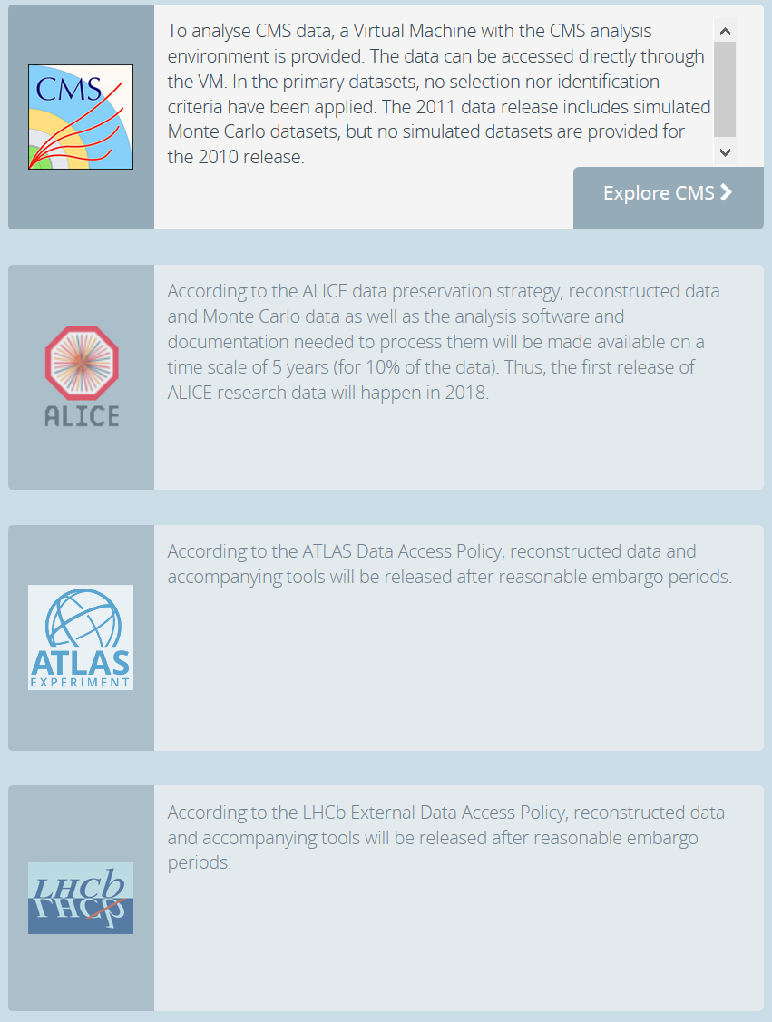
opendata.cern.ch

Slide 5
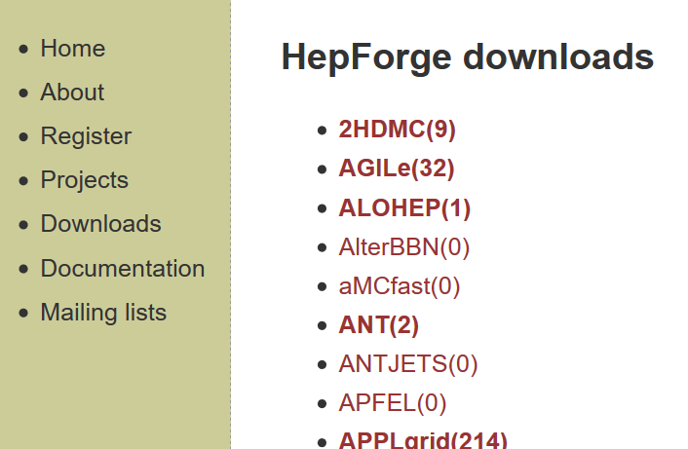
We have a diverse tradition …
DPHEP
HEPForge (and many sub-repositories)
HepData
CERN OC3 archive
INSPIRE-HEP (‘SPIRES’)
and we ‘spread the word’ through general-purpose services
Zenodo
https://www.nikhef.nl/grid/nikhef/dmp/

Slide 6
Nikhef RDMP ToR
must implement the NWO-I DM Framework (and NWO Protocol)
leaves us freedom of implementation, but we signed it, and it does require specific elements like the Replication Package
not undermine any past or future data management customs already in use
leverage as much as possible international efforts (such as DPHEP)
minimal impact on PhD students and their time
limit impact also for staff members as much as possible
not incur unnecessary costs or liabilities
Re-use as much as possible from partners – we re-used STFC/RAL ☺

Slide 7
The Document ...
Uses RFC2119 terminology
MUST
This word, or the terms "REQUIRED" or "SHALL", mean that the definition is an absolute requirement of the specification.
SHOULD
This word, or the adjective "RECOMMENDED", mean that there may exist valid reasons in particular circumstances to ignore a particular item, but the full implications must be understood and carefully weighed before choosing a different course.

Slide 8
Scope
defines Research Activities and re-usable data
non-reusable data (e.g. collected when building tools/components) need not be subject to the policy
but most data usually is

Slide 9
RDM Policy Principles
Encompasses all kinds of Data: raw, derived, published, logs & settings
Implement NWO Protocol & NWO-I DM Framework
Be legal, yet use of released data not our concern (beware of law & NWO)
Each Activity SHOULD have a Data Management Plan (DMP) (already required for NWO, H2020, ERC)
or at least implement the ‘default’ guidance in the Policy
Supply outline of DMP in proposal phase - already now for NWO/H2020
DMP SHOULD follow current best practice ‘for our domain’

Slide 10
but there are exclusions
specific agreements & treaties take precedence (e.g. CERN)
we exclude contract work – the responsibility in that case is with the third party
software as a product in itself (like control software)
physical detectors & components (but archive the design drawing)
personal “GDPR” data – you really ought to think why you need it @Nikhef
administrativa
you can obviously still be following the policy, but it will not be as absolutely mandatory

Slide 11
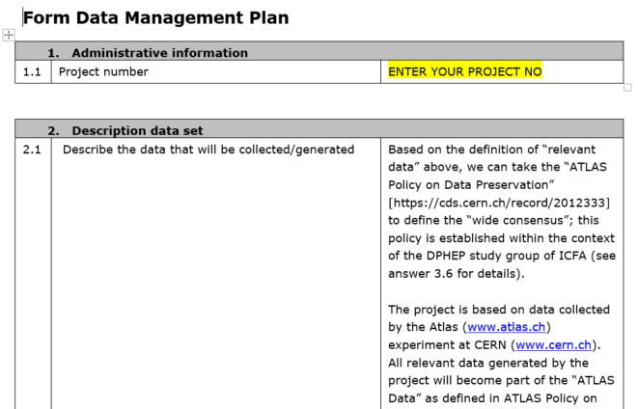
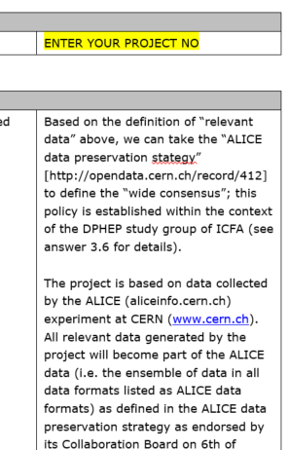
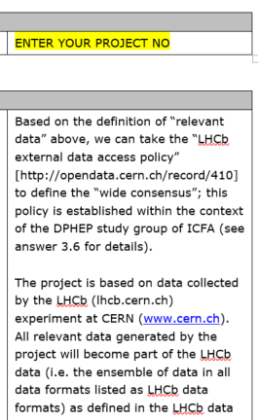
Standard DMPs
Many global experiments have a DM policy already in place: LHC experiments, Auger, LVC, …
To answer the NWO DM paragraph, we developed standard templates
https://www.nikhef.nl/grid/nikhef/dmp/

Slide 12
Otherwise, leverage the community
The aim for all non-standard DMP is to leverage existing community services and initiatives (DPHEP and more)
just your own DOI assignment costs €8500/yr for DataCite membership – or €4.50 per DOI @mEDRA

Slide 13
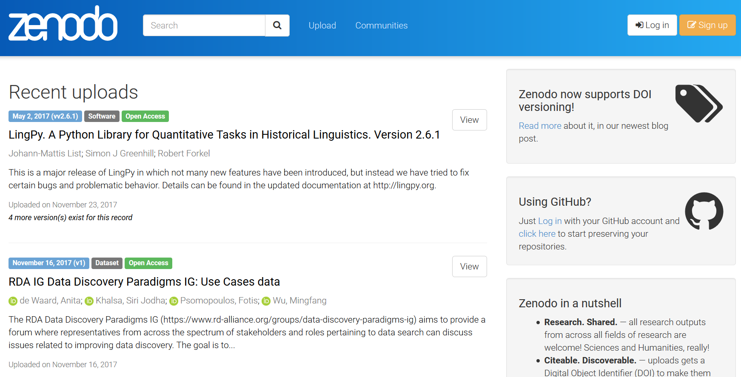
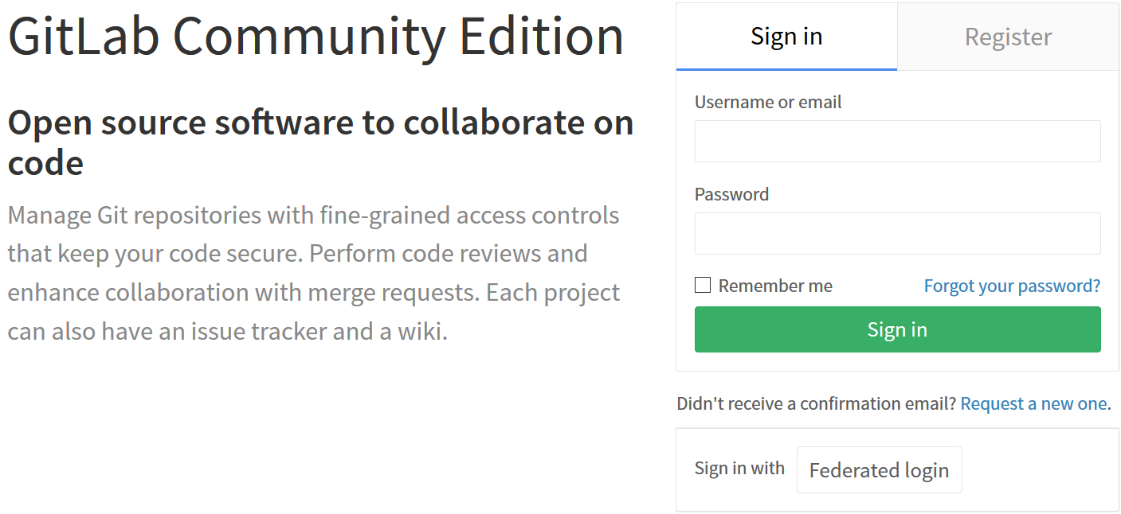
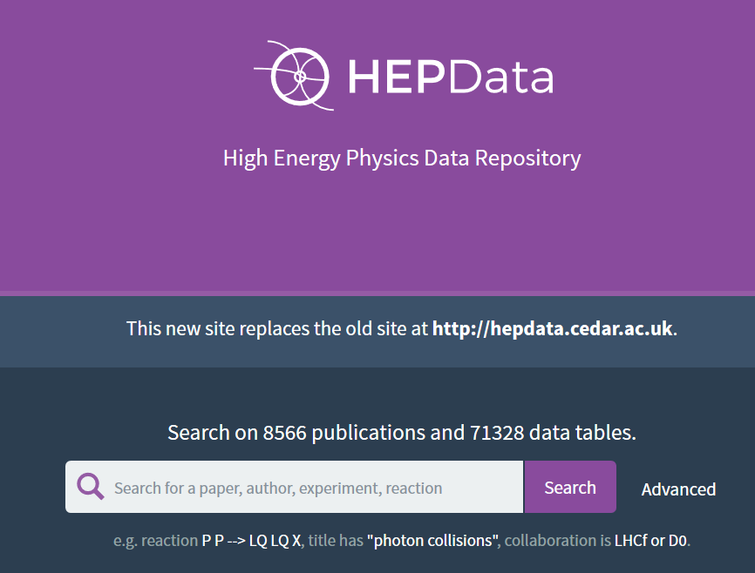
Repositories

Slide 14
Early feed-back from the staff
Standard DMP templates are much appreciated
Need to take balanced care about RDM in MoU negotiations ‘seek to ensure’ – not require
Wider diversity in practices for ‘smaller’ collaborations
many concerns about feasibility and cost/benefit analysis
‘depth’ of the replication package is a big concern
the “I” premise of FAIR does not quite work in our domain
Policy implementation will be a phased approach
Training is an essential component
both on RI and log keeping (e.g. Jupyter notebooks)
and on proper use of existing repository facilities (storage QoS classes)

Slide 16
The “FAIR” Principles
pick a name for the effort that is ‘hard to disagree with’ …
FAIR
Findable - data & metadata are easy to find by humans & computers
Accessible – standard download method & ‘protocols’ for access explicit
Interoperable - they can be automatically combined with other data
Reusable - sufficiently well described to be replicated or combined
but this is easier said than done, and implementation domain specific
Wilkinson et al. The FAIR Guiding Principles for scientific data management and stewardship doi:10.1038/sdata.2016.18

Slide 17
FAIR – a ‘slight’ LS bias
To be Findable:
F1. (meta)data are assigned a globally unique and persistent identifier
F2. data are described with rich metadata (defined by R1 below)
F3. metadata clearly and explicitly include the identifier of the data it describes
F4. (meta)data are registered or indexed in a searchable resource
To be Accessible:
A1. (meta)data are retrievable by their identifier using a standardized communications protocol
A1.1 the protocol is open, free, and universally implementable
A1.2 the protocol allows for an authentication and authorization procedure, where necessary
A2. metadata are accessible, even when the data are no longer available

Slide 18
FAIR – more microstatements
To be Interoperable:
I1. (meta)data use a formal, accessible, shared, and broadly applicable language for knowledge representation.
I2. (meta)data use vocabularies that follow FAIR principles
I3. (meta)data include qualified references to other (meta)data
To be Reusable:
R1. meta(data) are richly described with a plurality of accurate and relevant attributes
R1.1. (meta)data are released with a clear and accessible data usage license
R1.2. (meta)data are associated with detailed provenance
R1.3. (meta)data meet domain-relevant community standards
‘let’s really think that you can replace researchers with automated systems’

