Slide 1
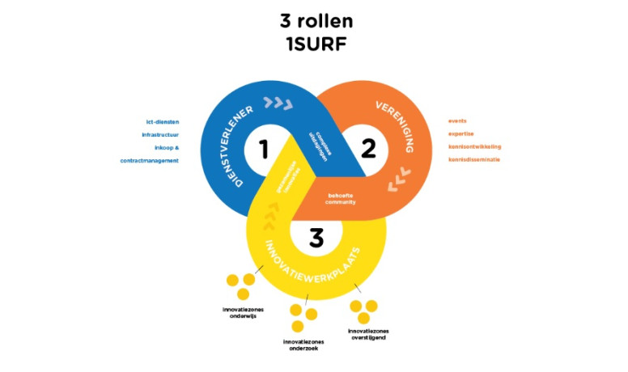
SURF, our ‘collaborative organisation for IT in edu and research’
Besides ‘commodity’ services (network, software licensing, joint procurement, &c) as a service provider, SURF adds
Research IT facilities HPC ‘snellius’, HPC Cloud, Grid, Data Archive, collaborative analysis platform
research support and open science national coordination research data management (LCRDM), digital competence centre initiatives (DCCs), European Open Science Cloud, expertise networks
Federated access and collaboration SURFconext, projects, international liaison & membership
Innovation of the IT knowledge basis at SURF and at co-creating member organisations

Slide 2
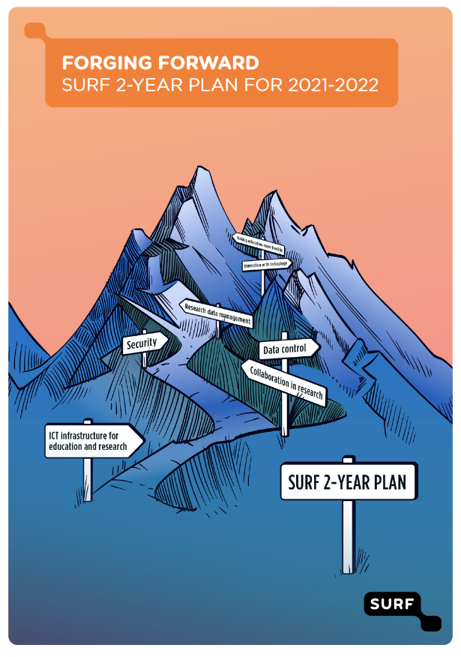
SURF Strategy
Seven themes – since 2021
Making education more flexible
Research data management
Collaboration in research
Data control
Security
ICT infrastructure for education and research
Innovation with technology

Slide 3
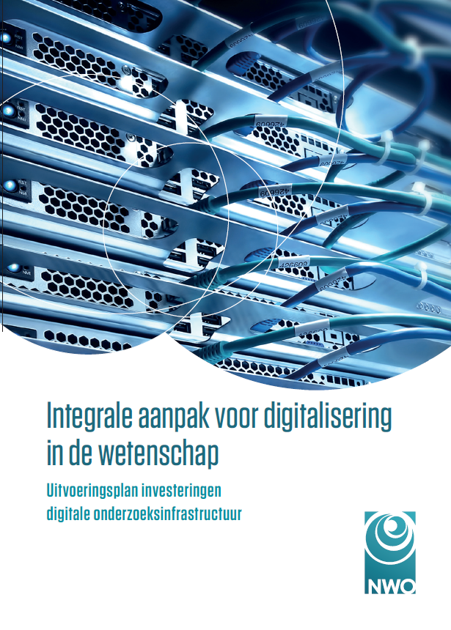
A comprehensive approach to research digitalization via SURF
Specific execution plans at SURF for research support, funded by the NWO ‘Apers’ means
Rekenfaciliteiten: Aanschaf nieuwe supercomputer
Rekenfaciliteiten: Toekomstige investeringen in HPC & jaarlijkse gebruikersbijdrage reserveringen HPC
Rekenfaciliteiten: Investeringen in overige rekenfaciliteiten en opslag hardware
Rekenfaciliteiten: Vernieuwing van de kennisbasis
Rekenfaciliteiten: Expertise en ondersteuning van rekenfaciliteiten en datacentra
Digitalisering: Impulsfinanciering lokale DCC’s
Digitalisering: Stimulering thematische DCC’s
Digitalisering: Ondersteuning DCC’s door SURF
Digitalisering: Investeringen in eScience
See: https://www.nwo.nl/onderzoeksprogrammas/uitvoeringsplan-ict-infrastructuur

Slide 4
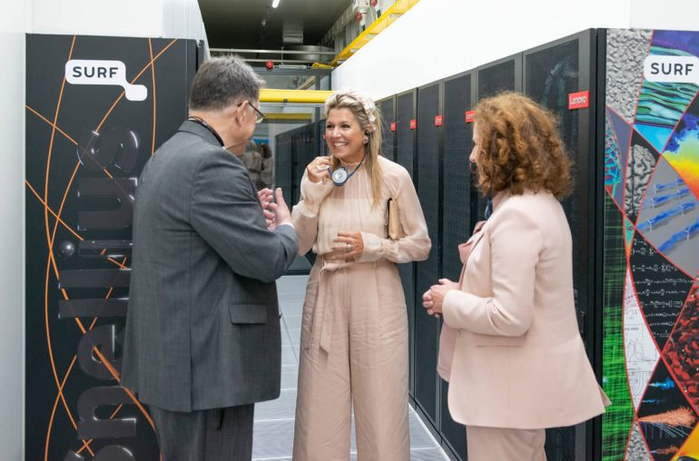
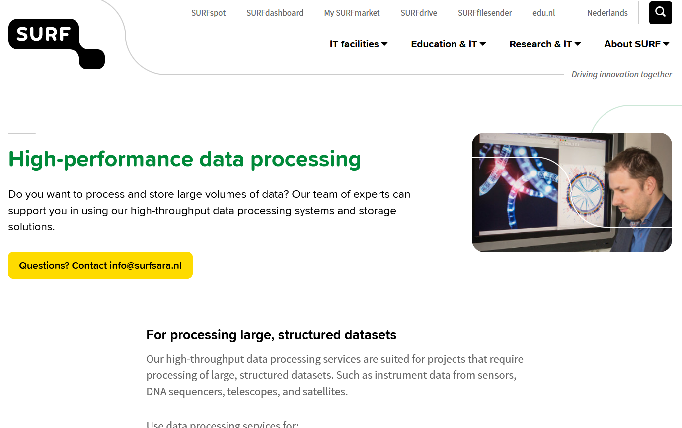
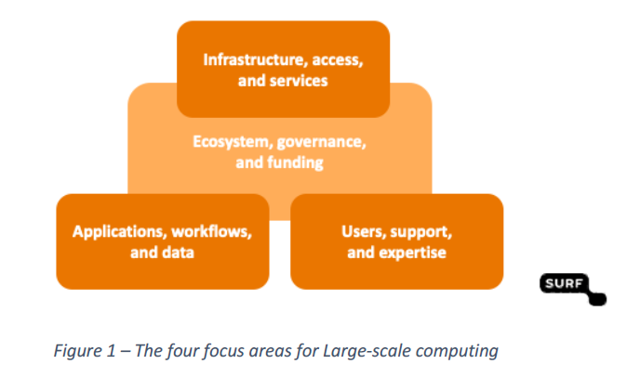
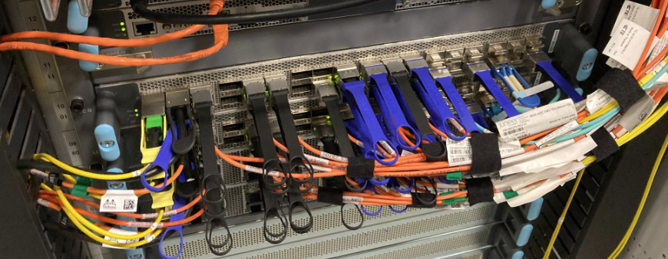
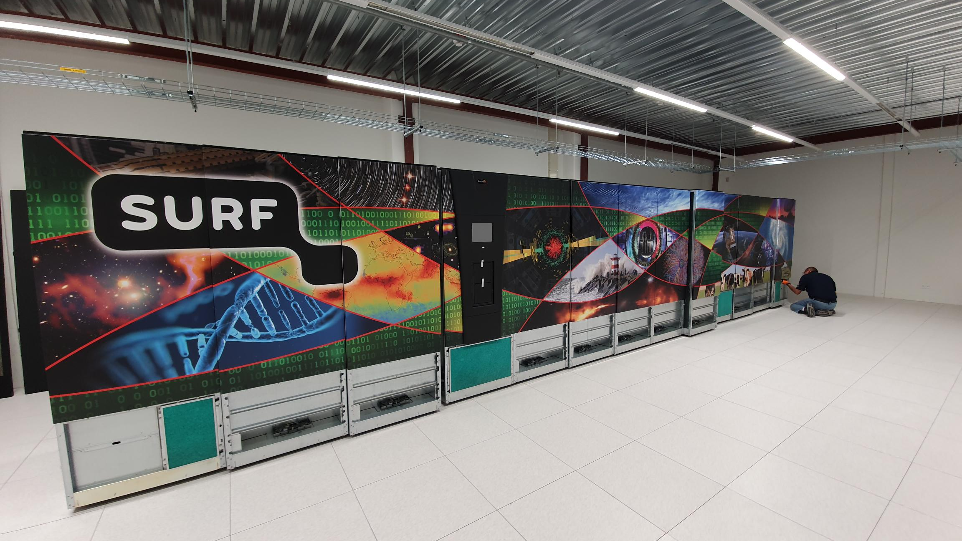
Research IT ecosystem: services, support, and innovation
Images: SURF Snellius, 400G network, SURF Data Archive, portfolio 2024, and the SURF ‘Ambition and Strategy large-scale computing 2023’

Slide 5
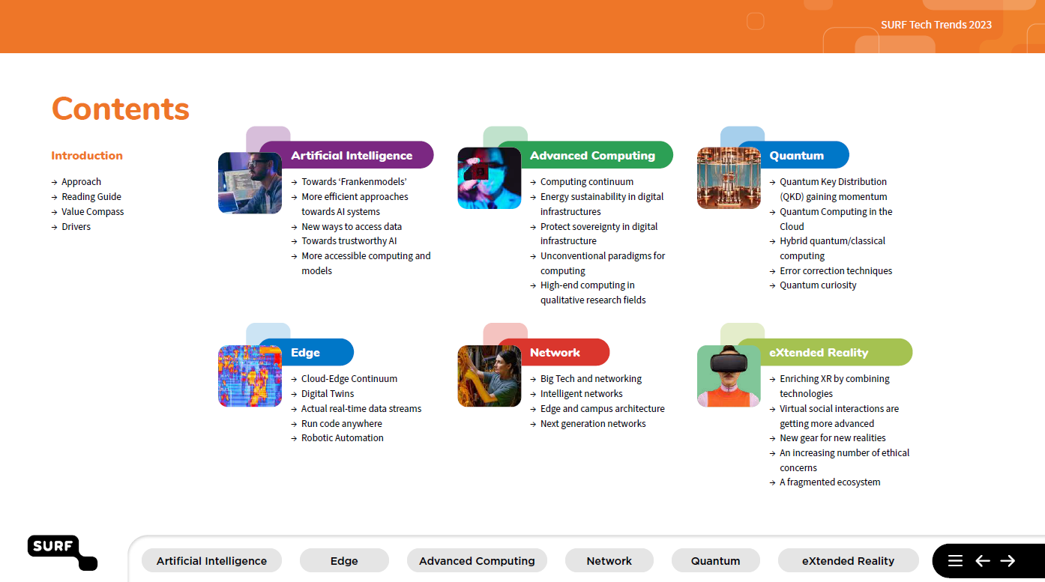
SURF co-operative – joint innovation & HPC Tier2 landscape
Representative expert group on knowledge basis innovation drives joint innovation with institutes on tech trends: AI, Advanced Computing, Quantum, Edge, Network, XR
Strengthening Tier-2 infrastructure
support interaction between SURF and institutes & universities
workshops on Federated HPC & Data
foreseen: rotating traineeship to strengthen organisational Research IT support
there is still ~1.2 M€ waiting for this!
Sources: https://www.surf.nl/en/tech-trends, FreedomLab Innovation Expert group report-out, HPC Tier-2 contact group

Slide 6
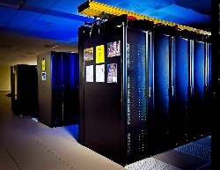
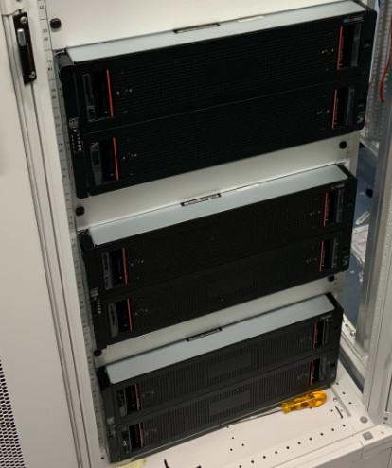
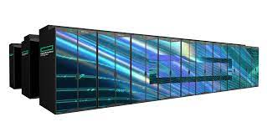
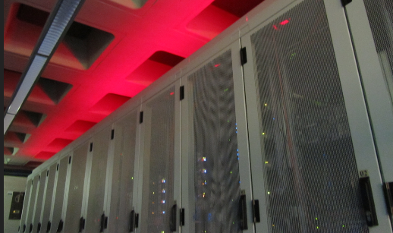
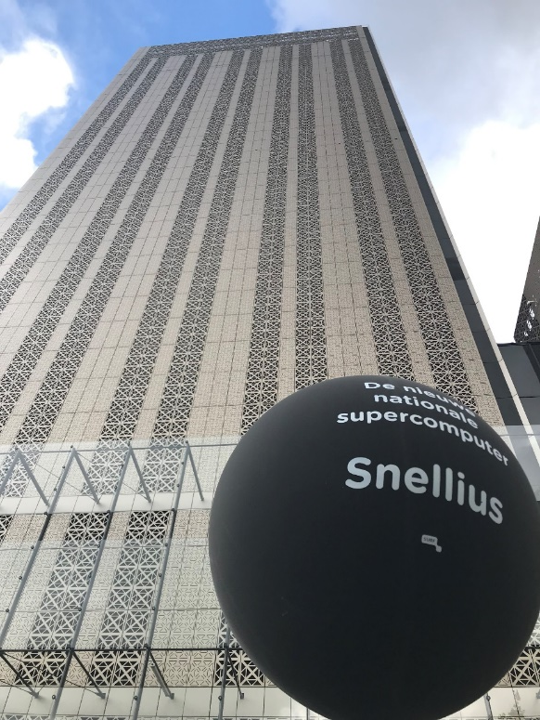
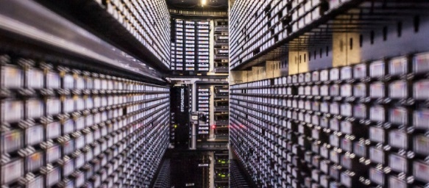
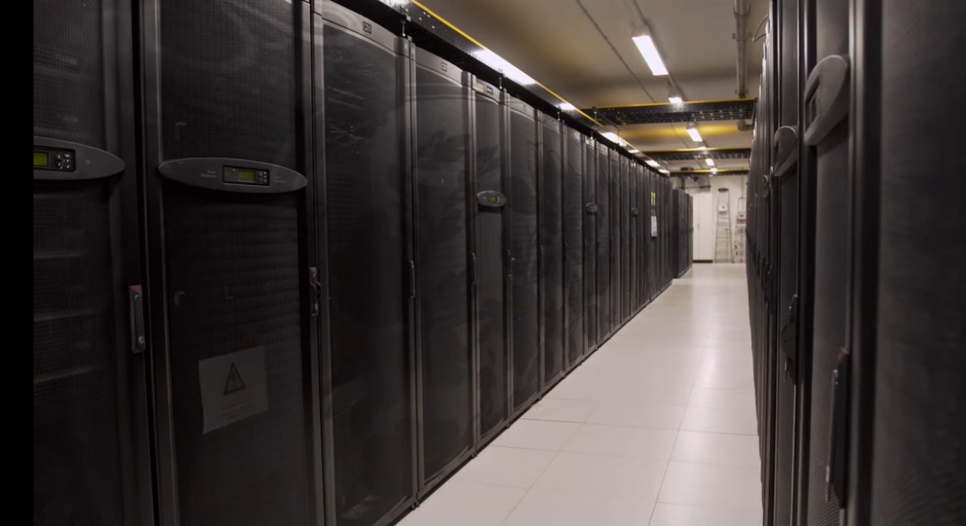
Research HPC staircase model: T2 → T1 → European T0
Local ‘Tier-2’ institutional facilities
OCW, via NWO and SURF, invested 2 M€ in LUMI (pre-exascale) EuroHPC plus 8M€ in Jules Verne (French-led exascale consortium)
[from 2022 intl. membership funds]
…
National Tier-1 Infrastructure at SURF
Photos: Nikhef NDPF, DelftBlue/TUDelft, SURF Data Repository, Snellius, SURF @ DigitalRealty LUMI: by CSC; Steamship: Michael on Unsplash (https://unsplash.com/photos/944sDSMQ778)

Slide 7
National T1 ‘snellius’ … and the road to the next one
Snellius was a 18 (OCW) +2 (SURF reserves) M€ invest
average lifespan before it becomes ‘obsolete’ (i.e. prohibitively expensive to maintain) is 5-7 years
operation much more expensive due to power cost (2MW!)
funding for this was provide one-time from OCW, but only … subject to the condition from OCW that users contribute to evolution of HPC Tier-1 capability
SURF coordinated this co-financing via a national HPC Governance Covenant 2 M€ / year across all WO + O&O members
related to current usage of Snellius by all ‘free-at-point-of-use’ grants of HPC time by the WGS/NWO funded research usage
direct contributions to Snellius (co-financing of nodes, RCCS credits) do not factor into the distribution of the 2M€ institutional covenant

