Slide 1
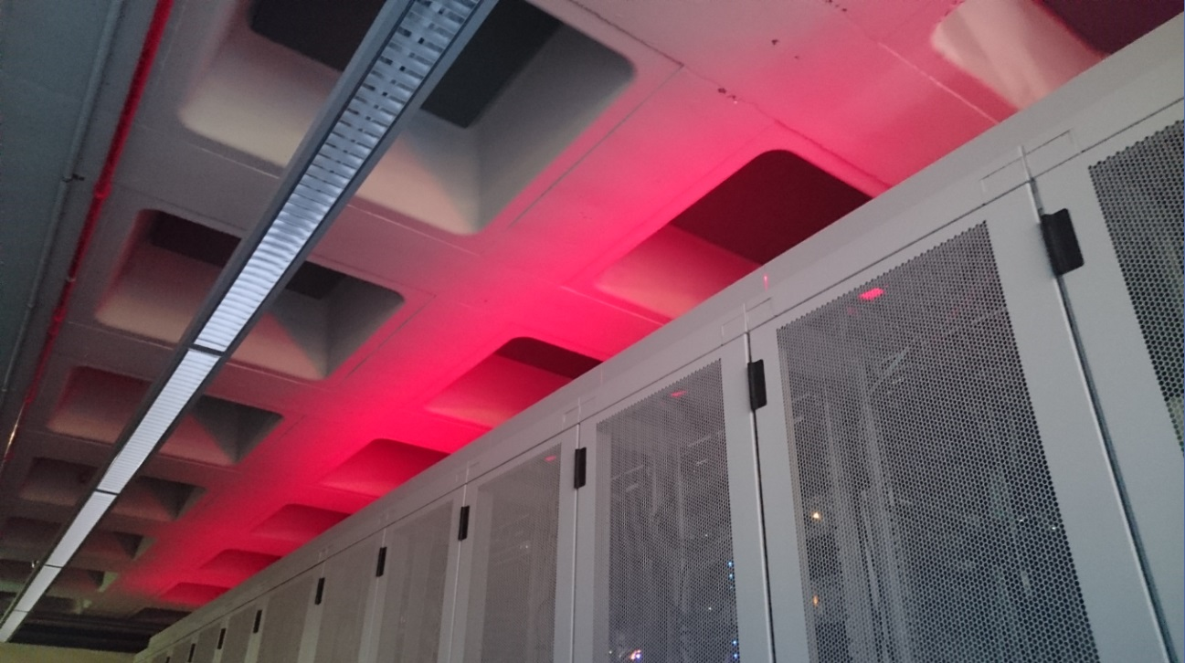
Accelerating Throughput – from the LHC to the World
David Groep
v5
Ignatius 2017

Slide 2
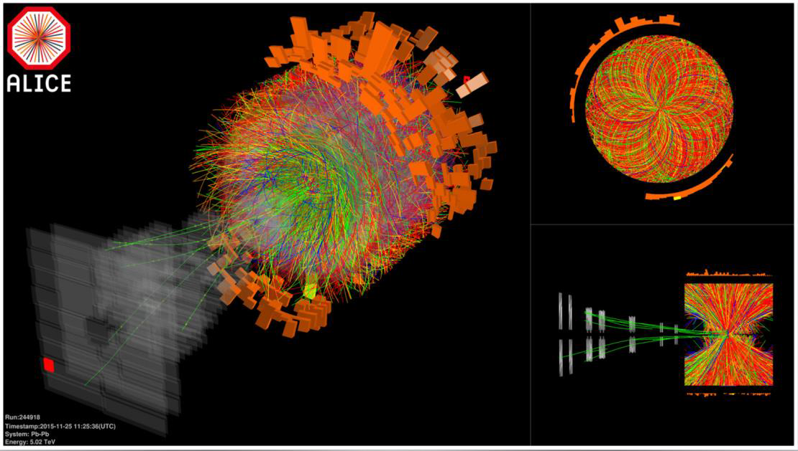
12.5 MByte/event … 120 TByte/s … and now what?

Slide 3

Kans Higgs deeltje:
1 op de 1.000.000.000.000 bostingen
- Dit is equivalent met zoeken van 1 persoon op 1000 wereldpopulaties
- Oftewel één naald in 20 miljoen hooibergen

Slide 4
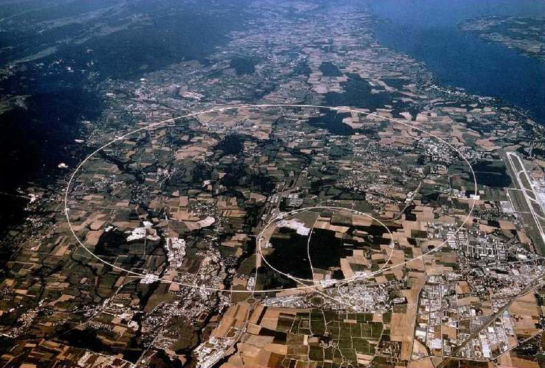
50 PiB/year
primary data

Slide 5
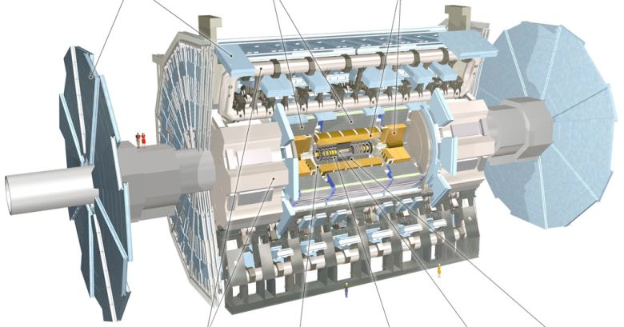
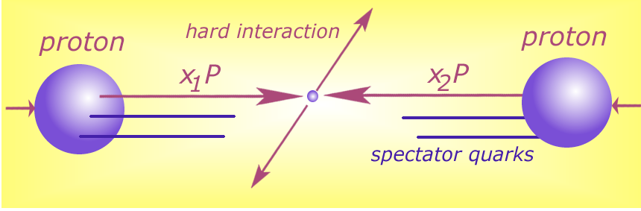





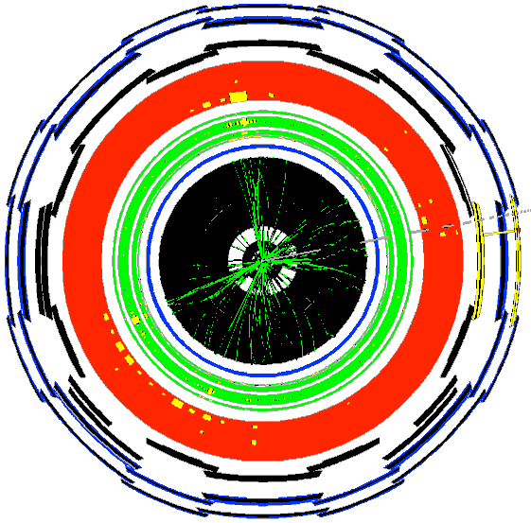







Detector to doctor ...
40 miljoen / seconde
Analyse van botsingen door promovendi
Trigger systeem selecteert 600 Hz
~ 1 GB/s data
and processing
Data distributie met
GRID computers
Collisions characterised by event signature:
  - electronen
  - muonen
  - jets
  -...

Slide 6
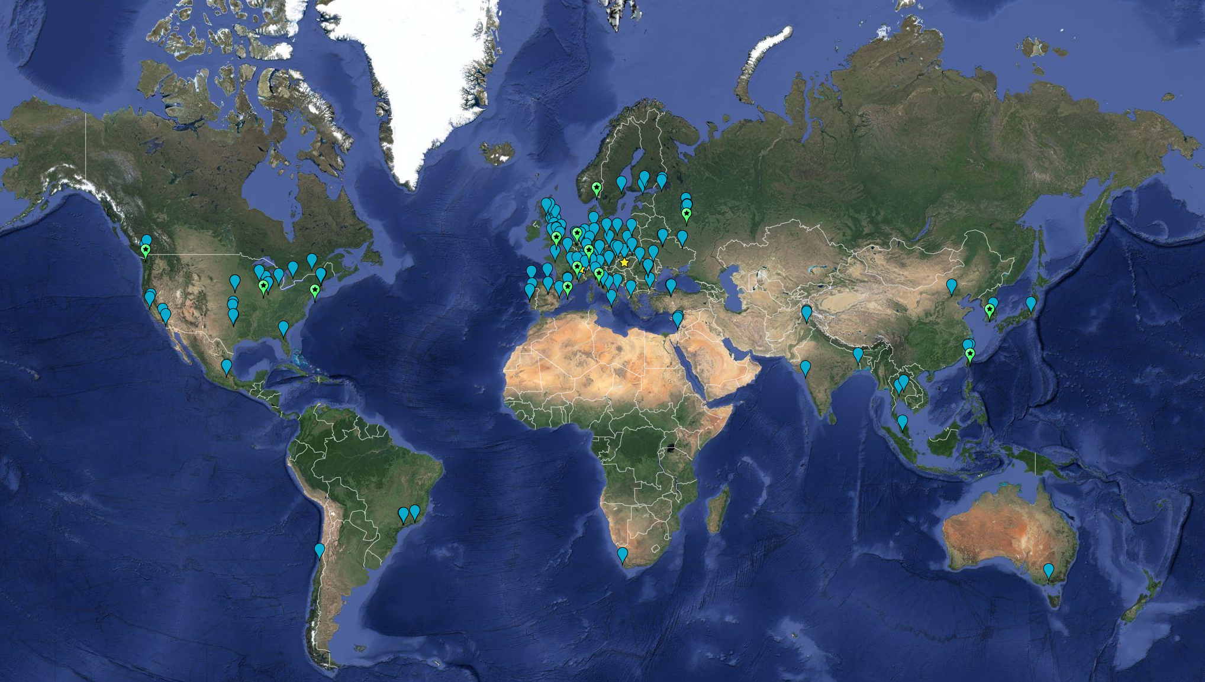
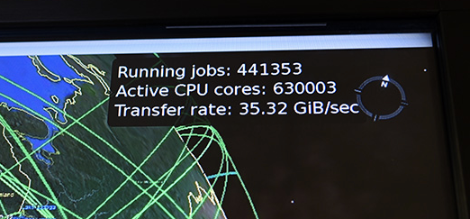
Building the Infrastructure … in a federated way
September 2016:
63 MoU’s
167 sites; 42 countries
CPU: 3.8 M HepSpec06
  If today’s fastest cores: ~ 350,000 cors
  Actually many more (up to 5 yr old cores)
Disk 310 PB
Tape 390 PB

Slide 7
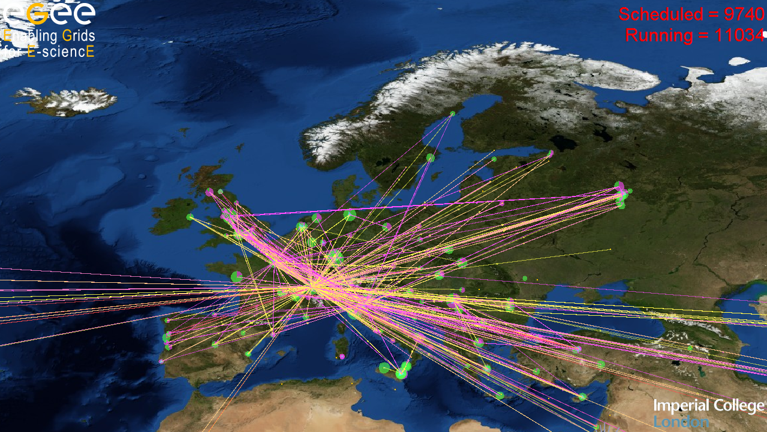

~300 resource centres
~250 communities
Federated infrastructure

Slide 8
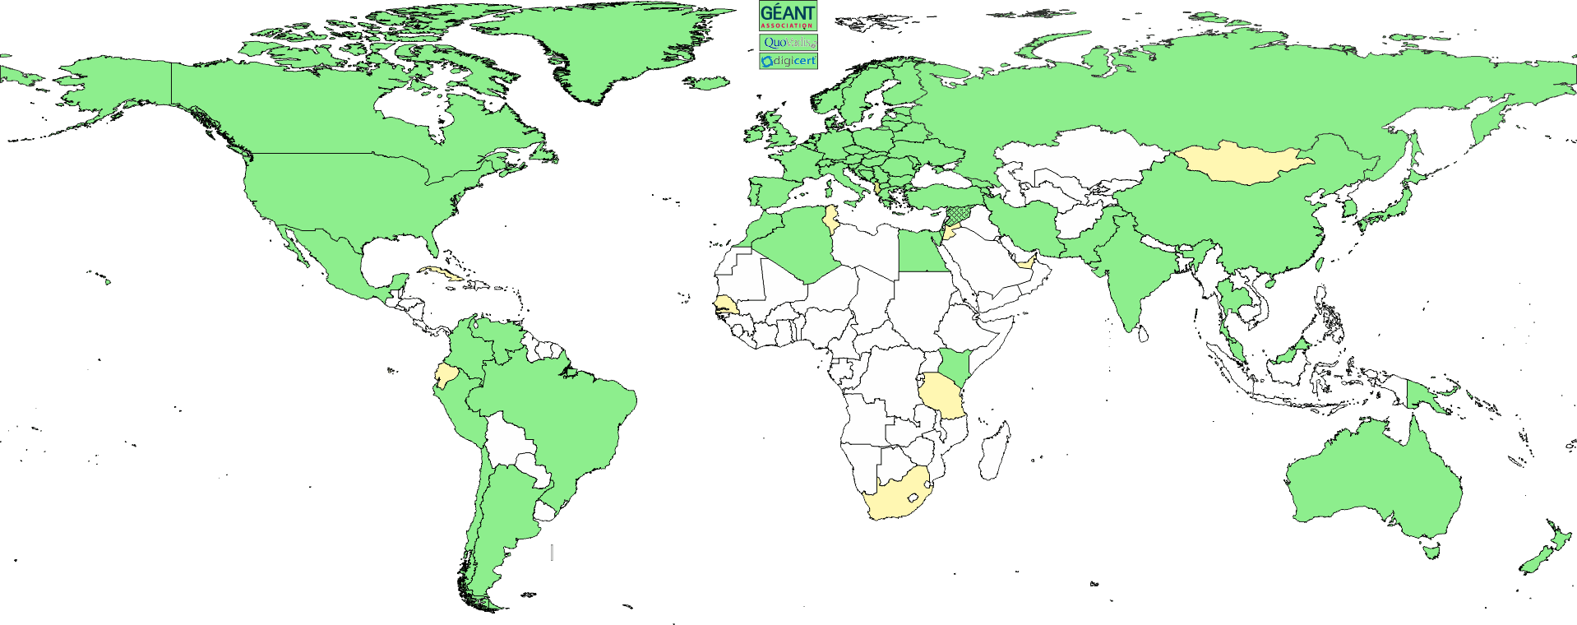
Global collaboration – in a secure way
Collaboration is people as well as (or even more than) systems
A global identity federation for e-Infra and cyber research infrastructures
Common baseline assurance (trust) requirements
Persistent and globally unique
needs a global scope – so we built the
Interoperable Global Trust Federation
  over 80 member Authorities
  Including your GÉANT
  Trusted Certificate Service

Slide 9
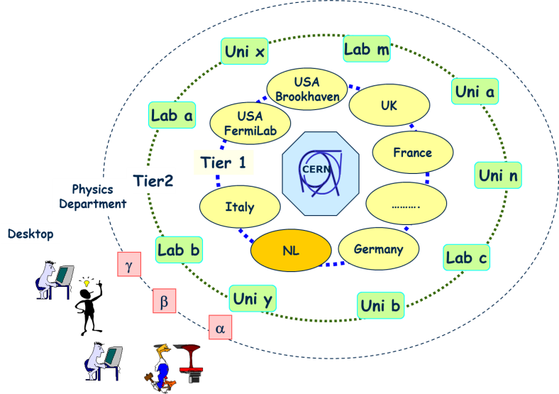
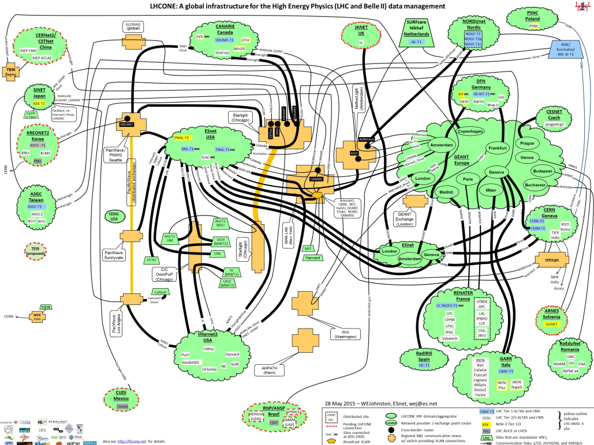

Building the infrastructure for the LHC data
From hierarchical data distribution to
a full mesh and dynamic data placement
Amsterdam/NIKHEF-SARA
LHCOne graphic: lhcone.net

Slide 10
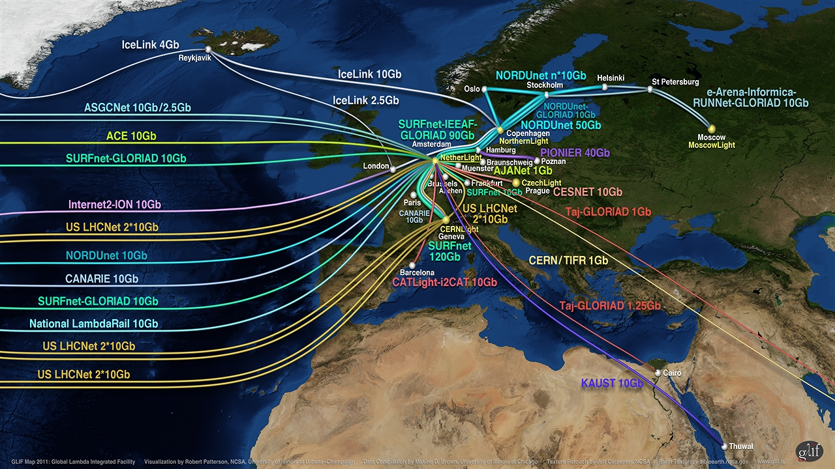
Connecting Science through Lambdas

Slide 11
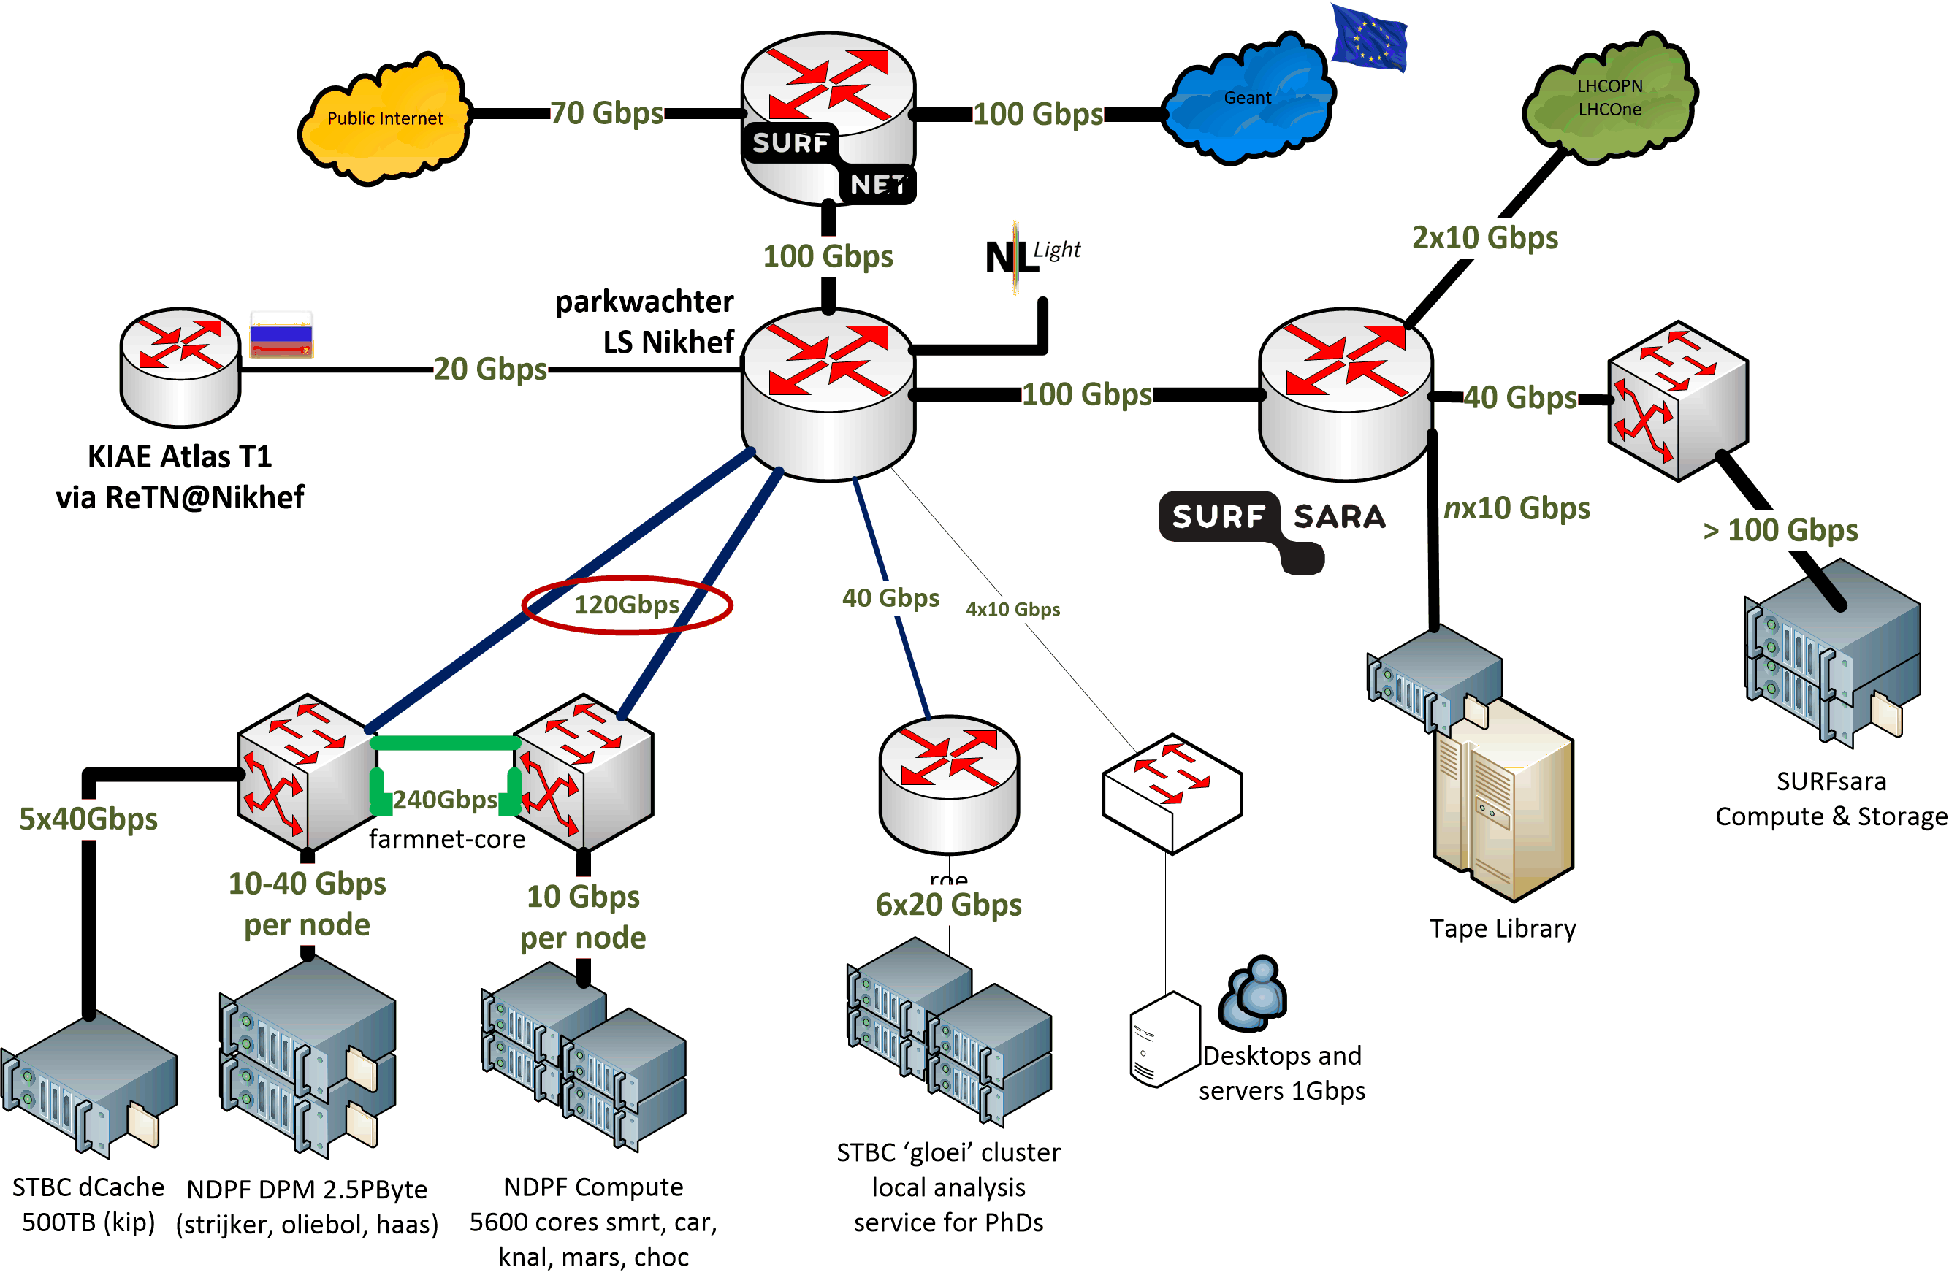
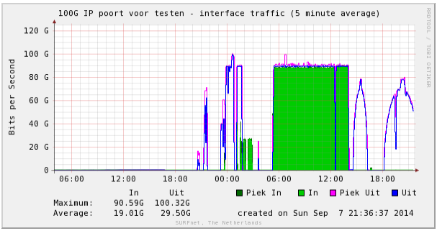
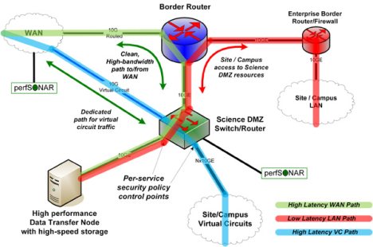
Network built around application data flow
Need to work together!
without our SURFsara peering,
SURFnet gets flooded ☺
and: you really want many of your own peerings

Slide 12
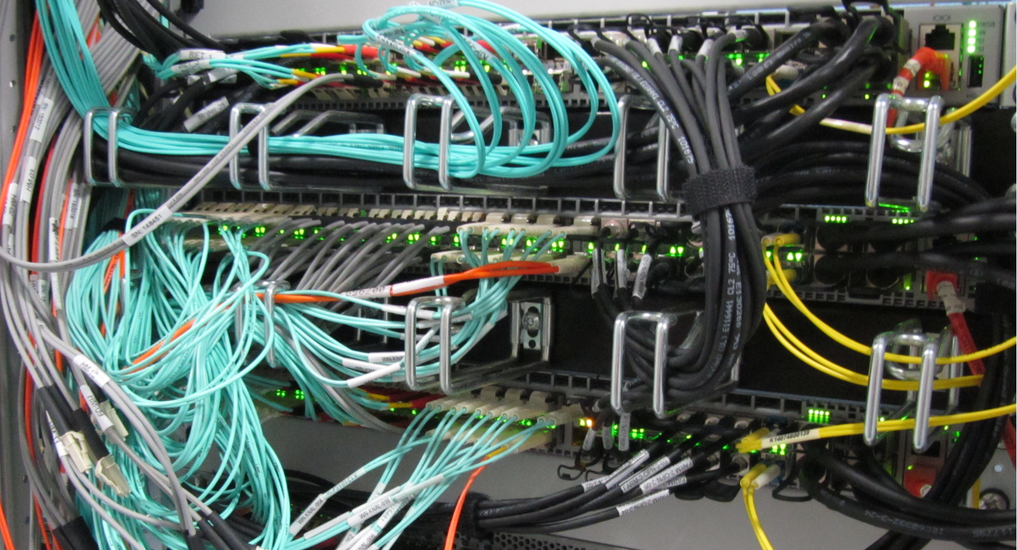

Slide 13
Statistics
Dutch National e-Infrastructure coordinated by
“BiG Grid” HTC and storage platform services
3 core operational sites: SURFsara, Nikhef, RUG-CIT
25+ PiB tape, 10+ PiB disk, 12000+ CPU cores
@Nikhef
~ 5500 cores and 3.5 PiB
focus on large/many-core systems
> 45 install flavours (service types)
and a bunch of one-off systems

Slide 14
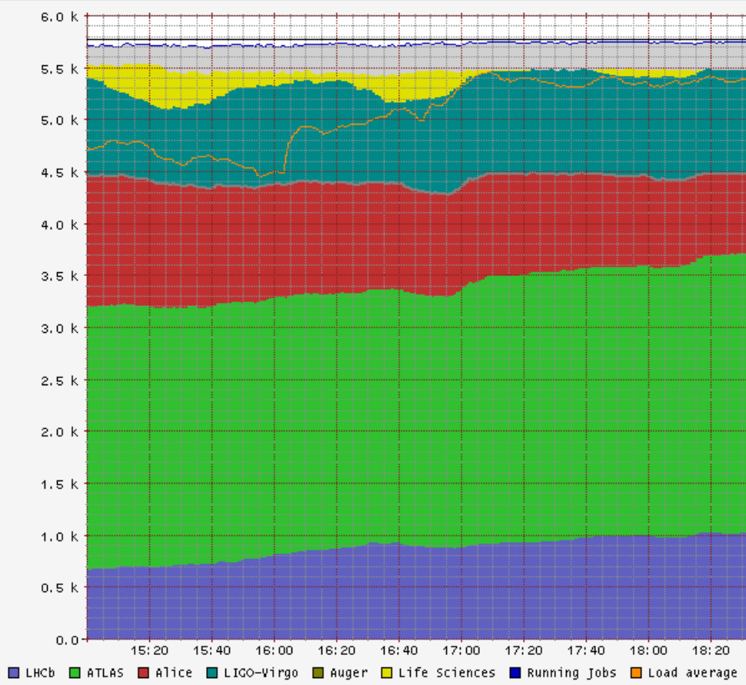
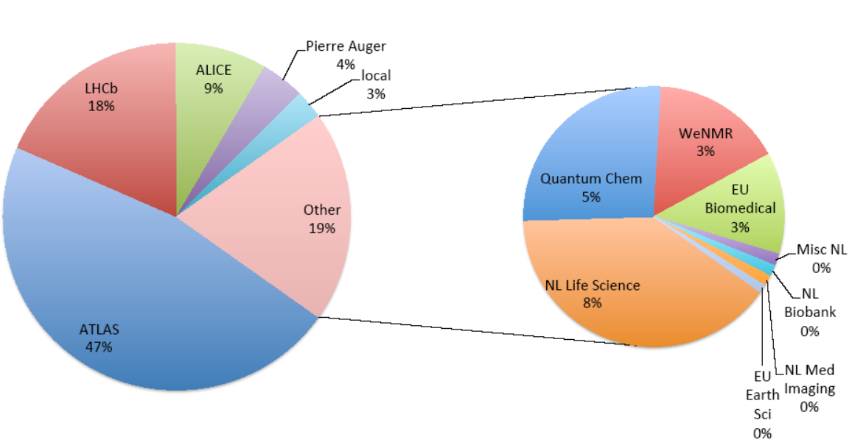
Shared infrastructure, efficient infrastructure!
>98% utilisation, >90% efficiency
NL: WeNMR
EGI biomedical
LIGO/Virgo gravitational waves
LHC Alice
LHC Atlas
LHCb
Right:: NIKHEF-ELPROD facility, Friday, Dec 9th, 2016
Left: annual usage distribution 2013-2014

Slide 15
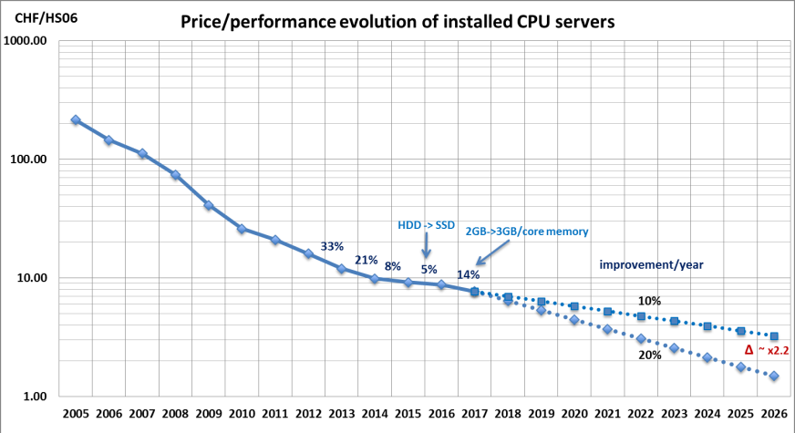
Waiting will not help you any more …
Helge Meinhard, Bernd Panzer-Steindel, Technology Evolution, https://indico.cern.ch/event/555063/contributions/2285842/

Slide 16
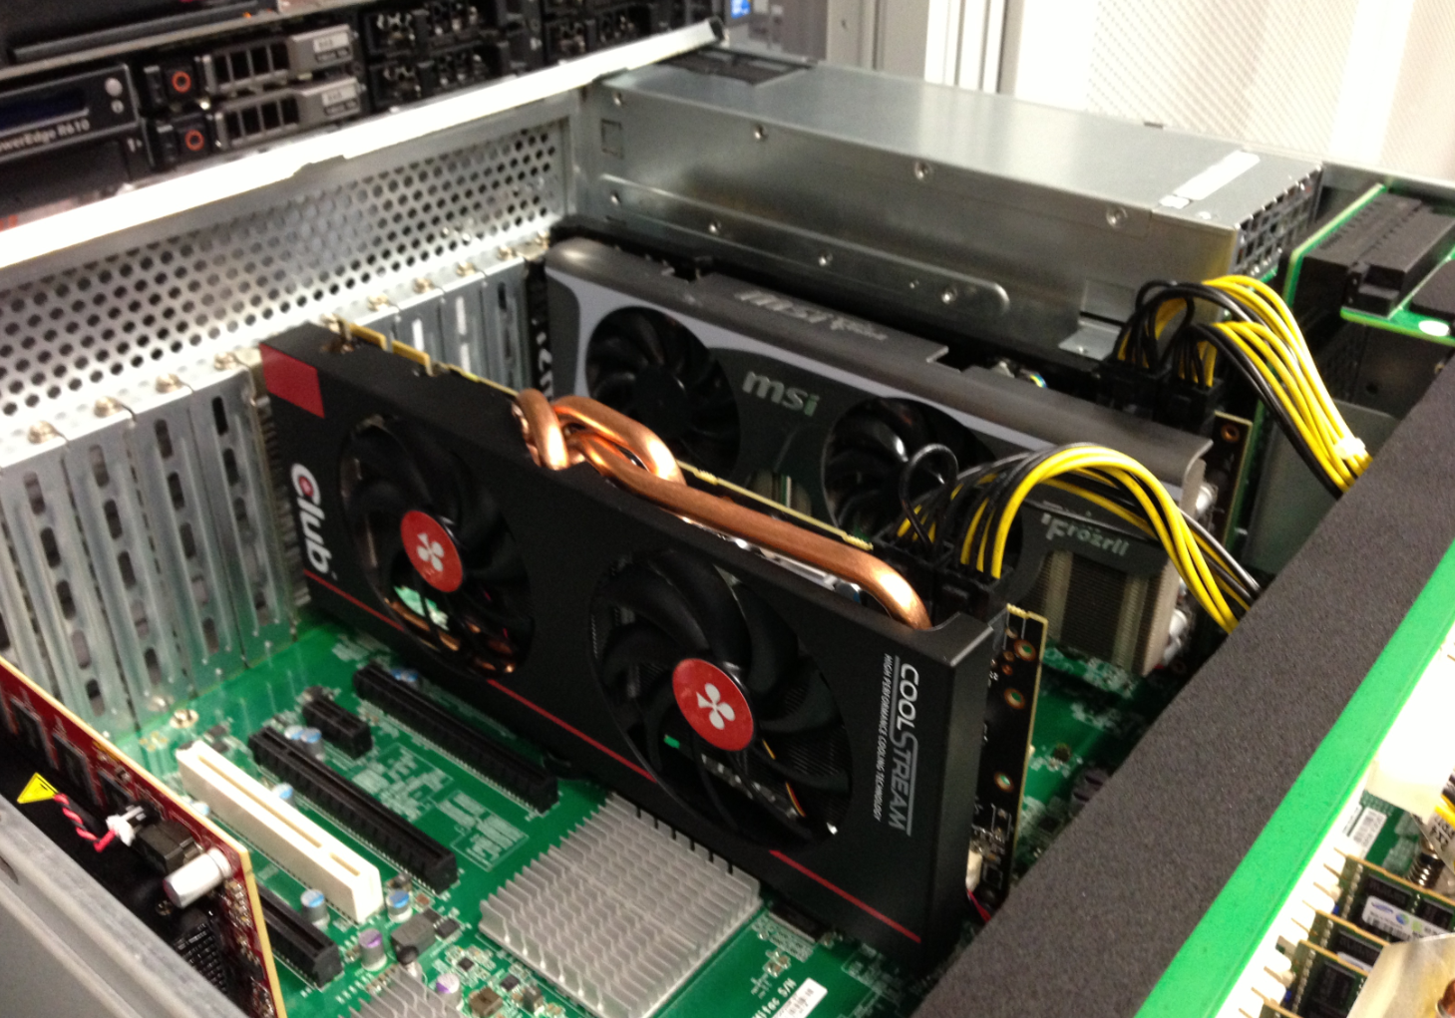
For (informed) fun & testing – some random one-off systems …
plofkip.nikhef.nl

Slide 17
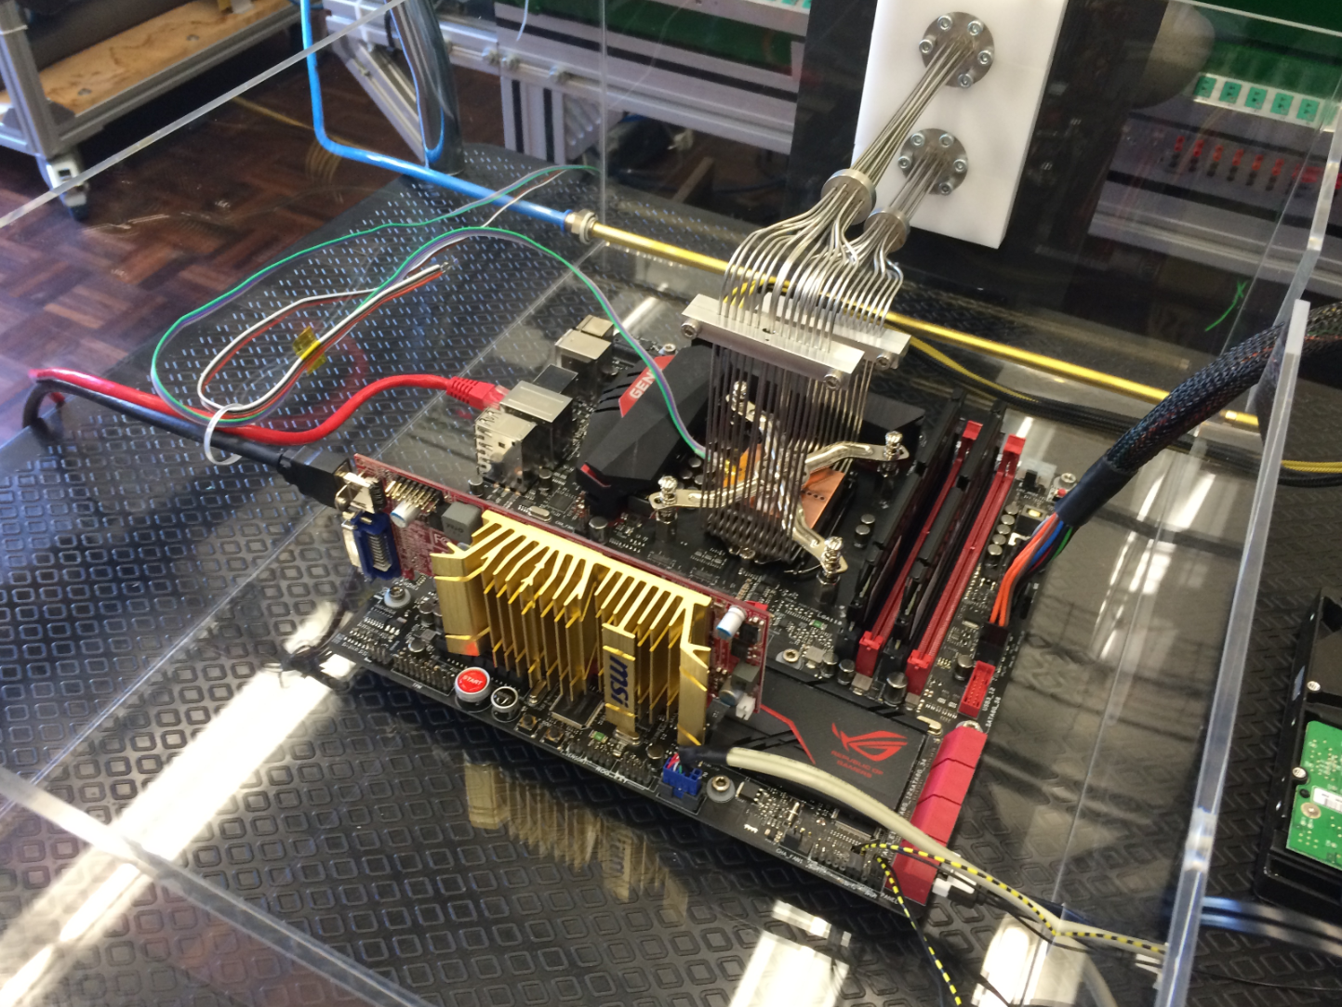
For (informed) fun & testing – some random one-off systems …
CO2-cooled Intel CPUs @6.2GHz

Slide 18
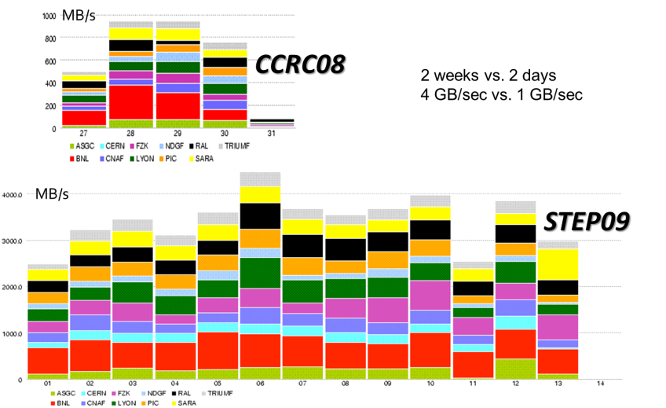
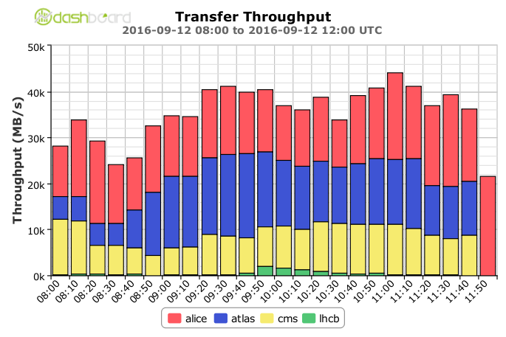
From SC04, CCRC08, STEP09, .. to today …
Global transfer rates increased to > 40 GB/s
Acquisition:10 PB/mo (~x2 for physics data)
STEP09 : Jamie Shiers, CERN IT/GS; Throughput 2016: WLCG Workshop 2016, Ian Bird, CERN

Slide 19
… and tomorrow ?!
Data:
Raw 2016: 50 PB → 2027: 600 PB
Derived (1 copy): 2016: 80 PB → 2027: 900 PB
CPU:
x60 from 2016
Technology at ~20%/year will bring x6-10 in 10-11 years

Slide 20
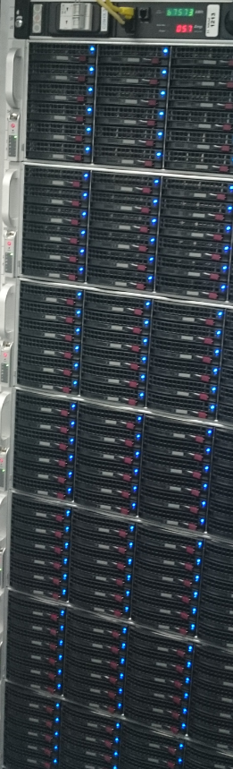
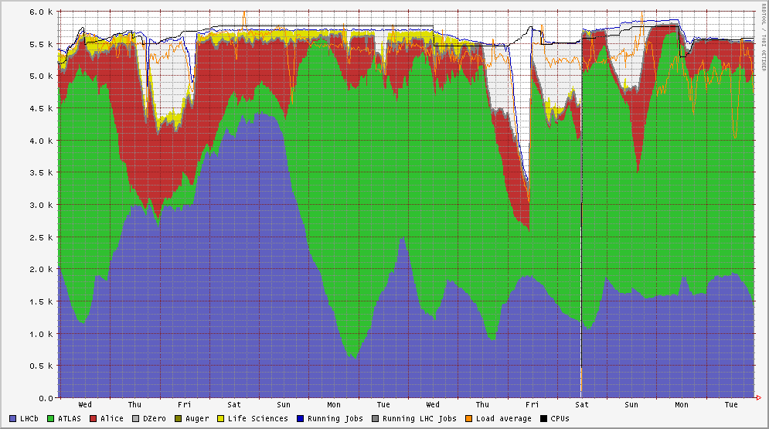
Interconnecting compute & storage
‘data shall not be a bottleneck’
5500 cores process together
~ 16 GByte/s of data sustained
or ~ 10 GByte/jobslot/hr
are ‘bursty’ when many tasks start together
and in parallel we have to serve the world

Slide 21
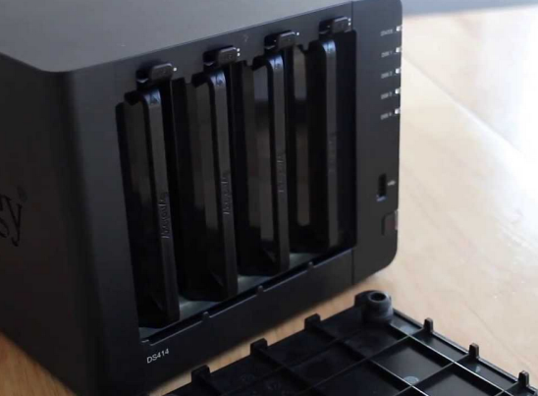
Infrastructure for research: balancing network, CPU, and disk
CPU and disk both expensive, yet idling CPUs are ‘even costlier’
architecture and performance matching averts any single bottleneck
but requires knowledge of application (data flow) behaviour
data pre-placement (local access), mesh data federation (WAN access)
This is why e.g. your USB drive does not cut it
– and neither does your ‘home NAS box’
… however much I like my home system using just
15 Watt idle and offering 16TB for just € 915 …

Slide 22
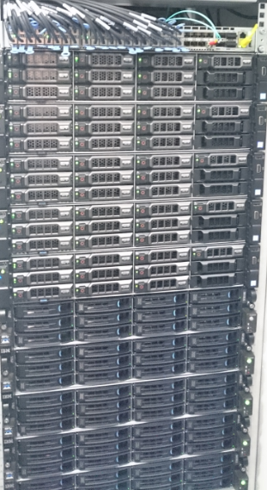
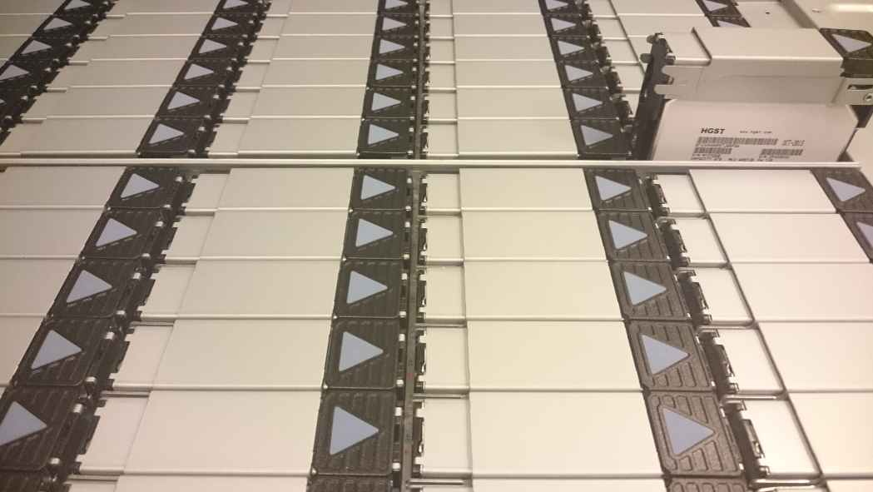
Getting more bytes through?
Power 8: more PCI lanes & higher clock should
give more throughput – if all the bits fit together
Only way to find out is … by trying it!
joint experiment with Nikhef and SURFsara
on comparing IO throughput between x86 & P8
yet more is needed
HGST: 480 TByte gross capacity/4RU
RAID card are now a performance bottleneck
JBOD changes CPU-disk ratio
closer integration of networking to get >100Gbps

Slide 23
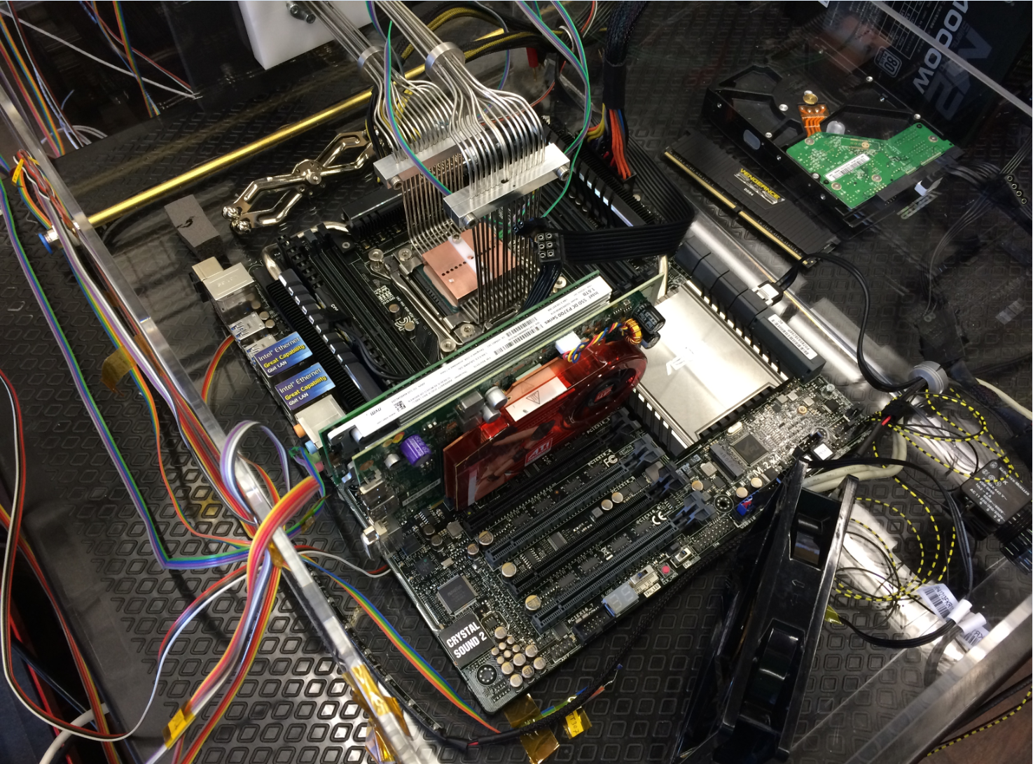
Fun, but not the solution to single-core performance …
Collaboration of Intel™ and Nikhef PDP & MT (Krista de Roo) “CO2 Inside”

