Slide 1
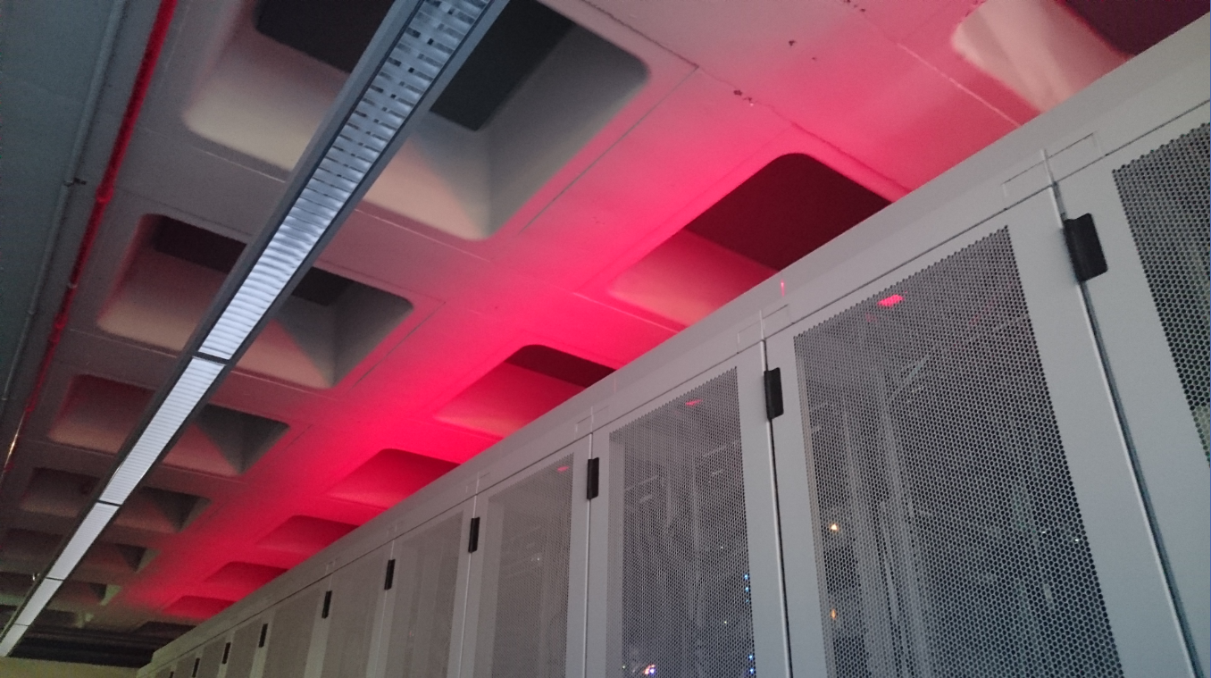
Nikhef – a Journey in
Physics and Data Processing
Dell YP Visit 2017-01-27

Slide 2
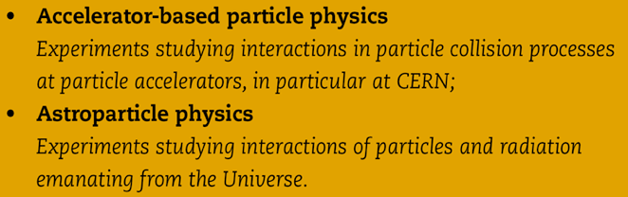
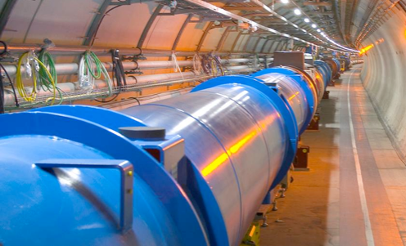
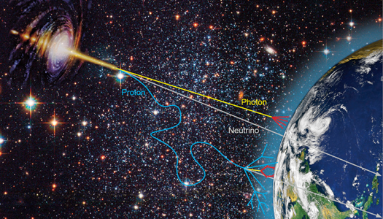


Nationaal instituut voor subatomaire fysica
Verleggen van de grenzen van onze kennis
Phenomenology
Collider physics
Astroparticle physics
8 september 2015
Orientatie Nikhef
Notes:
not on slide but important: concentrates all NL HEP infrastructure
machine shop, designers, ICT

Slide 3
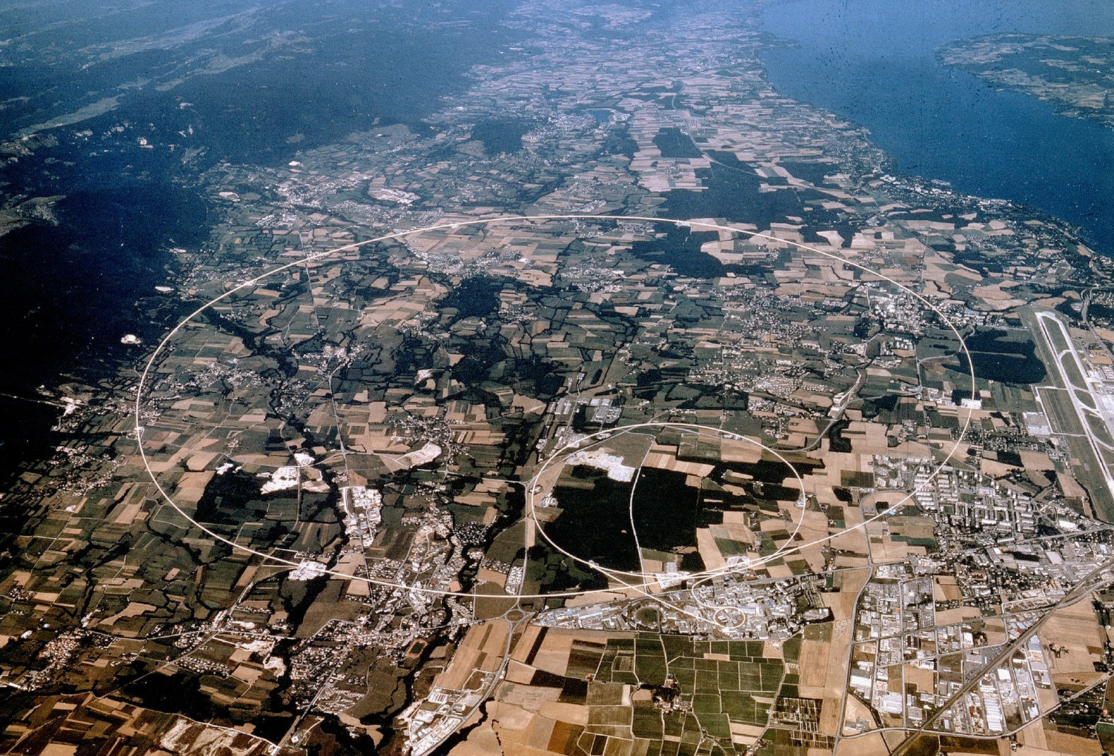


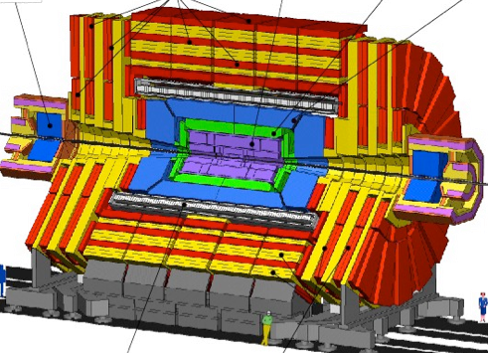




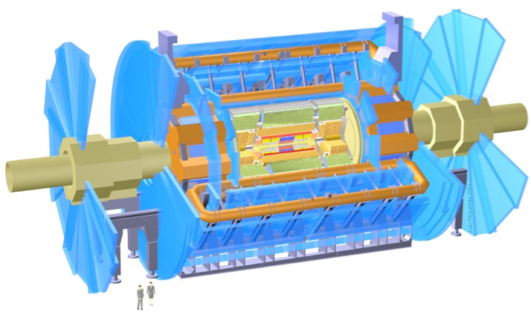

CMS
LHCb
ALICE
ATLAS
Atlas
protons
Imagery: CERN
Haarlemse Chemische Kring

Slide 4
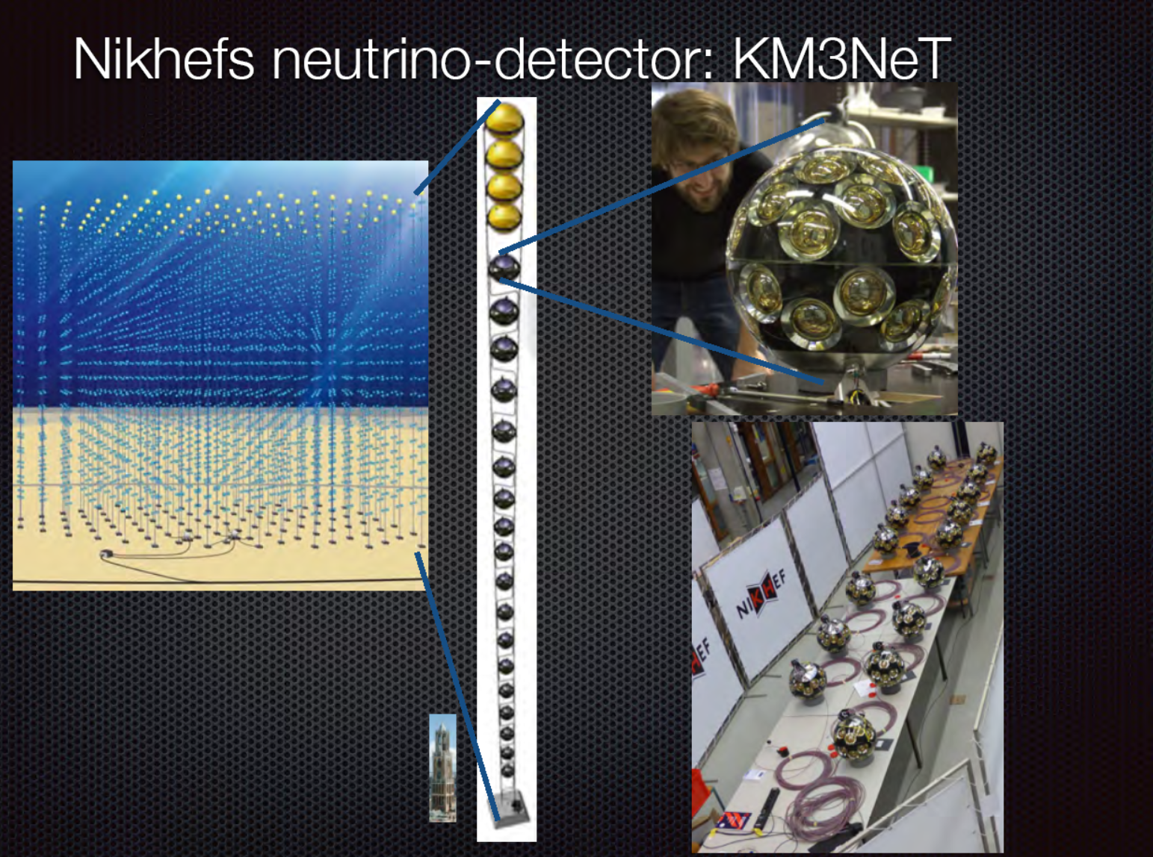

Slide 5
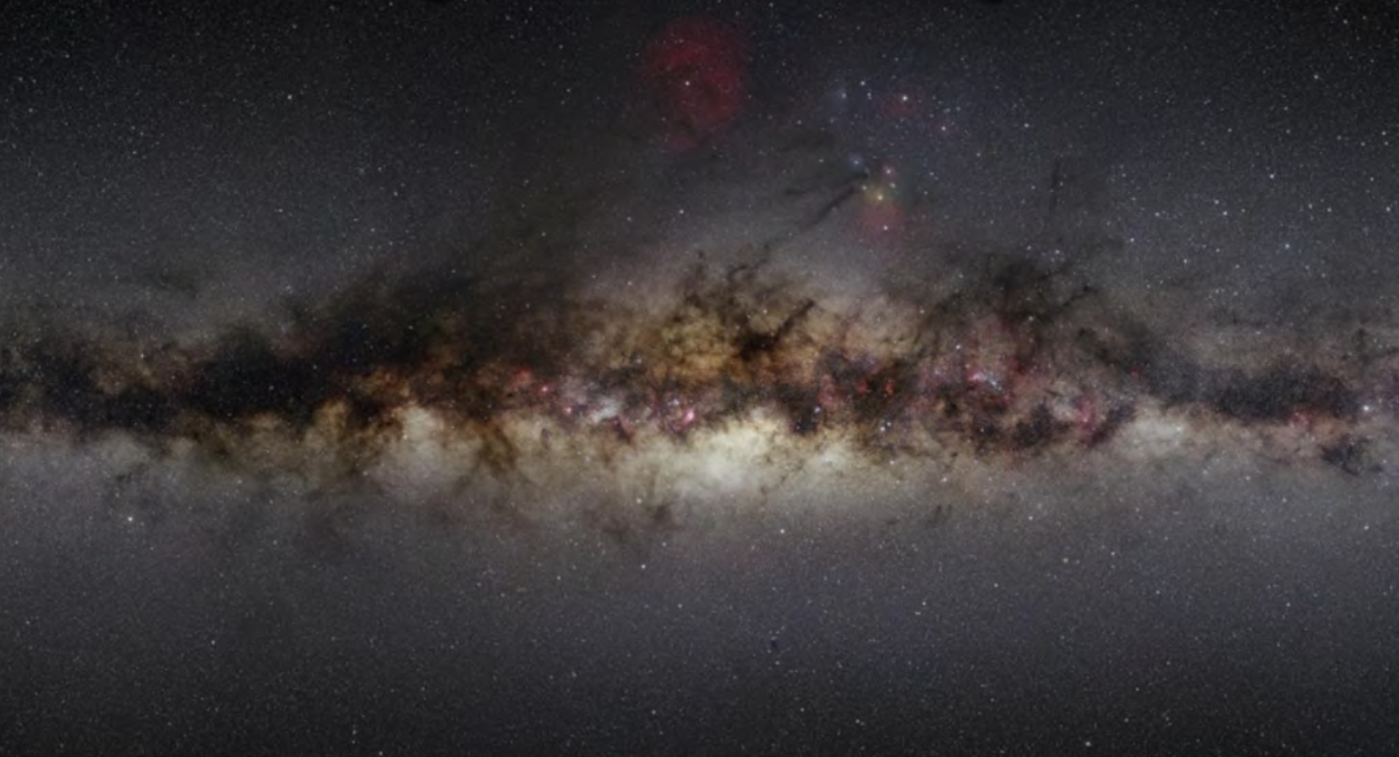
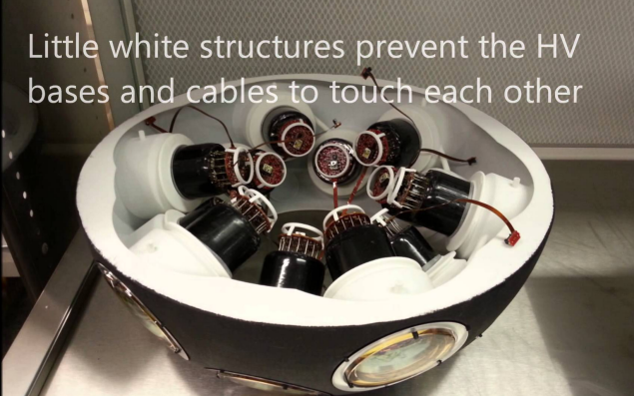
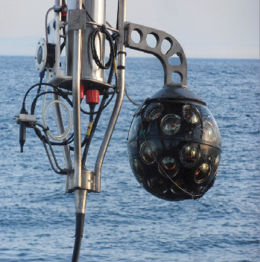
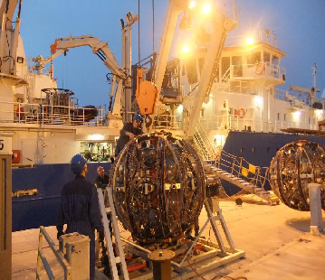
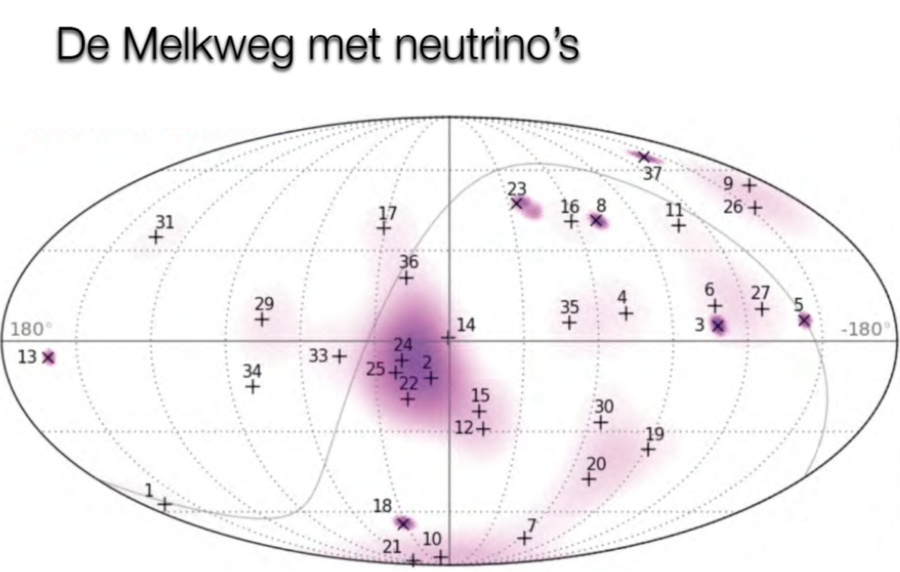
Imagery: Nikhef, NIOZ, KM3NET collaboration

Slide 6
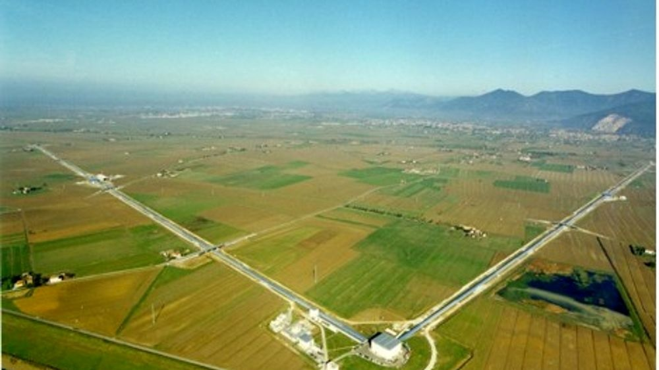
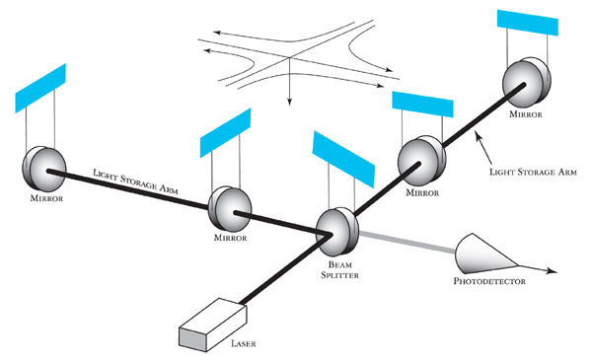
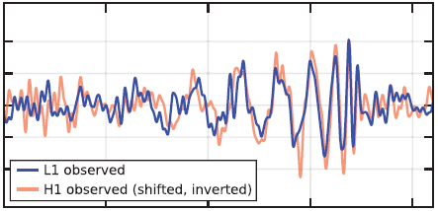

SLIDE OVER LIGO/VIRGO!!!
Imagery: gw-astronomy collaborations, LSC

Slide 7
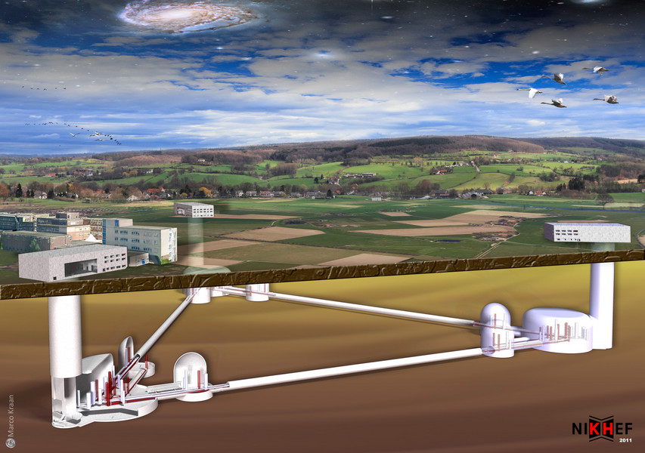
Einstein Telescope – projected onto Heuvelland Limburg, NL

Slide 8
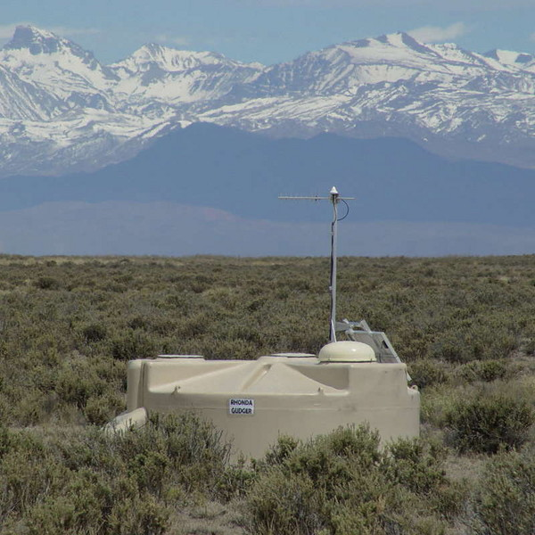
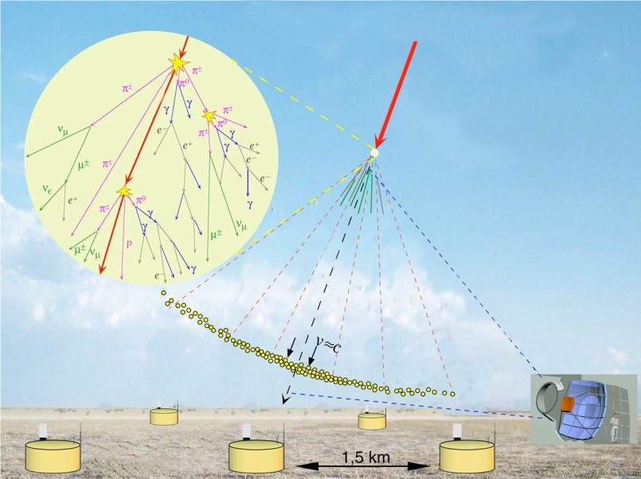
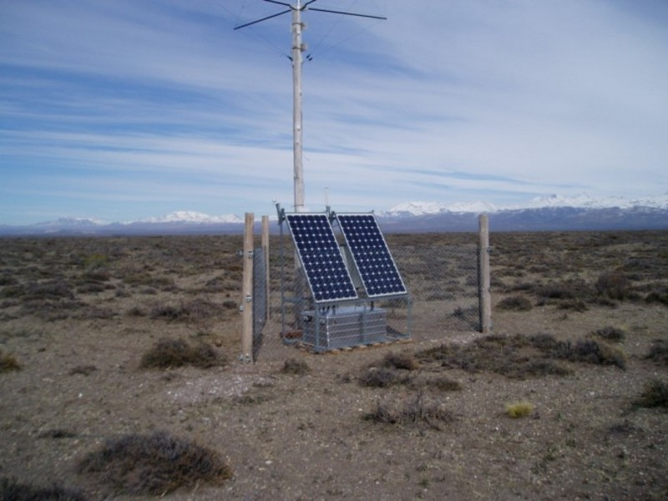
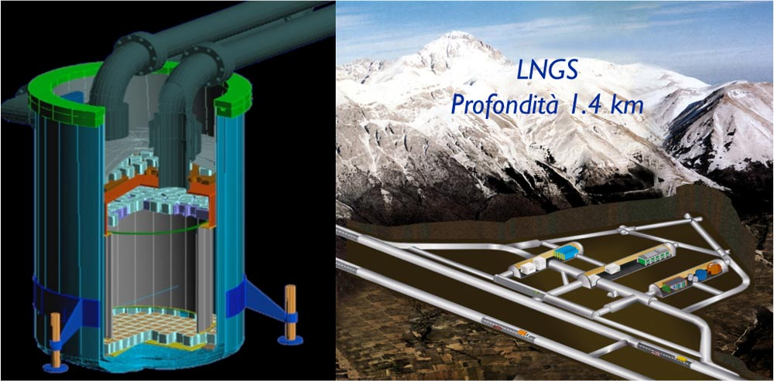
Image sources: LNGS/INFN, Xenon collaboration; Pierre Auger collaboration; Nikhef

Slide 9
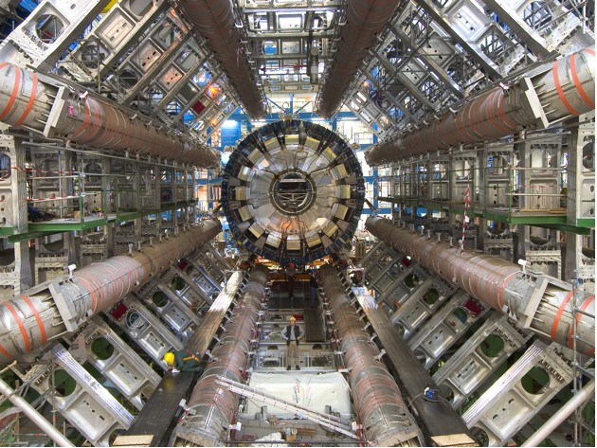
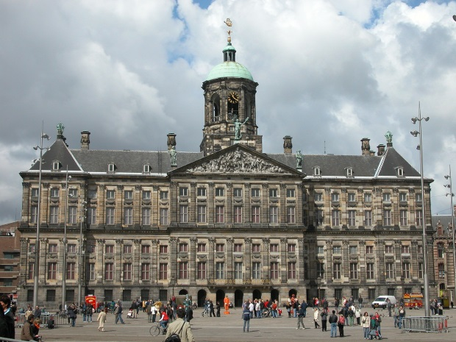
s
Imagery: ATLAS experiment,, atlas.ch; Paleis op de Dam: Robert Scarth, CC-BY-SA

Slide 10

Deeltjes botsingen
Notes:
In mijn onderzoek is antimaterie essentieel. Zonder antimaterie bots je biljartballen op biljartballen en dat is nogal suf. Eens een biljartbal, altijd een biljartbal zeg ik maar.

Slide 11





Deeltjes botsingen
Notes:
Je kan de biljartballen ook wat harder op elkaar knallen. Dan krijg je kapotte biljartballen. Leuk, maar veel leer je er ook niet van.

Slide 12
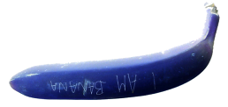
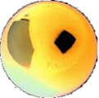
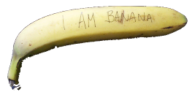
Deeltjes botsingen
E=mc²
Notes:
Nee, echt leuk kan het worden door biljartballen op antibiljartballen te knallen. Dan gaat er letterlijk een hele wereld open. Je maakt dan bijvoorbeeld een banaan en een antibanaan! Ja echt. Allemaal mede dankzij de beroemdste formule van Einstein E=mc²: zodra je voldoende energie in de botsende deeltjes stopt, zou je nieuwe zware deeltjes kunnen maken!
De vraag: Antimaterie: science fictie of realiteit?

Slide 13
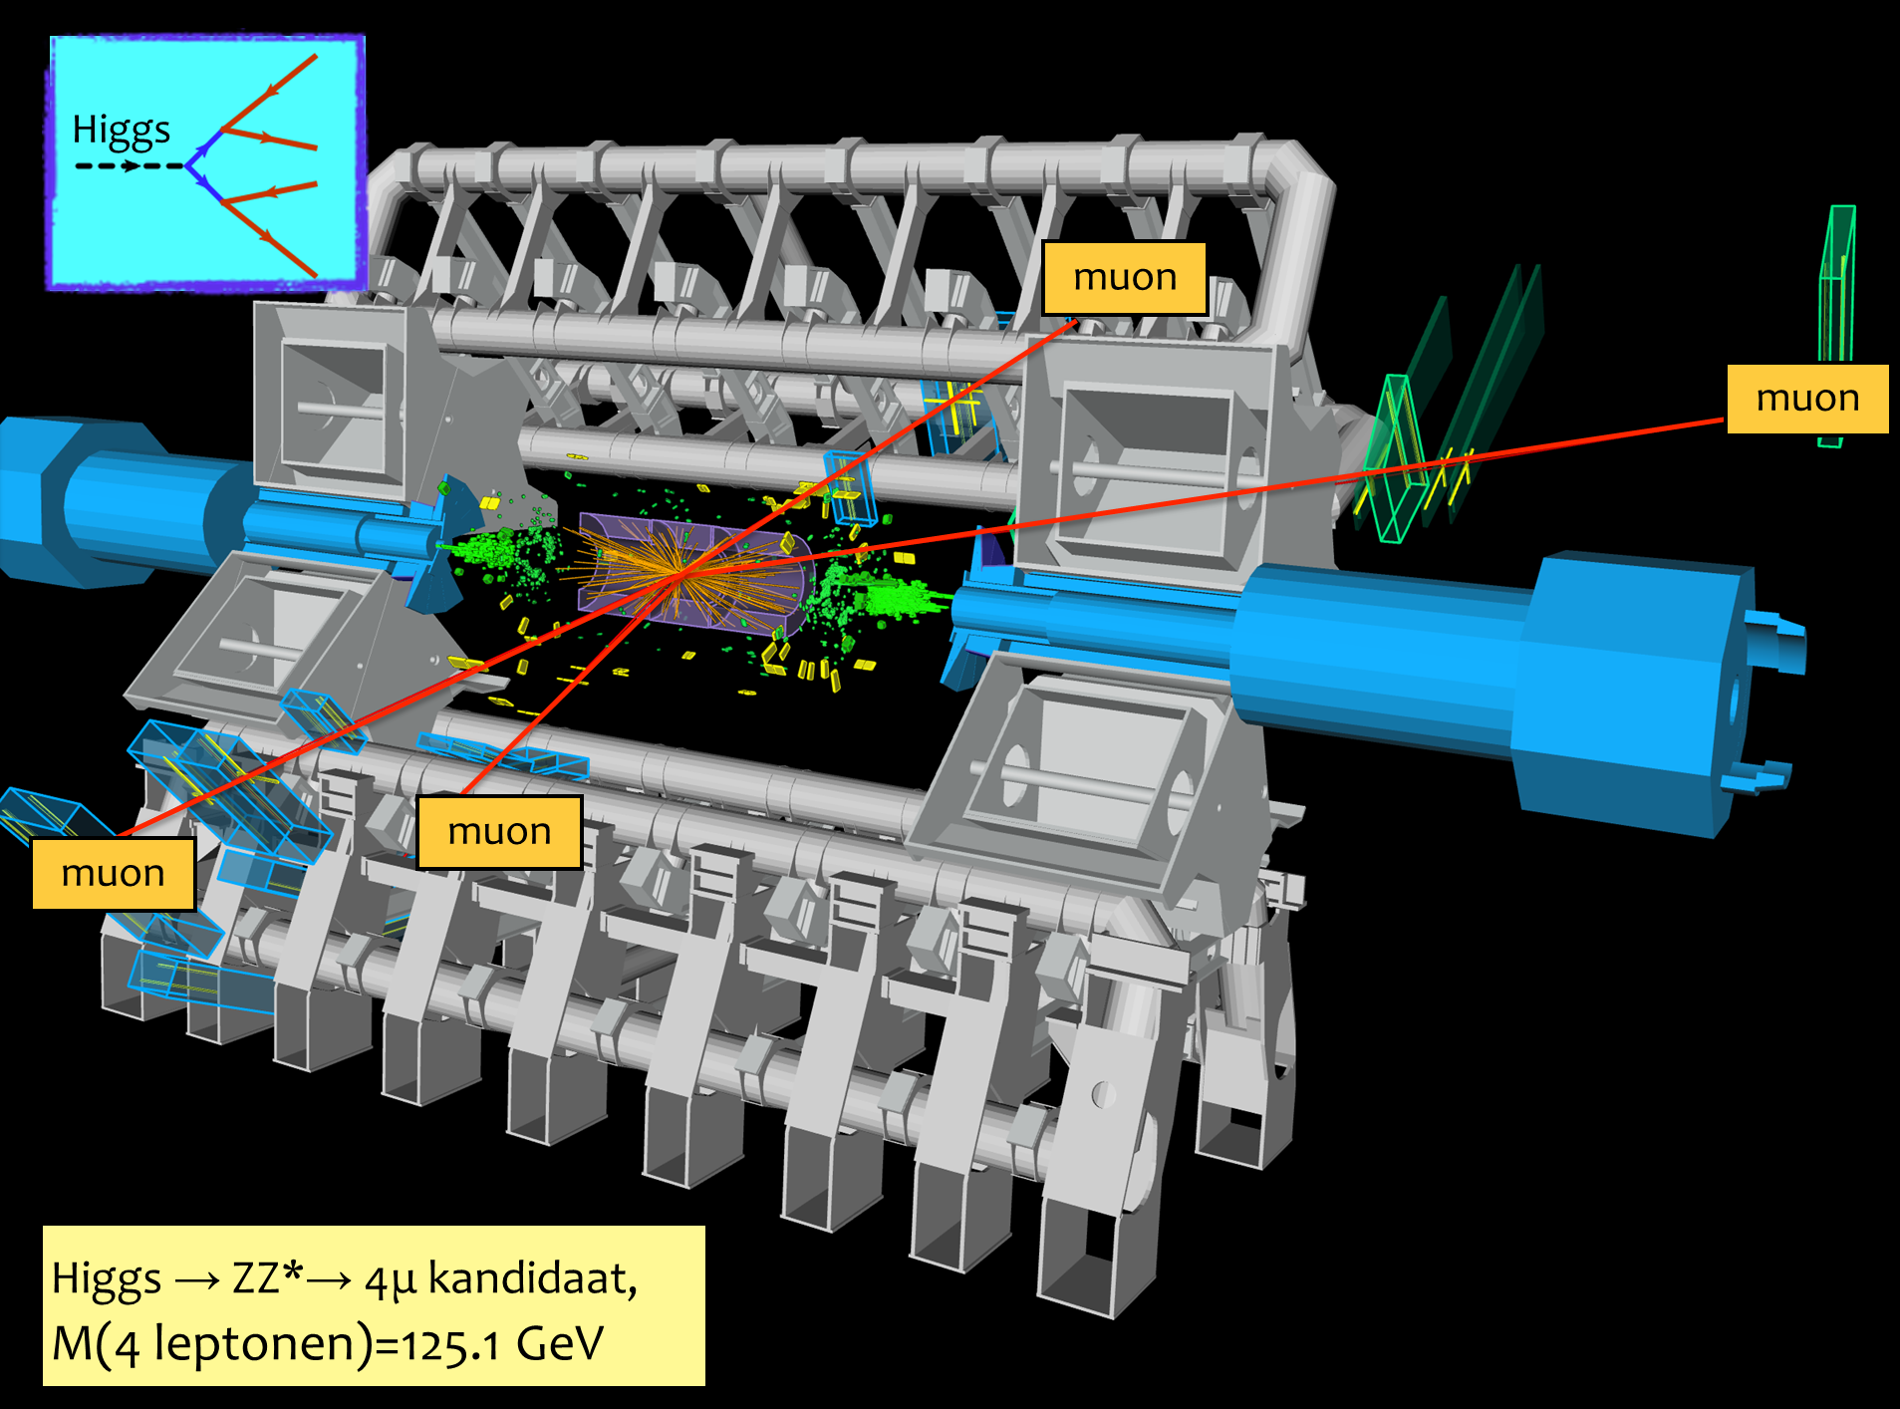
Kans Higgs deeltje:
1 op de 1.000.000.000.000 bostingen
- Dit is equivalent met zoeken van 1 persoon op 1000 wereldpopulaties
- Oftewel één naald in 20 miljoen hooibergen
Imagery: ATLAS experiment,, atlas.ch

Slide 14
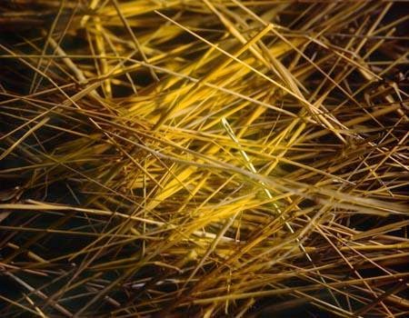
Kans Higgs deeltje:
1 op de 1.000.000.000.000 bostingen
- Dit is equivalent met zoeken van 1 persoon op 1000 wereldpopulaties
- Oftewel één naald in 20 miljoen hooibergen

Slide 15
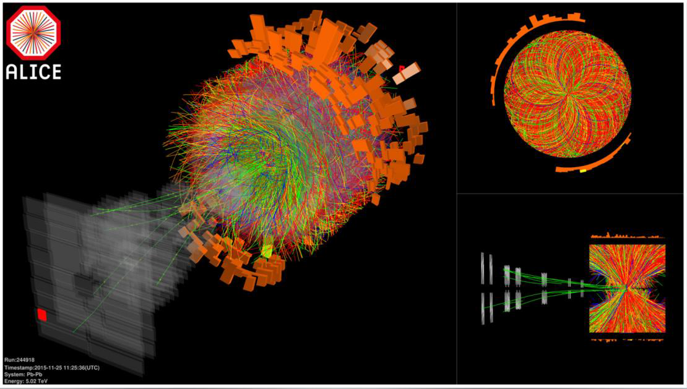
12.5 MByte/event … 120 TByte/s … and now what?

Slide 16
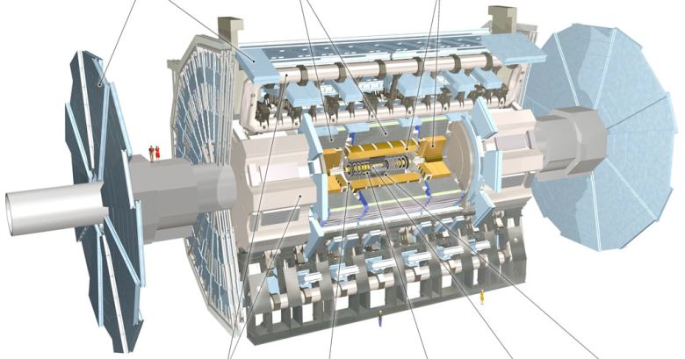
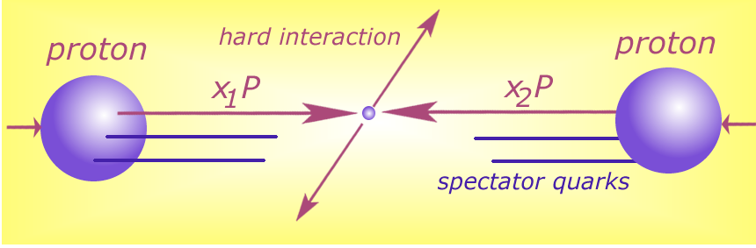





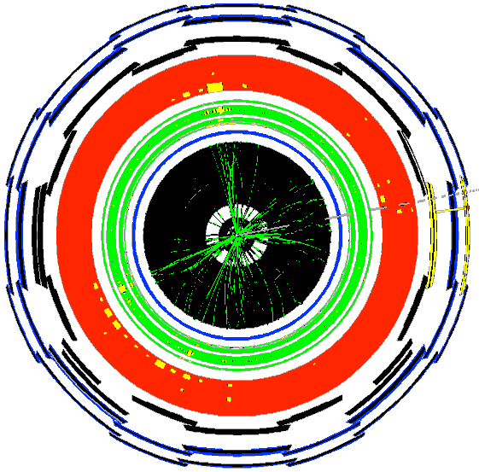

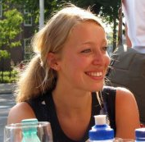


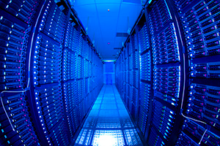


Detector to doctor ...
40 miljoen / seconde
Analyse van botsingen door promovendi
Trigger systeem selecteert 600 Hz
~ 1 GB/s data
and processing
Data distributie met
GRID computers
Collisions characterised by event signature:
  - electronen
  - muonen
  - jets
  -...

Slide 17
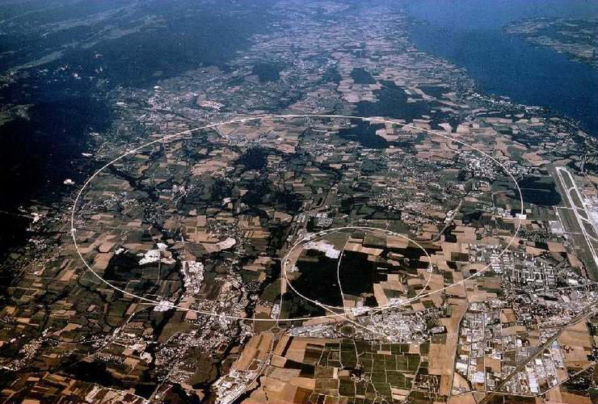
50 PiB/year
primary data

Slide 18
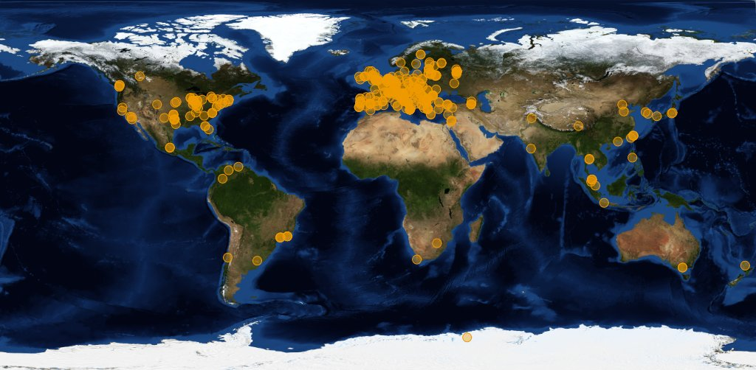




Image source: joint CERN (wLCG) and EGI
Organisations participating in the global collaboration of e-Infrastructures
Even just for wLCG, supporting the CERN LHC programme
More than 200 independent institutes with end-users
More than 50 countries & regions
More than 300 service centres
One independent ‘policy-bridge’ identity service
Handful regional ‘service coordination organisations’
500 000 CPU cores, 200+PByte storage

Slide 19
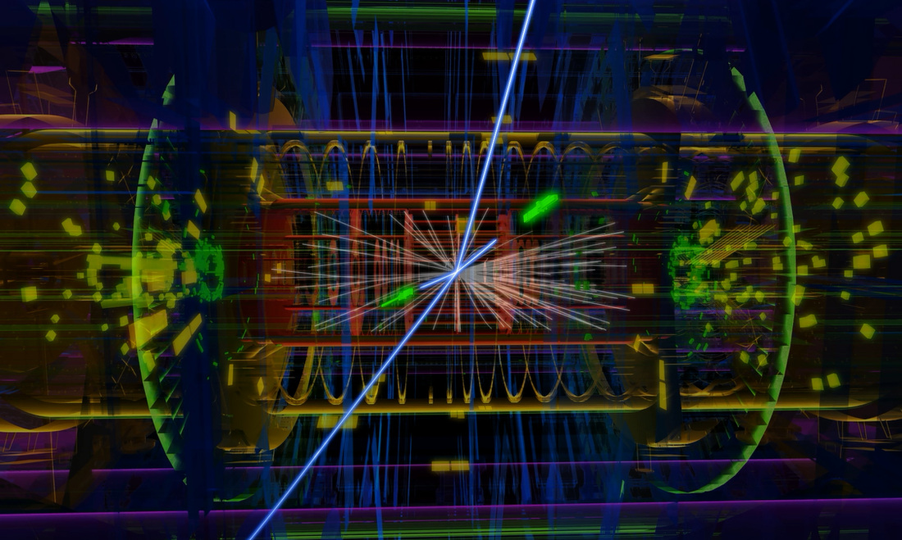
Atlas: ~50 TByte/day raw data to tape; 1000 TByte/day processed data transfers
Image source: CERN, Atlas

Slide 20
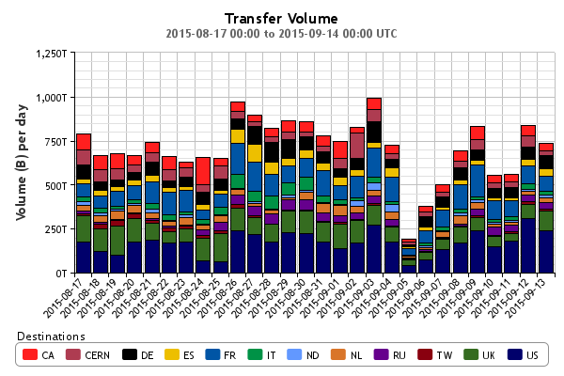
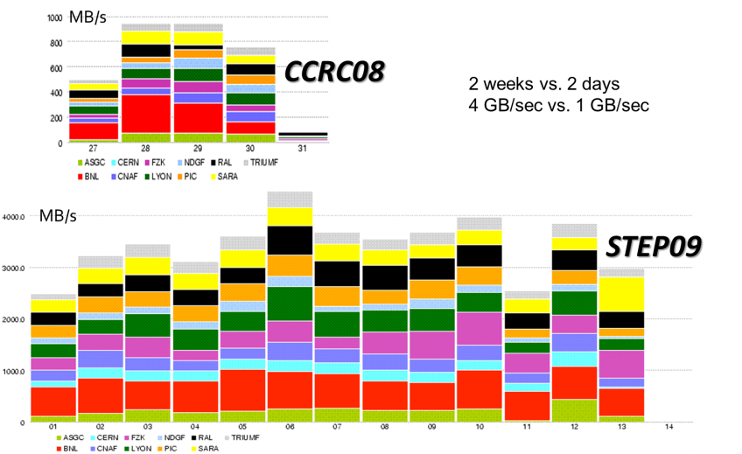
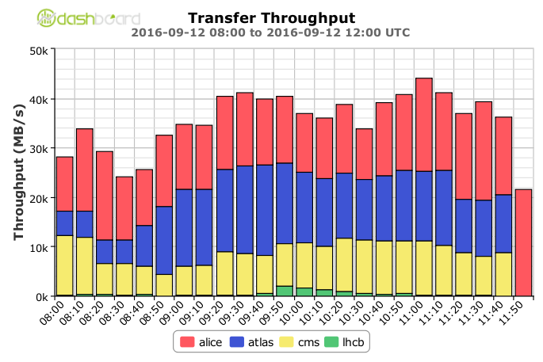
From SC04, CCRC08, STEP09, .. to today …
Global transfer rates now > 40 GB/s –
acquisition:10 PB/mo (~x2 derived data)
STEP09 : Jamie Shiers, CERN IT/GS; Throughput 2016: WLCG Workshop 2016, Ian Bird, CERN

Slide 21
… and tomorrow ?!
Data:
Raw 2016: 50 PB → 2027: 600 PB
Derived (1 copy): 2016: 80 PB → 2027: 900 PB
CPU:
x60 from 2016
Technology at ~20%/year will bring x6-10 in 10-11 years

Slide 22
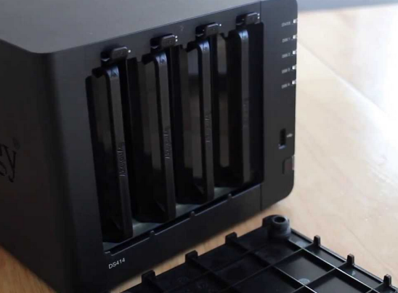
Infrastructure for research: balancing network, CPU, and disk
CPU and disk both expensive, yet idling CPUs are ‘even costlier’
architecture and performance matching averts any single bottleneck
but requires knowledge of application (data flow) behaviour
data pre-placement (local access), mesh data federation (WAN access)
This is why e.g. your USB drive does not cut it
– and neither does your ‘home NAS box’
… however much I like my home system using just
15 Watt idle and offering 16TB for just € 915 …

Slide 23
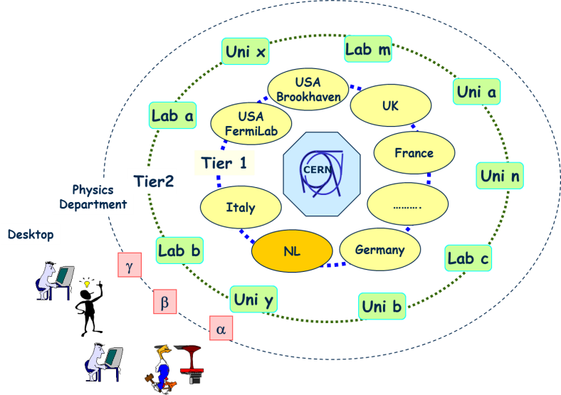
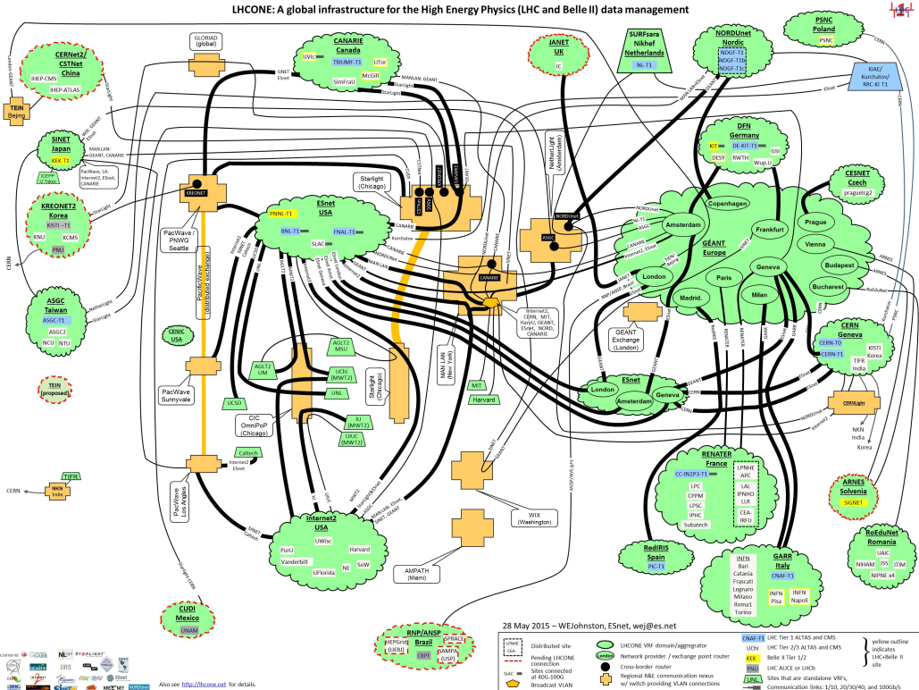
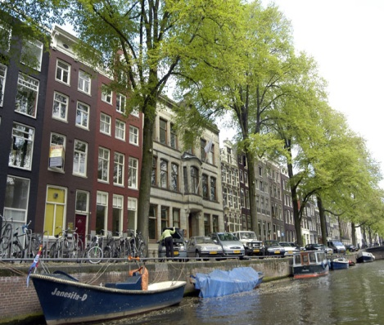
Building the infrastructure for the LHC data
From hierarchical data distribution to
a full mesh and dynamic data placement
Amsterdam/NIKHEF-SARA
LHCOne graphic: lhcone.net

Slide 24
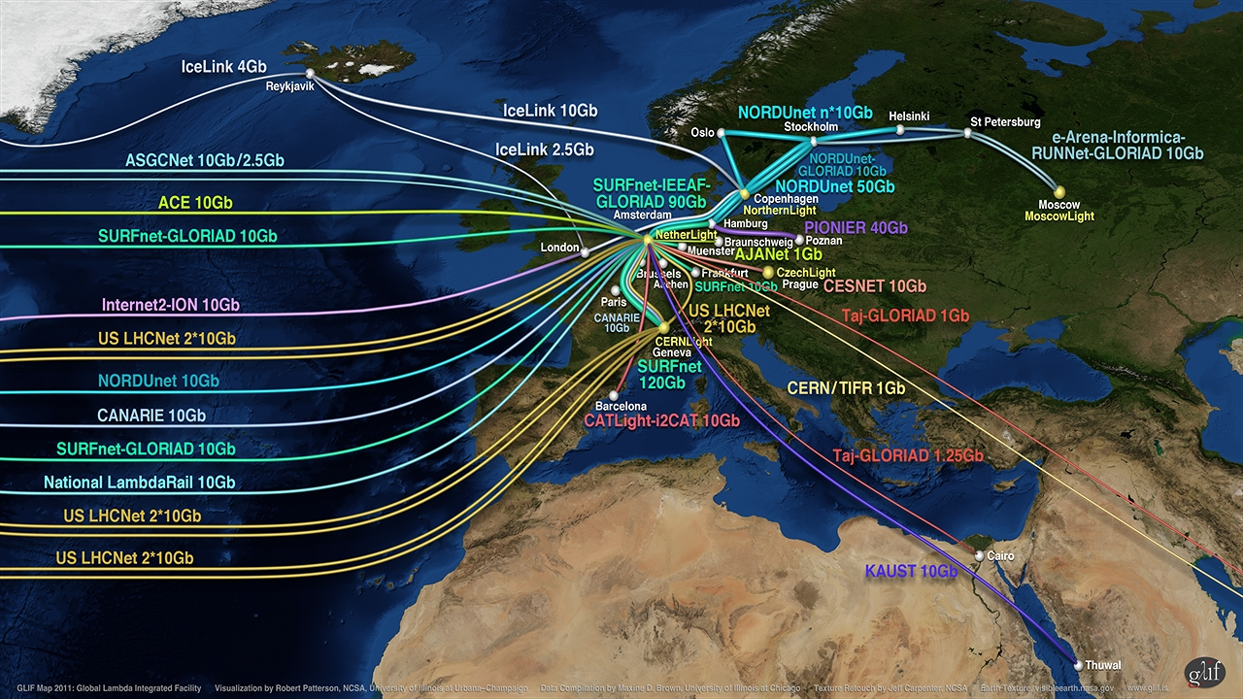
Connecting Science through Lambdas

Slide 25
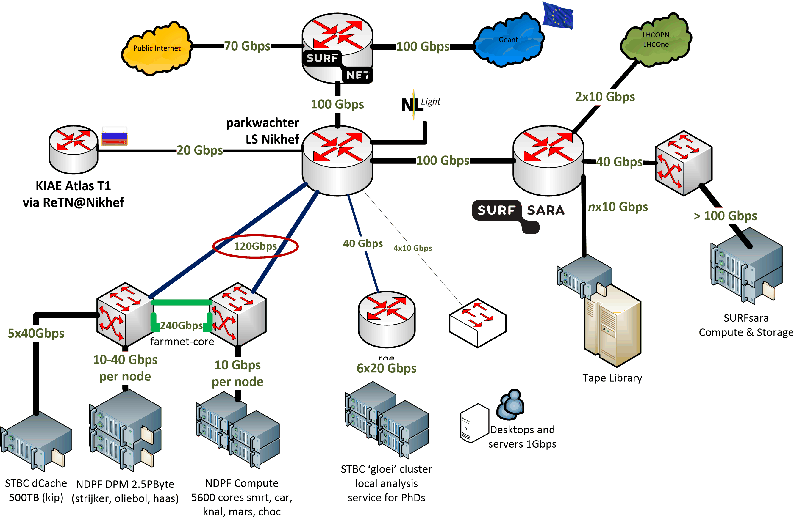
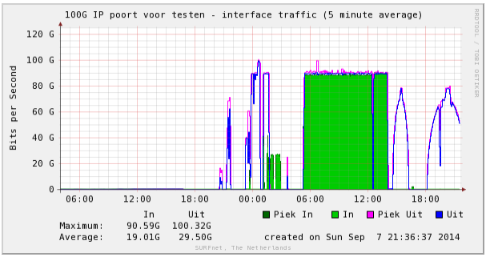
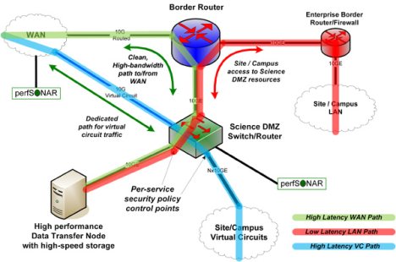
Network built around application data flow
Need to work together!
without our SURFsara peering,
SURFnet gets flooded ☺
and: you really want many of your own peerings

Slide 26

100Gbit
Nikhef → SURFnet → RUG-CIT||UvA
100Gbit testen met UvA
1e onderzoeksinstituut op Surfnet
NIKHEF-SARA koppeling
T Suerink
Nikhef
Amsterdam
PDP & Grid
slides courtesy Tristan Suerink
26

Slide 27
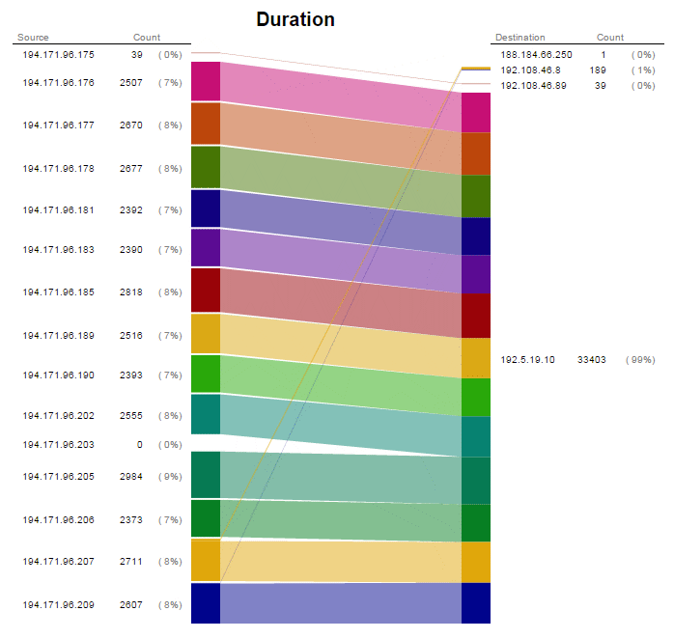
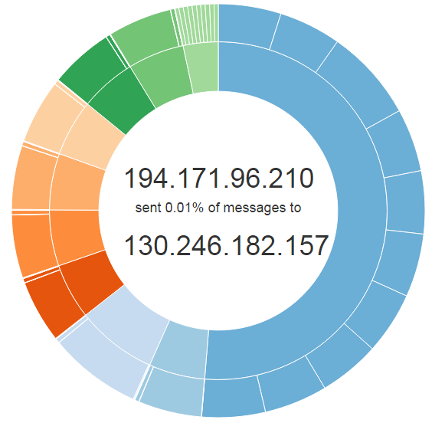
Data flows: a user at UC Irvine
reading a data set from Nikhef,
with some background from CERN
and KIT Karlsruhe
Graphics courtesy Jouke Roorda and Olivier Verbeek

Slide 28


Getting more bytes through?
Power vs x64: more PCI lanes & higher clock should
give more throughput – if all the bits fit together
Only way to find out is … by trying it!
joint experiment with Nikhef and SURFsara
on comparing IO throughput between x86 & P8
yet more is needed
HGST: 480 TByte gross capacity/4RU
RAID card are now a performance bottleneck
JBOD changes CPU-disk ratio
closer integration of networking to get >100Gbps

Slide 29


Matching systems architecture
Most applications using x86 today, and probably will for a long time
alternatives (GPGPU or Power) not quite viable
… although for ‘dedicated farms’ FPGAs help,
and KNH works better (we need the memory)
sales volume of different architectures
Yet change must be:
most gain to be had from SIMD vectorization and improved memory access patterns
C. Bozzi, INFN and LHCb
Helge Meinhard, Bernd Panzer-Steindel, Technology Evolution, https://indico.cern.ch/event/555063/contributions/2285842/

Slide 30


Improvements at the application layer
‘traditional’ (1990’s) style HEP applications were ‘lean’, and fail to scale even in pipelining
let alone vector instructions or multicore
2012
review of algorithms gave overall +34% in LHCb – memory layout still to be done …
To use current processor generations, you need better – machine-aware! – code
2007 Core 2 efficientcy: Sverre Jarp, CHEP2007
Performance data: M Schiller (CERN) et al. for LHCb, - profiling progress (update) 2015;; work by: Gerhard Raven, Nikhef

Slide 31

Systems architecture and your application
Many things you only find in production …
When you’re ‘embarrassingly parallel’ with a memory challenge
why not try ‘priming’ of memory for the first few events and then fork?
Towards single-socket systems: cache coherence limits performance
– there’s a penalty to pay for massive multi-socket-big-memory hosts!
Graphic: P van Gemmeren et al. ATLAS collaboration, ATL-SOFT-PROC-2015-020

Slide 32
Systems for Research @ Nikhef

Slide 33
Statistics
Dutch National e-Infrastructure coordinated by
“BiG Grid” HTC and storage platform services
3 core operational sites: SURFsara, Nikhef, RUG-CIT
25+ PiB tape, 10+ PiB disk, 12000+ CPU cores
@Nikhef
~ 5500 cores and 3.5 PiB
focus on large/many-core systems
> 45 install flavours (service types)
and a bunch of one-off systems

Slide 34


Shared infrastructure, efficient infrastructure!
>98% utilisation, >90% efficiency
NL: WeNMR
EGI biomedical
LIGO/Virgo gravitational waves
LHC Alice
LHC Atlas
LHCb
Right:: NIKHEF-ELPROD facility, Friday, Dec 9th, 2016
Left: annual usage distribution 2013-2014

Slide 35











Federation of high-throughput services
wLCG FIM4R pilot

Slide 36


‘cloud’ is a means, not an end-all solution …
/cvmfs/softdrive.nl
E. Tejedor et al., CERN, SWAN Service for Web-based Analtsis, CHEP2016
Dario.Berzano@cern.ch - CHEP 2016 - Experiences with the ALICE Mesos infrastructure
Collaborative advantage:
joint effort of infrastructure and users
http://doc.grid.surfsara.nl/en/latest/Pages/Advanced/grid_software.html#softdrive

Slide 37

For (informed) fun & testing – some random one-off systems …
CO2-cooled Intel CPUs @6.2GHz

Slide 38

For (informed) fun & testing – some random one-off systems …
plofkip.nikhef.nl

Slide 39

Fun, but not the solution to single-core performance …
Collaboration of Intel™ and Nikhef PDP & MT (Krista de Roo) “CO2 Inside”

