Slide 1
Computing for Research & the Worldwide LHC Computing Grid
Building a global large-scale
ICT infrastructure
for research data processing
David Groep
DACS & Nikhef
8 November 2022

Slide 2
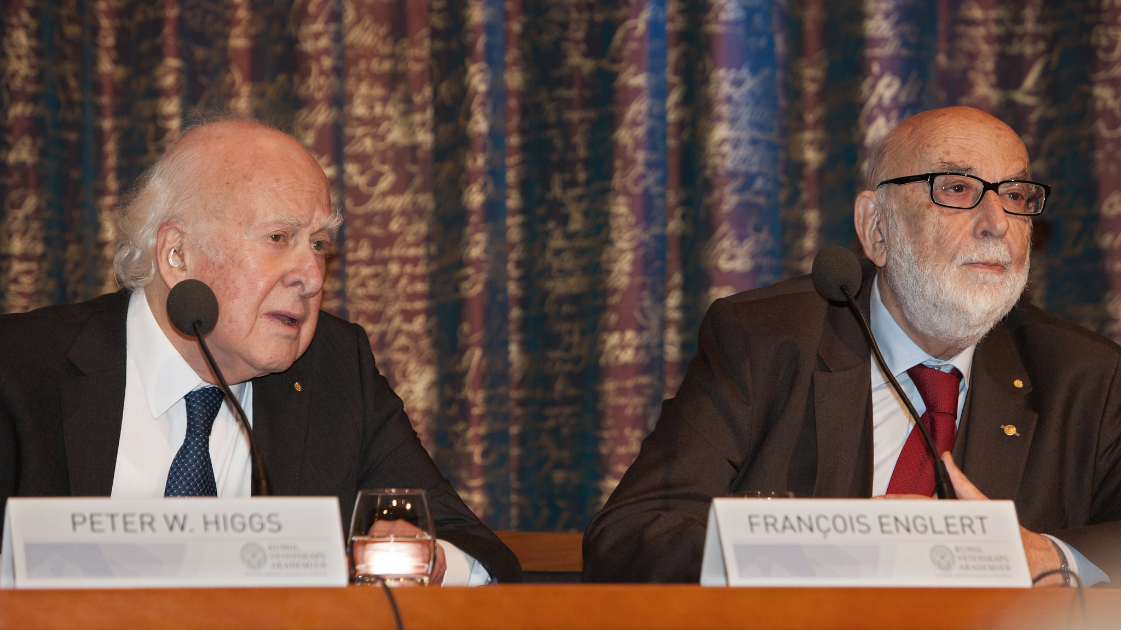

Peter Higgs and Francois Englert at the 2013 Nobel prize press conference, Stockholm. Photo: Bengt Nyman, https://www.flickr.com/photos/97469566@N00

Slide 3
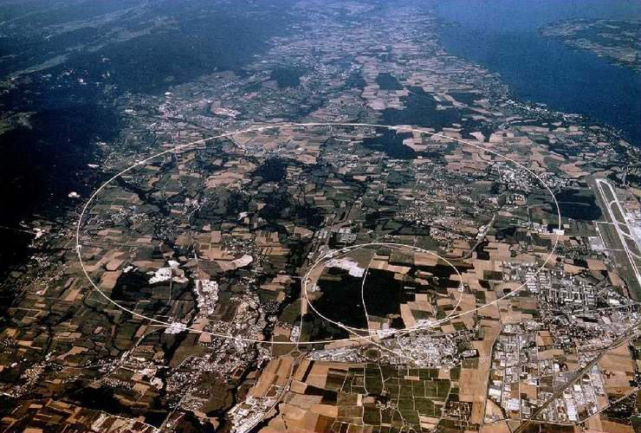
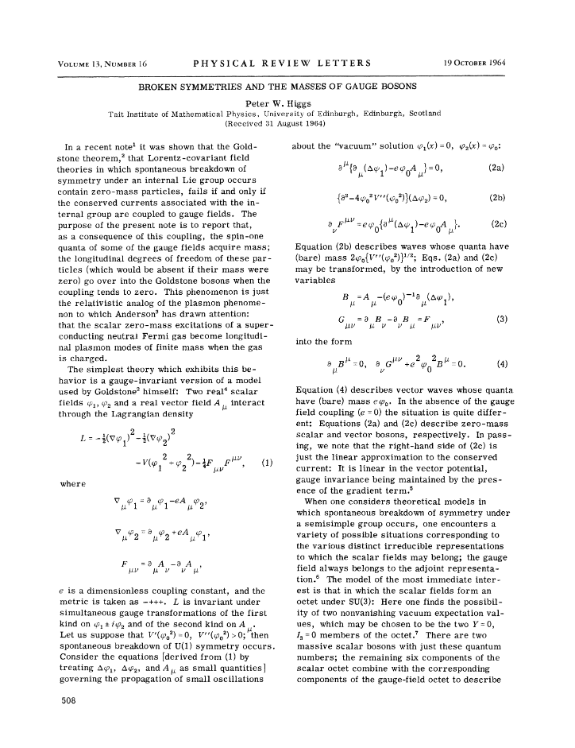
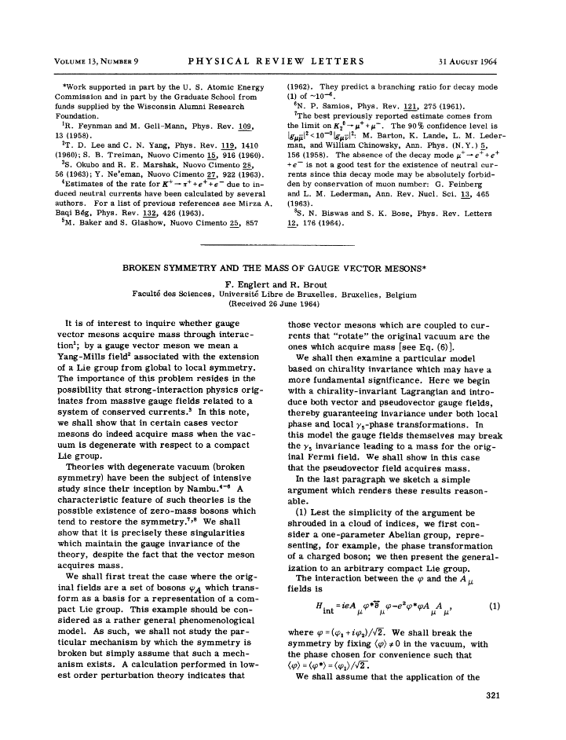
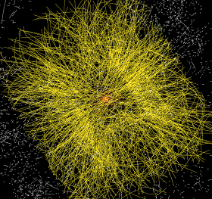
A ‘big science’ facility: the Large Hadron Collider at CERN
1964
1998 - 2012 … 2035+
50 PiB/year
primary data
Broken Symmetries and the
Masses of Gauge Bosons
P. Higgs, Phys. Rev. Lett. 13, 508
F. Englert, R. Brout, Phys. Rev. Lett. 13, 321
the LHC obviously looks for a lot more than just the Higgs mechanism. For example Alice looks at the Quark Gluon Plasma, LHCb for CP violation and the matter surplus (and lot more), and ATLAS and CMS look at almost anything. And all look at new BSM physics of course …

Slide 4

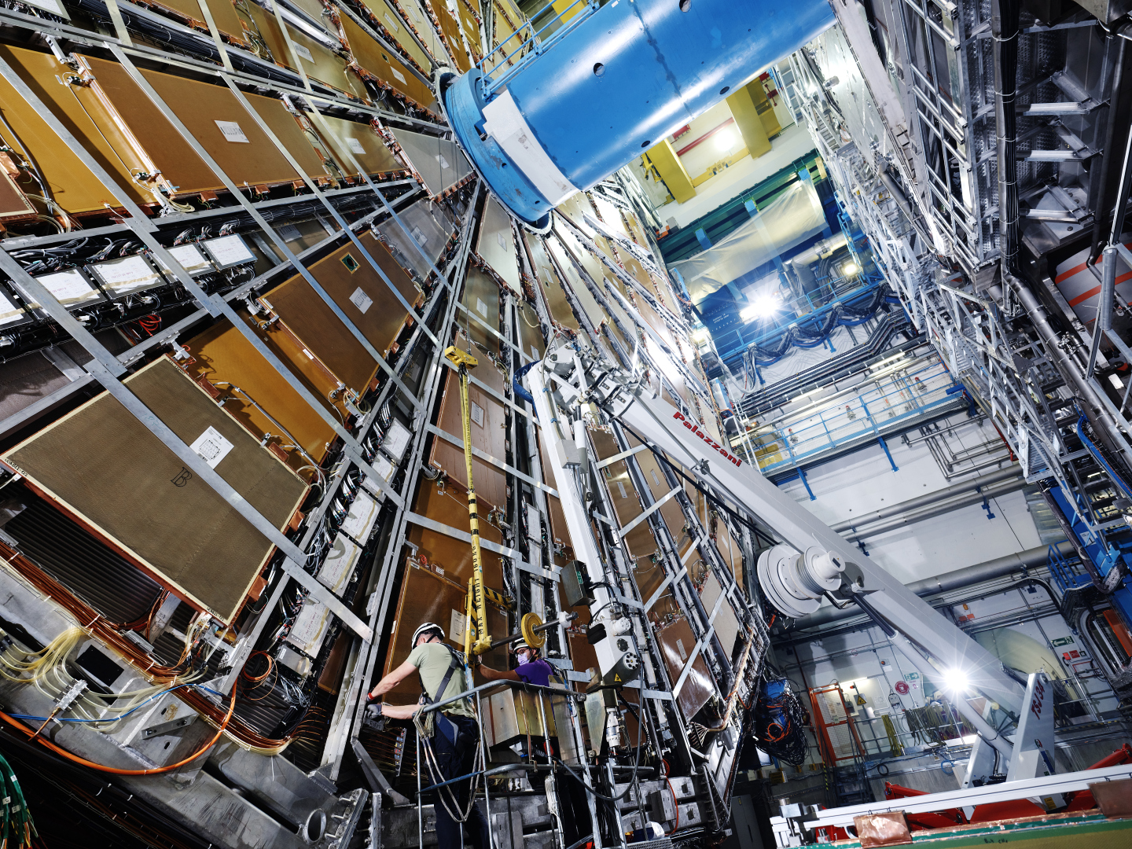
Images: ATLAS detector in the cavern at CERN. Source: CERN
Images: ATLAS detector in the cavern at CERN. Source: CERN

Slide 5
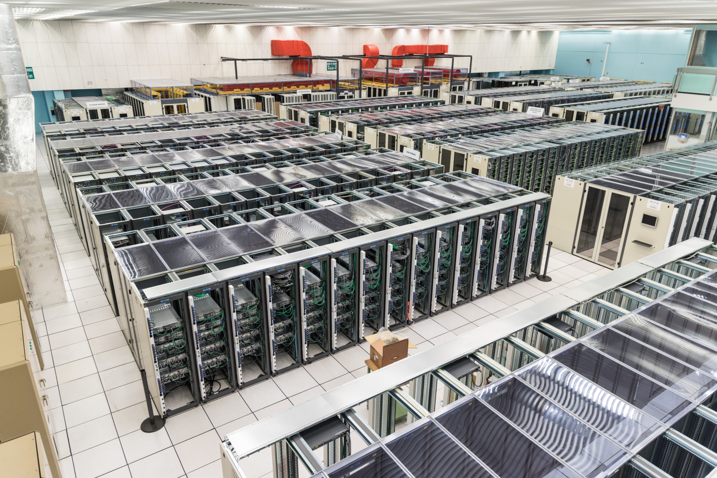
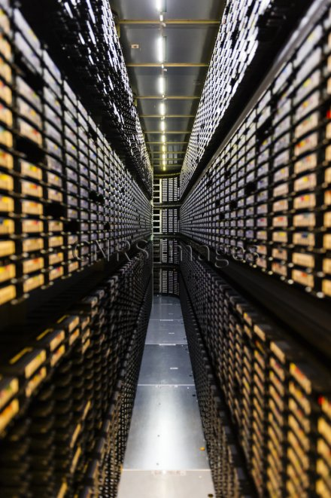
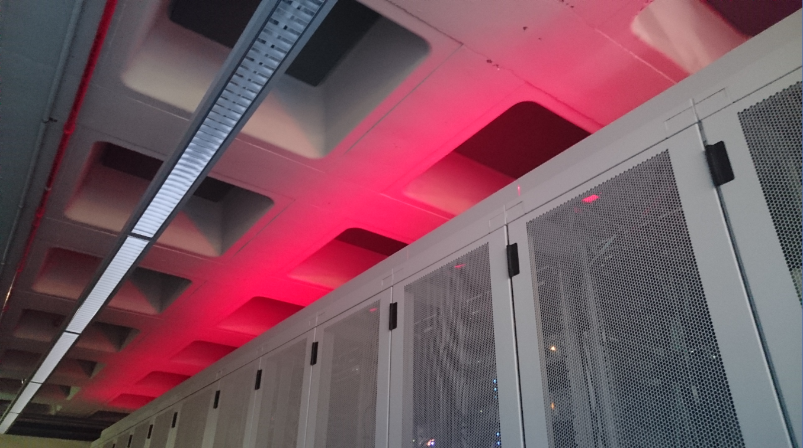
‘Big Science’ needs some computing …
CERN Computing Centre B513, image: CERN, https://cds.cern.ch/record/2127440; tape library image CC-IN2P3 with LHC and LSST data; cabinets: Nikhef H234b

Slide 6
Our journey today … building ‘scalable’ infrastructure for the LHC computing, storage, networking and a global AAI … if we make it to the end
Using science use cases from CERN’s Large Hadron Collider, the SKA radio telescope,
Gravitational Wave detection, structural biochemistry (WeNMR) …
Data intensive workflows
the end of every faster CPUs, the thermal barrier, and the rise of parallelism
More than one …
High Throughput Computing, herding large quantities of systems, and the cloud
Global distributed computing, scalable storage, and data placement
Linking ‘more than one’ into a common network
Elephants vs. mice: shipping large quantities of data … while keeping cat videos alive
LHC Optical Private Network and the Open Networking Environment LHCone
Networking the people
Authentication and authorization technologies
Federated identity, community management & global trust

Slide 7
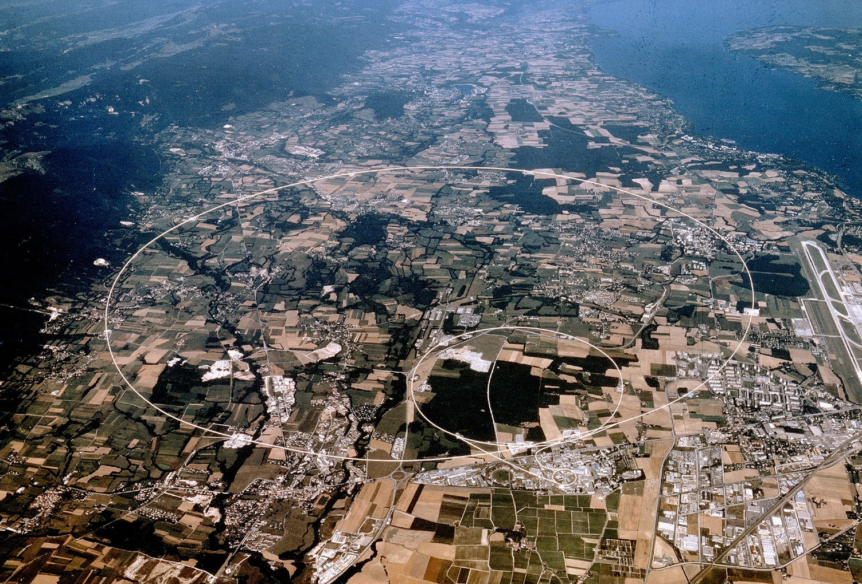

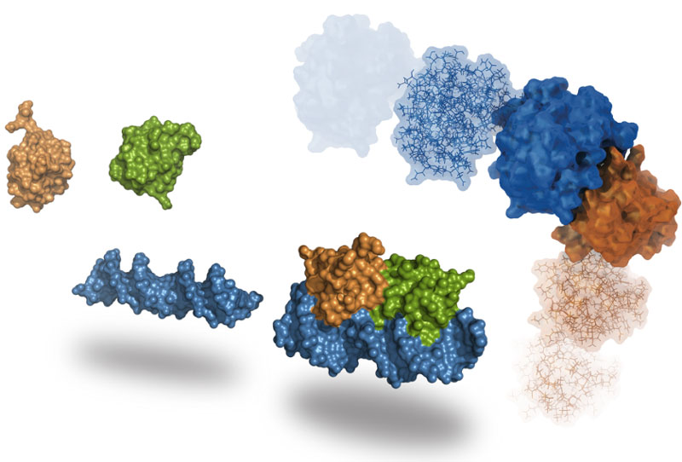
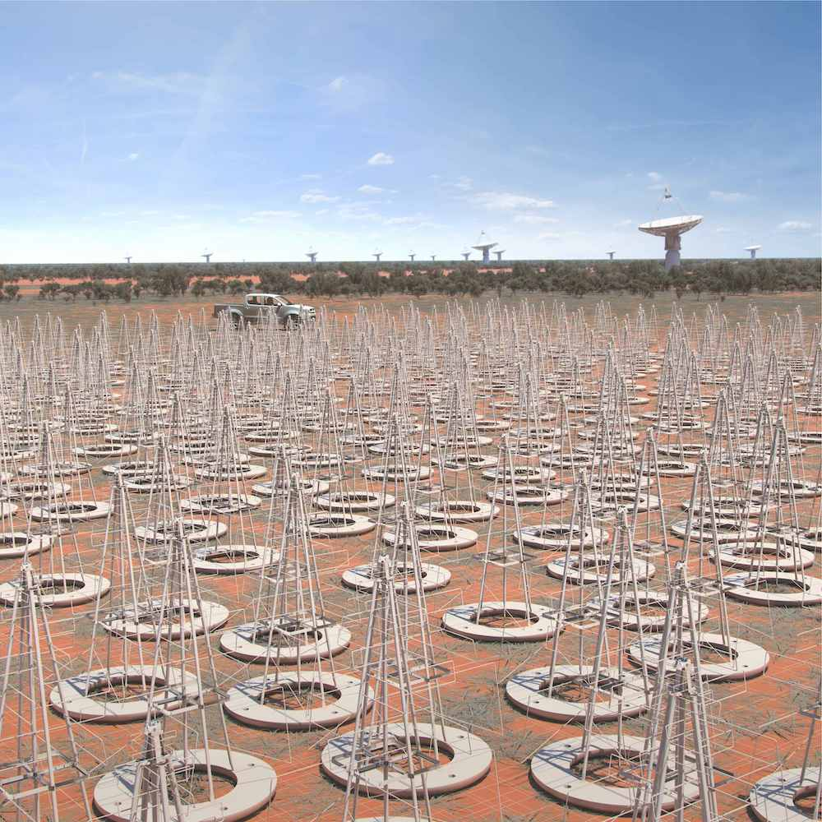



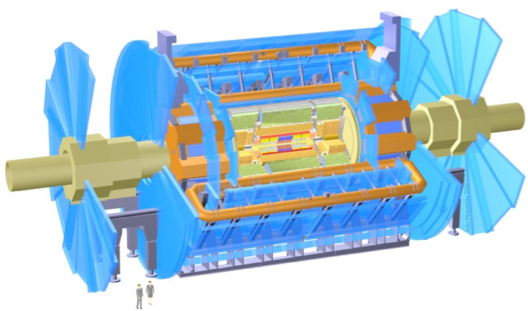

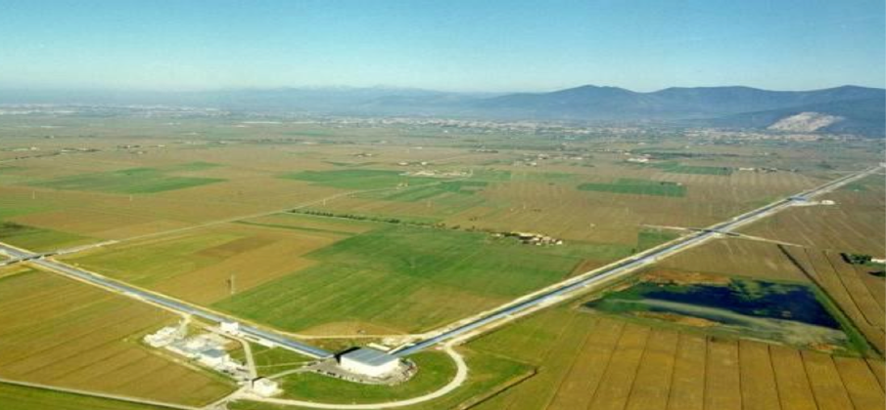
Larger scales for both facilities and computing
WeNMR
SKA-Low (impression, to-be-built in .au)
LHCb
ALICE
ATLAS
Atlas
protons
Gravitational Waves
Haarlemse Chemische Kring
7
Sources: CERN https://wlcg.web.cern.ch/; HADDOCK, WeNMR, @Bonvinlab https://wenmr.science.uu.nl/; Virgo, Pisa, IT; SKAO: the SKA-Low observatory, Australia https://www.skatelescope.org/

Slide 8
Processing at scale for data intensive science
Data from various sources, for
public entities: data ca. 2018,
indicative, within ~ factor 2
LHC volumes: LCG Resource Scrutiny Group & CERN; 2020
SKA and LOFAR volumes: ASTRON/Michiel van Haarlem, 2020

Slide 9
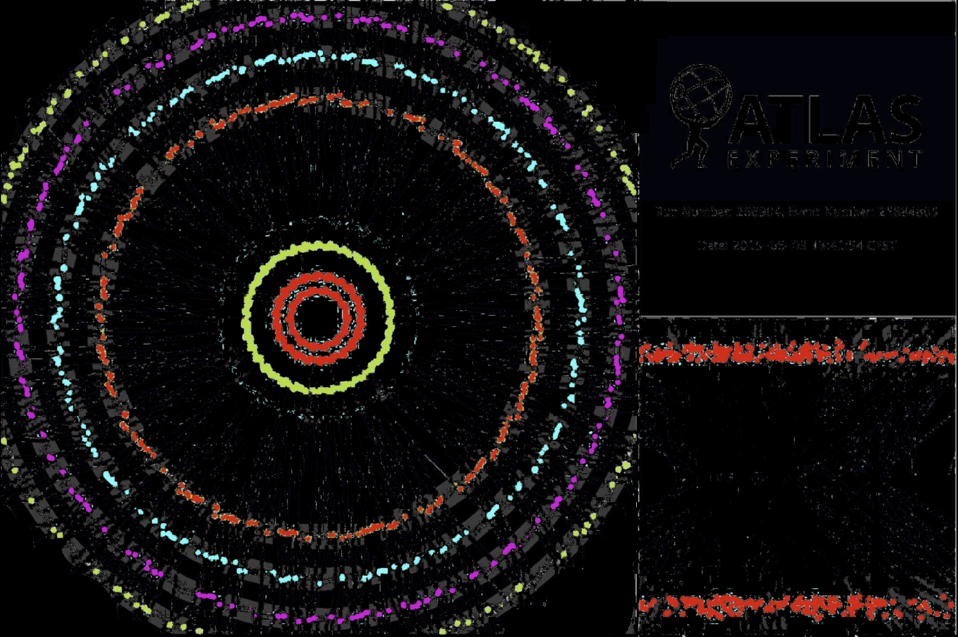
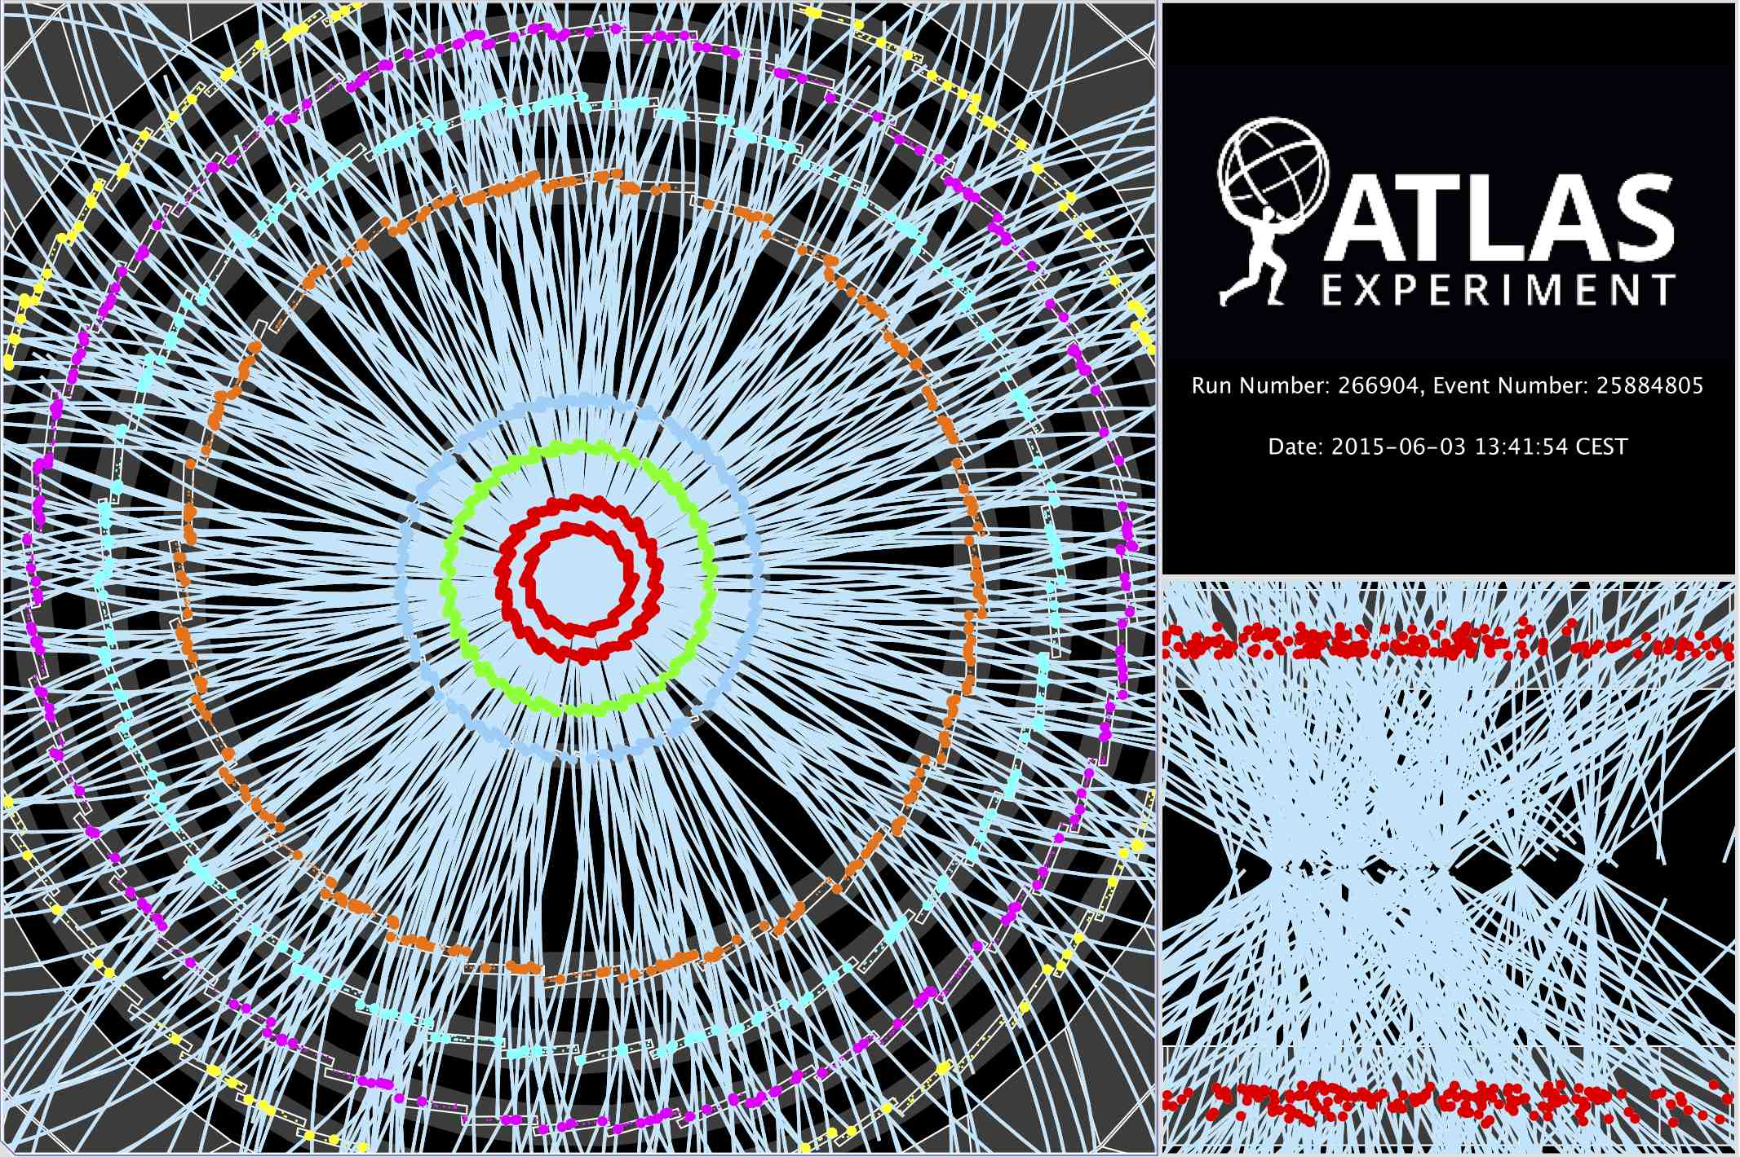

Computing on lots of data – 40Mevents/sec
~ 10 seconds to compute
a single event at ATLAS
for ‘jets’ containing ~30 collisions
Display of a proton-proton collision event recorded by ATLAS on 3 June 2015, with the first LHC stable beams at a collision energy of 13 TeV;
Event processing time: v19.0.1.1 as per Jovan Mitrevski and 2015 J. Phys.: Conf. Ser. 664 072034 (CHEP2015)

Slide 10
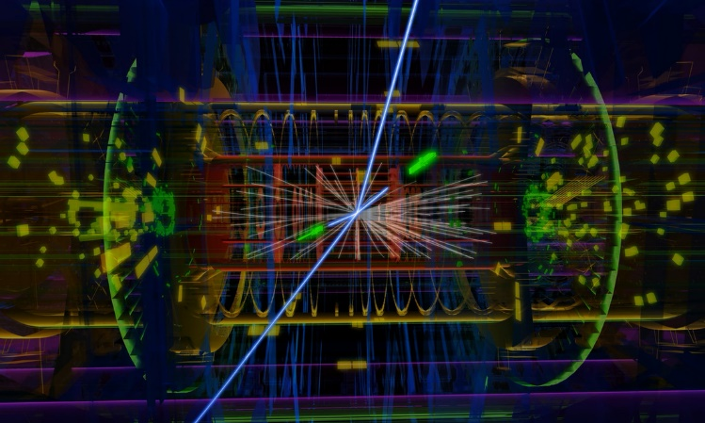
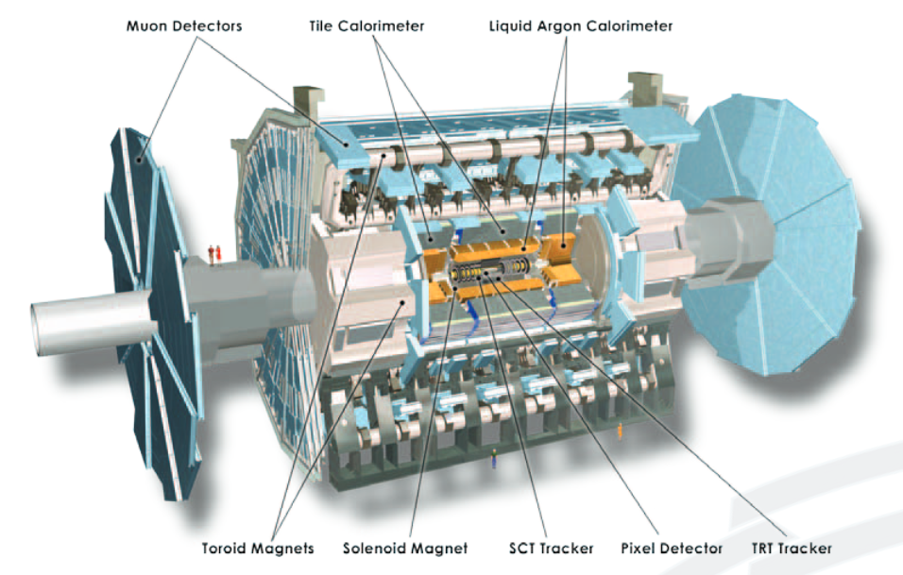
Data size per event, and computing per year
ATLAS_RAW_single_event.data
ROD File
1.60 MB
resource requirement expected
ATLAS detector,
~88 MP
not all sensors fire each time
number of detector elements and raw data size: https://cds.cern.ch/record/1457044/files/ATLAS%20fact%20sheet.pdf; resource planning: ATLAS, from 2019
current CPU performance is approx. 18 HEPSpec/core (e.g. AMD EPYC Rome); 1 modern CPU core (~ AMD Rome) is 18 HS08, so 100 MHS06 = ~5.5 million cores

Slide 11
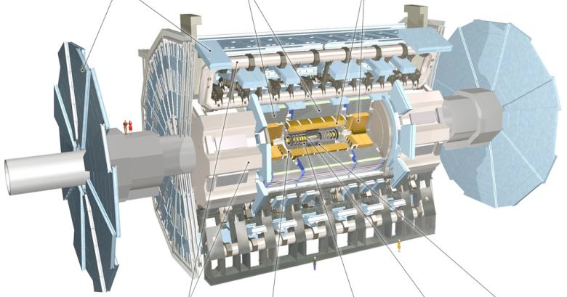

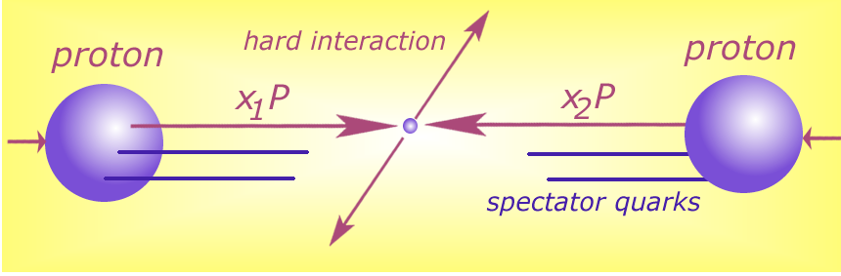

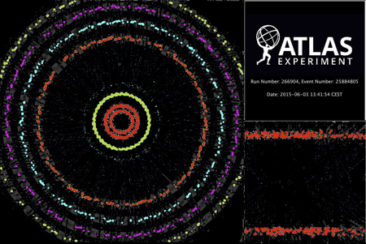


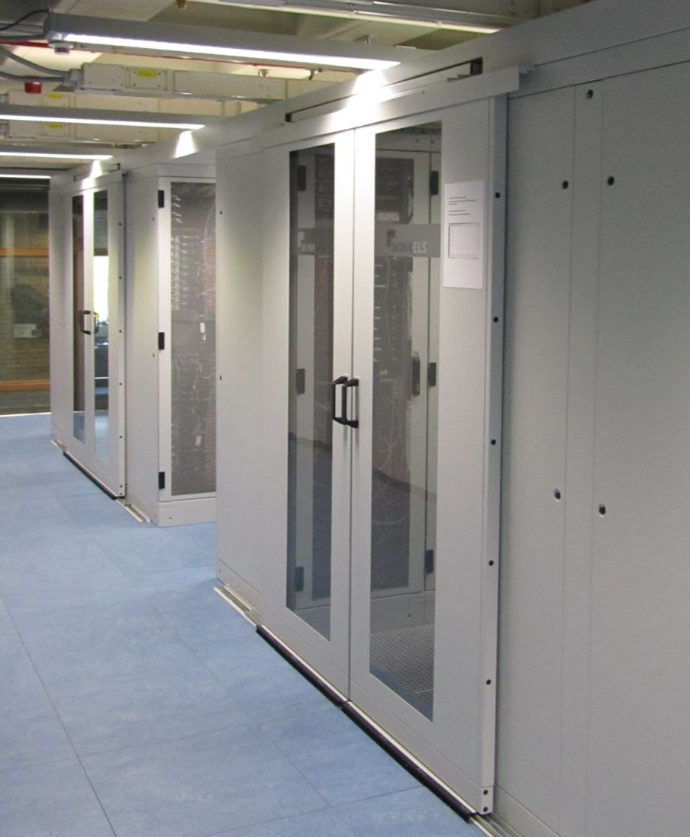





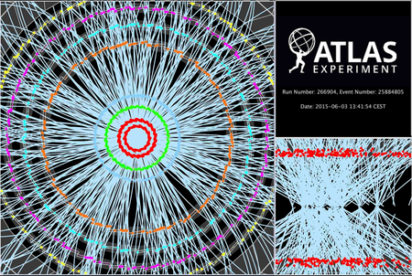

Detector to doctor workflow
40 million collisions / second
Physics analysis by (PhD) students, in papers & analysis notes
Trigger system selects
600 Hz ~ 1 GB/s data
Classify particles in collision and their physics properties:
- electrons
- muons
- jets consisting of hadrons
…
diagram adapted from Frank Linde; images: ATLAS collaboration, Nikhef. … and sorry for the GDPR-blur

Slide 12
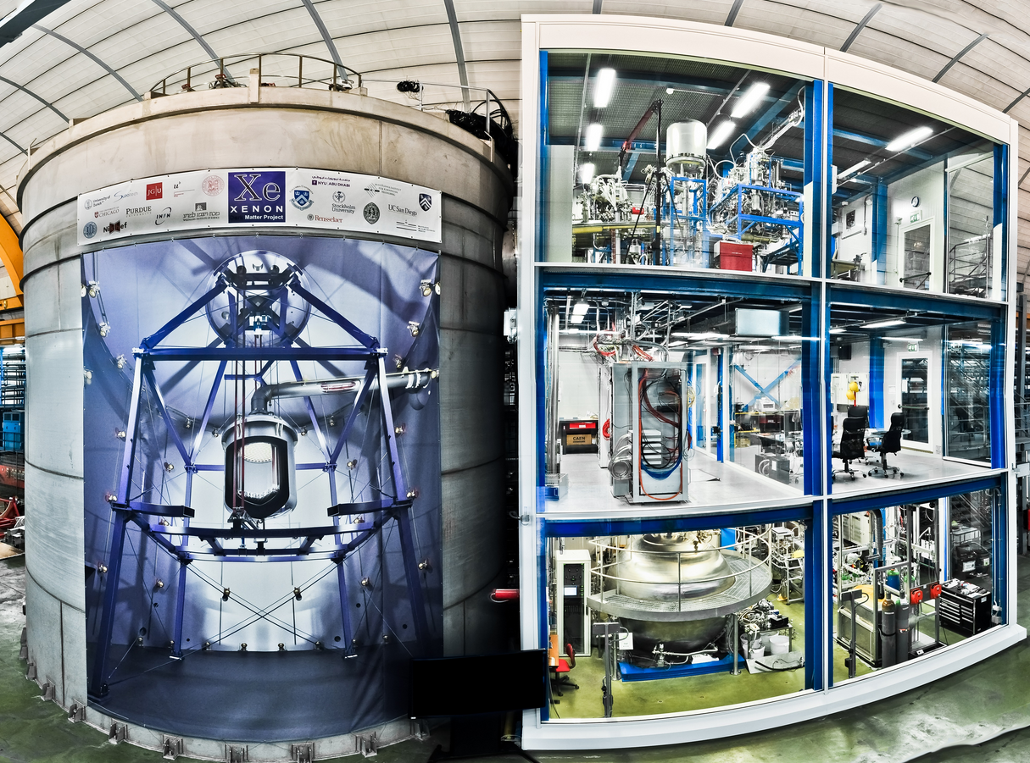
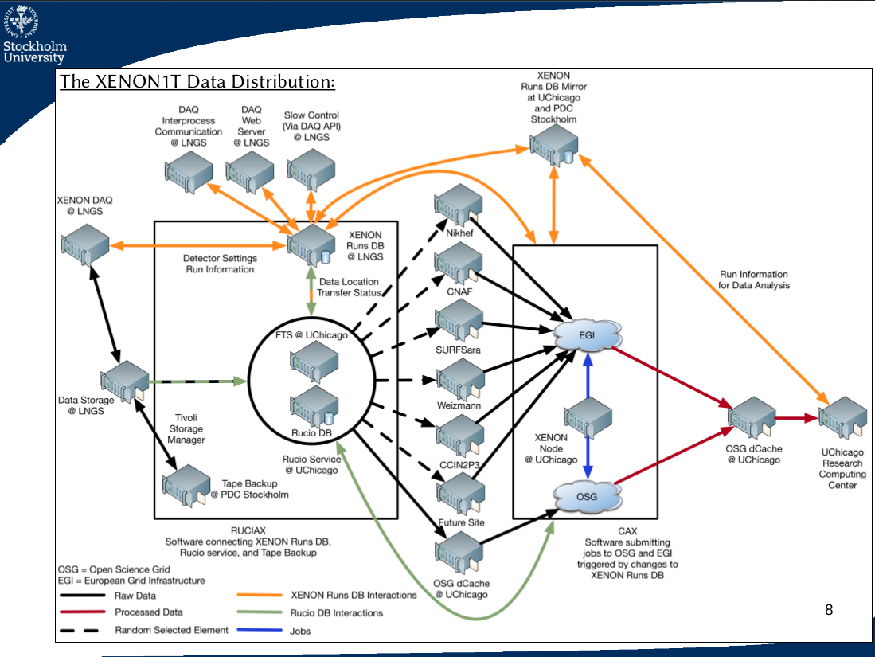
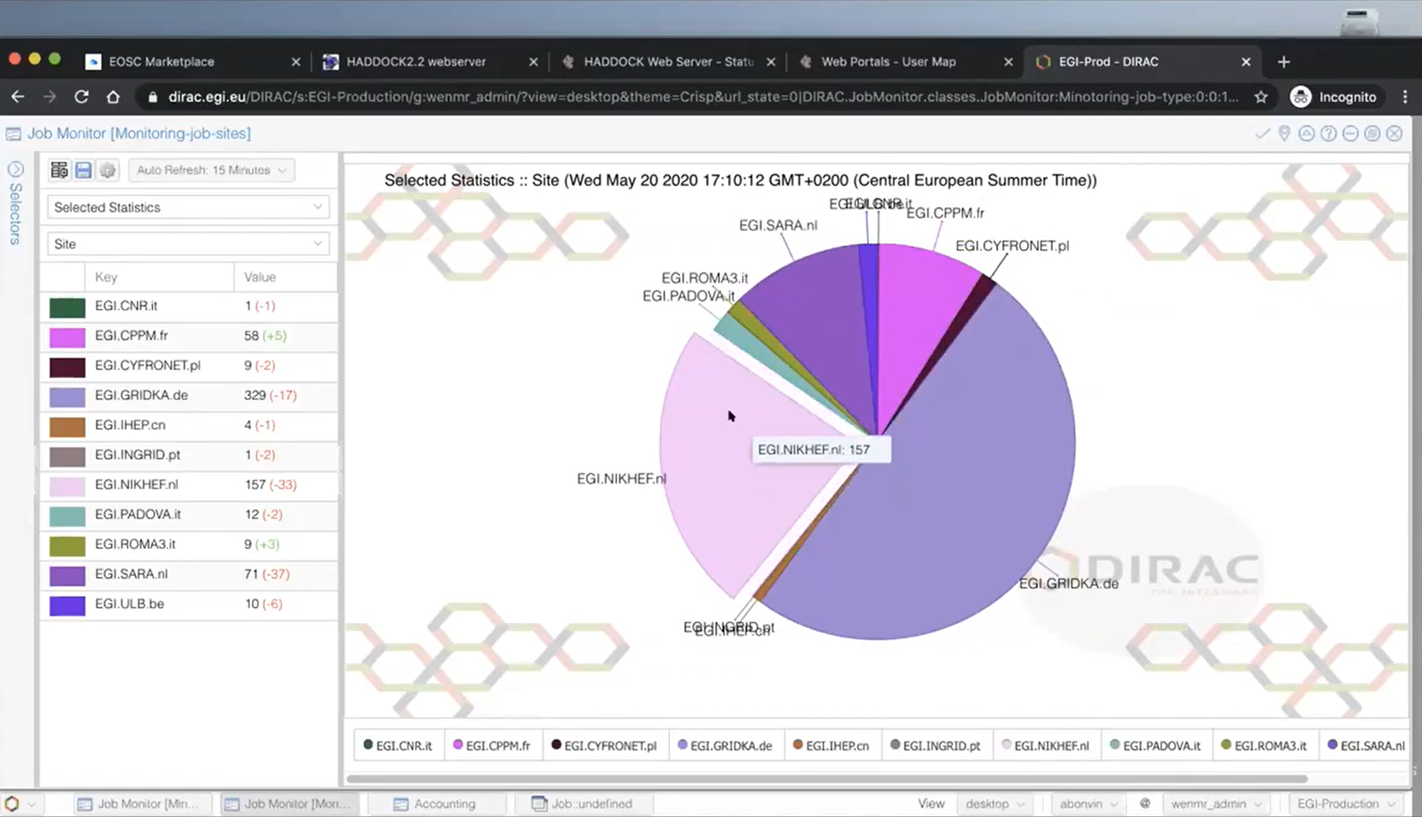
Data processing pipelines
Common pattern: LHC physics, but
also Xenon-nT, WeNMR Haddock,
LOFAR, SKA, …
Xenon: https://www.science.purdue.edu/xenon1t/, photo by Roberto Corrieri and Patrick De Perio; WeNMR: Alexandre Bonvin, UU, https://www.bonvinlab.org/

Slide 13
Different types of large scale resources
HPC and (computational) cluster computing:
  modelling for weather/climate, fluid dynamics, but also e.g. QC-simulation
HTC and data-intensive processing:
  lots of data, as in High Energy Physics (HEP), Gravitational Waves (GW) templates
  conveniently parallel,
  but (intensive) local I/O requirements on memory and scratch storage
portals and many web applications:
‘horizontal’ scaling, possibly backed by cloud and virtualized resources
  Cloud-native scaling and containers for ‘more of the same, different each time’
  If it’s data at scale: object stores and ‘CDN’ web-scale caching
HPC: High Performance Computing; HTC: High Throughput Computing; K8S: Kubernetes; CDN: Content Delivery Network

Slide 14
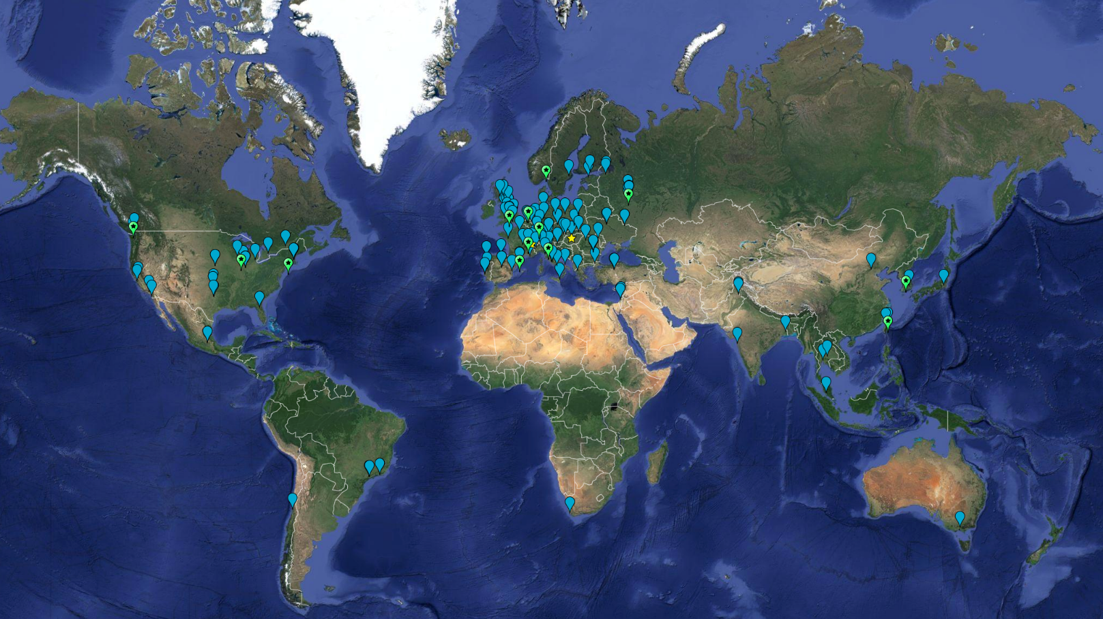
Example: the worldwide LHC Computing Grid
~ 1.4 million CPU cores
~ 1500 Petabyte
disk + archival
170+ institutes
40+ countries
13 ‘Tier-1 sites’
NL-T1:
SURF & Nikhef
e-Infrastructures
EGI
PRACE-RI
EuroHPC
OpenScienceGrid
XSEDE (ACCESS)
Earth background: Google Earth; Data and compute animation: STFC RAL for WLCG and EGI.eu; Data: https://home.cern/science/computing/grid
For the LHC Computing Grid: wlcg.web.cern.ch, for EGI: www.egi.eu; ACCESS (XSEDE): https://access-ci.org/, for the NL-T1 and FuSE: fuse-infra.nl, https://www.surf.nl/en/research-it

Slide 15

Global distribution of computing and data placement
WLCG and EGI Advanced Computing for Research

Slide 16
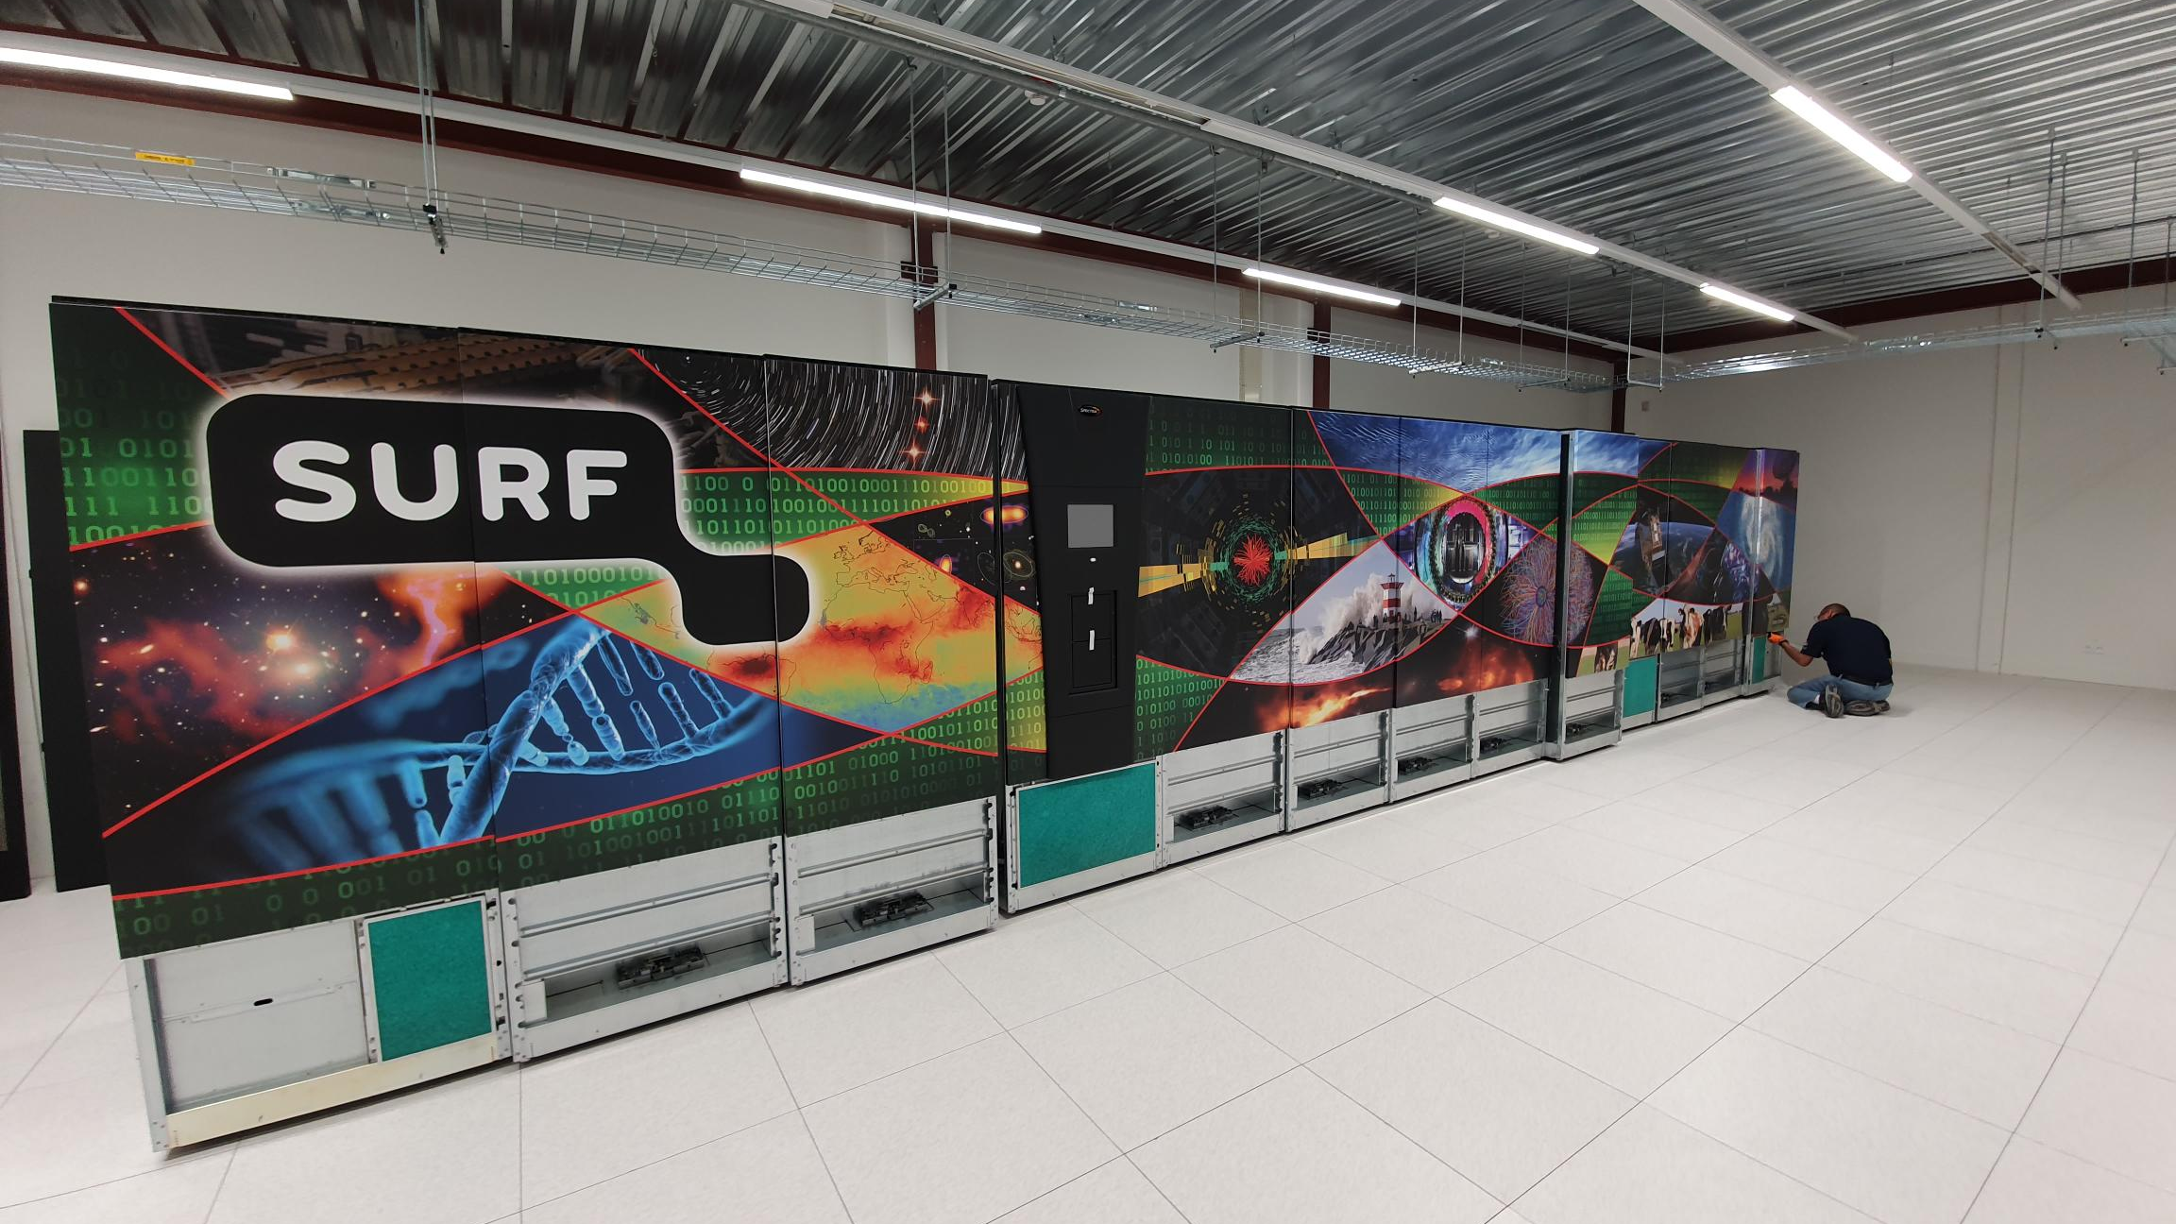
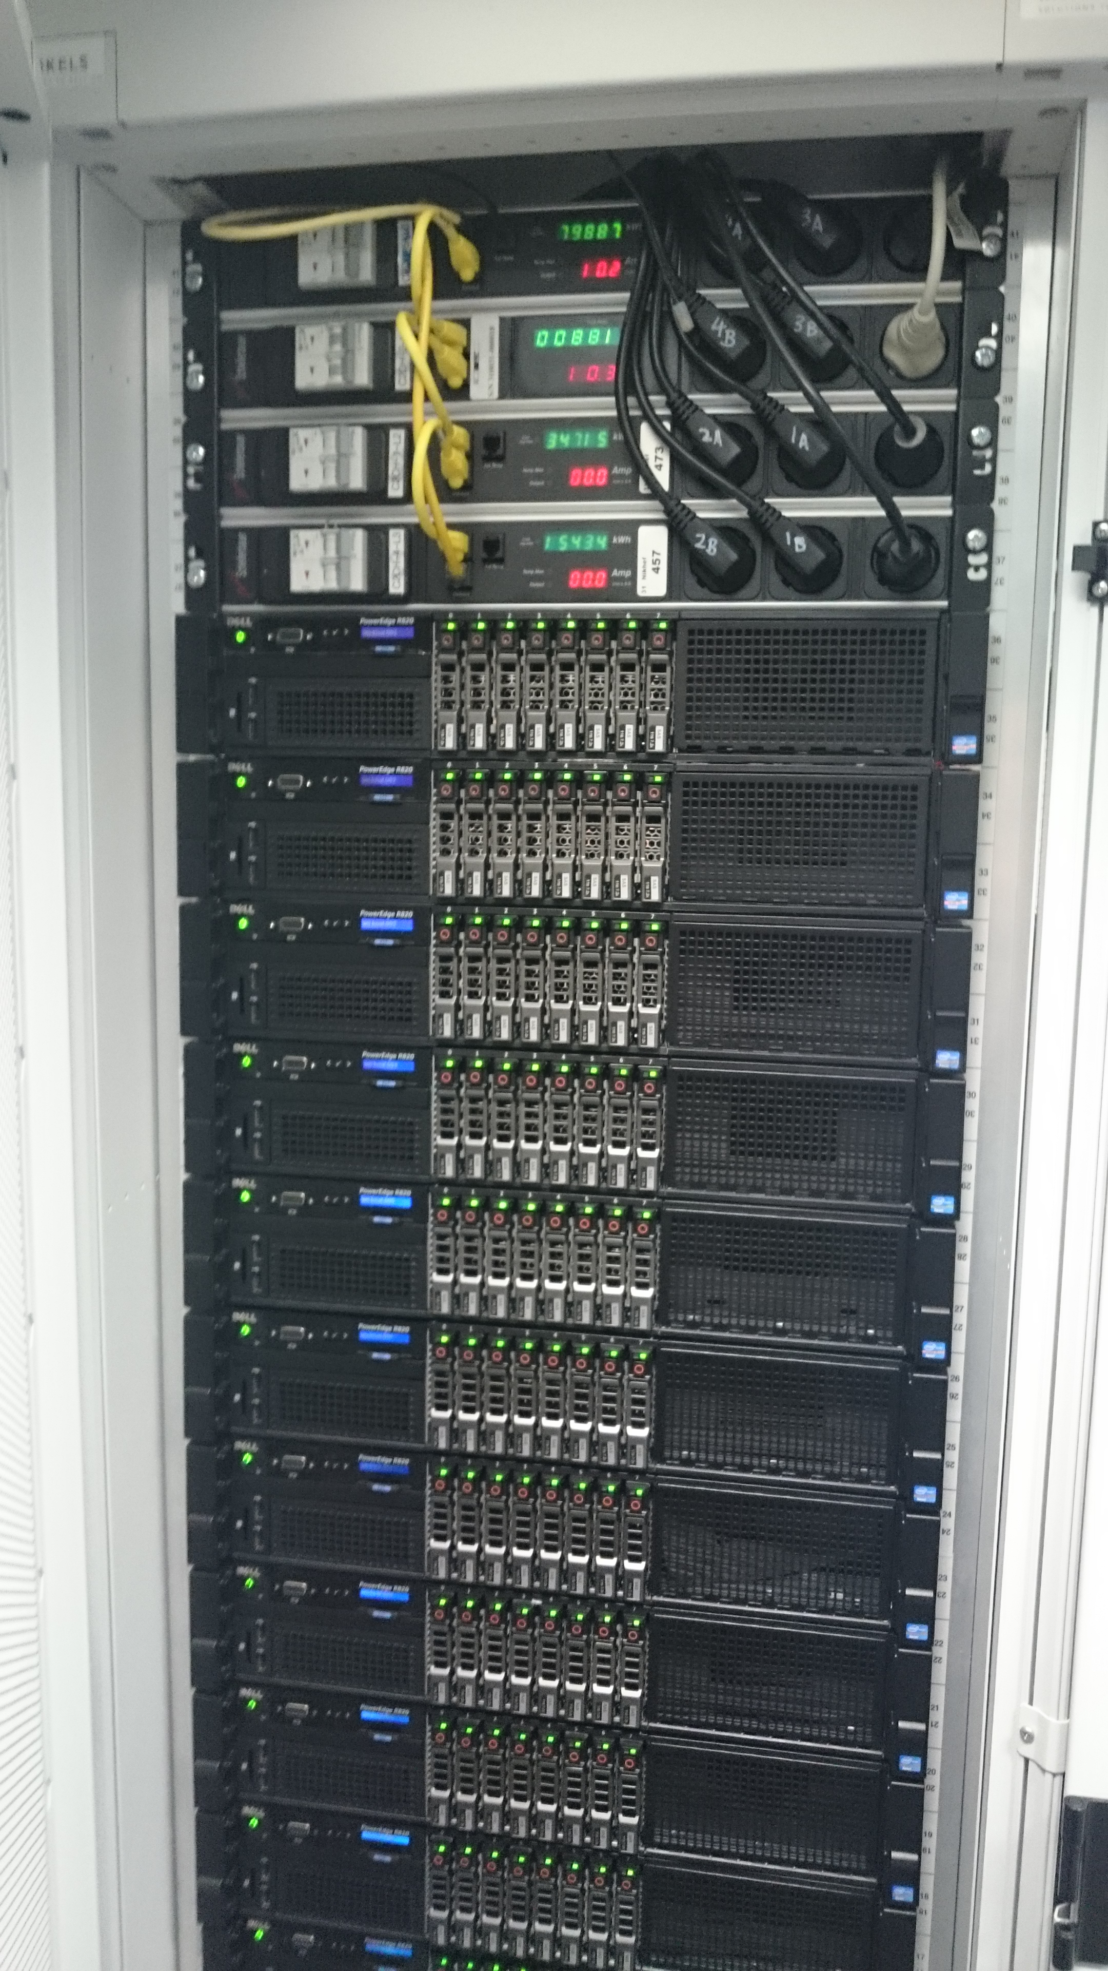
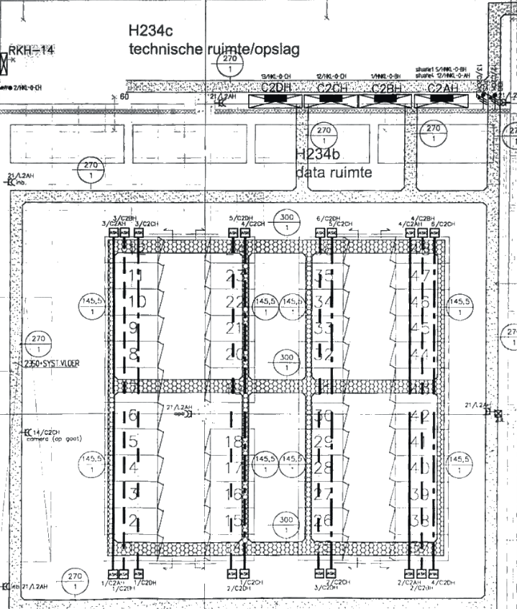
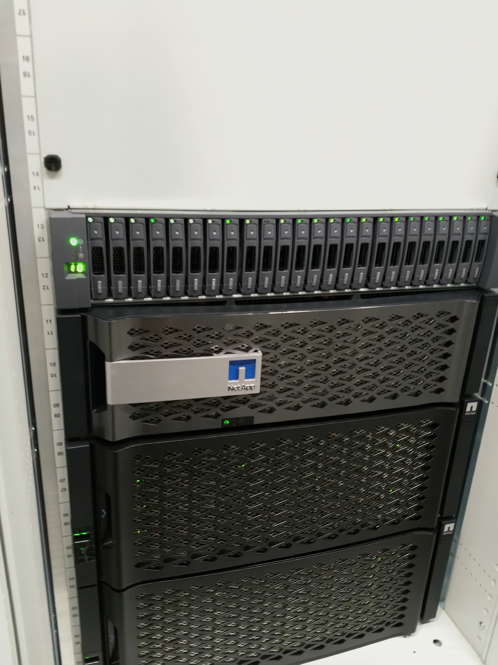
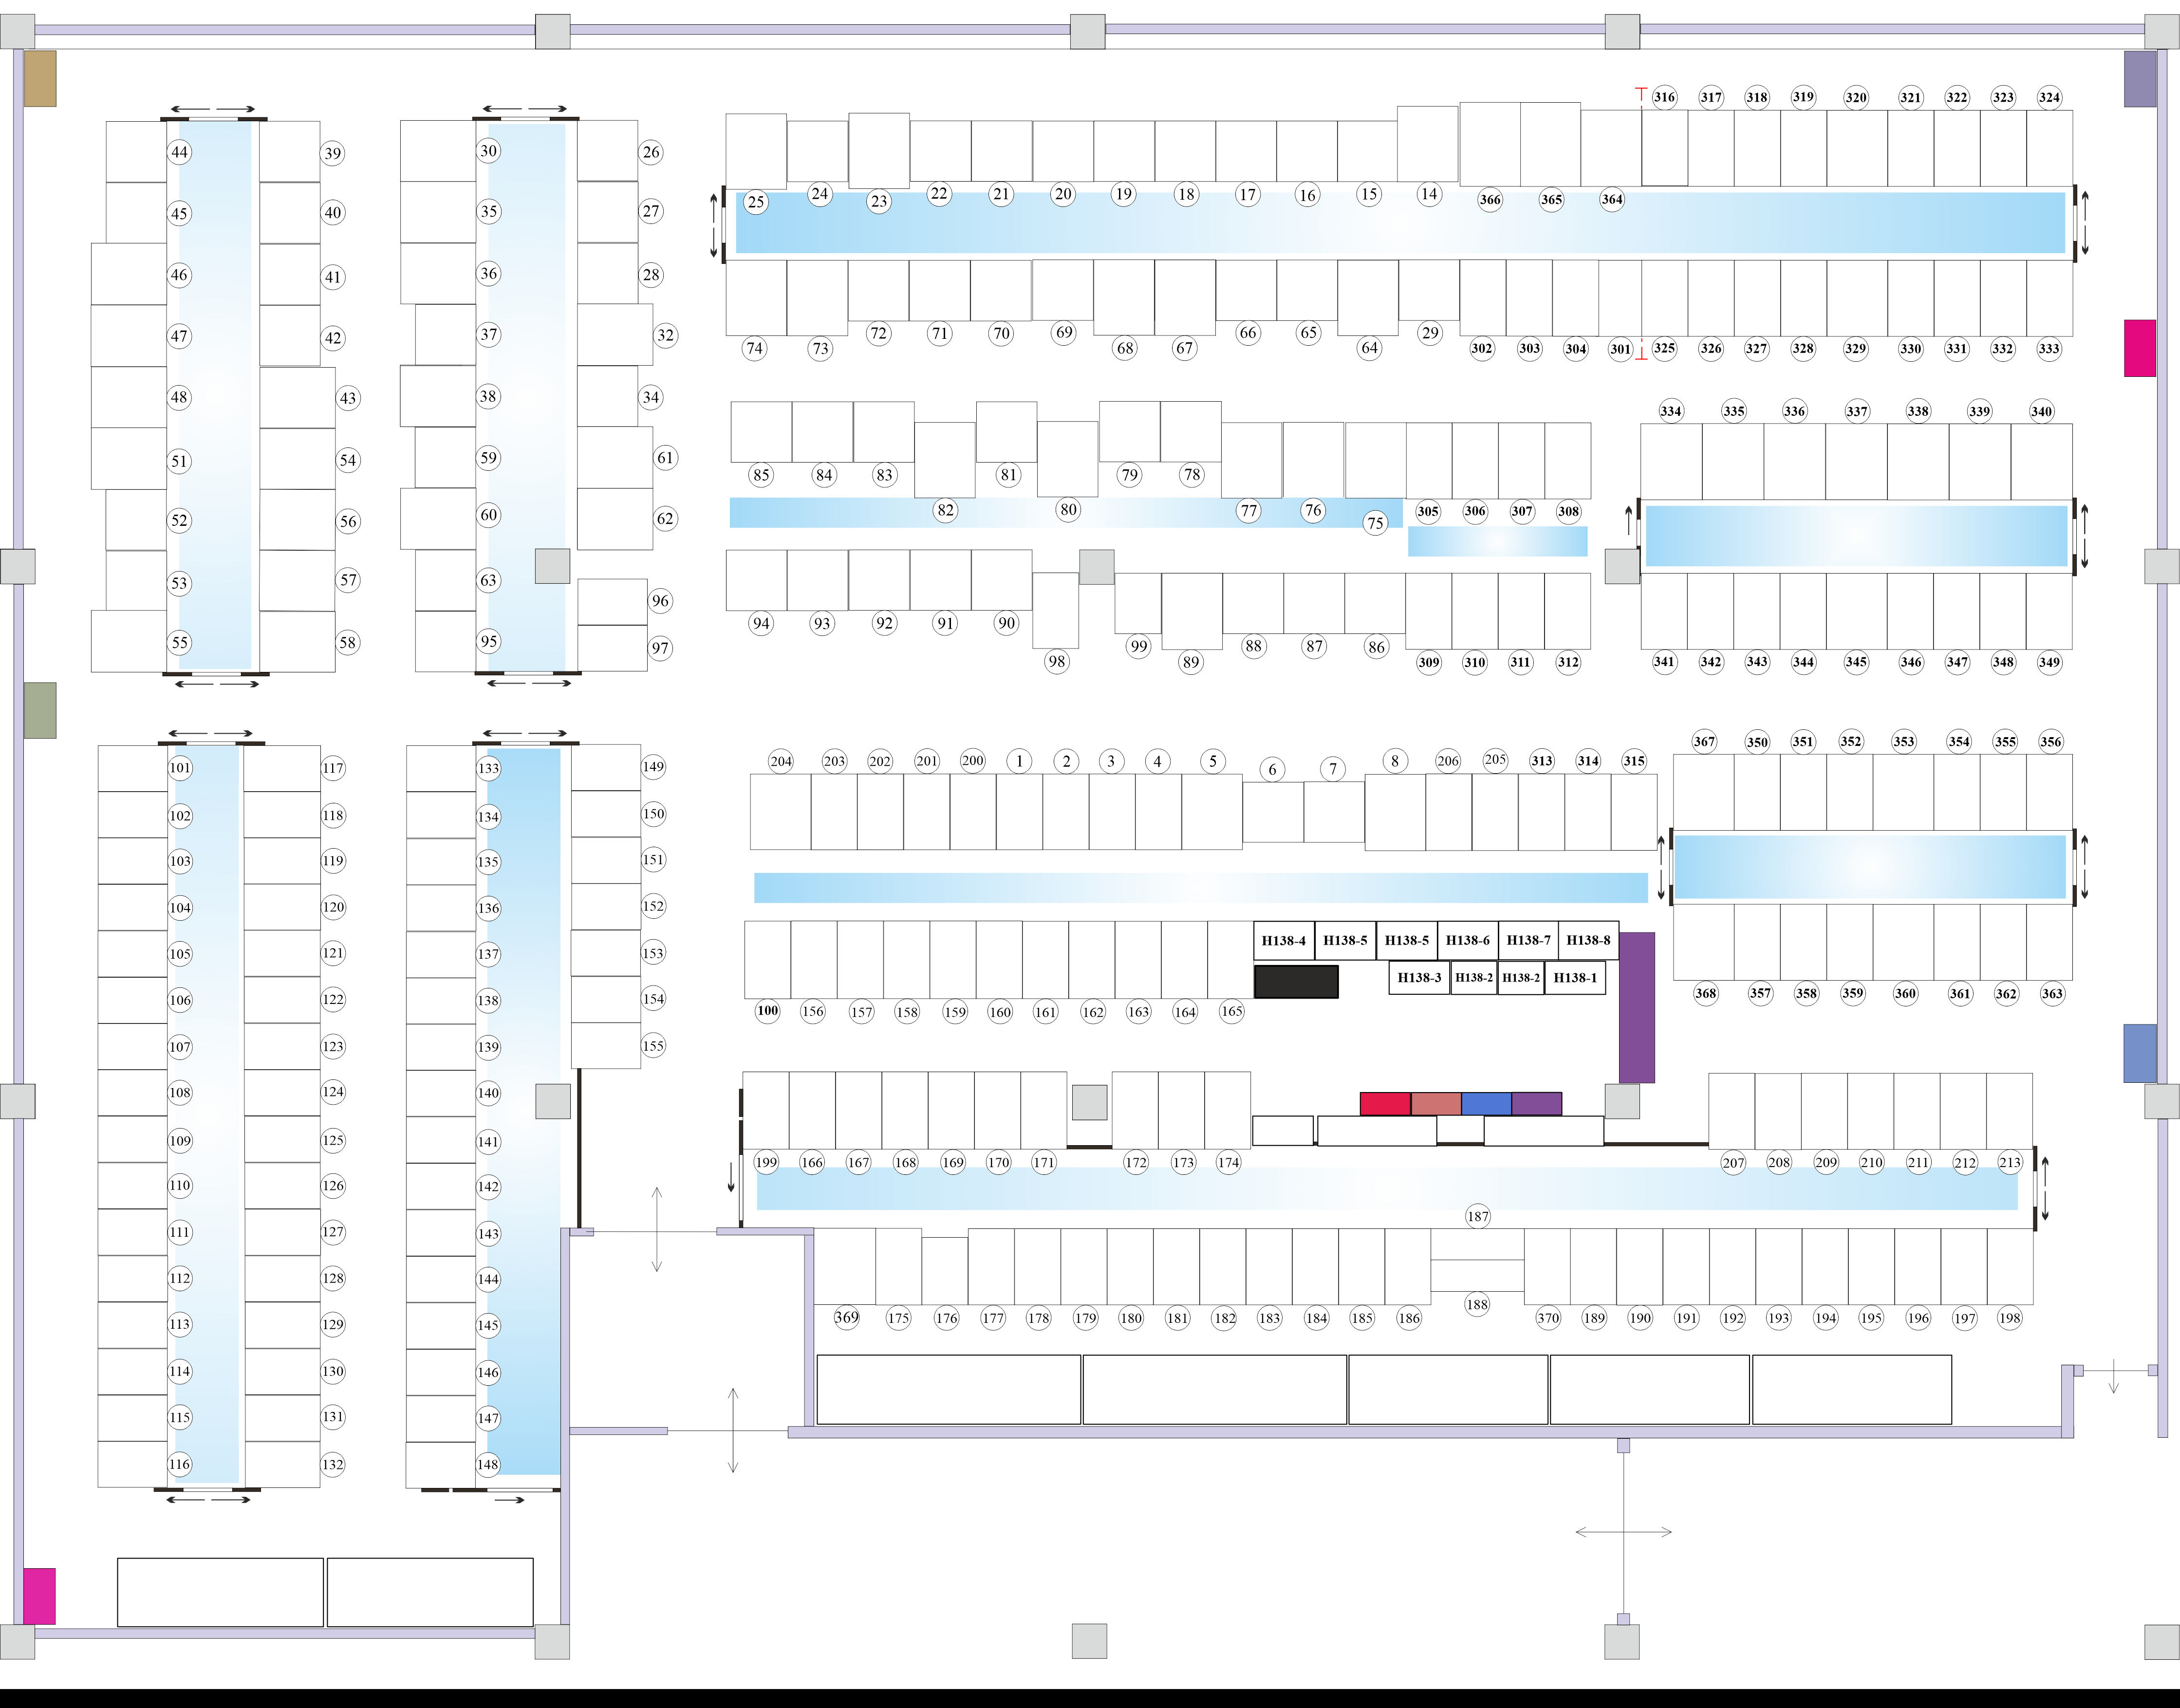
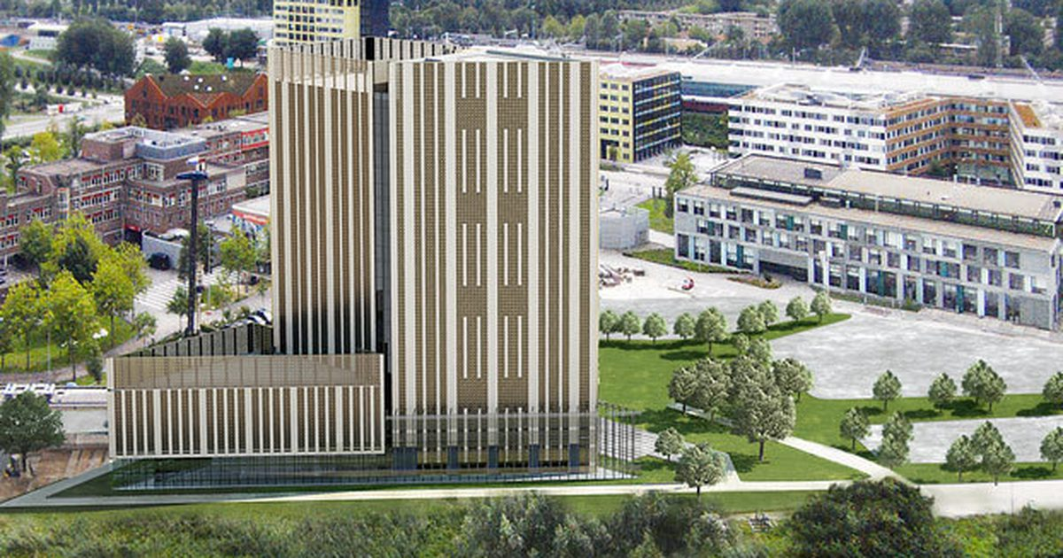
WLCG NL-T1 and the Dutch National Infrastructure
Joint SURF & Nikhef collective service – part of EGI, WLCG and FuSE
hosts WLCG, but also LOFAR radio telescope data, and ~100 other projects
59 PByte near-line storage (tape), 42.5 PByte on-line (disk), 27.6 k cores (cpu)
DNI and NL-T1 capacity from 2023 DNI NWO, LOFAR, and WLCG; see https://www.surf.nl/onderzoek-ict/toegang-tot-rekendiensten-aanvragen ; fuse-infra.nl
SURF tape total: ~80 PByte by end 2022; image library at Schiphol Rijk from Sara Ramezani; NikhefHousing: https://www.nikhef.nl/housing/datacenter/floorplan/

Slide 17
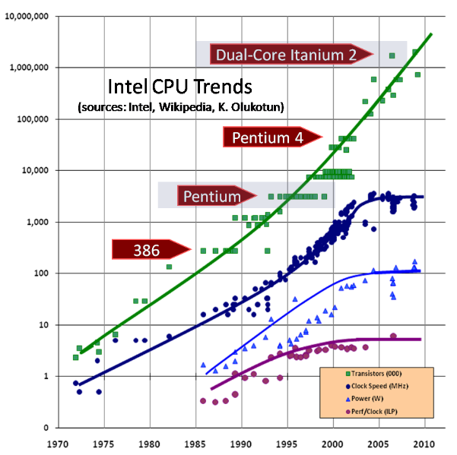
Single CPU scaling stopped around 2004
limitation is power, not circuit size
  and clock frequency is most ‘power-hungry’
  still some packages now @ TDP of 400W
multiple cores on the same die helped
  AMD EPYC Genoa (Zen 4) has 96 cores on die
  but Intel Cascade Lake AP is not even good
CPU design-level performance gains left
  predictive execution
  out-of-order execution
  on-die parallelism (multi-core)
  pre-fetching and multi-tier caching
  execution unit sharing (‘SMT’)
  but at increased risk for security/integrity
Image: Herb Sutter, Dr.Dobbs Journal 2004, updated 2009,
see http://www.gotw.ca/publications/concurrency-ddj.htm

Slide 18
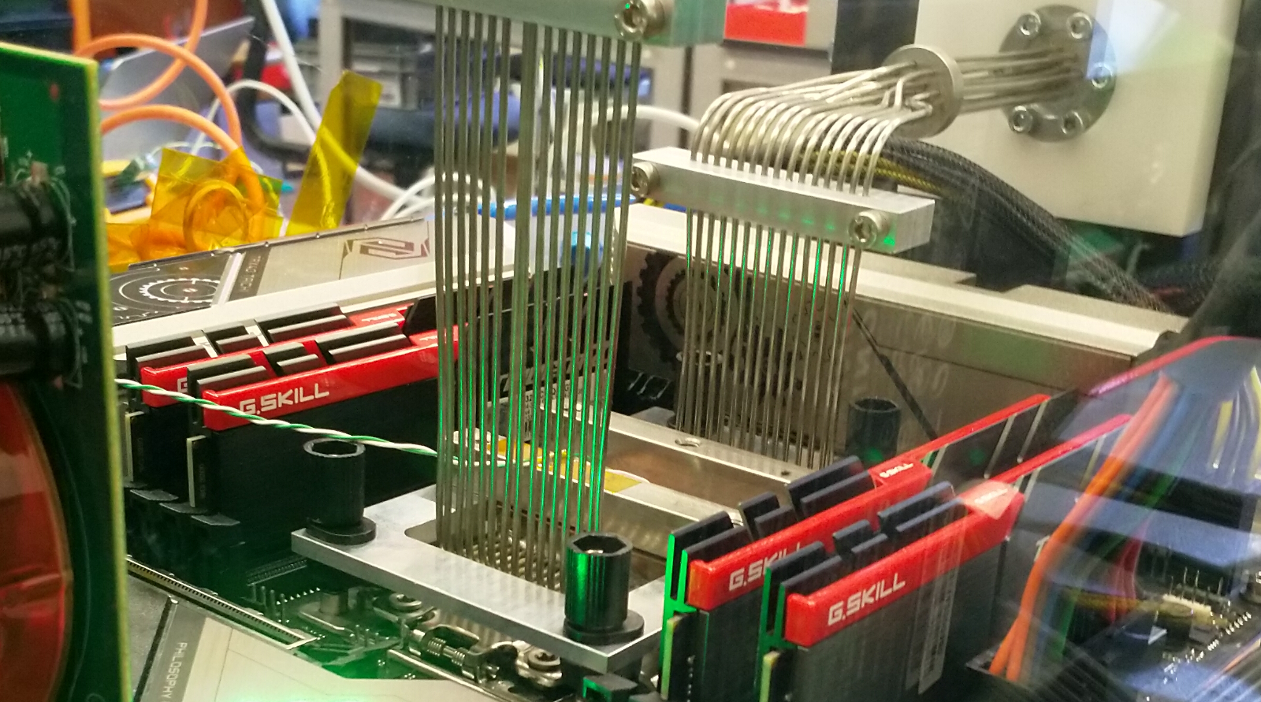
Fix the thing that didn’t scale well, CPU frequency??
LCO2 cooling of an AMD Ryzen Threadripper 3970X [56.38 °C] at 4600.1MHz processor (~1.5x nominal speed) sustained,
using the Nikhef LCO2 test bench system (https://hwbot.org/submission/4539341) - (Krista de Roo en Tristan Suerink)

Slide 19
… since you then need this around it …
Nikhef 2PA LCO2 cooling setup. Image from Bart Verlaat, Auke-Pieter Colijn CO2 Cooling Developments for HEP Detectors https://doi.org/10.22323/1.095.0031
proceed to clusters

Slide 20
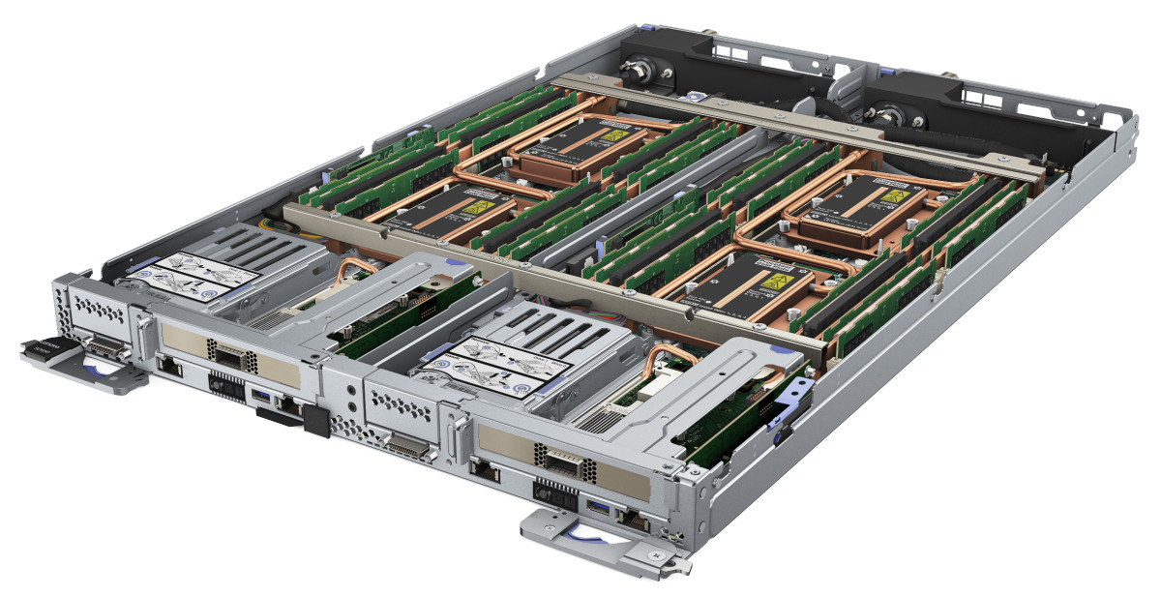

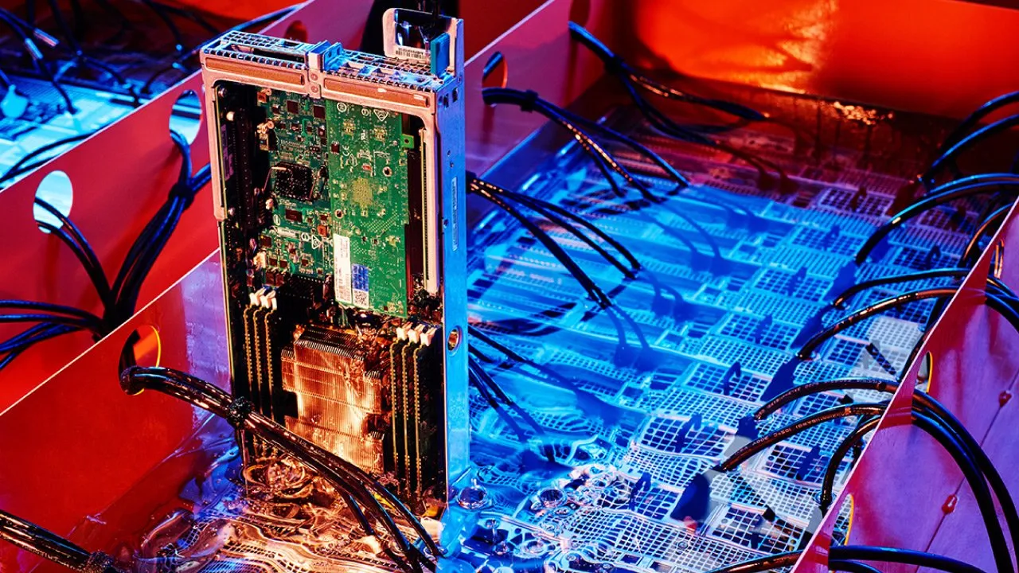

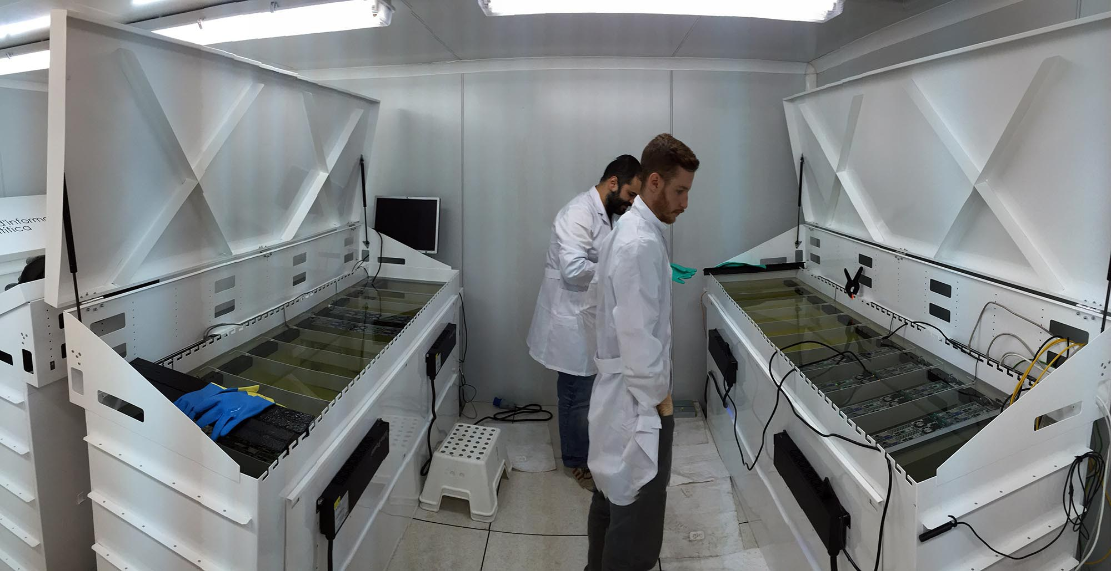
Getting the heat out in liquid form, maybe?
Heat capacity of liquid is much larger than air
by now (almost) standard for HPC systems
immersive systems
look cool, but are a bit
hard on maintenance
Strongly depends on systems engineering: when water inlet temperature can be >40 degC, you have almost always free cooling
Image source dual-board system: Lenovo, ThinkSystem SD650
immersive cooling image https://hypertec.com/blog/sustainable-emerging-tech-liquid-immersion-cooling/, PIC T1 centre, Barcelona, ES

Slide 21
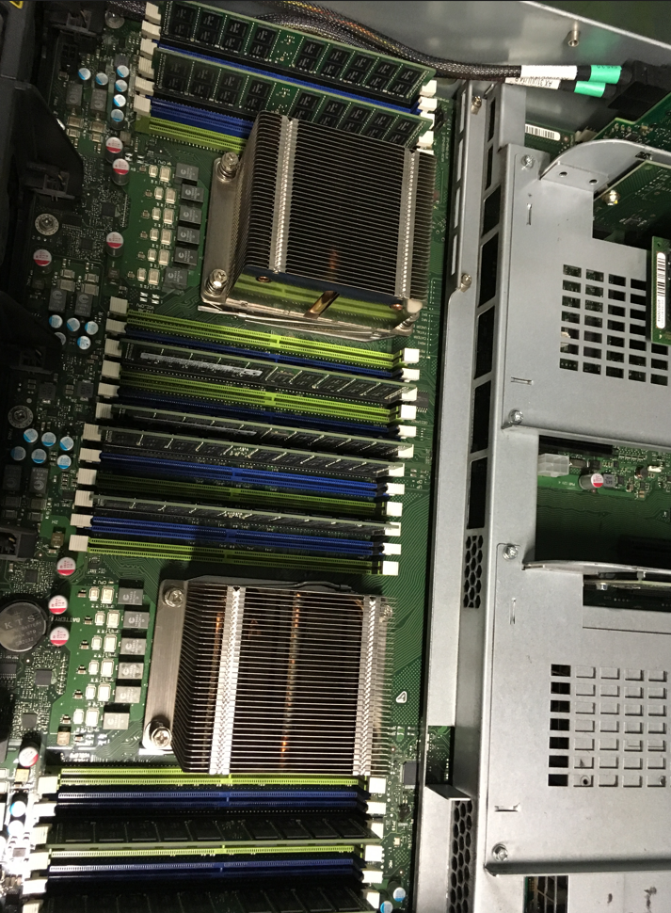
Or scale inside one system
‘trivial’ step-up is to do multiple sockets in one system
2-socket, sometimes 4 socket on a motherboard
to make it appear as a single shared memory system,
cache coherency is required between the CPUs
useful for tightly coupled parallel applications
(weather forecasting, fluid dynamics, climate), but
not needed for ‘trivially parallel’ high throughput needs
depending on architecture cache coherency
kills single-thread performance (although AMD did lot better here than Intel)
Image: dual-socket Fujitsu system at the Xenon experiment site, 2019. source: Tristan Suerink, Nikhef

Slide 22
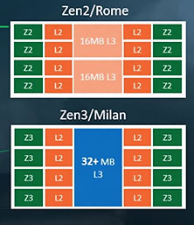
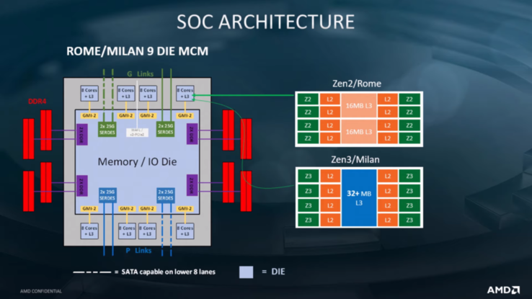
CPU design changes may fit application, or not
AMD EPYC effective for
applications like WLCG:
Naples → Rome added shared memory die
links all cores
directly to memory
Rome-Milan improvement?
shared L3 cache benefits tightly coupled HPC,
but not WLCG ‘HTC’
Image source: AMD, retrieved from https://m.hexus.net/tech/news/cpu/135479-amd-shares-details-zen-3-zen-4-architectures/

Slide 23
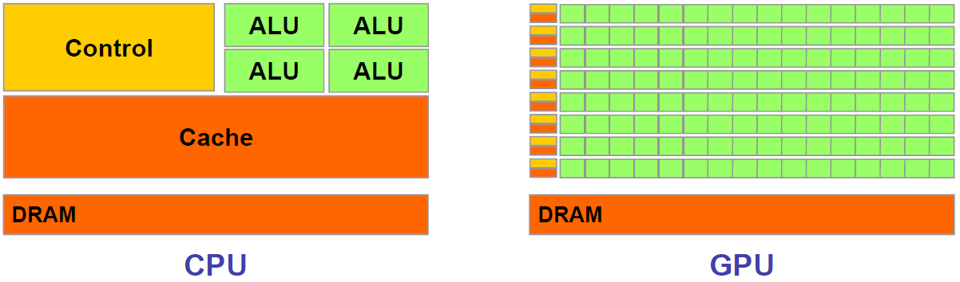
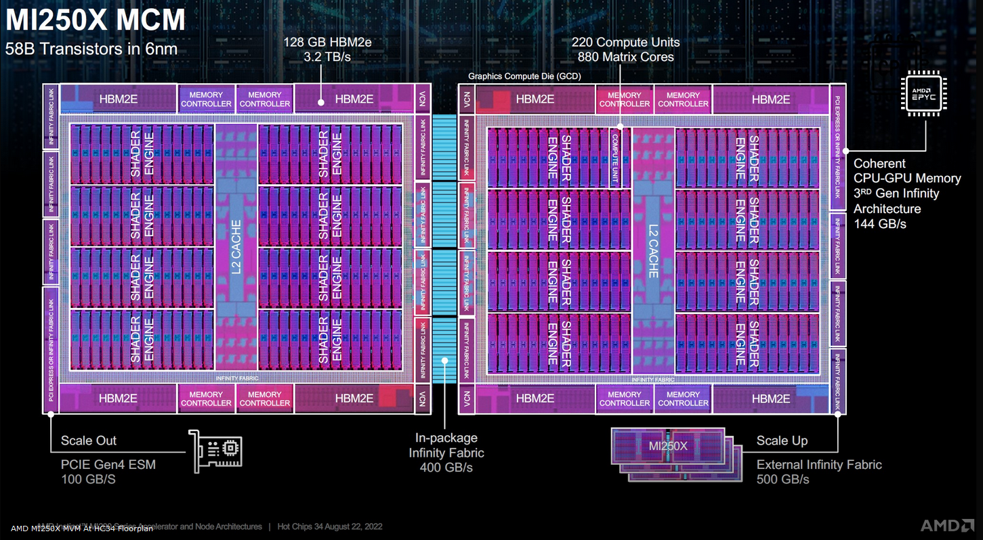
Accelerators – general purpose GPUs
but co-processing comes at a cost of moving data to and from the GPU
often faster to keep computing and do selection & conditionals later
computation speed heavily depends on precision (even 4-bit precision is used)
quite power hungry!
Image: ‘Massively Parallel Computing with CUDA’, Antonino Tumeo Politecnico di Milano, https://www.ogf.org/OGF25/materials/1605/CUDA_Programming.pdf
Floorplan image of die: AMD MI250 GPU, slide source: AMD

Slide 24
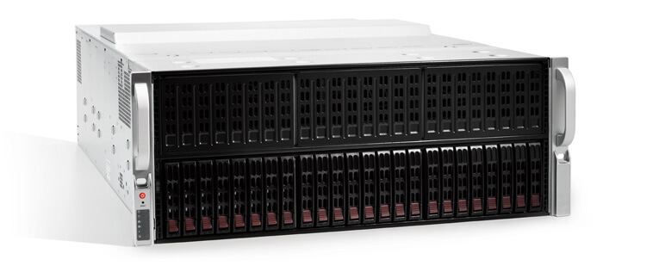

If large-scale IT does not quite fit … ahum …
SuperMicro (branded as ‘Lambda Blade’)
4U chassis, supporting 10 consumer-grade GPUs …
… with a bump
Image source: https://lambdalabs.com/products/blade

Slide 25
Scaling up – beyond one lone motherboard

Slide 26
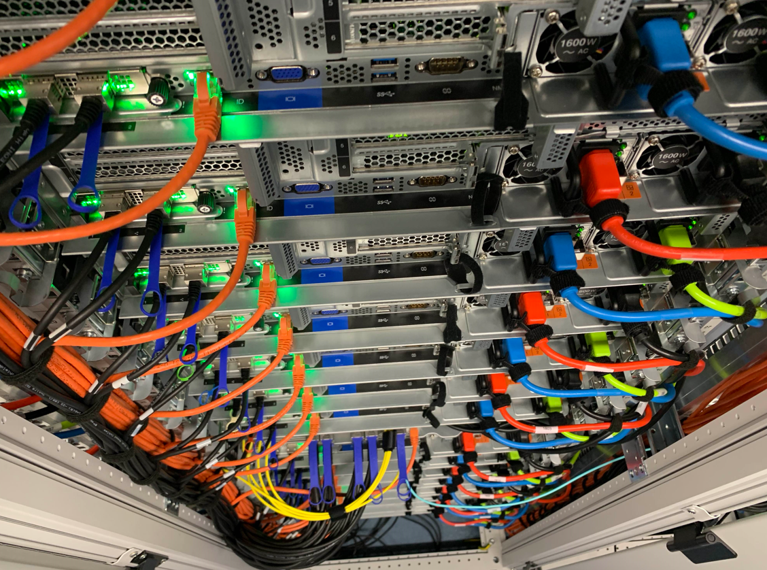
Physical farms: selecting the ‘worker nodes’
For HTC applications
– like WLCG, SKA, WeNMR – typically
balanced features for node throughput
(CPU, storage, memory bandwidth, network)
single-socket multicore systems are fine,
typical: 64-128 cores per system
network: 2x25Gbps
(+ ‘out of band’ management like IPMI)
memory: 8 GiB/core
local disk: 4TB NVME PCIe Gen4 x4
+ space (physical + power) to add GPU
Image: Cluster ‘Lotenfeest’ at the Nikhef NDPF, acquired March 2020. Lenovo SR655 with AMD EPYC 7702P 64-Core single-socket

Slide 27
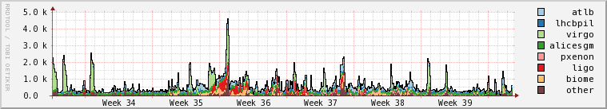
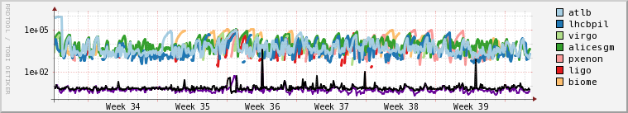
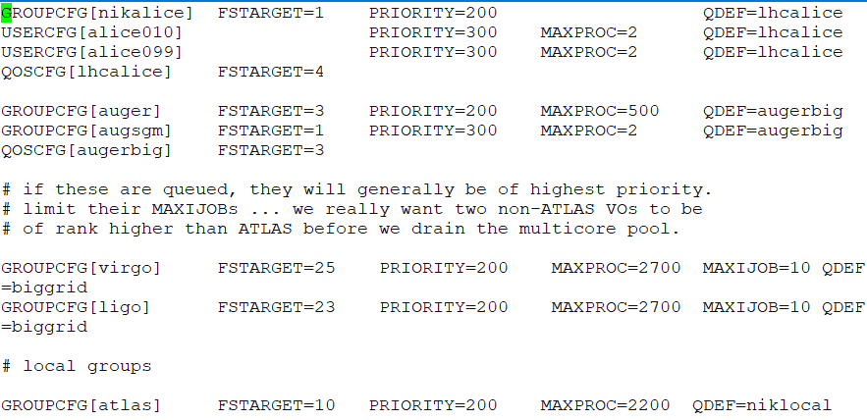
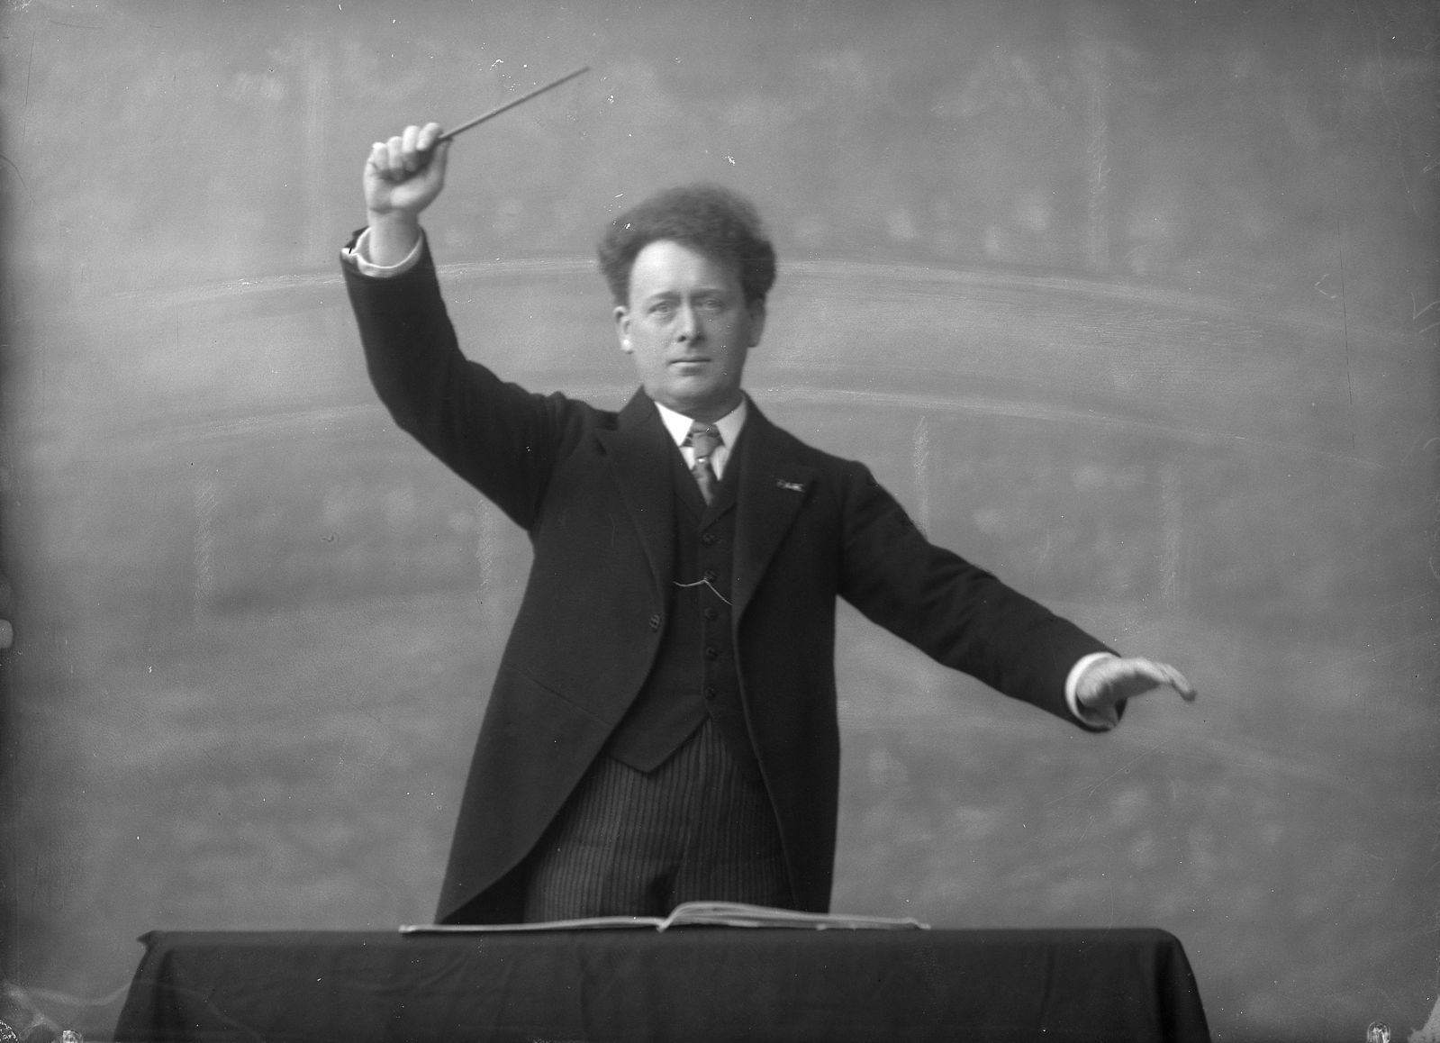


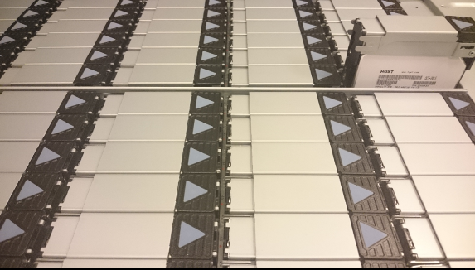

WLCG computing – conveniently parallel
?
‘like milking cows’ (if you feed them lots of power first)
parallel access to data comes at a cost of high IOPS

Slide 28




Batch system platform
Many things are conveniently parallel
HEP events & simulation
ligand matching
structural biochemistry
…
challenge not in parallelism itself
we have had HPC systems for ages
but
large numbers of single-core jobs
heterogeneous workloads
sharing the same set of worker nodes
computing with concurrent data access

Slide 29


Scalable submission: HTCondor
Matchmaking based on ‘ClassAds’
both jobs and machines advertise their requirements and capabilities in
‘classified advertisements’
Matchmaking done by the negotiator
execution nodes mostly autonomous
helps for scalability and resilience
HTCondor, Miron Livny et al, UWMadison; https://research.cs.wisc.edu/htcondor/CondorWeek2008/condor_presentations/desmet_admin_tutorial/

Slide 30



NDPF ‘WLCG and Dutch National Infra’ cluster
Running jobs:
period: March 2021 .. October 2022
# jobs
Waiting jobs (Week 40, 2022)
# jobs
drainage event on Sept 27 are nodes being moved to the LIGO-VIRGO specific cluster; Source: NDPF Statistics overview, https://www.nikhef.nl/pdp/doc/stats/
‘other’ waiting jobs are almost all for the Auger experiment - GRISview images: Jeff Templon for NDPF and STBC

Slide 31


Estimated Response Time (and predicting it)
‘Fair share’ – distributing load over time in a ‘continuous job supply’ system
# jobs
wait time (s)
Image: Nikhef NDPF DNI “Grid” cluster. Period: October 6-17, 2022; top-5 communities; GRISview images: Jeff Templon
For work on run time prediction in high-occupancy clusters , see Hui Li Workload characterization, modeling, and prediction … https://hdl.handle.net/1887/12574

Slide 32
For occupancy, intended target audience makes a difference
For organized experiment-wide analysis, planned months in advance in WLCG
predictable scheduling is more important (steady flow of results)
maximizing efficiency: resource cost is the limiting factor in (physics) results
co-scheduling with data (pre-placement) is required
community-authorization based access to data sources only
For ‘local’ users, e.g. students whose progress tomorrow depends on results today
response time is more important than efficiency
fast turn-around/short waiting times
data access must be parallelism-ready, but is ‘always’ local on-site
local storage credentials and sharing with desktop and Jupyter environments
so offering two distinct classes of services is (in this case) intentional

Slide 33


NDPF local analysis cluster ‘Stoomboot’
period: March 2021 .. October 2022
Running jobs:
# jobs
Waiting jobs (Week 40, 2022):
# jobs
Source: NDPF Statistics overview, https://www.nikhef.nl/pdp/doc/stats/ - GRISview images: Jeff Templon for NDPF and STBC

Slide 34
More of more than one …
More than one system
More than one site
More than one user group
More than one organization
More than one …
proceed to cloud management

Slide 35


Fancy an interactive console install?
Images: Nikhef Housing H234b NDPF science processing data centre

Slide 36
Managing multiple nodes – also virtual ones
Software Servers
Standard nodes
Managed nodes
Fabric (Configuration) Management
do you know what is out there?
update quickly & consistently when
vulnerabilities are found?
versioned repository for rollback?
note that not all tooling scales in itself
push: ansible using ssh logins,
or home-brewn scripting
pull: each node runs its own actions, e.g. Quattor, Saltstack, ansible-agent, …
http
SW package
Manager (SPMA)
cache
packages
nfs
RPM, PKG
SWRep
packages
(RPM, PKG)
ftp
Installed software
kernel, system, applications..
Install server
System services
AFS,LSF,SSH,accounting..
Vendor
System installer
RHEL*, Solaris,
Fedora,…
nfs/http
Node Configuration
Manager (NCM)
CCM
base OS
dhcp
Node
(re)install
Install Manager
pxe
(s)CDB
Illustration: German Cancio, CERN, quattor.org, used here as example; see also: ansible.com, saltproject.io, theforeman.org, cfengine.com, puppet.com, …

Slide 37
Scaling ‘as a service’
The managed servers usually are not physical
although there is lots of ‘fixed’ virtualization
of systems, network and (block) storage
When scale, or environment, must be flexible,
you get software defined infrastructure
IaaS: Infrastructure as a Service
PaaS: Platform as a Service
(containers, but also a batch system …)
SaaS: Software as a Service
(like the WeNMR portal)
driven from a configuration management DB
powerful tools, but also easy to get wrong (i.e. having plain-text secrets in the version control system to automate redeployment). And abstractions are leaky!
Image from CERN’s OpenShift, A Lossent et al 2017 J. Phys.: Conf. Ser. 898 082037 https://doi.org/10.1088/1742-6596/898/8/082037

Slide 38










Moving the management boundary
Infrastructure-as-a-Service
Platform-as-a-Service
Software-as-a-Service
Application
Data
Runtime environment
Middleware
Operating system
Virtualisation layer
Physical server
Network
Storage devices
Application
Data
Runtime environment
Middleware
Operating system
Virtualisation layer
Physical server
Network
Storage devices
Application
Data
Runtime environment
Middleware
Operating system
Virtualisation layer
Physical server
Network
Storage devices
Guest
Hyper
visor
Host
Astronomy catalogue: https://vizier.cds.unistra.fr/
IaaS: openstack.com, Oracle OCI; PaaS: dsri.maastrichtuniversity.nl, apptainer.org, cvmfs.readthedocs.io, kubernetes.io, slurm.schedmd.com; SaaS: Jupyter.org

Slide 39

Image source: Free Software Foundation Europe - https://fsfe.org/

Slide 40




Brief look at data centres
‘tier-1’ … ‘tier-4’ datacenters - increasingly redundant
all systems are ‘lights out’, since the DC may be miles away
  remotely controlled, incl. power-on, remote KVM
small and large in terms of power and cooling capacity
  Nikhef ~2 MW, Meta Zeewolde would have been 160 MW
data centre efficiency metric:
$$PUE=\frac{E_{total}}{E_{IT_equipment}}$$
Reducing cost and impact by improving “Power Unit Efficiency” of the data centre:
airflow engineering and efficient CRACs
(free) cooling by changing inflow temperature
Aquifer Thermal Energy Storage (ATES) to buffer heat (and re-use later for homes)
Typical PUEs vary from 1.03 (in Iceland) to 1.2 for ‘good’ datacenters in NL
Data centre tiering: Uptime Institute (Tunner, W.P.; Seader, J.H.; Brill, K.G. Tier Classifications Define Site Infrastructure Performance; White Paper)
Remote systems management: IPMI, RedFish and various vendor proprietary solutions – usually dedicated ‘out-of-band’ network connection, incl. remote KVM

Slide 41

‘Cloudification’ eases systems management …
OpenShift (OKD) system at CERN (accessible for CERN users only);

Slide 42

Common interfaces to the different clouds?
‘protocol hourglass’
hourglass image: Alessio Merlo in The Condor on the Grid: state of art and open issues,

Slide 43

Standard interfaces for compute and data?
‘hourglass’ model kind-of worked for IP,
and ~ web with http as common standard
a very simple stateless interface
protocols for higher-level services never reached this level of global interop
requirements too complex and stateful
use cases were usually scoped
slowly changing now but only for similar simple things like on-line object storage
Is distributed computing too bespoke …?
Interoperable cloud? Compare OGF’s OCCI WG GFD.221 (https://www.ogf.org/documents/GFD.221.pdf) with e.g. Amazon S3 API or the OwnCloud CS3 interfaces

Slide 44


DIRAC: spanning heterogeneous resource models
Adding a
scheduling layer on top
all sites in WLCG are autonomous – and
global standards failed
‘any (IT) problem can be solved by adding
one layer of indirection’
DIRAC is just one example
application software and (AppTainer, docker) container images
Image: DIRAC project, A. Tsaregorodtsev et al. CPPM Marseille, from https://dirac.readthedocs.io/ ; CVMFS (CERN VM File System) is a common software distribution platform using distributed signed data objects in a cached hierarchy using CDN techniques, see https://cernvm.cern.ch/fs/

Slide 45

Job distribution overlay and pilot jobs in WLCG
Building a cross-site ‘overlay’ batch system
work around
local bespoke interfaces and specific semantics
provides the single
community-level interface
Site Access Control with pilot jobs: gLExec, http://doi.org/10.1088/1742-6596/119/6/062032; GlideinWMS: https://glideinwms.fnal.gov/ based on Condor; also: PANDA

Slide 46



An overlay network of containers
Nobody wants a cloud per-se … what folk want is a solution …
‘alien containers’ HPC integration - container computing, using curated application images
Image sources: NDPF JupyterHub service “Callysto”; SLATE: Service Layer At The Edge – Rob Gartner (UChicago), Shawn KcMee (UMich) et al. – slateci.io

Slide 47


High throughput computing is also about data
source: https://monit-grafana.cern.ch/d/000000420/fts-transfers-30-day ; data: November 2020 ; CERN FTS instance WLCG: daily transfer volume ATLAS+LHCb

Slide 48





Getting the data to process … in the right place
ESCAPE reference components: Rucio, FTS, and DIRAC
Rucio FTS image: “The ESCAPE Datalake” Aris Fkiaras, CERN, February 26th, 2020 ESCAPE WP2 eDIOS;
https://indico.in2p3.fr/event/20203/sessions/12778/#20200226; DIRAC image from: A. Tsaregorodtsev, CPPM IN2P3,; EGI Webinar, 7 June 2016 ttps://indico.egi.eu/event/2978

Slide 49
Can storage support your parallel processing
Basic storage properties
throughput
IOPS – I/O Operations per Second
seek-time
but not many storage systems support concurrent parallel access by many clients
both data and (file system or index) meta-data must be scalably distributed
typically sacrifice either instant consistency, or (POSIX) semantics,
(or scalability) in a distributed storage system
Common commercial solutions: GPFS, (and still: CXFS), … but also NetApp, HDS, Dell-EMC, &c
Common open source: gluster, dCache, CephFS, Lustre, …
And storage is usually tiered – fast local → online (spinning) disk → near-line (tape)

Slide 50

Example: client-side managed GlusterFS
scalable through
independence of both clients and servers
design is stateless: file system meta-data kept in each server’s file system
data itself can be replicated and protected, but … inconsistencies in metadata linger around the corner in case of client failures (e.g. batch system worker nodes)
Image source Gluster community: https://docs.gluster.org/en/main/Quick-Start-Guide/Architecture/

Slide 51



Example: server-coherent distribution – dCache
separate client entry points, storage access scheduling, filesystem meta-data (namespaces), and storage
message layer for eventual consistency
redirect-based access
  doors and pools usually on all nodes
  now also feature of standard NFSv4.1
Images: Tigran Mkrtchyan (DESY, dCache.org), dCache on steroids - delegated storage solutions, ISGC 2016, https://dcache.org/manuals/publications.shtml

Slide 52

dCache: wide area distribution
can be widely (long latency) distributed
  Nordic Data Grid Facility: Sweden is quite long (~16ms RTT), and Ljubljana to Umeå is ~30ms RTT (~ 2900km)
redirect-then-access model limits interactions with any single node across a long-distance links
at ‘cost’ of POSIX features like atime or concurrent write
  most distributed applications don’t need these anyway
  but indeed it’s not a good backing store for databases ☺
Image NDGF instance: Jürgen Starek et al. (dCache team) at https://www.dcache.org/manuals/dCache-Whitepaper.pdf; https://dcache.org/manuals/Book-8.2
proceed to networking

Slide 53





Distributing storage infrastructure
‘making disks collaborate’
Storage infrastructure – even a few PBytes – requires some organization
management challenge is #files,
not capacity
cost challenge is throughput, not capacity
for the management software, see https://dcache.org , alternatives exist, like DPM https://lcgdm.web.cern.ch/dpm and EOS

Slide 54


Structure of application data placement impacts storage (hardware) systems design
pre-staging all data locally supports latency hiding,
posix-style access with lseek(2), and fast local ‘$TMPDIR’
e.g. why there are Data Transfer Nodes (DTNs) in the ‘Science DMZ’ concept
but, nowadays, pre-staging started coming at a cost, when using SSDs
as local ‘scratch’ area … because of their hardware characteristic ‘endurance’
Photo HGST nVME from: Dmitry Nosachev on Wikimedia Commons CC-BY-SA; Image Science DMZ and Data Transfer Nodes: ESnet fasterdata.es.net

Slide 55

Especially with WORN storage: Write Once Read Never
Frequency distribution of read-back vs. write volume, observed on local scratch for NDPF execution nodes for outside (‘grid’) access (blue) vs local access (orange)
Access pattern is rather different. But why?
external users pre-stage, because that is built
into the frameworks (like DIRAC, Athena), whereas ‘local’ users streaming data (‘dCache NFSv4’)
different types of workload:
ntuple-data analysis vs (re)processing
Data: NDPF execution nodes, based on SSD SMART data, integrated over total device lifetime; plot shows number of local analysis nodes scaled to DNI-WLCG count; collected using smartctl on 2020-10-28 – in total 97 ‘DNI’ and 34 ‘STBC’ SSDs were used in the analysis

Slide 56

Putting ‘more than one’ thing together
Connecting the bits
The Internet Is Not Enough!

Slide 57

‘Elephant streams in a packet-switched internet’
‘You may have plenty of shovels,
but where to leave the sand?’
wheelbarrow works fine in your garden
want to send it to different places?
Use waggons on a train, or ships
always from A-to-B?
A conveyer belt will do much better!
… although you still need
a hole to dump it in …
Image conveyor belt tunnel near Bluntisham, Cambridgeshire by Hugh Venables, CC-BY-SA-4.0 from https://www.geograph.org.uk/photo/4344525

Slide 58


A quick look at internet routing …
network paths
from various places
in Western Europe
towards an IP address at CERN
Data: RIPE NCC Atlas project, TraceMON IPmap, atlas.ripe.net, measurement 9249079

Slide 59


Many paths to Rome … i.e. to your server
From a home connected to Freedom Internet to spiegel.nikhef.nl
but from Interparts in Lisse, NH:
AS41960: Interparts; AS1200: AMS-IX route reflector; AS1103: SURFnet; AS1104: Nikhef; AS206238: Freedom Internet – on the FrysIX there is direct L2 peering

Slide 60

Where do internet packets go anyway?
Border Gateway Protocol (BGP) used here is based on (weighted)
path vector traversal mechanism
I want to sent this to
e.g. 194.171.96.130
194.171.96.128/25
is here at AS1104
grey-dash lines for illustration only: may not correspond to actual peerings or transit agreements; red lines: the three existing LHCOPN and R&E fall-back routes; yellow: public internet fall-back (least preferred option)

Slide 61

Announcing routes: the Border Gateway Protocol
IPv4 routes advertised from AS513/CERN (for all sites on LHCOPN) to AS1104/Nikhef (top), and the routes announced by AS1104/Nikhef to CERN, on 5 Nov 2022

Slide 62

Typical data traffic to and from the processing cluster
Source: Nikhef cricket graphs period June 2021 – October 2022 – aggregated (research) traffic to external peers from deelqfx – https://cricket.nikhef.nl/

Slide 63


Network is more than just what it says on the tin
More network bandwidth does
not mean your data gets there faster
memory requirements (since TCP needs a capability to re-transmit)
tcp ‘slow start’
congestion control algorithms
Useful sources: https://www.switch.ch/network/tools/tcp_throughput/, https://fasterdata.es.net/
tcp slow-start graphic from Abed et al, Improvement of TCP Congestion Window over LTE- Advanced Networks IJoARiC&CE 2012

Slide 64

That viral cat video destroyed it all …
latency AMS-GVA 17 ms
congestion event @20ms: 2 ms of UDP traffic to GVA
TCP protocol sensitive to packet loss
  3 lost packets is enough to trigger this
different congestion avoidance algorithms exists (~20 by now)
loss severely impacts links w/large ‘bandwidth-delay-product’ (BDP)
NL: ~3 ms, US East: 150ms
source: Catalin Meirosu et al. Native 10 Gigabit Ethernet experiments over long distances in FGCS, doi:10.1016/j.future.2004.10.003 – aka. ATL-D-TN-0001

Slide 65

LHCOPN – distributing raw data
Image source: Edoardo Martelli, CERN, https://lhcopn.web.cern.ch/

Slide 66

LHCOPN – traffic levels for T1T1 data transfer
CERN OpenMonIT LHCOPN, period Oct 7 .. Oct 14 2022, from https://monit-grafana-open.cern.ch/d/HreVOyc7z/all-lhcopn-traffic

Slide 67

LHCone
LHCone (“LHC Open Network Environment”) – visualization by Bill Johnston, ESnet version: October 2022 – updated with new AS1104 links

Slide 68

Just one random (smallish) autonomous system
AS1104

Slide 69




Exercising the network – sensor data and events
1.02 Bpps
400 Gbps and 593 Mpps –
connected to CERN via SURF
Image: ballenbak.nikhef.nl, Tristan Suerink

Slide 70



Scaling data access: ‘system-aware design’ at application layer
Reading data ‘scattered’ in a file - simply using POSIX-like IO - when done over the network severely exposes latency
and TCP slow-start makes that even worse
Image of TCP slow-start and packet loss impact (in Mpps): Antony Antony et al., Nikhef, for DataTAG, 2003(!)
Right: base graphic: Philippe Canal “Root I/O: the fast and the furious”, CHEP2010 Access pattern reflects Root versions < 5.28, before Ttree caching and ‘baskets’

Slide 71
Access, Trust & Identity
More than one user, from
more than one organizational domain, in
more than one country

Slide 72


WLCG: when we met a global trust scaling issue
170 sites
~60 countries & regions
~20000 users
just how many interactions
people photo: a small part of the CMS collaboration in 2017, Credit: CMS-PHO-PUBLIC-2017-004-3; site map: WLCG sites from Maarten Litmaath (CERN) 2021

Slide 73



Access control in a single domain
Dedicated to each service
where you need access
Usually strongly linked to authorization:
at times even
different accounts for different roles
In a multi-organizational system becomes
O(n_{sites}*n_{services}) * O(n_{users})
Image: AARC NA2 training module “Authentication and Authorisation 101” - https://aarc-community.org/training/aai-101/

Slide 74




Scaling issues – credentials at each site does not work
state of EDG and the HEP LHC computing in 2000

Slide 75


Authentication – who are you
Authenticating to a single service is relatively simple
per-service identity (username) and secrets (e.g. password or TOTP token)
server-side: list of valid users and (hashed and hopefully salted) secrets
Passport image: cropped from original by Jon Tyson on Unsplash https://unsplash.com/photos/Hid-yhommOg

Slide 76


Authorization – what you are allowed to do
soon needs specifying access rights to resources, based on an access policy
might be implicit or ad-hoc
be in formal policy language
example: Argus PDP
or be service-specific
example: Linux sssd config
Policy example: Argus system, https://argus-documentation.readthedocs.io/en/stable/misc/examples.html; service-specific: sssd.conf ldap auth_provider

Slide 77


Assertions to meet an authorization policy
assertions can be added to identity info
e.g. visa are strongly bound
to a specific entity
through an identity statement by a
trusted third party
but some are just a ‘bearer token’
others are looked up as needed
USA visa image source: https://2009-2017.state.gov/m/ds/rls/rpt/79785.htm

Slide 78

Authorization and access control
Unless data-level encryption is used, access control is ultimately enforced by the service provider
policy overlap diagram by Olle Mulmo, KTH for EGEE-I JRA3, policy pie: OpenGrod Forum OGSA working group and Globus Alliance

Slide 79



Authorization models: three AuthZ flows
‘push’
‘pull’
‘agent’
Authorization models: AAA Authorization Framework, RFC2904, Vollbrecht et al.

Slide 80

Authentication and Authorization Infrastructure
Image: AARC NA2 training module “Authentication and Authorisation 101” - https://aarc-community.org/training/aai-101/

Slide 81

Federation
portability of identity information across otherwise autonomous administrative domains
Shibboleth IdP image and SAML2 auth flow by SWITCH (CH) – see also https://refeds.org/ on federation structure and (assurance and security) guidelines

Slide 82


One simple federation you know: eduroam
service-specific trust
between organisations
globally
hierarchical RADIUS servers based
an 802.1x secure exchange
over TLS or EAP-TTLS
tunneling your credentials
back to your home institution
RADIUS server then instructs WiFi access point
eduroam: Klaas Wieringa et al., image from https://eduroam.org/how/, GEANT ; RADIUS: RC2865 https://www.rfc-editor.org/rfc/rfc2865; see also freeradius.org
skip past RSA background to 88

Slide 83
CIA interlude –trusted handshaking at a distance
Trust needs Confidentiality, Integrity, and Availability … and cryptography in some way
Client authentication
pre-shared secrets, may be salted hashed on service side
required: secure one-way hash function
need a protected channel
Mutual authentication
you either need lots of shared keys, or a trusted third party (TTP)
with the TTP and multiple services comes the need for encryption
across administrative domains, key distribution is the larger challenge
The cryptography used can be either symmetric or asymmetric, ‘public key’

Slide 84
Asymmetric crypto: RSA interlude needed?
(d,e,p,q)
(e,n)
(d,n)
(e,n)
Alice
n = pq
c
D_{d,n}(c) → m
c=E_{e,n}(m)
m
E_{e,n}(m) = m^{e} mod(n)
D_{d,n}(c) = c^{d} mod(n)
m = D(E(m)) = E(D(m)) (reversibility)
if a.o. if de = 1 mod(φ(p,q))
where φ(p,q) = (p-1)(q-1)
and (p-1) prime relative to e
Bob
Rivest, Shamir and Adleman, Communications of the ACM 21 (2), 120-126

Slide 85
6-bit RSA (note: this might be broken quickly …)
Take a (small) value e = 3
Generate a set of primes (p,q), each with a length of k/2 bits, with (p-1) prime relative to e.
(p,q) = (11,5)
φ(p,q) = (11-1)(5-1) = 40; n=pq=55
find d, in this case 27 [3*27 = 81 = 1 mod(40)]
Public Key: (3,55)
Private Key: (27,55)
E_{e,n}(m) = m^{e} mod(n)
D_{d,n}(c) = c^{d} mod(n)
m = D(E(m)) = E(D(m)) (reversibility)
if a.o. if de = 1 mod(φ(p,q))
where φ(p,q) = (p-1)(q-1)

Slide 86
Message exchange
Encryption:
Bob thinks of a plaintext m(<n) = 18
Encrypt with Alice’s public key (3,55)
c=E_{3;55}(18)=18³ mod(55) = 5832 mod(55) = 2
send message “2”
Decryption:
Alice gets “2”
she knows private key (27,55)
E_{27;55}(2) = 2²⁷ mod(55) = 18 !
If you just have (3,55), it’s hard to get the 27…
but also: the maximum plaintext is limited by the modulus length
(3,55)
E_{e,n}(m) = m^{e} mod(n)
D_{d,n}(c) = c^{d} mod(n)
m = D(E(m)) = E(D(m))
if a.o. if de = 1 mod(φ(p,q))
where φ(p,q) = (p-1)(q-1)

Slide 87


The most used asymmetric crypto application
Asymmetric crypto underpins
the transport layer security
of all of the web today
ASN.1 syntax data with
X.509 (RFC5280) structure
mostly RSA or Elliptic Curves (EC)
used to negotiate a
(symmetric) bulk cipher (typically AES)
then used to protect channel to usually unauthenticated client application (browser)

Slide 88



Multipurpose federation with SAML: SURFconext & eduGAIN
Images: SURFconext IdP dashboard by SURF, showing some services tagged with REFEDS R&S; eduGAIN map: GEANT, https://technical.edugain.org/status

Slide 89

Your favourite federated service?
https://surfspot.nl/

Slide 90

SAML federation
SAML2.0 auth flow
Try at https://attribute-viewer.nikhef.nl/ and select “Login via a global authentication SAML source”
Firefox: use F12, and SAML message decoder: https://addons.mozilla.org/en-US/firefox/addon/saml-message-decoder-extension/ (Magnus Suther)
SAML WebSSO flow image: SWITCH, CH

Slide 91
Under the hood, it’s a (signed) XML document
<saml:Subject>
<saml:NameID Format="urn:oasis:names:tc:SAML:2.0:nameid-format:persistent">xxxxxxxxxxxxxxxxxxxxxxxxxxxxxxxxxxxxxxxx</saml:NameID>
<saml:SubjectConfirmation Method="urn:oasis:names:tc:SAML:2.0:cm:bearer">
<saml:SubjectConfirmationData NotOnOrAfter="2022-10-21T18:16:40Z"
Recipient="https://attribute-viewer.aai.switch.ch/Shibboleth.sso/SAML2/POST"
InResponseTo="_64c10a60c382bdaeb328653d9d25951c" /></saml:SubjectConfirmation>
</saml:Subject>
<saml:Conditions NotBefore="2022-10-21T18:11:39Z"
NotOnOrAfter="2022-10-21T18:16:40Z">
<saml:AudienceRestriction>
<saml:Audience>https://attribute-viewer.aai.switch.ch/shibboleth</saml:Audience>
</saml:AudienceRestriction>
</saml:Conditions>
<saml:AuthnStatement AuthnInstant="2022-10-21T17:33:29Z"
SessionNotOnOrAfter="2022-10-22T02:33:29Z"
SessionIndex="_90f745f18f712b6a567a3c844269700bd8eb737741">
<saml:AuthnContext>
<saml:AuthnContextClassRef>urn:oasis:names:tc:SAML:2.0:ac:classes:PasswordProtectedTransport</saml:AuthnContextClassRef>
<saml:AuthenticatingAuthority>https://sso.nikhef.nl/sso/saml2/idp/metadata.php</saml:AuthenticatingAuthority>
</saml:AuthnContext>
</saml:AuthnStatement>
<saml:AttributeStatement>
<saml:Attribute Name="urn:mace:dir:attribute-def:cn"
NameFormat="urn:oasis:names:tc:SAML:2.0:attrname-format:uri">
<saml:AttributeValue xsi:type="xs:string">David Groep</saml:AttributeValue>
</saml:Attribute>
<saml:Attribute Name="urn:oid:2.5.4.3"
NameFormat="urn:oasis:names:tc:SAML:2.0:attrname-format:uri">
<saml:AttributeValue xsi:type="xs:string">David Groep</saml:AttributeValue>
</saml:Attribute>
<saml:Attribute Name="urn:mace:dir:attribute-def:eduPersonAffiliation"
NameFormat="urn:oasis:names:tc:SAML:2.0:attrname-format:uri">
<saml:AttributeValue xsi:type="xs:string">employee</saml:AttributeValue>
<saml:AttributeValue xsi:type="xs:string">member</saml:AttributeValue>
<saml:AttributeValue xsi:type="xs:string">faculty</saml:AttributeValue>
</saml:Attribute>
<saml:Attribute Name="urn:oid:1.3.6.1.4.1.5923.1.1.1.1“
...

Slide 92
Federation: different technologies, same idea
SAML - Security Assertion Markup Language and WebSSO (‘SAML2Int’)
  XML-formatted ‘attribute statements’ over web transport (usually POST)
  SAML-Metadata: list of entities with description of bindings with entityAttributes
PKI - Public Key Infrastructures
  certification authority (CA) signing X.509 formatted certificates
  with name, issuer, serial number, and extensions
  CAs can sign end-entities as well as other CAs (hierarchically or by cross-signing)
  bridge CAs render a technical implementation of a shared policy (assurance)
  policy-bridges don’t sign anything, but curate distribution (like browsers and operating systems based on CA/BF requirements, or the IGTF for research infras)
OIDC Fed - OpenID Connect Federation
  for end-points for OIDC Providers and Relying Parties – otherwise quite similar
federation based on ‘ultimate trust’ domains (e.g. cross-realm Kerberos) also exists, but …
See www.oasis.org for SAML, RFC5280 (tech) & RFC3247 (policy) for PKIX, https://igtf.net/ and https://cabforum.org;
OpenID Connect Federation: https://openid.net/specs/openid-connect-federation-1_0.html

Slide 93
Federation: technology, interoperability, policy
Image from SWITCH (CH) and edugain.org

Slide 94


Policy-bridged global federations for research computing
Auth 2
Authority 1
Auth n
Auth 3
charter
guidelines
acceptance process
3 regional IGTF chapters: EMEA, Americas, Asia Pacific
~ 90 Identity Providers (some leveraging a R&E federation)
~ 10 international major relying parties
~ 60 countries / economic areas / international treaty orgs
> 1000 relying service provider collaborations
relying
party n
relying
party 1
Image: Interoperable Global Trust Federation IGTF, https://igtf.net/; REFEDS Assurance Framework RAF: http://refeds.org/assurance, https://refeds.org/profile/mfa

Slide 95






PKIX federation
Policy-bridge trust federation: EGI.eu infrastructure
leveraging the IGTF federation
‘lcg-CA’
or explicit policy
trust remains with the relying party
can be bridged by either cross-signing (left) or by policy agreements (right)
ca-policy-egi-core
IGTF Classic
ca-AEGIS
…
IGTF MICS
ca-TCS
…
IGTF SLCS
ca-DFN-AAI
…
Left-hand image: 4 Bridges Forum, source: Scott Rea (then: Dartmouth)
Images: cabforum.org, WebTrust logo: from DigiCert.com; image MS root store, https://learn.microsoft.com/en-us/security/trusted-root/program-requirements

Slide 96

An X.509 RFC5280 Certificate (textually)
Version: 3 (0x2)
Serial Number:
34:f3:e3:5f:c0:53:0b:a6:ef:2b:4a:79:01:b5:50:3b
Signature Algorithm: sha384WithRSAEncryption
Issuer: C = NL, O = GEANT Vereniging, CN = GEANT eScience Personal CA 4
Validity
Not Before: Apr 2 00:00:00 2022 GMT
Not After : May 2 23:59:59 2023 GMT
Subject: DC = org, DC = terena, DC = tcs, C = NL, O = Nikhef, CN = David Groep davidg@nikhef.nl
Subject Public Key Info:
Public Key Algorithm: rsaEncryption
RSA Public-Key: (4096 bit)
Modulus:
00:f0:0d:c0:ff:ee:f0:0d:f0:0d:c0:ff:ee:f0:0d:
...
ff:50:6d
Exponent: 65537 (0x10001)
X509v3 extensions:
X509v3 Key Usage: critical
Digital Signature, Key Encipherment
X509v3 Basic Constraints: critical
CA:FALSE
X509v3 Extended Key Usage:
E-mail Protection, TLS Web Client Authentication
X509v3 Certificate Policies:
Policy: 1.2.840.113612.5.2.2.5
You should be able to get a ‘DOGWOOD’ assurance certificate from RCauth.eu. Go to
https://rcdemo.nikhef.nl/ and select the ‘Basic demo’ and use ‘run non-VOMS’
to get and view
your short-lived certificate

Slide 97

PKIX certificates (and proxies for non-web access)
Certificates are ASN.1 structures with (issuer, subject, serial) + extensions
The digest (hash) signed with the private key of the issuer
Verifiable using the issuer’s public key
RFC3820 ‘proxy’ certificates extend this concept to (restricted) identity delegation
To get an RFC3820 proxy certificate using your own federated identity, use RCauth.eu – see https://rcdemo.nikhef.nl/ and use the “Basic Demo” option

Slide 98

OpenID Connect and OAuth2
Very well known, and used by
much of big tech SSO (MS, Google)
shows in its initial design: one source of identity (Openid Provider, ‘OP’), and many services (Relaying Parties, ‘RP’)
Shown is the ‘implicit flow’, other flows possible. Image source: AARC NA2 training on AAI 101
See https://openid.net/ for protocols and standardization work

Slide 99

OpenID Connect Federation
endpoints + trust policy data for registration can be federated in a meta-data feed
makes OIDC ‘federatable’
as for PKIX, can be technical or policy bridge
delegated metadata
makes ‘OIDC-fed’ scale
in webscale scenarios
Image: Roland Hedberg, University of Umeå
OpenID Connect Fedrration:
https://openid.net/specs/openid-connect-federation-1_0.html

Slide 100

Identity federations give … identity (“AuthN”)
Authorization (what may you do) still needs to be added to the mix

Slide 101

Multiple sources of authority: the community
authorization assertion providers (attribute authorities) use
the identifier(s) from authentication in their membership services
source of authority for attributes is distributed
e.g. community membership
from the experiments,
home affiliation from a university
resource provider has control, but also subject to agreed authorization policies

Slide 102

Separating source of authenticator and identity

Slide 103

Most trust flows from the (research) community
AARC Blueprint Architecture (2019) AARC-G045 https://aarc-community.org/guidelines/aarc-g045/; stacked proxies: EOSC AAI Architecture
EOSC Authentication and Authorization Infrastructure (AAI), ISBN 978-92-76-28113-9, http://doi.org/10.2777/8702

Slide 104






Example: European Open Science Cloud
2
3
1
back to 1
+SSO to other services
EOSC Portal & Marketplace Amnesia service by the OpenAIRE e-infrastructure, EOSC Helpdesk: Zammad hosted by KIT https://eosc-helpdesk.eosc-portal.eu

Slide 105


With OAuth2-OIDC tokens & proxy link ssh + non-web
Slide: Eisaku Sakane, National Institute of Informatics, JP (https://eugridpma.org/agenda/56) – OAuth-sshd. Oidc-agent by KIT. GakuNin: Japanese identity federation

Slide 106

EOSC AAI Federation – beyond the proxy again
Christos Kanellopoulos (GEANT) for the EOSC AAI Federation in “The EOSC Core”, https://eoscfuture.eu/wp-content/uploads/2022/04/EOSC-Core.pdf

Slide 107
Putting it back together again
Common patterns in scalability

Slide 108


A global infrastructure of EGI, OSG and WLCG, …
An infrastructure with components
matched to application needs
systems architecture, compute (clusters), networking, storage, and application structure
in a cost-efficient, and energy-efficient, way
BerkeleyDB Information System for EGI, from top-level BDII at ldap://bdii03.nikhef.nl:2170/o=grid; Earth visualization: https://dashb-earth.cern.ch/, Google Earth

Slide 109
Did you discern a common pattern?
Make central components passive and as stateless as possible
  e.g. for fabric management, have central repository be a cacheable web service
  although persistent storage obviously has to retain some state ☺
Move complexity and volume requirements to the edge
  the edge scales horizontally and scaling from 2+ is much easier than from 1→ 2
You can move problems around, but it’s hard to actually solve them
  e.g. lack of a single common interface implies one needs adaptors and plugins
Scaling collaboration and trust federation is as complex as scaling systems
  and beyond ‘Dunbar’s Number’, ~150, you will need some assessment and policy

Slide 110





e-Infrastructures & WLCG was one (of many) ingredients …
CERN Higgs discovery conference, with Fabiola Gianotti and Joe Incandela, Nobel prize for Higgs and Englert, 4 July 2012 Image source: CERN; using WLCG resources
GW150914, Nobel prize Rainer Weiss, Barry Barish, Kip Thorne, souces LIGO, Caltech, and MIT https://www.ligo.org/news.php; using OSG, select EGI sites, and REFEDS federated ID

Slide 111









http://manyworldstheory.com/2013/10/03/the-9-kinds-of-physics-seminar/

Slide 112

Q&A time!
David Groep, davidg@nikhef.nl
https://www.nikhef.nl/~davidg/presentations/
https://orcid.org/0000-0003-1026-6606

Slide 113
Ancillary materials

Slide 114
Open Systems Interconnection model (OSI model)
Layer |  |  | Function
Host layers | 7 | Application | High-level protocols (resource sharing, remote file access)
 | 6 | Presentation | Translation of data between a networking service and an application
 | 5 | Session | Managing communication sessions, i.e., continuous exchange of information in the form of multiple back-and-forth transmissions between two nodes
 | 4 | Transport | Reliable transmission of data segments between points on a network
Media layers | 3 | Network | Addressing, routing and traffic control
 | 2 | Data link | Transmission of data frames between two nodes connected by a physical layer
 | 1 | Physical | Transmission and reception of raw bit streams over a physical medium
OSI X.200 layering model, ITU-T (CCITT), https://www.itu.int/rec/T-REC-X.200; image adapted from https://en.wikipedia.org/wiki/OSI_model

Slide 115
OSI vs Internet Protocol Architecture model
Application
Application
Application
Internet Protocol Architecture
Presentation
Standard bodies: W3C
OASIS
…
Collective
Session
Resource
Transport
Standard body: IETF
Connectivity
Transport
Internet
Network
Data Link
Standard body: IEEE
Link
Physical

Slide 116

Private (direct) peerings to distribute traffic load
Image sources: NLNOG RING map https://lg.ring.nlnog.net/

Slide 117

Anycast – high availability leveraging BGP
BGP.tools - https://bgp.tools/prefix/145.116.216.0/24#connectivity for anycasted RCauth.eu

Slide 118
RFC2904 authorization models: three AuthZ flows
‘push’
‘pull’
‘agent’
Authorization models: AAA Authorization Framework, RFC2904, Vollbrecht et al.

Slide 119

OAuth2 & JWTs: assertions can be quite detailed
OAuth2 Access Token following the WLCG AuthZ WG Profile, from: https://wlcg-authz-wg.github.io/wlcg-authz-docs/token-based-authorization/

Slide 120
Development background
Scope and structure

Slide 121
Infrastructures for collaboration
‘Security’ : confidentiality, integrity and availability (“CIA”)
security models: from egg-shell to ‘zero-trust’ models
‘zero trust’ is inherent in multi-domain infrastructures, like those discussed
Access management (and collaboration)
separate authentication (who you are) from authorization (what can may do)
Building blocks
technical intermezzo: (asymmetric) crypto primitives
carrying authentication and authorization info: X.509, JWTs, SAML+XML-DSIG
building trust infrastructures: identity federations, eduGAIN and the IGTF
policy bridges vs cross-signing technical bridges

Slide 122
Topics and context
case study WLCG and EGI
meer topics is goed , gaat als haakjes werken voor de rest van de lectures
storage is ook OK (RWTH CIT doet ook b.v. backup voor heel NRW)
authenticatie en security voor large scale
studenten hebben nog niet heel veel achtergrond, dus anycast kan wat veel zijn
maar wel netwerken, b.v. LHCone/LHCOPN, elephant streams
computig en clusters
balanced computing co-design netwerk-cpu-storage
research use case maakt het aantrekkelijk
90 min, vanaf 11.00
interactief, vragen tijdens verhaal, extra Q&A achteraf
daarna (of in laatste stukje) is de break van ~30 min

