Slide 1
EGI services for the long tail of science
Peter Solagna
Senior Operations Manager
peter.solagna@egi.eu
Gergely Sipos
Technical Outreach Manager
gergely.sipos@egi.eu
wiki
Slightly updated by DavidG for the TTC meeting

Slide 2
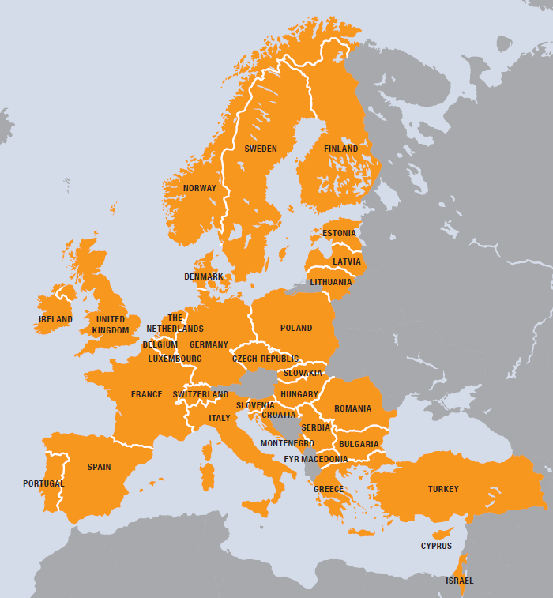
EGI Infrastructure
VO
European
Over 35 countries
Grid
HTC services
Cloud services
Storage services
Infrastructure
350 resource centres
400,000 cpu cores
190 PB storage
SLA AUP
VO
EGI.eu
SLA AUP
To support the long tail of science researchers EGI is developing a dedicated platform to address users’ requirements
?
?
For European researchers and their international collaborators

Slide 3
Users requirements for a LToS platform
Availability of resources HTC, cloud and storage
Short-medium term access
Quick access, avoid unnecessary bureaucracy
Long-term, dedicated resource access, dedicated SLAs, will still require separate community Vos
Pilot with resources from NGI_PL, NGI_GR, NGI_IT
“Zero-barrier’’ access: any user who carries out relevant research can access resources
No need for specialised relationship with an NGI, NREN, or CA
No need to establish an Registration Authority at user’s institute
User support
Available through the NGIs

Slide 4
EGI requirements for a LToS platform
reuse existing technology building blocks as much as possible
provide acceptable level of tracking of users and user activities
can scale up to support large number resource providers, technology providers, use cases and users
tangible outcomes
Traceable scientific publications from the long tail – with EGI acknowledgements
User stories from the long-tail
Easier to involve users in EGI

Slide 5
Long tail of science platform architecture
IdP
User Management Portal
Users DB
EGI SSO
IdP
Security Policy VO AUP
User support
Science Gateway
Science Gateway
X509 credentials factory
Resources

Slide 6
User Management Portal for the LToS
User facing features, users can:
Log in using their federated identity
Provide the additional information not available in the IdP
Submit a request for resources
EGI/NGIs facing features:
Assign a UID to all the users of the long tail of science platform
Approve the user’s request, or suspend a user
Check the user’s usage of resources

Slide 7
Improve User tracking
For EGI X509 certificates are at the moment still a requirement
Most of the science gateways are using robot certificates to generate short-term proxies for the users
Use of robot certificates proxies can be extended for the LToS platform
For the LToS platform the UID is provided by the User Portal. The user will have the same UID using different science gateways. It’s a per-user sub-proxy
X509 Proxy DN:
Robot Certificate info
User UID
VO Information
The same for every user of the gateway

Slide 8
Advantages of the per-user sub-proxy
User tracking
Services get “different” credentials for individual users
It’s possible to block one user without blocking all the users using the same robot certificate
Security
Individual users can be isolated, e.g. preventing them to access other users’ workspace
Accunting
Account for individual users’ usage
Report the actual number of real users accessing the infrastructrure
And the online CA?
It’s an alternative (more elegant?) solution for the same problem
Not as commonly available as the robot-certificates
Robot-certificates at the moment are the easiest solution to have the platform online in few months

Slide 9
Summary
Problems we want to solve:
Fragmentation of resources for the long-tail
Catch-all European VO
Lack of support for the long tail in some NGIs
European community with EGI.eu leadership
X509-based access even for individual users
Per-user sub-proxy mechanism
Restricted usability of robot certificates
Extended possibilities for user code on the new VO
Difficulties in engaging with individual researchers
User registration portal with links to NGI staff
Next steps
Science gateways are already in production
Developments to support per-user sub-proxies available in a couple of months
User Management Portal to be presented during the EGI Conference in May
Open for testing during the conference
Project wiki: https://wiki.egi.eu/wiki/Long-tail_of_science_pilot

Slide 10
Thank you for your attention!
Questions?

