Slide 1
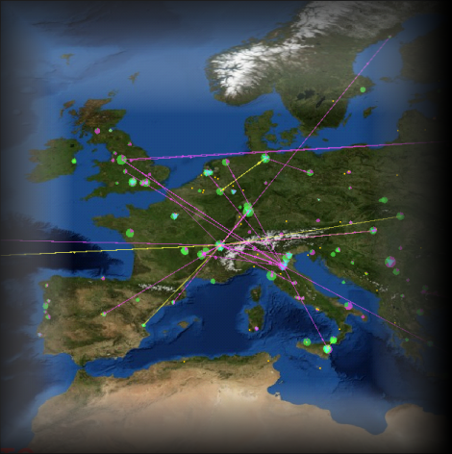
De BiG Grid e-Infrastructuur digitaal onderzoek verbonden
David Groep, Nikhef
KennisKring Amsterdam
28 october 2009
(abbreviated version)
David Groep, NIKHEF
Graphics: Real Time Monitor,
Gidon Moont, Imperial College London, see http://gridportal.hep.ph.ic.ac.uk/rtm/

Slide 2
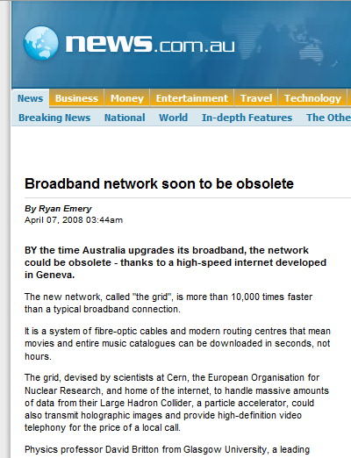

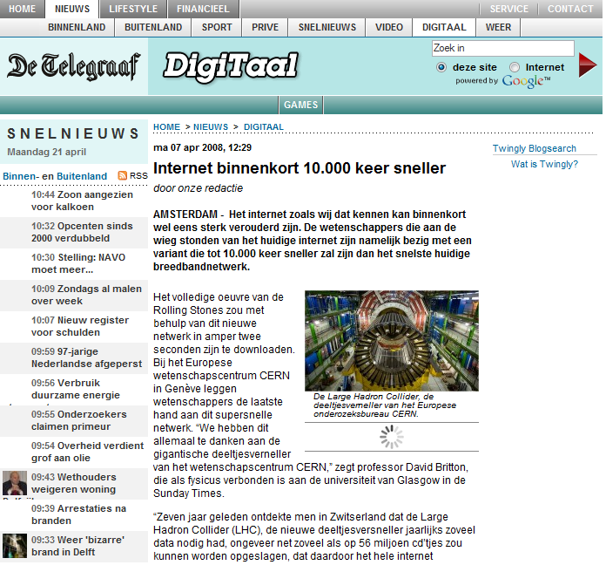
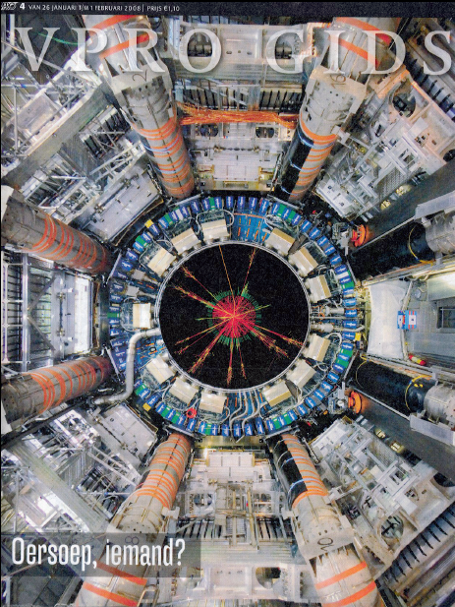
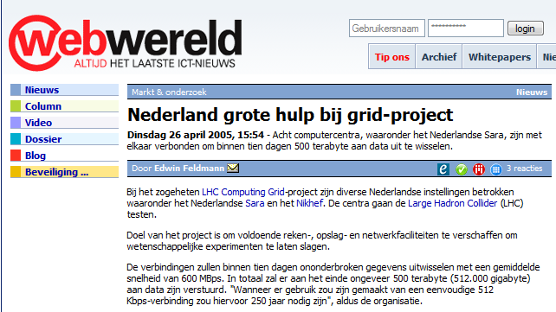


Slide 3
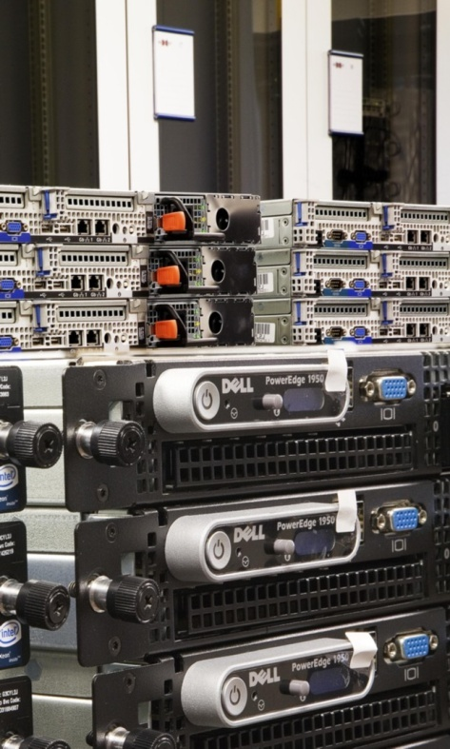
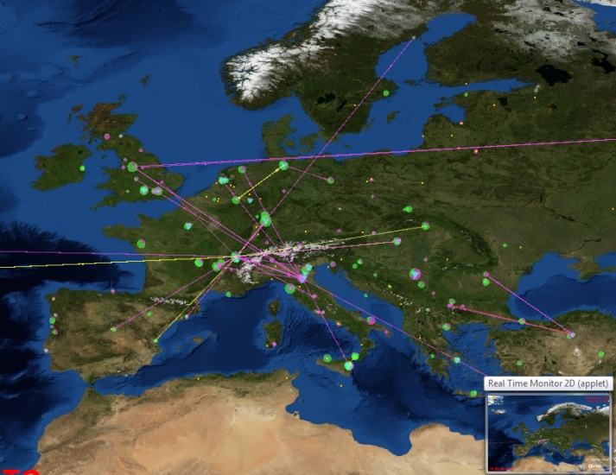
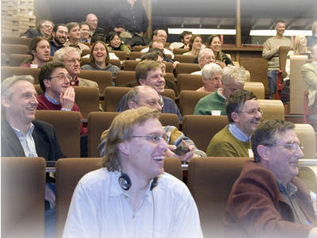
e-Infrastructure for Research
World Wide Web (1990) – sharing information
Grid (1997) – sharing computers and storage
Clouds (2007) – commoditizing the Grid
What Makes
e-Research Happen ...
more than one place on earth
more than one computer
more than one science!
more than …

Slide 4
And Why Do We Need It?
Enhanced Science needs more and more computations and
Collected data in science and industry grows exponentially
The Bible | 5 | MByte
Your own digital photographs | 5 | MByte/image
Bio-informatics databases | 500 | GByte each
Refereed journal papers | 1 | TByte/yr
Satellite world imagery | 5 | TByte/yr
Large Synoptic Survey Telescope | 30 | Tbyte/day
Internet Archive 1996-2002 | 100 | Tbyte
Web downloads for Google indexing | 4 | PByte/yr
Large Hadron Collider physics | 20 | PByte/yr
Astronomy tomorrow: SKA | 365 | PByte/yr
1 Petabyte = 1 000 000 000 Megabyte

Slide 5
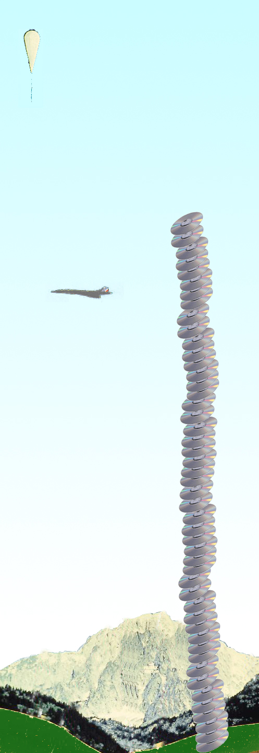
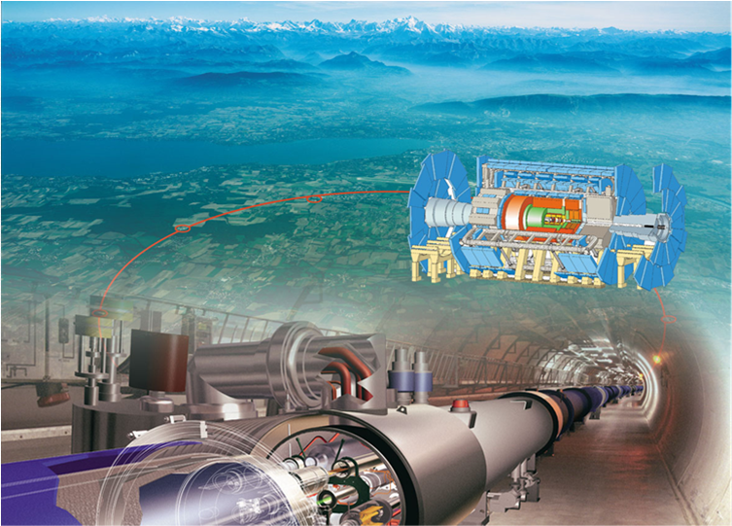

Computing for Sub-Atomic Physics
Balloon
(30 Km)
CD stack with
1 year LHC data!
(~ 20 Km)
Example: the Large Hadron Collider
looking at the
fundamental forces of nature
27 km circumference
Located at CERN, Geneva, CH
Concorde
(15 Km)
~ 20 000 000 Gigabyte per year
~ 60 000 modern PC-style computers
Mt. Blanc
(4.8 Km)

Slide 6
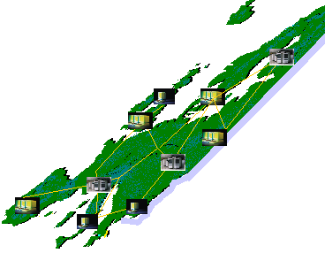

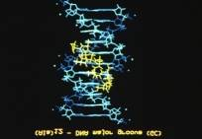
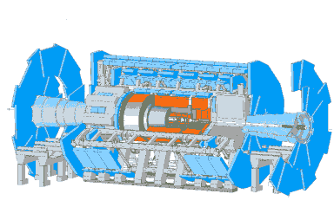
Beyond the Web: Grids for e-Science
Work regardless of geographical location, interact with colleagues, share and access data
Scientific instruments, libraries and experiments provide huge amounts of data
Grid – enabling distributed collaboration
Software enables resource sharing
Community building and collaboration
Access resources at any place
Move your work around the world, or in to the Cloud
Graphic: Federico.Carminati@cern.ch

Slide 7
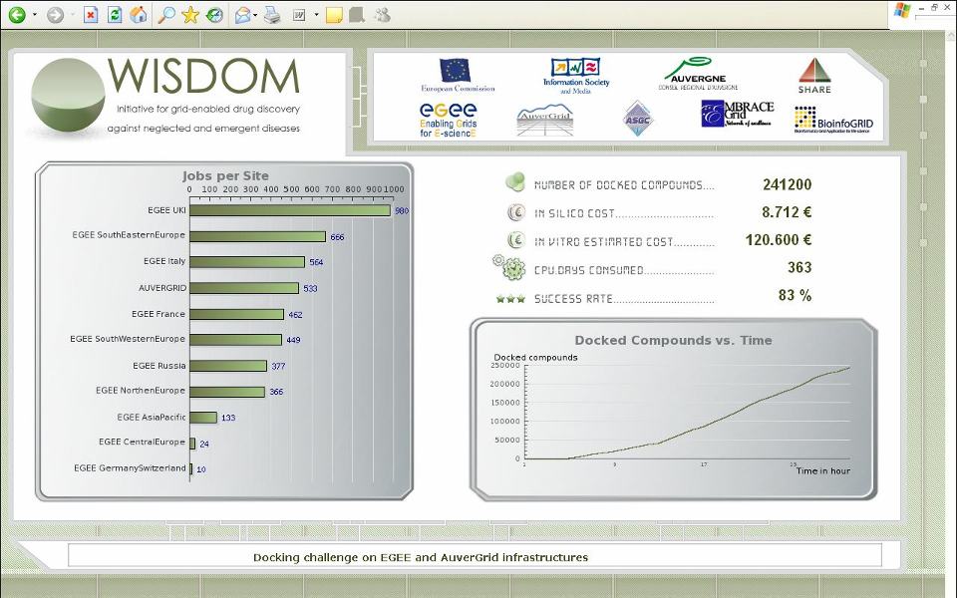
Wide-area In-Silico Docking On Malaria
  47 sites
  15 countries
  3000 CPUs
  12 TByte disk
over 46 million ligands virtually docked on malaria
and H5N1 avian flu viruses in less than a month

Slide 8
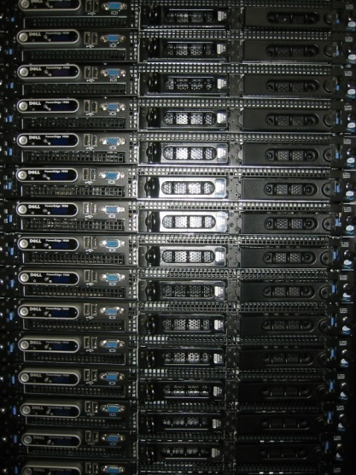
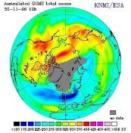
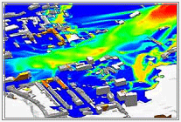
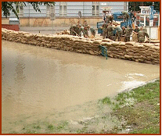
Science and Corporate Grids
Big science is not alone
Medical imaging
Aerospace modelling air flow and stress
Finance rapid what-if analyses (oops!)
Climate modelling
Flood prediction
But although the parallelism is convenient, managing complexity in a large-scale environment is not … and cooling and power constraints limit the data centre … the grid could help do the work in the ‘greenest’ place
image sources: EGEE ESR VO, EGEE BioMedical VO, EU FP5 CrossGrid project, Nikhef

Slide 9
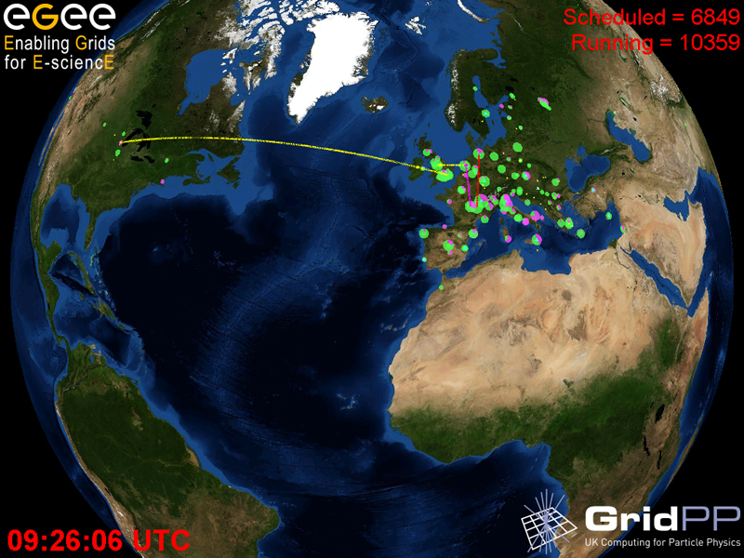
Making the Grid …
the persistent e-Infrastructure
Different Communities build Different Grids

Slide 10
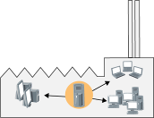
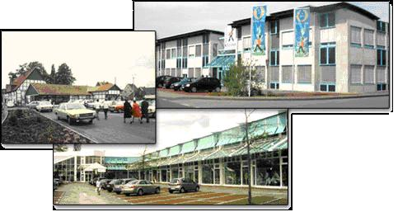
Finance
Pharma
Aerospace
Cinema
Enterprise Grids
‘the Cloud’
Amazon
Google
SalesForce.com
...
Large clusters
Dedicated or
Virtual Private Networks
Backup-as-a-Service
Software-as-a-Service
Infrastructure-as-a-Service
Commoditized services
Available to SMEs
… and even consumers
Different name, same concept!

Slide 11


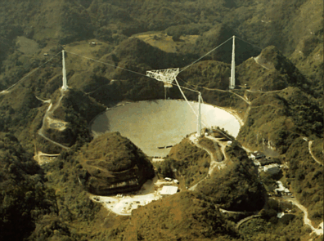


Contributed ‘Volunteer’ Computing
Many applications fit a ‘client-server’ model
– ‘it does not matter where the computer or data is’ –
and if you have mainly compute tasks and little data,
even idle home PCs can contribute compute power
– although network bandwidth is limited …
Pioneered ~ 1996 by SETI@home
and ‘distributed.net’
BOINC: generic middleware for ‘volunteer’ grids:
2005
go to boinc.berkeley.edu for information and links to projects

Slide 12
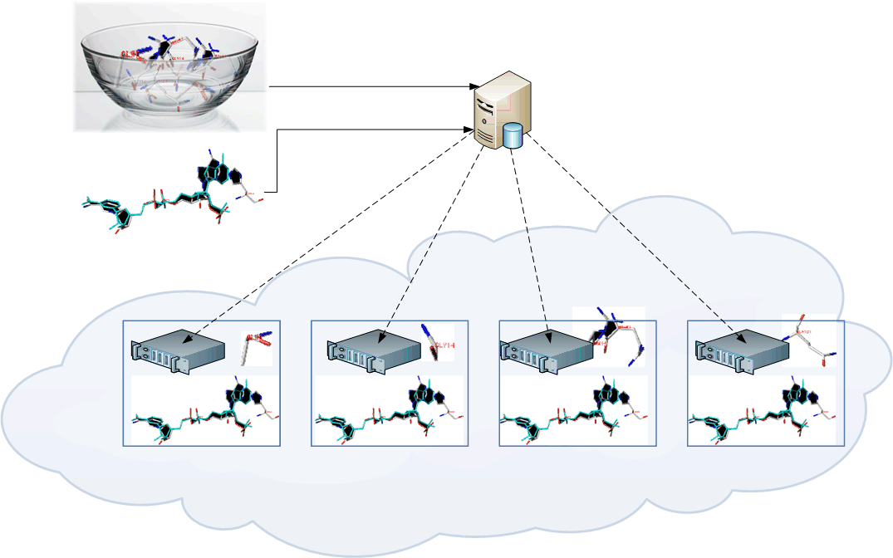
Conveniently Parallel Computing
Lab A
Find ligands from the bowl that match the molecule!
I can try all of them in parallel!
Computer centre B
Send results back
Grid Site
Grid Site
Grid Site
Grid Site
Does it fit?
– scientific and research cluster grid computing –

Slide 13
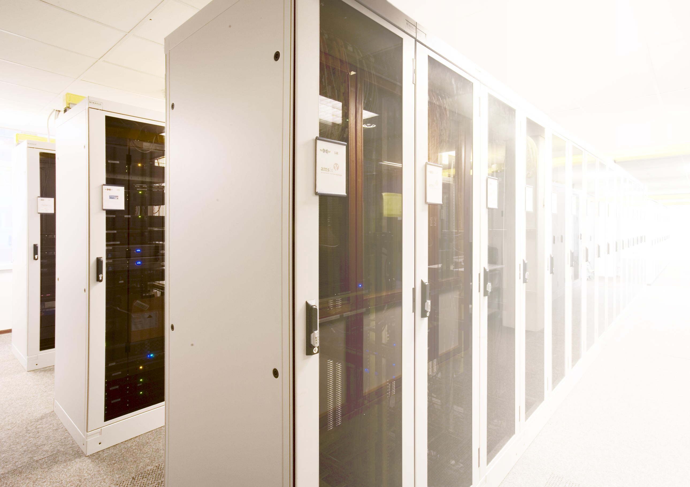
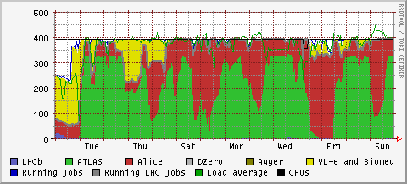
Nikhef (NDPF)
2550 processor cores
390 000 GByte disk
3x10000 Mbps networks
SARA (GINA+LISA)
~2900 processor cores
850 000 GByte disk
1 500 000 GByte tape
4x 10 000 Mbps networks
RUG-CIT (Grid)
> 200 processor cores
34 000 GByte disk
10 000 Mbps networks
Philips Research Ehv
416 processor cores
126 000 GByte disk
1 000 Mbps networks

Slide 14
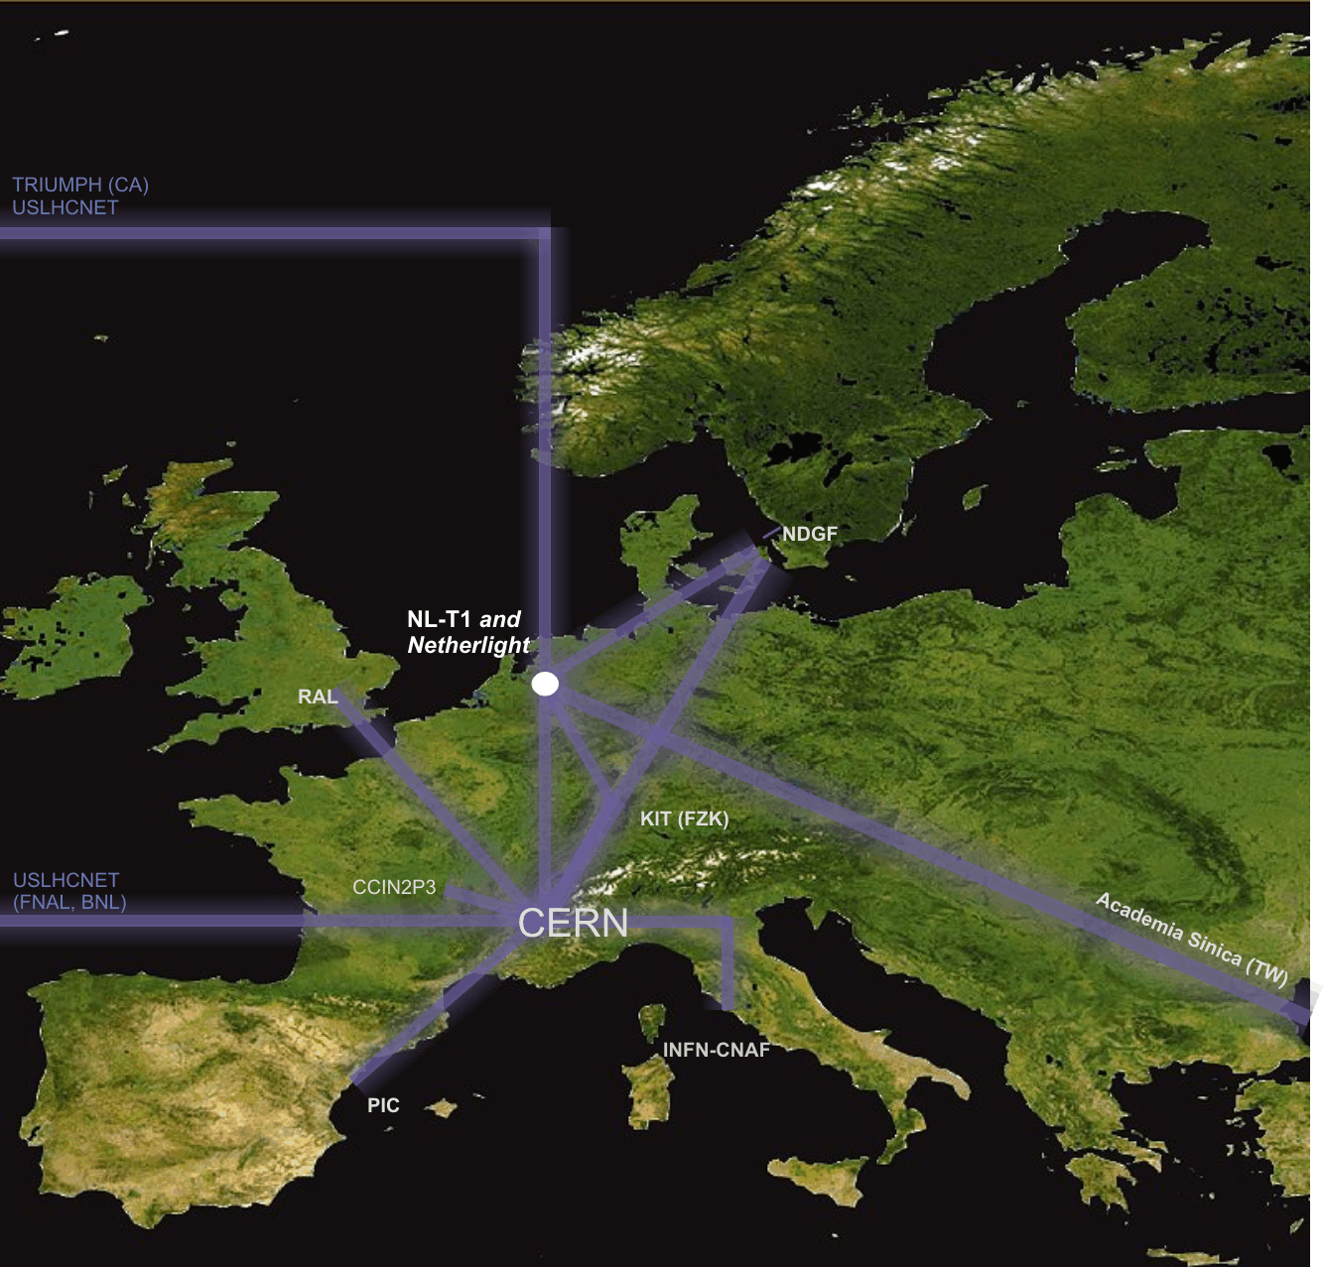
Enabling the Grid – the Network
LHC Optical Private Network
10 000 Mbps dedicated
global networks
“there’s always fibre within 2 miles from you –
where ever you are in the Netherlands
it’s just that last mile to your home that’s missing –
and a business model for your telecom provider…”

Slide 15
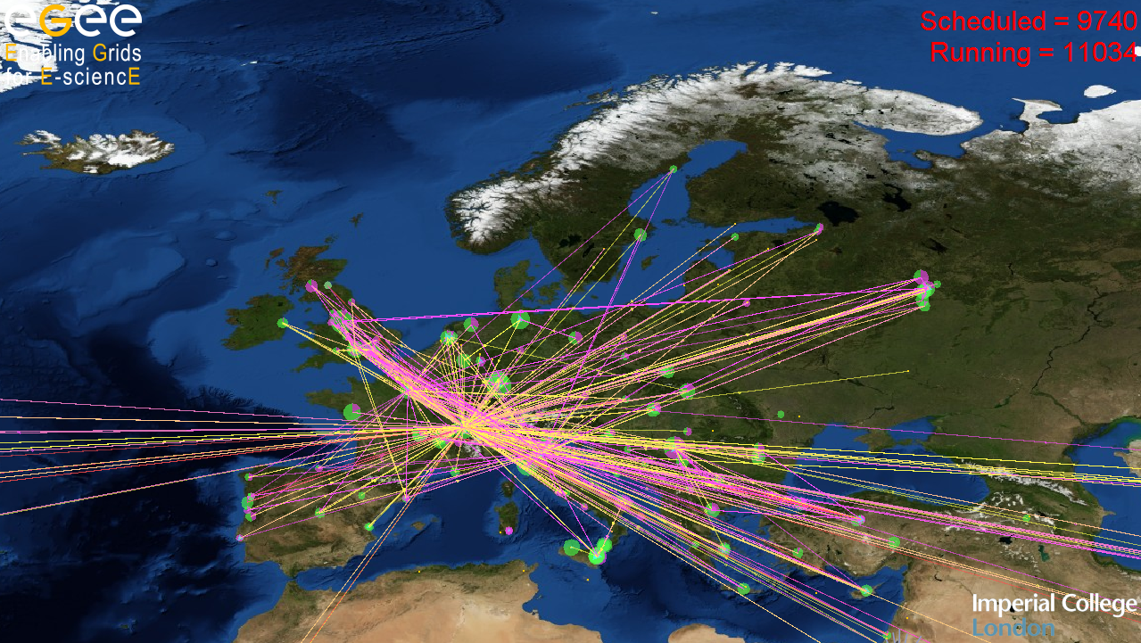
Applications
beyond Big Science
or: can the Grid help me?

Slide 16
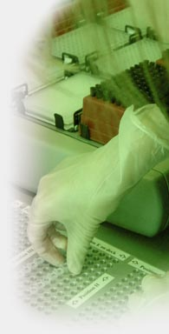
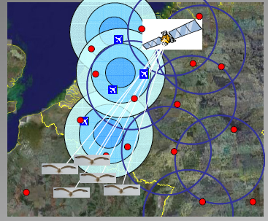
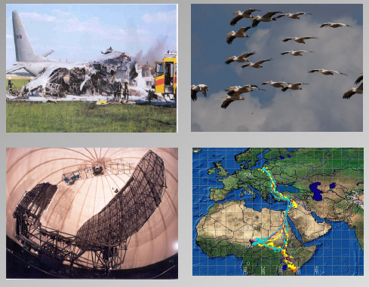
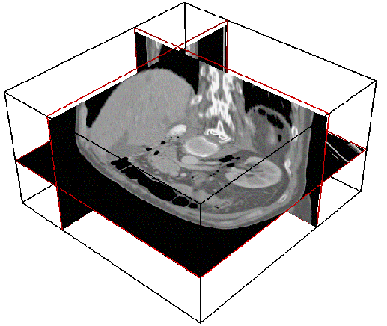
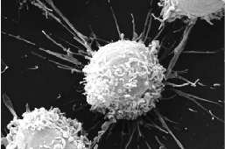
Virtual Laboratory for e-Science
Image sources: VL-e Consortium Partners
Data integration for
genomics, proteomics, etc.
analysis
Timo Breit et al.
Swammerdam
Institute of
Life Sciences
Medical Imaging and fMRI
Silvia Olabarriaga et al.
AMC and UvA IvI
Avian Alert and FlySafe
Willem Bouten et al.
UvA Institute for Biodiversity Ecosystem Dynamics, IBED
in ESA, SARA collaboration
Bram Koster et al.
LUMC
Microscopic Imaging group
Molecular Cell Biology and 3D Electron Microscopy

Slide 17

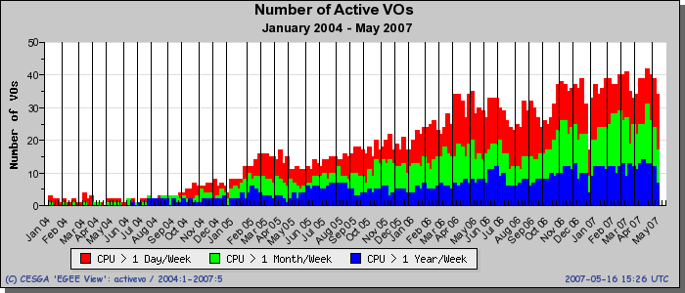
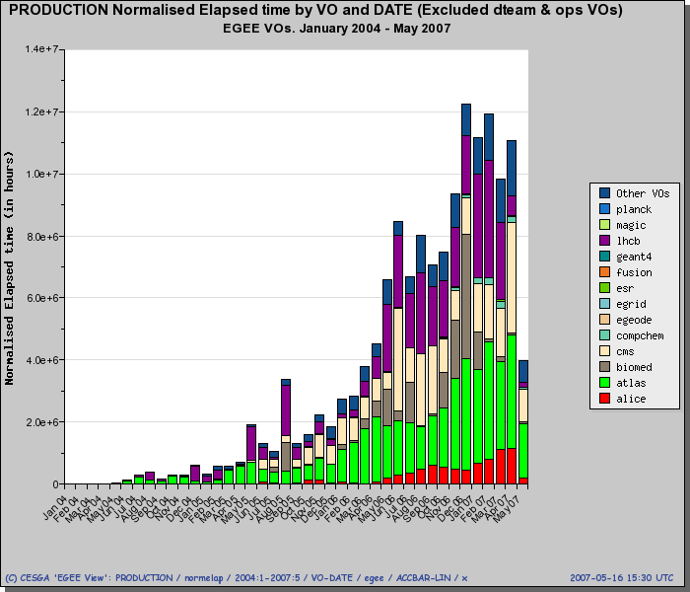

Grid Infrastructures Work!
260 distinct communities
in Europe
Number of active VOs
in EU since 2004
Compute usage since 2004 by VO
>12 million hrs/mo!
www.biggrid.nl
over 35 science communities
hosted in NL
data: EGEE monitoring, RAL and CESGA, http://goc.grid-support.ac.uk/gridsite/accounting/

Slide 18

Energizing the Data Centre – the next challenge
Floor space is no longer the limiting factor in data centres, its energy!
Rating of the power socket dominates the cost of in commercial housing
Our BiG Grid tenders drive vendors to offer the latest in Green IT hardware
Energy consumption is as important as investment price
We probably have the largest number, world-wide, of the energy efficient L5520 Intel CPUs at the Amsterdam Science Park
And maybe ... Grid computing, and fast networks, can
help move energy-intensive calculations to
where energy is plentiful ... and it could even follow the sun
It’s important to be where the network is –better: be right on top!
... and we are powered by ‘green electricity’ from renewable sources ☺ ...

Slide 19

http://www.vl-e.nl/
http://www.biggrid.nl/
http://www.nikhef.nl/grid/

