Slide 1
Internetworking and e-Infrastructure at Nikhef
David Groep
Physics Data Processing group
September 2019

Slide 2
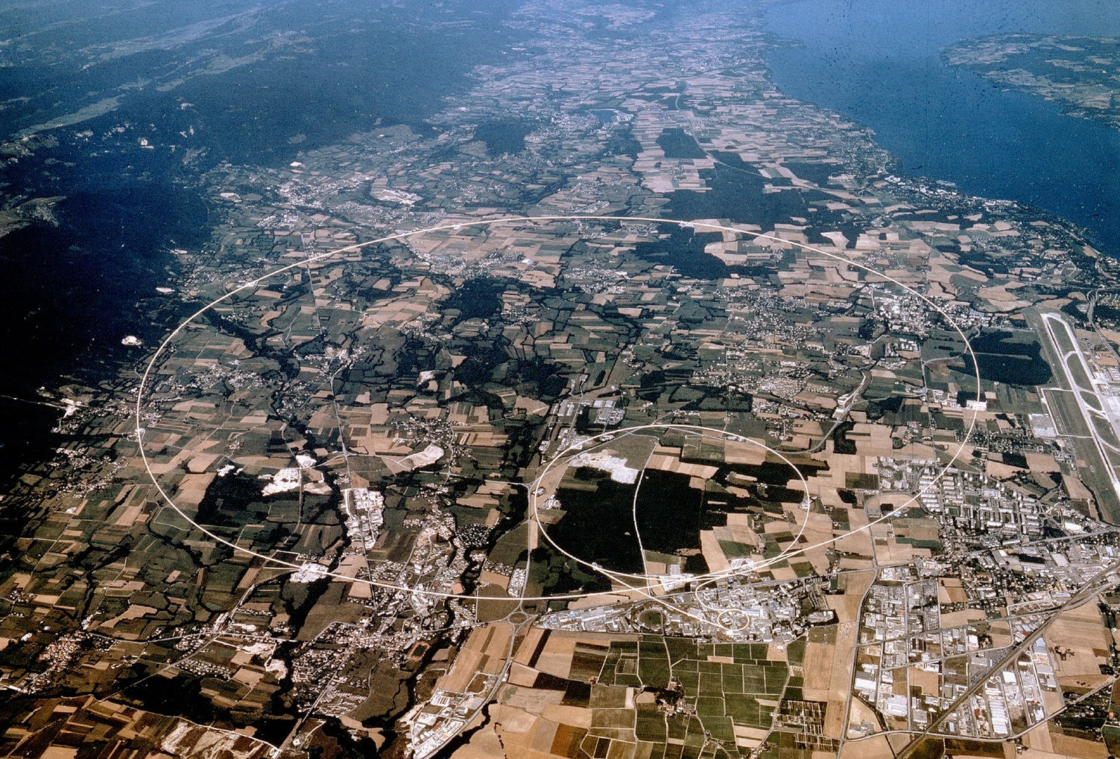





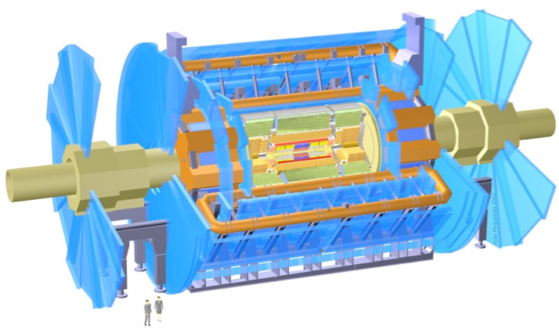

Nikhef – experiments at CERN
ATLAS
Higgs physics
Beyond the standard model
LHCb
rare decays
matter vs anti-matter
Alice
quark-gluon plasma
matter phase transitions
LHCb
ALICE
ATLAS
Atlas
protons
Haarlemse Chemische Kring
2

Slide 3
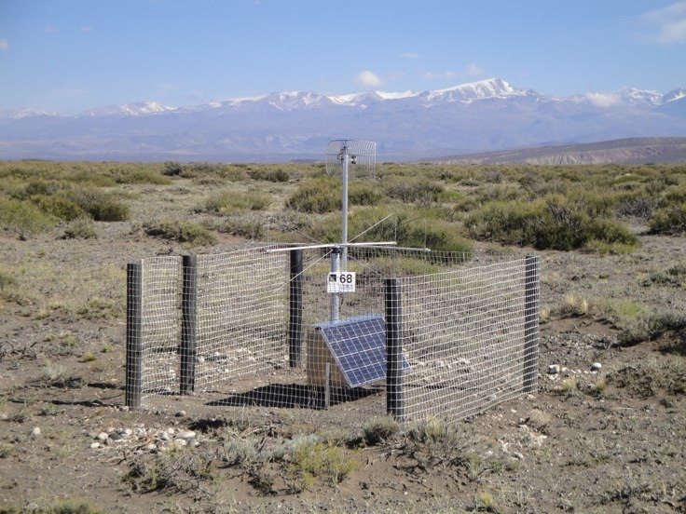
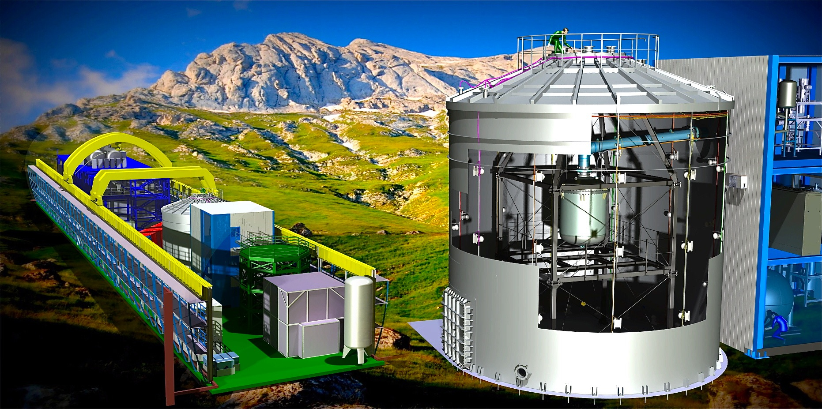
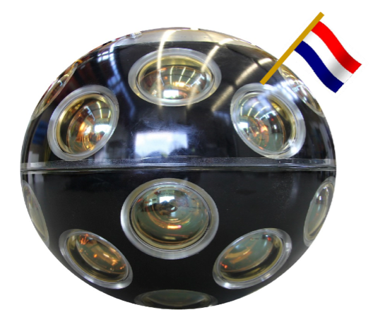
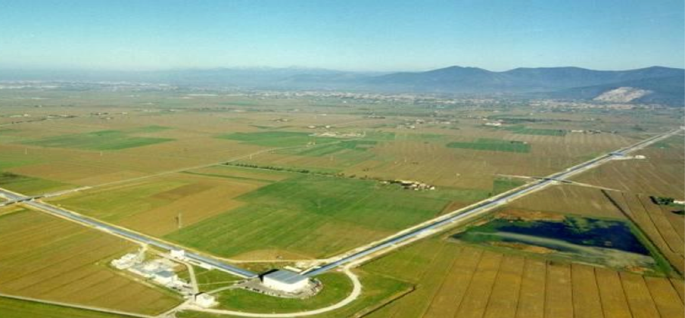
Nikhef – astroparticle physics
KM3NET
neutrino telescope
Virgo/LIGO
gravitational waves
Auger
ultra-high energy
cosmic rays
Xenon
search for dark matter
Pierre Auger - cosmic rays
Xenon1T - Dark Matter
Adv VIRGO - Gravitational Waves
KM3NeT - neutrino detection

Slide 4
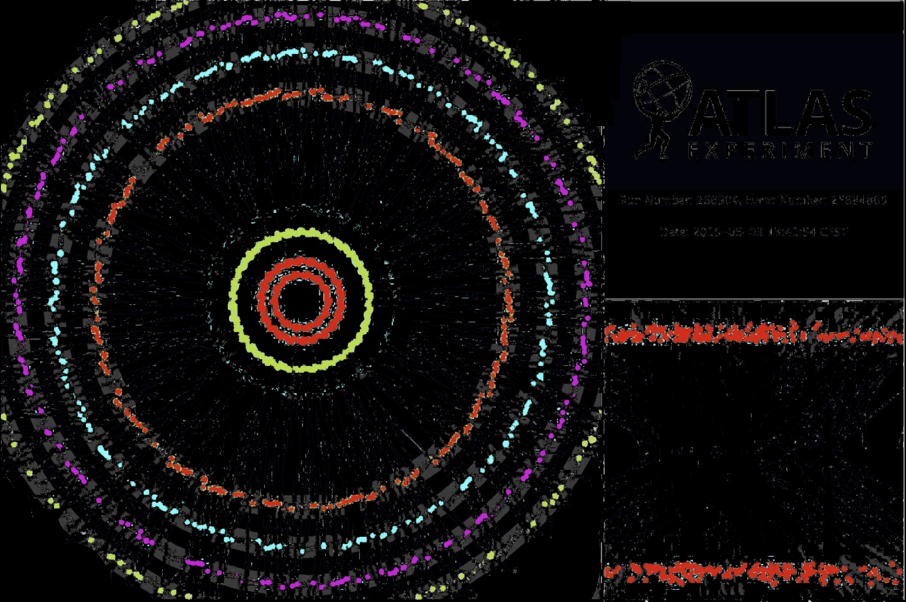
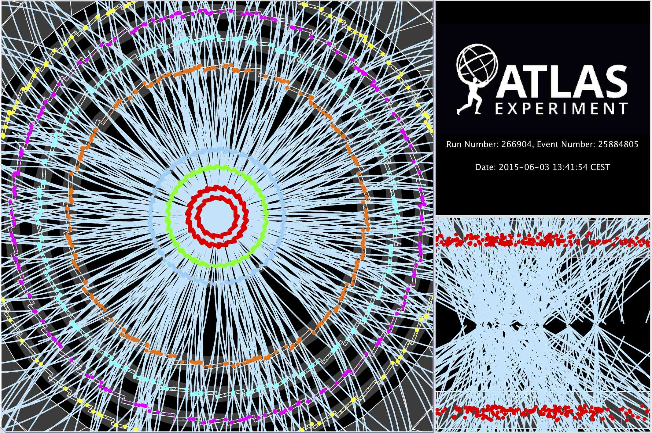

Computing on data: 40 million per second
~ 10 seconds to a compute a single event at ATLAS for ‘jets’ containing ~30 colllisions
Display of a proton-proton collision event recorded by ATLAS on 3 June 2015, with the first LHC stable beams at a collision energy of 13 TeV
Event processing time: v19.0.1.1 as per Jovan Mitrevski and 2015 J. Phys.: Conf. Ser. 664 072034 (CHEP2015)

Slide 5

On Needles and Haystacks
Selectie interessante gebeurtenissen uit ‘achtergrond’ van 1 op 10¹³ gebeurtenissen
- dit is equivalent met zoeken van
1 persoon op 1000 wereldpopulaties
oftewel: één speld in 20 miljoen hooibergen
event rates from LHC Run 1

Slide 6
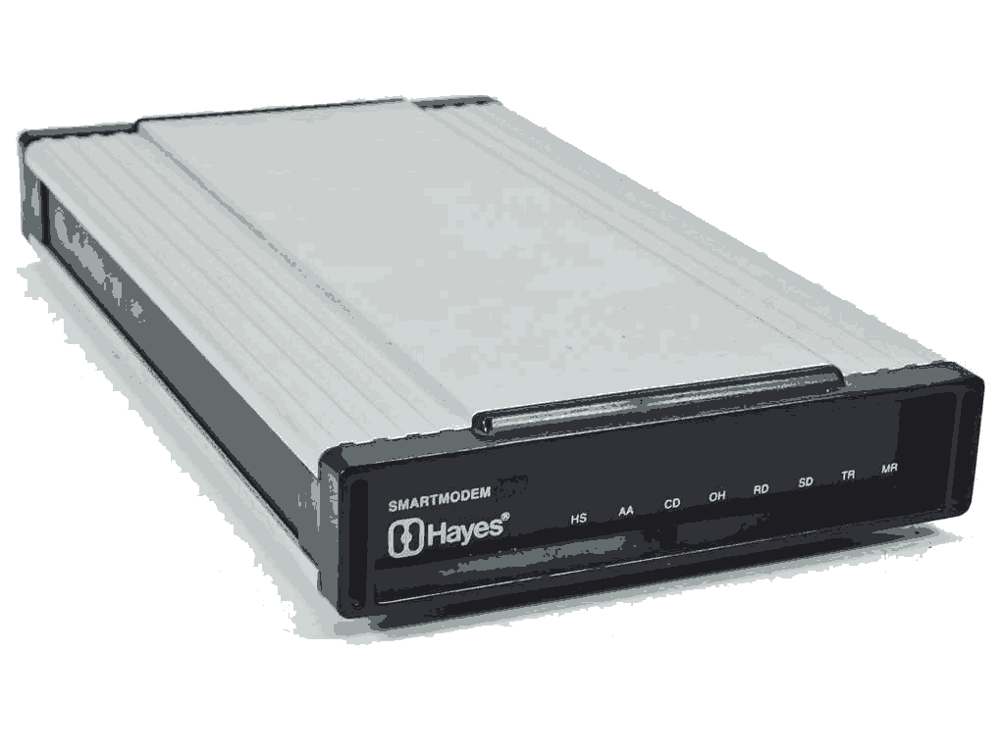
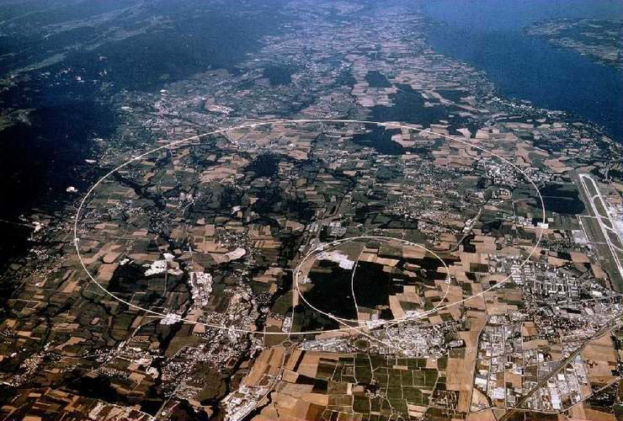
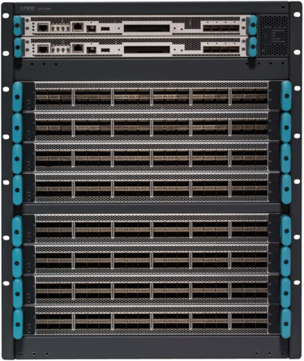
Network: from 9600bps to 1.2Tbps
4 cm
1990
~ 50 PiB/year data
from CERN to WLCG
2019
top-left: Hayes smart PSTN modem, 1200–9600bps
bottom-right: Juniper QFX10k16, up to 28.8Tbps
140cm!

Slide 7
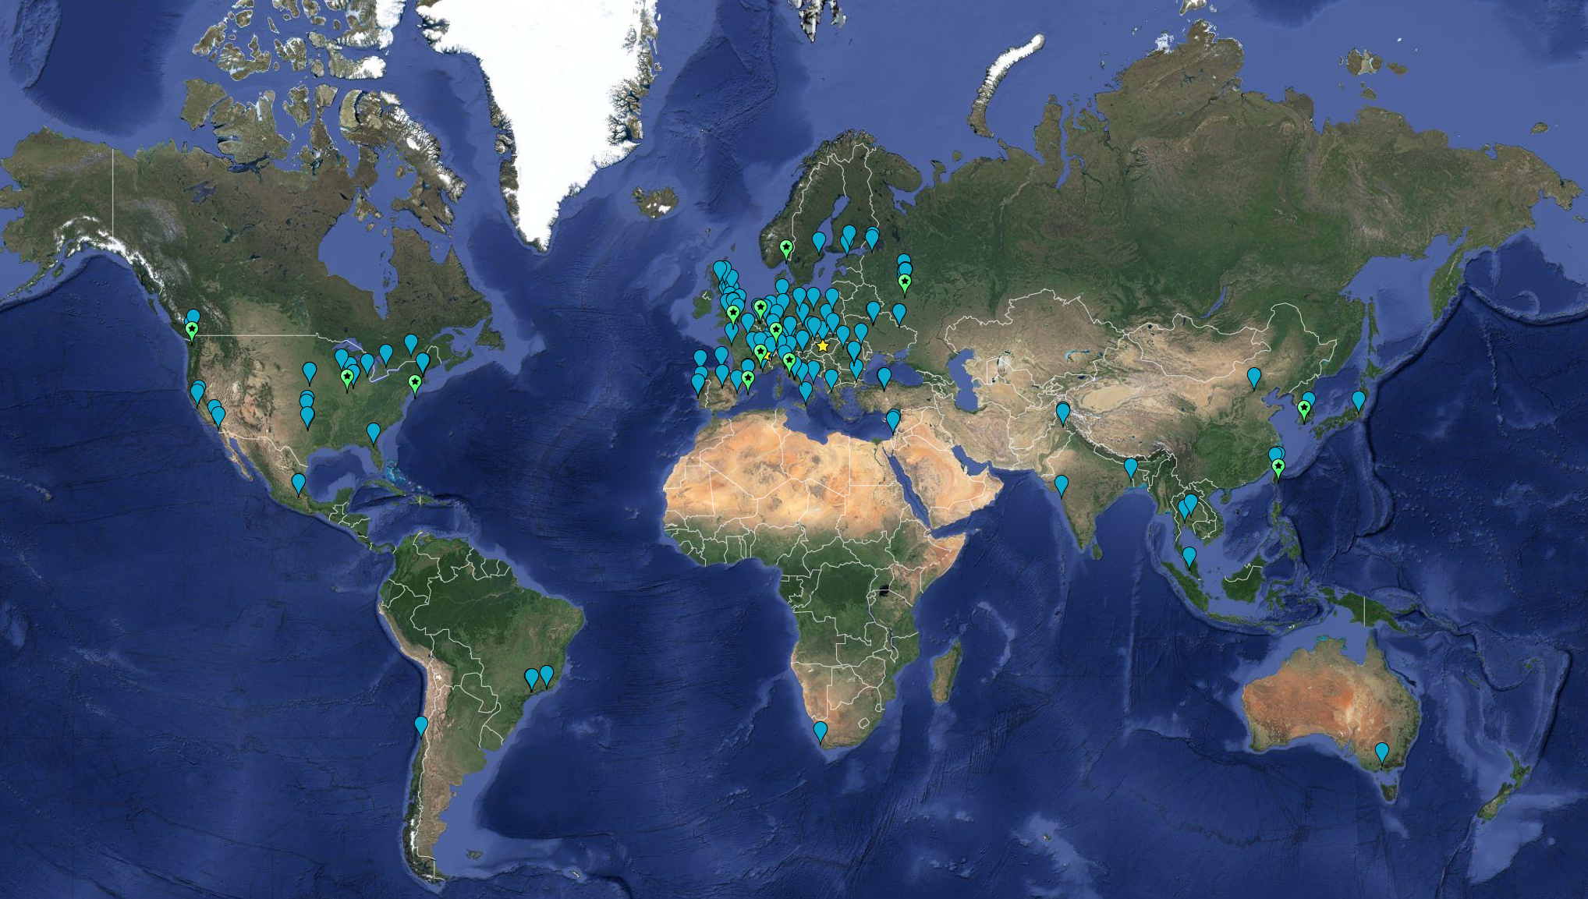


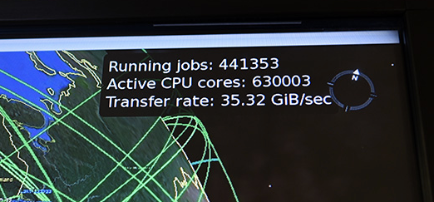

Globally distributed in EGI & WLCG
>170 institutes in >42 countries
and economic regions
Computing ~ 1,000,000 cores
On-line disks > 310 PB
Archival > 390 PB

Slide 8
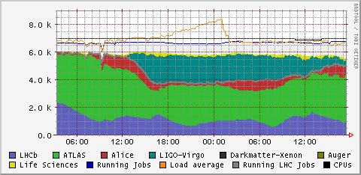
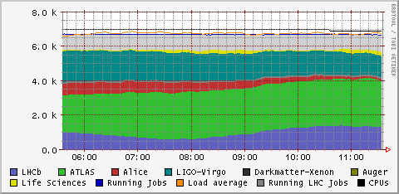
e-Infrastructure: Nikhef and SURF
other users: theory, Project MinE, ILC, ...
Nikhef Data Processing Facility, HTCompute platform utilisation, 4 September 2019

Slide 9
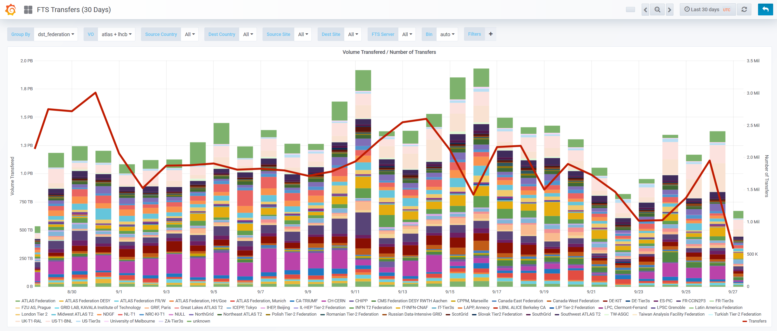
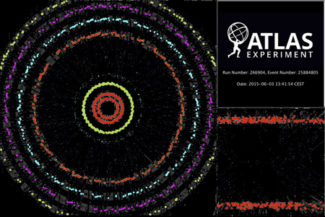
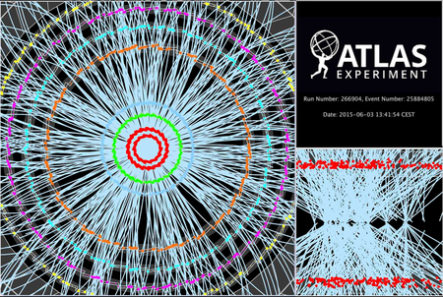

Distributing data via the network
2.6M
source: https://monit-grafana.cern.ch/d/000000420/fts-transfers-30-day on September 27, 2018

Slide 10
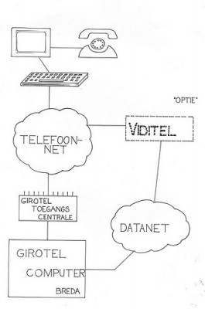
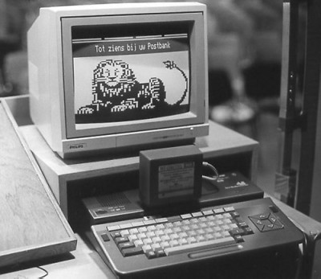
1985, at your home in the Netherlands …
September 1985: Girotel
Humble beginnings: a direct circuit link from your MSX modem to the IBM system in Breda
images: “Blauw bloed”, https://anekdotes.blauw-bloed.nl/2009/09/09/

Slide 11
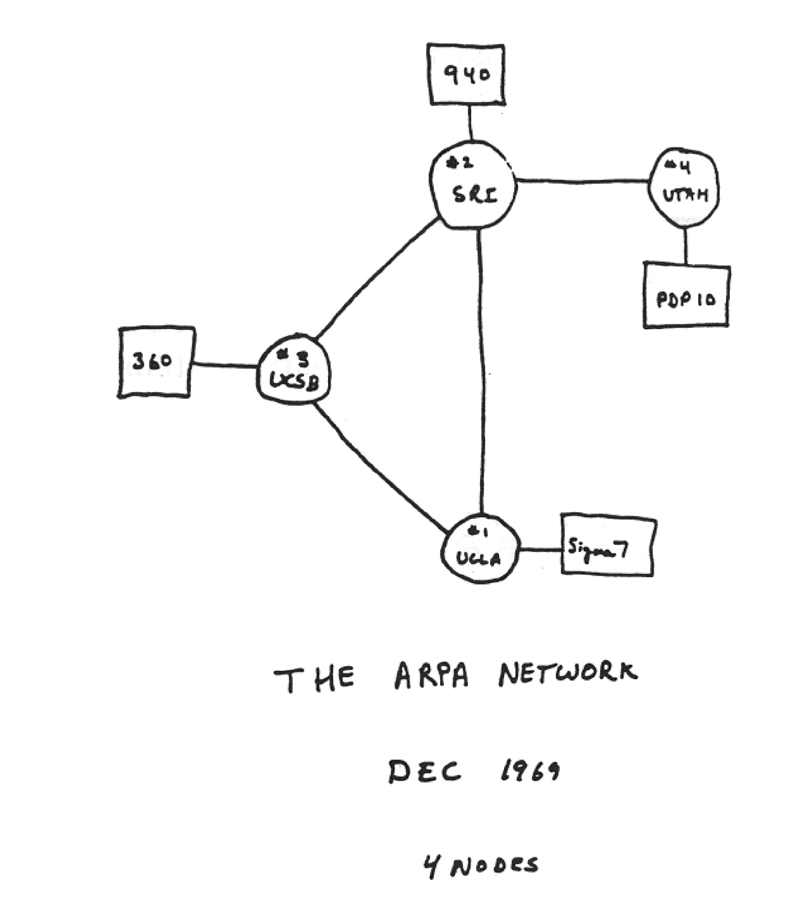
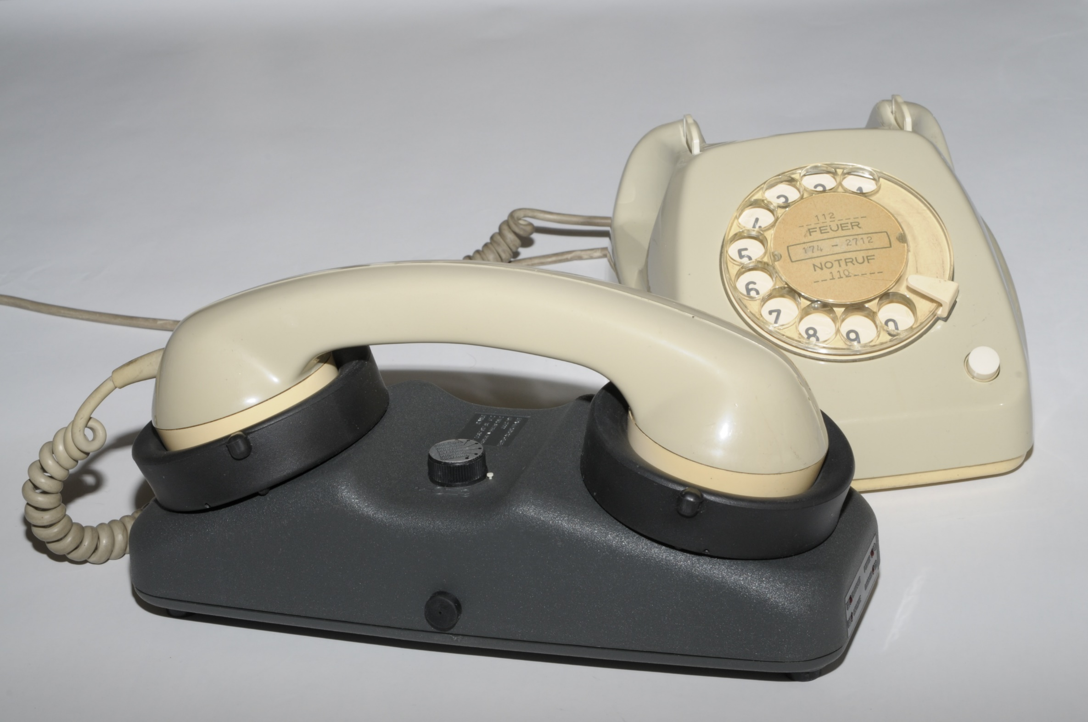
Paradigm change: packet vs circuit-switched
‘Ye olde compatibilitye’
Image source: Alex McKenzie and "Casting the Net", page 56. See https://personalpages.manchester.ac.uk/staff/m.dodge/cybergeography/atlas/arpanet2.gif ; acoustocoupler: Wikimedia

Slide 12
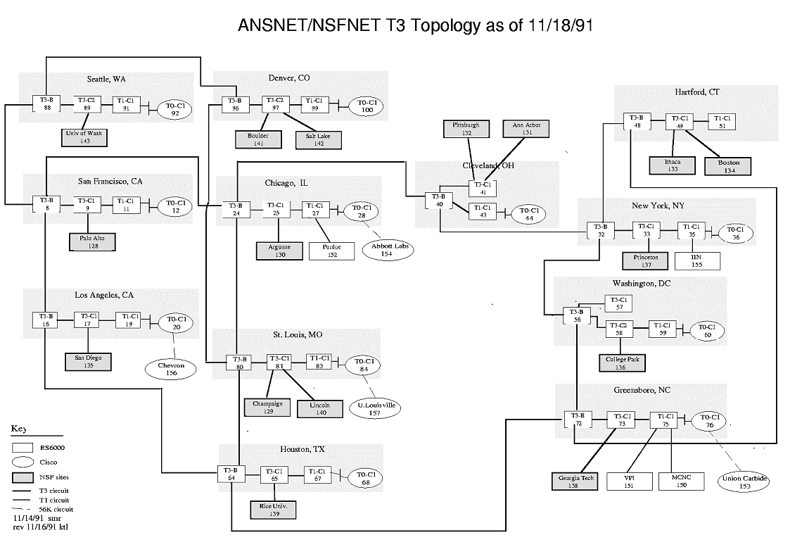

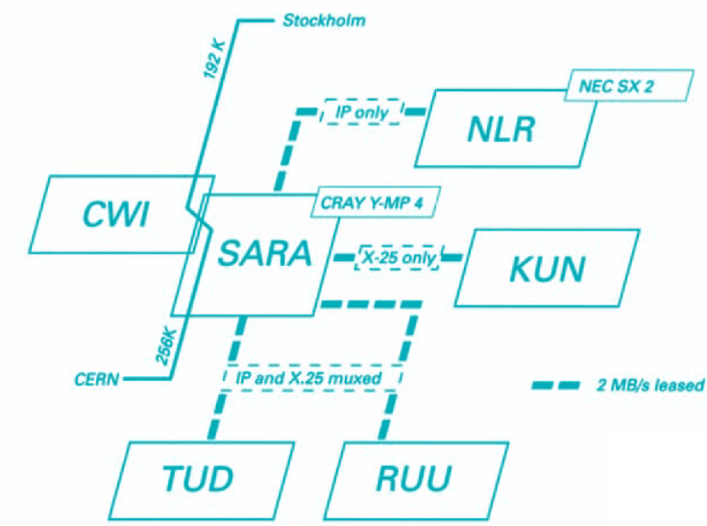

Early internet, and SURFnet in NL
SURFnet 2, 1990
See https://personalpages.manchester.ac.uk/staff/m.dodge/cybergeography/atlas/historical.html for more historic maps

Slide 13
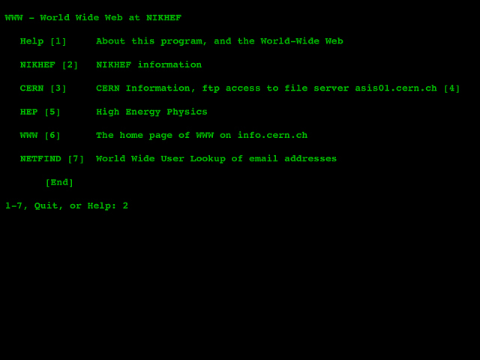
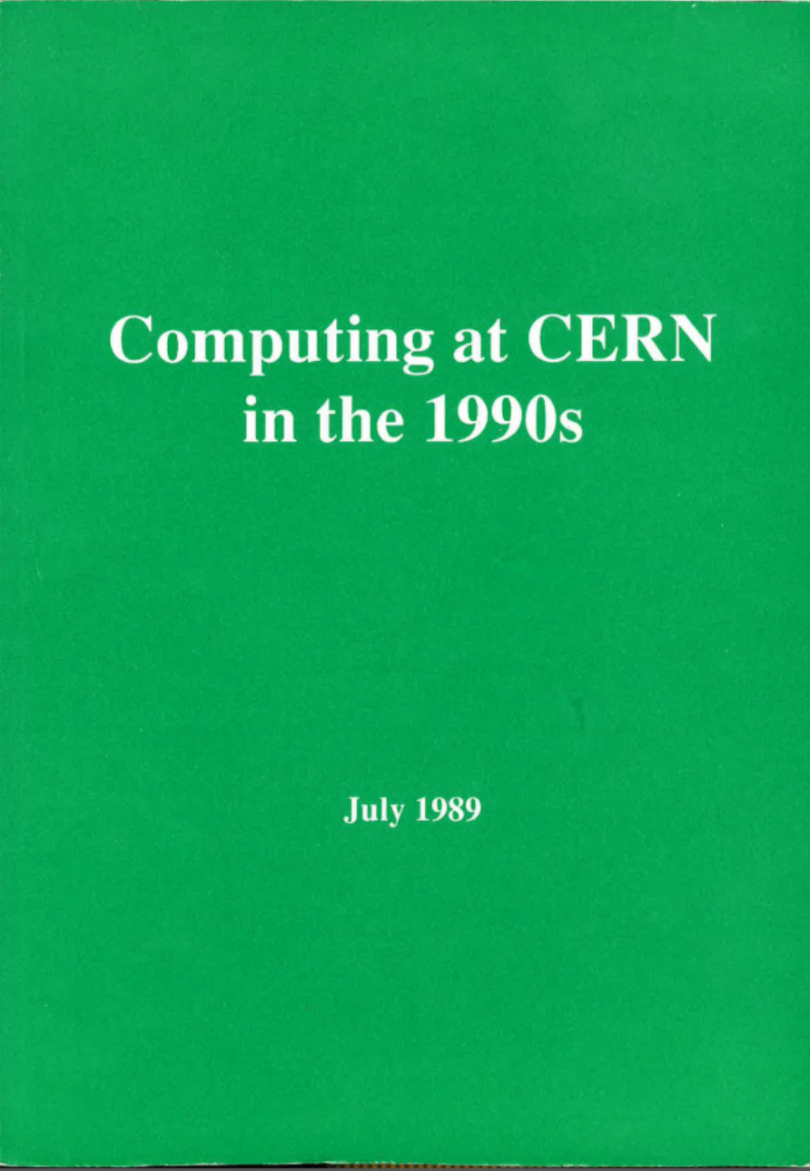
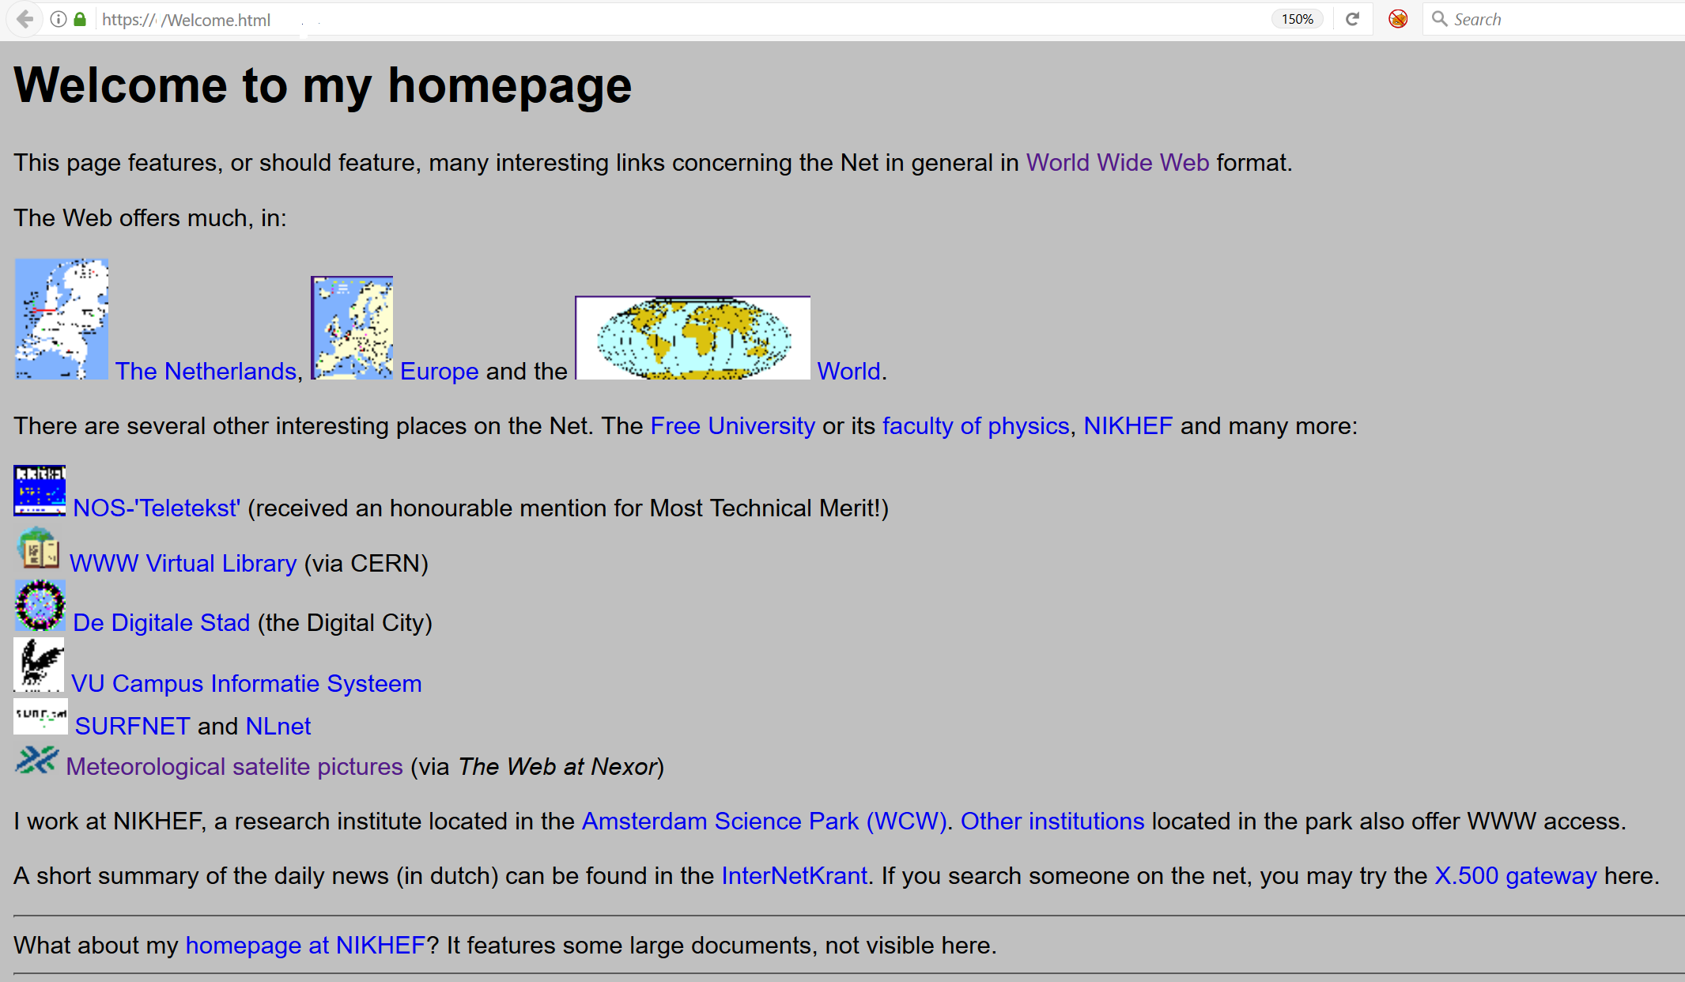
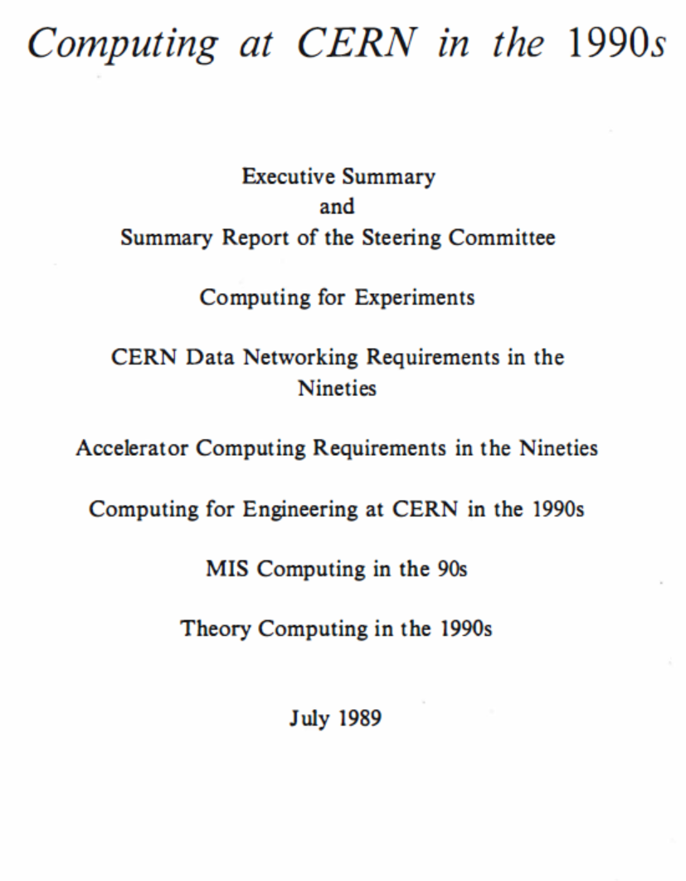
From remote access to collaboration
Sources:
nic.nikhef.nl (Feb 1992),
trivia.nat.vu.nl:8000 (Nov 1993), and
cds.cern.ch/record/206085/

Slide 14
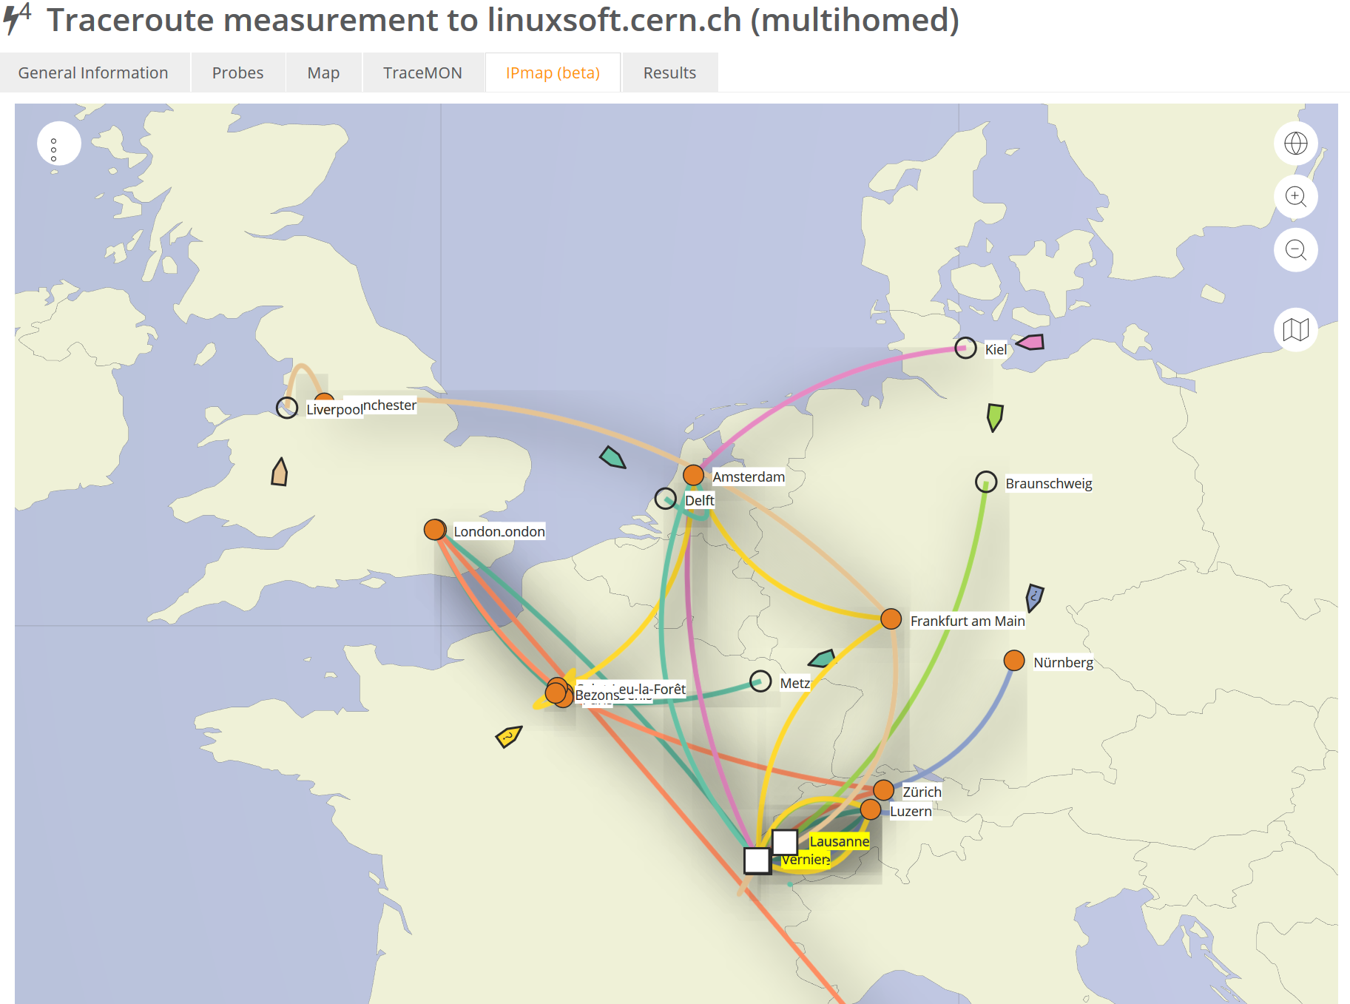

how would you get to CERN?
Data: TraceMON IPmap
from RIPE NCC Atlas
atlas.ripe.net
measurement 9249079

Slide 15
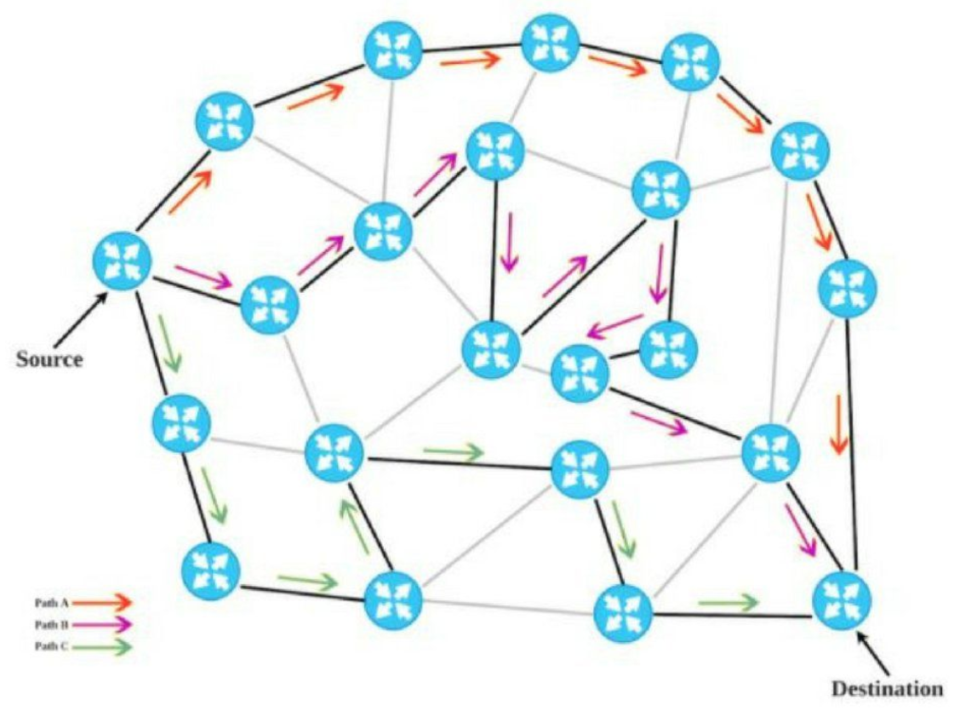



BGP, and Policy Based Routing
Ik ben AortaNet, AS6830,
(maar stiekem toch LibertyGlobal)
Ik ben CERN, AS513, en …
ik wil m’n pakketje kwijt …
188.184.38.9
Ik ben LibertyGlobal, AS9141,
en breng je wel ergens heen
Ik ben KPN, AS286,
en breng je wel ergens heen
Ik ben Sunrise CH, AS6730,
en breng je wel ergens heen
Ik ben ook GEANT, AS20965,
en breng je naar AS1103 en 1104
Ik ben SURFsara, AS1162,
en breng je direct naar AS1104!
Ik ben SURFnet, AS1103,
en breng je naar AS1104
Ik ben GEANT, AS21320,
en breng je naar AS1103 en 1104
Ik ben Nikhef, AS1104
en ik heb schijfruimte voor je
Ik ben SURFnet, AS1103,
en breng je naar AS1104
194.171.96.128/25
“segment routing”
image by David Penaloza, CISCO

Slide 16
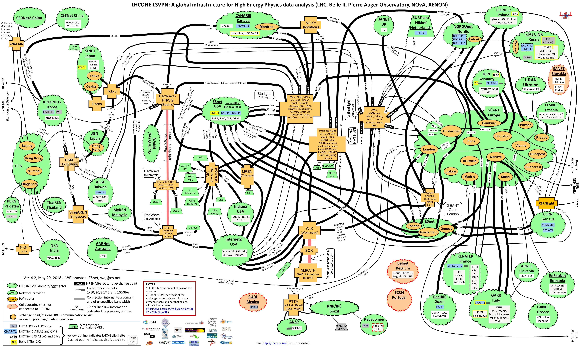
‘LHC Open Network Environment’

Slide 17
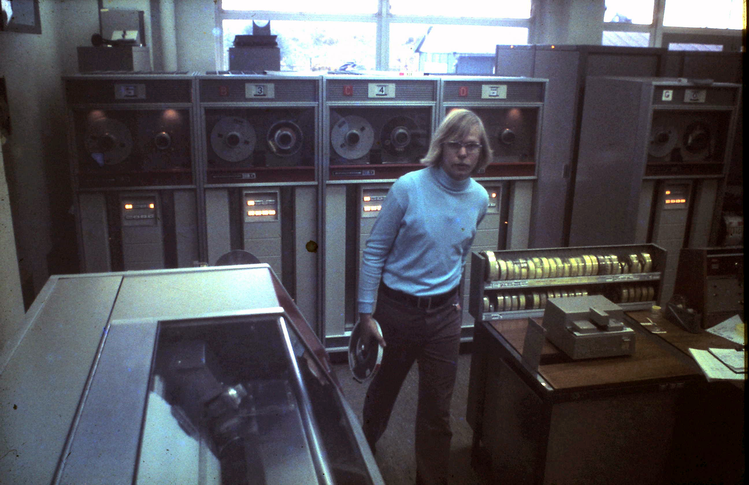
From the 80’s to today
this is how H1.40 could have looked …
it is actually the Nikhef-K computer room
on the Oosterringdijk

Slide 18
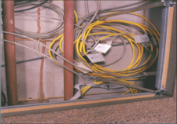
IBR LAN @Nikhef: the first exchange
1996, Nikhef H1.40
the yellow Ethernet cable is the WCW local area loop for the International Backbone Router (IBR-LAN)

Slide 19
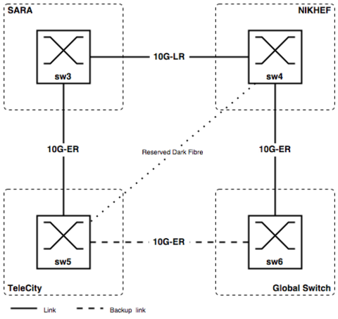
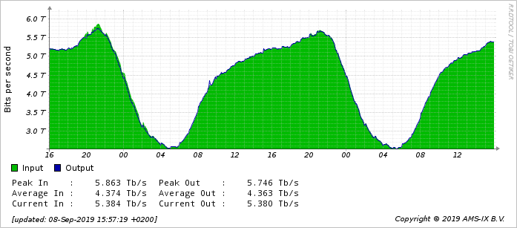
AMS-IX in ~2002, and traffic today
traffic graph: aggregate AMS-IX NL traffic on Sept 9, 2019
about 20% of the AMS-IX traffic is at Nikhef, out of 16 locations total
source: https://stats.ams-ix.net/

Slide 20
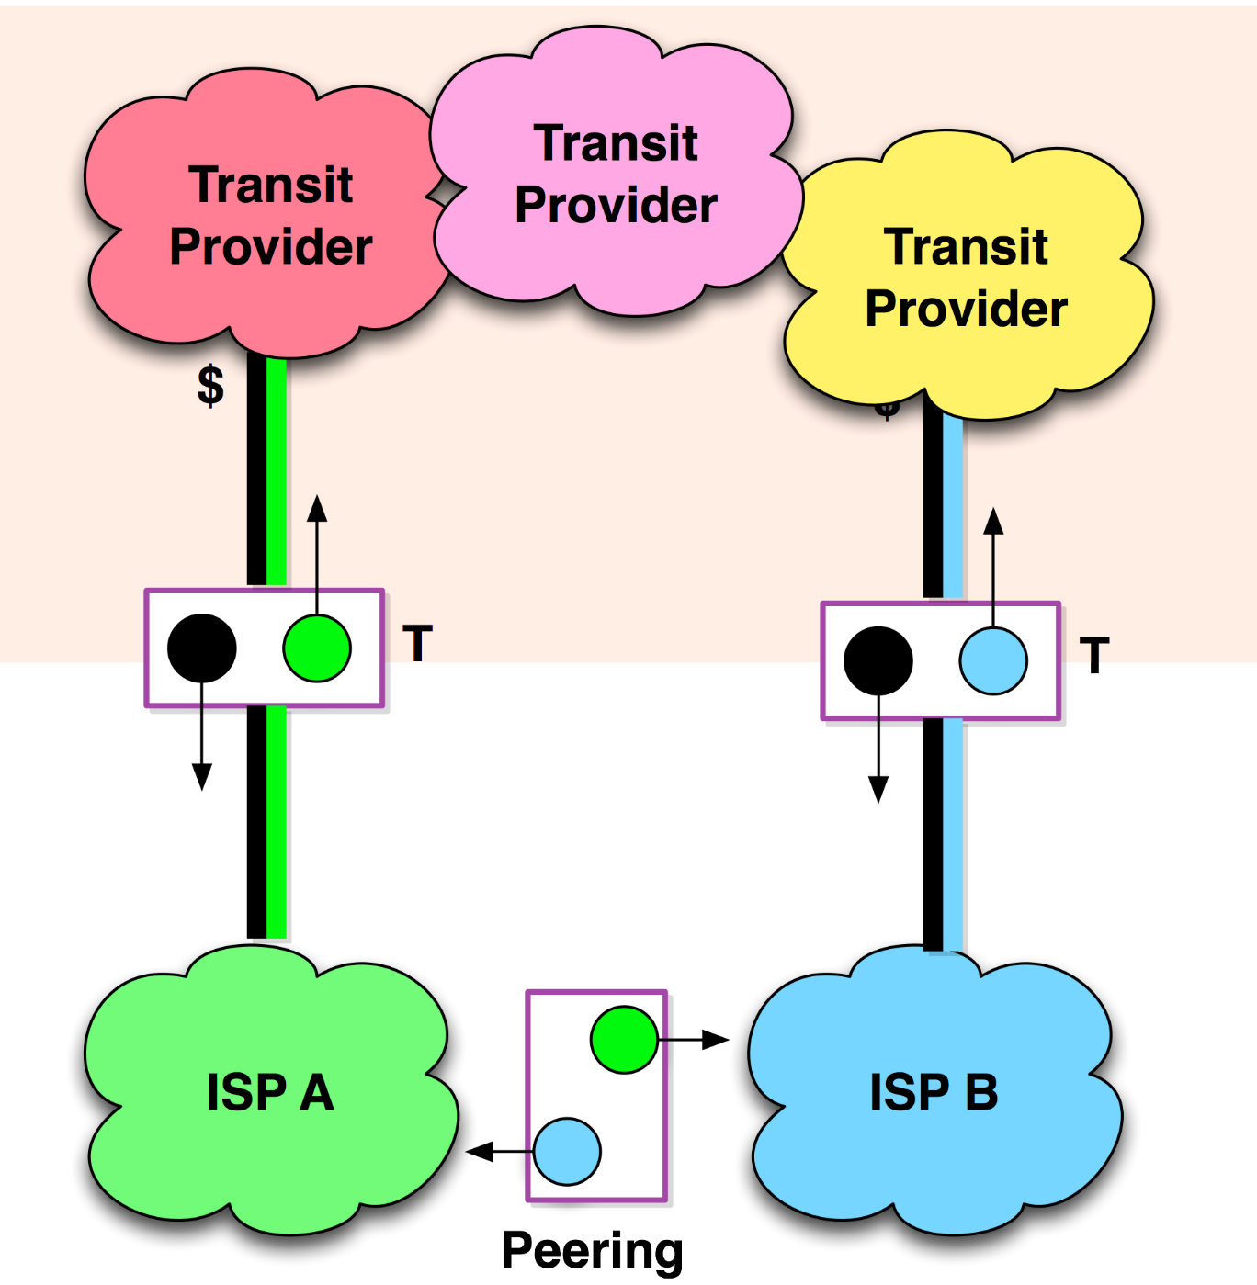

and private direct peering
Network Data Centres and Housing
the more ISPs are located together,
the easier private peerings become
parties ‘pay their own way’ to the housing location, and have their own equipment – so it’s not ‘free’
peerings can be settlement-free or paid
model takes traffic away from IX-es
For a quick summary on peering, see e.g. http://drpeering.net/core/ch4-Internet-Peering.html

Slide 21
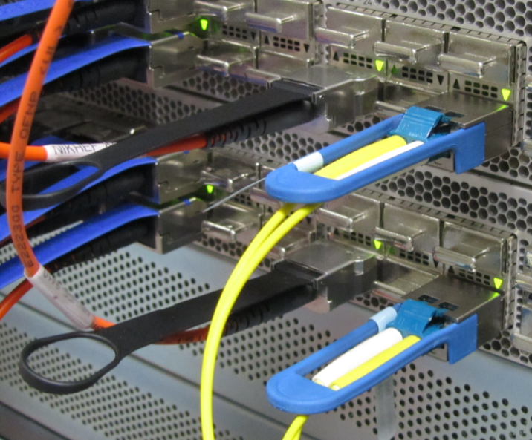
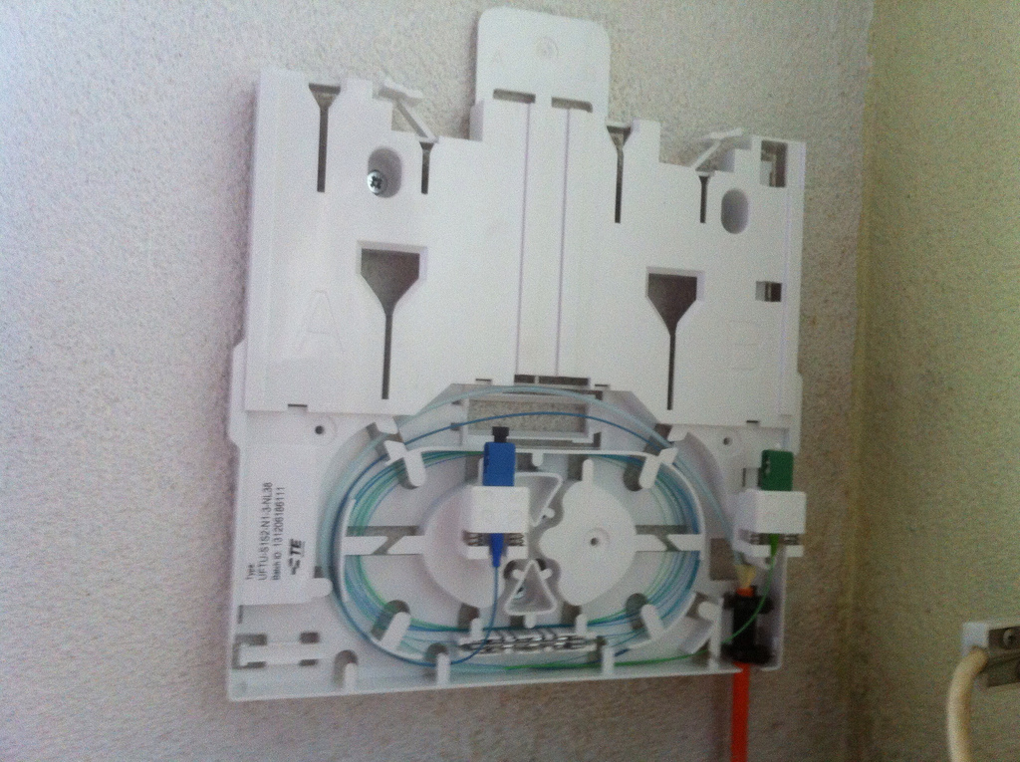
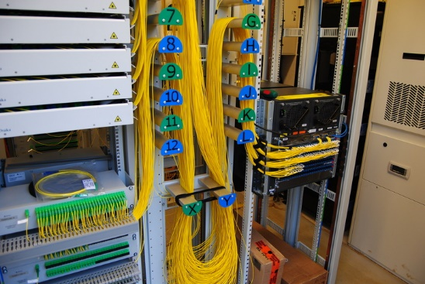
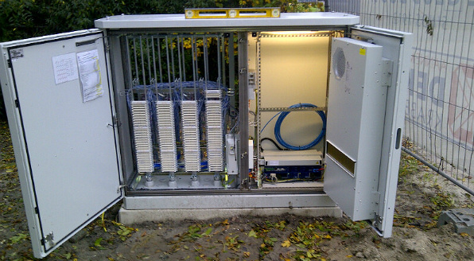
100 Gbps and up … beyond the LHC!
Thuis ‘FttH’
~0.1 – 1 Gbps BX
single strand SC
vergelijk:
VDSL BR straatkast
voor als je nog
op xDSL koper zit
0.02-0.2 Gbps
Nikhef
Data Processing
Facility
330 Gbps – 1200 Gbps

Slide 22
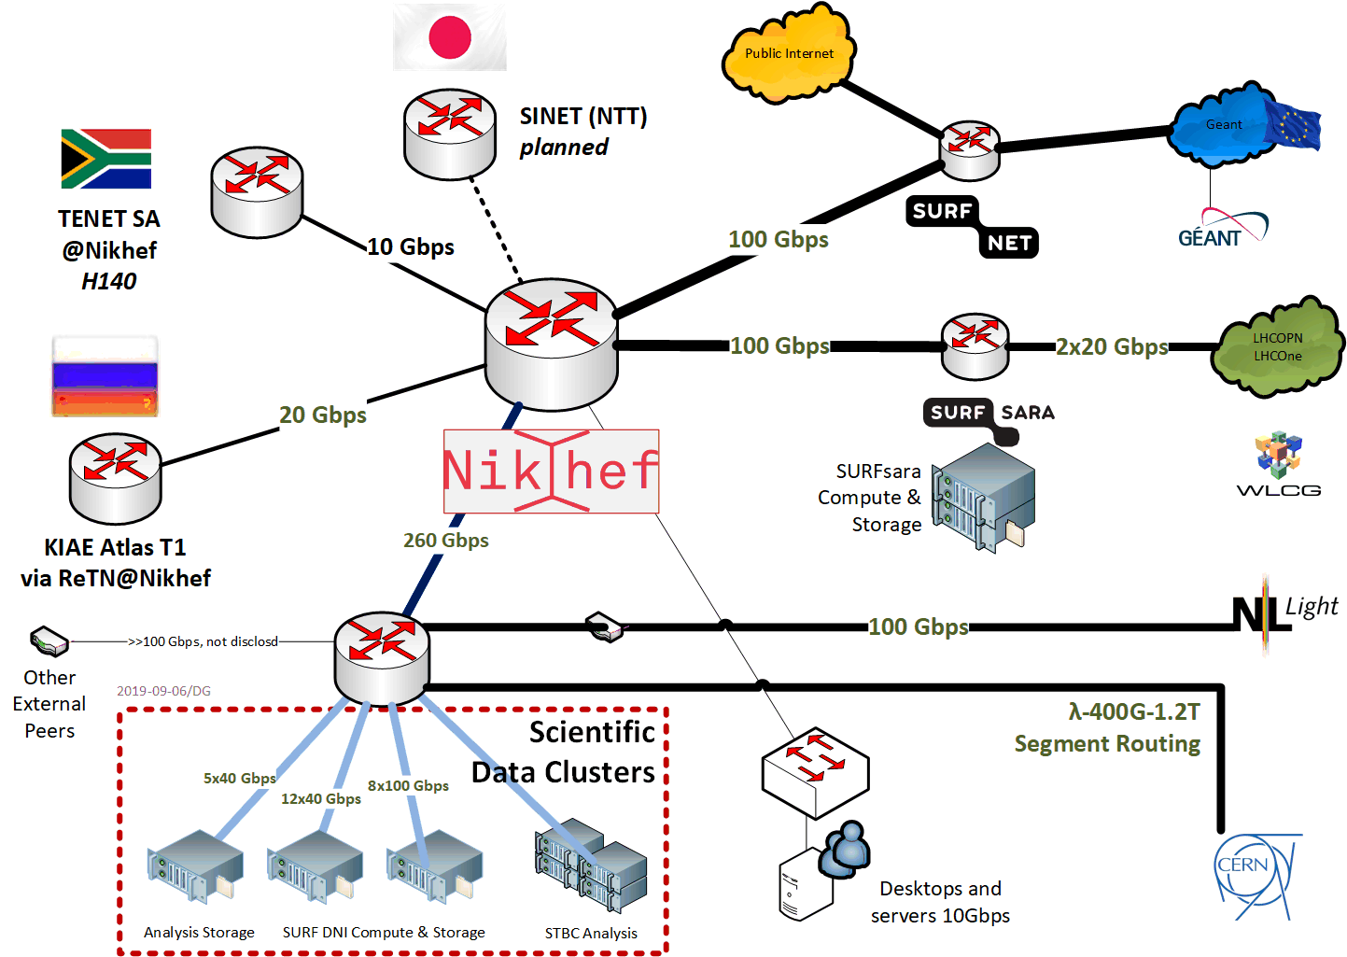
Direct peering infra for ‘big data’

Slide 23
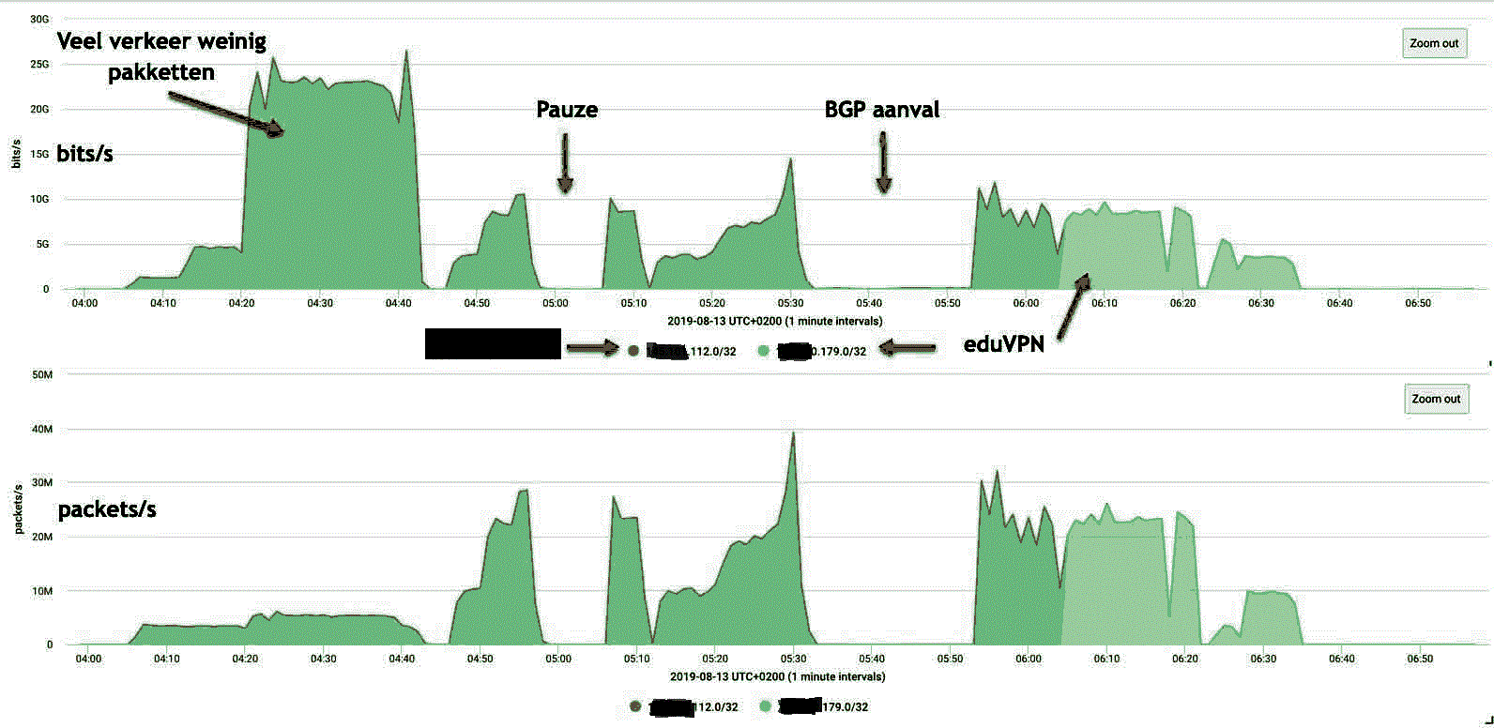
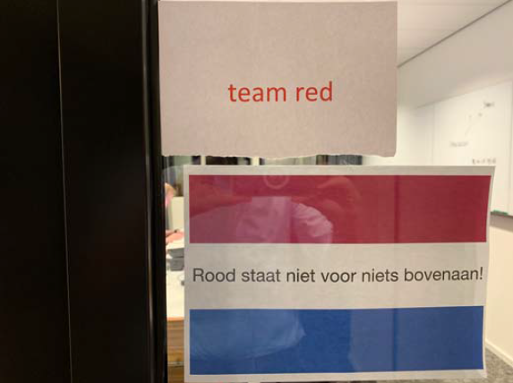
Our science data looks akin to a DDoS
evaluating resilience to cyberattack – in a cooperative way

Slide 24
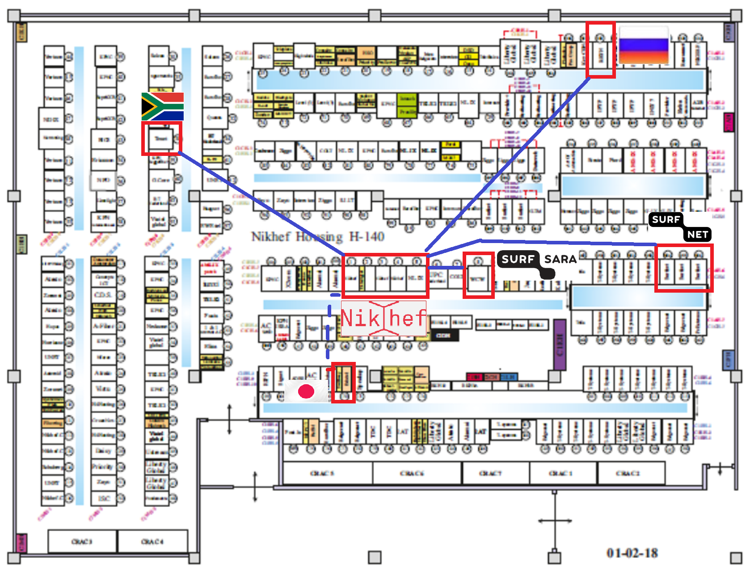
Touching the networks

Slide 25
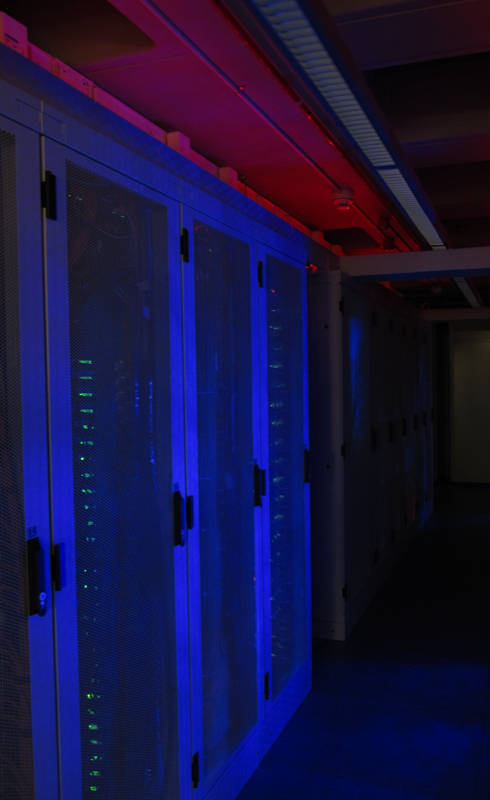
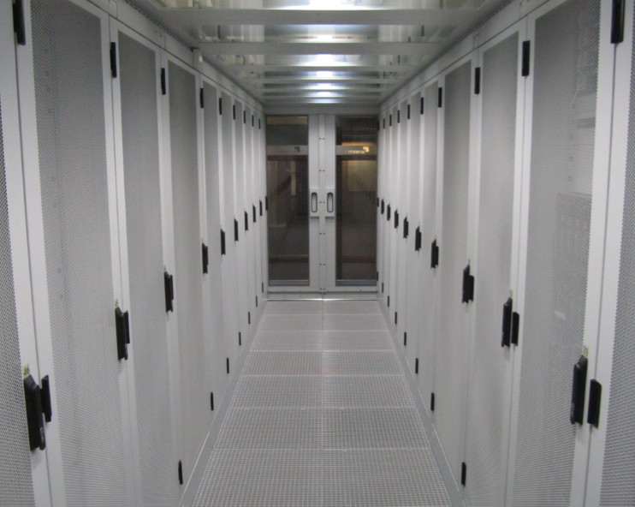
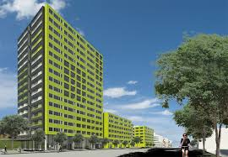
Some quick housing facts
~180 networks, 33 carriers
2.5 MW redundant power, A+B feed
Data Processing Facility (400 kW)
high-power ~9kW/rack, 24 C
Housing facility ~4kW/rack, ~18 C
many energy optimization methods …
~21% additional power needed for cooling
surplus heat (3500 GJoule/yr, ~112 kW-yr)
linked to student housing via an STES

Slide 27
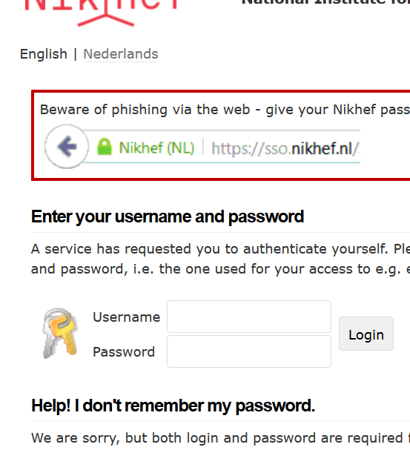
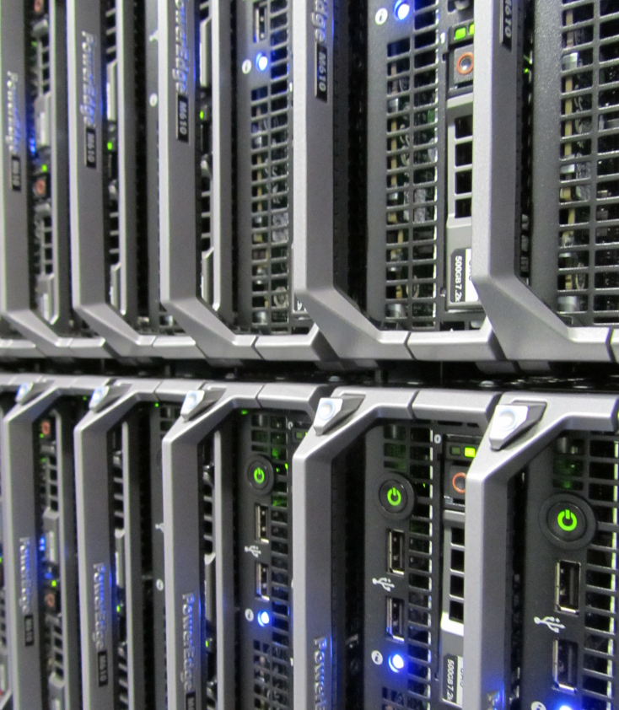
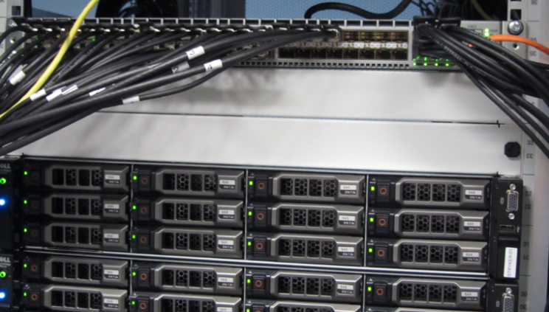



IT Infrastructures for Research
Networked
computing
Secure Collaboration
Parallel Data Storage
trusted global federation of researchers, organized in communities with common access policies
usage metering for fair sharing
prevent abuse of Nikhef, SURF, and EGI global infrastructure
~5 petabyte of data hosted at Nikhef, read by all 7000 cores that cannot wait …
each one reads
~10MB per second
while taking in data
from around the world
7000 compute cores
(~300 servers) working 24 hrs per day
with >97% utilisation

Slide 28

Reasons to become a DDoS victim
Organised groups
Extortion
Anti-competitive
practices (inside and outside)
Hacktivism
APTs
Individuals also very common
attacking your game opponent
attacking your school
to get your exam deferred
From Cyber Warfare: Techniques, Tactics and Tools for Security Practitioners; Jason Andress, Steve Winterfeld

Slide 29


‘Did you order your DDoS today?’
Traffic graph source: https://blog.cloudflare.com/the-new-ddos-landscape/

Slide 30
‘Styn’ is clearly a student …
INSERT INTO `users` VALUES
(102199,'Styn','john1968', '¤¤¤¤¤¤@¤¤¤¤¤¤.¤¤¤¤¤',0,1,1422654207,0,0,'');
from home with Ziggo as the ISP, and one in a while using a Vodafone mobile browser
INSERT INTO `checkip` (`id`, `ip`, `user`) VALUES (87,'¤¤.75.183.125','Styn');
INSERT INTO `checkip` (`id`, `ip`, `user`) VALUES (138,'¤¤.217.77.43','Styn');
and 95 attacks ordered, against a Dutch ROC, and later a Dutch university:
INSERT INTO `logs` VALUES (14071,'Styn','¤¤¤.97.64.171',80,95,'¤¤¤¤',...);
but meanwhile also on some Ziggo addresses – assumed his game opponents in a dorm
data thanks to a nice data leak of the LizardSquad DDoS-for-hire service in 2015 ☺

Slide 31



Reflection & amplification attacks
Graph: somebody attempting to DDoS Nikhef – and failing …
Image source top-left : https://labs.ripe.net/Members/gih/ntp-for-evil
NLNet labs: https://www.nlnetlabs.nl/downloads/publications/report-rrl-dekoning-rozekrans.pdf

Slide 32

DDoS usage of IP protocols

Slide 33

Beyond IX-es: direct transit

Slide 34


Friends … the more the merrier

Slide 35

LHC ‘Optical Private Network’

Slide 36


SURF and Netherlight
Imagery: https://www.glif.is/publications/maps/

Slide 37

Global Lambda Integrated Facility
Imagery: https://www.glif.is/publications/maps/

Slide 38














The LHC Analysis Chain
40 miljoen / seconde
Analyse van botsingen door promovendi
Trigger systeem
selecteert 600 Hz
~ 1 GB/s data
Classificatie van deeltjes in de botsingen:
electronen
muonen
jets van hadronen
…
diagram: from Frank Linde; images: ATLAS collaboration, Nikhef. And sorry for the AVG-blur

Slide 39

Overal rekenen … ‘high-troughput’
In Nederland:
De National
e-Infrastructuur
gecoordineerd
door SURF
www.surf.nl
Europees
HTC Platform
door EGI
www.egi.eu
Imagery: GridPP Job Monitor
by STFC Rutherford Appleton Lab

Slide 40

Verdeel en heers: we moeten wel
~ 4 GHz
~ 140W
8-10 instructies per tick
Graphic: Herb Sutter
The Free Lunch Is Over: A Fundamental Turn Toward Concurrency in Software

Slide 41

Zo hou je een rekencluster vol:
WeNMR
Xenon
LIGO & Virgo
Alice
NDPF voview short 1 October 2018
ATLAS
LHCb

Slide 42


Verdeel en heers
DotHill (HGST): 480 TByte gross capacity/4RU
Kengetallen van opslag
capaciteit (‘terabytes’)
bandbreedte (‘megabyte per seconde’)
aantal ‘opdrachten’ per seconds (“IOPS”)
5 Petabyte lezen in 1 dag?
Dat is dus 61 GByte per seconde!
(en dus ~500 Gbps)
Daarom kan onze data niet op een USB stick
– en doet je ‘thuis NAS’ oplossing het ook niet
… hoe leuk ik mijn eigen opslagdoosje ook vind
van slechts 15 Watt met 16Terabyte voor € 915 …

