Slide 1
Integrating Federations in the International Grid Trust Fabric
David Groep
Nikhef Dutch national institute for sub-atomic physics

Slide 2
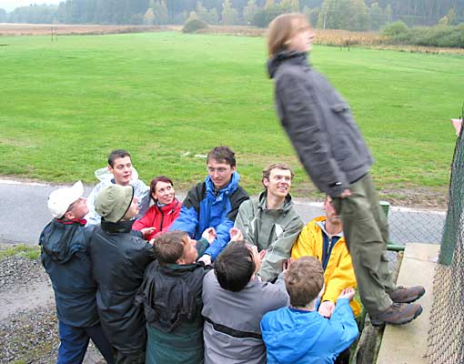
Grids, Eduroam, Federations
Different terms, same issues
How to provide access only the ‘proper’ people?
Most of whom you’ve never met and will never meet
Across organisations and countries
Traceable and consistent over many years
Core issue is trust

Slide 3
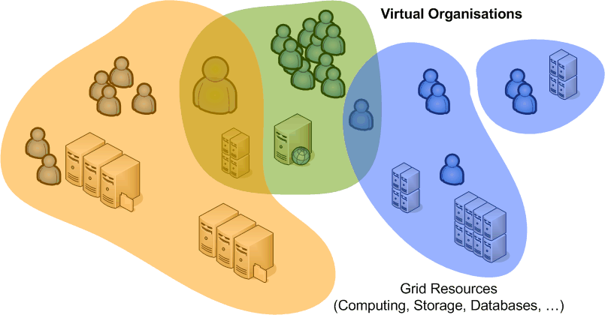
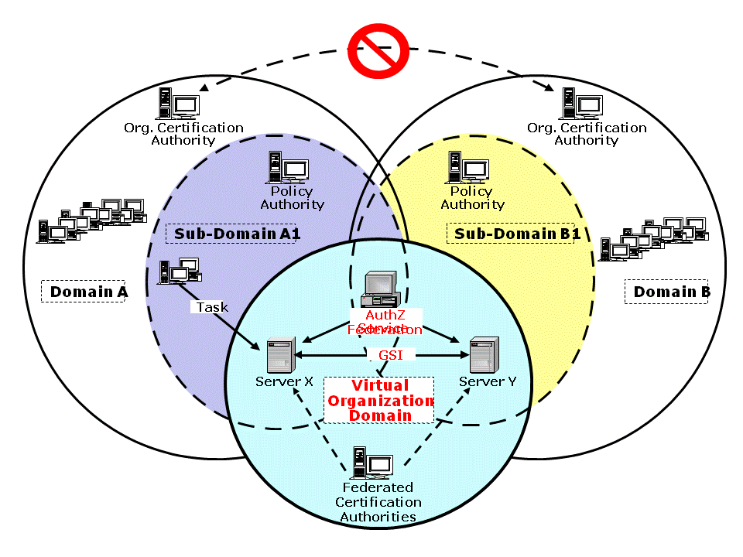
Grid: Trust in ‘Virtual Communities’

Slide 4
Grid: Where to Root Trust?
There is no a priori trust relationship between grid members or member organisations
Community (VO) ‘life time’ can vary from days to decades
people and resources are members of many VOs
VOs can accept some responsibility, but are a ‘bad source’ for identity as VO loyalty may be the ‘wrong way’ (as far as resource providers are concerned)
… but relationship user–VO–resource is required
for authorising access, traceability and liability, incident handling, and accounting
… so the grid needs trusted third parties

Slide 5
Federation Model for Authentication
CA 2
CA 1
authentication profiles
relying party n
CA n
distribution
CA 3
acceptance
process
relying party 1
A Federation of many independent CAs
common minimum requirements (in various flavours)
trust domain as inspired by users and relying parties where relying party is (an assembly of) resource providers
Using a peer-reviewed acceptance and audit process
No strict hierarchy with a single top
spread of reliability, and failure containment (resilience)
maximum leverage of national efforts and complementarities

Slide 6
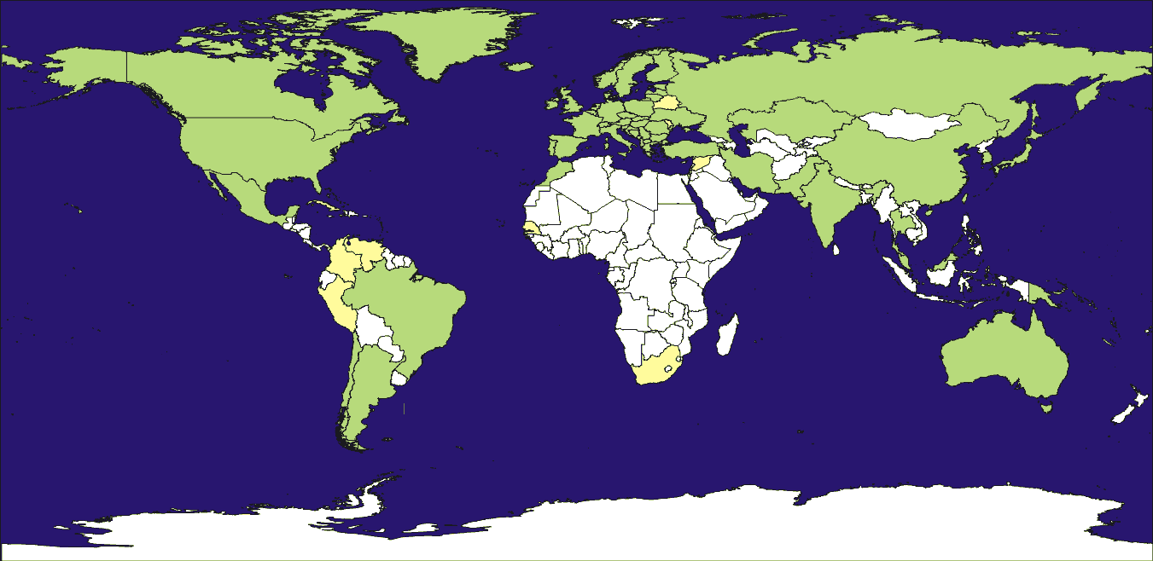
International Grid Trust Federation
Green: regular national CA accredited; Yellow: accreditation in progress

Slide 7
IGTF Status Today
Already 77 accredited authorities
EUGridPMA: 41 countries + 1 treaty organisation
TAGPMA: 6 countries (but several authorities in US and BR)
APGridPMA: 7 countries and economic regions (with several authorities in CN, JP, TW)
About 10 Major Relying Party members
6 in Europe: DEISA, EGEE, LCG, OSG, SEE-GRID, TERENA
PRAGMA, TeraGrid, OSG , LCG in other PMAs as well

Slide 8
Different technologies, different profiles
The IGTF established a single trust fabric, incorporating authorities using different techniques
Common Elements
Unique Subject Naming
Identifier Association
Publication & IPR
Contact and incident response
Auditability
Profiles
Classic
Real-time vetting (F2F or TTP)
13 months life time
SLCS
Existing IdM databases
100k – 1Ms life time
MICS
IdM Federation
13 months max
https://www.eugridpma.org/guidelines/

Slide 9
Guidelines: common elements in the IGTF
Coordinated namespace
Subject names refer to a unique entity (person, host) ‘Any single subject distinguished name (DN) in a certi ficate must be linked with one and only one entity for the whole lifetime of the service.’
Used as a basis (directly or indirectly) for authorization
Common Naming
Single distribution for all PMAs
Concerns and ‘incident’ handling
Guaranteed point of contact, to raise issues and concerns
Requirement for documentation of processes
PMA-disclosed, detailed policy and practice statement
Open to auditing by federation peers

Slide 10
Guidelines: secured X.509 CAs
Aimed at long-lived identity assertions
Identity vetting procedures
Based on (national) photo ID’s
Face-to-face verification of applicants via a network of Registration Authorities or ‘Trusted’ Registrars
Periodic renewal (once every year)
Reasonable representation of the person’s real name
Secured operation
off-line signing key or HSM-backed on-line systems (140.2-3+)
Response to incidents
Timely revocation of compromised certificates
CRL issuance required (downloaded up to 400 times/minute!)

Slide 11
Guidelines: short-lived credential service
Issue short-lived credentials based on another authentication system
e.g. Kerberos CA based, or existing (federated) administration
on-line issuing (with 140.2 level 2+ HSM or equivalent)
Based on crypto-data held by the applicant
Maybe only subset of entities in the database
Reasonable representation of the person’s real name
Same EE cert format, but no new user-held secrets
Can act like a ‘proxy’ (RFC3820), and has similar risks
The applicant can (and will) use it like a proxy
Risk of EE key exposure is mitigated by its shorter life time
Same common guidelines apply
reliable identity vetting to ensure uniqueness over CA life time

Slide 12
Specifics of a SLCS
Sufficient information must be recorded and archived such that the association of entity and subject DN can be confirmed at a later date.
Qualifying IdMs must suspend or revoke authorization to use the service if the traceability to the person is lost.
The CP/CPS must describe:
…
How it provides DN accountability, showing how they can verify enough identity information to trace back to the physical person for at least one year from the date of certification, and in keeping with audit retention requirements.
In the event documented traceability is lost, DN must never be reissued.

Slide 13
MICS vs SLCS
‘MICS’ is essentially a Classic CA, but with the identity vetting time-shifted & off-loaded to federation or IdM … which makes it look an awful lot like SLCS, but with better vetting and controls
But then:
The life time of the cert can be 13 months
To off-set this risk:
The requirements on IdM access and -use are stronger
Extra verification data is requested at issuance time to protect against weak or re-used IdM passwords

Slide 14
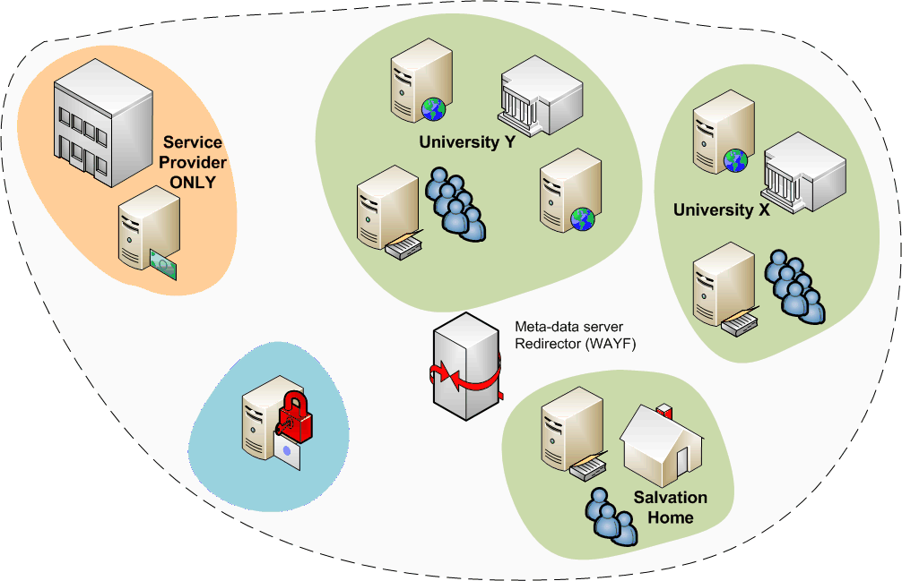
Federations
A common Authentication and Authorization Infrastructure
Allow access to common resources with a single credential
grid structure was not too much different!

Slide 15
Federation basics
Why Identity Federation?
To enable sharing of educational resources
Network (Wireless and/or not)
Applications
Online learning systems (e.g. for the Bologna Process)
What is needed to set-up an Identity Federation
Agreement on legal framework, policies, and trust (this is where OpenID &c fail :)
Technology
Security
Common Language and Interoperability
Identity Federations key element
authentication performed by user home institution
authZ performed by the service provider**
With thanks to Licia Florio, TERENA

Slide 16
Birth of Federation & Confederation
2002: a problem to solve
Provide wireless access only to authenticated users
On-line anywhere, anytime
eduroam: the operational, production quality, international confederation since ~2003
Solution?
eduroam = education roaming
federated network access for participating institutions
Started in a very simple way … eduroam technology: 802.1X + RADIUS
With thanks to Licia Florio, TERENA

Slide 17
A highly successful confederation!
With thanks to Licia Florio, TERENA

Slide 18
Beyond the network
Research community requirements go beyond network access
Increasing dynamics in the education system
Students can access courses in other faculties
Students take some course units abroad (Bologna)
On-line courses are more common
Users want to access the same services no matter where they are
Grid: example of access to distributed resources
More institutions dealing with the same users means:
Multiple registration of users
Overhead to manage guest users
Increased possibility of error in managing the users’ records
With thanks to Licia Florio, TERENA

Slide 19
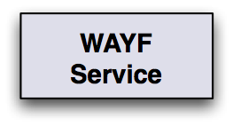
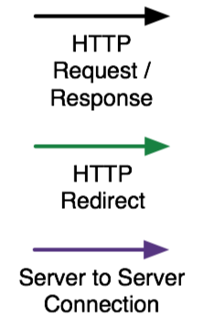
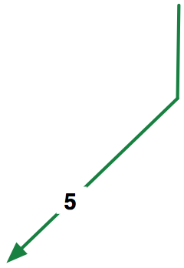
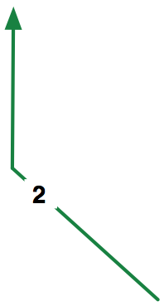
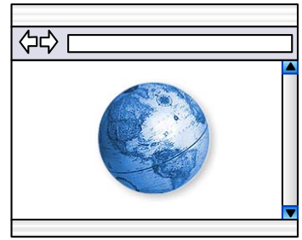
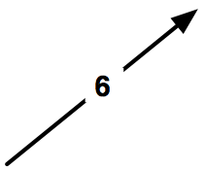
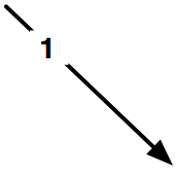
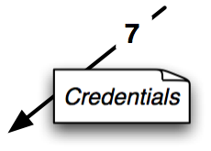
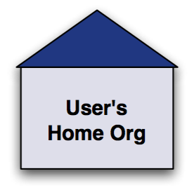
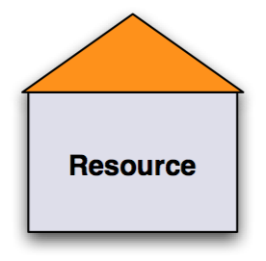
Using the federation (example)
Graphic from: Christoph Witzig, SWITCH and EGEE

Slide 20
Simplified Federation liaisons
With thanks to Licia Florio, TERENA

Slide 21
Key elements in national federations
Scalability (to 1-10 M people per country)
Various groups of people: students, walk-ins, staff
Each group has different identity profile and LoA
Minimize personnel involvement
Each helpdesk visit is costly
Compliance and regulations are an integral part
Universities are far more visible than grids
Then, there are easy gains from the federation
Large user base: many people already ‘well known’
Pretty good quality ID: paychecks, student IDs, exams

Slide 22
European Landscape
Identity Federations (or simply federations) are being developed at national level by the NRENs:
Most European countries have one in production, such as SURFfederation, FEIDE, WAYF, Swamid, UKAF, PAPI, HAKA, DFN, SWITCHaai, etc. – some as NREN function, others as a separate org.
Different (open source) technologies are used
PAPI: Spain
A-Select (Shib, PKI, ADFS, sSPHP,…): the Netherlands
Shibboleth: UK, Finland, Switzerland, Germany Well used technology, but certainly not the only one!
Sun Federation Manager based upon Liberty Alliance spec: Norway
Interoperation through use of SAML (2.0)

Slide 23
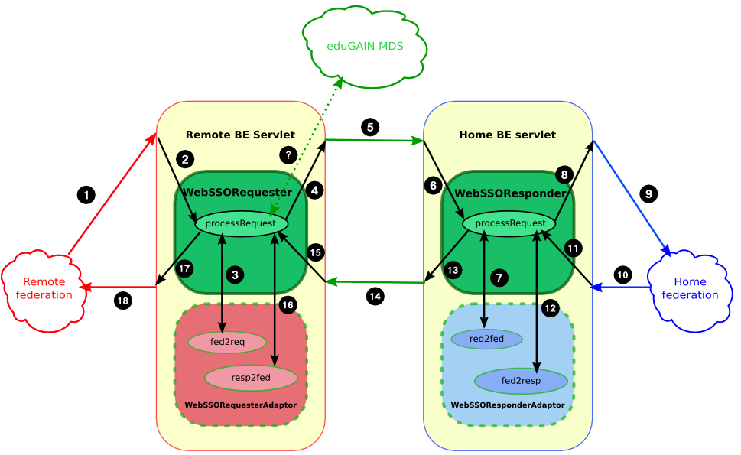
Confederation, the eduGAIN model
Graphic from: Diego Lopez, RedIRIS and GEANT2

Slide 24
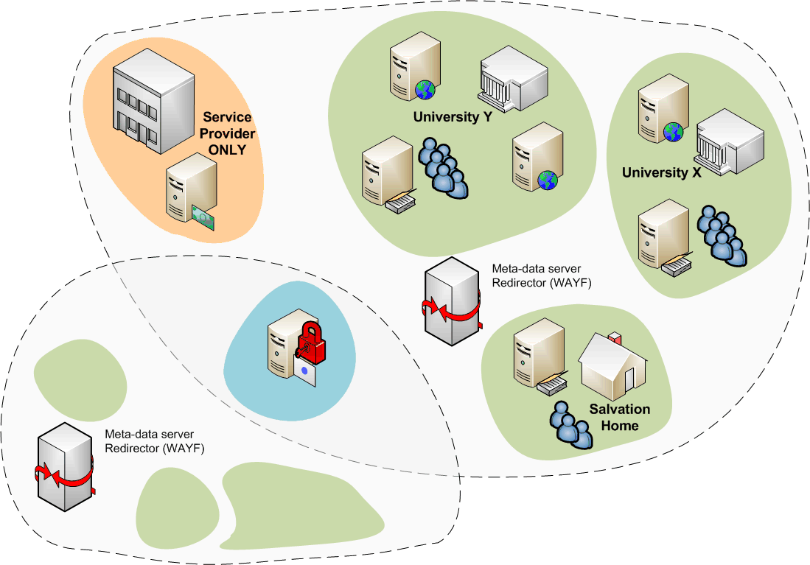
SP ‘multi-federation’
shared service provider

Slide 25
Grid & Federations - a logical combination
Many of the e-Infrastructure users have a federated account anyway
Could give users grid certificates within 5 minutes without any further hassle, if the trust level matches
Allows users to ’try’ the grid
Allows for scaling the number of grid users significantly
Comparable issues and trust levels
Federation assurance levels are going up, as more diverse services participate in the federation
User account management of IdPs is improving rapidly … far more than grid credential management!

Slide 26
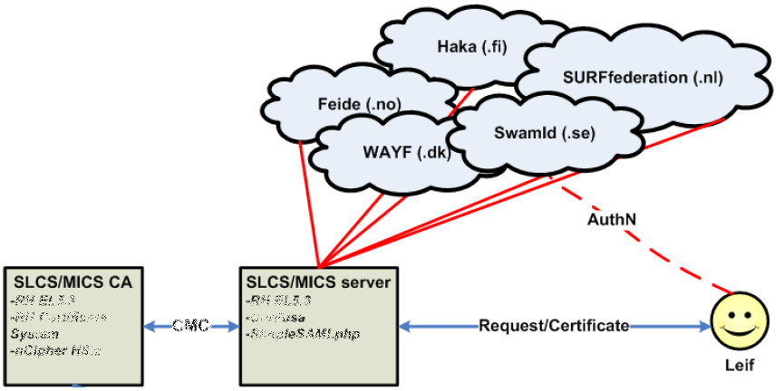
A Federated Grid CA
Use your federation ID
... to authenticate to a service
... that issues a certificate
... recognised by the Grid today
Graphic from:
Jan Meijer, UNINETT

Slide 27
Constraints on a Federated Grid CA
We are the first service to ask for a specific, higher, LoA
LoA was slow in catching on
various services in the federation have diverse value
but waiting for it can take years – need specific agreements
IdPs and services in a federation loosely coupled
How should loss of affiliation or expiry affect the CA and the issued certs
Pushing requirements on IdPs for just one SP requires effort
needed to overcome LoA issue, but should be minimal
Contract types and policy convergence required
Certainly possible for ‘interesting’ services, and done already
Any human interaction (helpdesk) is expensive

Slide 28
Matching the ‘easy’ requirements
Persistent and unique naming
IdPs historically tended to recycle login names
even eduPersonPrincipalName is often recyled
only eduPersonTargetedID is immune to thus, but not supported everywhere (and is usually opaque)
this adds a requirement to the federation or to the IdPs
Reasonable representation of names
Given name, surname and nickname are usually considered privacy sensitive
user-approved release of these appears doable
requires evaluation of legal framework

Slide 29
Matching the ‘harder’ requirements
How to protect against re-use of federation login and password (on e.g. Wiki’s, web sites, ISP mail)?
The ‘second attribute’ is either privacy sensitive, or not standard across all IdPs, or difficult to collect
IdPs improving credential management, as compensatory meansure
Handling revocation
The CA is ‘just a service provider’, and the IdP does not know about the issued certs per se
Even single sign-out is already difficult
Assurance level at the IdP
The CA SP is usually the first ‘high-LoA’ application

Slide 30
Where to put the onus of the service?
Homogeneous federation
No service should impose requirements on IdPs, only on the federation
Federation should do everything internal to it
Don’t ever bother IdPs
In the short term, only minimal assurance given
good in many cases, but maybe not here
Service based
Service can have contracts with specific IdPs (even for a subset of their users)
Federation mediates authN and attributes
Federation monitors IdPs for compliance in attribute exchange and authN
Today used for content licensed to specific IdPs

Slide 31
Federated CAs: there already!
SWITCH
Accredited 2007 under SLCS
Shib-only federation, dedicated software development
Leverages tightly-controlled SWITCHaai federation
TERENA Grid CA (formerly NetherNordic SLCS/MICS)
Under accreditation today
Multi-technology federation, SAML2 based
Heterogeneous federations, with web access being the only common element
CESNET
Same time line as TERENA or earlier

Slide 32
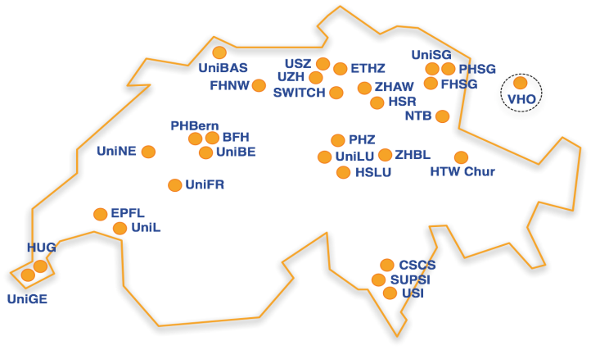
SWITCH SLCS CA, since May 2007
All IdP use comparable registration process
SLCS eligibility added by explicit human interaction

Slide 33
New: TERENA Grid CA Service
Initial partners: FEIDE, SURFfederatie, HAKA, WAYF, Swamid, TERENA
Trans-national, cross-federation service
But not (yet) confederated
How many SLCS/MICS CAs does Europe need ?
Consolidate operational PKI skills in one place
Better sustainability, in line with the European trend

Slide 34
TERENA Grid CA Pilot principles
Leverage federations as much as possible
Define criteria, not process
IdPs with good ID vetting can enable eligibility en-block
Use only open interconnect (SAML2)
Not a shib-only solution
Scalable contract model
Would like federations to join, but this runs into trouble for LoA and vetting criteria
IdPs can sign up with the service, through TERENA, if and only if they are members of their national federation
Compliance ensured through the federation contracts

Slide 35
Every Federation is special
FEIDE
Single federation portal, list of allowed browsers
SURFfederatie
A-Select history, multi-technology incl. PKI
LoA and vetting procedures
Normally already different within one federation
Across countries adds other legal aspects
‘proven’ solution: use ‘minimum requirements’ …
Specific fed. attribute decides SLCS-MICS eligibility?
via eduPersonEntitlement

Slide 36
Implementation
SWITCH-SLCS
Integrated client tool
Mimics shib exchange and relies on web-redirects,
works in pure-shib federation
Single command for users
TERENA Grid CA
mini-client supported by web browsers
actual authN happens through the web only -- the only portable way ☹
compliant with all federations
two-step process for users
works with any credential (incl. e-banking, SMS, PKI, …)
SWITCH ‘glite-slcs’
confusa.org

Slide 37
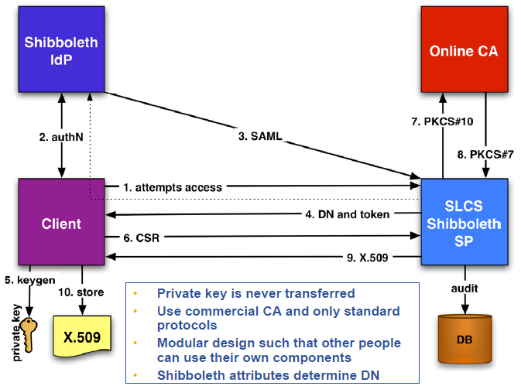
SWITCHaai SLCS CA model
Graphic from:
Christoph Witzig, SWITCH and EGEE

Slide 38
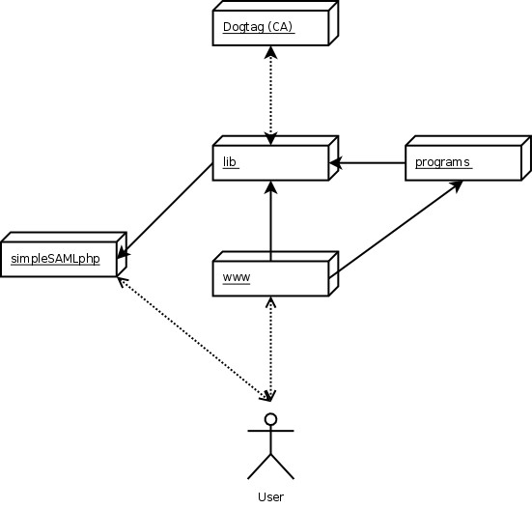
Confusa model
Create request out of band
SimpleSAMLphp handles all authN, integration with other Federations
Browser handles redirect, SAML-header magic
Client creates key and CSR
We verify AuthN, compare attribs and create CMC for CA to sign
Graphic from:
Hendrik Austad, UNINETT Sigma

Slide 39
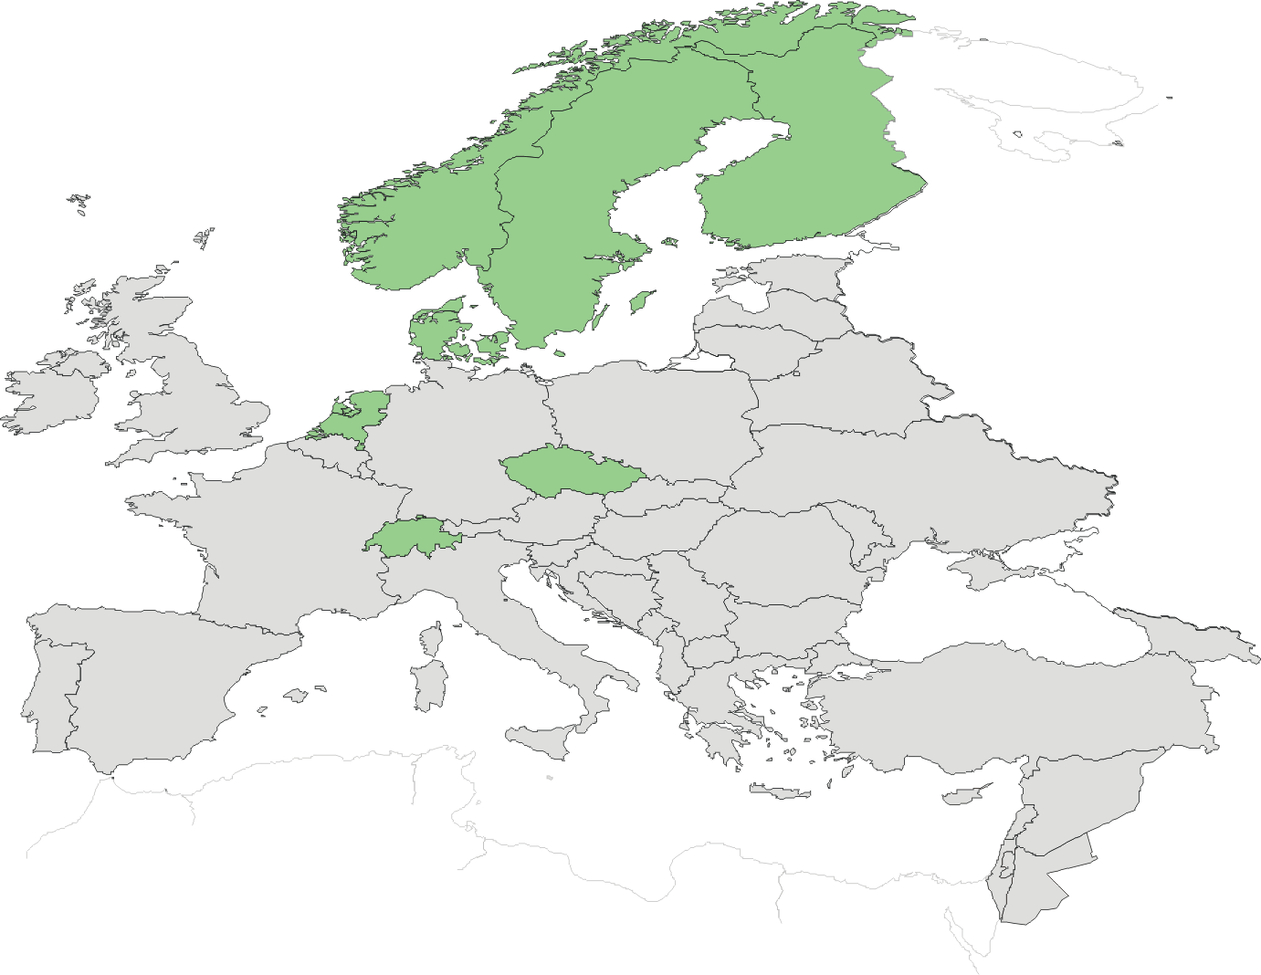
Federated CAs in Europe
SWITCH: May 2007
TERENA: May 2009?
CESNET: May 2009?

Slide 40
Joint vision and wide support
2004 policy by EUGridPMA and TERENA, approved by e-IRG:
The e-IRG notes the timely operation of the EUGridPMA in conjunction with the TACAR CA Repository and it expresses its satisfaction for a European initiative that serves e-Science Grid projects. […] The e-IRG strongly encourages the EUGridPMA / TACAR to continue their valuable work […]
The e-IRG encourages work towards a common federation for academia and research institutes that ensures mutual recognition of the strength and validity of their authorization assertions.
e-IRG Recommendations, 2004 and 2005, resp.

