Slide 1
Computing for
(astro)particle physics at Nikhef and in the world
Ignatius caput selectum deeltjesfysica 2023
David Groep
March 2023

Slide 2
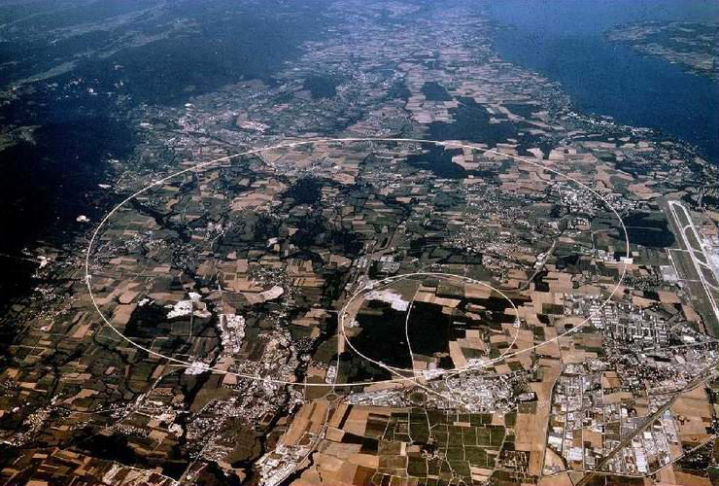
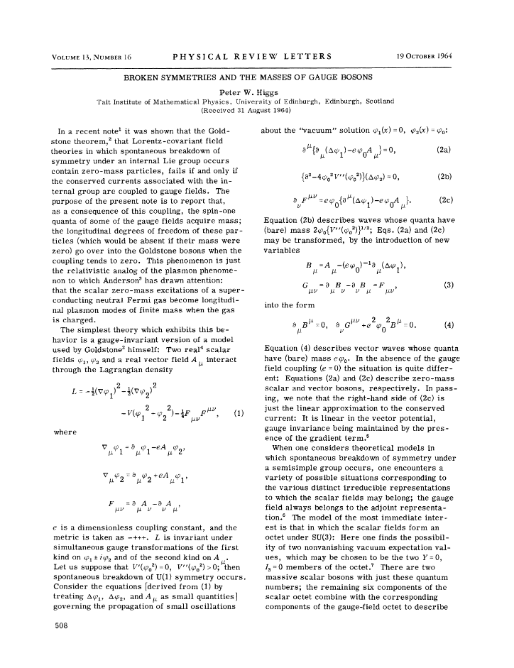
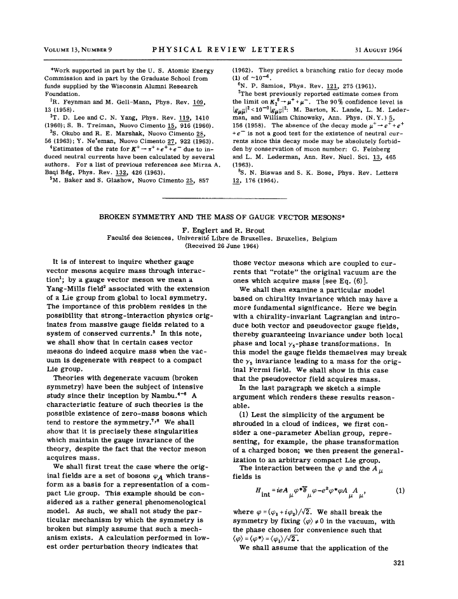
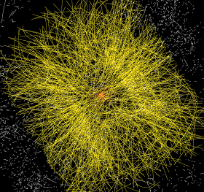
Data at the Large Hadron Collider at CERN
1964
~ 50 PiB/year
primary data
P. Higgs, Phys. Rev. Lett. 13, 508
16823 characters, 165kByte PDF

Slide 3
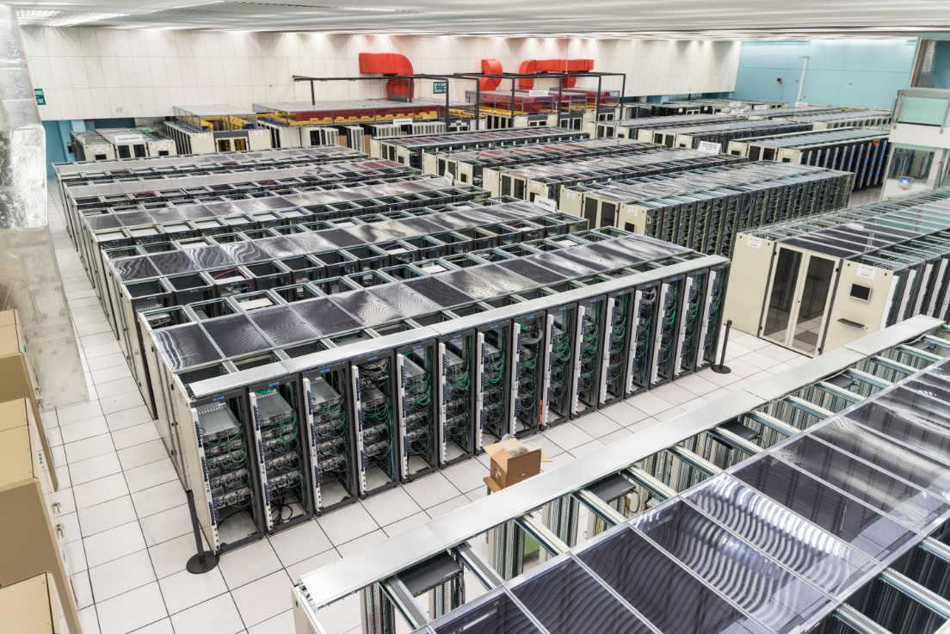
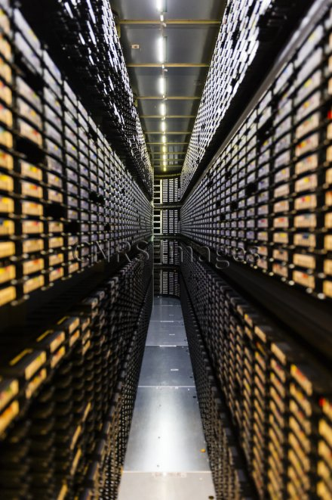
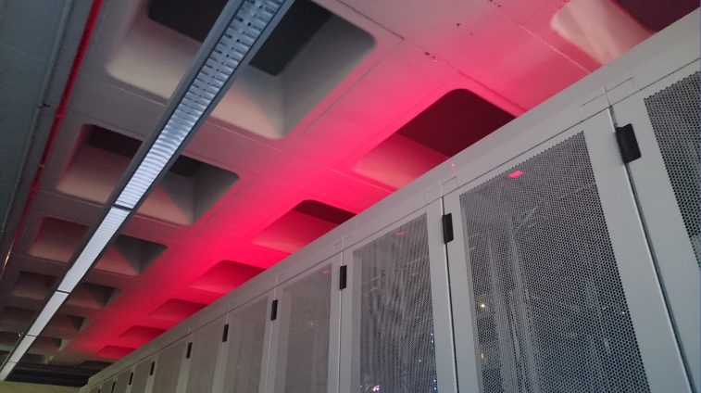
‘Big Science’ needs some computing …
CERN CC B513, image: https://cds.cern.ch/record/2127440; tape library: CC-IN2P3 with LHC and LSST data; cabinets: Nikhef H234b

Slide 4
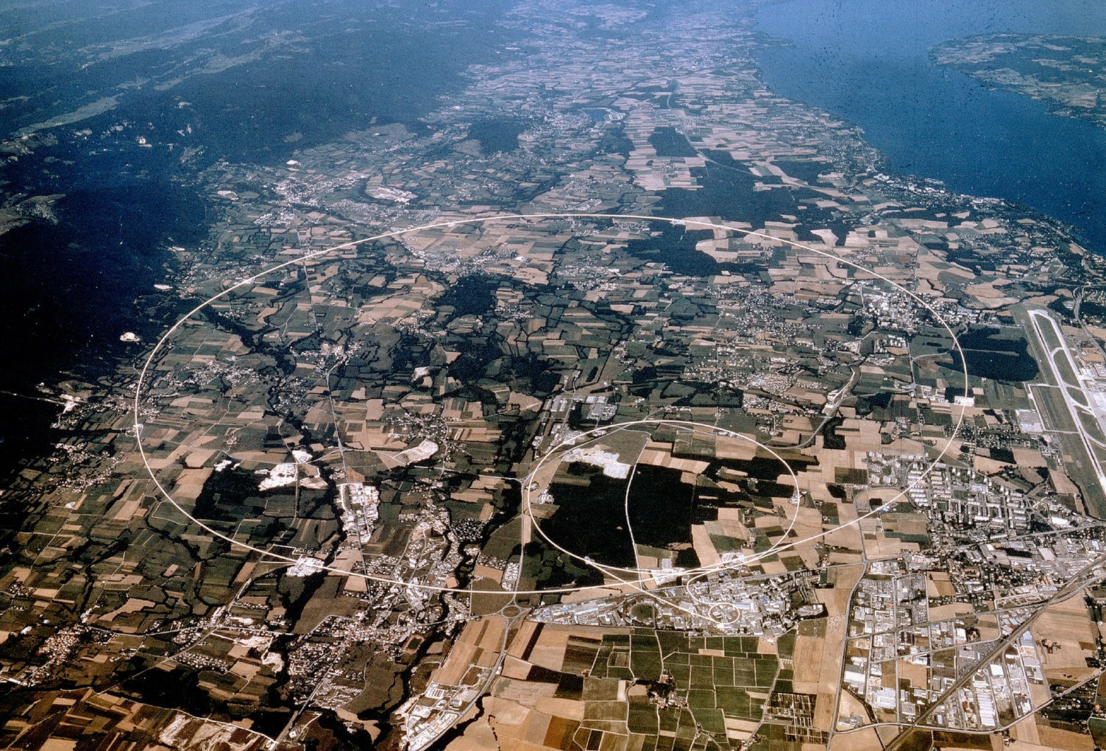

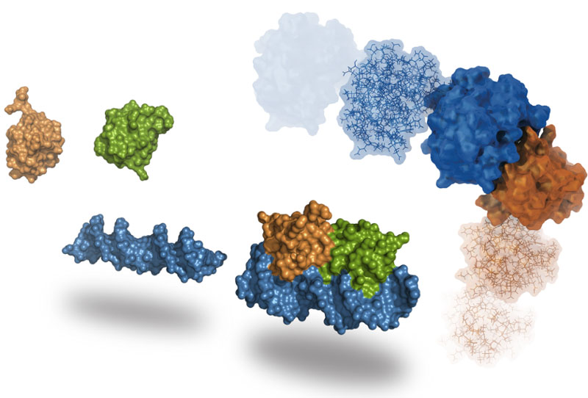
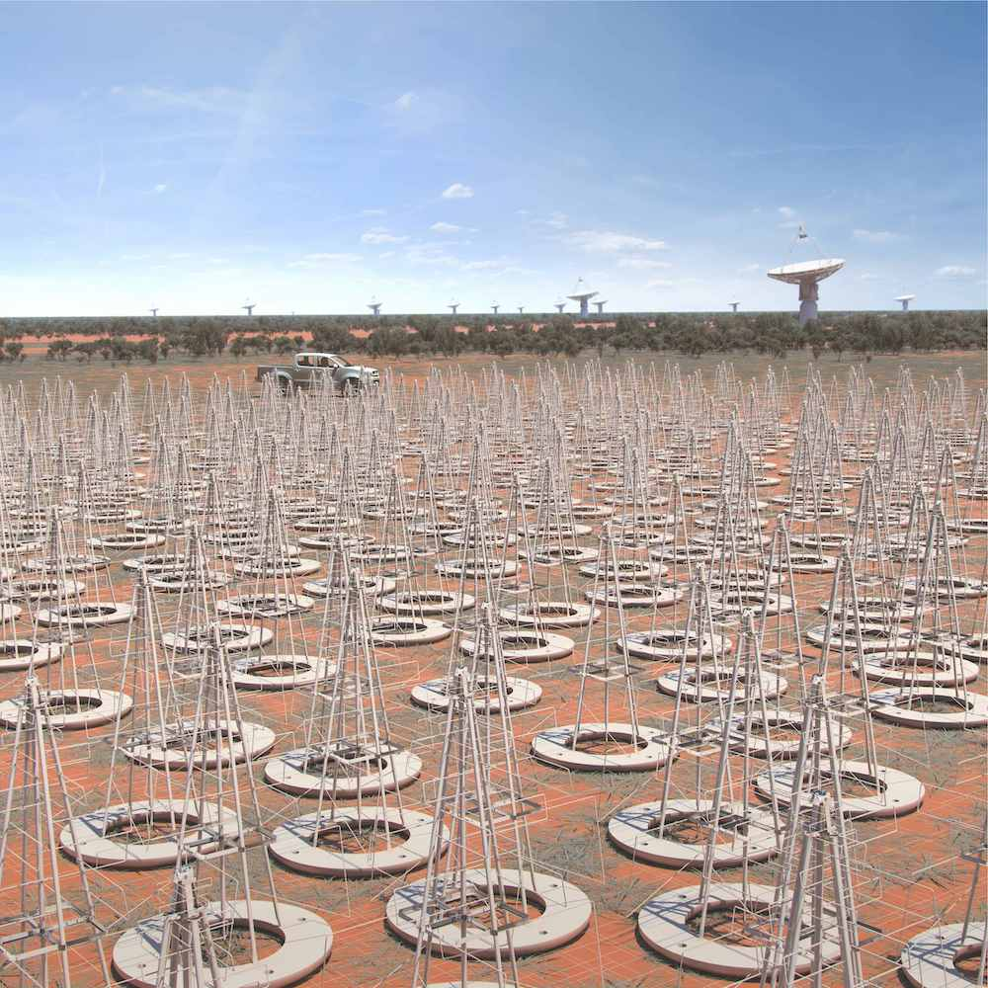



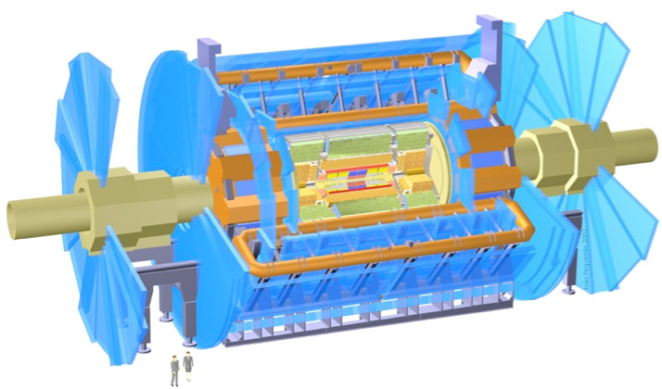

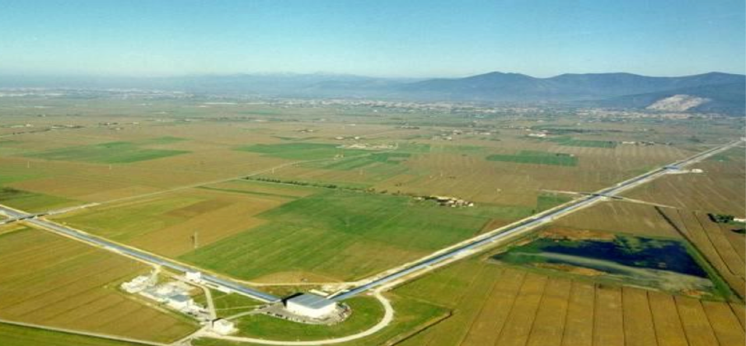
Larger scales for both facilities and computing
WeNMR
SKA-Low (impression, to-be-built in .au)
LHCb
ALICE
ATLAS
Atlas
protons
Gravitational Waves
Haarlemse Chemische Kring
4
Sources: CERN https://wlcg.web.cern.ch/; HADDOCK, WeNMR, @Bonvinlab https://wenmr.science.uu.nl/; Virgo, Pisa, IT; SKAO: the SKA-Low observatory, Australia https://www.skatelescope.org/

Slide 5
Processing at scale for data intensive science
More data is coming!
Data from various sources, for
public entities: data ca. 2018,
indicative, within ~ factor 2
LHC volumes: LCG Resource Scrutiny Group & CERN; 2020
SKA and LOFAR volumes: ASTRON/Michiel van Haarlem, 2020

Slide 6
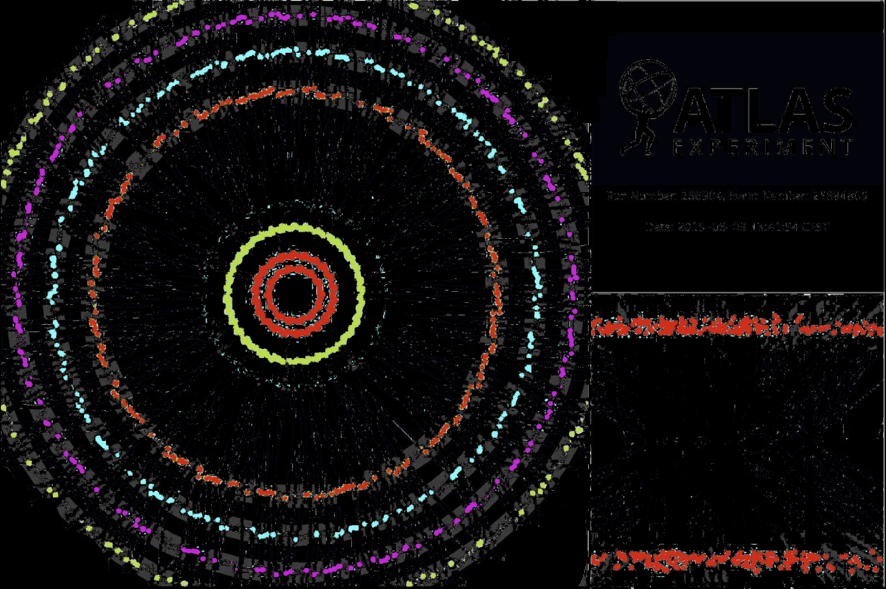
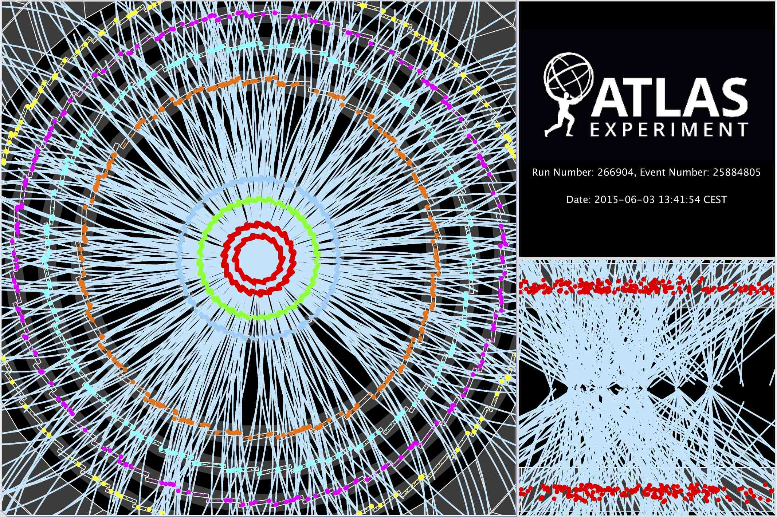

Computing on lots of data – 40 Mevents/sec
~ 10 seconds to compute
a single event at ATLAS
for ‘jets’ containing ~30 collisions
Display of a proton-proton collision event recorded by ATLAS on 3 June 2015, with the first LHC stable beams at a collision energy of 13 TeV;
Event processing time: v19.0.1.1 as per Jovan Mitrevski and 2015 J. Phys.: Conf. Ser. 664 072034 (CHEP2015)

Slide 7
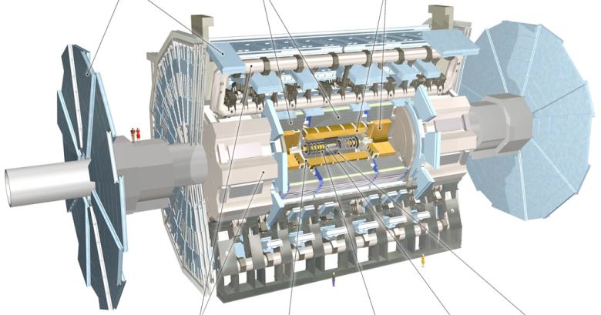

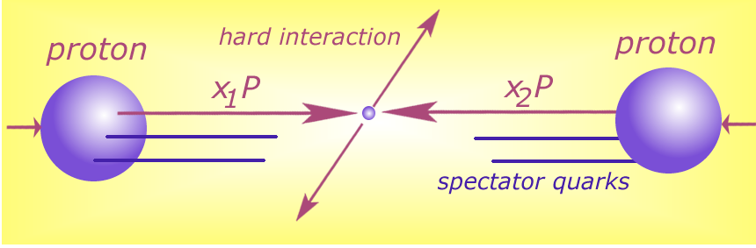




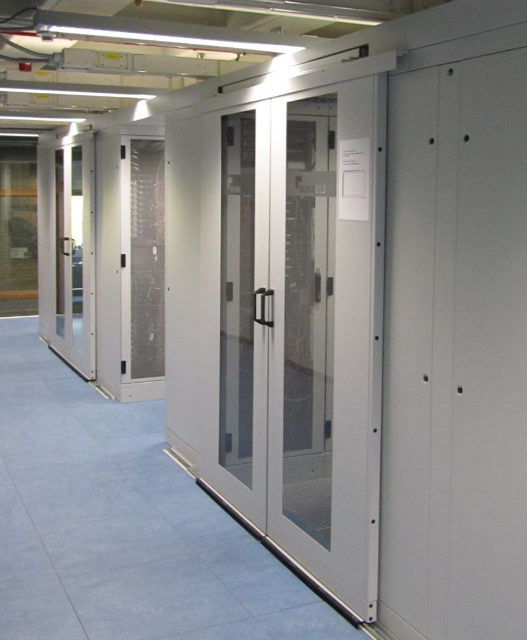






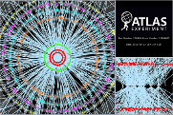

Detector to doctor workflow
40 million collisions / second
Physics analysis by (PhD) students, in papers & analysis notes
Trigger system selects
600 Hz ~ 1 GB/s data
Classify particles in collision and their physics properties:
- electrons
- muons
- jets consisting
of hadrons
- …
diagram adapted from Frank Linde; images: ATLAS collaboration, Nikhef. … and sorry for the GDPR-blur

Slide 8
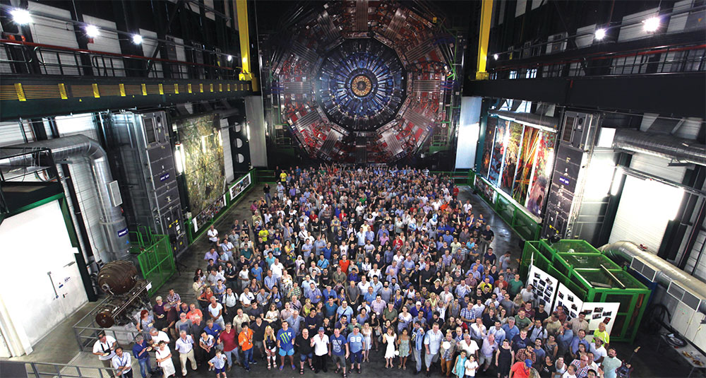
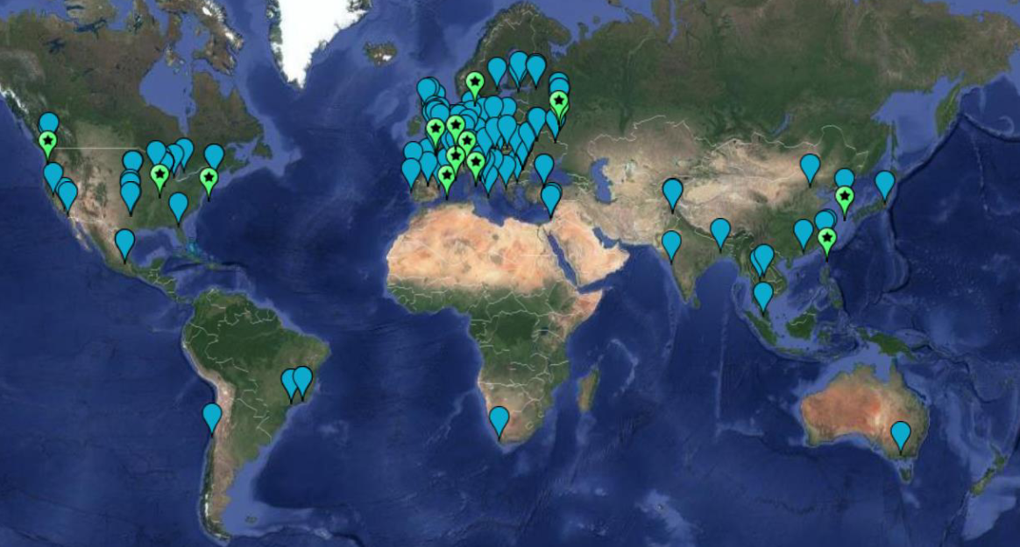
WLCG: when we met a global trust scaling issue
170 sites
~60 countries & regions
~20000 users
just how many interactions
people photo: a small part of the CMS collaboration in 2017, Credit: CMS-PHO-PUBLIC-2017-004-3; site map: WLCG sites from Maarten Litmaath (CERN) 2021

Slide 9
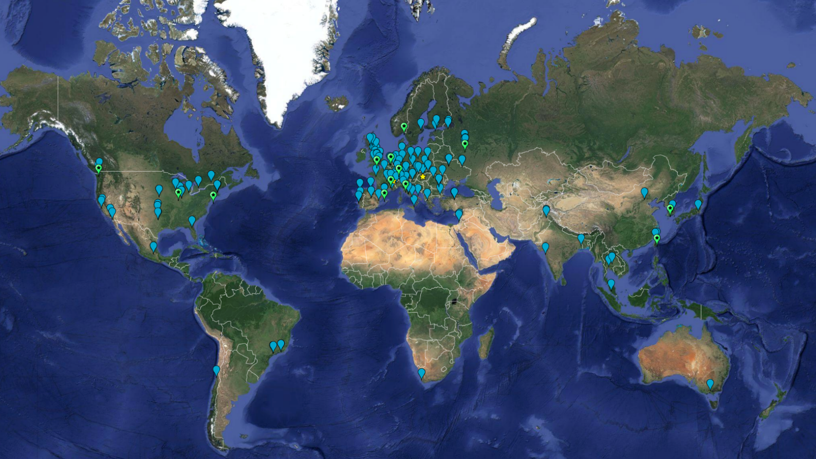
Example: the worldwide LHC Computing Grid
~ 1.4 million CPU cores
~ 1500 Petabyte
disk + archival
170+ institutes
40+ countries
13 ‘Tier-1 sites’
NL-T1:
SURF & Nikhef
e-Infrastructures
EGI
PRACE-RI
EuroHPC
OpenScienceGrid
XSEDE (ACCESS)
Earth background: Google Earth; Data and compute animation: STFC RAL for WLCG and EGI.eu; Data: https://home.cern/science/computing/grid
For the LHC Computing Grid: wlcg.web.cern.ch, for EGI: www.egi.eu; ACCESS (XSEDE): https://access-ci.org/, for the NL-T1 and FuSE: fuse-infra.nl, https://www.surf.nl/en/research-it

Slide 10

Global distribution of computing and data placement
WLCG and EGI Advanced Computing for Research

Slide 11
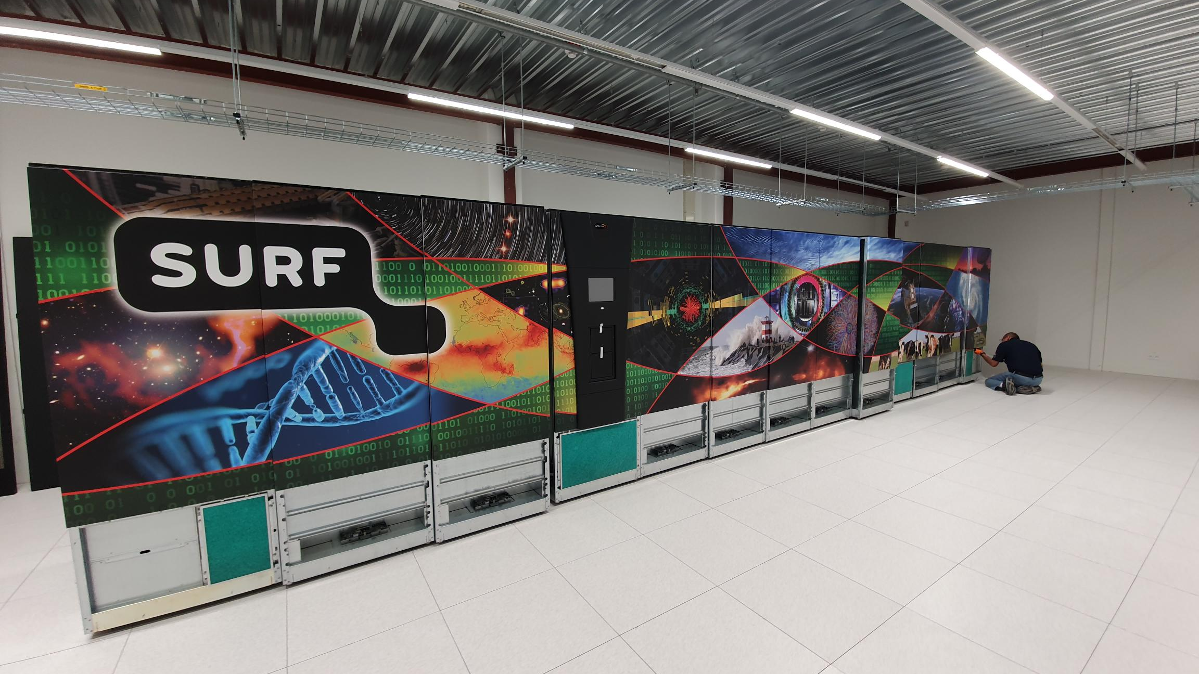
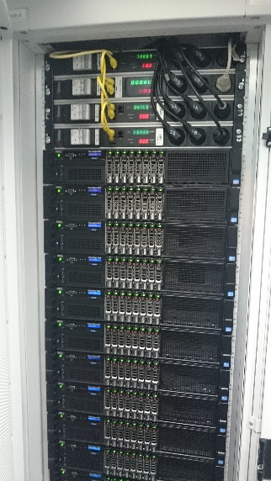
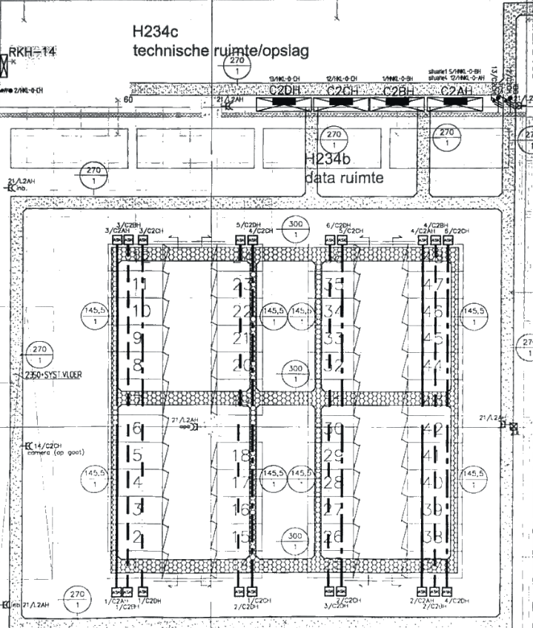
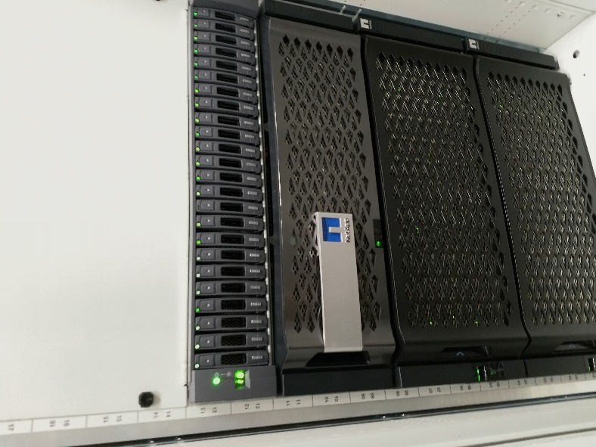
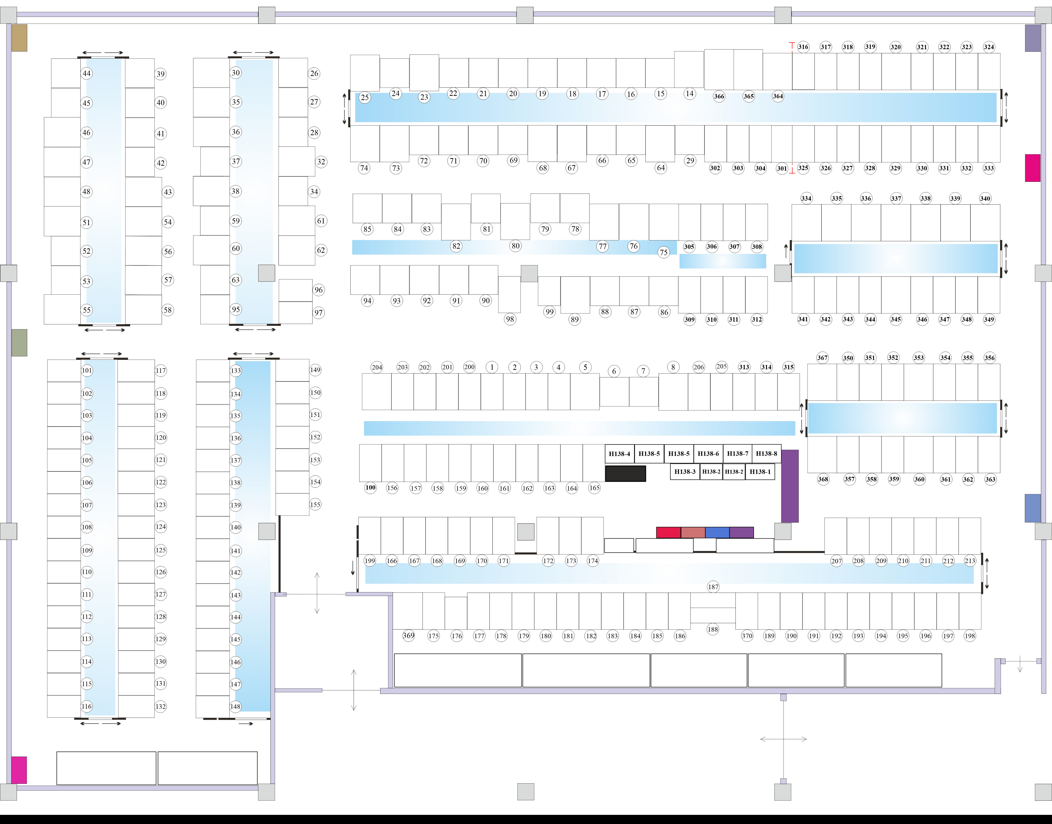
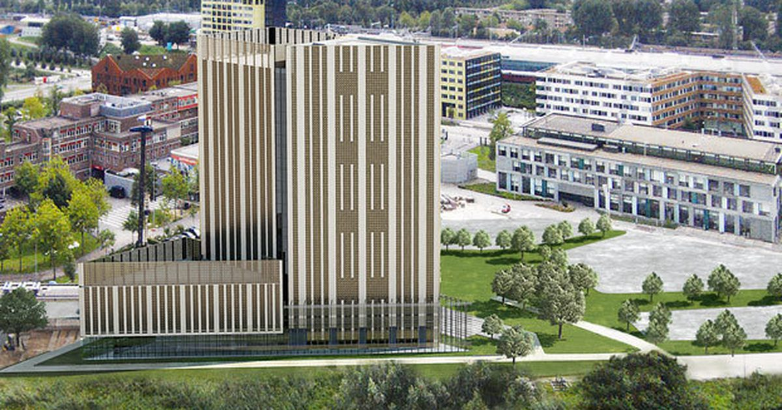
WLCG NL-T1 and the Dutch National Infrastructure
Joint SURF & Nikhef collective service – part of EGI, WLCG and FuSE
hosts WLCG, but also LOFAR radio telescope data, and ~100 other projects
59 PByte near-line storage (tape), 42.5 PByte on-line (disk), 27.6 k cores (cpu)
DNI and NL-T1 capacity from 2023 DNI NWO, LOFAR, and WLCG; see https://www.surf.nl/onderzoek-ict/toegang-tot-rekendiensten-aanvragen ; fuse-infra.nl
SURF tape total: ~80 PByte by end 2022; image library at Schiphol Rijk from Sara Ramezani; NikhefHousing: https://www.nikhef.nl/housing/datacenter/floorplan/

Slide 12
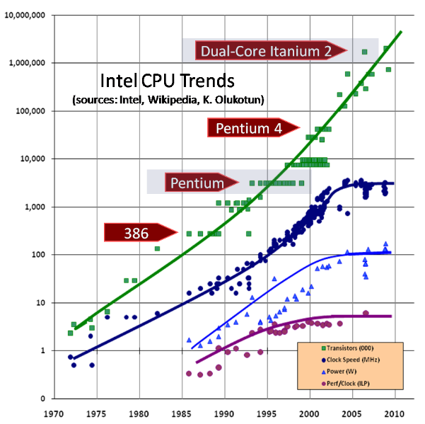
Single CPU scaling stopped around 2004
limitation is power, not circuit size
  and clock frequency is most ‘power-hungry’
  still some packages now @ TDP of 400W
multiple cores on the same die helped
  AMD EPYC Genoa (Zen 4) has 96 cores on die
  Intel Cascade Lake AP looked like a cludge
  but now Sapphire Rapids appears better again
CPU design-level performance gains left
  predictive execution
  out-of-order execution
  on-die parallelism (multi-core)
  pre-fetching and multi-tier caching
  execution unit sharing (‘SMT’)
  but at increased risk for security/integrity
Image: Herb Sutter, Dr.Dobbs Journal 2004, updated 2009,
see http://www.gotw.ca/publications/concurrency-ddj.htm

Slide 13
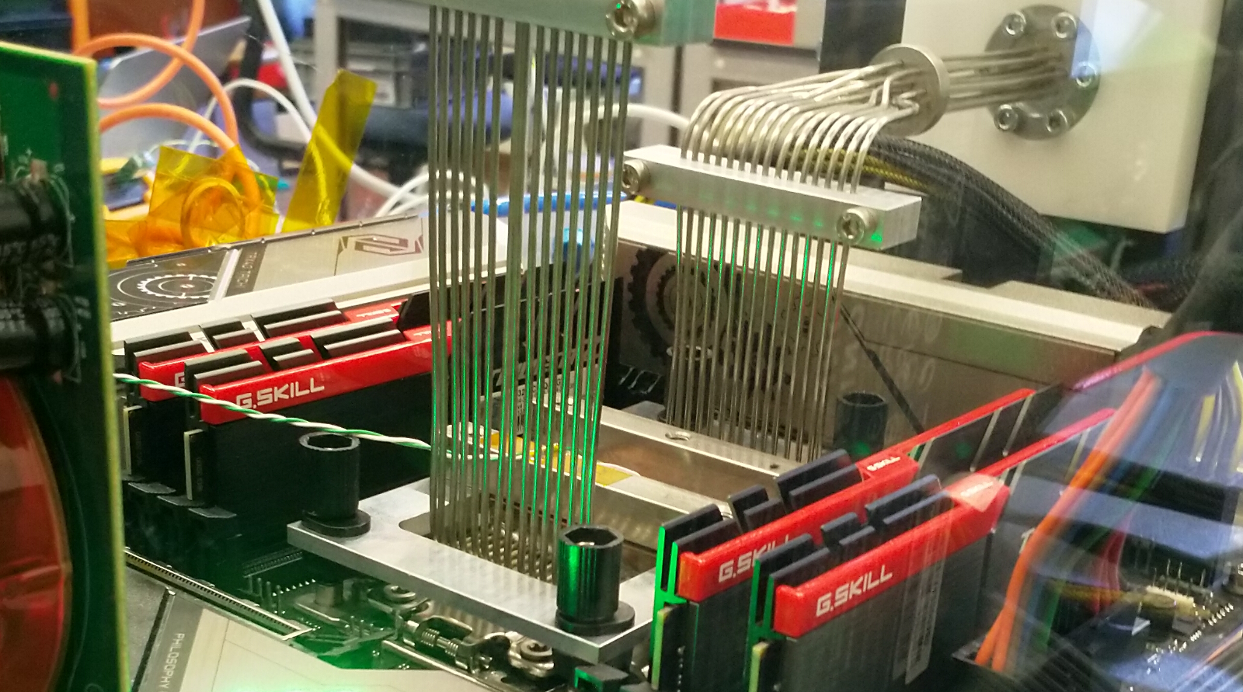
Fix the thing that didn’t scale well, CPU frequency??
LCO2 cooling of an AMD Ryzen Threadripper 3970X [56.38 °C] at 4600.1MHz processor (~1.5x nominal speed) sustained,
using the Nikhef LCO2 test bench system (https://hwbot.org/submission/4539341) - (Krista de Roo en Tristan Suerink)

Slide 14
… since you then need this around it …
Nikhef 2PA LCO2 cooling setup. Image from Bart Verlaat, Auke-Pieter Colijn CO2 Cooling Developments for HEP Detectors https://doi.org/10.22323/1.095.0031
proceed to clusters

Slide 15
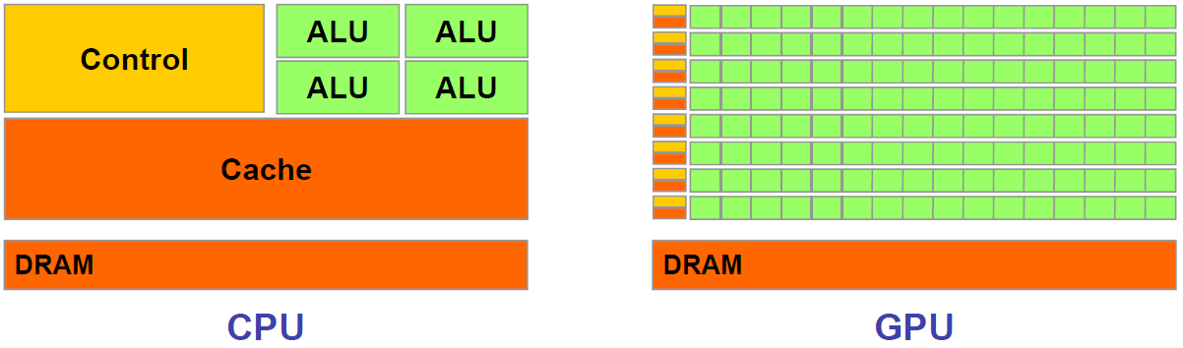
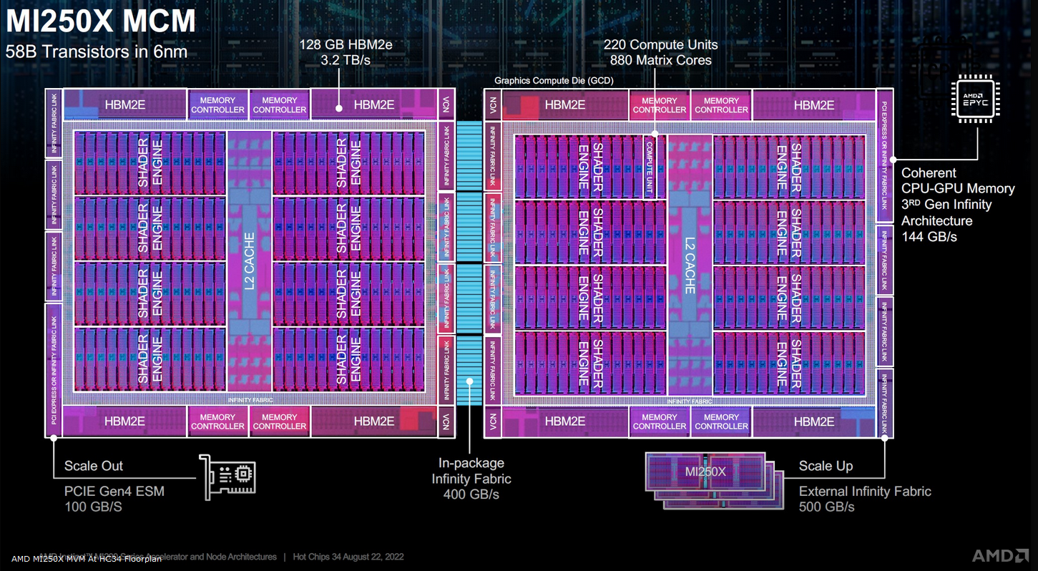
Accelerators – general purpose GPUs
but co-processing comes at a cost of moving data to and from the GPU
often faster to keep computing and do selection & conditionals later
computation speed heavily depends on precision (even 4-bit precision is used)
quite power hungry!
Image: ‘Massively Parallel Computing with CUDA’, Antonino Tumeo Politecnico di Milano, https://www.ogf.org/OGF25/materials/1605/CUDA_Programming.pdf
Floorplan image of die: AMD MI250 GPU, slide source: AMD

Slide 16
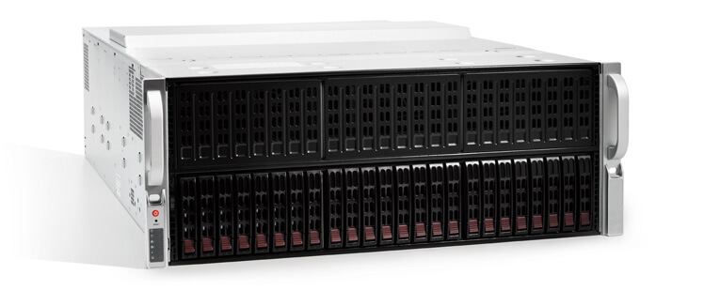

If large-scale IT does not quite fit … ahum …
SuperMicro (branded as ‘Lambda Blade’)
4U chassis, supporting 10 consumer-grade GPUs …
… with a bump
Image source: https://lambdalabs.com/products/blade

Slide 17
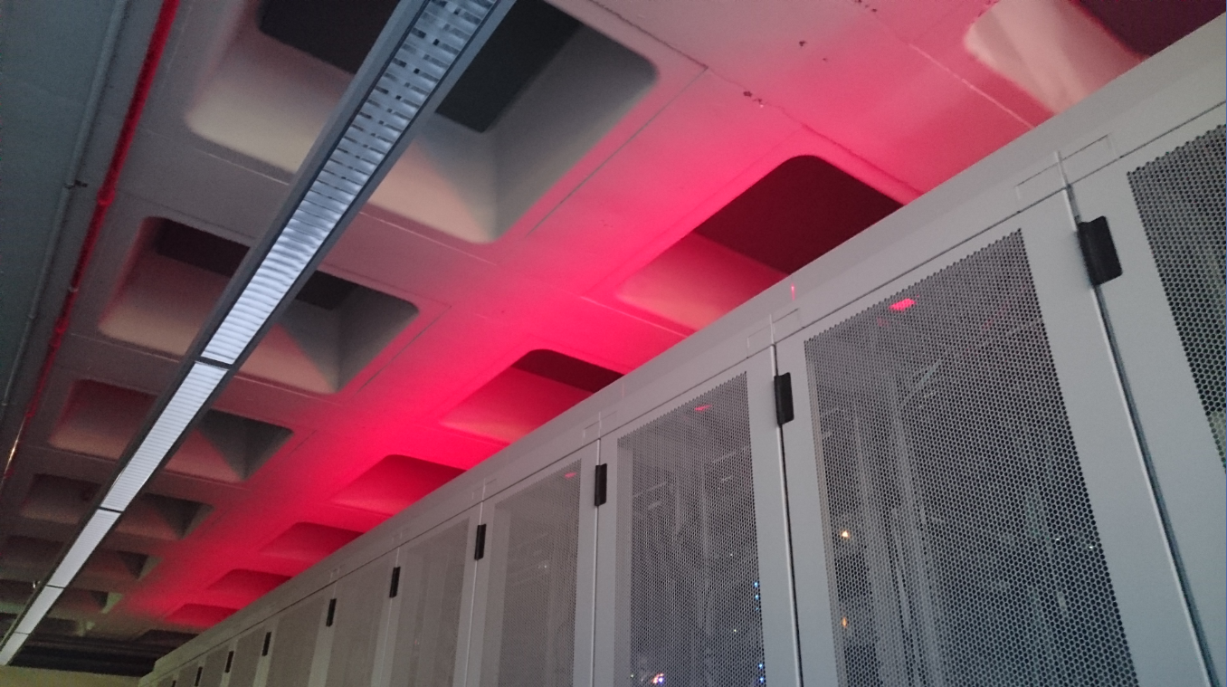
Scaling up – beyond one lone motherboard

Slide 18
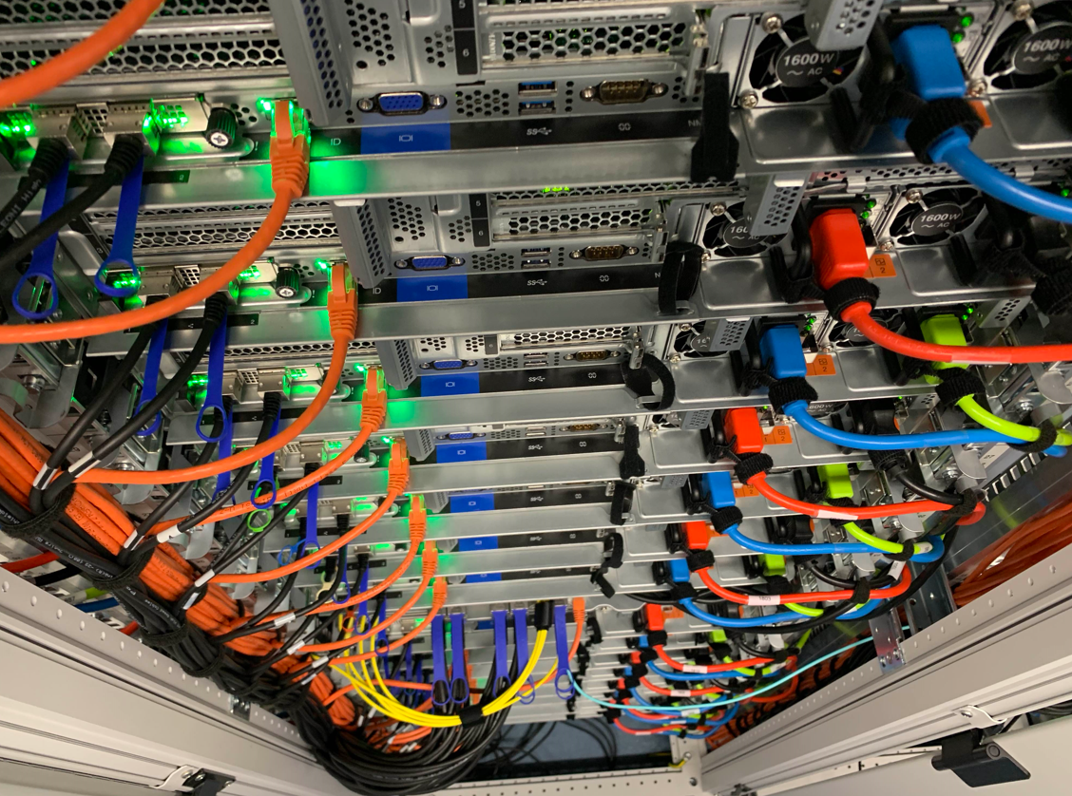
Physical farms: selecting the ‘worker nodes’
For HTC applications
– like WLCG, SKA, WeNMR – typically
balanced features for node throughput
(CPU, storage, memory bandwidth, network)
single-socket multicore systems are fine,
typical: 64-128 cores per system
network: 2x25Gbps
(+ ‘out of band’ management like IPMI)
memory: 8 GiB/core
local disk: 4TB NVME PCIe Gen4 x4
+ space (physical + power) to add GPU
Image: Cluster ‘Lotenfeest’ at the Nikhef NDPF, acquired March 2020. Lenovo SR655 with AMD EPYC 7702P 64-Core single-socket

Slide 19
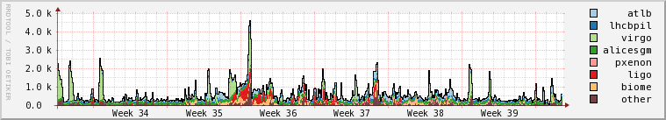
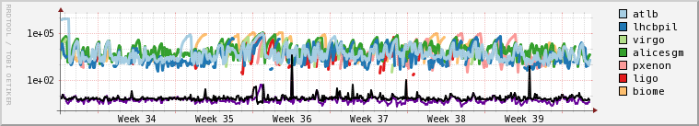
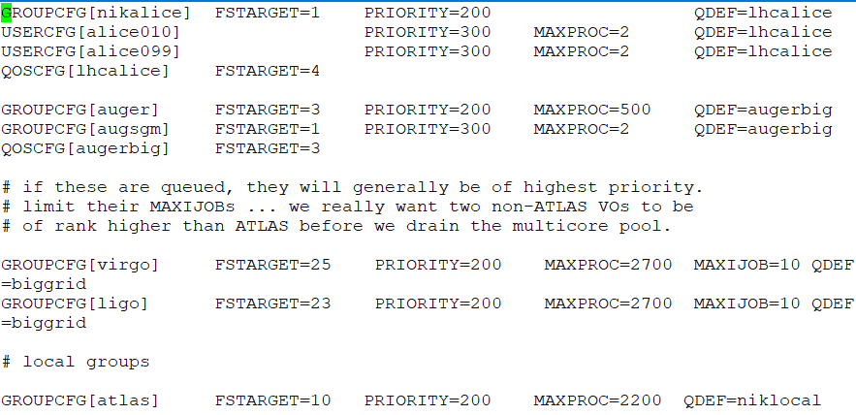
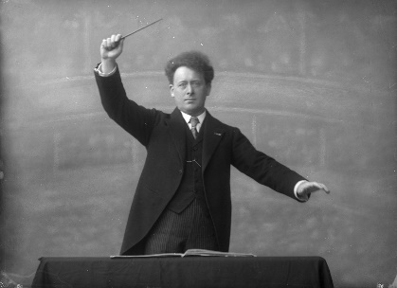


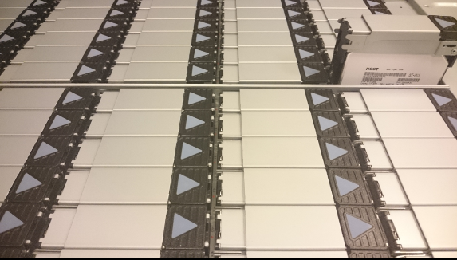

WLCG computing – conveniently parallel
?
‘like milking cows’ (if you feed them lots of power first)
parallel access to data comes at a cost of high IOPS

Slide 20
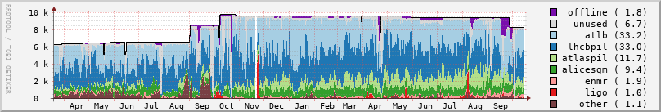
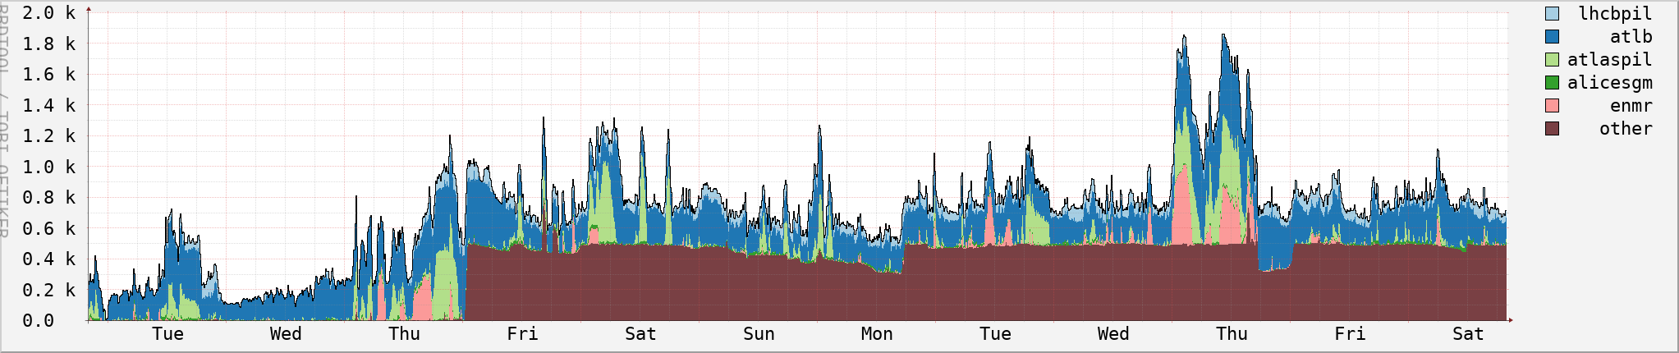

NDPF ‘WLCG and Dutch National Infra’ cluster
Running jobs:
period: March 2021 .. October 2022
# jobs
Waiting jobs (Week 40, 2022)
# jobs
drainage event on Sept 27 are nodes being moved to the LIGO-VIRGO specific cluster; Source: NDPF Statistics overview, https://www.nikhef.nl/pdp/doc/stats/
‘other’ waiting jobs are almost all for the Auger experiment - GRISview images: Jeff Templon for NDPF and STBC

Slide 21

More of more than one …
> 1 system
> 1 site
> 1 user group
> 1 organization
More than one …

Slide 22
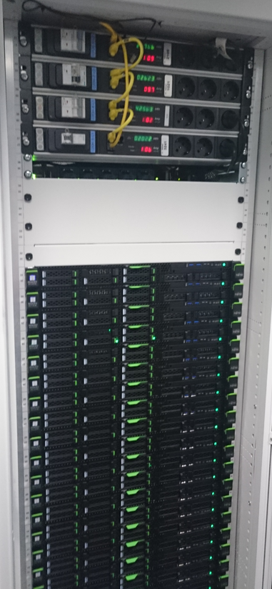
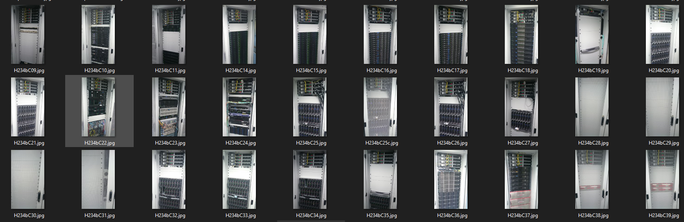
Fancy an interactive console install?
Images: Nikhef Housing H234b NDPF science processing data centre

Slide 23
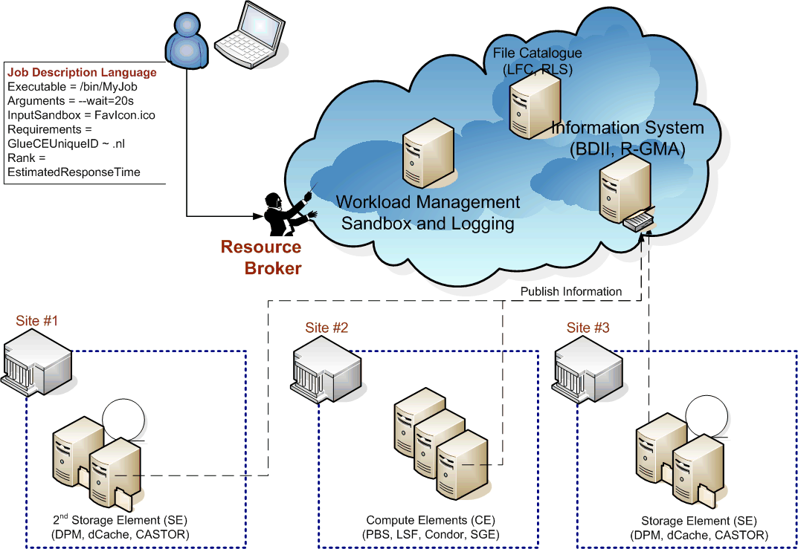
Standard interfaces for compute and data?
Global computing and workload management

Slide 24
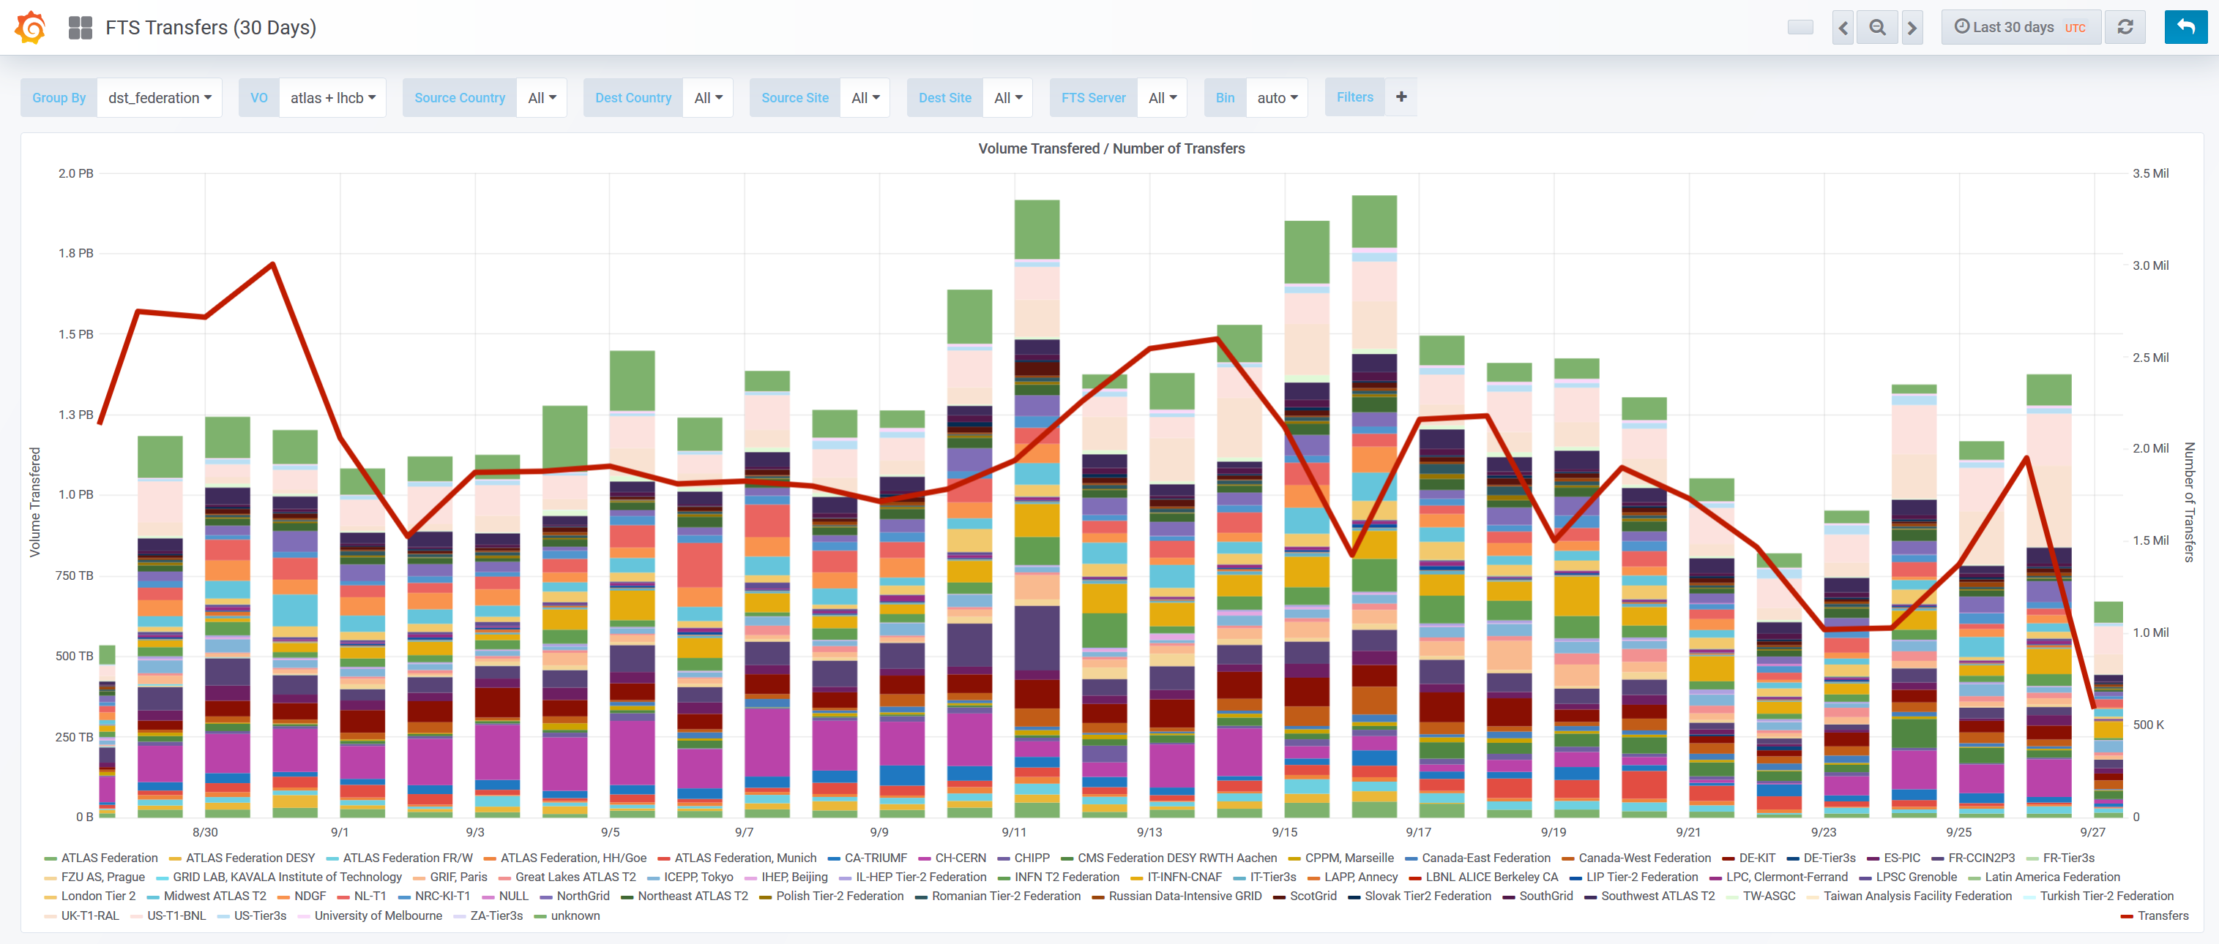

High throughput computing is also about data
source: https://monit-grafana.cern.ch/d/000000420/fts-transfers-30-day ; data: November 2020 ; CERN FTS instance WLCG: daily transfer volume ATLAS+LHCb

Slide 25
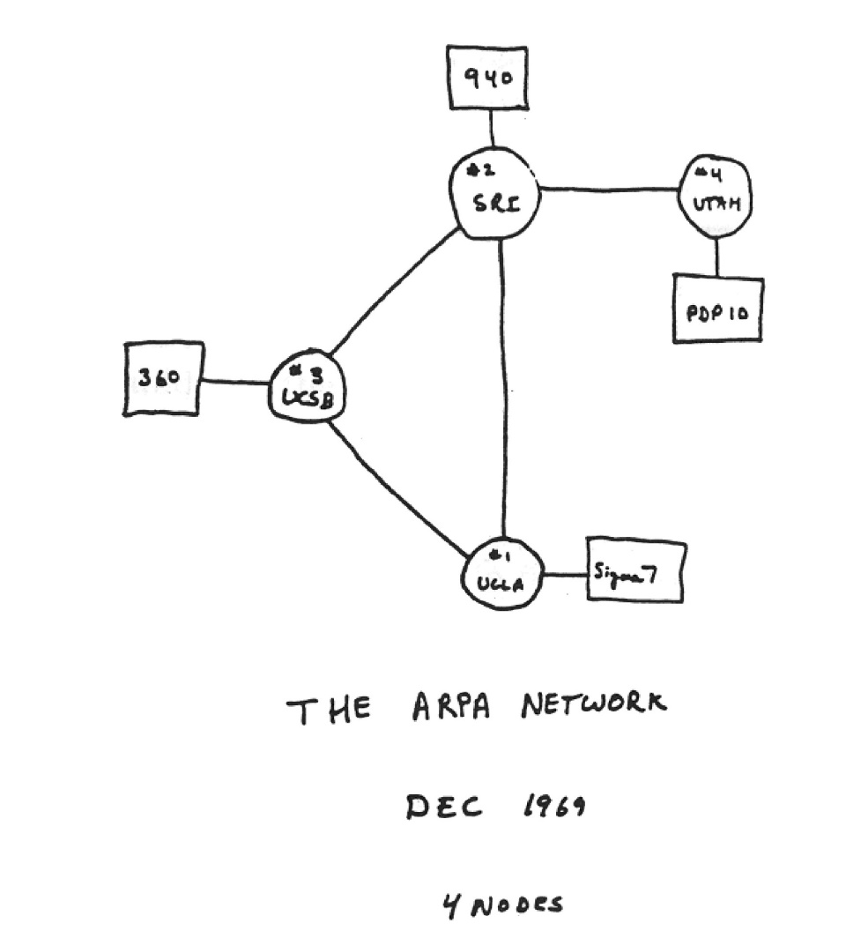

Het vroege internet ...
Image source: Alex McKenzie and "Casting the Net", page 56. See https://personalpages.manchester.ac.uk/staff/m.dodge/cybergeography/atlas/arpanet2.gif ; acoustocoupler: Wikimedia

Slide 26
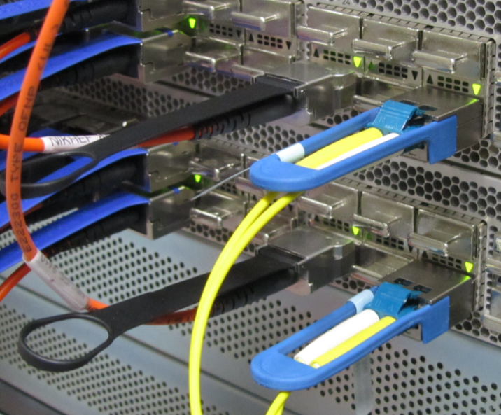
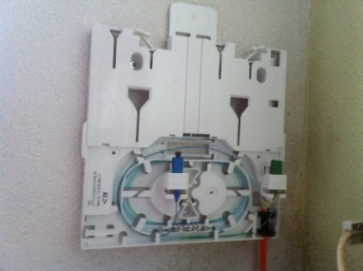
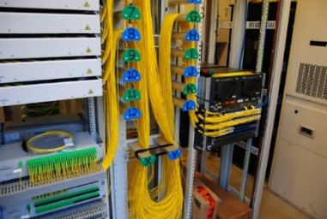
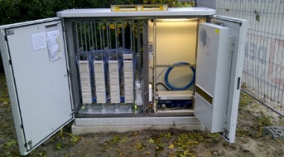
How does 100, or now 400 Gigabit per second look?
Thuis ‘FttH’
~1Gbps BX
single strand, SC
Nikhef
Data Processing
Facility
router ‘deel’
een KPN FttH
PoP in de wijk
vergelijk:
VDSL BR straatkast
voor als je nog
op xDSL koper zit

Slide 27

‘Elephant streams in a packet-switched internet’
Moving stuff around
wheelbarrows work fine in your garden
want to send it to different places?
Use waggons on a train, or ships,
going always from A-to-B anyway?
A conveyer belt will do much better!
… although you still need
a hole to dump it in …
Image conveyor belt tunnel near Bluntisham, Cambridgeshire by Hugh Venables, CC-BY-SA-4.0 from https://www.geograph.org.uk/photo/4344525

Slide 28


A quick look at internet routing …
network paths
from various places
in Western Europe
towards an IP address at CERN
Data: RIPE NCC Atlas project, TraceMON IPmap, atlas.ripe.net, measurement 9249079

Slide 29


Many paths to Rome … i.e. to your server
From a home connected to Freedom Internet to spiegel.nikhef.nl
but from Interparts in Lisse, NH:
AS41960: Interparts; AS1200: AMS-IX route reflector; AS1103: SURFnet; AS1104: Nikhef; AS206238: Freedom Internet – on the FrysIX there is direct L2 peering

Slide 30

Where do internet packets go anyway?
Border Gateway Protocol (BGP) used here is based on (weighted)
path vector traversal mechanism
I want to sent this to
e.g. 194.171.96.130
194.171.96.128/25
is here at AS1104
grey-dash lines for illustration only: may not correspond to actual peerings or transit agreements;
red lines: the three existing LHCOPN and R&E fall-back routes; yellow: public internet fall-back (least preferred option)

Slide 31

Typical data traffic to and from the processing cluster
Source: Nikhef cricket graphs period June 2021 – October 2022 – aggregated (research) traffic to external peers from deelqfx – https://cricket.nikhef.nl/

Slide 32

LHCone
LHCone (“LHC Open Network Environment”) – visualization by Bill Johnston, ESnet version: October 2022 – updated with new AS1104 links

Slide 33



Slide 34

Just one random
(smallish)
autonomous
system
AS1104

Slide 35




Exercising the network – sensor data and events
1.02 Bpps
400 Gbps and 593 Mpps –
connected to CERN via SURF
Image: ballenbak.nikhef.nl, Tristan Suerink

Slide 36





En … hoeveel gebruikt dat dan?
Eén server gebruikt zo’n 260W!
en het onderzoeksdatacentrum
Nikhef (de ‘glazen doos’) kan 400kW aan – waar blijft dat dan?
De snelste CPU is voor ons niet altijd de beste (sorry gamers!). Want 5 jaar energie en beheer zijn even kostbaar als de server zelf!
WKO: Warmte Koude Opslag
21% van het vermogen is nodig om te koelen, maar:
we mogen 3500GJoule/jaar (~112 kWjaar, ~982 000 kWh)
aan studenten tegenover leveren om ze warm te houden !

Slide 37
Let’s go on tour!

