Slide 1
Trust Assurance and Policy for Federated Identity
Requirements for Assurance and Policy along the AAI chain
David Groep
Policy and Best Practice Activity coordinator, AARC
Nikhef Physics Data Processing programme
Security Workshop ISGC 2016
March 2016

Slide 2
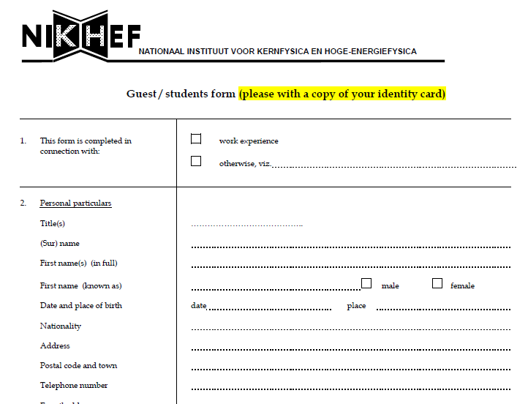
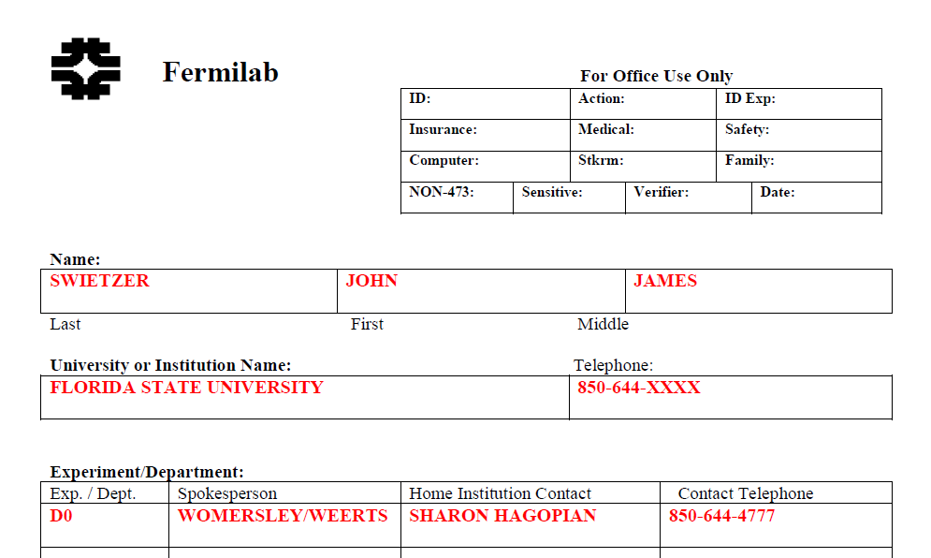
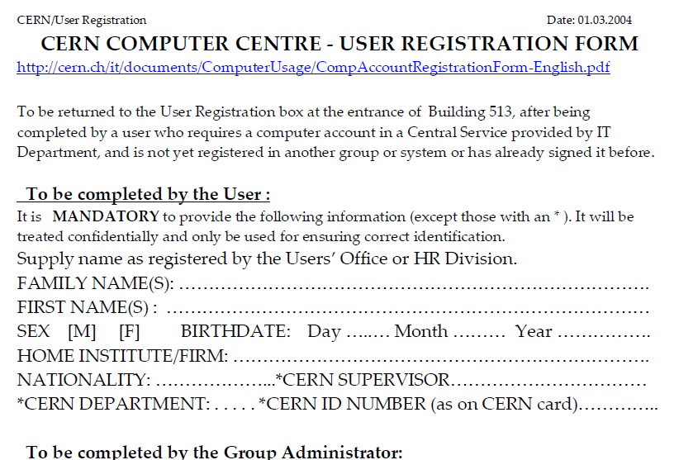
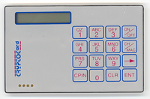
Remember these days … ?

Slide 3
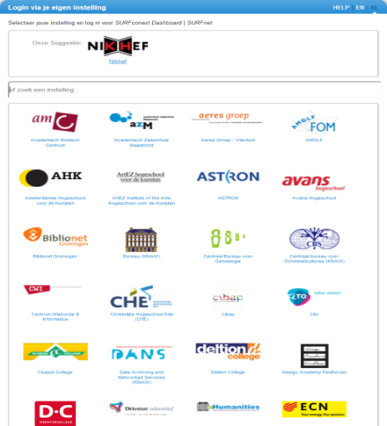
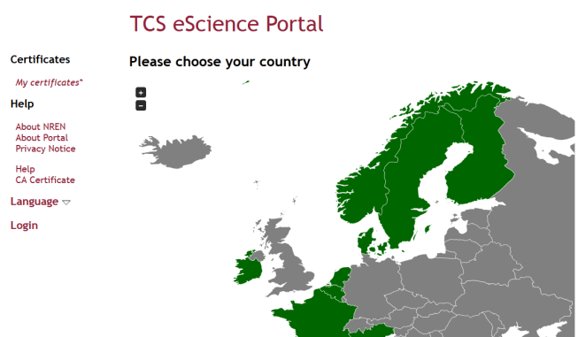
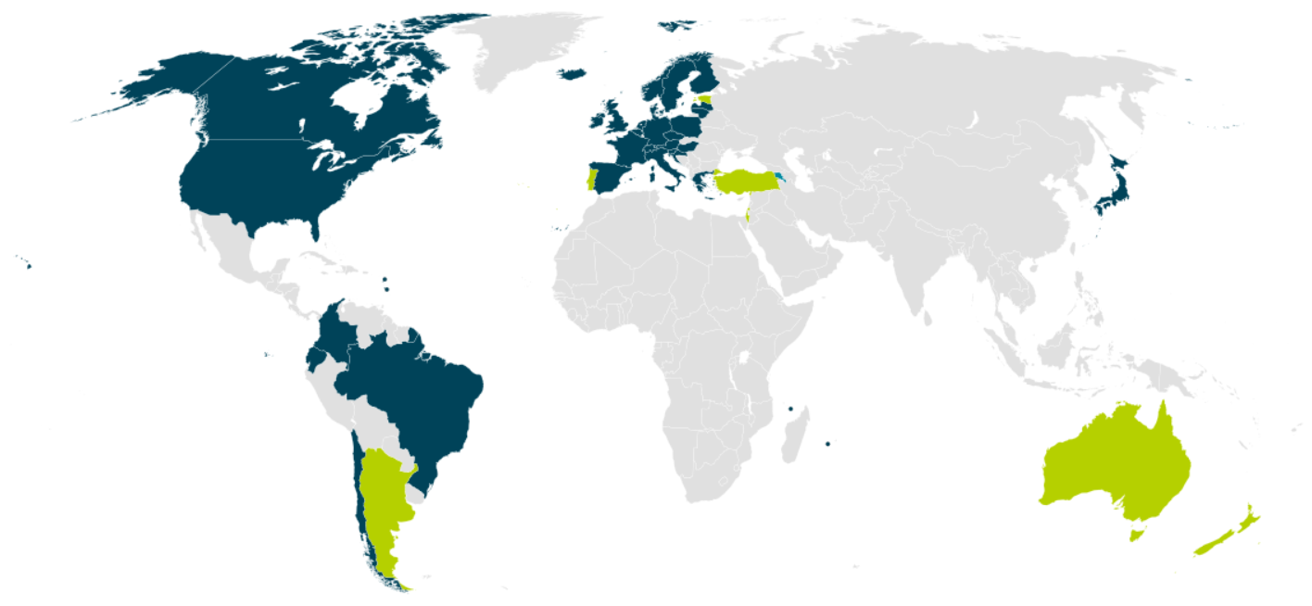


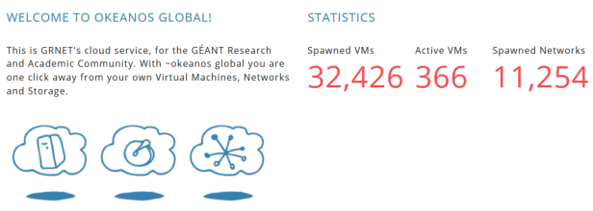

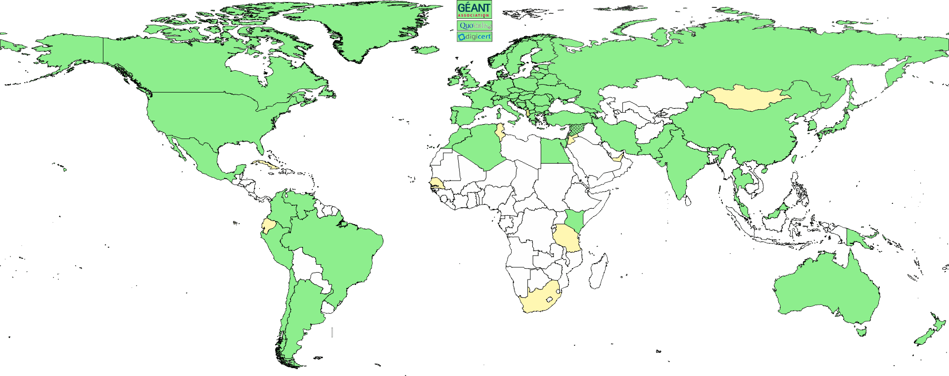
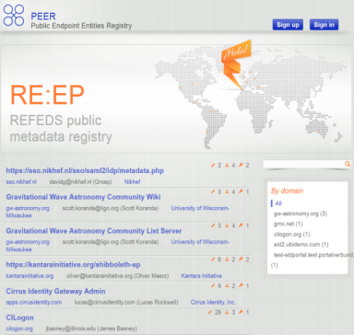
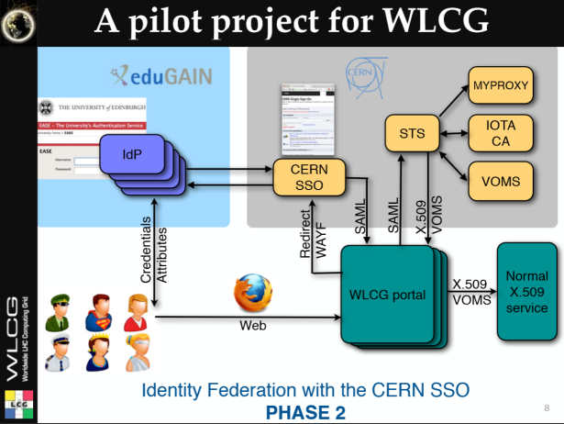

And now we have this!
wLCG FIM4R pilot
background: eduGAIN connected federations as of November 2014, and others – Brook Schofield, TERENA

Slide 4



Identifying responsibility – assessing risks
Subject
Action
Resource
ID & Vetting Attributes
Identifier
Other
Attributes
P
Independent administrative domains collaborate in distinct roles

Slide 5
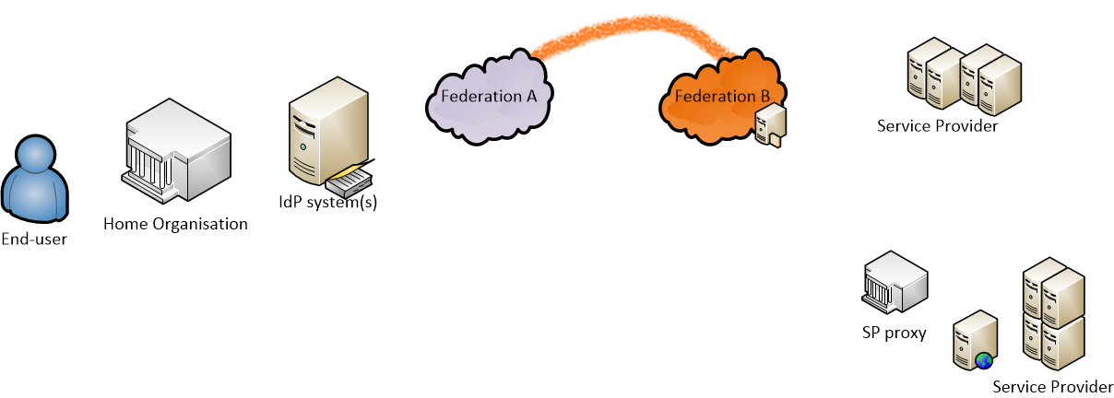
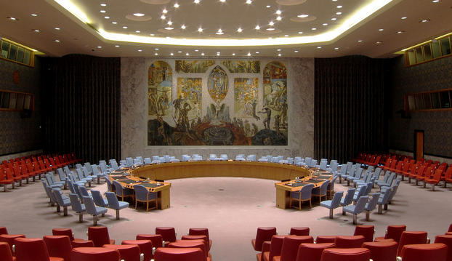

Chain of assurances …
Confederation
‘eduGAIN’
Federation contract
Data protection & privacy
Federation contract
Trust marks & categories
Data exchange
Infrastructure Commons
Incident Response
Authenticators
Identity vetting
IdM Policy
Attribute release
?
representation
attribute source hiding

Slide 6

Assurance as an element of risk assessment
Federation contract
Trust marks & categories
Federation contract
Data protection & privacy
Confederation
‘eduGAIN’
Data exchange
Infrastructure Commons
Authenticators
Identity vetting
IdM Policy
Attribute release
representation
attribute source hiding
Are the assertions provided by the IdP true?
At the time of issuance? At a later time - i.e. can they revoke, and will they notify you?
How do you trust the IdP? Does the registrar (federation) assert the right trust marks for it? Will the federation support you in contacting the IdP, and the IdP in finding the end-user?
Is the federation meta-data complete and understandable?
Can you make sweeping trust statement for the whole federation or
do you have to assess each and every IdP?
Do you see the IdP you’re about to trust? Or do you just see a H&S federation masking it?
Or is it a user community, hiding all of the world recursively with an ‘IdP-SP proxy’ setup?
When an IdP-SP proxy does attribute assertion, you cannot see if these are the original attributes … what is the assurance given by the VO/community?

Slide 7
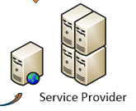
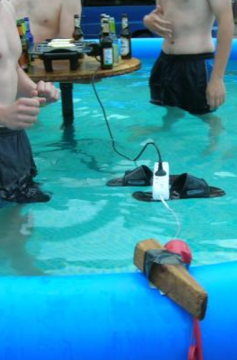
Relying Parties as a Defining Element?
Service providers (‘relying parties’) absorb almost all of the residual risk
– as they host and manage resources under threat
Sources of ‘subject authority’ should
align with RP interests to be useful
RP must have policy controls to
compose sources of authority
RP must be equipped with
effective controls to mitigate risks
To make the risk assessment, you need to ‘predict’ the behaviour of others action chain:
Home organisation, its IdP, Federation Operators, Attribute Authorities, peer service providers
source: NorthWood LAN party 7 - http://www.linuxno.de/

Slide 8
Expressing trust and assurance in different, complementary ways
Formal and ITSM approaches
Prevalent e-Infrastructure and RI approaches
ISO 27000 series compliance
ISO 29115
(NIST SP800-63, OMB M0404, OECD, Kantara)
Assessment Frameworks
(RFC 3647, ISO27002, SP800-53)
External, periodic, independent audits
Risk-based, multi-layer classifications
But also
Costly, suitable mostly for large legal entities
Depends often on regulatory pressure, so different in each country, even the mere specs
Standards-inspired frameworks
Community standards (IGTF Assurance Profiles, GEANT Federation Template)
Self-assessment and peer review
Single or baselined classification of risk
Personal trust groups
But also
‘blind’ trust (framework-only models, eduGAIN declaration)
sometimes no trust definition at all
(in a ‘non-intervention’ mode)

Slide 9
Confederation
‘eduGAIN’
Federation contract
Data protection & privacy
Federation contract
Trust marks & categories
Data exchange
Infrastructure Commons
Incident Response
Authenticators
Identity vetting
IdM Policy
Attribute release
representation
attribute source hiding

Slide 10
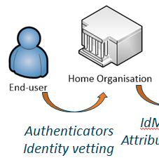
Authentication and identity vetting
A wide variety of assurance levels exists
  Formal specifications: ISO29115, Kantara, NIST SP800-63 (OMB M-04-04) – usually four levels
  Europe put in a new scheme for their “eIDAS” regulation, using three levels (including a “substantial”)
  CI and e-Infrastructures around the IGTF now have ~ two levels (classic and ‘identifier-only’)
Levels are usually a combination of authenticator strength (passwords, tokens, biometrics) and identity vetting assurance (face-to-face, two photo IDs, verified home address, naming)
How to get a defined assurance level?
Negotiate 1-on-1 with each IdP and get e.g. the eduPersonAssurance attribute set
Rely on a ‘policy filter’ like the IGTF – only compliant and assessed IdPs make it through
and how that is done depends on the CA model, e.g. TCS uses specific entitlements, InCommon Silver uses eduPersonAssurance and institutional accreditation
For low assurance use cases, infer it from other IdP properties or ‘generate’ uniqueness
e.g. if an organisation has some incident response capability & send useful attributes …

Slide 11
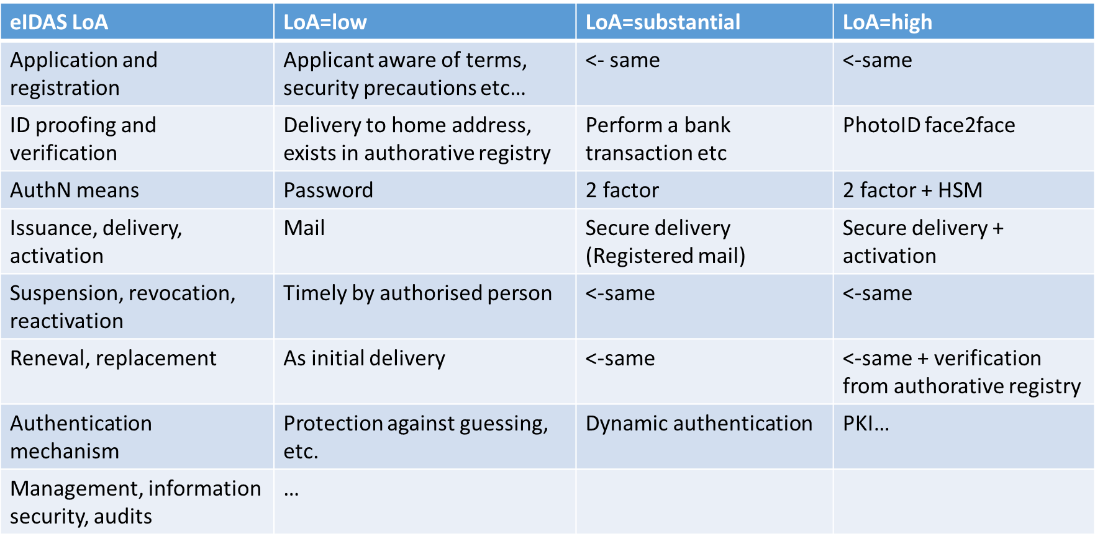
LoA example: eIDAS

Slide 12
A baseline LoA for federated identity
At the moment, there is no common baseline assurance for identity. Individual federations may however have guidelines. E.g. at SURFnet:
  Organisations adequately protect and configure systems and networks used for the IdP
  Ensures that attributes of users are up-to-date and complete, and that the user has been identified on enrolment (but does not ask how the user was identified in the first place!)
  Some attributes are mandatory (displayname, email, affiliation status, &c)
  Access is restricted to a specific class of users only (so even if you express another affiliation, you still cannot authenticate third parties, even if you’ve identified them … and you cannot act as an IdP of last resort)
  Organisations maybe asked to make their processes transparent (but that’s not compulsory!)
  They comply with SURFnet’s privacy interpretation
But this is – in a global context – already a very tightly controlled assurance level … there are much more open federations and IdPs out there

Slide 13
A common baseline for assurance for e-Infrastructures
AARC MNA3.1 (Mikael Linden et al.):
“Recommendation on minimal assurance level relevant for low-risk research use cases”
Based on depth-interviews with the major Research communities and e-Infra’s in Europe ...
Accounts belong to a known individual (i.e. no shared accounts)
Persistent identifiers (i.e. are not re-assigned)
Documented identity vetting (not necessarily F2F)
Password authN (with some good practices)
Departing user’s account closes/ePA changes promptly
Self-assessment (supported with specific guidelines)
A REFEDS task force will evolve these recommendations into globally implementable guidelines
https://wiki.geant.org/display/AARC/LoA+-+Level+of+Assurance

Slide 14
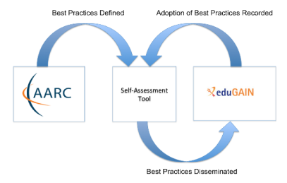
Expressing identity assurance
The CIs and research infrastructures are ‘happy’ with self-assessment & peer review
while it works well is smallish (< ~150 people) communities, anything beyond
this ‘Dunbar limit’ needs some documented trust process and automation support
Self-assessment tool*
Self-completion of maturity surveys – with optional peer review indicators
Distribution of assessment status to federation participants, also via SAML meta-data
Comparison of status between assessed participants (IdPs & SPs, against various policies)
IETF registry for LoA
Defined vocabulary for IdP LoA
RFC 6711 (Leif Johansson) established https://www.iana.org/assignments/loa-profiles/
One new AARC/REFEDS artefact (Sirtfi, https://refeds.org/sirtfi) submitted recently!
* https://docs.google.com/document/d/10kguCdxWn38z_EGRnrdjCI4GSeO44zFGeXWHGmzz27o

Slide 15
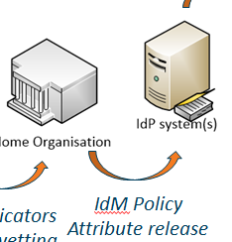
Attribute release & IdM policy
So the organisation can authenticate and qualify users … and now what?
you have seen various models for federation: hub-&-spoke, full-mesh, and hybrids
how can the recipient know about user identity, status, qualities? Via an attribute statement:
But you may not get information: many considerations pose challenges for an IdP operator:
some are assuming decisions on behalf of their users (unwillingness to release)
unclear regulatory constraints scare IdPs operators:
data protection in the EU + New Zealand, Argentina, Canada, Uruguay, &c ; FERPA in the US
differing rules per country make for complex interfederation negotiations
Yet most ‘hub-&-spoke’ federations provide some collective qualities for their amalgamated IdPs
<samlp:Response ID="_2af69a..." Version="2.0" IssueInstant="2016-03-12T04:05:57Z"
Destination="https://engine.surfconext.nl/authentication/sp/consume-assertion" ... >
<saml:Issuer>https://sso.nikhef.nl/sso/saml2/idp/metadata.php</saml:Issuer>
<ds:Signature xmlns:ds="http://www.w3.org/2000/09/xmldsig#">
<saml:AttributeStatement>
<saml:Attribute Name="eduPersonUniqueId“ NameFormat="urn:oasis:names:tc:SAML:2.0:attrname-format:basic">
<saml:AttributeValue xsi:type="xs:string">40ea621a0a7355cf4fb1ca8d4f22a53d@nikhef.nl</saml:AttributeValue>
https://addons.mozilla.org/en-US/firefox/addon/saml-tracer/

Slide 16





Attribute sets and release policies
Release models
All kinds of attributes
- user approval based
- usually no real ID info
what you would like to see …
what you get
If you offer a carrot
REFEDS R&S
- implicit release of basic
attributes, likely true
- scales well, but ‘slow’
adoption
- works globally if it does!
Attributes when you Ask
- 1-on-1 attribute release
- Both in mesh and H&S
- Scalability issues
Authenticator only
- no useful ID
- for risk-averse IdPs
what your users
will ask for …
. . .
. . .
“R&S Service Providers MUST resolve issues of non-compliance within a reasonable period of time from when they become aware of the issue. Failure to do so MUST result in revocation of the entity’s membership in the R&S category.” – but nothing on IdPs ☹
Research and Scholarship Attribute Set
displayName or (givenName and sn)
mail
eduPersonPrincipalName
eduPersonTargetedID
eduPersonScopedAffiliation
[https://refeds.org/category/research-and-scholarship]

Slide 17
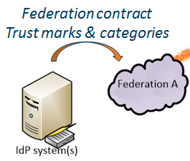
Federation policies for IdPs – Entity Categories and trust marks
Federations operate according to very different assurance levels
Rather strict: SURFnet, HAKA, SWAMID, …
Very loose: ACOnet, InCommon, …
Little common practice in older federations, new ones might follow Marina’s Best Practice*
When assessing a federation itself for usefulness, look for these elements:
Technology Profiles (WebSSO, eduroam, …) – some technologies are transparent, others not
Authentication LoA profiles – is there a common baseline in the federation
Data Protection – can IdPs in that federation work with you and release attributes?
Operating practices (service level, contacts, &c) – are they willing to talk to you, as an outsider?
Governance and eligibility – what kind of entities can you expect in this federation?
* https://wiki.refeds.org/display/FBP/Policy+Templates

Slide 18
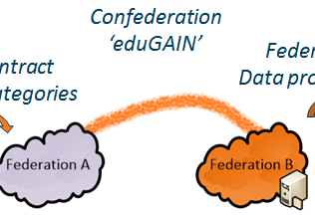

Interfederation – eduGAIN framework and interfederation
eduGAIN is a inter-federation scheme to connect federations to each other
although the one global known entity,
it is not supposed to be seen by anyone but federation operators
yet an SP and IdP should be aware of it, since it conveys your assertions and impacts trust
Limited policy around it: a top-level Declaration and a Constitution
Governance is by federation operators, and at two levels
Public policy level Steering Group, and an Executive (actually: just the GEANT Project Executive)
Operations Team (Brook Schofield)
Besides this, there are informal groups where things actually happen …
the REFEDS Federation Operators Group (FOG)
wider scope than just eduGAIN, and more practical - it’s the one reliable comms mechanism
closed - with Fed operators usually concerned about PR issues like outages handled there
services.geant.net/edugain/Resources/

Slide 19
Interfederation – eduGAIN policy-less operation
Technical implementation: a large meta-data feed at http://mds.edugain.org/
You could filter on entities in there, and – as an independent service provider – you probably should
But it’s not much encouraged: you need your own software to process this. But then deploying a few scripts is not too complex for a service provider (unless you’re hidden behind a classic hub-n-spoke federation operator), and e.g. mod_mellon has this as a default feature
What to consider as an independent Service Provider
Ability to suspend IdPs and registrars (=federations)
Filter on Entity Categories (attributes in the meta-data)
Subscribe to a central emergency suspension service? Of the self-assessment tool? But those are not there yet …
Use the meta-data feed and MET to explore the world, via https://met.refeds.org/
https://github.com/UNINETT/mod_auth_mellon - and see MellonIdPIgnore

Slide 20
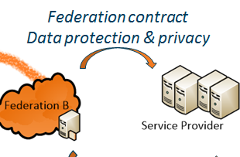
Federation policies: the impact on SPs
No way for general global SPs to connect directly to eduGAIN
Always has to go either via a federation, or via one-to-one agreements with IdPs
But as an SP you can go federation shopping
Some require a fee for signup (e.g. InCommon)
Some require you’re either academic or have a contract in place (e.g. SURFconext)
Some are open for everyone that can demonstrate a good reason (e.g. ACOnet)
Same applies for policies
Some require strict adherence to e.g. a Data Protection Code of Conduct (e.g. HAKA)
Some are more a conventional registrar and having good response and conditions is fine
There’s quite a lack of ‘market’ for registrars in eduGAIN, but as a global SP you can pick your favourite ☺

Slide 21
Data Protection and privacy
Rapidly evolving global landscape related to privacy and data protection
High-profile data leaks have raised public awareness, with Europe most pushy in this area
but other countries follow in order to do business …
You can declare adherence (in the EU) to a ‘GEANT Data Protection Code of Conduct’
Uses mostly informed consent of the user as a basis for getting personal data from the IdP
Plus
helps negotiating attribute release with IdPs, since they ‘know’ this model
If you have a comprehensive policy framework, you may be compatible already
Minus
mostly duplicates what’s EU law anyway (so why state that again …)
doesn’t work outside of Europe – and the International CoCo can’t progress for now

Slide 22
Policy mapping and GEANT DPCoCo
Legal compliance: in SP jurisdiction
Purpose limitation: collect only those data needed to enable access
Data minimisation: also use the least intrusive attribute you can use for a purpose
Deviating purposes: not permitted
Data retention: delete when no longer needed (some federations say 6 months only! ☹)
Third parties: no transfer, except if needed to give access, when 3rd party is also CoCo, or on consent
Security measures: secure your service and protect data (see e.g. what the GDPR pushes for)
Inform the end-users, via a privacy policy with certain rights.
But the right to delete data is not supposed to apply to security logs, luckily
Inform the IdP: via a machine-readable compliance statement (EC) and link to the Privacy Policy
Note that specific agreements take precedence, and it formally only works in the EU/EEA for now
https://wiki.refeds.org/display/CODE/Data+Protection+Code+of+Conduct+Home
http://geant.net/uri/dataprotection-code-of-conduct/

Slide 23
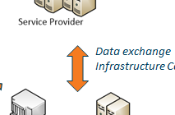
Exchanging data between SPs
Having agreed to DPCoCo or its principles, now what?
To exchange use data (accounting) and logged information, you need to stay within purpose
So in your policies and statement, add ‘security’ as a purpose of the data collection
Make sure your peer service providers in the infrastructure sign up to the same policy suite
“Personal Data may only be transferred to or otherwise shared with individuals or organisations where the recipient -
has agreed to be bound by this Policy and the set of common Infrastructure policies, or
is part of a recognised Computer Incident Response Team framework and as part of an incident investigation to prevent active or suspected misuse of Infrastructure services, or
presents an appropriately enforced legal request.”
Personal Data of End Users (hereinafter “Personal Data”) shall be Processed only for those administrative, operational, accounting, monitoring and security purposes that are necessary for the safe and reliable operation of Infrastructure services, without prejudice to the End Users’ rights under the relevant laws.
Ian Neilson et al. based on the EU BCR model
e.g. https://documents.egi.eu/document/669, and https://indico.egi.eu/indico/event/2923/contribution/2/material/0/

Slide 24
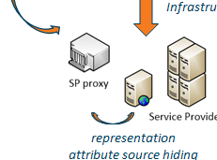
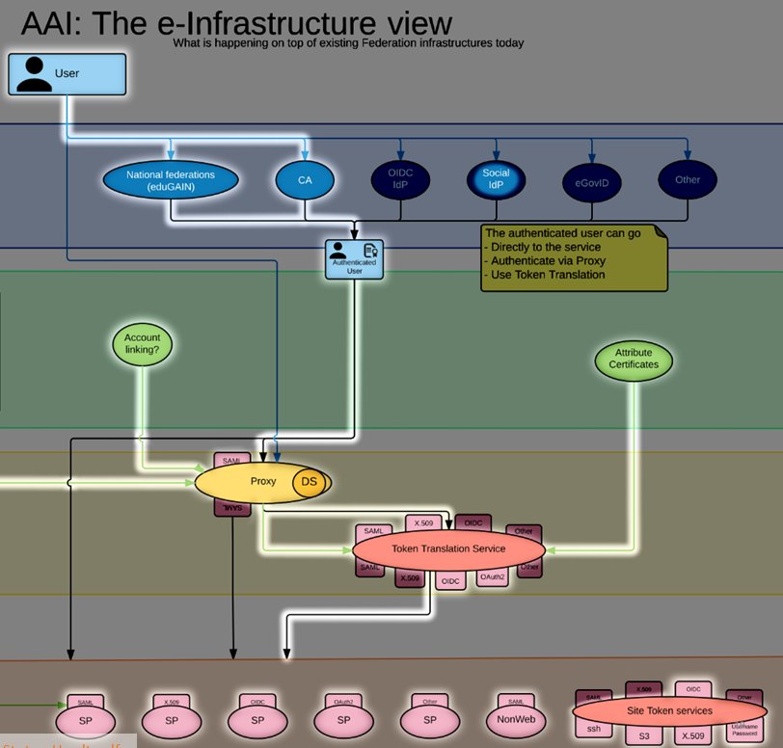
IdP – SP proxies and credential translation services
Community stepping in where IdP has left off
adding collaboration and increasing assurance
also hides back-end IdP assurance
Roles
when in the attribute flow, becomes data processor
otherwise it’s a conventional filter service (members)
with a set of membership policies
and registration practices
Communities come in various shapes & sized
Highly structured, like WLCG
Very loose small communities
You need differentiates assurance at the SP end to filter!
Marcus Hardt, KIT and AARC
https://aarc-project.eu/wp-content/uploads/2015/11/20151102-JRA1.2-Blueprint-Status-Hardt.pdf

Slide 25
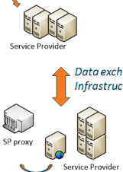
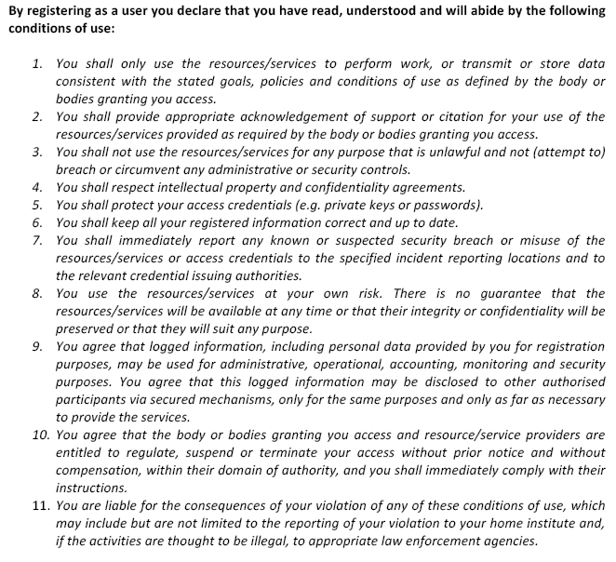
Improving scalability and avoiding silos
When possible, ask common things
as early as possible, and/or in a common way
Otherwise you create a silo at the point of asking
Common AUP is hard, comparable AUP
works even across widely different infrastructures
‘Taipei Accord’, 2005
https://documents.egi.eu/document/2623

Slide 26
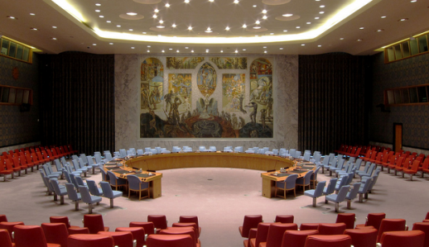
Collaborating in incident response among the AAI chain
Confederation
‘eduGAIN’
Federation contract
Data protection & privacy
Federation contract
Trust marks & categories
Data exchange
Infrastructure Commons
Authenticators
Identity vetting
IdM Policy
Attribute release
representation
attribute source hiding
Sirtfi – Security Incident Response Trust Framework for Federated Identity

Slide 27
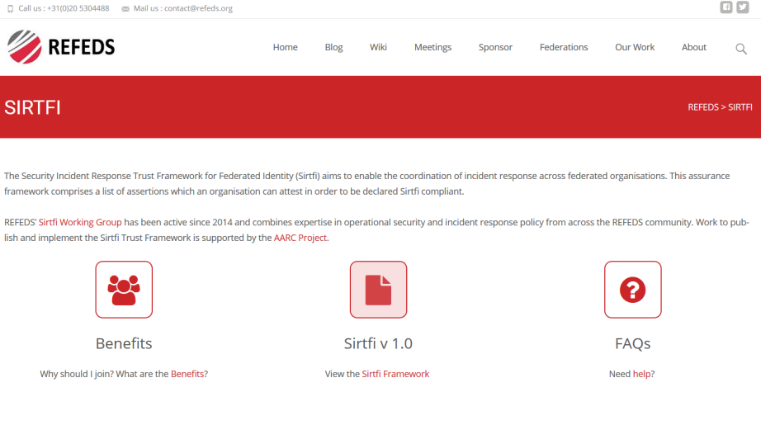
Sirtfi Framework for Incident Response Collaboration
Asserting Sirtfi compliance by an IdP or SP (e.g. via SAML meta-data) means concretely
Operational Security
  Managed vulnerability patching and processes, some intrusion detection,
  account management, contact information available, CSIRT established
Incident Response
  Provide contact information, timely response to assistance requests, willing to collaborate,
  respect privacy and TLP classifications
Traceability
  Logs are timestamped, retained, and available; and there is a policy governing its retention
Participant Responsibilities
  There is an AUP for participants, users are made aware of it and agree to abide by it
Some, not all, federation agreements actually cover some of this (e.g. an AUP in SURFconext)
https://refeds.org/SIRTFI

Slide 28
Sirtfi – the road ahead!
Phase I: develop the SIRTFI Trust Framework specification, defining
basic security incident response capabilities - organizations can self-assert compliance
  Define meta-data schema for security contacts
  Entity category definition and registration
Phase II: means for member organisations in R&E federations to indicate their compliance
  Training and communication
  Implement contact and category definitions in production federations (and keep it up to date)
Phase III: means for proactive notification of account compromise along the chain
  Automated mechanisms for incident notification in the federation chain
  Look e.g. at initiatives like Confyrm – incidents mostly spread based on commons user across SPs and IdPs
  Tooling is needed, but maintaining privacy is always a challenge …

Slide 29
Sirtfi in practice – Security Contact Meta-data in federations
Security Contact Data in the meta-data specification
Extends InCommon contactType (and will likely be renamed):
<ContactPerson contactType="other" xmlns:icmd="http://id.incommon.org/metadata" icmd:contactType=
"http://id.incommon.org/metadata/contactType/security">
Who to expect there?
Somebody in the entity organisation security team who knows about TLP and confidentiality
Promptly (within one business day) acknowledge receipt of the security incident report.
As soon as circumstances allow, investigate incident reports regarding resources, services, or identities for which they are responsible.
Respond to the incident reporter and any other impacted parties when the incident is resolved.

Slide 30
Along the Chain
Federation contract
Trust marks & categories
Federation contract
Data protection & privacy
Confederation
‘eduGAIN’
Data exchange
Infrastructure Commons
Authenticators
Identity vetting
IdM Policy
Attribute release
representation
attribute source hiding
Levels of Authentication Assurance: common baseline being drafted. Usually you get reasonable entities, protected with a username-password, and data not older than a few years
IdP maturity level is generally low (undocumented), with exceptions. Some federations include
a minimum bar, but this will differ per country.
At least REFEDS R&S gives you non-reassigned identifiers - but you’re not sure which one.
Assignment of entity categories by IdP (SirTFi) and federation (REFEDS R&S) enhances trust
eduGAIN is great for finding meta-data and some contacts (e.g. in the MET tool), but
no common policy apart from being “something academiccy” and a registrar name.
Remember that it’s nothing more – and that real discussions are in closed federation-only groups
User attributes and data sharing between service providers may involve regulatory issues
When there’s a science gateway involved, VO, or IdP-proxy, that’s the place to get information
Security contact information and collaboration is evolving through Sirtfi

Slide 31
https://www.nikhef.nl/~davidg/presentations/ISGC-SecWS-2016-Assurance-and-Federation-AARC.ppdf
davidg@nikhef.nl

Slide 32
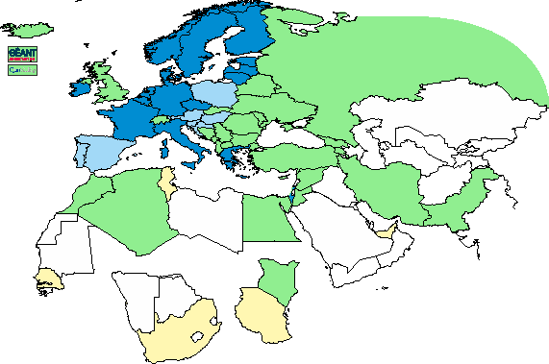
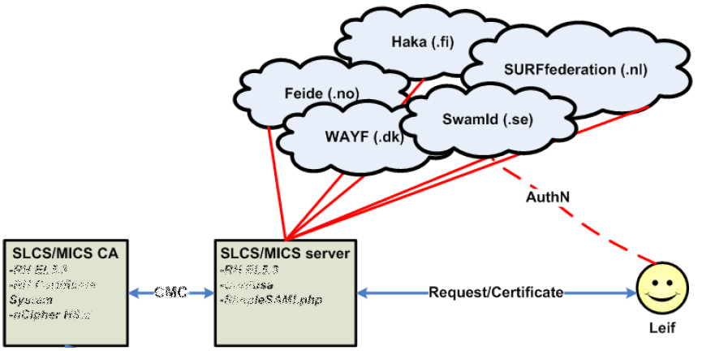
Building incremental assurance federations
‘trust is technology agnostic’
GEANT TCS
DFN AAI SLCS
CILogon Basic, Silver
SLCS/MICS graphic: Jan Meijer, UNINETT

Slide 33
Title
Subtitle
A change in trust relationships
Trust mechanisms: ISO compliance and accountants; Peer review and self-assessment
Enabling traceabulity: releasing data: Rules regardig attribute release; REFEDS R&S, reluctance
You’re not supposed to be opaque: common threats (see Hannah’s talk): Federation rules, Differences between federrations; eduGAIN as policy neutral
Adding capabilities: One-on-one actions likeTCS, ePEntitlements; Commonality and assurance: inCommon silver experience (c.f. bronze, cf. none==basic!); Sirtfi; Phases in Sirtfi and compliance
RCauth requiremetnts: trust is technology agnostic; Assurance registries and LoA - and the RFC for Sirtfi
Along the value chain: being able to rely on AUPs, reliance on ‘good’ behaviour by all participants, including federation operators. The latter is not to be taken for granted (some think they’re an island, and some prevalent thinking supports such a view, unfortunately “it’s their problem, not ours” is still common for ops issues)
Risk based analysis: risk and impact analysis by an IdP or federation may be very, very different from yours!

