Slide 1
Leveraging the IGTF authentication fabric for research
the IGTF-to-eduGAIN Bridge and the registration authority network
David Groep
Nikhef
co-supported by the Dutch National e-Infrastructure coordinated by SURF, and by EGI Core Services

Slide 2
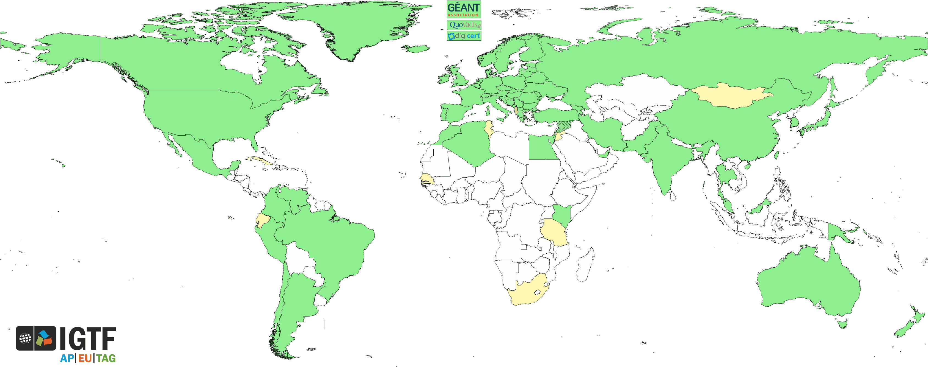
A different look at the IGTF?

Slide 3
What we do
User-centric authentication – across organisations
Independent of user’s home organization
Inspired by and aligned with
research communities and e-Infrastructures
Differentiated assurance derived from a both
solid and transparent assurance level
Ability to transfer registrations across authorities and countries (with the Registration Practice Statement)
… and guidance around trust and trustworthy operations for AuthN and Attributes … and …

Slide 4
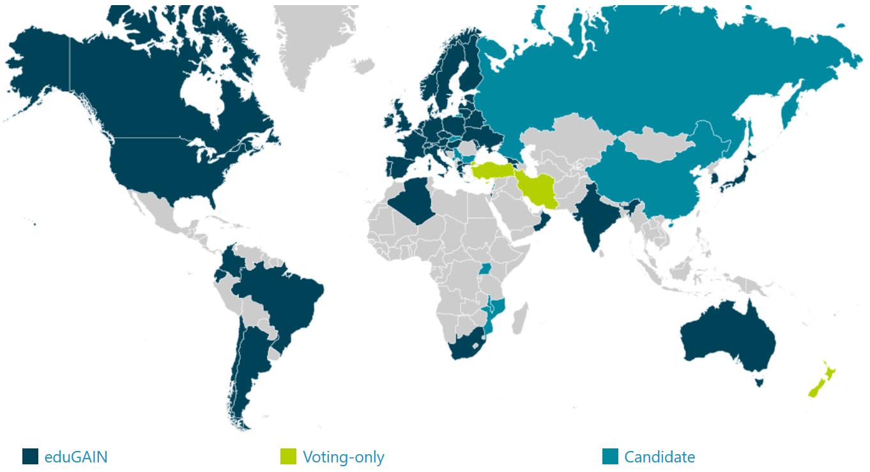
eduGAIN
40 NRENS (≈ countries)
4254 entities
(of which 2533 IdPs, i.e.,
authentication providers)
eduGAIN (status Sept 2017)
organisation-centric, and with much national autonomy in policy & practice
where it reaches the users and a ‘link’ is made, provides great ease of use
in most organisations, research is not the primary use case (yet) for the ‘IdP’

Slide 5

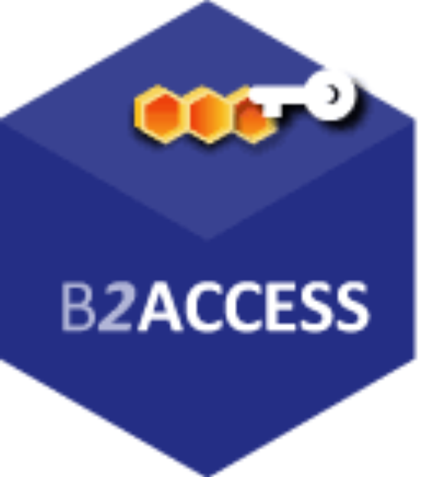


Infrastructure specific hubs
EGI CheckIn
B2ACCESS
CILogon
ORCID
…
Local log-in, mangled tokens, directory auth,
‘golden’ portals that ‘snoop’ your credentials,
‘golden’ portals assuming ownership of everything, …
Service-bespoke solutions

Slide 6
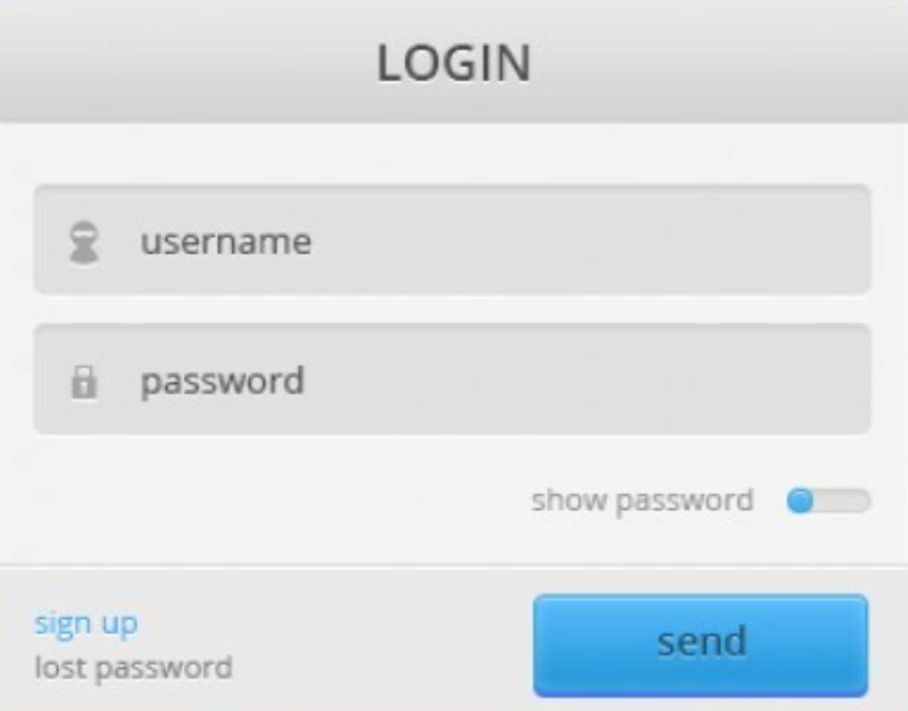
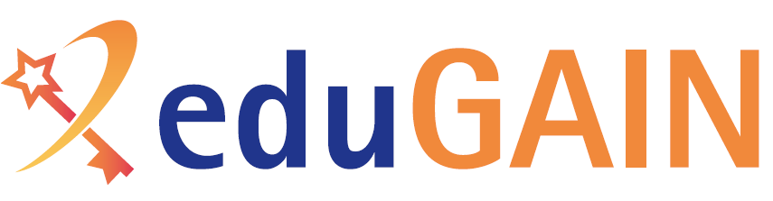


Turtles all the way down … and up!
…

Slide 7
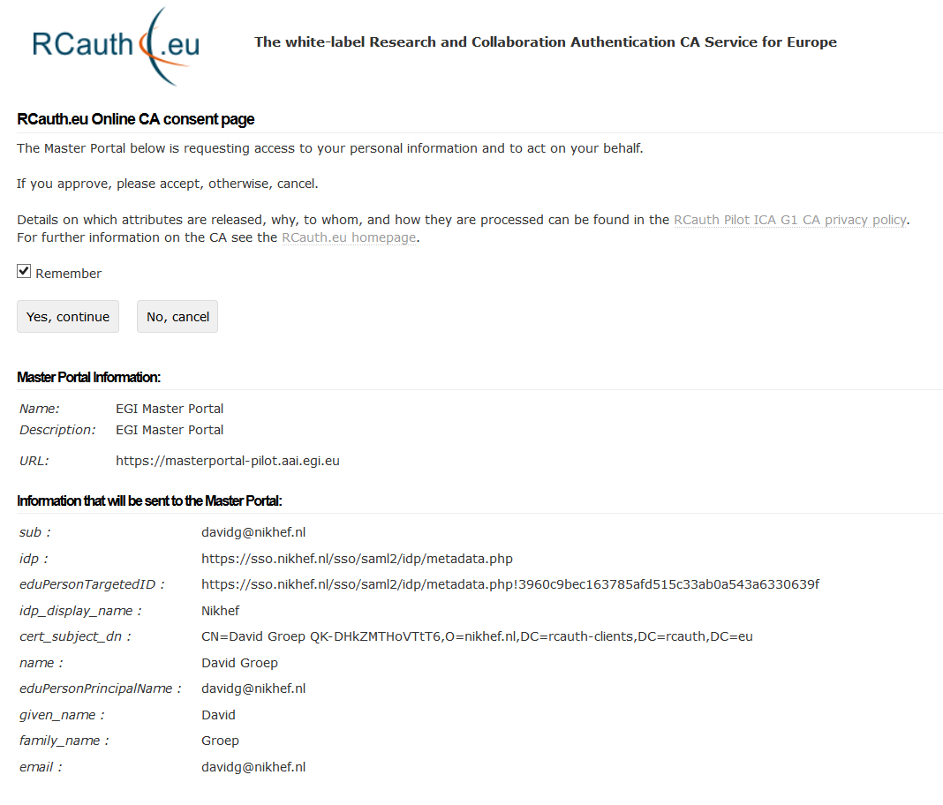
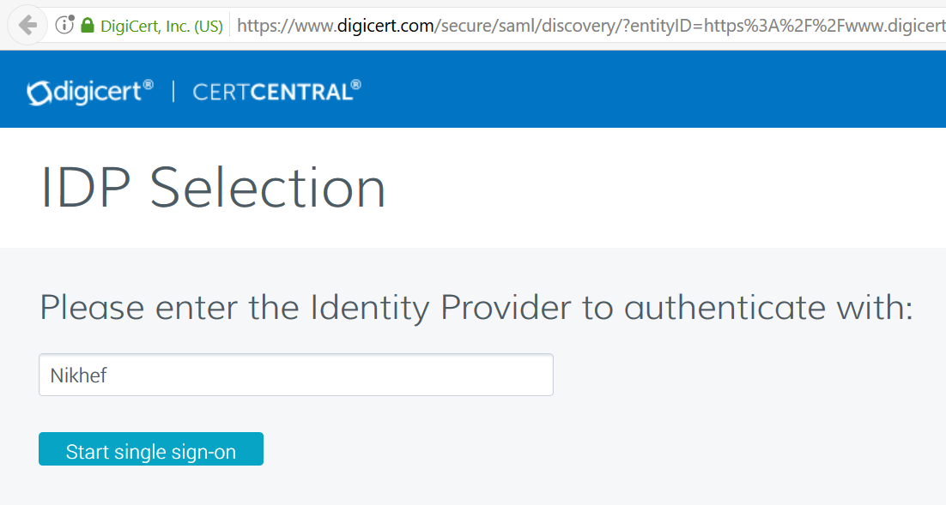
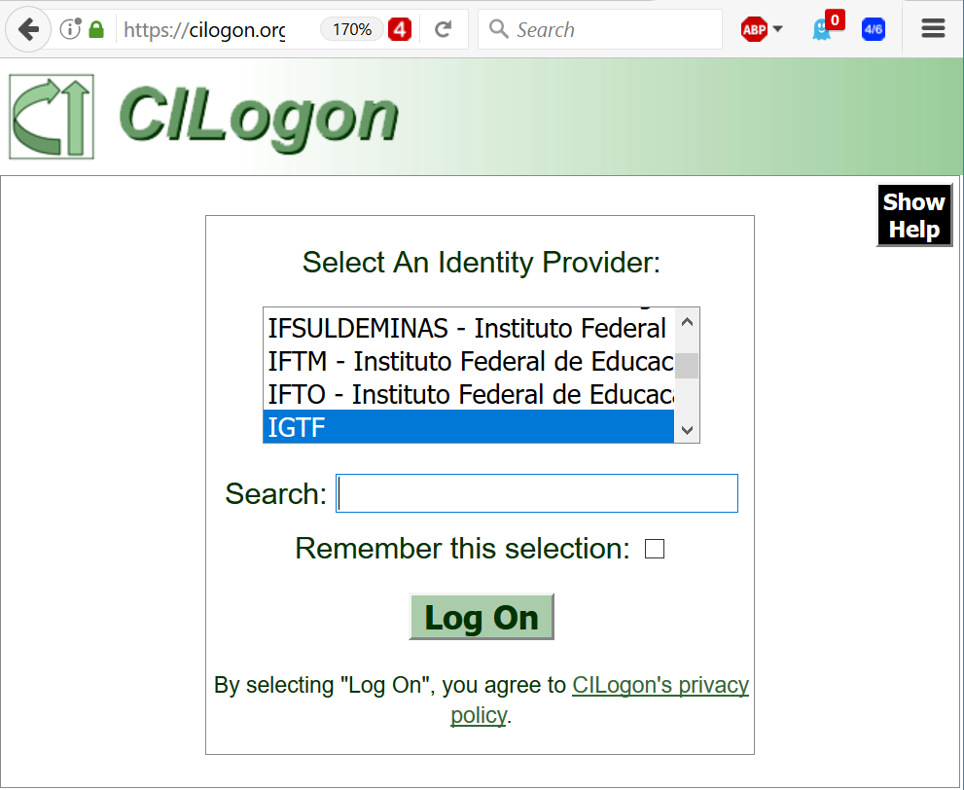
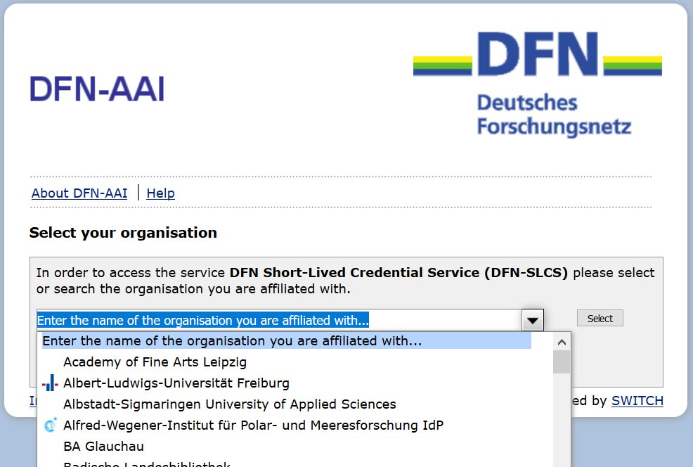
TCS – CILogon – DFN SLCS – RCauth.eu

Slide 8
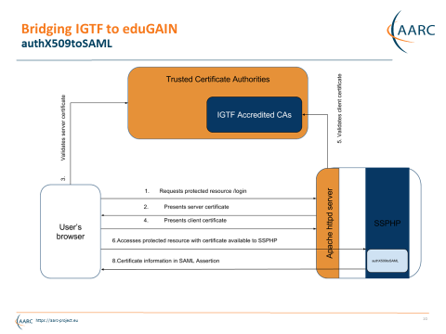
IGTF to eduGAIN bridge
Work by Ioannis Kakavas and Nicolas Liampotis (GRNET) for the AARC project

Slide 9
Guidance we have and use
Assurance Profile
https://www.igtf.net/ap/
Assessment support
http://wiki.eugridpma.org/Main/AssuranceAssessment
‘Back-office’ template practices
https://www.eugridpma.org/documentation/rps/

Slide 10
Registration Networks
Although the process is labour-intensive and relatively slow, for some user categories the prevalent ‘user-held’ credential is the only one that ‘works’:
non-academic users (SMEs, industrial R&S)
users in a place without an eduGAIN federation
users in a place that does not do unique ID
users in an organization that does not release attributes
users in an organization that does not provide assurance
…

Slide 11
A ‘high-quality IdP of last resort’?
Most useful asset is our RA network!

Slide 12
Ideas …
Promote the use of (existing) bridges
Support other credential types and/or interfaces?
In places without an existing federation
  Promote its establishment, as now eduGAIN is more open than before …
  join eduGAIN yourself – as a ‘trivial hub&spoke’ using the bridge IdP technology?
Where a federation exists
  Establish direct links – there’s an opportunity in
  ‘long-tail’ support and IdP-of-last-resort services ☺?
  Push for a federation policy aligned with global (researcher) needs?
Expose differentiated assurance model to subscribers?
User-held credentials avoid much of the privacy issues: a USP?

Slide 13
Building a global trust fabric
Discussion!

